Slide 1
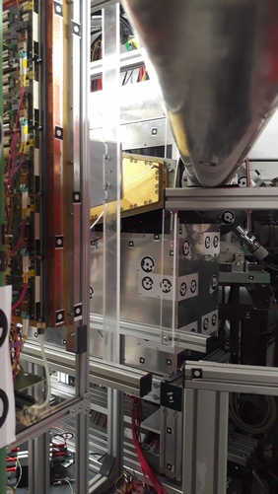
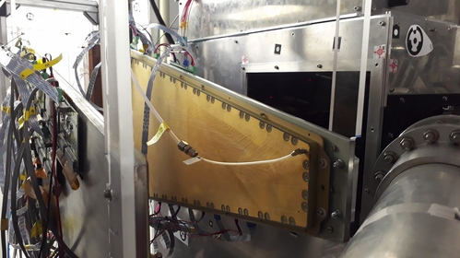
GEM modules for mCBM 2025
Modules installed in June 2024
GEM2
GEM1
-- testing with fast extracted beam in June
Obtained spill structure, time correlation and
Spatial coorelation between GEM1 and GEM2 --
--> reported in CBM collaboration meeting in Sep.2024 by C. Ghosh

Slide 2
GEM modules for mCBM 2025
1. (a) Two pre-production series of
Station-1 GEM modules installed
in mCBM cave
(b) New orientation (78 deg. rotation
With respect to earlier)
(c) Drift board with staggered layout of
OptoCouplers – Final design.
(d) Read out and Electronics :
STS/XYTER v2.0 / MuCh-FEB
2. Plan to install : station-2 full-scale Module for May 2025 beamtest.
...One module fabricated And tested long time back. --> Readout for the
new one has been ordered Should be ready for May 2025 test by December.
--> Mechanics help (as forseen now) -- a couple of holes-drilling ! --> Next slide:
--
3. Goal
(a) detector testing at high rates :
--> beam: Au+Au, or U+Au,
--> with better defined beams (without micro-structures) than before and from 10**5/ spill to maximum,
--> Long term exposure to high rates
(b) Testing with final version of LVDB, first version of
HVDB, new version of FMC board snd Gas flow
monitoring devices

Slide 3
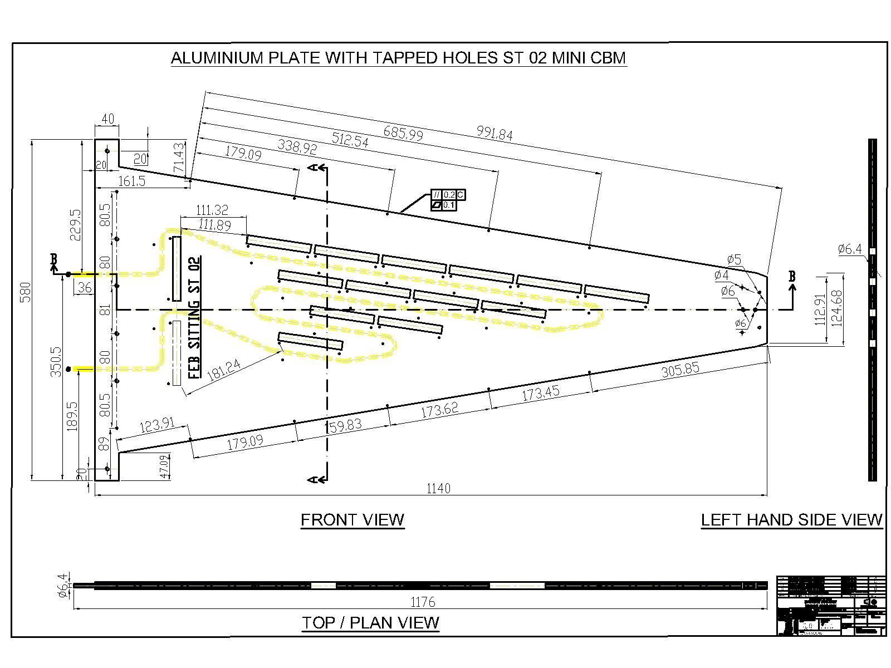
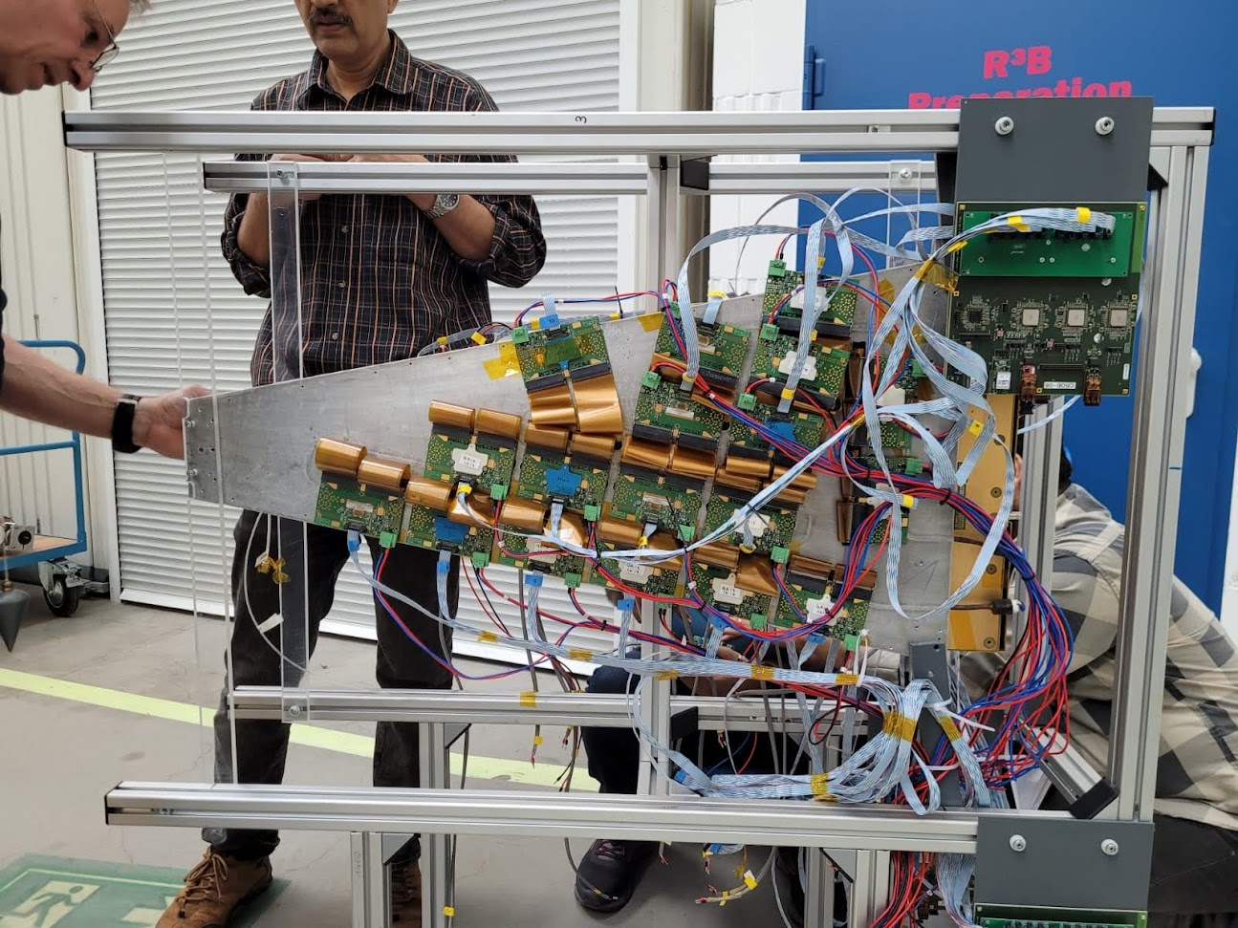
Mounting of station-2 module in May 2025: GEM 2 to be replaced
--> The broad side for station-2 is about
10 cms more than that for station-1
--> enough space to accommodate this
In the present frame
--> few holes may have to be drilled.
This perpex bar(for GEM2) may have to be moved by 2-3 cms
towards the beampipe and we have 12 cm gap from the beam pipe

Slide 4
Data taking plan with GEMs in m2025 :
1. With two GEM modules
2. Populating the detector with FULL acceptance
GEM1 is now fully populated while GEM2 has 15 FEBs.
3. FEB-2025 – two st-1 modules: Data taken with other substems
4. May 2025: With St-1 and St-2 modules:
--> Rate scan at about 3-4 operating High voltages
~4 min/run (10**7 ions/spill or higher ) without downscaling
– large statistics -- useful for tracking, preferably multiple short runs.
-- for 10**5/spill – more number of runs for higher statistics
--> for at least at 5 diff. Intensity values
5. Things already shipped to GSI : Two Al cooling plates.
One Station-2 detector
2-channel indigenous HVPS

Slide 5
The Overall work schedule :
1. Setting up calibration setup followed by calibrating of MuCh FEBs as well STS/XYTERs
2. Modification in DAQ software for running new MuCh FEBs using GERI based DAQ emulator.
3. Integration of the indigenously built HVPS with MuCh detector
4. Nosie optimization and commissioning
5. Setting up the new HVDB board and commissioning it
6. Opening the second station detector and testing it in Detector Lab, GSI using beta source
7. Replacement of GEM2 with new station-2 prototype. The 30 Kg heavy support frame has to be unmounted from the beamtable, followed by the unmounting of second (GEM2) detector module. All the 18 FEBs of GEM2 will be unistalled and reinstalled on the new Al-plate of station-2. Mounting the entire heavy frame back into the mCBM cave.
8. Setting up of the cooling system
9. Setting up of the online monitoring software and online analysis.

Slide 6
Support Needed from GSI for GEM tests
Ar and CO2 cylinders,
MFC
Lauda chiller for cooling
HV module (5 kV, 2 mA) with at least 1 uA precision
-- as a backup to our indeginous power supply.
Mechanical support for mounting Station-2

