Slide 1
Indian Institute of Technology Indore
Raghunath Sahoo
Principal Investigator
PU, Chandigarh, 25 April 2025

Slide 2
My proposal of joining CBM: was discussed with Prof. Peter Senger in a conference in
India (2013), Dr. Y.P. Viyogi and Dr. Subhasis Chattopadhyay
An official proposal was given to the then Spokesperson Prof. Peter Senger and CB Chair, Dr. Y.P. Viyogi: Early 2014.

Slide 3
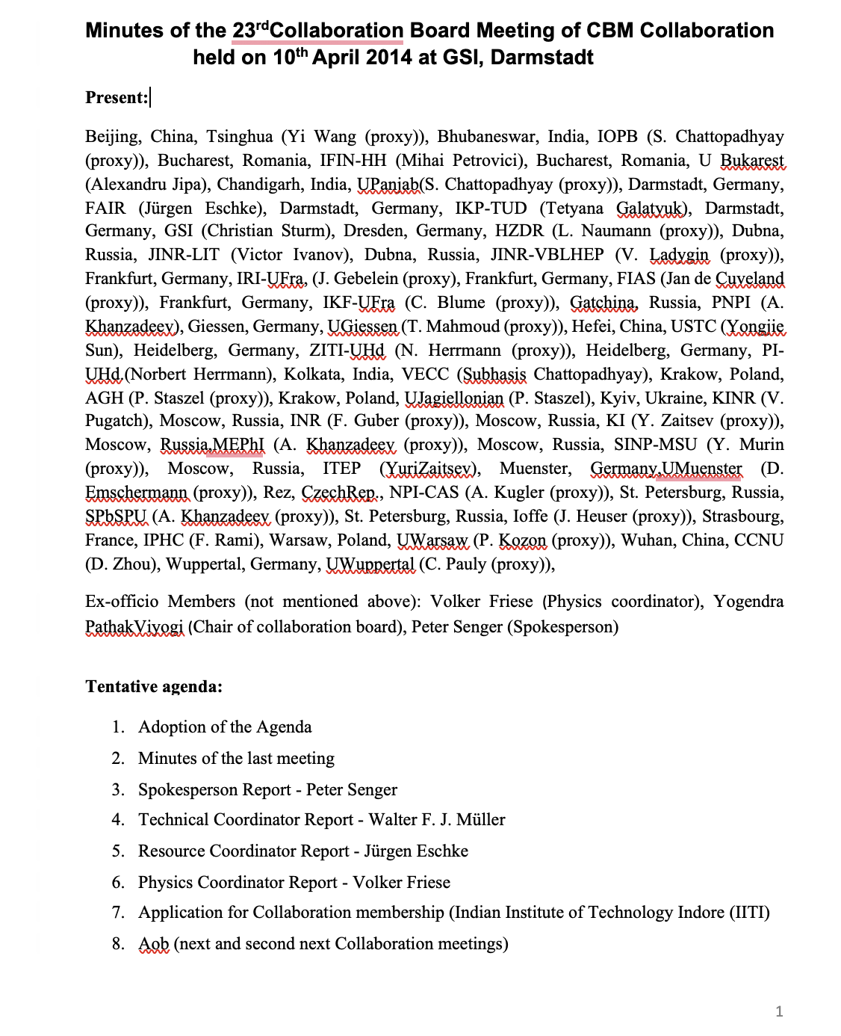
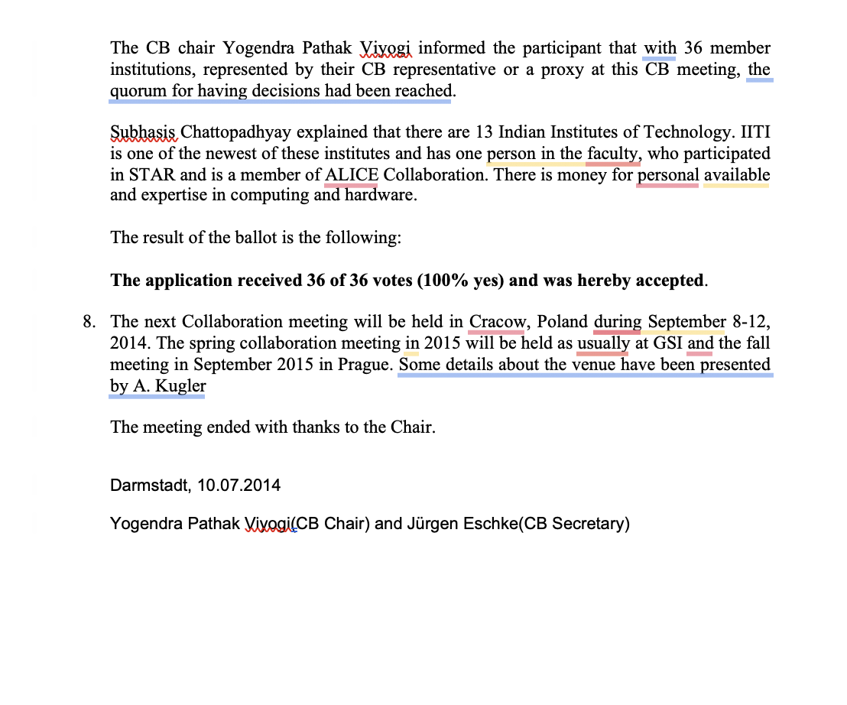
23rd CBM CB: 10 April 2024

Slide 4
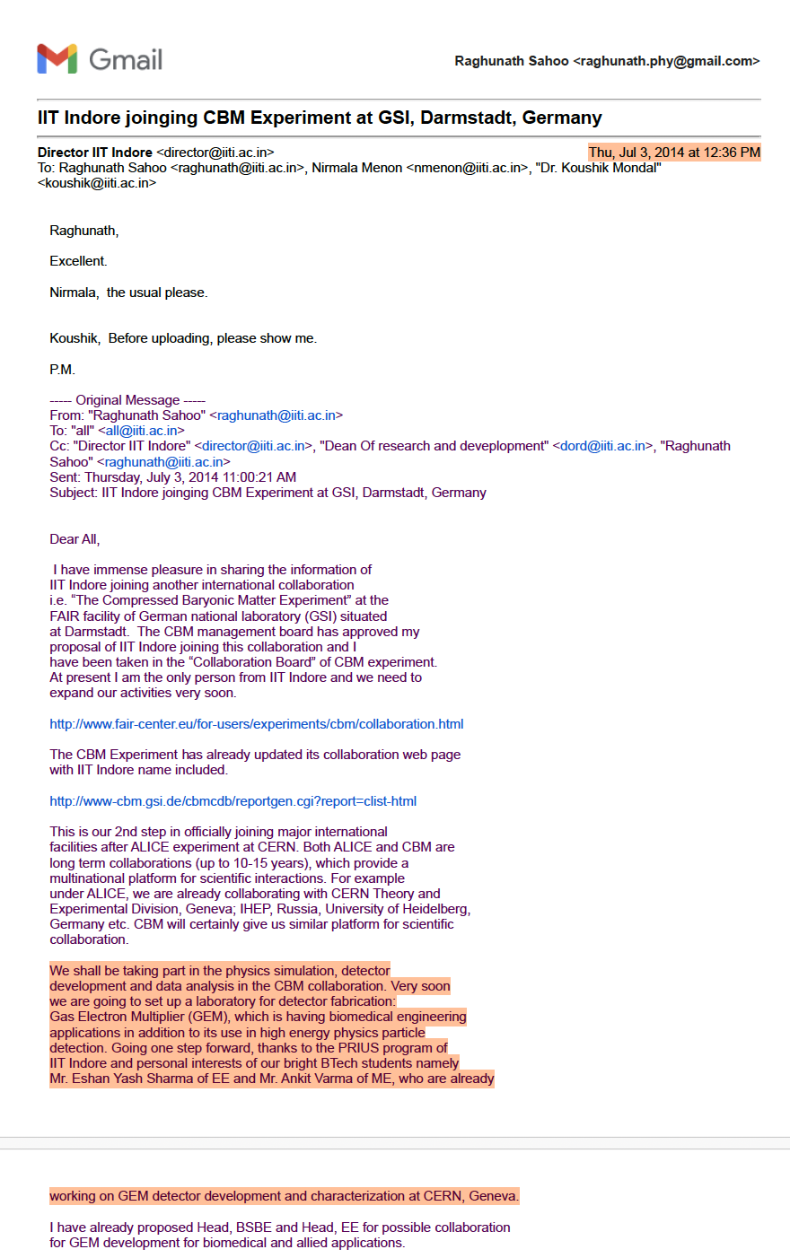
We started working with a PhD student, Sushanta Tripathy for
CBM Physics simulation. He was sent to VECC Kolkata.
After coming back, decided to switch to ALICE and now
he is a Marie Curie Postdoctoral Fellow in Lund, Sweden!
At the meantime, Sumit Kundu did PhD under Ankhi Roy in CBM in
collaboration with Bose Institute.
No contribution to CBM since then!
Several times, we were asked to give expression of interest
and budget table, but no news thereafter!

Slide 5
Group Expertise and Possible Contributions:
No hardware activities so far.
Small hardware activities along with our Engineering Departments can be taken up.
Physics Simulation and Analysis: Resonance production, heavy flavors, global properties
event shape analysis etc.
Group: Raghunath Sahoo, Ankhi Roy, Sumanta Samal, Amit Shukla and Future students

