Slide 1
Bond
Introduction to the project
N.Peray
18/03/2025

Slide 2
HFM program
Magnet overview
Tooling overview
On going work & timeline

Slide 3

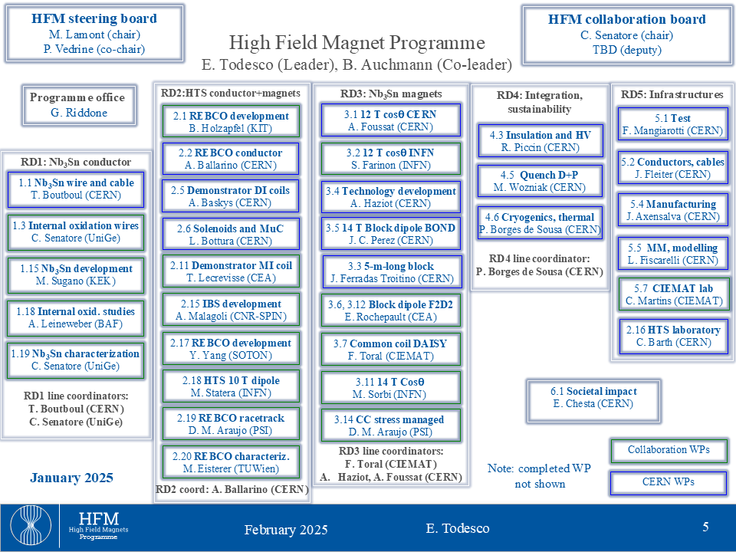
The HFM Programme – broad goals are:
Develop an Nb3Sn accelerator dipole with 14 T operational field for FCC-hh, giving an energy of 85 TeV c.o.m., with a focus on sustainability, cost versus performance, and large scale production
Explore the HTS magnet technologies for accelerator applications in the range from 14 T up to 20 T
Promote the required developments for superconductors
Highlight the innovative of high field magnets developments, both for particle physics instruments different from FCC, and for societal applications
Courtesy of E. Todesco

Slide 4
HFM program
Magnet overview
Tooling overview
On going work & timeline

Slide 5
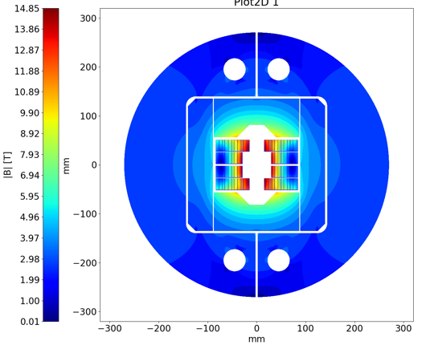
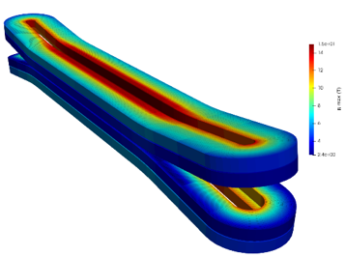
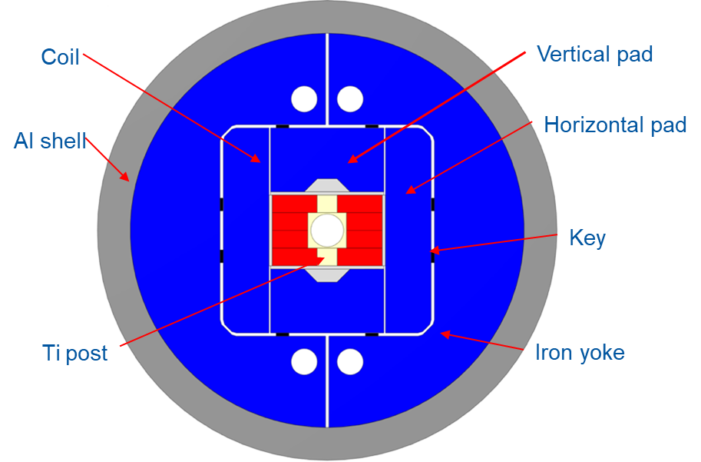
Magnet overview
Name |  | Bond_14T Single
 |  | Baseline
Aperture | (mm) | 50
Field | (T) | 14.00
Field integral | (T m) | 15.10
Magnetic length | (m) | 1.08
Coil length | (m) | 1.31
Number of apertures | (adim) | 1
Distance between apertures | (mm) | -
Yoke outer diameter | (mm) | 540
Shell outer diameter | (mm) | 640
Cable data
Material |  | Nb3Sn
Process |  | RRP
No. strands | (adim) | 40
Strand diameter | (mm) | 1.100
Cu/NonCu | (adim) | 0.9
RRR | (adim) | 150
Bare cable thickness (R) | (mm) | 2.06
Bare cable width (R) | (mm) | 23.275
Insulation thick radial (5 Mpa) | (mm) | 0.150
Insulated cable surface | (mm²) | 55.64
Filling factor | (adim) | 0.360
Coil design
Insulated cable surface (one aperture) | (mm²) | 11572
Equivalent coil width | (mm) | 53.4
Coil efficiency | (T mm / A) | 0.00073
N. layers | (adim) | 2
N. turns/pole | (adim) | 52
Cable length/pole | (m) | 136
Operational parameters
Current (Inom) | (kA) | 20.005
Peak Field | (T) | 14.85
Short sample current @ 1.9 K | (kA) | 24.199
Short sample current @ 4.5 K | (kA) | 21.602
Short sample field @ 1.9 K | (T) | 17.55
Short sample field @ 4.5 K | (T) | 15.93
j overall⁷ | (A/mm²) | 360
j strand | (A/mm²) | 526
j superconductor | (A/mm²) | 1000
Loadline fraction @1.9 K | (%) | 82.7
Loadline fraction @4.2 K | (%) | 92.6
Stored energy/m | (MJ/m) | 1.031
Inductance/m | (mH/m) | 4.72
Stored energy | (MJ) | 1.35
Field quality
Harmonic b2 @ Inom | (10-4) | 0.00
Harmonic b3 @ Inom | (10⁻⁴) | -3.49
Harmonic b4 @ Inom | (10⁻⁴) | 0.00
Harmonic b5 @ Inom | (10⁻⁴) | 2.78
Harmonic b7 @ Inom | (10-4) | 0.88
Harmonic b2 from Iinj to Inom | (10-4) | 0.00
Harmonic b3 @ Iinj | (10-4) | 9.66
Protection
Coil energy density | (J/mm³) | 0.089
j copper | (A/mm²) | 1111
Temperature margin @ 1.9 K | (K) | 3.99
Time margin | (ms) | 74
Hot spot Temperature | (K) | 114
MIITS | (MAAS) | 75
Voltage to ground | (V) | 120
Mechanics
Forces x | (MN/m) | 5.937
Forces y | (MN/m) | -2.680
Force z | (MN) | 0.958
Fx/2*Wcable | (MPa) | 125.9
File : 14T_40_reference_parameters
\\eosproject-smb\eos\project\s\smt-projects\Magnet_Laboratory\Projects\HFM_Program\14T\Reference_Information

Slide 6
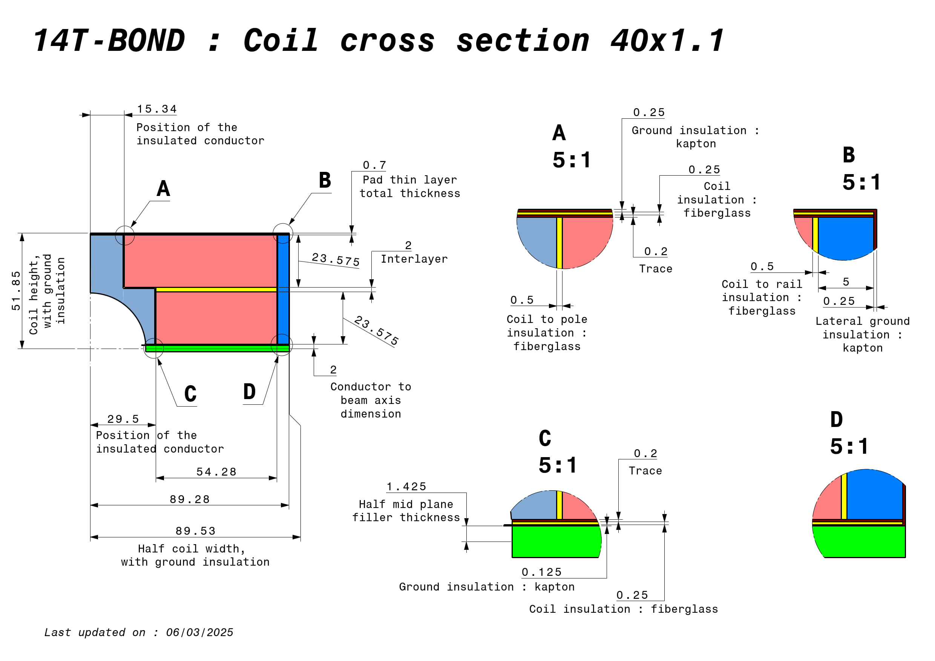
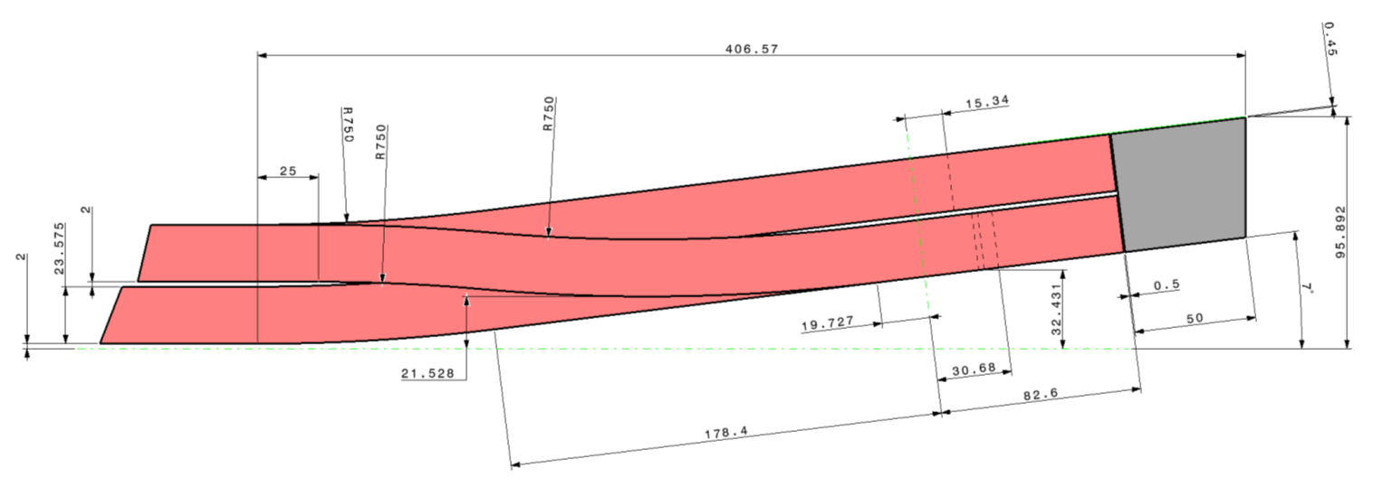
Magnet overview
Wind & react process :
Winding
Reaction (heat treatment ; @650°C for 2-3 weeks)
Splicing & instrumentation
Impregnation
NbTi
Nb3Sn
Lead stabilizer
Cu
Splice cover
Cu
Coil reference cross section
https://plm.cern.ch/p/CAD/number:ST2412841_02

Slide 7
HFM program
Magnet overview
Tooling overview
On going work & timeline

Slide 8
Winding tool : Lower layer

Slide 9
Winding tool : Upper layer

Slide 10
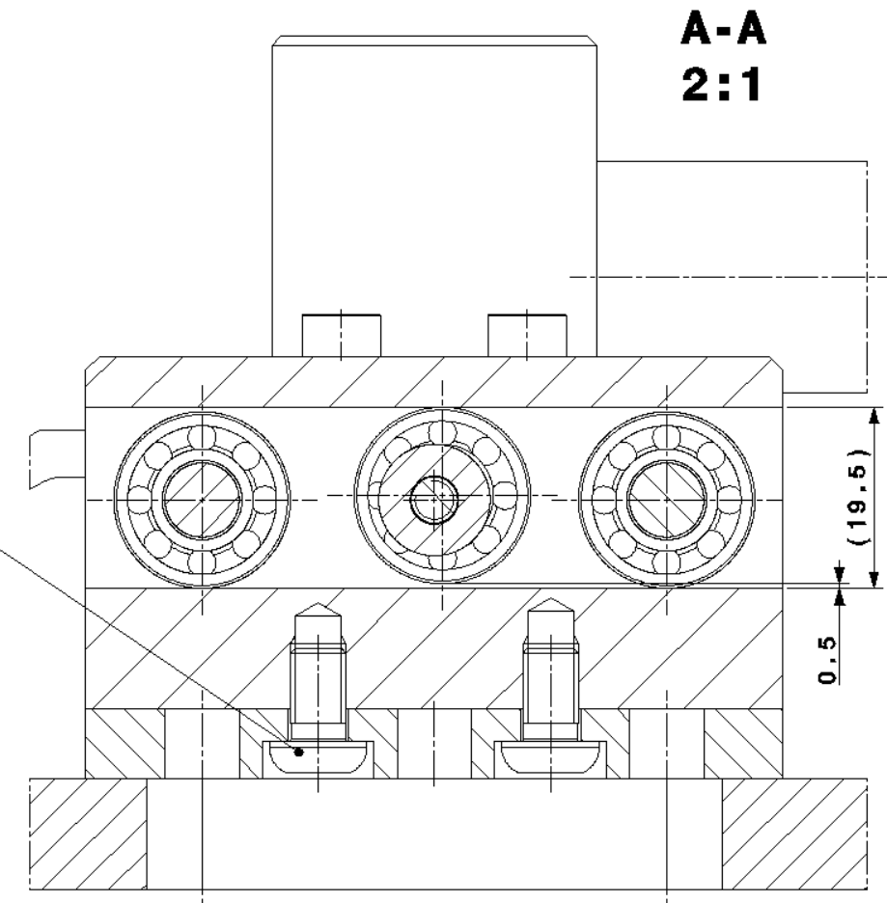
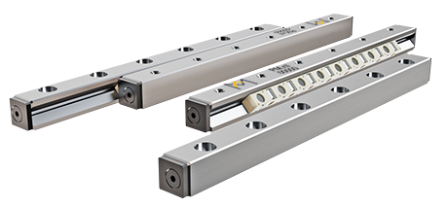
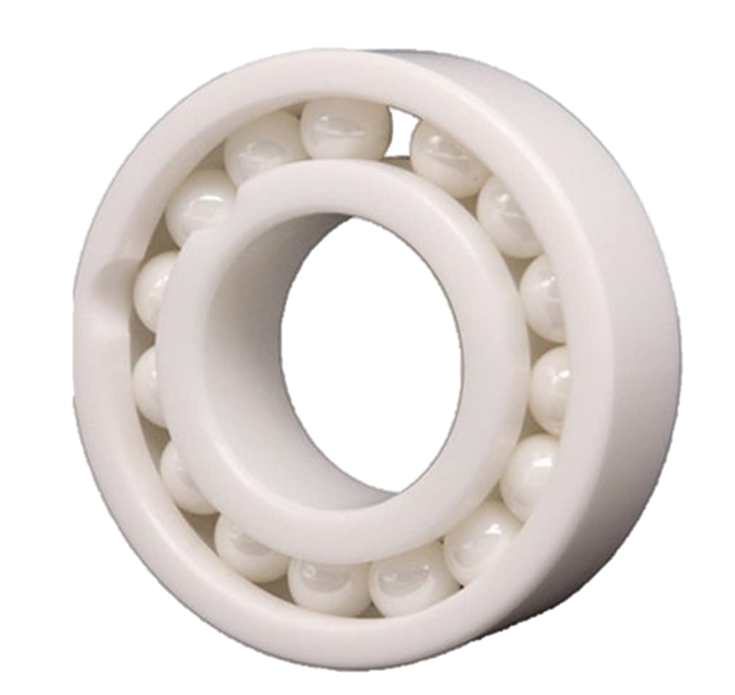
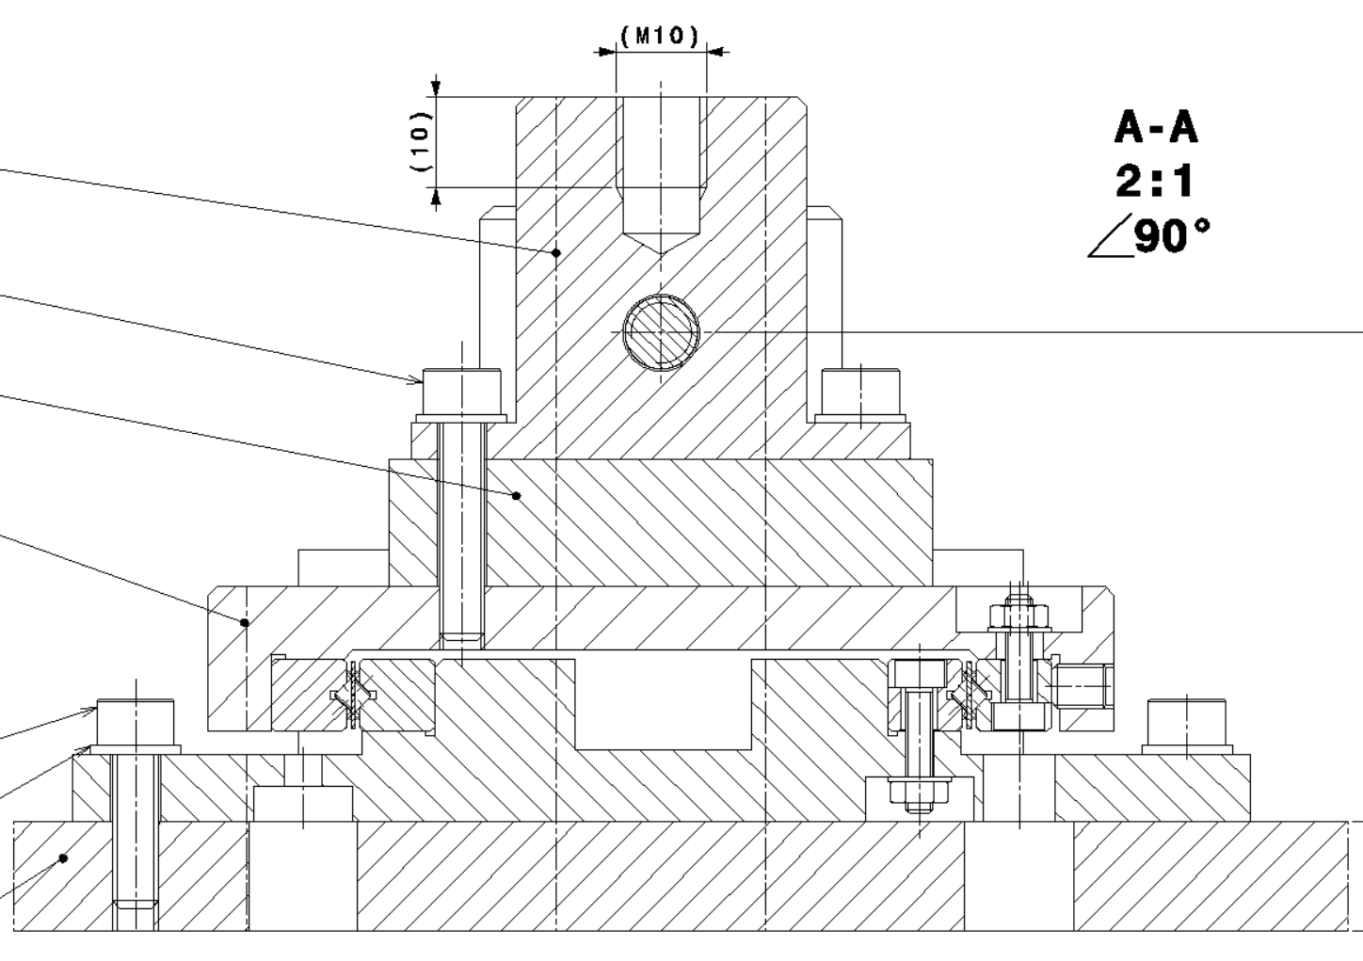
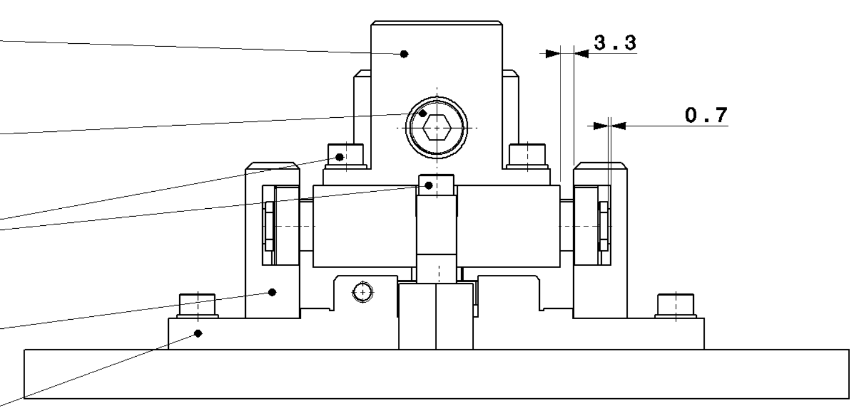
Reaction mold
Differential thermal expansion main direction
Reaction mold
Guiding table
Circular bearing
(Si₃N₄)
Linear bearing
(ZrO₂ rails/Si₃N₄ rollers)
Mock-up test setup designed by B. Pellet & N. Lusa

Slide 11
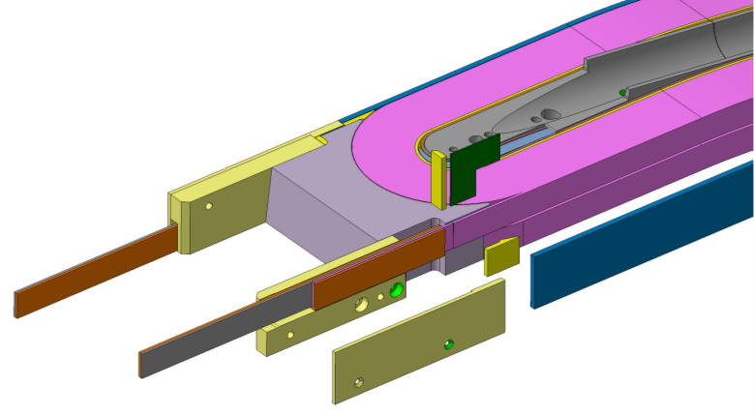
Splicing tool
NbTi
Nb3Sn
Lead stabilizer
Cu
Splice cover
Cu

Slide 12
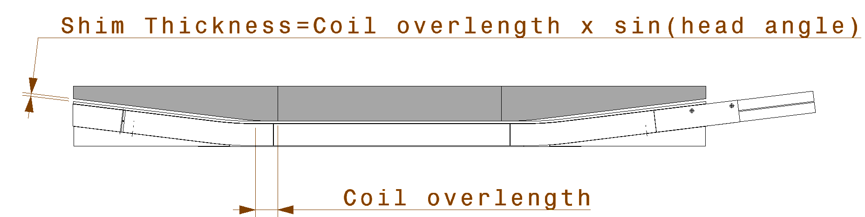
Impregnation mold
To obtain a uniform stress at each interface, coils geometry should be the closest to perfection possible.
Due to the behavior of the cable and the tooling during reaction, the position of the cable in the head cannot be fully guarantied.
Meaning that distance between cables and the pad in the head can vary and need to be filled for the final assembly.
Coil overlenght | Total shim thickness*
mm | mm
1 | 0.12
2 | 0.24
3 | 0.37
4 | 0.49
5 | 0.61
6 | 0.73
7 | 0.85
8 | 0.97
9 | 1.10
10 | 1.22
11 | 1.34
12 | 1.46
13 | 1.58
14 | 1.71
15 | 1.83
16 | 1.95
17 | 2.07
18 | 2.19
19 | 2.32
20 | 2.44
*Shim thickness to be split in two if equally spread at each end

Slide 13
Impregnation mold : box mold with adaptative filler
Filler are tailored to fit the overlength of the coil. This, to avoid extra layer of impregnated material.
The pad, used in the mechanical structure, will be tailored the same way to fit the coil.
Tailored filler

Slide 14
HFM program
Magnet overview
Tooling overview
On going work & timeline

Slide 15
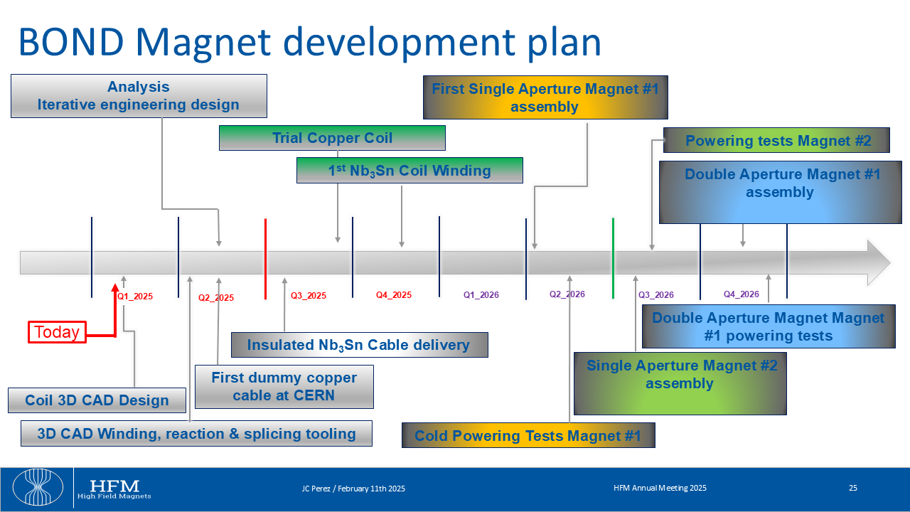

Slide 16
Priority tasks :
BOND - Conception mécanique
Taches en cours
Ensemble | Description
Bobine impregné | Modèle detaillé du cable
 | Couches minces (fibres+traces)
 | Instrumentation du pole
 | Plan de détail des poles
Bobine réagie | Modèle detaillé du cable
Outil de bobinage | Guide de câbles de la couche inférieure dans la tête coté connexion
 | Goupille titane pole/table
 | Modèle détaillé des tiges filetées de bridage latéral
 | Support du touret en réserve
 | Faire un assemblage propre avec toute la visserie
 | Plans de détails des pièces et plans d'ensembles
Outil de réaction | Couches fines (mica)
 | Jeux fonctionnels entres les pièces latérales
 | Trous de dégazages pour chaques volumes piégés
 | Vis percées à certains endroits pour dégazage
 | Gorges de distribution d'Argon et point d'injection
 | Evidages des pièces massives
 | Interface avec le système de guidage
 | Plan de détails de la table
Winding tool :
https://plm.cern.ch/p/CAD/number:ST2414350_01
Reaction tool :
https://plm.cern.ch/p/CAD/number:ST2408362_01
File : BOND – Conception mécanique – Taches en cours
\\eosproject-smb\eos\project\s\smt-projects\Magnet_Laboratory\Projects\HFM_Program\14T\Reference_Information

Slide 17
Thanks for your attention

