Slide 1
Bond
Engineering question
N.Peray
18/03/2025

Slide 2
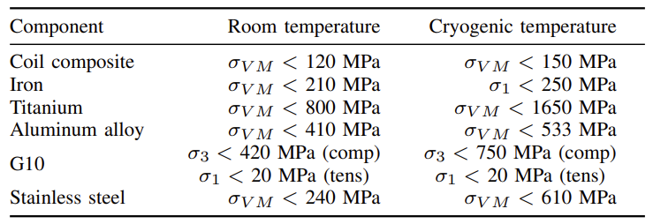
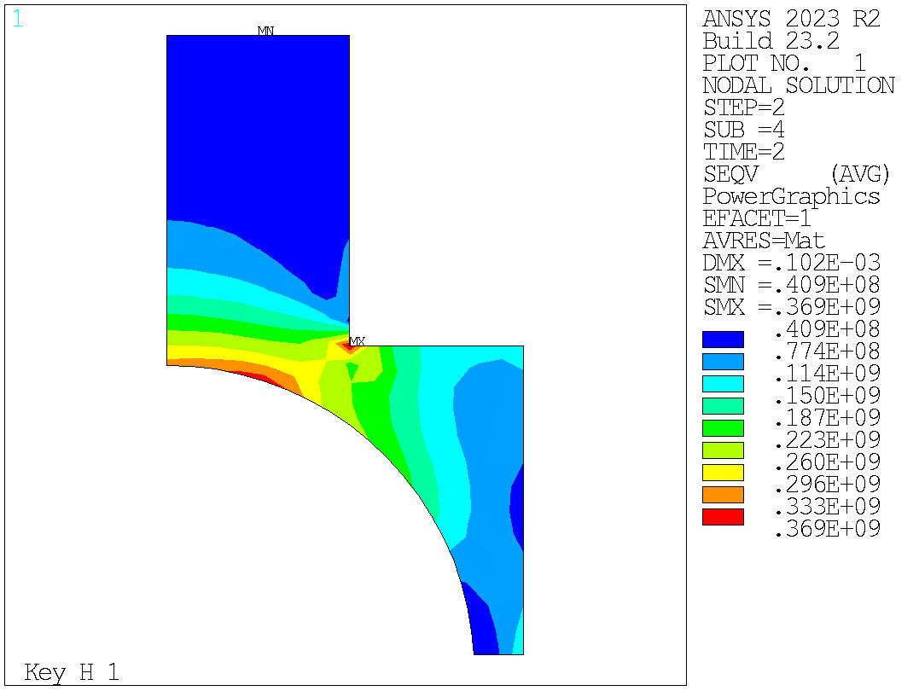
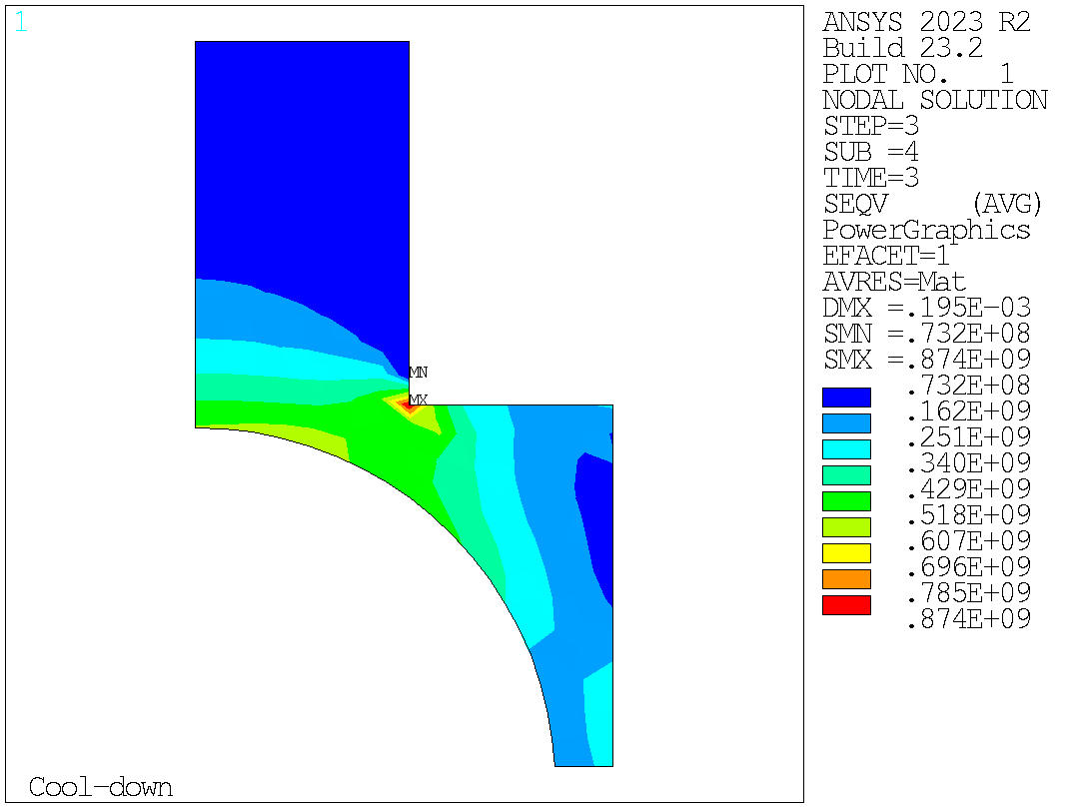
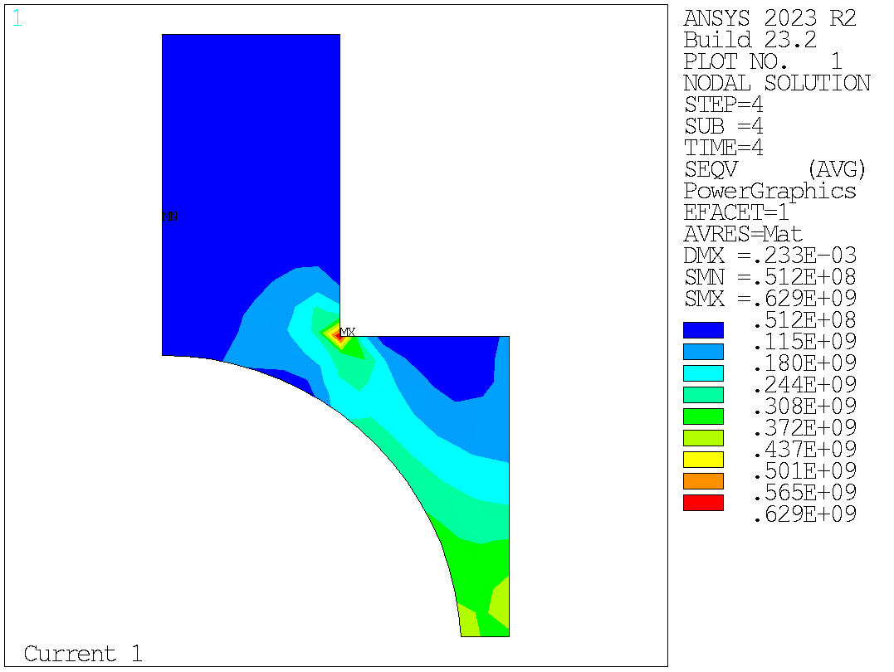
Aperture dimension
Shouldn’t we increase a little bit the aperture to have a 50mm free aperture when adding the aperture instrumentation ?
Courtesy of J. Ferradas Troitino

Slide 3
Reaction gaps
Pole gaps @ RT
600mm
Should we machine the straight section of the pole and the table shorter to let them expand freely during reaction ?
Tool gaps @ RT
520mm
Coil insulation and axial gaps by J. Ferradas Troitino :
BOND_GapsAndInsulation_12_12_2024.pdf

Slide 4
Reaction : Head spacer axial retaining system
251 mm
193 mm
Ti
Nb3Sn
Stainless steel
Ti
Ti

Slide 5
Thanks for your attention

