Slide 2
Introduction to BOND Design March 2025
BOND 14 T Dipole design meeting
Author: Juan Carlos Perez
Date: Tuesday March 18th

Slide 3
Table of contents
High Field Magnet Program
BOND design status
Tooling and Mock-ups for BOND fabrication

Slide 4
HFM steering board
M. Lamont (chair)
P. Vedrine (co-chair)
HFM collaboration board
C. Senatore (chair)
TBD (deputy)
High Field Magnet Programme
E. Todesco (Leader), B. Auchmann (Co-leader)
Programme office
G. Riddone
RD2:HTS conductor+magnets
RD2 coord: A. Ballarino (CERN)
RD3: Nb₃Sn magnets
RD3 line coordinators:
F. Toral (CIEMAT)
Haziot, A. Foussat (CERN)
RD4: Integration,
sustainability
RD4 line coordinator:
P. Borges de Sousa (CERN)
RD5: Infrastructures
2.1 REBCO development
B. Holzapfel (KIT)
3.1 12 T cosθ CERN
A. Foussat (CERN)
5.1 Test
F. Mangiarotti (CERN)
4.3 Insulation and HV
R. Piccin (CERN)
RD1: Nb₃Sn conductor
RD1 line coordinators:
T. Boutboul (CERN)
C. Senatore (UniGe)
2.2 REBCO conductor
A. Ballarino (CERN)
3.2 12 T cosθ INFN
S. Farinon (INFN)
5.2 Conductors, cables
J. Fleiter (CERN)
1.1 Nb₃Sn wire and cable
T. Boutboul (CERN)
4.5 Quench D+P
M. Wozniak (CERN)
2.5 Demonstrator DI coils
A. Baskys (CERN)
3.4 Technology development
A. Haziot (CERN)
5.4 Manufacturing
J. Axensalva (CERN)
1.3 Internal oxidation wires
C. Senatore (UniGe)
2.6 Solenoids and MuC
L. Bottura (CERN)
3.5 14 T Block dipole BOND
J. C. Perez (CERN)
4.6 Cryogenics, thermal
P. Borges de Sousa (CERN)
5.5 MM, modelling
L. Fiscarelli (CERN)
1.15 Nb₃Sn development
M. Sugano (KEK)
2.11 Demonstrator MI coil
T. Lecrevisse (CEA)
3.3 5-m-long block
J. Ferradas Troitino (CERN)
5.7 CIEMAT lab
C. Martins (CIEMAT)
1.18 Internal oxid. studies
A. Leineweber (BAF)
2.15 IBS development
A. Malagoli (CNR-SPIN)
3.6, 3.12 Block dipole F2D2
E. Rochepault (CEA)
2.16 HTS laboratory
C. Barth (CERN)
1.19 Nb₃Sn characterization
C. Senatore (UniGe)
2.17 REBCO development
Y. Yang (SOTON)
3.7 Common coil DAISY
F. Toral (CIEMAT)
2.18 HTS 10 T dipole
M. Statera (INFN)
3.11 14 T Cosθ
M. Sorbi (INFN)
6.1 Societal impact
E. Chesta (CERN)
2.19 REBCO racetrack
D. M. Araujo (PSI)
3.14 CC stress managed
D. M. Araujo (PSI)
2.20 REBCO characteriz.
M. Eisterer (TUWien)
Collaboration WPs
January 2025
Note: completed WP
not shown
CERN WPs

Slide 5
Scope of the Work Package
WP3.5: Nb₃Sn 14 T Block dipole BOND
Demonstrate Nb₃Sn performance in a 14 T block-type dipole at 1.9 K
Design and construction of a 14 T accelerator quality dipole model magnet
  The short model magnet should reach 15-15.5 T field
Explore alternatives and develop design and technology for Nb₃Sn accelerator dipoles

Slide 6
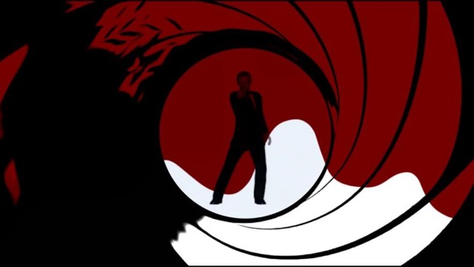
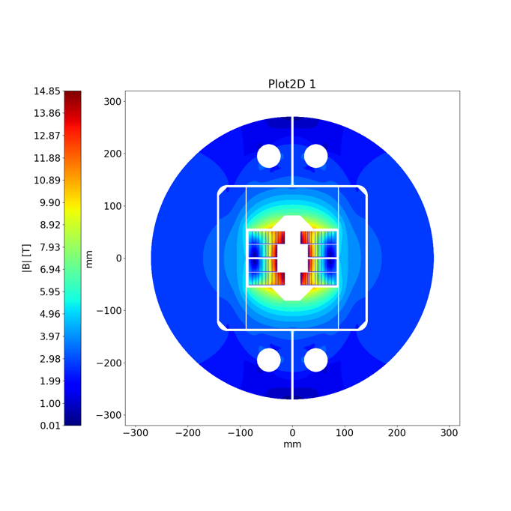
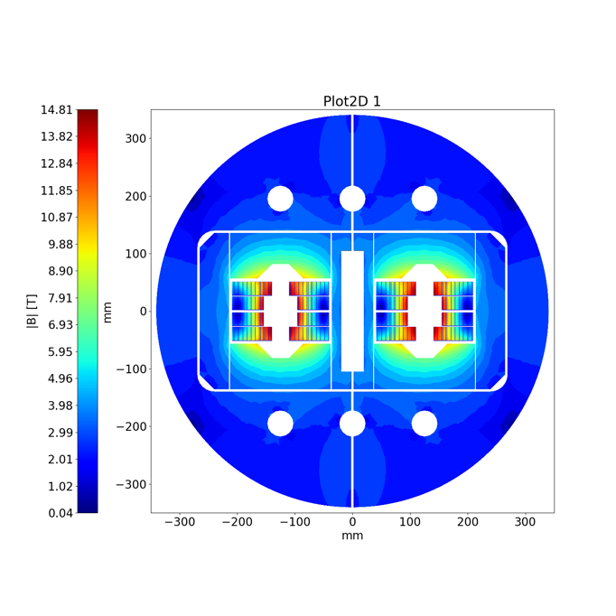
14 T Block dipole BOND
BOND
BOND stands for BlOck coil Nb₃Sn Dipole

Slide 7
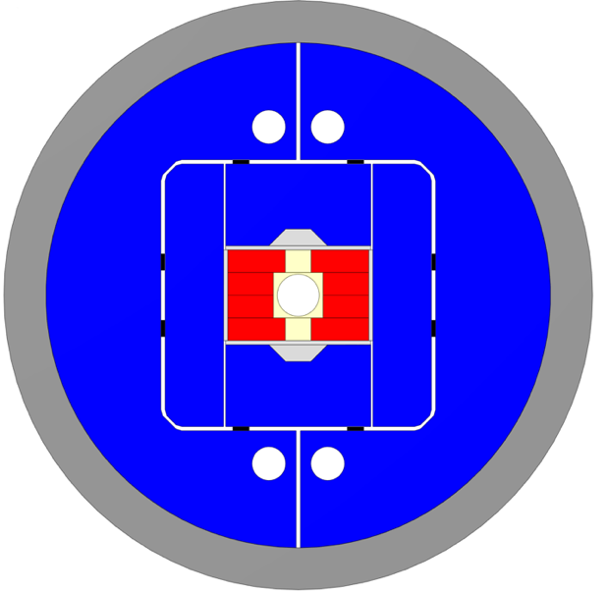
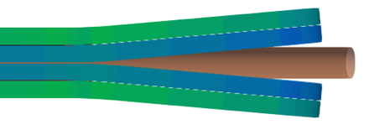
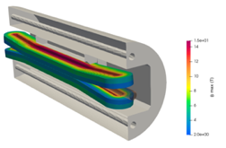
14 T Block dipole BOND
Design requirements:
14 T bore field with ≈ 20 % load line margin
(1.9 K using HFM specs).
Protection time margin*¹ > 40 ms.
Aperture = 50 mm.
Eq. coil width*² < 60 mm → “accelerator coil size”.
Field quality within 10 units at all current levels (excluding PC effects).
Magnet OD:
  Double aperture, inter-beam distance: 250 mm.
  Cold mass OD: 800 mm and Magnet OD: 760 mm.
  For the 1 in 1, we will scale down.
Coil
Vertical pad
Al shell
Horizontal pad
Key
Ti post
Iron yoke
Courtesy of A. Haziot, J. Ferradas & E. Fernandez

Slide 8
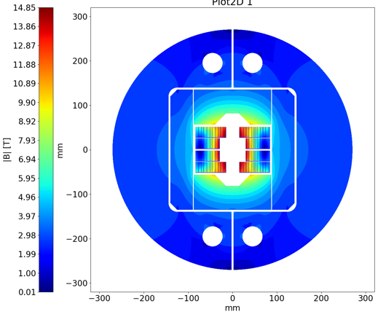
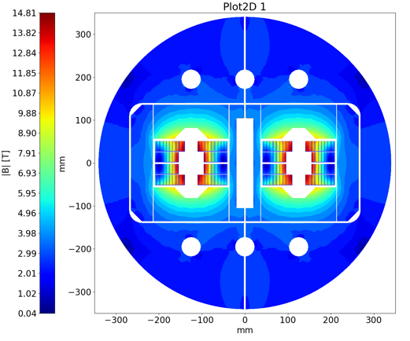
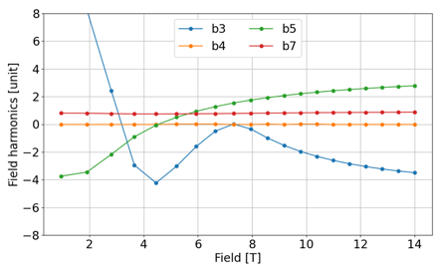
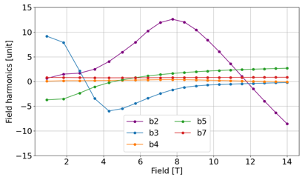
BOND Design Parameters
The 2D & 3D electromagnetic design for the single aperture configuration was completed in January 2025.
Magnet |  | Single | Double
Aperture | [mm] | 50 | 50
Intra-beam distance | [mm] | - | 250
Yoke diameter | [mm] | 540 | 680
Shell diameter | [mm] | 640 | 780
Nominal current | [kA] | 20.005 | 19.340
J overall | [A/mm2] | 360 | 348
J strand (eng.) | [A/mm2] | 526 | 509
Nominal field | [T] | 14.00 | 14.00
Peak field | [T] | 14.85 | 14.81
Ap. to peak field ratio | [%] | 6.0 | 5.7
Load line fraction @1.9 K | [%] | 82.7 | 81.7
Load line fraction @4.2 K | [%] | 92.6 | 91.2
Temperature margin | [K] | 3.99 | 4.11
Inductance | [mH/m] | 4.72 | 10.24
Stored energy | [MJ/m] | 1.031 | 2.064
Coil |  | Single | Double
No. of turns per pole |  | 52
Insulated cable surface | [mm²] | 11572
Equivalent coil width | [mm] | 53.4
Coil efficiency *¹ | [T.mm/A] | 0.00073 | 0.00075
Courtesy of A. Haziot

Slide 9
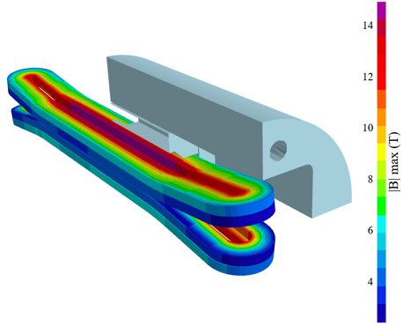
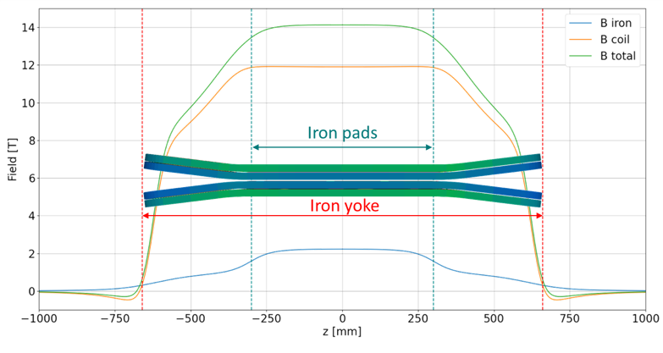
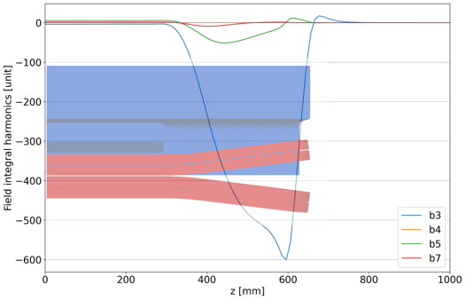
BOND Coils Configuration and Field Profile
Flared end curvature radius | mm | 750
Flared end angle | º | 7
Flared end straight section | mm | 178.4

Slide 10
Tooling & components design
Coil components and coil fabrication tooling design is well on track.
The 3D design will be completed by end of April.
First tooling delivered is expected by late summer 2025.
Impregnation
Winding
Reaction
Courtesy of N. Peray

Slide 11
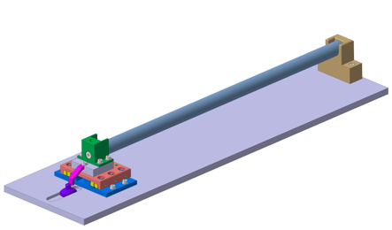
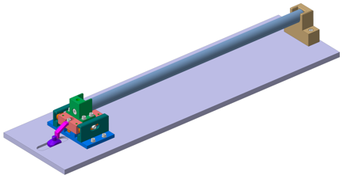
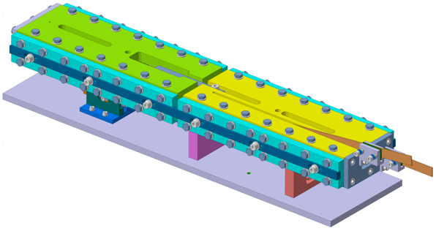
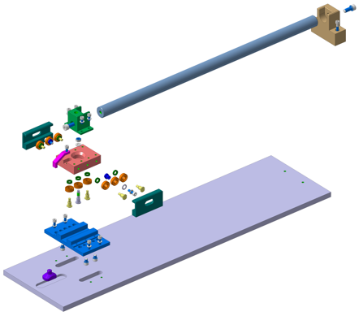
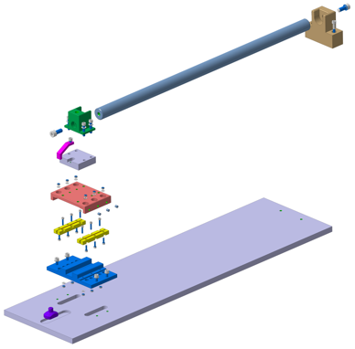
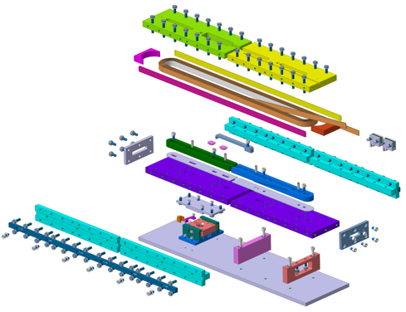
Mock-up design of sliding reaction tooling
Thanks to the experience gained during the construction of the Race-tracks, FRESCA2 and MQXF magnets, BOND tooling designed to compensate for dimensional variations during heat treatments is currently in the design phase.
Racetrack coil mock-up with integrated sliding system
Linear ceramic bearing
Circular ceramic bearing
The basic concepts will be validated using simplified mock-ups that replicate conditions close as possible to those that will be used during coil manufacturing.
Courtesy of N. Lusa, J. Ferradas & B. Pellet

Slide 12
BOND Magnet development plan
Analysis
Iterative engineering design
First Single Aperture Magnet #1 assembly
Trial Copper Coil
Powering tests Magnet #2
Today
1st Nb₃Sn Coil Winding
Double Aperture Magnet #1 assembly
Q1_2025
Q2_2025
Q3_2025
Q4_2025
Q1_2026
Q2_2026
Q3_2026
Q4_2026
Insulated Nb₃Sn Cable delivery
Double Aperture Magnet Magnet #1 powering tests
First dummy copper cable at CERN
Single Aperture Magnet #2 assembly
Coil 3D CAD Design
Cold Powering
Tests Magnet #1
3D CAD Winding, reaction & splicing tooling
Tests using Mock-ups

