Slide 1
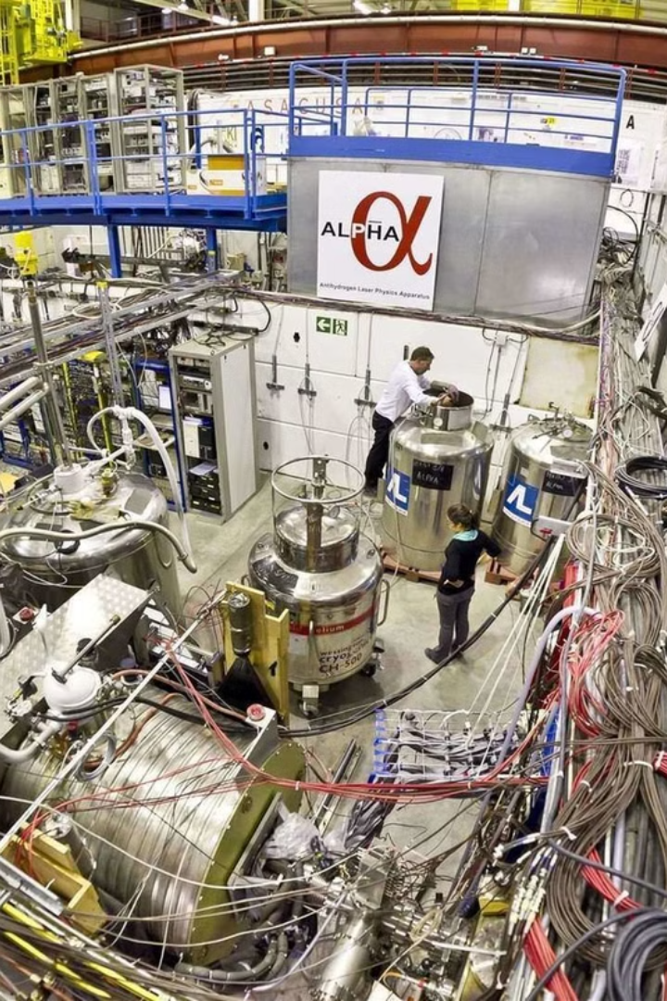
Data Analysis for Antihydrogen Experiments at CERN
Internship Report – ALPHA2 & ALPHAg Experiments
Presented by Dmytro Skorubskyi

Slide 2

Data Sources
1
CERN’s ALPHA Experiment
2
Data Type
Uses antiprotons from the Antiproton Decelerator (AD) and ELENA.
Annihilation vertex positions and timing events.
Combines antiprotons with positrons to form antihydrogen.
Reconstructed particle tracks and time-of-flight measurements.

Slide 3




Data Ingestion & Filtering
File Import
Use Pandas to read CSV files.
Artifact Filtering
Remove spurious entries.
Quality Cuts
Retain only high-quality data.

Slide 4



Defining the Fitting Region
Peak Detection
2
Identify local maxima.
Initial Range
1
Establish initial Z-range.
Narrowing the Range
3
Set tighter fit boundaries.

Slide 5
Model Fitting & Optimization
Model Description
1
Data modeled as two Gaussians plus background.
Fitting Procedure
2
Minimize the NLL to determine best-fit parameters.
Extracting Z Position
3
Calculate final Z position.

Slide 6
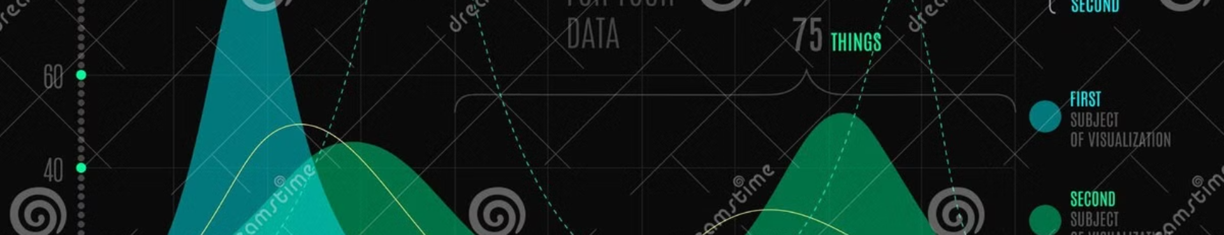



Visualization & Statistical Analysis
Histogram Generation
Fitting Graphs
Regression Analysis

Slide 7
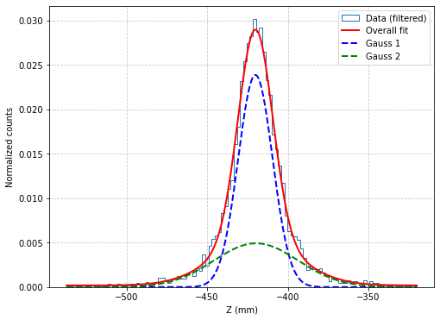
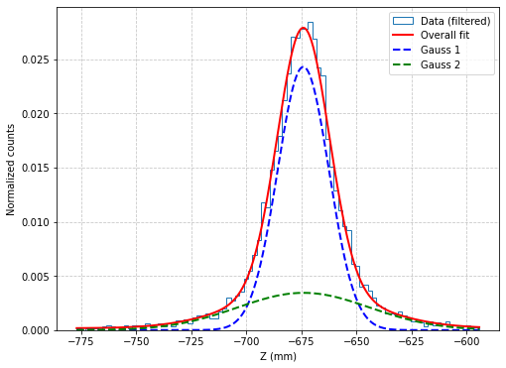
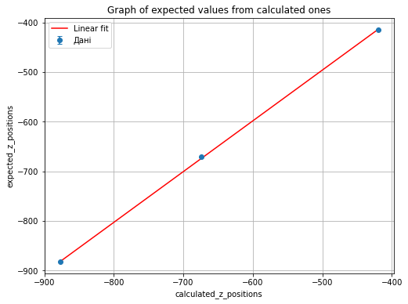
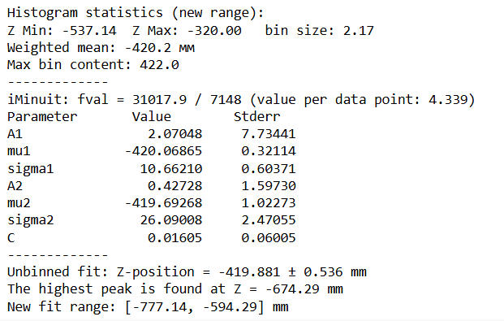
Results for the ALPHAg Experiment

Slide 8
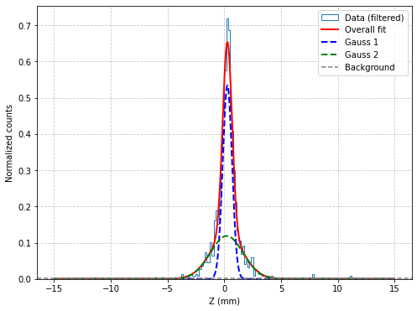
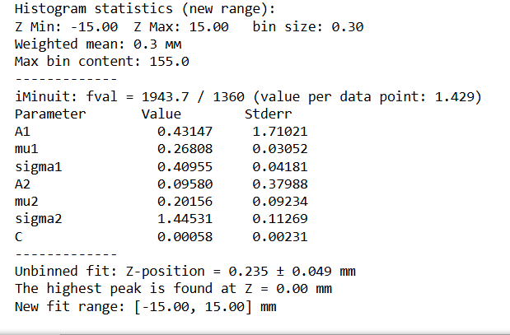
Results for the ALPHA2 Experiment

Slide 9
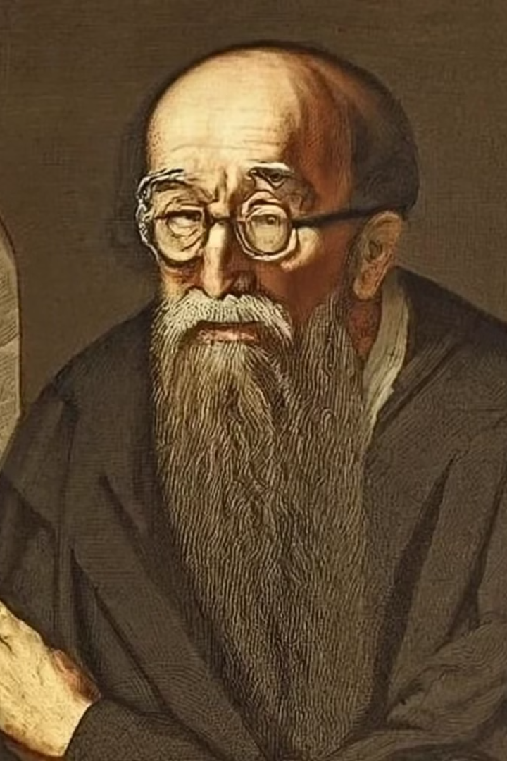
Results & Conclusions
Parameter Estimation
Regression Findings
Precise measurement of antihydrogen Z position.
Correlation between calculated and expected values.
Implications
Confirms reliability for testing fundamental principles.

