Slide 1



Data Analysis and Hardware Implementation for the ALPHA-g Experiment
Presented by Dmytro Skorubskyi
Mentor: Dr. Ina Carli
CERN | 2025

Slide 2
What is ALPHA?
📌 Goal of the experiment:
To study antimatter — specifically, antihydrogen — and test fundamental symmetries in physics.
🧪 Why it matters:
  Our Universe is made almost entirely of matter, but the laws of physics suggest it should contain equal amounts of matter and antimatter.
  ALPHA investigates whether antimatter behaves the same as matter (CPT symmetry, gravitational interaction, etc.).
🎯 Key objectives:
  Trap antihydrogen atoms.
  Perform precision measurements, such as spectroscopy
  Test how antihydrogen responds to gravity (ALPHA-g).
CERN | 2025

Slide 3
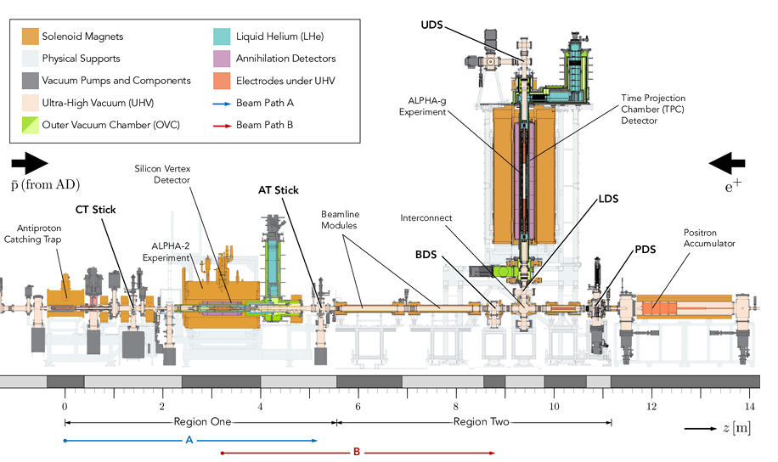
THE ALPHA EXPERIMENT
CERN | 2025

Slide 4



My contribution
Data analysis
Calibrating the scintillating detectors
CERN | 2025

Slide 5
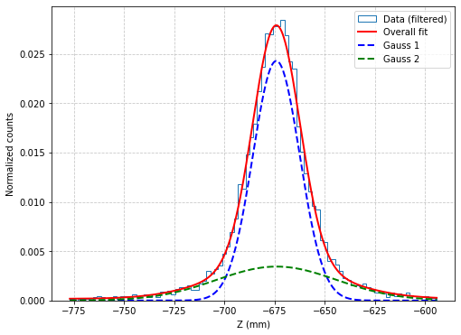
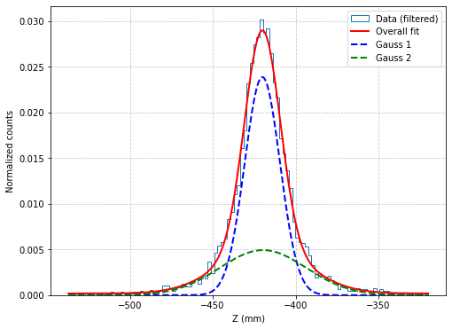
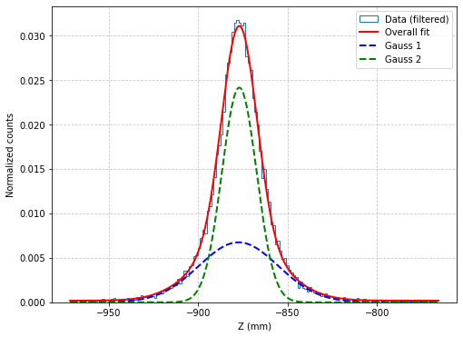
OUR MODEL
Fig. 1
Fig. 2
Fig. 3
Model Description:
We model our data using a combination of two Gaussian functions, each representing a distinct component.
We add a constant term C to account for any baseline signal.
CERN | 2025

Slide 6
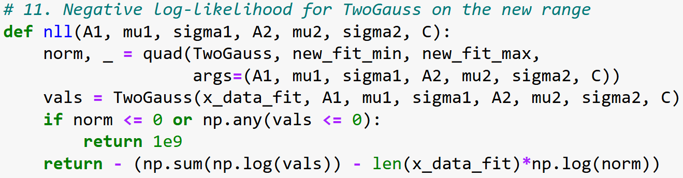
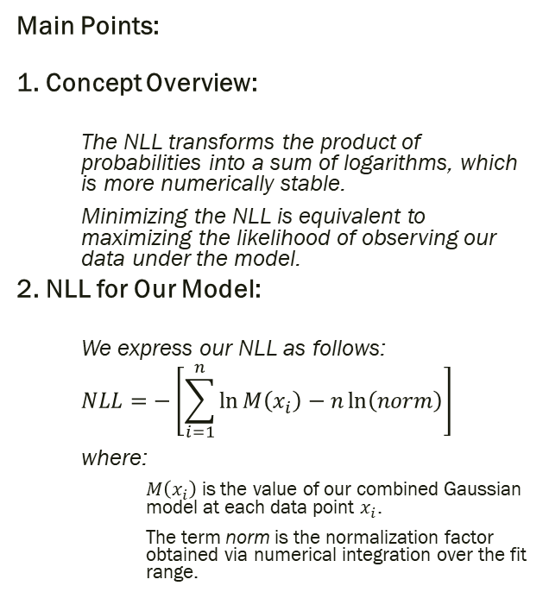
Negative log-likelihood method
Main Points:
1. Concept Overview:
  The NLL transforms the product of probabilities into a sum of logarithms, which is more numerically stable.
  Minimizing the NLL is equivalent to maximizing the likelihood of observing our data under the model.
2. NLL for Our Model:
  We express our NLL as follows:
  $$NLL=−\left[\sum_{i=1}^{n}{\ln{M\left(x_{i}\right)−n\ln\left(norm\right)}}\right]$$
  where:
    $M\left(x_{i}\right)$ is the value of our combined Gaussian model at each data point $x_{i}$.
    The term norm is the normalization factor obtained via numerical integration over the fit range.
Fig. 4

Slide 7
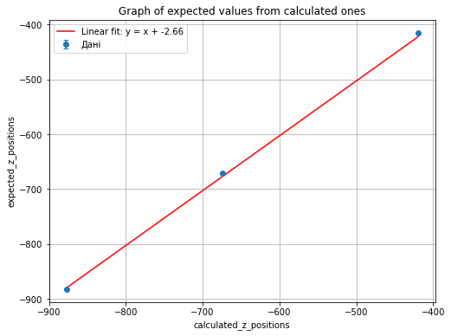
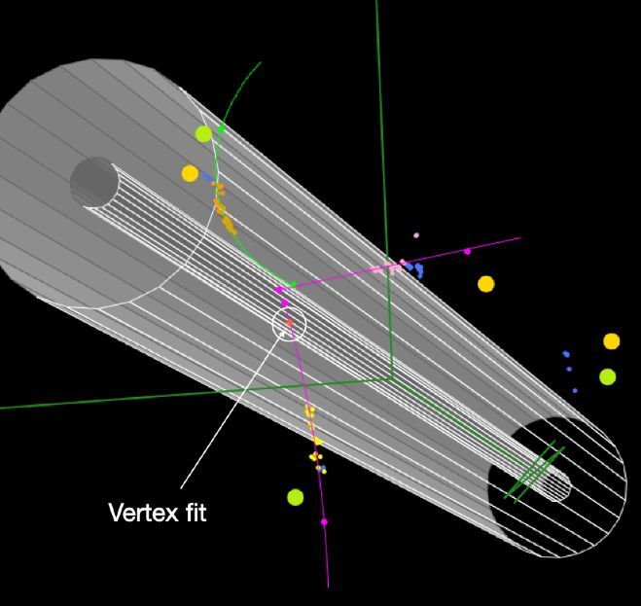
The offset of the trap
Fig. 5
🔍 Motivation:
To ensure accurate spatial measurements in future analyses—such as vertex reconstruction—we need to understand and correct any systematic offsets in position data.
🧪 Methodology:
We compared the calculated z-positions with the expected values and performed a linear regression analysis. The slope near 1 confirms consistency, while the intercept reveals a measurable offset.
📏 Result:
An offset of approximately 2.66 mm was identified. This correction factor will be essential in improving the spatial precision of future reconstruction efforts.
📊 Visualization:
The graph shows the relationship between expected and calculated z-values. The 3D image illustrates a simulated vertex fit—a future application of the improved accuracy.
Fig. 6
Fig. 6

Slide 8
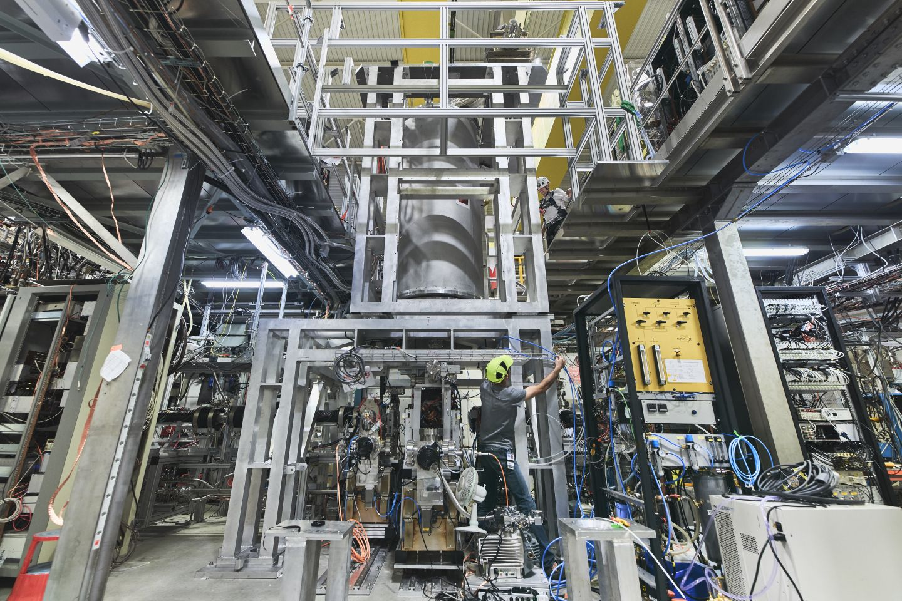
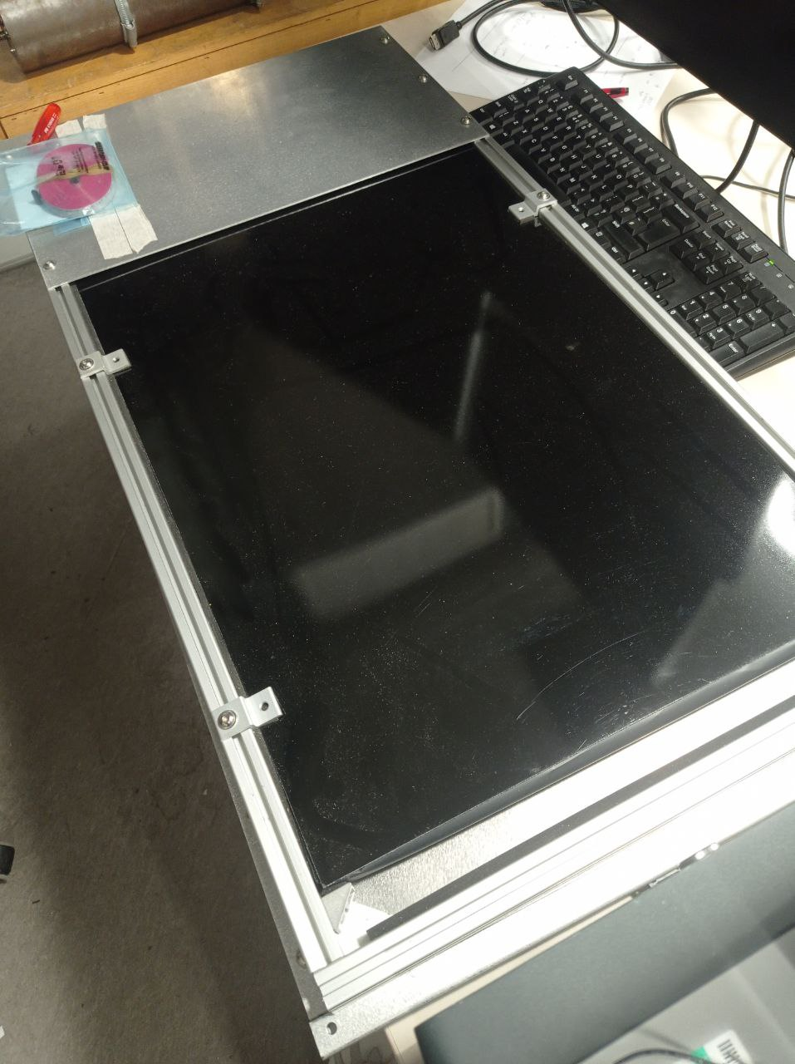
The Hardware Part
ALPHA-g experimental setup
Scintillating panels
CERN | 2025

Slide 9
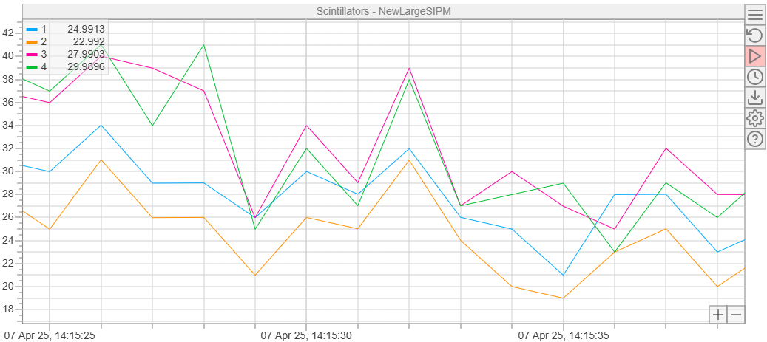
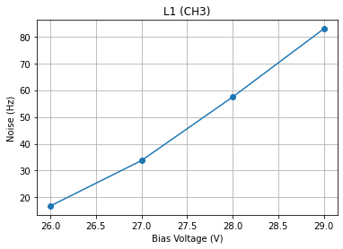
Noise Response to Bias Voltage
Fig. 7
Main Points:
🔬 Measurement Objective:
We investigated how cosmic ray noise changes as we vary the bias voltage applied to each scintillating panel.
📊 Observed Trend:
As shown in the plot, increasing the bias voltage leads to a higher noise frequency. This behavior is expected due to the enhanced sensitivity of the photodetectors at higher voltages.
💡 Implication:
These measurements help define the optimal working voltage range—balancing noise levels and detection efficiency for future operation.
Fig. 8

Slide 10
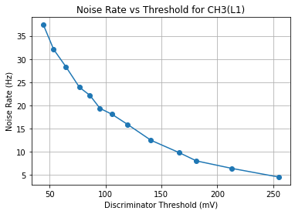
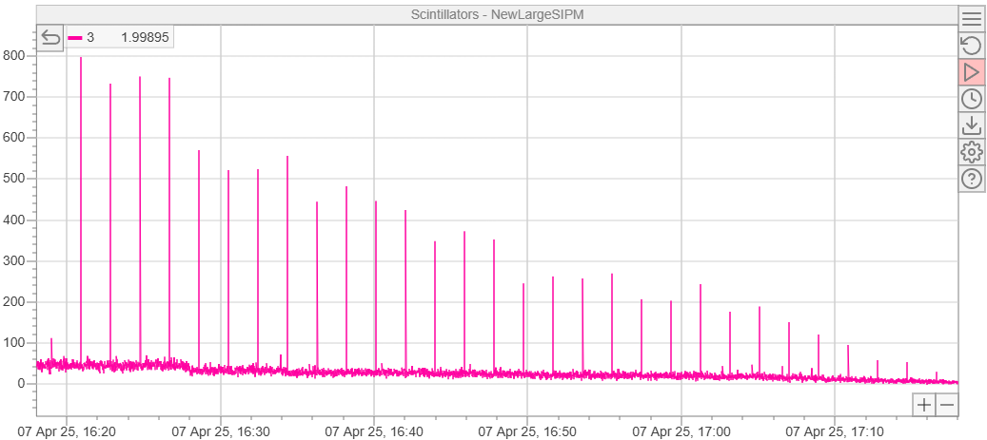
Noise Rate vs Threshold
Fig. 9
Main Points:
🎯 Measurement Goal:
We explored how the noise rate changes depending on the discriminator threshold for each scintillating panel—shown here for CH3 (L1).
🔍 Trend Observed:
As the threshold increases, the noise rate rapidly drops. This behavior is expected since higher thresholds filter out lower-energy (noisy) signals.
⚖ Optimization Insight:
By combining this data with bias voltage results, we can identify the ideal operating point—maximizing real signal detection while keeping the cosmic ray noise in check. ✅
Fig. 10

Slide 11
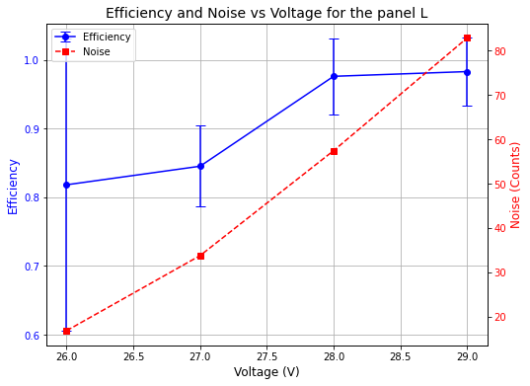
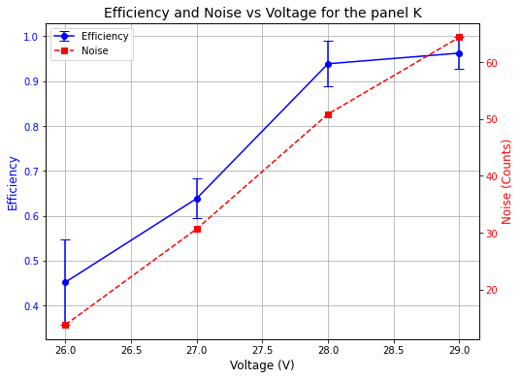
Panel Efficiency vs Voltage ⚡
Fig. 11
What did we do? 🧐
To measure the detection efficiency of the two scintillating panels, we used a "sandwich" configuration:
A reference (small) panel with known performance on top 🥪
The two panels under test are placed below.
How did it work?
📊 Reference Coincidence:
We collected events where the top and bottom panels fired at the same time — this gives us the total number of muons passing through the system.
📍 Triple Coincidence:
Then, we looked at how often all three panels gave a signal — indicating the tested panel saw the particle too.
➗ Efficiency Calculation:
Efficiency =
(Triple coincidences)
÷
(Reference coincidences)
for each bias voltage level.
Why does it matter?
By comparing efficiency and noise for each voltage (see Figs. 11 & 12), we can optimize performance and find the sweet spot between reliable detection and minimal noise 🌟.
Fig. 12

Slide 12
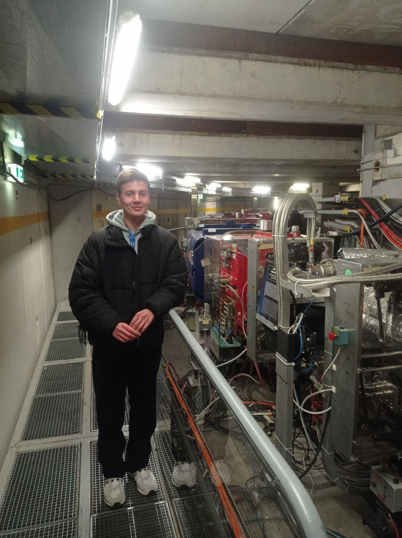
THANK YOU FOR YOUR ATTENTION!
CERN | 2025

