Slide 1




Under the program: Research abroad at CERN
small Monitored Drift Tube modules commissioning
Ruslan Yakubovych
16/04/2025

Slide 2
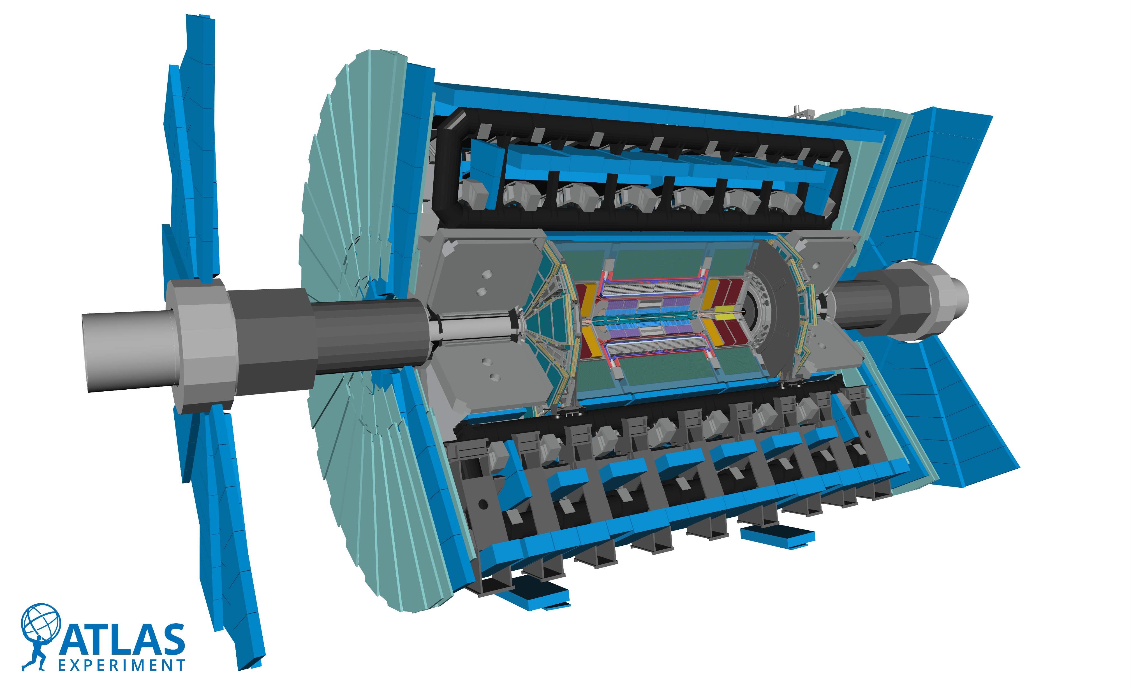
2
A few words about the program
The program is provided by the University of Michigan and sponsored by the U.S. State Department.
Program is based at CERN and for 3 months the student works on one CERN project
Students are distributed to top CERN projects such as ATLAS, ALIS, ALPHA.

Slide 3
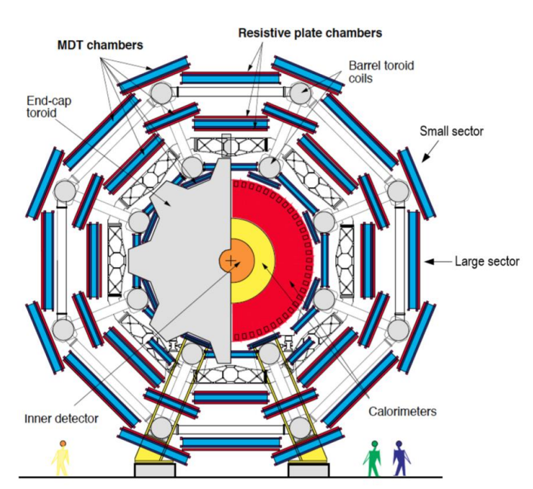
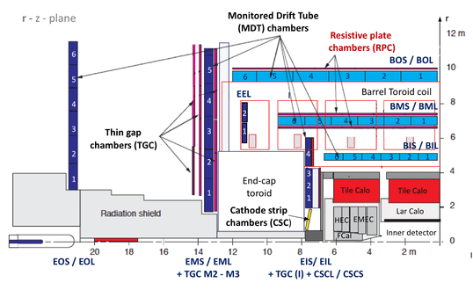
3
Where I work and general information
I was assigned to the ATLAS experiment, the biggest detector of all.
And I was integrated into the muon group working on the new sMDT chambers.
My advisors were Chihao Li and Jiajin Ge, and the head of the group was Bing Zhou.
The task of our group was to prepare and test the sMDT chambers before installing them in the detector.
I did both software and hardware work at the same time.

Slide 4
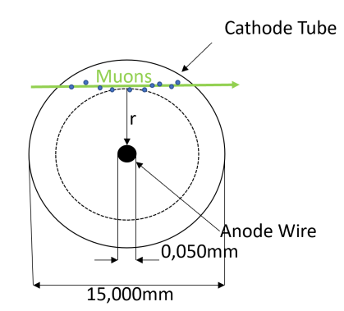
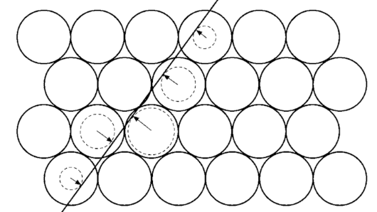
4
What is MDT and why is it being changed to sMDT
MDT chambers are the main muon tracking technology in the muon system of the ATLAS detector at the LHC. They allow very precise determination of the trajectory of muons travelling through the detector.
Now MDT chambers will be replaced by new sMDT chambers, with smaller tube diameter, to make space for RPC chambers while maintaining high muon tracking resolution in HL-LHC period.
The new chambers are supposed to have significantly lower rate fake muon triggers, higher frequency of operation, smaller size compared to MDTs.
The muon flies through the tube and ionises the gas.
The released electrons begin to drift to the wire under the action of the electric field.
The drift time is measured - from the moment of ionisation until the signal is recorded.
Knowing the drift velocity (~50 µm/ns) it is possible to reconstruct the transverse distance from the muon track to the wire.

Slide 5
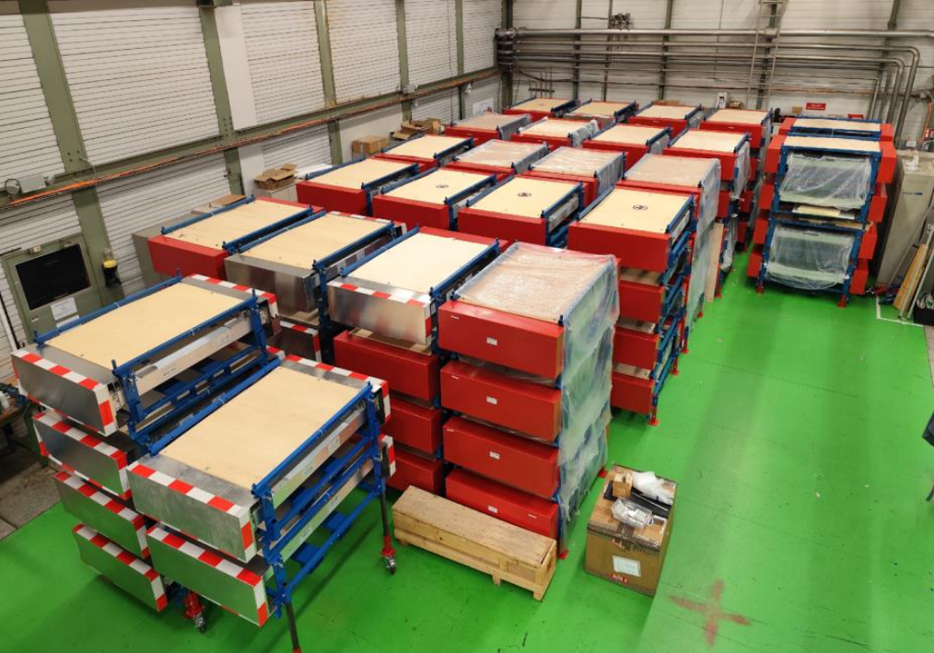
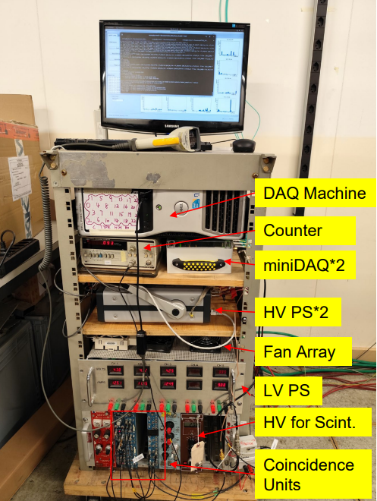
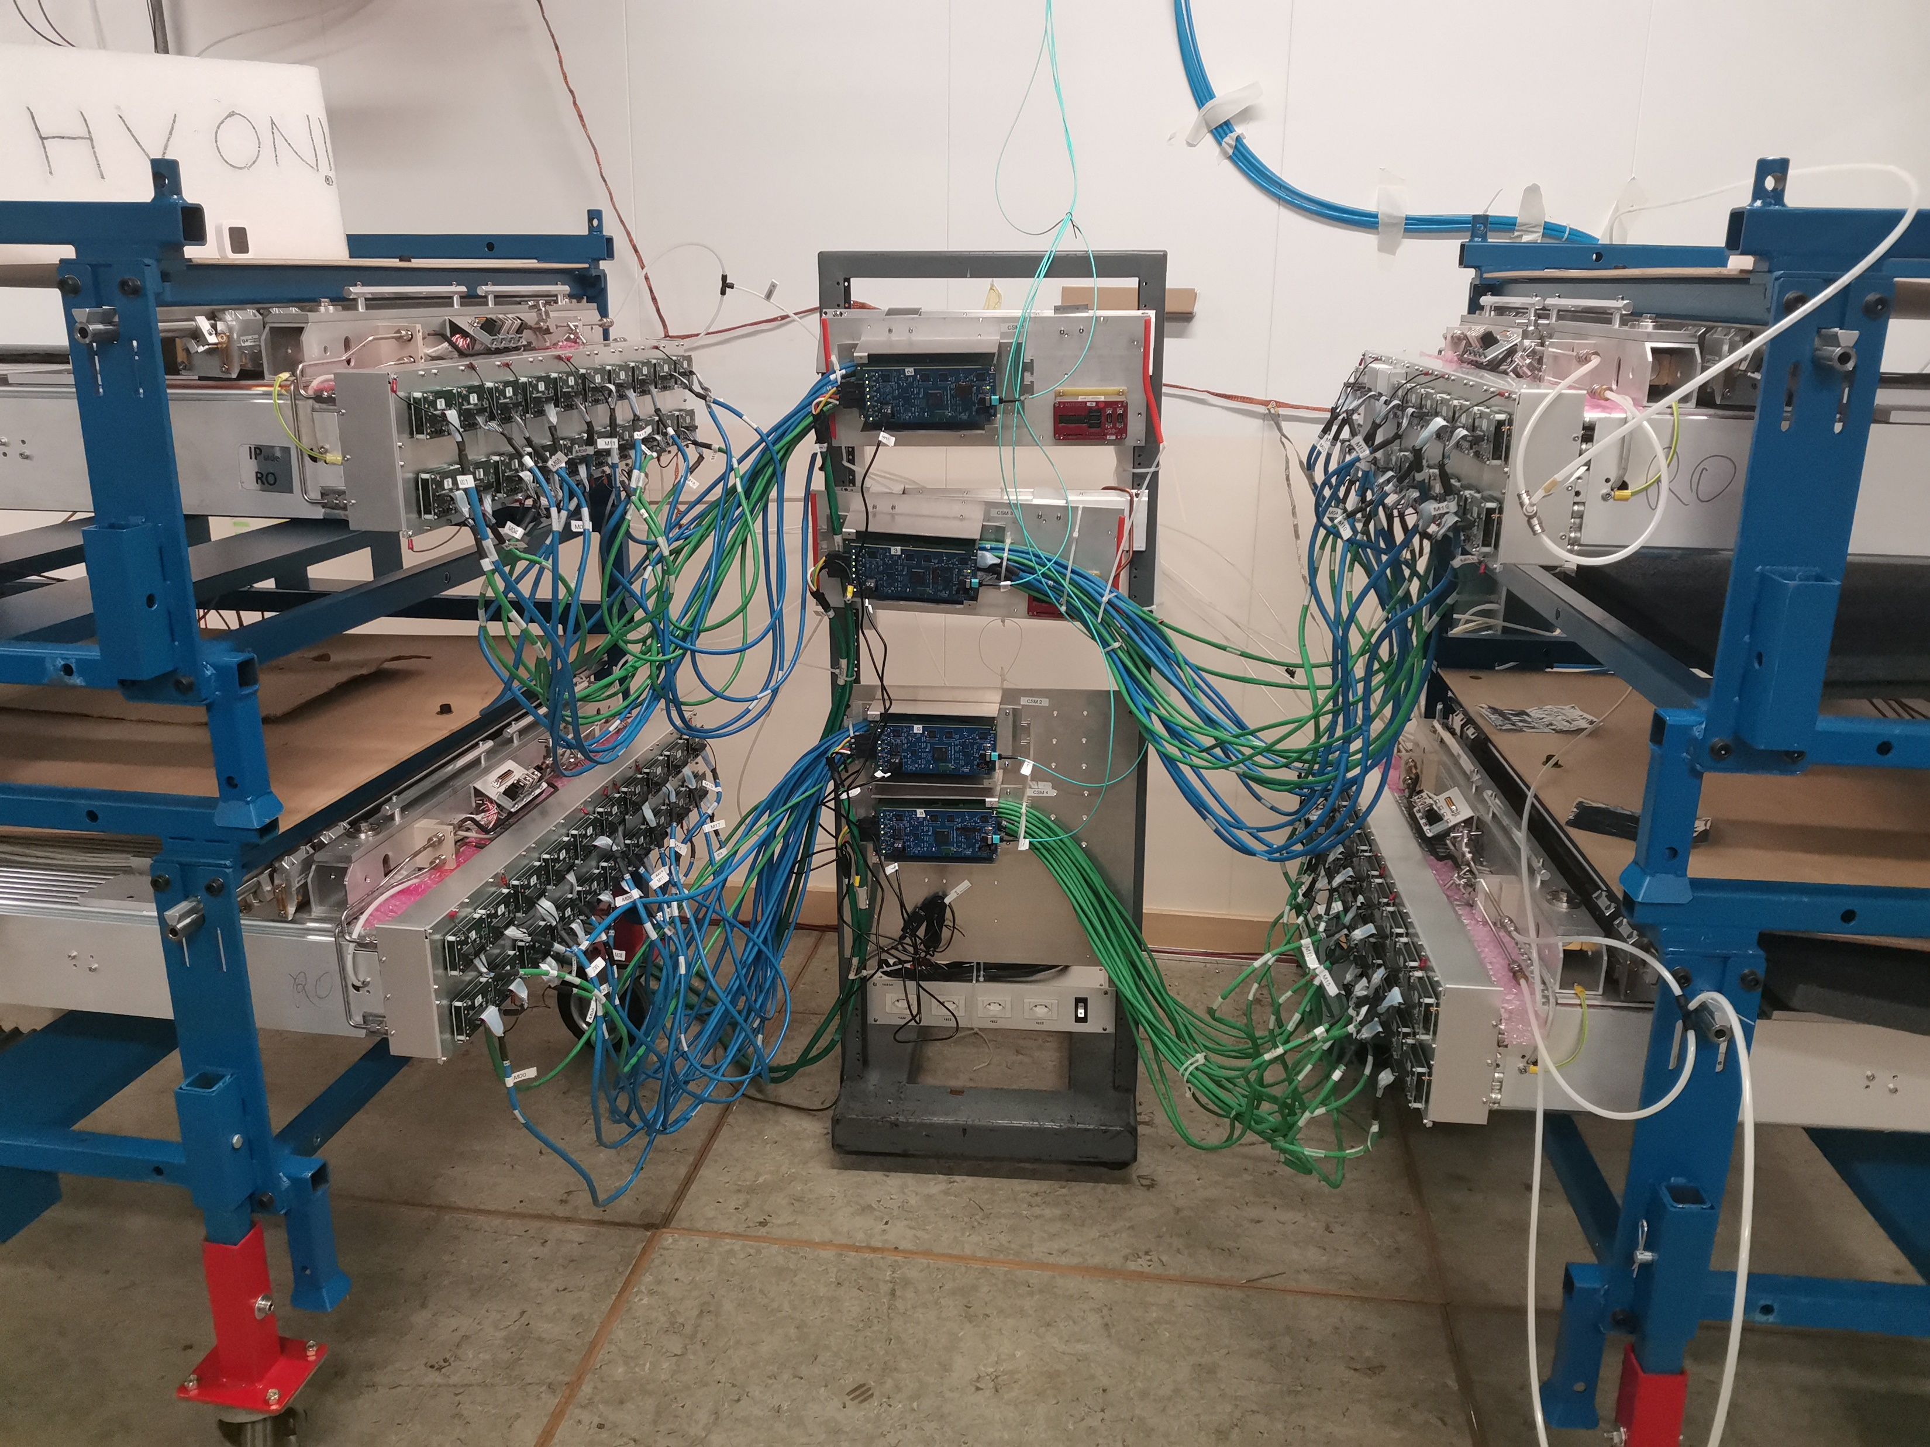
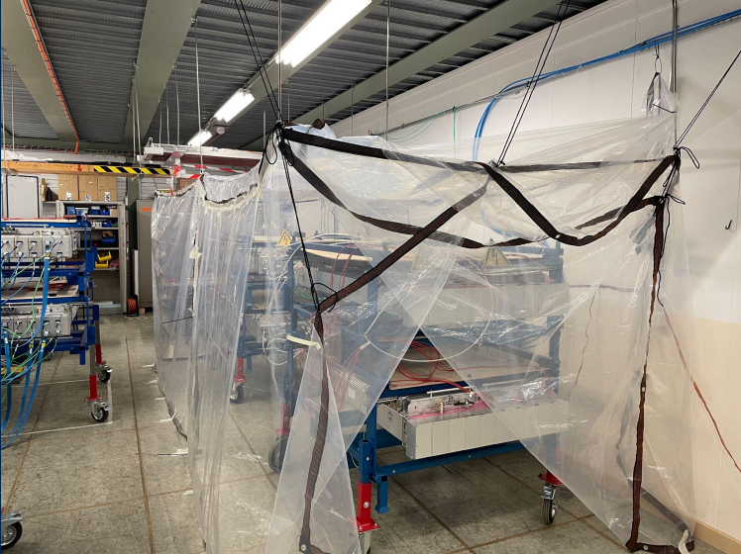
5
About hardware work
We have 50 modules of sMDT detector, we test them in the test room. We allow 2 weeks to test 4 modules.
During this time we have to collect and test the chamber data.
sMDT tests are carried out using the pre-production CSM, CSM-MB and we use the miniDAQ to collect the data from CSMs.

Slide 6
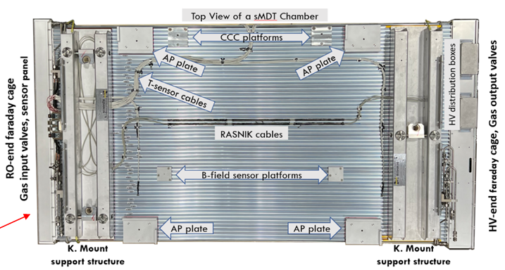
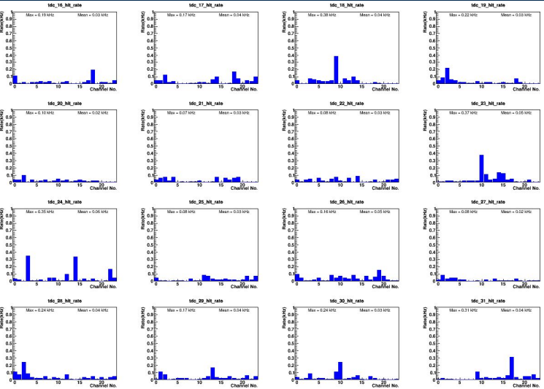
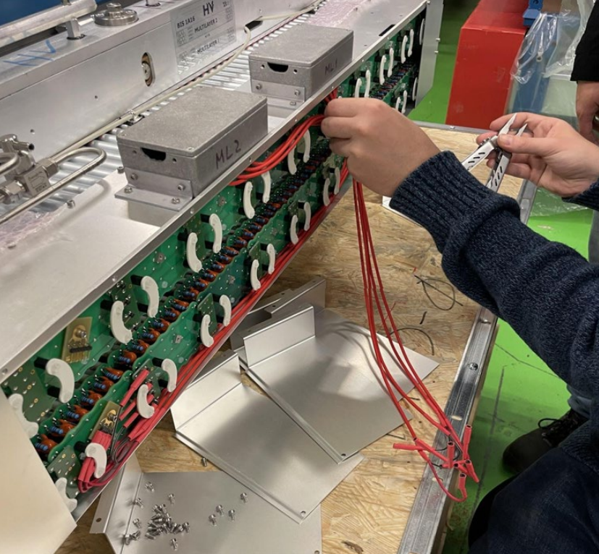
6
About hardware work
Since I work with the working group, my job is no different than theirs. I finish assembling the chambers, check them for defects and noise, fix them and eliminate issues.
Our goal is to make sure that the noise is less than 1 kHz and that the efficiency of the modules is high. Often we achieve a noise of ~ 40 Hz.

Slide 7
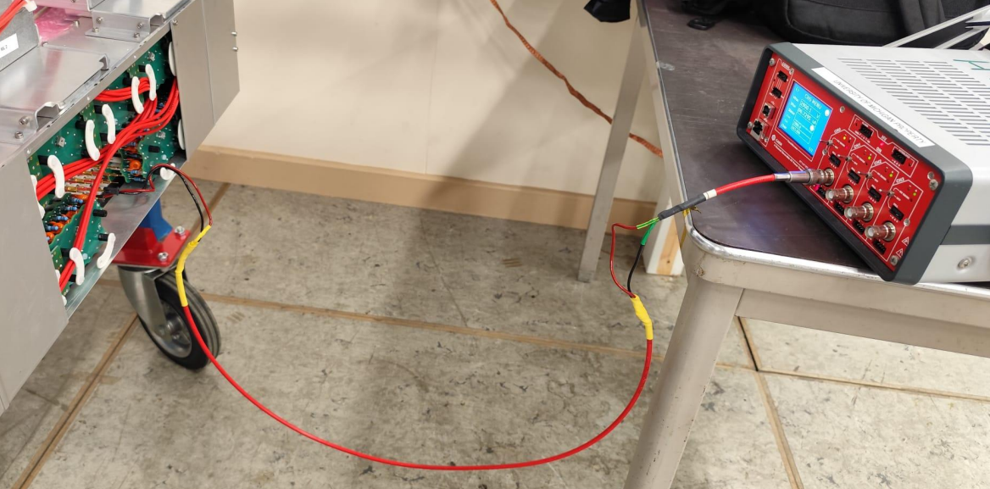
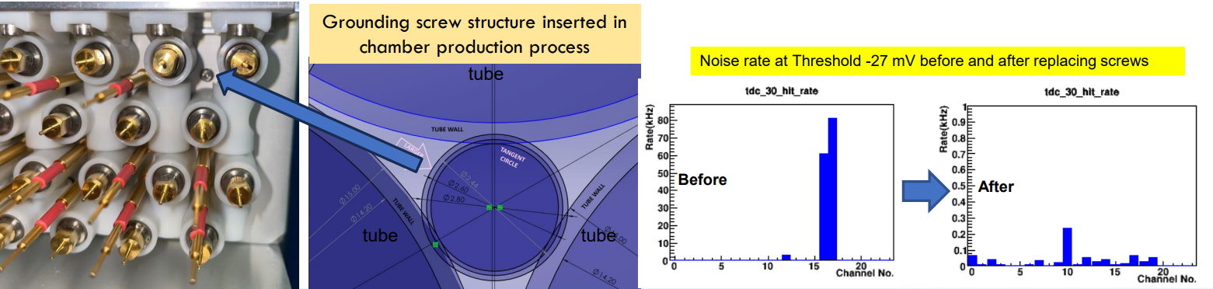
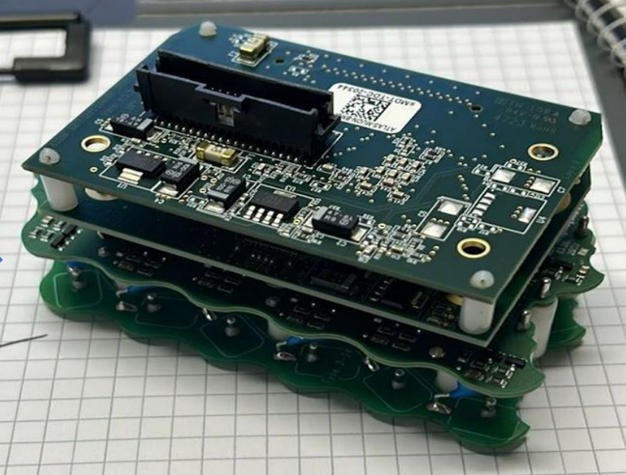
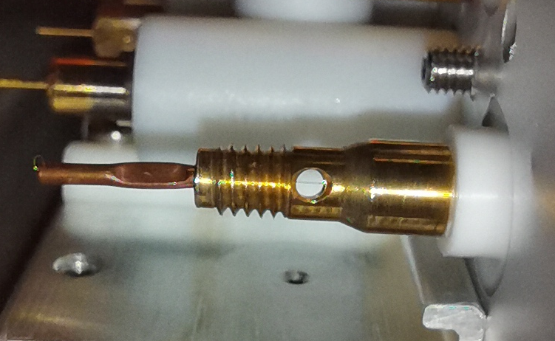
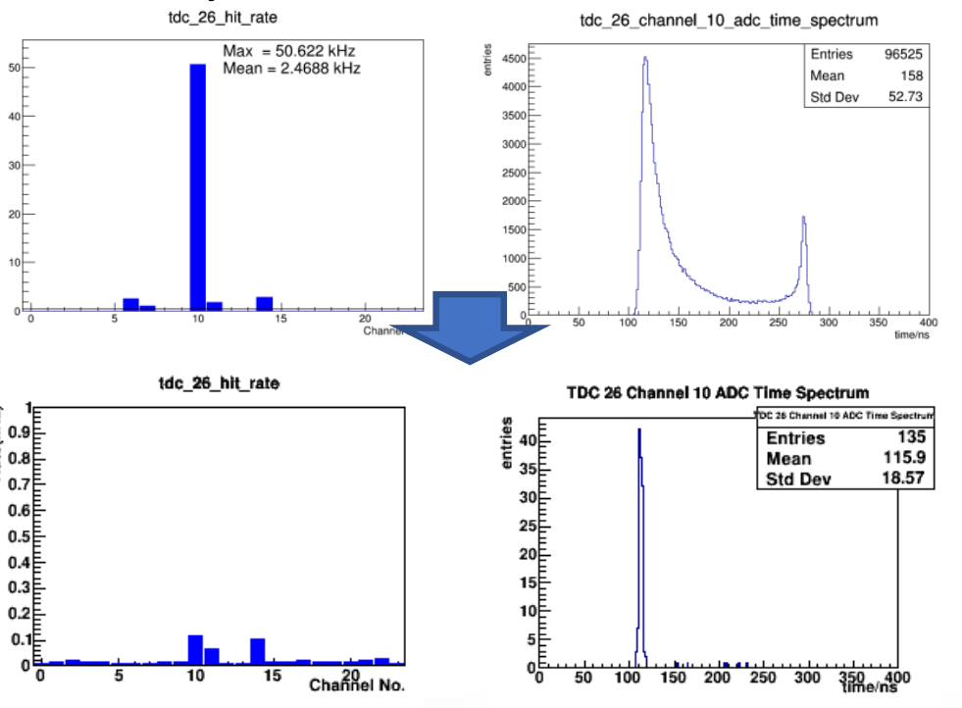
7
About hardware work
Some examples of chamber problems
Reducing dust noise by burning dust with reverse voltage.
Noise rate at Threshold -27 mV before and after replacing screws
dust can get in here
and you can see the thread.

Slide 8
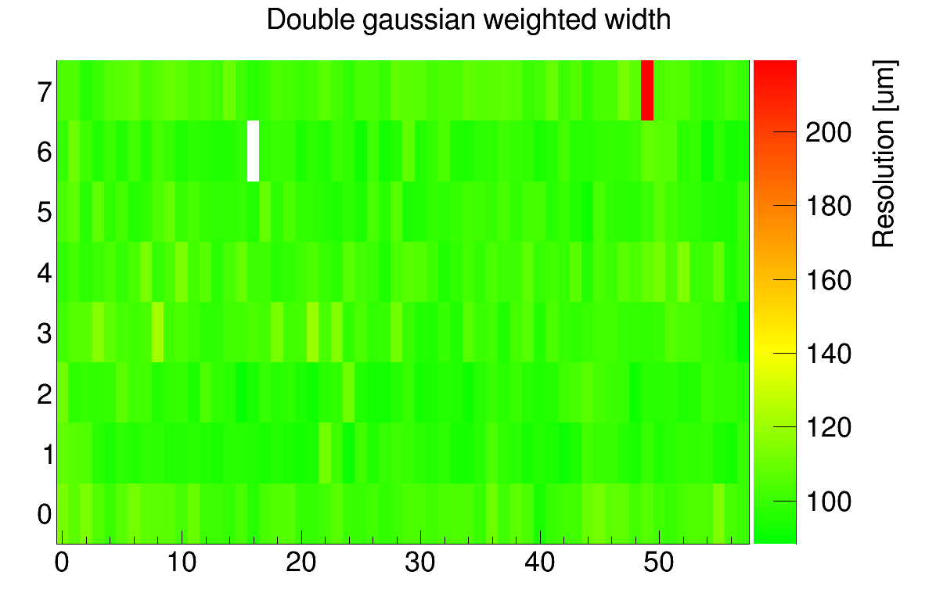
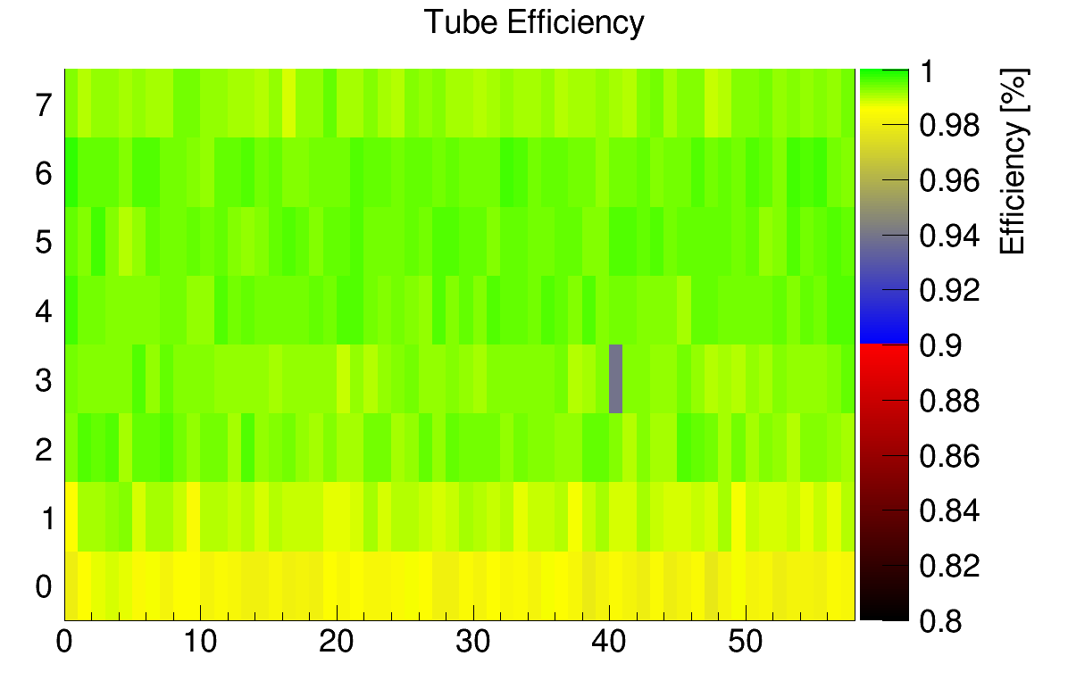
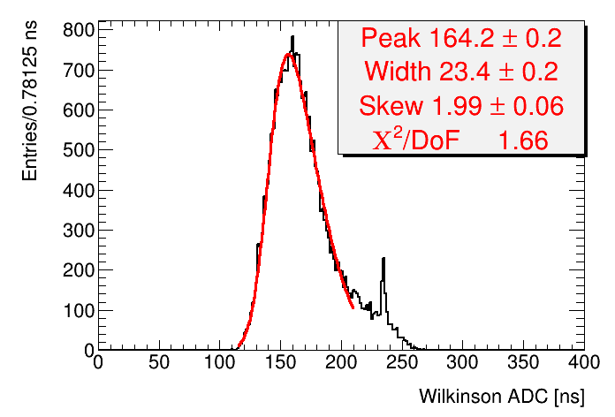
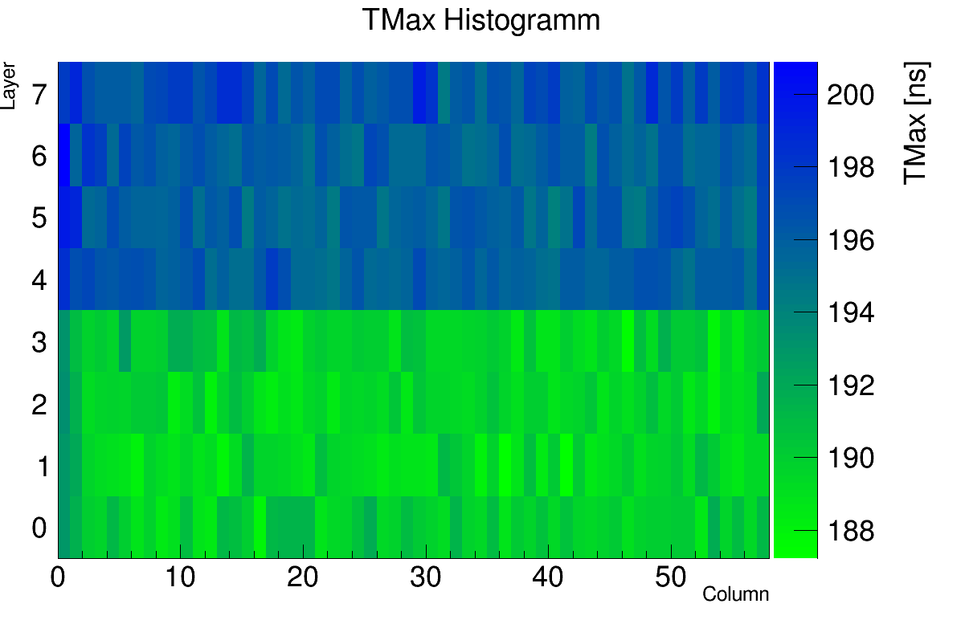
8
About software part
On the software side, my job was to analyse data and find problems that cannot be detected in the lab, such as efficiency, resolution, undetectable noise.
bad resolution
low efficiency
overall problem
bad electronics

Slide 9
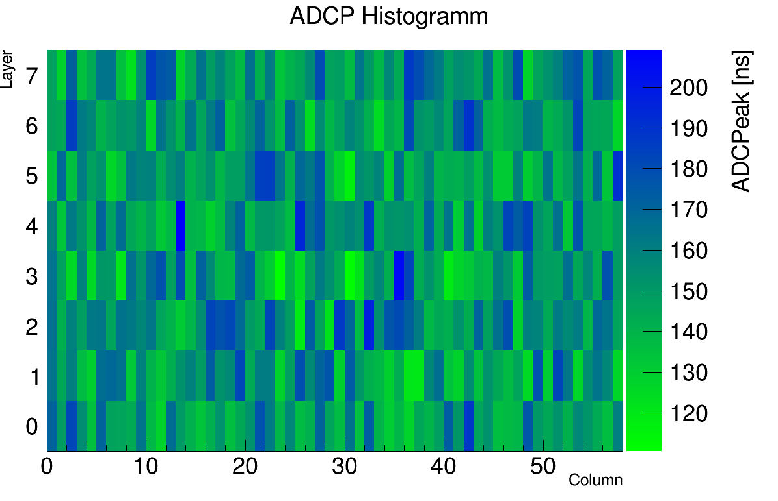
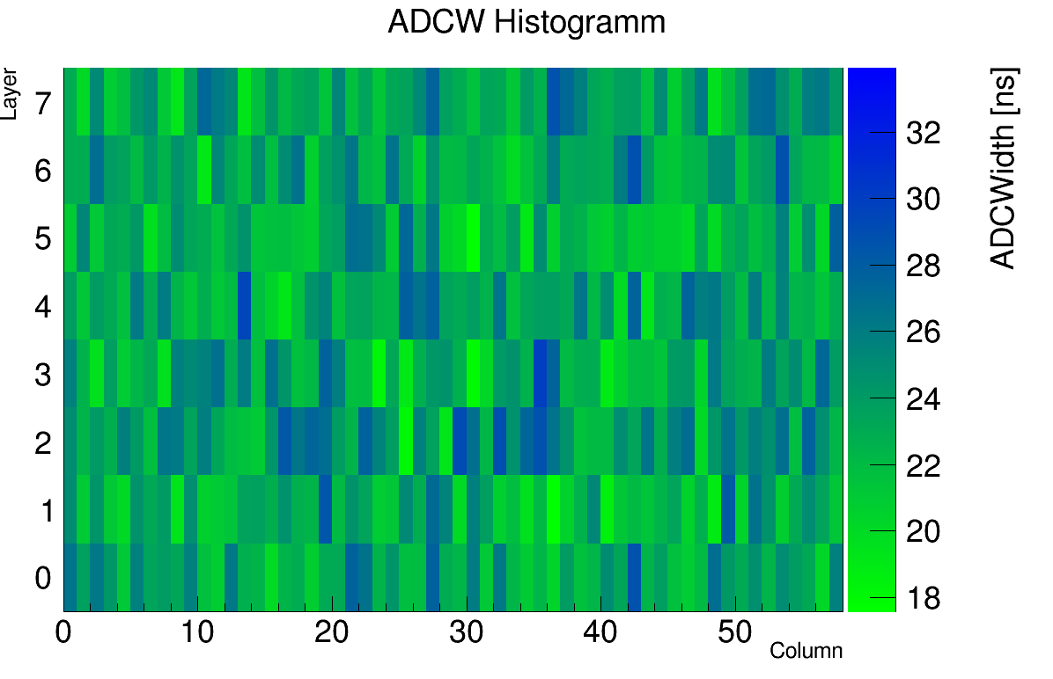
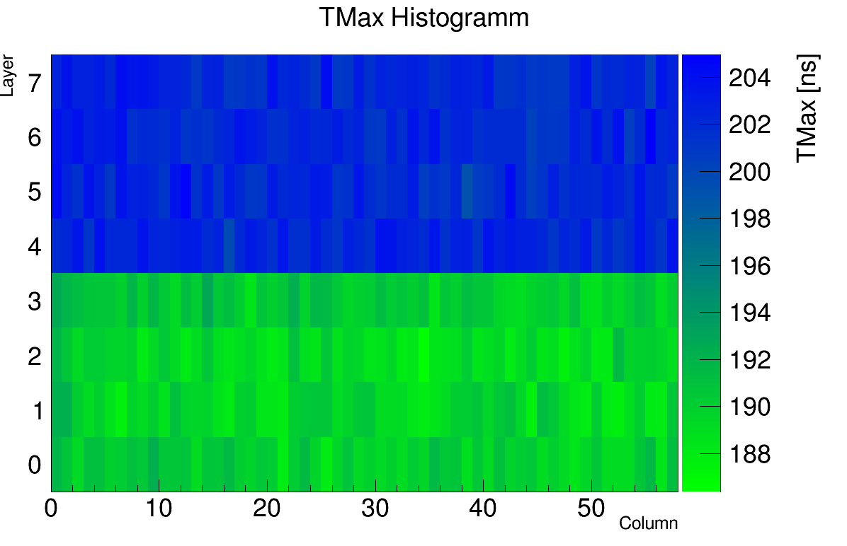
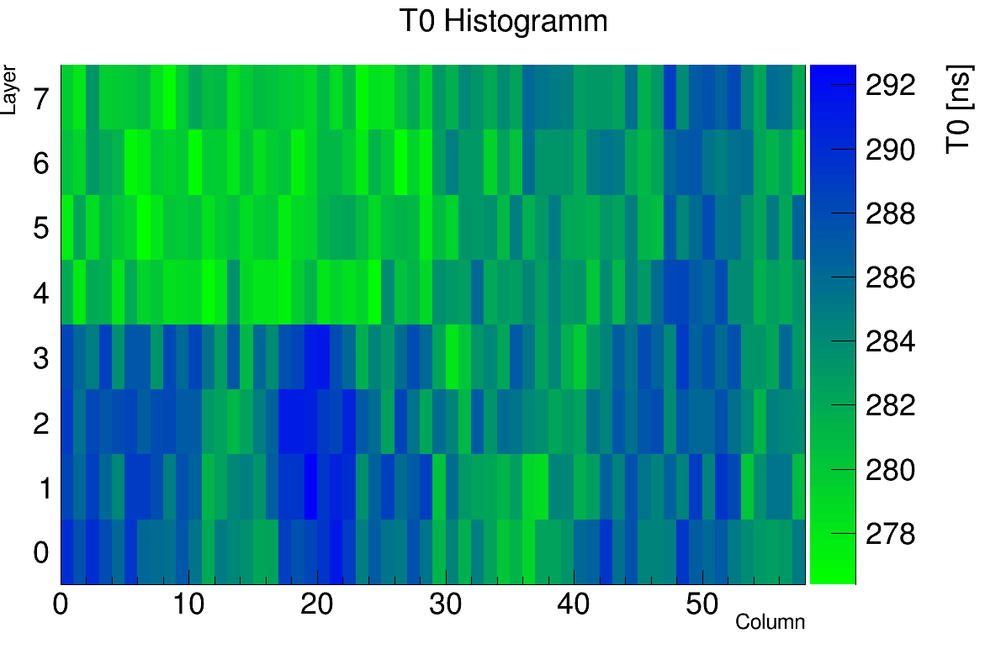
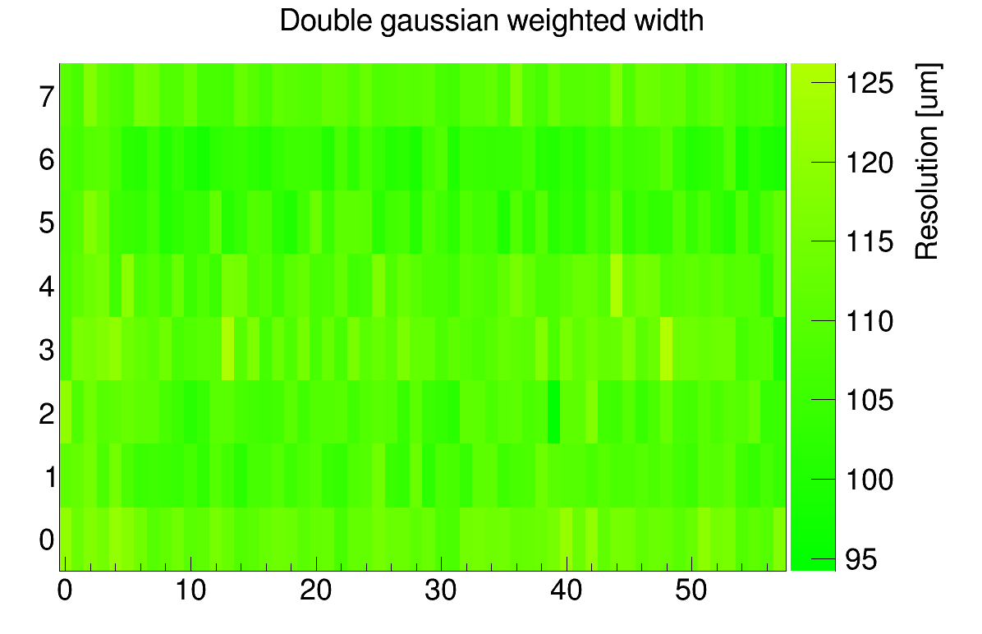
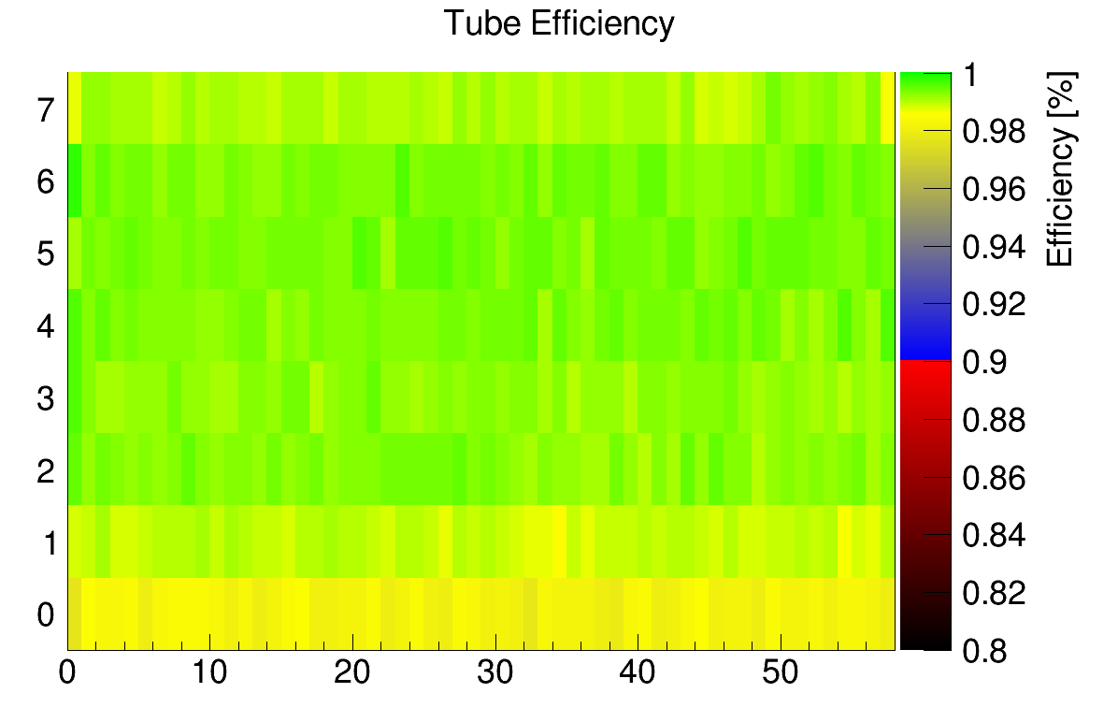
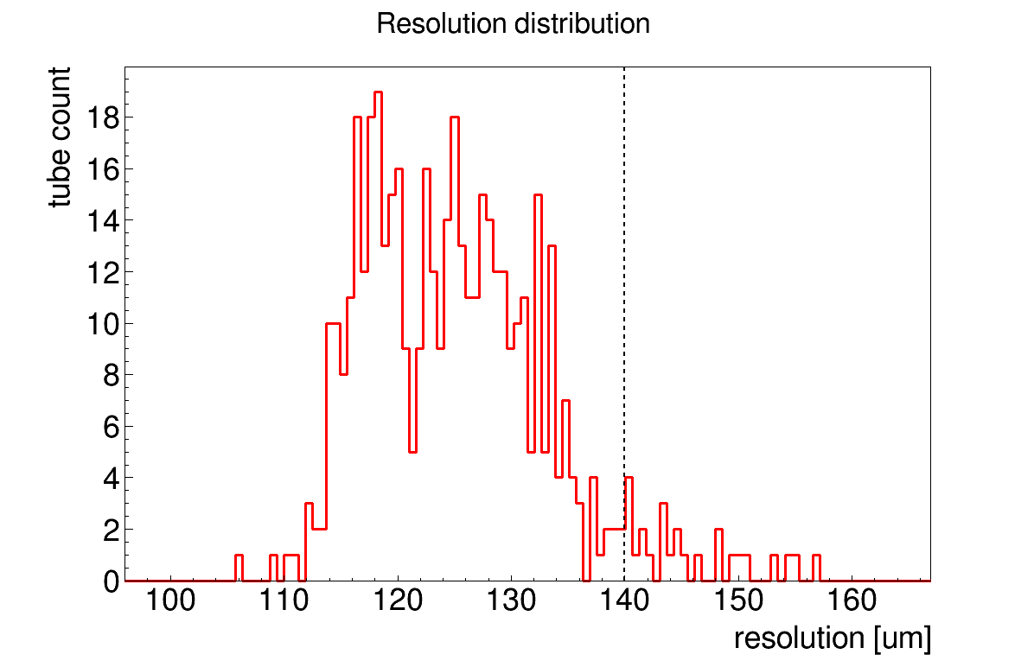
9
About software part
To decode raw data I use code written by sMDT team specifically for testing these chambers.
Also for analysing the decoded data I have developed 2 scripts that allow me to instantly detect problems in the chamber and get information about them.
The first one finds all abnormal values of key parameters and also deals with visualisation and I get all the information about those edge-tubes immediately.

Slide 10
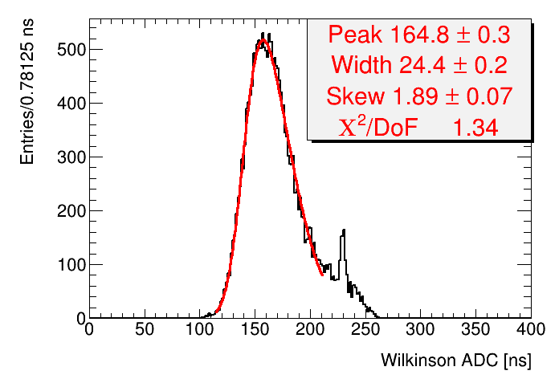
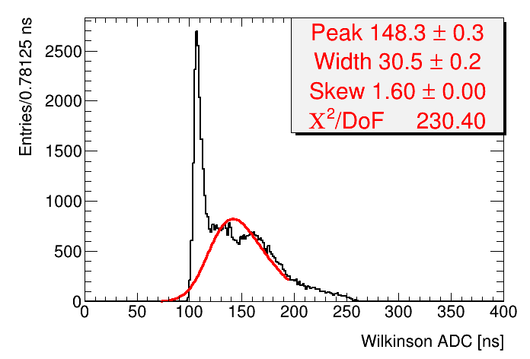
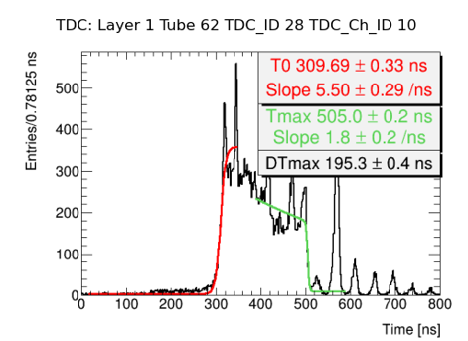
10
About software part
The second one analyses the spectra of the tubes and finds all abnormal ones.
In this way problems can be found even if they do not corrupt key parameters, which is very important, because such problems can accidentally pop up when it is too late.
In this way I was able to fully automate my work.
And afterwards I was actively involved in the hardwares part, as it freed up a lot of time.

Slide 11
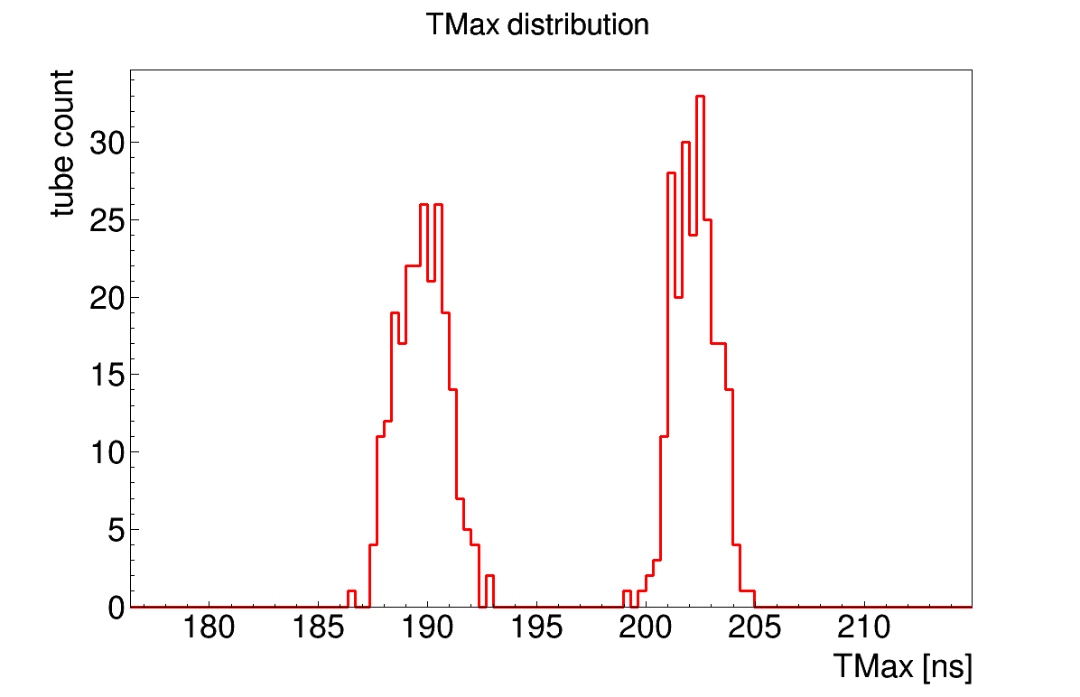
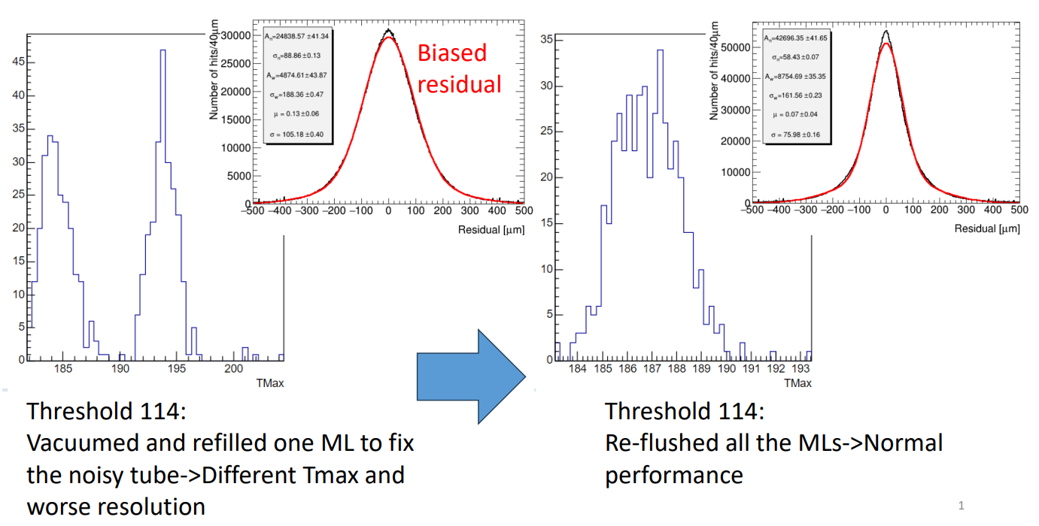
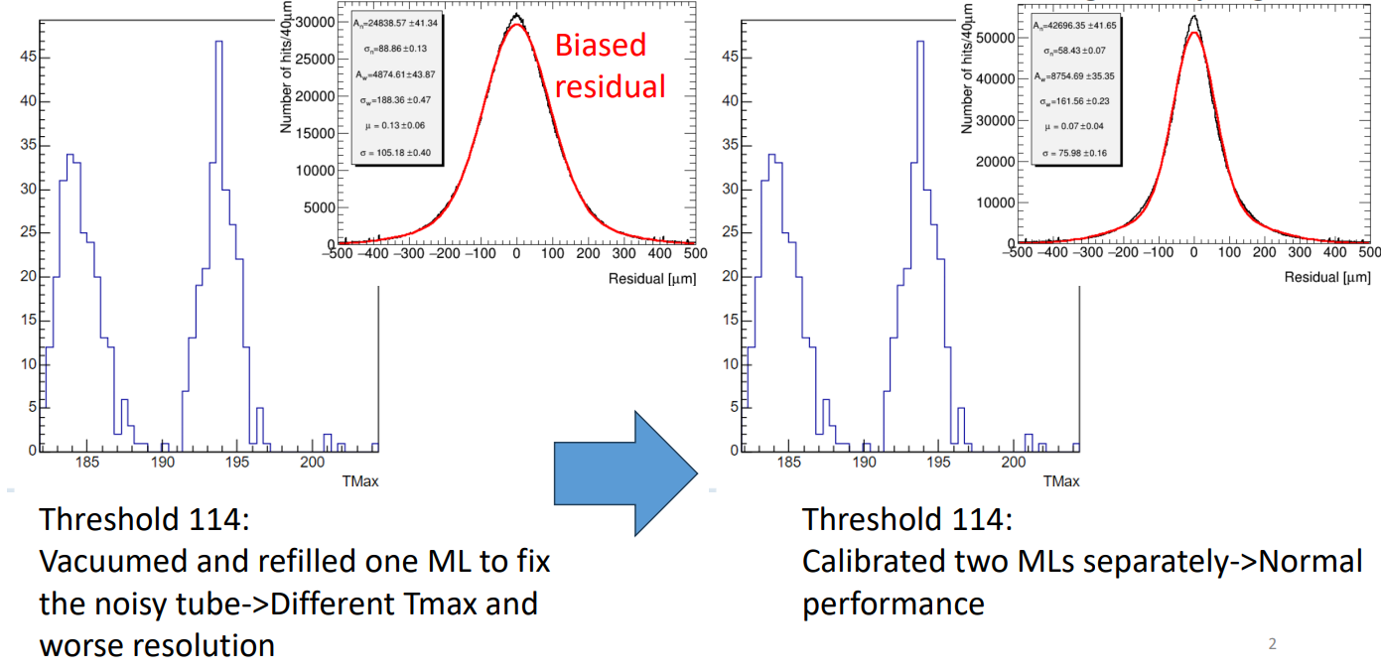
11
Additional resolved issues
From the analysed data I found some bad tubes and components, such as dust in the tube or bad mezzanine, in the chambers which I obviously reported and they will be fixed.
Also I found one global problem which was visible in almost all chambers. I have found the cause and we were successful in offsetting the effects.
The problem was that different multilayers of the chamber had different mean DTmax value, which spoilt resolution of chamber.
The cause was that gas in the chambers during tests is not constantly refreshed, but refilled from the tank one time and not always multilayers are refilled at the same time.
We found a way to eliminate the effects of this problem. We split the calibration of tubes by multilayers at the software level.

Slide 12
12
Results
During my stay at CERN (up to the time of the report):
with the working group, we had time to prepare 20 modules of the sMDT detector
I had time to check the data for 10 modules. Checking 1 module includes checking 2 datasets of information corresponding to 2 different module settings.
One student from Tufts University also worked with me, so the data analysis was split equally.

Slide 13
13
What's left to do?
In terms of the work that is available to be done, I've done everything.
And made an additional contribution to resolving the problems I discovered.
There are 26 more chambers left on the schedule, which my work group plans to complete by ~9 September.

Slide 14
Thank you for your attention

Slide 15
supplementary

