Slide 1



Front End Electronics options
E. Di Meco, I. Sarra – INFN Laboratori Nazionali di Frascati
Crilin Internal Meeting - LNF
February 20, 2025

Slide 2
Three FEE Choices
New prototype → 250 readout channels
Different options (and possible acquisitions) available
Our custom FEE +
CAEN V1742 digitizers
Our custom FEE +
CAEN DT5203 picoTDC
CAEN DT5204 board

Slide 3
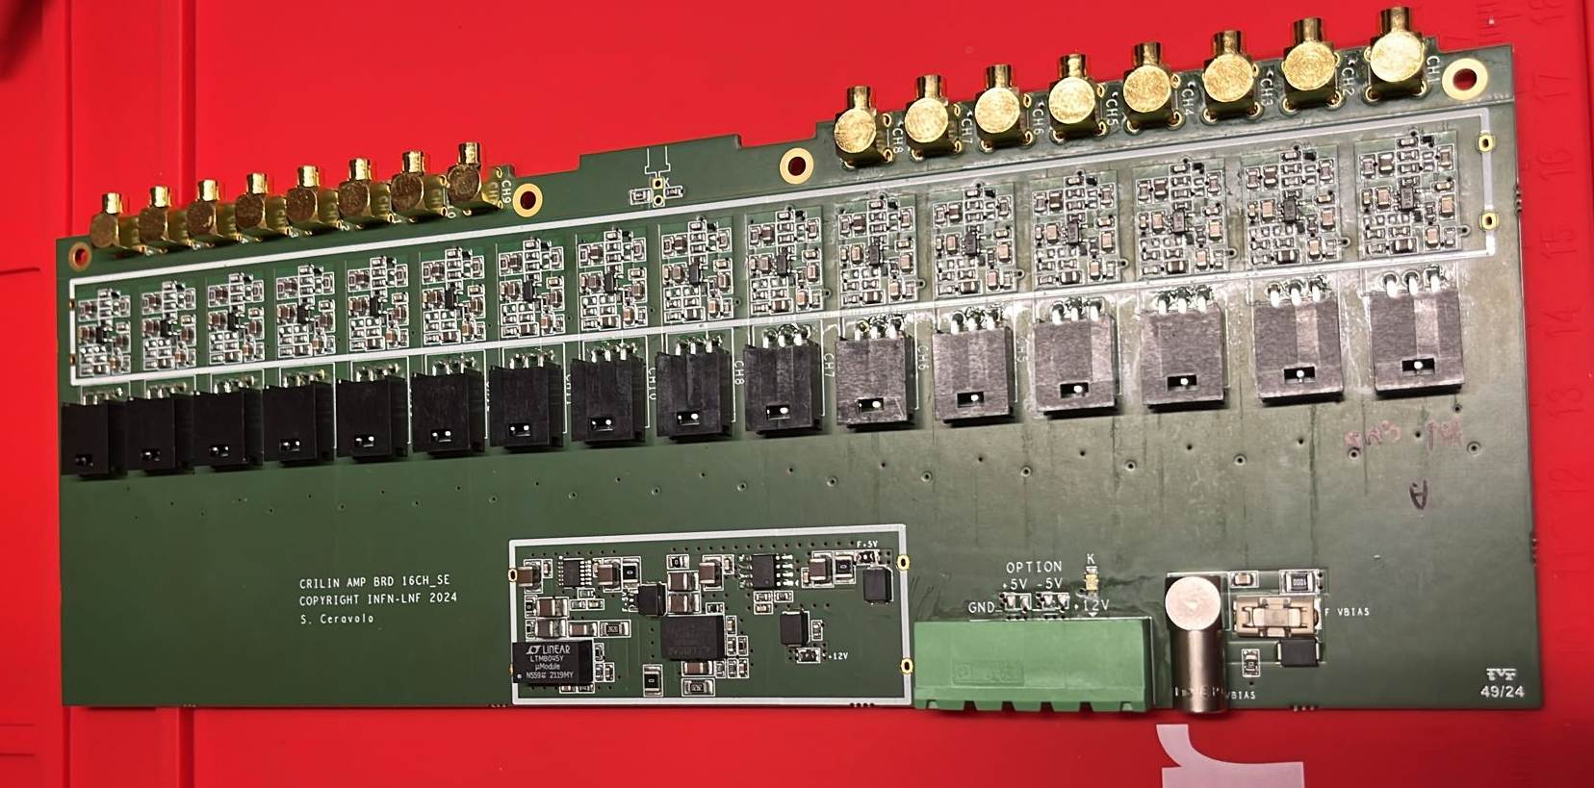
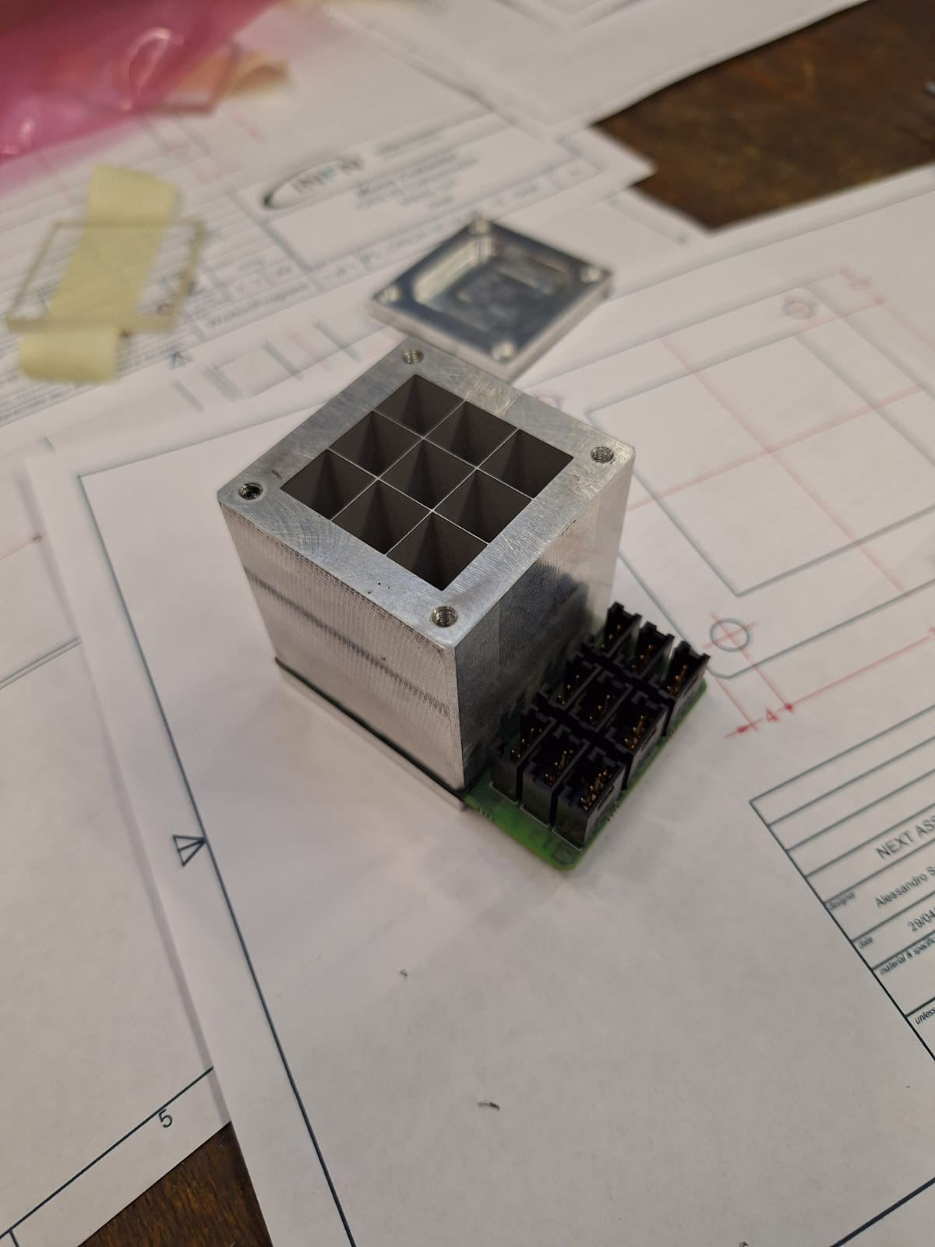
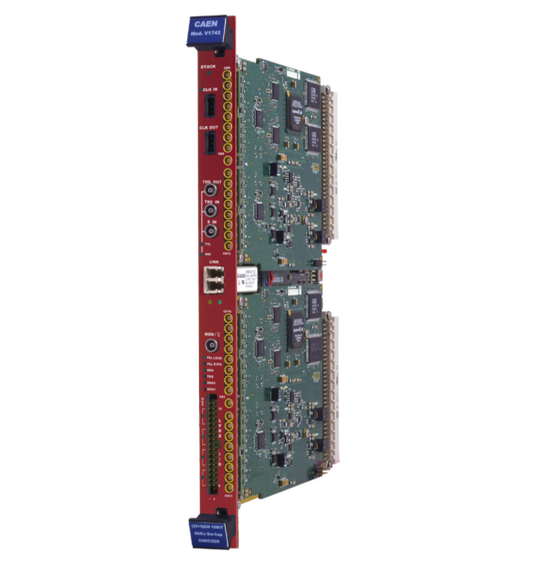
Custom FEE + CAEN V1742
9 chn prototype of our FEE is ready to be tested
DAQ and readout chain ready (same used for all recent test beams)
Digitizers probably available soon (spares from PADME + ours: 8 in total needed) for all 250 channels
Pros: all well know (and reliable) and already (or soon to be) tested
Cons: lots of disk space occupied to digitize 250 chns waveforms
Our custom FEE +
CAEN V1742 digitizers

Slide 4
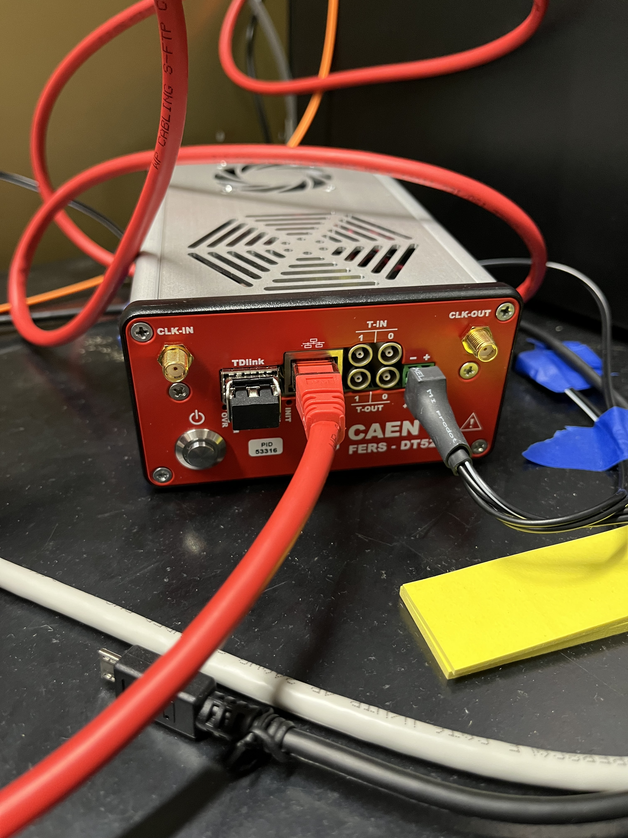
Custom FEE + CAEN DT5203 picoTDC
9 chn prototype of our FEE is ready to be tested
each DT5203 picoTDC has 64 channels available for readout
DAQ to be built from scratch (built in software already installed and ready to be tested), calibration for ToT vs Q conversion needed
Pros: data size significantly reduced, great time resolution
Cons: unknown resolution in charge with ToT method
Our custom FEE +
CAEN DT5203 picoTDC

Slide 5
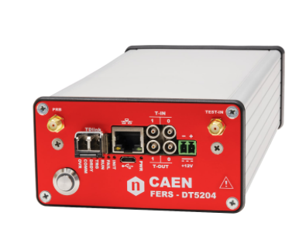
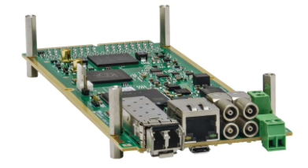
CAEN DT5204
Integrated amplification electronics, based on the 64-channel Radioroc unit for FERS-5200 and Pico TDC (total cost for 250 channels ~ 60k EUR)
DAQ to be built from scratch, also this has a built in DAQ software
Pros: data size significantly reduced, same time resolution of picoTDC
Cons: unknown resolution in charge
ready (most probably) for June
CAEN DT5204

Slide 6
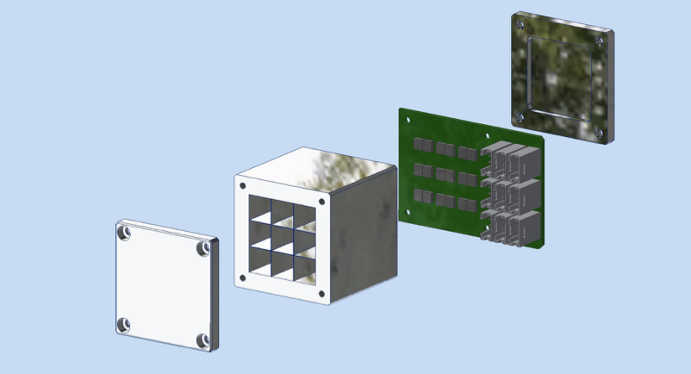
Testing stages
Laser test to check our FEE + v1742 or picoTDC
  Check cross talk between channels and timing performances
  First test bench to compare the performances between option 1 and 2 acquisitions and start the production for the FEE boards
Test beam at PS (probably end of August) to compare all 3 options and start familiarizing with the DAQ before the final prototype

Slide 7
Backup slides

Slide 8
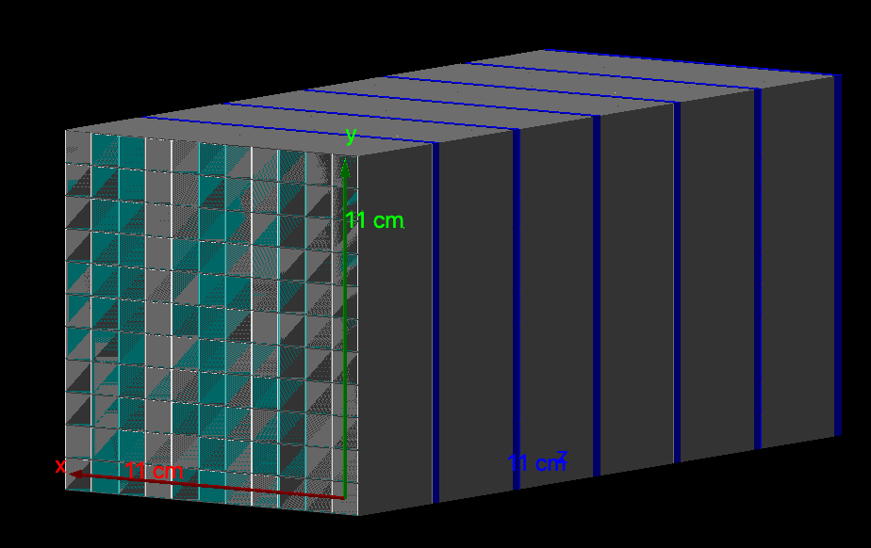
Geant4 simulation of the new prototype
Initial proposal 11x11x6 layer (crystals 10x10x40 mm² each) → 2.5 R_{M} – 26 X₀
Crystals wrapped in 150 um Mylar foils and placed a 150 um aluminum honeycomb
2 SiPMs 3x3 mm² per cystal, 2 mm thick, per layer
2 mm thck PcB, per layer
Photostatistics and noise measured during beam tests : Poisson 0.3 p.e./MeV, Gauss 5 MeV

Slide 9
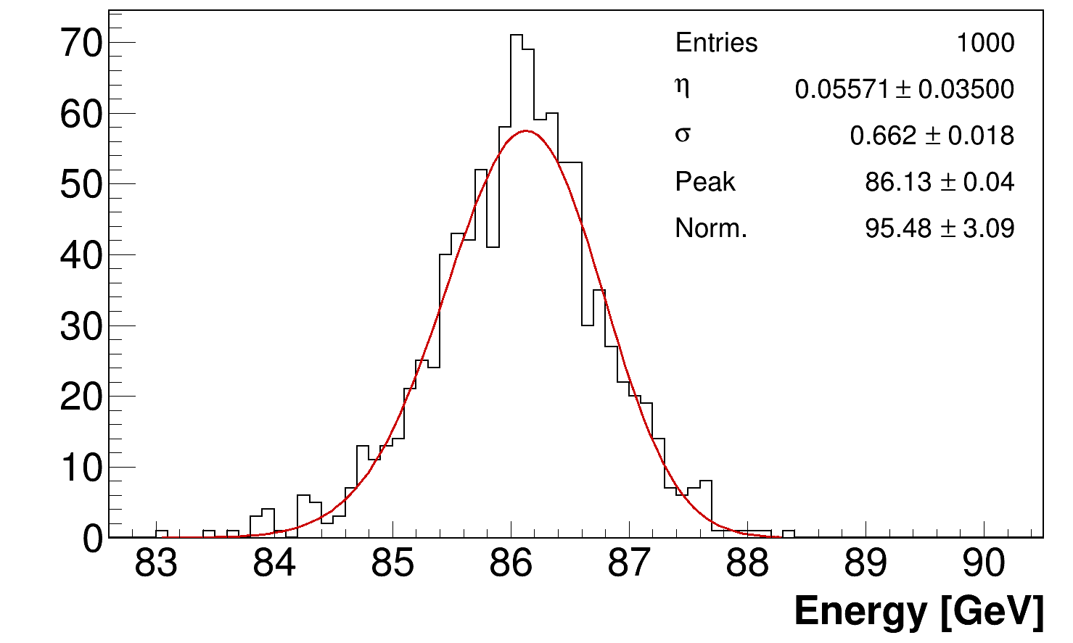
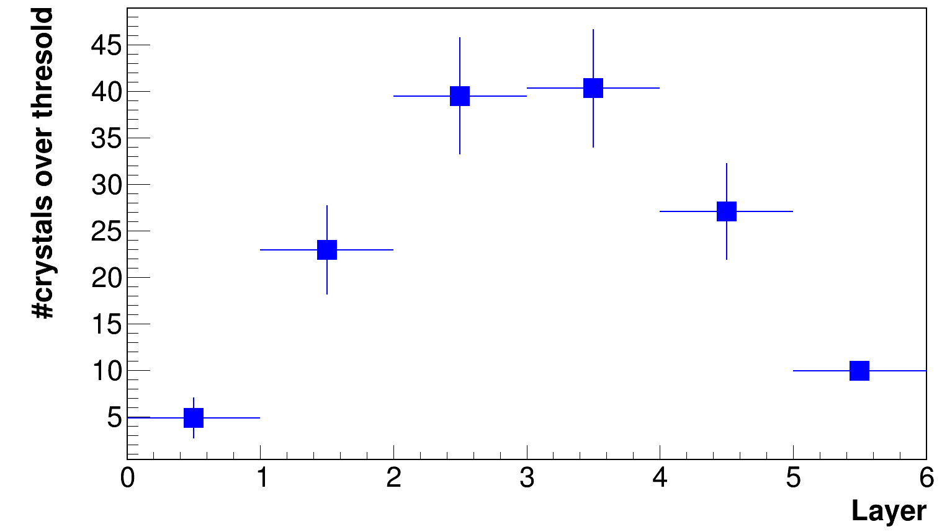
Number of crystals optimization
By setting a threshold similar to that expected for the Muon Collider (i.e. 40 MeV) per crystal, we optimized the number of crystals, with the goal of minimizing the energy resolution loss → optimization performed for an electron beam with 100 GeV of energy.
11x11 x6 layer
σ_{Ε}/Ε _{(100 GeV)} = 0.8%

Slide 10
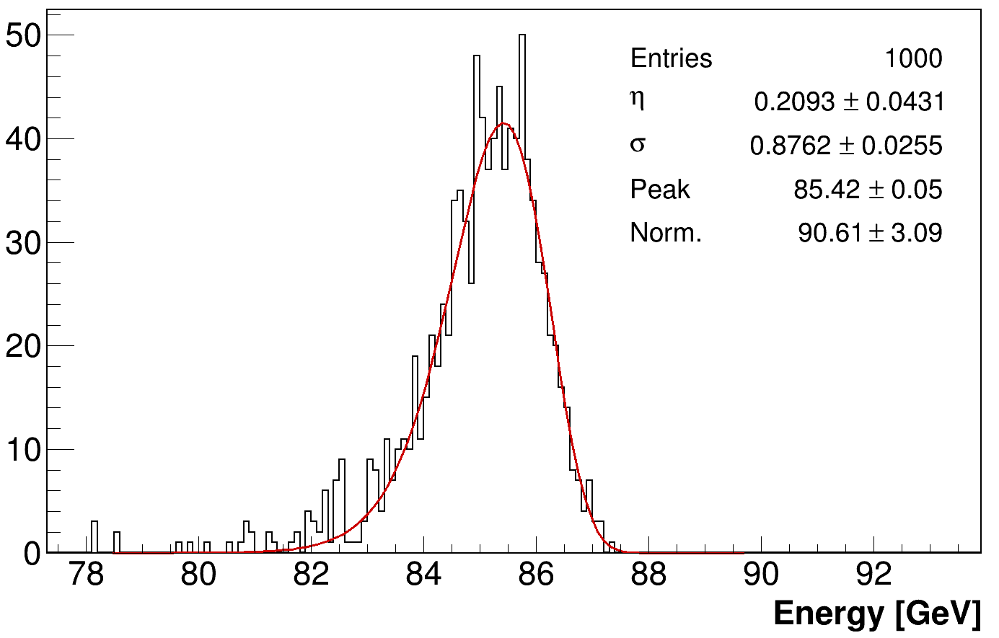
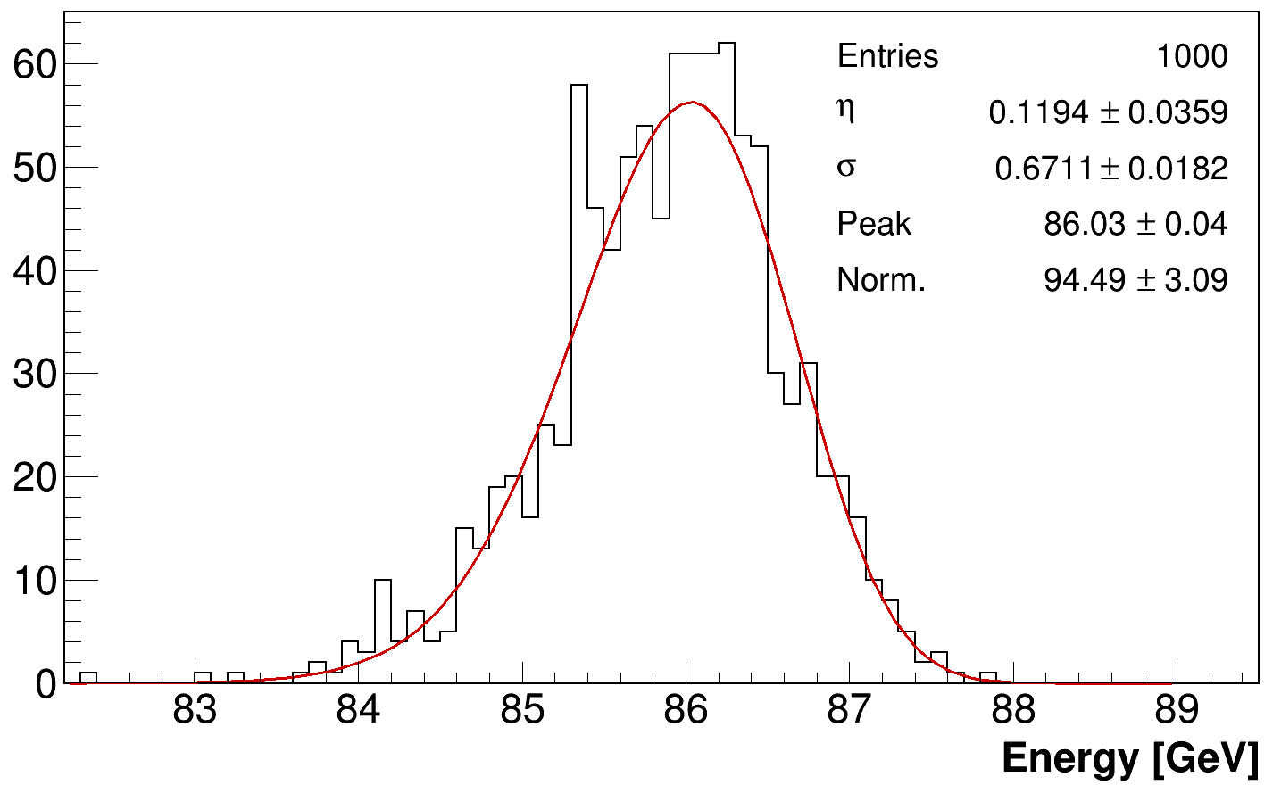
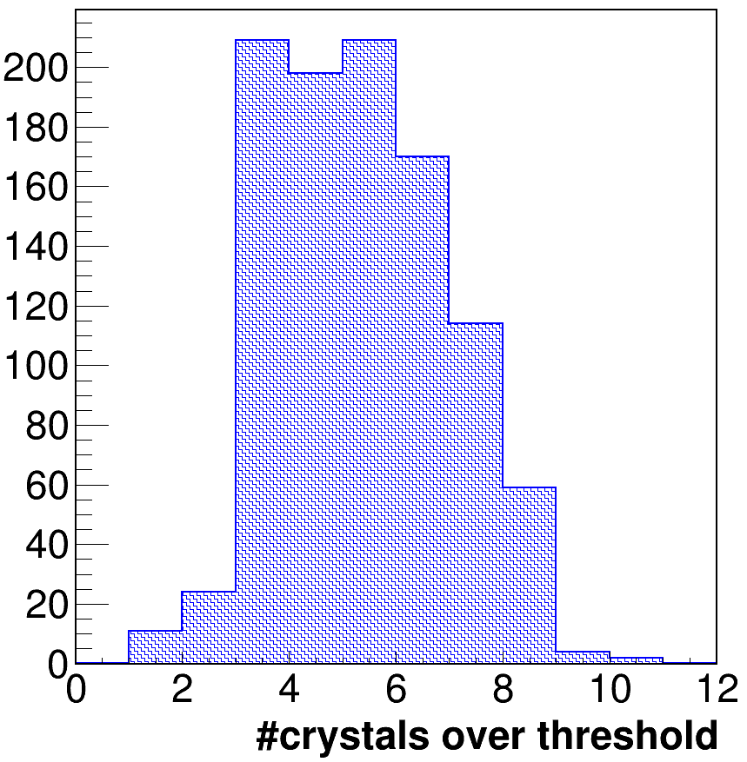
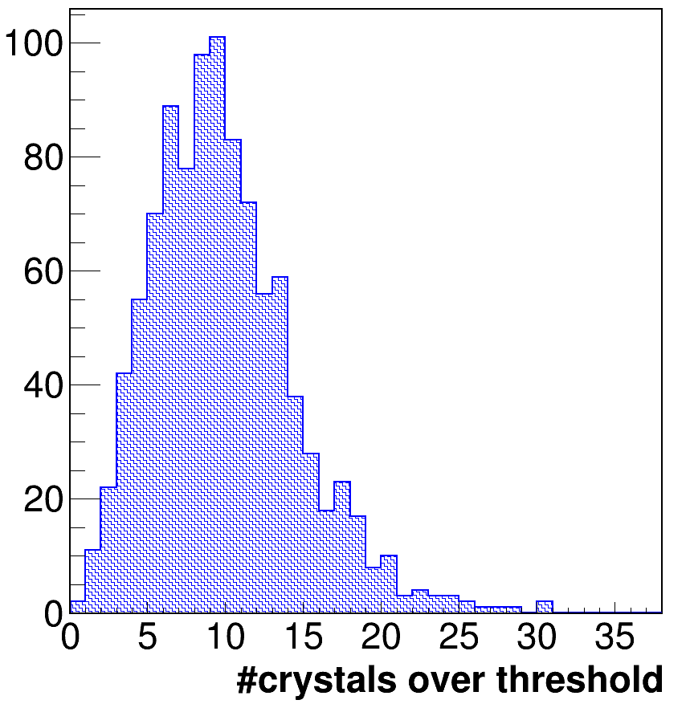
Number of layers optimization
The average number of crystals triggered above the threshold leads to a 7x7 configuration for layers 2, 3, 4, and 5
The sixth layer is crucial for maximizing energy resolution→ longitudinal leakage creates a much larger energy fluctuation compared to lateral leakage (for the same amount of leakage).
7x7 x5 layer
σ_{Ε}/Ε _{(100 GeV)} = 1.0 %
7x7 x6 layer
σ_{Ε}/Ε _{(100 GeV)} = 0.8 %
Layer 1
Layer 6
The average number of crystals triggered above the threshold leads us to a 5x5 configuration for layers 1 and 6.

Slide 11
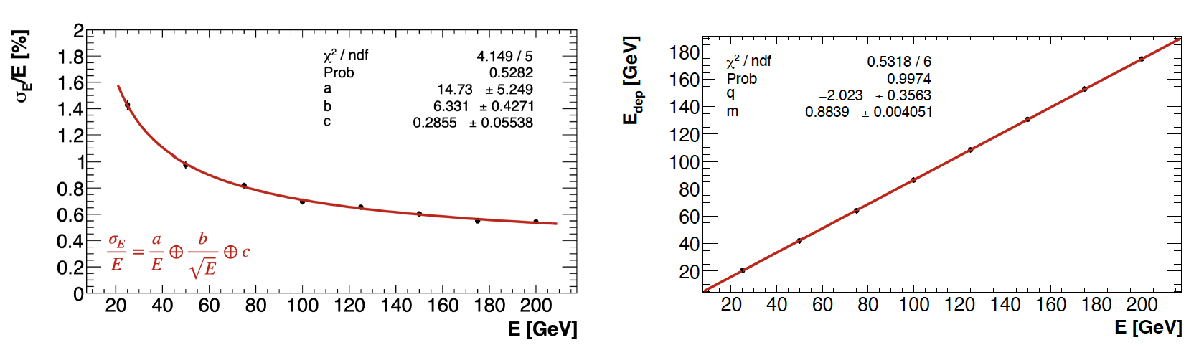
Energy resolution and linearity
Energy Resolution and Linearity as a function of E for the reduced matrix:
7x7 in layers 2, 3, 4, and 5, and 5x5 in layers 1 and 6 → ~250 crystals in total.
𝜎_{E}/E ~ 6%/√E satisfies the Muon Collider requirements!
stochastic term comparable to the one expected from photo-statistics (5.8%)

Slide 12
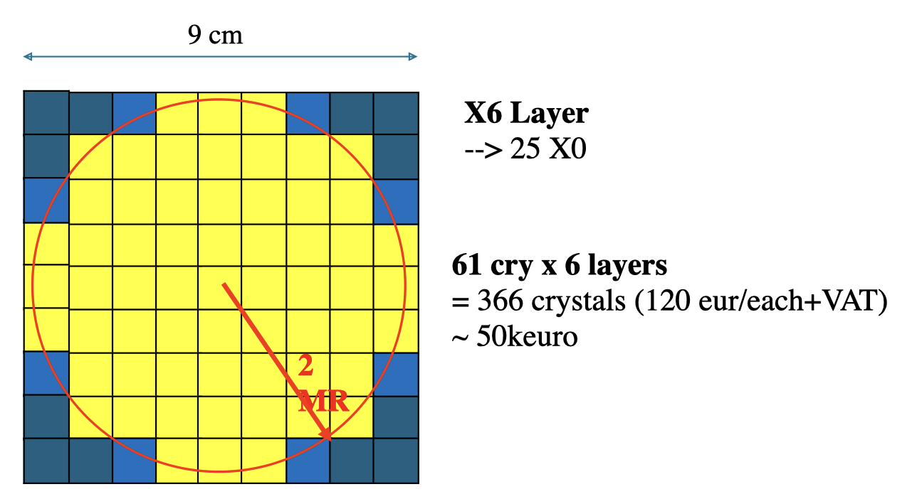
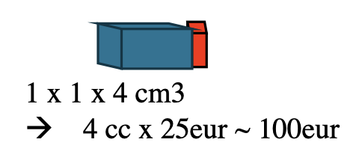
Prototype development -2
Meanwhile we are looking for crystals to fill the full matrix→ requested PbF₂ from g-2 to be reshaped
The idea is to reach 6 layers matrix → 1st 25 crystals, other 5 layer 61 crystals (choice linked to number of FEE channels)
Second beam time period requested:
  7 days between Weeks 36 to 48 (SPS, requiring the 20-150 GeV e-/e+ energy range): this second period is intended for testing the prototype.

Slide 13
Crilin Module Prototype
Aluminum matrix to hold the crystals:
  50-100 µm thickness between crystals
  Thicker (~ 2mm) in the external envelope with micro channels for cooling
Kapton strip for polarization and output signal:
  Handles polarization and output signals for each channel of two SiPMs in series.
Connectors at the back of the 5 assembled modules.
95 mm
95 mm
94 mm
90.5 mm
Notes:
allows an easy assembly of the calorimeter and allows to assemble the calorimeter with submodules arranged in series and in parallel to obtain any configuration needed.
MZB which provides signal amplification and shaping, along with all slow control functions - individual bias regulation, temperature and current monitoring

