Slide 1
Introduction to Sailing part 1
Sebastian Łopieński
e-mail: Sebastian.Lopienski@gmail.com
YCC, http://cern.ch/yachting

Slide 2
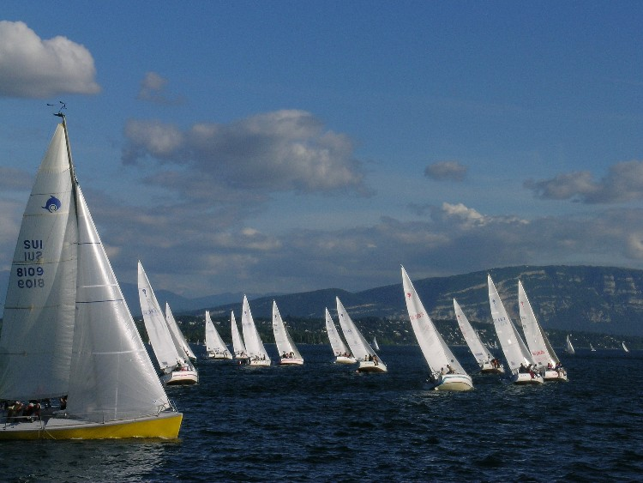
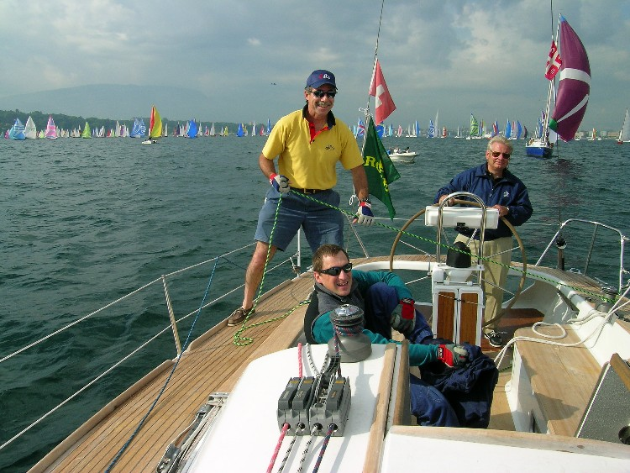
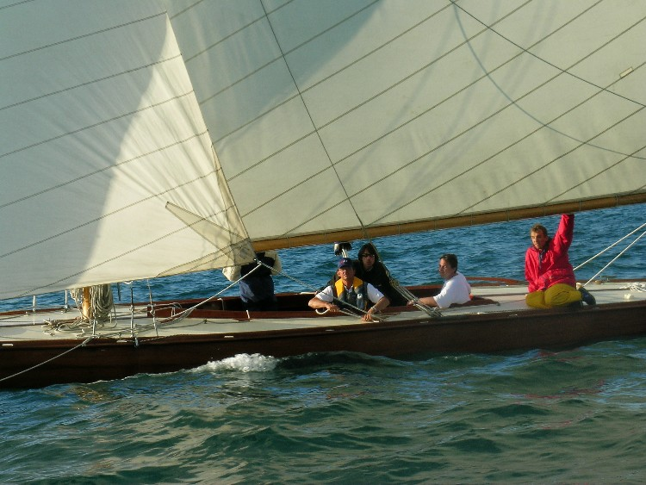
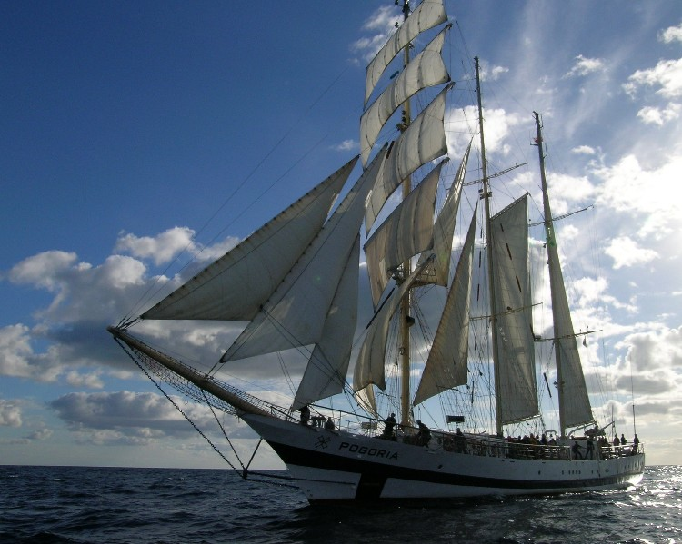
Good choice!
Pictures © Sebastian Łopieński

Slide 3
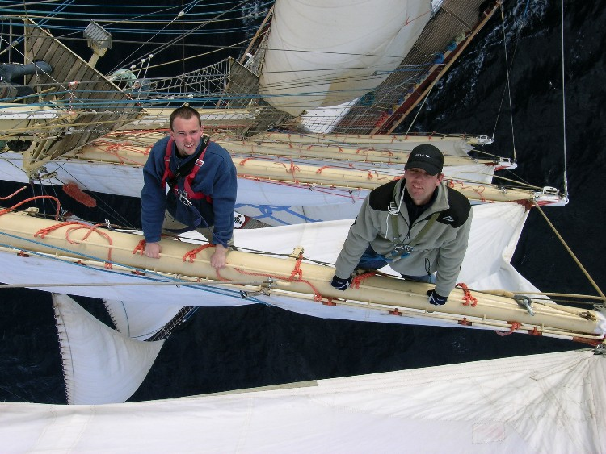
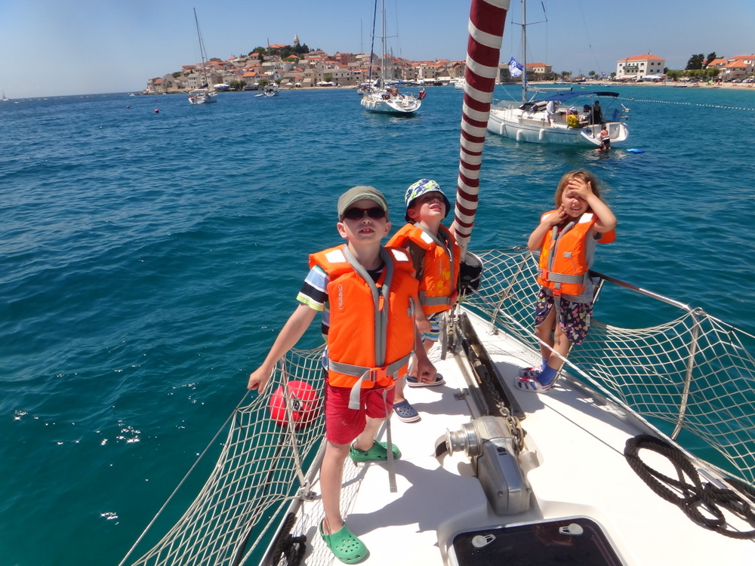
Good choice!
Pictures © Sebastian Łopieński
Poll “Sailing experience”

Slide 4
Outline
A boat
Why does it move?
Sails, sailing points
Helming and manoeuvres
Safety
Knots
+ some other information
vocabulary…
please interrupt
and ask questions!!!

Slide 5
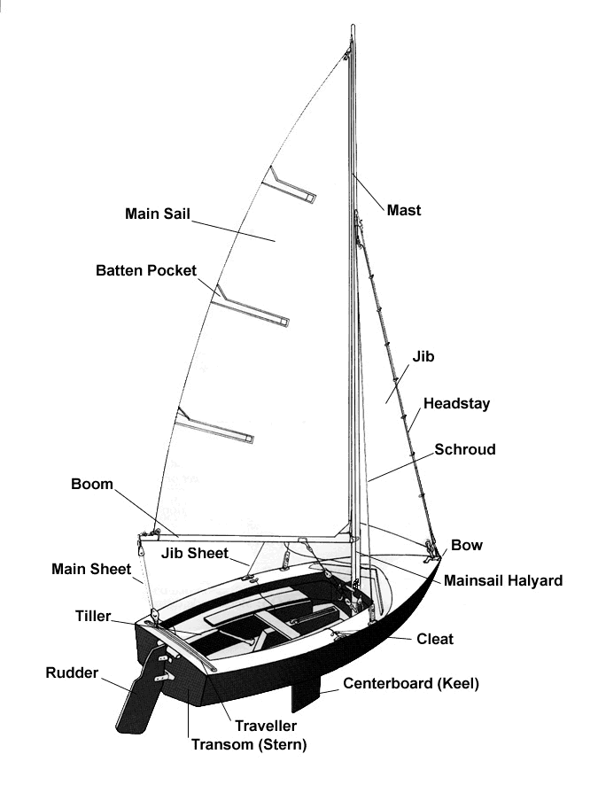
A boat
Hull
Rigging
Sheets
right → starboard
left → port
what can be moved?
Courtesy of www.easytolearn.net
memo trick: both have 4 letters

Slide 6
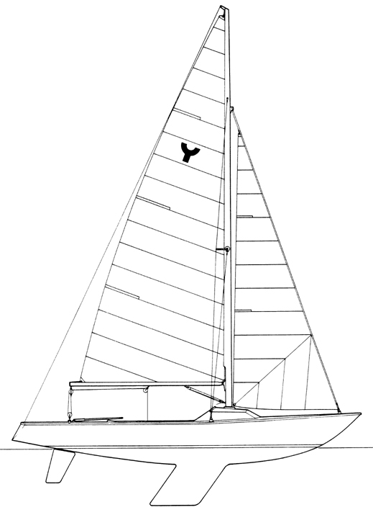
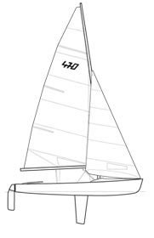
Boats in the club *
* in the beginners’ courses
keelboat (Yngling)
dinghy (RS 400/500, Xenon, Laser 2)
Poll “Stability”

Slide 7
How does a boat keep upright
keelboat

Slide 8
How does a boat keep upright
keelboat
dinghy

Slide 9
Boats in the club *
* in the beginners’ courses
keelboat (Yngling)
dinghy (RS 400/500, Xenon, Laser 2)
Poll “Speed and inertia”

Slide 10
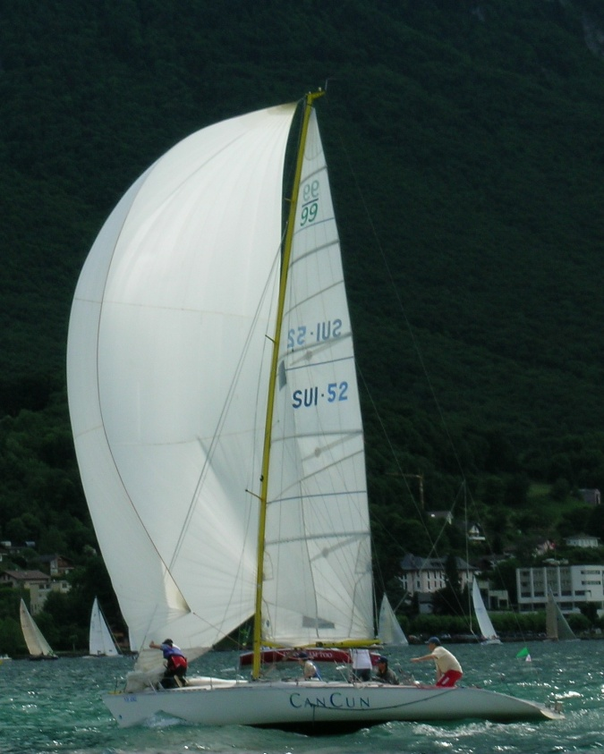
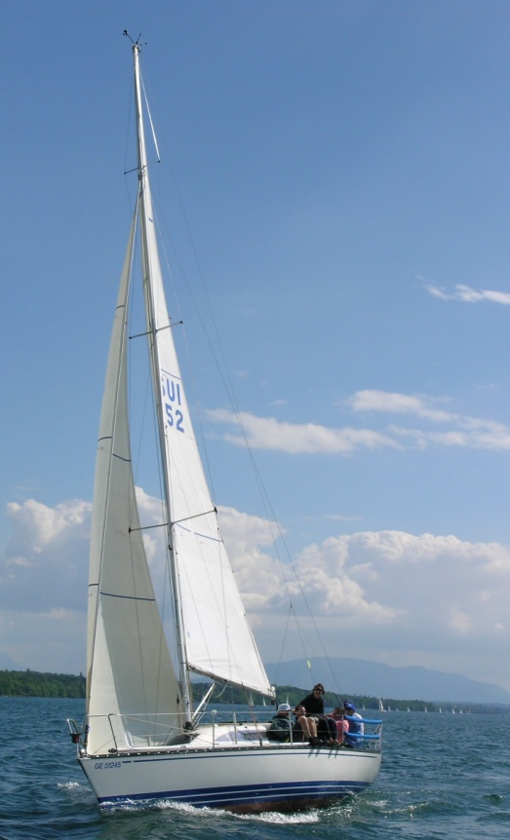
Why a boat moves?
wind “pushes” a boat – going downwind
but what about going upwind???
wind
wind
Pictures © Sebastian Łopieński

Slide 11
Sailing upwind
wind
wind
wind
force on the keel
-
+
-
+
+
+
-
+
+
-
+
+
+
+
-
+
-
+
aerodynamic force

Slide 12
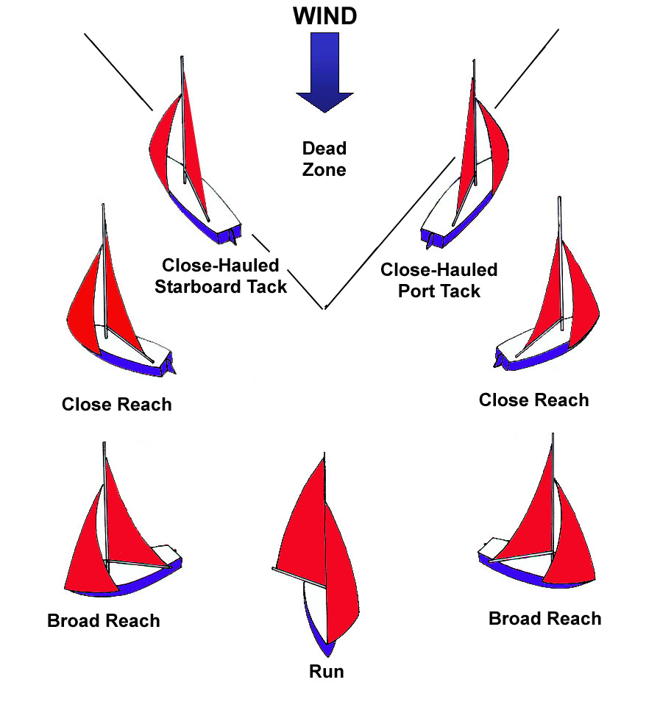
Sailing points
close-hauled
(upwind)
close reach
beam reach
broad reach
running
(dead downwind)
Courtesy of www.easytolearn.net
But how to go directly into the wind???
Poll “Sailing directions”

Slide 13
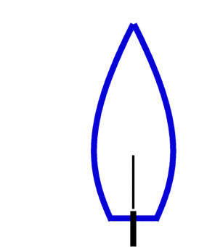
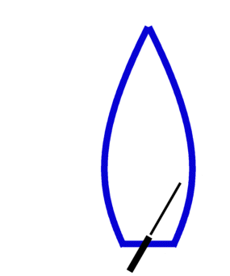
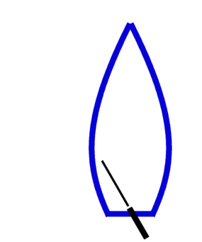
Helming
tiller is opposite
to the rudder
tiller is opposite
to the rudder
rudder is in the center
→ the boat goes straight
rudder is turned to port
→ the boat turns left
rudder is turned to starboard
→ the boat turns right
no speed => you cannot turn

Slide 14
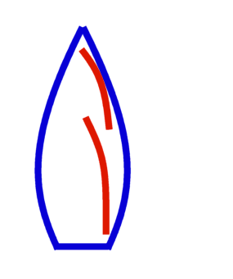
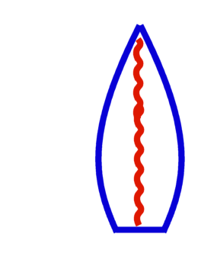
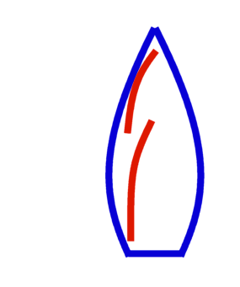
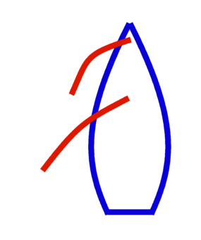
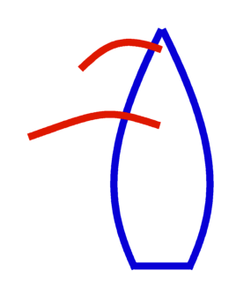
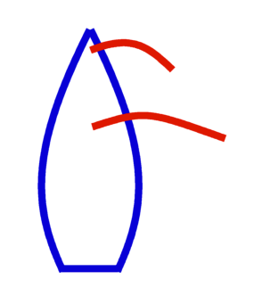
Manoeuvres
wind
wind
tacking
easing sails
(releasing sheets)
luffing up
bearing away (falling off)
trimming sails
(pulling sheets)
gybing
Poll “Manoeuvres”

Slide 15
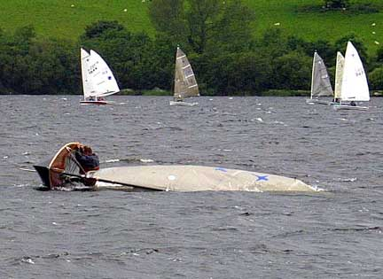
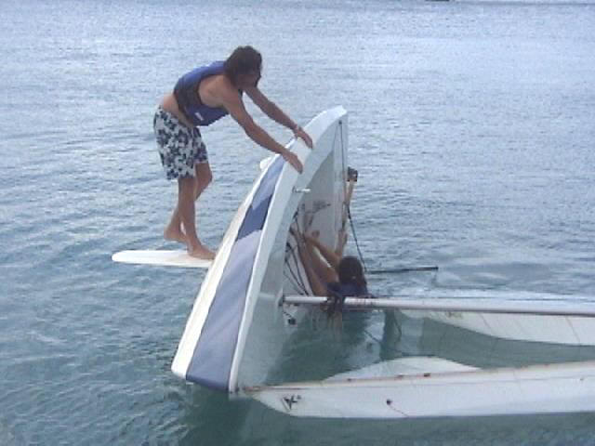

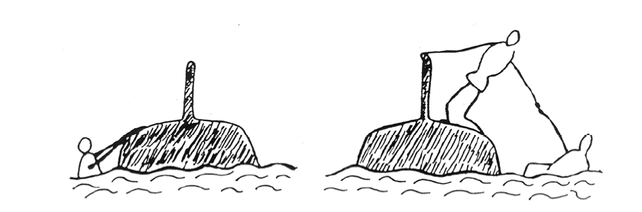
Capsizing (dinghies)
sometimes a dinghy capsizes:
wait for help
…or put it upright yourself
like this

Slide 16
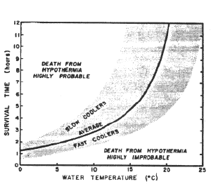


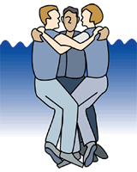
Safety
Water is (often) cold!
Wear buoyancy aid
(lifejackets)
Stay with the capsized boats
Save your heat and energy
Courtesy of www.hypothermia.org
Used by permission. Copyright © Boat Ed.

Slide 17
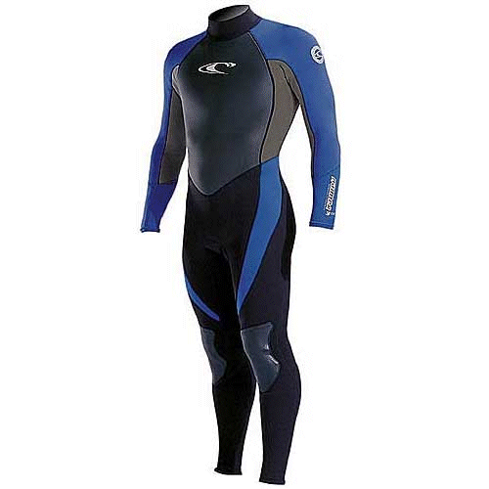
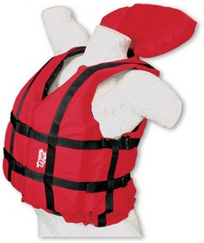
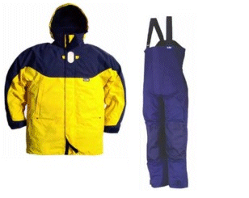
Clothing
dinghies (RS, Xenon, Laser 2) → wetsuit
    no wetsuit = no course
    neoprene 3-4 mm thick
    reinforced knees & seat
    long sleeve better than a „shorty”
    shoes that can get wet (neoprene)
keelboat (Yngling) → waterproof jacket
    warm clothes and good shoes
    no need for ocean-passing clothing
+ buoyancy aid

Slide 18




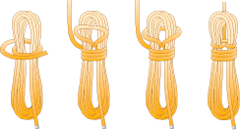
Most important knots
Square knot
Bowline
Figure of eight
Cleat knot
Coiling a rope
Images courtesy of UKDivers.net

Slide 19
Next lecture…
True and apparent wind
Trimming sails
Spinnaker
More on manoeuvres
    Tacking and gybing
    Man overboard (MOB)
    Leaving and entering a harbour
Priority rules
And other things that I didn’t cover today

Slide 20
Further reading
“YCC Sailing Course for Beginners” booklet:
http://cern.ch/yachting/courses/YCCSailingCourse.pdf

Slide 21
Take part in YCC activities
Attend other Theory courses
Come and sail on Thursday practice evenings
  meet people, sail on different boats
Participate in Internal regatta
  best way to learn sailing, even for complete beginners
Register to Surveillance boat shifts
  you’ll have to do two shifts before taking a sailing test
Check the Calendar for other events
  Newcomers Welcome, Opening Dinner, etc.

Slide 22
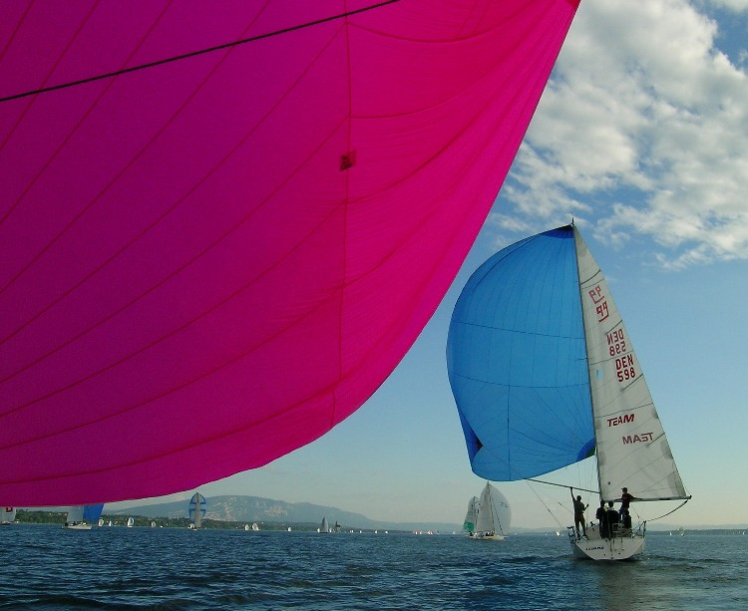
Thank you
…and please
ask questions!!!
also to
Sebastian.Lopienski@gmail.com
Pictures © Sebastian Łopieński
Notes:
And enjoy sailing

