Slide 1
Introduction to Sailing part 2
Sebastian Łopieński
e-mail: Sebastian.Lopienski@gmail.com
YCC, http://cern.ch/yachting

Slide 2
After first outings…
“Where does the wind come from?”
“How to slow down/break?”

Slide 3
After first outings…
“Where does the wind come from?”
“How to slow down/break?”
Helming
Trimming sails
Is it FUN or just too complicated? ☺

Slide 4
Outline
True and apparent wind
Trimming sails
Spinnaker
More on manoeuvres:
tacking, gybing
MOB (man overboard)
leaving and entering port
Priority rules
please interrupt
and ask questions!!!

Slide 5
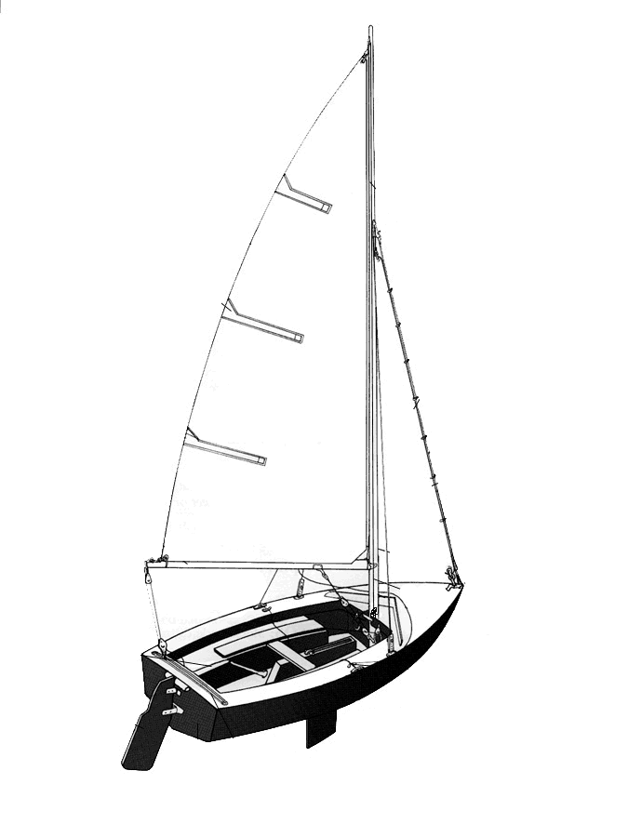
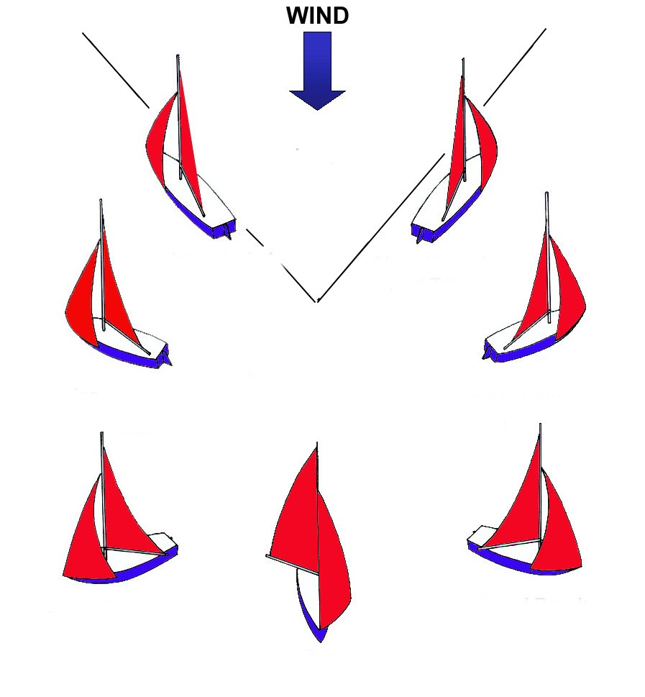
Do you still remember…?
Courtesy of www.easytolearn.net

Slide 6
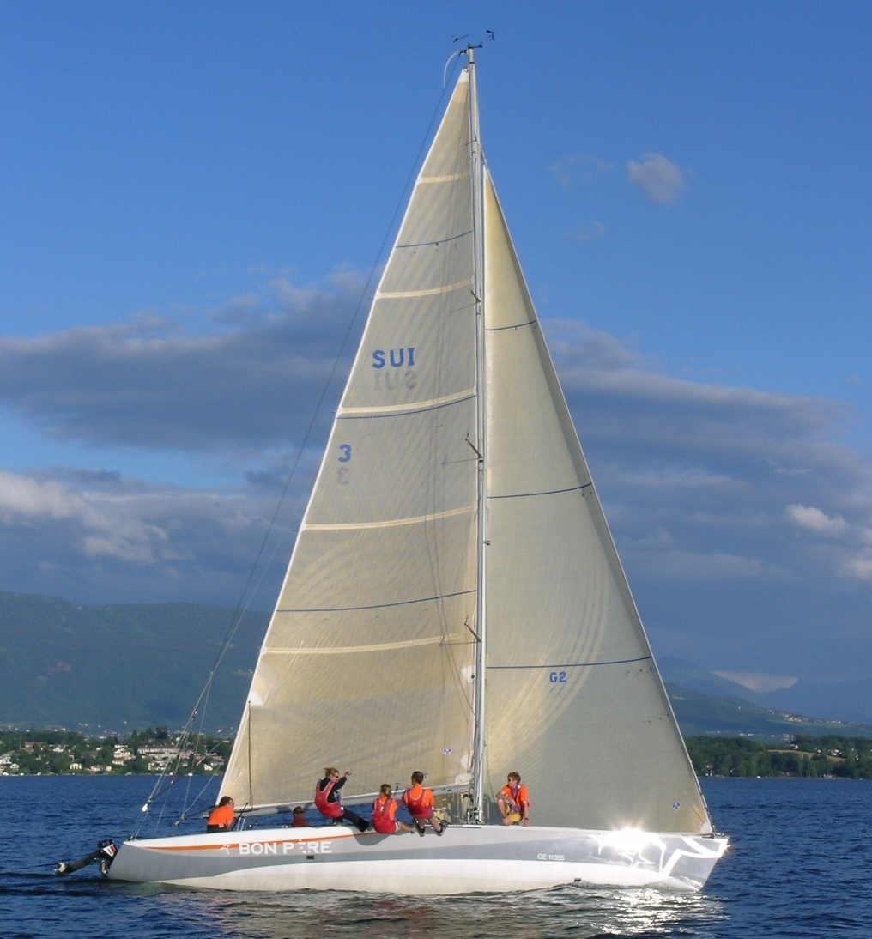
A sail
See different types of sails
mainsail halyard
head
head
battens
battens
battens
battens
battens
jib halyard
luff
Pictures © Sebastian Łopieński
luff
cunningham
leech
… and obviously: mainsail and jib sheets
clew
outhaul
vang /
kicker
foot
foot
tack
tack

Slide 7
Some verbs...
to hoist a sail (fr. hisser)
and to lower it (fr. affaler)
to trim a sail (fr. border)
and to ease it (fr. choquer)
to luff (fr. lofer)
and to bear away (fr. abattre)
to tack (fr. virer)
and to gybe (fr. empanner)

Slide 8
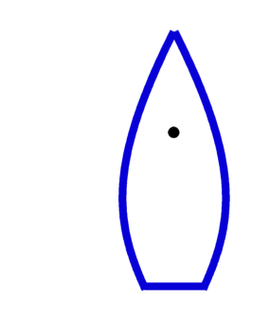
True and apparent wind
wind
boat speed
„boat wind”
true wind
apparent wind

Slide 9
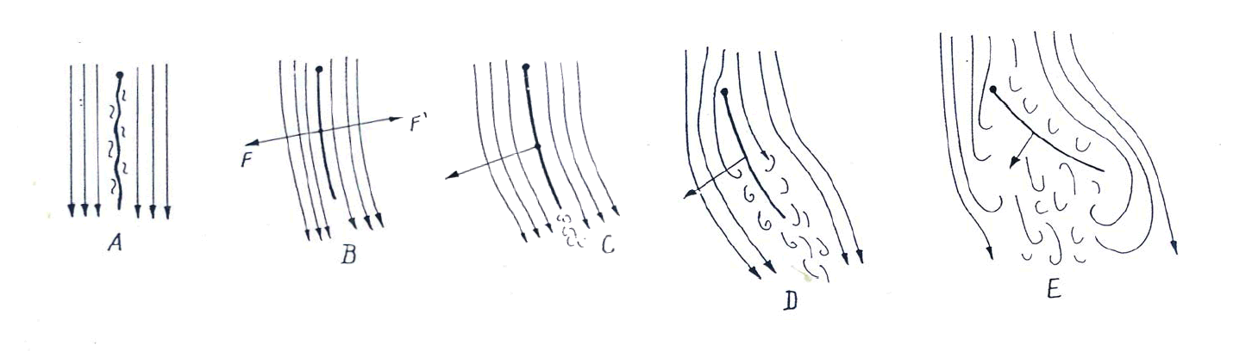
Trimming a sail
wind
wind
Drawings © YCC
Sail eased completely flatters and generates no force (A)
Sail pulled slightly doesn’t flatter, but still no force (B)
When trimmed some more, sail starts to work (C)
More trimming generates air turbulence and lowers the force (D)
Hard trimming against the wind is highly inefficient (E)
OPTIMUM
Poll “Sail trimming”

Slide 10
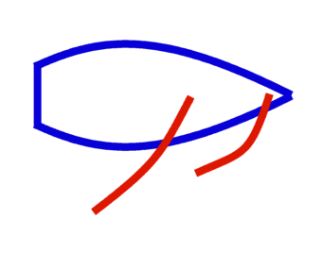
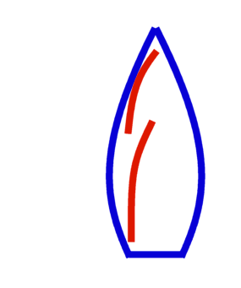
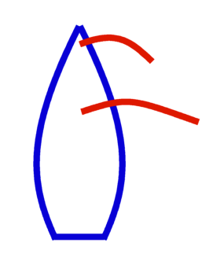
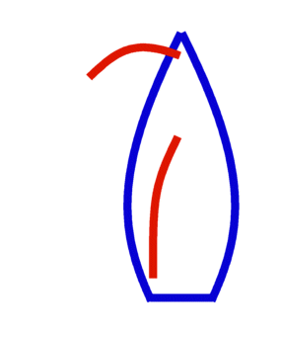
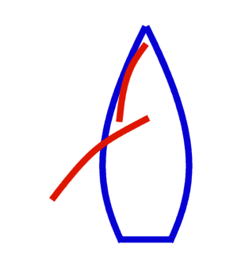
Trimming sails
wind
wind
wind
wind
wind
A
B
C
D
E
Correctly trimmed
Overtrimmed – WRONG!
Not enough trimmed – WRONG!
Sails not parallel – something is WRONG!
A sail should be let out until it stops working,
…and then trimmed a little to make it stop flatter
Correct sail trim depends on the course, so:
Changing your course? → work on your sails!
Both sails (mainsail and the jib) should be (more or less) parallel
Poll “Correct trim”

Slide 11
Trimming sails
wind
wind
wind
wind
Correctly trimmed
Overtrimmed – WRONG!
Not enough trimmed – WRONG!
Sails not parallel – something is WRONG!
A sail should be let out until it stops working,
…and then trimmed a little to make it stop flatter
Correct sail trim depends on the course, so:
Changing your course? → work on your sails!
Both sails (mainsail and the jib) should be (more or less) parallel

Slide 12
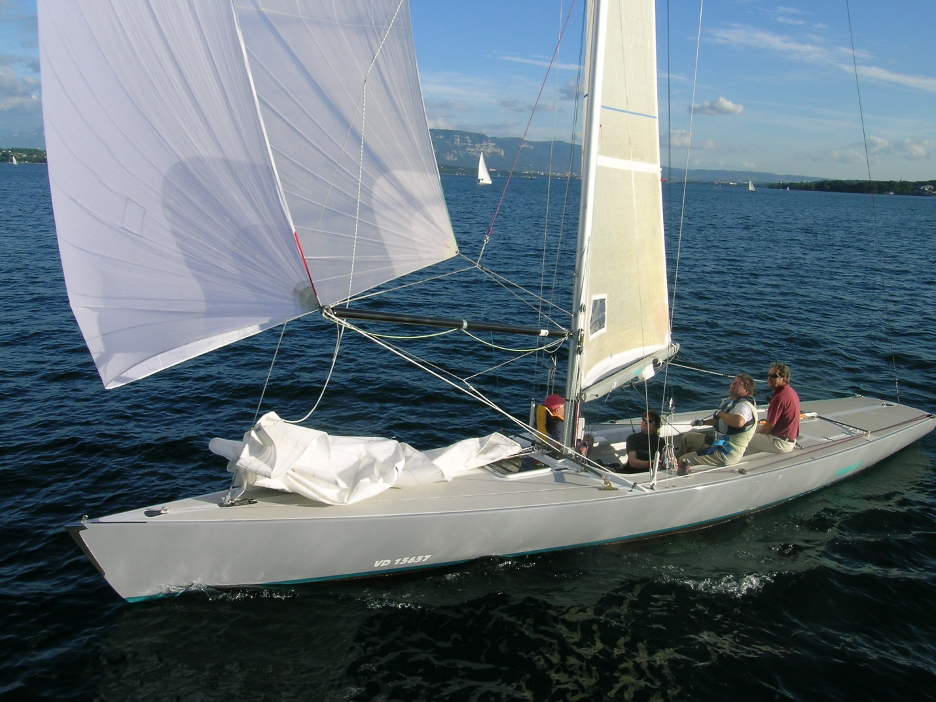
Spinnaker (symmetric)
spinnaker
Moving the pole
up and down:
uphaul
downhaul
Pictures © Sebastian Łopieński
Controlling
the spinnaker
to port and starboard:
leeward sheet
windward sheet (guy)
spinnaker pole

Slide 13
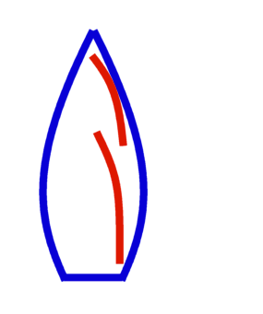
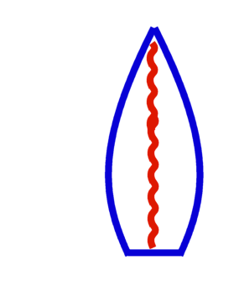
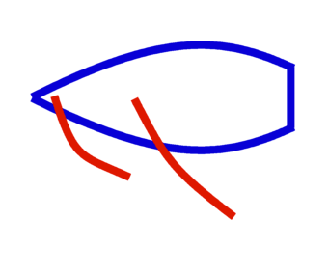
Tacking
wind
helmsman:
5. rudder zero
4. changing place when
passing line of the wind
3. “tacking!” / “lee-oh!”
luffing up more
(rudder to starboard *)
2. “ready to tack?”
1. trimming mainsail
luffing up
to close-hauled course
crew:
5. trimming jib on the new side
4. changing place when
passing line of the wind
3. easing jib completely
when it stops working
2. grabbing other jib sheet
“ready!”
1. trimming jib
5.
4.
3.
2.
1.
* in the case drawn

Slide 14
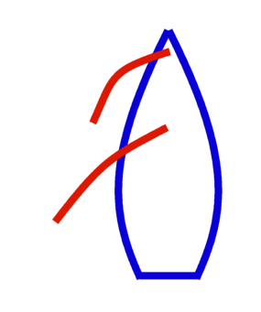
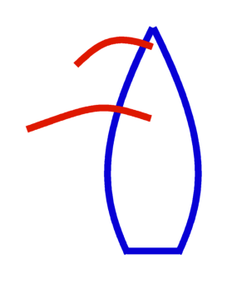
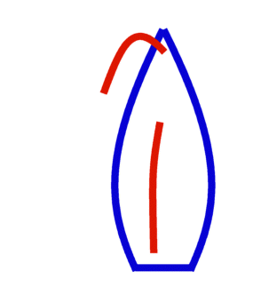
Gybing
wind
helmsman:
1. easing mainsail
falling off
to broad-reach course
2. “ready to gybe?”
3. “gybing!”
falling off (very slowly!)
bringing mainsail to the middle
“watch your head” /
“heads down”
4. changing place when
passing line of the wind
easing mainsail to the other side
5. rudder zero
crew:
1. easing jib
2. grabbing other jib sheet
“ready!”
3. continue easing jib
4. changing place when
passing line of the wind
pulling jib to the new side
5. trimming jib (loosely!)
1.
2.
3.
Slow rotation!!!
(go almost straight)
4.
5.

Slide 15
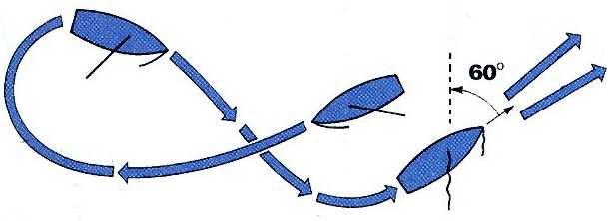
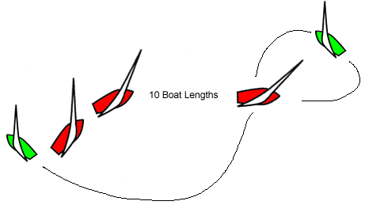
Man overboard (MOB)
wind
From http://www.lalizas.com/products.asp?S0=1&S1=4
wind
2. tack
3. approach upwind, sails eased out
(not working)
1. sail away in broad reach
From http://www.learn2sail.co.uk/dinghies/section.asp?id=11
tack

Slide 16
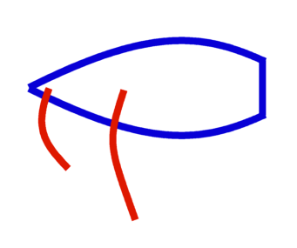
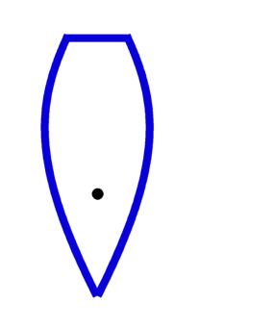
Leaving and entering a harbour
typical in
Port Choiseul
wind
wind
wind
Land
dangerous!
difficult
Land
keep to windward
ready to ease or put down sails
(when entering harbour)
Land
both maneuvres easy

Slide 17
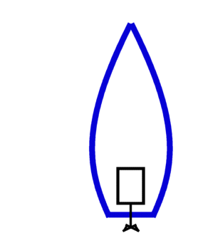
Priority rules
wind
wind
port tack boat
starboard tack boat
(wind from starboard)
windward boat
leeward boat
Port tack boat must keep clear
of starboard tack boat
Windward boat must keep clear
of boats to leeward
boat clear astern (behind another boat)
motor boat
sailing boat
Boat clear astern must keep clear
of slower boat in front
Sailing boat has a priority
over motorboats
There are exceptions!!!

Slide 18
Distance, speed etc.
1 nautical mile (nm) is 1852 meters
(length of 1 minute of arc on the equator)
1 knot (kn) is 1 nautical mile per hour
(2 knots = 1 m/s)
(YCC) boats - usually 3 to 5 knots,
up to 7-10 knots (could be more for planing dinghies)

Slide 19
Wind – Beaufort scale
0 | 0-1 knots | 0-1 km/h | flat water
1 | 1-3 knots | 2-5 km/h | ripple
2 | 4-6 knots | 6-11 km/h | wavelets
3 | 7-10 knots | 12-19 km/h | large wavelets
4 | 11-16 knots | 19-28 km/h | small waves, white horses
5 | 17-21 knots | 29-38 km/h | long moderate waves, many white horses
6 | 22-27 knots | 39-49 km/h | large breaking waves, white foam
7 | 28-33 knots | 50-61 km/h
8 | 34-40 knots | 62-74 km/h
9 | 41-47 knots | 75-87 km/h
10 | 48-55 knots | 88-102 km/h
11 | 56-63 knots | 103-117 km/h
12 | 64+ knots | 118+ km/h | the air is filled with foam and spray
Hopefully you won’t be sailing in these winds on Lac Leman!

Slide 20
Further reading
“YCC Sailing Course for Beginners” booklet:
http://cern.ch/yachting/courses/YCCSailingCourse.pdf

Slide 21
Take part in YCC activities
Attend other Theory courses
Come and sail on Thursday practice evenings
  meet people, sail on different boats
Participate in Internal regatta
  best way to learn sailing, even for complete beginners
Register to Surveillance boat shifts
  you’ll have to do two shifts before taking a sailing test
Check the Calendar for other events
  Newcomers Welcome, Opening Dinner, etc.

Slide 22
The famous Lake Geneva races
Geneve-Rolle regatta Saturday, early June
(200+ boats passing by Versoix around 15-16h)
Bol d’Or regatta Saturday, mid-June
(600+ boats passing by Versoix around 11h-13h)

Slide 23
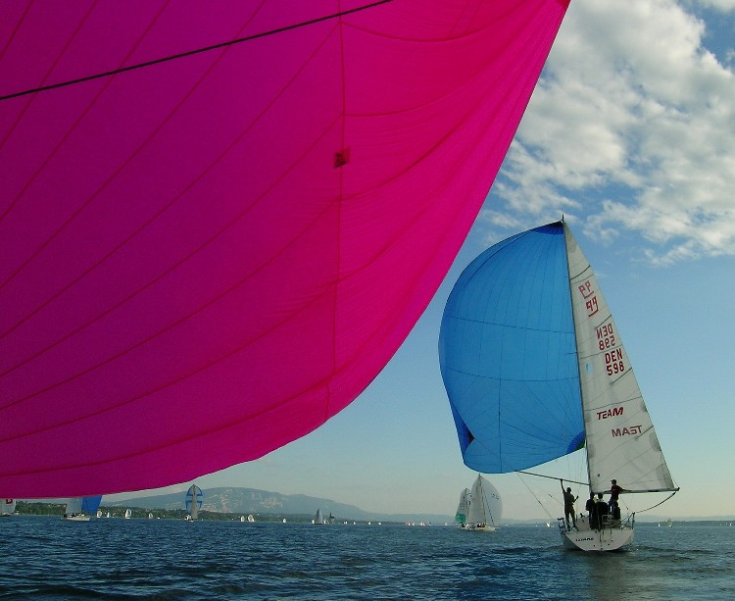
Thank you
…and please
ask questions!!!
also to
Sebastian.Lopienski@gmail.com
Pictures © Sebastian Łopieński
Notes:
And enjoy sailing

