Slide 1
MBRD field quality
A. Pampaloni, B. Caiffi
S. Farinon, A. Bersani - INFN Genova

Slide 2
Coupling Strategy for the Series Magnets
Coil type | Avg [mm] | # Aperture | Shimming scheme | # Magnet
AS01 | 0.41 | AP01 | Shimming1 | MBRD1
BS01 | 0.48
AS02 | 0.53 | AP02 | Shimming2
BS02 | 0.46
AS04 | 0.53 | AP03 | Shimming2 | MBRD2
BS04 | 0.48
AS06 | 0.49 | AP04 | Shimming2
BS06 | 0.50
AS05 | 0.52 | AP05 | Shimming2 | MBRD3
BS07 | 0.47
AS07 | 0.46 | AP06 | Shimming3
BS08 | 0.48
Coil type | Avg [mm] | # Aperture | Shimming scheme | # Magnet
AS09 | 0.45 | AP07 | Shimming1 | MBRD4
BS11 | 0.43
AS08 | 0.43 | AP08 | Shimming1
BS10 | 0.46
AS10 | 0.43 | AP09 | Shimming1 | MBRD5
BS12 | 0.46
AS11 | 0.54 | AP10 | Shimming4
BS05 | 0.57
AS03 | 0.63 | AP11 | Shimming5 | MBRD6
BS09 | 0.67
AS12 | 0.43 | AP12 | Shimming4
BS03 | 0.65
Azimuthal oversize at 70 MPa of the coils
Azimuthal oversize at 70 MPa of the coils

Slide 3








Series Shimming Plans
  Baseline
  Shimming1
  Shimming2
  Shimming3
$$584.2 μm$$
$$+$$
$$127 μm$$
$$533.4 μm$$
$$+$$
$$50.8 μm$$
$$457.2 μm$$
$$+$$
$$50.8 μm$$
$$482.6 μm$$
$$+$$
$$50.8 μm$$
$$711.2 μm$$
$$584.2 μm$$
$$508 μm$$
$$533.4 μm$$
$$50.8 μm$$
$$76.2 μm$$
$$127 μm$$

Slide 4




Series Shimming Plans
  Shimming4
  Shimming5
$$406.4 μm$$
$$+$$
$$50.8 μm$$
$$304.8 μm$$
$$+$$
$$50.8 μm$$
$$457.2 μm$$
$$355.6 μm$$
$$50.8 μm$$
$$76.2 μm$$
$$127 μm$$

Slide 5
MBRD1
  Shimming1
  CS view
  Shimming2
  BS01
  AS02
  AP01
  AP02
  AS01
  BS02
$$50.8 μm$$
$$76.2 μm$$
$$127 μm$$
5

Slide 6
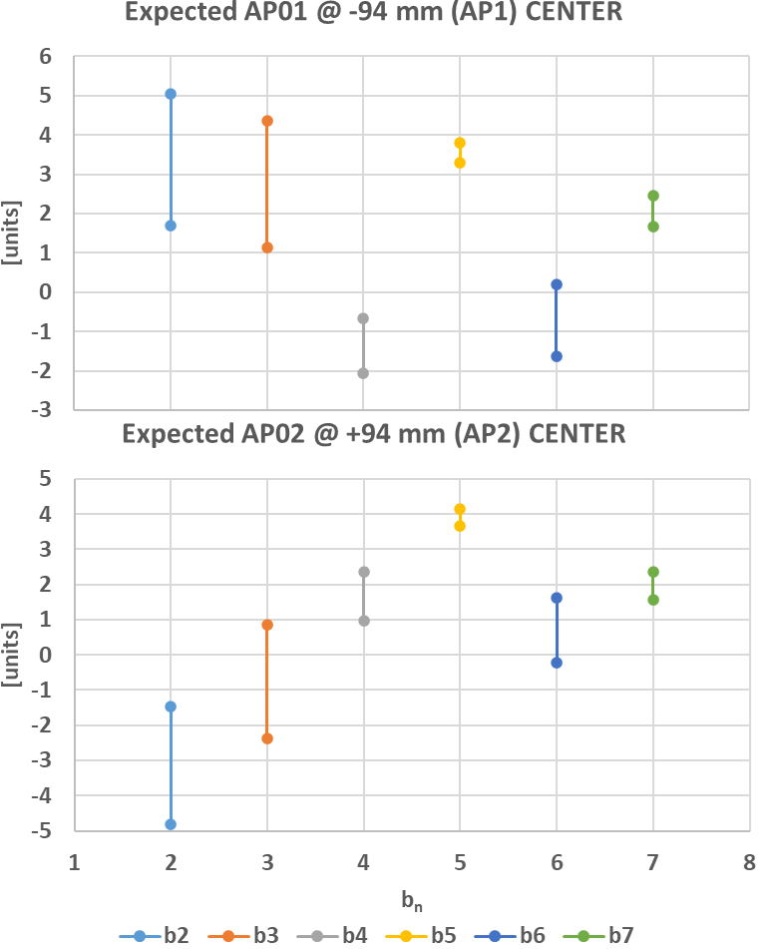




Expected Field Quality of MBRD1 @ Nominal Operation
 | CENTER
 | AP01 @ -94 mm (AP1) |  |  | AP02 @ +94 mm (AP2)
 | SIMU | EXPE PROTO | EXPE SERIE | SIMU | EXPE PROTO | EXPE SERIE
b2 | 5.87 | 5.04 | 1.70 | -5.66 | -4.82 | -1.48
b3 | -11.00 | 4.37 | 1.13 | -14.52 | 0.85 | -2.39
b5 | -1.37 | 3.31 | 3.81 | -1.03 | 3.65 | 4.16
a2 | 0.00 | 3.47 | 0.75 | 0.00 | -3.47 | -0.75
$$∆_{1}={Meas}_{PROTO}^{@ I_{nom}}−{Simu}_{PROTO}^{@ I_{nom}}$$
$$EXPE PROTO={Simu}_{MBRD1}^{@ I_{nom}}+∆_{1}$$
$$∆_{2}={Meas}_{MBRD1}^{iron @ RT}−{Simu}_{MBRD1}^{iron @ RT}$$
$$EXPE SERIE={Simu}_{MBRD1}^{@ I_{nom}}+∆_{2}$$

Slide 7
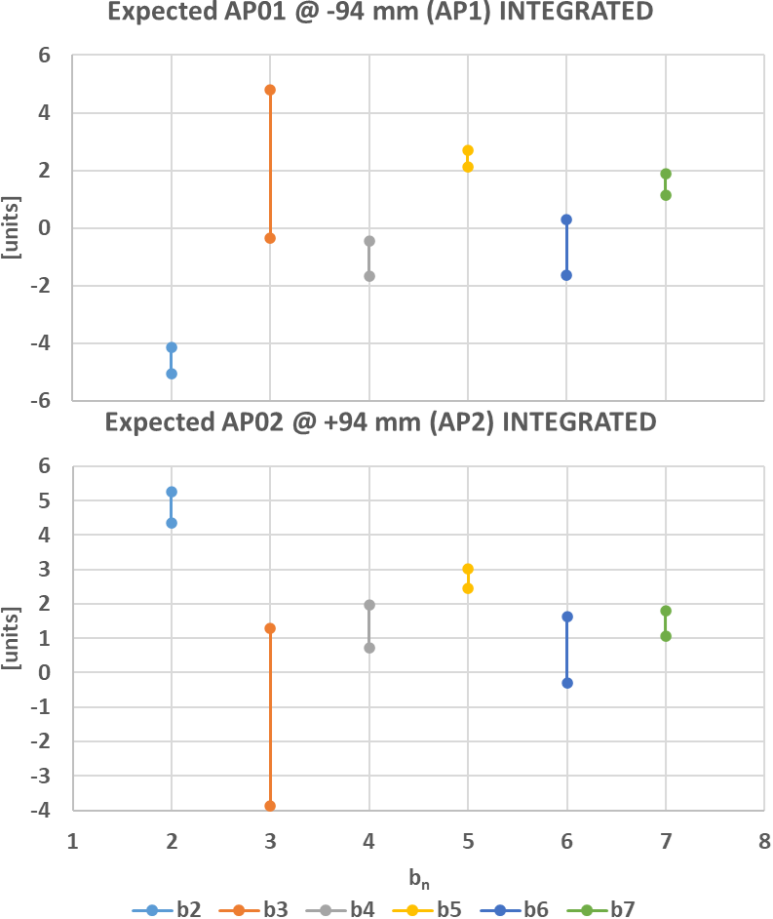
Expected Field Quality of MBRD1 @ Nominal Operation
 | INTEGRATED
 | AP01 @ -94 mm (AP1) |  |  | AP02 @ +94 mm (AP2)
 | SIMU | EXPE PROTO | EXPE SERIE | SIMU | EXPE PROTO | EXPE SERIE
b2 | -3.19 | -4.15 | -5.04 | 3.41 | 4.37 | 5.26
b3 | -10.71 | 4.79 | -0.35 | -14.22 | 1.28 | -3.86
b5 | -2.64 | 2.12 | 2.68 | -2.30 | 2.46 | 3.02
a2 | 0.90 | 3.20 | 1.28 | -0.89 | -3.20 | -1.28
$$∆_{1}={Meas}_{PROTO}^{@ I_{nom}}−{Simu}_{PROTO}^{@ I_{nom}}$$
$$EXPE PROTO={Simu}_{MBRD1}^{@ I_{nom}}+∆_{1}$$
$$∆_{2}={Meas}_{MBRD1}^{iron @ RT}−{Simu}_{MBRD1}^{iron @ RT}$$
$$EXPE SERIE={Simu}_{MBRD1}^{@ I_{nom}}+∆_{2}$$

Slide 8
MBRD2
  Shimming2
  CS view
  Shimming2
  BS06
  AS04
  AP04
  AP03
  AS06
  BS04
$$50.8 μm$$
$$76.2 μm$$
$$127 μm$$
8

Slide 9
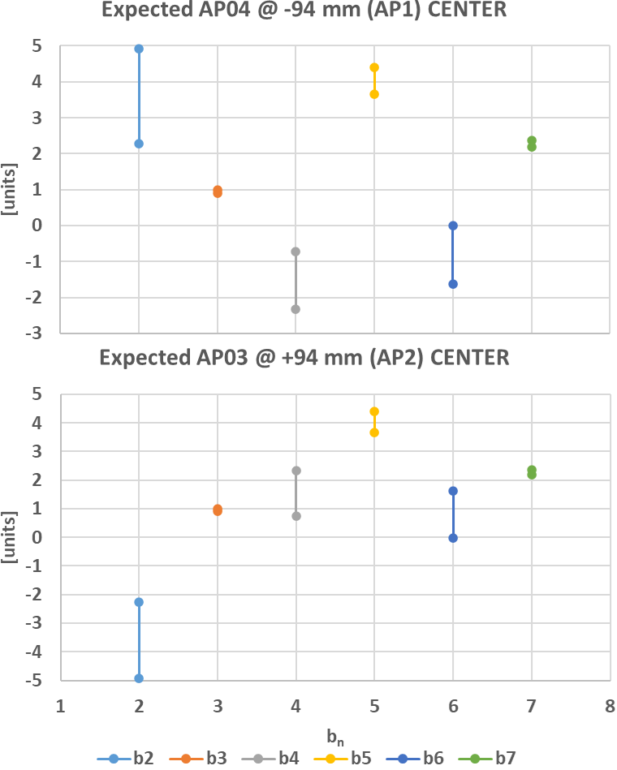



Expected Field Quality of MBRD2 @ Nominal Operation
 | CENTER
 | AP04 @ -94 mm (AP1) |  |  | AP03 @ +94 mm (AP2)
 | SIMU | EXPE PROTO | EXPE SERIE | SIMU | EXPE PROTO | EXPE SERIE
b2 | 5.76 | 4.92 | 2.27 | -5.76 | -4.92 | -2.27
b3 | -14.46 | 0.91 | 1.00 | -14.46 | 0.91 | 1.00
b5 | -1.02 | 3.66 | 4.41 | -1.02 | 3.66 | 4.41
a2 | 0.00 | 3.47 | -1.56 | 0.00 | -3.47 | 1.56
$$∆_{1}={Meas}_{PROTO}^{@ I_{nom}}−{Simu}_{PROTO}^{@ I_{nom}}$$
$$EXPE PROTO={Simu}_{MBRD2}^{@ I_{nom}}+∆_{1}$$
$$∆_{2}={Meas}_{MBRD2}^{iron @ RT}−{Simu}_{MBRD2}^{iron @ RT}$$
$$EXPE SERIE={Simu}_{MBRD2}^{@ I_{nom}}+∆_{2}$$

Slide 10
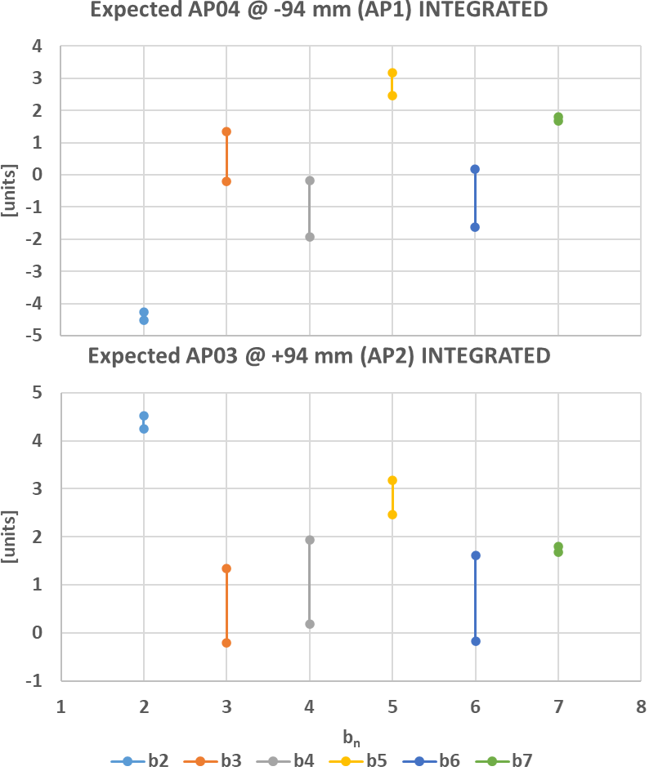
Expected Field Quality of MBRD2 @ Nominal Operation
 | INTEGRATED
 | AP04 @ -94 mm (AP1) |  |  | AP03 @ +94 mm (AP2)
 | SIMU | EXPE PROTO | EXPE SERIE | SIMU | EXPE PROTO | EXPE SERIE
b2 | -3.30 | -4.26 | -4.52 | 3.30 | 4.26 | 4.52
b3 | -14.16 | 1.34 | -0.20 | -14.16 | 1.34 | -0.20
b5 | -2.30 | 2.47 | 3.18 | -2.30 | 2.47 | 3.18
a2 | 0.89 | 3.20 | -1.09 | -0.89 | -3.20 | 1.09
$$∆_{1}={Meas}_{PROTO}^{@ I_{nom}}−{Simu}_{PROTO}^{@ I_{nom}}$$
$$EXPE PROTO={Simu}_{MBRD2}^{@ I_{nom}}+∆_{1}$$
$$∆_{2}={Meas}_{MBRD2}^{iron @ RT}−{Simu}_{MBRD2}^{iron @ RT}$$
$$EXPE SERIE={Simu}_{MBRD2}^{@ I_{nom}}+∆_{2}$$

Slide 11
MBRD3
  Shimming2
  CS view
  Shimming3
  BS07
  AS07
  AP05
  AP06
  AS05
  BS08
$$50.8 μm$$
$$76.2 μm$$
$$127 μm$$
11

Slide 12
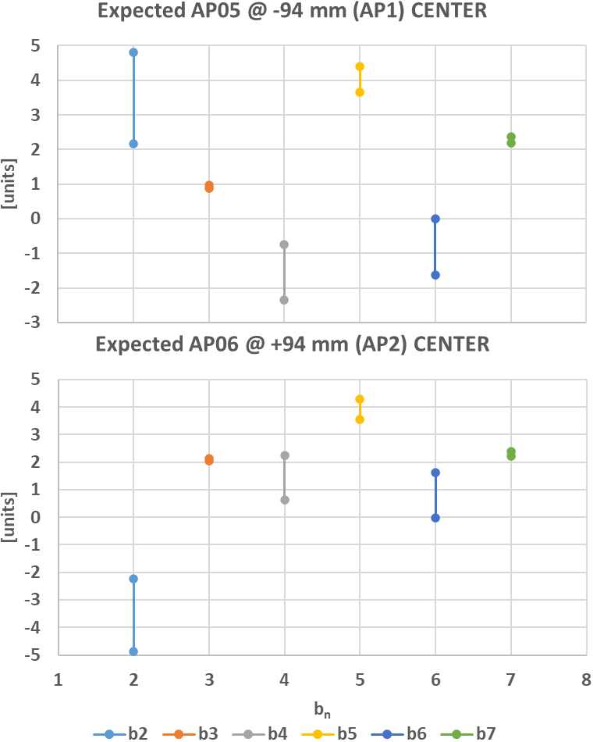


Expected Field Quality of MBRD3 @ Nominal Operation
 | CENTER
 | AP05 @ -94 mm (AP1) |  |  | AP06 @ +94 mm (AP2)
 | SIMU | EXPE PROTO | EXPE SERIE | SIMU | EXPE PROTO | EXPE SERIE
b2 | 5.65 | 4.81 | 2.16 | -5.72 | -4.88 | -2.23
b3 | -14.49 | 0.88 | 0.97 | -13.32 | 2.05 | 2.14
b5 | -1.02 | 3.66 | 4.41 | -1.13 | 3.54 | 4.29
a2 | 0.00 | 3.47 | -1.56 | 0.00 | -3.47 | 1.56
$$∆_{1}={Meas}_{PROTO}^{@ I_{nom}}−{Simu}_{PROTO}^{@ I_{nom}}$$
$$EXPE PROTO={Simu}_{MBRD3}^{@ I_{nom}}+∆_{1}$$
$$∆_{2}={Meas}_{MBRD2}^{iron @ RT}−{Simu}_{MBRD2}^{iron @ RT}$$
$$EXPE SERIE={Simu}_{MBRD3}^{@ I_{nom}}+∆_{2}$$

Slide 13
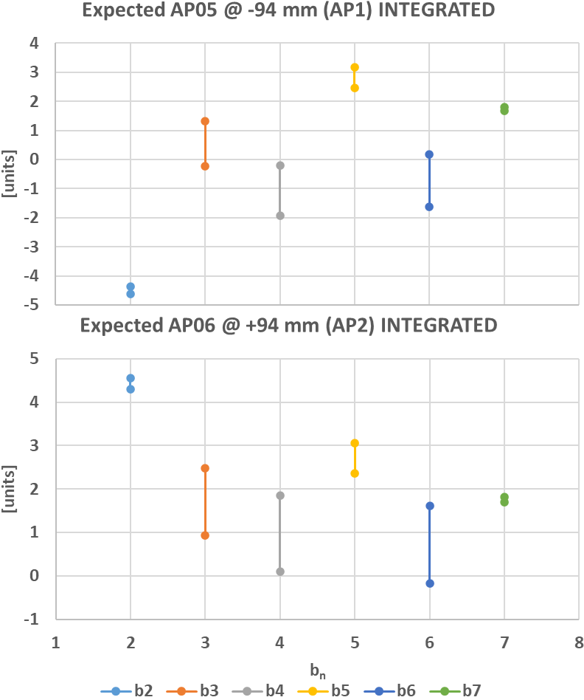
Expected Field Quality of MBRD3 @ Nominal Operation
 | INTEGRATED
 | AP05 @ -94 mm (AP1) |  |  | AP06 @ +94 mm (AP2)
 | SIMU | EXPE PROTO | EXPE SERIE | SIMU | EXPE PROTO | EXPE SERIE
b2 | -3.41 | -4.37 | -4.63 | 3.34 | 4.30 | 4.56
b3 | -14.19 | 1.31 | -0.23 | -13.02 | 2.47 | 0.93
b5 | -2.30 | 2.47 | 3.18 | -2.41 | 2.35 | 3.07
a2 | 0.89 | 3.20 | -1.09 | -0.89 | -3.20 | 1.09
$$∆_{1}={Meas}_{PROTO}^{@ I_{nom}}−{Simu}_{PROTO}^{@ I_{nom}}$$
$$EXPE PROTO={Simu}_{MBRD3}^{@ I_{nom}}+∆_{1}$$
$$∆_{2}={Meas}_{MBRD2}^{iron @ RT}−{Simu}_{MBRD2}^{iron @ RT}$$
$$EXPE SERIE={Simu}_{MBRD3}^{@ I_{nom}}+∆_{2}$$

Slide 14
MBRD4
  Shimming1
  CS view
  Shimming1
  BS11
  AS08
  AP07
  AP08
  AS09
  BS10
$$50.8 μm$$
$$76.2 μm$$
$$127 μm$$
14

Slide 15
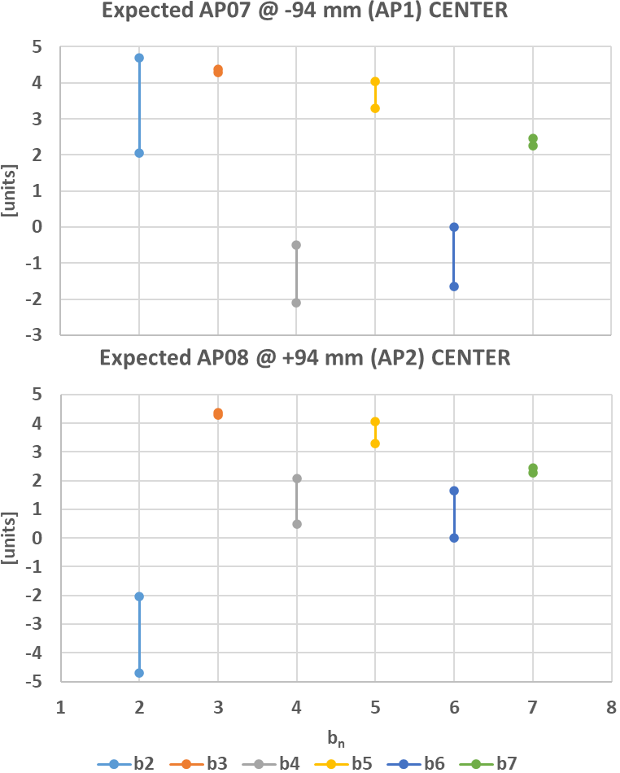


Expected Field Quality of MBRD4 @ Nominal Operation
 | CENTER
 | AP07 @ -94 mm (AP1) |  |  | AP08 @ +94 mm (AP2)
 | SIMU | EXPE PROTO | EXPE SERIE | SIMU | EXPE PROTO | EXPE SERIE
b2 | 5.54 | 4.70 | 2.05 | -5.54 | -4.70 | -2.05
b3 | -11.09 | 4.28 | 4.37 | -11.09 | 4.28 | 4.37
b5 | -1.38 | 3.30 | 4.05 | -1.38 | 3.30 | 4.05
a2 | 0.00 | 3.47 | -1.56 | 0.00 | -3.47 | 1.56
$$∆_{1}={Meas}_{PROTO}^{@ I_{nom}}−{Simu}_{PROTO}^{@ I_{nom}}$$
$$EXPE PROTO={Simu}_{MBRD4}^{@ I_{nom}}+∆_{1}$$
$$∆_{2}={Meas}_{MBRD2}^{iron @ RT}−{Simu}_{MBRD2}^{iron @ RT}$$
$$EXPE SERIE={Simu}_{MBRD4}^{@ I_{nom}}+∆_{2}$$

Slide 16
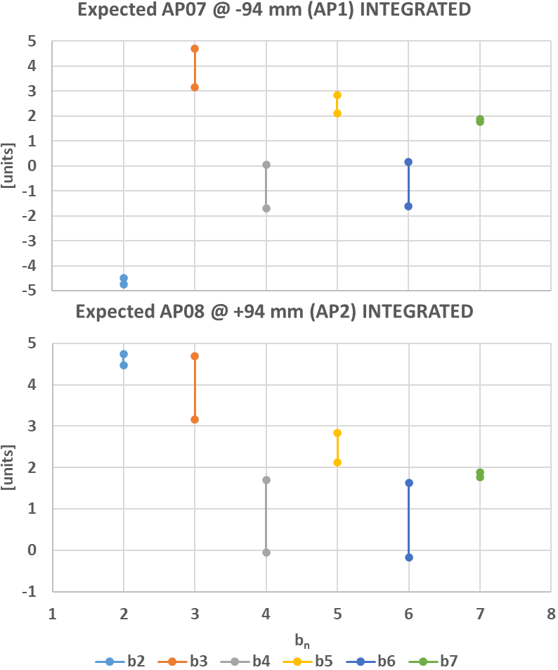
Expected Field Quality of MBRD4 @ Nominal Operation
 | INTEGRATED
 | AP07 @ -94 mm (AP1) |  |  | AP08 @ +94 mm (AP2)
 | SIMU | EXPE PROTO | EXPE SERIE | SIMU | EXPE PROTO | EXPE SERIE
b2 | -3.52 | -4.48 | -4.74 | 3.52 | 4.48 | 4.74
b3 | -10.80 | 4.70 | 3.15 | -10.80 | 4.70 | 3.15
b5 | -2.64 | 2.12 | 2.83 | -2.64 | 2.12 | 2.83
a2 | 0.90 | 3.20 | -1.09 | -0.90 | -3.20 | 1.09
$$∆_{1}={Meas}_{PROTO}^{@ I_{nom}}−{Simu}_{PROTO}^{@ I_{nom}}$$
$$EXPE PROTO={Simu}_{MBRD4}^{@ I_{nom}}+∆_{1}$$
$$∆_{2}={Meas}_{MBRD2}^{iron @ RT}−{Simu}_{MBRD2}^{iron @ RT}$$
$$EXPE SERIE={Simu}_{MBRD4}^{@ I_{nom}}+∆_{2}$$

Slide 17
MBRD5
  Shimming1
  CS view
  Shimming4
  BS12
  AS11
  AP09
  AP10
  AS10
  BS05
$$50.8 μm$$
$$76.2 μm$$
$$127 μm$$
17

Slide 18
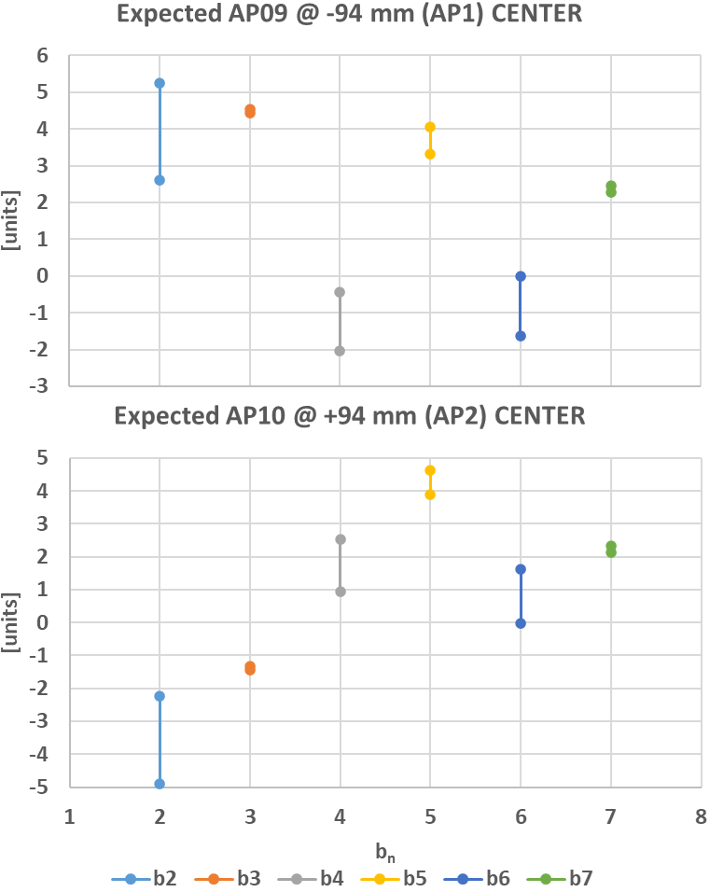


Expected Field Quality of MBRD5 @ Nominal Operation
 | CENTER
 | AP09 @ -94 mm (AP1) |  |  | AP10 @ +94 mm (AP2)
 | SIMU | EXPE PROTO | EXPE SERIE | SIMU | EXPE PROTO | EXPE SERIE
b2 | 6.09 | 5.26 | 2.60 | -5.73 | -4.89 | -2.24
b3 | -10.93 | 4.44 | 4.53 | -16.80 | -1.43 | -1.34
b5 | -1.37 | 3.31 | 4.06 | -0.79 | 3.89 | 4.64
a2 | 0.00 | 3.47 | -1.56 | 0.00 | -3.47 | 1.56
$$∆_{1}={Meas}_{PROTO}^{@ I_{nom}}−{Simu}_{PROTO}^{@ I_{nom}}$$
$$EXPE PROTO={Simu}_{MBRD5}^{@ I_{nom}}+∆_{1}$$
$$∆_{2}={Meas}_{MBRD2}^{iron @ RT}−{Simu}_{MBRD2}^{iron @ RT}$$
$$EXPE SERIE={Simu}_{MBRD5}^{@ I_{nom}}+∆_{2}$$

Slide 19
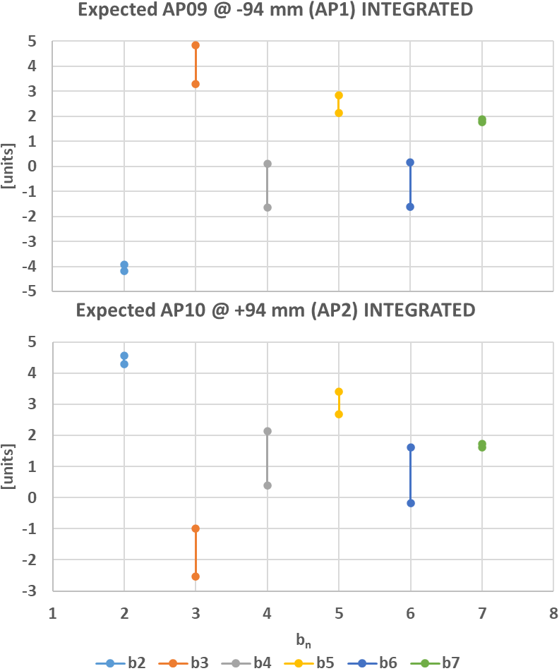
Expected Field Quality of MBRD5 @ Nominal Operation
 | INTEGRATED
 | AP09 @ -94 mm (AP1) |  |  | AP10 @ +94 mm (AP2)
 | SIMU | EXPE PROTO | EXPE SERIE | SIMU | EXPE PROTO | EXPE SERIE
b2 | -2.97 | -3.93 | -4.19 | 3.34 | 4.30 | 4.56
b3 | -10.65 | 4.85 | 3.31 | -16.49 | -0.99 | -2.54
b5 | -2.63 | 2.13 | 2.84 | -2.08 | 2.69 | 3.40
a2 | 0.90 | 3.20 | -1.09 | -0.89 | -3.20 | 1.09
$$∆_{1}={Meas}_{PROTO}^{@ I_{nom}}−{Simu}_{PROTO}^{@ I_{nom}}$$
$$EXPE PROTO={Simu}_{MBRD5}^{@ I_{nom}}+∆_{1}$$
$$∆_{2}={Meas}_{MBRD2}^{iron @ RT}−{Simu}_{MBRD2}^{iron @ RT}$$
$$EXPE SERIE={Simu}_{MBRD5}^{@ I_{nom}}+∆_{2}$$

Slide 20
MBRD6
  Shimming4
  CS view
  Shimming5
  BS03
  AS03
  AP12
  AP11
  AS12
  BS09
$$50.8 μm$$
$$76.2 μm$$
$$127 μm$$
20

Slide 21
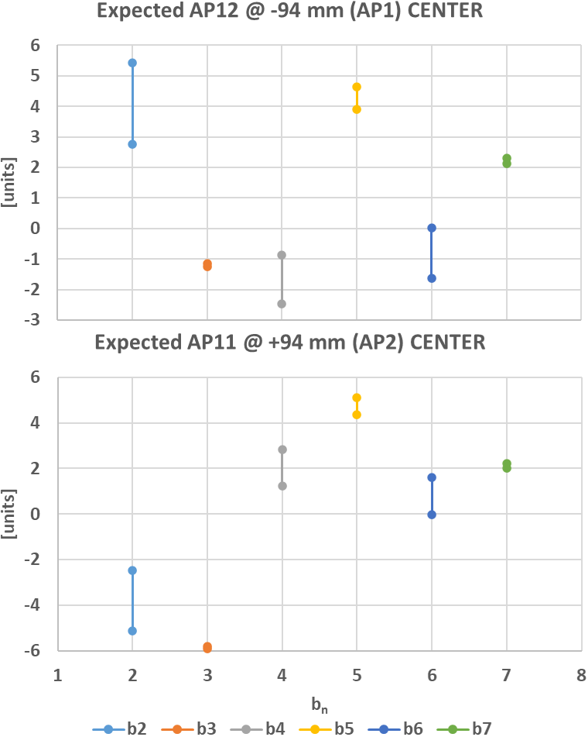


Expected Field Quality of MBRD6 @ Nominal Operation
 | CENTER
 | AP12 @ -94 mm (AP1) |  |  | AP11 @ +94 mm (AP2)
 | SIMU | EXPE PROTO | EXPE SERIE | SIMU | EXPE PROTO | EXPE SERIE
b2 | 6.26 | 5.43 | 2.77 | -5.97 | -5.13 | -2.48
b3 | -16.61 | -1.24 | -1.15 | -21.27 | -5.91 | -5.81
b5 | -0.78 | 3.90 | 4.65 | -0.30 | 4.37 | 5.13
a2 | 8.75 | 12.22 | 7.19 | -0.31 | -3.79 | 1.25
$$∆_{1}={Meas}_{PROTO}^{@ I_{nom}}−{Simu}_{PROTO}^{@ I_{nom}}$$
$$EXPE PROTO={Simu}_{MBRD6}^{@ I_{nom}}+∆_{1}$$
$$∆_{2}={Meas}_{MBRD2}^{iron @ RT}−{Simu}_{MBRD2}^{iron @ RT}$$
$$EXPE SERIE={Simu}_{MBRD6}^{@ I_{nom}}+∆_{2}$$

Slide 22
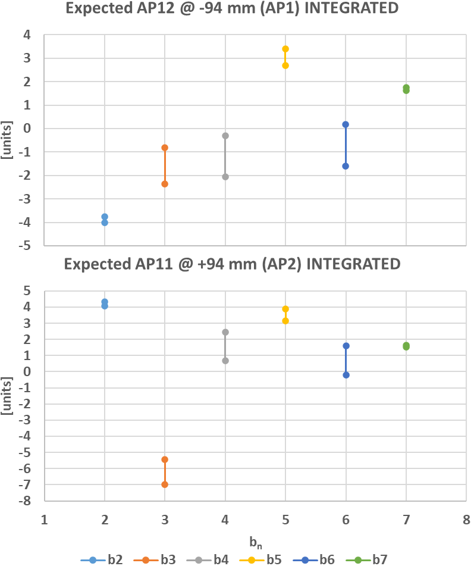
Expected Field Quality of MBRD6 @ Nominal Operation
 | INTEGRATED
 | AP12 @ -94 mm (AP1) |  |  | AP11 @ +94 mm (AP2)
 | SIMU | EXPE PROTO | EXPE SERIE | SIMU | EXPE PROTO | EXPE SERIE
b2 | -2.80 | -3.76 | -4.02 | 3.10 | 4.05 | 4.32
b3 | -16.30 | -0.81 | -2.35 | -20.94 | -5.45 | -6.99
b5 | -2.06 | 2.70 | 3.41 | -1.60 | 3.16 | 3.87
a2 | 9.66 | 11.97 | 7.68 | -1.20 | -3.51 | 0.79
$$∆_{1}={Meas}_{PROTO}^{@ I_{nom}}−{Simu}_{PROTO}^{@ I_{nom}}$$
$$EXPE PROTO={Simu}_{MBRD6}^{@ I_{nom}}+∆_{1}$$
$$∆_{2}={Meas}_{MBRD2}^{iron @ RT}−{Simu}_{MBRD2}^{iron @ RT}$$
$$EXPE SERIE={Simu}_{MBRD6}^{@ I_{nom}}+∆_{2}$$

Slide 23
Comparison of magnetic measurements with iron yoke @ RT
 | MAGNET 1 - CENTER
 | AP01 @ -94 mm (AP1) |  |  | AP02 @ +94 mm (AP2)
 | SIMU | MEAS | Δ | SIMU | MES | Δ
b2 | 3.08 | -1.27 | 4.35 | -2.89 | 1.32 | -4.21
b3 | -10.48 | -1.84 | -8.64 | -13.57 | 1.35 | -14.92
b5 | -0.65 | 4.90 | -5.54 | -0.34 | 4.23 | -4.57
a2 | 0.00 | 5.39 | -5.39 | 0.00 | 3.89 | -3.89
 | MAGNET 2 - CENTER
 | AP04 @ -94 mm (AP1) |  |  | AP03 @ +94 mm (AP2)
 | SIMU | MEAS | Δ | SIMU | MES | Δ
b2 | 3.02 | 0.16 | 2.85 | -3.02 | 1.11 | -4.12
b3 | -13.50 | 1.98 | -15.48 | -13.50 | 1.95 | -15.45
b5 | -0.33 | 5.38 | -5.71 | -0.33 | 4.82 | -5.15
a2 | 0.00 | -1.40 | 1.40 | 0.00 | 1.72 | -1.72
 | MAGNET 3 - CENTER
 | AP05 @ -94 mm (AP1) |  |  | AP06 @ +94 mm (AP2)
 | SIMU | MEAS | Δ | SIMU | MES | Δ
b2 | 2.93 | -0.52 | 3.45 | -2.99 | 1.94 | -4.93
b3 | -13.52 | 1.99 | -15.50 | -12.49 | -2.55 | -9.94
b5 | -0.33 | 4.91 | -5.24 | -0.43 | 4.90 | -5.34
a2 | 0.00 | -5.26 | 5.26 | 0.00 | 1.00 | -1.00
 | MAGNET 4 - CENTER
 | AP07 @ -94 mm (AP1) |  |  | AP08 @ +94 mm (AP2)
 | SIMU | MEAS | Δ | SIMU | MES | Δ
b2 | 2.81 | -2.63 | 5.44 | -2.81 | 1.33 | -4.14
b3 | -10.53 | 1.33 | -11.86 | -10.53 | 1.72 | -12.25
b5 | -0.65 | 4.16 | -4.81 | -0.65 | 4.65 | -5.30
a2 | 0.00 | -1.58 | 1.58 | 0.00 | -0.84 | 0.84

Slide 24
Comparison of magnetic measurements with iron yoke @ RT
 | MAGNET 1 - INTEGRATED
 | AP01 @ -94 mm (AP1) |  |  | AP02 @ +94 mm (AP2)
 | SIMU | MEAS | Δ | SIMU | MEAS | Δ
b2 | -3.19 | -5.19 | 1.99 | 3.38 | 5.17 | -1.79
b3 | -10.76 | -3.26 | -7.50 | -13.83 | -0.87 | -12.96
b5 | -1.61 | 4.01 | -5.63 | -1.32 | 3.61 | -4.93
a2 | 0.79 | 6.00 | -5.21 | -0.79 | 3.66 | -4.45
 | MAGNET 2 - INTEGRATED
 | AP04 @ -94 mm (AP1) |  |  | AP03 @ +94 mm (AP2)
 | SIMU | MEAS | Δ | SIMU | MEAS | Δ
b2 | -3.26 | -3.59 | 0.34 | 3.26 | 5.36 | -2.10
b3 | -13.76 | 0.29 | -14.05 | -13.76 | 0.10 | -13.86
b5 | -1.31 | 4.38 | -5.69 | -1.31 | 3.94 | -5.25
a2 | 0.79 | -1.05 | 1.84 | -0.79 | 1.35 | -2.13
 | MAGNET 3 - INTEGRATED
 | AP05 @ -94 mm (AP1) |  |  | AP06 @ +94 mm (AP2)
 | SIMU | MEAS | Δ | SIMU | MEAS | Δ
b2 | -3.34 | -4.73 | 1.38 | 3.28 | 5.70 | -2.42
b3 | -13.78 | -0.27 | -13.51 | -12.76 | -3.97 | -8.79
b5 | -1.31 | 3.98 | -5.30 | -1.41 | 4.15 | -5.56
a2 | 0.79 | -4.02 | 4.80 | -0.79 | 1.17 | -1.96
 | MAGNET 4 - INTEGRATED
 | AP07 @ -94 mm (AP1) |  |  | AP08 @ +94 mm (AP2)
 | SIMU | MEAS | Δ | SIMU | MEAS | Δ
b2 | -3.46 | -6.66 | 3.20 | 3.46 | 5.17 | -1.70
b3 | -10.81 | -0.99 | -9.82 | -10.81 | -0.18 | -10.63
b5 | -1.62 | 3.21 | -4.82 | -1.62 | 3.79 | -5.41
a2 | 0.79 | -1.77 | 2.55 | -0.79 | -0.36 | -0.43

Slide 25
25

Slide 26
MBRD1
  Shimming1
  CS view
  Shimming2
  BS01
  AS02
  AP01
  AP02
  AS01
  BS02
$$50.8 μm$$
$$76.2 μm$$
$$127 μm$$
26

Slide 27




Expected Field Quality of MBRD1 @ Nominal Operation
 | CENTER
 | AP01 @ -94 mm (AP1) |  |  | AP02 @ +94 mm (AP2)
 | SIMU | EXPE PROTO | EXPE SERIE | SIMU | EXPE PROTO | EXPE SERIE
b2 | 5.87 | 5.04 | 1.70 | -5.66 | -4.82 | -1.48
b3 | -11.00 | 4.37 | 1.13 | -14.52 | 0.85 | -2.39
b4 | -1.29 | -2.06 | -0.68 | 1.59 | 2.36 | 0.97
b5 | -1.37 | 3.31 | 3.81 | -1.03 | 3.65 | 4.16
b6 | -0.57 | -1.64 | 0.20 | 0.56 | 1.63 | -0.21
b7 | 2.50 | 2.46 | 1.66 | 2.41 | 2.37 | 1.58
b8 | 1.06 | 2.90 | 1.39 | -1.04 | -2.89 | -1.37
b9 | 1.55 | 1.10 | 1.84 | 1.59 | 1.14 | 1.88
b10 | 0.15 | -2.13 | -1.20 | -0.17 | 2.12 | 1.19
a2 | 0.00 | 3.47 | 0.75 | 0.00 | -3.47 | -0.75
a3 | 0.00 | 2.63 | -3.81 | 0.00 | 2.63 | -3.81
a4 | 0.00 | 0.16 | 1.10 | 0.00 | -0.16 | -1.10
a5 | 0.00 | 1.67 | -0.82 | 0.00 | 1.67 | -0.82
a6 | 0.00 | 0.08 | 0.64 | 0.00 | -0.08 | -0.64
a7 | 0.00 | 0.94 | 0.92 | 0.00 | 0.94 | 0.92
a8 | 0.00 | -1.51 | 0.91 | 0.00 | 1.51 | -0.91
a9 | 0.00 | 1.57 | -0.92 | 0.00 | 1.57 | -0.92
a10 | 0.00 | 2.78 | -0.02 | 0.00 | -2.78 | 0.02
$$∆_{1}={Meas}_{PROTO}^{@ I_{nom}}−{Simu}_{PROTO}^{@ I_{nom}}$$
$$∆_{2}={Meas}_{MBRD1}^{iron @ RT}−{Simu}_{MBRD1}^{iron @ RT}$$
$$EXPE PROTO={Simu}_{MBRD1}^{@ I_{nom}}+∆_{1}$$
$$EXPE SERIE={Simu}_{MBRD1}^{@ I_{nom}}+∆_{2}$$

Slide 28
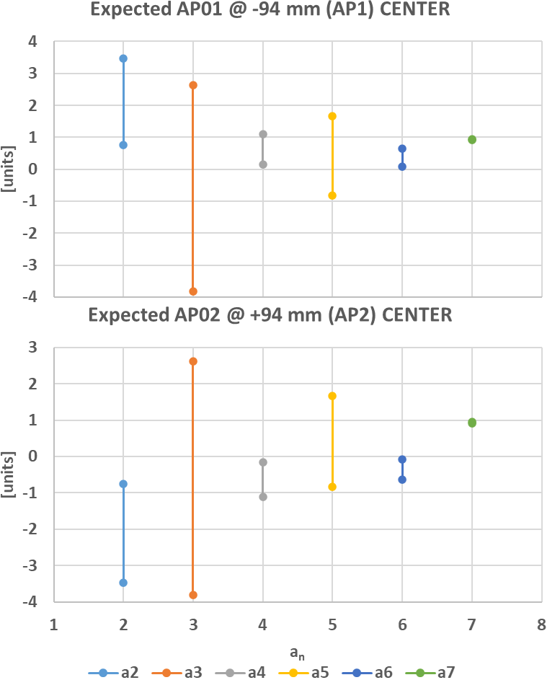
Expected Field Quality of MBRD1 @ Nominal Operation
 | CENTER
 | AP01 @ -94 mm (AP1) |  |  | AP02 @ +94 mm (AP2)
 | SIMU | EXPE PROTO | EXPE SERIE | SIMU | EXPE PROTO | EXPE SERIE
b2 | 5.87 | 5.04 | 1.70 | -5.66 | -4.82 | -1.48
b3 | -11.00 | 4.37 | 1.13 | -14.52 | 0.85 | -2.39
b4 | -1.29 | -2.06 | -0.68 | 1.59 | 2.36 | 0.97
b5 | -1.37 | 3.31 | 3.81 | -1.03 | 3.65 | 4.16
b6 | -0.57 | -1.64 | 0.20 | 0.56 | 1.63 | -0.21
b7 | 2.50 | 2.46 | 1.66 | 2.41 | 2.37 | 1.58
b8 | 1.06 | 2.90 | 1.39 | -1.04 | -2.89 | -1.37
b9 | 1.55 | 1.10 | 1.84 | 1.59 | 1.14 | 1.88
b10 | 0.15 | -2.13 | -1.20 | -0.17 | 2.12 | 1.19
a2 | 0.00 | 3.47 | 0.75 | 0.00 | -3.47 | -0.75
a3 | 0.00 | 2.63 | -3.81 | 0.00 | 2.63 | -3.81
a4 | 0.00 | 0.16 | 1.10 | 0.00 | -0.16 | -1.10
a5 | 0.00 | 1.67 | -0.82 | 0.00 | 1.67 | -0.82
a6 | 0.00 | 0.08 | 0.64 | 0.00 | -0.08 | -0.64
a7 | 0.00 | 0.94 | 0.92 | 0.00 | 0.94 | 0.92
a8 | 0.00 | -1.51 | 0.91 | 0.00 | 1.51 | -0.91
a9 | 0.00 | 1.57 | -0.92 | 0.00 | 1.57 | -0.92
a10 | 0.00 | 2.78 | -0.02 | 0.00 | -2.78 | 0.02
$$∆_{1}={Meas}_{PROTO}^{@ I_{nom}}−{Simu}_{PROTO}^{@ I_{nom}}$$
$$∆_{2}={Meas}_{MBRD1}^{iron @ RT}−{Simu}_{MBRD1}^{iron @ RT}$$
$$EXPE PROTO={Simu}_{MBRD1}^{@ I_{nom}}+∆_{1}$$
$$EXPE SERIE={Simu}_{MBRD1}^{@ I_{nom}}+∆_{2}$$

Slide 29
Expected Field Quality of MBRD1 @ Nominal Operation
 | INTEGRATED
 | AP01 @ -94 mm (AP1) |  |  | AP02 @ +94 mm (AP2)
 | SIMU | EXPE PROTO | EXPE SERIE | SIMU | EXPE PROTO | EXPE SERIE
b2 | -3.19 | -4.15 | -5.04 | 3.41 | 4.37 | 5.26
b3 | -10.71 | 4.79 | -0.35 | -14.22 | 1.28 | -3.86
b4 | -0.69 | -1.67 | -0.44 | 0.98 | 1.96 | 0.73
b5 | -2.64 | 2.12 | 2.68 | -2.30 | 2.46 | 3.02
b6 | -0.43 | -1.63 | 0.29 | 0.42 | 1.62 | -0.29
b7 | 2.13 | 1.88 | 1.15 | 2.05 | 1.80 | 1.06
b8 | 1.09 | 3.24 | 1.24 | -1.07 | -3.23 | -1.23
b9 | 1.28 | 0.63 | 1.30 | 1.32 | 0.66 | 1.33
b10 | 0.18 | -2.49 | -1.03 | -0.20 | 2.47 | 1.02
a2 | 0.90 | 3.20 | 1.28 | -0.89 | -3.20 | -1.28
a3 | 0.04 | 3.08 | -3.80 | 0.04 | 3.08 | -3.80
a4 | -0.34 | -0.45 | 0.75 | 0.34 | 0.45 | -0.75
a5 | -0.08 | 1.57 | -0.76 | -0.08 | 1.57 | -0.76
a6 | 0.10 | 0.05 | 0.49 | -0.10 | -0.05 | -0.49
a7 | -0.01 | 0.92 | 0.87 | -0.01 | 0.92 | 0.87
a8 | -0.02 | -1.20 | 0.74 | 0.02 | 1.20 | -0.74
a9 | 0.01 | 1.42 | -0.92 | 0.01 | 1.42 | -0.92
a10 | 0.01 | 0.83 | 0.08 | -0.01 | -0.83 | -0.08
$$∆_{1}={Meas}_{PROTO}^{@ I_{nom}}−{Simu}_{PROTO}^{@ I_{nom}}$$
$$∆_{2}={Meas}_{MBRD1}^{iron @ RT}−{Simu}_{MBRD1}^{iron @ RT}$$
$$EXPE PROTO={Simu}_{MBRD1}^{@ I_{nom}}+∆_{1}$$
$$EXPE SERIE={Simu}_{MBRD1}^{@ I_{nom}}+∆_{2}$$

Slide 30
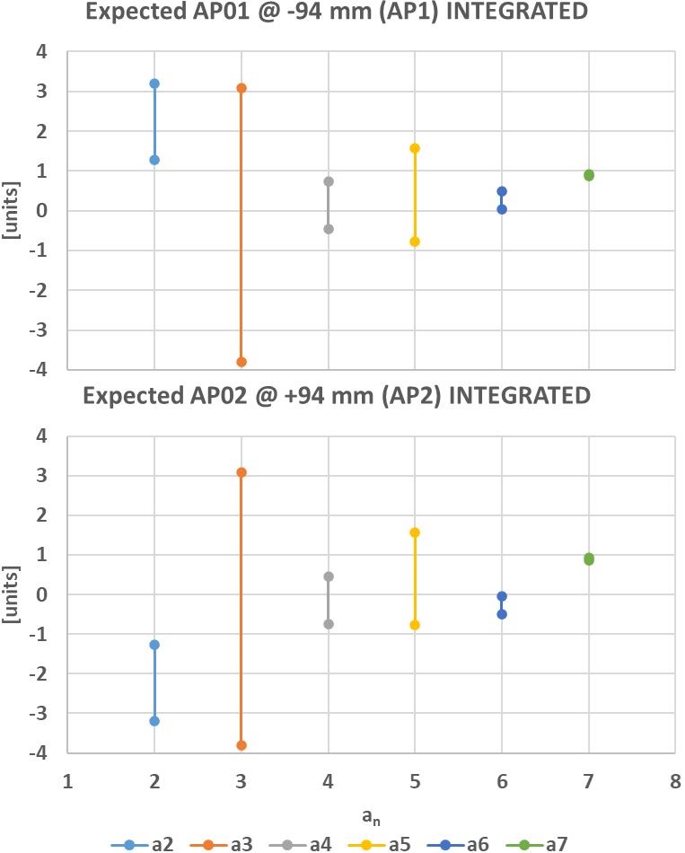
Expected Field Quality of MBRD1 @ Nominal Operation
 | INTEGRATED
 | AP01 @ -94 mm (AP1) |  |  | AP02 @ +94 mm (AP2)
 | SIMU | EXPE PROTO | EXPE SERIE | SIMU | EXPE PROTO | EXPE SERIE
b2 | -3.19 | -4.15 | -5.04 | 3.41 | 4.37 | 5.26
b3 | -10.71 | 4.79 | -0.35 | -14.22 | 1.28 | -3.86
b4 | -0.69 | -1.67 | -0.44 | 0.98 | 1.96 | 0.73
b5 | -2.64 | 2.12 | 2.68 | -2.30 | 2.46 | 3.02
b6 | -0.43 | -1.63 | 0.29 | 0.42 | 1.62 | -0.29
b7 | 2.13 | 1.88 | 1.15 | 2.05 | 1.80 | 1.06
b8 | 1.09 | 3.24 | 1.24 | -1.07 | -3.23 | -1.23
b9 | 1.28 | 0.63 | 1.30 | 1.32 | 0.66 | 1.33
b10 | 0.18 | -2.49 | -1.03 | -0.20 | 2.47 | 1.02
a2 | 0.90 | 3.20 | 1.28 | -0.89 | -3.20 | -1.28
a3 | 0.04 | 3.08 | -3.80 | 0.04 | 3.08 | -3.80
a4 | -0.34 | -0.45 | 0.75 | 0.34 | 0.45 | -0.75
a5 | -0.08 | 1.57 | -0.76 | -0.08 | 1.57 | -0.76
a6 | 0.10 | 0.05 | 0.49 | -0.10 | -0.05 | -0.49
a7 | -0.01 | 0.92 | 0.87 | -0.01 | 0.92 | 0.87
a8 | -0.02 | -1.20 | 0.74 | 0.02 | 1.20 | -0.74
a9 | 0.01 | 1.42 | -0.92 | 0.01 | 1.42 | -0.92
a10 | 0.01 | 0.83 | 0.08 | -0.01 | -0.83 | -0.08
$$∆_{1}={Meas}_{PROTO}^{@ I_{nom}}−{Simu}_{PROTO}^{@ I_{nom}}$$
$$∆_{2}={Meas}_{MBRD1}^{iron @ RT}−{Simu}_{MBRD1}^{iron @ RT}$$
$$EXPE PROTO={Simu}_{MBRD1}^{@ I_{nom}}+∆_{1}$$
$$EXPE SERIE={Simu}_{MBRD1}^{@ I_{nom}}+∆_{2}$$

Slide 31
MBRD2
  Shimming2
  CS view
  Shimming2
  BS06
  AS04
  AP04
  AP03
  AS06
  BS04
$$50.8 μm$$
$$76.2 μm$$
$$127 μm$$
31

Slide 32



Expected Field Quality of MBRD2 @ Nominal Operation
 | CENTER
 | AP04 @ -94 mm (AP1) |  |  | AP03 @ +94 mm (AP2)
 | SIMU | EXPE PROTO | EXPE SERIE | SIMU | EXPE PROTO | EXPE SERIE
b2 | 5.76 | 4.92 | 2.27 | -5.76 | -4.92 | -2.27
b3 | -14.46 | 0.91 | 1.00 | -14.46 | 0.91 | 1.00
b4 | -1.56 | -2.33 | -0.73 | 1.56 | 2.33 | 0.73
b5 | -1.02 | 3.66 | 4.41 | -1.02 | 3.66 | 4.41
b6 | -0.56 | -1.63 | 0.01 | 0.56 | 1.63 | -0.01
b7 | 2.41 | 2.37 | 2.18 | 2.41 | 2.37 | 2.18
b8 | 1.04 | 2.89 | 1.25 | -1.04 | -2.89 | -1.25
b9 | 1.59 | 1.14 | 1.22 | 1.59 | 1.14 | 1.22
b10 | 0.17 | -2.12 | -0.47 | -0.17 | 2.12 | 0.47
a2 | 0.00 | 3.47 | -1.56 | 0.00 | -3.47 | 1.56
a3 | 0.00 | 2.63 | -2.62 | 0.00 | 2.63 | -2.62
a4 | 0.00 | 0.16 | -0.55 | 0.00 | -0.16 | 0.55
a5 | 0.00 | 1.67 | -0.32 | 0.00 | 1.67 | -0.32
a6 | 0.00 | 0.08 | 0.00 | 0.00 | -0.08 | 0.00
a7 | 0.00 | 0.94 | 0.86 | 0.00 | 0.94 | 0.86
a8 | 0.00 | -1.51 | 0.20 | 0.00 | 1.51 | -0.20
a9 | 0.00 | 1.57 | -0.62 | 0.00 | 1.57 | -0.62
a10 | 0.00 | 2.78 | -0.13 | 0.00 | -2.78 | 0.13
$$∆_{1}={Meas}_{PROTO}^{@ I_{nom}}−{Simu}_{PROTO}^{@ I_{nom}}$$
$$∆_{2}={Meas}_{MBRD2}^{iron @ RT}−{Simu}_{MBRD2}^{iron @ RT}$$
$$EXPE PROTO={Simu}_{MBRD2}^{@ I_{nom}}+∆_{1}$$
$$EXPE SERIE={Simu}_{MBRD2}^{@ I_{nom}}+∆_{2}$$

Slide 33
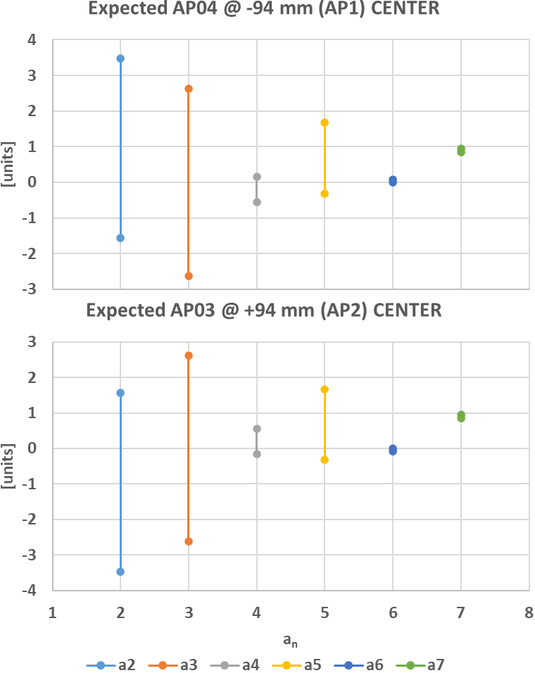
Expected Field Quality of MBRD2 @ Nominal Operation
 | CENTER
 | AP04 @ -94 mm (AP1) |  |  | AP03 @ +94 mm (AP2)
 | SIMU | EXPE PROTO | EXPE SERIE | SIMU | EXPE PROTO | EXPE SERIE
b2 | 5.76 | 4.92 | 2.27 | -5.76 | -4.92 | -2.27
b3 | -14.46 | 0.91 | 1.00 | -14.46 | 0.91 | 1.00
b4 | -1.56 | -2.33 | -0.73 | 1.56 | 2.33 | 0.73
b5 | -1.02 | 3.66 | 4.41 | -1.02 | 3.66 | 4.41
b6 | -0.56 | -1.63 | 0.01 | 0.56 | 1.63 | -0.01
b7 | 2.41 | 2.37 | 2.18 | 2.41 | 2.37 | 2.18
b8 | 1.04 | 2.89 | 1.25 | -1.04 | -2.89 | -1.25
b9 | 1.59 | 1.14 | 1.22 | 1.59 | 1.14 | 1.22
b10 | 0.17 | -2.12 | -0.47 | -0.17 | 2.12 | 0.47
a2 | 0.00 | 3.47 | -1.56 | 0.00 | -3.47 | 1.56
a3 | 0.00 | 2.63 | -2.62 | 0.00 | 2.63 | -2.62
a4 | 0.00 | 0.16 | -0.55 | 0.00 | -0.16 | 0.55
a5 | 0.00 | 1.67 | -0.32 | 0.00 | 1.67 | -0.32
a6 | 0.00 | 0.08 | 0.00 | 0.00 | -0.08 | 0.00
a7 | 0.00 | 0.94 | 0.86 | 0.00 | 0.94 | 0.86
a8 | 0.00 | -1.51 | 0.20 | 0.00 | 1.51 | -0.20
a9 | 0.00 | 1.57 | -0.62 | 0.00 | 1.57 | -0.62
a10 | 0.00 | 2.78 | -0.13 | 0.00 | -2.78 | 0.13
$$∆_{1}={Meas}_{PROTO}^{@ I_{nom}}−{Simu}_{PROTO}^{@ I_{nom}}$$
$$∆_{2}={Meas}_{MBRD2}^{iron @ RT}−{Simu}_{MBRD2}^{iron @ RT}$$
$$EXPE PROTO={Simu}_{MBRD2}^{@ I_{nom}}+∆_{1}$$
$$EXPE SERIE={Simu}_{MBRD2}^{@ I_{nom}}+∆_{2}$$

Slide 34
Expected Field Quality of MBRD2 @ Nominal Operation
 | INTEGRATED
 | AP04 @ -94 mm (AP1) |  |  | AP03 @ +94 mm (AP2)
 | SIMU | EXPE PROTO | EXPE SERIE | SIMU | EXPE PROTO | EXPE SERIE
b2 | -3.30 | -4.26 | -4.52 | 3.30 | 4.26 | 4.52
b3 | -14.16 | 1.34 | -0.20 | -14.16 | 1.34 | -0.20
b4 | -0.95 | -1.93 | -0.18 | 0.95 | 1.93 | 0.18
b5 | -2.30 | 2.47 | 3.18 | -2.30 | 2.47 | 3.18
b6 | -0.42 | -1.62 | 0.18 | 0.42 | 1.62 | -0.18
b7 | 2.05 | 1.80 | 1.68 | 2.05 | 1.80 | 1.68
b8 | 1.07 | 3.23 | 1.31 | -1.07 | -3.23 | -1.31
b9 | 1.32 | 0.66 | 0.67 | 1.32 | 0.66 | 0.67
b10 | 0.20 | -2.47 | -0.40 | -0.20 | 2.47 | 0.40
a2 | 0.89 | 3.20 | -1.09 | -0.89 | -3.20 | 1.09
a3 | 0.04 | 3.08 | -3.16 | 0.04 | 3.08 | -3.16
a4 | -0.34 | -0.45 | -0.46 | 0.34 | 0.45 | 0.46
a5 | -0.08 | 1.57 | -0.35 | -0.08 | 1.57 | -0.35
a6 | 0.10 | 0.05 | 0.07 | -0.10 | -0.05 | -0.07
a7 | -0.01 | 0.92 | 0.90 | -0.01 | 0.92 | 0.90
a8 | -0.02 | -1.20 | 0.17 | 0.02 | 1.20 | -0.17
a9 | 0.01 | 1.42 | -0.72 | 0.01 | 1.42 | -0.72
a10 | 0.01 | 0.83 | -0.06 | -0.01 | -0.83 | 0.06
$$∆_{1}={Meas}_{PROTO}^{@ I_{nom}}−{Simu}_{PROTO}^{@ I_{nom}}$$
$$∆_{2}={Meas}_{MBRD2}^{iron @ RT}−{Simu}_{MBRD2}^{iron @ RT}$$
$$EXPE PROTO={Simu}_{MBRD2}^{@ I_{nom}}+∆_{1}$$
$$EXPE SERIE={Simu}_{MBRD2}^{@ I_{nom}}+∆_{2}$$

Slide 35
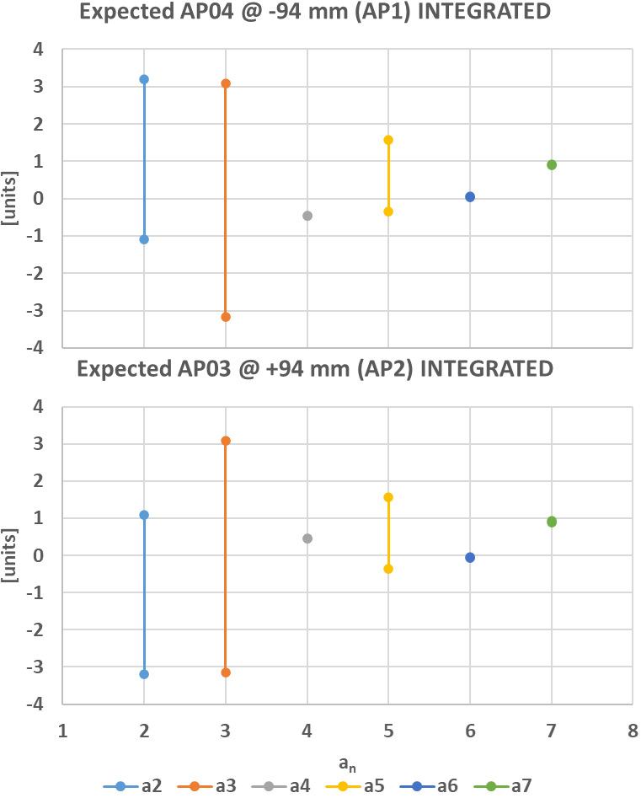
Expected Field Quality of MBRD2 @ Nominal Operation
 | INTEGRATED
 | AP04 @ -94 mm (AP1) |  |  | AP03 @ +94 mm (AP2)
 | SIMU | EXPE PROTO | EXPE SERIE | SIMU | EXPE PROTO | EXPE SERIE
b2 | -3.30 | -4.26 | -4.52 | 3.30 | 4.26 | 4.52
b3 | -14.16 | 1.34 | -0.20 | -14.16 | 1.34 | -0.20
b4 | -0.95 | -1.93 | -0.18 | 0.95 | 1.93 | 0.18
b5 | -2.30 | 2.47 | 3.18 | -2.30 | 2.47 | 3.18
b6 | -0.42 | -1.62 | 0.18 | 0.42 | 1.62 | -0.18
b7 | 2.05 | 1.80 | 1.68 | 2.05 | 1.80 | 1.68
b8 | 1.07 | 3.23 | 1.31 | -1.07 | -3.23 | -1.31
b9 | 1.32 | 0.66 | 0.67 | 1.32 | 0.66 | 0.67
b10 | 0.20 | -2.47 | -0.40 | -0.20 | 2.47 | 0.40
a2 | 0.89 | 3.20 | -1.09 | -0.89 | -3.20 | 1.09
a3 | 0.04 | 3.08 | -3.16 | 0.04 | 3.08 | -3.16
a4 | -0.34 | -0.45 | -0.46 | 0.34 | 0.45 | 0.46
a5 | -0.08 | 1.57 | -0.35 | -0.08 | 1.57 | -0.35
a6 | 0.10 | 0.05 | 0.07 | -0.10 | -0.05 | -0.07
a7 | -0.01 | 0.92 | 0.90 | -0.01 | 0.92 | 0.90
a8 | -0.02 | -1.20 | 0.17 | 0.02 | 1.20 | -0.17
a9 | 0.01 | 1.42 | -0.72 | 0.01 | 1.42 | -0.72
a10 | 0.01 | 0.83 | -0.06 | -0.01 | -0.83 | 0.06
$$∆_{1}={Meas}_{PROTO}^{@ I_{nom}}−{Simu}_{PROTO}^{@ I_{nom}}$$
$$∆_{2}={Meas}_{MBRD2}^{iron @ RT}−{Simu}_{MBRD2}^{iron @ RT}$$
$$EXPE PROTO={Simu}_{MBRD2}^{@ I_{nom}}+∆_{1}$$
$$EXPE SERIE={Simu}_{MBRD2}^{@ I_{nom}}+∆_{2}$$

Slide 36
MBRD3
  Shimming2
  CS view
  Shimming3
  BS07
  AS07
  AP05
  AP06
  AS05
  BS08
$$50.8 μm$$
$$76.2 μm$$
$$127 μm$$
36

Slide 37


Expected Field Quality of MBRD3 @ Nominal Operation
 | CENTER
 | AP05 @ -94 mm (AP1) |  |  | AP06 @ +94 mm (AP2)
 | SIMU | EXPE PROTO | EXPE SERIE | SIMU | EXPE PROTO | EXPE SERIE
b2 | 5.65 | 4.81 | 2.16 | -5.72 | -4.88 | -2.23
b3 | -14.49 | 0.88 | 0.97 | -13.32 | 2.05 | 2.14
b4 | -1.57 | -2.34 | -0.74 | 1.47 | 2.24 | 0.64
b5 | -1.02 | 3.66 | 4.41 | -1.13 | 3.54 | 4.29
b6 | -0.56 | -1.63 | 0.01 | 0.56 | 1.63 | -0.01
b7 | 2.41 | 2.37 | 2.18 | 2.44 | 2.40 | 2.21
b8 | 1.04 | 2.89 | 1.25 | -1.05 | -2.89 | -1.26
b9 | 1.59 | 1.14 | 1.22 | 1.57 | 1.13 | 1.21
b10 | 0.17 | -2.12 | -0.47 | -0.16 | 2.12 | 0.47
a2 | 0.00 | 3.47 | -1.56 | 0.00 | -3.47 | 1.56
a3 | 0.00 | 2.63 | -2.62 | 0.00 | 2.63 | -2.62
a4 | 0.00 | 0.16 | -0.55 | 0.00 | -0.16 | 0.55
a5 | 0.00 | 1.67 | -0.32 | 0.00 | 1.67 | -0.32
a6 | 0.00 | 0.08 | 0.00 | 0.00 | -0.08 | 0.00
a7 | 0.00 | 0.94 | 0.86 | 0.00 | 0.94 | 0.86
a8 | 0.00 | -1.51 | 0.20 | 0.00 | 1.51 | -0.20
a9 | 0.00 | 1.57 | -0.62 | 0.00 | 1.57 | -0.62
a10 | 0.00 | 2.78 | -0.13 | 0.00 | -2.78 | 0.13
$$∆_{1}={Meas}_{PROTO}^{@ I_{nom}}−{Simu}_{PROTO}^{@ I_{nom}}$$
$$∆_{2}={Meas}_{MBRD2}^{iron @ RT}−{Simu}_{MBRD2}^{iron @ RT}$$
$$EXPE PROTO={Simu}_{MBRD3}^{@ I_{nom}}+∆_{1}$$
$$EXPE SERIE={Simu}_{MBRD3}^{@ I_{nom}}+∆_{2}$$

Slide 38
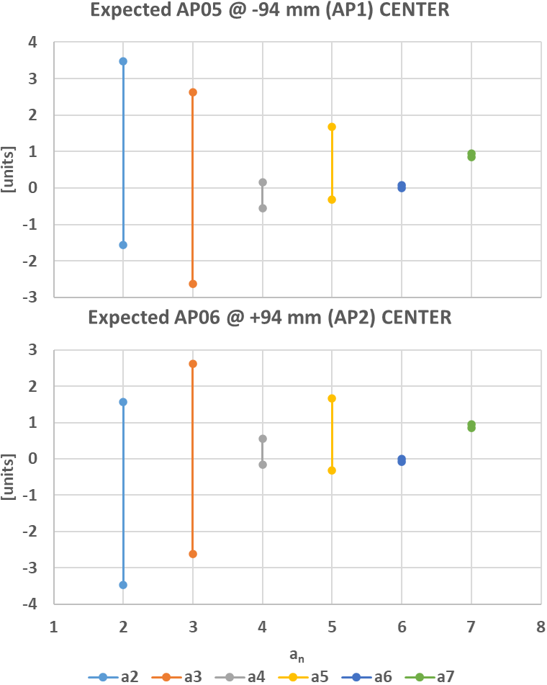
Expected Field Quality of MBRD3 @ Nominal Operation
 | CENTER
 | AP05 @ -94 mm (AP1) |  |  | AP06 @ +94 mm (AP2)
 | SIMU | EXPE PROTO | EXPE SERIE | SIMU | EXPE PROTO | EXPE SERIE
b2 | 5.65 | 4.81 | 2.16 | -5.72 | -4.88 | -2.23
b3 | -14.49 | 0.88 | 0.97 | -13.32 | 2.05 | 2.14
b4 | -1.57 | -2.34 | -0.74 | 1.47 | 2.24 | 0.64
b5 | -1.02 | 3.66 | 4.41 | -1.13 | 3.54 | 4.29
b6 | -0.56 | -1.63 | 0.01 | 0.56 | 1.63 | -0.01
b7 | 2.41 | 2.37 | 2.18 | 2.44 | 2.40 | 2.21
b8 | 1.04 | 2.89 | 1.25 | -1.05 | -2.89 | -1.26
b9 | 1.59 | 1.14 | 1.22 | 1.57 | 1.13 | 1.21
b10 | 0.17 | -2.12 | -0.47 | -0.16 | 2.12 | 0.47
a2 | 0.00 | 3.47 | -1.56 | 0.00 | -3.47 | 1.56
a3 | 0.00 | 2.63 | -2.62 | 0.00 | 2.63 | -2.62
a4 | 0.00 | 0.16 | -0.55 | 0.00 | -0.16 | 0.55
a5 | 0.00 | 1.67 | -0.32 | 0.00 | 1.67 | -0.32
a6 | 0.00 | 0.08 | 0.00 | 0.00 | -0.08 | 0.00
a7 | 0.00 | 0.94 | 0.86 | 0.00 | 0.94 | 0.86
a8 | 0.00 | -1.51 | 0.20 | 0.00 | 1.51 | -0.20
a9 | 0.00 | 1.57 | -0.62 | 0.00 | 1.57 | -0.62
a10 | 0.00 | 2.78 | -0.13 | 0.00 | -2.78 | 0.13
$$∆_{1}={Meas}_{PROTO}^{@ I_{nom}}−{Simu}_{PROTO}^{@ I_{nom}}$$
$$∆_{2}={Meas}_{MBRD2}^{iron @ RT}−{Simu}_{MBRD2}^{iron @ RT}$$
$$EXPE PROTO={Simu}_{MBRD3}^{@ I_{nom}}+∆_{1}$$
$$EXPE SERIE={Simu}_{MBRD3}^{@ I_{nom}}+∆_{2}$$

Slide 39
Expected Field Quality of MBRD3 @ Nominal Operation
 | INTEGRATED
 | AP05 @ -94 mm (AP1) |  |  | AP06 @ +94 mm (AP2)
 | SIMU | EXPE PROTO | EXPE SERIE | SIMU | EXPE PROTO | EXPE SERIE
b2 | -3.41 | -4.37 | -4.63 | 3.34 | 4.30 | 4.56
b3 | -14.19 | 1.31 | -0.23 | -13.02 | 2.47 | 0.93
b4 | -0.96 | -1.94 | -0.19 | 0.86 | 1.84 | 0.09
b5 | -2.30 | 2.47 | 3.18 | -2.41 | 2.35 | 3.07
b6 | -0.42 | -1.62 | 0.18 | 0.42 | 1.62 | -0.18
b7 | 2.05 | 1.80 | 1.68 | 2.08 | 1.82 | 1.70
b8 | 1.07 | 3.23 | 1.31 | -1.08 | -3.23 | -1.31
b9 | 1.32 | 0.66 | 0.68 | 1.31 | 0.65 | 0.66
b10 | 0.20 | -2.47 | -0.40 | -0.19 | 2.48 | 0.40
a2 | 0.89 | 3.20 | -1.09 | -0.89 | -3.20 | 1.09
a3 | 0.04 | 3.08 | -3.16 | 0.04 | 3.08 | -3.16
a4 | -0.34 | -0.45 | -0.46 | 0.34 | 0.45 | 0.46
a5 | -0.08 | 1.57 | -0.35 | -0.08 | 1.57 | -0.35
a6 | 0.10 | 0.05 | 0.07 | -0.10 | -0.05 | -0.07
a7 | -0.01 | 0.92 | 0.90 | -0.01 | 0.92 | 0.90
a8 | -0.02 | -1.20 | 0.17 | 0.02 | 1.20 | -0.17
a9 | 0.01 | 1.42 | -0.72 | 0.01 | 1.42 | -0.72
a10 | 0.01 | 0.83 | -0.06 | -0.01 | -0.83 | 0.06
$$∆_{1}={Meas}_{PROTO}^{@ I_{nom}}−{Simu}_{PROTO}^{@ I_{nom}}$$
$$∆_{2}={Meas}_{MBRD2}^{iron @ RT}−{Simu}_{MBRD2}^{iron @ RT}$$
$$EXPE PROTO={Simu}_{MBRD3}^{@ I_{nom}}+∆_{1}$$
$$EXPE SERIE={Simu}_{MBRD3}^{@ I_{nom}}+∆_{2}$$

Slide 40
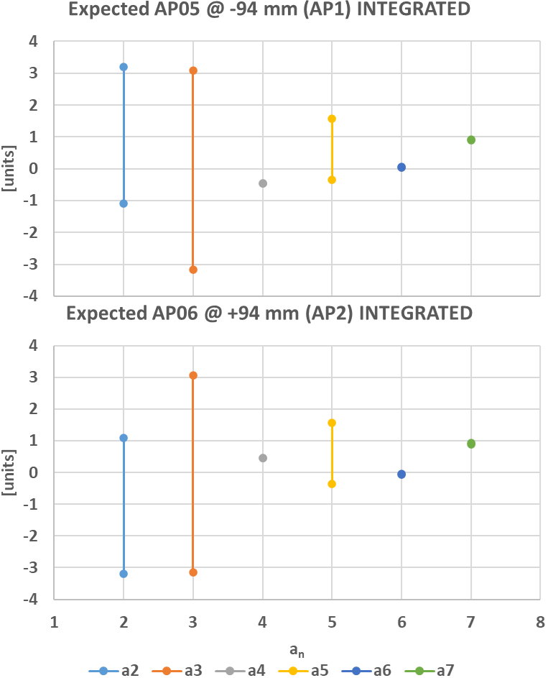
Expected Field Quality of MBRD3 @ Nominal Operation
 | INTEGRATED
 | AP05 @ -94 mm (AP1) |  |  | AP06 @ +94 mm (AP2)
 | SIMU | EXPE PROTO | EXPE SERIE | SIMU | EXPE PROTO | EXPE SERIE
b2 | -3.41 | -4.37 | -4.63 | 3.34 | 4.30 | 4.56
b3 | -14.19 | 1.31 | -0.23 | -13.02 | 2.47 | 0.93
b4 | -0.96 | -1.94 | -0.19 | 0.86 | 1.84 | 0.09
b5 | -2.30 | 2.47 | 3.18 | -2.41 | 2.35 | 3.07
b6 | -0.42 | -1.62 | 0.18 | 0.42 | 1.62 | -0.18
b7 | 2.05 | 1.80 | 1.68 | 2.08 | 1.82 | 1.70
b8 | 1.07 | 3.23 | 1.31 | -1.08 | -3.23 | -1.31
b9 | 1.32 | 0.66 | 0.68 | 1.31 | 0.65 | 0.66
b10 | 0.20 | -2.47 | -0.40 | -0.19 | 2.48 | 0.40
a2 | 0.89 | 3.20 | -1.09 | -0.89 | -3.20 | 1.09
a3 | 0.04 | 3.08 | -3.16 | 0.04 | 3.08 | -3.16
a4 | -0.34 | -0.45 | -0.46 | 0.34 | 0.45 | 0.46
a5 | -0.08 | 1.57 | -0.35 | -0.08 | 1.57 | -0.35
a6 | 0.10 | 0.05 | 0.07 | -0.10 | -0.05 | -0.07
a7 | -0.01 | 0.92 | 0.90 | -0.01 | 0.92 | 0.90
a8 | -0.02 | -1.20 | 0.17 | 0.02 | 1.20 | -0.17
a9 | 0.01 | 1.42 | -0.72 | 0.01 | 1.42 | -0.72
a10 | 0.01 | 0.83 | -0.06 | -0.01 | -0.83 | 0.06
$$∆_{1}={Meas}_{PROTO}^{@ I_{nom}}−{Simu}_{PROTO}^{@ I_{nom}}$$
$$∆_{2}={Meas}_{MBRD2}^{iron @ RT}−{Simu}_{MBRD2}^{iron @ RT}$$
$$EXPE PROTO={Simu}_{MBRD3}^{@ I_{nom}}+∆_{1}$$
$$EXPE SERIE={Simu}_{MBRD3}^{@ I_{nom}}+∆_{2}$$

Slide 41
MBRD4
  Shimming1
  CS view
  Shimming1
  BS11
  AS08
  AP07
  AP08
  AS09
  BS10
$$50.8 μm$$
$$76.2 μm$$
$$127 μm$$
41

Slide 42


Expected Field Quality of MBRD4 @ Nominal Operation
 | CENTER
 | AP07 @ -94 mm (AP1) |  |  | AP08 @ +94 mm (AP2)
 | SIMU | EXPE PROTO | EXPE SERIE | SIMU | EXPE PROTO | EXPE SERIE
b2 | 5.54 | 4.70 | 2.05 | -5.54 | -4.70 | -2.05
b3 | -11.09 | 4.28 | 4.37 | -11.09 | 4.28 | 4.37
b4 | -1.32 | -2.09 | -0.49 | 1.32 | 2.09 | 0.49
b5 | -1.38 | 3.30 | 4.05 | -1.38 | 3.30 | 4.05
b6 | -0.57 | -1.64 | 0.00 | 0.57 | 1.64 | 0.00
b7 | 2.49 | 2.45 | 2.27 | 2.49 | 2.45 | 2.27
b8 | 1.06 | 2.90 | 1.27 | -1.06 | -2.90 | -1.27
b9 | 1.55 | 1.11 | 1.19 | 1.55 | 1.11 | 1.19
b10 | 0.15 | -2.13 | -0.48 | -0.15 | 2.13 | 0.48
a2 | 0.00 | 3.47 | -1.56 | 0.00 | -3.47 | 1.56
a3 | 0.00 | 2.63 | -2.62 | 0.00 | 2.63 | -2.62
a4 | 0.00 | 0.16 | -0.55 | 0.00 | -0.16 | 0.55
a5 | 0.00 | 1.67 | -0.32 | 0.00 | 1.67 | -0.32
a6 | 0.00 | 0.08 | 0.00 | 0.00 | -0.08 | 0.00
a7 | 0.00 | 0.94 | 0.86 | 0.00 | 0.94 | 0.86
a8 | 0.00 | -1.51 | 0.20 | 0.00 | 1.51 | -0.20
a9 | 0.00 | 1.57 | -0.62 | 0.00 | 1.57 | -0.62
a10 | 0.00 | 2.78 | -0.13 | 0.00 | -2.78 | 0.13
$$∆_{1}={Meas}_{PROTO}^{@ I_{nom}}−{Simu}_{PROTO}^{@ I_{nom}}$$
$$∆_{2}={Meas}_{MBRD2}^{iron @ RT}−{Simu}_{MBRD2}^{iron @ RT}$$
$$EXPE PROTO={Simu}_{MBRD4}^{@ I_{nom}}+∆_{1}$$
$$EXPE SERIE={Simu}_{MBRD4}^{@ I_{nom}}+∆_{2}$$

Slide 43
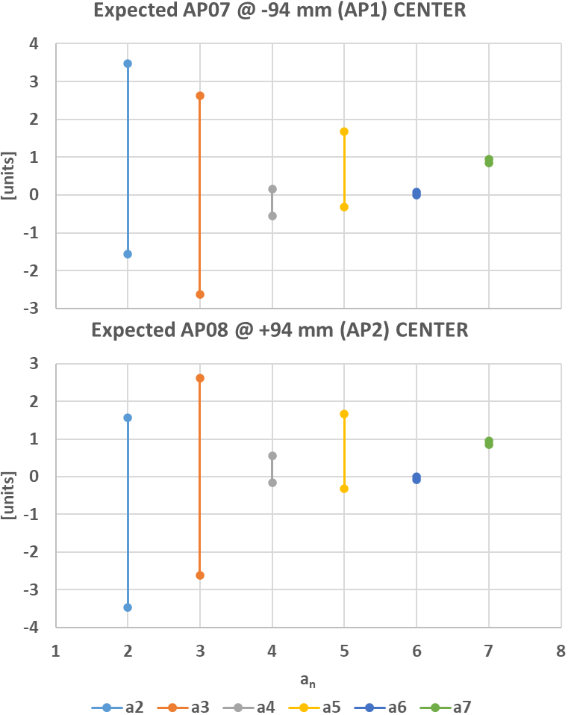
Expected Field Quality of MBRD4 @ Nominal Operation
 | CENTER
 | AP07 @ -94 mm (AP1) |  |  | AP08 @ +94 mm (AP2)
 | SIMU | EXPE PROTO | EXPE SERIE | SIMU | EXPE PROTO | EXPE SERIE
b2 | 5.54 | 4.70 | 2.05 | -5.54 | -4.70 | -2.05
b3 | -11.09 | 4.28 | 4.37 | -11.09 | 4.28 | 4.37
b4 | -1.32 | -2.09 | -0.49 | 1.32 | 2.09 | 0.49
b5 | -1.38 | 3.30 | 4.05 | -1.38 | 3.30 | 4.05
b6 | -0.57 | -1.64 | 0.00 | 0.57 | 1.64 | 0.00
b7 | 2.49 | 2.45 | 2.27 | 2.49 | 2.45 | 2.27
b8 | 1.06 | 2.90 | 1.27 | -1.06 | -2.90 | -1.27
b9 | 1.55 | 1.11 | 1.19 | 1.55 | 1.11 | 1.19
b10 | 0.15 | -2.13 | -0.48 | -0.15 | 2.13 | 0.48
a2 | 0.00 | 3.47 | -1.56 | 0.00 | -3.47 | 1.56
a3 | 0.00 | 2.63 | -2.62 | 0.00 | 2.63 | -2.62
a4 | 0.00 | 0.16 | -0.55 | 0.00 | -0.16 | 0.55
a5 | 0.00 | 1.67 | -0.32 | 0.00 | 1.67 | -0.32
a6 | 0.00 | 0.08 | 0.00 | 0.00 | -0.08 | 0.00
a7 | 0.00 | 0.94 | 0.86 | 0.00 | 0.94 | 0.86
a8 | 0.00 | -1.51 | 0.20 | 0.00 | 1.51 | -0.20
a9 | 0.00 | 1.57 | -0.62 | 0.00 | 1.57 | -0.62
a10 | 0.00 | 2.78 | -0.13 | 0.00 | -2.78 | 0.13
$$∆_{1}={Meas}_{PROTO}^{@ I_{nom}}−{Simu}_{PROTO}^{@ I_{nom}}$$
$$∆_{2}={Meas}_{MBRD2}^{iron @ RT}−{Simu}_{MBRD2}^{iron @ RT}$$
$$EXPE PROTO={Simu}_{MBRD4}^{@ I_{nom}}+∆_{1}$$
$$EXPE SERIE={Simu}_{MBRD4}^{@ I_{nom}}+∆_{2}$$

Slide 44
Expected Field Quality of MBRD4 @ Nominal Operation
 | INTEGRATED
 | AP07 @ -94 mm (AP1) |  |  | AP08 @ +94 mm (AP2)
 | SIMU | EXPE PROTO | EXPE SERIE | SIMU | EXPE PROTO | EXPE SERIE
b2 | -3.52 | -4.48 | -4.74 | 3.52 | 4.48 | 4.74
b3 | -10.80 | 4.70 | 3.15 | -10.80 | 4.70 | 3.15
b4 | -0.71 | -1.69 | 0.05 | 0.71 | 1.69 | -0.05
b5 | -2.64 | 2.12 | 2.83 | -2.64 | 2.12 | 2.83
b6 | -0.43 | -1.63 | 0.17 | 0.43 | 1.63 | -0.17
b7 | 2.13 | 1.88 | 1.76 | 2.13 | 1.88 | 1.76
b8 | 1.08 | 3.24 | 1.32 | -1.08 | -3.24 | -1.32
b9 | 1.29 | 0.63 | 0.64 | 1.29 | 0.63 | 0.64
b10 | 0.18 | -2.49 | -0.42 | -0.18 | 2.49 | 0.42
a2 | 0.90 | 3.20 | -1.09 | -0.90 | -3.20 | 1.09
a3 | 0.04 | 3.08 | -3.16 | 0.04 | 3.08 | -3.16
a4 | -0.34 | -0.45 | -0.46 | 0.34 | 0.45 | 0.46
a5 | -0.08 | 1.57 | -0.35 | -0.08 | 1.57 | -0.35
a6 | 0.10 | 0.05 | 0.07 | -0.10 | -0.05 | -0.07
a7 | -0.01 | 0.92 | 0.90 | -0.01 | 0.92 | 0.90
a8 | -0.02 | -1.20 | 0.17 | 0.02 | 1.20 | -0.17
a9 | 0.01 | 1.42 | -0.72 | 0.01 | 1.42 | -0.72
a10 | 0.01 | 0.83 | -0.06 | -0.01 | -0.83 | 0.06
$$∆_{1}={Meas}_{PROTO}^{@ I_{nom}}−{Simu}_{PROTO}^{@ I_{nom}}$$
$$∆_{2}={Meas}_{MBRD2}^{iron @ RT}−{Simu}_{MBRD2}^{iron @ RT}$$
$$EXPE PROTO={Simu}_{MBRD4}^{@ I_{nom}}+∆_{1}$$
$$EXPE SERIE={Simu}_{MBRD4}^{@ I_{nom}}+∆_{2}$$

Slide 45
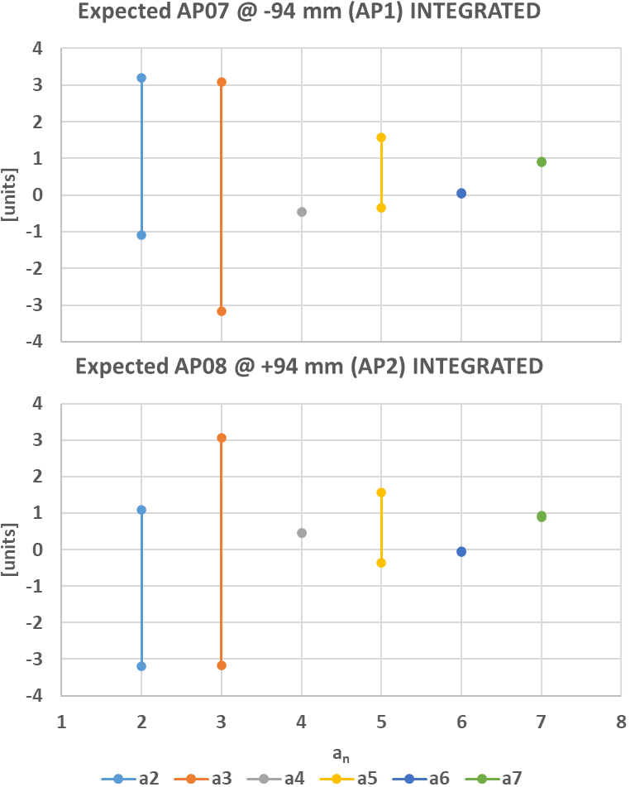
Expected Field Quality of MBRD4 @ Nominal Operation
 | INTEGRATED
 | AP07 @ -94 mm (AP1) |  |  | AP08 @ +94 mm (AP2)
 | SIMU | EXPE PROTO | EXPE SERIE | SIMU | EXPE PROTO | EXPE SERIE
b2 | -3.52 | -4.48 | -4.74 | 3.52 | 4.48 | 4.74
b3 | -10.80 | 4.70 | 3.15 | -10.80 | 4.70 | 3.15
b4 | -0.71 | -1.69 | 0.05 | 0.71 | 1.69 | -0.05
b5 | -2.64 | 2.12 | 2.83 | -2.64 | 2.12 | 2.83
b6 | -0.43 | -1.63 | 0.17 | 0.43 | 1.63 | -0.17
b7 | 2.13 | 1.88 | 1.76 | 2.13 | 1.88 | 1.76
b8 | 1.08 | 3.24 | 1.32 | -1.08 | -3.24 | -1.32
b9 | 1.29 | 0.63 | 0.64 | 1.29 | 0.63 | 0.64
b10 | 0.18 | -2.49 | -0.42 | -0.18 | 2.49 | 0.42
a2 | 0.90 | 3.20 | -1.09 | -0.90 | -3.20 | 1.09
a3 | 0.04 | 3.08 | -3.16 | 0.04 | 3.08 | -3.16
a4 | -0.34 | -0.45 | -0.46 | 0.34 | 0.45 | 0.46
a5 | -0.08 | 1.57 | -0.35 | -0.08 | 1.57 | -0.35
a6 | 0.10 | 0.05 | 0.07 | -0.10 | -0.05 | -0.07
a7 | -0.01 | 0.92 | 0.90 | -0.01 | 0.92 | 0.90
a8 | -0.02 | -1.20 | 0.17 | 0.02 | 1.20 | -0.17
a9 | 0.01 | 1.42 | -0.72 | 0.01 | 1.42 | -0.72
a10 | 0.01 | 0.83 | -0.06 | -0.01 | -0.83 | 0.06
$$∆_{1}={Meas}_{PROTO}^{@ I_{nom}}−{Simu}_{PROTO}^{@ I_{nom}}$$
$$∆_{2}={Meas}_{MBRD2}^{iron @ RT}−{Simu}_{MBRD2}^{iron @ RT}$$
$$EXPE PROTO={Simu}_{MBRD4}^{@ I_{nom}}+∆_{1}$$
$$EXPE SERIE={Simu}_{MBRD4}^{@ I_{nom}}+∆_{2}$$

Slide 46
MBRD5
  Shimming1
  CS view
  Shimming4
  BS12
  AS11
  AP09
  AP10
  AS10
  BS05
$$50.8 μm$$
$$76.2 μm$$
$$127 μm$$
46

Slide 47


Expected Field Quality of MBRD5 @ Nominal Operation
 | CENTER
 | AP09 @ -94 mm (AP1) |  |  | AP10 @ +94 mm (AP2)
 | SIMU | EXPE PROTO | EXPE SERIE | SIMU | EXPE PROTO | EXPE SERIE
b2 | 6.09 | 5.26 | 2.60 | -5.73 | -4.89 | -2.24
b3 | -10.93 | 4.44 | 4.53 | -16.80 | -1.43 | -1.34
b4 | -1.28 | -2.04 | -0.45 | 1.76 | 2.53 | 0.94
b5 | -1.37 | 3.31 | 4.06 | -0.79 | 3.89 | 4.64
b6 | -0.57 | -1.64 | 0.00 | 0.56 | 1.63 | -0.02
b7 | 2.50 | 2.46 | 2.27 | 2.36 | 2.32 | 2.13
b8 | 1.06 | 2.90 | 1.27 | -1.03 | -2.88 | -1.24
b9 | 1.55 | 1.10 | 1.19 | 1.61 | 1.16 | 1.25
b10 | 0.15 | -2.13 | -0.48 | -0.18 | 2.11 | 0.46
a2 | 0.00 | 3.47 | -1.56 | 0.00 | -3.47 | 1.56
a3 | 0.00 | 2.63 | -2.62 | 0.00 | 2.63 | -2.62
a4 | 0.00 | 0.16 | -0.55 | 0.00 | -0.16 | 0.55
a5 | 0.00 | 1.67 | -0.32 | 0.00 | 1.67 | -0.32
a6 | 0.00 | 0.08 | 0.00 | 0.00 | -0.08 | 0.00
a7 | 0.00 | 0.94 | 0.86 | 0.00 | 0.94 | 0.86
a8 | 0.00 | -1.51 | 0.20 | 0.00 | 1.51 | -0.20
a9 | 0.00 | 1.57 | -0.62 | 0.00 | 1.57 | -0.62
a10 | 0.00 | 2.78 | -0.13 | 0.00 | -2.78 | 0.13
$$∆_{1}={Meas}_{PROTO}^{@ I_{nom}}−{Simu}_{PROTO}^{@ I_{nom}}$$
$$∆_{2}={Meas}_{MBRD2}^{iron @ RT}−{Simu}_{MBRD2}^{iron @ RT}$$
$$EXPE PROTO={Simu}_{MBRD5}^{@ I_{nom}}+∆_{1}$$
$$EXPE SERIE={Simu}_{MBRD5}^{@ I_{nom}}+∆_{2}$$

Slide 48
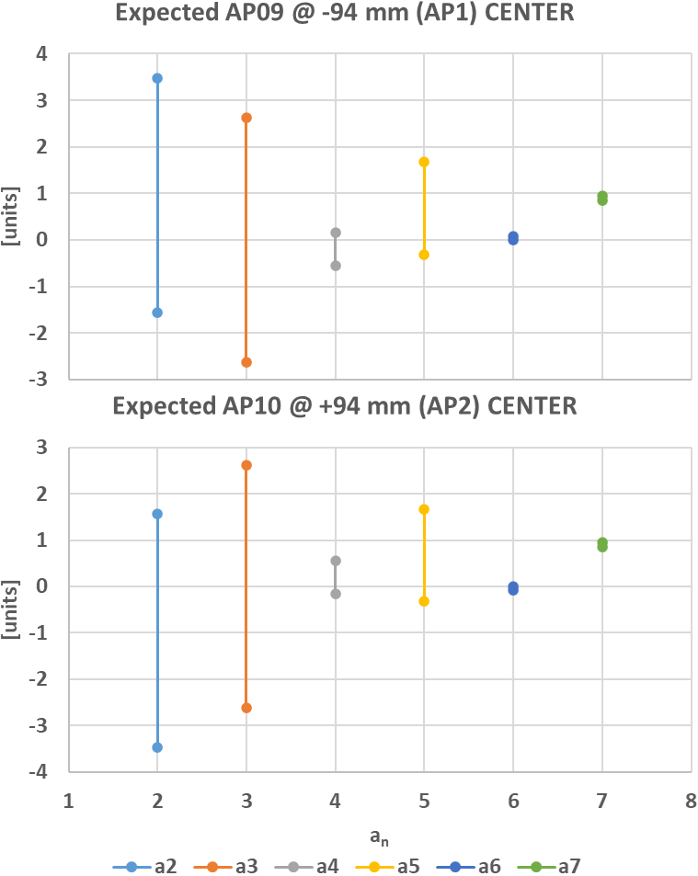
Expected Field Quality of MBRD5 @ Nominal Operation
 | CENTER
 | AP09 @ -94 mm (AP1) |  |  | AP10 @ +94 mm (AP2)
 | SIMU | EXPE PROTO | EXPE SERIE | SIMU | EXPE PROTO | EXPE SERIE
b2 | 6.09 | 5.26 | 2.60 | -5.73 | -4.89 | -2.24
b3 | -10.93 | 4.44 | 4.53 | -16.80 | -1.43 | -1.34
b4 | -1.28 | -2.04 | -0.45 | 1.76 | 2.53 | 0.94
b5 | -1.37 | 3.31 | 4.06 | -0.79 | 3.89 | 4.64
b6 | -0.57 | -1.64 | 0.00 | 0.56 | 1.63 | -0.02
b7 | 2.50 | 2.46 | 2.27 | 2.36 | 2.32 | 2.13
b8 | 1.06 | 2.90 | 1.27 | -1.03 | -2.88 | -1.24
b9 | 1.55 | 1.10 | 1.19 | 1.61 | 1.16 | 1.25
b10 | 0.15 | -2.13 | -0.48 | -0.18 | 2.11 | 0.46
a2 | 0.00 | 3.47 | -1.56 | 0.00 | -3.47 | 1.56
a3 | 0.00 | 2.63 | -2.62 | 0.00 | 2.63 | -2.62
a4 | 0.00 | 0.16 | -0.55 | 0.00 | -0.16 | 0.55
a5 | 0.00 | 1.67 | -0.32 | 0.00 | 1.67 | -0.32
a6 | 0.00 | 0.08 | 0.00 | 0.00 | -0.08 | 0.00
a7 | 0.00 | 0.94 | 0.86 | 0.00 | 0.94 | 0.86
a8 | 0.00 | -1.51 | 0.20 | 0.00 | 1.51 | -0.20
a9 | 0.00 | 1.57 | -0.62 | 0.00 | 1.57 | -0.62
a10 | 0.00 | 2.78 | -0.13 | 0.00 | -2.78 | 0.13
$$∆_{1}={Meas}_{PROTO}^{@ I_{nom}}−{Simu}_{PROTO}^{@ I_{nom}}$$
$$∆_{2}={Meas}_{MBRD2}^{iron @ RT}−{Simu}_{MBRD2}^{iron @ RT}$$
$$EXPE PROTO={Simu}_{MBRD5}^{@ I_{nom}}+∆_{1}$$
$$EXPE SERIE={Simu}_{MBRD5}^{@ I_{nom}}+∆_{2}$$

Slide 49
Expected Field Quality of MBRD5 @ Nominal Operation
 | INTEGRATED
 | AP09 @ -94 mm (AP1) |  |  | AP10 @ +94 mm (AP2)
 | SIMU | EXPE PROTO | EXPE SERIE | SIMU | EXPE PROTO | EXPE SERIE
b2 | -2.97 | -3.93 | -4.19 | 3.34 | 4.30 | 4.56
b3 | -10.65 | 4.85 | 3.31 | -16.49 | -0.99 | -2.54
b4 | -0.67 | -1.65 | 0.10 | 1.15 | 2.13 | 0.38
b5 | -2.63 | 2.13 | 2.84 | -2.08 | 2.69 | 3.40
b6 | -0.43 | -1.62 | 0.17 | 0.41 | 1.61 | -0.18
b7 | 2.13 | 1.88 | 1.76 | 2.00 | 1.74 | 1.62
b8 | 1.09 | 3.24 | 1.32 | -1.06 | -3.22 | -1.30
b9 | 1.28 | 0.63 | 0.64 | 1.34 | 0.68 | 0.70
b10 | 0.18 | -2.49 | -0.42 | -0.21 | 2.46 | 0.39
a2 | 0.90 | 3.20 | -1.09 | -0.89 | -3.20 | 1.09
a3 | 0.04 | 3.08 | -3.16 | 0.05 | 3.08 | -3.16
a4 | -0.34 | -0.45 | -0.46 | 0.34 | 0.45 | 0.46
a5 | -0.08 | 1.57 | -0.35 | -0.08 | 1.57 | -0.36
a6 | 0.10 | 0.05 | 0.07 | -0.10 | -0.05 | -0.07
a7 | -0.01 | 0.92 | 0.90 | -0.01 | 0.92 | 0.90
a8 | -0.02 | -1.20 | 0.17 | 0.02 | 1.20 | -0.17
a9 | 0.01 | 1.42 | -0.72 | 0.01 | 1.42 | -0.72
a10 | 0.01 | 0.83 | -0.06 | -0.01 | -0.83 | 0.06
$$∆_{1}={Meas}_{PROTO}^{@ I_{nom}}−{Simu}_{PROTO}^{@ I_{nom}}$$
$$∆_{2}={Meas}_{MBRD2}^{iron @ RT}−{Simu}_{MBRD2}^{iron @ RT}$$
$$EXPE PROTO={Simu}_{MBRD5}^{@ I_{nom}}+∆_{1}$$
$$EXPE SERIE={Simu}_{MBRD5}^{@ I_{nom}}+∆_{2}$$

Slide 50
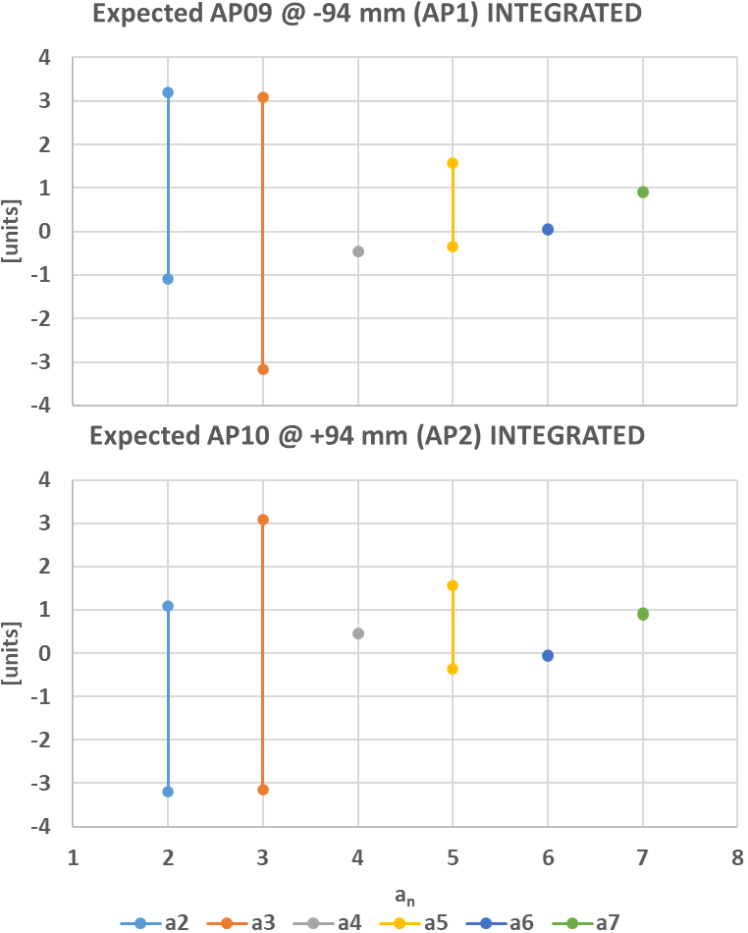
Expected Field Quality of MBRD5 @ Nominal Operation
 | INTEGRATED
 | AP09 @ -94 mm (AP1) |  |  | AP10 @ +94 mm (AP2)
 | SIMU | EXPE PROTO | EXPE SERIE | SIMU | EXPE PROTO | EXPE SERIE
b2 | -2.97 | -3.93 | -4.19 | 3.34 | 4.30 | 4.56
b3 | -10.65 | 4.85 | 3.31 | -16.49 | -0.99 | -2.54
b4 | -0.67 | -1.65 | 0.10 | 1.15 | 2.13 | 0.38
b5 | -2.63 | 2.13 | 2.84 | -2.08 | 2.69 | 3.40
b6 | -0.43 | -1.62 | 0.17 | 0.41 | 1.61 | -0.18
b7 | 2.13 | 1.88 | 1.76 | 2.00 | 1.74 | 1.62
b8 | 1.09 | 3.24 | 1.32 | -1.06 | -3.22 | -1.30
b9 | 1.28 | 0.63 | 0.64 | 1.34 | 0.68 | 0.70
b10 | 0.18 | -2.49 | -0.42 | -0.21 | 2.46 | 0.39
a2 | 0.90 | 3.20 | -1.09 | -0.89 | -3.20 | 1.09
a3 | 0.04 | 3.08 | -3.16 | 0.05 | 3.08 | -3.16
a4 | -0.34 | -0.45 | -0.46 | 0.34 | 0.45 | 0.46
a5 | -0.08 | 1.57 | -0.35 | -0.08 | 1.57 | -0.36
a6 | 0.10 | 0.05 | 0.07 | -0.10 | -0.05 | -0.07
a7 | -0.01 | 0.92 | 0.90 | -0.01 | 0.92 | 0.90
a8 | -0.02 | -1.20 | 0.17 | 0.02 | 1.20 | -0.17
a9 | 0.01 | 1.42 | -0.72 | 0.01 | 1.42 | -0.72
a10 | 0.01 | 0.83 | -0.06 | -0.01 | -0.83 | 0.06
$$∆_{1}={Meas}_{PROTO}^{@ I_{nom}}−{Simu}_{PROTO}^{@ I_{nom}}$$
$$∆_{2}={Meas}_{MBRD2}^{iron @ RT}−{Simu}_{MBRD2}^{iron @ RT}$$
$$EXPE PROTO={Simu}_{MBRD5}^{@ I_{nom}}+∆_{1}$$
$$EXPE SERIE={Simu}_{MBRD5}^{@ I_{nom}}+∆_{2}$$

Slide 51
MBRD6
  Shimming4
  CS view
  Shimming5
  BS03
  AS03
  AP12
  AP11
  AS12
  BS09
$$50.8 μm$$
$$76.2 μm$$
$$127 μm$$
51

Slide 52


Expected Field Quality of MBRD6 @ Nominal Operation
 | CENTER
 | AP12 @ -94 mm (AP1) |  |  | AP11 @ +94 mm (AP2)
 | SIMU | EXPE PROTO | EXPE SERIE | SIMU | EXPE PROTO | EXPE SERIE
b2 | 6.26 | 5.43 | 2.77 | -5.97 | -5.13 | -2.48
b3 | -16.61 | -1.24 | -1.15 | -21.27 | -5.91 | -5.81
b4 | -1.68 | -2.45 | -0.86 | 2.08 | 2.84 | 1.25
b5 | -0.78 | 3.90 | 4.65 | -0.30 | 4.37 | 5.13
b6 | -0.55 | -1.62 | 0.02 | 0.54 | 1.61 | -0.04
b7 | 2.36 | 2.32 | 2.13 | 2.25 | 2.21 | 2.02
b8 | 1.03 | 2.88 | 1.24 | -1.01 | -2.86 | -1.22
b9 | 1.60 | 1.16 | 1.24 | 1.65 | 1.20 | 1.29
b10 | 0.18 | -2.11 | -0.46 | -0.20 | 2.08 | 0.43
a2 | 8.75 | 12.22 | 7.19 | -0.31 | -3.79 | 1.25
a3 | 0.30 | 2.93 | -2.32 | 0.12 | 2.75 | -2.49
a4 | 2.14 | 2.30 | 1.59 | -0.04 | -0.20 | 0.51
a5 | 0.18 | 1.85 | -0.14 | 0.01 | 1.69 | -0.30
a6 | 0.33 | 0.41 | 0.33 | 0.00 | -0.08 | -0.01
a7 | 0.05 | 1.00 | 0.91 | 0.00 | 0.95 | 0.86
a8 | 0.05 | -1.46 | 0.25 | 0.00 | 1.50 | -0.20
a9 | 0.03 | 1.60 | -0.59 | 0.00 | 1.57 | -0.62
a10 | -0.02 | 2.76 | -0.15 | 0.00 | -2.78 | 0.13
$$∆_{1}={Meas}_{PROTO}^{@ I_{nom}}−{Simu}_{PROTO}^{@ I_{nom}}$$
$$∆_{2}={Meas}_{MBRD2}^{iron @ RT}−{Simu}_{MBRD2}^{iron @ RT}$$
$$EXPE PROTO={Simu}_{MBRD6}^{@ I_{nom}}+∆_{1}$$
$$EXPE SERIE={Simu}_{MBRD6}^{@ I_{nom}}+∆_{2}$$

Slide 53
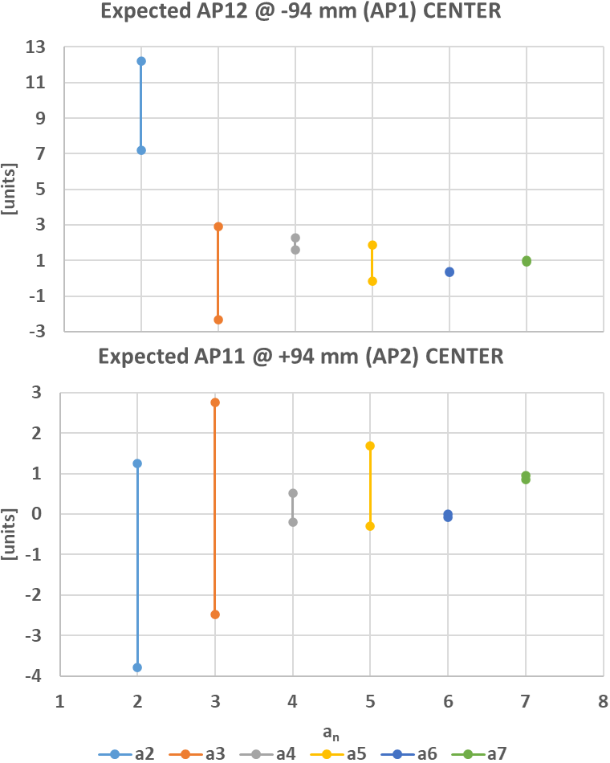
Expected Field Quality of MBRD6 @ Nominal Operation
 | CENTER
 | AP12 @ -94 mm (AP1) |  |  | AP11 @ +94 mm (AP2)
 | SIMU | EXPE PROTO | EXPE SERIE | SIMU | EXPE PROTO | EXPE SERIE
b2 | 6.26 | 5.43 | 2.77 | -5.97 | -5.13 | -2.48
b3 | -16.61 | -1.24 | -1.15 | -21.27 | -5.91 | -5.81
b4 | -1.68 | -2.45 | -0.86 | 2.08 | 2.84 | 1.25
b5 | -0.78 | 3.90 | 4.65 | -0.30 | 4.37 | 5.13
b6 | -0.55 | -1.62 | 0.02 | 0.54 | 1.61 | -0.04
b7 | 2.36 | 2.32 | 2.13 | 2.25 | 2.21 | 2.02
b8 | 1.03 | 2.88 | 1.24 | -1.01 | -2.86 | -1.22
b9 | 1.60 | 1.16 | 1.24 | 1.65 | 1.20 | 1.29
b10 | 0.18 | -2.11 | -0.46 | -0.20 | 2.08 | 0.43
a2 | 8.75 | 12.22 | 7.19 | -0.31 | -3.79 | 1.25
a3 | 0.30 | 2.93 | -2.32 | 0.12 | 2.75 | -2.49
a4 | 2.14 | 2.30 | 1.59 | -0.04 | -0.20 | 0.51
a5 | 0.18 | 1.85 | -0.14 | 0.01 | 1.69 | -0.30
a6 | 0.33 | 0.41 | 0.33 | 0.00 | -0.08 | -0.01
a7 | 0.05 | 1.00 | 0.91 | 0.00 | 0.95 | 0.86
a8 | 0.05 | -1.46 | 0.25 | 0.00 | 1.50 | -0.20
a9 | 0.03 | 1.60 | -0.59 | 0.00 | 1.57 | -0.62
a10 | -0.02 | 2.76 | -0.15 | 0.00 | -2.78 | 0.13
$$∆_{1}={Meas}_{PROTO}^{@ I_{nom}}−{Simu}_{PROTO}^{@ I_{nom}}$$
$$∆_{2}={Meas}_{MBRD2}^{iron @ RT}−{Simu}_{MBRD2}^{iron @ RT}$$
$$EXPE PROTO={Simu}_{MBRD6}^{@ I_{nom}}+∆_{1}$$
$$EXPE SERIE={Simu}_{MBRD6}^{@ I_{nom}}+∆_{2}$$

Slide 54
Expected Field Quality of MBRD6 @ Nominal Operation
 | INTEGRATED
 | AP12 @ -94 mm (AP1) |  |  | AP11 @ +94 mm (AP2)
 | SIMU | EXPE PROTO | EXPE SERIE | SIMU | EXPE PROTO | EXPE SERIE
b2 | -2.80 | -3.76 | -4.02 | 3.10 | 4.05 | 4.32
b3 | -16.30 | -0.81 | -2.35 | -20.94 | -5.45 | -6.99
b4 | -1.07 | -2.05 | -0.30 | 1.46 | 2.44 | 0.69
b5 | -2.06 | 2.70 | 3.41 | -1.60 | 3.16 | 3.87
b6 | -0.41 | -1.61 | 0.19 | 0.40 | 1.59 | -0.20
b7 | 2.00 | 1.74 | 1.62 | 1.89 | 1.63 | 1.51
b8 | 1.06 | 3.22 | 1.30 | -1.04 | -3.20 | -1.28
b9 | 1.34 | 0.68 | 0.69 | 1.38 | 0.73 | 0.74
b10 | 0.21 | -2.46 | -0.39 | -0.23 | 2.44 | 0.37
a2 | 9.66 | 11.97 | 7.68 | -1.20 | -3.51 | 0.79
a3 | 0.34 | 3.38 | -2.86 | 0.17 | 3.21 | -3.03
a4 | 1.82 | 1.70 | 1.69 | 0.29 | 0.40 | 0.42
a5 | 0.10 | 1.75 | -0.17 | -0.07 | 1.58 | -0.34
a6 | 0.43 | 0.38 | 0.40 | -0.10 | -0.05 | -0.07
a7 | 0.05 | 0.98 | 0.95 | 0.00 | 0.93 | 0.90
a8 | 0.03 | -1.15 | 0.22 | 0.02 | 1.20 | -0.17
a9 | 0.04 | 1.45 | -0.69 | 0.01 | 1.42 | -0.72
a10 | -0.01 | 0.81 | -0.08 | -0.01 | -0.83 | 0.06
$$∆_{1}={Meas}_{PROTO}^{@ I_{nom}}−{Simu}_{PROTO}^{@ I_{nom}}$$
$$∆_{2}={Meas}_{MBRD2}^{iron @ RT}−{Simu}_{MBRD2}^{iron @ RT}$$
$$EXPE PROTO={Simu}_{MBRD6}^{@ I_{nom}}+∆_{1}$$
$$EXPE SERIE={Simu}_{MBRD6}^{@ I_{nom}}+∆_{2}$$

Slide 55
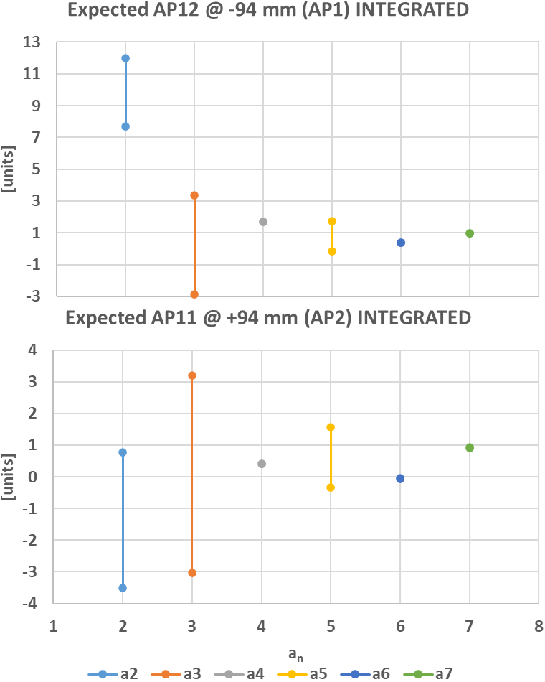
Expected Field Quality of MBRD6 @ Nominal Operation
 | INTEGRATED
 | AP12 @ -94 mm (AP1) |  |  | AP11 @ +94 mm (AP2)
 | SIMU | EXPE PROTO | EXPE SERIE | SIMU | EXPE PROTO | EXPE SERIE
b2 | -2.80 | -3.76 | -4.02 | 3.10 | 4.05 | 4.32
b3 | -16.30 | -0.81 | -2.35 | -20.94 | -5.45 | -6.99
b4 | -1.07 | -2.05 | -0.30 | 1.46 | 2.44 | 0.69
b5 | -2.06 | 2.70 | 3.41 | -1.60 | 3.16 | 3.87
b6 | -0.41 | -1.61 | 0.19 | 0.40 | 1.59 | -0.20
b7 | 2.00 | 1.74 | 1.62 | 1.89 | 1.63 | 1.51
b8 | 1.06 | 3.22 | 1.30 | -1.04 | -3.20 | -1.28
b9 | 1.34 | 0.68 | 0.69 | 1.38 | 0.73 | 0.74
b10 | 0.21 | -2.46 | -0.39 | -0.23 | 2.44 | 0.37
a2 | 9.66 | 11.97 | 7.68 | -1.20 | -3.51 | 0.79
a3 | 0.34 | 3.38 | -2.86 | 0.17 | 3.21 | -3.03
a4 | 1.82 | 1.70 | 1.69 | 0.29 | 0.40 | 0.42
a5 | 0.10 | 1.75 | -0.17 | -0.07 | 1.58 | -0.34
a6 | 0.43 | 0.38 | 0.40 | -0.10 | -0.05 | -0.07
a7 | 0.05 | 0.98 | 0.95 | 0.00 | 0.93 | 0.90
a8 | 0.03 | -1.15 | 0.22 | 0.02 | 1.20 | -0.17
a9 | 0.04 | 1.45 | -0.69 | 0.01 | 1.42 | -0.72
a10 | -0.01 | 0.81 | -0.08 | -0.01 | -0.83 | 0.06
$$∆_{1}={Meas}_{PROTO}^{@ I_{nom}}−{Simu}_{PROTO}^{@ I_{nom}}$$
$$∆_{2}={Meas}_{MBRD2}^{iron @ RT}−{Simu}_{MBRD2}^{iron @ RT}$$
$$EXPE PROTO={Simu}_{MBRD6}^{@ I_{nom}}+∆_{1}$$
$$EXPE SERIE={Simu}_{MBRD6}^{@ I_{nom}}+∆_{2}$$

