Slide 1
New FTA & FTN BPMs Integration
PS Complex Integration Pre-Study
D. del Álamo – EN-ACE-INT
ICL 26-03-2025
EDMS# 3262804/3262807

Slide 2

Track-it Data
Tracks for the Integration Studies:
Integration for new BPMs for FTA – 123870
Integration for new BPMs for FTN – 123869
# 3262804/3262807

Slide 3
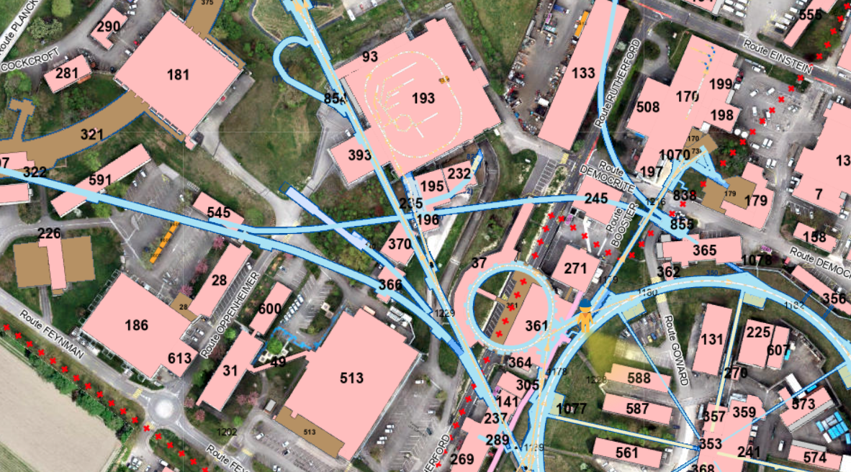
TT2 Gallery – FTA
FTA
# 3262804/3262807

Slide 4
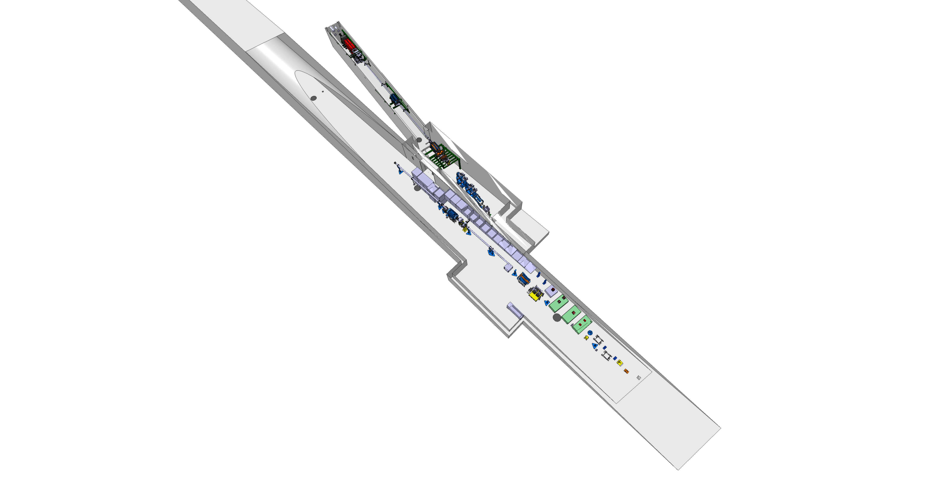
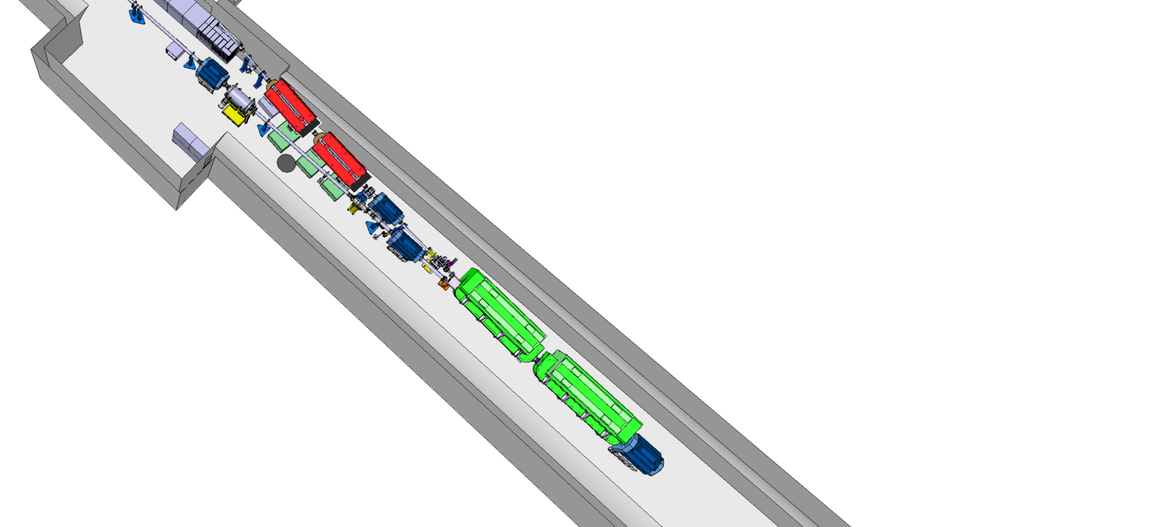
FTA Line
Position 3
Position 4
Position 2
FTA
Position 1
ST0666635_07
# 3262804/3262807

Slide 5
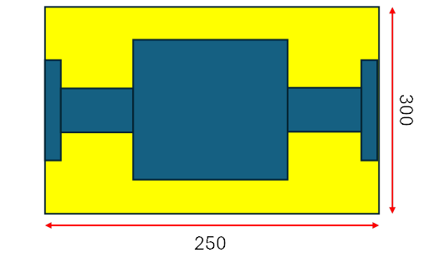
FTA New BPM Envelope
D 300mm
250mm
# 3262804/3262807

Slide 6
FTA Position 1 – Upstream QDN9010
FTA
Position 1
# 3262804/3262807

Slide 7
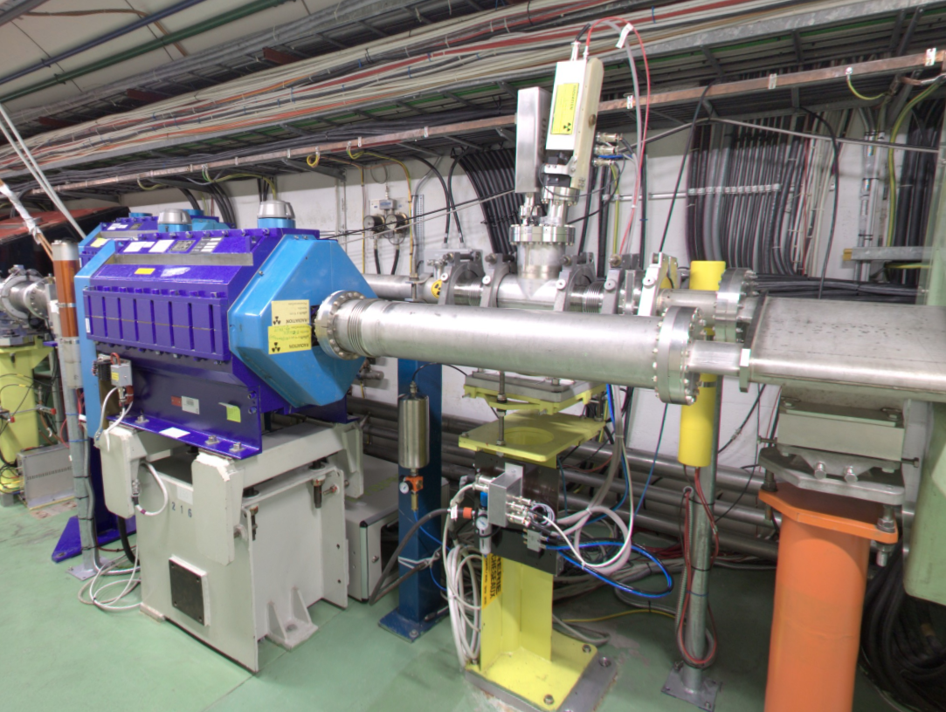
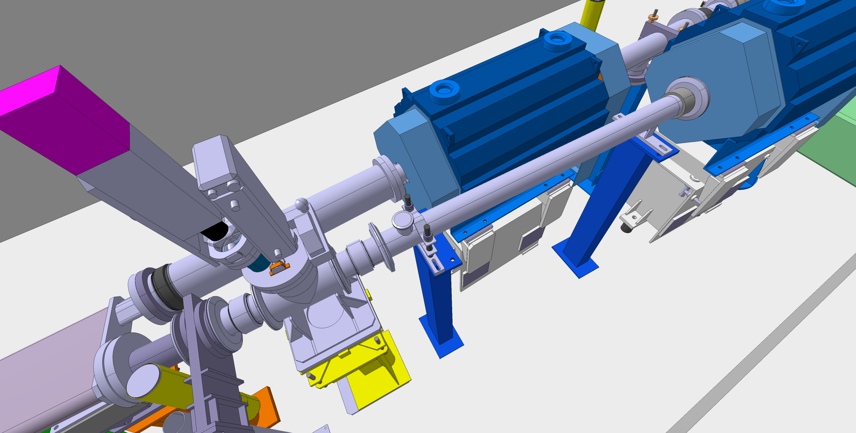
FTA Position 1 – Upstream QDN9010
FTA
Existing box
# 3262804/3262807

Slide 8
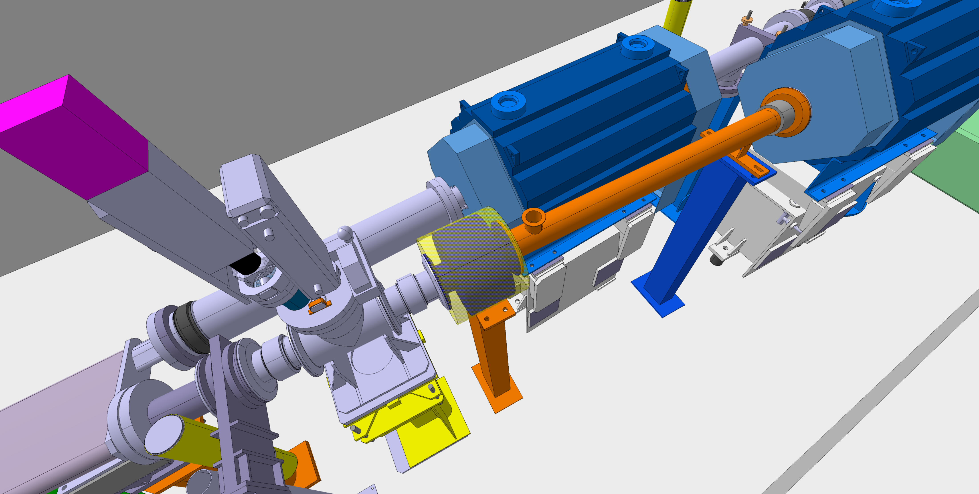
FTA Position 1 – Proposal A
FTA
Existing box
Shorten the existing vacuum chamber
New support for the new BPM
# 3262804/3262807

Slide 9
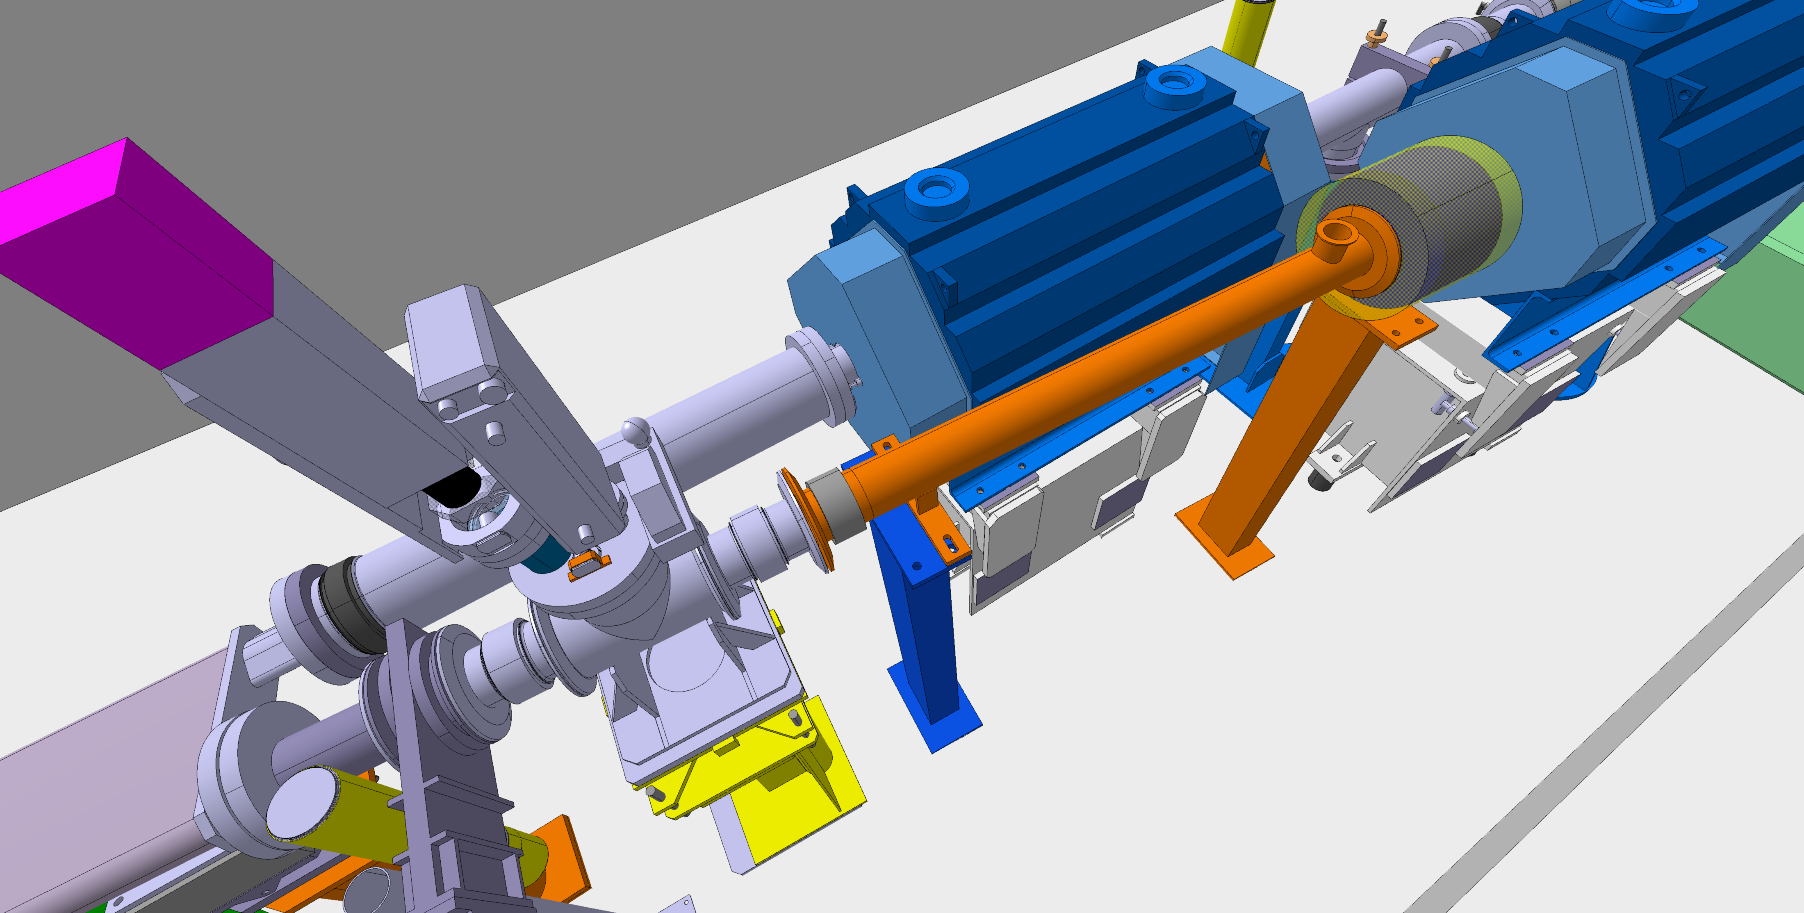
FTA Position 1 – Proposal B
FTA
Existing box
Shorten the existing vacuum chamber
Turn the vacuum chamber 180 degrees
New support for the new BPM
# 3262804/3262807

Slide 10
FTA Position 2 – Upstream QFN9020
Position 2
FTA
# 3262804/3262807

Slide 11
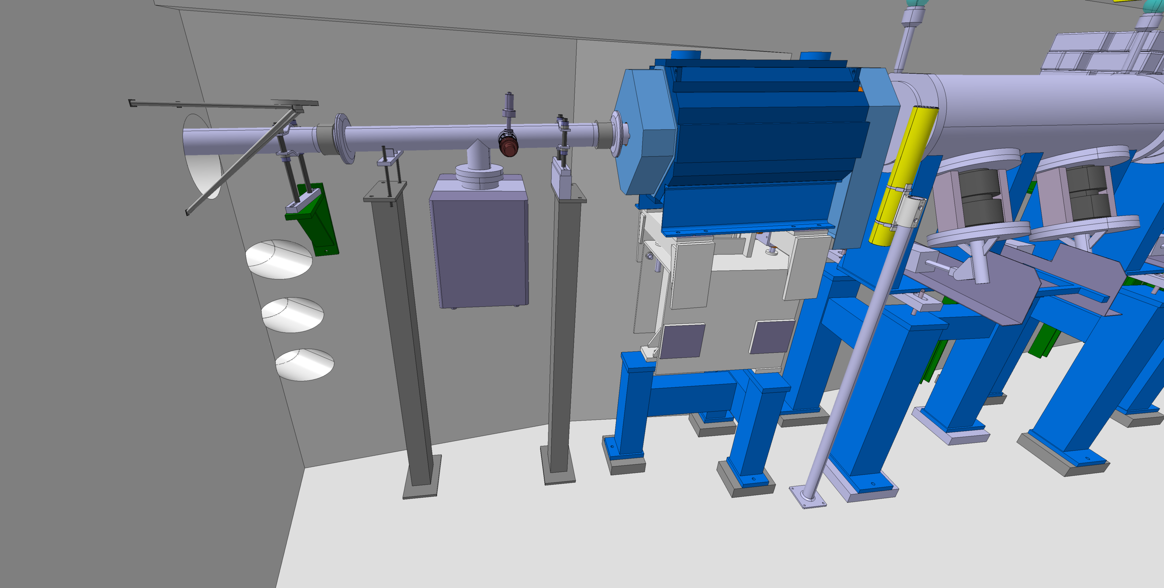
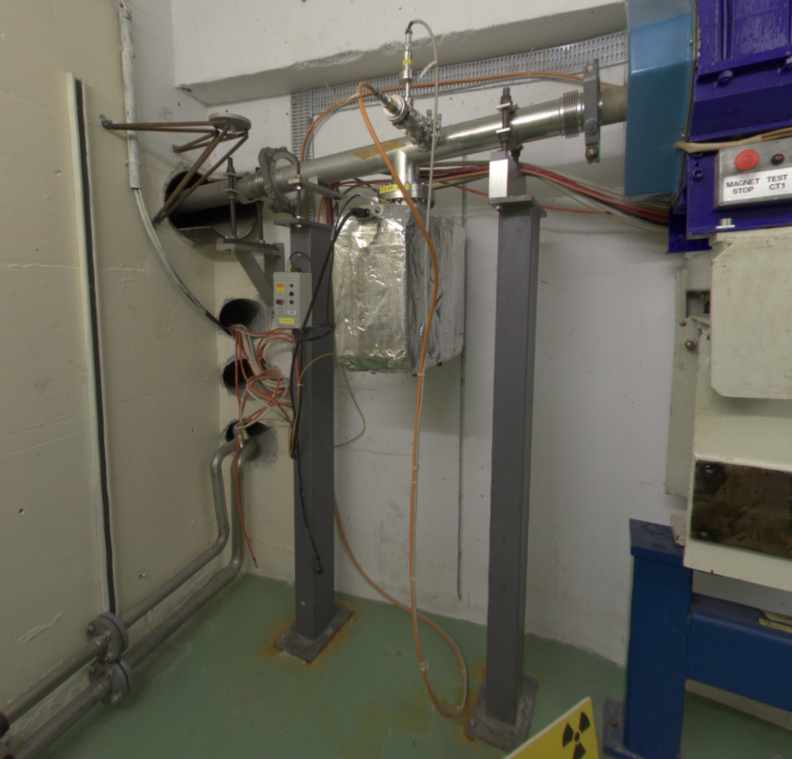
FTA Position 2 – Upstream QFN9020
Not up to date
FTA
# 3262804/3262807

Slide 12
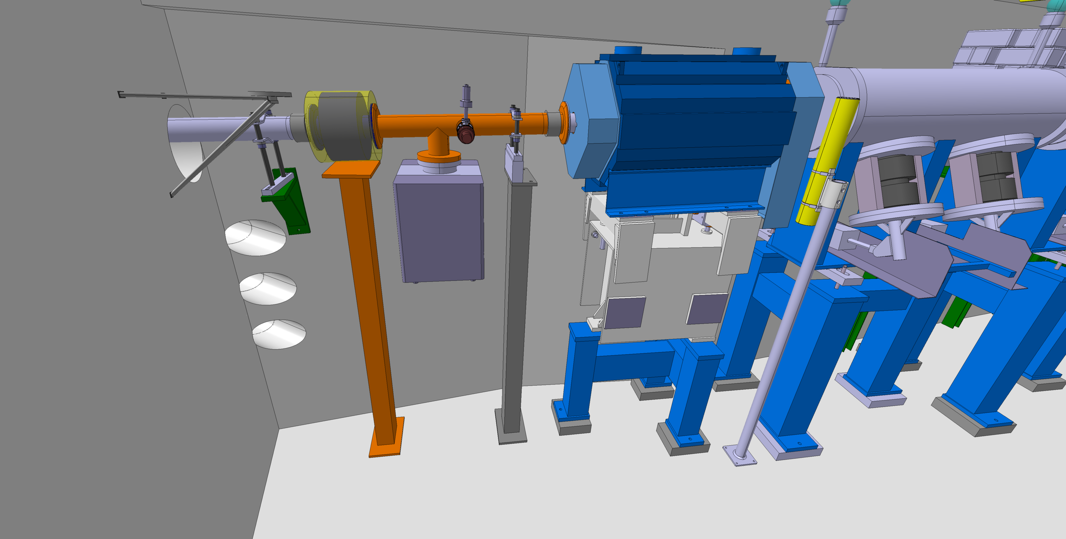
FTA Position 2 – Upstream QFN9020
FTA
Shorten the existing vacuum chamber
New support for the new BPM
Is it enough support for the pump?
# 3262804/3262807

Slide 13
FTA Position 3 – Upstream QFN9040
Position 3
FTA
# 3262804/3262807

Slide 14
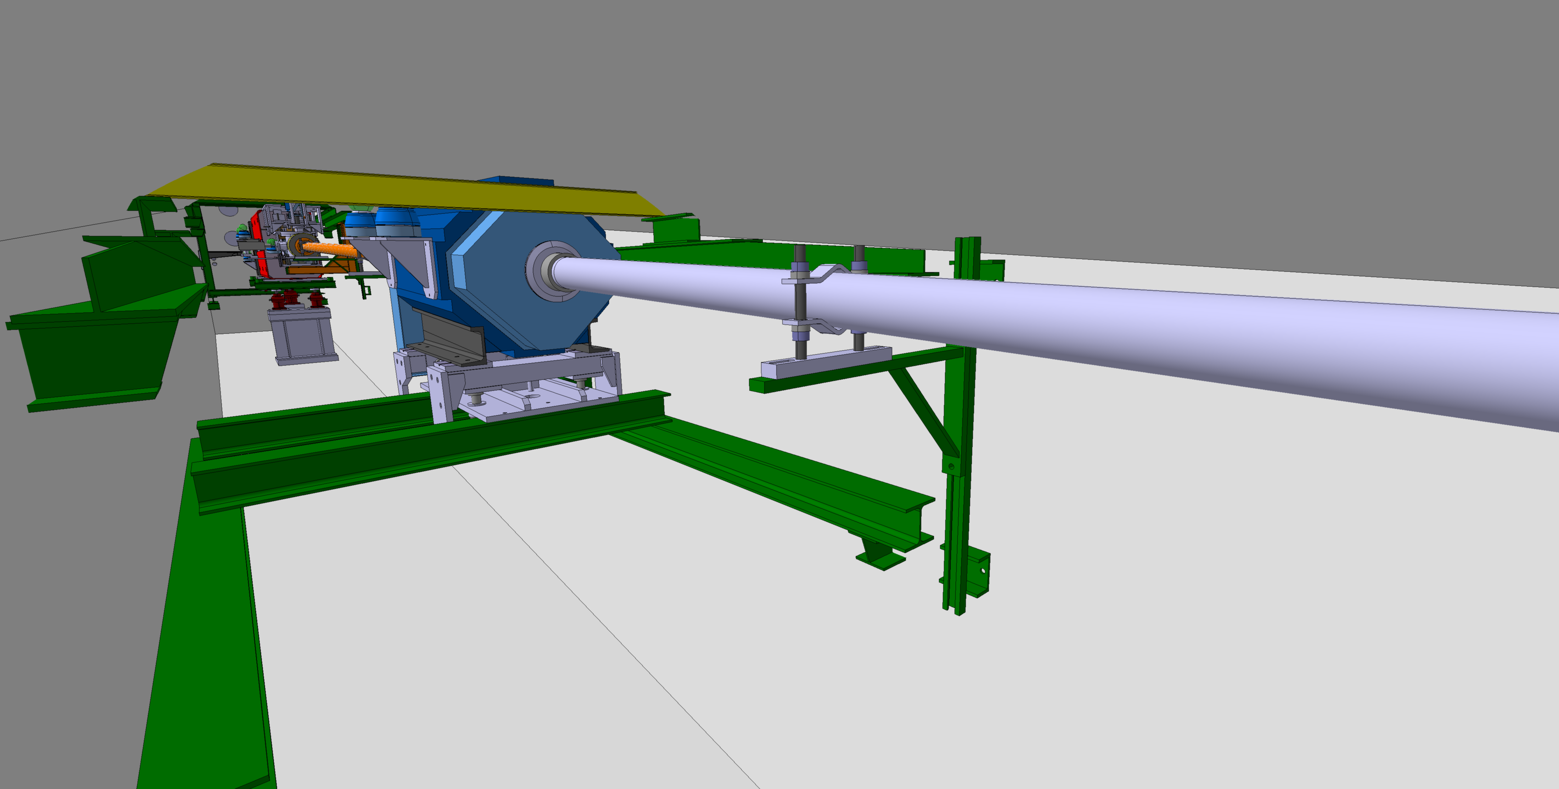
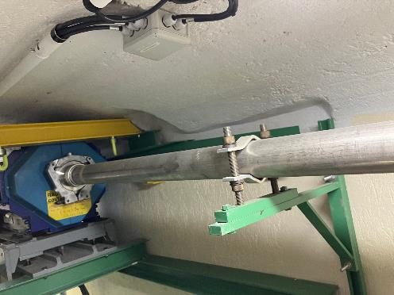
FTA Position 3 – Upstream QFN9040
FTA
# 3262804/3262807

Slide 15
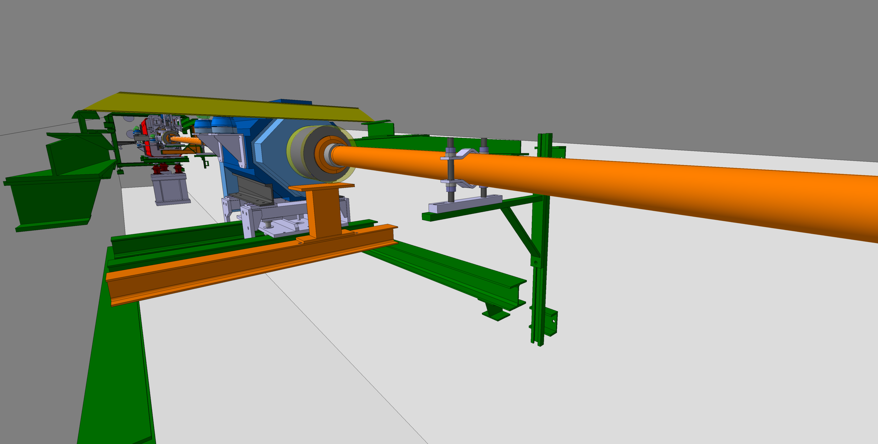
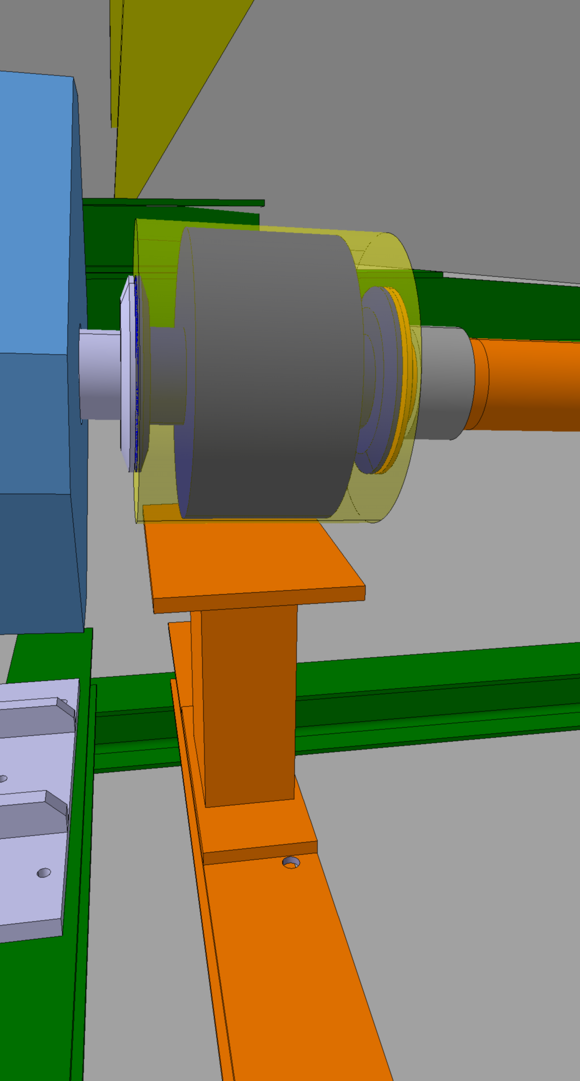
FTA Position 3 – Upstream QFN9040
FTA
Shorten the existing vacuum chamber
New support for the new BPM
# 3262804/3262807

Slide 16
FTA Position 4 – Downstream DHZ9047
Position 4
FTA
# 3262804/3262807

Slide 17
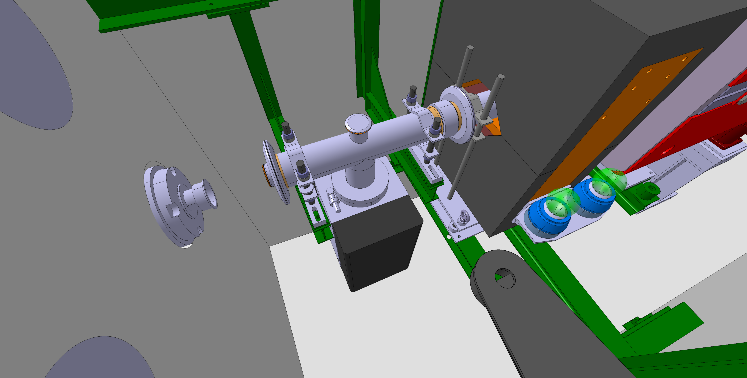
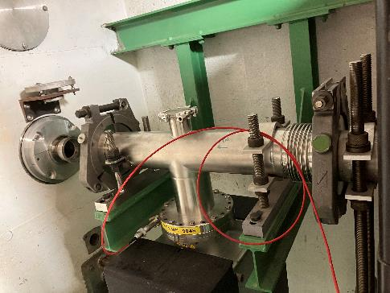
FTA Position 4 – Downstream DHZ9047
FTA
From the Integration point of view, the installation of the BPM on this location is not feasible if the vacuum components are not removed
# 3262804/3262807

Slide 18
FTA Position 4 – Upstream BTV9043
Position 4
FTA
# 3262804/3262807

Slide 19
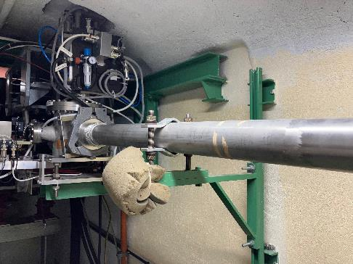
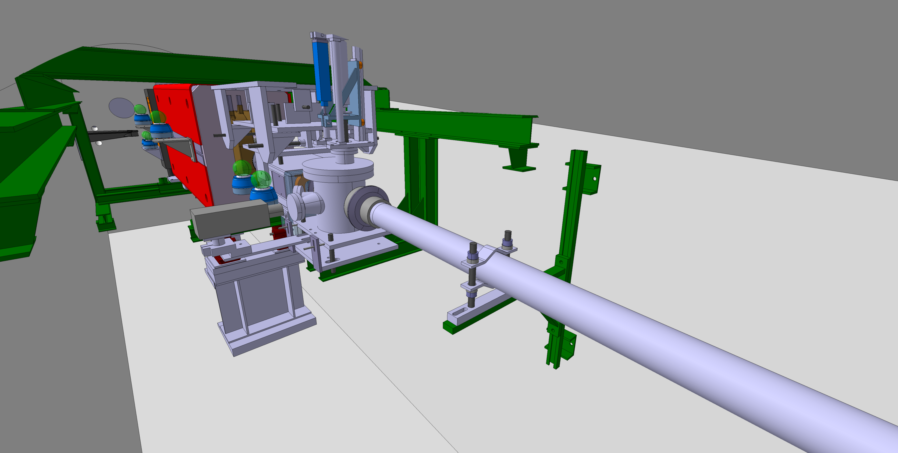
FTA Position 4 – Upstream BTV9043
FTA
# 3262804/3262807

Slide 20
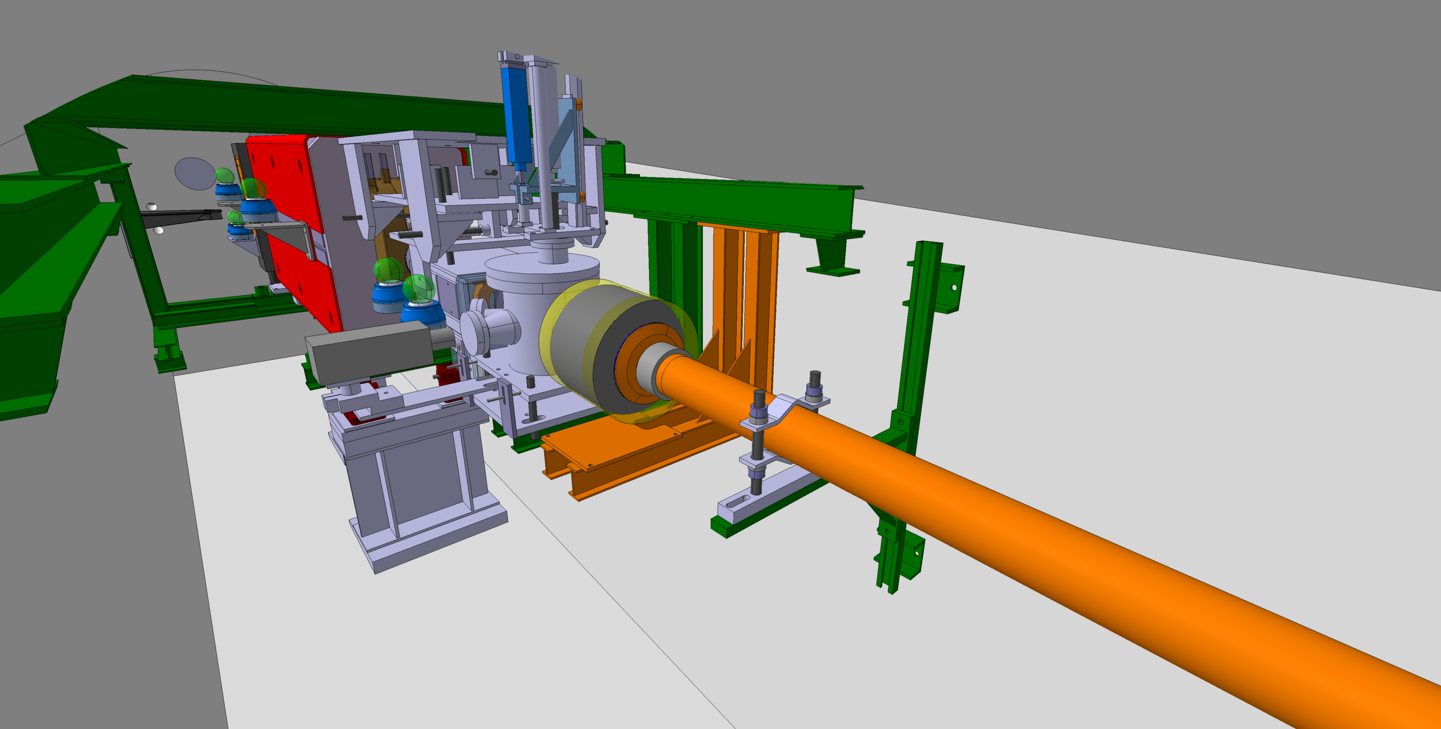
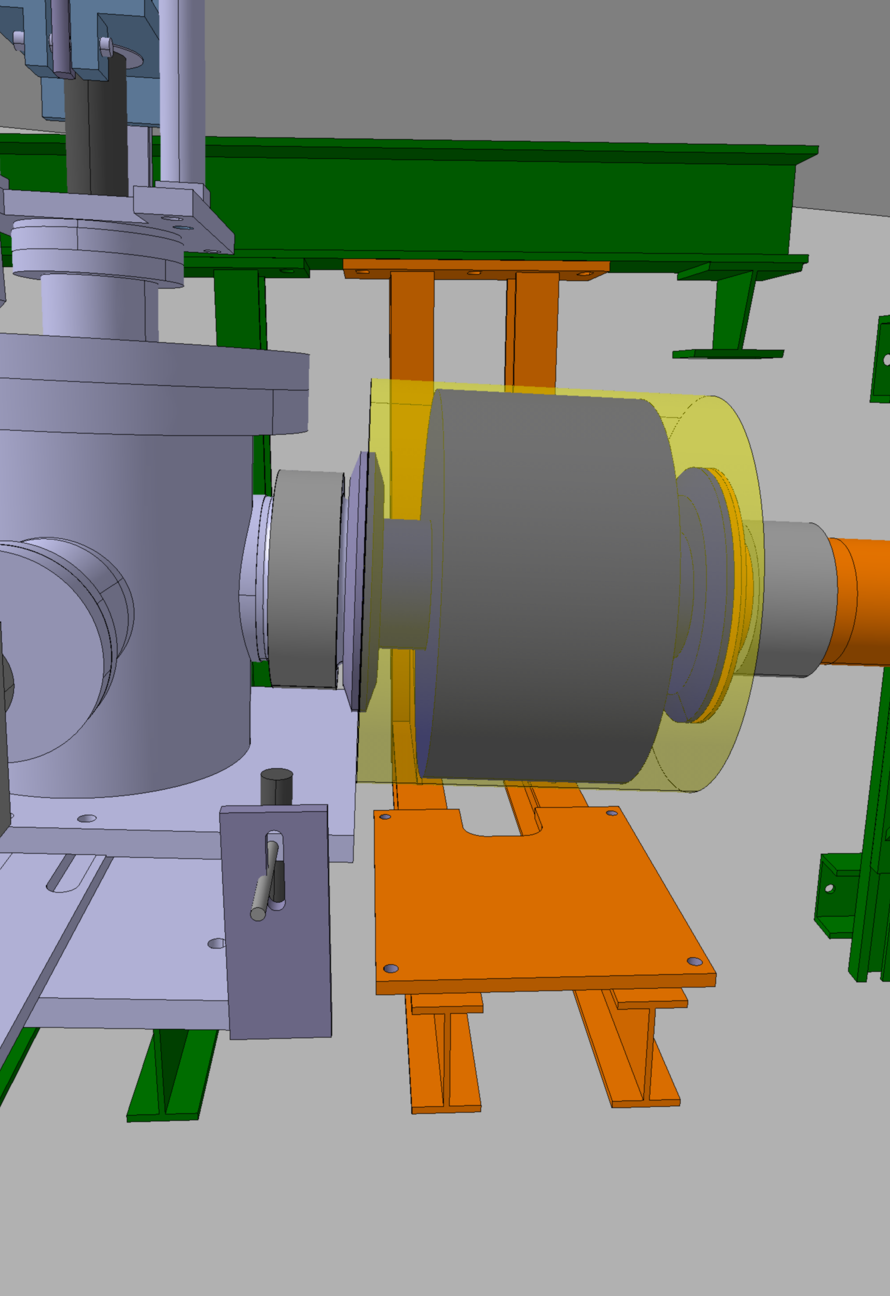
FTA Position 4 – Upstream BTV9043
FTA
Shorten the existing vacuum chamber
New support for the new BPM
# 3262804/3262807

Slide 21
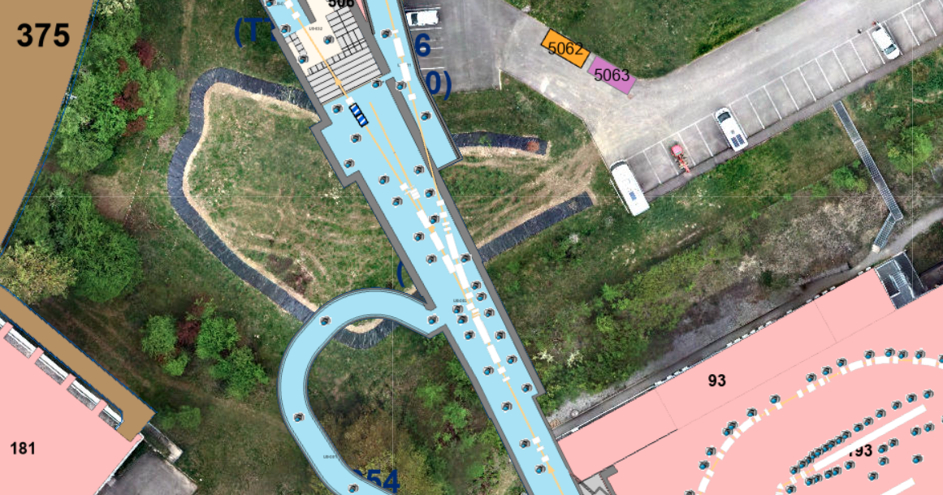
TT2 Gallery – FTN
FTN
EN-ACE-INT
# 3262804/3262807

Slide 22
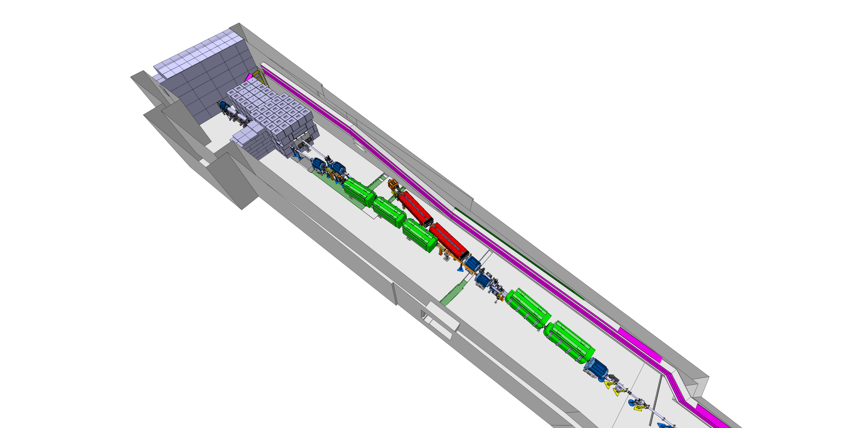
FTN Line
FTA
Position 2
Position 1
ST1554859_02
# 3262804/3262807

Slide 23
FTN New BPM Envelope
D 350mm
720mm
# 3262804/3262807

Slide 24
FTN Position 1 – Upstream BHZ403
FTA
Position 1
# 3262804/3262807

Slide 25
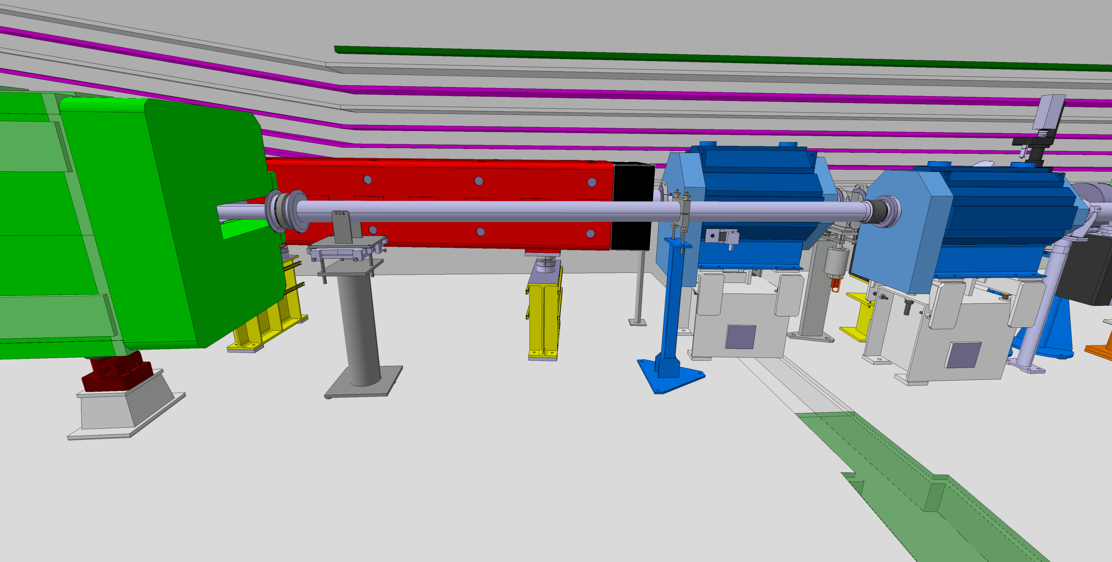
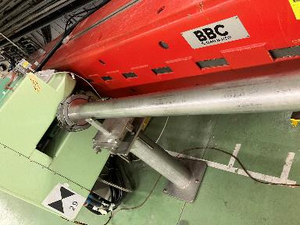
FTN Position 1 – Upstream BHZ403
FTA
# 3262804/3262807

Slide 26
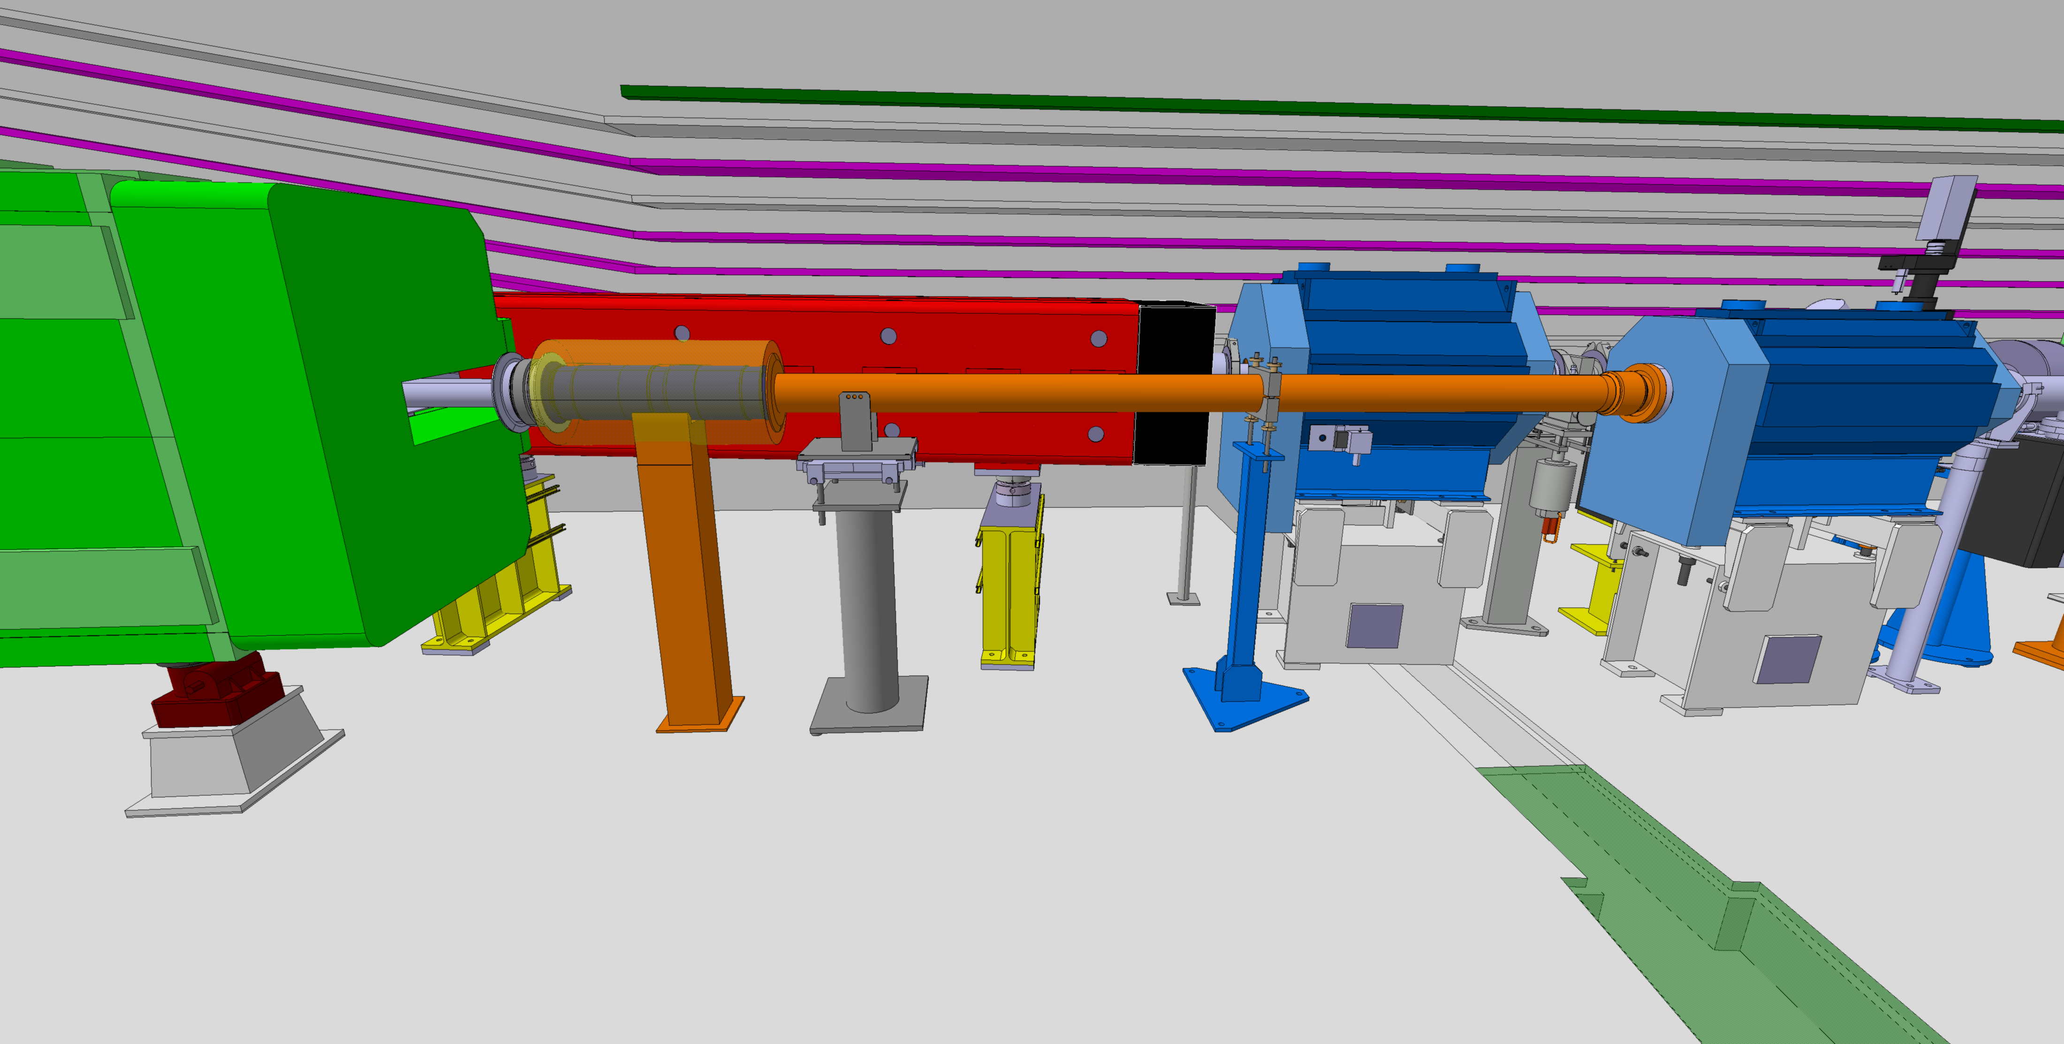
FTN Position 1 – Proposal A
FTA
Keep the transition vacuum chamber
Shorten the existing vacuum chamber
Move the existing supports
New support for the new BPM
# 3262804/3262807

Slide 27
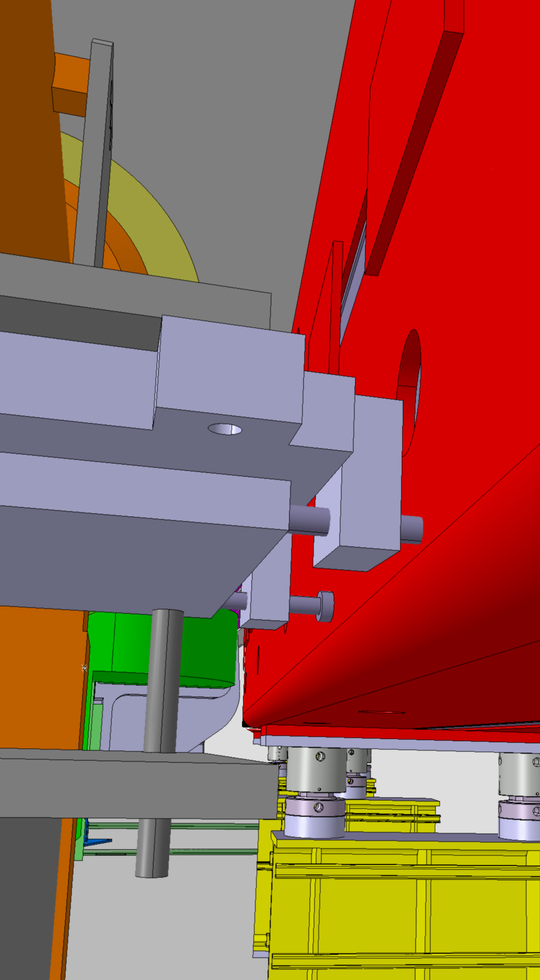
FTN Position 1 – Proposal A
FTA
Clash between the support and the magnet
# 3262804/3262807

Slide 28
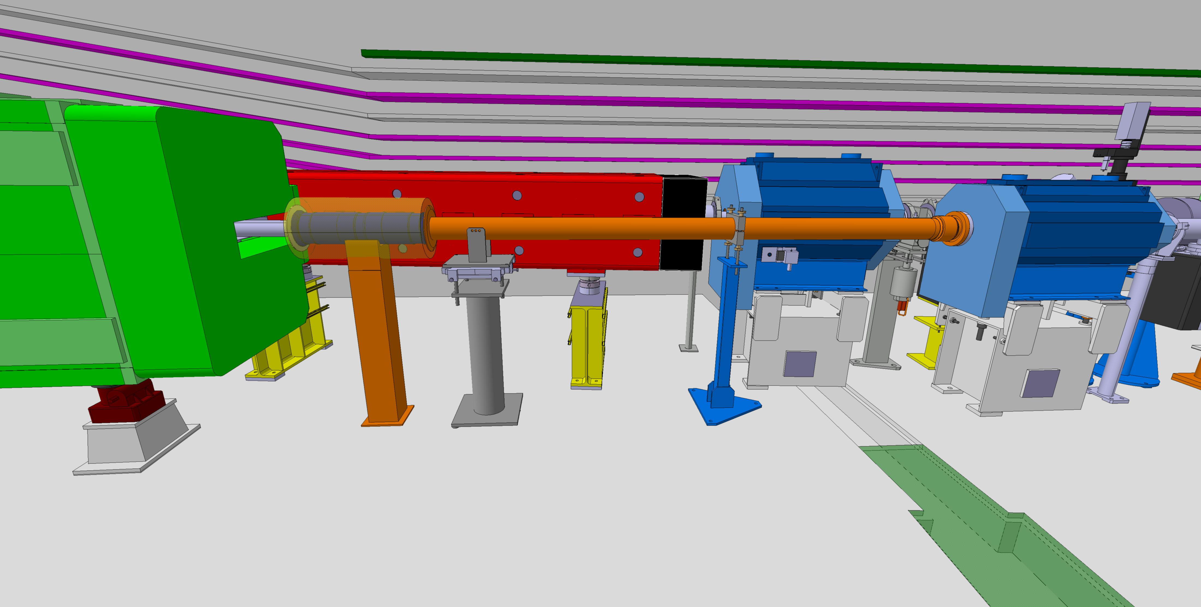
FTN Position 1 – Proposal B
FTA
Remove the transition vacuum chamber
Shorten the existing vacuum chamber
Move the existing supports
New support for the new BPM
# 3262804/3262807

Slide 29
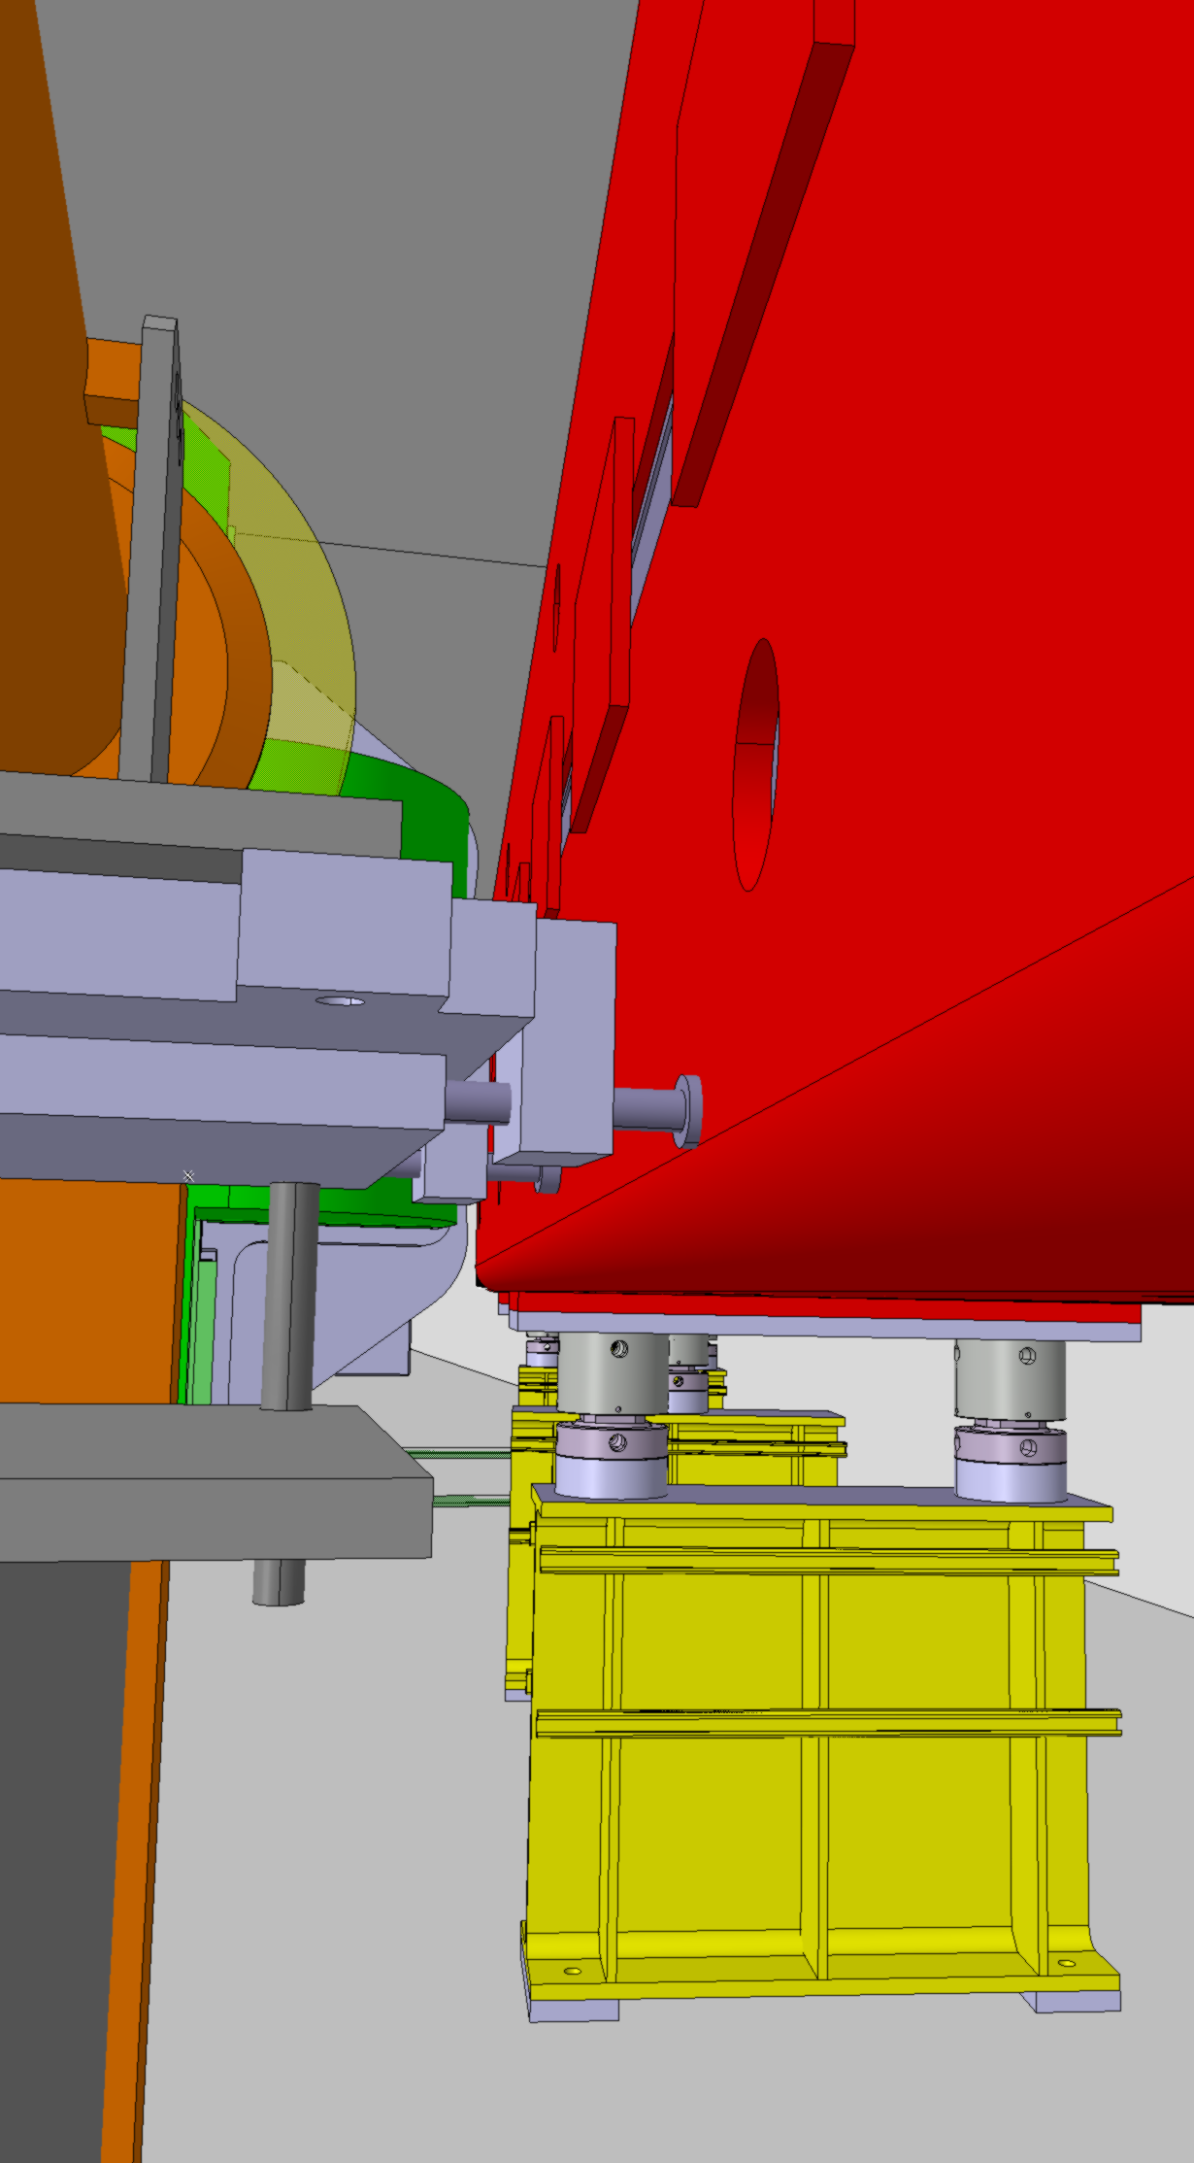
FTN Position 1 – Proposal B
FTA
Clash between the support and the magnet
# 3262804/3262807

Slide 30
FTN Position 2 – Upstream QFN415
FTA
Position 2
# 3262804/3262807

Slide 31
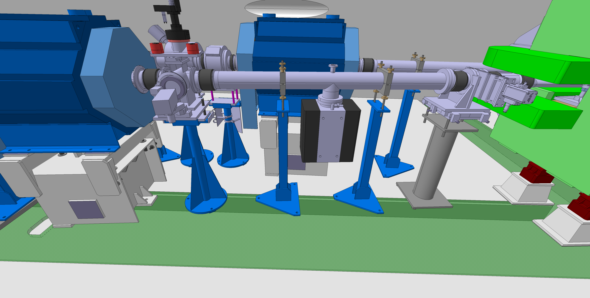
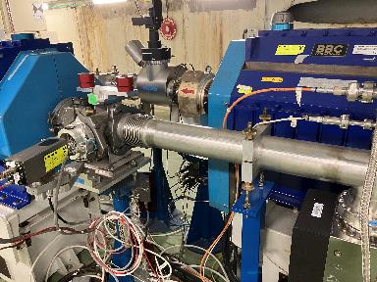
FTN Position 2 – Upstream QFN415
FTA
# 3262804/3262807

Slide 32
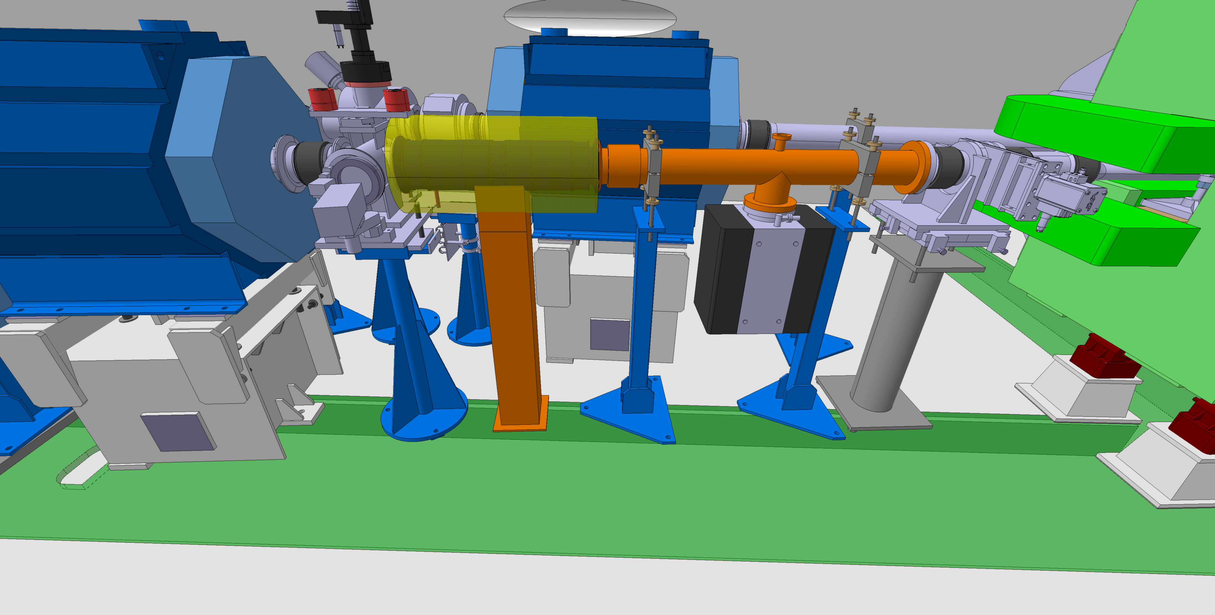
FTN Position 1 – Proposal B
FTA
Modification of the existing vacuum chamber
Move the existing supports
New support for the new BPM
# 3262804/3262807

Slide 33
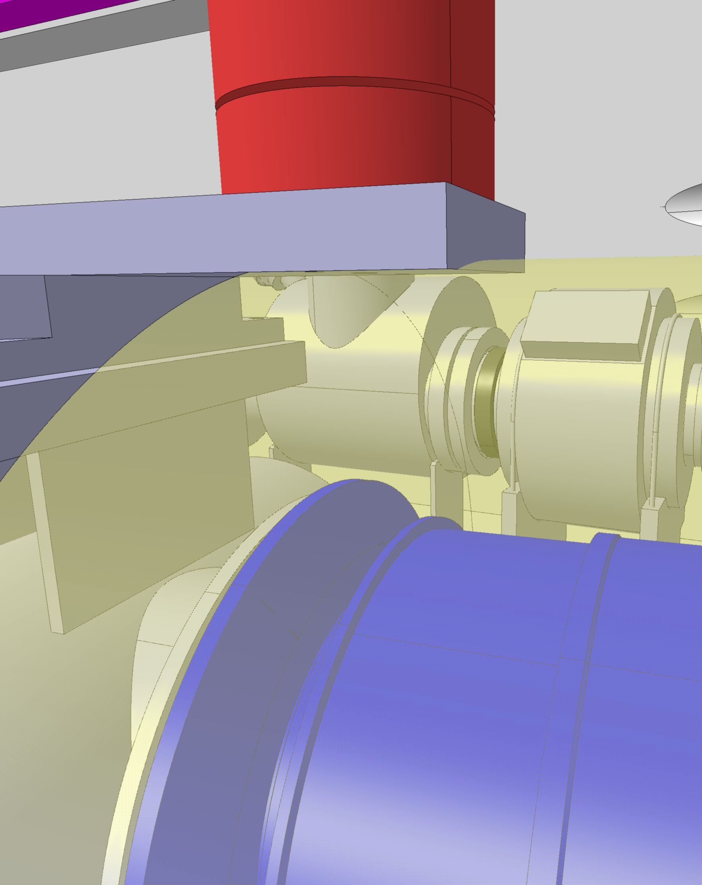
FTN Position 1 – Proposal B
FTA
Small interference with the envelope
# 3262804/3262807

