Slide 1
Integration of the octant 2 ovoid Fire Door
PS Complex Integration Study
D. del Álamo – EN-ACE-INT
ICL 26-03-2025
EDMS# 3283324

Slide 2

Track-it Data
Tracks for the Integration Studies:
Integration of the octant 2 ovoid Fire Door– 121202
# 3283324

Slide 3
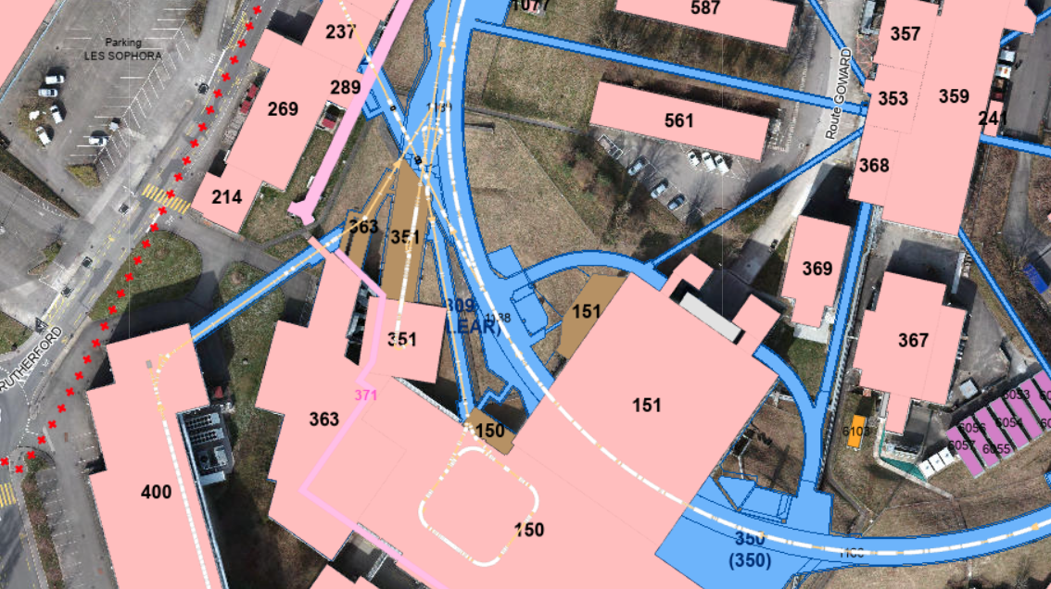
PS Ovoid 2
# 3283324

Slide 4
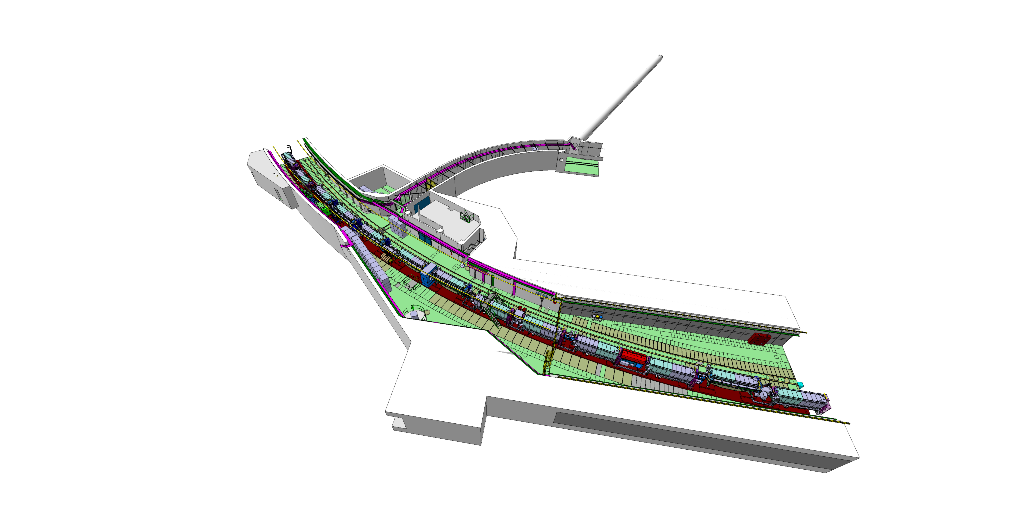
PS Octant 2
FTA
ST0710381_04
# 3283324

Slide 5
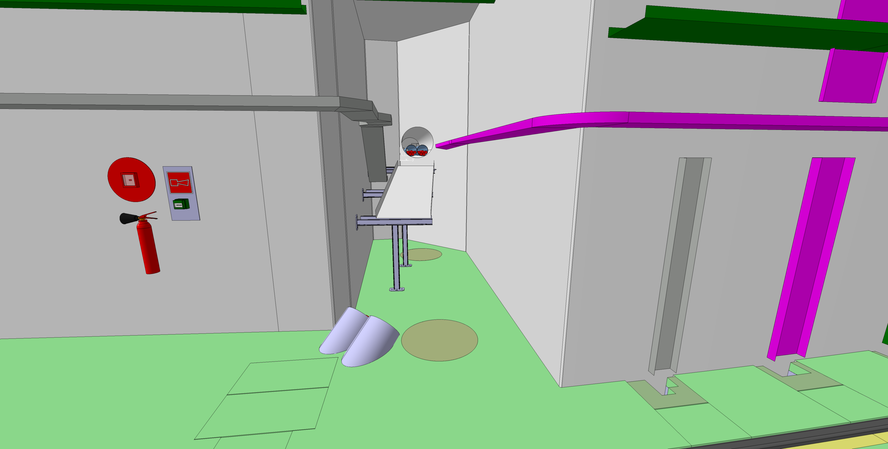
PS Octant 2
FTA
The 3D model must be updated to the existing situation.
# 3283324

Slide 6
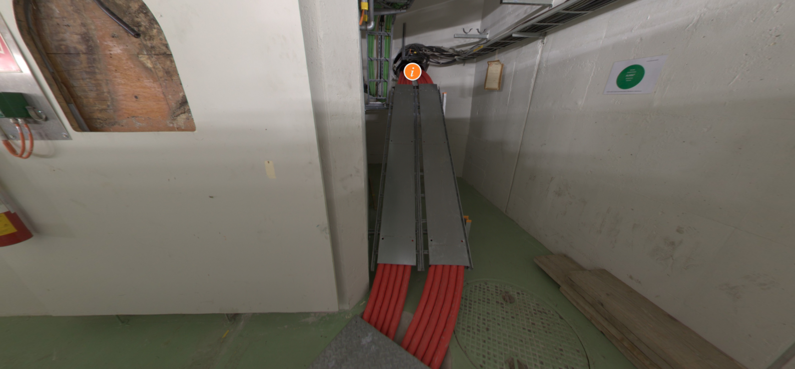
PS Octant 2
Available space for the installation of the fire door.
# 3283324

Slide 7
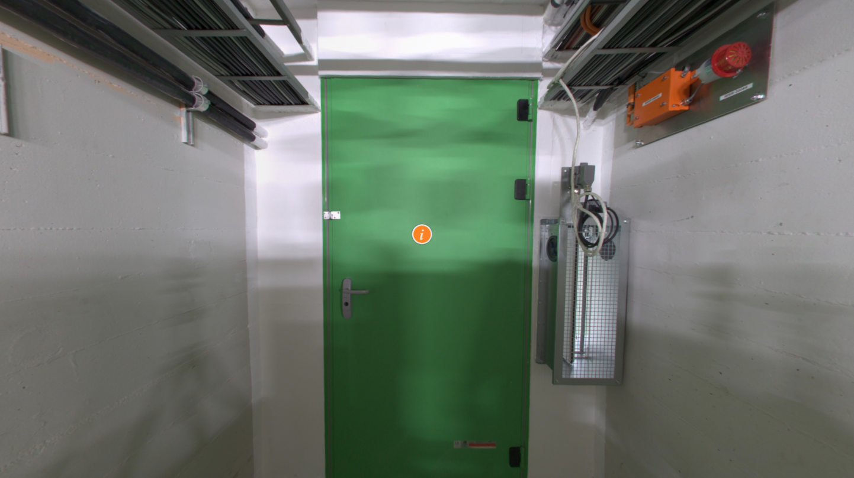
PS Octant 2
Existing fire door in octant 4.
# 3283324

Slide 8
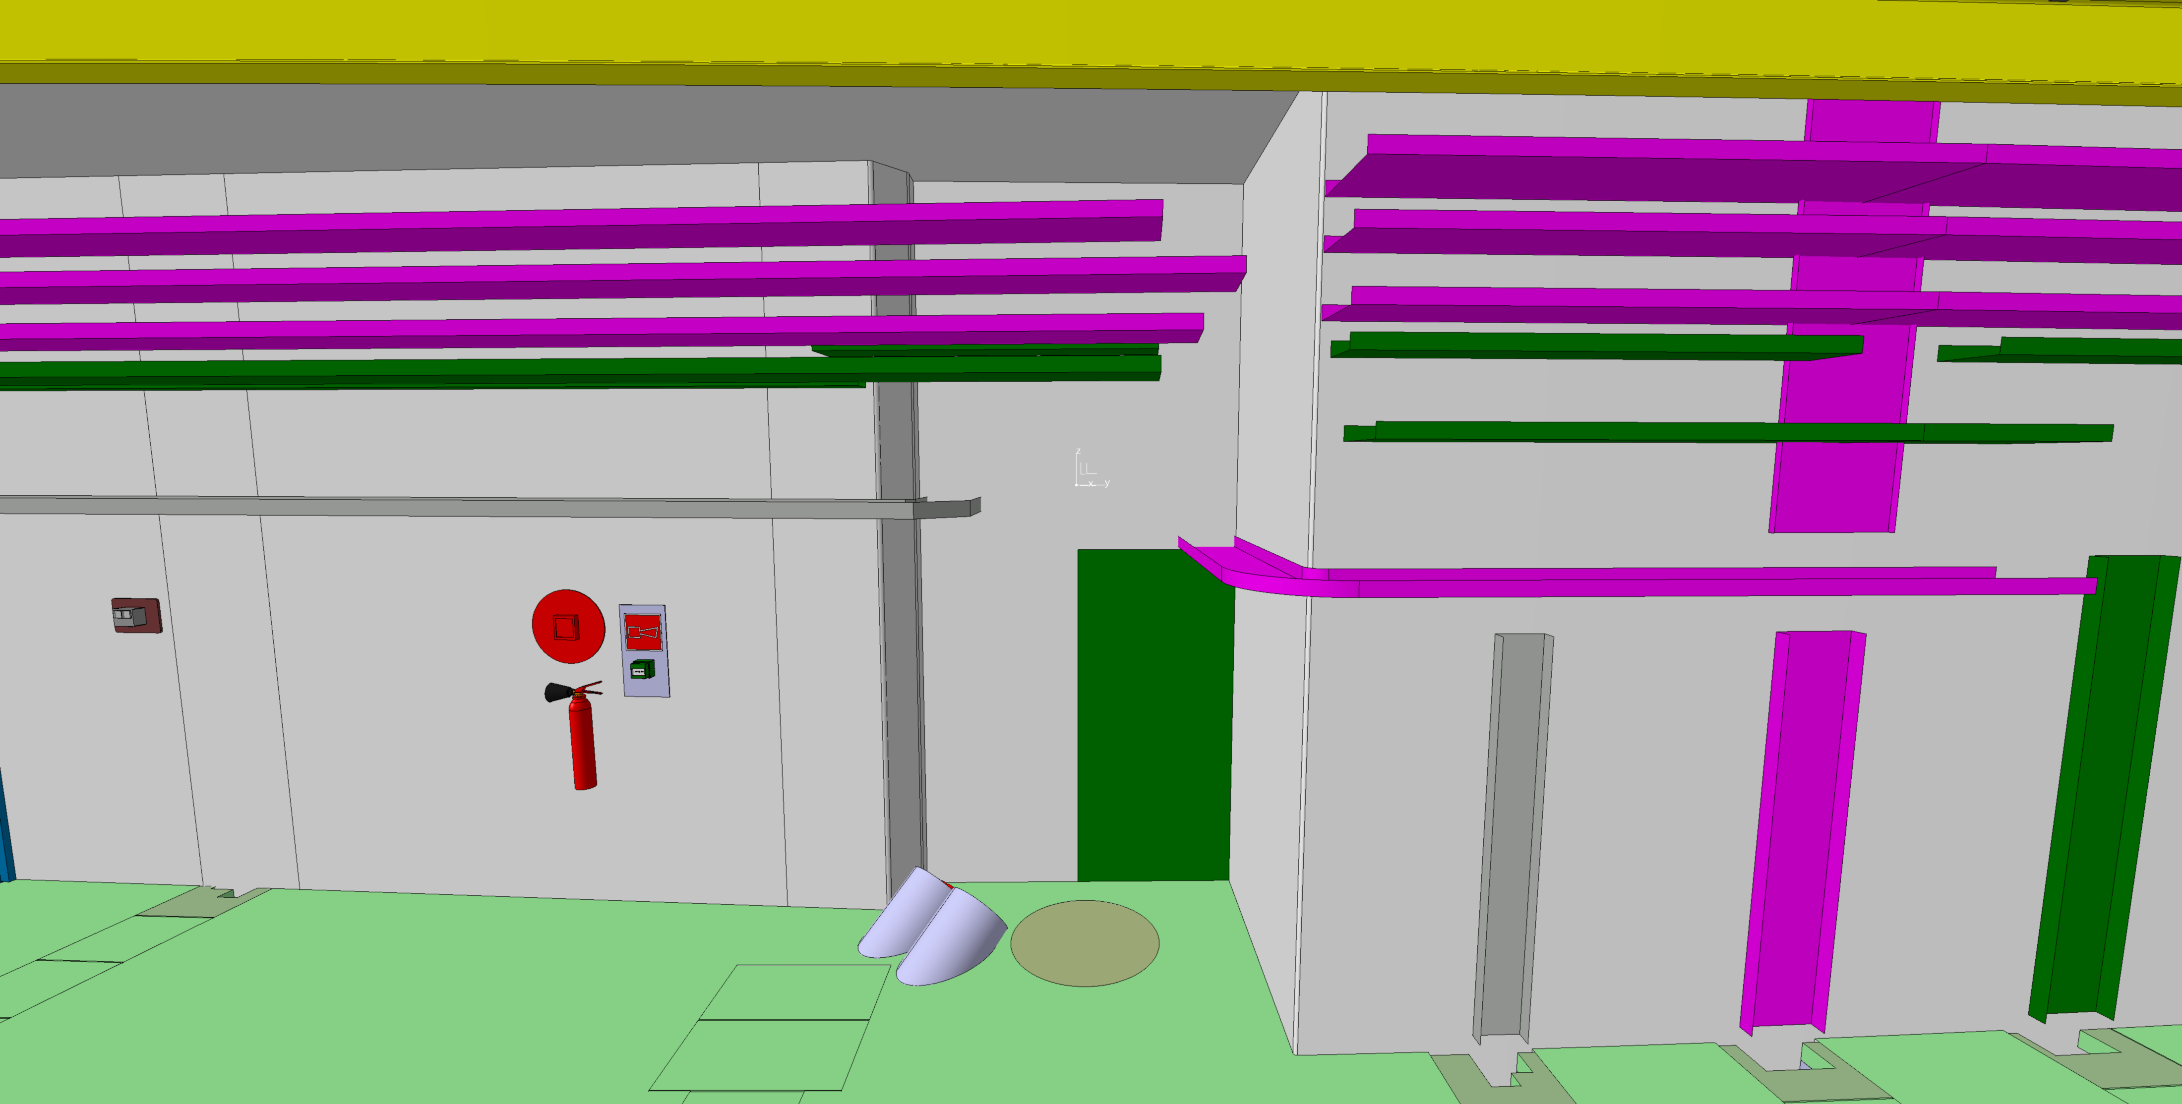
PS Octant 2
FTA
# 3283324

Slide 9
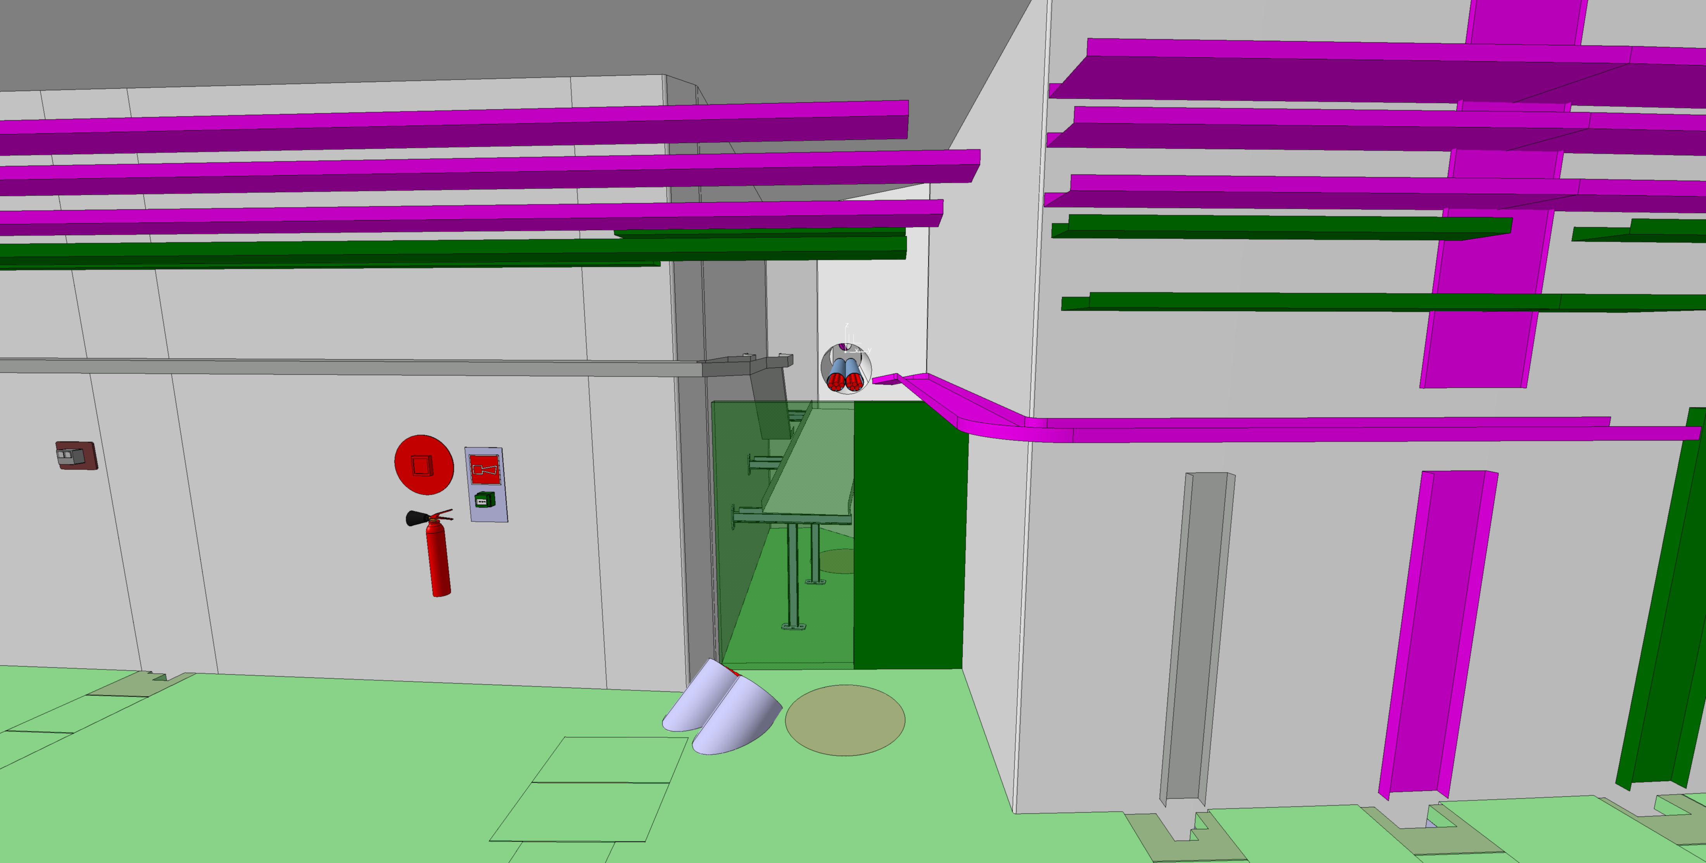
PS Octant 2
FTA
# 3283324

