Slide 1
355-359-365 Tuning Power converters study
PS Surface Integration Study
D. del Álamo – EN-ACE-INT
ICL 26-03-2025
EDMS#3267928

Slide 2

Track-it Data
Tracks for the Integration Studies:
TUNING POWER CONVERTERS FOR PS 10 MHz RF CAVITIES – 107646
# 3267928

Slide 3
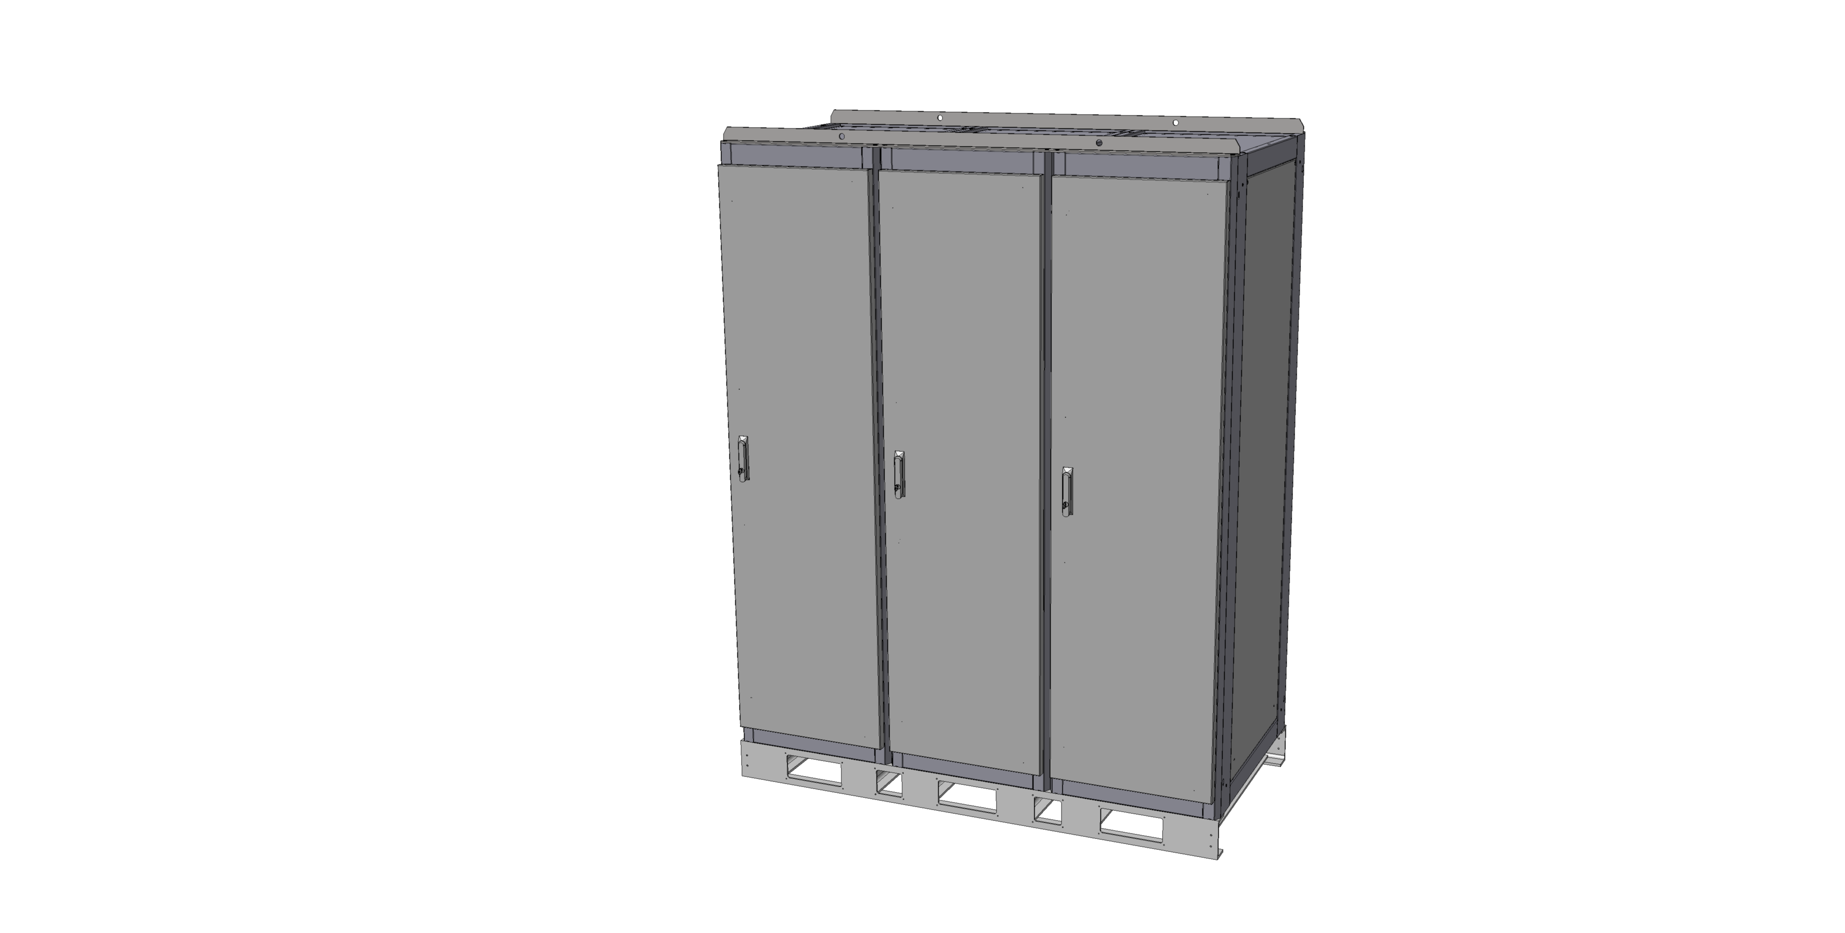
ELEMENTS TO BE INSTALLED
RF3kA Converters:
L=1800mm
W=900mm
H=2360mm
# 3267928

Slide 4
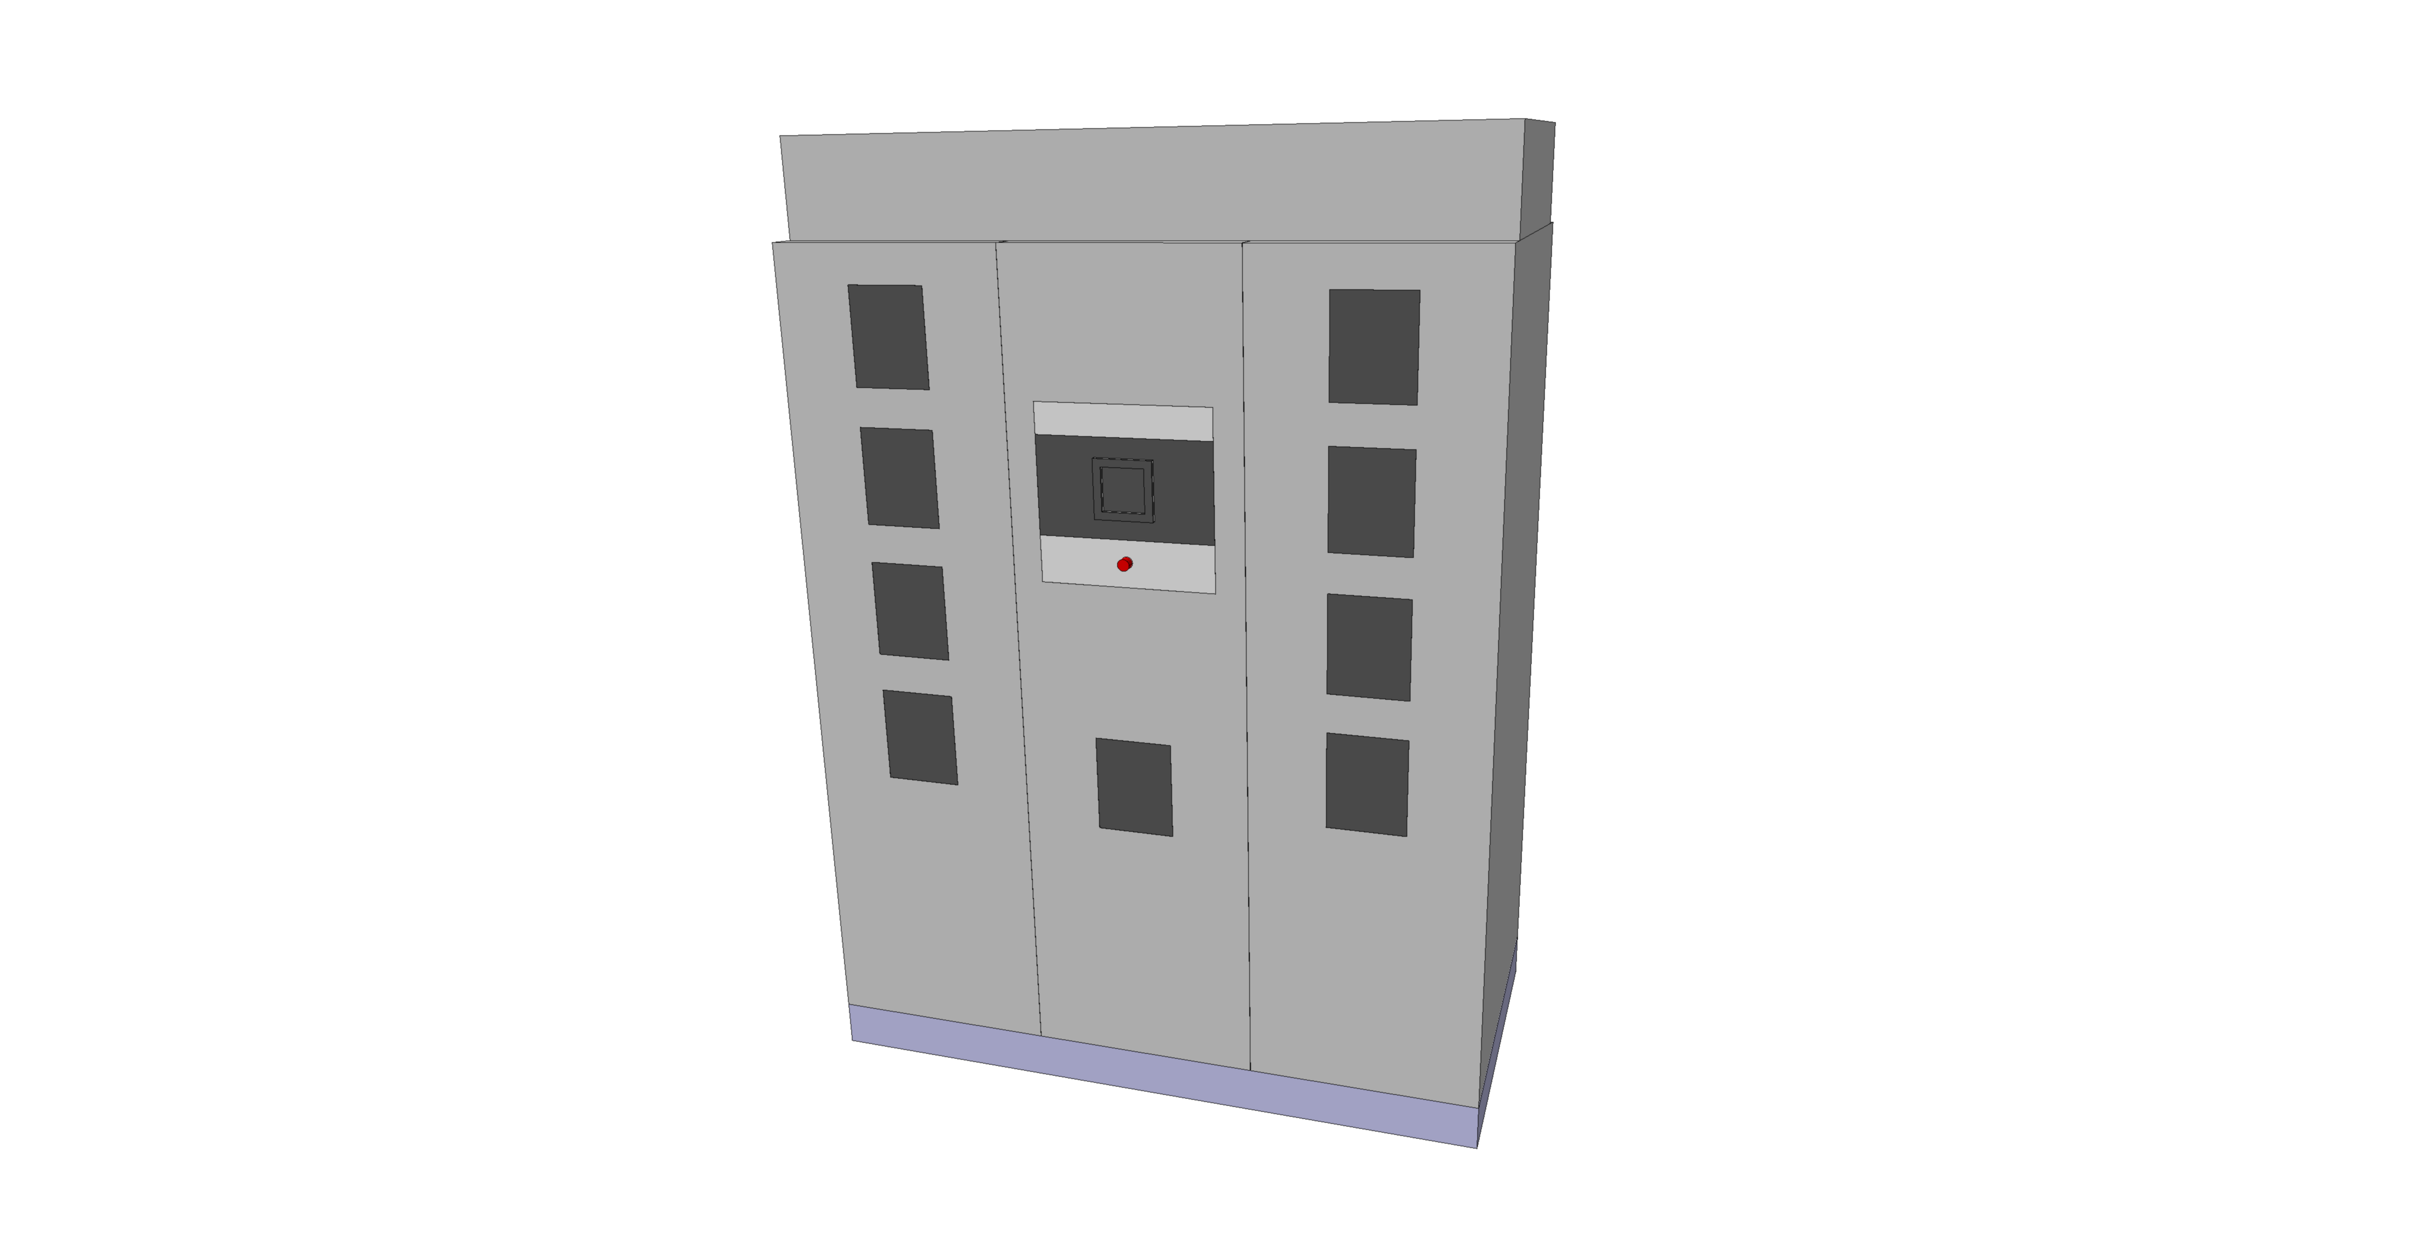
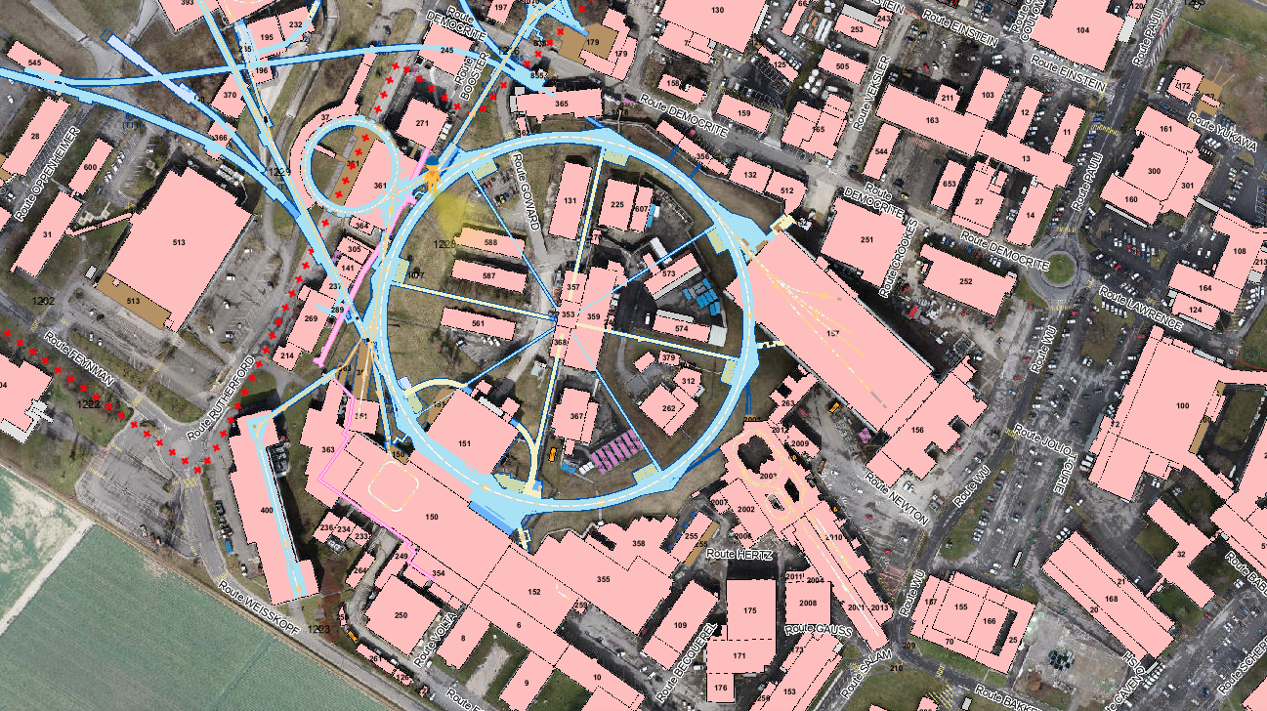
355
# 3267928

Slide 5
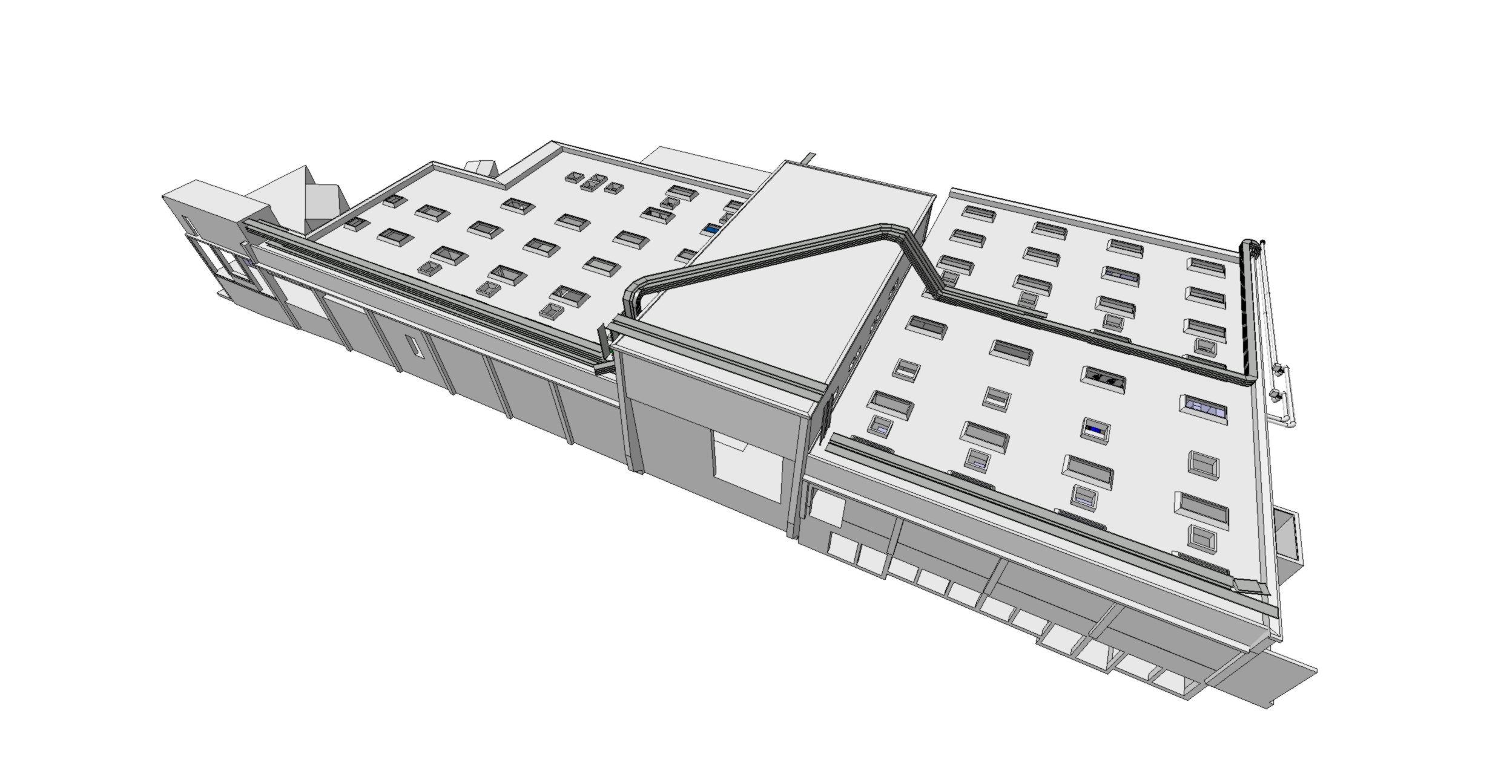
355
ST0793486_04
Valid for Integration
# 3267928

Slide 6
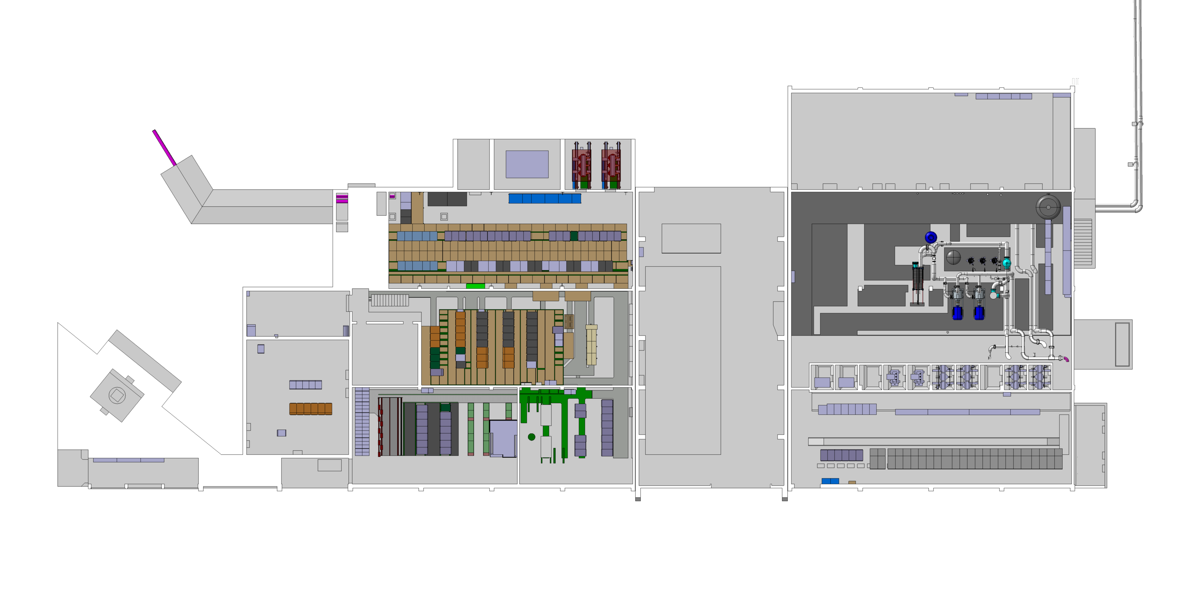
355 – Current situation
Area for the future installation
# 3267928

Slide 7
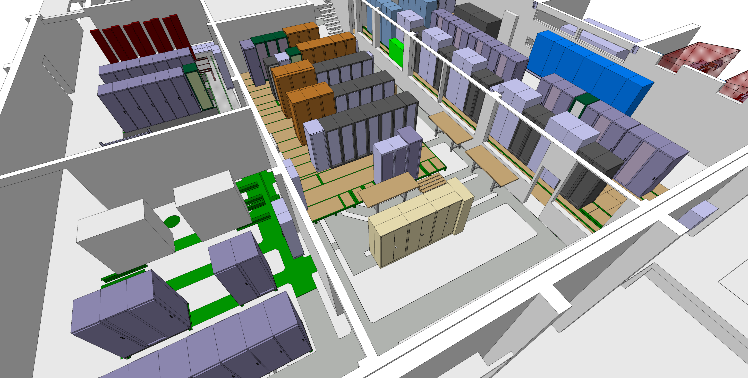
355 – Current situation
Area for the future installation
# 3267928

Slide 8
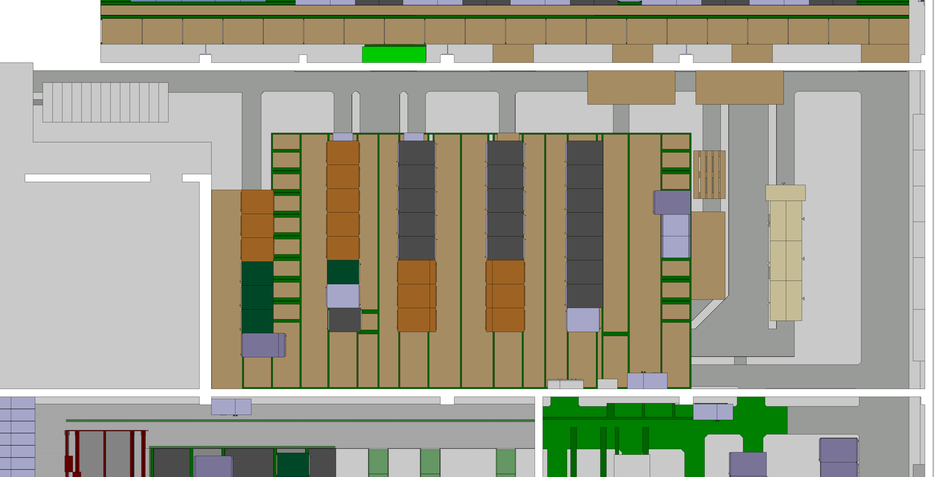
355 – Actions
Remove or move existing furniture
# 3267928

Slide 9
355 – Actions
Install a converter on top of the existing structure
# 3267928

Slide 10
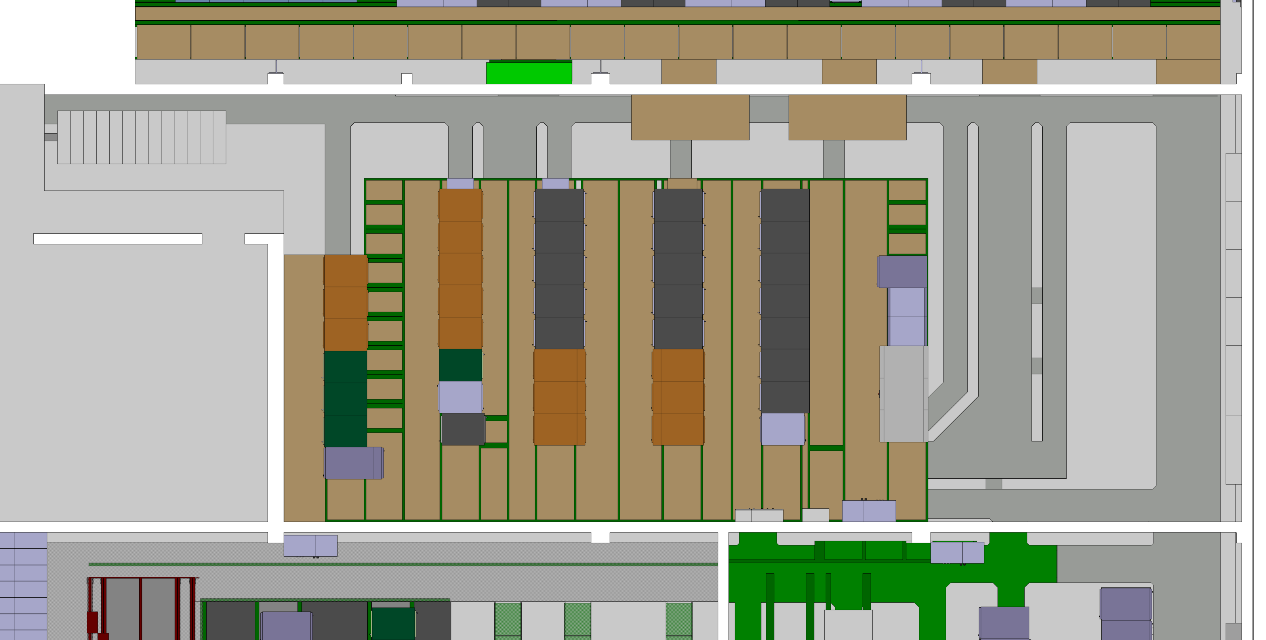
355 – Actions
Verify the false floor to see if the converters can be installed or there is the need for modifying or adding support structures.
On site visit with CE to check the feasibility of the installation.
# 3267928

Slide 11
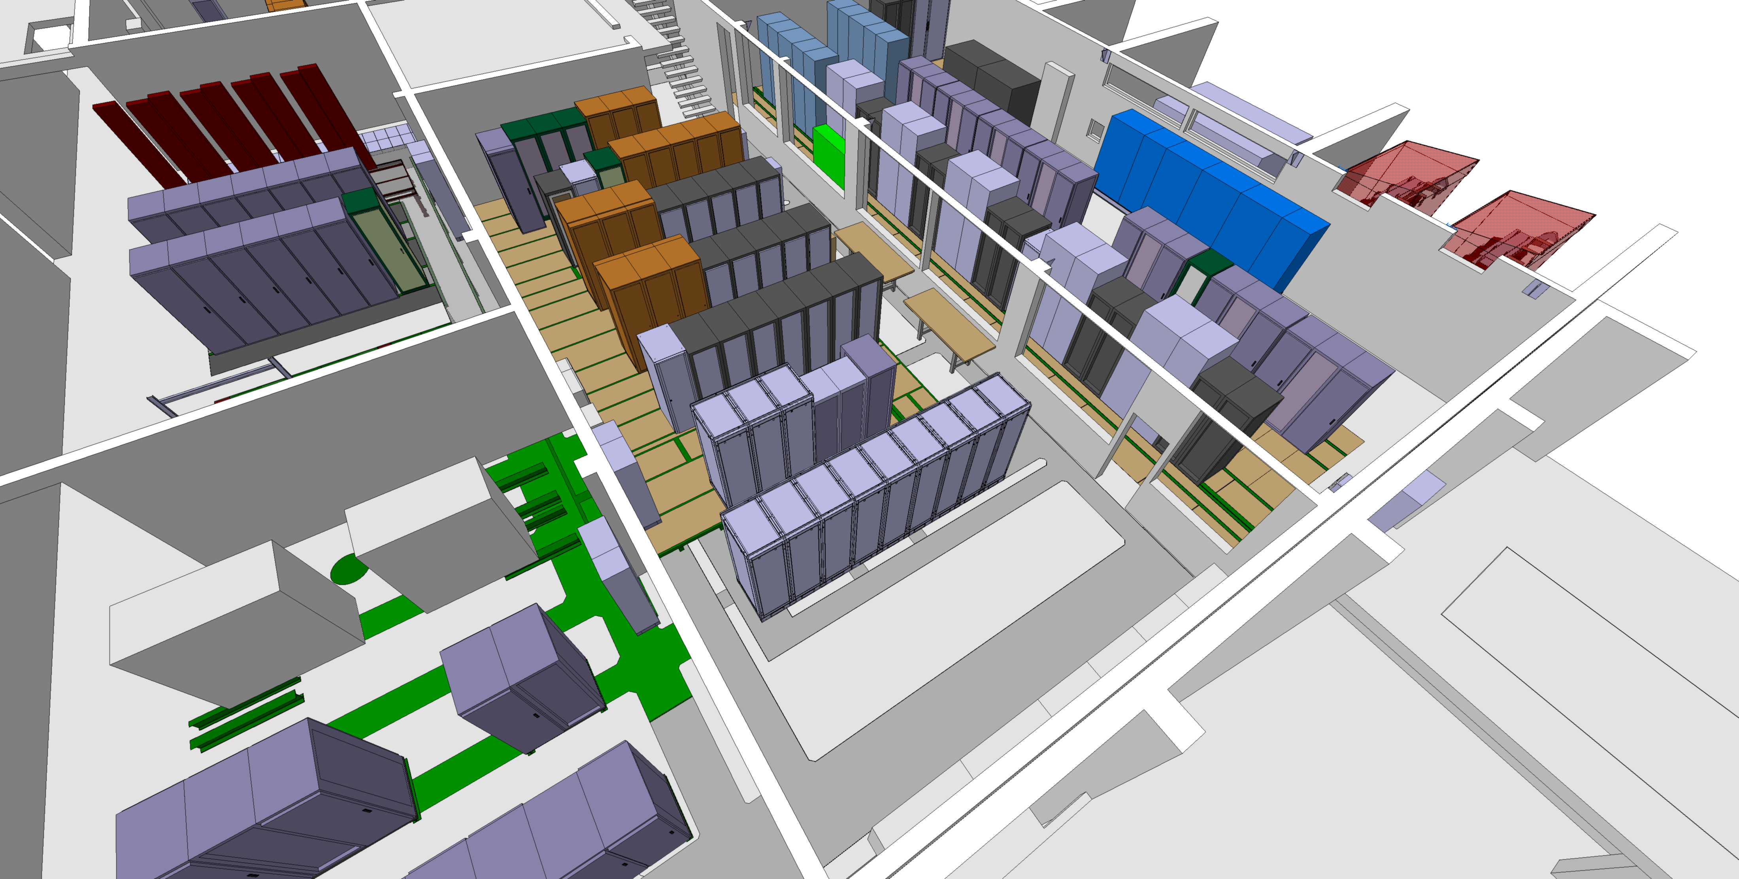
355 – LS3
# 3267928

Slide 12
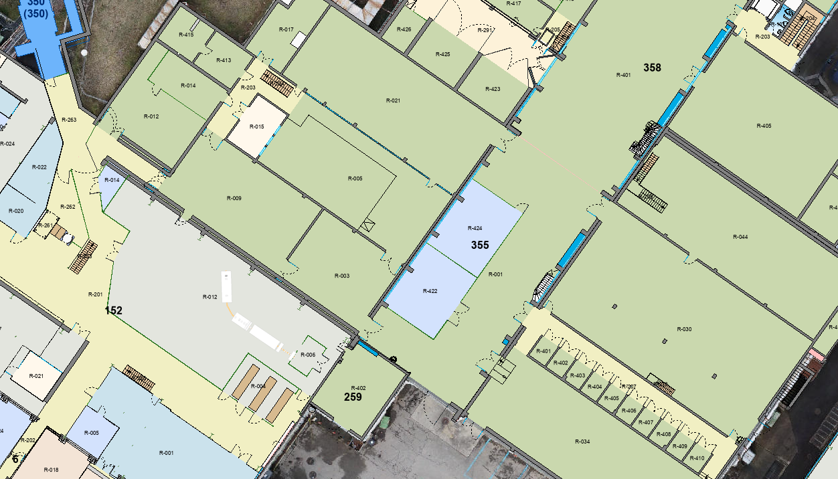
355 – ACCESS/HE
Access to the building
# 3267928

Slide 13
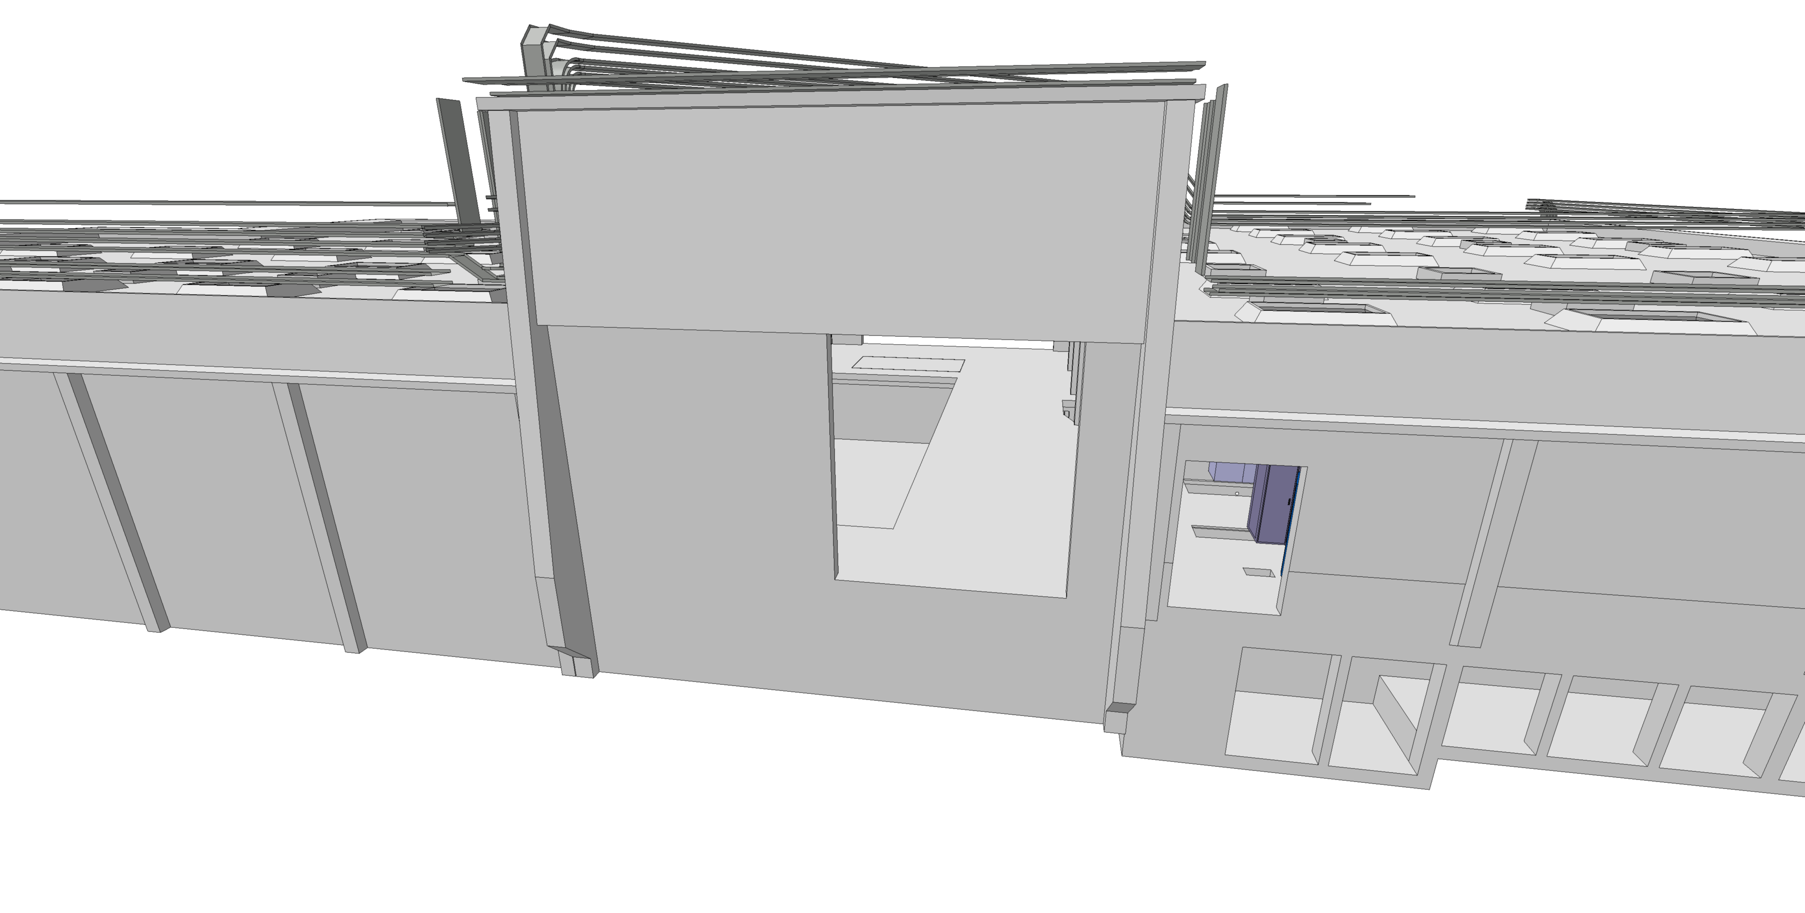
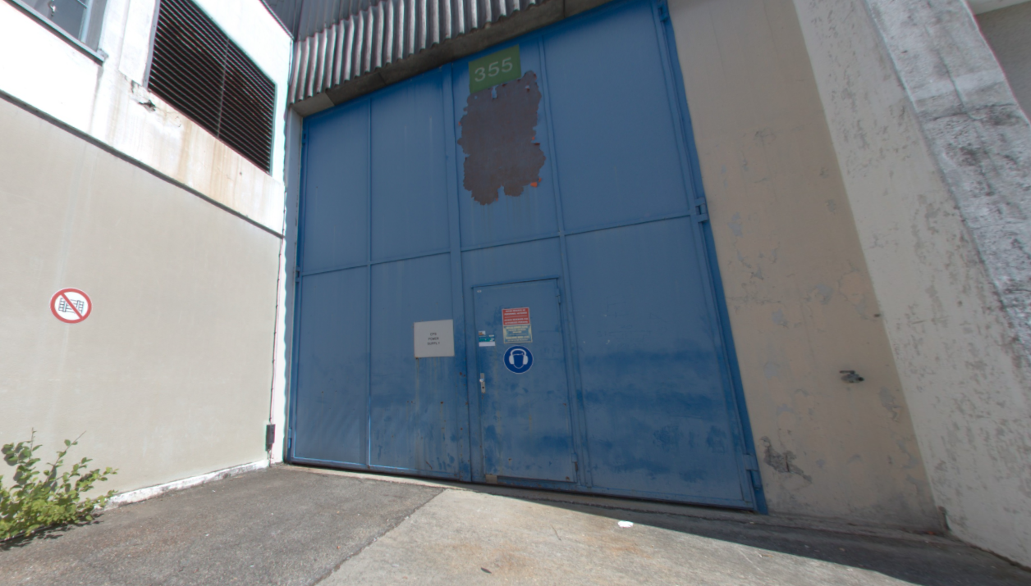
355 – ACCESS/HE
Access to the building
# 3267928

Slide 14
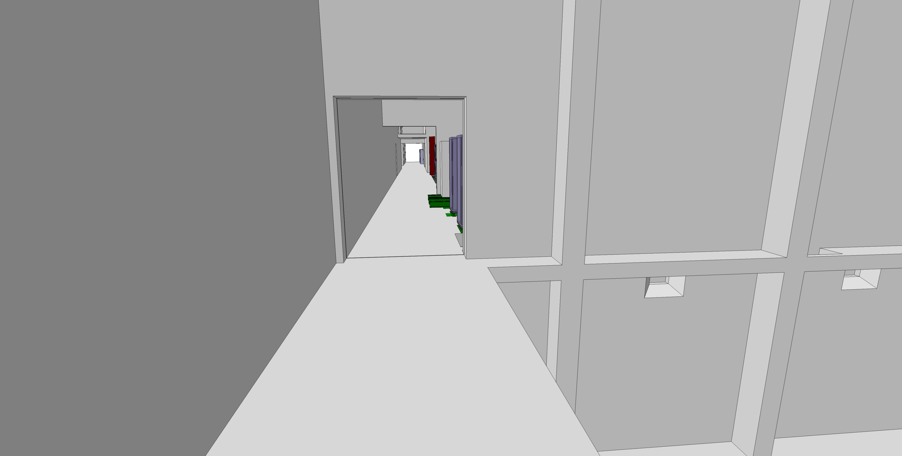
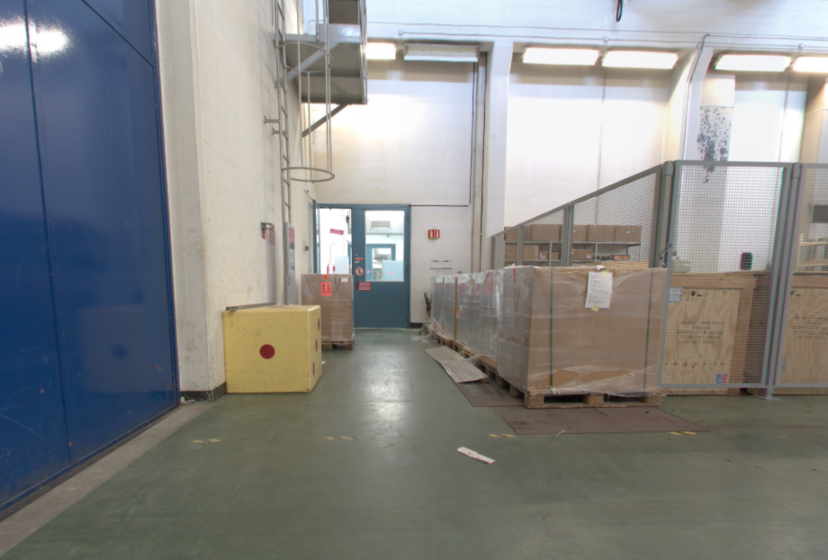
355 – ACCESS/HE
Validated On-site
2850mm
2200mm
# 3267928

Slide 15
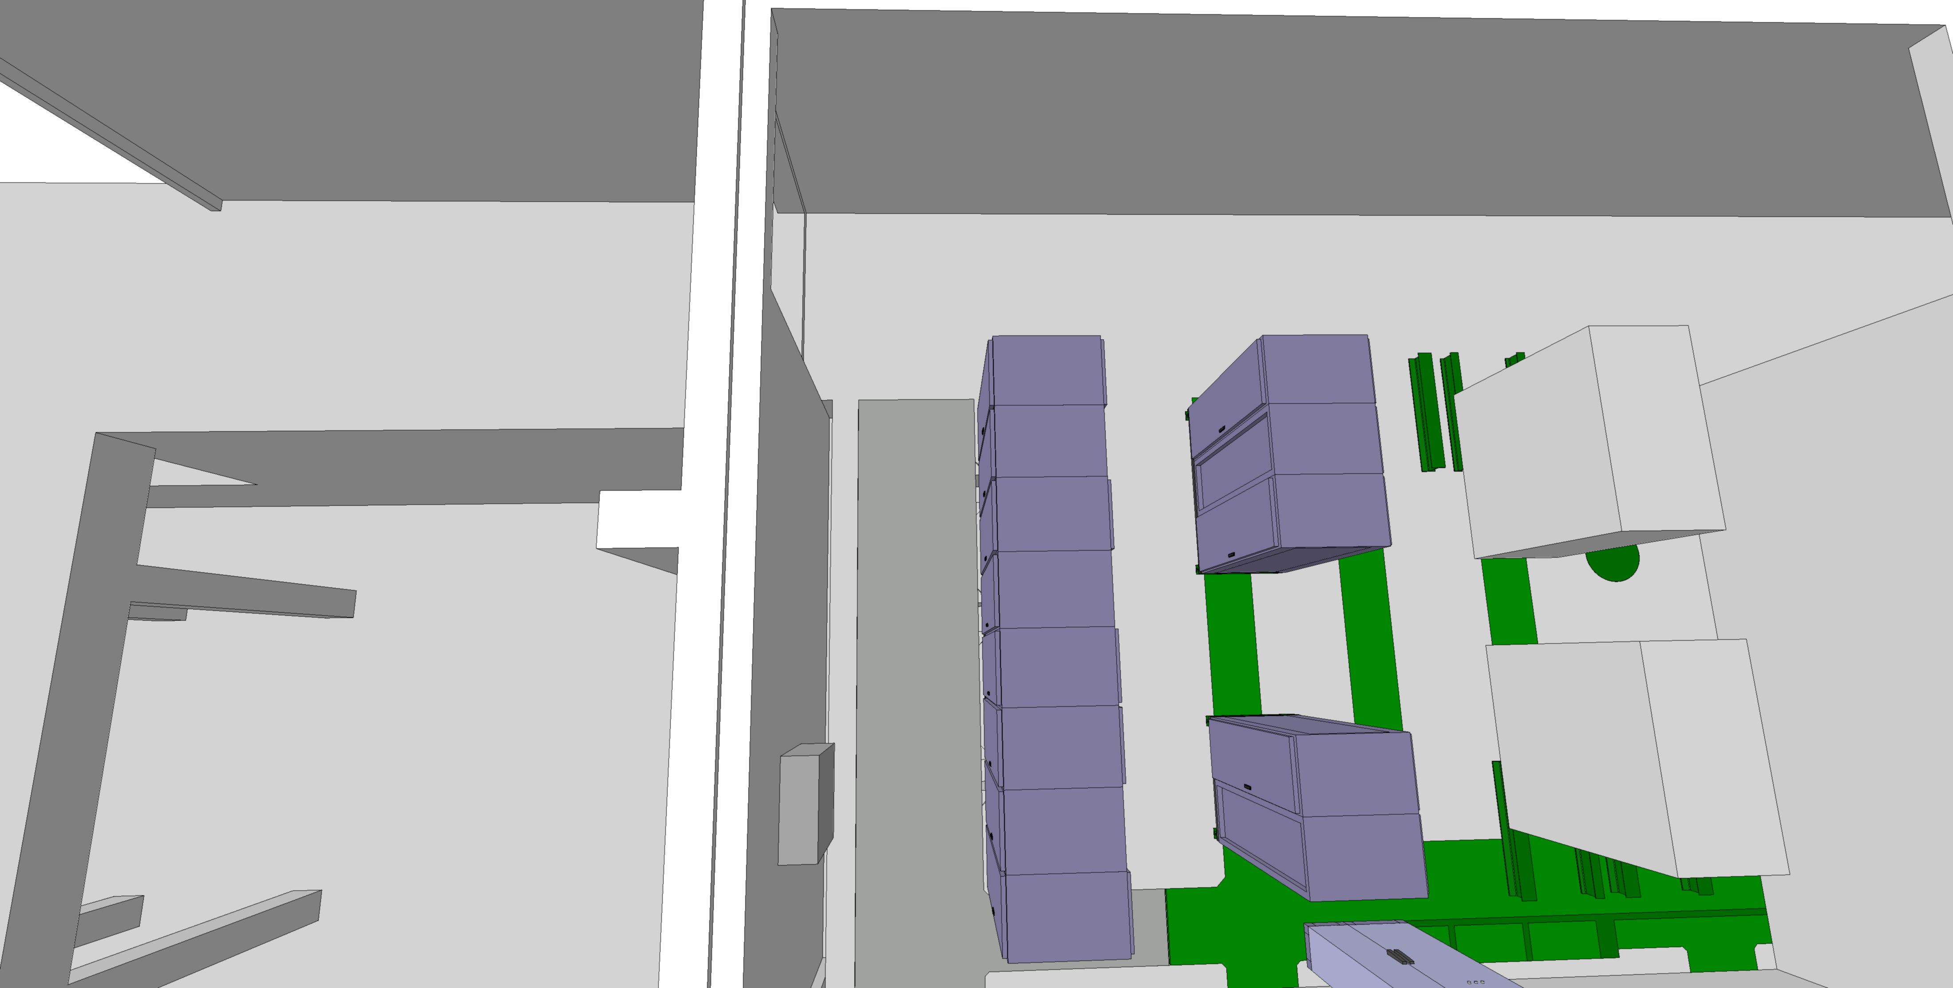
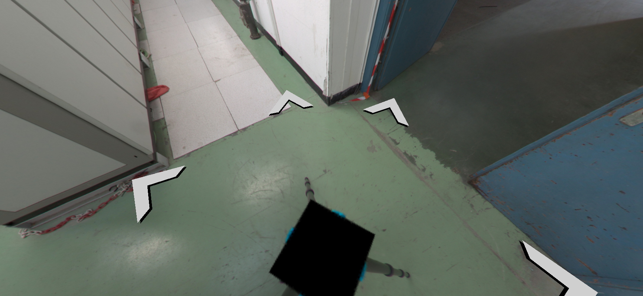
355 – ACCESS/HE
Validated On-site
# 3267928

Slide 16
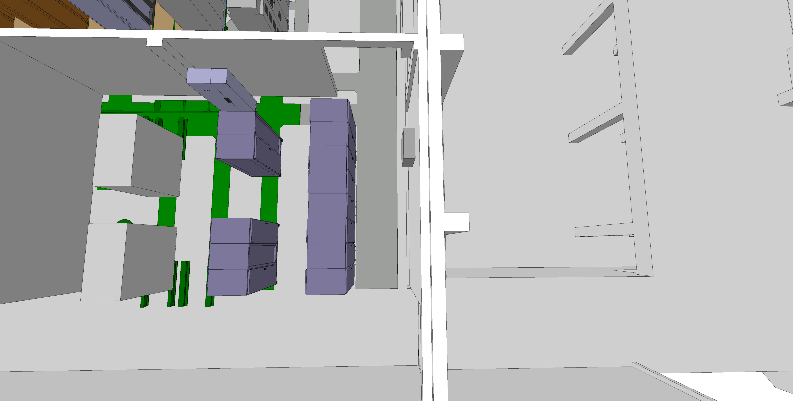
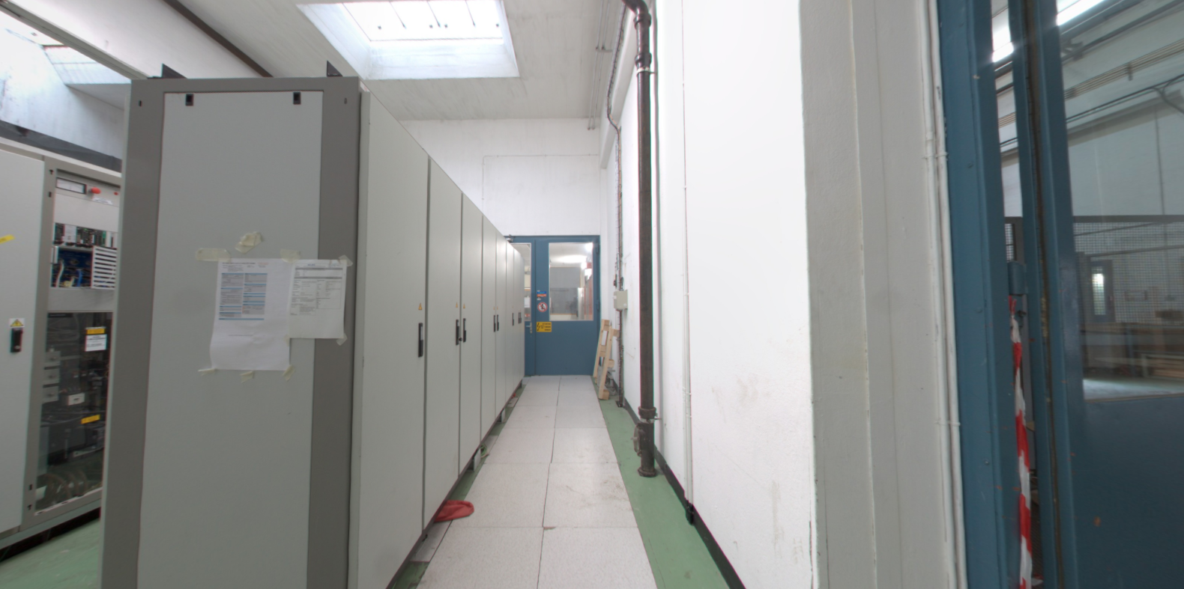
355 – ACCESS/HE
Validated On-site
1100mm
The false floor needs load verification for transport
# 3267928

Slide 17
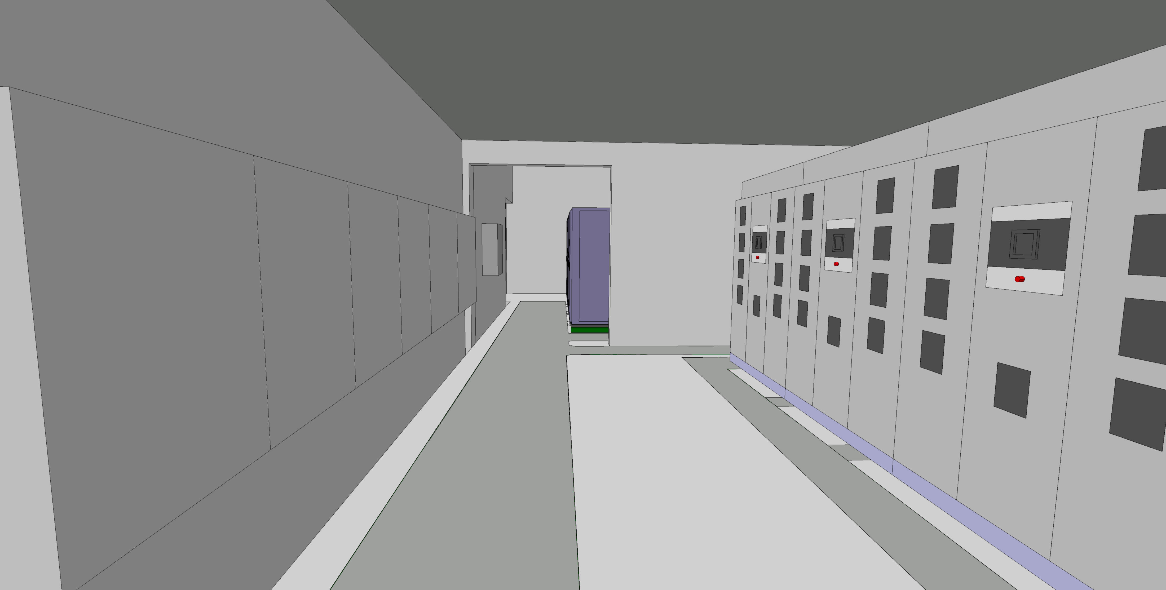
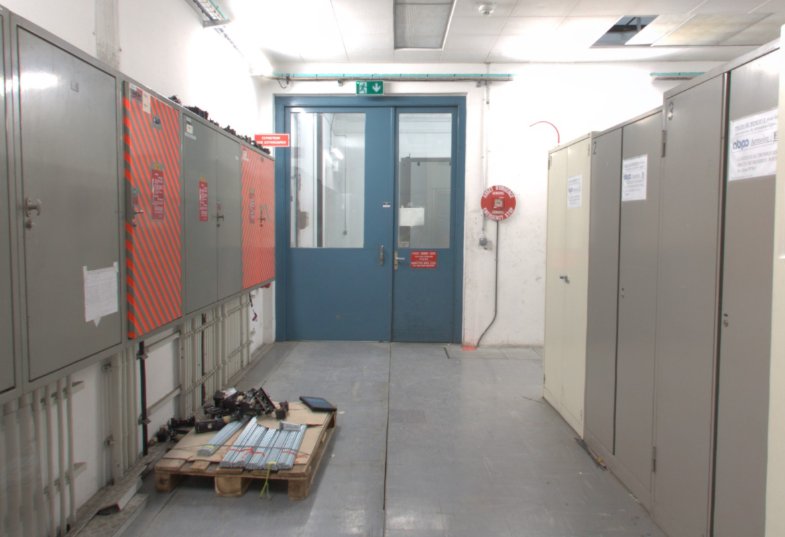
355 – ACCESS/HE
Validated On-site
2850mm
2200mm
The false floor needs load verification for transport
# 3267928

Slide 18
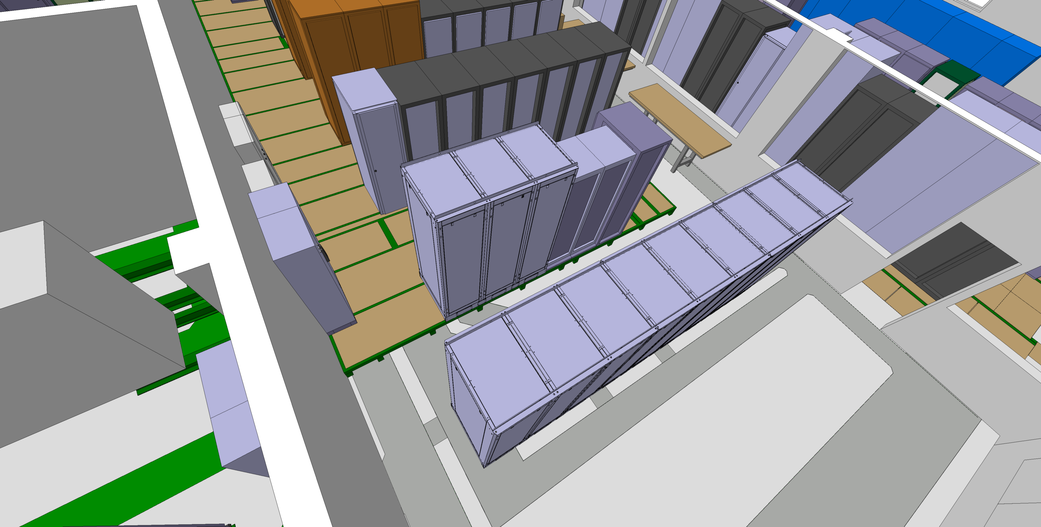
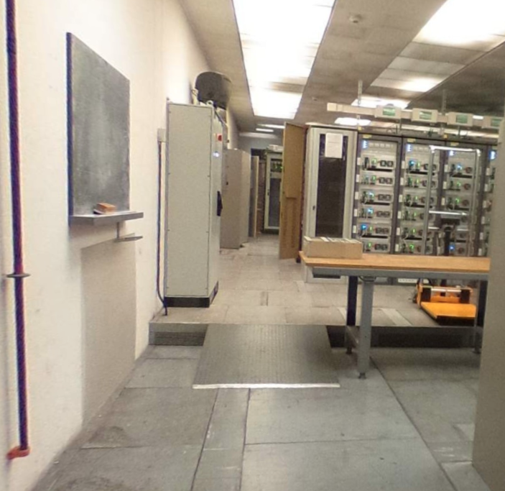
355 – ACCESS/HE
Validated On-site
Transport study needs to confirmed their tools fit the space
# 3267928

Slide 19
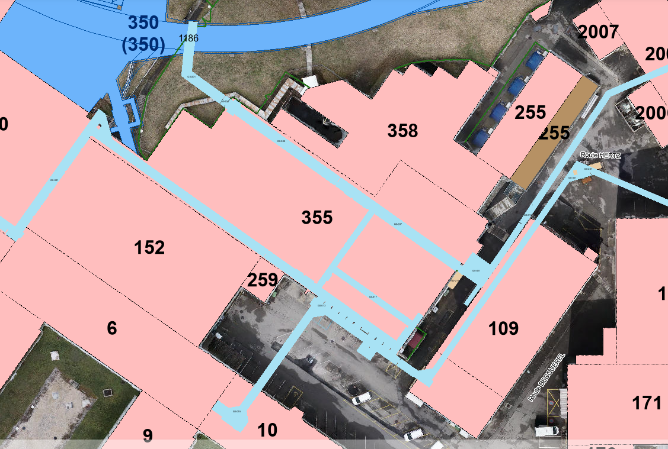
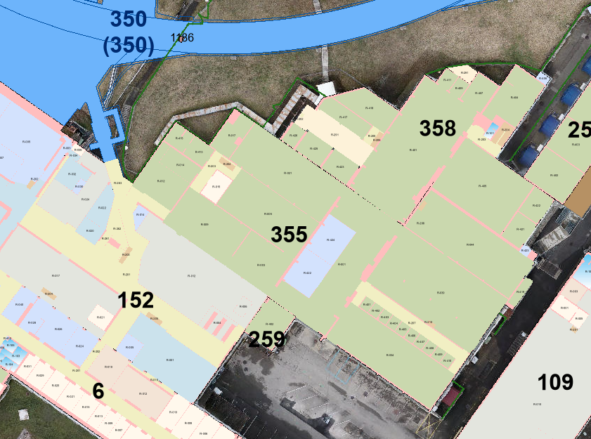
355 – EL
# 3267928

Slide 20
355 – CV
Converters are water refrigerated. No feedback from CV.
# 3267928

Slide 21
359
# 3267928

Slide 22
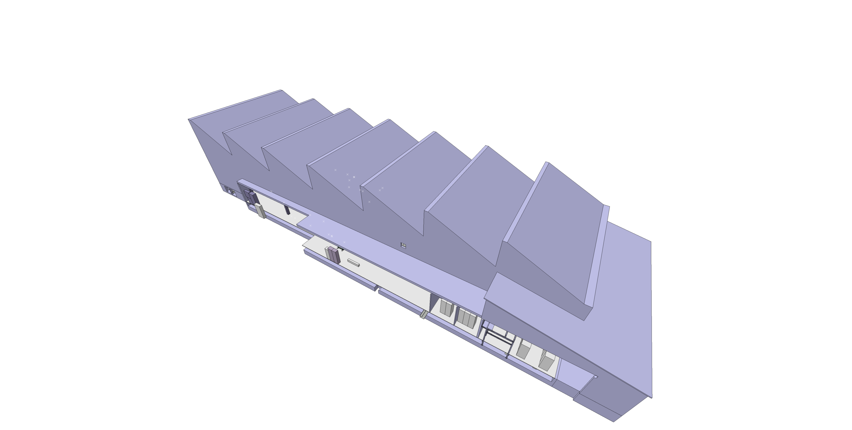
359
ST1791746_01
Valid for Integration
# 3267928

Slide 23
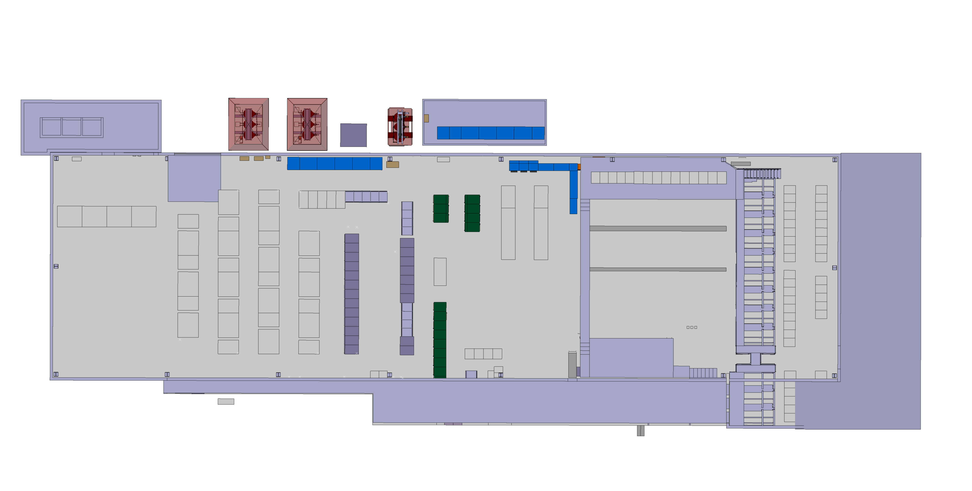
359 – Current situation
Area for the future installation
# 3267928

Slide 24
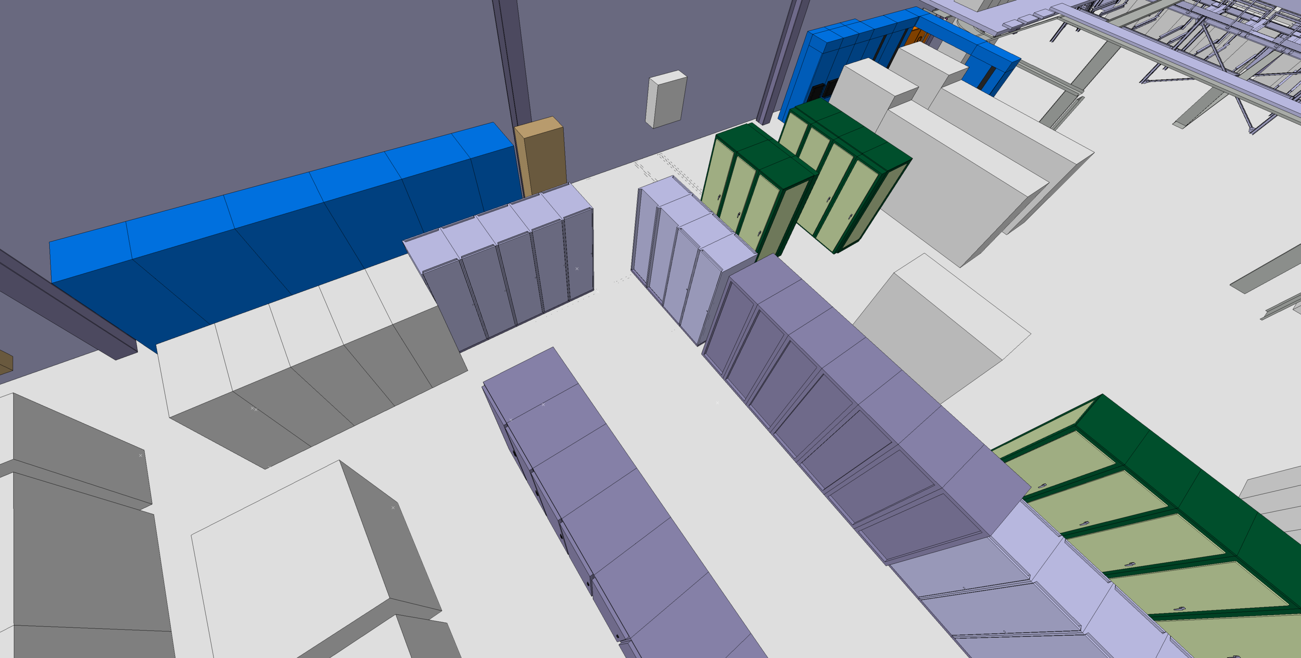
359 – Current situation
Area for the future installation
# 3267928

Slide 25
359 – CONSOLIDATION FOR LS3
Are these elements going to be removed during LS3?
# 3267928

Slide 26
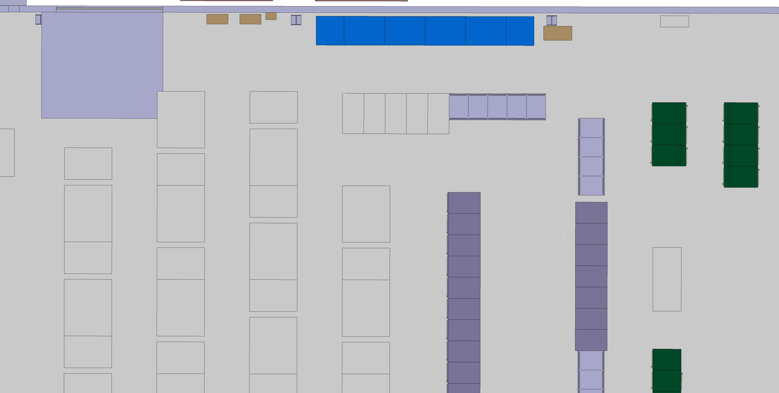
359 – Actions
Is this rack going to be removed or reused?
For this study it is considered that the rack is replaced
# 3267928

Slide 27
359 – Actions
Remove the racks
# 3267928

Slide 28
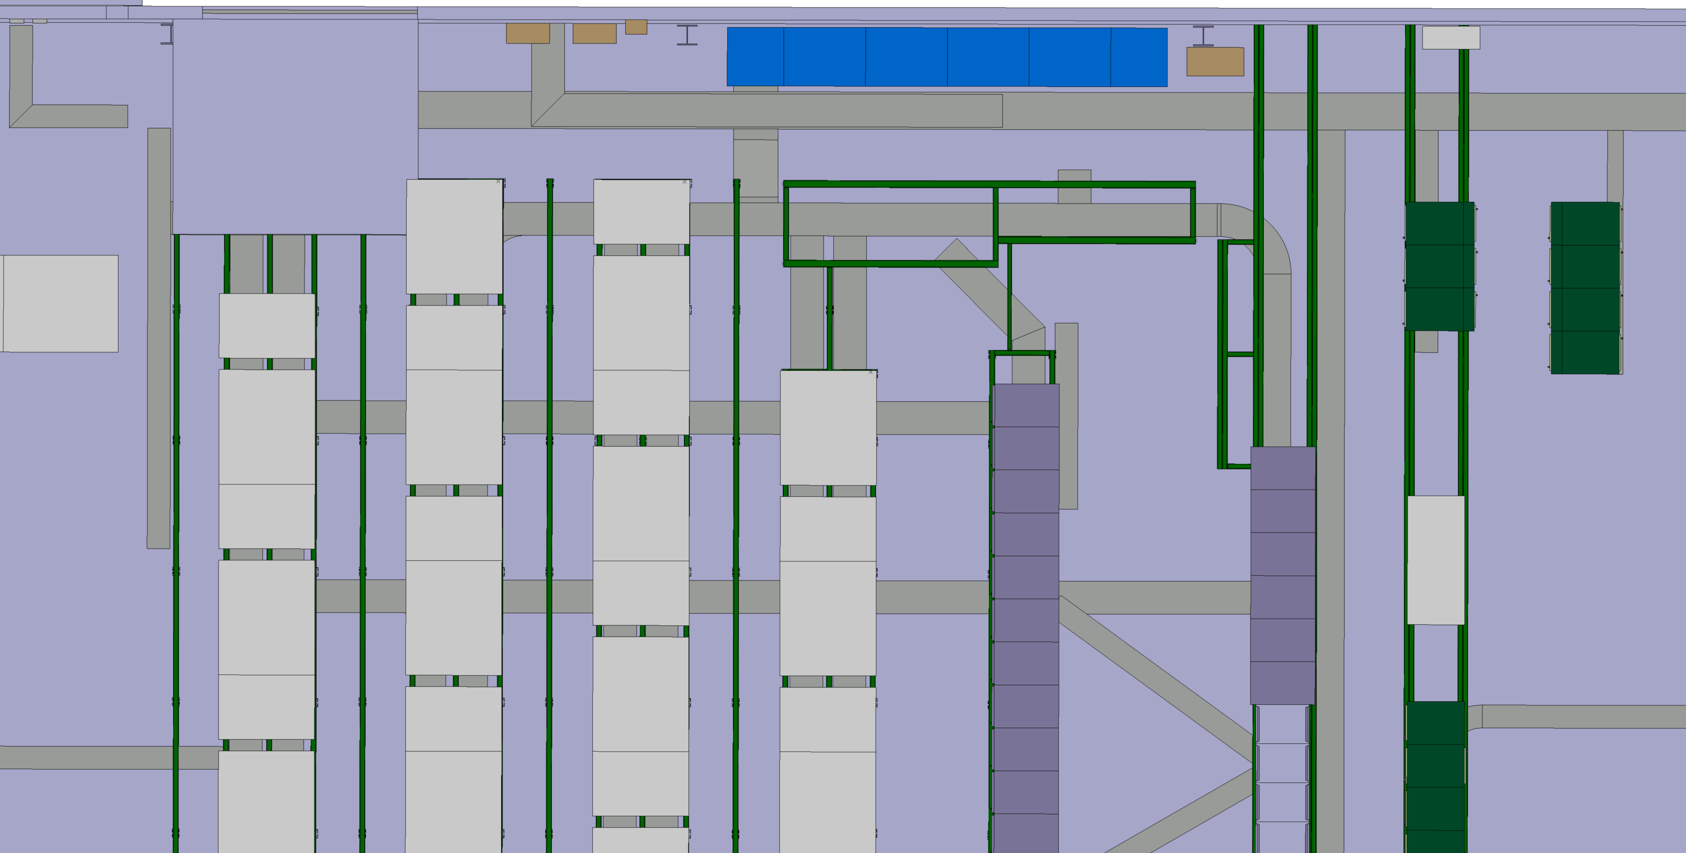
359 – Actions
Reinforce this structure to install the converters
# 3267928

Slide 29
359 – Actions
Reinforce this structure to install the converters
# 3267928

Slide 30
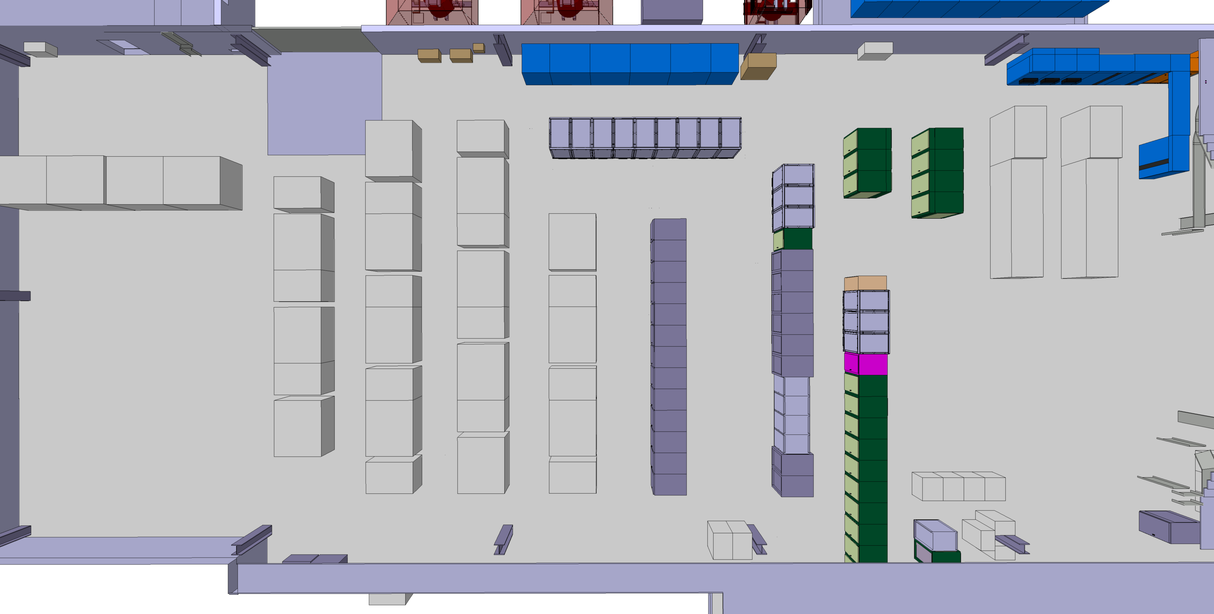
359 – Actions
Install the converters and the control rack
# 3267928

Slide 31
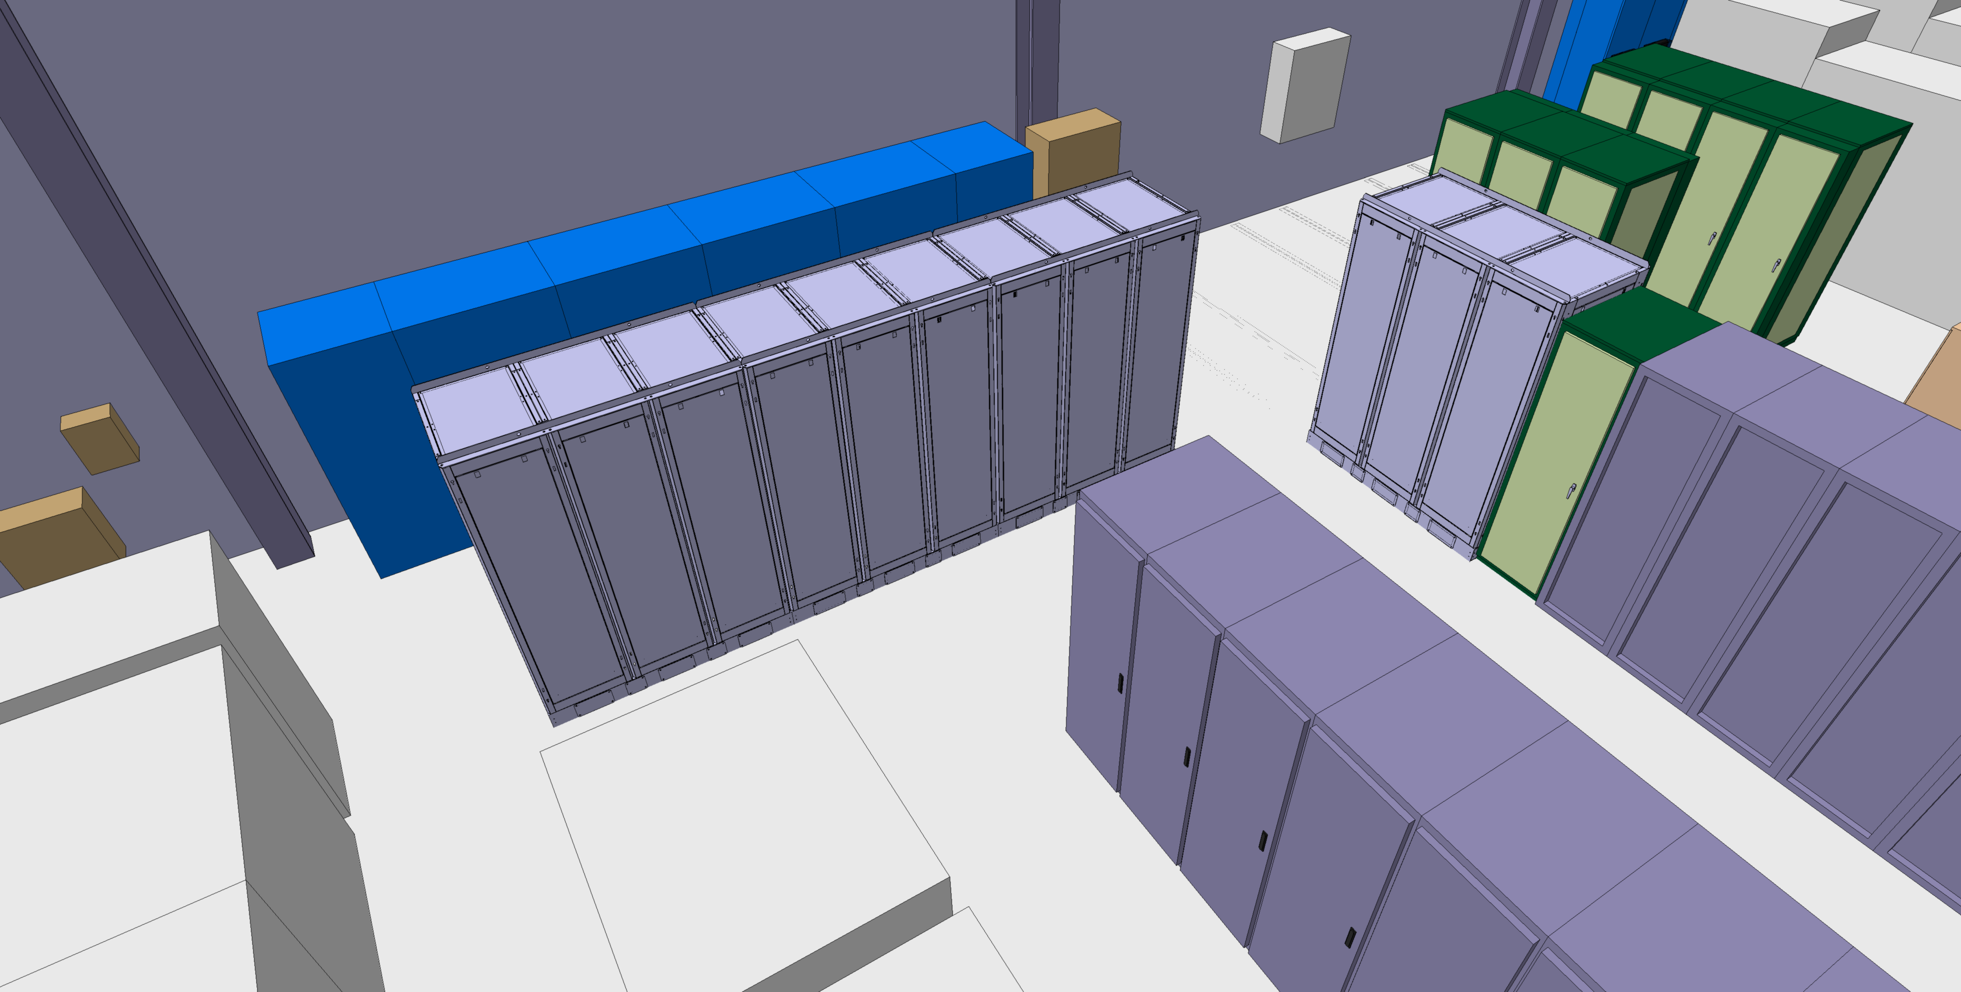
359 – LS3
# 3267928

Slide 32
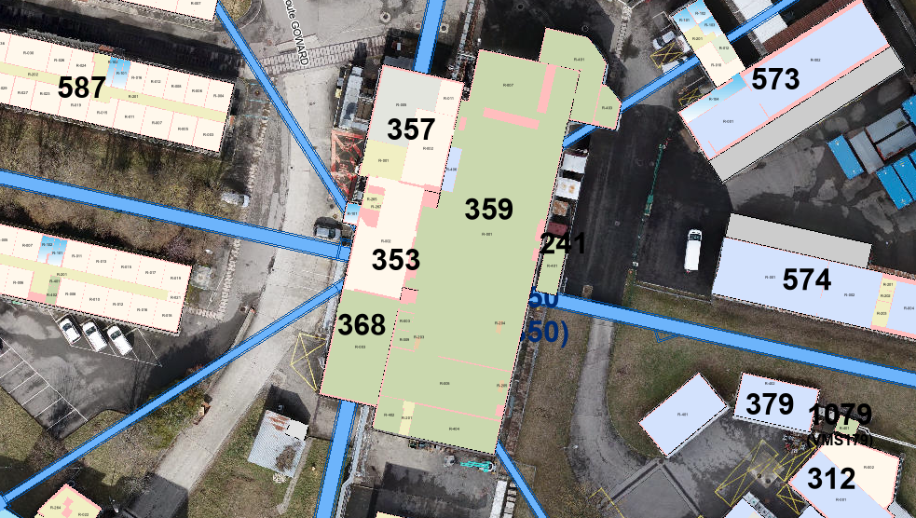
359 – ACCESS/HE
# 3267928

Slide 33
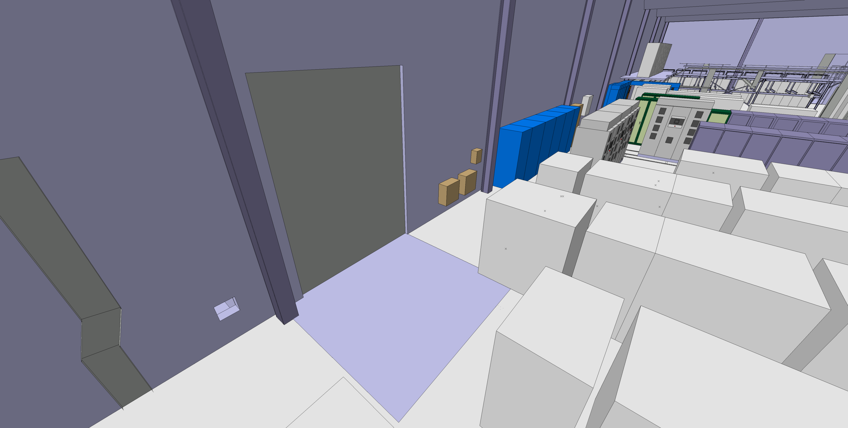
359 – ACCESS/HE
# 3267928

Slide 34
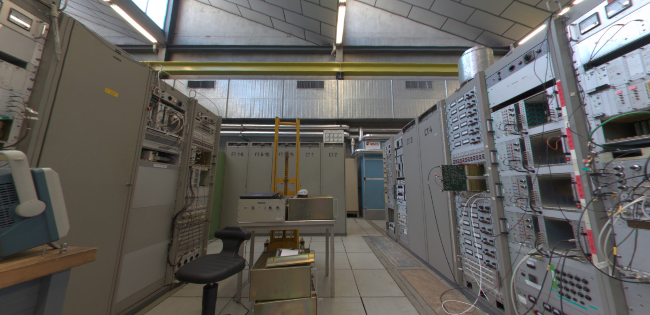
359 – ACCESS/HE
The 359 has a crane that can be used for transport
# 3267928

Slide 35
365
# 3267928

Slide 36
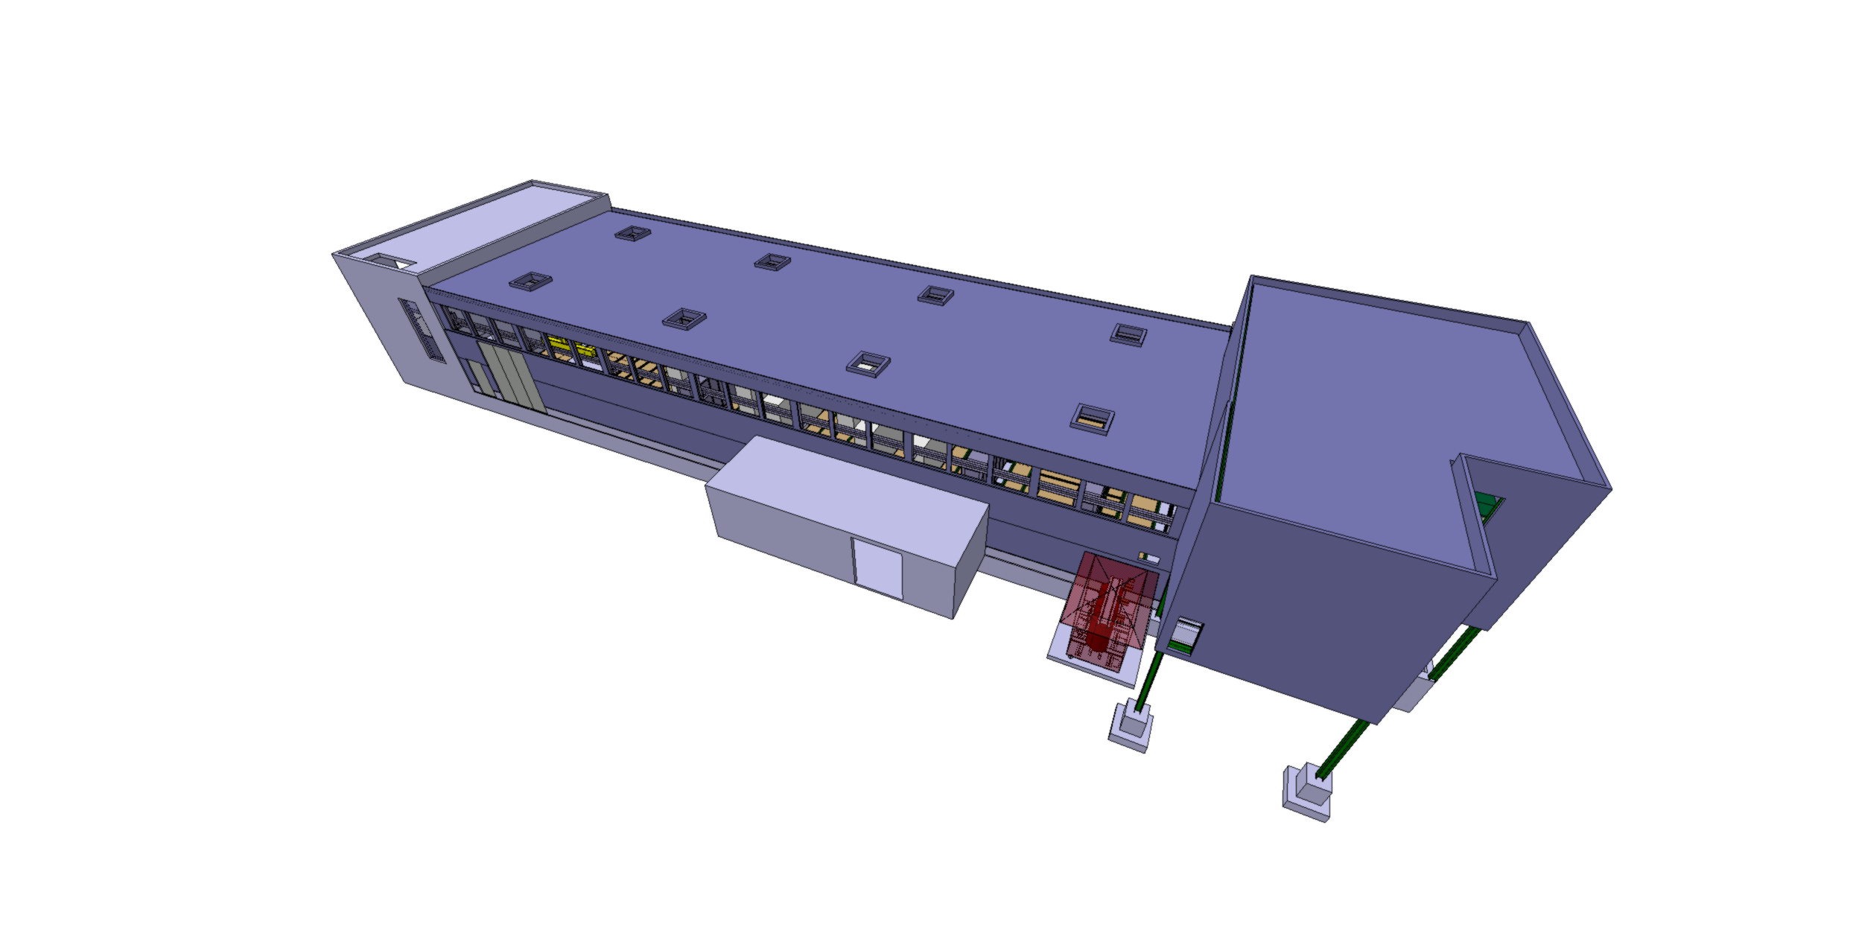
365
ST0943290_02
Valid for Integration
# 3267928

Slide 37
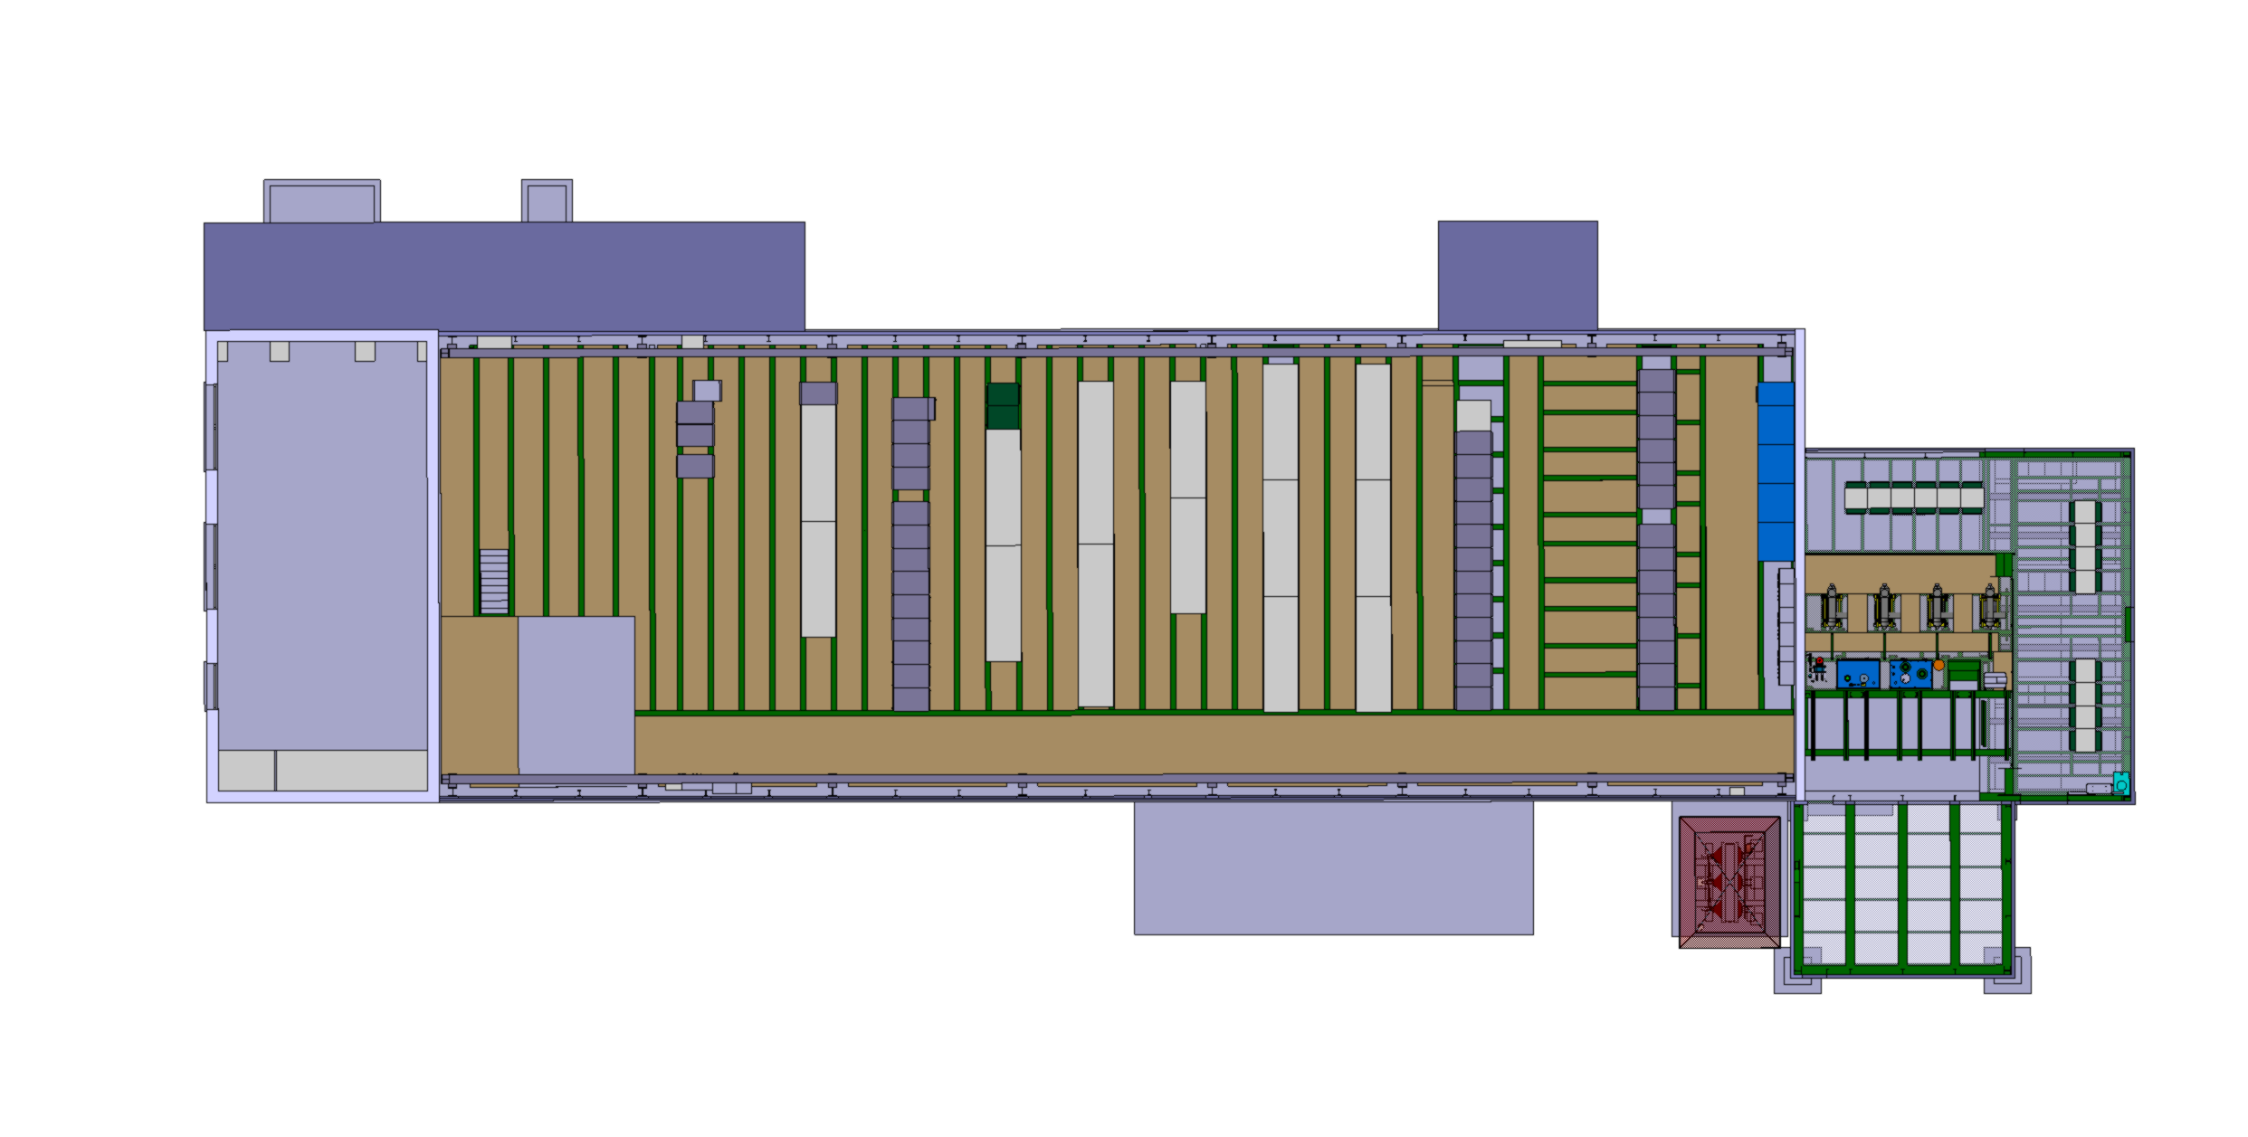
365 – Current situation
Area for the future installation
# 3267928

Slide 38
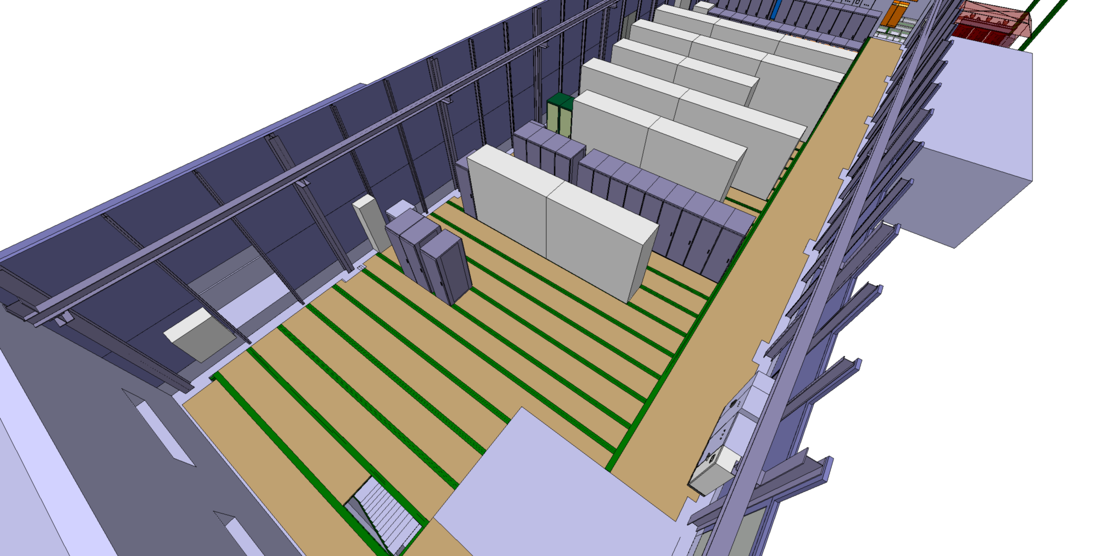
365 – Current situation
Area for the future installation
# 3267928

Slide 39
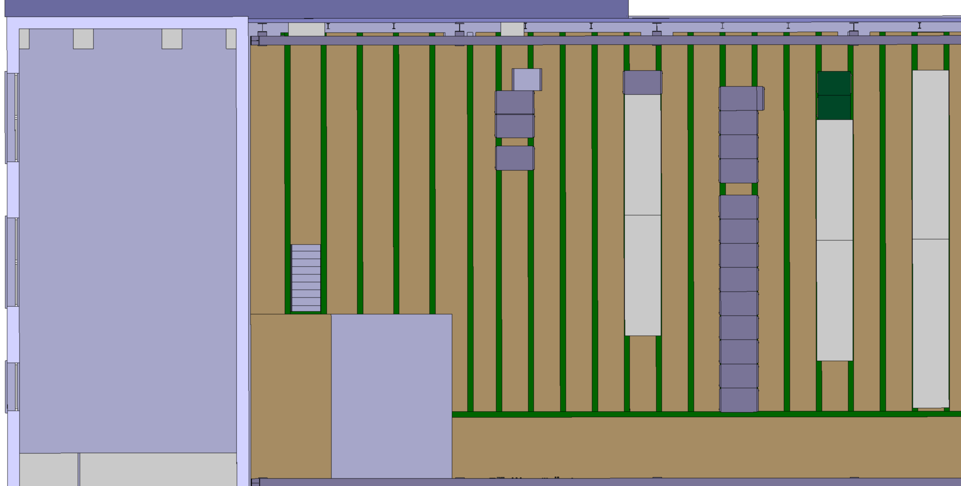
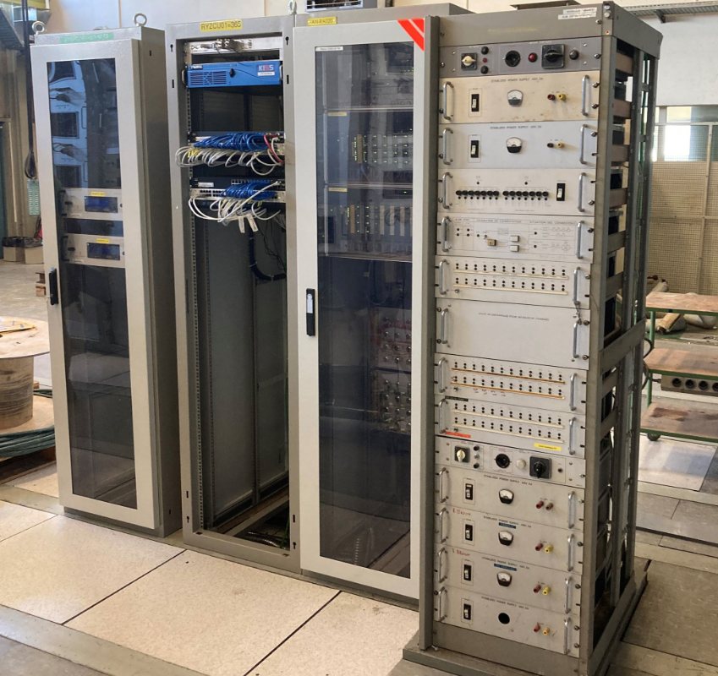
365 – Actions
Remove the obsolete rack
# 3267928

Slide 40

365 – Actions
Put the racks together
# 3267928

Slide 41
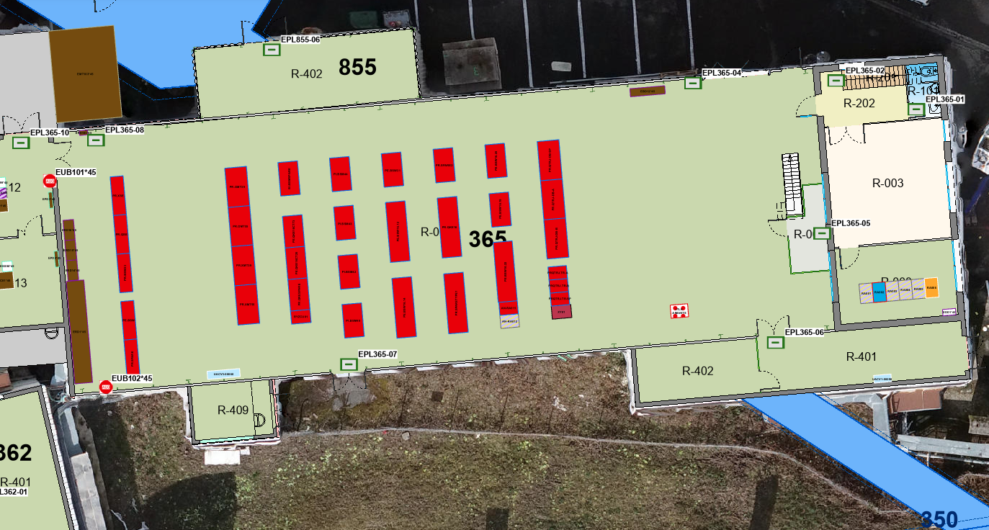
365 – Actions
According to the information in the GIS Portal, this area is already free of all racks but one (ITLK AIMANTS) which is the obsolete one belonging to TE-MPE
# 3267928

Slide 42

365 – Actions
Area ready for installation
# 3267928

Slide 43
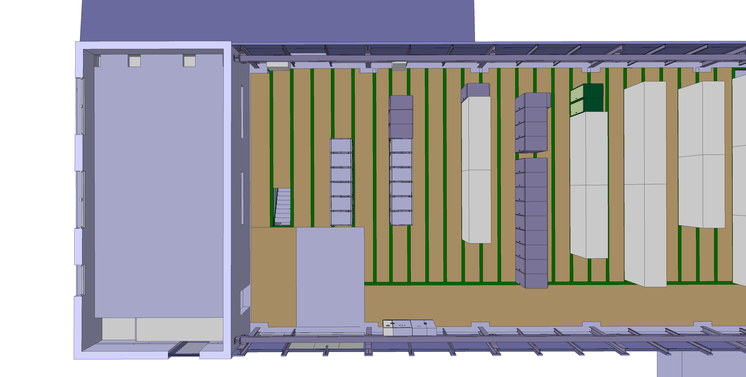
365 – Actions
Installation of the power converters
# 3267928

Slide 44
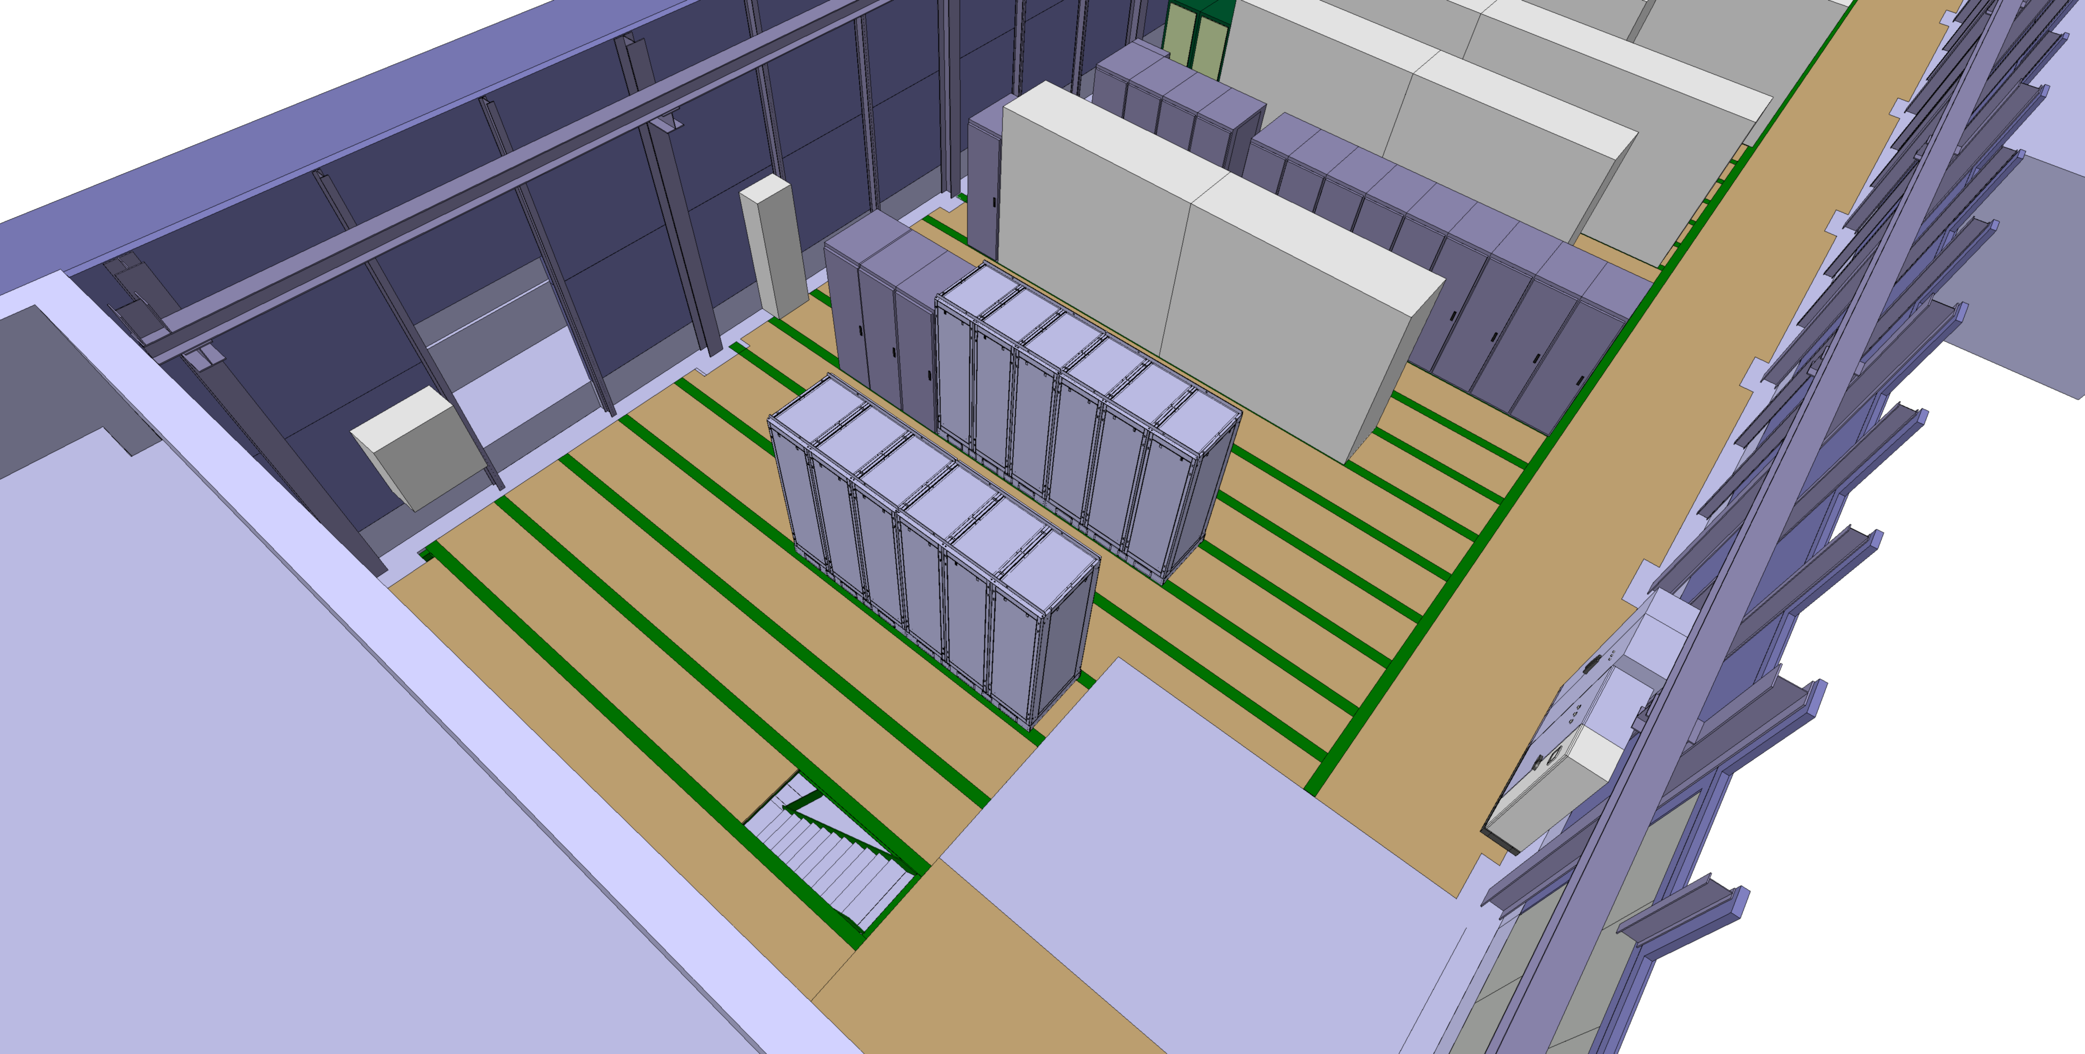
365 – LS3
# 3267928

Slide 45
365 – ACCESS/HE
# 3267928

Slide 46
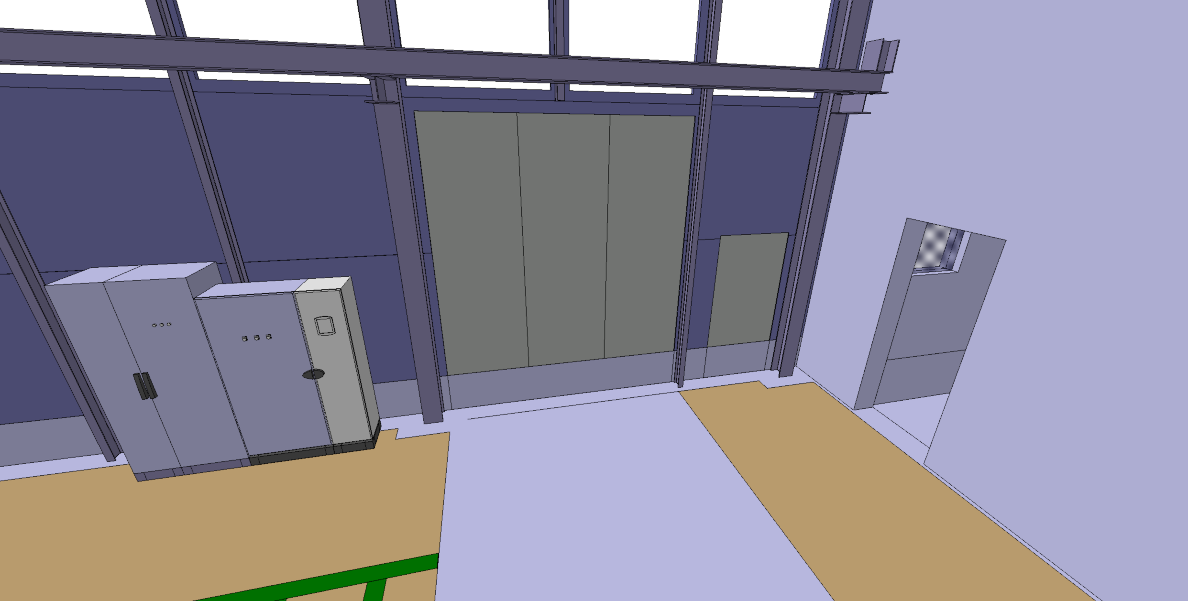
365 – ACCESS
3500mm
3000mm
# 3267928

