Slide 1
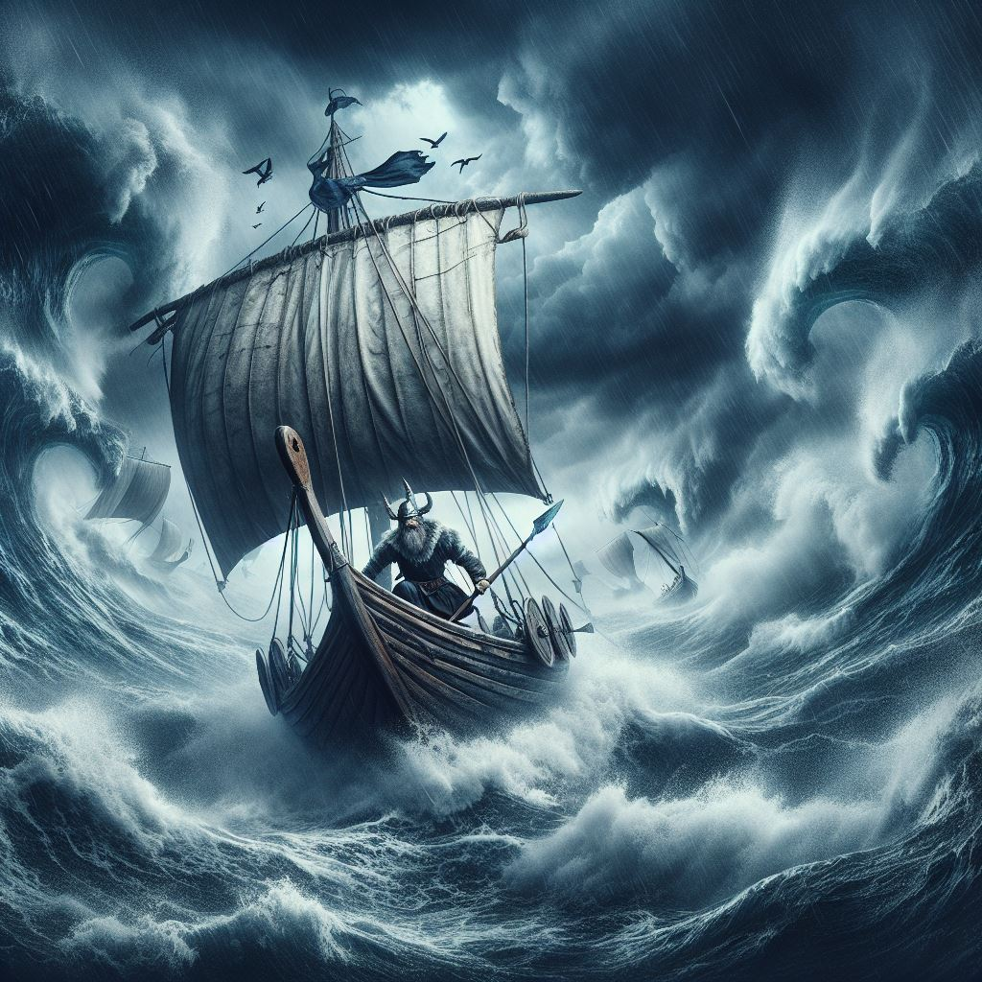
The Art of Navigating
Part VI: The Tides
Torsten Layda
Yachting Club CERN
31.03.2025
torsten.layda@protonmail.ch

Slide 2
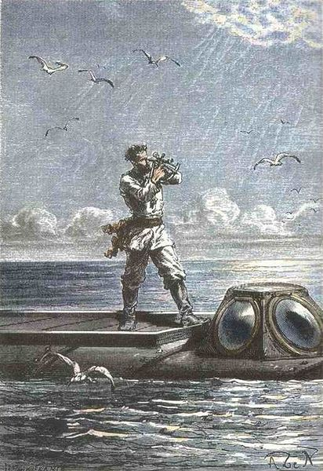
Overall Curriculum
Charts and GPS
Coastal Navigation (basics)
Beacons and Lights
Meteorology
The Plotter
The Tides
Coastal Navigation (advanced)
Off-shore Passages
Celestial Navigation

Slide 3
Setting the Scene: The Various Courses
No wind, no current: the easiest situation
Add wind
Add current

Slide 4
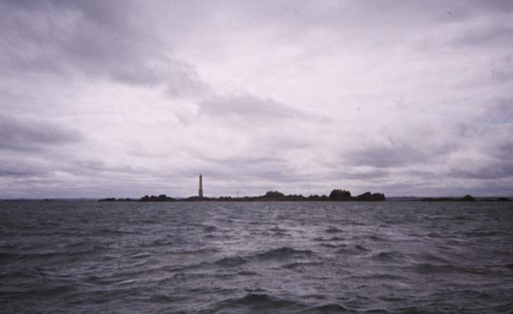
Landscape and Seascape
In real life

Slide 5
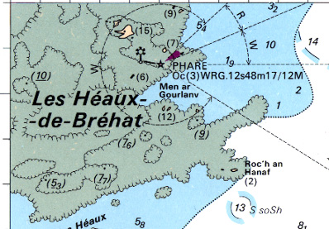
Landscape and Seascape
On the chart

Slide 6
The Log (-book)
Tides |  | (HT or LT) |  | (HT or LT) |  | (HT or LT) |  | (HT or LT)
Port | Coeff | Time | Height | Time | Height | Time | Height | Time | Height
Log | Position | Cc | d | Cm | D | Cv | dér. | Rs | Crt | Rf | Notes

Slide 7







Position
Absolute Position from, e.g., GPS
$$L$$
$$45′$$
Latitude:
Longitude:
$$36^{o}40′ N$$
$$G$$
$$25′$$
$${002}^{o}30′ E$$
$$35′$$
Log | Position | Cc | d | Cm | D | Cv | dér. | Rs | Crt | Rf | Notes
50.4 | 45°N46’.60 002°E25’.35

Slide 8

Motoring in the Mediterranean
True Heading == Course Through Water == Course Over Ground
$$L$$
$$45′$$
$$C_{v}=R_{s}=R_{f}$$
$$36^{o}40′ N$$
$$G$$
$$25′$$
$${002}^{o}30′ E$$
$$35′$$
Log | Position | Cc | d | Cm | D | Cv | dér. | Rs | Crt | Rf | Notes
… | ..N .. …E .. |  |  |  |  | 135 |  | 135 |  | 135

Slide 9
Magnetic North vs True North
The Declination, aka Variation
Geographic north pole is not the magnetic north pole
The difference is expressed as the Declination, D
Est-ce plus, ou est-ce moins?
Westerly Declinations are negative, easterly Declinations are positive
D = D(t, L, G)
N_{m}
N_{v}

Slide 10
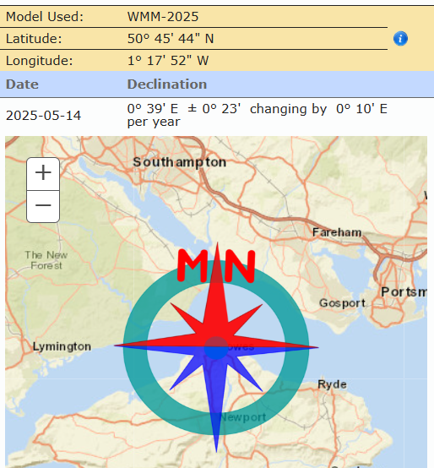
Magnetic North vs True North
True Heading → Compass Course
C_{m} = C_{v} – D
C_{c} = C_{m} – d,
Assume Deviation d ≈ 0
So, C_{c} = C_{v} – D
use minus
Log | Position | Cc | d | Cm | D | Cv | dér. | Rs | Crt | Rf | Notes
… | ..N .. …E .. | 134 | 0 |  | 1 | 135 |  | 135 |  | 135

Slide 11


The Leeway dér.
$$L$$
Wind
Port tack ⇒ dér. > 0
Starboard tack ⇒ dér. < 0
$$45′$$
$$C_{v}=R_{s}−der.$$
close hauled: | dér.| ≈ 10
$$R_{s}=R_{f}$$
beam reach: | dér.| ≈ 5
broad reach: | dér.| ≈ 3
$$36^{o}40′ N$$
$$G$$
use minus
$$25′$$
$${002}^{o}30′ E$$
$$35′$$
Log | Position | Cc | d | Cm | D | Cv | dér. | Rs | Crt | Rf | Notes
… | ..N .. …E .. |  |  |  |  | 130 | 5 | 135 |  | 135

Slide 12
Why there are Tides
The basics

Slide 13
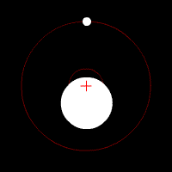
The Earth-Moon System
Daily Rotation around the common center of gravity
Two maxima, ca. 45 cm
  One maximum “under” the moon,
  due to the gravitational pull of the moon
  The other on the opposite side,
  due to the centrifugal force being larger than the gravitational pull

Slide 14
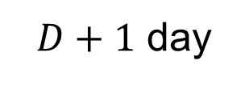


Moon Going Around the Earth
Daily shift of the tidal curve by ca. 50 min
After 24 hours the moon is in position D+1
Observer needs to travel a tad extra:
$D+1$ day
$$D$$
$∆t=t_{HW}^{D+1}−t_{HW}^{D} ≈50 min$

Slide 15
Effects of the Geography
Higher amplitude
  Bay of Fundy
  St. Malo
  Solent / southern Brittany / German Bight
Actually, there are also areas with smaller, even 0, amplitude
Different times for high/low water
Distortion of the tide curve

Slide 16
A Third Body in the System: The Sun
Slightly less effect than moon
The tidal wave remains effectively “under” the moon, i.e., high water when moon is in the south
Superposition leads to neap tides and spring tides

Slide 17
Monthly Cycle: Springs and Neaps
New moon
Addition of the effects of moon and sun — spring tides
High water (moon in the south) at about 12:00 (sun also in the south)

Slide 18
Monthly Cycle: Springs and Neaps
First quarter
Partial compensation of the effects of moon and sun — neap tides
High water (moon in the south) at about 18:00 (sun setting in the west)

Slide 19
Monthly Cycle: Springs and Neaps
Full moon
Addition of the effects of moon and sun — spring tides
High water (moon in the south) at about 00:00 (sun in the “north”)

Slide 20
Monthly Cycle: Springs and Neaps
Third quarter
Partial compensation of the effects of moon and sun — neap tides
High water (moon in the south) at about 06:00 (sun rising in the east)

Slide 21
Tidal Range Oscillates → (Tidal) Coefficients
Tidal Coefficients: Measure for the tidal range (not only HW!)
  This is about the amplitude (not only high water)
  During springs, high water higher, low water lower
  During neaps, high water lower, low water higher
20 ≤ Coeff ≤ 120
Equinoxes
20
45
70
95
120

Slide 22
Monthly Cycle: Springs and Neaps
Equivalence of coefficient and HW/LW times
Constellation (south up)
Phase | New Moon | First Quarter | Full Moon | Third Quarter
Springs / neaps | Spring tide | Neap tide | Spring tide | Neep tide
HW time | 12:00 | 18:00 | 00:00 | 06:00
Average Coeff | 95 | 45 | 95 | 45

Slide 23
Yearly Cycle: Earth-Moon System Travels around the Sun
Spring equinox | ca. 20th March |  | Strong tides In particular, when coinciding with full/new moon
Summer solstice | ca. 21st June
Autumn equinox | ca. 22nd September |  | Strong tides In particular, when coinciding with full/new moon
Winter solstice | ca. 21st December

Slide 24
Coefficients Over The Year
Cherbourg 2025 (Jan-Nov)
Lag of springs and neaps compared to moon phase: Age de la marée
Note the effects of the equinoxes and the summer solstice

Slide 25
Meteorological Effects
Air pressure
Wind
It can happen that water does not recede during the ebb

Slide 26
Main Problem #1: Depth as Function of Time

Slide 27
Chart Datum and Related Quantities
Dark Sea Green areas cover and uncover
Bisque areas never cover (“land”)
Depths are with respect to the chart datum
Heights in the uncovering area are with respect to the chart datum
Heights on land are with respect to the average spring high water (coefficient 95)

Slide 28
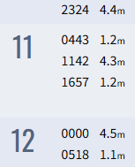
Principal Ports
High Water Portsmouth, May 2025:
High Water Portsmouth, May 2025
Times per Royal Yacht Squadron, Cowes
  https://www.rys.org.uk/yachting/tides
  In UT/BST as appropriate
More general source: Reeds Nautical Almanac
Tides |  | LT |  | HT |  | LT |  | HT
Port | Coeff | Time | Height | Time | Height | Time | Height | Time | Height
Portsmouth |  | 04:43 | 1.2 | 11:42 | 4.3 | 16:47 | 1.2 | 00:00 | 4.5

Slide 29
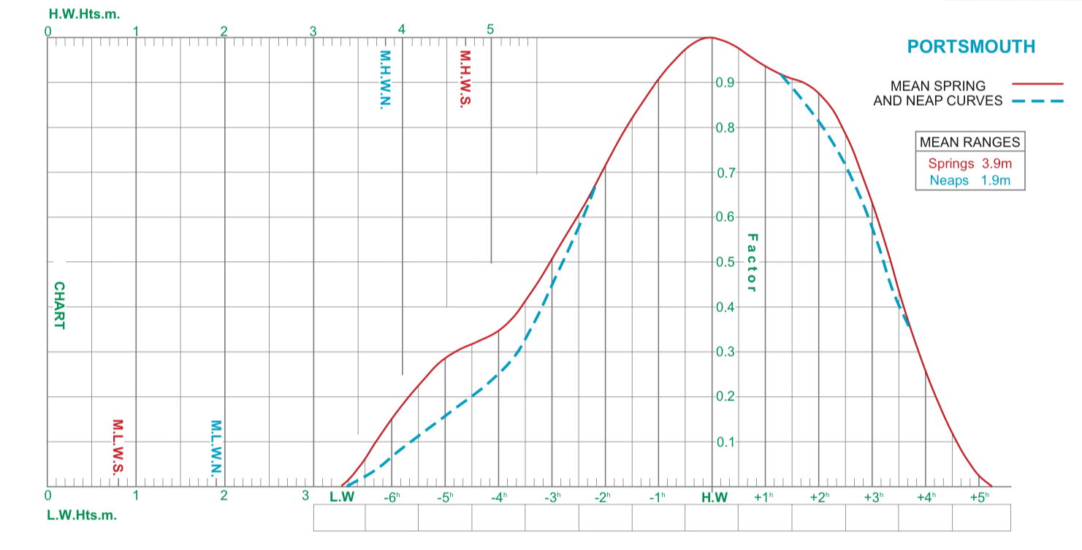
Tidal Curves
Portsmouth
Including plotting area for graphical determination heights/times

Slide 30
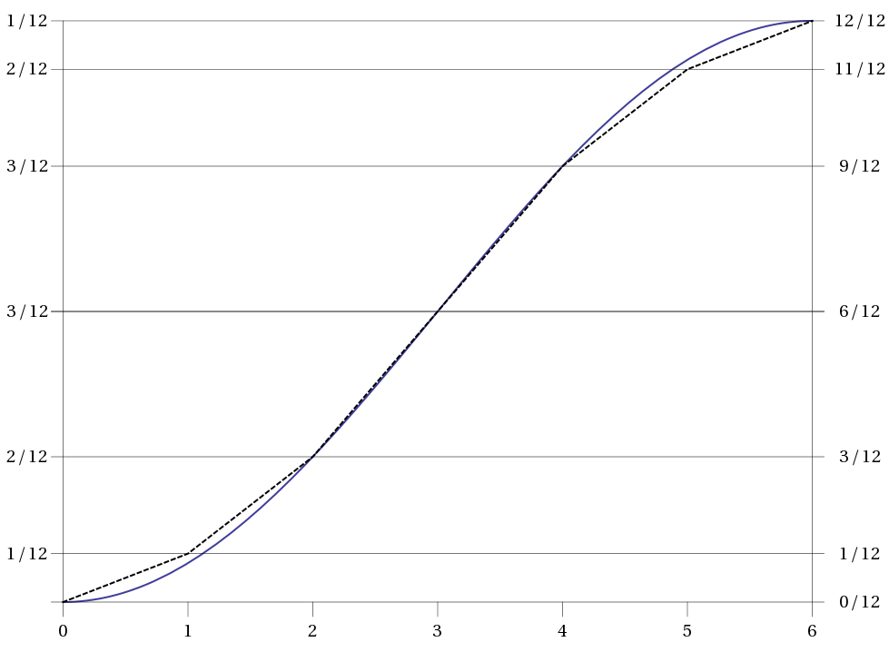
Approximation of the Tide Curve: Rule of Twelfths
Assume a tidal range of 6 m
So, 1/12 = 0.5 m
Hour since LW | Tidal Range Fraction | Δh with respect to LW
0 |  | 0
1 | 1/12 | 0.5 m
2 | 2/12 | 1.5 m
3 | 3/12 | 3.0 m
4 | 3/12 | 4.5 m
5 | 2/12 | 5.5 m
6 | 1/12 | 6.0 m

Slide 31
Secondary Ports
British Approach, Example 1
 | TIME DIFFERENCES |  |  |  | HEIGHT DIFFERENCES
 | High Water |  | Low Water |  | MHWS | MHWN | MLWN | MLWS
Plymouth (Devonport) | 00:00 and 12:00 | 06:00 and 18:00 | 00:00 and 12:00 | 06:00 and 18:00 | 5.5 | 4.4 | 2.2 | 0.8
Starcross | +00:40 | +01:10 | +00:55 | +00:25 | -1.4 | -1.5 | -0.8 | -0.1
If HW at Plymouth is at midnight or midday, 40 min to be added for Starcross.
If HW at Plymouth is at 06:00 or 18:00, 1 h 10 min to be added for Starcross.
If HW height at Plymouth is 5.5 m, 1.4 m to be deducted for Starcross.
If HW height at Plymouth is 4.4 m, 1.5 m to be deducted for Starcross.

Slide 32
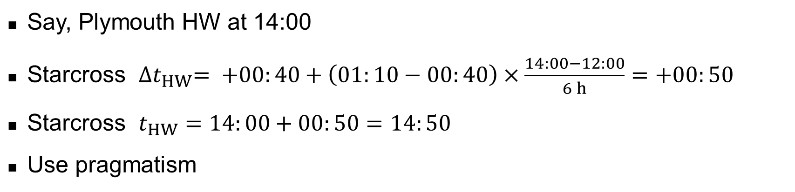
Secondary Ports
Time Interpolation, Example 1
 | TIME DIFFERENCES |  |  |  | HEIGHT DIFFERENCES
 | High Water |  | Low Water |  | MHWS | MHWN | MLWN | MLWS
Plymouth (Devonport) | 00:00 and 12:00 | 06:00 and 18:00 | 00:00 and 12:00 | 06:00 and 18:00 | 5.5 | 4.4 | 2.2 | 0.8
Starcross | +00:40 | +01:10 | +00:55 | +00:25 | -1.4 | -1.5 | -0.8 | -0.1
Say, Plymouth HW at 14:00
Starcross ${∆t}_{HW}= +00:40+\left(01:10−00:40\right)×\frac{14:00−12:00}{6 h}=+00:50$
Starcross $t_{HW}=14:00+00:50=14:50$
Use pragmatism

Slide 33
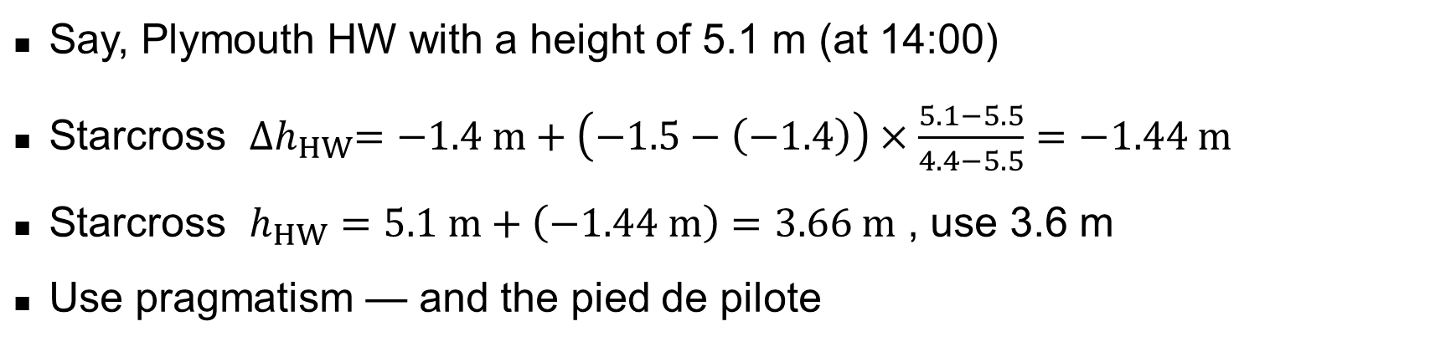
Secondary Ports
Height Interpolation, Example 1
 | TIME DIFFERENCES |  |  |  | HEIGHT DIFFERENCES
 | High Water |  | Low Water |  | MHWS | MHWN | MLWN | MLWS
Plymouth (Devonport) | 00:00 and 12:00 | 06:00 and 18:00 | 00:00 and 12:00 | 06:00 and 18:00 | 5.5 | 4.4 | 2.2 | 0.8
Starcross | +00:40 | +01:10 | +00:55 | +00:25 | -1.4 | -1.5 | -0.8 | -0.1
Say, Plymouth HW with a height of 5.1 m (at 14:00)
Starcross ${∆h}_{HW}=−1.4 m+\left(−1.5−\left(−1.4\right)\right)×\frac{5.1−5.5}{4.4−5.5}=−1.44 m$
Starcross $h_{HW}=5.1 m+\left(−1.44 m\right)=3.66 m$ , use 3.6 m
Use pragmatism — and the pied de pilote

Slide 34
Secondary Ports
Logbook, Example 1
Fill in the deltas or the absolute values
French approach: Coefficients instead of HW/LW times to chose the set of the corrections
Tides |  | HT
Port | Coeff | Time | Height | Time | Height | Time | Height | Time | Height
Plymouth |  | 14:00 | 5.1
Starcross |  | +00:50 | -1.44
 |  | 14:50 | 3.66

Slide 35
Secondary Ports
British Approach, Example 2
 | TIME DIFFERENCES |  |  |  | HEIGHT DIFFERENCES
 | High Water |  | Low Water |  | MHWS | MHWN | MLWN | MLWS
Portsmouth | 00:00 and 12:00 | 06:00 and 18:00 | 05:00 and 17:00 | 11:00 and 23:00 | 4.7 | 3.8 | 1.9 | 0.8
Yarmouth | -01:05 | +00:05 | -00:25 | -00:30 | -1.7 | -1.2 | -0.3 | 0.0
If HW at Portsmouth is at midnight or midday, 65 min to be deducted for Yarmouth.
If HW at Portsmouth is at 06:00 or 18:00, 5 min to be added for Yarmouth.
If HW height at Portsmouth is 4.7 m, 1.7 m to be deducted for Yarmouth.
If HW height at Portsmouth is 3.8 m, 1.2 m to be deducted for Yarmouth.

Slide 36
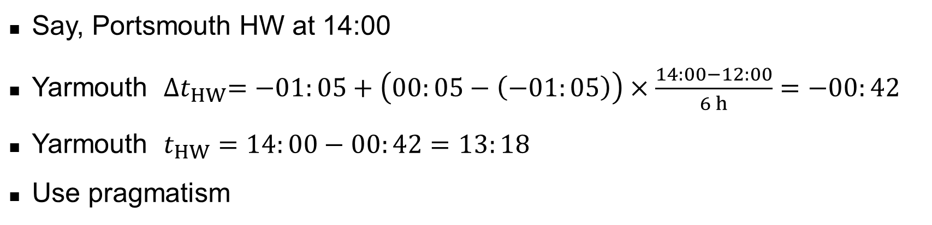
Secondary Ports
Time Interpolation, Example 2
 | TIME DIFFERENCES |  |  |  | HEIGHT DIFFERENCES
 | High Water |  | Low Water |  | MHWS | MHWN | MLWN | MLWS
Portsmouth | 00:00 and 12:00 | 06:00 and 18:00 | 05:00 and 17:00 | 11:00 and 23:00 | 4.7 | 3.8 | 1.9 | 0.8
Yarmouth | -01:05 | +00:05 | -00:25 | -00:30 | -1.7 | -1.2 | -0.3 | 0.0
Say, Portsmouth HW at 14:00
Yarmouth ${∆t}_{HW}=−01:05+\left(00:05−\left(−01:05\right)\right)×\frac{14:00−12:00}{6 h}=−00:42$
Yarmouth $t_{HW}=14:00−00:42=13:18$
Use pragmatism

Slide 37
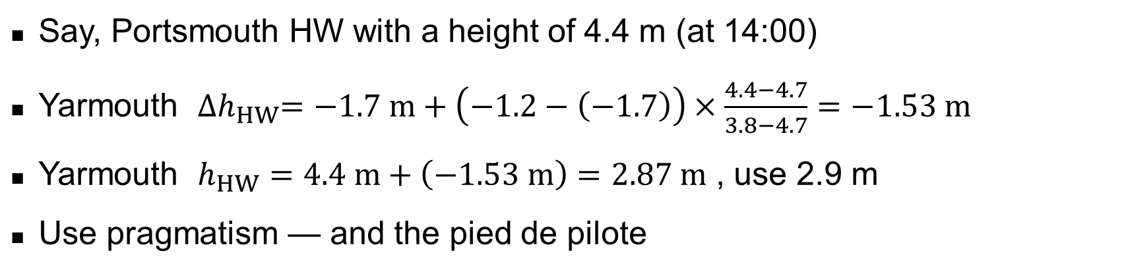
Secondary Ports
Height Interpolation, Example 2
 | TIME DIFFERENCES |  |  |  | HEIGHT DIFFERENCES
 | High Water |  | Low Water |  | MHWS | MHWN | MLWN | MLWS
Portsmouth | 00:00 and 12:00 | 06:00 and 18:00 | 05:00 and 17:00 | 11:00 and 23:00 | 4.7 | 3.8 | 1.9 | 0.8
Yarmouth | -01:05 | +00:05 | -00:25 | -00:30 | -1.7 | -1.2 | -0.3 | 0.0
Say, Portsmouth HW with a height of 4.4 m (at 14:00)
Yarmouth ${∆h}_{HW}=−1.7 m+\left(−1.2−\left(−1.7\right)\right)×\frac{4.4−4.7}{3.8−4.7}=−1.53 m$
Yarmouth $h_{HW}=4.4 m+\left(−1.53 m\right)=2.87 m$ , use 2.9 m
Use pragmatism — and the pied de pilote

Slide 38
Secondary Ports
Logbook, Example 2
Fill in the deltas or the absolute values
French approach: Coefficients instead of HW/LW times to chose the set of the corrections
Tides |  | HT
Port | Coeff | Time | Height | Time | Height | Time | Height | Time | Height
Portsmouth |  | 14:00 | 4.4
Yarmouth |  | -00:42 | -1.53
 |  | 13:18 | 2.9

Slide 39
Main Problem #2: Current as Function of Time

Slide 40
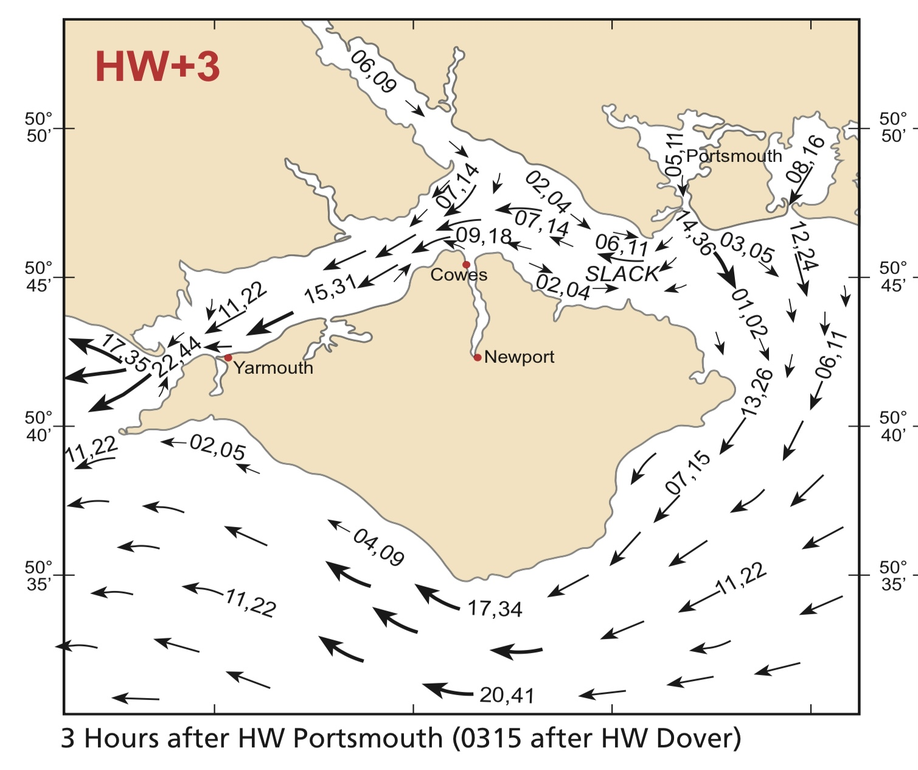
Currents as Function of Time
Tidal Stream Atlases
Speed
  1/10 kn
  Neaps, springs
… and Direction
… for every hour relative to HW
  Tidal hour lasts from half an hour before the nominal time to half an hour after
  In the example,
  from HW+2 ½ to HW+3 ½

Slide 41
Currents as Function of Time
Tidal Diamonds
 |  | J | ..N .. …E ..
Before High Water | -6 | 064 | 1.0 0.5
 | -5 | 053 | 2.8 1.5
 | -4 | 047 | 3.7 2.0
 | -3 | 045 | 3.9 2.1
 | -2 | 040 | 3.1 1.6
 | -1 | 035 | 2.0 1.0
HW | 0 | 206 | 0.6 0.3
After High Water | +1 | 231 | 2.7 1.4
 | +2 | 226 | 4.1 2.2
 | +3 | 225 | 4.3 2.2
 | +4 | 226 | 3.2 1.7
 | +5 | 236 | 1.7 0.9
 | +6 | 139 | 0.3 0.1
Direction
Rate at spring tides in knots
Rate at neap tides in knots
J

Slide 42



How to go from CTW to COG
From Surface to Seabed
Figure out the applicable current vector
Vector addition:
This yields a prediction of where we end up, given a specific R_{s}
Fill in the missing parts in the logbook:
$$\vec{R_{s}}$$
$${\vec{R_{f}} }_{ }=\vec{R_{s}}+\vec{Crt}$$
$$\vec{Crt}$$
use plus
Log | Position | Cc | d | Cm | D | Cv | dér. | Rs | Crt | Rf | Notes
… | ..N .. …E .. |  |  |  |  |  |  | 120 | 185 3.0 | 140 | v_{s} = 8 kn

Slide 43




How to go from COG to CTW
From Seabed to Surface
Figure out the applicable current vector
Vector subtraction:
This yields a verification of our R_{s} given a specific R_{f}
Or a verification of the current:
Fill in the missing parts in the logbook:
$\vec{R_{s}}$ $=\vec{R_{f}}−\vec{Crt}$
$${\vec{R_{f}} }_{ }$$
$$−\vec{Crt}$$
$\vec{R_{f}}−\vec{R_{s}}=\vec{Crt}$
use minus
Log | Position | Cc | d | Cm | D | Cv | dér. | Rs | Crt | Rf | Notes
… | ..N .. …E .. |  |  |  |  |  |  | 120 | 185 3.0 | 140 | v_{f} = 11 kn

Slide 44
Putting it all Together
The preparation of the day
Constant adaptation

Slide 45
Preparation of a Stage
Principle
WP 5
WP 6
WP 4
WP 3
WP 7
WP 2
WP 1

Slide 46
Preparation of a Stage
Basic Checklist
Identity port of arrival, an alternative as well as shelters en route
Take down the weather forecast
Study the chart and plot the Course Over Ground, R_{f}
Determine noticeable beacons and the appropriate way points
Note
  the features of the noticeable beacons
  the coordinates of the way-points
  the R_{f}, the D_{f} and the rough C_{c} for every leg
Enter the way-points in the GPS, just in case...
  verify the R_{f} and D_{f} with the GPS

Slide 47
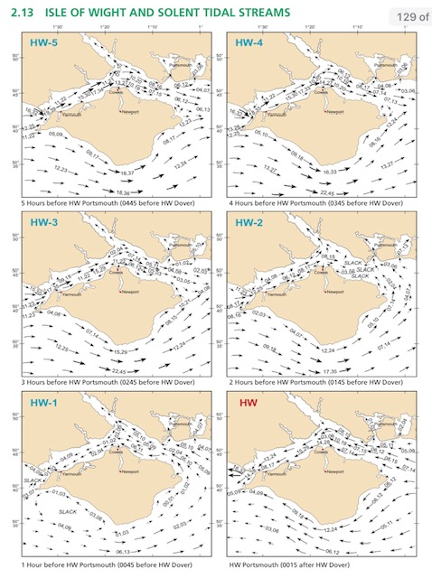
Preparation of a Stage
Additional Items for Tidal Waters
Determine the departure window for your current location
In the tidal atlas, note the actual time at which the charts apply (post-it)
Determine the rough arrival times at each waypoint
Determine the current vector for each leg
Make sure you can actually get into the port of arrival
Study the approach to the port of arrival prior to departure
12:23
13:23
14:23
15:23
16:23
17:23

Slide 48
While at Sea: Continuous Prediction & Confirmation
Navigators never sleep
Just in time for the arrival at the next waypoint
  Verify the position (and potentially the current vector for the actual leg)
  Determine the current vector for the next leg
  Determine the Magnetic Heading, C_{c}, from the envisioned COG and the current vector
It is not a fundamental issue to deviate from the stage plan:
  May even be necessary in case of unsuitable weather, issues with the boat, etc.
  Use the identified alternative arrival port and shelters
  Redo the routing checklist for the new legs

Slide 49
Some Practical Aspects in Tidal Waters

Slide 50
Practical Considerations
Avoid current against wind
Avoid running aground during the ebb
Note that current acts below water, and the wind above the waterline
The vector sum of the effect of wind and current is relevant
  Going with the current with wind from astern can lead to zero apparent wind
Mooring maneuvers against the combo of wind/current
  Usually, current prevails
  Mooring infrastructure is foreseen accordingly

Slide 51
Practical Considerations
Using transits
Switch off the log when moored
Put on life-line when on bathing platform at anchor
Mind eddies
Anticipate the change of water level also, and in particular, when moored
Anchoring is a tactical measure
  Bow and stern anchor
  Bahamian moor (“empenneler”)

Slide 52
The End

Slide 53
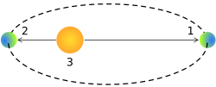
The Perihelion and Perigee / Aphelion and Apogee
Perigee: Supermoon / Apogee: Micromoon
  Effect ≈5 cm for springs
Perihelion (2)
  02nd – 04th January
  Strong tides, in particular when coinciding with full/new moon
Aphelion (1)
  03rd – 07th July
  Week tides, in particular when, coinciding with half moon

