Slide 1
Navigation rules on Swiss lakes
Michel Chevallier
Michel Chevallier - Navigation rules on Swiss lakes – YCC - 2025

Slide 2
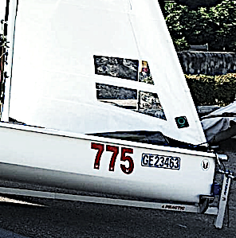

Boats are registered vehicles
There is a Swiss sailing federation,
as there is a Swiss tennis federation
It only defines rules related to competitions
Yet, boats, like cars, are vehicles registered with the state
And, as there are laws on the usage and maintenance of cars and the licenses required to drive them, there are laws
on the usage, maintenance and licenses needed for boats
Therefore, sailing (or more broadly boating) is not strictly similar to other sports from the point of view of the law
(there is no law on tennis practice for instance)
https://www.fedlex.admin.ch/eli/cc/1979/337_337_337/fr: Ordonnance sur la navigation dans les eaux intérieures (ONI)
Available in F/D/It
Michel Chevallier
The registration plate on one of our Melges 15
Michel Chevallier - Navigation rules on Swiss lakes – YCC – 2025 – 1

Slide 3
Today’s topics
Boats on Swiss lakes are subject to rules concerning mostly:
  International regulations
  Licenses
  Right of way
  Equipment (construction, buoyancy aids ...)
  Crew behavior
  Weather warnings
All sailing legislation anywhere have an overarching rationale: avoiding accidents and collisions
Let’s browse it!
Michel Chevallier
Did you know:
If you are caught drunk driving, you will not lose your sailing licenses, but if you area caught drunk sailing you may well lose your driving licenses
As for car driving, the limit is 5 per thousand
Michel Chevallier - Navigation rules on Swiss lakes – YCC – 2025 – 2

Slide 4
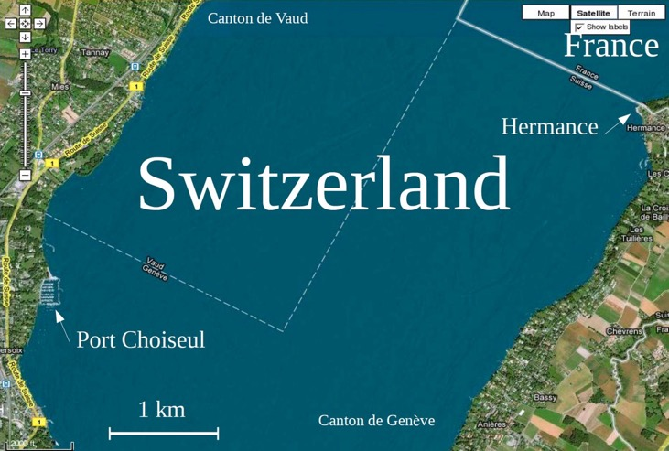
CH shares 4 lakes with neighboring countries: Bodensee, Lago Maggiore, Lake Lugano and Lake Geneva. For each one, there is an international agreement relative to navigation
A very close border
Switzerland shares 4 lakes with neighboring countries: Bodensee, Lago Maggiore, Lake Lugano and Lake Geneva.
For each one, there is an international agreement relative to navigation that slightly alters the Swiss basic law
Michel Chevallier
Our base is on the GE-VD border and very close to France
The red square shows the sailing area for dinghy classes and Thursday practice
Michel Chevallier - Navigation rules on Swiss lakes – YCC – 2025 – 3

Slide 5
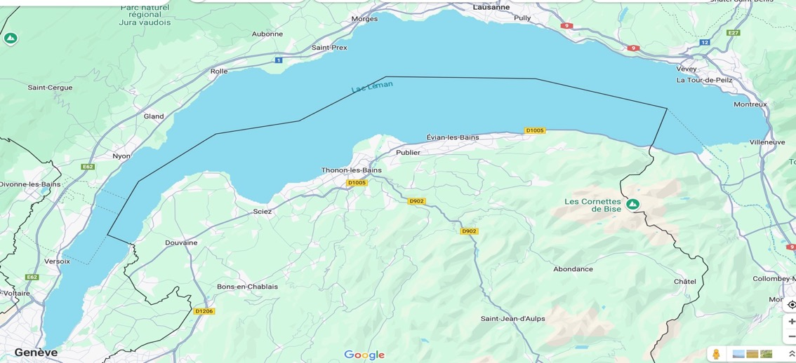
One lake, two nations
Border
Border
Border
Border
Michel Chevallier
Our harbour
Michel Chevallier - Navigation rules on Swiss lakes – YCC – 2025 – 4

Slide 6
The Swiss-French agreement
L’Accord franco-Suisse sur la navigation sur la lac Léman of December 1976 is available at https://www.fedlex.admin.ch/eli/cc/1978/1987_1987_1987/fr
It states that each country is responsible for policing its own part of the lake, according to its own legislation
As far as their equipment is concerned, boats must comply
with the provisions of the agreement AND with the provisions
of the country where they are harboured
For motor boats over 10HP (the Q-Boat and Mother Duck II), a license delivered by the country where the driver has is residence (meaning either Switzerland or France) is mandatory
If the driver is not a resident of one of these, a license delivered by the country where the boat is registered is mandatory
Michel Chevallier
Michel Chevallier - Navigation rules on Swiss lakes – YCC – 2025 – 5

Slide 7
French regulations
In addition to the Swiss law, France has its own regulations for the Lake Geneva
  Règlement particulier de police de la navigation sur le lac Léman
  Règlement de police de la navigation intérieure
When navigating on the French side of the lake, you must have onboard,
as hard or digital copy
  Le Règlement de navigation sur le Léman (RNL)
  Le Règlement général de police de la navigation intérieure (RGP)
  Le Règlement particulier de police de la navigation sur le lac Léman (RPP) sous
This is the skipper responsibility. We advise you to download them to your phone
All French texts are available at
https://www.haute-savoie.gouv.fr/Actions-de-l-Etat/Vos-loisirs/Lacs-et-cours-d-eau/Vos-loisirs-sur-le-lac-Leman-et-ses-rives/Naviguer-sur-le-lac-Leman#rnl
Michel Chevallier
Michel Chevallier - Navigation rules on Swiss lakes – YCC – 2025 – 6

Slide 8
Licenses
With respect to our fleet, Switzerland requires an official license in the following cases:
  for sailboats having sails areas above 15m² (D, one must be over 14 to have one)
  for boats (including sailboats) with engines developing more than 8HP (6KW) (A, one must be over 18 to have one)
Swiss residents must have them to sail our bigger boats
Up to 2023, Geneva recognized the national licenses (Polish, German..) of French residents. Not anymore (note that France does not issue sailing permits)
To skipper a boat of the above-mentioned groups, French residents must own either
  A Swiss license
  A Cruising Club Suisse Sea license with the sailing option
  An international certificate issued on the basis of UNECE resolution Nr 40
The skipper of a boat having an engine exceeding 6 HP (4.5 KW) must have a license
to sail in French waters
Michel Chevallier
Michel Chevallier - Navigation rules on Swiss lakes – YCC – 2025 – 7

Slide 9
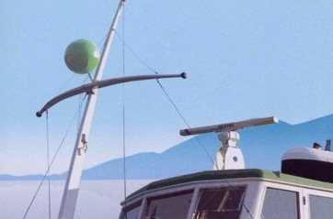
Priority rules
The priority order is (boats on top have priority over boats below):
  1 Passenger boats (Bateaux en service régulier) - they display a green balloon
    2 Professional fishermen - they display a yellow balloon
      3 Sailing boats (we the YCC)
        4 Rowing boats
          5 Motorboats
            6 Windsurfs, kitesurfs and paddles
As a common sense rule, always keep away of
  CGN boats (legally, you must not approach them at less than 50 m)
  Fishermen, whether professional (yellow balloon) or recreational (no sign), and nets
  Regattas
  Never pass too close to another boat
This is an important mix of legal, safety and common sense rules
Michel Chevallier - Navigation rules on Swiss lakes – YCC – 2025 – 8

Slide 10
Priority rules between sailing boats
Right-of-way between sailing boats is decided on the basis of the wind direction
  Port tack: wind from port – the color red is associated with port (French : babord)
  Starboard tack: wind from starboard – the color green is associated with starboard (French: tribord)
When these boats meet, the boat receiving wind
by starboard (A) has priority over B. B must tack or
bear away to let A pass
B
A
Two different depictions of starboard tack vs port tack
Michel Chevallier - Navigation rules on Swiss lakes – YCC – 2025 – 9

Slide 11
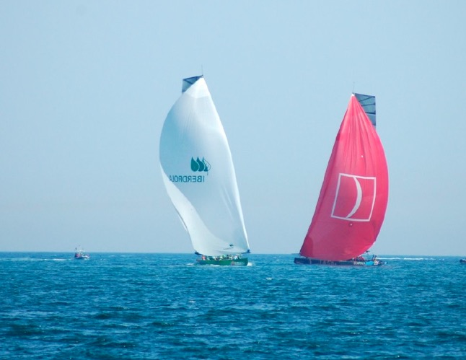
Priority rules between sailing boats - examples
B
Who has priority: the white or the red spinnaker?
Michel Chevallier - Navigation rules on Swiss lakes – YCC – 2025 – 10

Slide 12
Priority rules between sailing boats
What happens when 2 boats sail in the same direction?
The one leeward (furthest from the wind) has priority
Rationale: the windward boat has more space to maneuver
and can do so without endangering the other boat
B
Michel Chevallier - Navigation rules on Swiss lakes – YCC – 2025 – 11

Slide 13
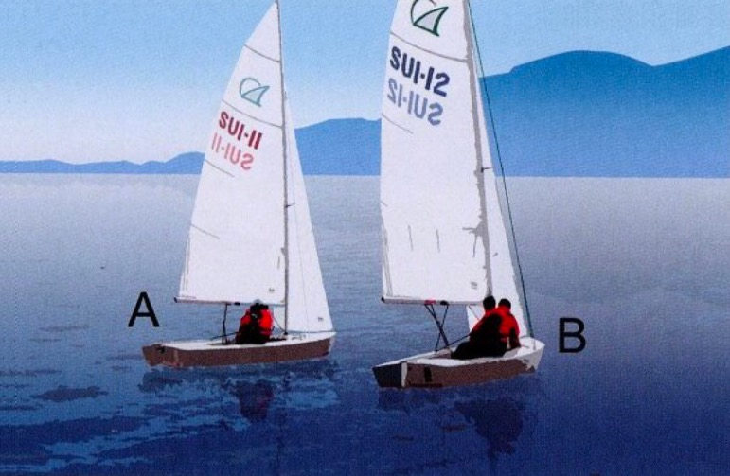
Priority rules between sailing boats - examples
B
Who has priority: Nr 11 (A) or Nr 12 (B)?
Michel Chevallier - Navigation rules on Swiss lakes – YCC – 2025 – 12

Slide 14
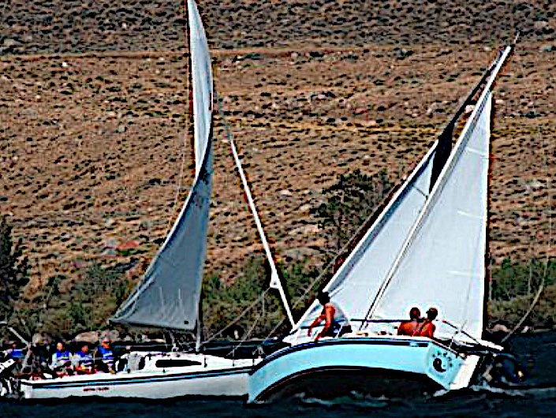
Priority rules between sailing boats - examples
B
Who has priority: the blue or the white hull?
Michel Chevallier - Navigation rules on Swiss lakes – YCC – 2025 – 13

Slide 15
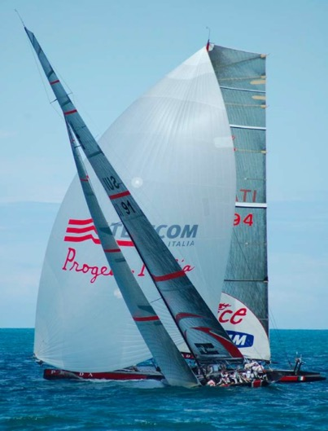
Priority rules between sailing boats - examples
B
Who has priority: the boat on close haul course, or the boat on downwind course ?
Michel Chevallier - Navigation rules on Swiss lakes – YCC – 2025 – 14

Slide 16
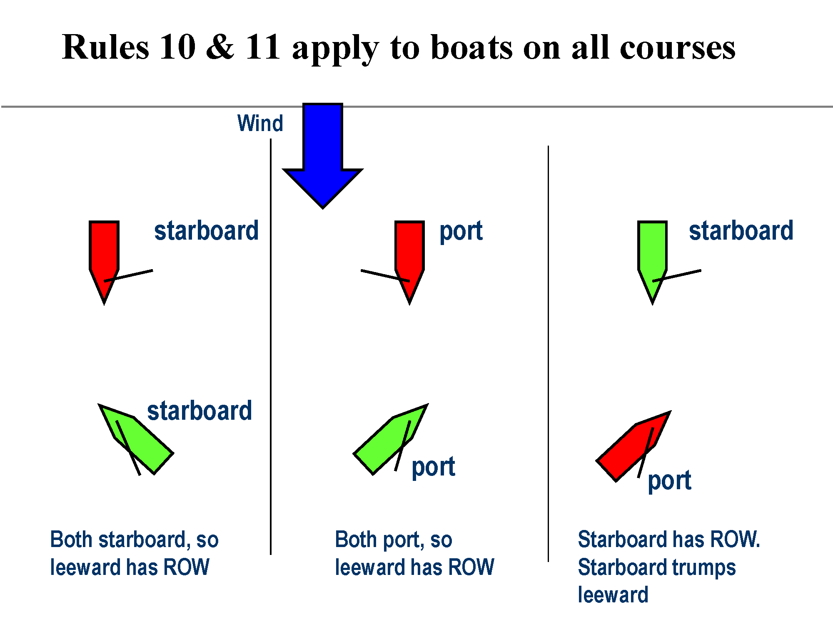
Priority rules between sailing boats - examples
B
Michel Chevallier - Navigation rules on Swiss lakes – YCC – 2025 – 15

Slide 17
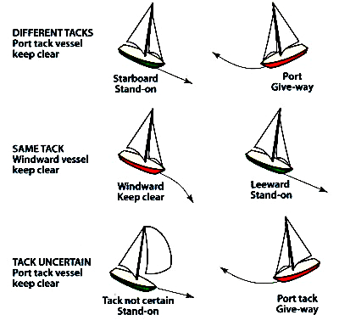
Priority rules between sailing boats - examples
B
Michel Chevallier - Navigation rules on Swiss lakes – YCC – 2025 – 16

Slide 18
Other priority situations
Harbour entrance:
  In Switzerland and on the Geneva lake, boats leaving a harbour have priority
  over those entering
  This exception from the general rule (in France or at sea, boats entering
  a harbour have priority over the boats leaving) is written into the Swiss-French agreement on Lake Geneva and is thus valid also on the French side of the lake
  Under engine, the boat that sees another motorboat on her starboard must yield
  (Remember motorboats must yield before all other boats, bar windsurf and kites)
  The right of way under engine is similar to the right of way on the road:
  the vehicle coming from the right has priority
  It applies while on the lake, in the harbour or entering the harbour
  It also applies between sailing boats rowing in the harbour (typically dinghies
  or ynglings)
An overtaking boat must keep clear of the boat being overtaken
B
Michel Chevallier - Navigation rules on Swiss lakes – YCC – 2025 – 17

Slide 19
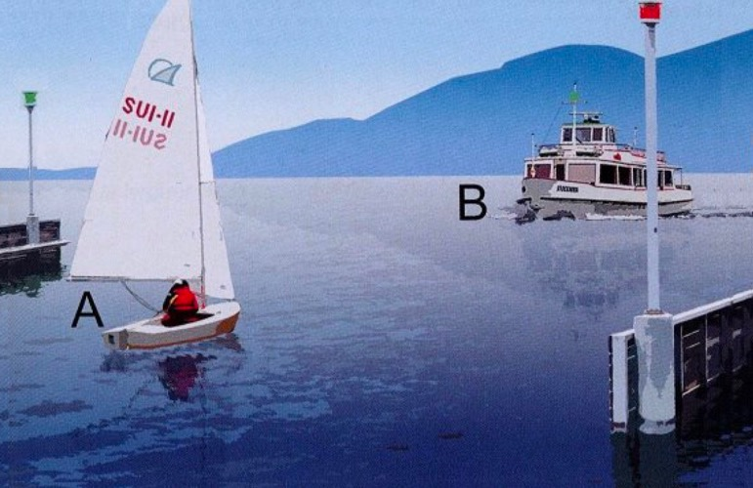
Other priority situations - examples
B
Passenger boats (bateaux en service régulier) have also priority in harbor situations.
Here, the sailing boat must change its course to let the CGN come in
Michel Chevallier - Navigation rules on Swiss lakes – YCC – 2025 – 18

Slide 20
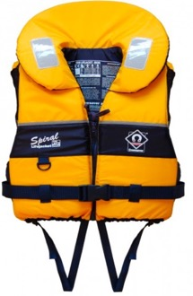
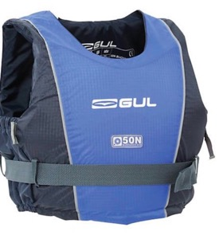
Personal flotation devices
By law, there must be one lifejacket per person in each boat
Lifejackets must have a hydrostatic push of at least 75 Newton
Boats that have no adequate storage for lifejackets (in our case dinghies
and catamarans) can be provided with buoyancy aid instead of lifejackets
It is mandatory within the club to wear a buoyancy aid on dinghies and catamarans
It is highly recommended to wear lifejackets on bigger boats with winds above 3Bft or water temperature under 18°C (typically until the end of May)
B
Buoyancy aid
Lifejacket
Michel Chevallier - Navigation rules on Swiss lakes – YCC – 2025 – 19

Slide 21
Club rule 8.2
The Club recommends that all persons on board a Club boat wear a life jacket whenever the wind reaches 4 Beaufort.
The skipper may at any time order all persons on board to wear a life jacket.
Michel Chevallier - Navigation rules on Swiss lakes – YCC – 2025 – 20

Slide 22
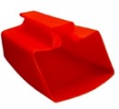
Mandatory equipment
Sailing boats with less than 15 m2 sail area must carry by law
(remember: this is the sail area above which a license in compulsory)
  A bailer or a bucket
  A hook
  A paddle
  Red flag (distress flag)
  Whistle or horn
  Ropes (useful for towing)
B
Michel Chevallier - Navigation rules on Swiss lakes – YCC – 2025 – 21

Slide 23
Skipper role and duties according to the law
The law mandates that people onboard a boat must abide by the skippers decisions and orders
It may sound obvious or trivial but it is paramount to sailing safely
Plus:
  The skipper must do everything he/she can to prevent collisions
  The skipper must provide assistance when there is an accident close to his position
  His/her manoeuvres must be unambiguous and must not create danger for others
  Whatever you think of your skipper’s decision, implement it first,
  and then discuss it - not the reverse order
The skipper is responsible for the safety of all on-board and
for the respect of the lake rules
B
Michel Chevallier - Navigation rules on Swiss lakes – YCC – 2025 – 22

Slide 24


Strong wind and gale warnings
Meteosuisse is running a network of orange lights around the lake to warn of strong winds and gales
In the Petit lac, there are lights in Geneva (La Nautique), Versoix, and Nernier
The lights operate at 40 flashes per minute when the wind is forecast
to blow between 25 and 33 knots (6 to 7 Bft) (strong wind warning)
By club rule, no dinghy nor catamaran should leave the harbour in these conditions
The lights operate at 90 flashes per minute when the wind is forecast to blow
above 33 knots (8 Bft) (gale warning)
The flashes operate for two hours
after the start of the warning.
If you don’t see them, it does not necessarily
mean the warning is over
In France (and according to club rules), no boat
may leave a harbour in these conditions
B
Michel Chevallier - Navigation rules on Swiss lakes – YCC – 2025 – 23

Slide 25
The log book
The log book can be requested by the authorities in case of an accident
Alternatively, it can be a tool in support of our good faith in such a situation
Therefore, it is extremely important to fill it correctly
Indications such as “very nice outing” provide zero value information
The skipper MUST register
  His/her first and last name
  All crew first and last names (no “Michel with friends” whose info value is again zero)
  Weather, wind strength and origin (3bft NE, strengthening to 4 around 5 pm. Showers towards the end of the outing)
  Where he/she went (sailed around Versoix, went to Geneva, went to Yvoire for supper…)
  Any other issue (lost a fender, found boat unlocked, repaired the cover)
After that, you may say whether you enjoyed it (or not). But only after that!
B
Michel Chevallier - Navigation rules on Swiss lakes – YCC – 2025 – 24

Slide 26
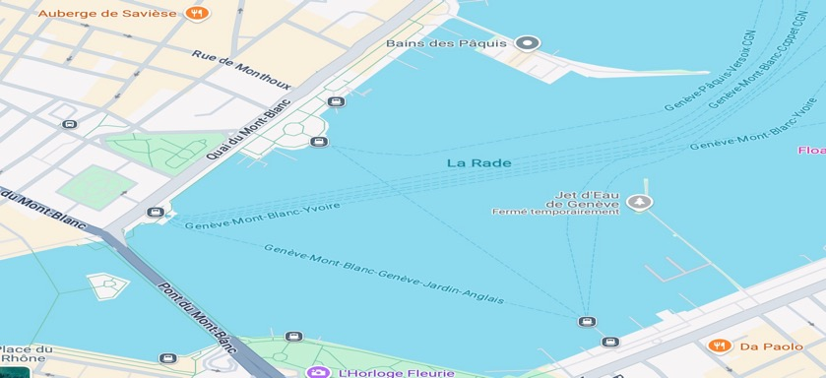
And also
By law, small boats (< 2,5m in length) and paddle must stay within 150m of the shore
It is forbidden to swim at less than 100m of the harbour entrances
Motorboat should not go faster than 10kph in the first 300m from the shore
Boats and trailer are inspected every 3 years by state inspectors
Sailing boats without engine (the ynglings) are not allowed downstream of this line:
B
Michel Chevallier - Navigation rules on Swiss lakes – YCC – 2025 – 23
Michel Chevallier - Navigation rules on Swiss lakes – YCC – 2025 – 25

Slide 27
B
Questions?
Michel Chevallier - Navigation rules on Swiss lakes – YCC – 2025 – 26

