Slide 1

Physics Beyond Colliders
Enhancing the Scientific Diversity at CERN
Heidelberg University
G. Arduini, J. Jaeckel, G. Schnell
Most Slides adopted and adapted from Gunar Schnell ;-). Thanks!
Pictures, partial slides etc from talks at PBC Workshops, PBC reports etc..
HUGE THANKS to everybody!

Slide 2

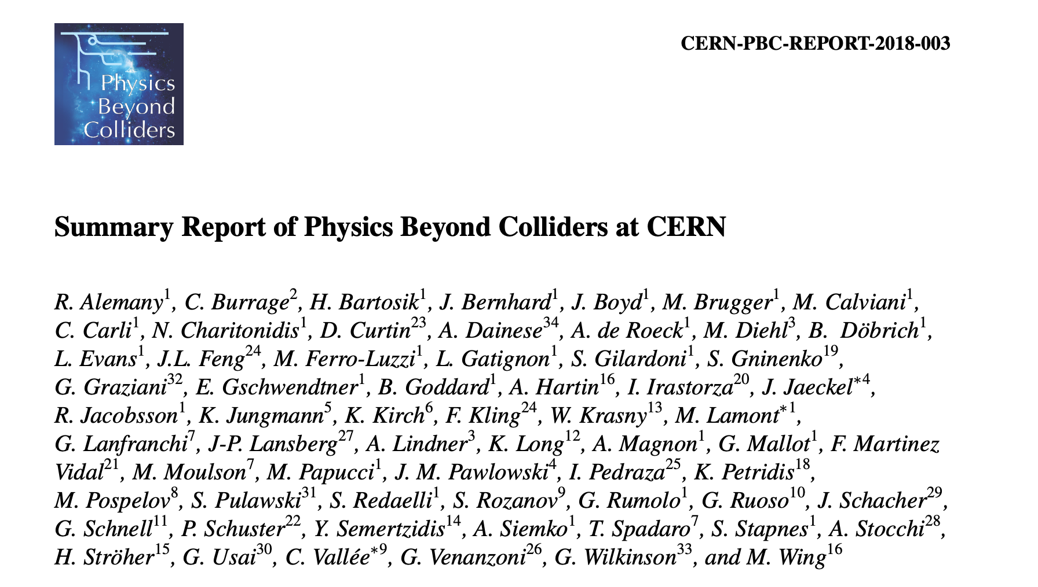
Physics Beyond Colliders
exploratory study launched in 2016
provide input for the future of CERN:
  enrich & diversify scientific program
  exploit the unique opportunities offered by CERN’s accelerator complex & scientific infrastructure
  complement the laboratory’s collider program (LHC, HL-LHC and possible future colliders)
input to the 2020 ESPP update process
Summary Report is a good source of information for many of the projects discussed here
about O(30) different projects

Slide 3
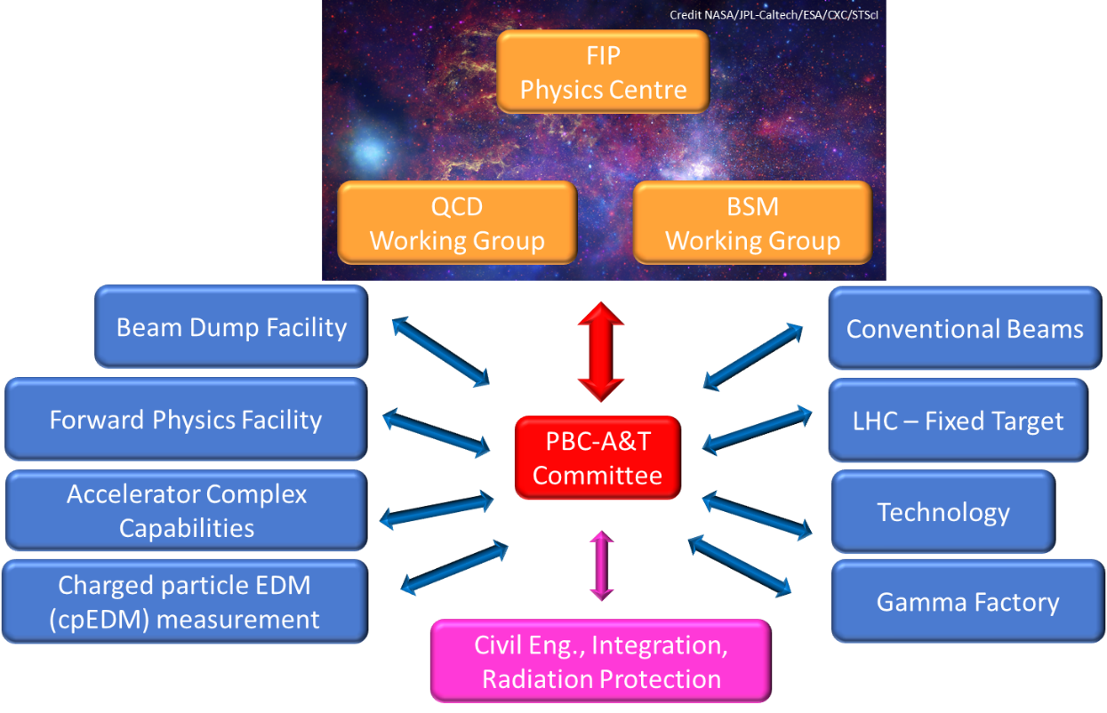
Physics Beyond Colliders
2020 Update of ESPP
updated mandate taking into account ESPP recommendations:
  increase synergies with cosmology, astroparticle, nuclear, and atomic physics
  strengthen collaboration of CERN with large National Laboratories
  act as central forum of exchanges between theorists and experimentalists
Post-EPPSU PBC events:
  March 2021: first post-EPPSU workshop: relaunch of PBC activities after EPPSU recommendations
  December 2021: general working group meeting: PBC updated organization and projects status
  November 2022: PBC annual workshop: focus on consolidations and preparations for post-LS3
  March 2024: PBC annual workshop: focus on preparations for post-LS3 and upcoming ESPP update
2021++:
organization and follow-up of activities
documented on https://pbc.web.cern.ch/

Slide 4

Physics Beyond Colliders
Physics working groups
  Physics case
  Experimental realization
  Comparison to experiments worldwide
2021++:
organization and follow-up of activities
documented on https://pbc.web.cern.ch/

Slide 5
Physics Beyond Colliders
Accelerator and Technical WG
  Develop realization
  Location
  Engineering
  Integration
2021++:
organization and follow-up of activities
documented on https://pbc.web.cern.ch/

Slide 6
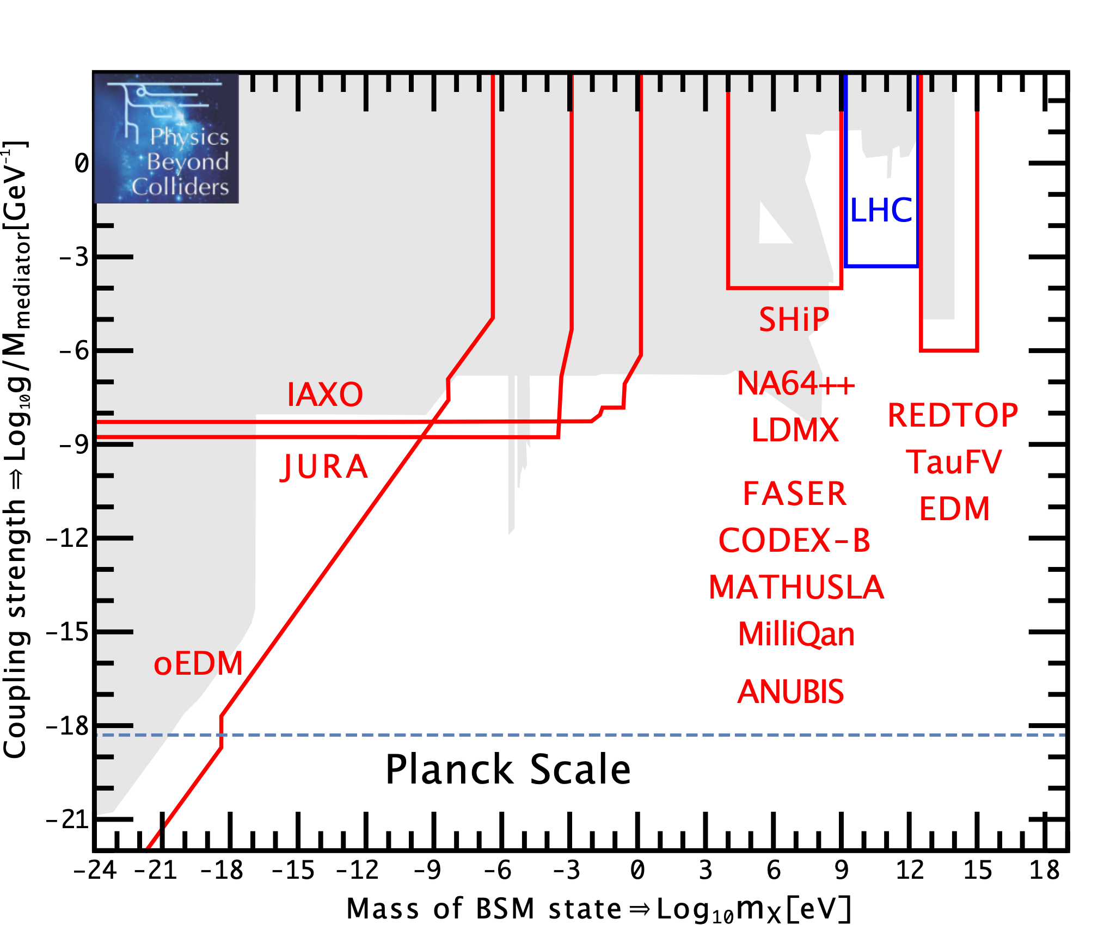





Physics Beyond the Standard Model (BSM/FPC)
EDM & non-accelerator
projects cover
the very low-mass domain
high-precision &
rare processes
experiments extend reach of high-E colliders
SPS beam dumps
probe specific
MeV—GeV domain
SM
particle
BSM
particle
40+ orders of magnitude to cover!

Slide 7
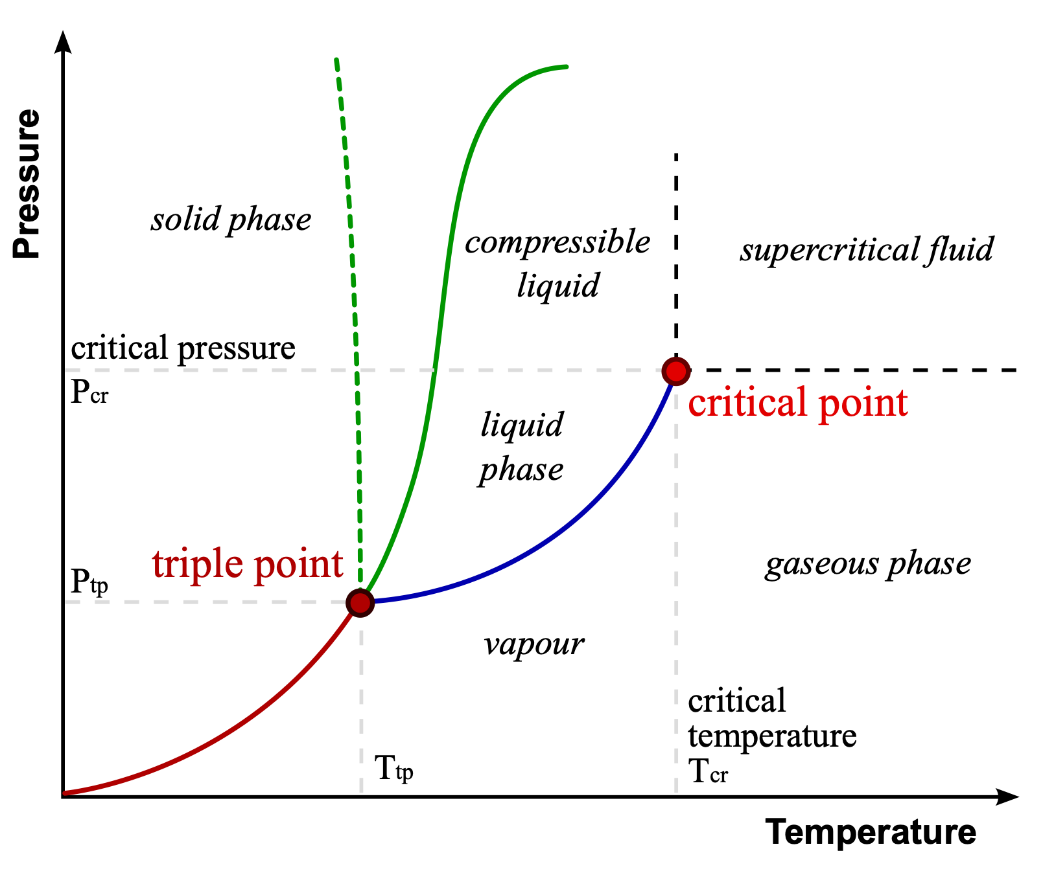
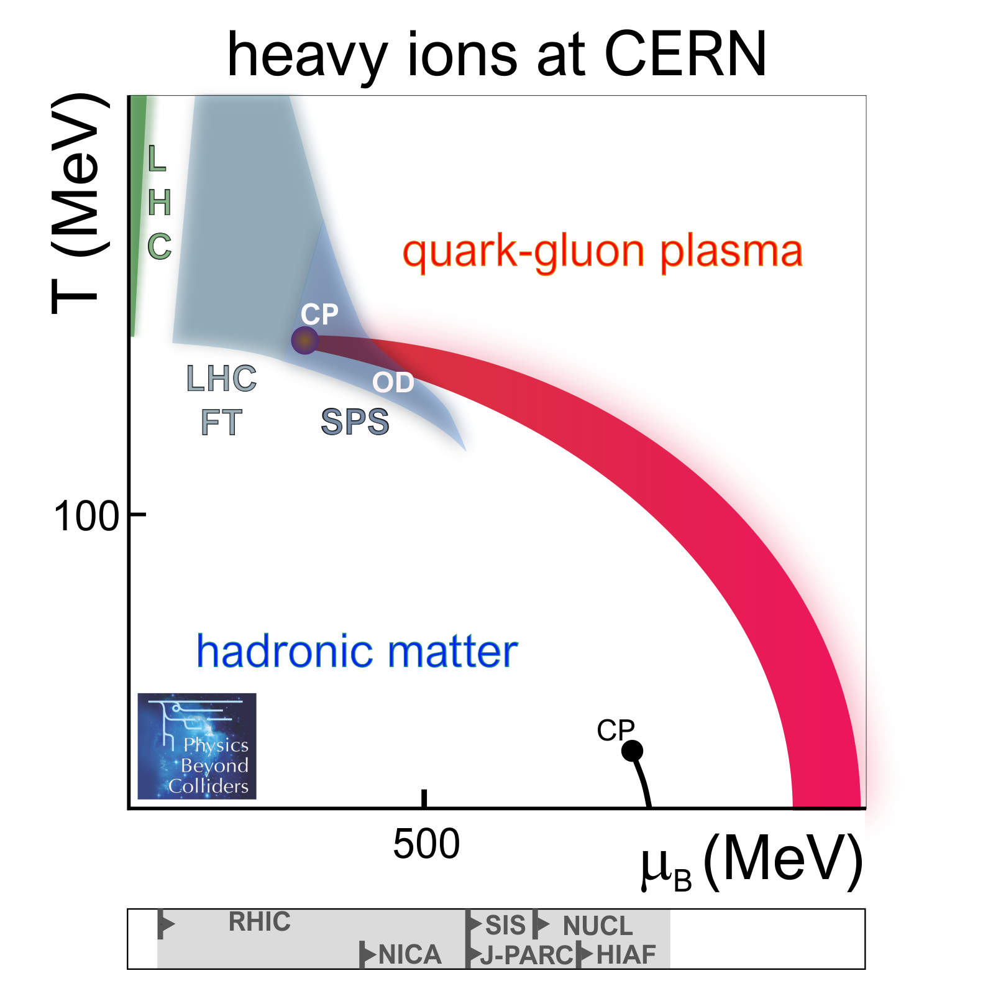


Understanding QCD (QCD)
(typical) material phases:
QCD phases:
Unique reach of LHC-FT & SPS
in transition region to high-µ_{B}
anomalous behaviour of water
By Matthieumarechal, CC BY-SA 3.0

Slide 8
Not entirely disconnected!
This can also have crucial impact on BSM searches, e.g.
  mu-e scattering
  ➔ determine hadronic vacuum polarization
  ➔ essential for (g-2)_{¹}
  Fixed target measurements with LHC beam
  ➔ PDF’s for collider searches
  ➔ IMPACT LHC BSM SEARCHES

Slide 9
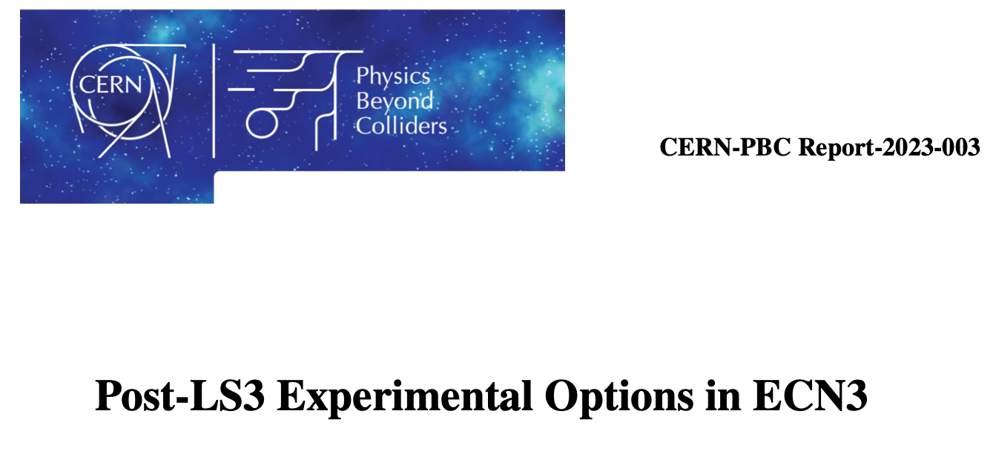
Recent developments/successes: SHiP
ECN3 decision in 2024:
  SHiP as a dedicated large-volume beam-dump experiment, among others
    Searching for feebly interacting particles
    Neutrino physics

Slide 10
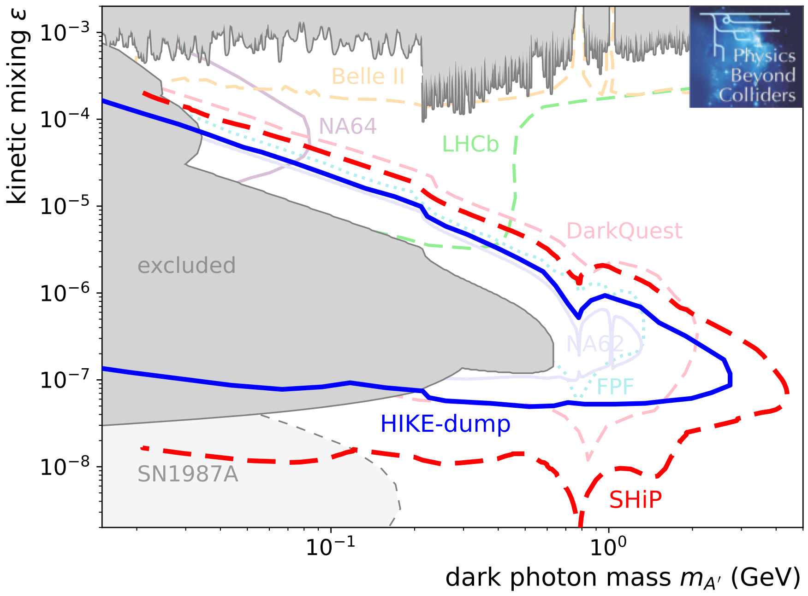
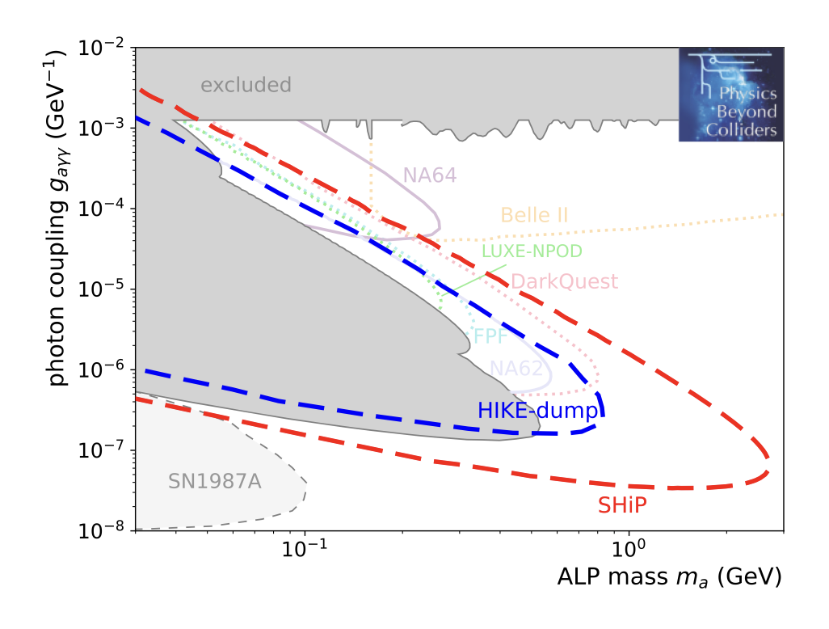
Recent developments/successes: SHiP
ECN3 decision in 2024:
  SHiP as a dedicated large-volume beam-dump experiment, among others
    Searching for feebly interacting particles
    Neutrino physics
  Dominant for many FPC benchmark models
BC1: Dark photon visible decay to SM
https://arxiv.org/pdf/2310.17726
BC9: ALP coupled to photons

Slide 11
Recent developments/successes: SHiP
ECN3 decision in 2024:
  SHiP as a dedicated large-volume beam-dump experiment, among others
    Searching for feebly interacting particles
    Neutrino physics
  Dominant for many FPC benchmark models
BC1: Dark photon visible decay to SM
Discovery would point to
new TeV scale physics!
https://arxiv.org/pdf/2310.17726
BC9: ALP coupled to photons

Slide 12
Things going on and plans

Slide 13
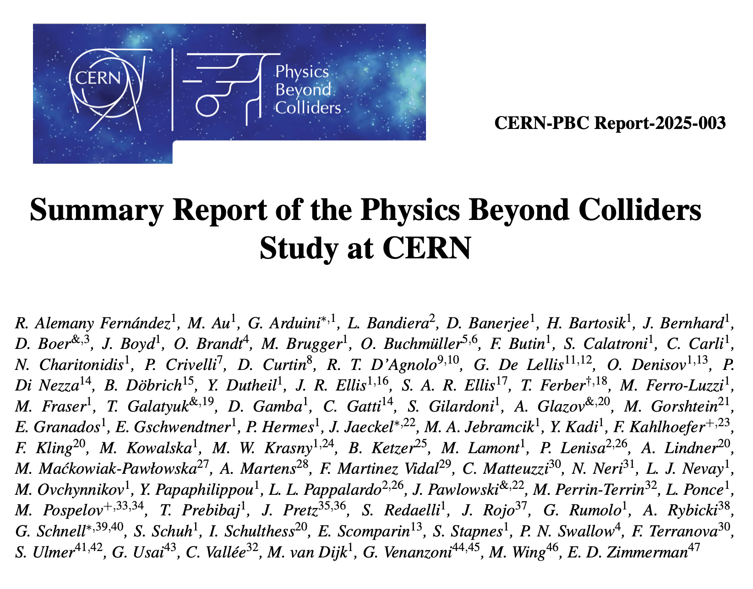
European Strategy for Particle Physics Update 2026
PBC input
https://arxiv.org/pdf/2505.00947

Slide 14
small selection out of many
PBC ideas/projects/things going on
apologies to all those I do not cover

Slide 15
FPC/BSM-Pheno/Theory

Slide 16
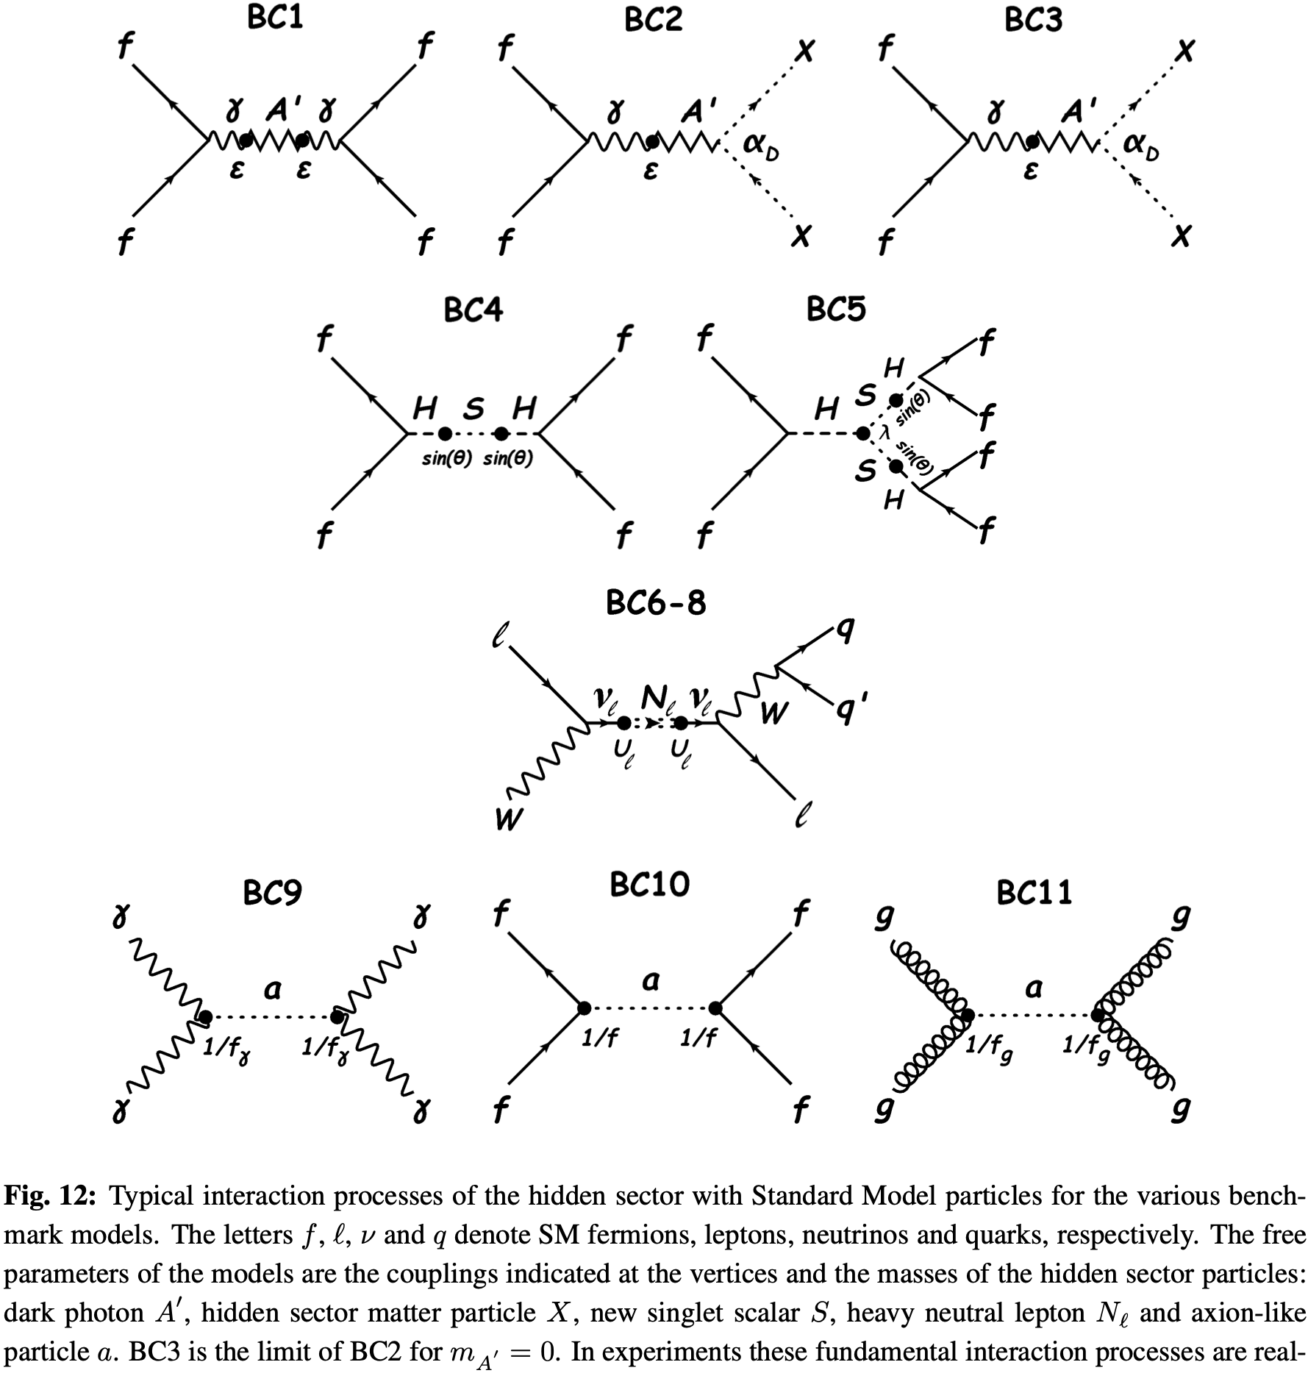
Feebly Interacting Particle Physics Center
dark sector marked by myriad of BSM scenarios
  FIP Physics Center (FPC)
  development of (existing) benchmarks and improving the calculation of experimental signals
[R. Alemany et al., CERN-PBC-REPORT-2018-003, arXiv:1902.00260]

Slide 17
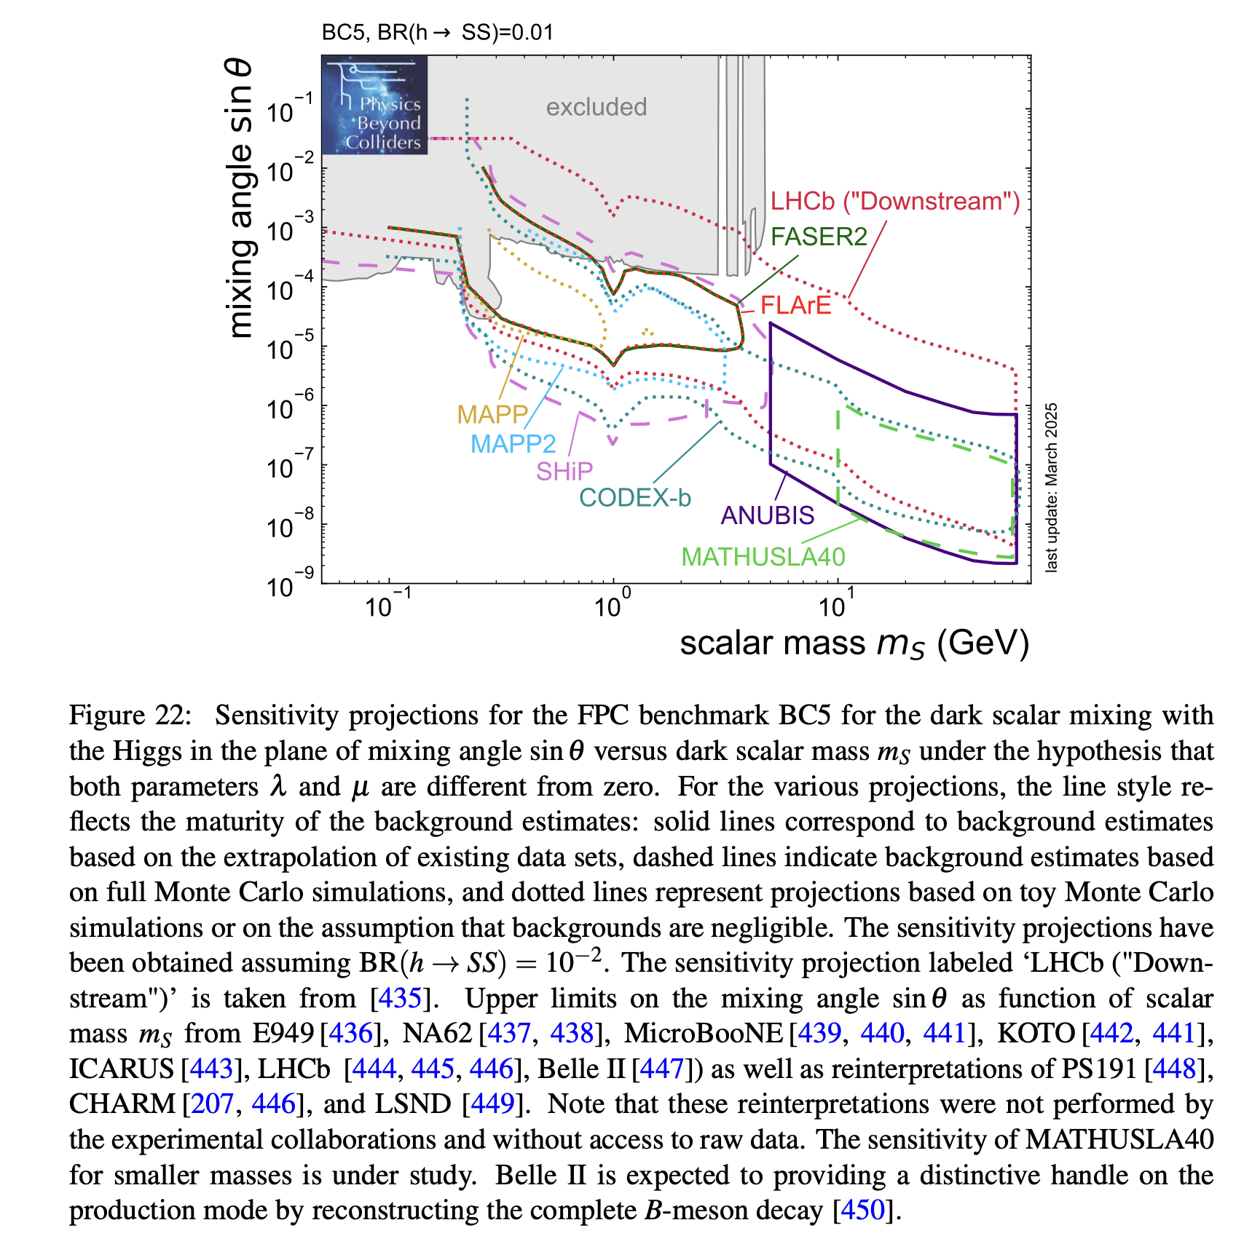
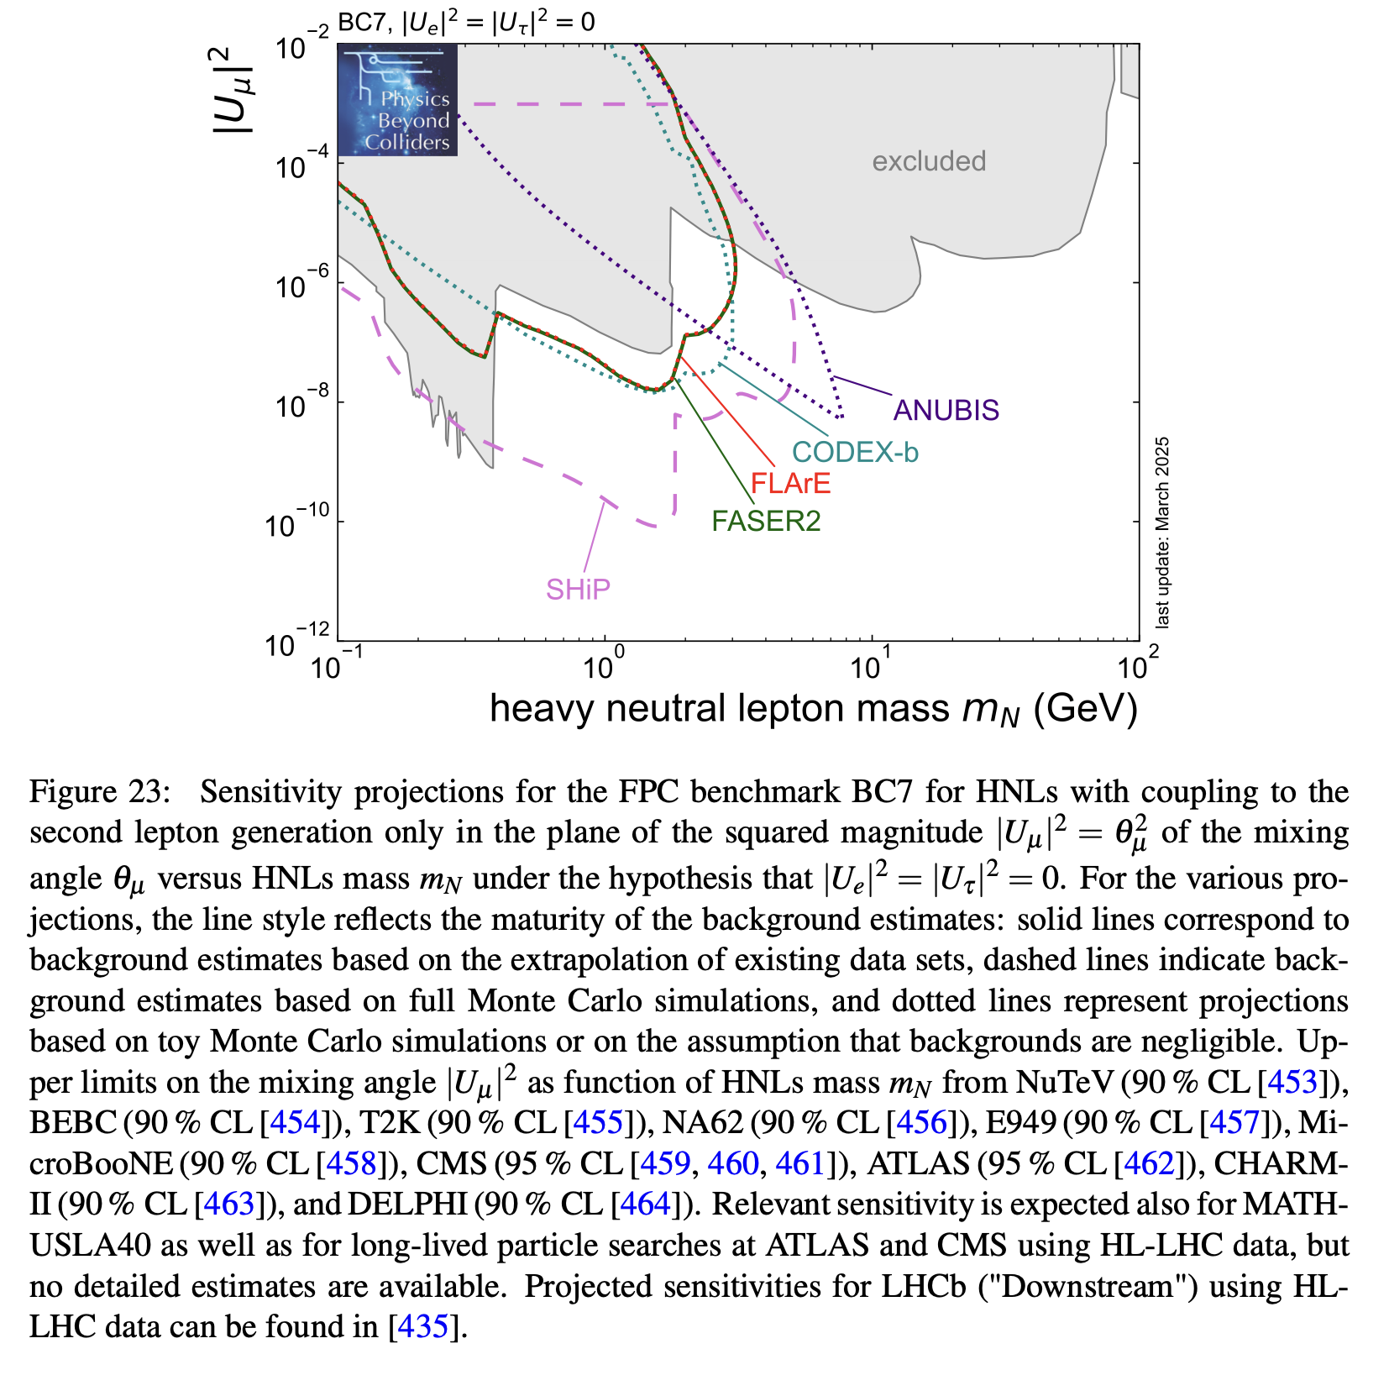
Feebly Interacting Particle Physics Center
Sensitivities to Benchmark models
https://arxiv.org/pdf/2505.00947

Slide 18

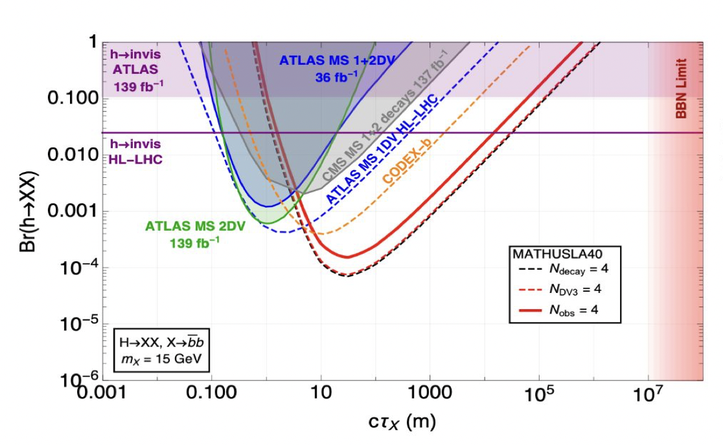
Feebly Interacting Particle Physics Center + BSM Working group
Convenors: Felix Kahlhoefer + Torben Ferber
“Showcase Models”
➔ Adapted to highlight capabilities of specific Experiments
Examples: Quirks (https://arxiv.org/abs/2404.13814)
General Long Lived Particles
From Talk by David Curtin
https://indico.cern.ch/event/1468126/contributions/6181428/attachments/2953681/5192784/2024.10.23%20MATHUSLA40%20Curtin%20Joint%20BSM_FPC%20bi-weekly%20meeting.pdf

Slide 19
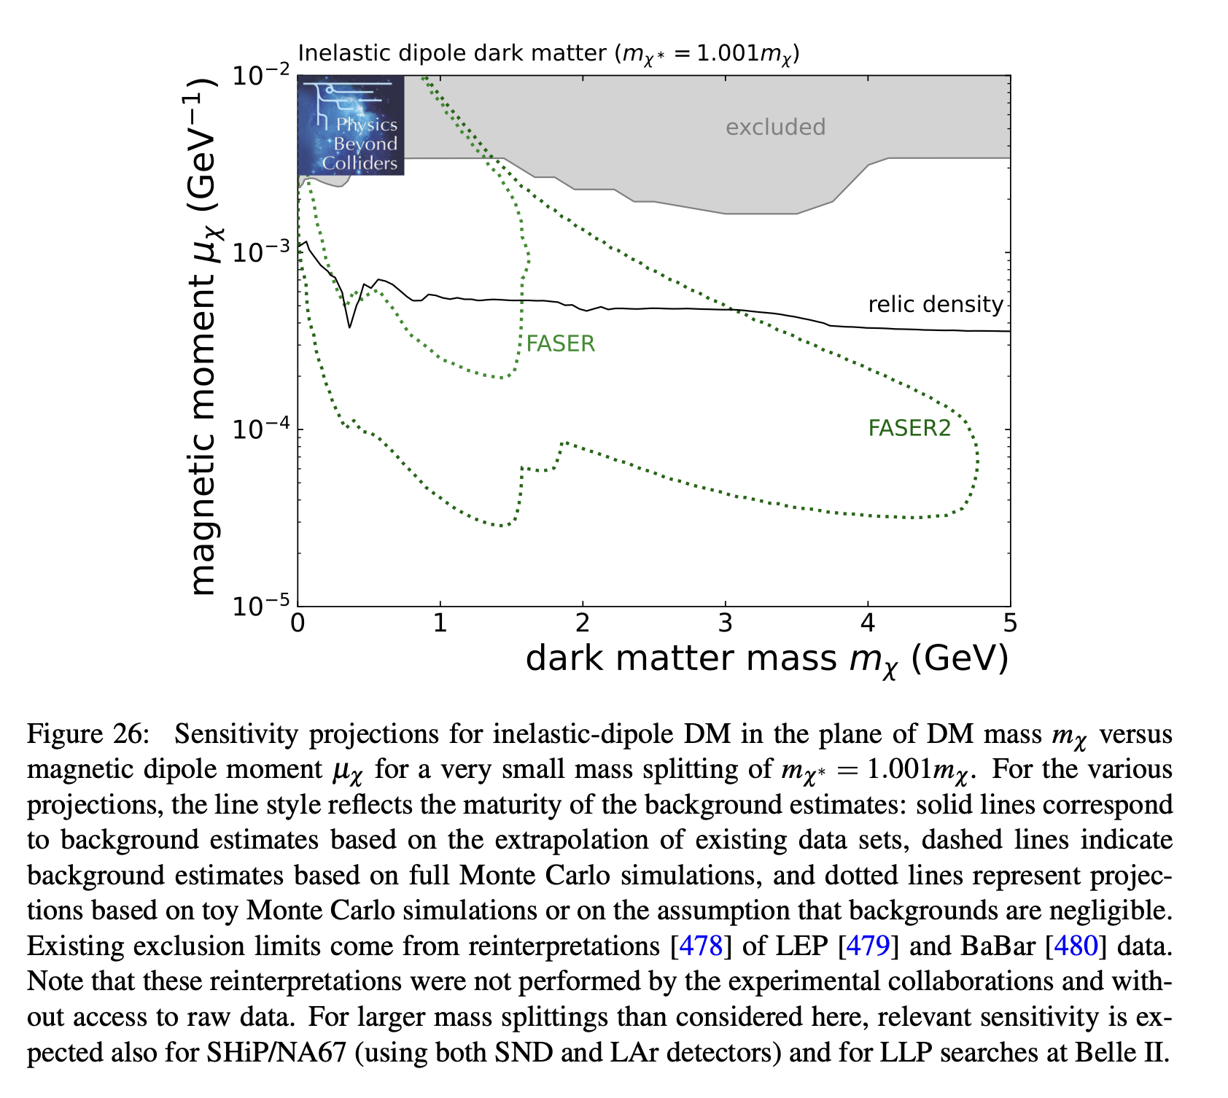
Possible interplay with high energy facility
Could provide motivation for
new TeV scale searches!
https://arxiv.org/abs/2505.00947

Slide 20
the energy frontier
selected exemplary projects

Slide 21
LHC energies:
dedicated long-lived particle (LLP) detectors
selected exemplary examples

Slide 22
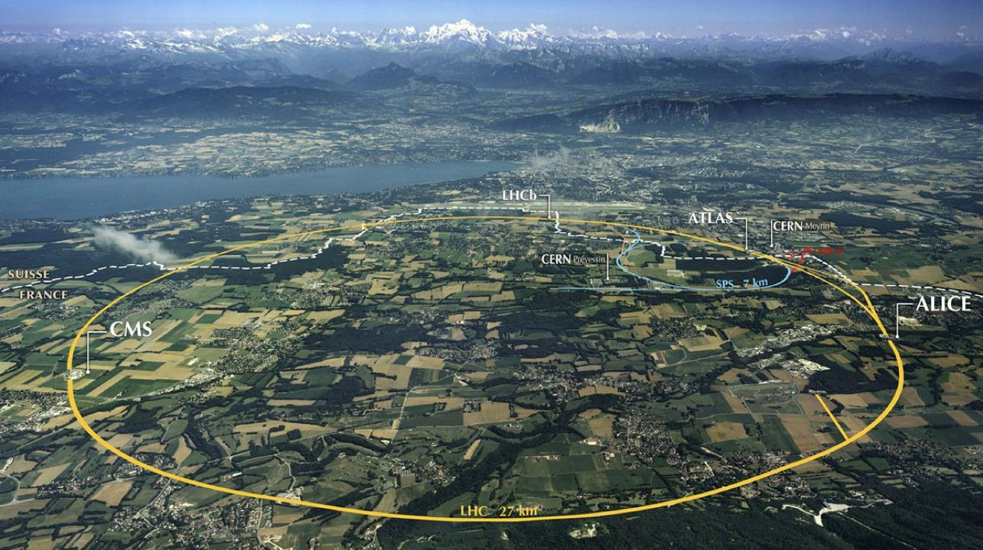
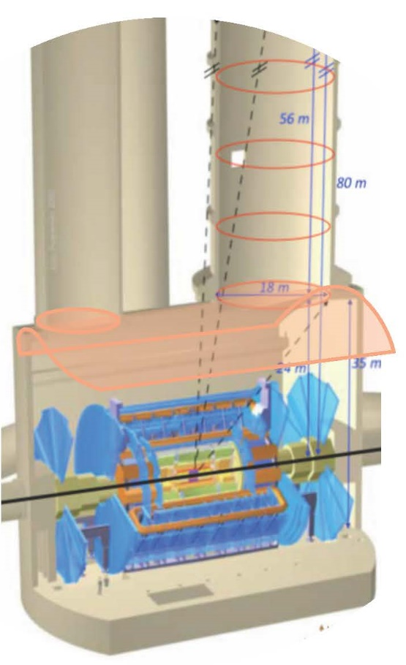
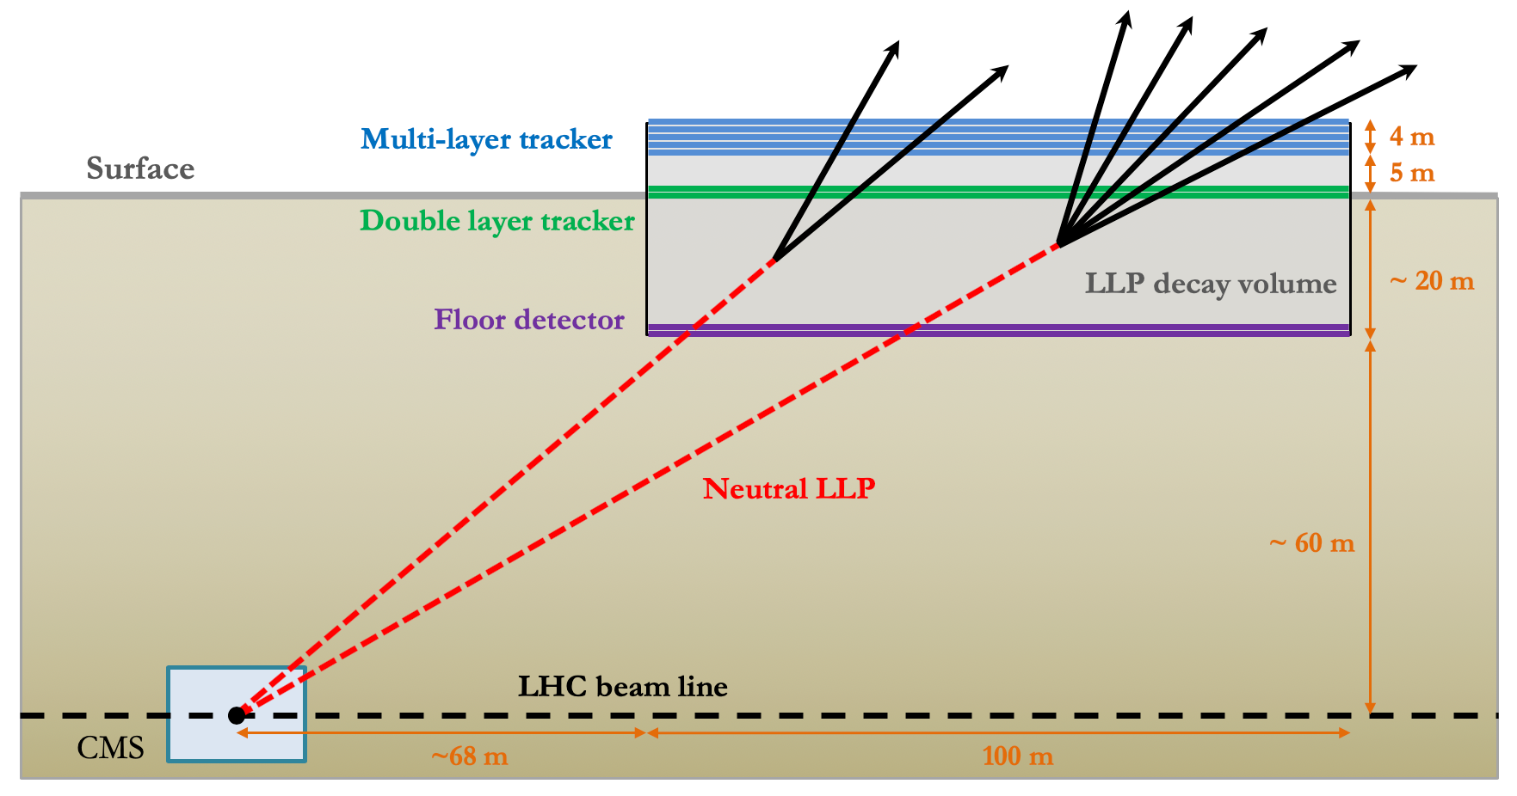
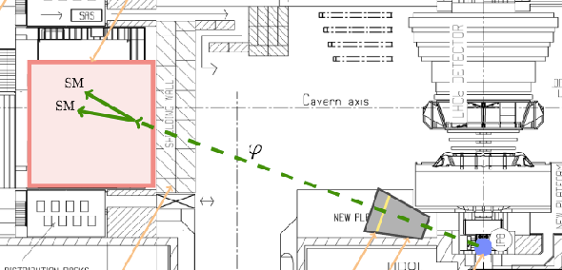
Proposed large-angle LongLivedParticles @ HL-LHC
search for GeV scale LLPs with lifetimes O(100m)
MATHUSLA
on CMS surface
ANUBIS
in ATLAS access shaft
CODEX-b in LHCb hall
3 detectors of similar concept:
demonstrators and detailed simulations ongoing during run3

Slide 23
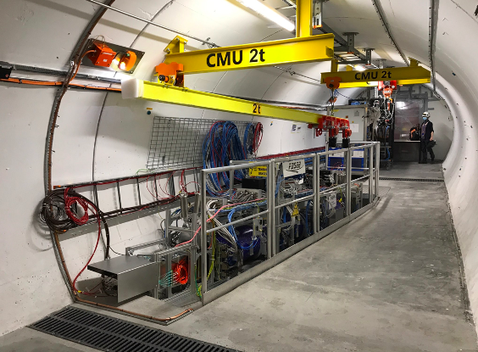
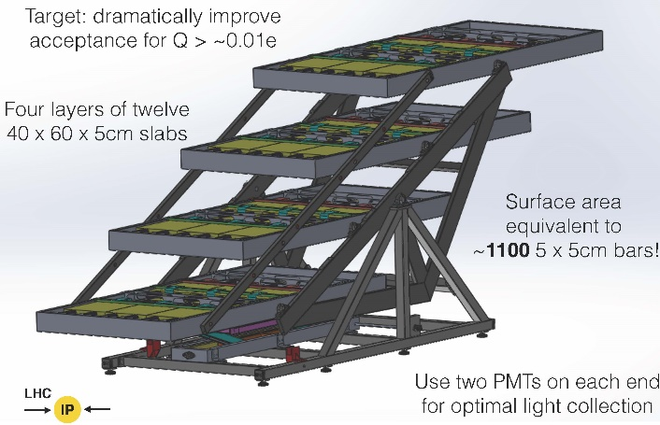
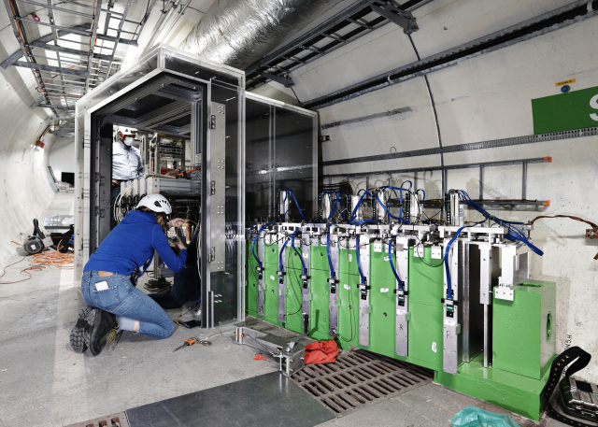
LongLivedParticles @ LHC
pioneered in run 3 by FASER/SND@LHC/milliQan
FASER: Dark photons & TeV neutrinos
480m from ATLAS IP
CMS
milliQan: milli-charged particles
33m from CMS IP
SND@LHC: TeV neutrinos
slightly off axis opposite to FASER

Slide 24
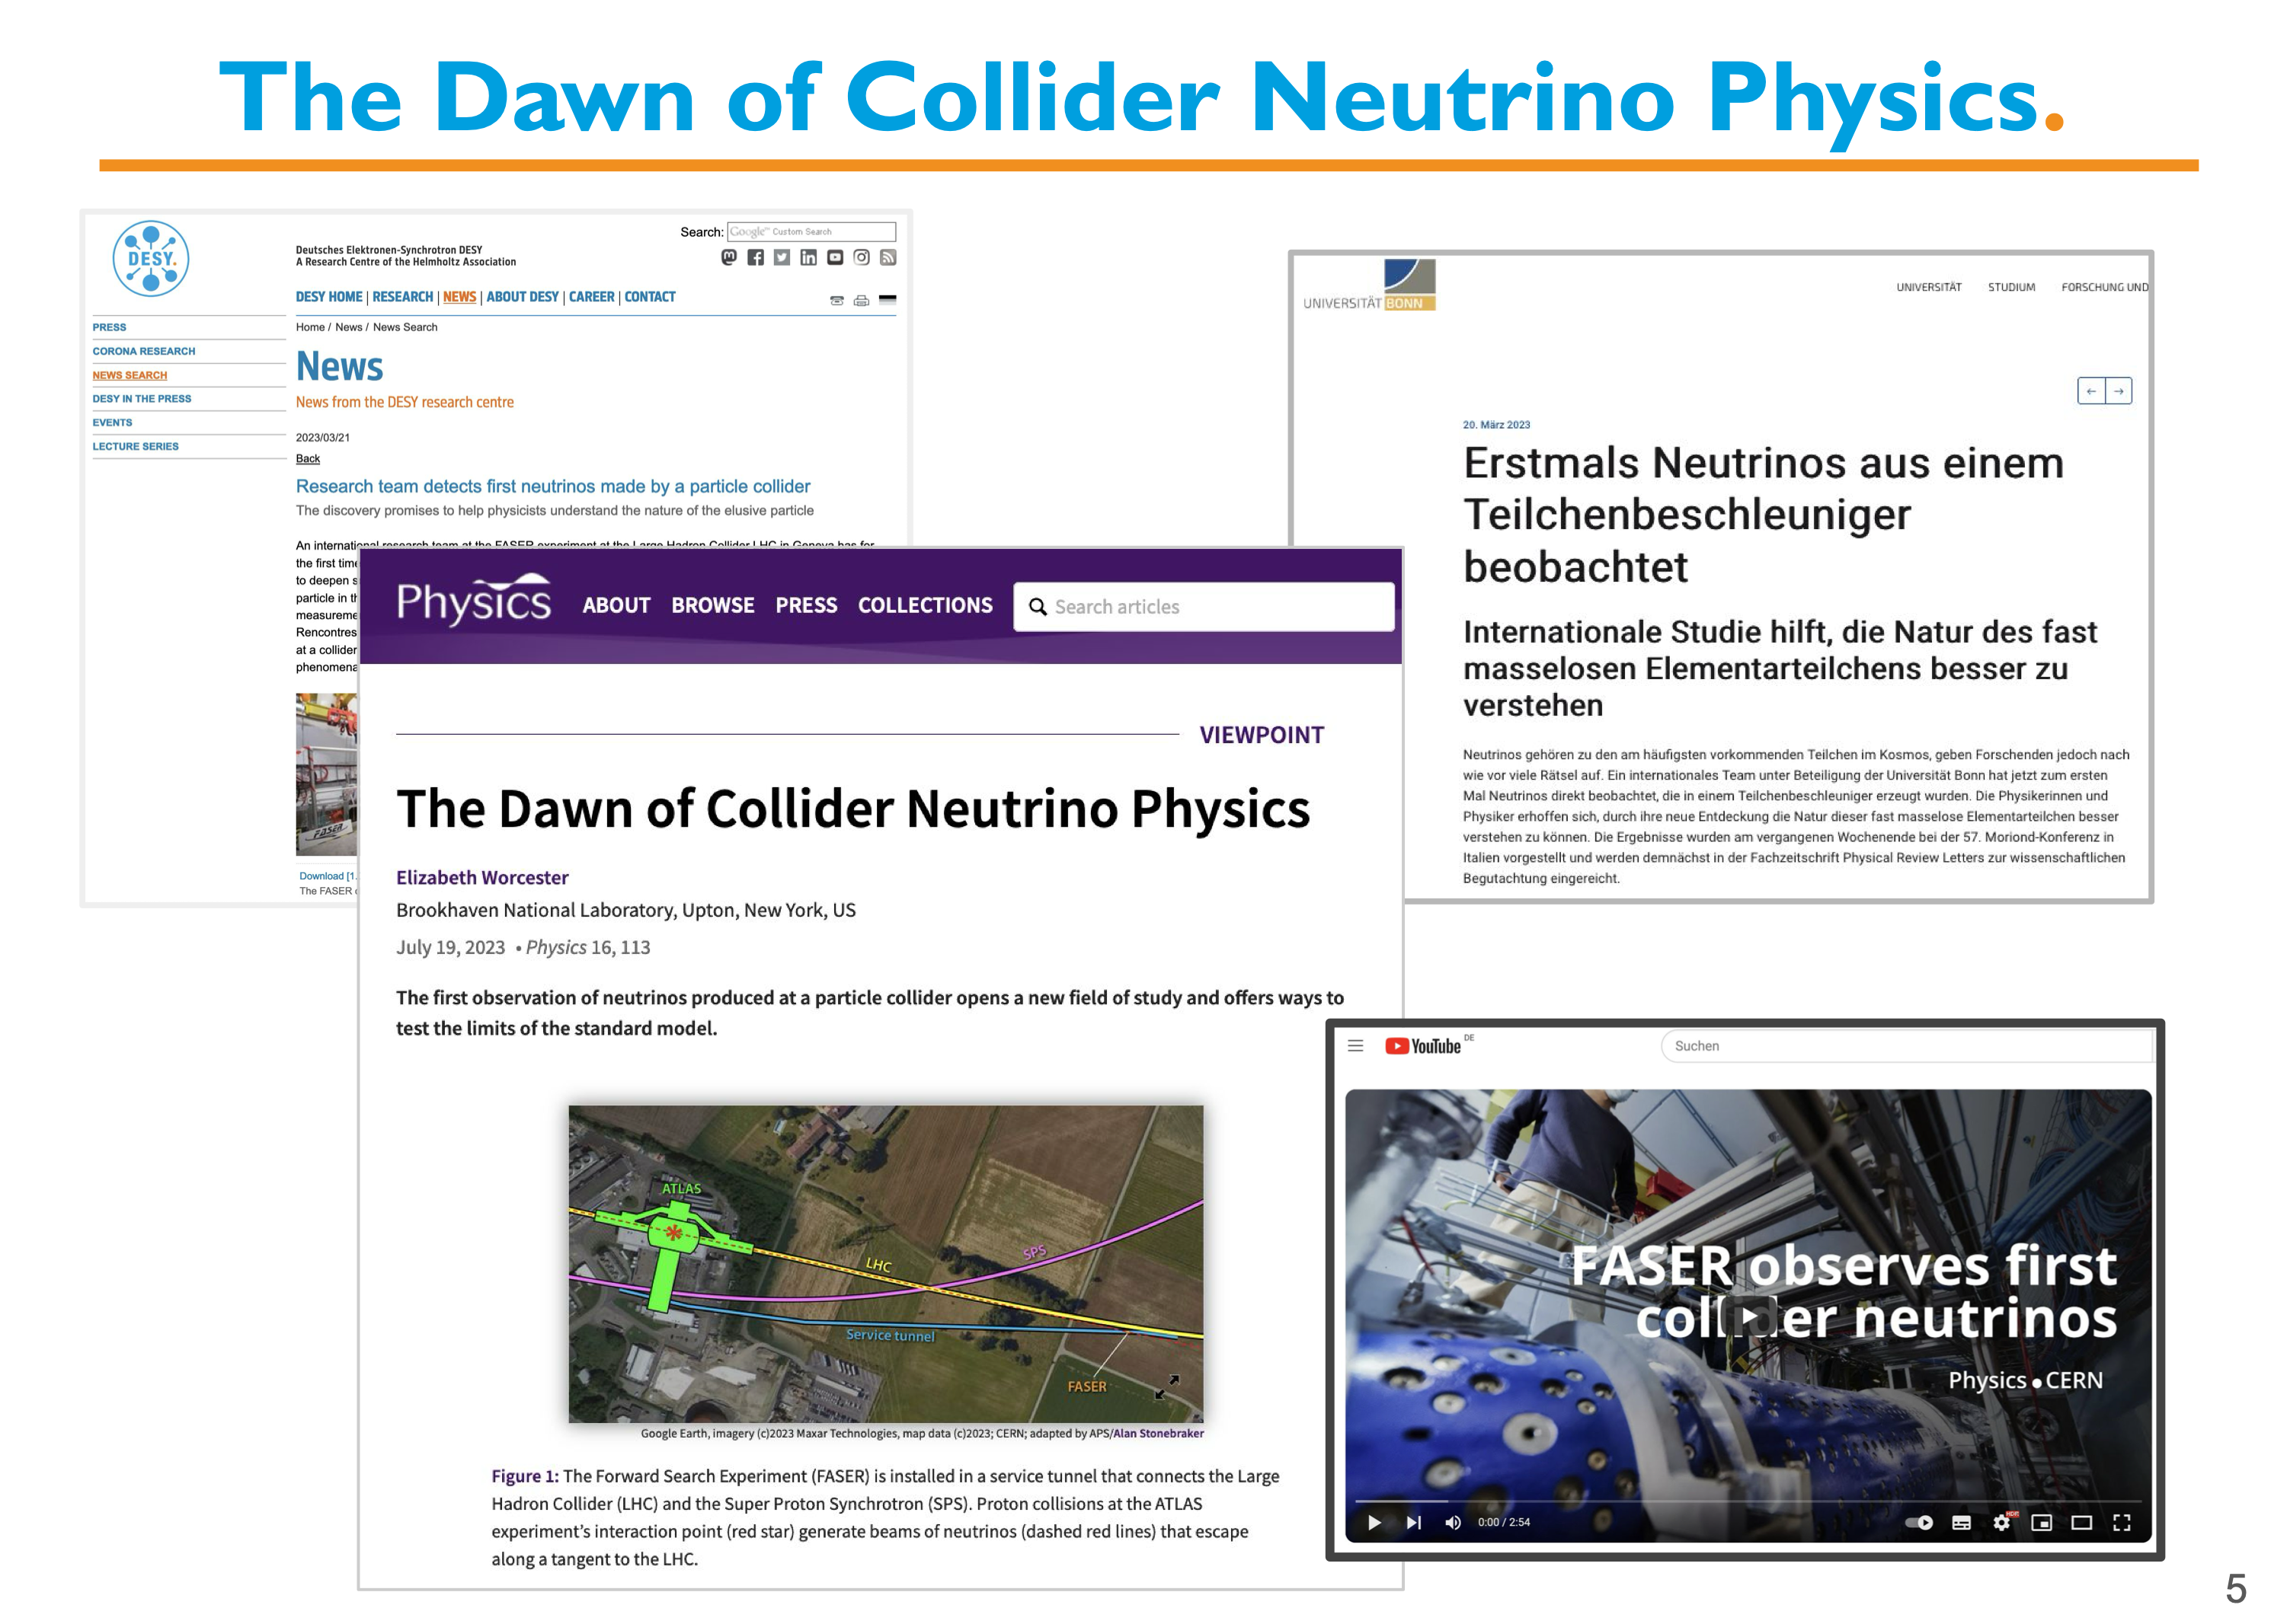
LongLivedParticles @ LHC
pioneered in run 3 by FASER/SND@LHC/milliQan
FASER: Dark photons & TeV neutrinos
480m from ATLAS IP
Felix Kling, Neutrinos@CERN workshop Jan. 24, 2025
CMS
milliQan: milli-charged particles
33m from CMS IP
SND@LHC: TeV neutrinos
slightly off axis opposite to FASER

Slide 25
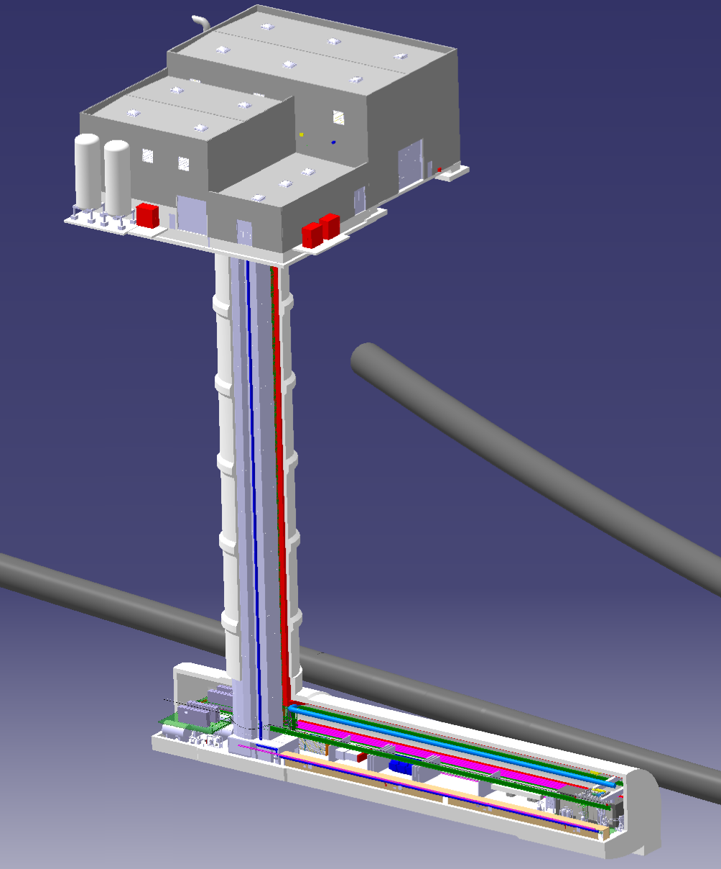
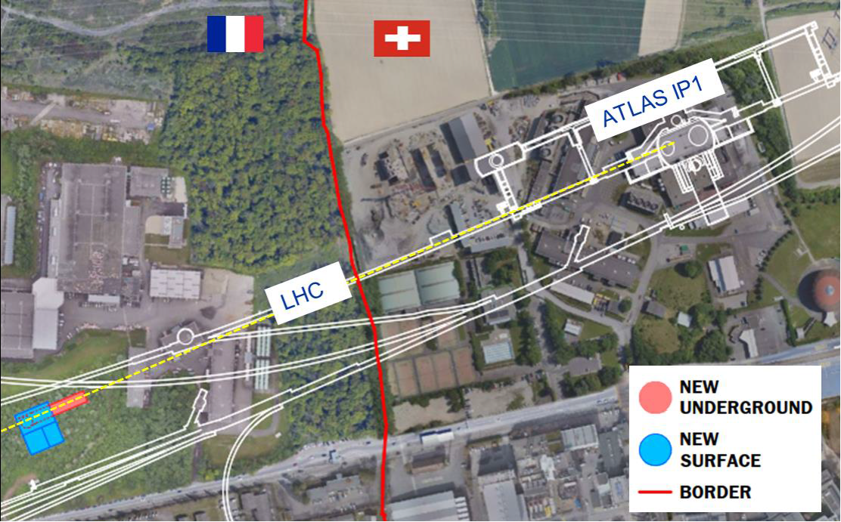
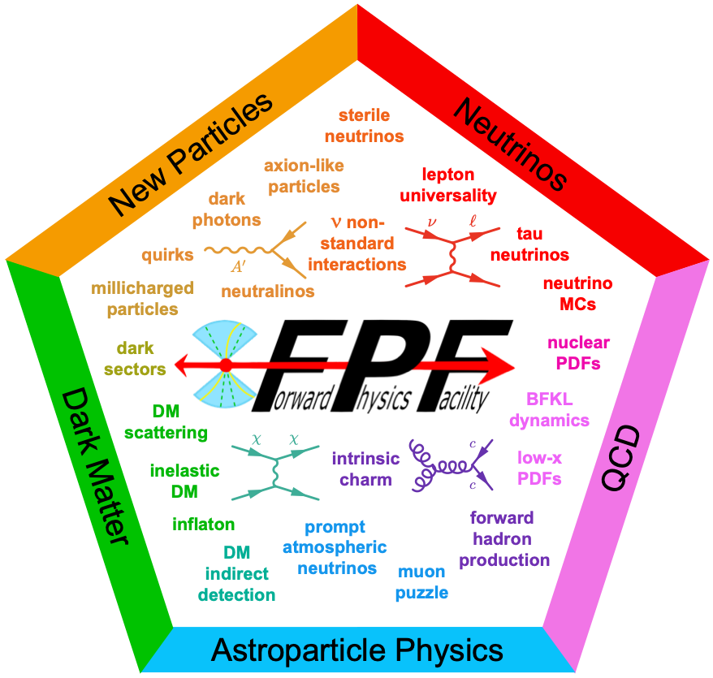
Proposed LHC far-forward LLP detectors for HL-LHC
Forward Physics Facility
dedicated underground cavern
aimed at maximizing the HL-LHC
physics reach in the forward region
(LLPs, ν’s & QCD)
FPF White Paper (429 pp, 392 authors +
endorsers representing over 200 institutes)
J. Phys. G 3, 030501 (2023), arXiv: 2203.05090.

Slide 26

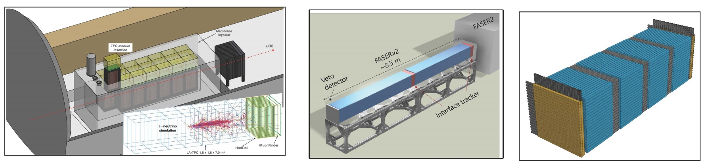
Proposed LHC far-forward LLP detectors for HL-LHC
Forward Physics Facility
dedicated underground cavern
aimed at maximizing the HL-LHC
physics reach in the forward region
(LLPs, ν’s & QCD)
FLArE
FASER(𝜈)2
FORMOSA
FPF White Paper (429 pp, 392 authors +
endorsers representing over 200 institutes)
J. Phys. G 3, 030501 (2023), arXiv: 2203.05090.

Slide 27
one step downward in c.m. energy:
LHC Fixed-Target (LHC-FT)
selected exemplary projects

Slide 28
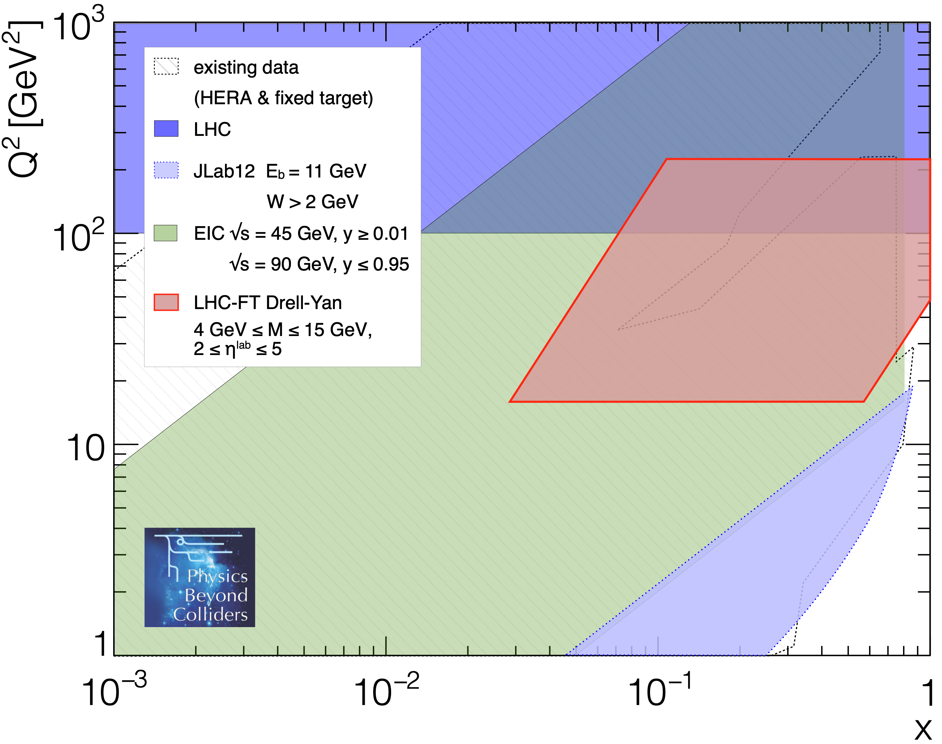
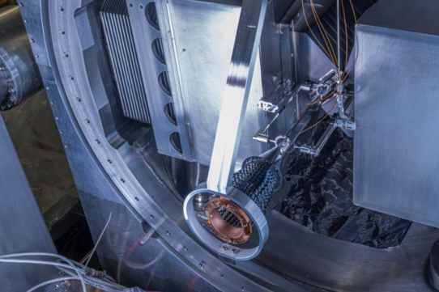
LHC Fixed Target (gas)
fixed-target setup using LHC beam in unique
kinematic domain
  large forward boost provides access to
  very high x at sufficiently large scale
  large luminosities, wide range of probes
installation of SMOG2@LHCb during LS2
  simultaneous running in FT & collider mode
proton PDF data sets

Slide 29
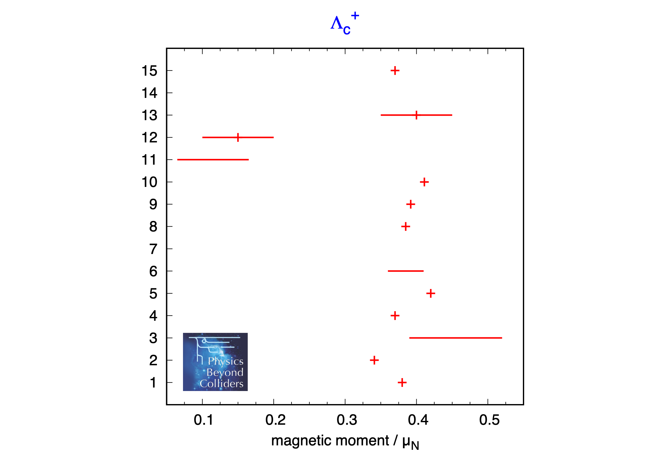
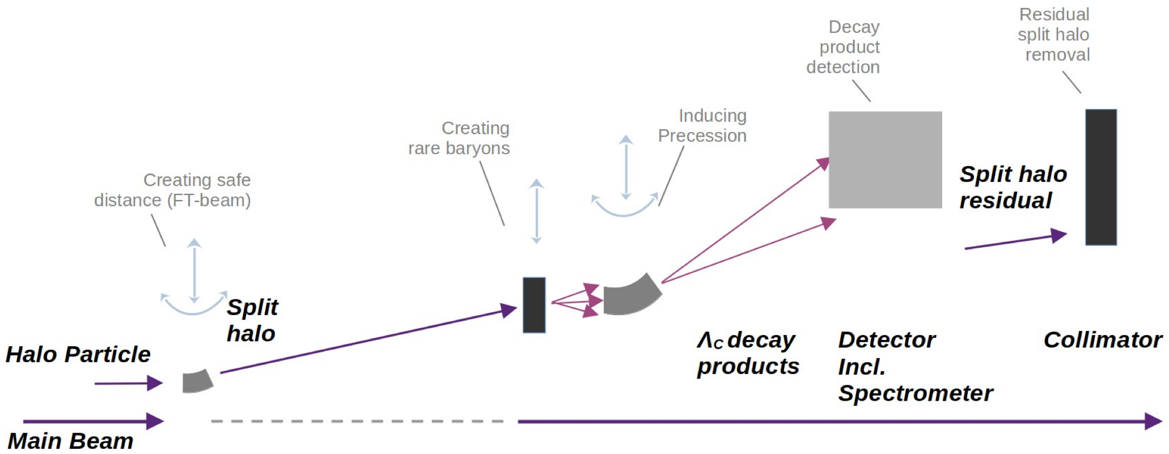
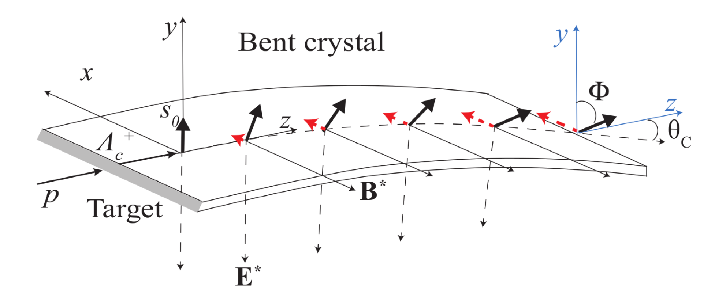
LHC Fixed Target (crystals)
magnetic (and electric) dipole moments of many short-lived particles (heavy baryons, τ) poorly constrained
  e.g. spread in theory predictions for Λc
benchmarks for modern heavy-quark effective theory
exploit intense fields inside bent crystals for measurement at LHC
TWOCRYST & ALADDIN @ LHC IR3
[EPJ C77 (2017) 828]

Slide 30
one more step downward in energy:
SPS Fixed-Target (FT@SPS)
selected exemplary projects

Slide 31
CERN accelerator complex

Slide 32
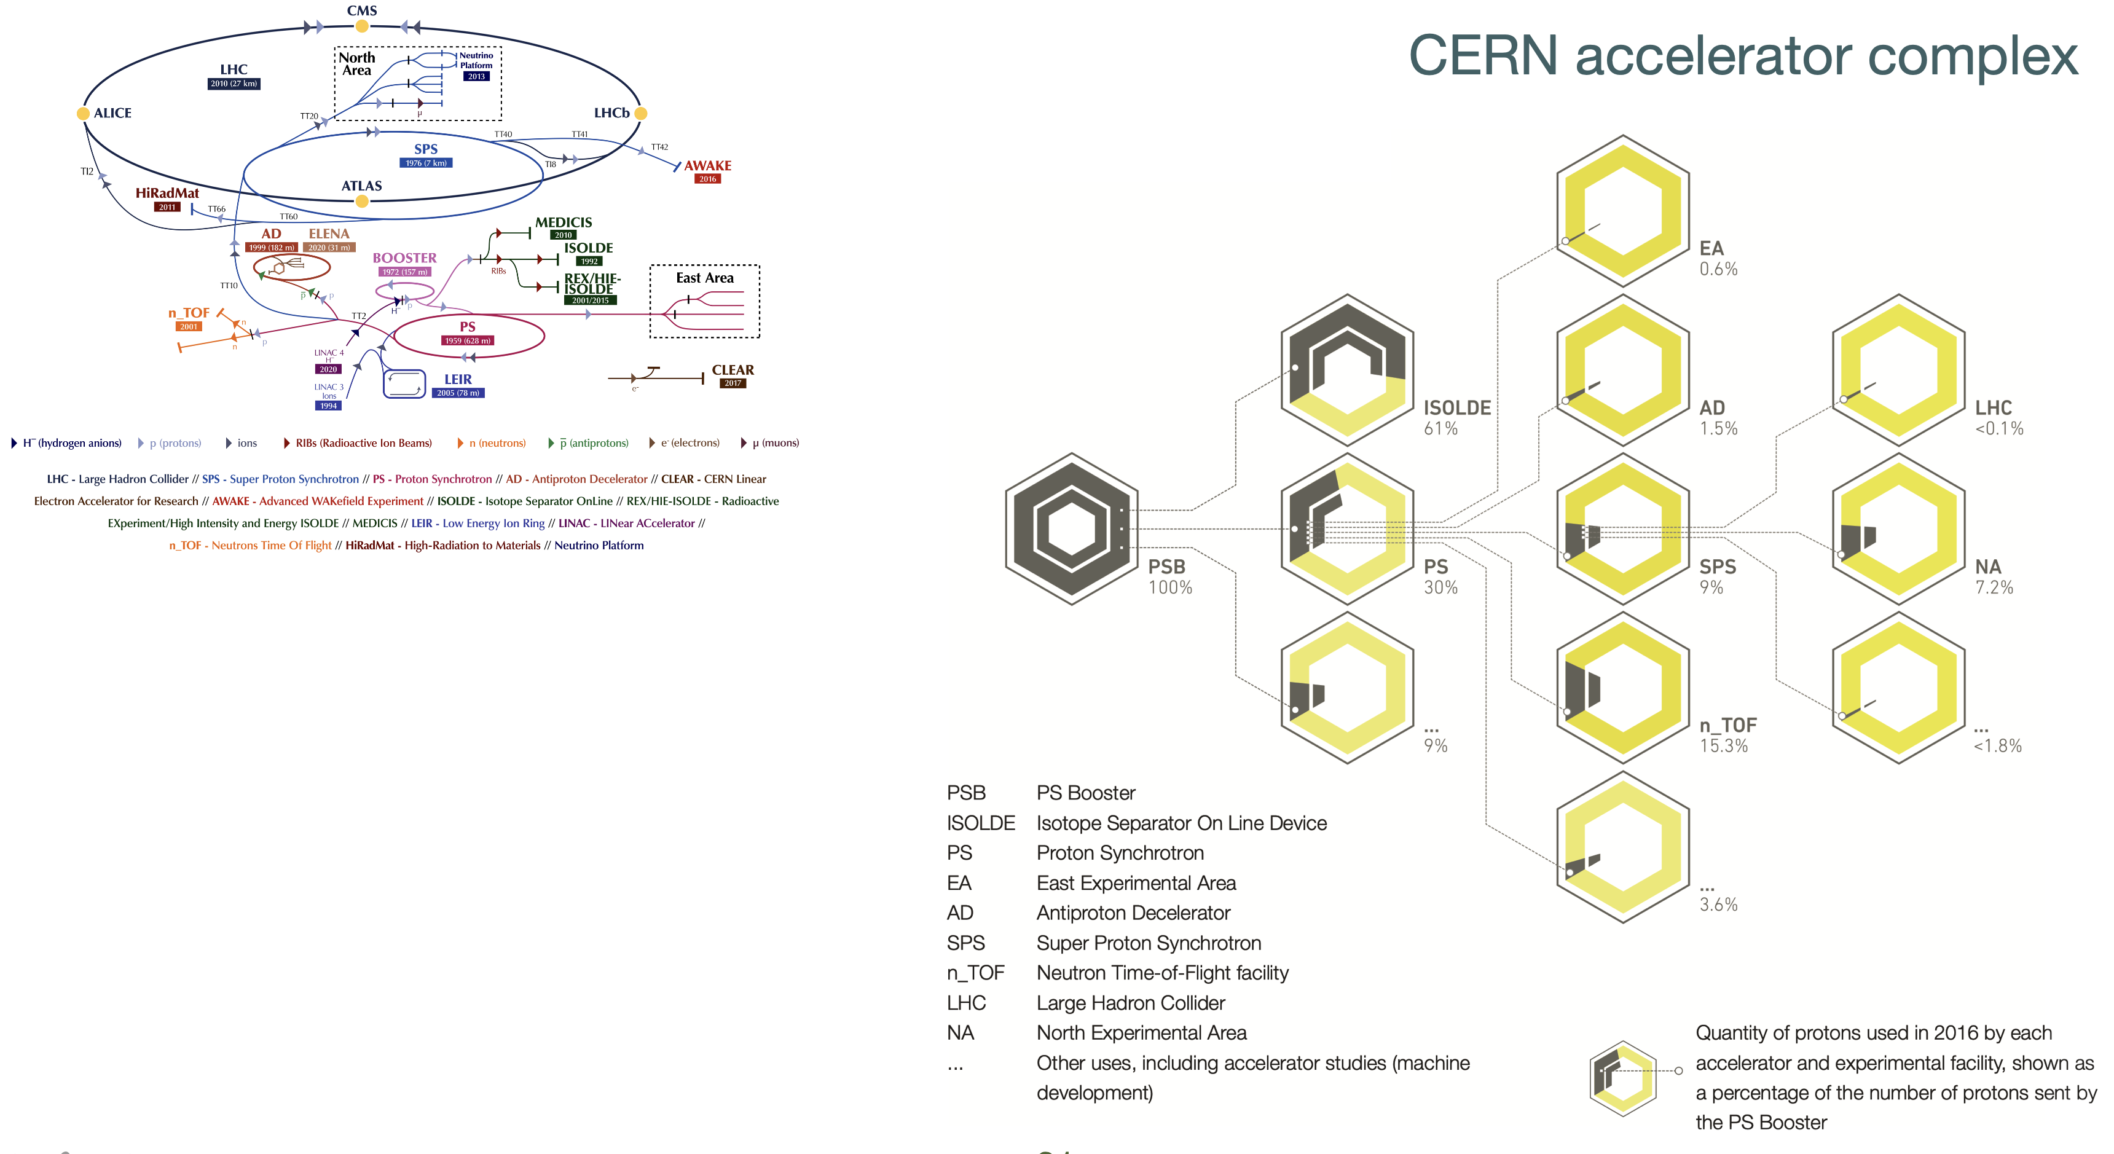

Slide 33
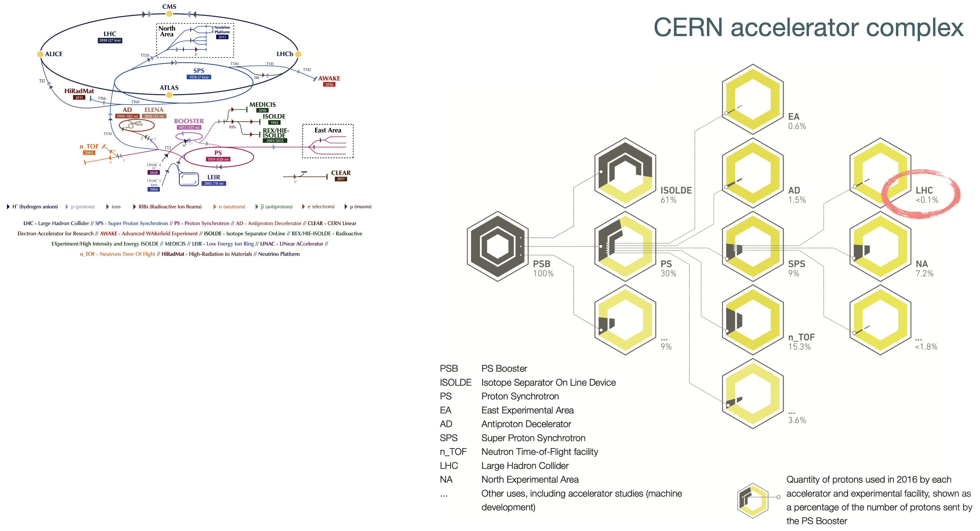

Slide 34
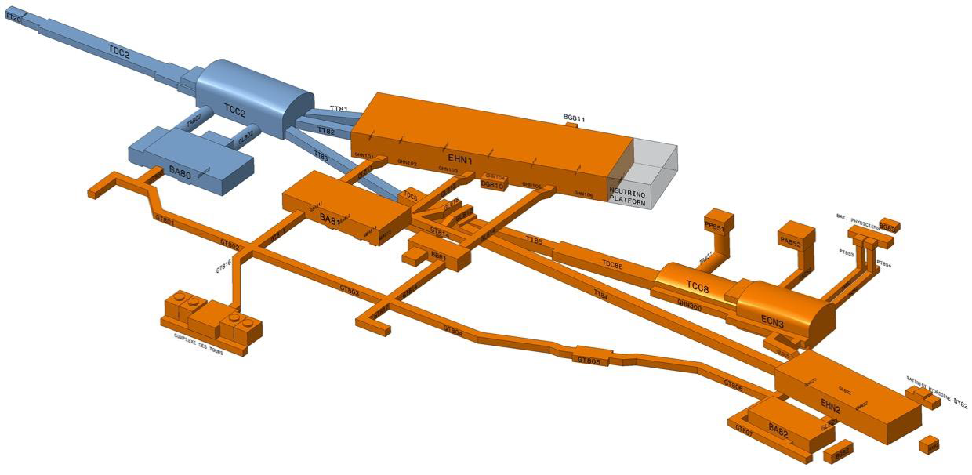
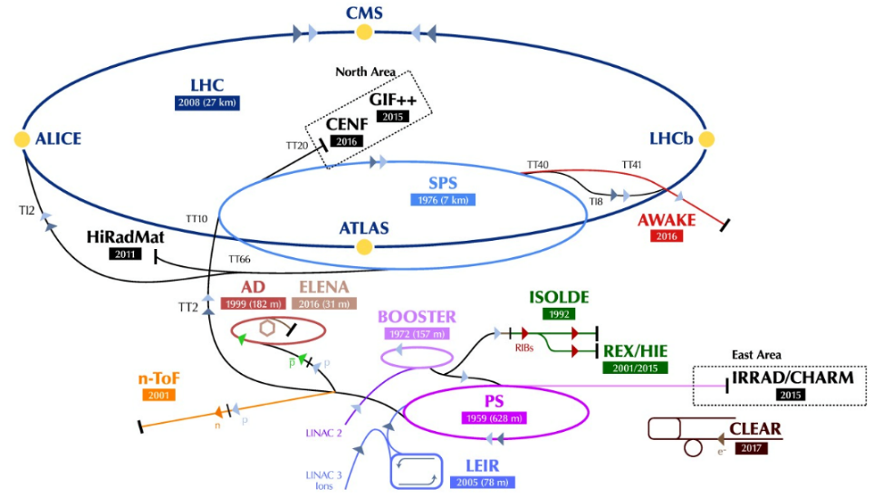
The „work horse“ of FT@SPS: the SPS North Area
EHN1: large surface hall with multi-purpose low-I beams
QCD: NA60++ and NA61/SHINE
BSM: NA64(e,h)
ECN3: unique underground hall
for high-I hadron beams
BSM: NA62(K⁺, BD), SHiP(BD), TauFV
EHN2: surface hall with unique
high-E/high-I µ beam
QCD: AMBER, MUonE
BSM: NA64(µ)
Consolidation of the NA provides an opportunity for new experimental projects

Slide 35
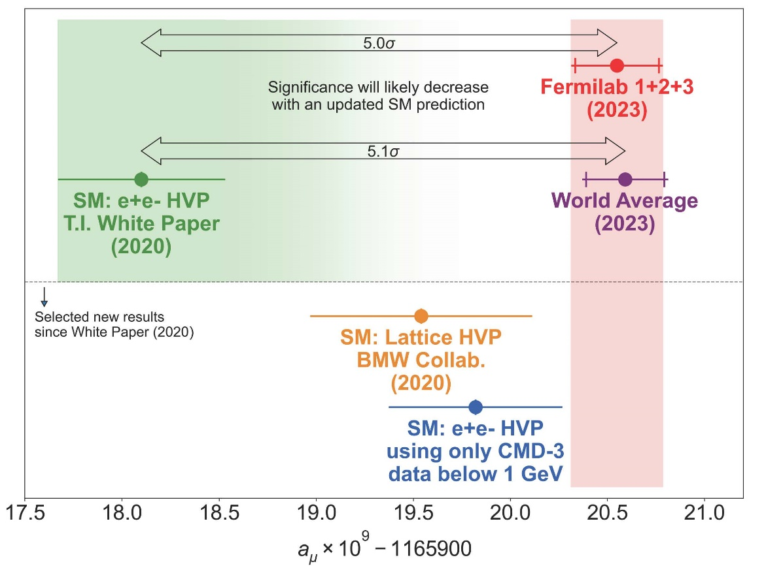
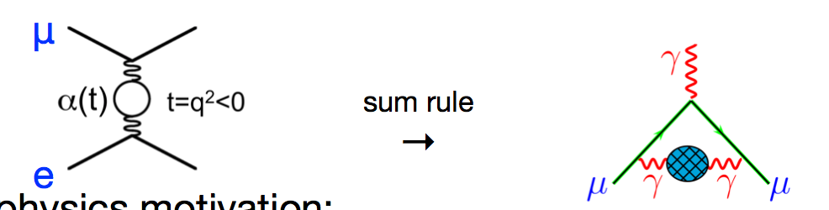
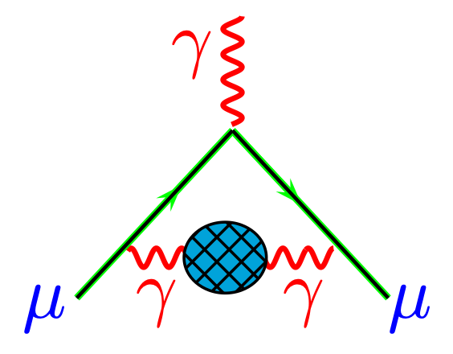
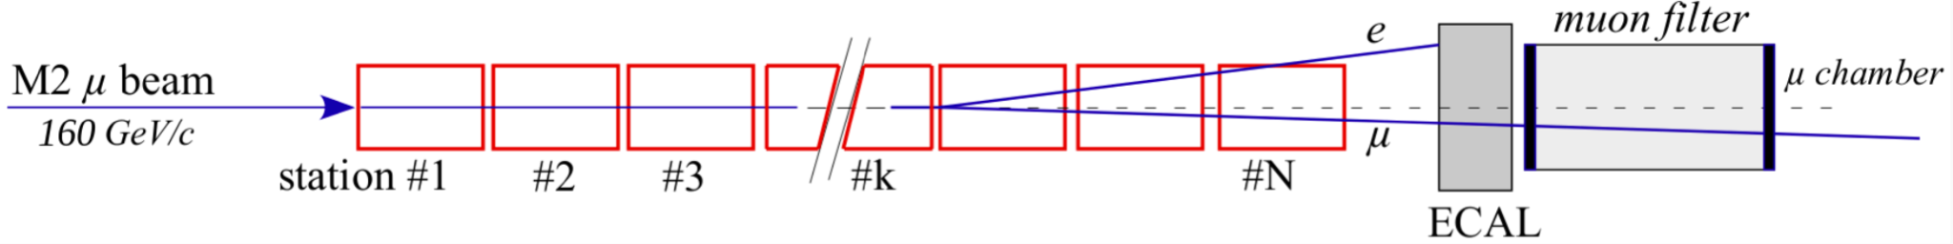
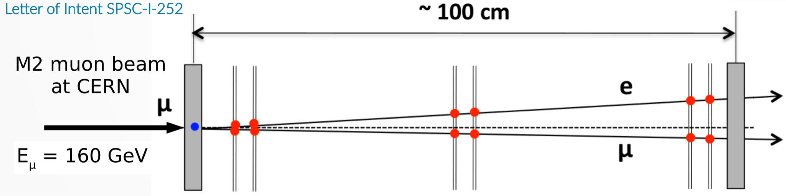

MUonE (new idea introduced within PBC)
direct measurement of
HVP contribution to (g-2)_{µ}
with μ-e elastic scattering
(g-2)_{μ} recent measurement
complementary to predictions based on dispersion relation with e⁺e⁻ data and on lattice QCD
very challenging experimentally:
10⁻⁵ (relative) precision required on cross-section

Slide 36
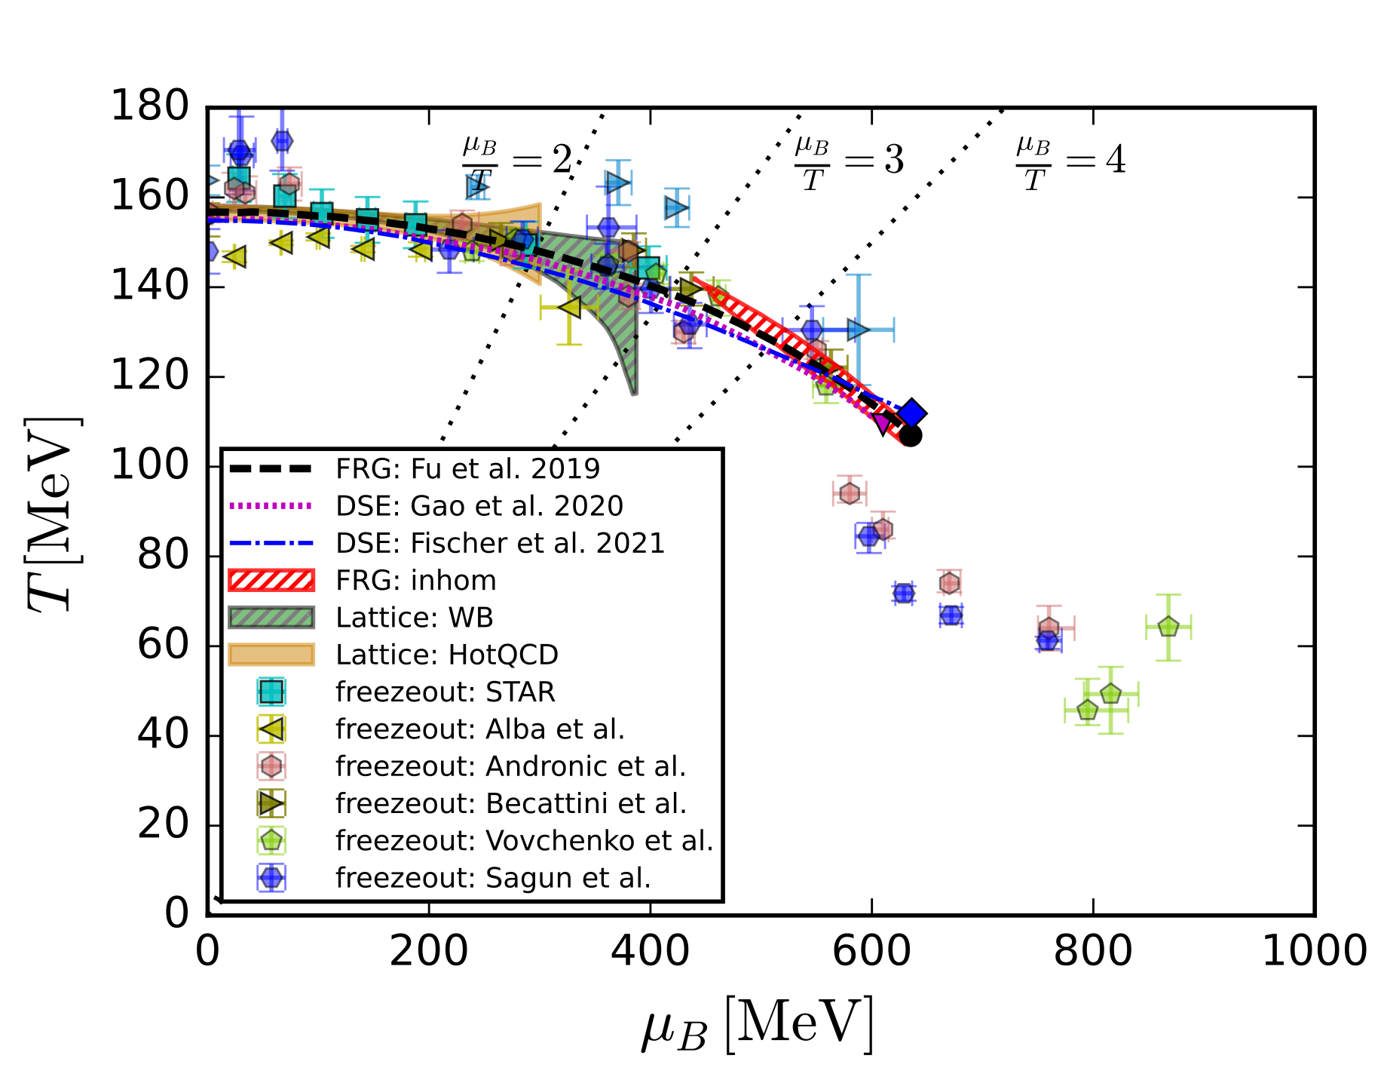
NA60++ & NA61/SHINE
CEP/new physics
See also https://arxiv.org/pdf/1909.02991
compilation of state-of-the-art
lattice & functional QCD
phase structure results

Slide 37
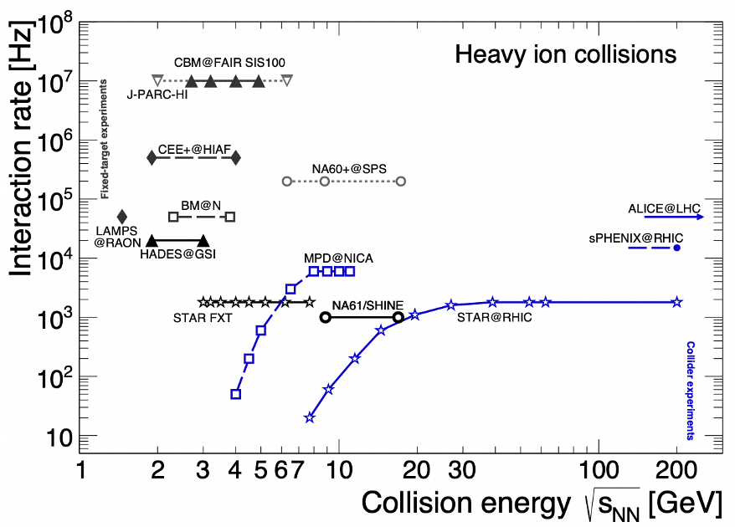
NA60++ & NA61/SHINE
CEP/new physics
NA60+
NA61/SHINE++
[T. Galatyuk, A982 (2019) update 2021; CBM, EPJA 53 3 (2017) 60]
Need full coverage

Slide 38
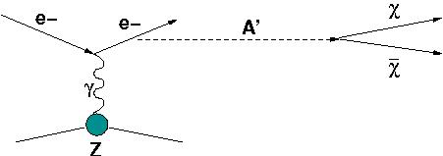
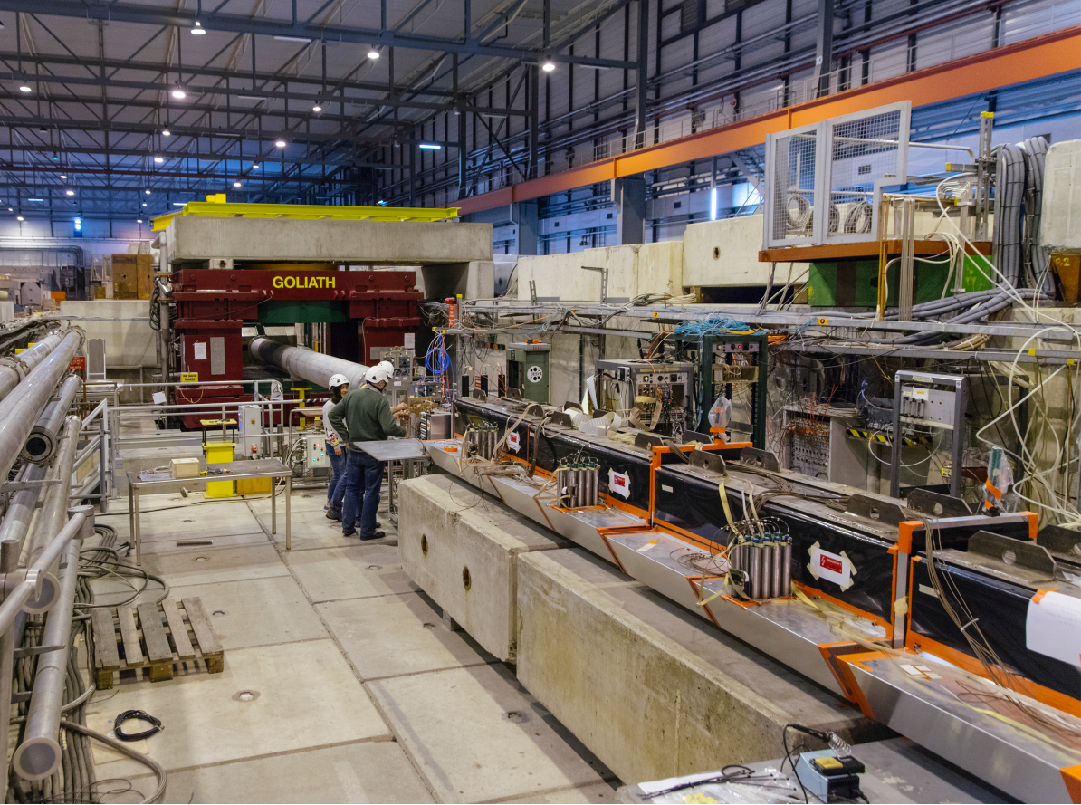
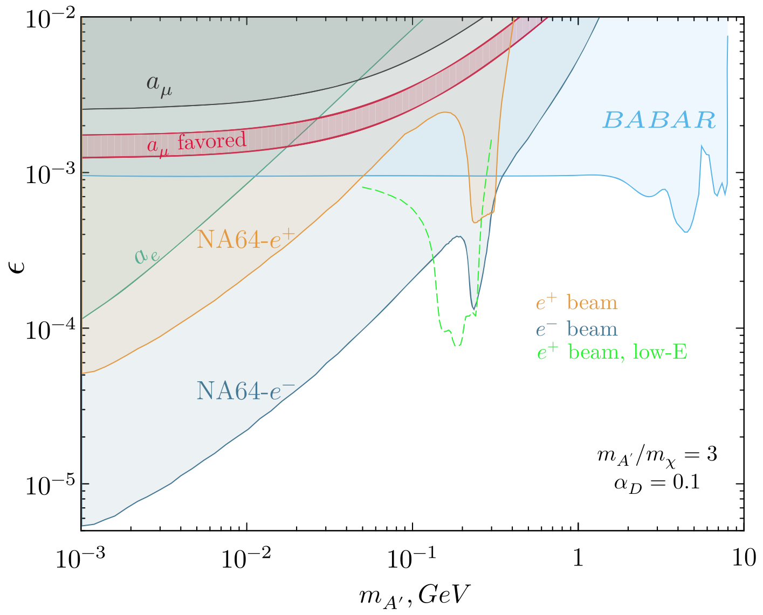
BeamDump@SPS: NA64
NA64(e): cheap electron beam-dump setup implemented in 2015 on H4
e⁻ test beam, now permanent; optimized for invisible production
currently leading the field for a wide range of dark photons!
➠ aiming for 2-3 × e⁻ beam intensity (1.5 × 10^7 EoT/spill) post-LS3
[NA64, Phys. Rev. D109 (2024) L031103]
38

Slide 39
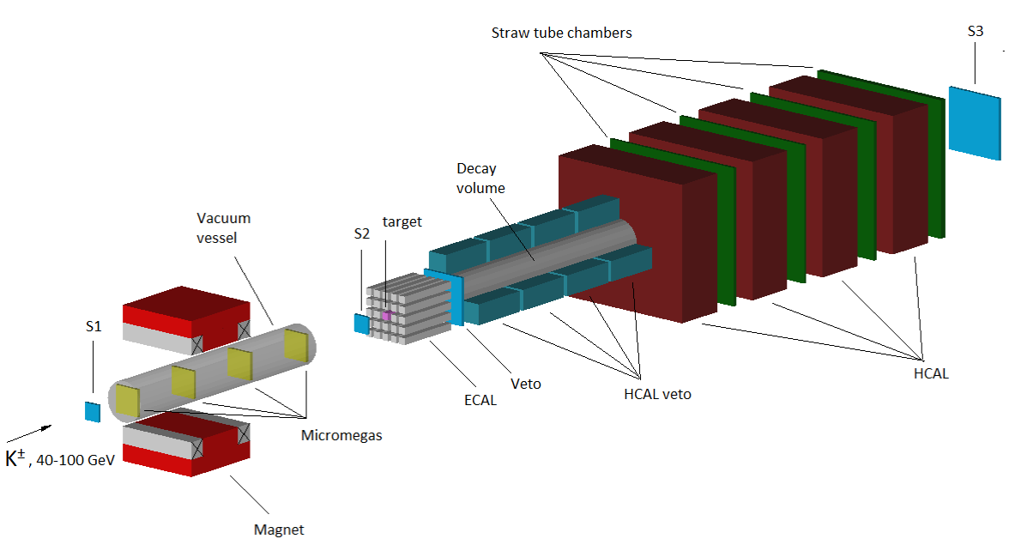
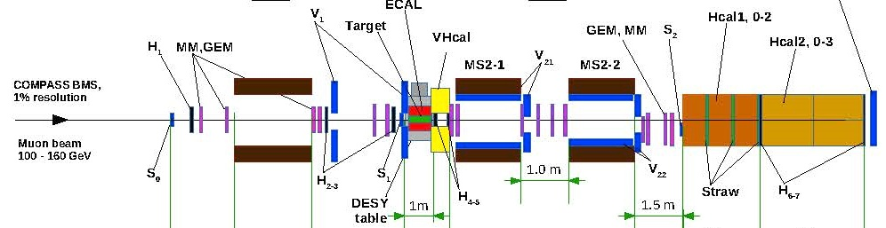
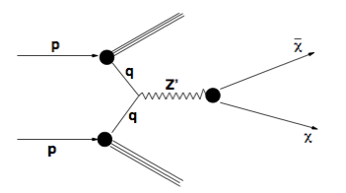
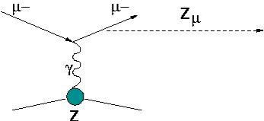
BeamDump@SPS: NA64
NA64(e): cheap electron beam-dump setup implemented in 2015 on H4
e⁻ test beam, now permanent; optimized for invisible production
currently leading the field for a wide range of dark photons!
➠ aiming for 2-3 × e⁻ beam intensity (1.5 × 10^7 EoT/spill) post-LS3
NA64(μ,h): proposed extensions of the method to other types of beams:
p 200 GeV
μ beams:
test of (g-2)_{µ} interpretations
and µ-coupled dark sector
hadron beams:
meson decays to invisible particles
and leptophobic dark sector
39

Slide 40
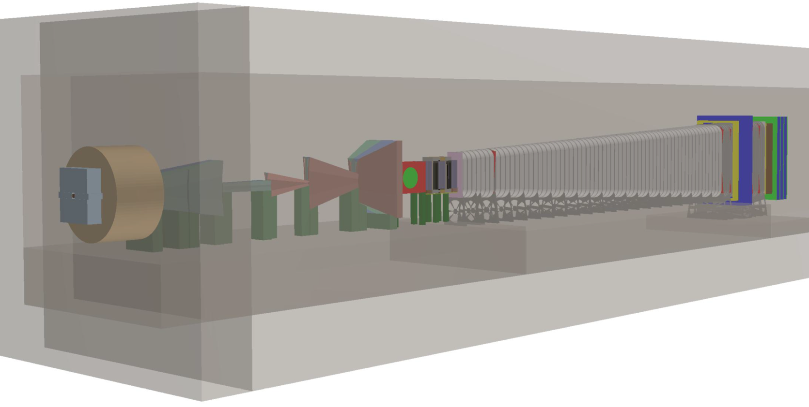

BD@SPS: BDF/SHiP@ECN3
state-of-the-art dual spectrometer
for hidden particle searches
with 15+ years program
high-precision spectrometer
for DM scattering
+ ν_{τ} physics
DM
decay vessel
spectrometer
for DM decays
active magnetic
muon filter
SHiP@ECN3
relocation to ECN3 and
re-optimization studied
within PBC to reduce overall BDF/SHiP cost
40

Slide 41
R&D for longer-term future PBC facilities & other (outside) projects
selected exemplary projects

Slide 42




International Axion Observatory
IAXO
(axion helioscope successor of CAST@CERN)
BabyIAXO precursor approved and in construction at DESY
with CERN PBC support to magnet design
unique physics reach for ALPs searches
BabyIAXO
42
INTERNATIONAL AXION OBSERVATORY
(axion helioscope successor of CAST@CERN)

Slide 43


FLASH
Also use for gravitational waves
Claudio Gatti; https://indico.cern.ch/event/1369776/contributions/5795140/attachments/2827617/4940174/PBC-CGatti.pdf

Slide 44




AION-100@CERN
towards gravitational wave detection in a new frequency range and searches for ultralight scalars
AION-10 in Oxford
Depth
143 m
Coupled atom sources have a larger potential for measurement of gravitational waves and dark matter
a 100m Atom Interferometer in LHC access shaft PX46
44

Slide 45



Novel neutrino beams
Recent new ideas of monitored & tagged neutrino beams being investigated
for neutrino precision measurements and next generation LBL projects
NuTAG:
ν_{µ} beam with (E_{ν},θ_{ν},φ_{ν}) tagged from individual
π decays with HL-LHC silicon trackers
ENUBET:
ν_{e} beam monitored from K decays
prototyping performed at Neutrino Platform
PBC-SBN
PBC instrumental in study of beamline reducing the required pot to a few 2x10^18 pot/y from few 10^19 pot/y
location and implementation
at CERN (or outside?) under study
45

Slide 46



Gamma Factory
Goal of 10⁷ intensity gain vs. existing facilities
[E. Granados @ 5th PBC Annual Workshop]
Stored PSI with boost γ
Laser beam →
4γ²
γ-ray beam
Important milestone reached within PBC
with successful acceleration and storage
of Partially Stripped Ions in LHC
46

Slide 47

Gamma Factory
Goal of 10⁷ intensity gain vs. existing facilities
Stored PSI with boost γ
Laser beam →
4γ²
γ-ray beam
important milestone reached within PBC
with successful acceleration and storage
of Partially Stripped Ions in LHC
proof-of-principle experiment with
full configuration in preparation at SPS
Validation of main building blocks for a PoP experiment ongoing in collaboration with IJCLab
Simulations of transverse emittance cooling for Xe ion beams encouraging: up to 20% lumi increase at LHC
47

Slide 48
summary

Slide 49
PBC and what is going on
Exploring broad range of physics scenarios
Exploit accelerator complex and infrastructure at CERN, incl. technological expertise
Initial portal for new ideas, facilitating and supporting the evaluation of their relevance and technical feasibility in preparation of submission to corresponding scientific committees
Loads of Cool Physics
      - Feebly Interacting Particles
      - Long Lived Particles
      - Novel Phases of QCD
      - Novel Tools for Discovery Physics
      - May provide guidance what future physics to explore
        Diverse physics program important for health and long-term viability ➔ opportunities for the next generation
49

