Slide 1
The Pion Parton Distribution Puzzle in
the Valence Region
Misak Sargsian
Florida International University, Miami
* Chris Leon, Alan Sosa, Joseph Maerovitz
IWHSS-25 &QCD-N’25, San Sebastian, 01-05 September 2025

Slide 2
Dual Nature of Pion
- Pion is a Goldstone particle of spontaneously broken chiral symmetry of QCD
- Pion contains valence quarks, see quarks and gluons which can be probed in
Deep Inelastic Processes by extracting their distribution functions

Slide 3
Pion Puzzle
At high x limit
2
2
Farrar, Jackson PRL 1979
Berger Brodsky PRL 1979
Barry, Ji, Sato, Melnitchouk, PRL 2021
Barry, Sato, Melnitchouk, Ji, PRL 2018
Extracted from the fit:
or

Slide 4
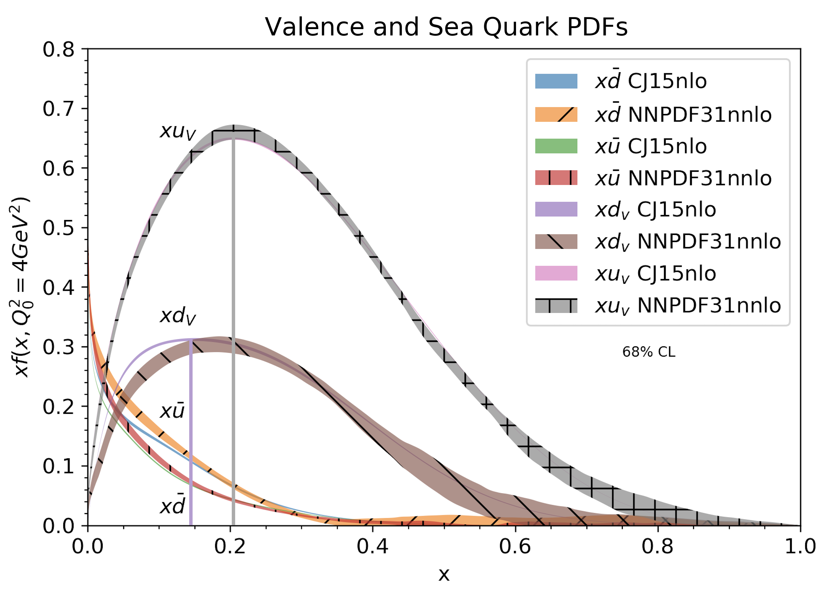
Uniqueness of valence quarks

Slide 5
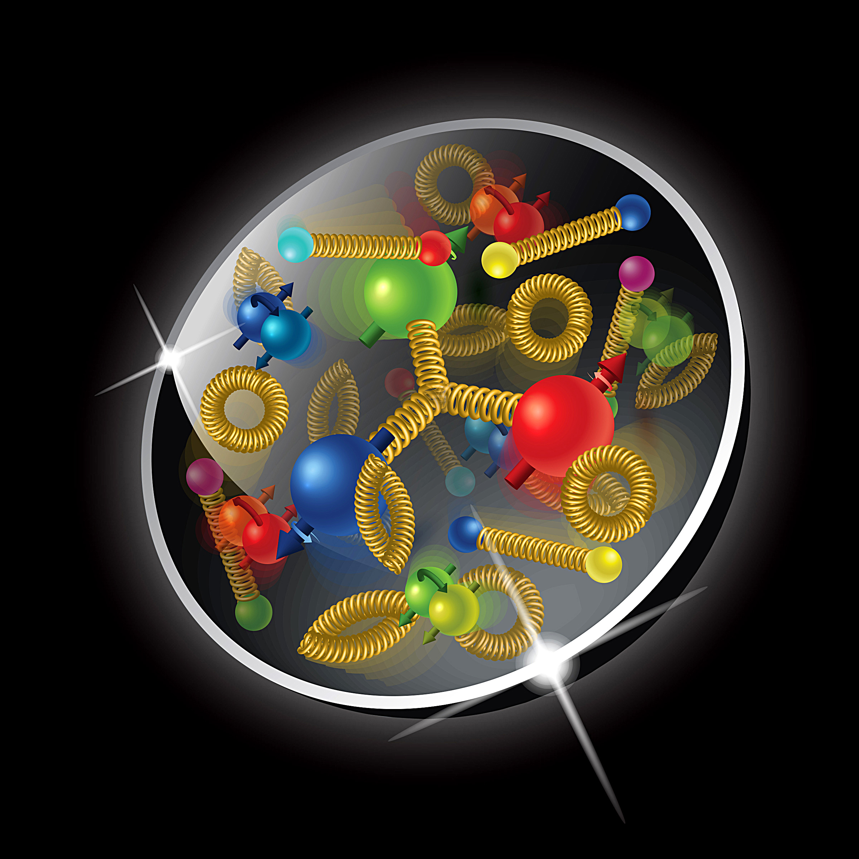
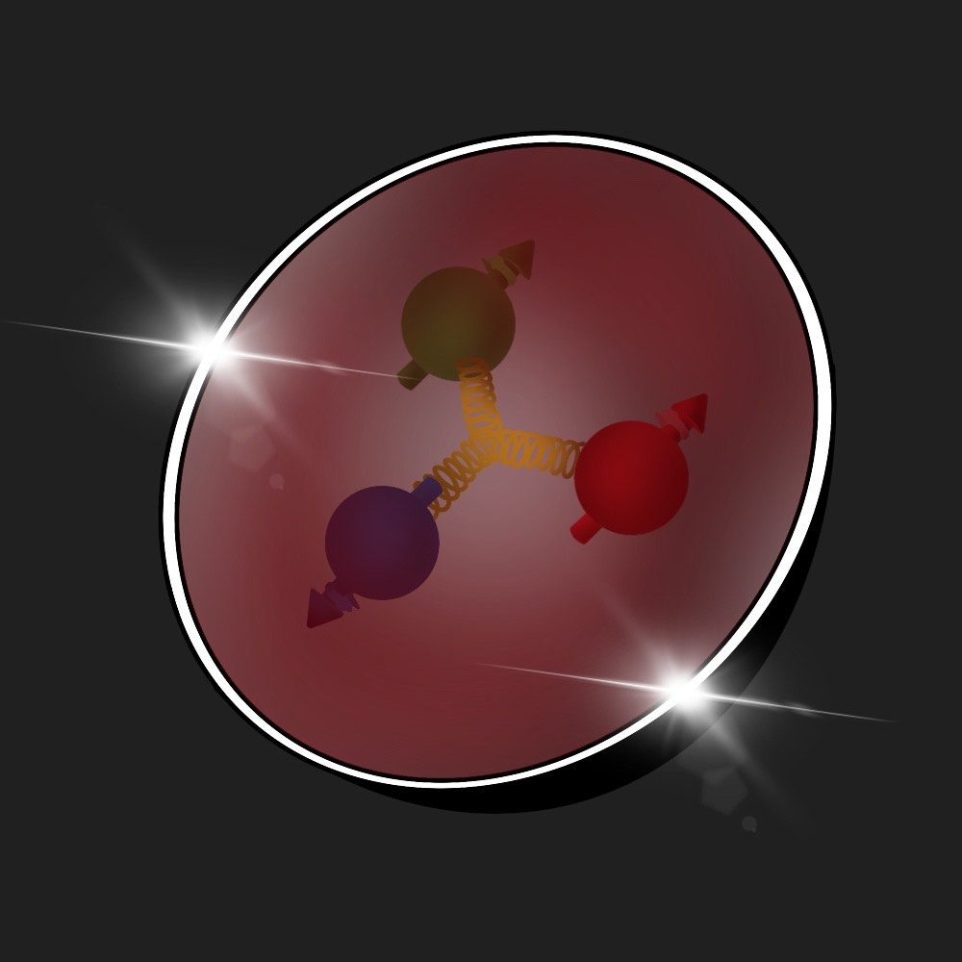
Valence quarks in the hadron
at medium to high x: 0.1 < x < 1
Mean Field
Mean Field
Mean Field

Slide 6
Motivation: Valence quarks in the hadrons
Valence quarks play a unique role in QCD dynamics of the hadrons
- They define baryonic number of hadrons:
They represent “effective fermions” whose number is conserved with complex
interaction among themselves and with hadronic environment
Because of their conserved number “quantum mechanics can be applied”
introducing concept of mean-field interaction with the hadronic environment
Quantum mechanically, this becomes a problem of fermions in the
strong external field – (see e g. Migdal Fermions in the Strong Field)
Short range interaction among three valence quarks responsible to
the generation of high x distribution of PDFs

Slide 7
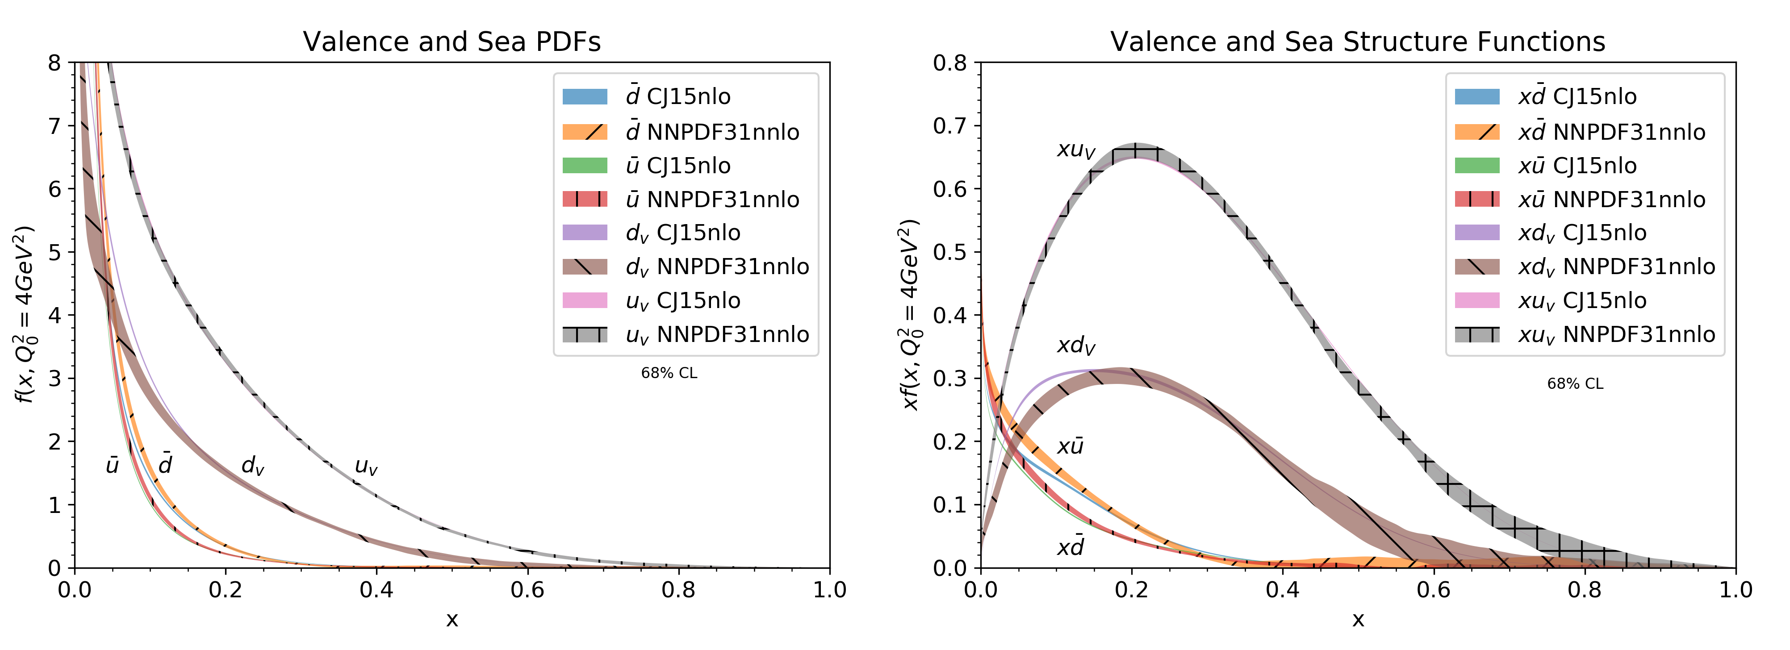
ty
Treating the height of the peak h(x_{p},Q²) and position of the peak x_{p} as “physical observables”:
h(x,Q2) = x_{p}q_{v}
x_{p}(Q²)

Slide 8
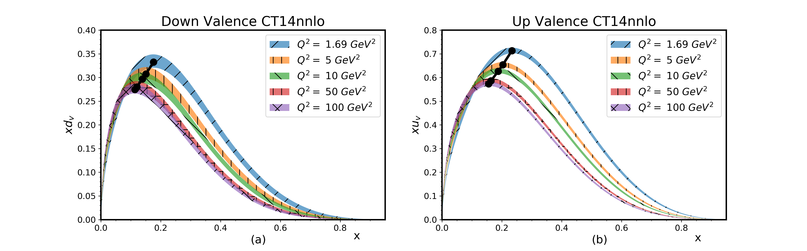
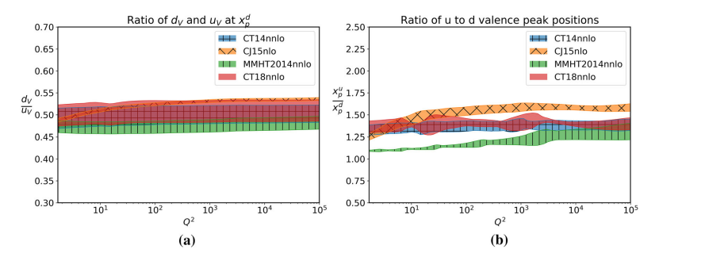
Treating the height of the peak h(x_{p},Q²) and position of the peak x_{p} as “physical observables”:

Slide 9
“New Approaches” in modeling valence quark dynamics
In general the peaking property of bound Fermi-system is a hallmark for
mean-field dynamics
Our assumption is that the peaking feature of valence quark distributions
is due to interaction of valence quarks in the strong mean field generated by
“residual hadronic system”
We introduce concept of “residual hadronic system” as a composite part
of the light-front wave function of valence quarks

Slide 10
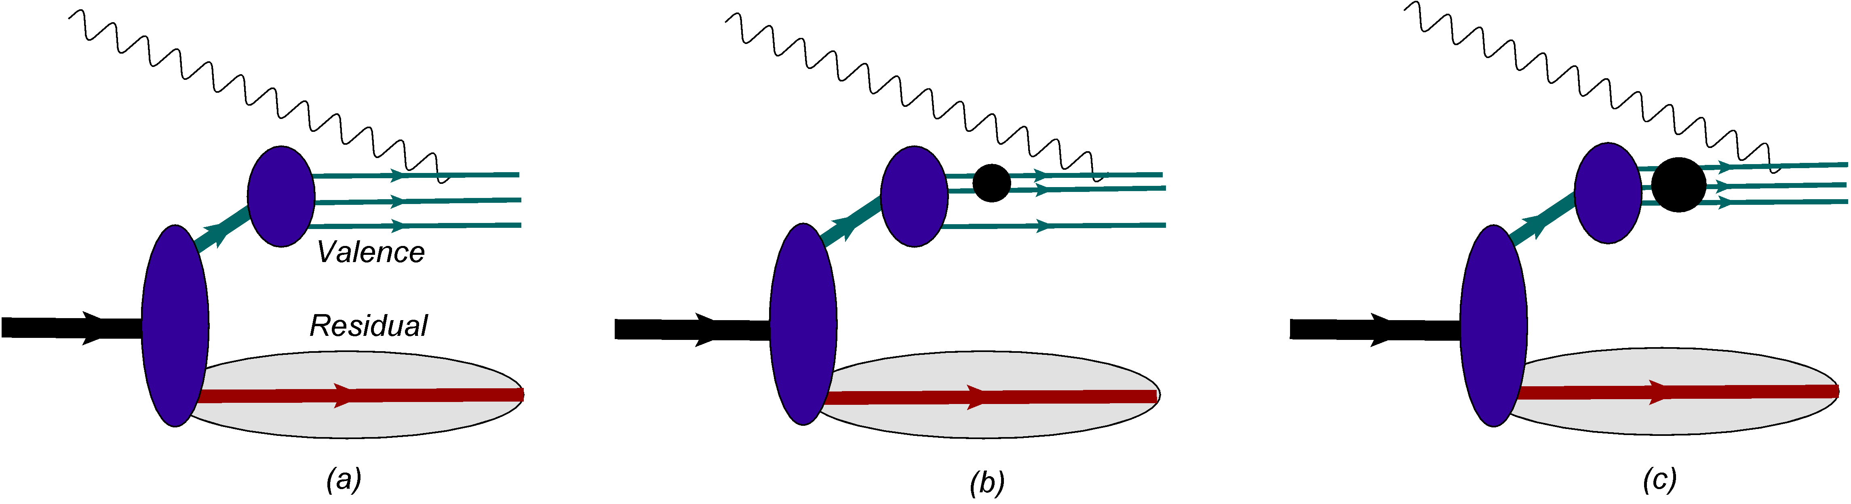
ty
h(x,Q2) = x_{p}q_{v}
x_{p}(Q²)

Slide 11
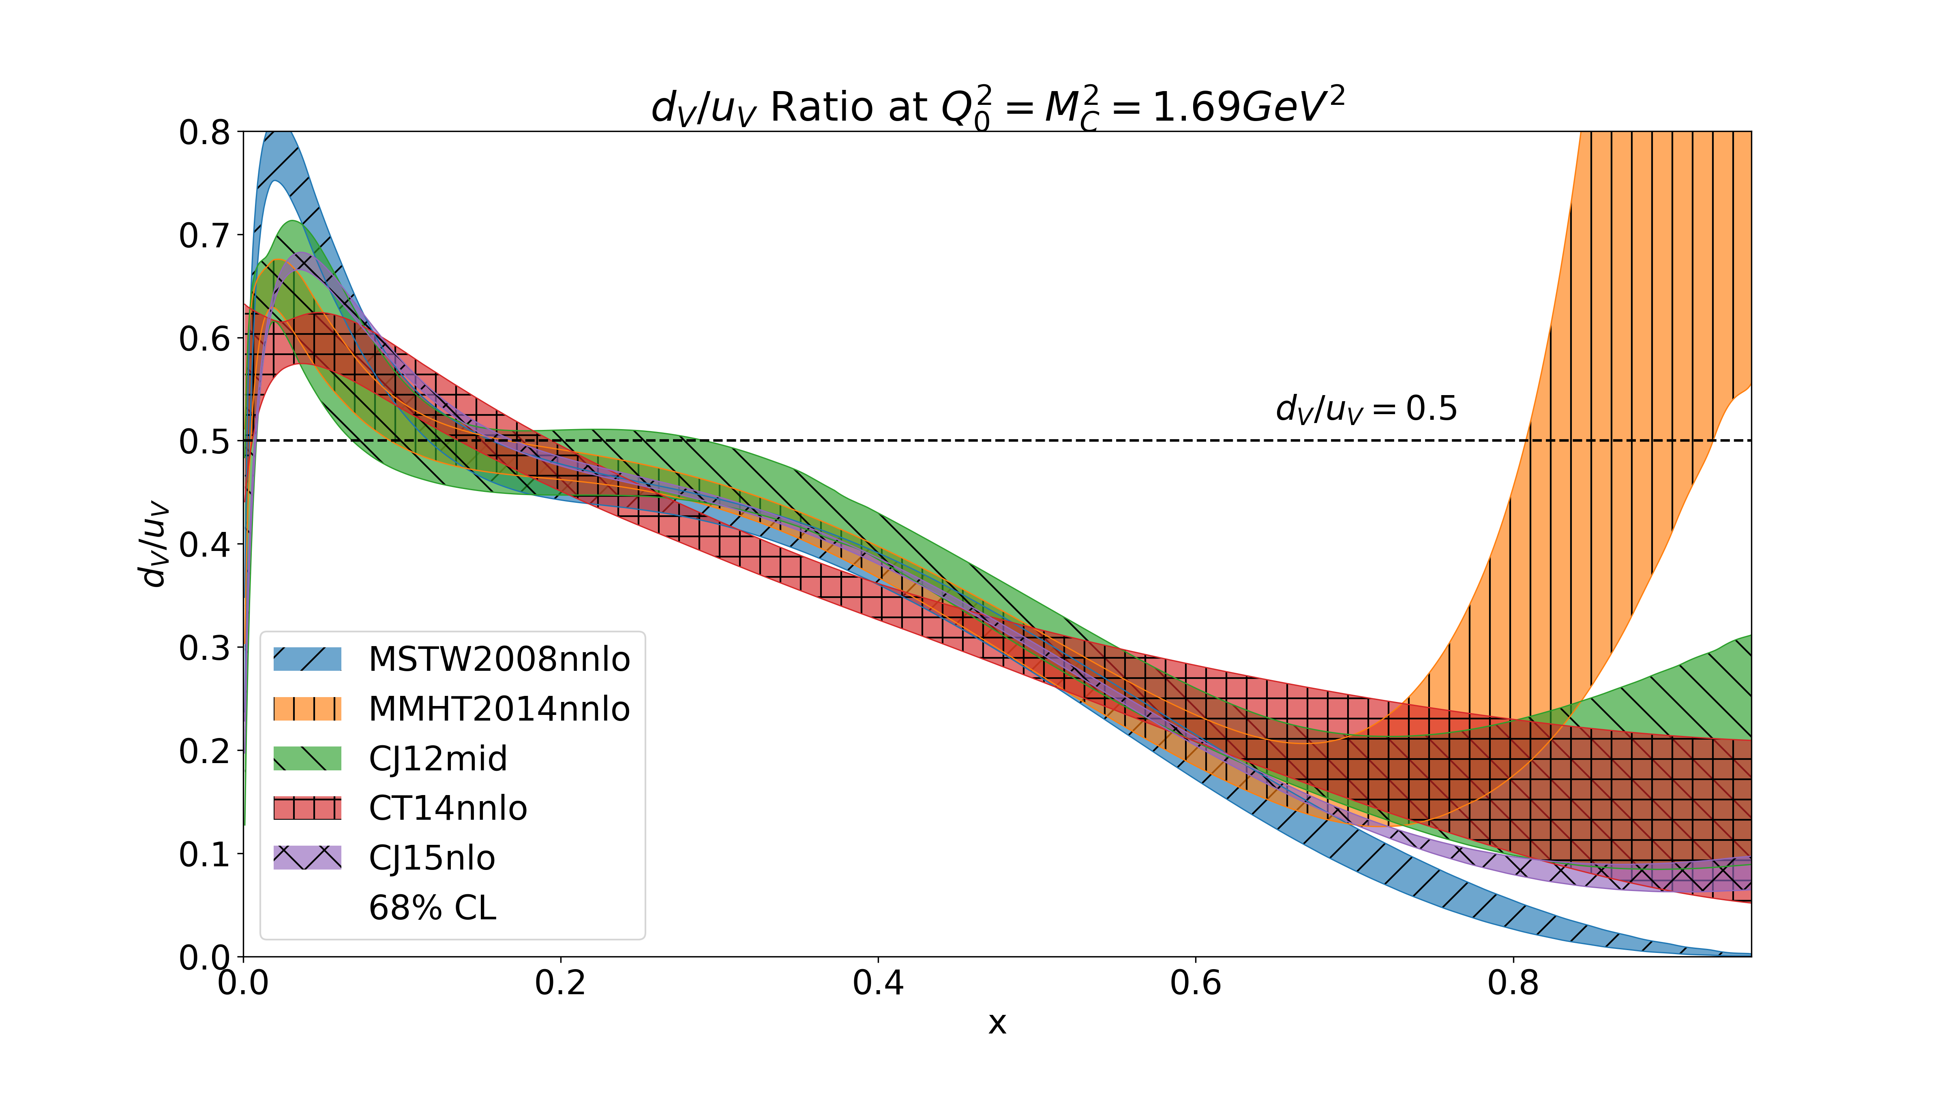
SU3 Symmetry

Slide 12
Main assumptions of the model
Dynamics: The main assumption is that the mean field, two- and three- quark short-range correlations define the dynamics of the valence quarks in the range of
0.1 ≤ x ≤ 1.

Slide 13
Valence Quarks in the Hadron:
- The model assumes an existence of almost massless valence quark cluster V
in the nucleon.
- The cluster is compact with the transverse separation between any qq,
- Valence quark system defines the baryonic number but not necessarily the total
isospin of the nucleon. It can have total total isospin, I_{V} = 1/2 or 3/2 each of them
corresponding to the different excitations or masses of the residual nucleon system.
(For the lowest mass of the recoil system one expects the 3q system to have the same
isospin and its projection that the considered nucleon has.)

Slide 14
Residual Structure:
- Introducing residual structure of the hadron with the spectrum of mass, m_{R} -
spectral function formalism in the description of the hadron structure.
- The model assumes a certain universality of the residual structure, R, entering in
all other mechanisms of generation of valence quark distribution.
- This universality is reflected in the fact that one can fix its main properties within
mean field and apply it in the calculation of 2q- and 3q- correlation contributions.
-The mass spectrum of the residual system is continuous and effectively depends
on whether u- or d- valence quarks are probed in the nucleon.
For proton:

Slide 15
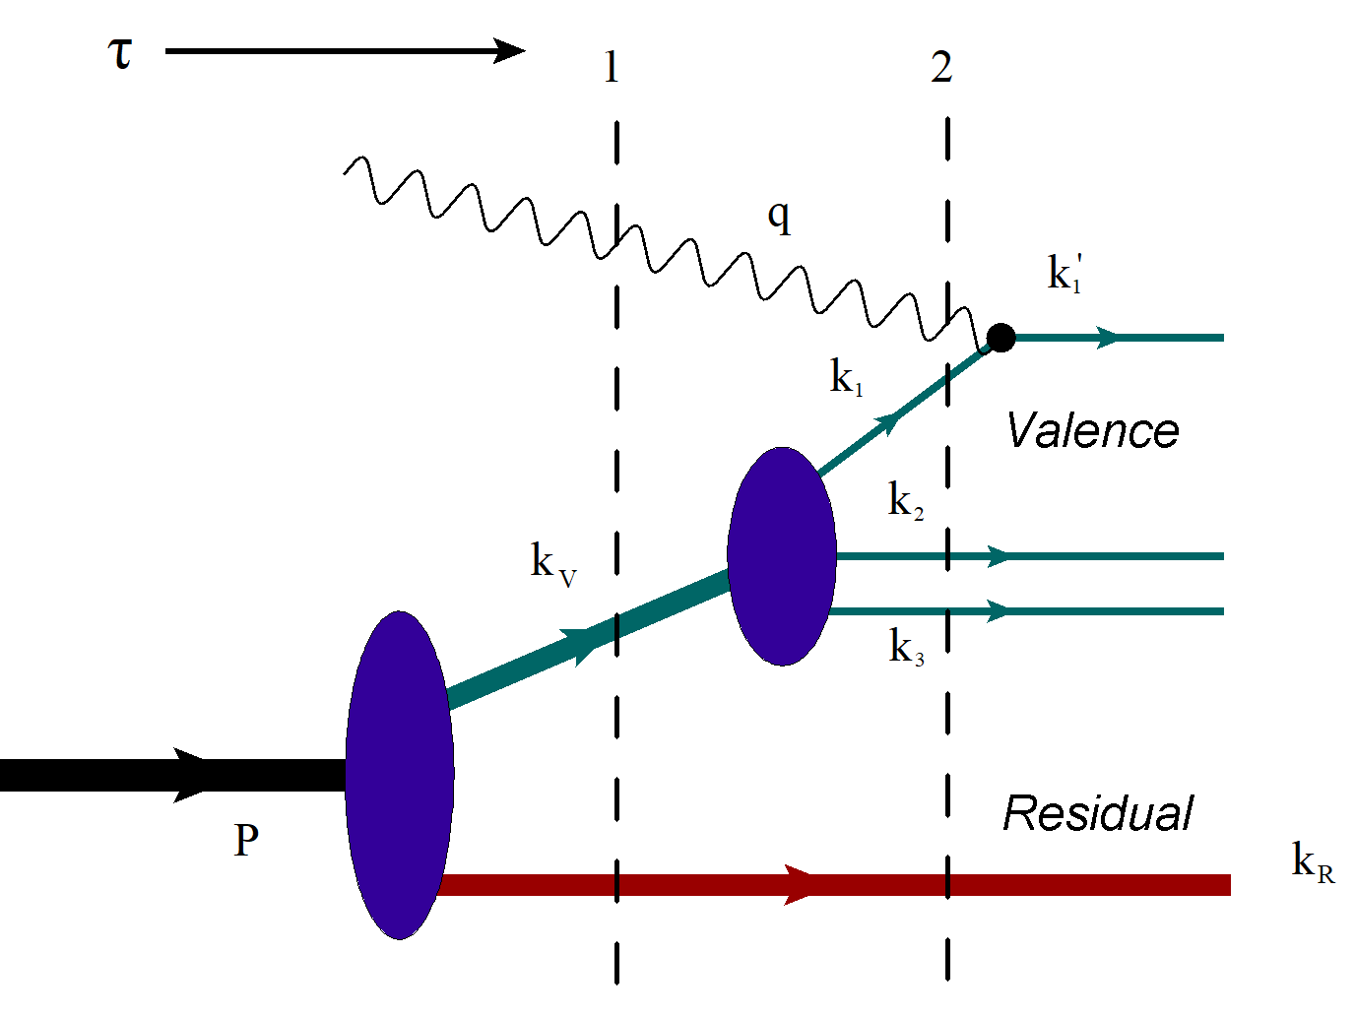
Mean-Field Model of Valence Quark Distributions
- The valence 3q system occupies a region of ~0.6Fm and is described by mutually coupled
three-dimensional harmonic oscillators, thus satisfying confinement condition.
- The valence system does not define the total radius of the nucleon.
- Valence quarks are almost massless with the invariant energy characterizing its
virtuality
- The residual system generates the mean field and occupies a volume less or equal to
the hadronic volume.

Slide 16
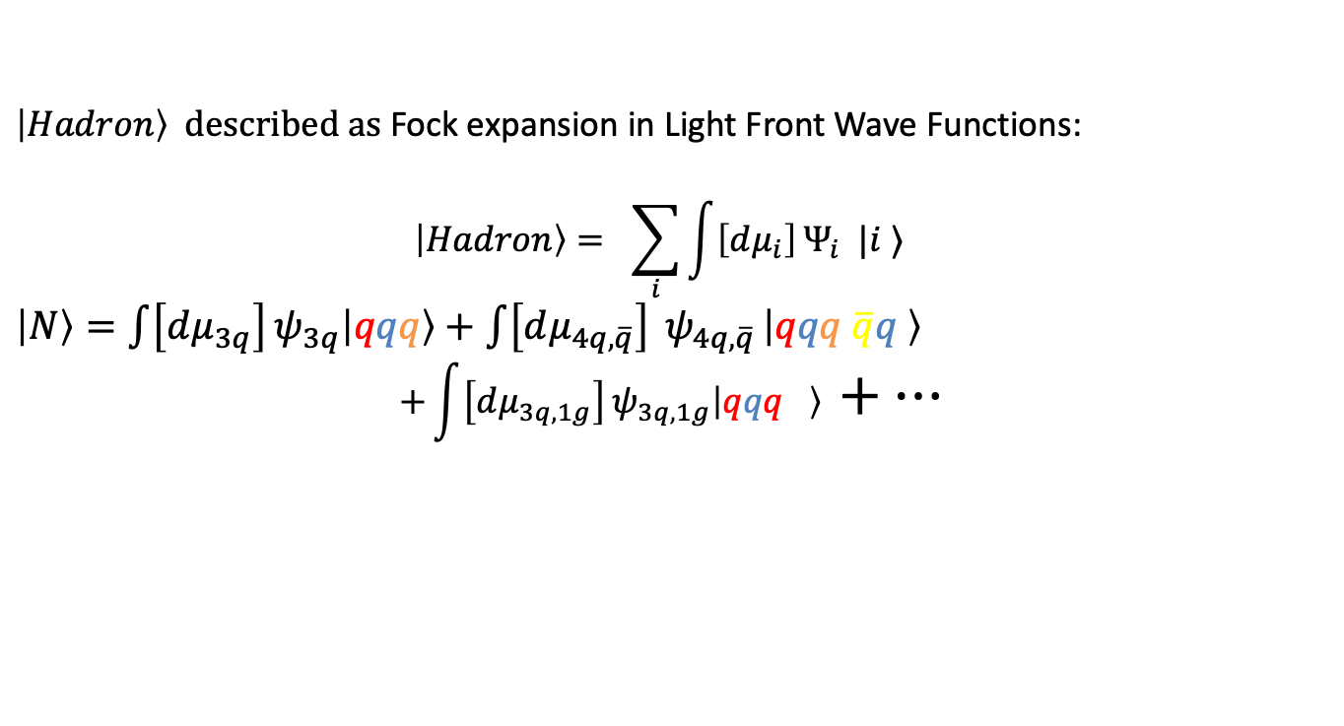
Light-Front Wave Functions
$\left|Hadron\right\rangle$ described as Fock expansion in Light Front Wave Functions:
$$\left|Hadron\right\rangle = \sum_{i}{\int{\left[dμ_{i}\right]}Ψ_{i} |i ⟩}$$
$\left|N\right\rangle =\int{\left[dμ_{3q}\right]}ψ_{3q}\left|qqq\right\rangle +$ $\int{\left[dμ_{4q, \overline{q}}\right]} ψ_{4q, \overline{q} }\left|qqq \overline{q}q \right\rangle$
$${+\int{\left[dμ_{3q,1g}\right]}ψ}_{3q,1g}\left|qqq \right\rangle +…$$
Infinite set of coupled integral equations

Slide 17
Phenomenological Light-Front Wave Functions

Slide 18
Reference Frame, Kinematics and Structure Function

Slide 19
Calculation of the scattering amplitude

Slide 20
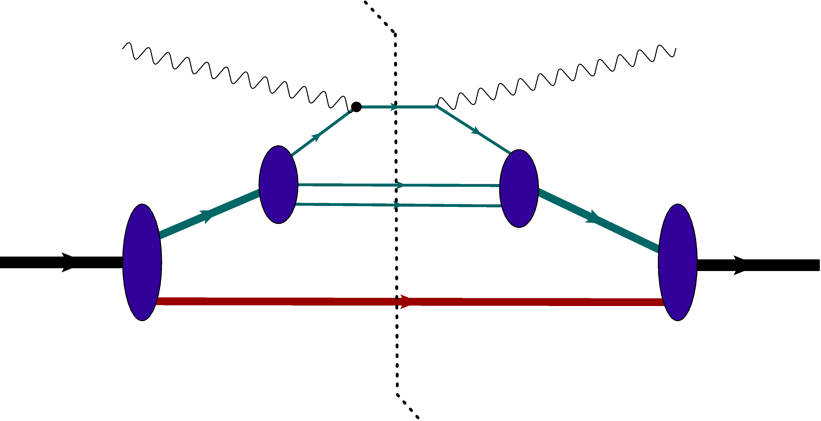
Calculation of the Structure Function

Slide 21
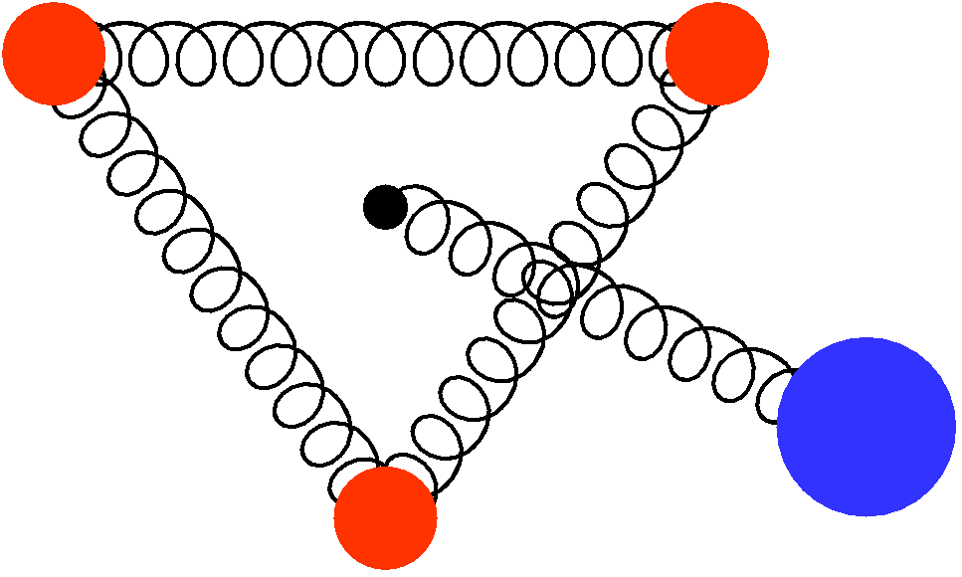
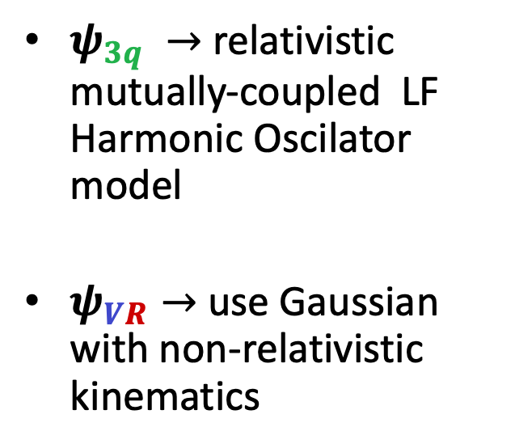
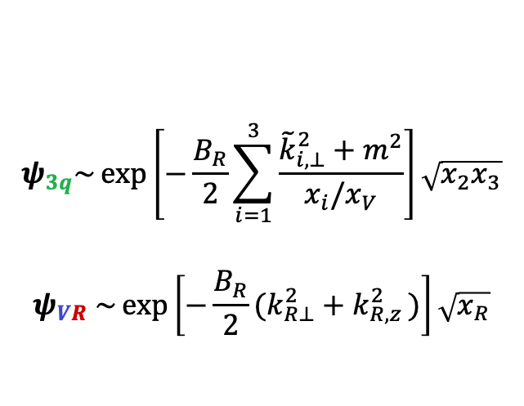
Model – Light Front Wave Functions
q
q
$ψ_{3q} →$relativistic mutually-coupled LF Harmonic Oscilator model
$ψ_{VR}→$ use Gaussian with non-relativistic kinematics
R
q
$$ψ_{3q}\sim \exp\left[−\frac{B_{R}}{2}\sum_{i=1}^{3}{\frac{{\tilde{k}}_{i, ⊥}^{2}+m^{2}}{x_{i}/x_{V}}}\right]\sqrt{x_{2}x_{3}}$$
$$ψ_{VR} \sim \exp\left[−\frac{B_{R}}{2}(k_{R⊥}^{2}+k_{R,z }^{2})\right]\sqrt{x_{R}}$$

Slide 22
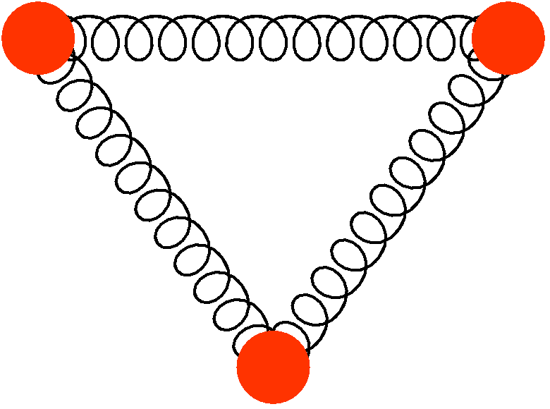
Modeling Wave Functions
Wave function of 3q valence system:
Relativistic coupled Harmonic Oscillator

Slide 23
Modeling Cluster-Residual Nucleon Wave Functions
Wave function of V-R system:
Model in a Gaussian form
x_{R} – light-cone momentum fraction of the recoil system
p_{R} – relative momentum between CMs of V and R system
- Considering a non-relativistic approximation for recoil system p_{R} <m_{R}

Slide 25
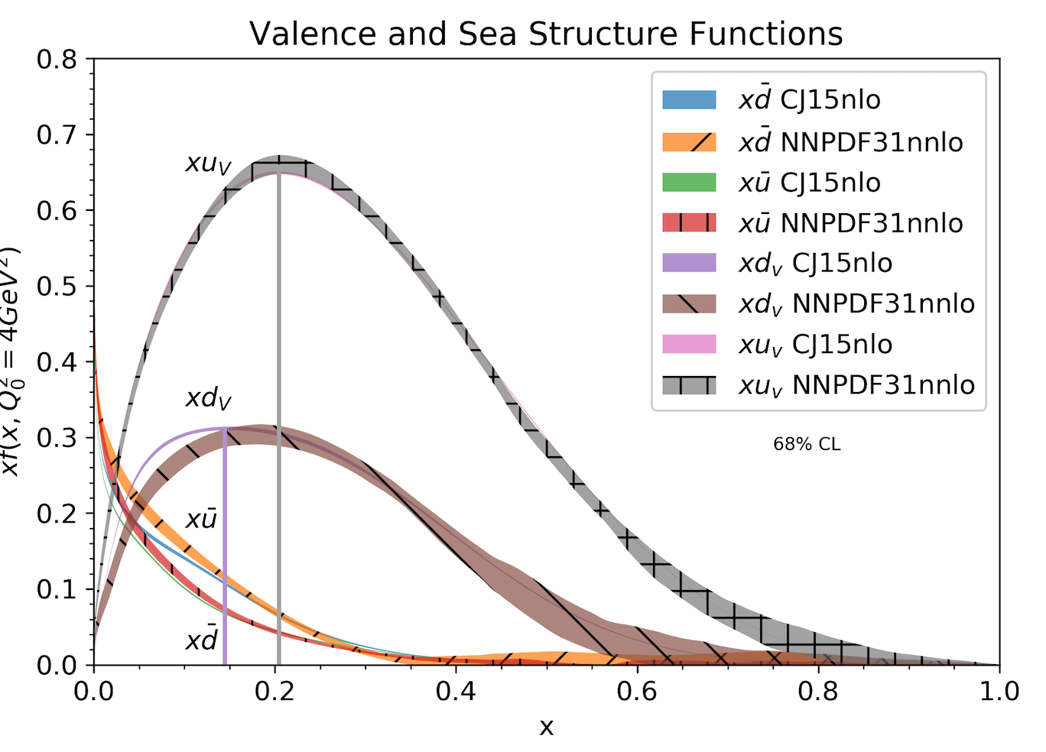
Qualitative Features of the Model
- Evaluating the integral at the maximum of exponent:
In this case
which peaks at
In the model: m_{R}(u) < m_{R}(d):

Slide 26
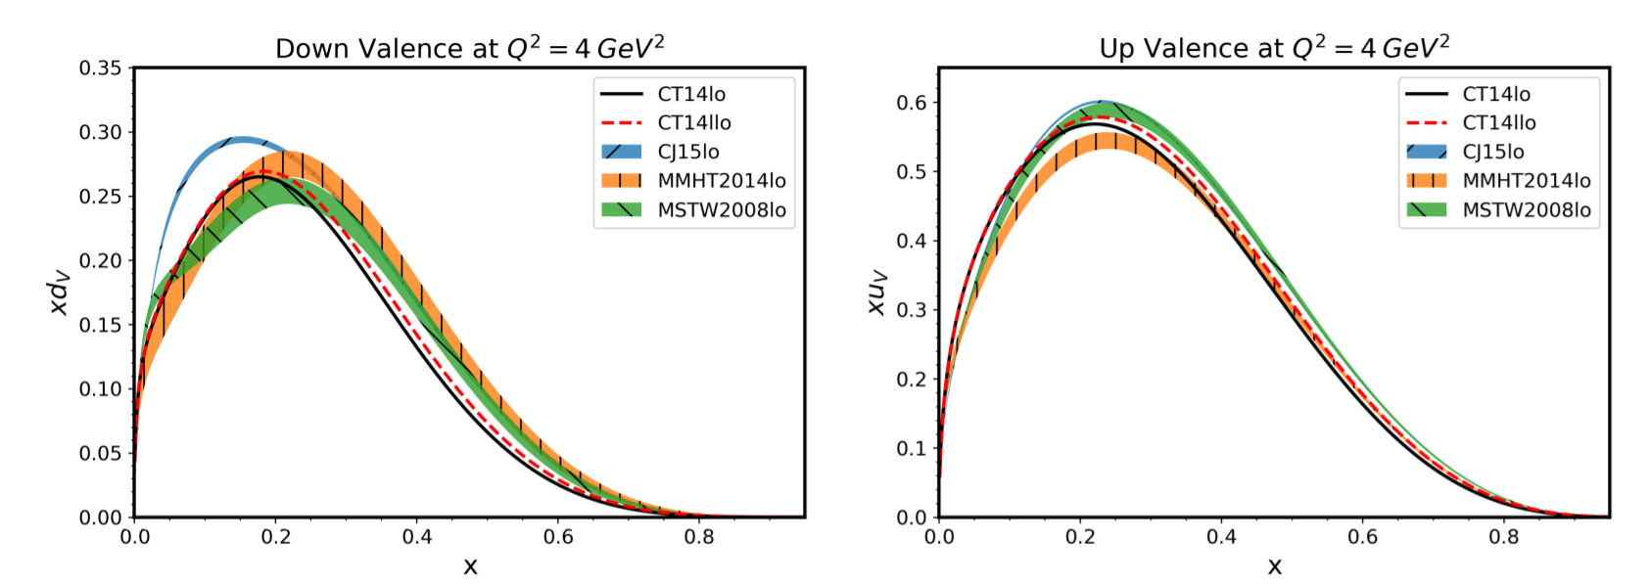
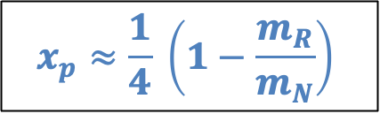

Nucleon – Valence q Peak
For $m_{R}≈m_{π}$ $→$ $x_{p}≈0.2$
Massless valence quarks
Different from diquark (Close & Thomas (1988)):
$x_{p}=1−\frac{m_{dq}}{m_{N}}$
$m_{dq}≈800 MeV$, $x_{p}≤1$
$$x_{p}≈\frac{1}{4} \left(1−\frac{m_{R}}{m_{N}}\right)$$

Slide 27
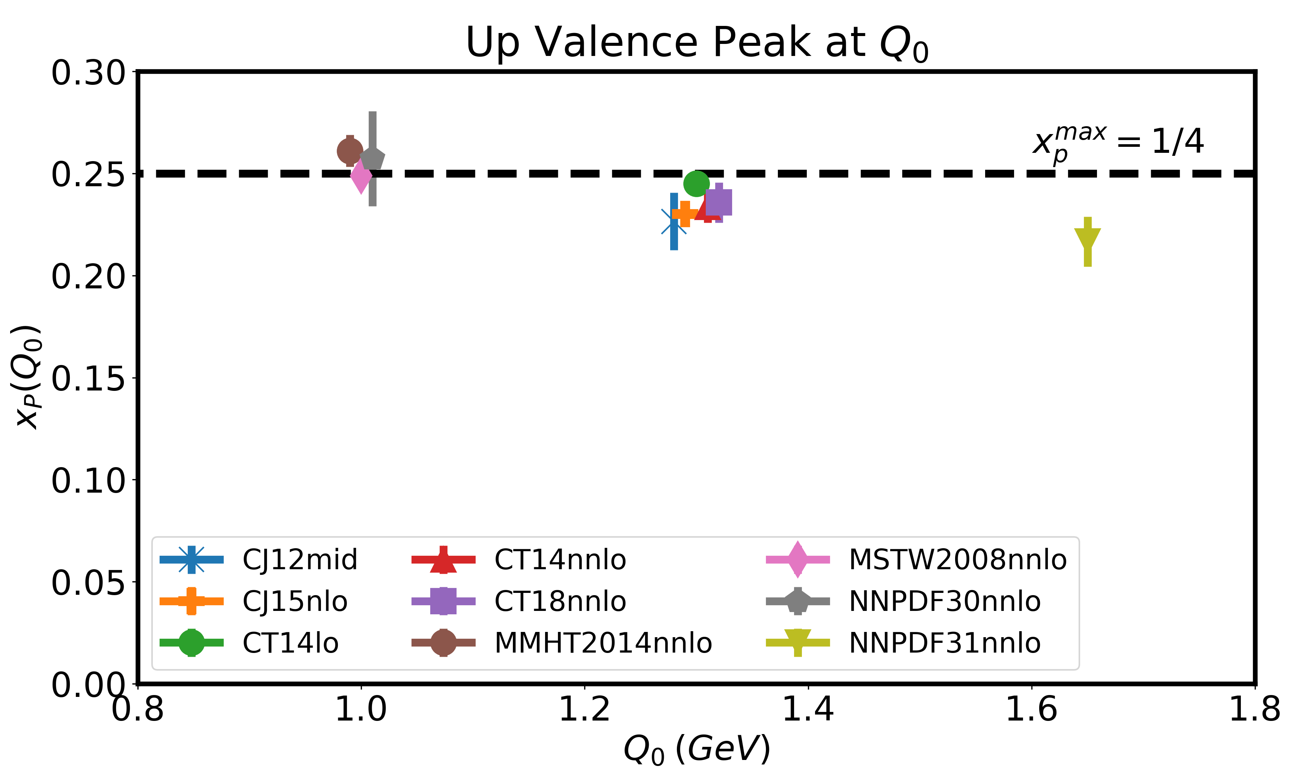
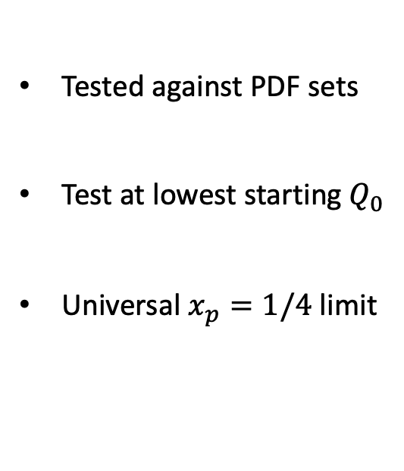

Possible Universal Limit
Universal $x_{p}=1/4$ limit
Tested against PDF sets
Test at lowest starting $Q_{0}$
Universal $x_{p}=1/4$ limit
Leon, C. and Sargsian, M. Eur. Phys. J. C 82, 309 (2022)
Notes:
Goes to smallest possible Q_0
Lowest case 1 GeV when partonic model suspicious
Whenever partonic
Q_0 once low that partonic model is valid ratio
Universal number: ¼
System for
Check at smallest. Seems universal
IF ask: ¼ from residual

Slide 28
Numerical Estimates:
choosing the parameters of the model
the model has five parameters A_{V,} B_{V}, A_{R}, B_{R} and m_{R}.

Slide 29
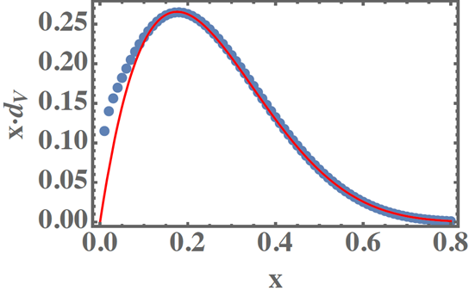
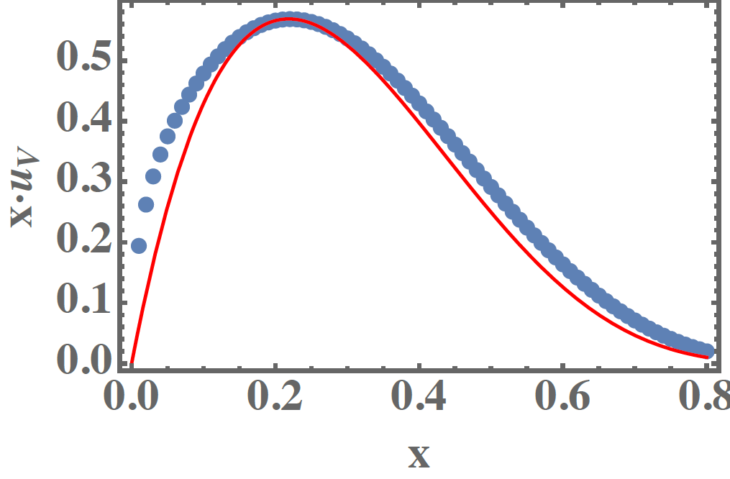
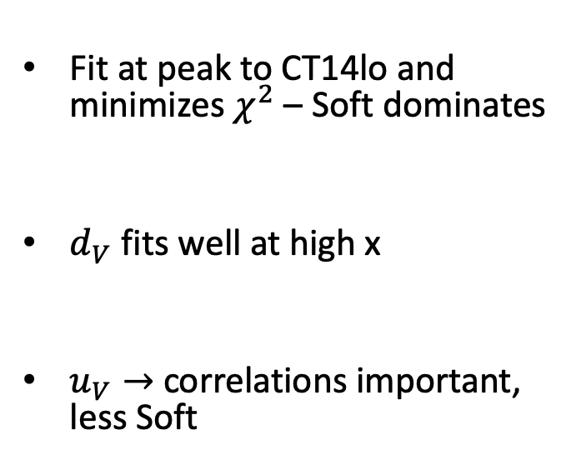
Nucleon - Fitting Results
- CT14lo
- Model
Fit at peak to CT14lo and minimizes $χ^{2}$ – Soft dominates
$d_{V}$ fits well at high x
$u_{V}→$correlations important, less Soft
Leon, C. and Sargsian, M. Eur. Phys. J. C 82, 309 (2022)

Slide 30
Once parameters are fixed we can evaluate the strength of the missing high momentum
component

Slide 31
“Calculation of Pion valence PDF”
Maerovitz, Leon, Sosa, Sargsian, ArXiV 2025

Slide 34
Two-Body Light-Front Wave Functions

Slide 35
Diffuse Residual System

Slide 36
Feynman Mechanism
Hard Contribution

Slide 37
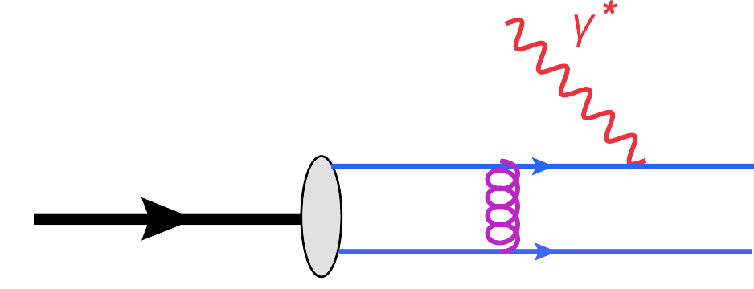
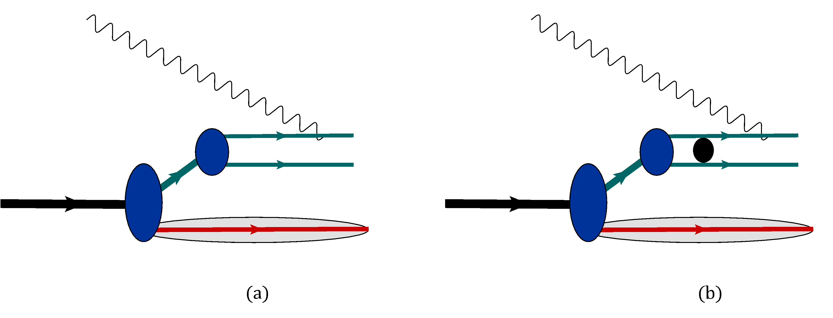
Hard Contribution
Before
2
To Conserve Unitarity
2
+

Slide 38
pion
- Diffuse Residual System
- Highly Virtual Valence Quark Cluster

Slide 39
Some Empirical Observation
valence quarks in nucleon peak at ¼ - this requires
valence quarks in pion peak at 1/2 - this requires
But then what is observed is
“experimentally”:
and
Somehow peak positions of
at
Define the asymptotic behavior at

Slide 40
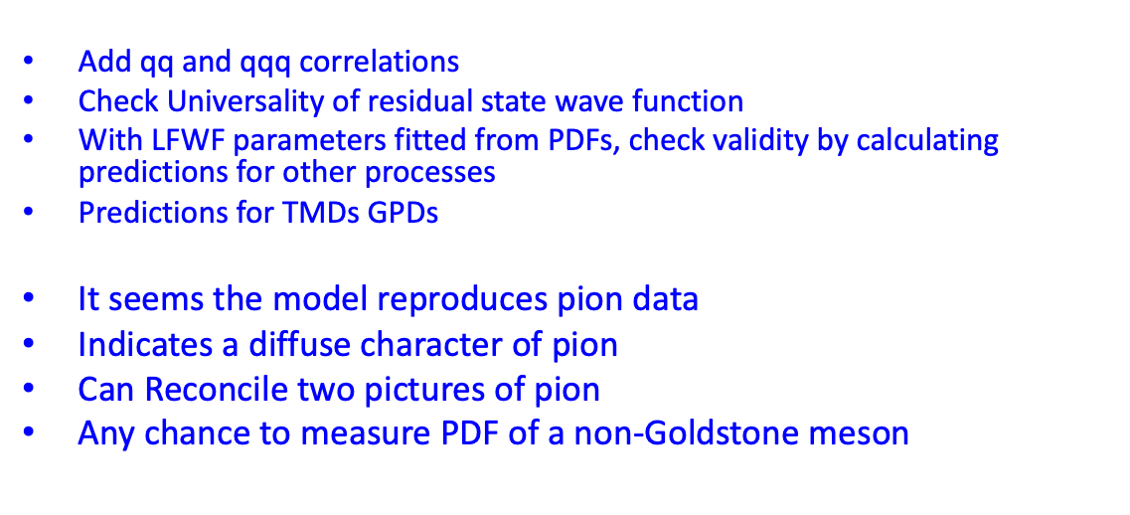
Outlook
Based on phenomenological wave functions -> Spectral Function
Add qq and qqq correlations
Check Universality of residual state wave function
With LFWF parameters fitted from PDFs, check validity by calculating predictions for other processes
Predictions for TMDs GPDs
It seems the model reproduces pion data
Indicates a diffuse character of pion
Can Reconcile two pictures of pion
Any chance to measure PDF of a non-Goldstone meson
It seems there is a relation between peak position of xf_{V} and f_{V} at x 1
- Other explanations why x_{p} = 1/4 ?

