Slide 1



Pion-in-jet production in pp collisions: TMD-FF phenomenology
Umberto D’Alesio
C. Flore & M. Zaccheddu, arXiv:2506.21959

Slide 2
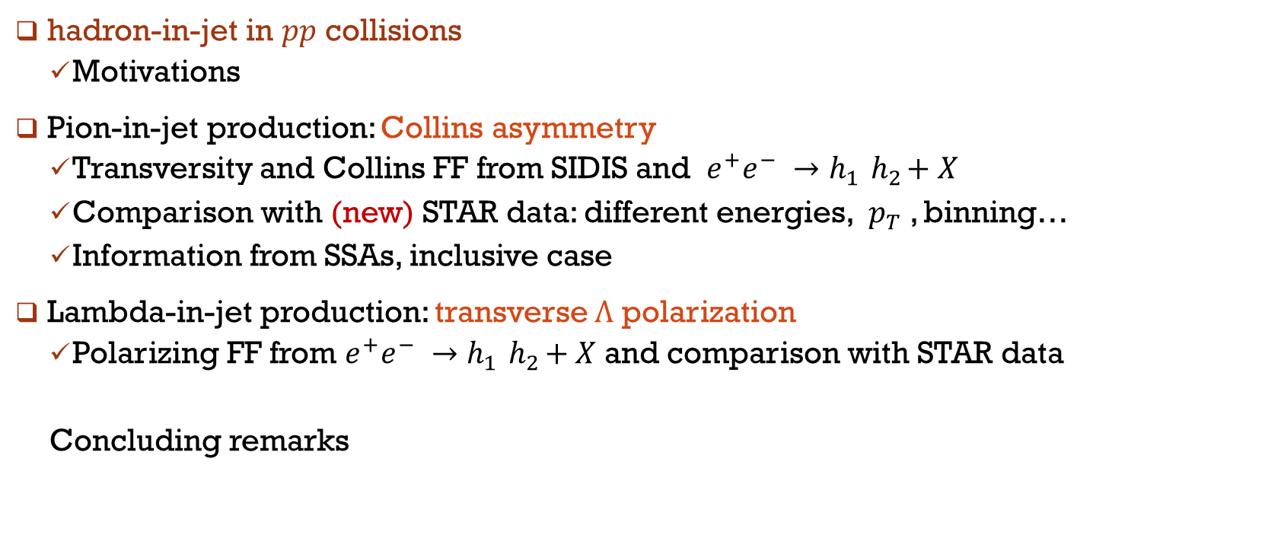
Outline
hadron-in-jet in $pp$ collisions
Motivations
Pion-in-jet production: Collins asymmetry
Transversity and Collins FF from SIDIS and $e^{+}e^{−} →h_{1}{ h}_{2}+X$
Comparison with (new) STAR data: different energies, $p_{T}$, binning…
Information from SSAs, inclusive case
Lambda-in-jet production: transverse $Λ$ polarization
Polarizing FF from $e^{+}e^{−} →h_{1}{ h}_{2}+X$and comparison with STAR data
Concluding remarks

Slide 3
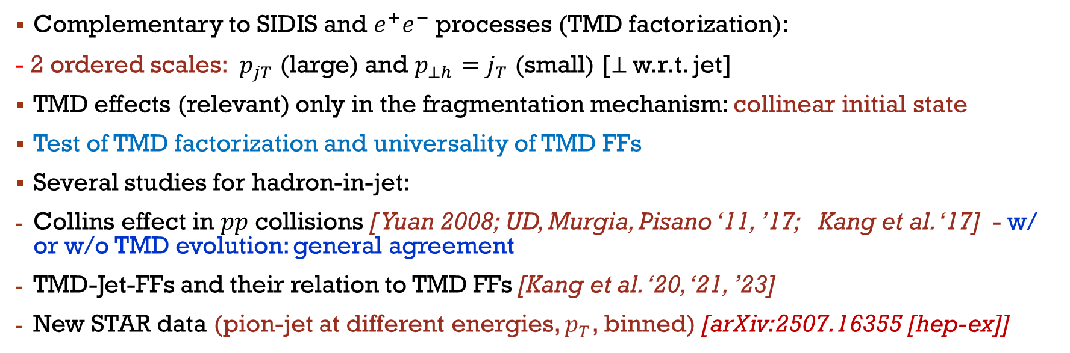
Motivations
Complementary to SIDIS and $e^{+}e^{−}$ processes (TMD factorization):
- 2 ordered scales: $p_{jT}$ (large) and $p_{⊥h}=j_{T}$ (small) [⊥ w.r.t. jet]
TMD effects (relevant) only in the fragmentation mechanism: collinear initial state
Test of TMD factorization and universality of TMD FFs
Several studies for hadron-in-jet:
Collins effect in $pp$ collisions [ Yuan 2008; UD, Murgia, Pisano ‘11, ’17; Kang et al. ‘17] - w/ or w/o TMD evolution: general agreement
TMD-Jet-FFs and their relation to TMD FFs [Kang et al. ‘20, ‘21, ’23]
New STAR data (pion-jet at different energies, $p_{T}$, binned) [arXiv:2507.16355 [hep-ex]]

Slide 4

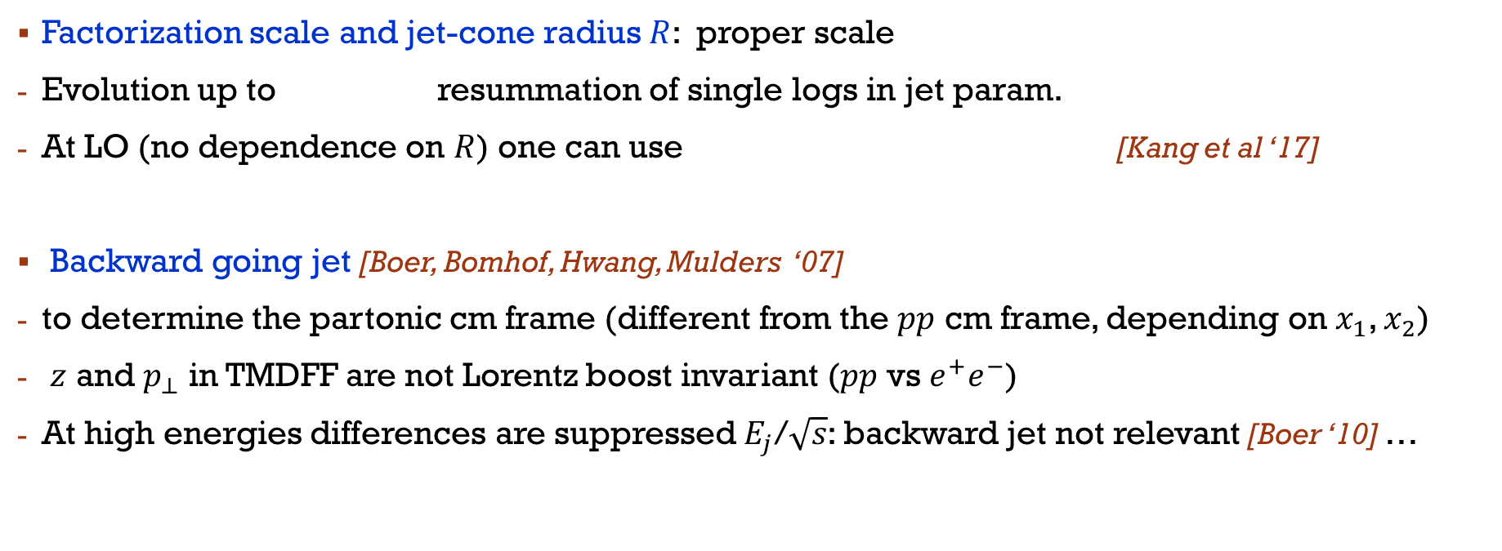
Factorization scale and jet-cone radius $R$: proper scale
Evolution up to resummation of single logs in jet param.
At LO (no dependence on $R$) one can use [Kang et al ‘17]
Backward going jet [Boer, Bomhof, Hwang, Mulders ‘07]
to determine the partonic cm frame (different from the $pp$ cm frame, depending on $x_{1}$, $x_{2}$)
$z$ and $p_{⊥}$ in TMDFF are not Lorentz boost invariant ($pp$ vs $e^{+}e^{−}$)
At high energies differences are suppressed $E_{j}$/$\sqrt{s}$: backward jet not relevant [Boer ‘10] …

Slide 5
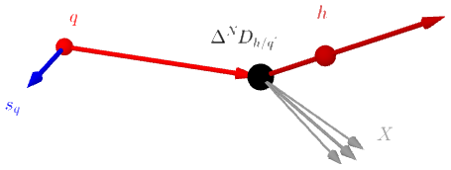
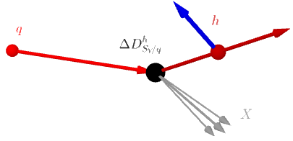
TMD Ffs for spin ½ hadrons
Collins FF
T-odd, chiral-odd
T-odd, chiral-even
polarizing FF

Slide 6


Kinematic configuration
collinear

Slide 7
Collins asymmetry

Slide 8
parametrizations
MSHT20nlo ‘21
DSSV ‘09
valence
DEHSS ‘15
DGLAP evolution
Boglione, UD, Flore, Gonzalez-Hernandez, Murgia, Prokudin, PLB2024

Slide 9
results

Slide 10
Results [predictions vs. data] I
Collins azimuthal asymmetries vs. $z$ at fixed $p_{jT}$ integrated over $η_{j}$[0:0.9]. Uncertainties at 2$σ$ CL.
STAR data: PRD 2022 (200 GeV) and arXiv:2507.16355 [hep-ex] (510 GeV)

Slide 11
Results [predictions vs. data] II
Collins azimuthal asymmetries vs. $x_{T}=2p_{jT}/\sqrt{s},$integrated over $z$ [0.1:0.8] and over $η_{j}$ [0:0.9].
STAR data: PRD 2022 (200 GeV) and arXiv:2507.16355 [hep-ex] (510 GeV)

Slide 12
Results [predictions vs. data] III
Collins azimuthal asymmetries vs. $z$ integrated over $η_{j}$: [0:0.9], for various $p_{jT}$ bins.
STAR data: SPIN2023 (510 GeV)

Slide 13
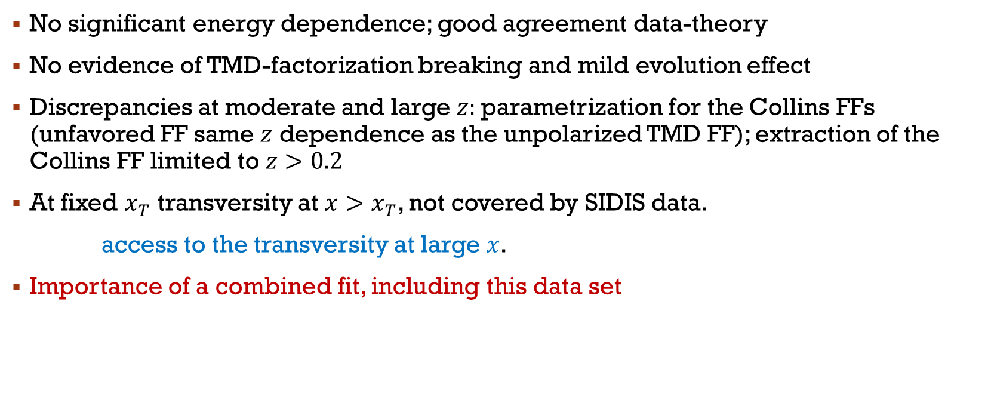
Remarks I
No significant energy dependence; good agreement data-theory
No evidence of TMD-factorization breaking and mild evolution effect
Discrepancies at moderate and large $z:$parametrization for the Collins FFs (unfavored FF same $z$ dependence as the unpolarized TMD FF); extraction of the Collins FF limited to $z>0.2$
At fixed $x_{T}$ transversity at $x>x_{T}$, not covered by SIDIS data.
access to the transversity at large $x$.
Importance of a combined fit, including this data set

Slide 14
Results [predictions vs. data] IV
Collins azimuthal asymmetries vs. $j_{T},$integrated over $z$ [0.1:0.8] and over $η_{j}$ [0:0.9], for various $p_{jT}$ bins.
STAR data: SPIN2023 (510 GeV)

Slide 15
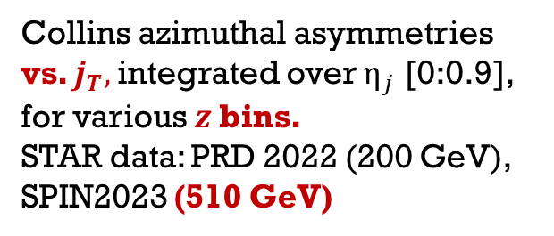
Results [predictions vs. data] IV
Collins azimuthal asymmetries vs. $j_{T},$integrated over $η_{j}$ [0:0.9], for various $z$bins.
STAR data: PRD 2022 (200 GeV), SPIN2023 (510 GeV)

Slide 16
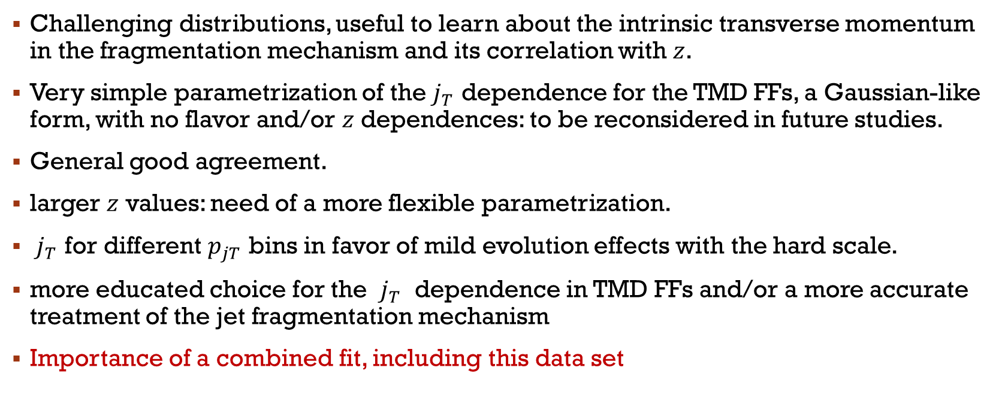
Remarks II
Challenging distributions, useful to learn about the intrinsic transverse momentum in the fragmentation mechanism and its correlation with $z$.
Very simple parametrization of the $j_{T}$ dependence for the TMD FFs, a Gaussian-like form, with no flavor and/or $z$ dependences: to be reconsidered in future studies.
General good agreement.
larger $z$ values: need of a more flexible parametrization.
$j_{T}$ for different $p_{jT}$ bins in favor of mild evolution effects with the hard scale.
more educated choice for the $j_{T}$ dependence in TMD FFs and/or a more accurate treatment of the jet fragmentation mechanism
Importance of a combined fit, including this data set

Slide 17
Towards a unified TMD picture?

Slide 18

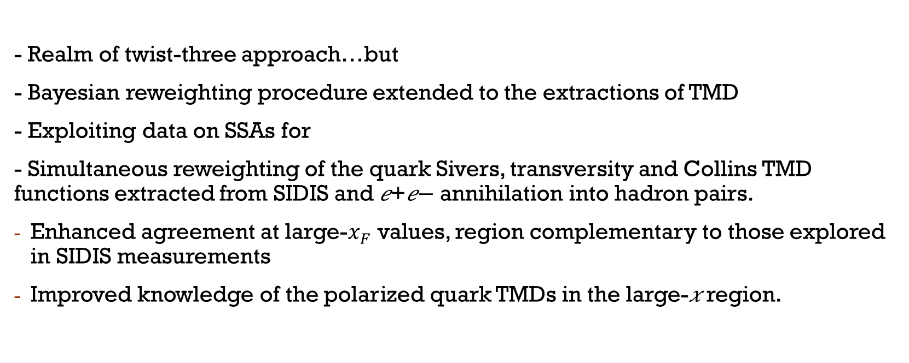
Towards a unified TMD picture?
Boglione, UD, Flore, Gonzalez-Hernandez, Murgia, Prokudin, PLB2024
- Realm of twist-three approach…but
- Bayesian reweighting procedure extended to the extractions of TMD
- Exploiting data on SSAs for
- Simultaneous reweighting of the quark Sivers, transversity and Collins TMD functions extracted from SIDIS and 𝑒+𝑒− annihilation into hadron pairs.
Enhanced agreement at large-$x_{F}$ values, region complementary to those explored in SIDIS measurements
Improved knowledge of the polarized quark TMDs in the large-𝑥 region.

Slide 19
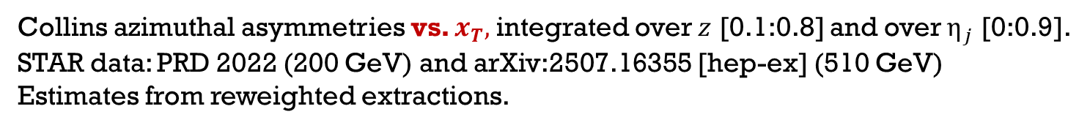
Use of reweighted extractions from SSAs
Collins azimuthal asymmetries vs. $x_{T},$integrated over $z$ [0.1:0.8] and over $η_{j}$ [0:0.9].
STAR data: PRD 2022 (200 GeV) and arXiv:2507.16355 [hep-ex] (510 GeV)
Estimates from reweighted extractions.

Slide 21



UD, Gamberg, Murgia, Zaccheddu ’24
$$q$$
$$h$$
$$X$$
- Polarization transverse w.r.t. the jet-Λ plane
- Numerator involves the polarizing FF
- similar study/results [Kang, Lee, Zhao ‘20]
- Extraction within CSS framework at NLL accuracy from Belle $e^{+}e^{−} →h_{1}{ h}_{2}+X$ data
[UD, Gamberg, Murgia, Zaccheddu ‘22, ’23]
STAR data [Gao et al. @SPIN2023]

Slide 22
Results: Λ
Transverse Λ polarization vs. $z$(left) $p_{⊥Λ}$ (right) for different scenarios

Slide 23

Concluding Remarks
$h$-jet in $pp$ collisions: tool to test universality of TMD FFs and TMD factorization
TMD scheme with TMD effects only in the fragmentation mechanism (advantages, direct access, two-scale processes)
general agreement both for the Collins asymmetries and for the transverse Λ polarization
Future work:
- open theoretical issues in hadron-in-jet production: jet fragmentation mechanism beyond LO accuracy, TMD FF parametrizations
- Collins asymmetries and transverse Λ polarization in SIDIS and in $h$-jet in $ep$ (@EIC: low $x,$ sea transversity)
THANKS for the ATTENTION

Slide 24
Back-up slides

Slide 25
Collins azimuthal asymmetries vs. $z$ integrated over $η_{j}$: [0:0.9], for various $p_{jT}$ bins.
STAR data: PRD 2022 (200 GeV)

Slide 26
Results [predictions vs. data] IV’
Collins azimuthal asymmetries vs. $j_{T},$integrated over $z$ [0.1:0.8] and over $η_{j}$ [0:0.9], for various $p_{jT}$ bins.
STAR data: PRD 2022 (200 GeV)

Slide 27

Results: $\overline{Λ}$
Transverse $\overline{Λ}$polarization vs. $z$(left) $p_{⊥Λ}$ (right) for different scenarios

