Slide 1
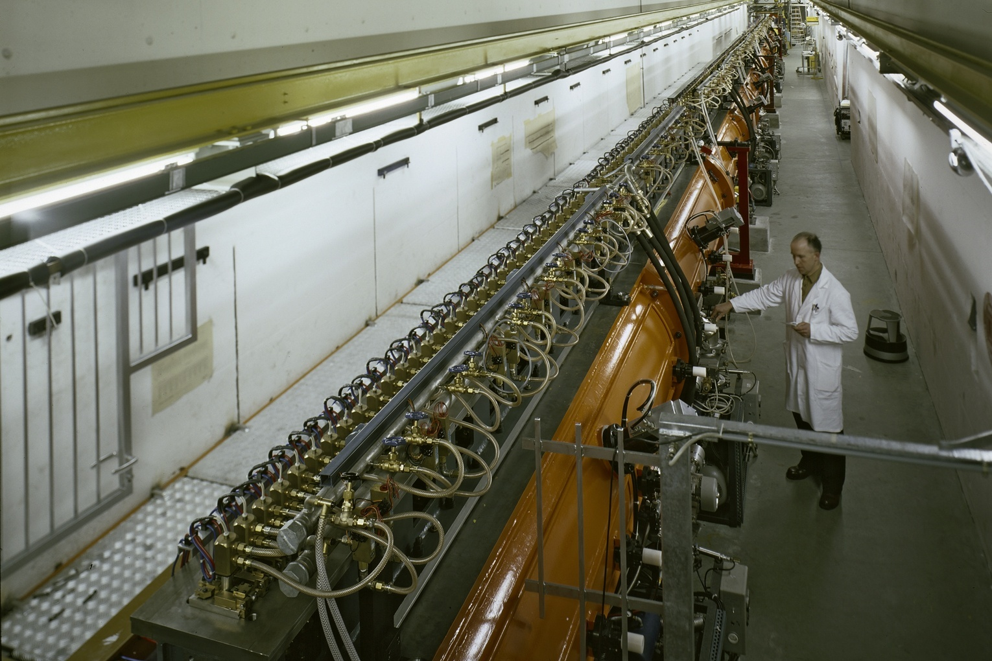
DTL Mini Workshop
Introduction
MV, 12.09.2011
Welcome to all participants (CERN and external) from the Linac4 management

Slide 2
Accelerating structure architecture
When β increases during acceleration, either the phase difference between cavities Δφ must decrease or their distance d must increase.
d = const.
φ variable
d
Individual cavities – distance between cavities constant, each cavity fed by an individual RF source, phase of each cavity adjusted to keep synchronism, used for linacs required to operate with different ions or at different energies. Flexible but expensive!
Better, but 2 problems:
create a “coupling”;
create a mechanical and RF structure with increasing cell length.
φ = const.
d variable
d ∝ βλ
Coupled cell cavities - a single RF source feeds a large number of cells (up to ~100!) - the phase between adjacent cells is defined by the coupling and the distance between cells increases to keep synchronism . Once the geometry is defined, it can accelerate only one type of ion for a given energy range. Effective but not flexible.
Notes:
How must be spaced the gaps? How should they be connected to the source of the wave? How many quadrupoles should we have?

Slide 3
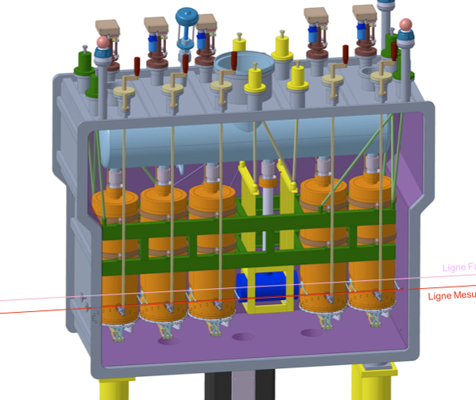
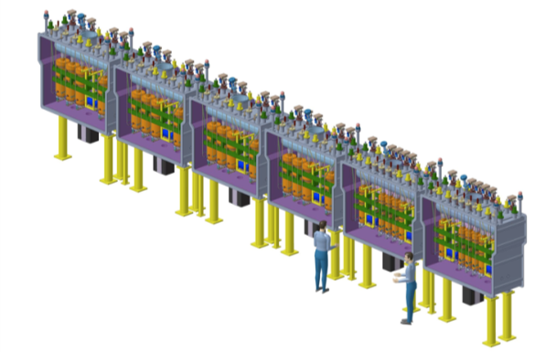
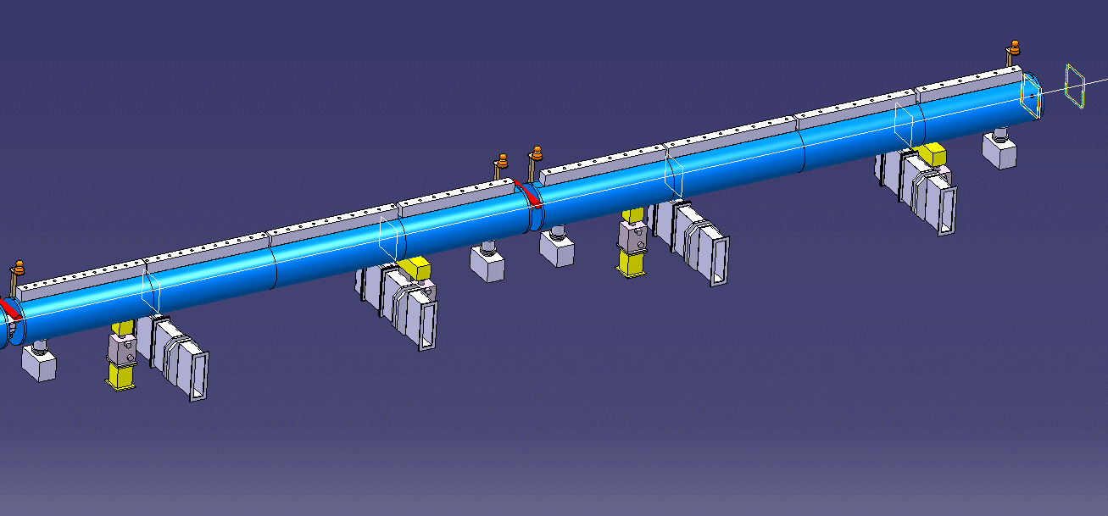
The two main options
1.
Sequence of short (1 or 2-gap) cavities, usually superconducting, spaced by quadrupoles.
high cost (many RF systems & cav.)
can reach CW operation
flexible (different ions possible)
2.
Drift Tube Linac (sequence of drift tubes with quadrupoles).
lower cost (high-power RF system)
simple only to duty cycle ~20% (then cost goes up)
not flexible (only 1 particle)
For the Linac4/SPL section between 3 and 50 MeV, the DTL is the logical choice.

Slide 4
TE mode: CH-DTL
Interdigital-H Structure
Operates in TE110 mode
Transverse E-field “deflected” by adding drift tubes
Used for ions, β<0.3
CH Structure operates in TE210, used for protons at β<0.6
High ZT² but more difficult beam dynamics (no space for quads in drift tubes)

Slide 5
CH used only in FAIR
Comparing the 2 most recent linac projects (SNS and JPARC)
and the 2 European linacs in construction or close to construction (Linac4 and FAIR):
402 MHz
1.4mA avg.
325 MHz
0.7mA avg.
352 MHz
0.02-2.4mA
325 MHz
5 μA avg.
Common features: all designs normal conducting,
sequence of different accelerating structures

Slide 6
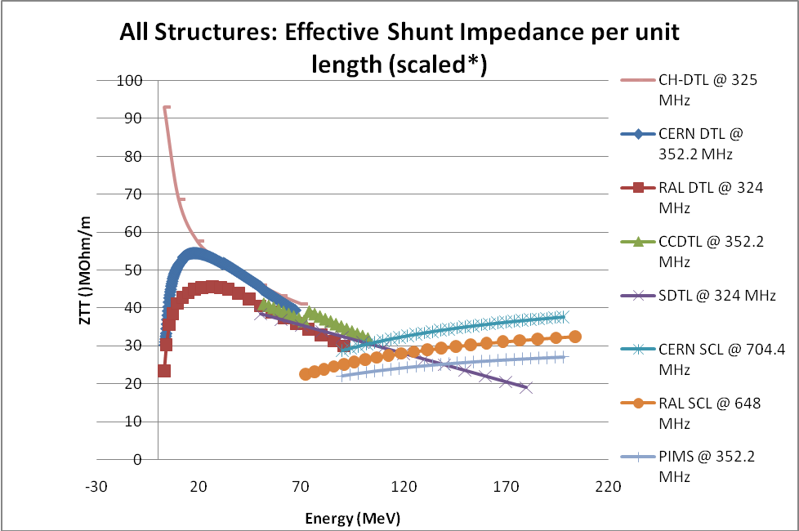
Comparing DTL and CH
The shunt impedance of the CH-DTL is higher, but only below 20 MeV.
The special beam dynamics used to overcome the fact that the tubes have no quadrupole (KONUS) leads to higher emittance growth, more sensitivity to errors and probably some beam loss when errors are present, inacceptable for high duty cycle.
From:
Eds. C Plostinar
Comparative Assessment of HIPPI Normal Conducting Structures
CARE-Report-2008-071-HIPPI
http://epubs.cclrc.ac.uk/bitstream/3705/CARE-Report-08-071-HIPPI.pdf

Slide 7
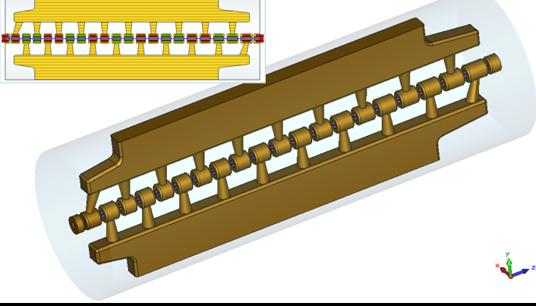
One last candidate
Nice poster at IPAC11 from S. Kurennoy (LANL) on an IH design with PMQs inside drift tubes (the best of two worlds, high shunt impedance and clean FODO dynamics?).
At the moment, it does not look like a possible candidate for replacing the DTL:
Length of 1st drift tube (3 MeV, 352 MHz) is 0.5*βλ/2 ≈ 17 mm → the 1st PMQ would be about 15 mm long, with 20 mm aperture … no way.
The shunt impedance with large diameter drift tubes is lower, probably higher than DTL only in the first MeV’s (up to 10 MeV?).
Drift tubes with quadrupoles need to be more precisely aligned than for the pure IH.

Slide 8
History of Linac4 DTL R&D
DTL development project started with ITEP Moscow and VNIIEF Sarov on 1.2.2005: construction of a prototype to be sent to CERN for evaluation, to be completed by 31.1.2007 (2 years). In September 2011, 6 years and 8 months later, the prototype is not yet finished.
In parallel, start a “DTL Task Force”, with a 1st meeting on 2.12.2004. Idea was to gather CERN experts to develop an alternative design.
After a long discussion on the main features of the design, the mechanical team started to work actively on the drawing board in 2007. Outcome was the design of the prototype.
The prototype parts were provided by INFN (2008); the prototype was assembled and fully tested at CERN in 2009.

