Slide 1
Linac4 DTL Beam Dynamics
Mini-workshop on DTL design – 13 September 2011
JB Lallement, A. Lombardi, E. Sargsyan.

Slide 2
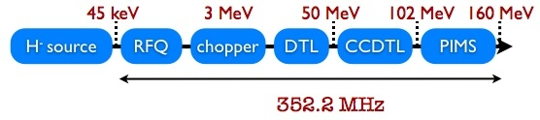
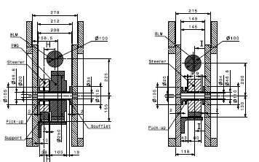
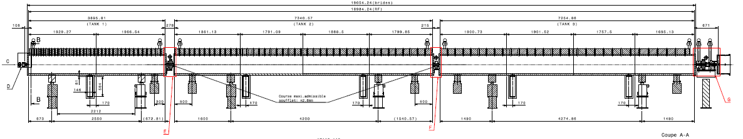
DTL Layout
Tank 1
39 Cells
EMQ
Steerer
Tank 2
42 Cells
Steerer
Tank 3
30 Cells
2 βλ
1 βλ

Slide 3
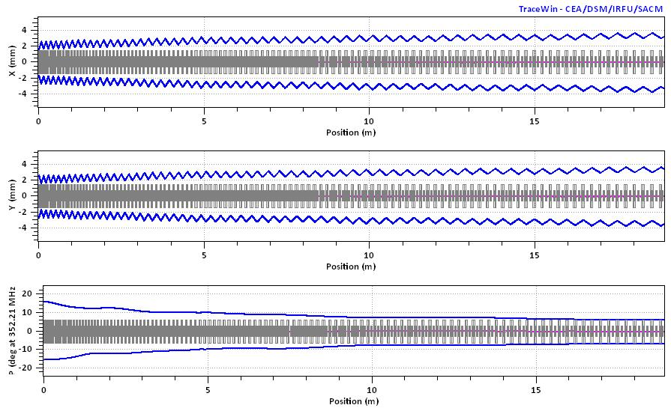
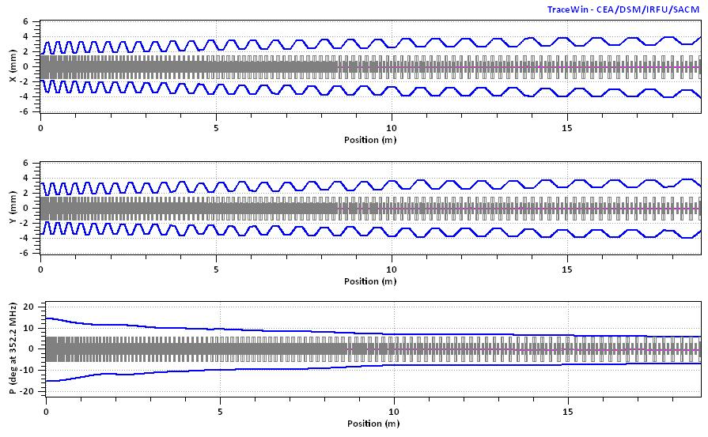
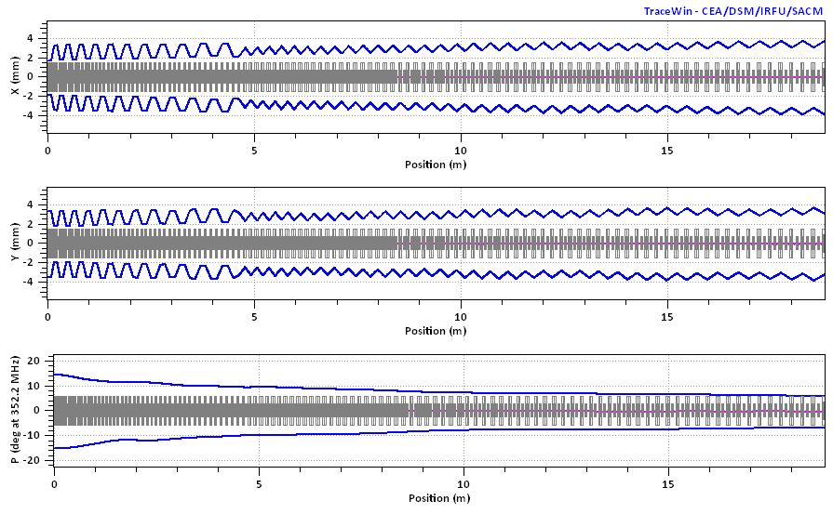
3 possible focusing schemes
FODO (FD)
FFDD
FFDD and FD
No « exotic » schemes.

Slide 4
Transverse Focusing Scheme
FFDD
FFDD
FFDD
FFDD !
FFDD less sensitive to quadrupole gradient and alignement errors.
FD in tank 1 → 106 T/m for the first quad.
PMQ focusing 45 mm in tank 1 and in the end-cups.
        80 mm in tank 2&3.
        EMQ 105 mm in intertank 1-2.

Slide 5
Longitudinal Parameters
3.1 MV/m
-35° to -24°
3.3 MV/m
-24°
3.3 MV/m
-24°
Phase is adjusted at tank transitions to compensate the missing gap(s).

Slide 6
Beam Dynamics “Choices”
Tranverse phase advance at zero current less than 90°.
Smooth variation of the phase advance.
Avoid resonnances.

Slide 7
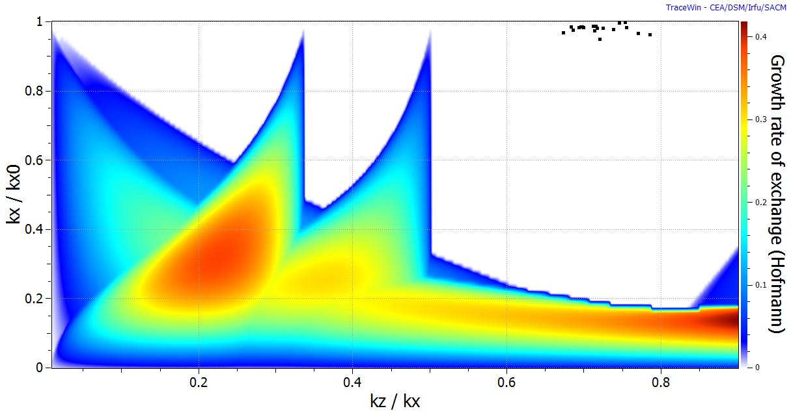
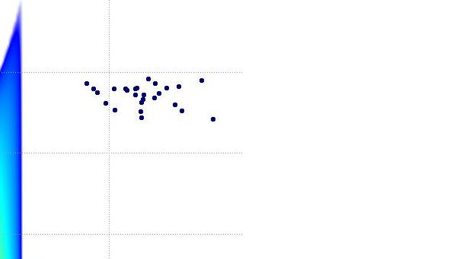
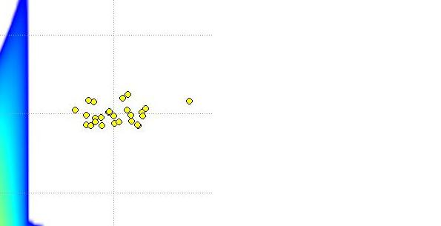
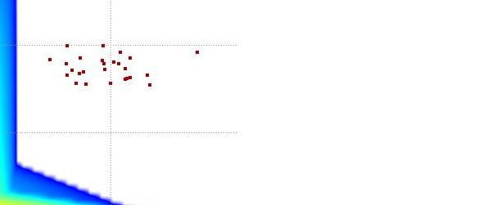
Hofmann resonance diagram
0 mA
30 mA
63 mA
80 mA
Diagram obtained with “E2E” beam.

Slide 8
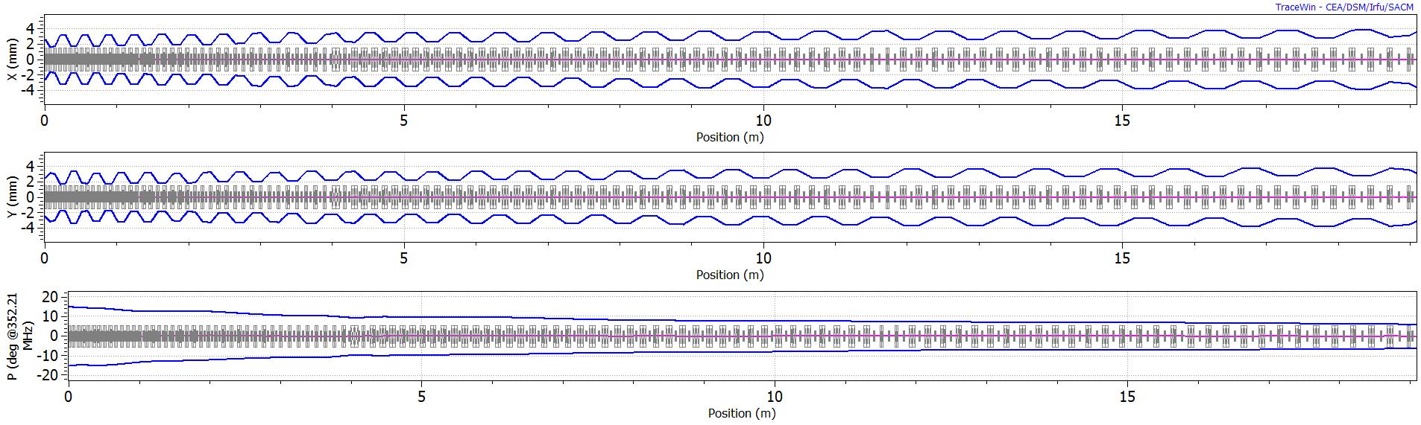
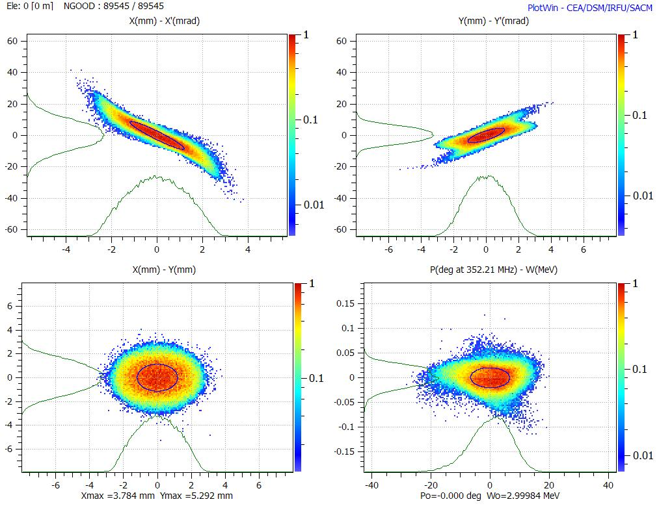
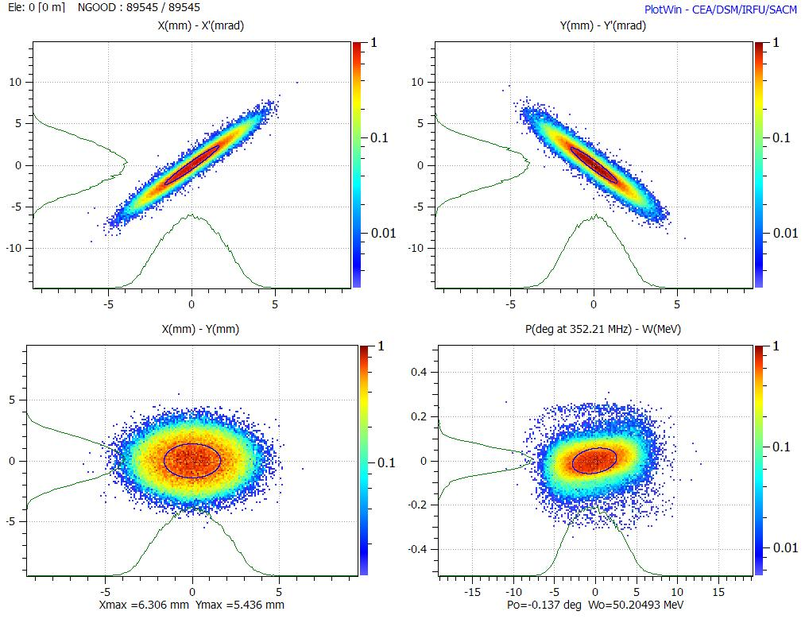
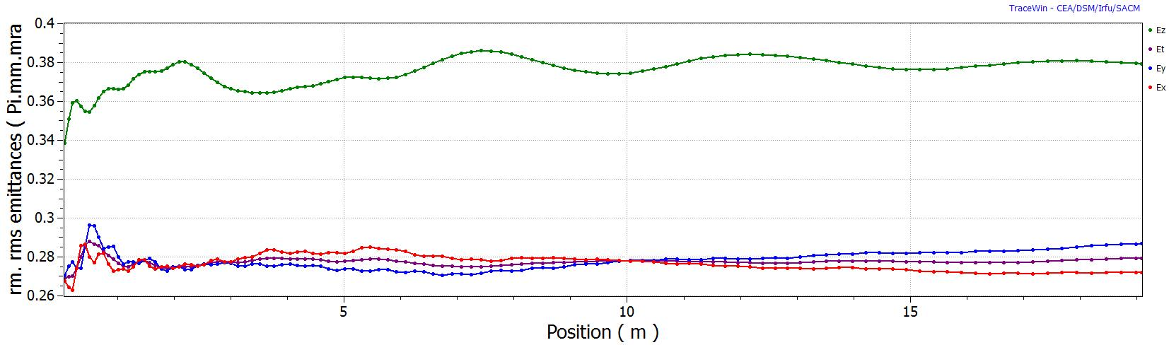
DTL Beam Dynamics (1)

Slide 9
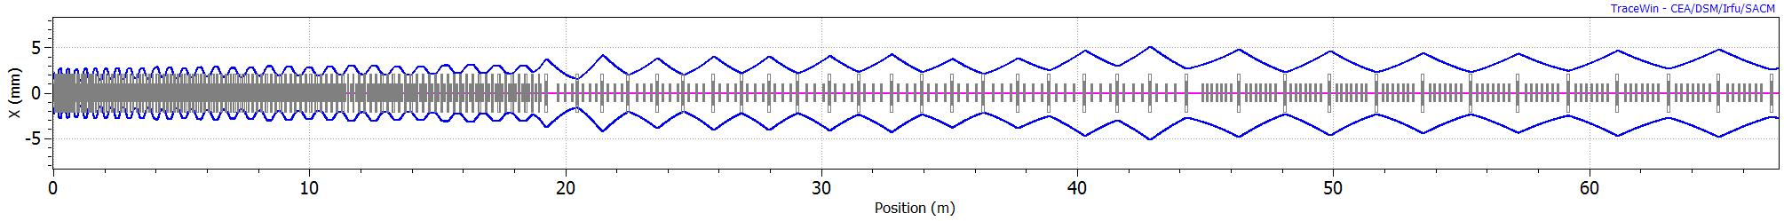


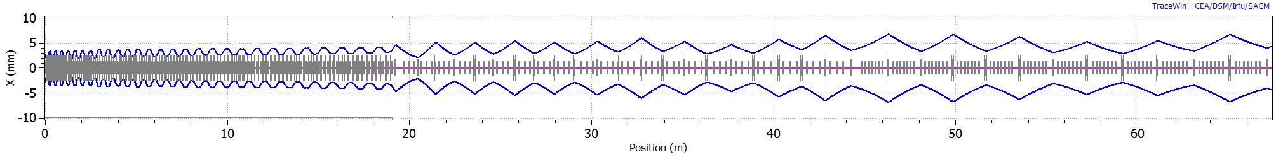
DTL Beam Dynamics (2)
Having PMQ focusing in the DTL does not limit the flexibility of the Linac.
By adjusting EMQs in the MEBT and at structure transitions, we are able to match the beam for any current from 0 to 80 mA (100…).
20 mA
40 mA
63 mA
80 mA
Range of Possible Beam Current in Linac4, Lallement J-B, CERN-BE-Note-2009-017.

Slide 10
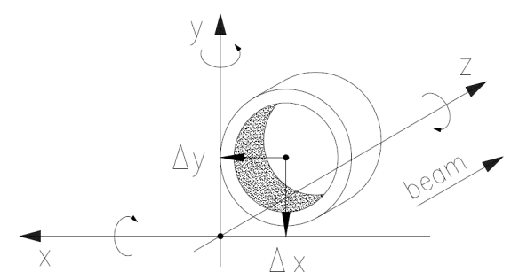
Error studies / Definition of tolerances
Transverse error studies :
    Stay below the limit of 1 W/m at 5% duty cycle!
  Quadrupole misalignments.
  Quadrupole gradient errors.
  Input beam error : 0.3 mm, 0.3 mrad (1 σ cut at 3 σ).
X, Y (1 σ) | Roll (1 σ) | Pitch & Yaw (1 σ) | Gradient
± 0.1 mm | ± 1 mrad | ± 2 mrad | ± 0.5 %
Loss Control and Steering Strategy for the CERN LINAC4, A. Lombardi et al, CERN-AB-Note-2007-033.

Slide 11
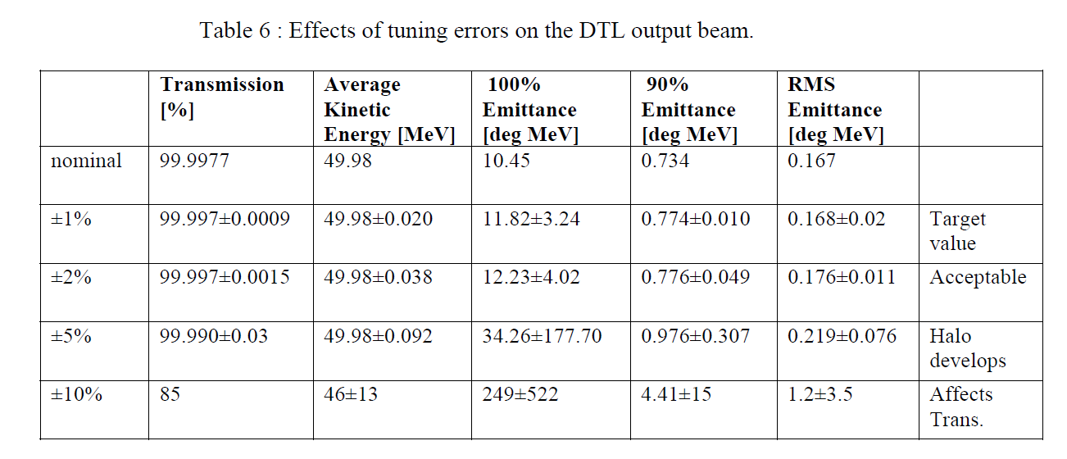
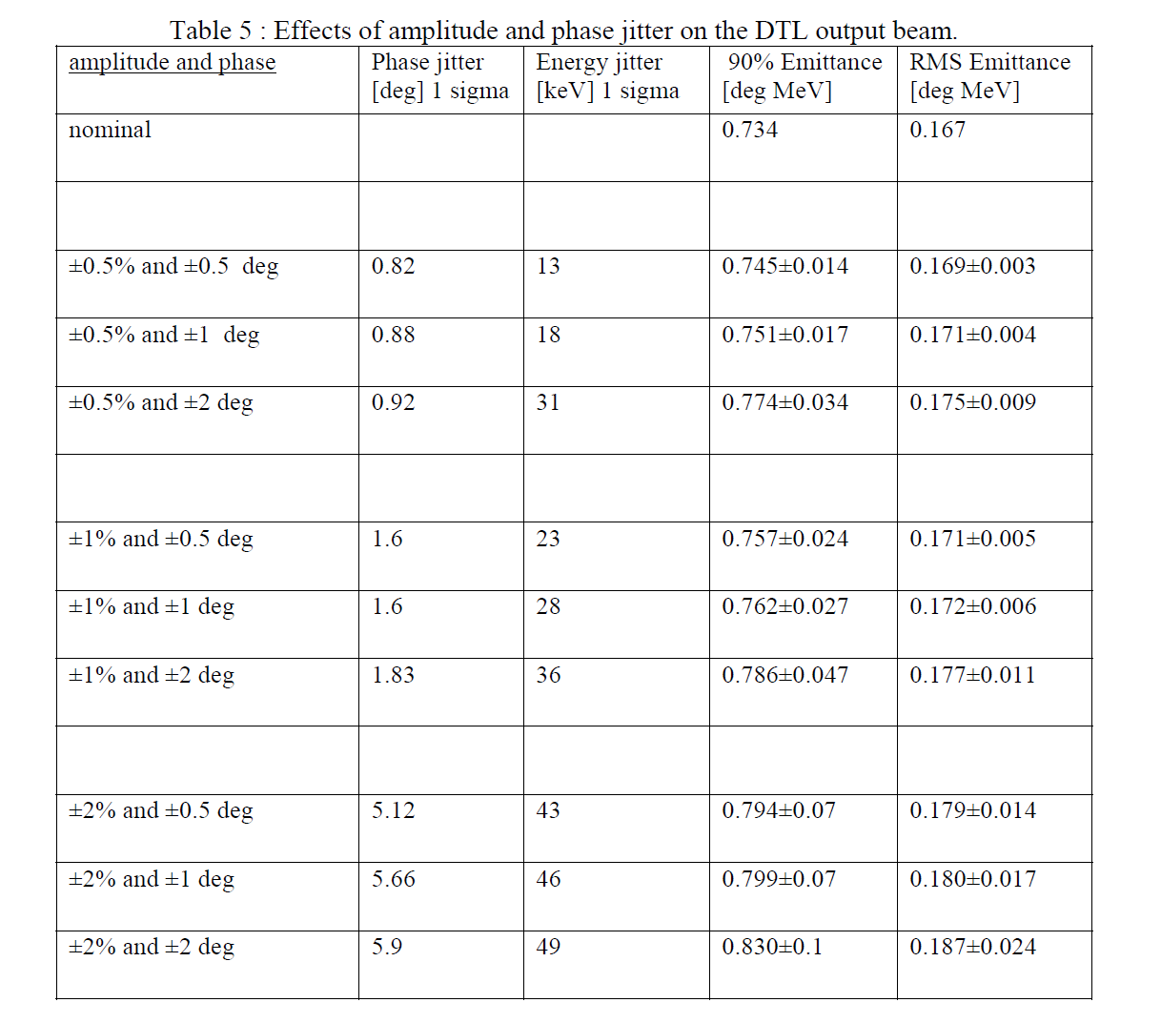
Error studies / Definition of tolerances
Remanent beam error : 6 keV
Longitudinal error studies.
  Static errors.
  Errors up to 2% can be accepted, provided enough RF power to bring the average field in each tank to nominal value.
  Dynamic errors.
  Klystron phase and amplitude should be controlled ideally to ± 0.5% ± 0.5°. ± 1% ± 1° is still acceptable.
Alignment and Field Error Tolerance in Linac4, A. Lombardi et al, CERN-ATS-Note-2011-021.

Slide 12
Conclusion
Several years of studies summarized in 10 slides…
Linac4 DTL beam dynamics design is:
- Robust:
- Respect of the beam dynamics “laws”.
- RF and transverse tolerances defined to preserve nominal performances.
- Flexible: The choice of having PMQ focusing does not limit the flexibility in beam current.
Hope to measure tomorrow (2013) what we have today on paper…

Slide 13
Thank you for your attention

Slide 15
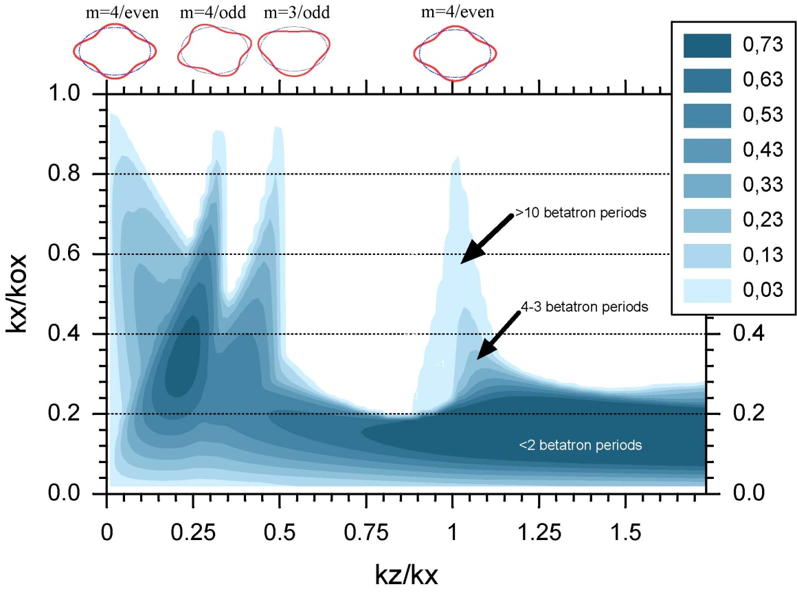

Slide 16
Error Studies – E2E Beam

