Slide 1
DTL: Basic Considerations
Thanks to J. Stovall, for the help!
M. Comunian & F. Grespan

Slide 2
OutLine
Design parameters
Design Method
Design of PMQ, Field Law, Lattice
Beam dynamics optimization
Example of a FODO and FFDD DTL
Conclusion

Slide 3
DTL Parameters
Particles is proton.
Input energy of 3 MeV. (β=0.0798)
Output energy of 50 MeV. (β=0.314)
Frequency is 352.2 MHz.
Current of 70 mA.
Duty cycle 4%.
Total peak power (SF*1.2+Beam) < 6 MW.
Total DTL length <20 m (inter tanks space?).
Input Transverse RMS emittance Norm. of 0.22 mmmrad. (output of RFQ+10% in the MEBT)
Input Longitudinal RMS emittance Norm. of 0.32 mmmrad (output of RFQ).
Input distribution Gaussian (5 sigma on size, i.e. a very large total emittance).
Simulation Code: TraceWin with a minimum of 10^5 particles (i.e. 1.4 W for particle).
Calculated matched input beam conditions.
Constant PMQ gradient or Equipartitioning.
PMQ size as Linac 4 PMQ tender.

Slide 4
Design method
Maximum of 1.4 Ekp? -> limited By Moretti Criteria.
Maximum of 2 MW power for Tanks. -> From Klystron limit.
Maximum RF Tank length of 7-8 m? -> From RF tuning.
Maximum PMQ field of 50-70 T/m? -> From manufacturing.
Maximum output emittance? -> From SC Linac Acceptance.
Maximum losses allowed? (1 W/m?) -> From radioprotection.
Maximize effective shunt impedance? -> From Cell design and Field stabilization.
Equipartitioned BD design? -> SNS design rule.
Field E0 ramping? -> SNS yes, CERN no.
Lattice? FFDD(CERN)? FODO? FFODDO(SNS)? O=space for steering/BPM.
Intertank distance? 3βλ(CERN)? or 1 βλ(SNS)?
Maximum Mechanical module length? ->2 m from manufacturing.

Slide 5
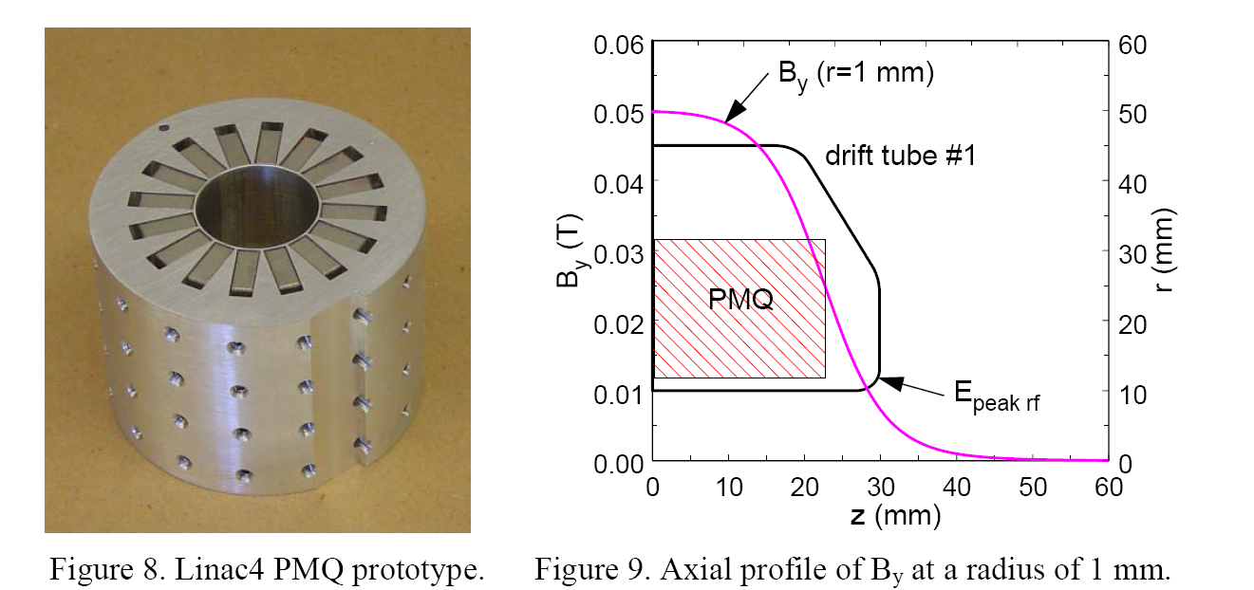
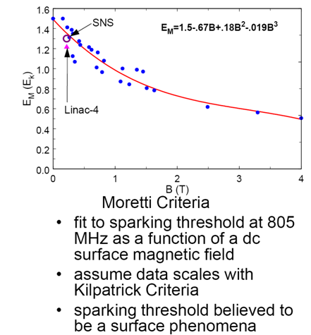
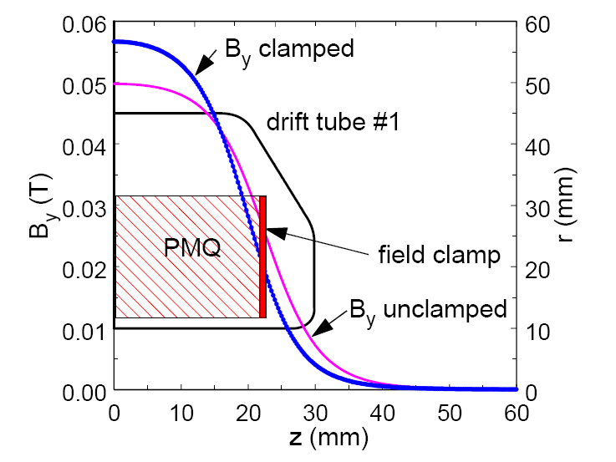
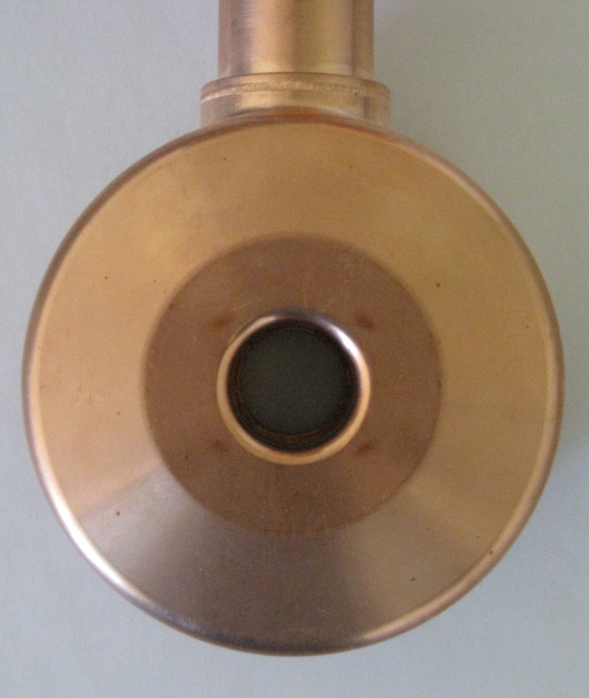
Moretti Criteria is more demanding respect to the Kilpatrick “Brave” factor
sparking in the region of collinear B & E fields.
Clamp effects
Sparking effects (@1.7kp)
on Linac4 DTL prototype

Slide 6
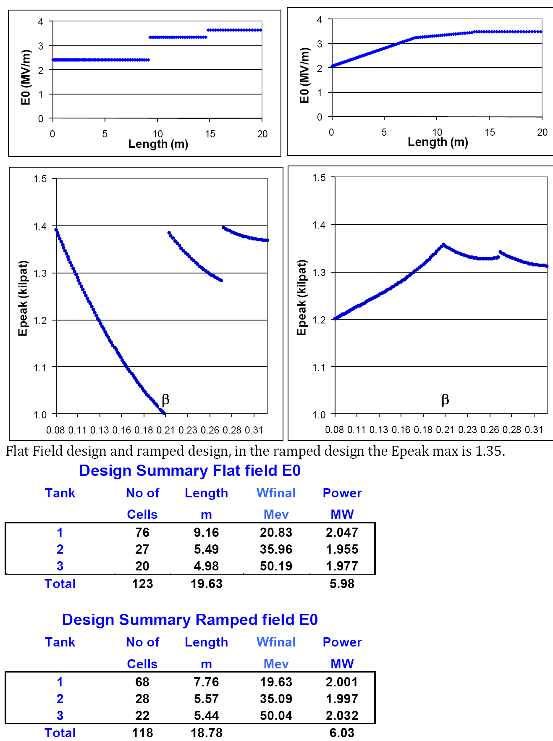
Flat or Ramped Field E0?
The idea is to model the longitudinal behavior
of the field distribution with the goal of
determining the dimensions of perturbations
applied to the tank end walls that will pre-set
the longitudinal field distribution to
approximately that of the design.
Shapes of the individual drift tubes are
the same as the design except for the face angles.
The ramped solution is better in term of performance.

Slide 7
DTL Example
FODO Lattice:
  Space inside DTL for steering and BPM.
  Optimizations of Shunt impedance by asymmetric cell.
  Reduce number of PMQ.
  High gradient of PMQ, from 54 T/m to 71 T/m.
FFDD Lattice:
  No space inside DTL.
  Low gradient of PMQ.

Slide 8
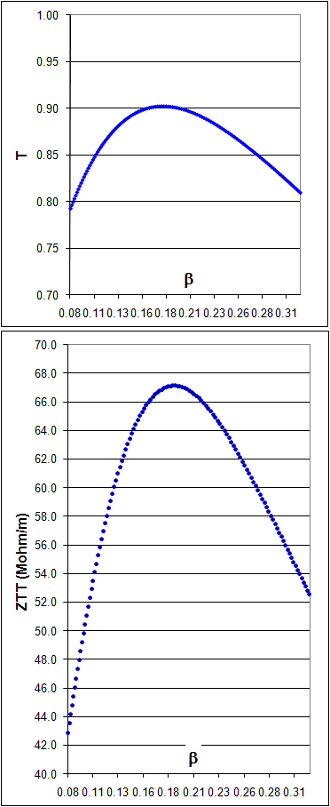
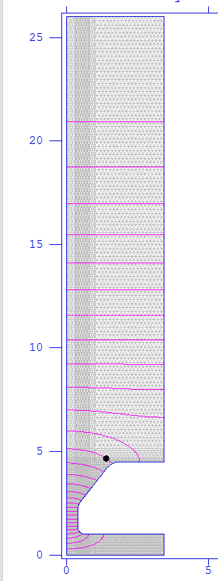
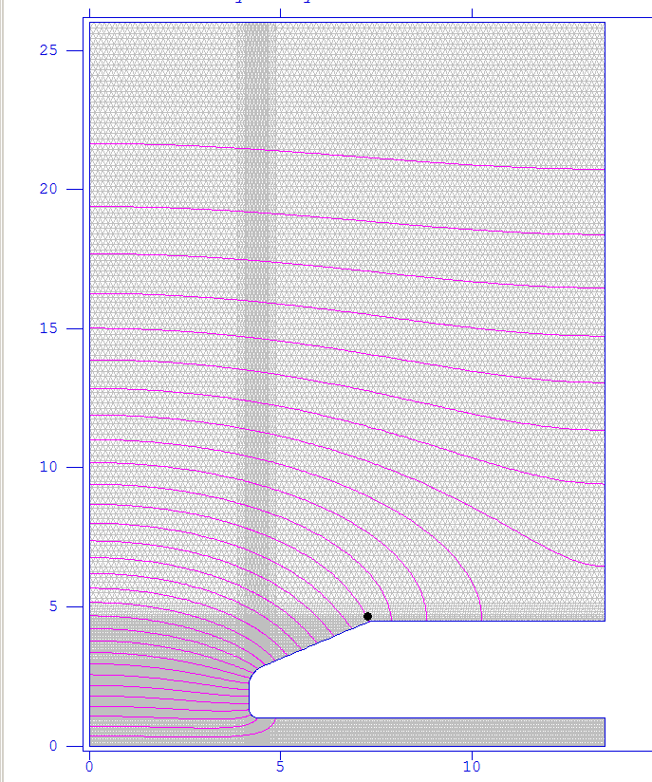
DTL Example
SF runs from 3 to 50 MeV
Data collect and analysis on Excel
Power by SF*1.25
Design Summary
Tank | No of | Length | Wfinal | Power
 | Cells | m | Mev | MW
1 | 66 | 7.47 | 19.20 | 2.050
2 | 29 | 5.75 | 34.88 | 2.045
3 | 24 | 5.93 | 50.26 | 2.072
Total | 119 | 19.15 |  | 6.17

Slide 9
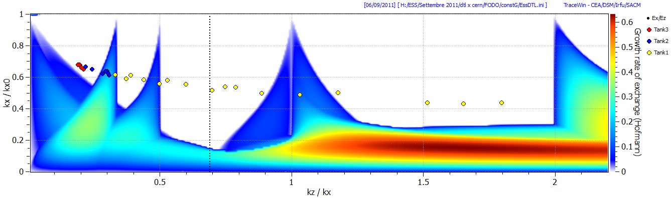
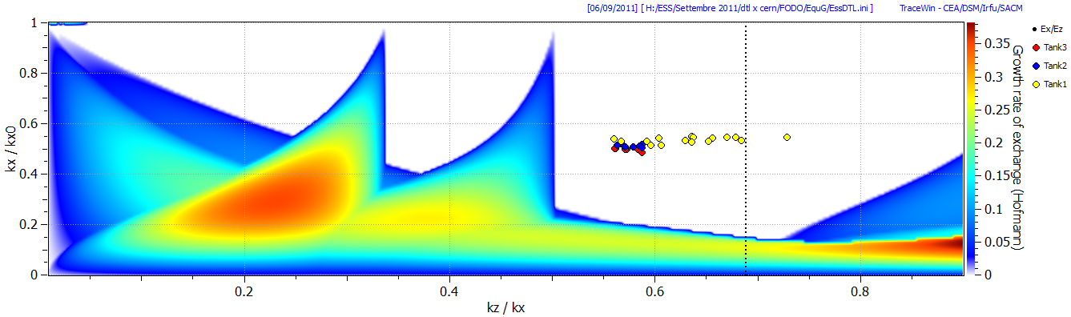
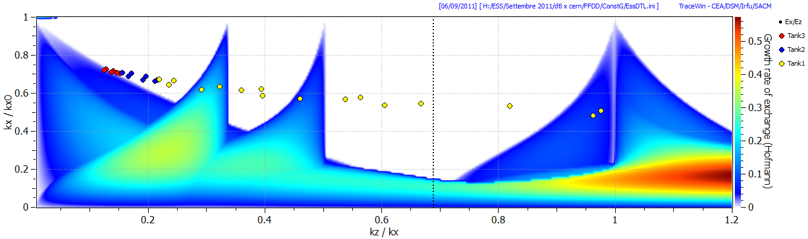
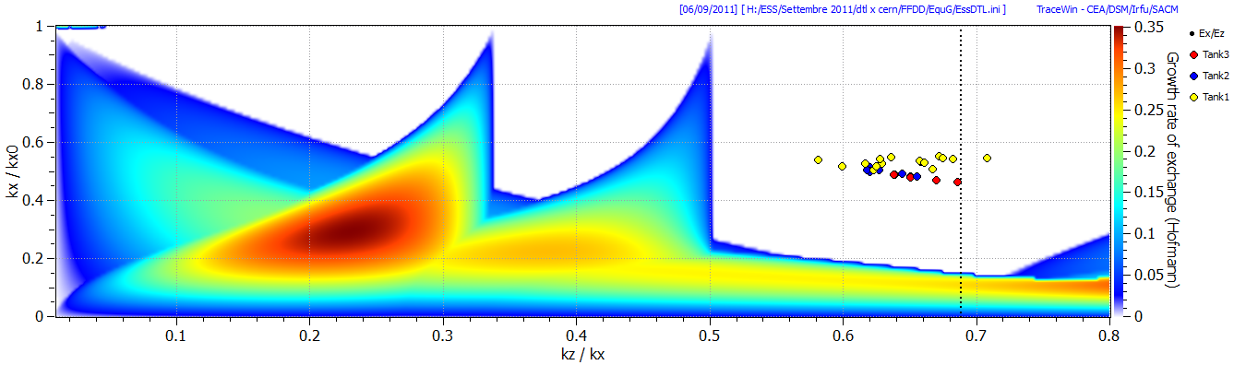
FODO const. G
FODO Equip. G
FFDD const. G
FFDD Equip. G

Slide 10
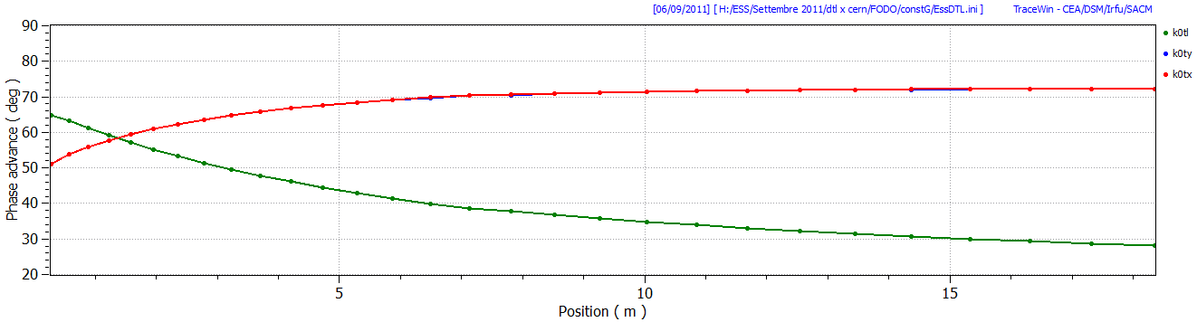
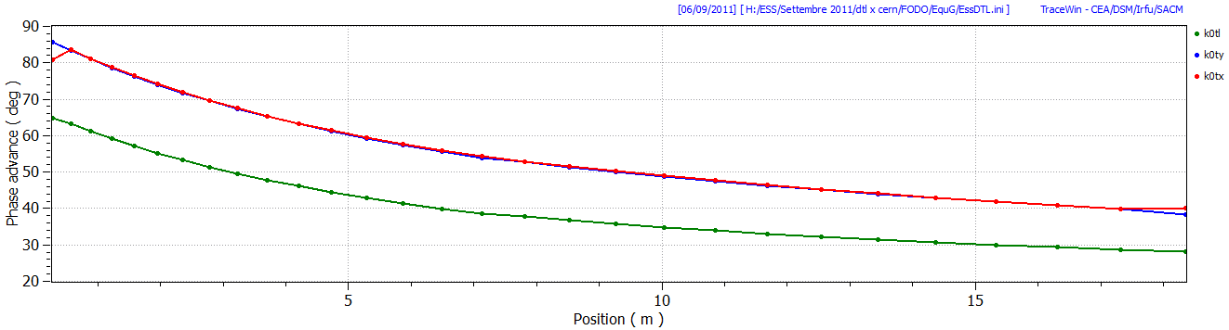
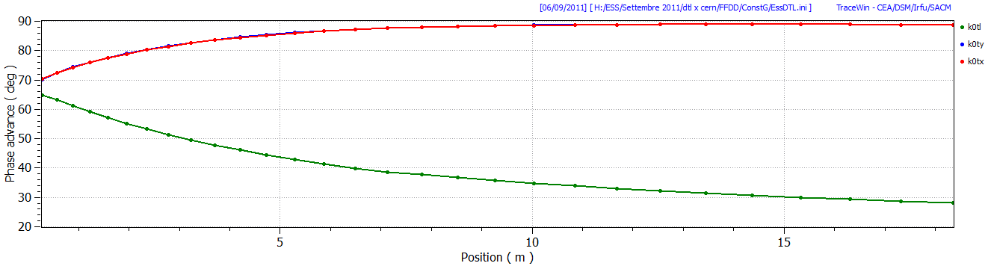
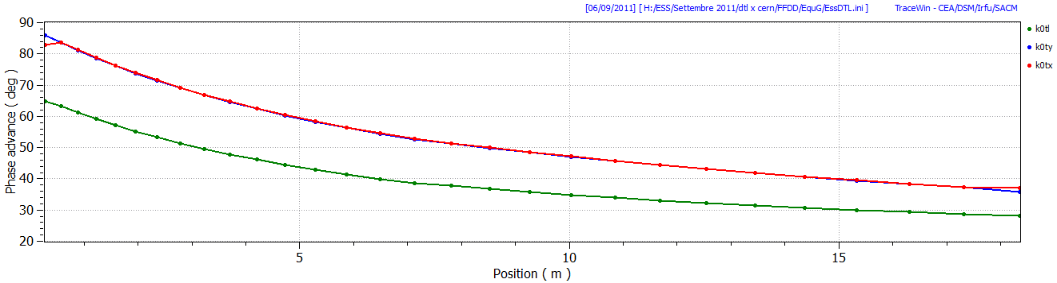
FODO const. G
FODO Equip. G
FFDD const. G
FFDD Equip. G

Slide 11
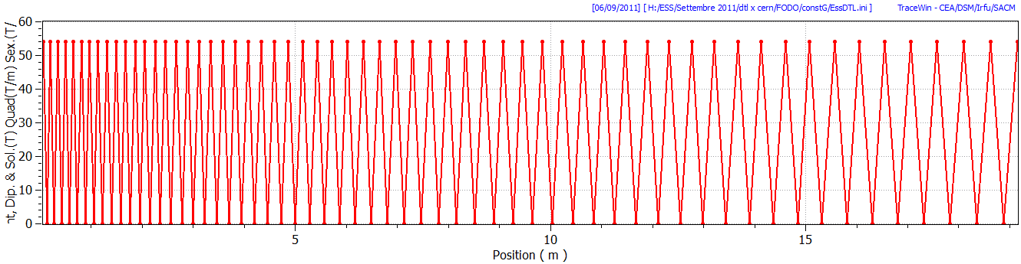
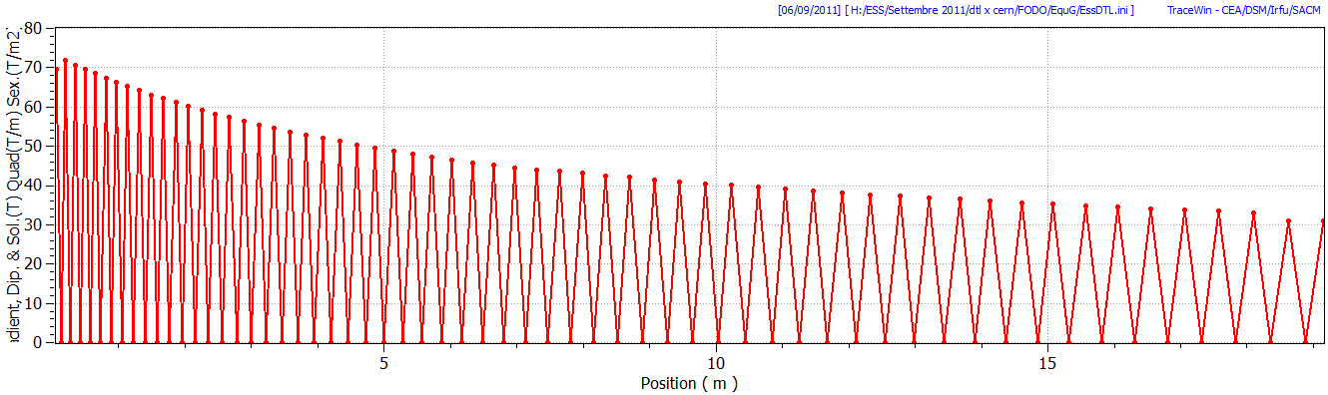
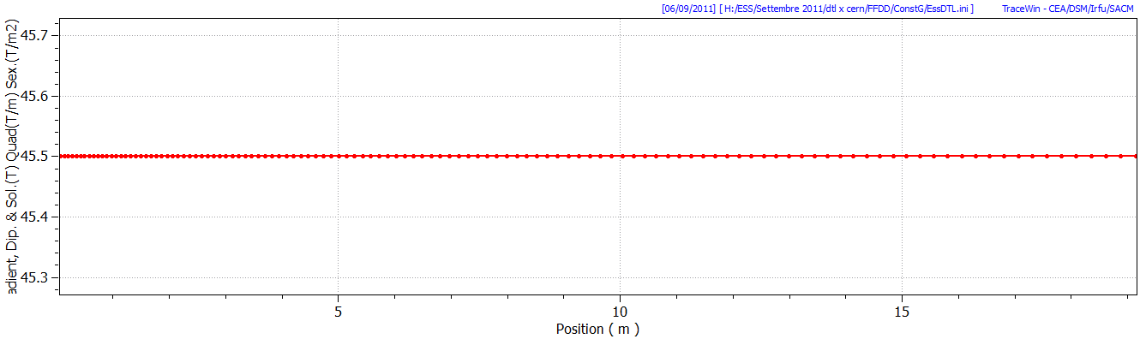
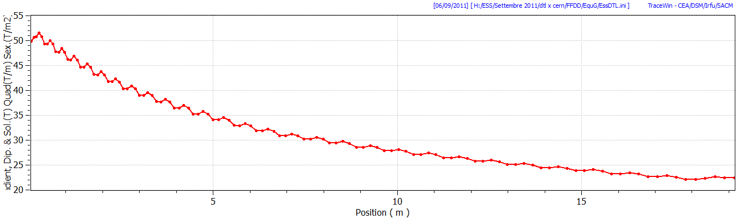
FODO const. G
FODO Equip. G
FFDD const. G
FFDD Equip. G

Slide 12
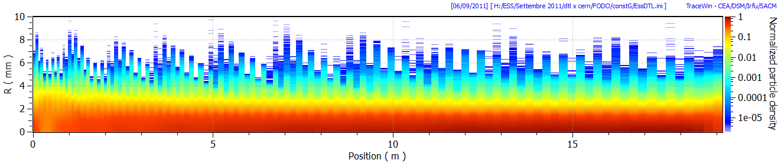
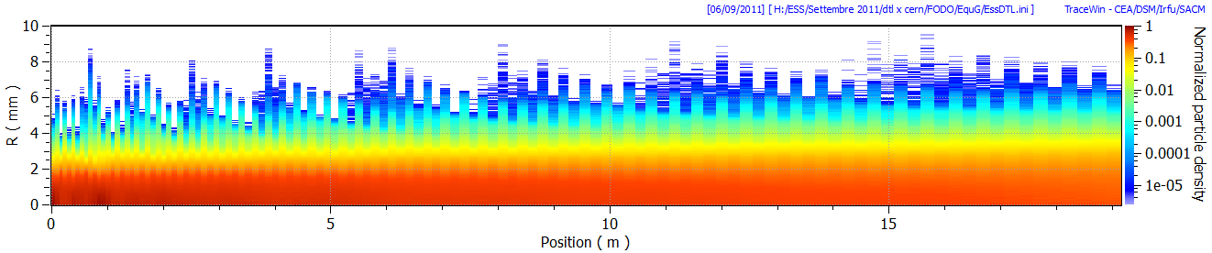
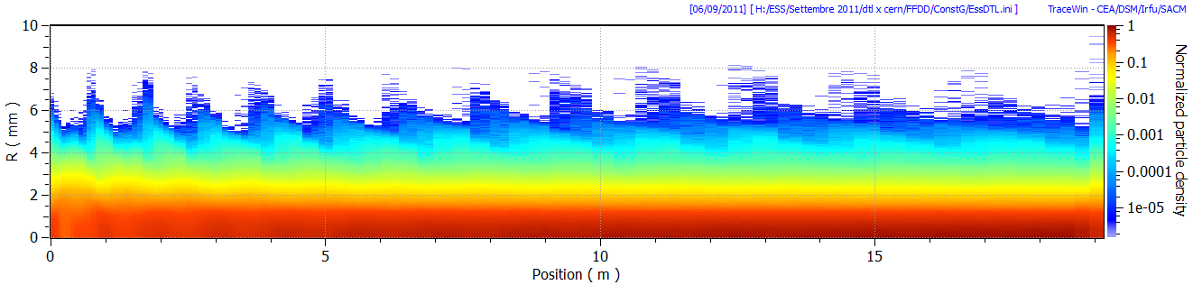
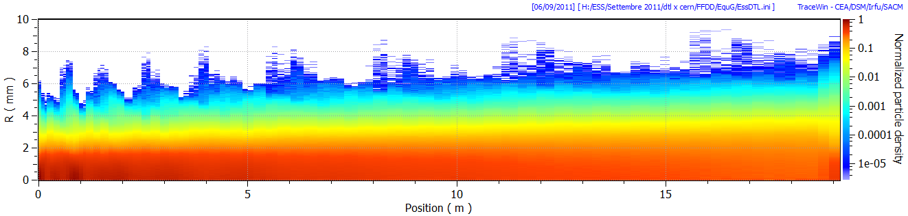
FODO const. G
FODO Equip. G
FFDD const. G
FFDD Equip. G

Slide 13
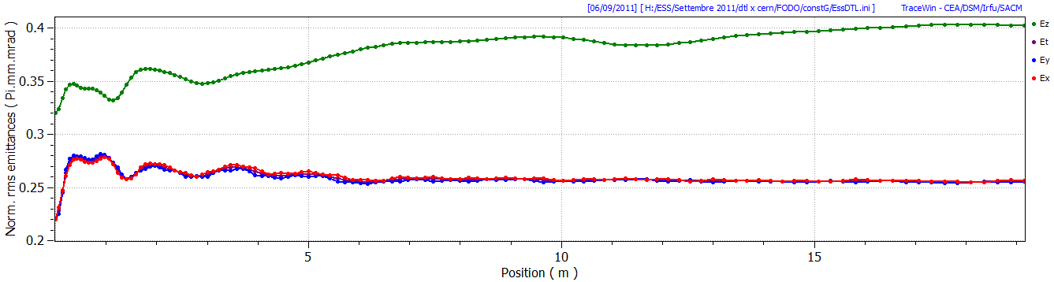
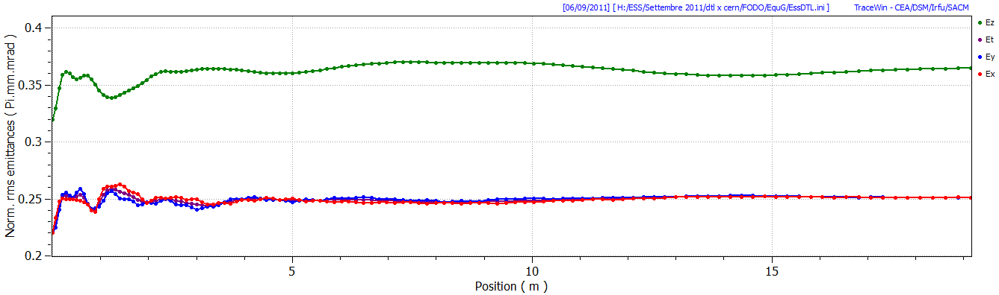
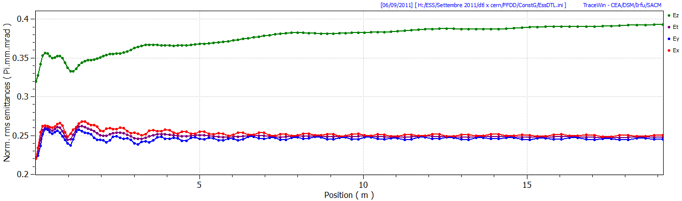
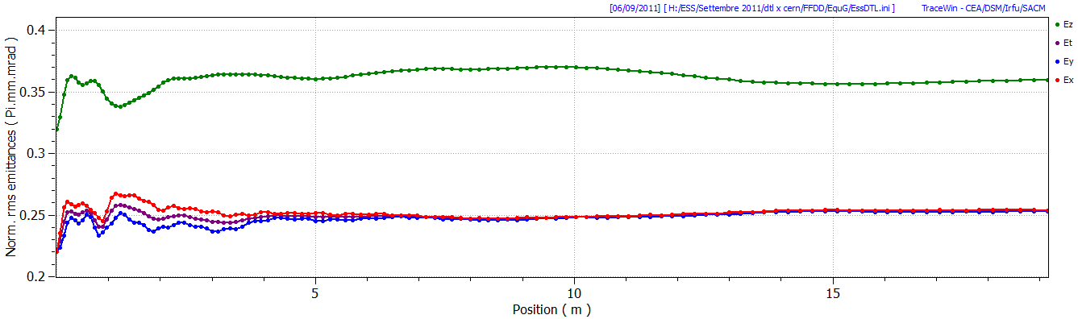
FODO const. G
FODO Equip. G
FFDD const. G
FFDD Equip. G

Slide 14
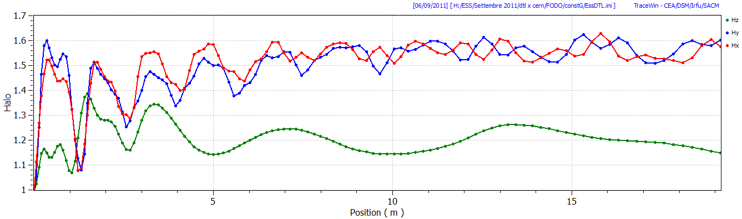
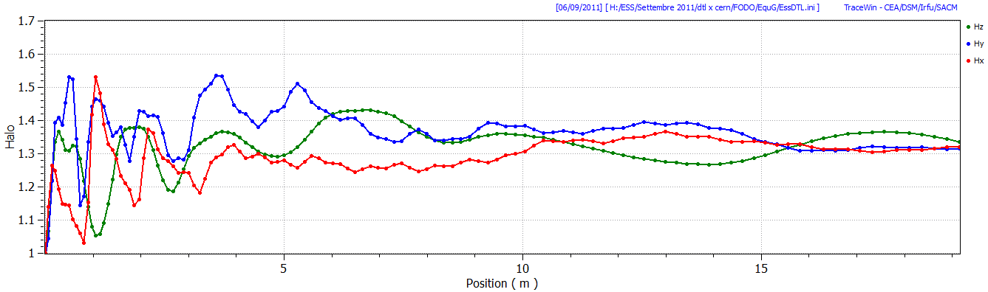
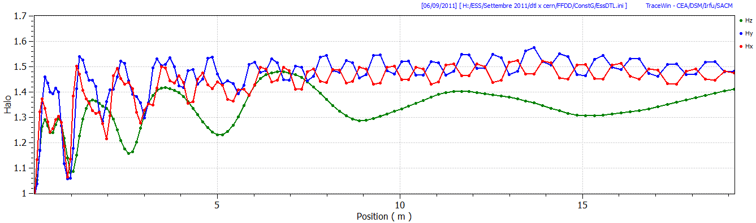
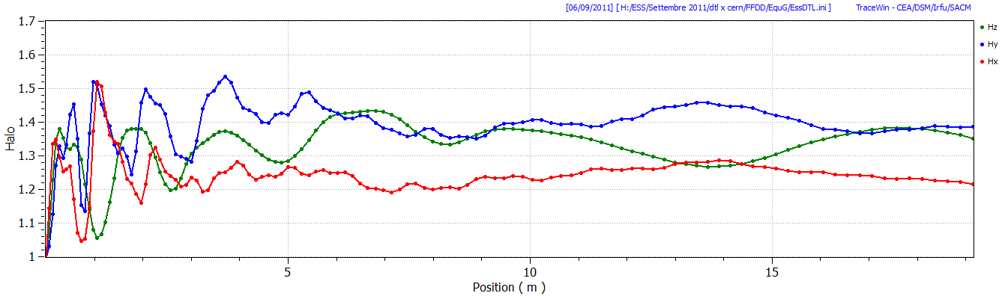
FODO const. G
FODO Equip. G
FFDD const. G
FFDD Equip. G

Slide 15
Lattice | FODO Const. G | FODO Equip. G | FFDD Const. G | FFDD Equip. G
# PMQ | 62 | 62 | 119 | 119
G PMQ [T/m] | 54 | 72 - 31 | 45.5 | 51.5 - 22.5
Emit(x,y) increase [%] | 16 | 14 | 13 | 15
Emit(z) increase [%] | 26 | 14 | 23 | 13
Halo(x,y) increase [%] | 59 | 32 | 48 | 30
Halo(z) increase [%] | 14 | 34 | 41 | 35
The Equipartitioned design show less emittance and halo increase.

Slide 16
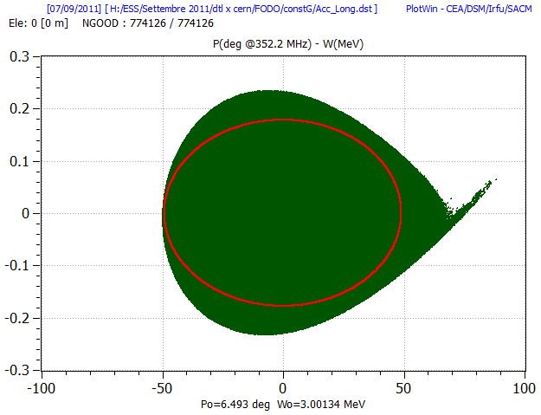
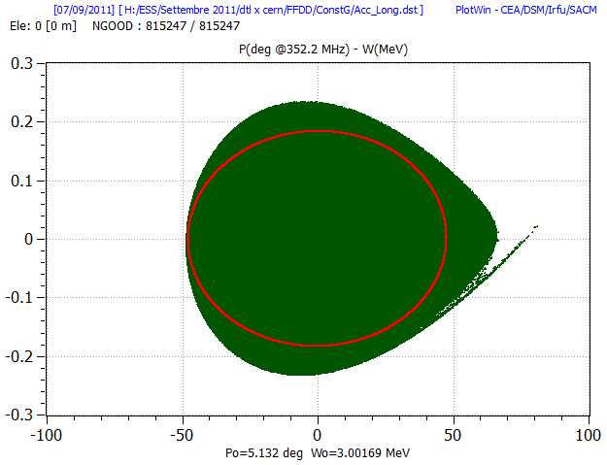
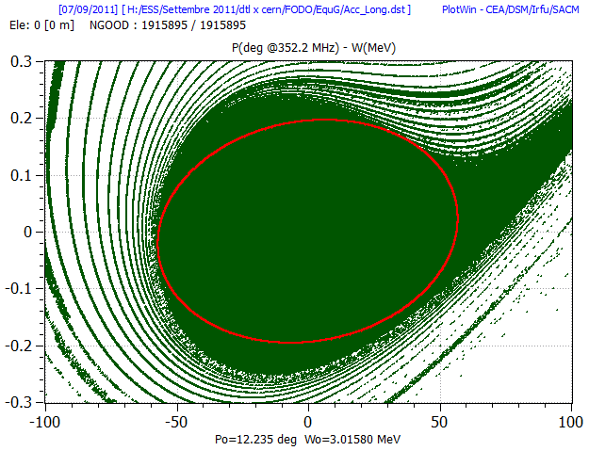
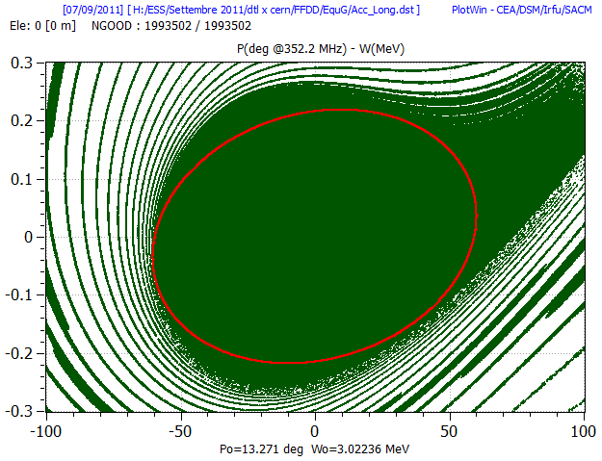
Longitudinal Acceptance of the DTL
FODO const. G
Emit [82%] = 8.7326 Pi.deg.MeV
FFDD const. G
Emit [84%] = 8.7523 Pi.deg.MeV
FODO Equip. G
Emit [78%] = 11.1151 Pi.deg.MeV
FFDD Equip. G
Emit [73%] = 12.9853 Pi.deg.MeV

Slide 17
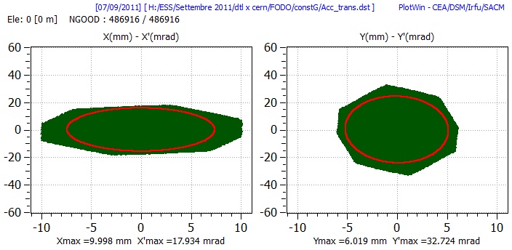
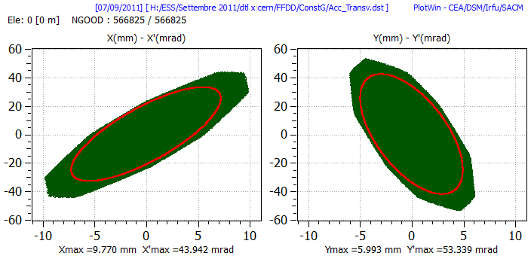
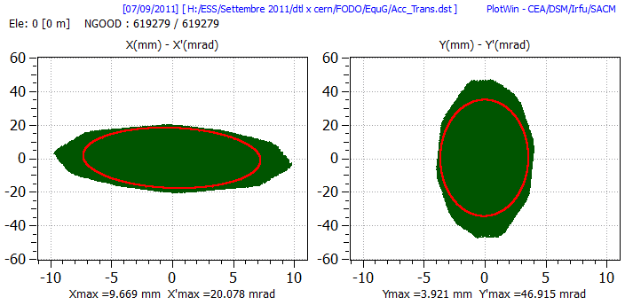
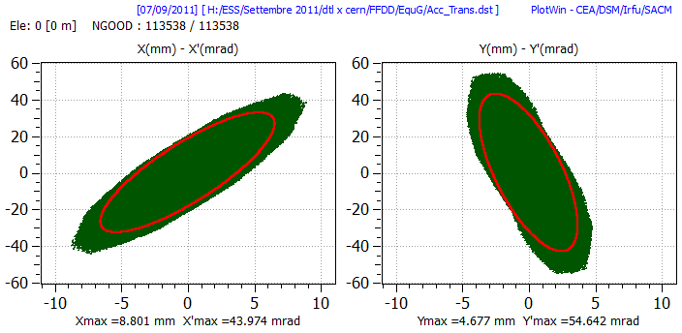
Transverse Acceptance of the DTL
FODO Const. G
X-Xp Emit [82%] = 9.2989 Pi.mm.mrad [ Norm. ]
FFDD Const. G
X-Xp Emit [83%] = 12.3347 Pi.mm.mrad [ Norm. ]
FODO Equip. G
Y-Yp Emit [87%] = 10.0178 Pi.mm.mrad [ Norm. ]
FFDD Equip. G
Y-Yp Emit [82%] = 9.4390 Pi.mm.mrad [ Norm. ]

Slide 18
Errors study on the DTL example
Magnetic center respect the geometrical center shake of +/- 0.2 mm
Yaw/pitch/Roll of +/-1°=17mrad
Gradient error of +/-1%
All errors apply together with a Gaussian input beam distribution
100 DTL generated.
10^5 particles i.e. 1.4 W for particles.

Slide 19
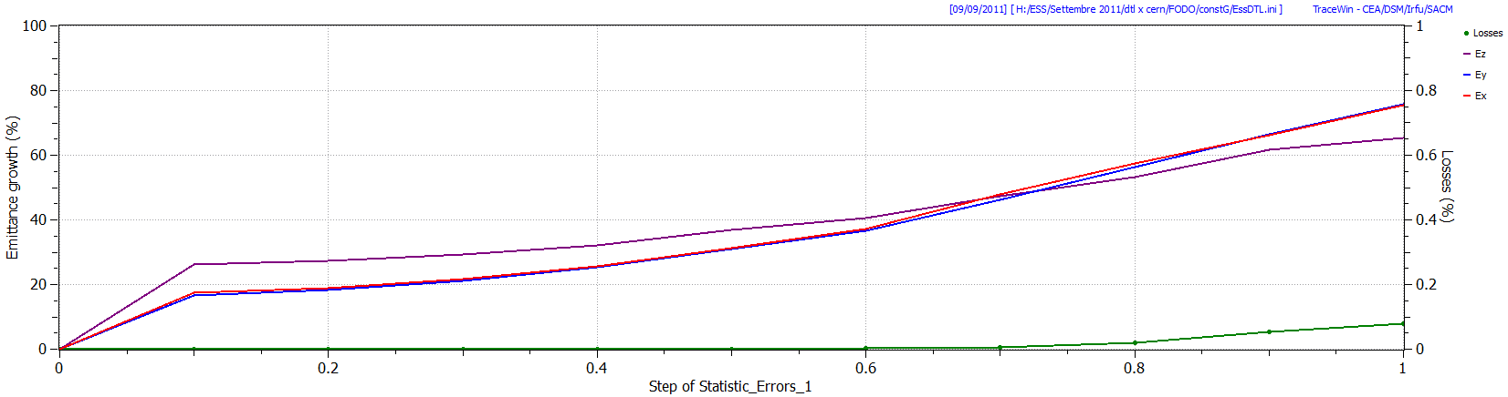
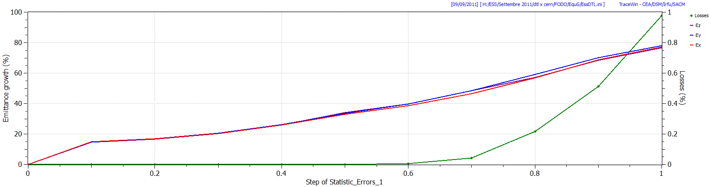
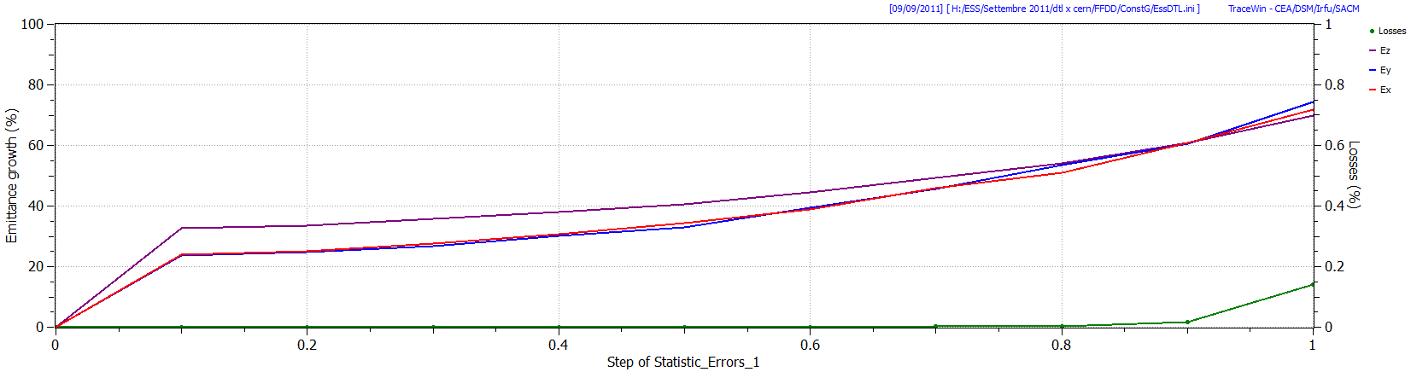
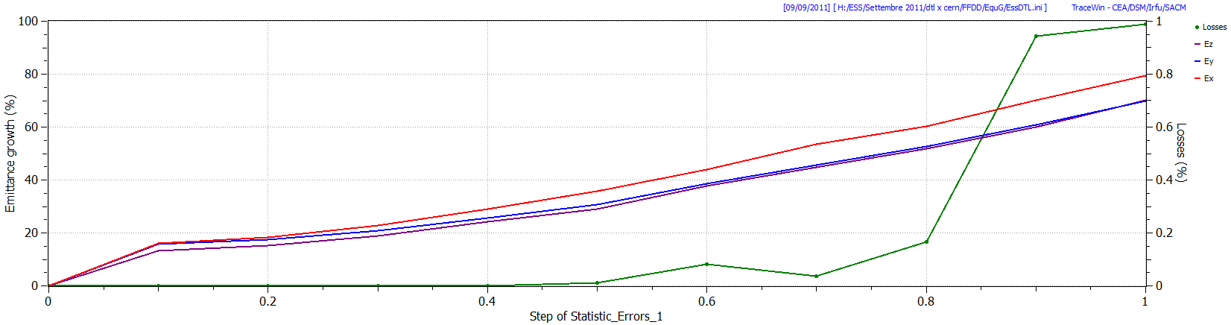
FODO const. G
FODO Equip. G
FFDD const. G
FFDD Equip. G
10^5 particles;10^2 DTL; Max Quad shake of X,Y ±0.2 mm; ±1°; ±1%

Slide 20
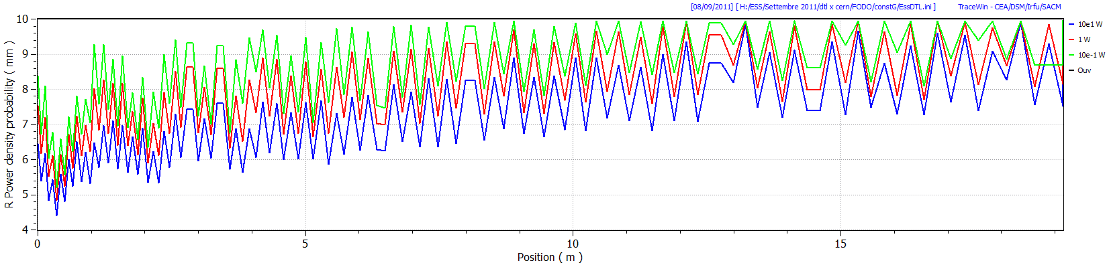
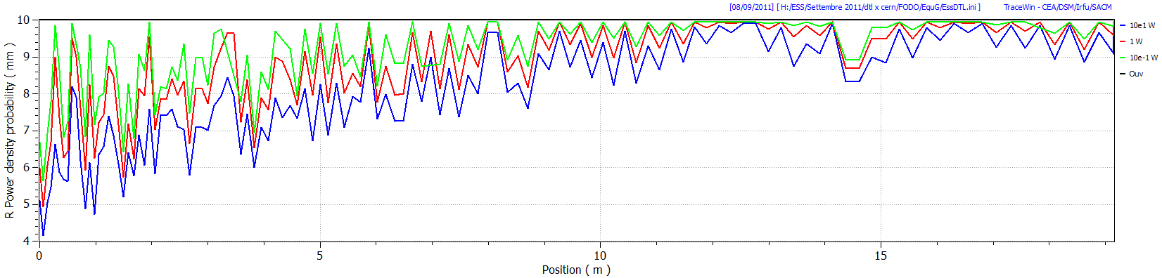
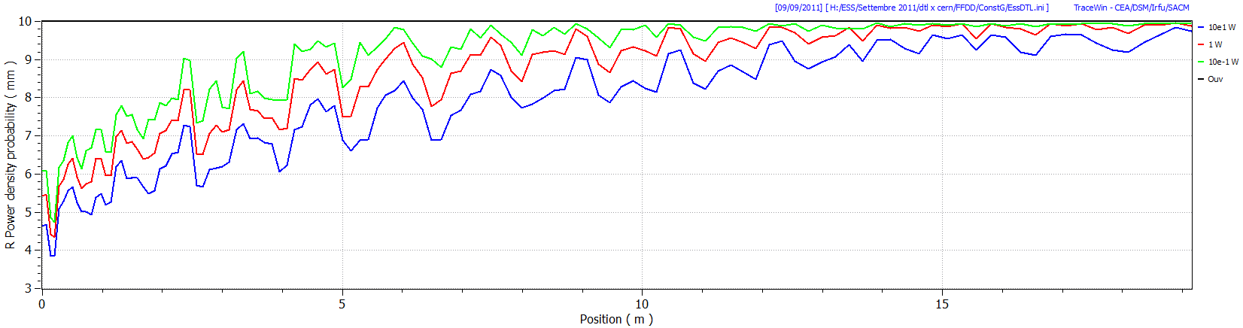
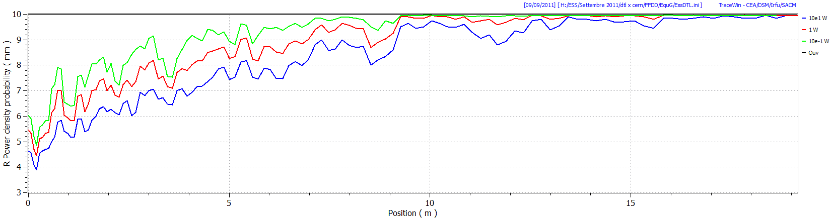
FODO const. G
FODO Equip. G
FFDD const. G
FFDD Equip. G
Quad shake of X,Y ±0.2 mm; ±1°; ±1%

Slide 21
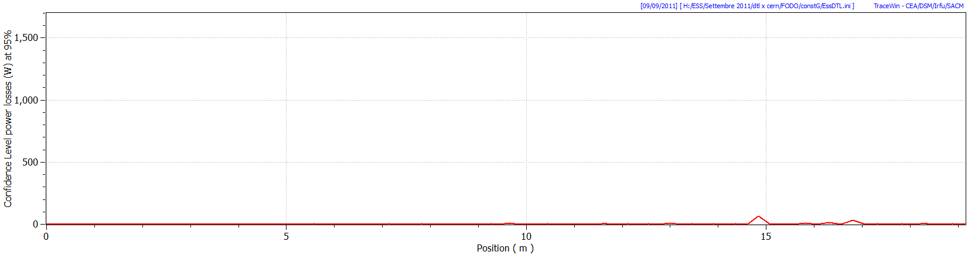
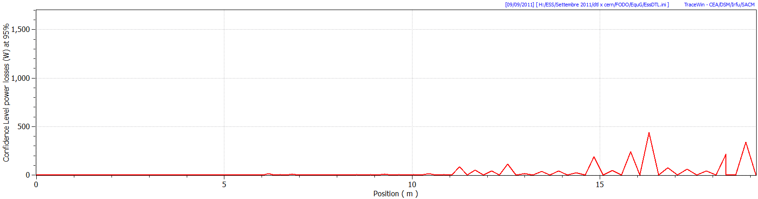


FODO const. G max=65 W
FODO Equip. G max=434 W
FFDD const. G=130 W
FFDD Equip. G max=1700 W
Quad shake of X,Y ±0.2 mm; ±1°; ±1%

Slide 22

Steerers on FODO Lattice
Using the empty space it has been put steerers X;Y almost at 90° phase advance apart for tank and 2 BPMs.
8 Steerers for tank1
4 steerers for tank 2 and 3

Slide 23




Max=5 W
FODO const. G with 32 steerers

Slide 24




Max=14 W
FODO Equip. G with 32 steerers

Slide 25
Conclusion on DTL example
FFDD and FODO almost same PMQ grad.
FFDD better output emittance.
Constant Grad. more “robust” respects to errors.
FODO more flexible and at lower cost.
Steerers on FODO reduce the losses by 1 order of magnitude.
A possible solution with PMQ G=54 T/m -> as Linac4 DTL tender.
Space for steerers and BPM -> low tolerance on PMQ and reduced intertank distance.
No problem by losses -> low tolerance on PMQ.

Slide 26
Thank you!

Slide 27



Design Method
DTLFISH: design and optimization of the DTL shape from 3 to 50 MeV.
Worksheet: import of DTLFISH data and fit cell by cell.
Worksheet : Synch. Phase, PMQ, Lattice and E0, Es Fields design.
Worksheet : data for TraceWin cell by cell, including TTF’ and TTF’’.
TraceWin: Phase advance design and input matched conditions.
TraceWin: Errors study.

Slide 28


Emittance evolution on the DTL
UNIFORM Distribution
GAUSSIAN Distribution
The emittance increase depend from the input beam distribution

Slide 29



PMQ
Difficult to housing the Quad on the first DTL cell.
The least expensive type has rectangular PM pieces.
The most performing is the Bullet shape.
Field clamp?
Bore aperture ID?
PMQ tolerance!!!
First DTL Cell
CERN Linac4
ID=22 mm
L=45 mm
Gmax=54 T/m

Slide 30






FODO
LATTICE DESIGN
FFODDO
FFDD
FFDDO
FDO
FD
Particles density plot for different focusing scheme along the DTL

Slide 31




FODO const. G
FODO Equip. G
FFDD const. G
FFDD Equip. G

