Slide 1
Supply Chain
Q1 2025
Lisa Bellini-Devictor
27.03.2025

Slide 2
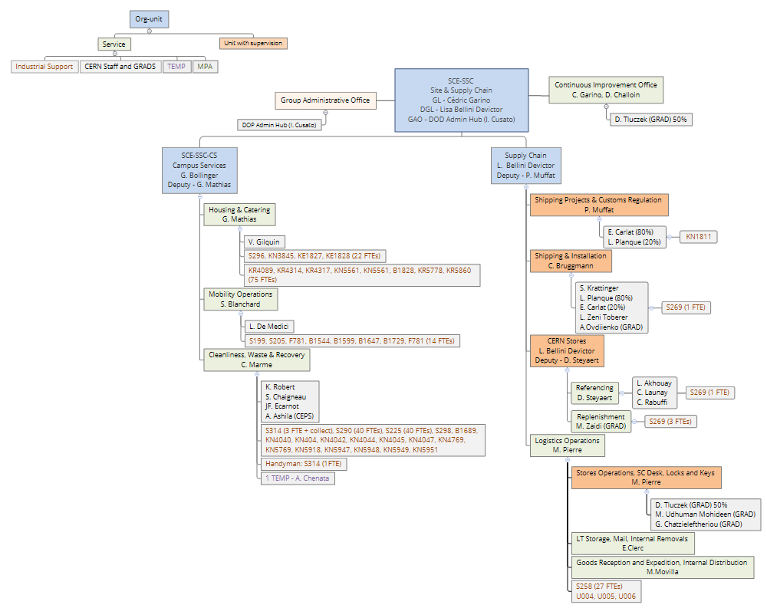
Org-chart
(from Q2)
New unit
Change of unit operational lead :
Maggie → Logistics Ops
Didier → Referencing
3 GRADs back under the same supervision (Maggie)

Slide 3
Team communication and Meetings
Informal communication and co-working :
  Significant change since all section is on the 3rd floor
Weekly Meetings :
  Unit leaders meeting every Monday
  Each unit leader sets weekly meetings (or other frequency) as deemed appropriate
  C3 meeting :
    operational meeting where useful information about section activities is shared
    Participation encouraged, even if not regular
Group Monthly Meetings
Quarterly Section Meetings :
  Focus on progress made against initial objectives
  Section KPI reporting (to be developed)
  Zoom on quality tips, processes
Team Social Life
Suggestion : monthly section coffee
(by team of 3 on voluntary basis?)
Summer Event
End of Year Event
(to be defined, work in progress)
Any idea, initiative is welcome of course

Slide 4
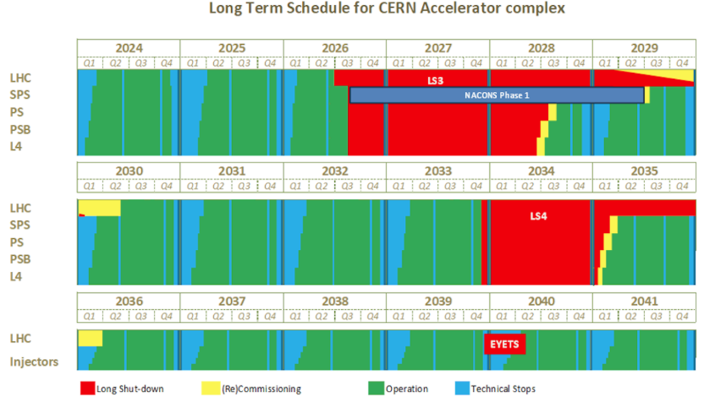
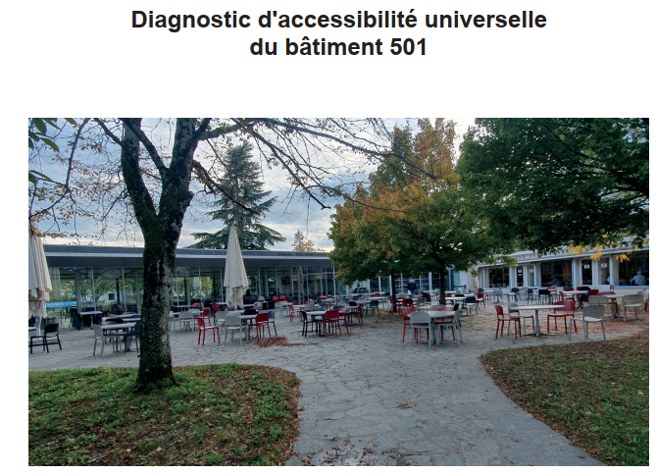

2025 key objectives (SSC Group) – as announced
Projects
  LS3 preparation (materials + cleaning + storage TF implementation + waste)
  AI pilots and support for FAP-BC roadmaps
  Future and cleaning + Concierge pilot (the last mile…). Objective: Calibration (scope of services, territory size, outcome) and preparation for phase 2 (change of existing service contracts + whole CERN deployment)
  Continuous improvement office in SSC: Roadmap, resources (including certified MPs), PoW, training program
Sustainability, accessibility and inclusion: Implementation program for hotels + R1 + access. Foster handicap visibility at CERN through service contracts and local associations.
Collaboration: Agreement with EPFL (catering roadmap + waste + Campus App) + visit of DESY + Corporate Social Responsibility (CSR) workshop with key service contracts fostering 3-5 years objective alignments, RI Logistica
Communication: Leverage Campus App
In progress
Done
Warning
Blocked

Slide 5
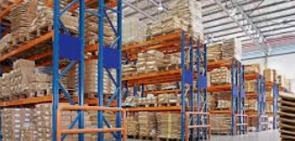

2025 objectives – as announced
Roadmaps: Stores v2 & Shipping – Customs
Continuous improvement:
  Removal service completion
  Stores reception/picking flows
  cycle counting
Contracts’ PoW & CSC support
Quality integration for Cables & Connectors
IT solutions:
  EDH SHIP
  Qualiac upgrade for shipping ops
  Stores Catalogue
Click & Collect
Inventory management support for BE-CEM-EPR Electronic pool
Pilot for storage of equipment/material in standard boxes + “poste restante”
LCA: Study for one catalogue family
Equipment: Schelling + storage upgrade + optimization
In progress
Done
Warning
Blocked/on-hold

Slide 6
2025 – Challenges for SC
Organization
  Consolidation of SC org. structure (change management) and roadmap development
  New CERN Organization & management with new DG in shadowing
Projects
  LS3 preparation (materials + cleaning + storage TF implementation + waste)
  Stores Catalogue
  Continuous improvement office in SSC

Slide 7
Success Factors
& Key strategic pilars
Lisa Bellini-Devictor
27.03.2025

Slide 8






CERN STORES Success Criteria Overview (Oct 24 Workshop)
1
2
3
4
5
6
Maximise STORE Utilisation
Happy Users
Efficient Operations
Thriving Partnerships
Happy & Engaged Team
Green Planet

Slide 9
Initiatives by CERN STORES Success Criteria
Maximise STORE Utilisation
    Complete in-catalogue "Item Master“ (information collection/ in system)
    Gain transparency on direct purchases (monthly report)
    Select Supply Route based on key article characteristics
    (theory, automation based on parameters)
Happy Users
    Improve service experience for users (one-stop catalogue interface, holistic service measure (KPI), status info to users (cutting!))
    Enable unit picking & repacking
    Ensure high-quality cutting services (equipment, training)
Efficient Operations
    Excel in Inventory Management
    Create Demand Planning
    Apply LEAN Methodology to key processes (physical & office processes)
    Ensure availability of storage capacity (technology selection, implementation)
    Ensure state-of-the-art systems support (landscape & functionality)
    Complete Activity-Based-Costing coverage
    Manage selected user inventories (=> long term)
Thriving Partnerships
  Implement Goal Alignment in SC (purpose, common goal, participation, …)
  Extend Partnership with (selected) Users,
  … with Procurement,
  … with Technical experts,
  … with Industrial Support Contractors
  … with other Logistics
  … with Business Computing
  … with HSE
  … with External suppliers
  Drive Standardisation initiative (Committee, …
  Happy & Engaged Team
  Deploy team engagement methodologies & tools
  Create pleasant working environment for Team
  Promote high level of expertise, engagement and ensure recognition
Green Planet
  Define sustainability initiative
  Connect to waste management roadmap
  Connect to sustainable procurement

Slide 10
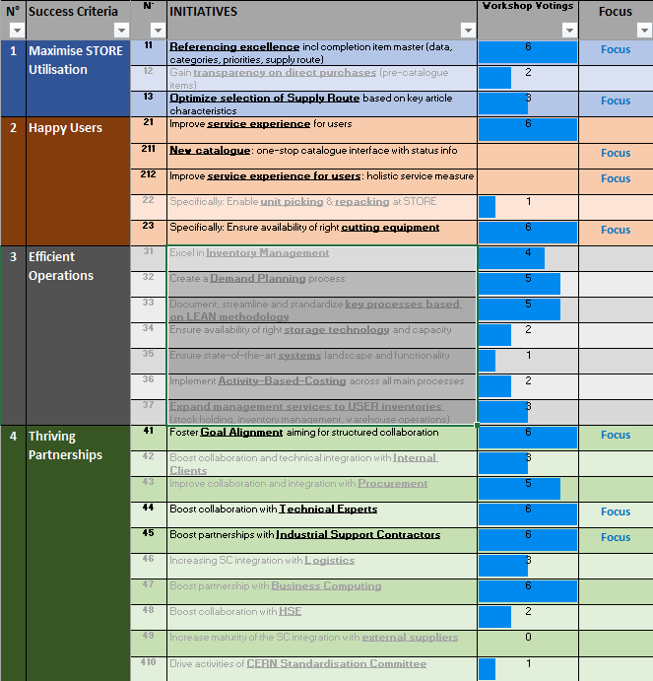
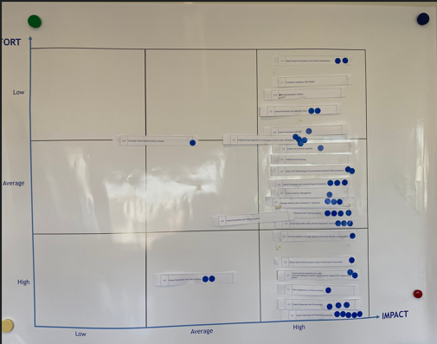
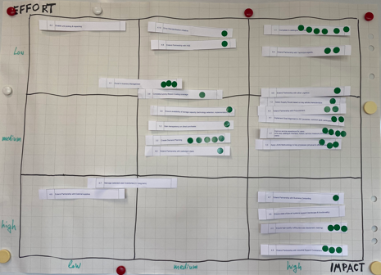
Initiatives Scoring/Priorities

Slide 11
2025 - Strategic Pilars and Initiatives
COMMUNICATION | GET THE BASICS RIGHT
Purpose, Identity and Visibility of Supply Chain services: Renovation of front desk area in B.73 / new showroom Click and collect service Guideline for customs Standard presentations on customs and taxes at Bidders conferences Communication plan: internal (team/group/Dept), CERN community/users, suppliers | Document Processes/standards Roadmaps, Goal alignment Reporting, KPI : Data extraction, Analytics, Visualization Modernization of IT systems and tools: New stores catalogue, EDH SHIP review Import/Export ERP integration Continuous Improvement
Minimize impact on environment initiatives Develop knowledge on environmental impact of SC activities Gather Data
COVERED BY MERIT OBJECTIVES THROUGHOUT ALL SECTION

Slide 12
Document Management
(general introduction)
Lisa Bellini-Devictor
27.03.2025

Slide 13
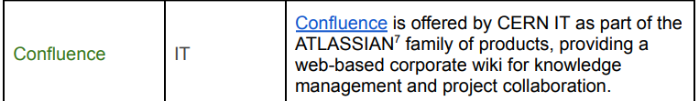
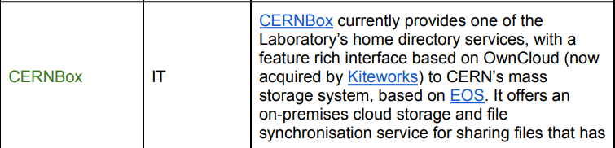
Tools Available
General Information on Document Management Systems at CERN can be found here :
Confluence
          CERN Box
          EDMS “allows to store, manage, organise, and distribute large amounts of engineering information, covering as well the formalisation of the corresponding methodologies and supported procedures”
          Service Now
Document Management Systems Landscape at CERN - CERN Document Server
Will be reorganized to align with new structure and archive past/obsolete information By Mid-April (Lisa)
To be used for sharing factual information/documents, follow-up of projects, meetings presentations
to be used for sharing files and for collaborative editing
to be used for all approved official documents and/or requiring signature (e.g: PDP, Memos, technical data sheet but NOT for Standards and KB)
to be used for Standards and KB

