Slide 2


The Extensible WOrKflow System
Standardizing data processing with FAIR results
Loic HUDER
Software Engineer, Data Automation Unit - ESRF

Slide 3
The Extensible WOrKflow System
“The main goal of EWOKS is to automate and standardize data processing and experiments at large-scale facilities as well as making data processing FAIR (reproducible and traceable).”
https://ewoks.esrf.fr

Slide 4
EWOKS = Extensible WOrKflow System
🎯 GOALS
Automation: Remove manual repetitive tasks for scientists, reduce time to publication.
Standardization: Share common operational practices across scientific domains — and potentially across institutes.
Experiment Integration: Enable feedback from results into data acquisition
FAIR Principles: Ensure data processing is repeatable, reproducible, and validated.
Extensibility: Keep scientific logic independent of underlying operational technologies.

Slide 5
Core design philosophy

Slide 6














EWOKS is extensible
EWOKS = Extensible WOrKflow System
Extensible: use existing technologies in different situations
Curated list of computational workflow systems by the CWL community
(~360 systems) https://s.apache.org/existing-workflow-systems

Slide 7
EWOKS is extensible
EWOKS = Extensible WOrKflow System
Extensible: use existing technologies in different situations
Graphical interface for desktop
Interactive execution
Parallel execution
Distribution on a compute cluster
Support for loops
Python can be easily integrated
In-memory data transfer
Web service to manage and execute workflows
Workflow execution without the need for infrastructure
No workflow system has all features we need.
The list of requirements will change over time.

Slide 8
EWOKS is extensible
Isolate workflows and their implementation from workflow technologies.
✔ Independent data provenance.
✔ Independent scientific software.
Curated list of computational workflow systems by the CWL community
(~360 systems) https://s.apache.org/existing-workflow-systems

Slide 9
EWOKS is extensible
Ewoks currently supports three engines.
✔ Orange: interactive workflow execution on desktop.
✔ Pypushflow: supports workflows with loops and conditions for self-driving experiments.
✔ Dask: parallel and distributed execution of workflows for HPC.
Curated list of computational workflow systems by the CWL community
(~360 systems) https://s.apache.org/existing-workflow-systems

Slide 10
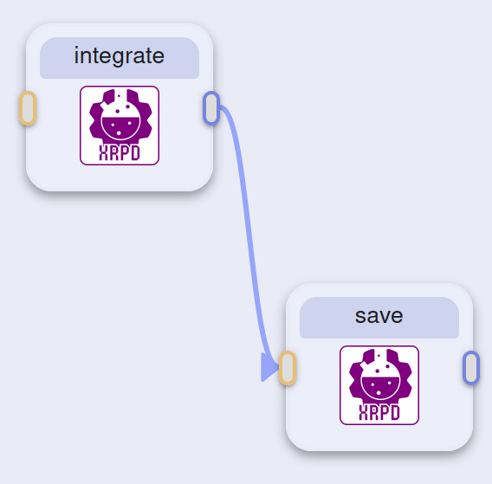
In essence
Definition of workflows across workflow systems
Definition of tasks across workflow systems
from ewokscore import Task
class Integrate1D(
Task,
input_names=["image", "geometry"],
optional_input_names=["normalization_factor"],
output_names=["x", "y", "xunits", "info"],
):
"""1D integration of a single diffraction pattern."""
def run(self):
raw_data = self.inputs.image
geometry = self.inputs.geometry
normalization_factor = self.get_input_value('normalization_factor', None)
ai = pyFAI.load(geometry)
result = ai.integrate1d(raw_data, normalization_factor=normalization_factor)
self.outputs.x = result.radial
self.outputs.y = result.intensity
self.outputs.xunits = result.unit.name
self.outputs.info = pyfai_utils.compile_integration_info(geometry)
{
"graph": {
"id": "integrate_save"
},
"nodes": [
{
"task_identifier": "ewoksxrpd.tasks.integrate.Integrate1D",
"task_type": "class",
"id": "integrate"
},
{
"task_identifier": "ewoksxrpd.tasks.nexus.SaveNexusPattern1D",
"task_type": "method",
"id": "save"
}
],
"links": [
{
"source": "integrate",
"target": "save",
"data_mapping": [
{ "source_output": "x", "target_input": "x" },
{ "source_output": "y", "target_input": "y" }
]
}
]
}
import h5py
def SaveNexusPattern1D(filename, x, y):
with h5py.File(filename, "filemode") as h5file:
nxprocess = h5file.create_group("integration")
nxdata = nxprocess.create_group("integrated")
nxdata.attrs["NX_class"] = "NXdata"
nxprocess.attrs["default"] = "integrated"
nxdata.create_dataset("radial", data=x)
nxdata.create_dataset("intensity", data=y)
nxdata.attrs["axes"] = "radial"
nxdata.attrs["signal"] = "intensity"
Tasks can also be regular Python functions or shell scripts or Jupyter notebooks

Slide 11
INTERFACES

Slide 12
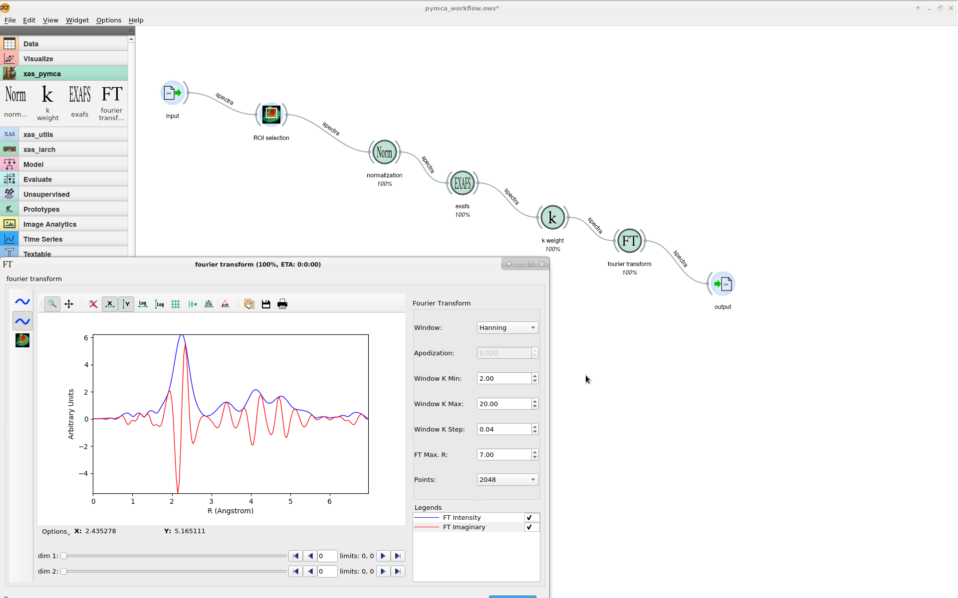
EWOKS interfaces
EWOKS interfaces
Desktop
Web
Shell
Python
Used for interactive workflows.

Slide 13
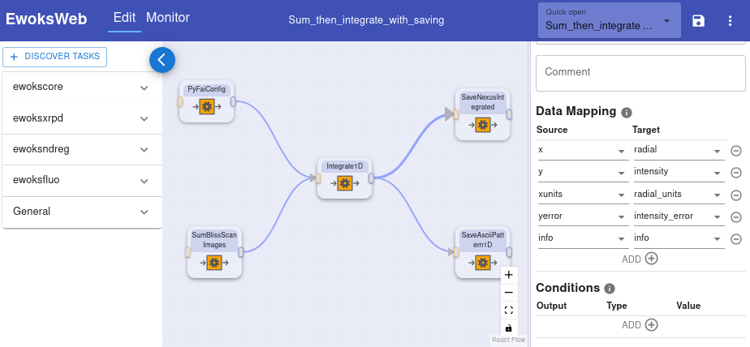
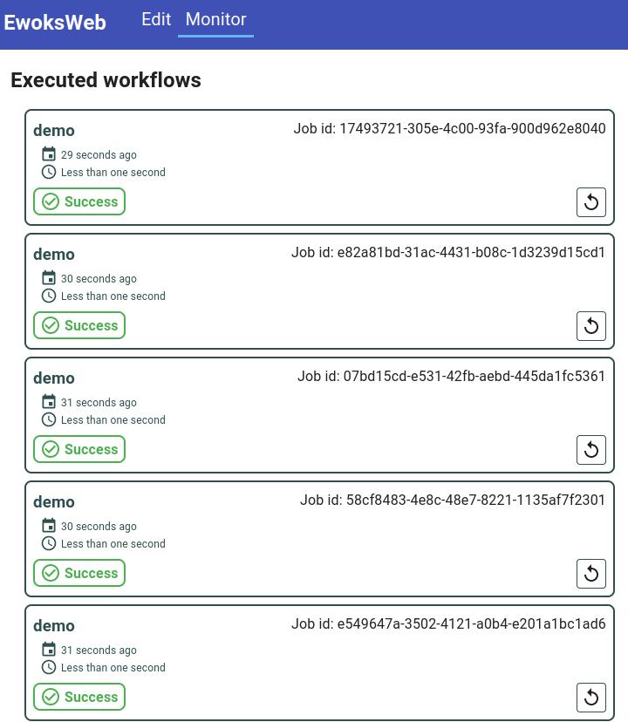
EWOKS interfaces
EWOKS interfaces
Desktop
Web
Shell
Python
Used to create and execute workflows with a GUI in case no graphical components (Orange widgets) have been developed or a desktop GUI is not convenient.
Standalone usage similar to Jupyter notebooks.

Slide 14
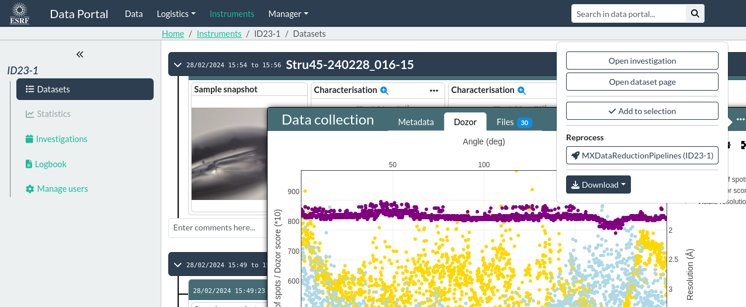
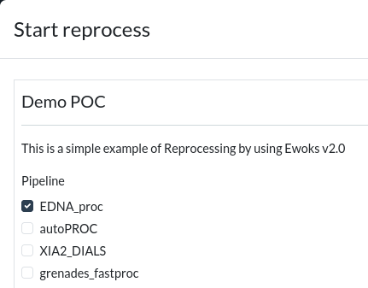
EWOKS interfaces
EWOKS interfaces
Desktop
Web
Shell
Python
Data processing as a service
(e.g. from the ESRF data portal)

Slide 15
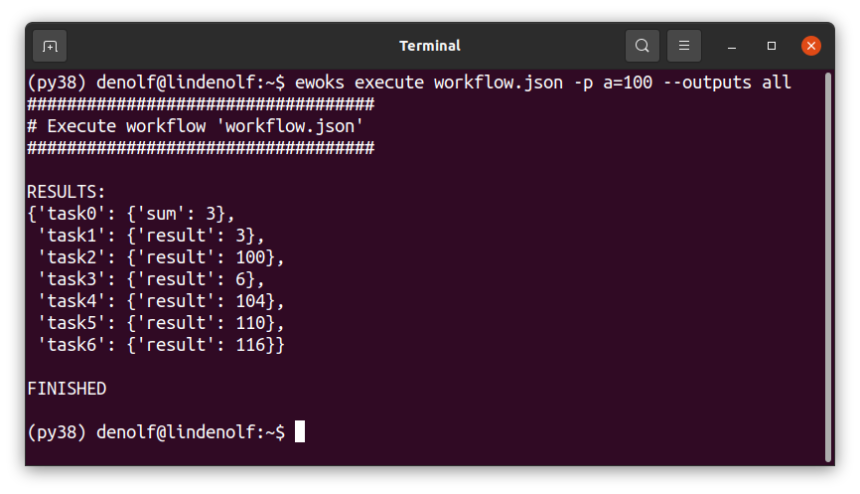
EWOKS interfaces
EWOKS interfaces
Desktop
Web
Shell
Python
Used for headless execution.

Slide 16
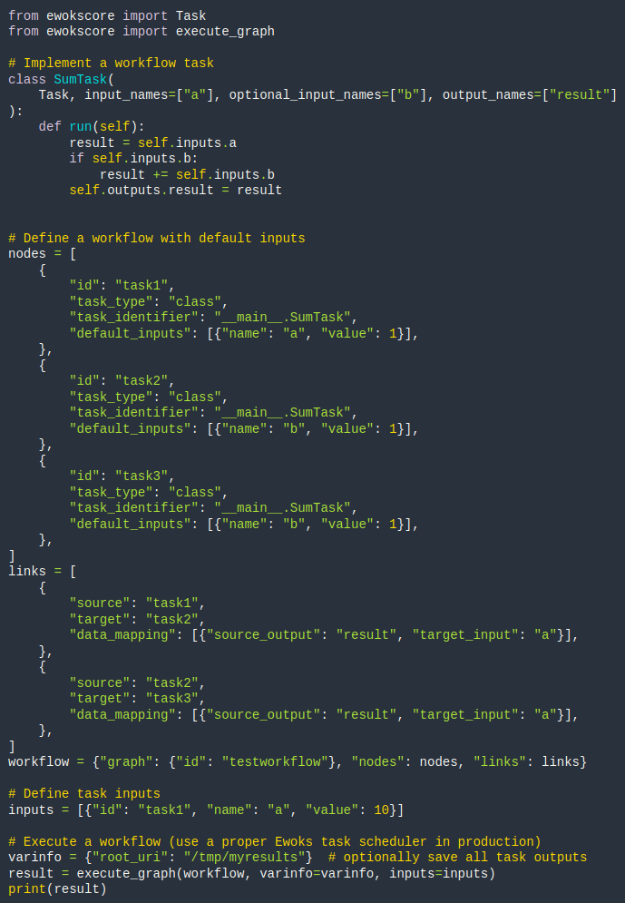
EWOKS interfaces
EWOKS interfaces
Desktop
Web
Shell
Python
Developer usage like triggering workflows from the acquisition control system.

Slide 17
EXECUTION AND SCALABILITY

Slide 18



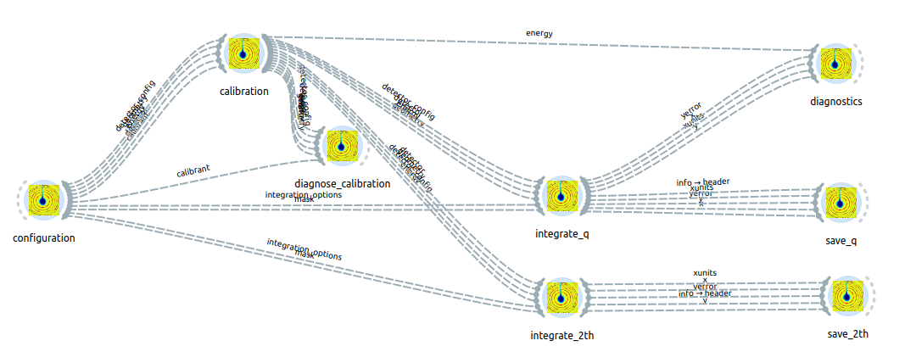


Typical setup for online data processing at the ESRF
Acquisition control system
(Bliss, Daiquiri, MxCube)
Execute EWOKS workflow on
local machines (immediate)
compute cluster (queue)
Visualization
Persist result for further analysis
Data portal
(FAIR results including the workflows with DOI for publication)

Slide 19
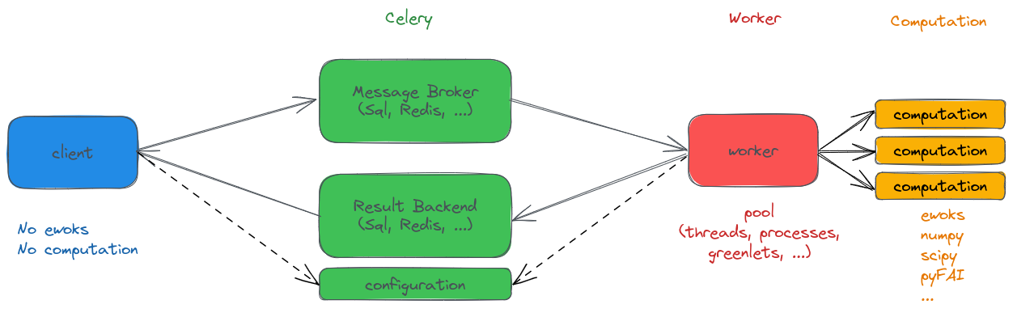
Typical setup for online data processing at the ESRF
Submit
Submit
Results
Results
Workers: venv or conda environments
Deployed with ansible
Messaging handled by ewoksjob
States the configuration
of the machine

Slide 20
Ewoks is not only a beamline tool
Ewoks was designed to be used at beamlines but also by users on their local machine
The Ewoks ecosystem is made of Python packages
that can easily be installed locally by Python package managers:
pip install ewoks
Core packages to start using ewoks
pip install ewoksweb
Install the web interface to edit workflows
pip install ewoksxrpd
Install tasks for X-ray powder diffraction data (mostly integration with pyFAI)
And many more !

Slide 21
REPRODUCIBILiTY and SHARING

Slide 22




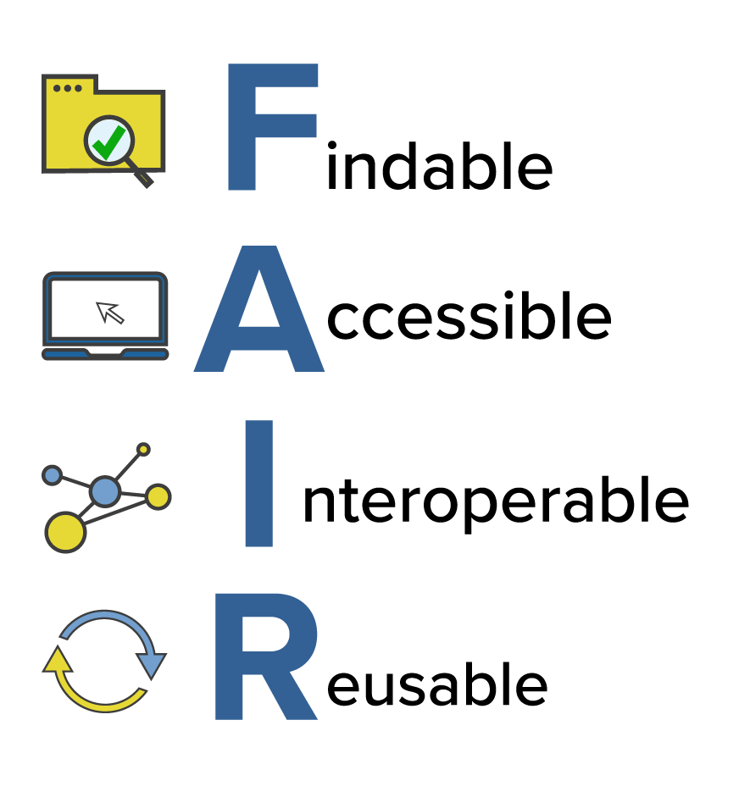
Reproducibility and sharing
Workflow = Data provenance document
✔installable
✔executable
⮩ reproduce and validate
Data portal
{
"graph": {
"id": "integrate_scan_with_saving",
"schema_version": "1.1",
"requirements": [
"ewoks==2.0.0",
"ewokscore==2.0.0",
"ewoksdata==1.2.1",
"ewoksjob==1.1.2",
"ewoksorange==2.0.0",
"ewoksutils==1.4.0",
...
]
}
Publication
beamline_workflow.json
ewoks install
Installs all requirements in the current environment
ewoks execute
Executes with the same requirements as on the beamline

Slide 23
EXAMPLES IN PRODUCTION AT ESRF BEAMLINES

Slide 24
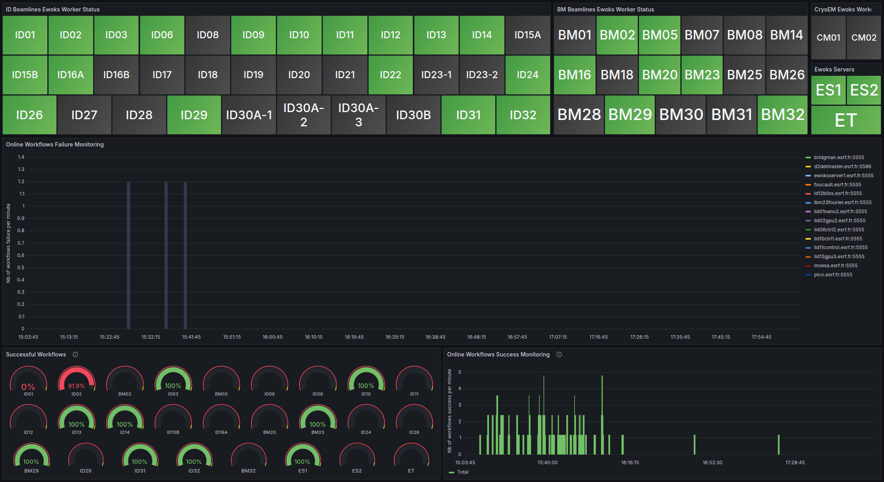

Ewoks examples at the ESRF
Automatic data processing pipelines active at 30 ESRF beamlines with central monitoring

Slide 25
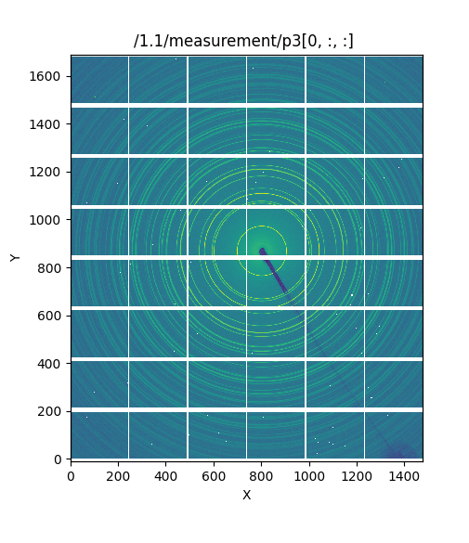
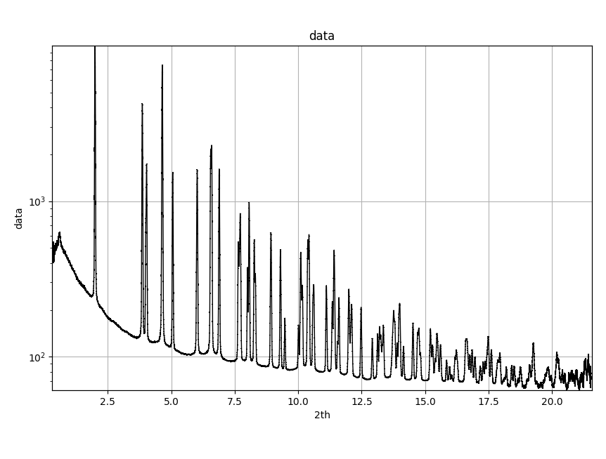
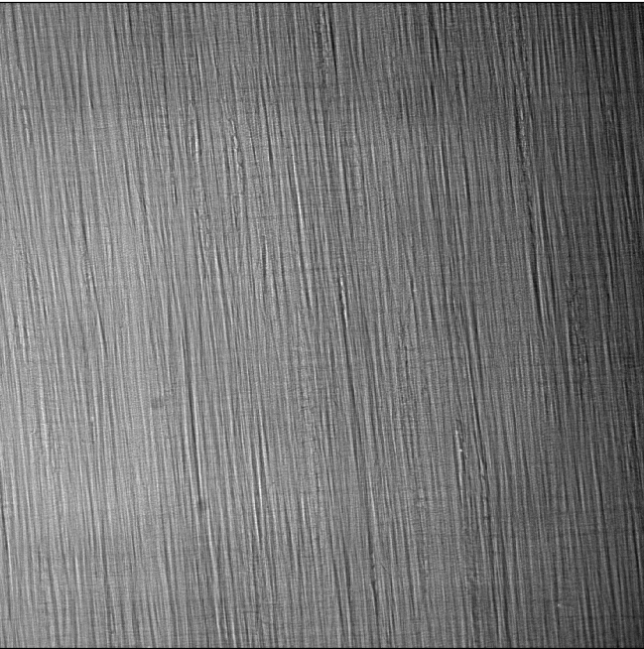
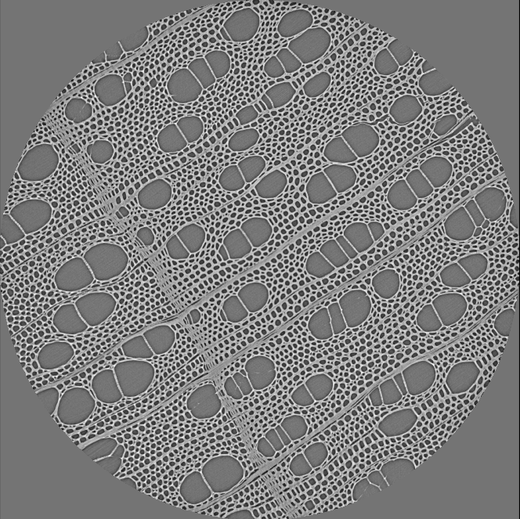
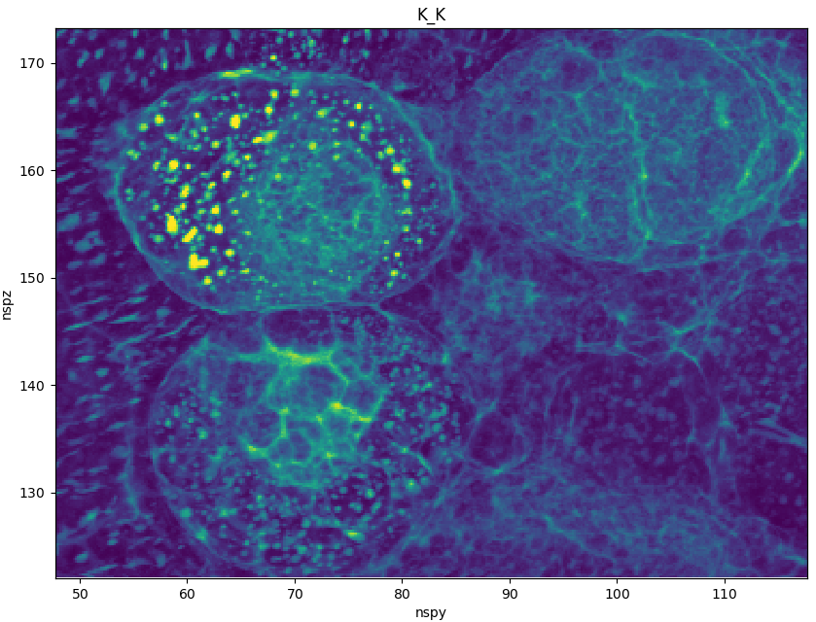
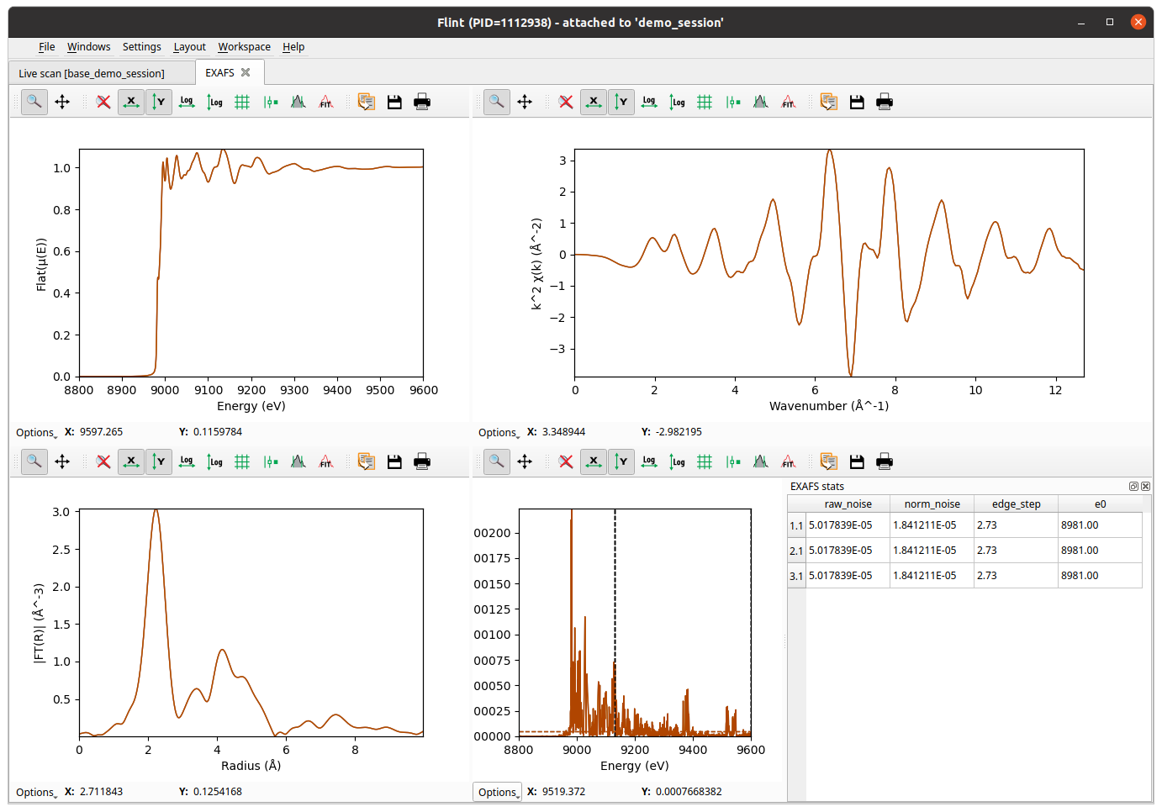
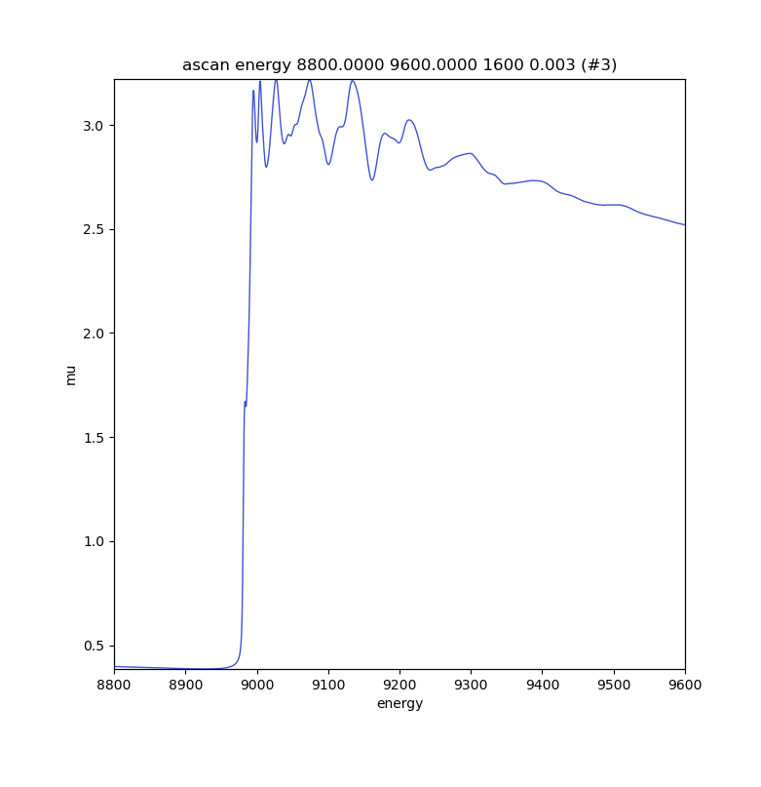
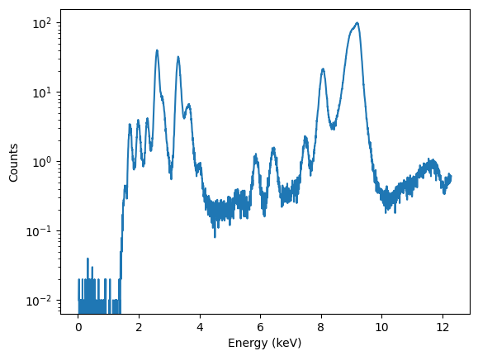
Ewoks examples at the ESRF
Automatic data processing pipelines active at 30 ESRF beamlines in different scientific domains
XRPD
pyFAI
6 beamlines
Tomography
nabu
8 beamlines
XAS
xraylarch
2 beamlines
XRF
pymca
3 beamlines

Slide 26
GETTING STARTED WITH EWOKS

Slide 27
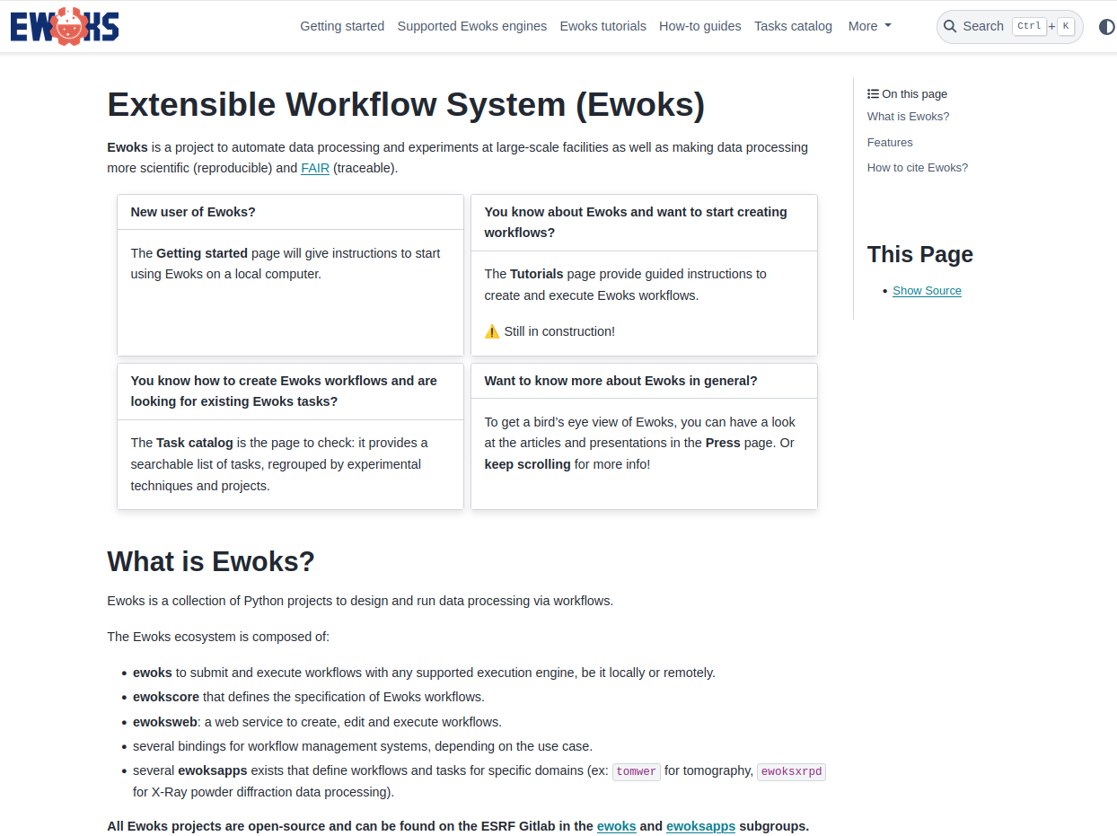
Getting started with EWOKS
https://ewoks.esrf.fr
Tutorials & How-to Guides

Slide 28
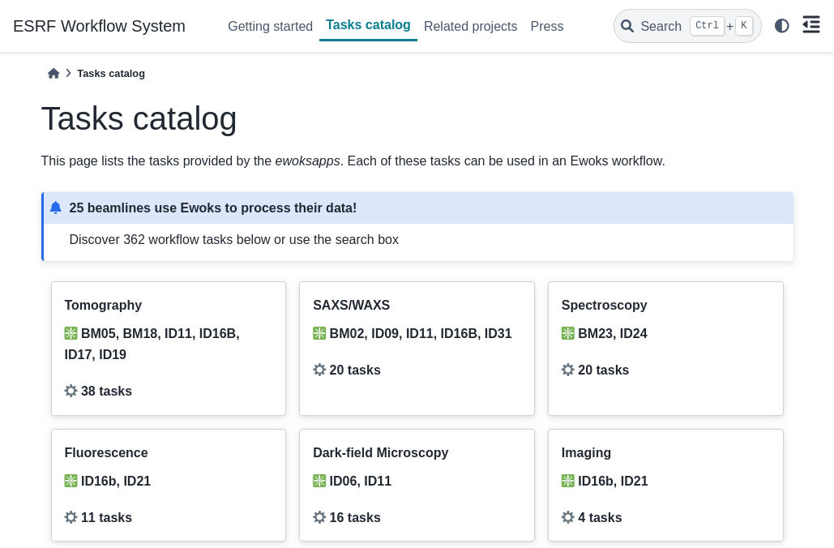
Getting started with EWOKS
https://ewoks.esrf.fr
Task catalog to build workflows

Slide 29
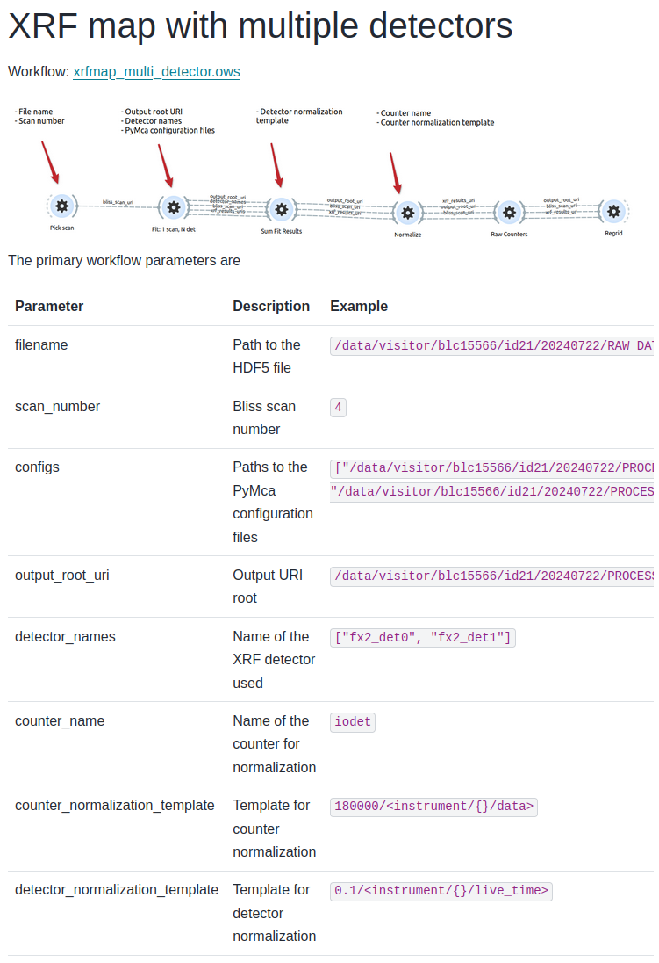
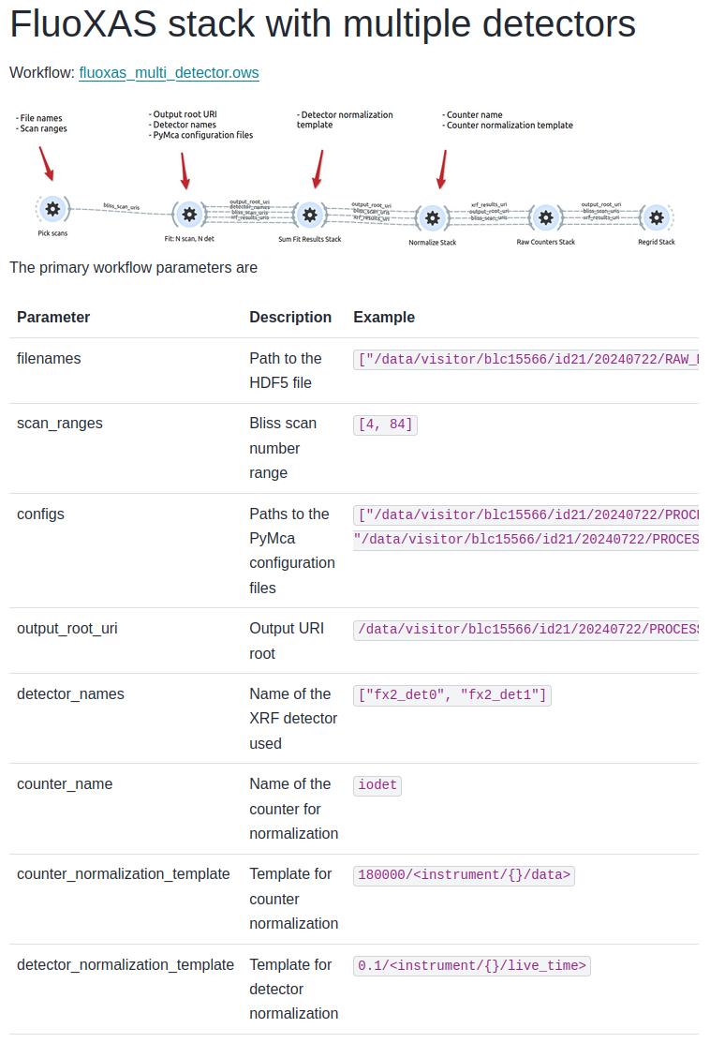
Getting started with EWOKS
Planned for the future
Workflow catalog with proper description on how to install, run and parameterize
Examples from
https://ewoksfluo.readthedocs.io

Slide 30
Take-home messages
Ewoks acts a reconciling layer above workflow systems
Ewoks workflows are installable and executable
data provenance documents
Ewoks can be installed and used at the beamline or locally by users
Choose the best engine depending on the situation
All packages available on PyPI
Open-source (MIT) https://gitlab.esrf.fr/workflow/ewoks/
Decouple the Ewoks workflows and tasks from the underlying technology

Slide 31

The Extensible WOrKflow System
https://ewoks.esrf.fr
https://gitlab.esrf.fr/workflow/ewoks/
📨 data-automation-unit@esrf.fr

Slide 33
EWOKS = Extensible WOrKflow System
🛠️ REQUIREMENTS
Portable: Easy to install and run everywhere — from laptops to HPC clusters. Bring compute to the data or instruments, not the other way around.
Flexible Workflow Modes: Support both interactive and non-interactive workflows — automation isn’t always possible.
Hybrid Processing Models: Handle offline data processing (DAGs) as well as online/real-time workflows with loops and conditions (expert systems).
Software Integration: Use existing scientific software (often in Python); don’t force reimplementation.
In-Memory Communication: Enable data transfer between workflow nodes without copying or serialization.
Context-Aware Execution: The same workflow must run in diverse contexts — with a GUI on a laptop, headless on an HPC cluster, through the ESRF data portal, or from the acquisition control system.
Reproducibility and Traceability: Save a fully installable and executable data provenance document alongside results.

Slide 34
EWOKS project information
Project started in July 2021. Stable since January 2023.
Currently 6 core developers
MIT License
Ewoks workflows are published under the FAIR principles so the ESRF is committed to long term support.
Open-source on https://gitlab.esrf.fr/workflow/ewoks/ but can be moved to allow for non-ESRF contributions.

Slide 35
Technical reference slides
Integrate workflow execution (experiment, data portal , ...)
Local compute resources

Slide 36
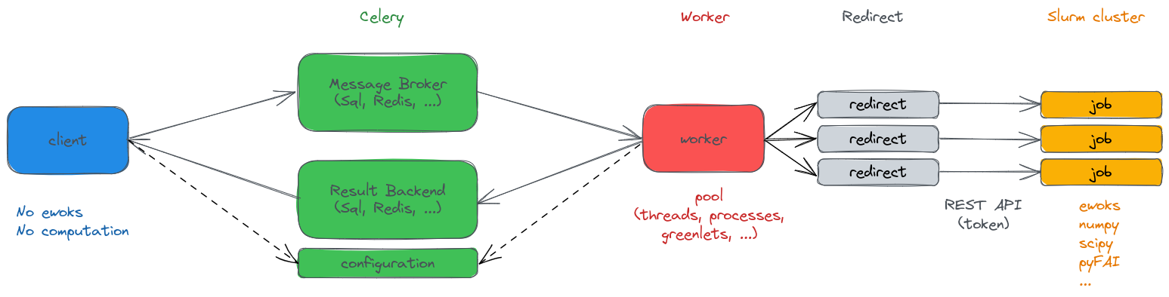
Technical reference slides
Integrate workflow execution (experiment, data portal , ...)
Compute cluster

Slide 37
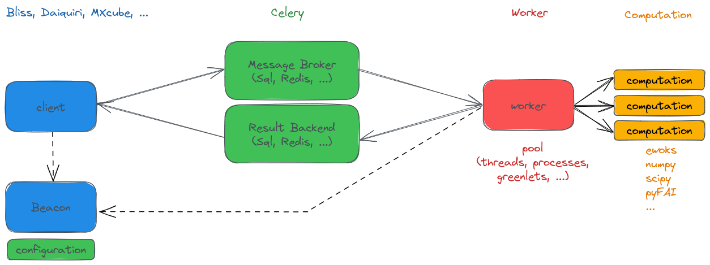
Technical reference slides
Integrate workflow execution (experiment, data portal , ...)
ESRF beamline

Slide 38

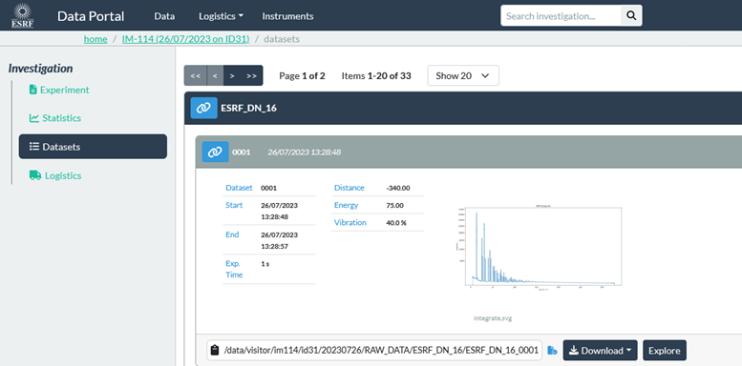
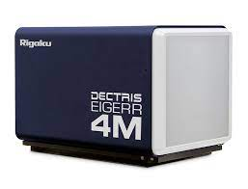
Ewoks examples at the ESRF
Diffraction (SAXS/WAXS): convert synchrotron data to traditional powder diffractograms
ESRF beamlines BM02, ID06, ID11, ID09, ID16B, ID31
images + metadata
(flux, energy, geometry)
calibration (pyFAI)
integration (pyFAI)
save (HDF5)
EWOKS
Further analysis to be brought online in the future

Slide 39
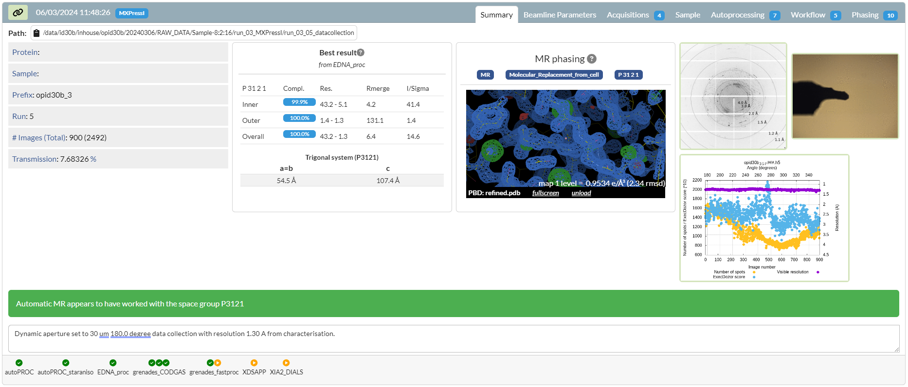
Ewoks examples at the ESRF
Diffraction (macromolecular crystallography): Automatic structure solution from single-crystal diffraction
ESRF beamlines ID23-1, ID23-2, ID30A-1, ID30A-3, ID30B
Example where the complete analysis was brought online (completely automated with diagnostics for validation).
Also data acquisition itself is part of the workflow (determine the optimal measurement strategy for the crystal).

Slide 40
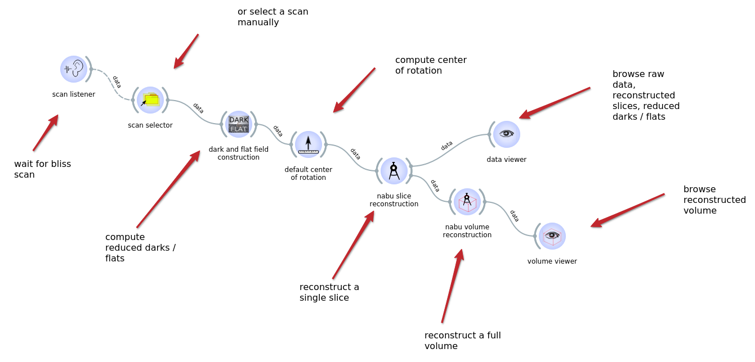
Ewoks examples at the ESRF
Tomography: 3D volume reconstruction of the X-ray density from projections
ESRF beamlines ID03, BM05, ID11, ID15A, ID16A, ID16B, BM18, ID19
Inputs
Images of the sample in transmission + dark field images + flat field images + metadata
EWOKS
Outputs
Reconstructed volumes

Slide 41
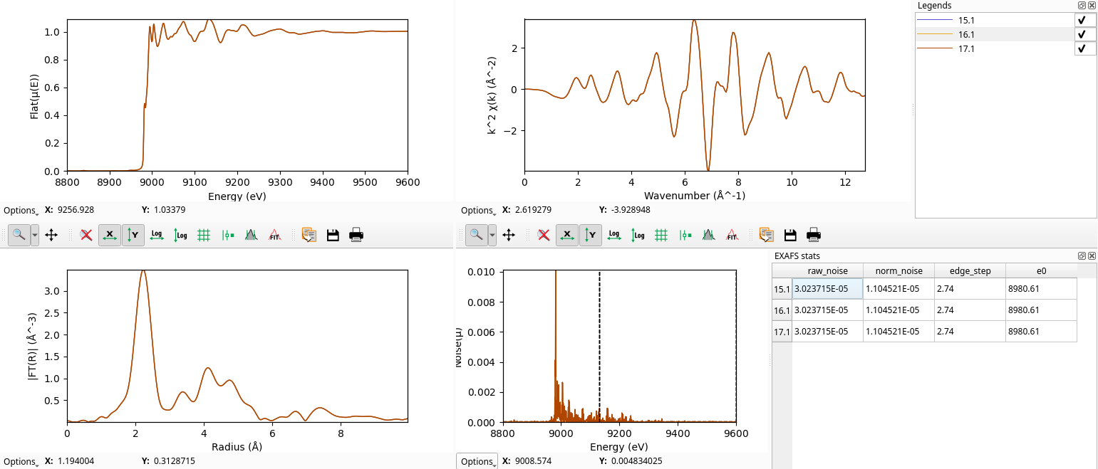
Ewoks examples at the ESRF
Spectroscopy: Online visualization of EXAFS data for the scientist to make informed decisions during the experiment
ESRF beamlines BM23, ID24
energy-space
k-space
R-space
Quality control

Slide 42
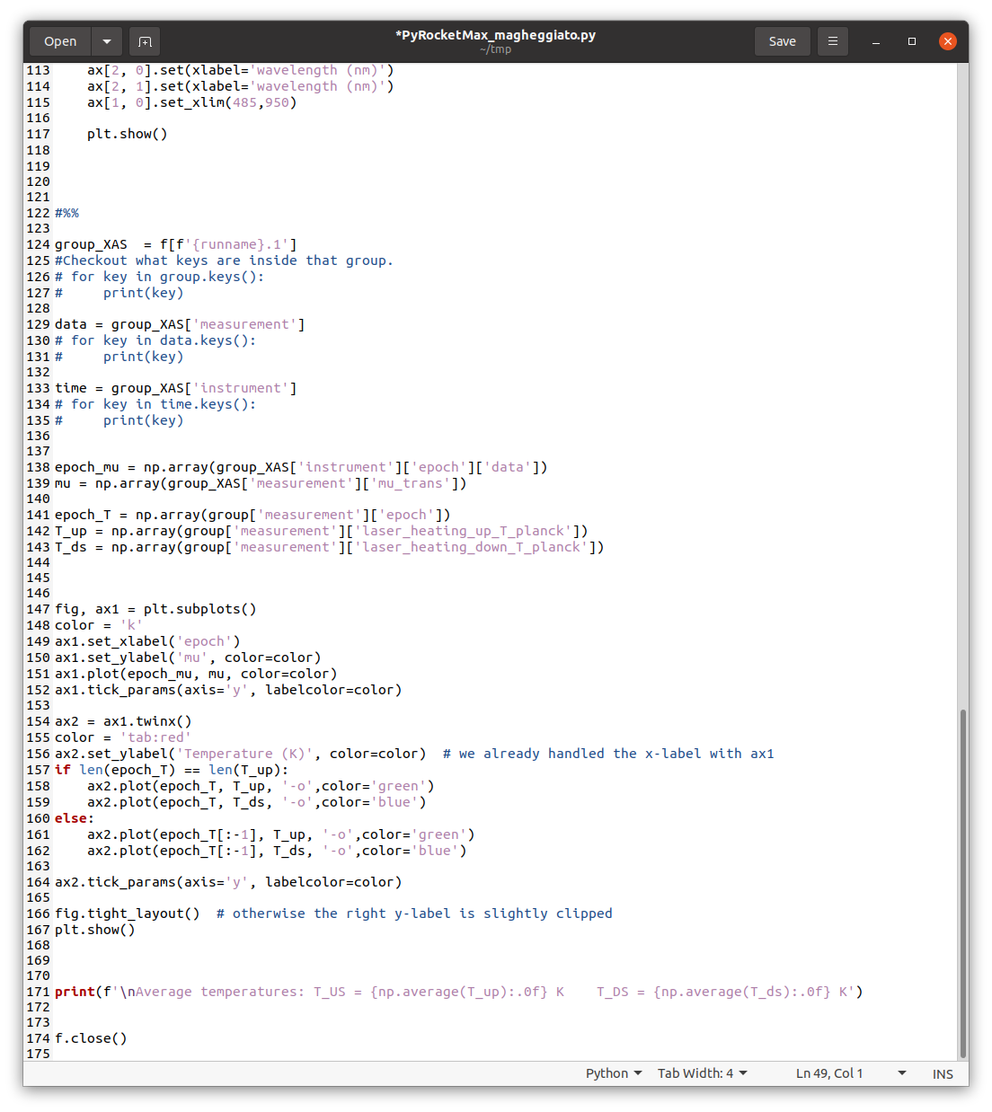
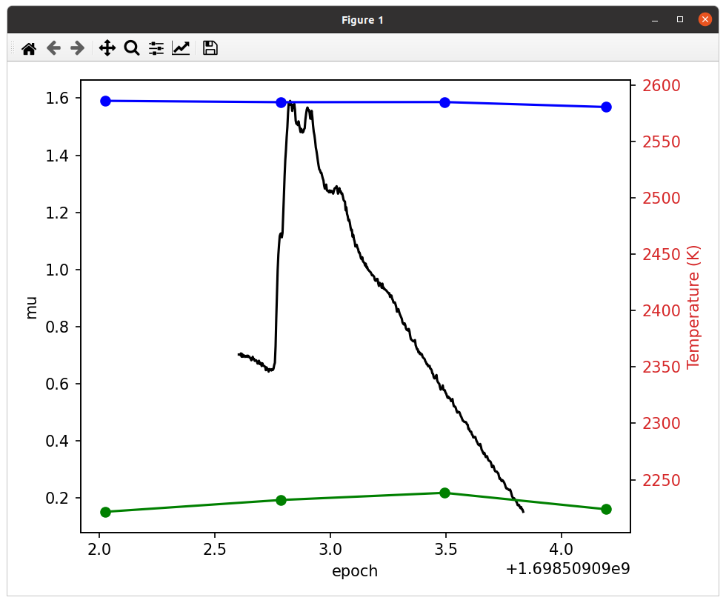
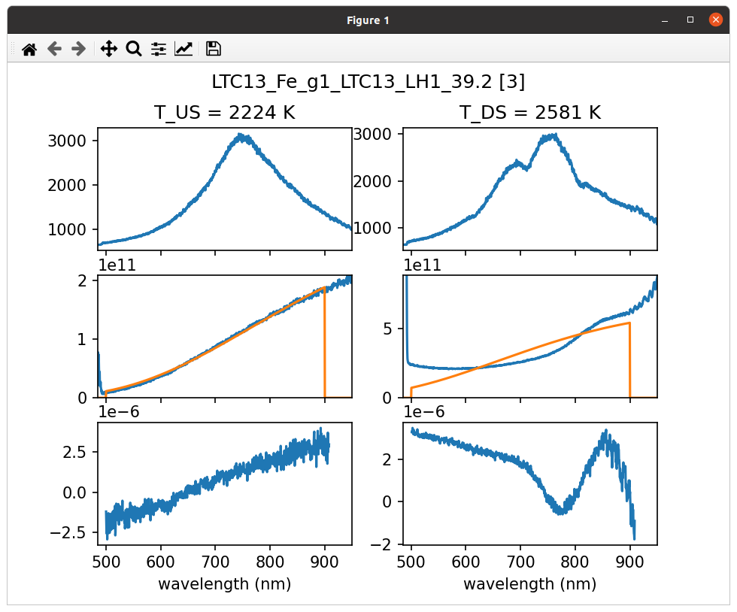
Ewoks examples at the ESRF
In addition to the major data pipelines, EWOKS can be used to automate smaller tasks to give users and beamline staff some breathing room during experiments.
Script written by user/post-doc at ID24: temperature monitoring based on analyzing black-body radiation.
Run manually for every scan
Run automatically for every relevant scan.

