Slide 1
CLEAR beyond 2025: hardware consolidation/upgrades and relevance for the CERN future accelerator program
R. Corsini, D. Gamba for the CLEAR Team
CLEAR Scientific Board Meeting - 26th Mar 2025 - CERN

Slide 2
Outline
Ongoing Hardware consolidations and upgrades:
  Overview
  RF consolidation: status and plans
  Laser consolidation: status, plans and new opportunities
Looking ahead:
  Operation and Opportunities during CERN Long Shutdown 3 (LS3)
  Looking toward FCC-ee
Conclusions

Slide 3
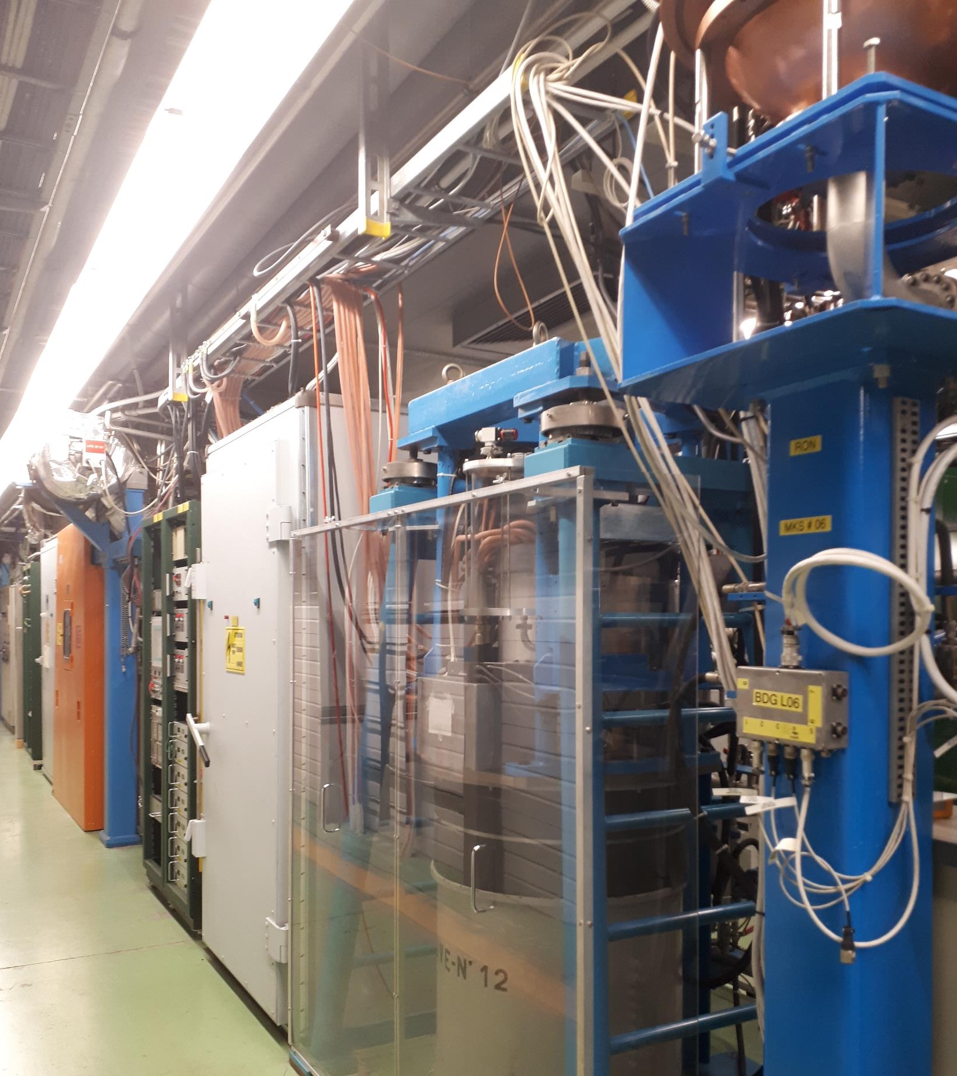
CLEAR: Hardware Challenges
Mainly relying on old equipment from CTF3
  Made of old/spare magnets and cavities
  Cherry picking of CTF3 power converters and cables
  Adaptation of existing vacuum chambers/equipment
  Old and complex laser system
Main concerns with RF:
  Outdated modulators and scarce availability of TH2100 klystrons on the market and/or long delivery delays
  Outdated and fully-analogue LLRF system
    Still providing low jitter (ps level) triggering system with some unique features at CERN
Simple machine… for who knows it !
  Operation is for a large part covered by temporary personnel
  Modelling/standardisation/documentation is limited mainly by manpower

Slide 4
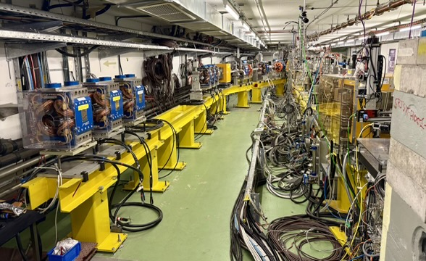
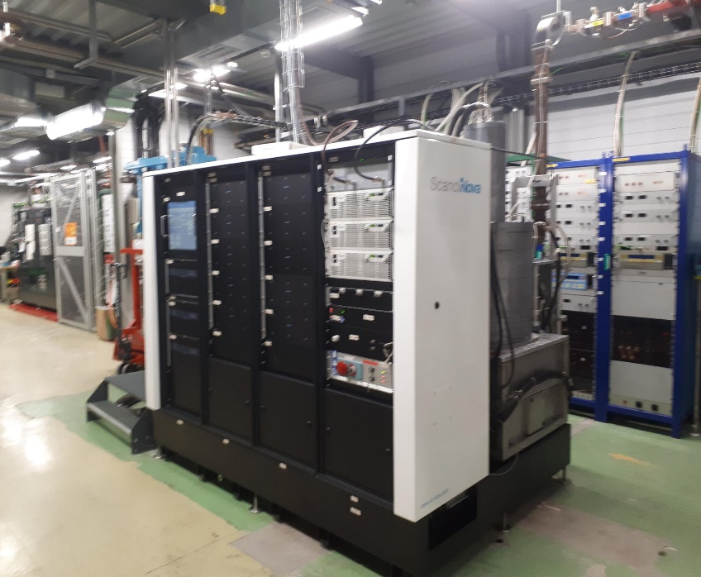
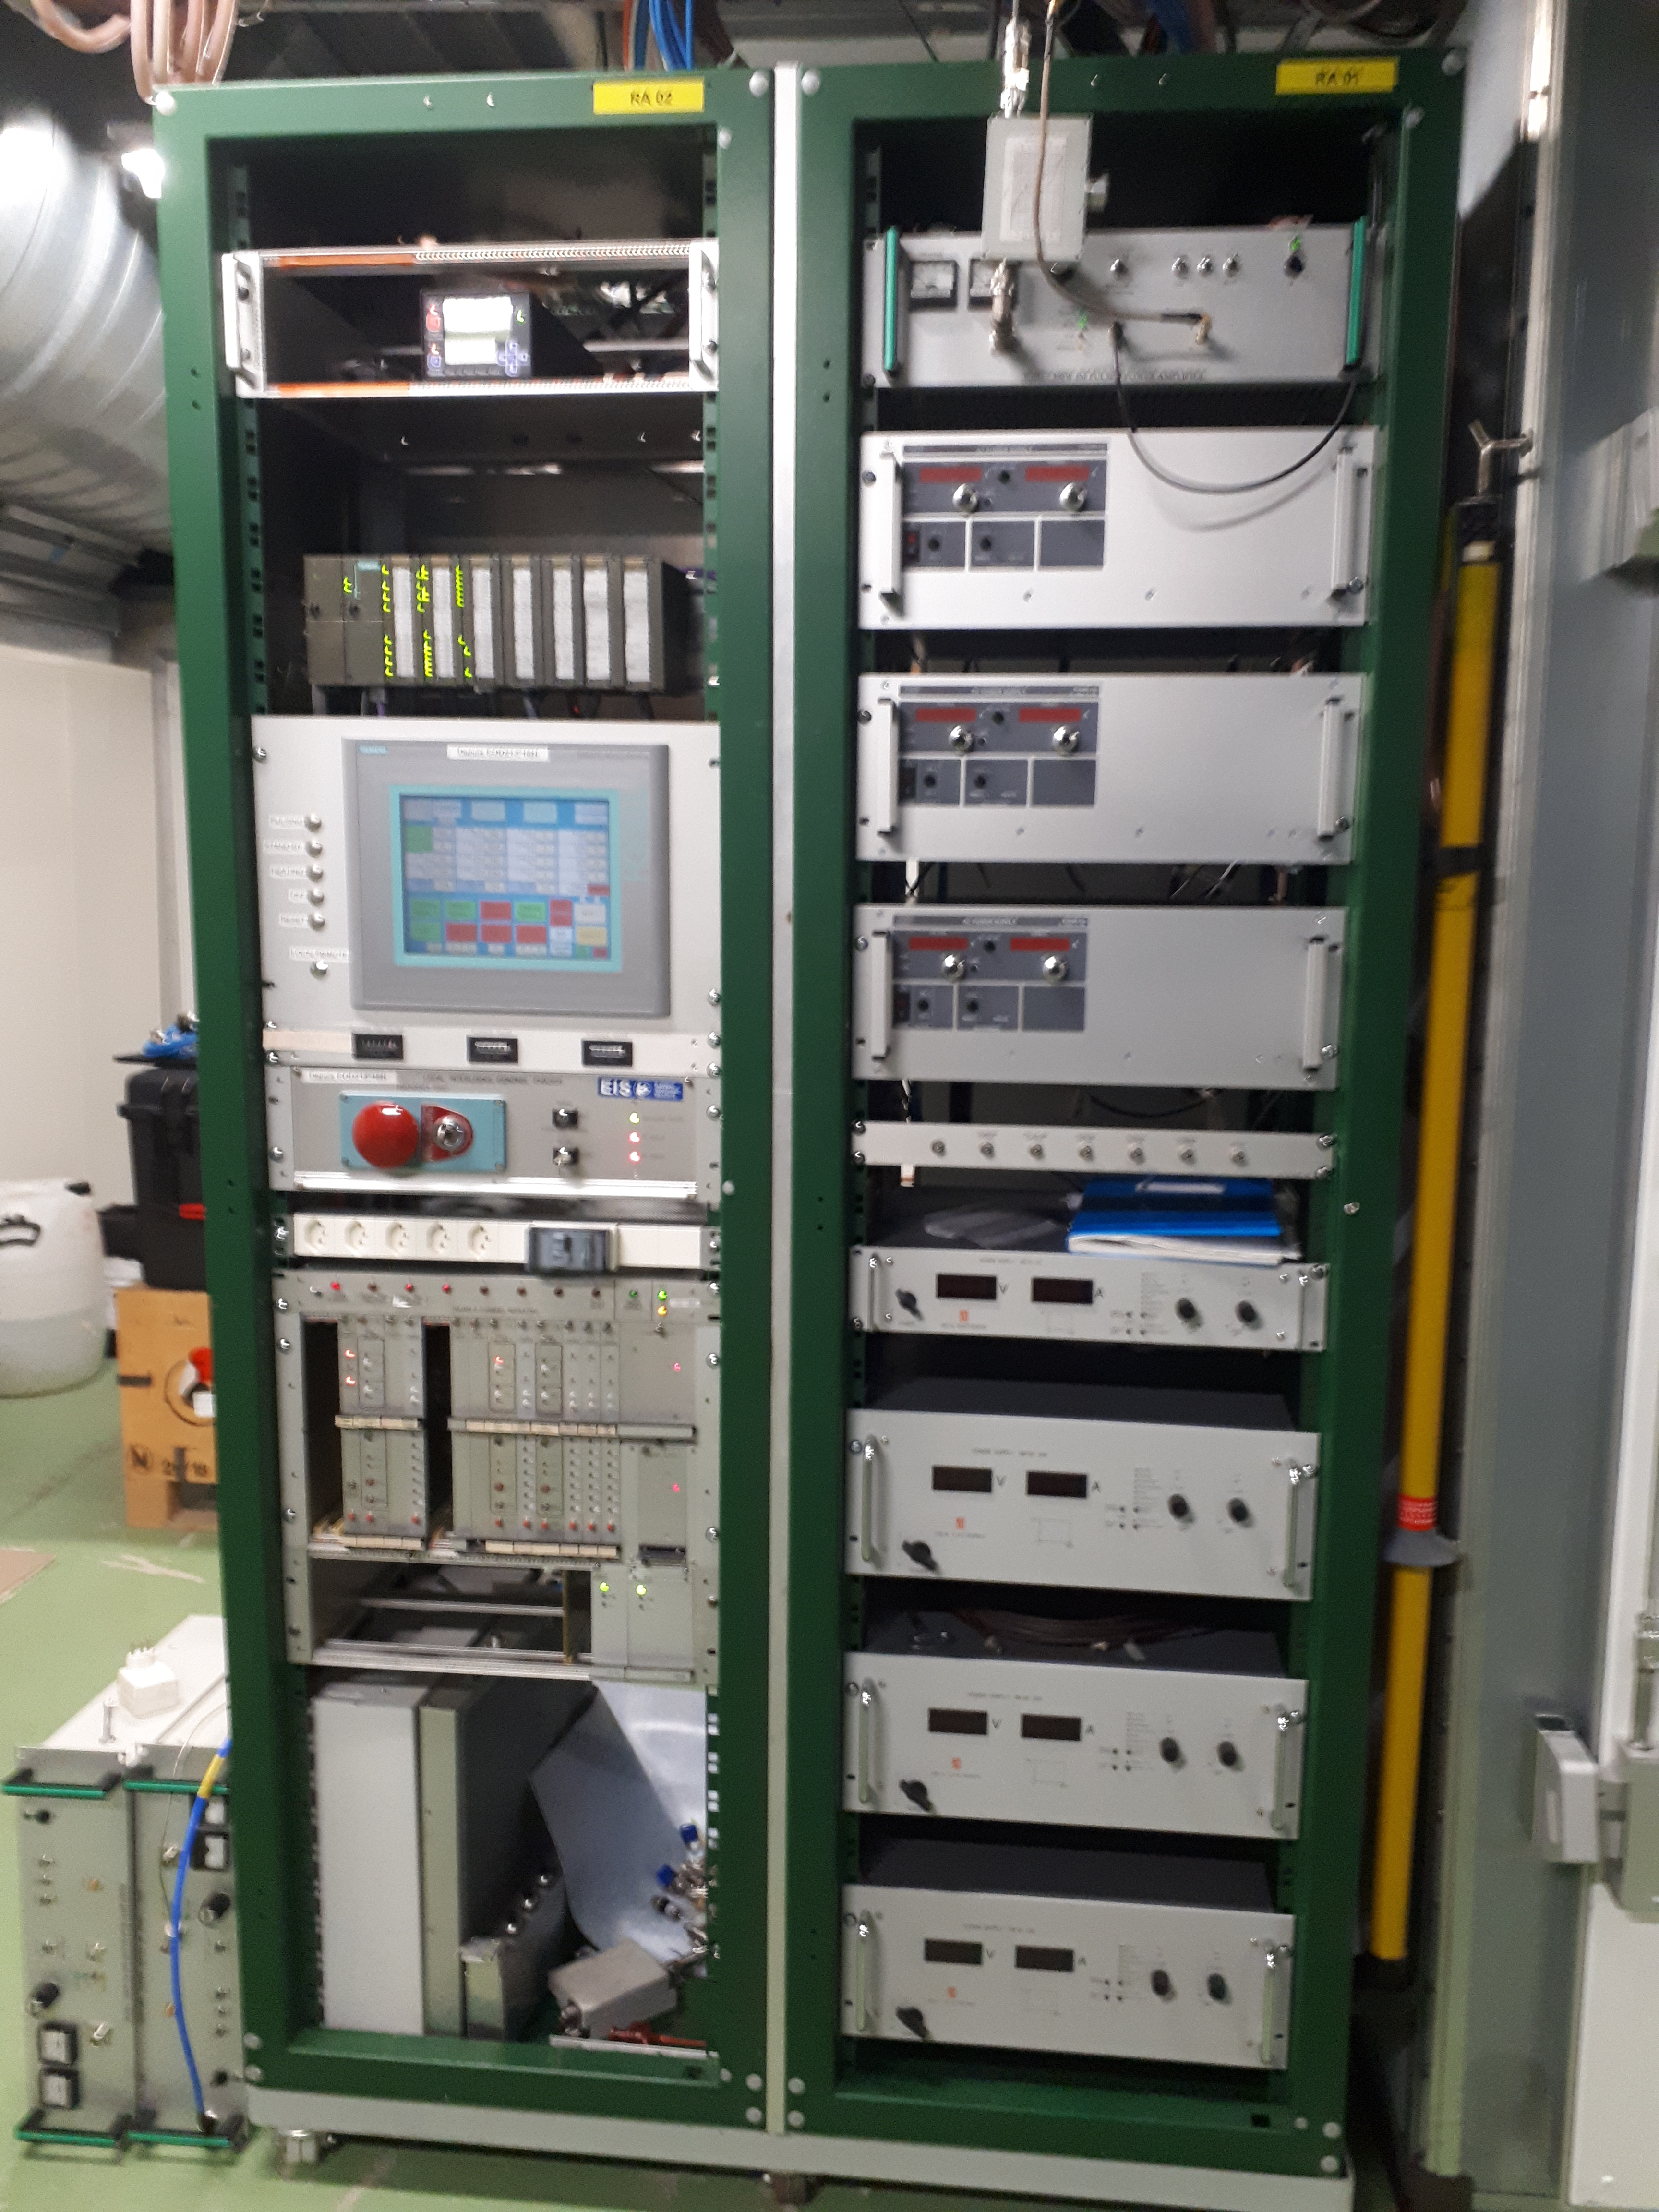
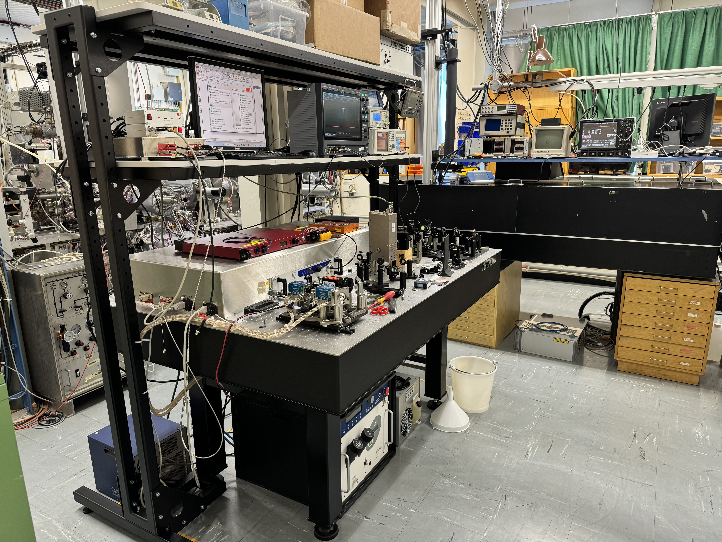
CLEAR – Extension of Operation & Improvements
Operation Extended Until 2030 ( running also during LS3 ):
  Following a successful review in spring 2024, CLEAR's operation is extended with strong scientific justification: “CLEAR is a great asset to CERN, achieving excellent efficiency with modest resources.”
Unlocked Ongoing Upgrades:
  New Beamline Under Construction:
    Commissioning planned for 2025
    to support future experimental programs
  Consolidation of high/low level RF:
    Exploring synergies with AWAKE
  New EO Comb Laser Front-End:
    Ready in 2025, enabling enhanced
    experimental capabilities
Strategic Vision:
  Current Focus: Expanding the experimental program with upgrades already in progress
  Future Role: Exploring CLEAR’s potential contribution to major CERN initiatives (e.g., Higgs Factory)
Focus of this presentation

Slide 5
RF SYSTEMS for CLEAR (and AWAKE)

Slide 6
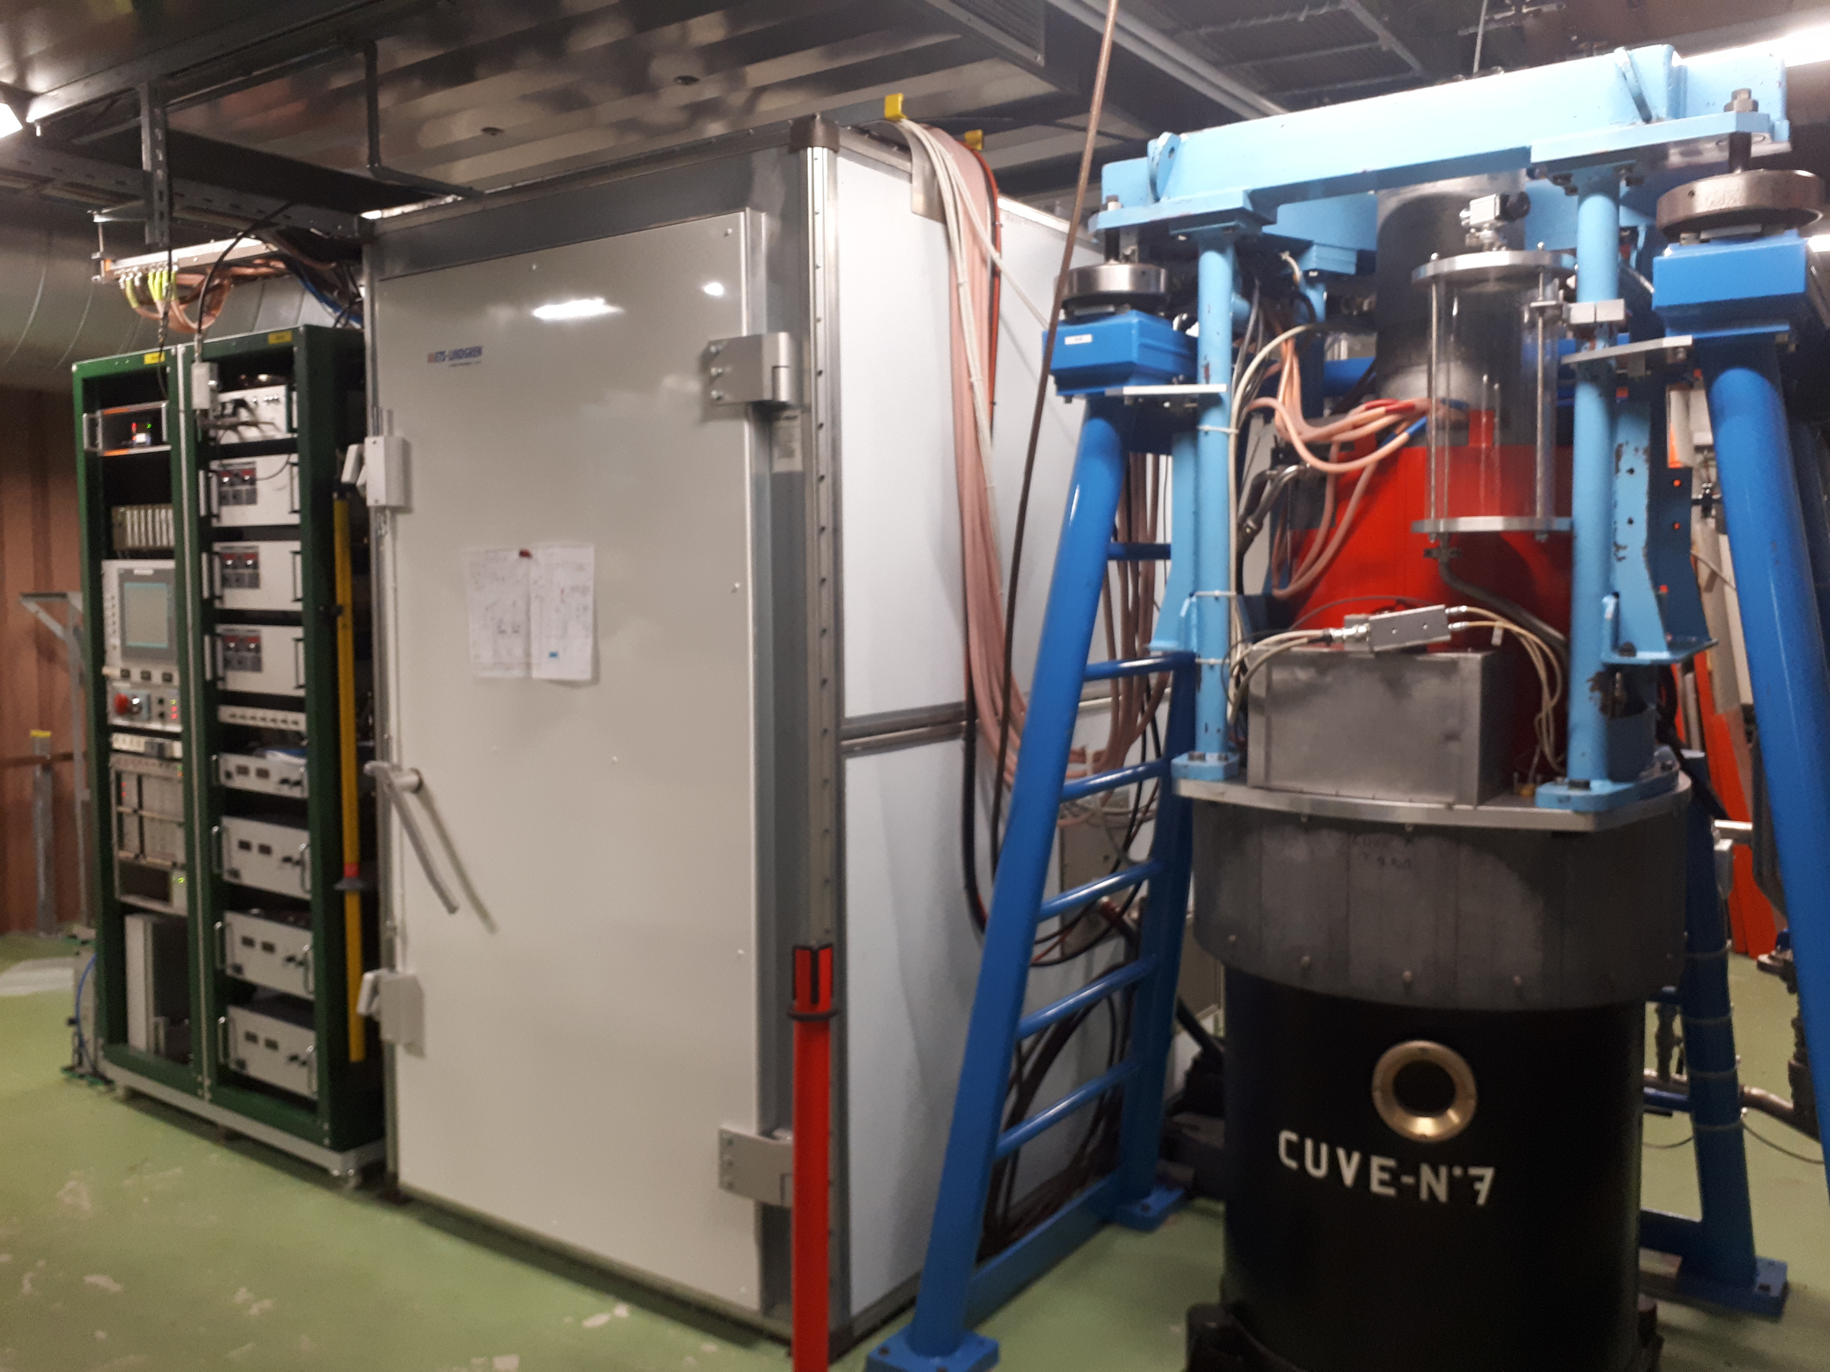
High-Level RF plans
Courtesy S. Doebert
Modulators:
Systems working well and spare parts exist
Possible to add charger units to access higher rep. rate
No major change foreseen on the side
Klystron tubes:
Call for tender out asking prices for klystron refurbishment or buying new ones
  Request to have up to 2-3 spare tubes in the coming 2-3 years
  Pool possibly shared with AWAKE
Answers expected in a few weeks time

Slide 7
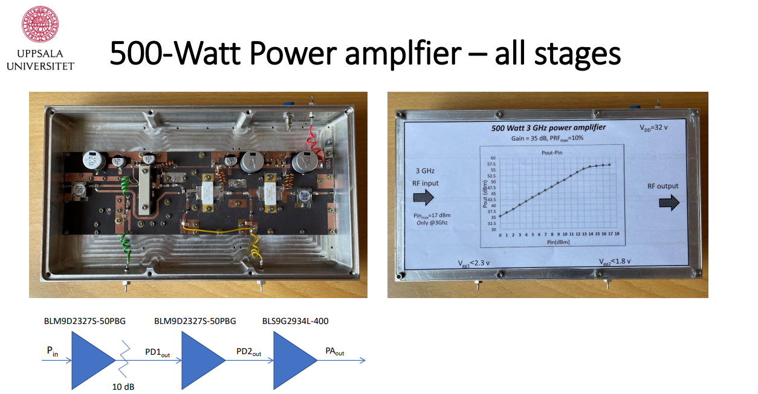
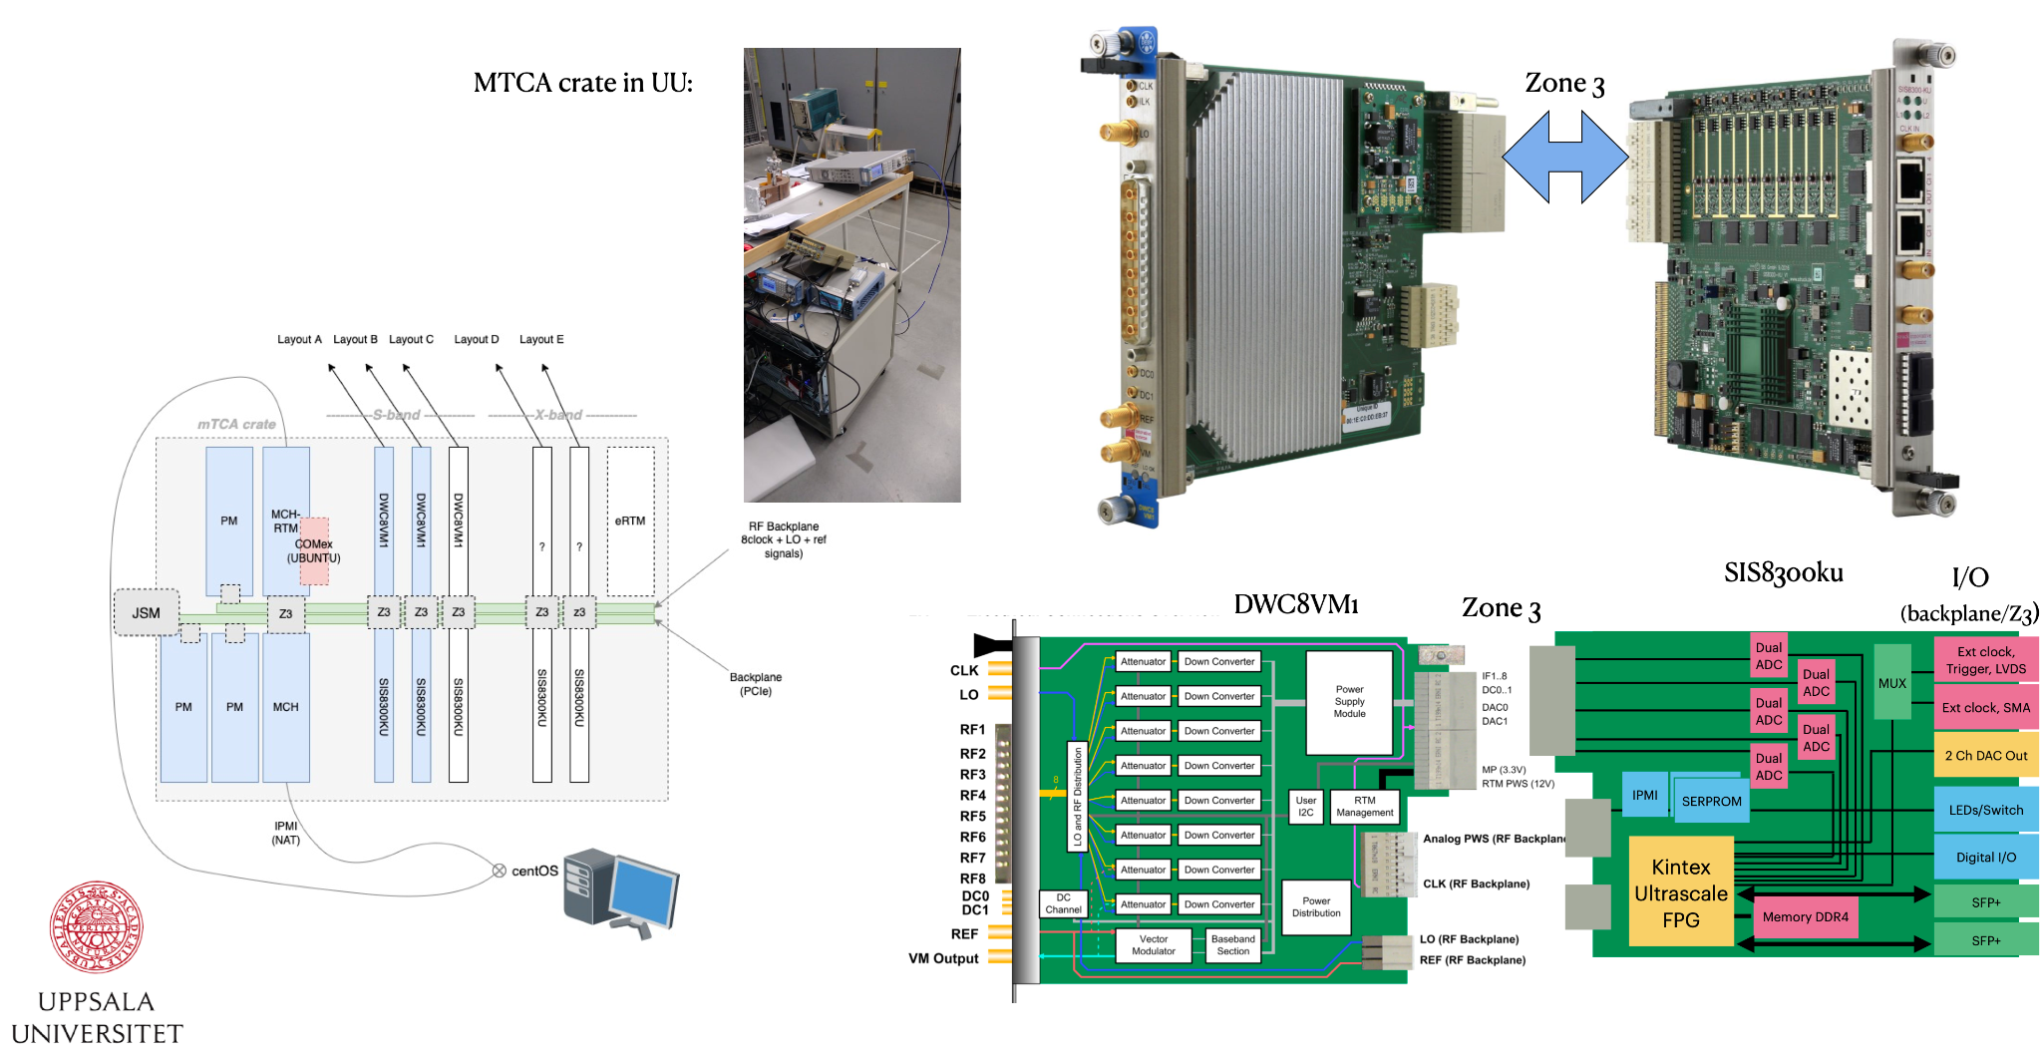
Low-Level RF plans
Courtesy S. Doebert
Hardware:
LLRF Amplifiers:
  Currently covered using refurbished CTF3 spares
  Alternative: MicrowaveAmp (commercially available, already used in AWAKE)
LLRF klystron drive and control:
  Plan to upgrade to uTCA developed by Uppsala for AWAKE
  Prototype for AWAKE already exists
    AWAKE cards could be tested first in CLEAR
Frequency generation, distribution, and fast delay units:
  To be developed, potentially using existing/commercial building blocks
Personnel being hired to tackle these challenges:
1 STAFF (funded by AWAKE) for digital LLRF (uTCA system development and deployment) - now hiring
1 GRAD (funded by CLEAR) for ‘analog’ LLRF (frequency generation and distribution) - post advertised

Slide 8
LASER SYSTEMS

Slide 9
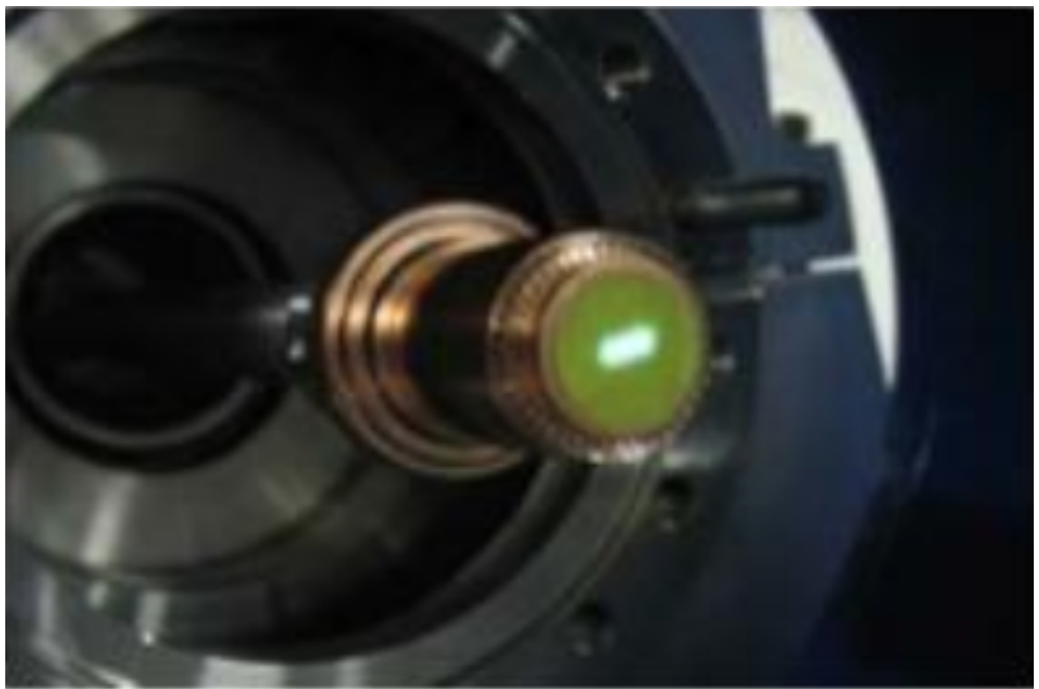
General schematic layout of CLEAR LASER systems
Courtesy E. Granados
2 (3) laser systems hosted in a rather small laser lab on top of CTF2
CLEAR photo-injector
CLEAR LASER LAB
RF locking
PHIN photo-injector (decommissioned)
CTF2 photo-injector
Double pulse setup
Harmonic converter
Oscillator
PHIN1 Amplifier
RF locking
Pre-amp
OneFive front-end 500 MHz
(spare)
PHIN2 Amplifier
Oscillator
Stretcher
Main Amplifier
Pulse picker
Harmonic converter
Regen amp
Harmonic converter
Compressor
Safety system
Safety system
Beam delivery
system
CLEAR photocathode
CTF2 RF gun
Beam delivery
system
Cooling system
User interface
Controls & Diagnostics
UV conditioning
UV conditioning
Controls & Diagnostics

Slide 10
CLEAR laser system overall activity and status
Courtesy E. Granados
Laser oscillator
Pre-amplifier
Pulse picker
Power amplifier
Harmonic conversion
Transport
Conditioning system
e- gun
New SESAM mirror (2022)
Pump diode replacement (2023)
Steering optics with low thermal expansion (2021)
RF locking jitter issues (2023)
Amplitude modulation issues (2018-2023)
Replacement of pumping diode stacks (2019, 2021, 2023)
Cylindrical lenses replacement (2021, 2023)
Refurbishment of used diode stacks (2022)
Cooling system work (every year)
Repair of HV power supplies (2019, 2020, 2021, 2022, 2023, 2024)
New upgraded design for HV PS in (2022)
Commissioning of supercharge mode (2020)
Timing jitter minimization (2019)
Impedance matching for ultra-flat-trains (2020)
Many leaks repaired in diode stack cooling system (every year)
Pumping chamber corrosion – replacement (2023, 2024)
Spare amplifier designed, procured and commissioned (2021, 2024)
Diode stacks repaired; 1 spare produced (2022)
New harmonic crystals installed (2019, 2021)
High precision oven with remote capability (2020)
Fundamental, VIS, and UV monitors (2020)
3 GHz train and double pulse capability (2019)
Full motorization of attenuators and polarization (2021)
Nitrogen pressure for relay system (2019)
Replacement of windows and relay optics (2020)
On-line power meters before and after transport (2023)
New shutter motor and power supply (2019, 2022)
16 GHz traces for users (2021)
Stepper motors for beam steering (2018)
Variable spot size on cathode (2019)
Imaging system repairs (2022)
UV imager 4x (2019)
Variable aperture (2020) – decommissioned
New PLC for controls and diagnostics (2020)
Digital camera (2025)
New PXI (2025)
Spare under development: EO Comb
Overall performance
Availability
General upgrades/repairs
1% RMS stability (5% Pk-Pk)
Up to 7 nC/bunch (>1 nC/bunch)
1 - 150 bunches
0.833 - 10 Hz
1.5 – 3 GHz
Year | Laser up-time
2021 | 98.6%
2022 | 98%
2023 | 99.6%
2024 | 99.0%
New PXI of laser control and diagnostics system (2025)
Data publishing real-time via CMW (2024)
New ventilation system (2025)
Power meter auto-scaling (2025, in progress)

Slide 11
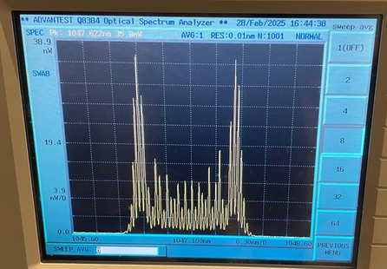
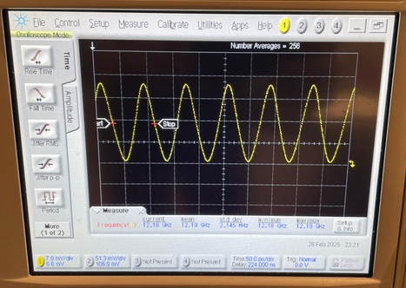
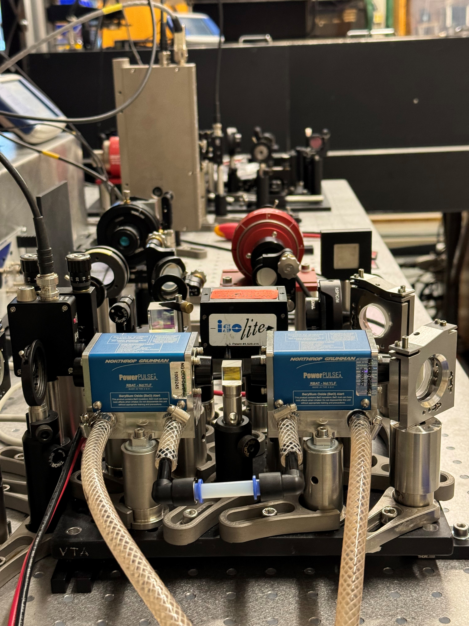
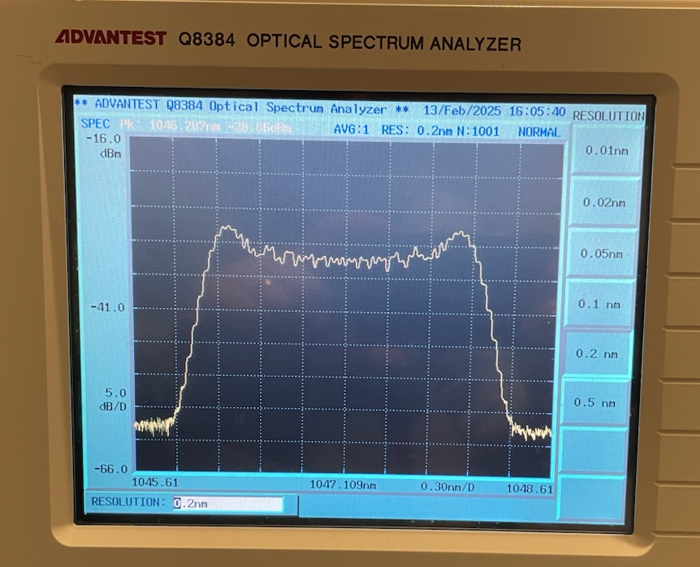
Status CLEAR EO frequency comb development
Courtesy E. Granados
Prototype under construction – currently operating at 12 GHz rep rate, working on the decimation to 1.5 GHz and 3 GHz + amplification + UV conversion
  Variable pulse duration on demand (0.5 - 15 ps), RF locked by construction
  100% of required items already procured – assembly phase
PhD student with Uppsala (Eva Roikova), started 1st April 2024 to integrate the laser into CLEAR
  Integration and commissioning at CLEAR by end of 2025
Will enable full flexibility for exploration of FLASH effect
Synergy with developments for Gamma Factory PoP experiment at SPS and Compton polarimeter for FCC-ee
  Can also produce FCC-ee electron bunch structure
EO Frequency comb demonstrated
12 GHz repetition rate demonstrated

Slide 12
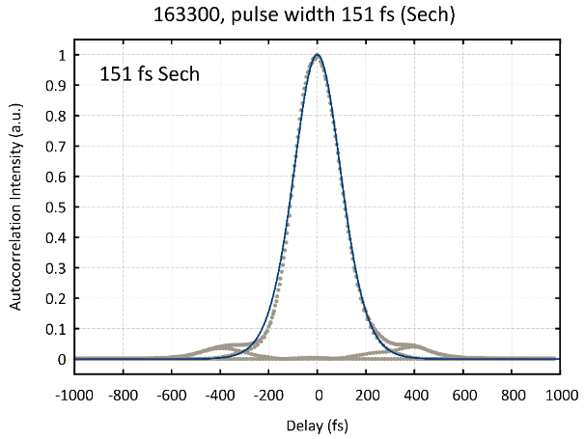
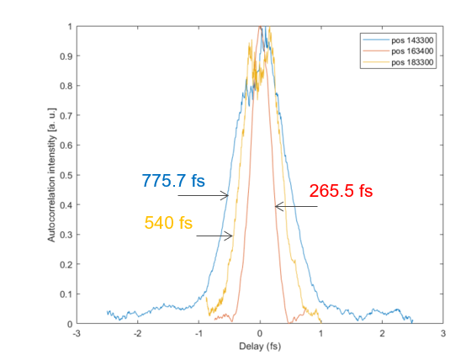
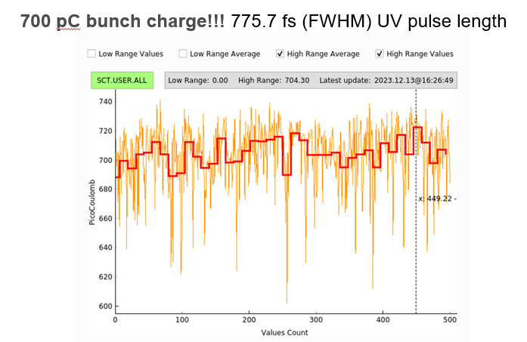
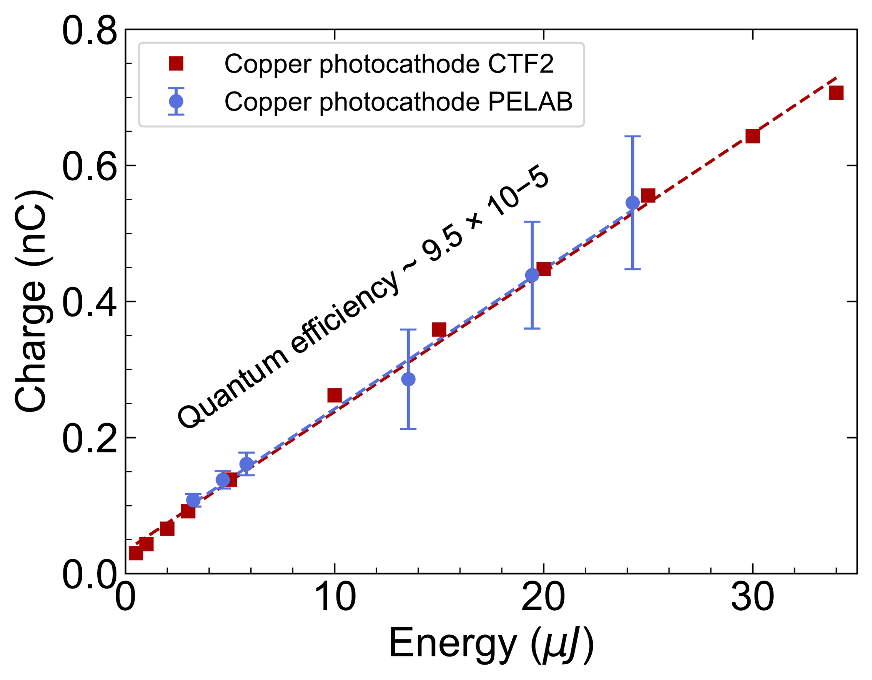
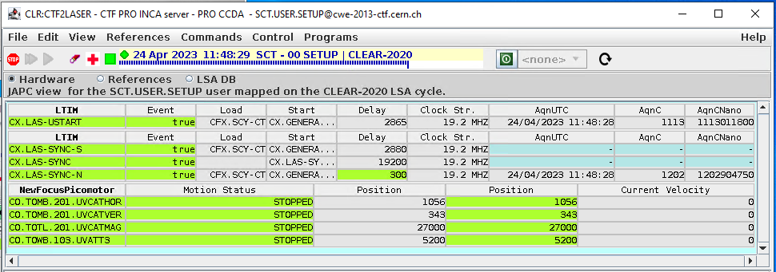
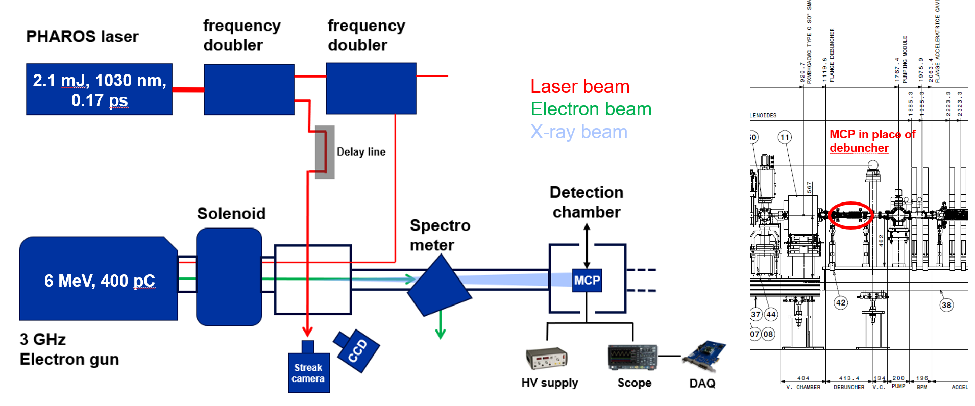
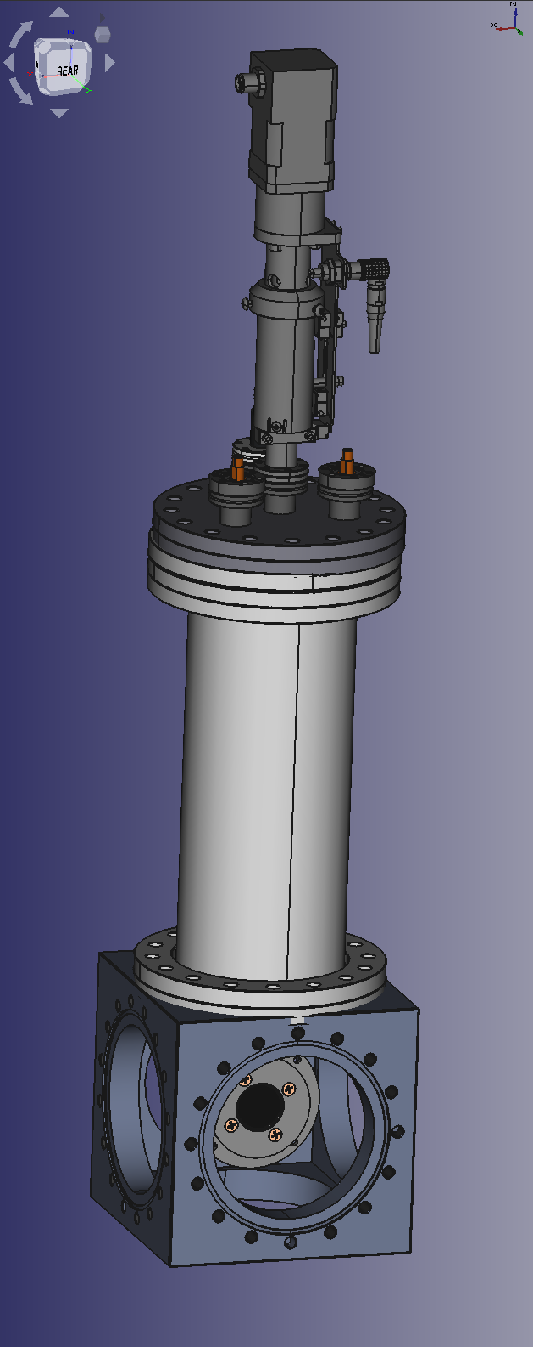
CTF2 laser and e⁻ beamline operation (AWAKE run 2c injector)
Courtesy E. Granados
Locking system and remote controls fully operational, including tunable pulse duration
  Running 24/7 with full remote operation
Inverse Compton Scattering (ICS) experiment in CTF2:
  Laser upgrades in 2024 included commissioning of mJ-class IR beamline for pump-probe experiments
  X-rays observed in Dec. 2024
  -publication in preparation-
=> New class of experiments possible?

Slide 13


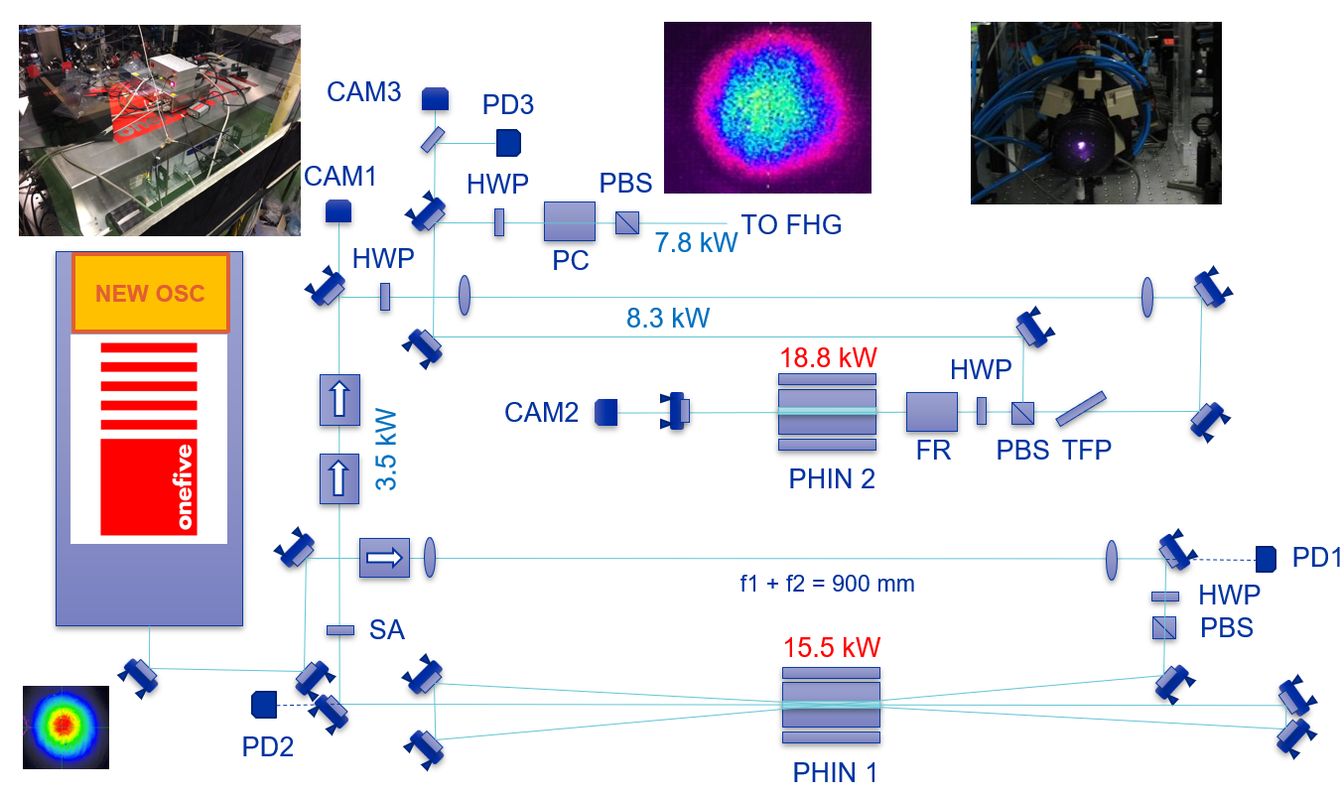
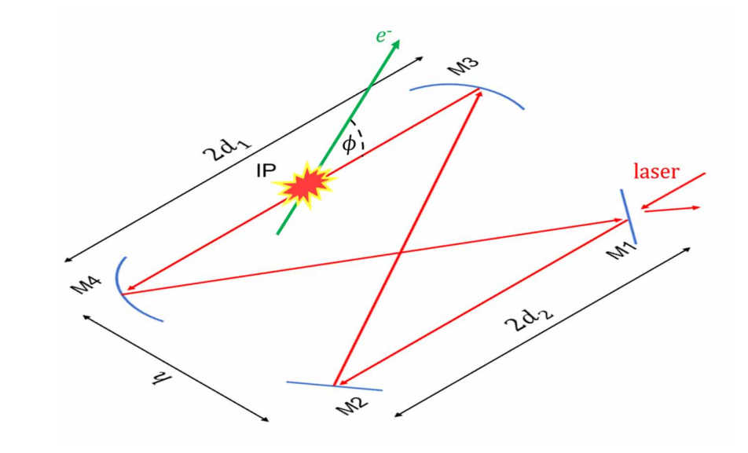
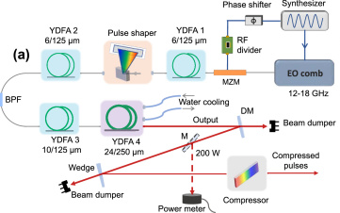
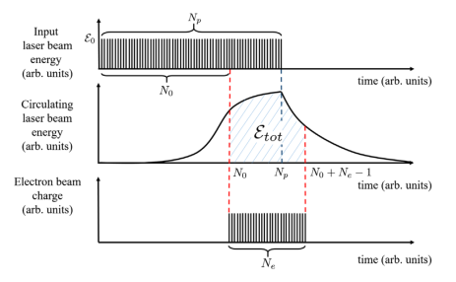
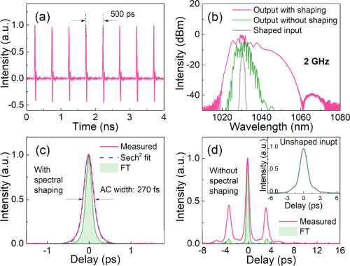

X-rays via inverse Compton scattering at CTF2 / CLEAR
Potential for high-energy, high-flux X-Rays in CLEAR combining developments already ongoing !
Courtesy E. Granados
GHz rep rate Electro-Optic frequency comb
Burst Amplification Chain to > 1 J/train
Burst-mode Fabry-Perot enhancement cavity
Material / Wavelength | Nd:YLF / 1047 nm
Pulse duration / Rep Rate | 4 ps / 1.5 GHz
Pump power (burst) | 20 kW
Train duration | 250 us
# pulses/train | 375,000
Train rep rate | 5 Hz
Average Power | 10 W
Energy/pulse | 5 uJ / pulse
Energy/train | 2 J / train
Phys. Rev. Accel. Beams 21, 121601 (2018)
CTF2:$2×{10}^{10}$ph/s @ 890 eV
CLEAR: 3 $×{10}^{10}$ ph/s @ 740 keV
Opt. Express 30, 10605-10613 (2022)
“An Efficient Optimisation of a Burst Mode-Operated Fabry-Perot Cavity
for Compton Light Sources”, doi:10.18429/JACoW-FLS2023-TU1C1 (2023)

Slide 14
LOOKING AHEAD

Slide 15
Shortage of R&D Test Facilities during CERN LS3
Expecting an increase of CERN internal user requests !
International Test Beam Schedule (from B. Holzer@Chamonix2024 and P. Pelissou@BTTB-SW24)
Compilation by the respective test beam coordinators
  See https://cern.ch/international-facilities
Aim: Rough estimate on available beam time to help the users with the planning
HEP detector R&D mostly performed at CERN, DESY and Fermilab
Last Update July 2024
Running
Winter/Summer Shutdown
Longer Shutdown
Unclear
Likely
Pending Approval
 | 2024 |  |  |  |  |  |  |  |  |  |  |  | 2025 |  |  |  |  |  |  |  |  |  |  |  | 2026 |  |  |  |  |  |  |  |  |  |  |  | 2027 |  |  |  |  |  |  |  |  |  |  |  | 2028 |  |  |  |  |  |  |  |  |  |  |  | 2029 |  |  |  |  |  |  |  |  |  |  |  | 2030 |  |  |  |  |  |  |  |  |  |  |  | 2031
 | J | F | M | A | M | J | J | A | S | O | N | D | J | F | M | A | M | J | J | A | S | O | N | D | J | F | M | A | M | J | J | A | S | O | N | D | J | F | M | A | M | J | J | A | S | O | N | D | J | F | M | A | M | J | J | A | S | O | N | D | J | F | M | A | M | J | J | A | S | O | N | D | J | F | M | A | M | J | J | A | S | O | N | D | J | F | M | A | M | J | J | A | S | O | N | D
DESY II Test Beam Facility | 2 | 1 | 1 | 1 | 1 | 1 | 1 | 1 | 1 | 1 | 1 | 1 | 2 | 1 | 1 | 1 | 1 | 1 | 1 | 1 | 1 | 1 | 1 | 1 | 2 | 1 | 1 | 1 | 1 | 1 | 1 | 1 | 1 | 1 | 1 | 1 | 2 | 1 | 1 | 1 | 1 | 1 | 1 | 1 | 1 | 1 | 1 | 1 | 2 | 1 | 1 | 1 | 1 | 1 | 1 | 1 | 1 | 1 | 1 | 1 | 2 | 1 | 1 | 1 | 1 | 1 | 1 | 1 | 1 | 1 | 1 | 1 | 2 | 3 | 3 | 3 | 3 | 3 | 3 | 3 | 3 | 3 | 3 | 3 | 3 | 3 | 3 | 3 | 3 | 3 | 3 | 3 | 3 | 3 | 3 | 3
CERN SPS North Area | 2 | 2 | 2 | 1 | 1 | 1 | 1 | 1 | 1 | 1 | 1 | 2 | 2 | 2 | 2 | 1 | 1 |  |  |  |  |  | 1 | 2 | 2 | 4 | 1 | 1 | 1 | 1 | 1 | 1 | 3 | 3 | 3 | 3 | 3 | 3 | 3 | 3 | 3 | 3 | 3 | 3 | 3 | 3 | 3 |  | 3 | 3 | 3 | 3 | 3 | 3 | 3 | 3 | 3 | 3 | 3 | 3 | 3 | 3 | 3 | 3 | 3 | 3 | 3 | 1 | 1 | 1 | 1 | 2 | 2 | 2 | 2 | 2 | 1 | 1 | 1 | 1 | 1 | 1 | 1 | 2 | 2 | 2 | 2 | 2 | 1 | 1 | 1 | 1 | 1 | 1 | 1 | 2
CERN PS East Area | 2 | 2 | 2 | 1 | 1 | 1 | 1 | 1 | 1 | 1 | 1 | 2 | 2 | 2 | 2 | 1 | 1 | 1 | 1 | 1 | 1 | 1 | 1 | 2 | 2 | 4 | 1 | 1 | 1 | 1 | 1 | 1 | 3 | 3 | 3 | 3 | 3 | 3 | 3 | 3 | 3 | 3 | 3 | 3 | 3 | 3 | 3 | 3 | 3 | 3 | 3 | 3 | 3 | 3 | 3 | 1 | 1 | 1 | 1 | 2 | 2 | 2 | 2 | 1 | 1 | 1 | 1 | 1 | 1 | 1 | 1 | 2 | 2 | 2 | 2 | 1 | 1 | 1 | 1 | 1 | 1 | 1 | 1 | 2 | 2 | 2 | 2 | 1 | 1 | 1 | 1 | 1 | 1 | 1 | 1 | 2
Fermilab | 1 | 1 | 1 | 1 | 1 | 1 | 2 | 2 | 2 | 2 | 1 | 1 | 1 | 1 | 1 | 1 | 1 | 1 | 2 | 2 | 2 | 2 | 1 | 1 | 1 | 1 | 1 | 1 | 1 | 1 | 2 | 2 | 2 | 1 | 1 | 1 | 3 | 3 | 3 | 3 | 3 | 3 | 3 | 3 | 3 | 3 | 3 | 3 | 3 | 3 | 3 | 3 | 3 | 3 | 3 | 3 | 3 | 3 | 3 | 3 | 3 | 3 | 3 | 3 | 3 | 3 | 3 | 3 | 3 | 3 | 3 | 3 | 3 | 3 | 3 | 3 | 3 | 3 | 3 | 1 | 1 | 1 | 1 | 1 | 1 | 1 | 1 | 1 | 1 | 1 | 2 | 2 | 2 | 2 | 1 | 1
PITZ (22MeV) | 1 | 1 | 1 | 1 | 1 | 1 | 1 | 1 | 1 | 1 | 1 | 1 | 1 | 1 | 1 | 1 | 1 | 1 | 1 | 1 | 1 | 1 | 1 | 1 |  | 1 | 1 | 1 | 1 | 1 | 1 | 1 | 1 | 1 | 1 | 1 | 5 | 5 | 5 | 5 | 5 | 5 | 5 | 5 | 5 | 5 | 5 | 5 | 5 | 5 | 5 | 5 | 5 | 5 | 5 | 5 | 5 | 5 | 5 | 5 | 5 | 5 | 5 | 5 | 5 | 5 | 5 | 5 | 5 | 5 | 5 | 5
SLAC |  |  |  |  |  |  |  |  |  | 2 | 2 | 2 | 4 | 4 | 4 | 4 | 4 | 3 | 3 | 3 | 3 | 3 | 3 | 3 | 3 | 3 | 3 | 3 | 3 | 3 | 3 | 3 | 3 | 3 | 6 | 6 | 6 | 6 | 6 | 6 | 6 | 6 | 2 | 6 | 6 | 6 | 6 | 2 | 6 | 6 | 6 | 6 | 6 | 6 | 2 | 6 | 6 | 6 | 6 | 2 | 6 | 6 | 6 | 6 | 6 |  | 2 |  |  |  |  | 2 |  |  |  |  |  |  | 2 |  |  |  |  | 2 |  |  |  |  |  |  | 2 |  |  |  |  | 2
CLEAR | 2 | 2 | 1 | 1 | 1 | 1 | 1 | 1 | 1 | 1 | 1 | 1 | 2 | 2 | 1 | 1 | 1 | 1 | 1 | 1 | 1 | 1 | 1 | 1 | 2 | 2 | 1 | 1 | 1 | 1 | 1 | 1 | 1 | 1 | 1 | 1 | 2 | 2 | 1 | 1 | 1 | 1 | 1 | 1 | 1 | 1 | 1 | 1 | 2 | 2 | 1 | 1 | 1 | 1 | 1 | 1 | 1 | 1 | 1 | 1 | 2 | 2 | 1 | 1 | 1 | 1 | 1 | 1 | 1 | 1 | 1 | 1 | 2 | 2 | 1 | 1 | 1 | 1 | 1 | 1 | 1 | 1 | 1 | 1 | 4 | 4 | 4 | 4 | 4 | 4 | 4 | 4 | 4 | 4 | 4 | 4
PARTREC Groningen | 2 | 2 | 2 | 2 | 2 | 1 | 2 | 2 | 2 | 1 | 1 | 2 | 2 | 2 | 1 | 1 | 1 | 1 | 2 | 2 | 2 | 1 | 1 | 2 | 2 | 2 | 1 | 1 | 1 | 1 | 2 | 2 | 2 | 1 | 1 | 2 | 2 | 2 | 1 | 1 | 1 | 1 | 2 | 2 | 2 | 1 | 1 | 2 | 2 | 2 | 1 | 1 | 1 | 1 |  | 2 | 2 | 1 | 1 | 2 | 2 | 2 | 1 | 1 | 1 | 1 | 2 | 2 | 2 | 1 | 1 | 2 | 2 | 2 | 1 | 1 | 1 | 1 | 2 | 2 | 2 | 1 | 1 | 2 | 2 | 2 | 1 | 1 | 1 | 1 | 2 | 2 | 2 | 1 | 1 | 2
DESY ARES | 2 | 1 | 1 | 1 | 1 | 1 | 1 | 1 | 1 | 1 | 1 | 2 | 2 | 1 | 1 | 1 | 1 | 1 | 1 | 1 | 1 | 1 | 1 | 2 | 2 | 1 | 1 | 1 | 1 | 1 | 1 | 1 | 1 | 1 | 1 | 1
PSI (HIPA) | 2 |  |  |  |  |  |  |  |  |  |  |  | 2 |  |  |  |  |  |  |  |  |  |  |  | 2 |  |  |  |  |  |  |  |  |  |  |  | 2 |  |  |  |  |  |  |  |  |  |  |  | 2
KEK(PF-AR) | 2 | 1 | 1 |  | 1 | 1 | 2 | 2 | 2 | 1 | 1 | 1 | 2 | 1 | 1 |  | 1 | 1 | 2 | 2 | 2 | 1 | 1 | 1 | 2 | 1 | 1 |  | 1 | 1 | 2 | 2 | 2 | 1 | 1 | 1 | 2 | 1 | 1 |  | 1 | 1 | 2 | 2 | 2 | 1 | 1 | 1 | 2 | 1 | 1 |  | 1 | 1 | 2 | 2 | 2 | 1 | 1 | 1 | 2 | 1 | 1 |  | 1 | 1 | 2 | 2 | 2 | 1 | 1 | 1 | 2 | 1 | 1 |  | 1 | 1 | 2 | 2 | 2 | 1 | 1 | 1 | 2 | 1 | 1 |  | 1 | 1 | 2 | 2 | 2 | 1 | 1 | 1
Other CERN
Facilities
CLEAR
Note: till today, CLEAR has been marginally used for Detectors R&D
  Might become relevant to bridge over LS3+, when most facilities will be in shutdown
  CLEAR might be missing “low intensity” capabilities
    Independent testing of low intensity beams (down to single electron) ongoing in 2024/25

Slide 16
LS3: Challenges and Opportunities
From mid 2026, CLEAR will be one the very few accelerator operating at CERN
Challenges:
  Disruption to key services (water, controls, power, etc.) are to be expected
    Nonetheless, experience from LS1/2 was overall positive
  No operator (OP) support from CCC for access control and overnight supervision
    Access will need to be handled by the CLEAR team (as during LS2)
    Discussions ongoing to implement a local access control (though unlikely before LS3)
  This may lead to a slight reduction in operation efficiency
Opportunities:
  Potential support from OP resources for long-awaited infrastructure consolidation, such as:
    Developing FESA classes, additional control tools for automation and parametric control (LSA?)
    Deploying automatic Performance and Fault Tracking (e.g. using BPT and AFT?)
    Updating facility documentation
  A formal request has been submitted to the OP group
  Efficient Particle Accelerator (EPA) project: strong interest in using CLEAR as testbed for AI/ML tools
    Informal request received for several “MD-like” sessions during LS3

Slide 17
FURTHER IN THE FUTURE

Slide 18
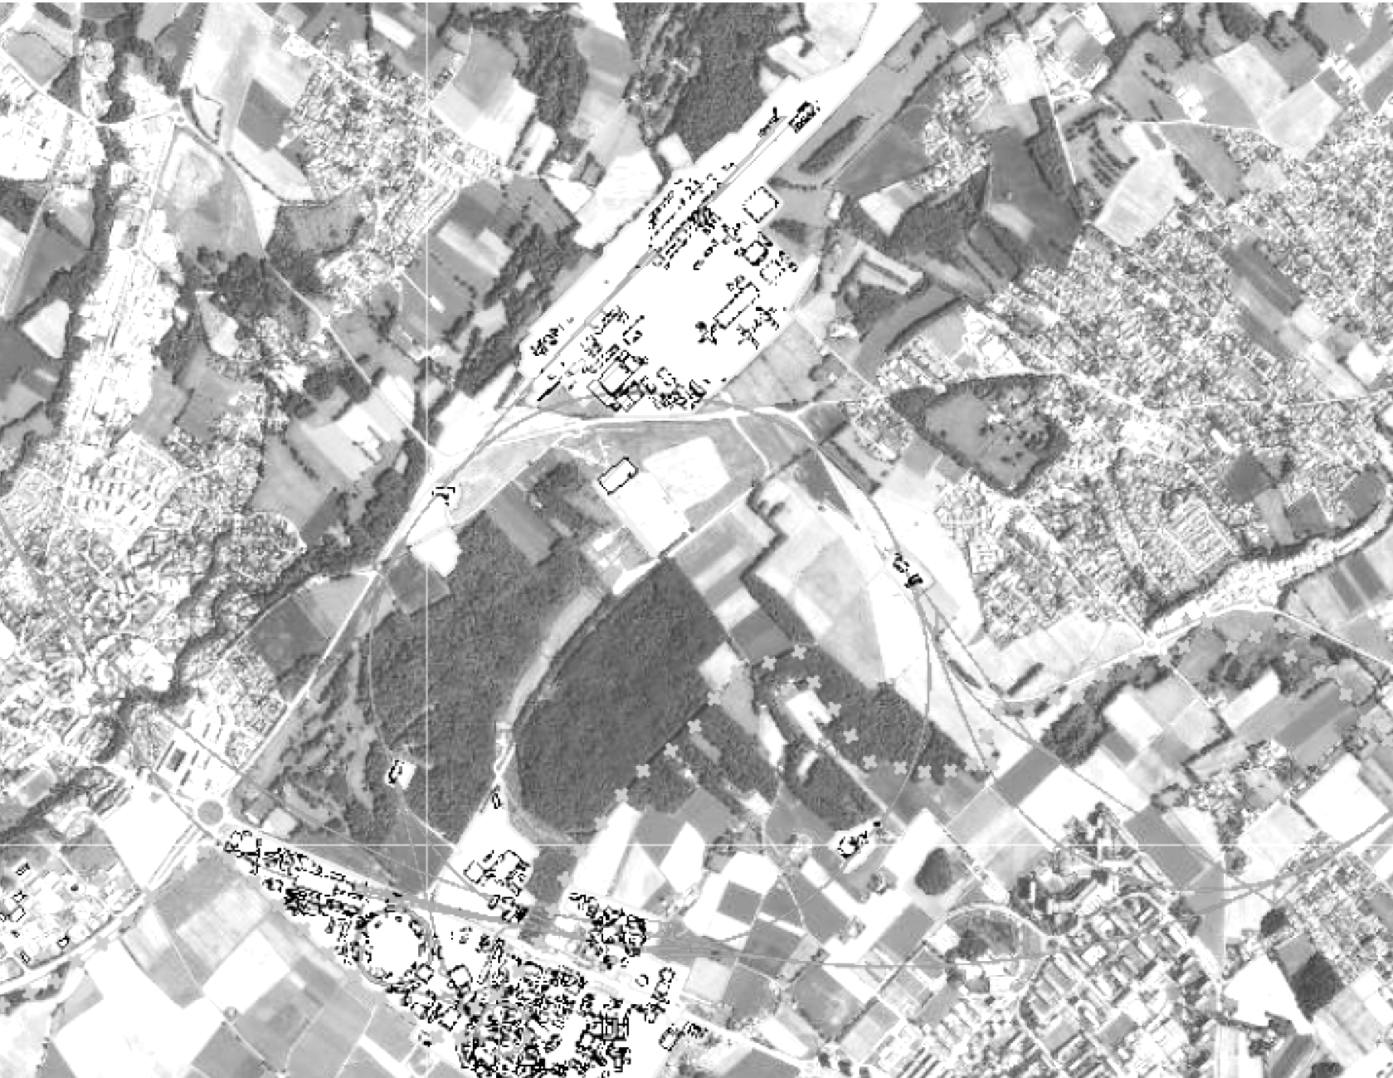
FCC-ee Complex and its Injector
Injector design and sitting still evolving:
LINACs & damping ring on Prevessin site
(Previous) layout(s) show here:
Transfer to SPS BA4
1 beam through SPS tunnel
1 beam through TT40/TI8
  (can also send beam toward AWAKE)
In general, size/challenges of such a complex are not comparable to CLEAR
FCC-ee pre-injector
Baseline option
SPS
FCC
AWAKE
final energy: 16 GeV
LHC
1.54 GeV
CLEAR
final energy: 20 GeV
1.54 GeV
Option 2 is the present baseline
1.54 GeV
Parts of this slides from H. Bartosik @ PBCWS2024

Slide 19
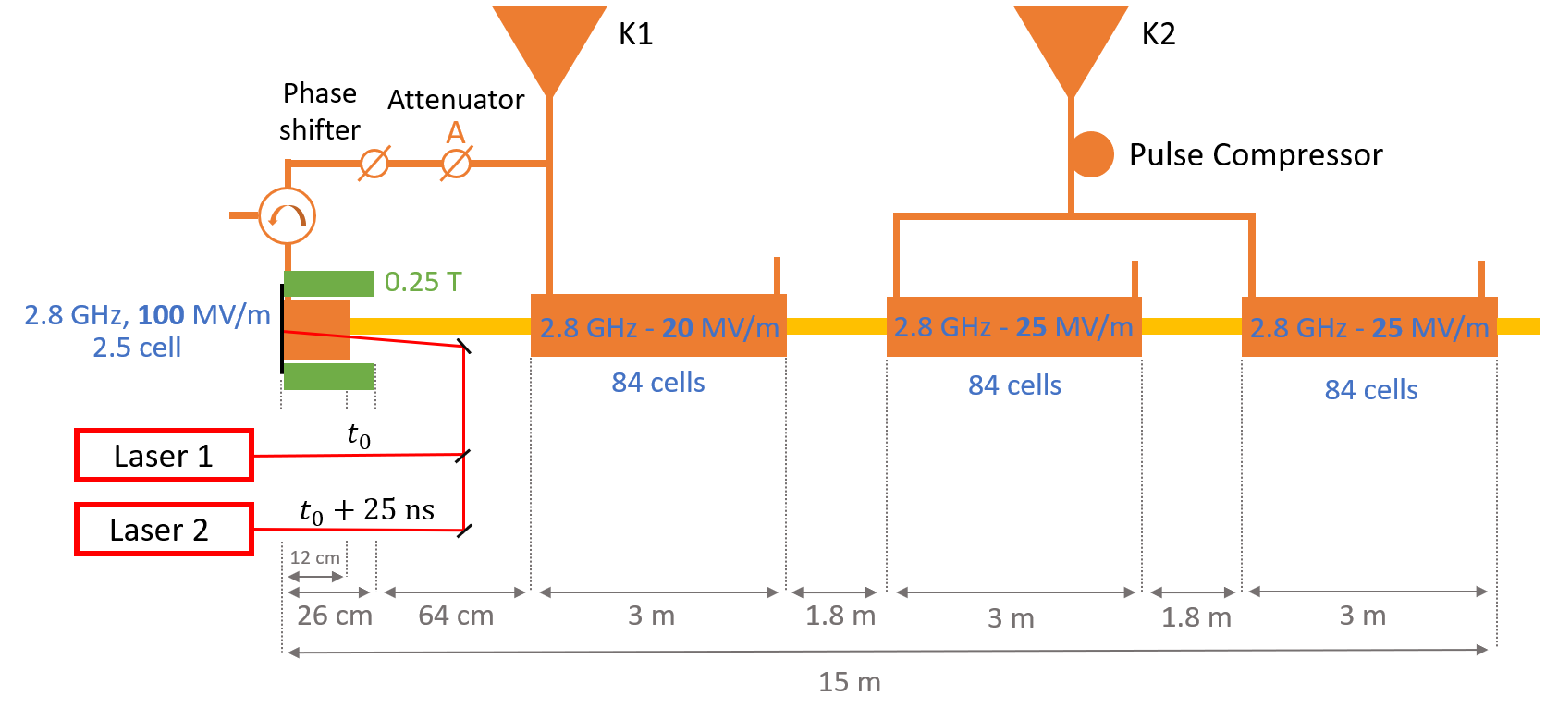
FCC-ee Electron Source Frontend
No surprise that FCC-ee front end not very different than CLEAR one
CLEAR/CTF2 have expertise and space adapted to test prototypes of key components
2(or 4)-bunches production logic as
FCC-ee could be tested at CLEAR
Ideas to prototype 2.8 GHz modules
being explored by SY-RF
CLEAR can be a test bed for tools/techniques for beam properties characterisation
CLEAR:
200 MeV
1 nC/bunch
σ_{z} = 1 mm
σ_{δ} = 0.2 %
ε_{N} < 20 μm
200 MeV
5 nC/bunch
σ_{z} = 1 mm
σ_{δ} = 0.2 %
ε_{N} < 4 μm
From P. Craievich @ FCC-Week-2024
Design by Zdenek Vostrel and Steffen Doebert documented in NIMA2024.169261

Slide 20
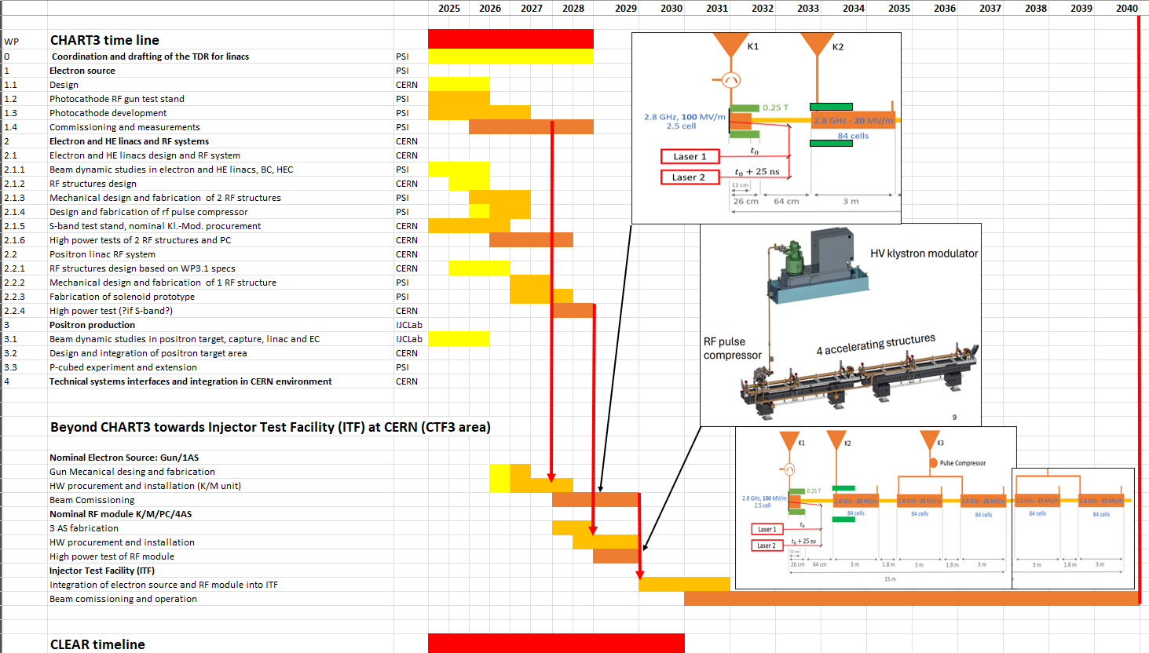

An Injector Test Facility (ITF) in the CTF3 DB LINAC?
Idea being explored by SY-RF
Motivations:
Enable high-energy (70–300 MeV) beam tests: emittance, energy spread, breakdown effects
Demonstrate full RF module performance (BDR, beam loading, control systems)
Provide testbed for BI, LLRF, and system integration in CERN environment
Support FCC-ee and other future Higgs factory needs (CLIC, LEP3, ILC@CERN)
Possible impact on CLEAR:
Potential for resources and infrastructure consolidation
Long-term availability of an additional(?) beam with CLEAR-like specs
  Seeding a future user community?
?
Courtesy A. Grudiev

Slide 21
Conclusions
Following the recent extension of CLEAR operations, the facility is receiving long-awaited infrastructure upgrades and attention
  Major hardware consolidations are ongoing or planned — notably in the RF and laser systems — to ensure reliability and continuity through 2030
  The new laser system and upcoming beamline will significantly enhance the facility’s capabilities and open the door to new classes of experiments
CLEAR is a versatile testbed, especially during LS3, supporting local developments in beam instrumentation, beam control tools/techniques, and diagnostics
  LS3 may offer the possibility to attract additional resources, including operational (OP) support
Requests from internal users are expected to increase, along with growing interest and synergies with FCC-ee
  The idea of a CERN-hosted integration facility for an FCC-ee-like injector is gaining traction
CLEAR is well positioned to serve as a flexible, high-impact facility for
beam-based R&D in the coming years
Thanks for your attention, comments, and support !

Slide 22
APPENDIX

Slide 23
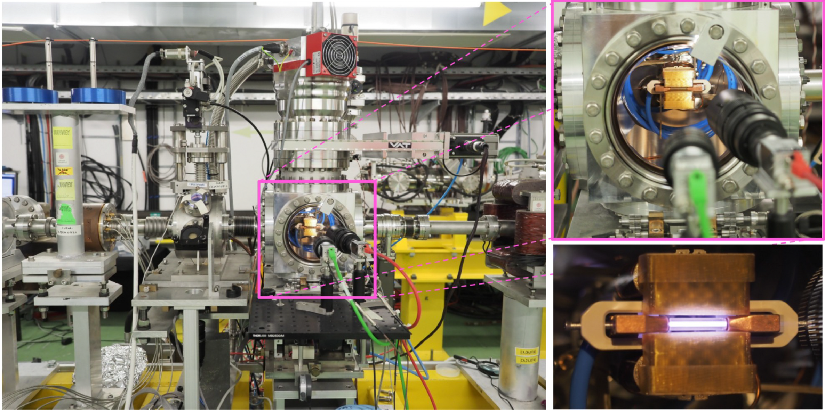
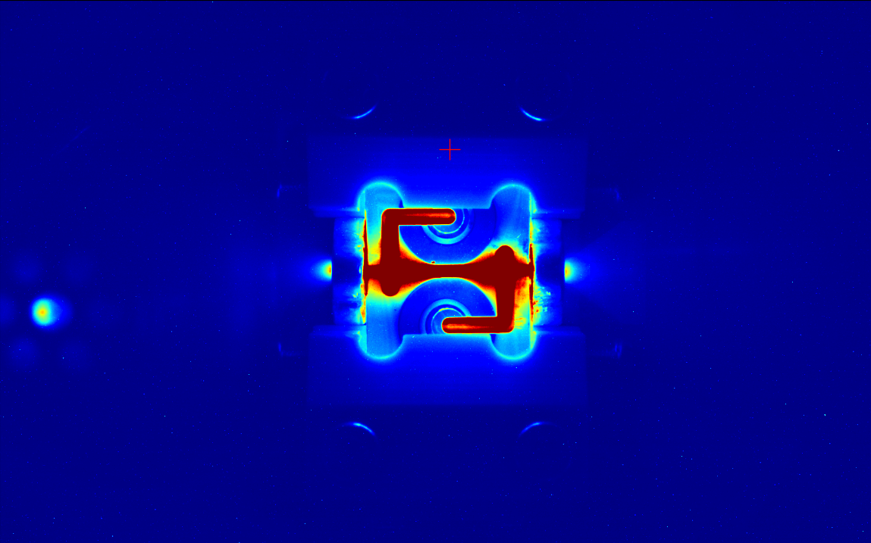
Investing more toward plasma-components R&D?
CLEAR (and AWAKE) is the only existing opportunities at CERN
Probably not enough resources invested so far internally, but steady activity from Oslo
Courtesy K. N. Sjobaek

Slide 24
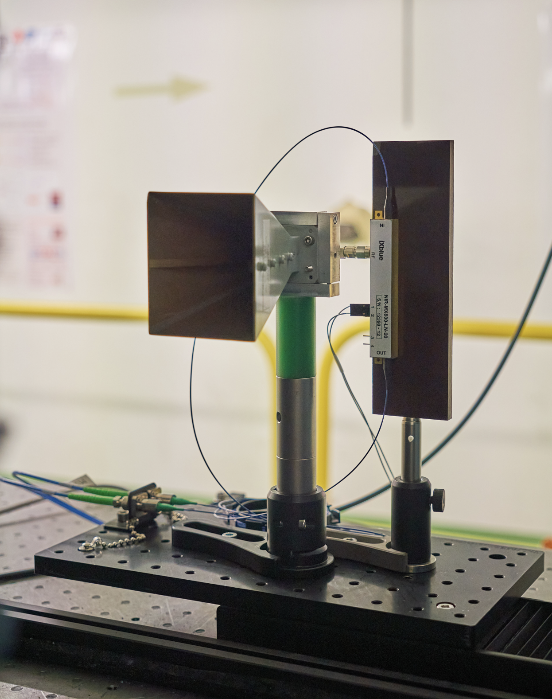
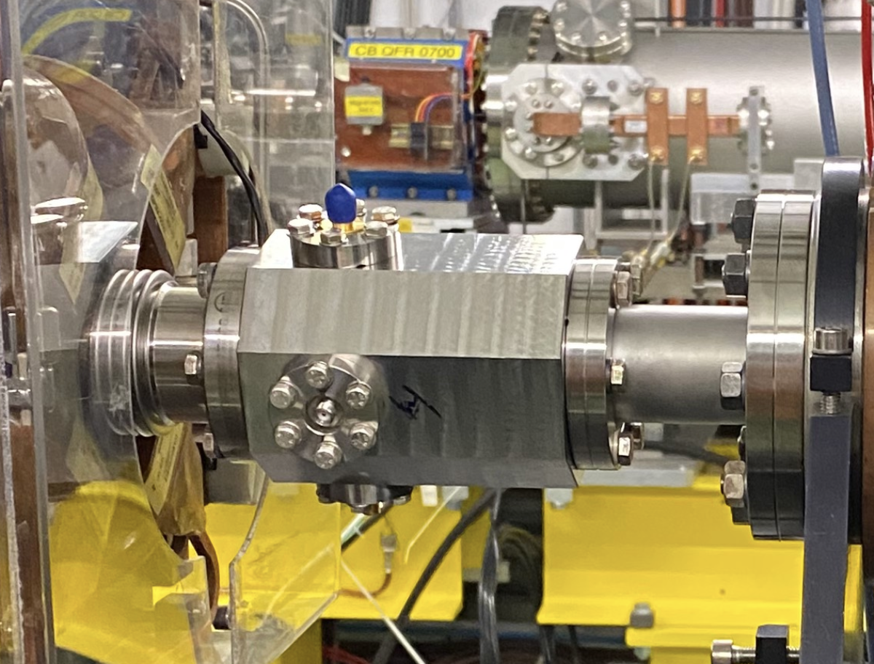
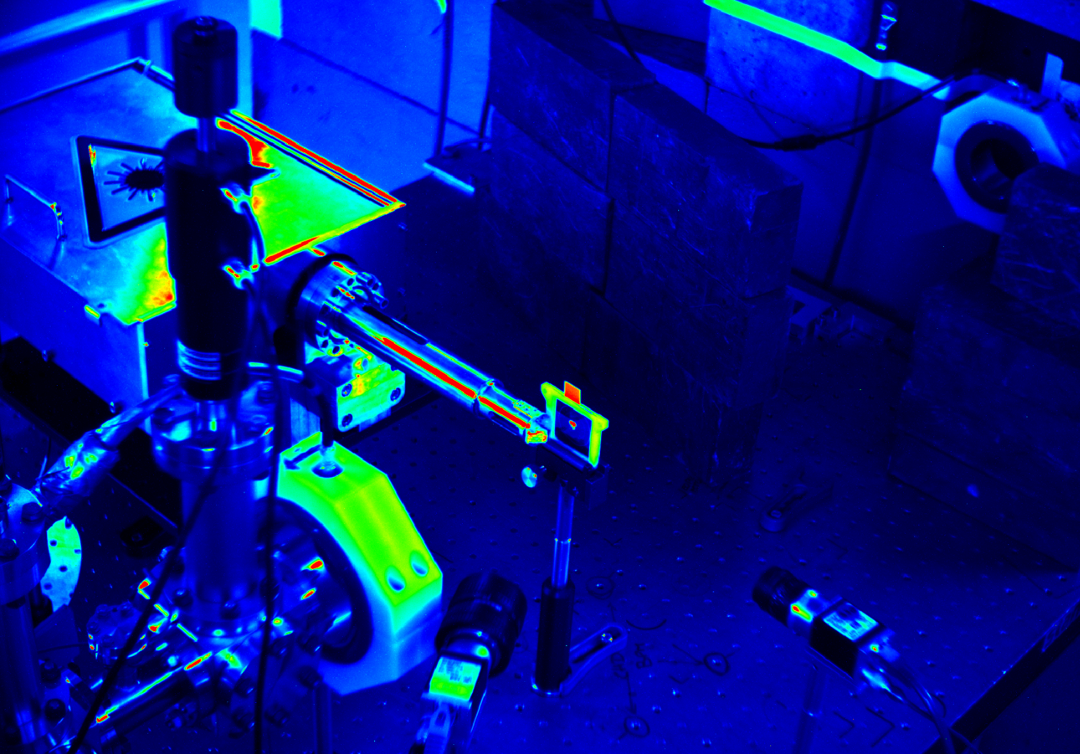
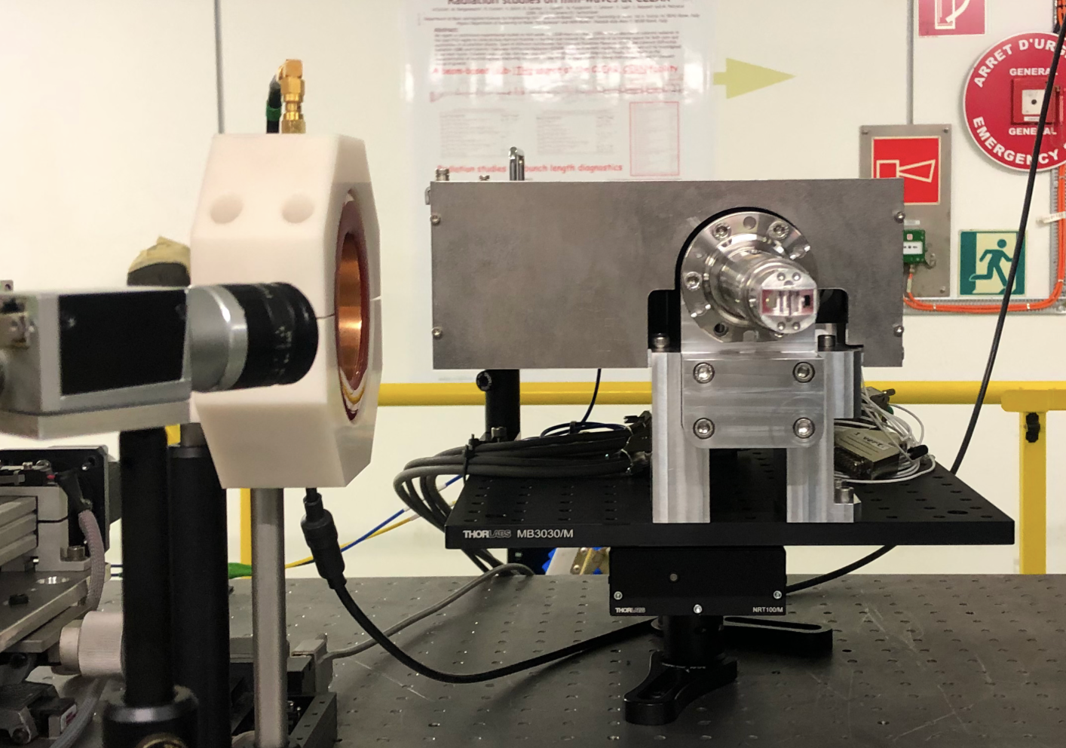
Present CLEAR Contributions to FCC-ee
Beam-Diagnostics experiments done
by CERN & external institutes, usually in collaboration
Coherent Cherenkov diffraction radiation dielectric buttons
(FCC-ee bunch length monitors)
Broadband Pick-up for the
PSI Positron Production Project
(P³ - FCC-ee collaboration)
Bunch Profile Monitor for FCC-ee (KIT - Karlsruhe)
Not yet materialized:
Damage test of positron target materials (CERN/STI – M. Calviani, A. P. Marcone)
➯ discussion ongoing on the program, including positron detection, etc…
Others??

Slide 25
Prototyping of LINACs Control Technology
Most of CERN injector complex is based on “low” frequency RF, low-rep-rate machines and has developed associated technology to ensure their reliable operation
CTF3 before, and now CLEAR (and AWAKE) are depositary of high-frequency (up to X-band), and high-rep rate (up to 50/100 Hz) accelerator/beam control technology
CLEAR is the ideal test bed to deploy future technologies relevant to any Higgs Factory:
  White rabbit timing distribution (they don’t seem to be interested, yet – see EDMS#3088857)
  Test of new generation ADCs cards for fast digitisers (see AOS-3601)
  New generation of Digital Cameras for BTVs (and associated controls)
  Possibly many other systems, e.g. new LLRF components/controls, new transfer lines BPMs, …
  BONUS:
    Consolidation of CLEAR infrastructure with benefit to maintainability and reliability
    Low impact/risk of downtime/damages in case of failure of technology under test
CLEAR is the ideal test bed for new operation paradigm for LINACs, e.g. using Machine Learning models:
  Some AI-based experiment done in the past, e.g. Imaging experiment by G. Trad
  Presently working on an AI-based “energy-predictor” by A. Gilardi
  Discussions ongoing with the Data Science for Beam Operation (BE-CCS-DSB) section

Slide 26
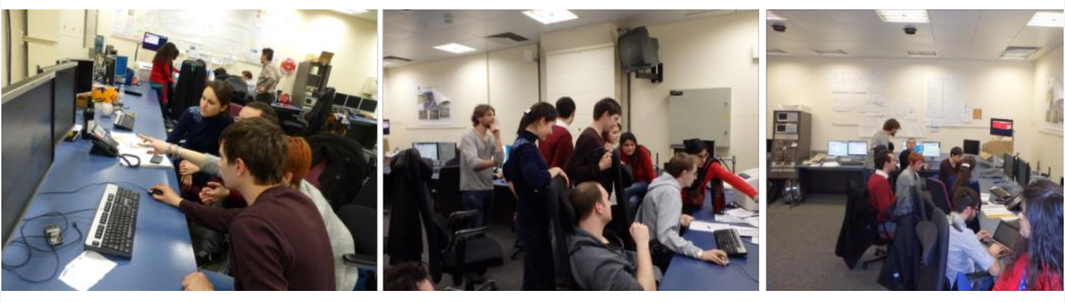
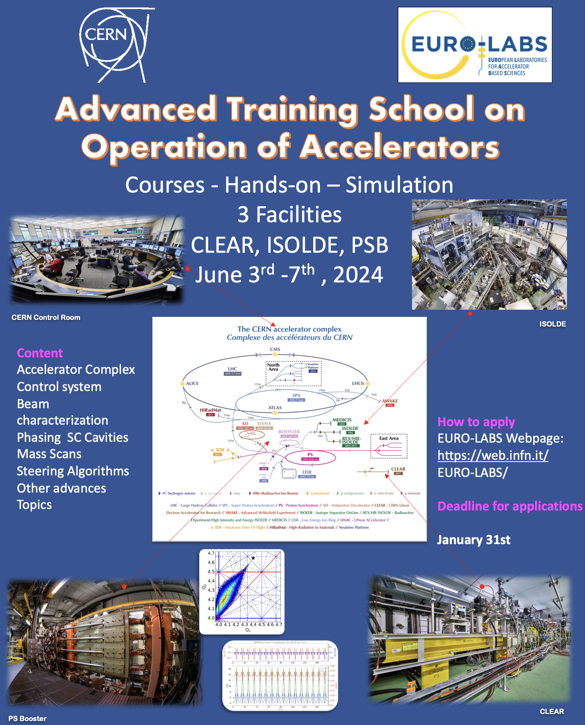

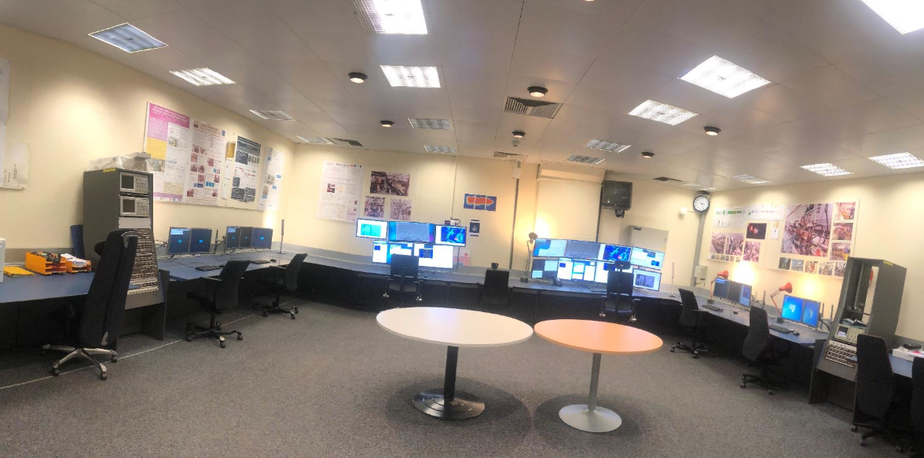
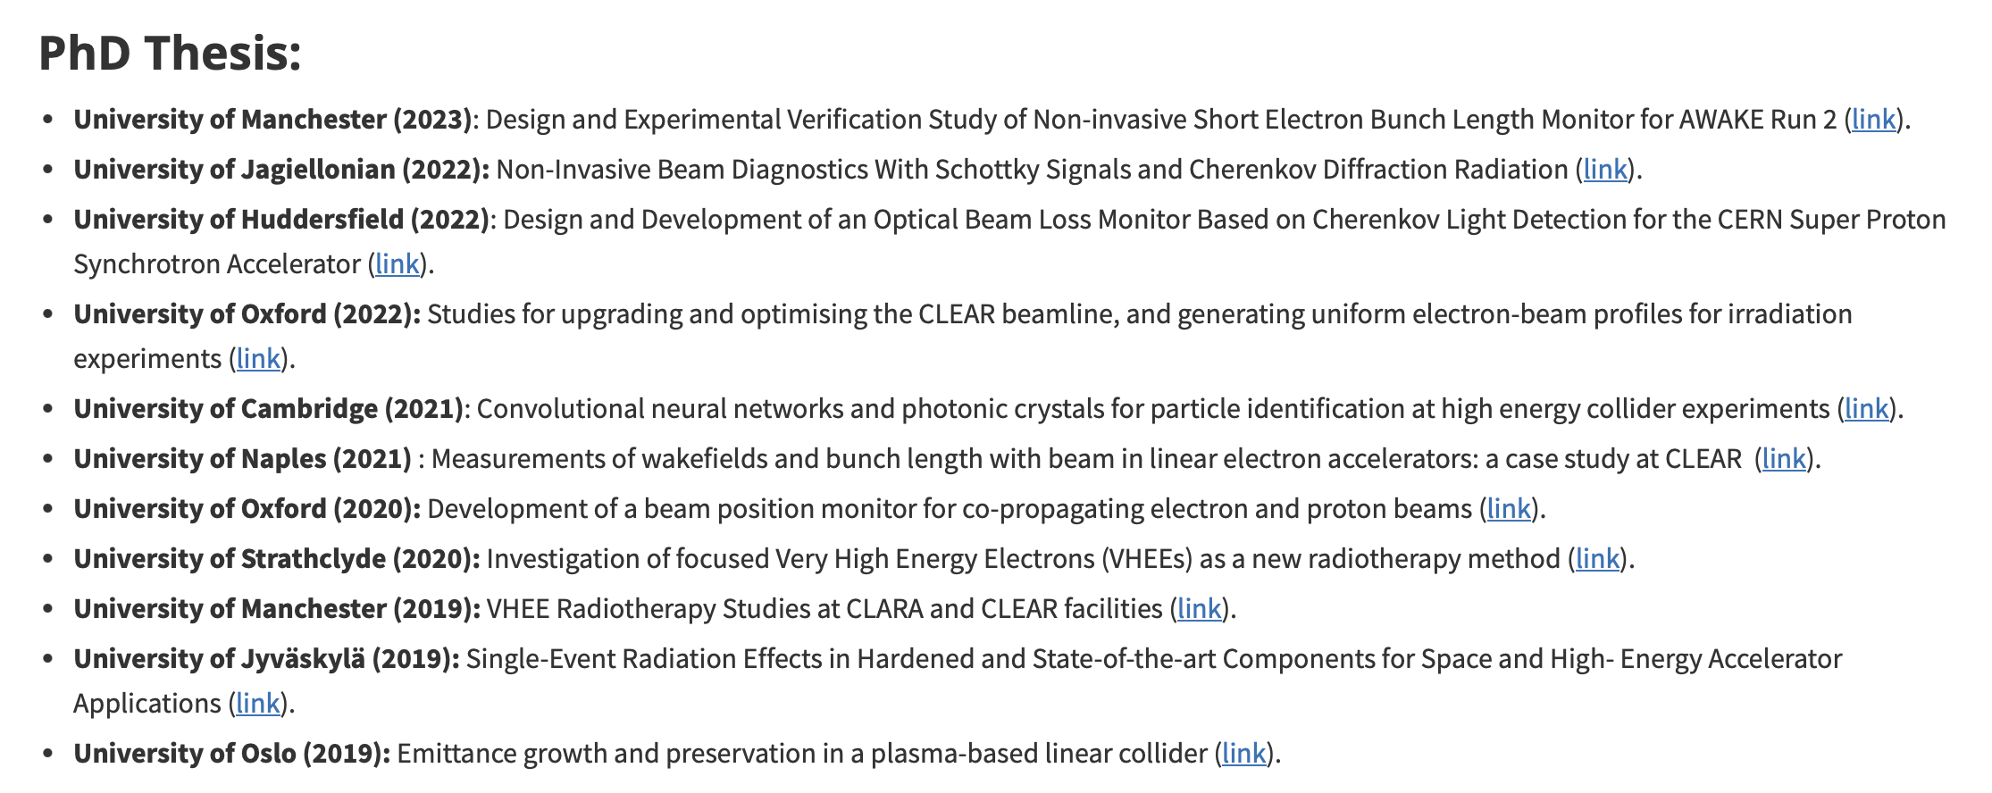
High Demand for Training Opportunities
Hands-on training (JUAS, EURO-LABS)
Hosting Trainees, Summer/Technical and
PhD students, Fellows, Associates…
Possible to develop specific trainings for people involved in future e⁻ machine design/operation !
Contributed to more than 10 PhD thesis in the last 5 years!

Slide 27
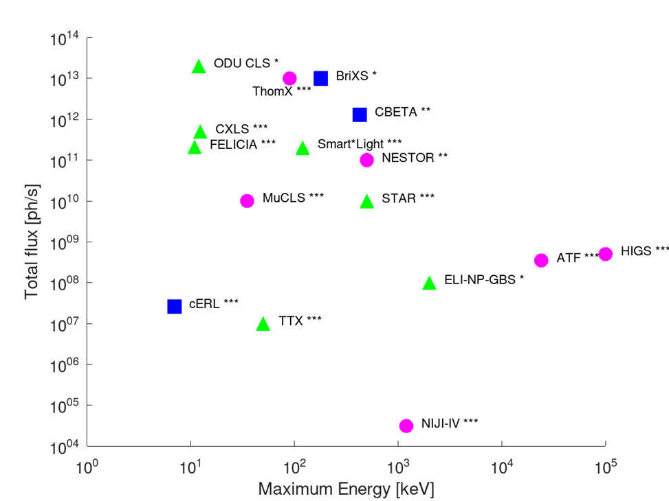
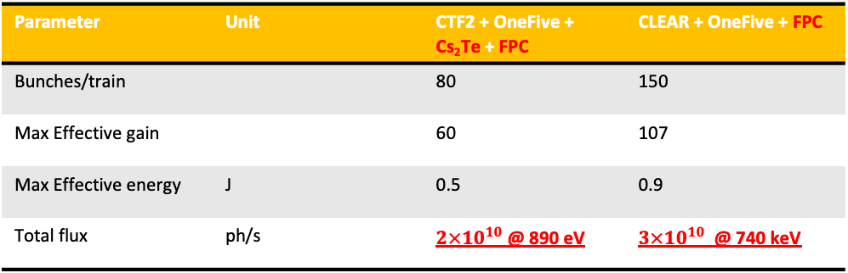
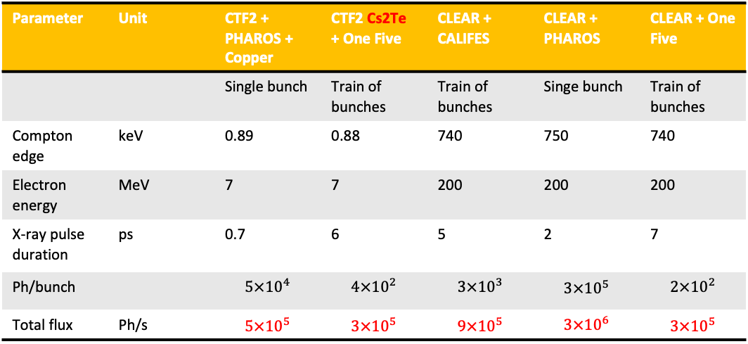
Impact on ICS @ CLEAR
Storage Ring
Linac
ERL
* Design
** Under commissioning
*** Existing
Parameter | Unit | CTF2 + PHAROS + Copper | CTF2 Cs2Te + One Five | CLEAR + CALIFES | CLEAR + PHAROS | CLEAR + One Five
 |  | Single bunch | Train of bunches | Train of bunches | Singe bunch | Train of bunches
Compton edge | keV | 0.89 | 0.88 | 740 | 750 | 740
Electron energy | MeV | 7 | 7 | 200 | 200 | 200
X-ray pulse duration | ps | 0.7 | 6 | 5 | 2 | 7
Ph/bunch |  | $$5×{10}^{4}$$ | $$4×{10}^{2}$$ | $$3×{10}^{3}$$ | $$3×{10}^{5}$$ | $$2×{10}^{2}$$
Total flux | Ph/s | $$5×{10}^{5}$$ | $$3×{10}^{5}$$ | $$9×{10}^{5}$$ | $$3×{10}^{6}$$ | $$3×{10}^{5}$$
FPC
FPC
CTF2
CLEAR
Parameter | Unit | CTF2 + OneFive + Cs₂Te + FPC | CLEAR + OneFive + FPC
Bunches/train |  | 80 | 150
Max Effective gain |  | 60 | 107
Max Effective energy | J | 0.5 | 0.9
Total flux | ph/s | $2×{10}^{10}$ @ 890 eV | $3×{10}^{10}$ @ 740 keV
“Water window”
gamma beams
Without Fabry-Perot cavity (FPC), ICS experiment doomed to have very low flux.
FPC requires EO comb as front-end of laser system to be effective.
Multi-step approach possible but tied to one option from the beginning.
Acknowledgement: Vlad Musat, Andrea Latina

Slide 28
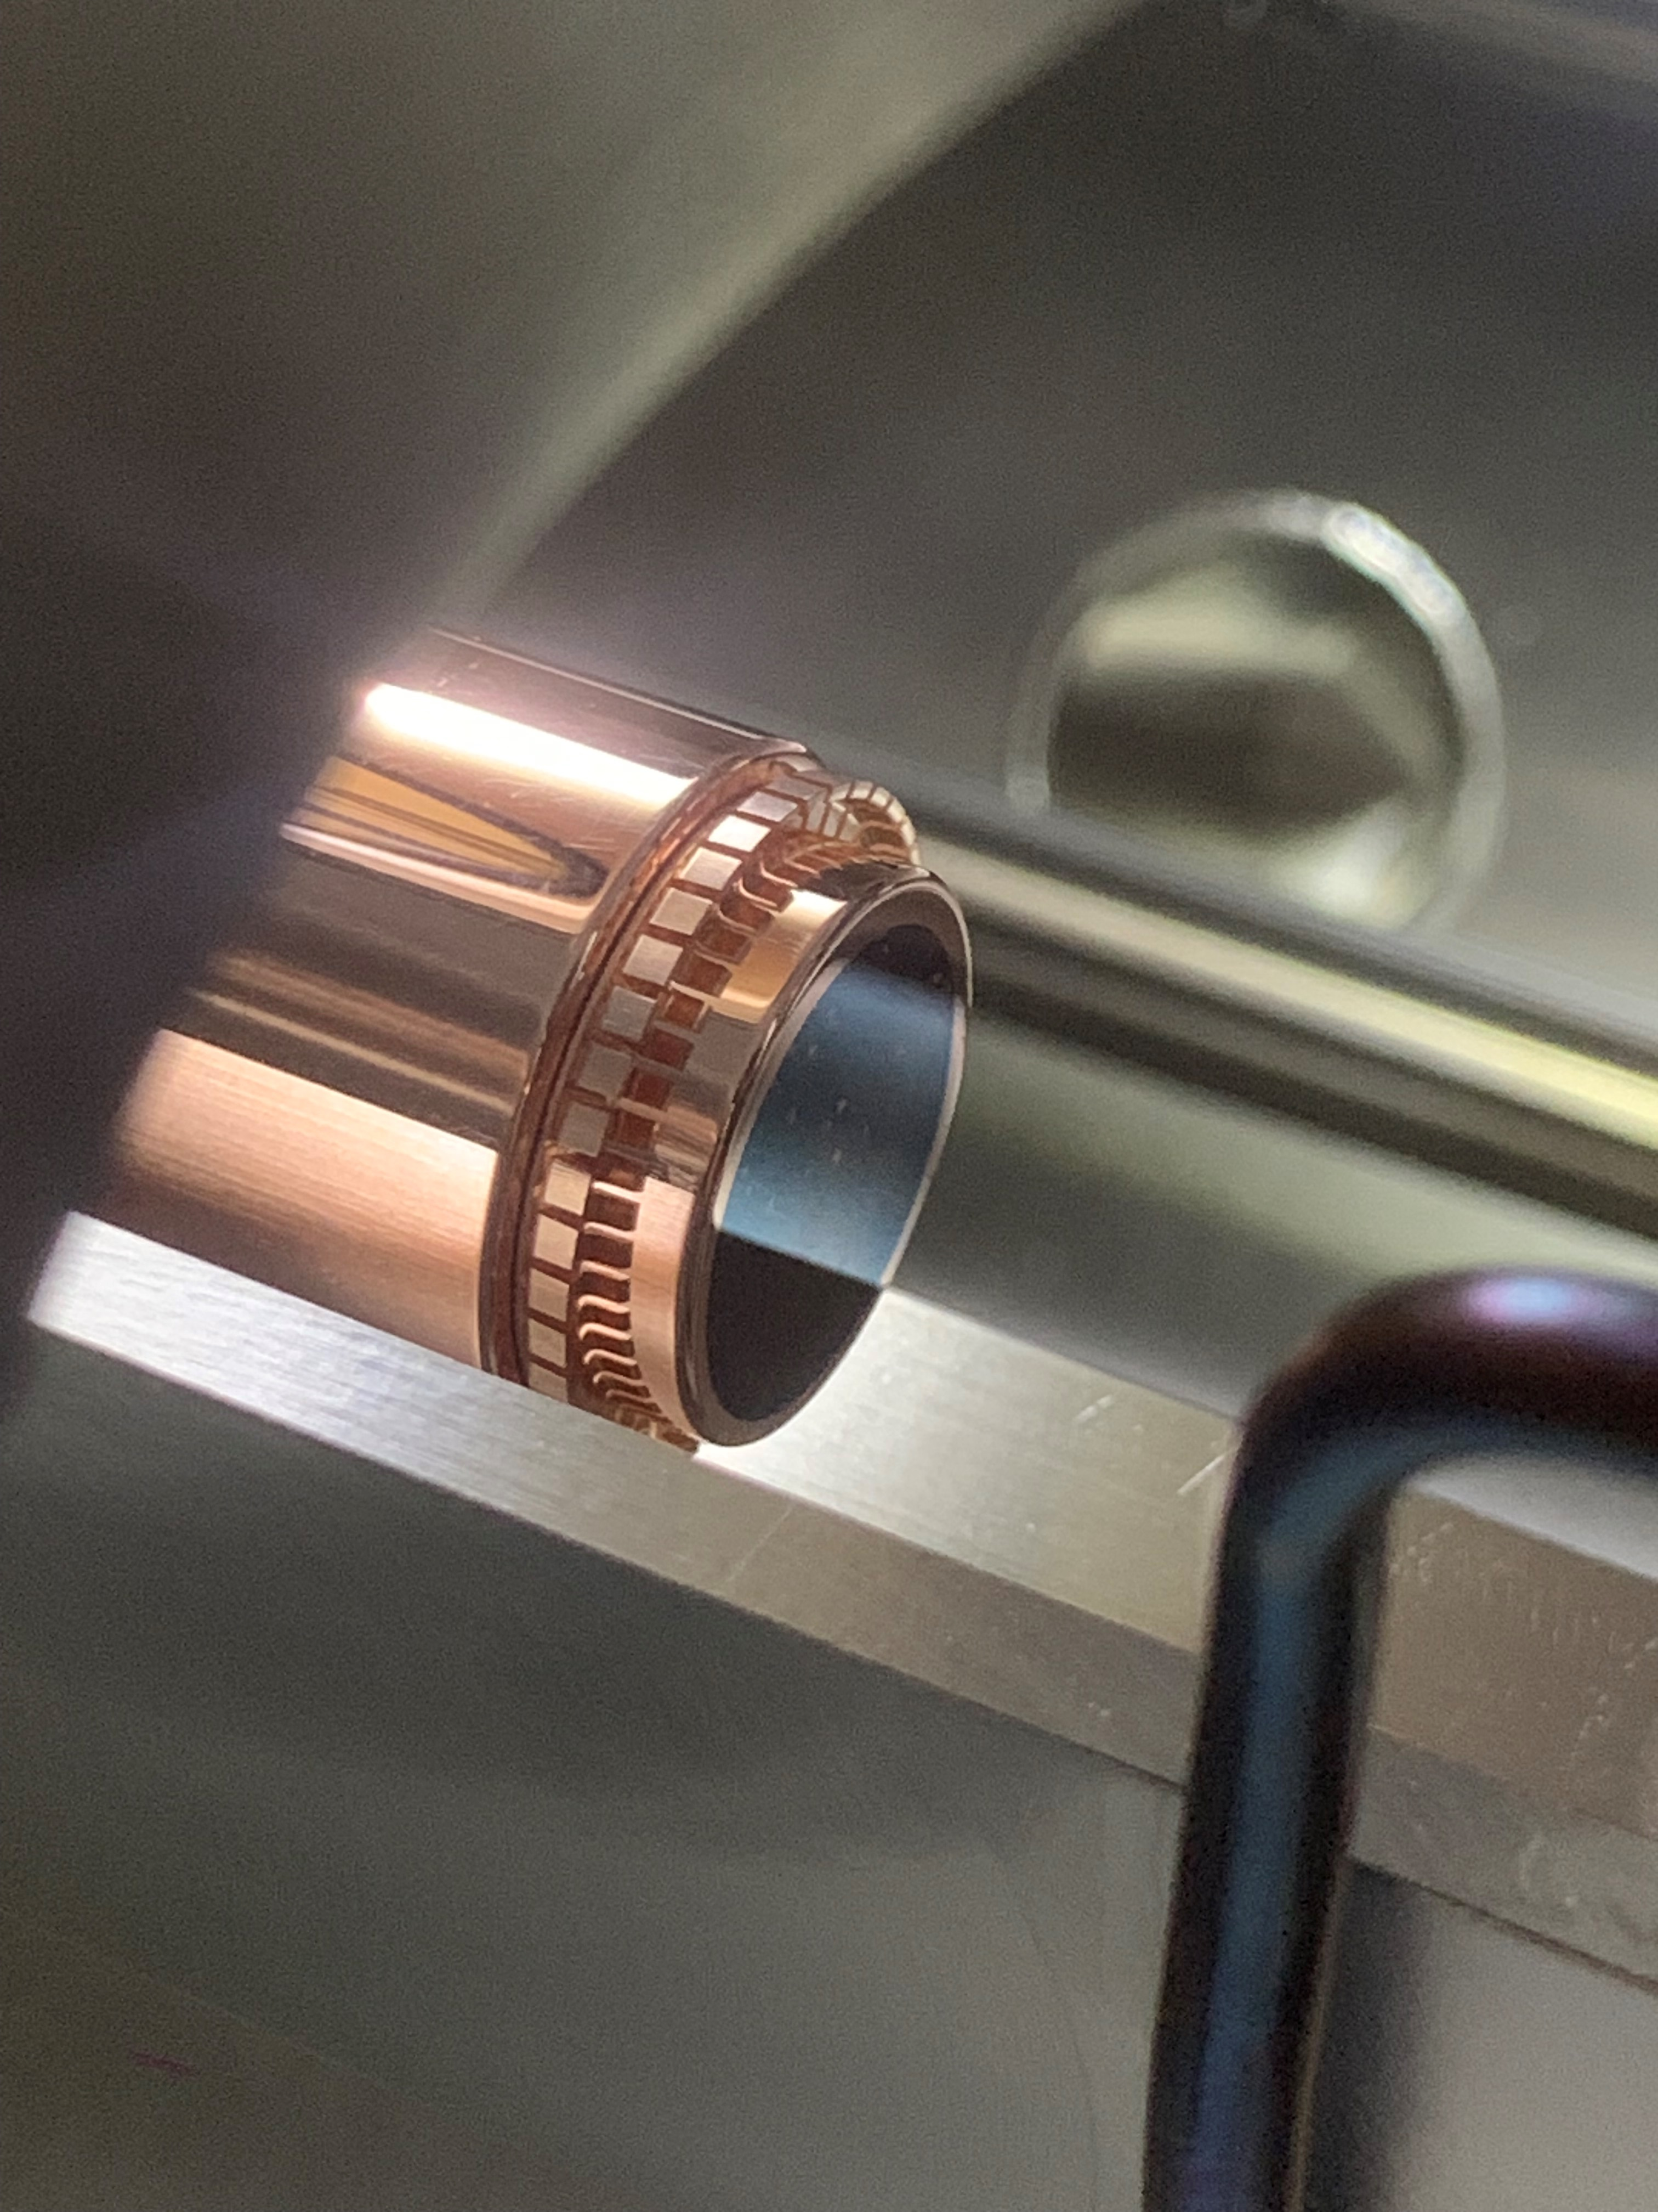
CLEAR laser and photoinjector during 2024
March | April | May | June | July | August | September | October | November | December
JUAS | MD and dosimetry studies | Plasmids & gold nanoparticles (HUG) | EURO-LABS school | HUG Zebra fish eggs irradiation (Geneva) | VULCAN neutron source (DAES) | VULCAN neutron source (DAES) | Dosimetry studies (Strathclyde) | HUG ZFE (Geneva) | Micro-lens array OTR studies (Liverpool)
EO Monitor for FCC-ee (KIT, Germany) | HUG Biodosimeters | LUXE sapphire detectors (INFN) | MD | Fibre beam loss monitor (Liverpool) |  | Plasma lens (U. Oslo) | VHEE Nanoparticles (G. Roussy) | Artificial Intelligence experiment (Naples) | Passive streakers
MD and dosimetry studies | Pressurized hollow core fiber (Groningen) | VHEE UHDR (Drosophilae) (U. Victoria) | Digital micro-mirror device and OTR (Liverpool) | Chromox screen studies (Sheffield) |  | FlashDiamond (Rome) | MD | Bergoz WCM | EOSD
 | AWAKE spectrometers (UCL) | SFRT & Material studies | ChDR EOSD | Cuvette dosimetry studies (Strathclyde) |  | MD | HUG ZFE (Geneva) | E- internal clock studies (IJCLab)
 | HUG Biodosimeter | Solvay Camp Students |  |  |  |  |  | Sapphire detector studies (INFN)
Ventilation issues in laser room, laser amplifier failed | No issue | Laser diode failed, replacement (6 hours down) | Imaging system issues | Chiller issues (6 hours down) | No issues | Power cut 2h, trigger issues. Power supply failed | RF locking issues 6 hours down | Virtual line heavily misaligned | No issues
90% | 100% | 98% | 98% | 98% | 100% | 98.7% | 98% | 99% | 100%
Beamtimes
Laser Issues
uptime
34 beam-times in 2024 (mostly external users), typically 70 h/week
Achieved 7 nC/bunch after commissioning new photocathode in March 2024
Laser up-time total ~7000 h, down-time ~70 h (up 99%). Laser available 24/7
Laser parameters all integrated via CMW -> machine learning algorithm implemented

Slide 29
CLEAR laser operational request for support 2024 – 2030
Material budget
Personnel needs
Budget (in kCHF) | 2024 | 2025 | 2026 | 2027 | 2028 | 2029 | 2030 |  |  | Personnel support (FTE/year) | 2024 | 2025 | 2026 | 2027 | 2028 | 2029 | 2030
Maintenance of main elements* | 10 | 10 | 10 | 0 | 0 | 0 | 0 |  |  | Operational support / maintenance | 0.5 | 0.5 | 0.5 | 0.5 | 0.5 | 0.5 | 0.5
Optical elements | 5 | 5 | 15 | 15 | 10 | 10 | 10 |  |  | Photocathode rejuvenation | 0.1 | 0.1 | 0.1 | 0.1 | 0.1 | 0.1 | 0.1
Sensors (power meter and position) | 10 | 10 | 10 | 10 | 10 | 10 | 10 |  |  | New front-end | 1 | 1.2 | 1.2 | 1.2 | 1.2 | 1.2 | 1.2
Upgrades of system capabilities | 5 | 5 | 5 | 5 | 5 | 5 | 5 |  |  | Total | 1.6 | 1.8 | 1.8 | 1.8 | 1.8 | 1.8 | 1.8
PhD student | 34.5 | 46 | 46 | 46 | 46 | 46 | 46
EO Comb integration + maintenance | 0 | 0 | 0 | 20 | 20 | 20 | 20 |  |  | Current allocation
 |  |  |  |  |  |  |  |  |  | STAFF | 0.3 | 0.3 | 0.3 | 0.3 | 0.3 | 0.3 | 0.3
Total | 64.5 | 76 | 86 | 96 | 91 | 91 | 91 |  |  | Fellow | 0.5 | 0.5 | 0.5 | 0.5 | 0.5 | 0.5 | 0.5
 |  |  |  |  |  |  |  |  |  | PhD | 0.8 | 1 | 1 | 1 | 1 | 1 | 1
EO Comb laser development |  |  |  |  |  |  |  |  |  | Total | 1.6 | 1.8 | 1.8 | 1.8 | 1.8 | 1.8 | 1.8
RF amplifiers | 7.5
CW laser | 27.4
Modulators | 15
GHz synthesizer |  | 46.6
Total | 49.9 | 46.6
(all budget already committed)
*Main elements that require repairs | ~Yearly
CALIFES amplifier power supply | 2.5
Pulse picker power supply | 1
Chillers | 4
EO Comb development is driven by CLEAR funded PhD student + 100 kCHF material expenses.
EO Comb development finishes in 2026, with the integration and commissioning
From 2027 – 2030 no further R&D is foreseen, regular operational budget is around ~55 kCHF
Not included here is the CTF2 operation and maintenance (this is funded using the AWAKE budget instead).
Requested funds and resources for development of FCC-ee compatible spatio-temporal shaper.
CLEAR photo-injector laser points of failure:
  Laser sub-systems often fail and require replacements and spares: Chillers, pulse-picker power supplies, laser diodes, laser power supplies, beamline optical elements, and motors.

Slide 30
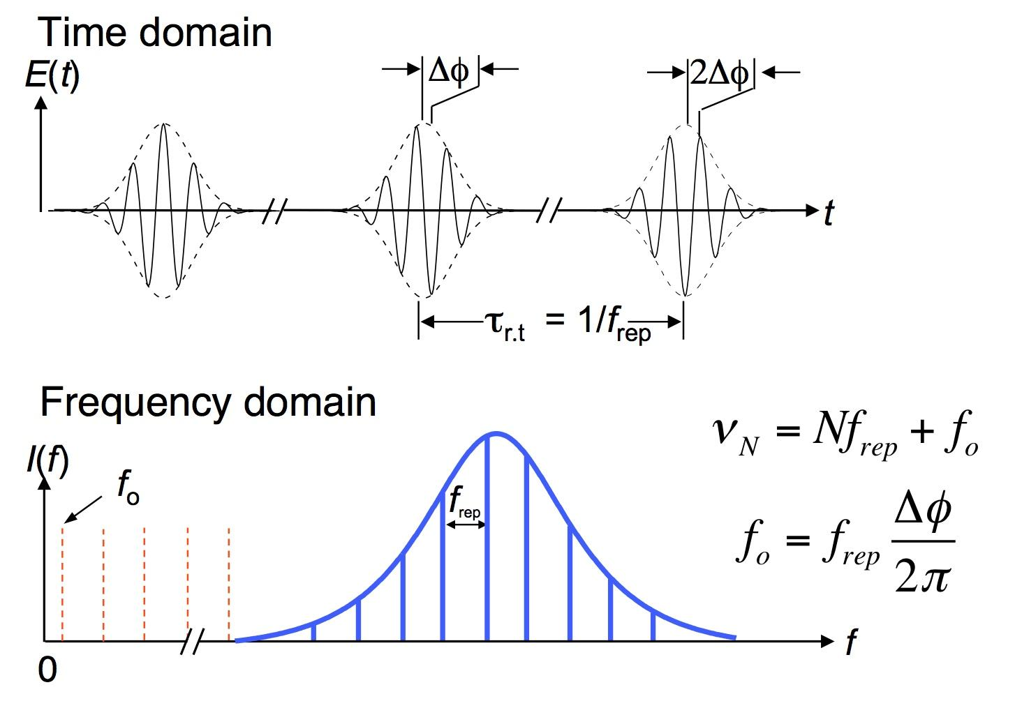






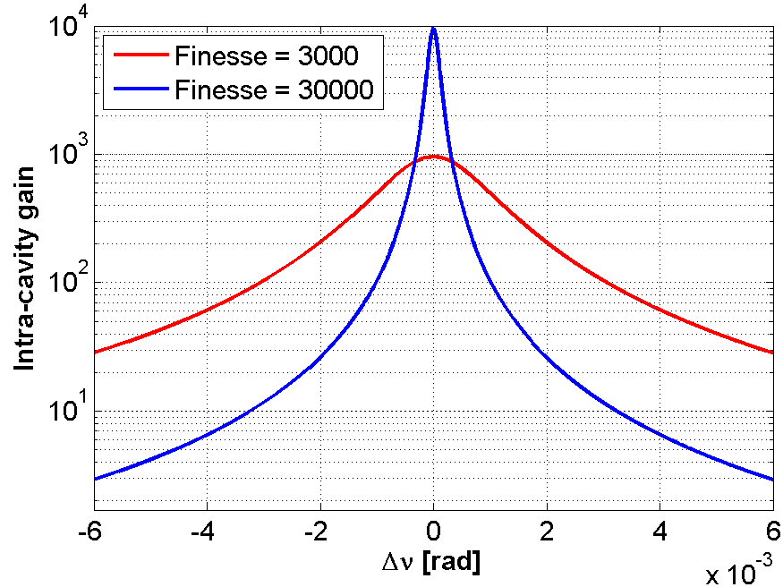
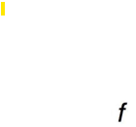







Fabry Perot enhancement cavity principle
Maximizing the intracavity power
Excellent spectral mode matching
Large cavity gain
Laser frequency comb modes
$$FSR=f_{rep}$$
$<δν$
⇒
5000
Absorption
10⁻⁶
Diffraction
10⁻⁵
Transmission
10⁻⁴
$$\frac{δν}{ν}\sim {10}^{−11}$$
$$\frac{δν}{ν}\sim {10}^{−10}$$
$$\frac{δν}{ν}=\frac{λ}{L ℱ}=3×{10}^{−11}$$
Resonator modes
$$δν$$
$δν$ ~ 10 kHz
FSR
Excellent mirrors and stability
Minimal phase noise

Slide 31
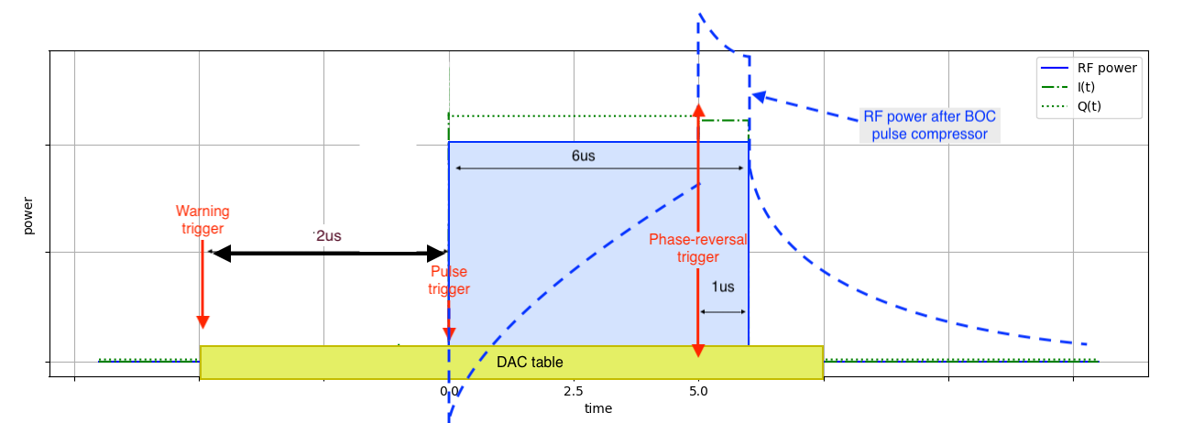
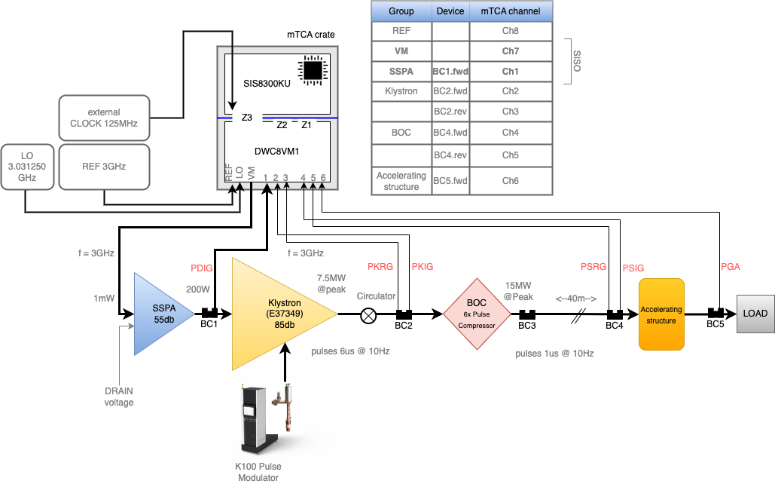

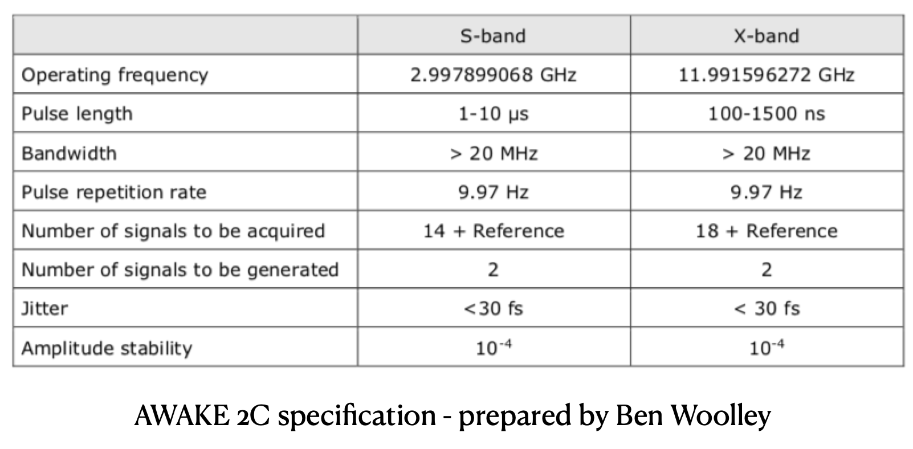
Setup: LLRF
1024 samples (8ns * 1024)

Slide 32
Back to the Basics: CLEAR and its Scientific and Strategic Goals
Bld. 2010/CLEX
CLEAR Beamline(s)
1 nC/b; ~200 MeV; 3 GHz
Bld. 2013/CTF2
ARTI Injector
0.1 nC/sb; 6(70) MeV; 3 GHz
Bld. 2003
Was CLIC DBRC prototype @CTF3
Was hosting EPA ring (C=125 m, 500 MeV)
Old EPA/CTF3 Complex
Bld. 2001
Was CLIC DB Linac Prototype (120 MeV, 4 A e⁻ train @1.5 GHz) @CTF3
Was hosting LIL injector (500 MeV e⁻/e⁺ (from 200 MeV e⁻))
Providing a test facility at CERN with high availability, easy access and high-quality e⁻ beams.
  Performing R&D on accelerator components, including beam instrumentation prototyping and high gradient RF technology
  Providing an irradiation facility with high-energy electrons, e.g. for testing electronic components (e.g. in collaboration with ESA) or for medical purposes (e.g. VHEE/FLASH)
  Performing R&D on novel accelerating techniques – electron driven plasma and THz acceleration
Providing a training infrastructure for the next generation of accelerator scientists and engineers
Maintaining CERN and European expertise for electron LINACs linked to future collider studies

Slide 33
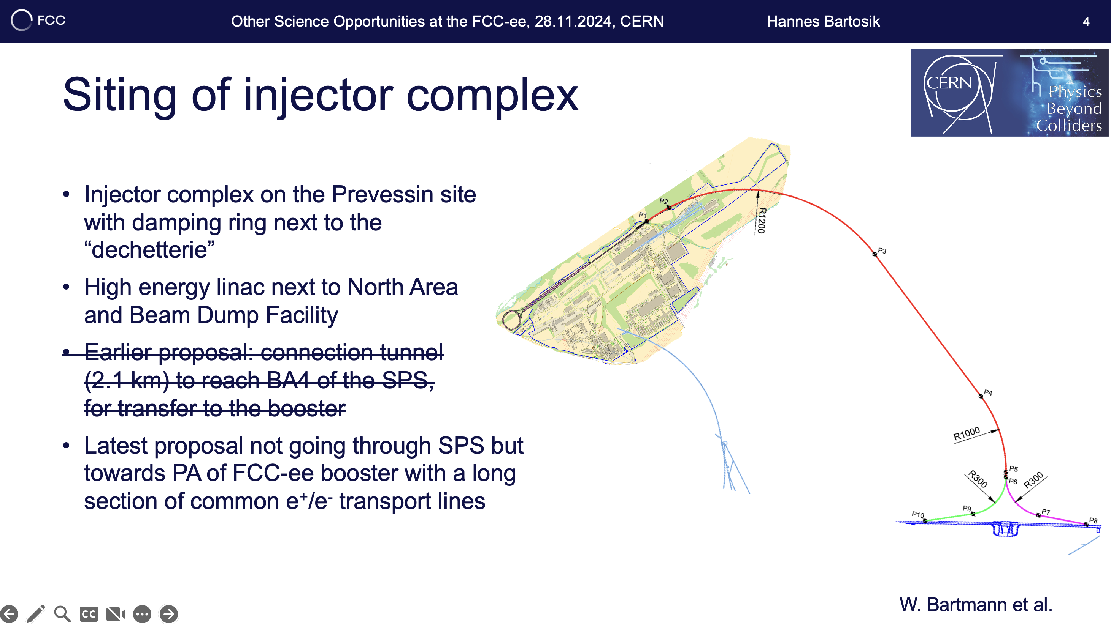
PS: latest updates on injector design
From H.Bartosik@Other Science Opportunities at the FCC-ee

Slide 34
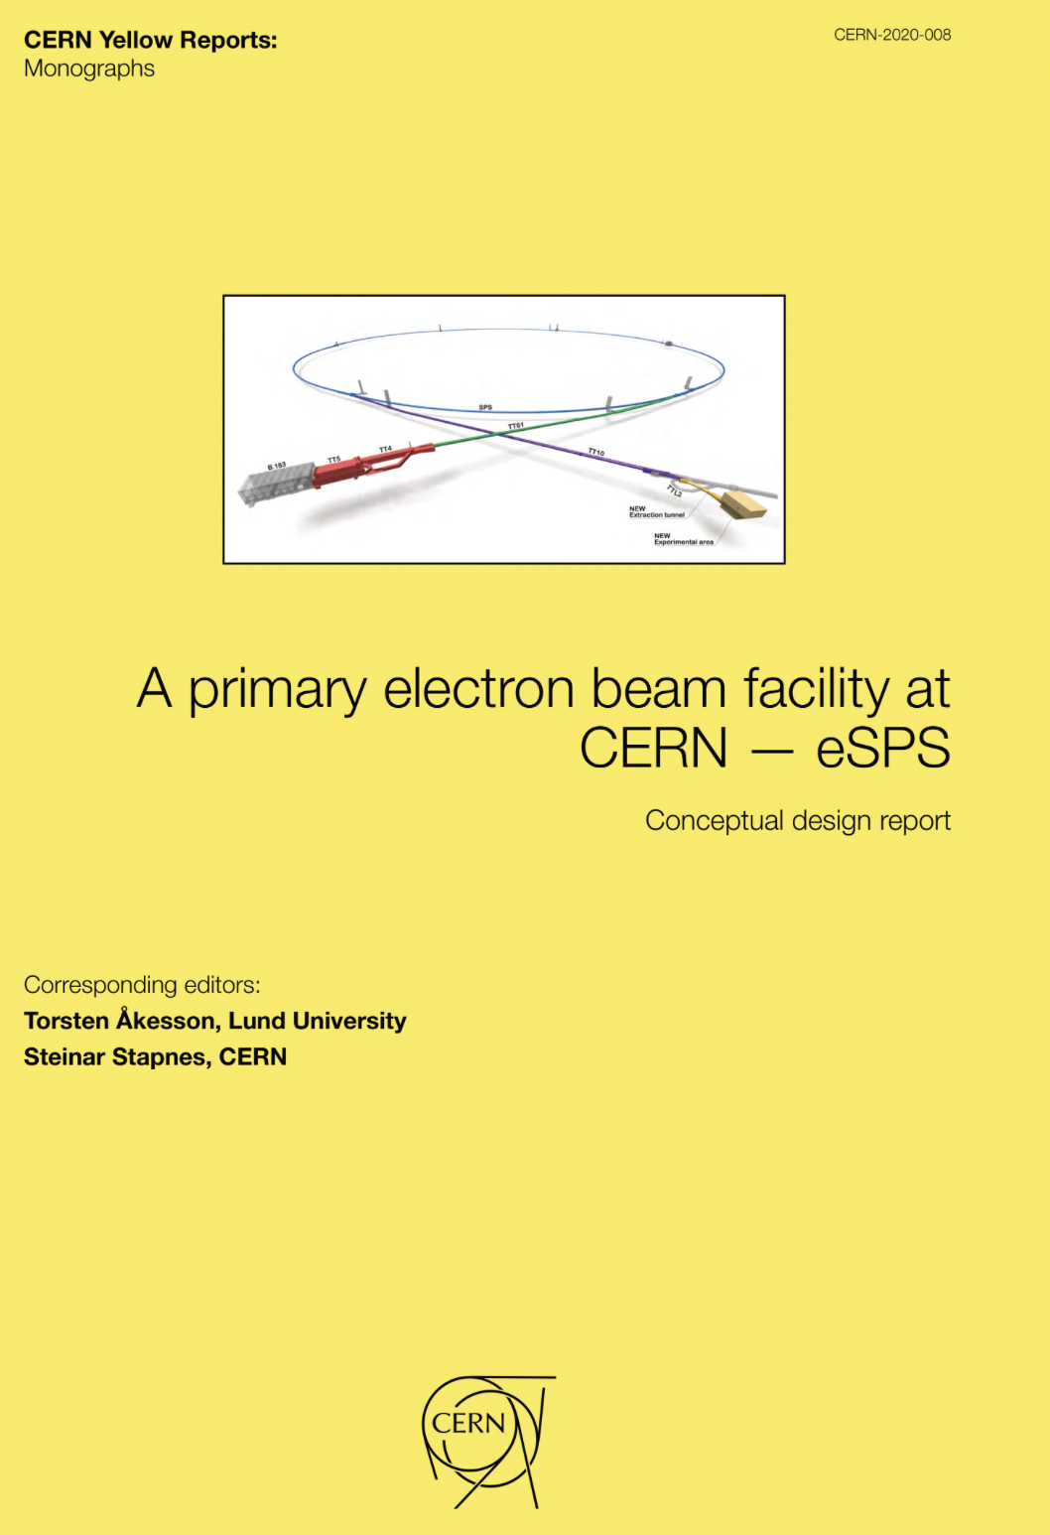
CLEAR++ during FCC-ee Construction!
Slide mostly from H. Bartosik @ PBCWS2024 and @ Other Science Opportunities at the FCC-ee
Proposal for primary electron facility was already made in context of eSPS (original proposal for Light Dark Matter eXperiment – LDMX)
Inspired by this proposal, FCC-ee injector beams could be used for
a CLEAR-like facility (including also damping ring):
  R&D for accelerator components and beam diagnostics for FCC-ee
  or the injector itself (in particular if injector goes online ahead of FCC-ee
  and/or is built in stages)
  Irradiation facility (e.g. for testing electronics components)
  Medical research
  Use synchrotron light from damping ring at 2.86 GeV to test coatings,
  photon desorption, but also other low emittance rings beam dynamics and technology (BT elements, RF, wigglers, instrumentation,…) for
  FCC-ee and beyond
  Plasma wakefield acceleration test facilities (electron driven, but maybe even in combination with proton driven plasma, see next slide)
  The present CLEAR User Community could be the seed of a wider user community of such a facility!
BONUS: FCC-ee injector layout could still work for eSPS proposal
(especially if SPS is part of the FCC-ee injector)

Slide 35

Plus: e+/e- beams interesting for AWAKE++!
35
Slide mostly from H. Bartosik @ PBCWS2024
The previous layout of the FCC-ee injector complex passes through SPS BA4, i.e. the SPS extraction point of protons for the plasma wakefield acceleration experiment AWAKE
Keeping SPS operation with protons, there would be a unique opportunity to perform proton driven plasma wakefield acceleration of 20 GeV electrons and positrons
  Lepton beam parameters fit extremely well for wakefield experiments
  Unique possibility of positron acceleration (currently no experiments worldwide)
With the two-bunches setup, also electron driven plasma
wakefield acceleration experiments can be performed
  1st electron beam is the drive beam, 2nd one is the witness beam
  In addition, another unique possibility to test electron-to-positron acceleration
Proton beam line, experimental facility as well as lepton injection area
and tunnel to the experiment exists
  Would require ~800 m transfer line for e+/e- in TT40/41 tunnel + transfer to SPS with latest layout
CLEAR++ and AWAKE++: Perfectly Aligning with the LDG Roadmap to
Strengthen CERN's Ambitions in Novel Acceleration Techniques!
AWAKE

Slide 36

Positrons for dark matter searches – requiring a high energy ring…
From H.Bartosik@Other Science Opportunities at the FCC-ee

