Slide 1
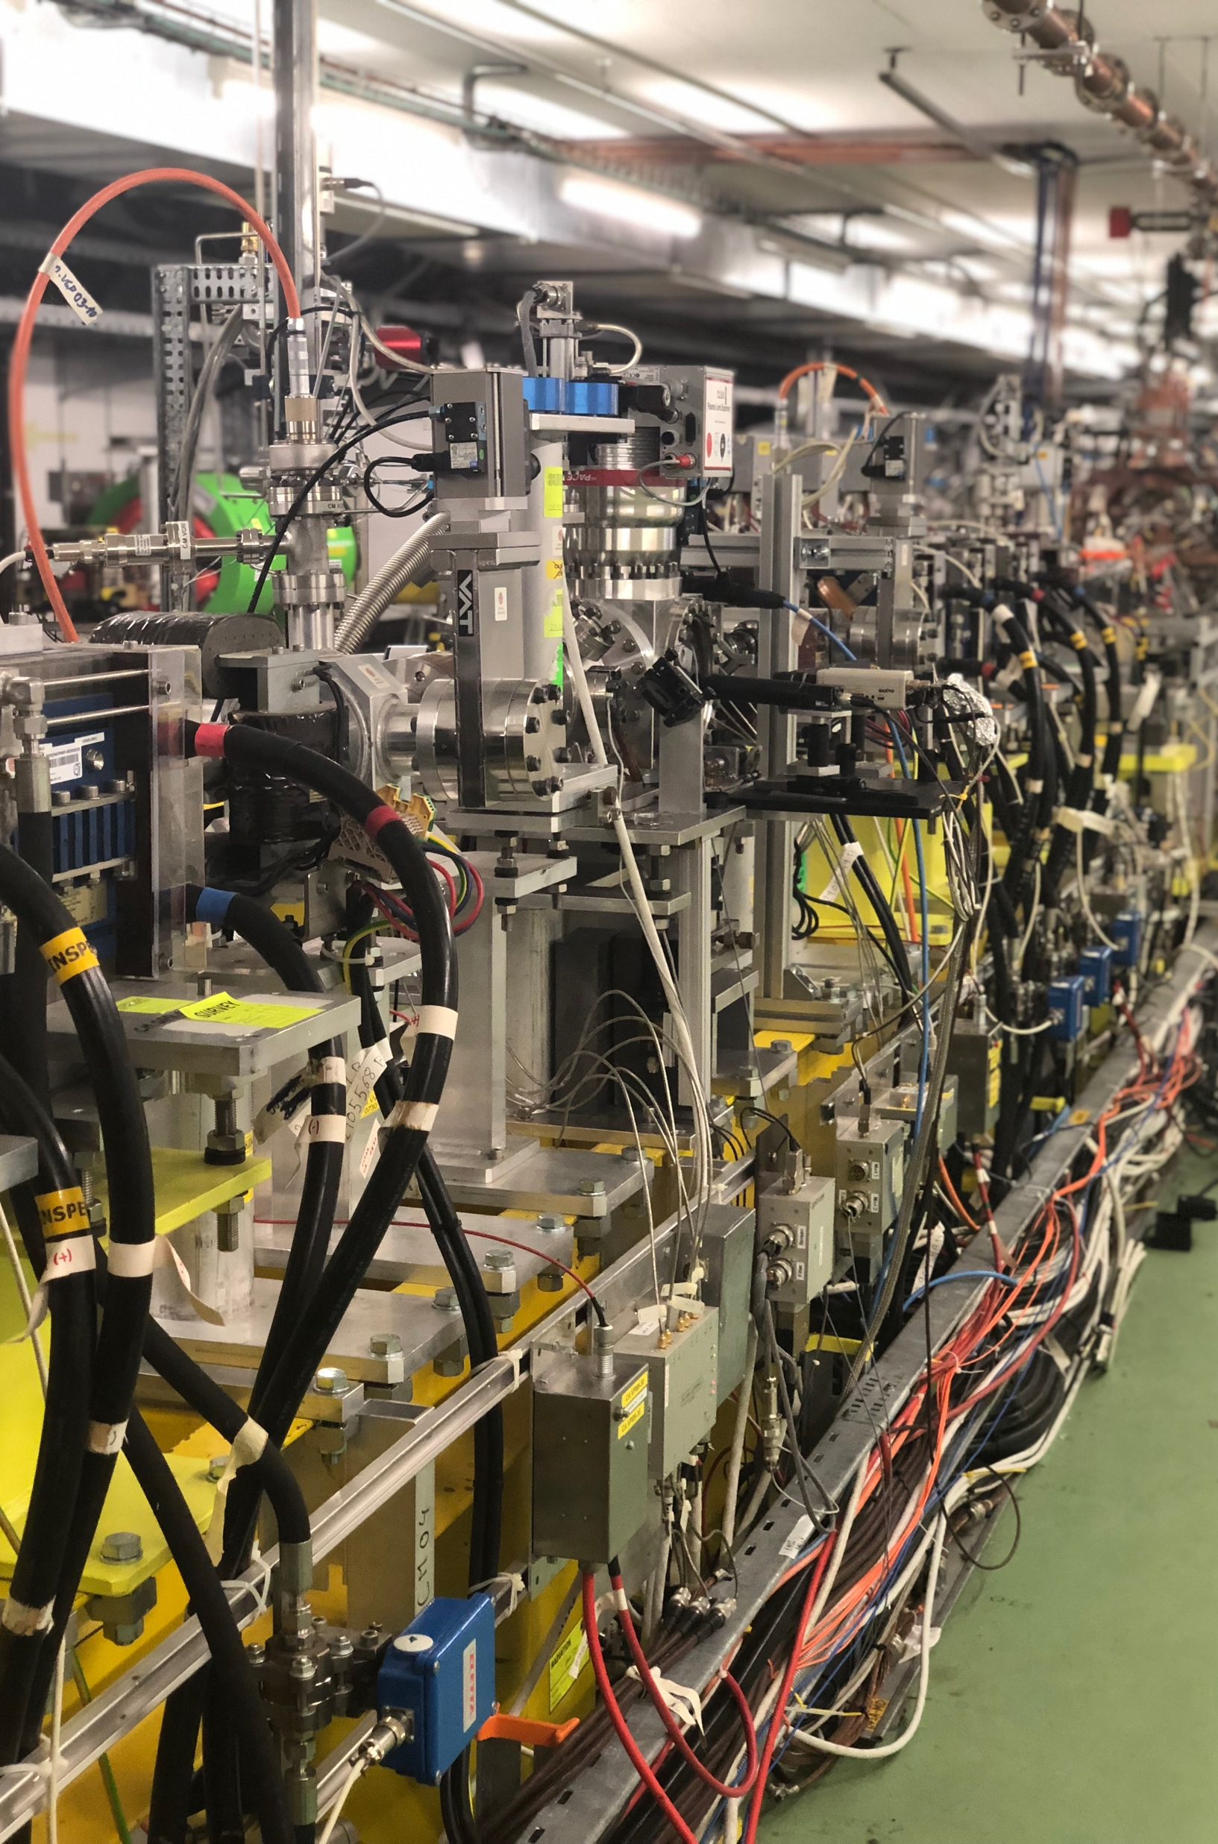
Beam operation consolidation and improvements in CLEAR
CLEAR Scientific Board Meeting
Antonio Gilardi
Welcome to my journey
One driving question: how do we make CLEAR
better?
CLEAR Scientific Board Meeting Antonio Gilardi (antonio.gilardi@cern.ch) 1/36

Slide 2
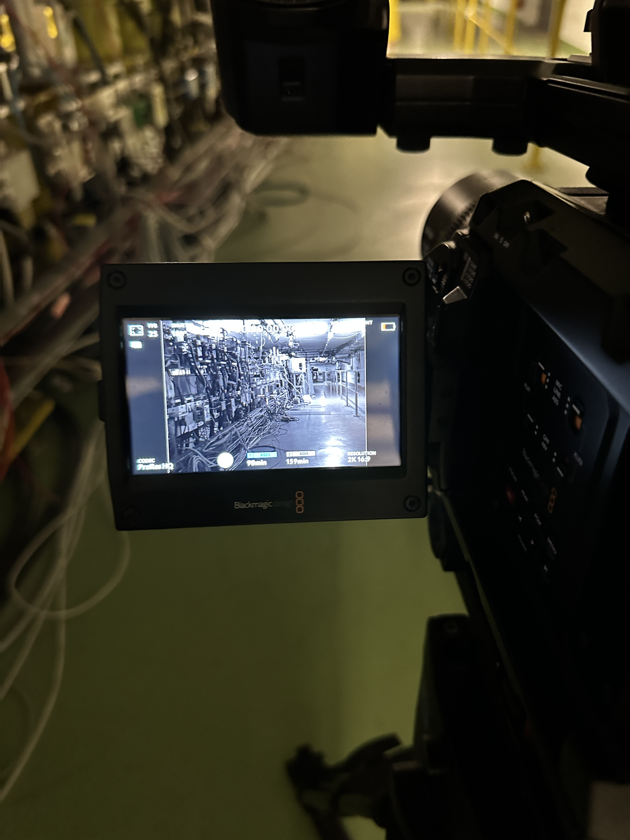
Table of Contents
The Team
03
Who are we exactly? Closer look to the team
Operation status
04
The main challenges we are facing
Consolidation & Improvements
06
Actions, on going or future, for overcoming our challenges
R&D as MD
23
Research effort that has become useful for daily operation (or the other way around)
On going collaboration
35
Main established collaborations
Conclusion
36
Everything I am reporting here is the result of a tremendous team effort.
None of this would have been possible without the hard work, dedication, and collaboration of team.
CLEAR Scientific Board Meeting Antonio Gilardi (antonio.gilardi@cern.ch) 2/36

Slide 3
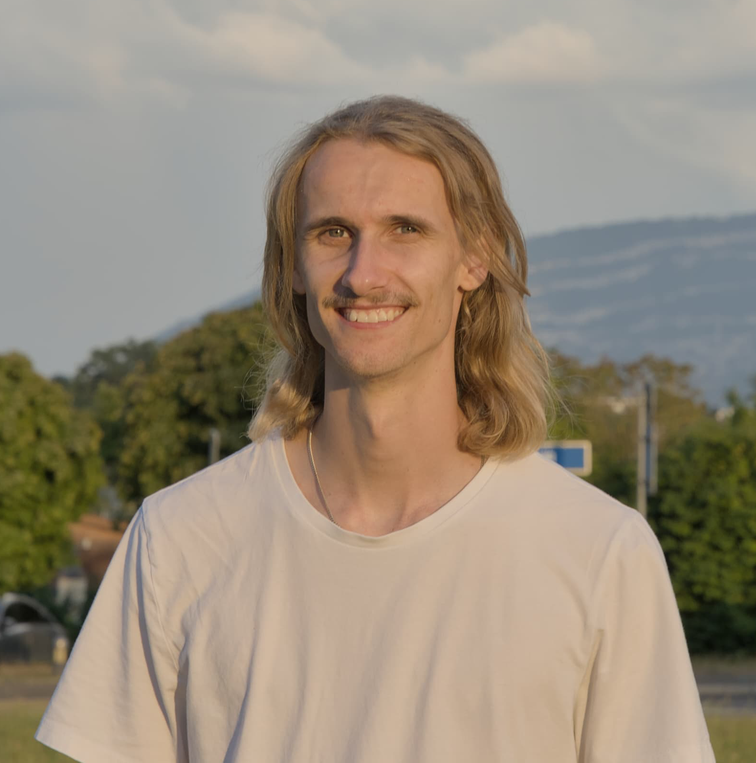
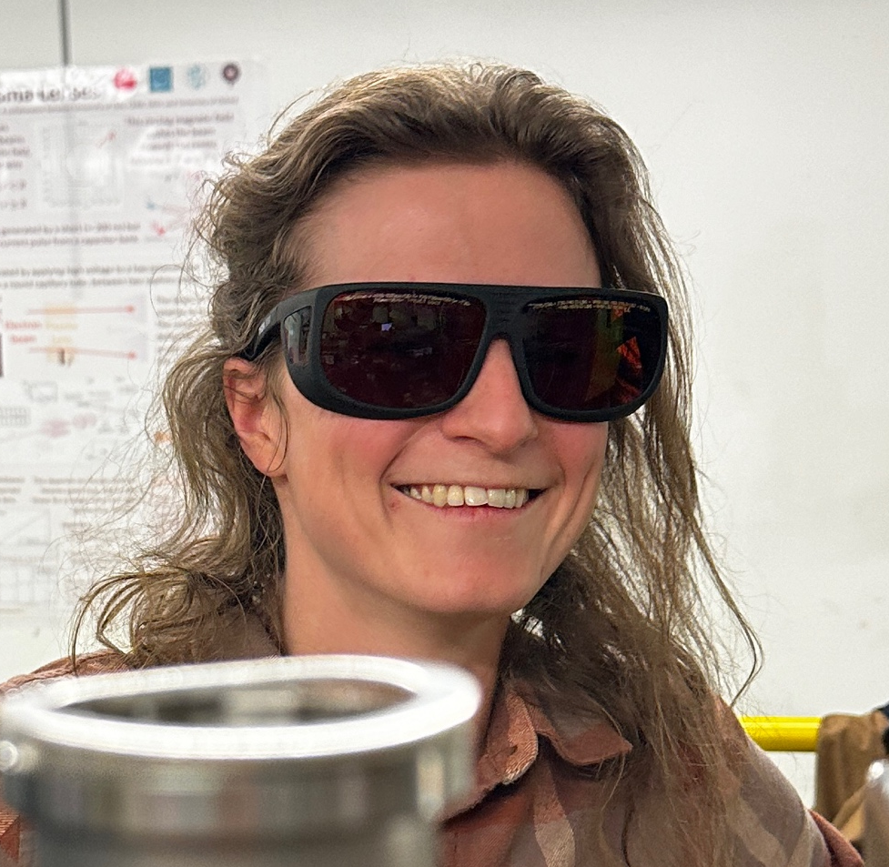
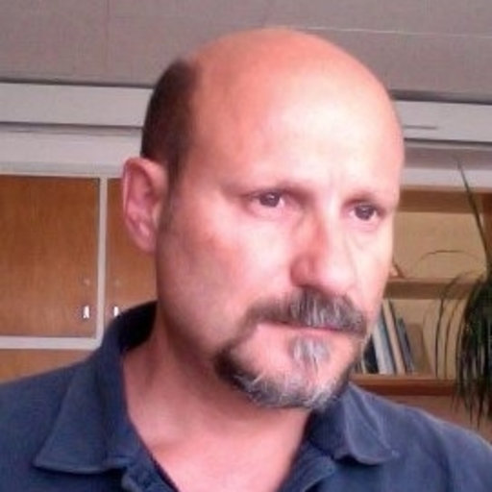
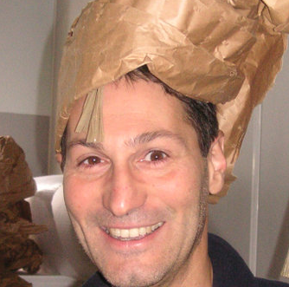
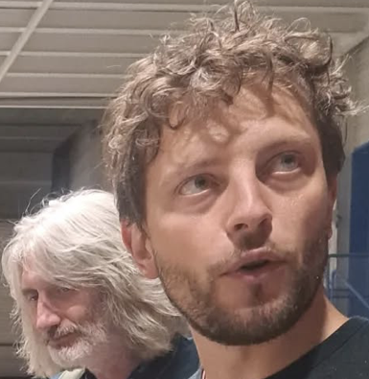
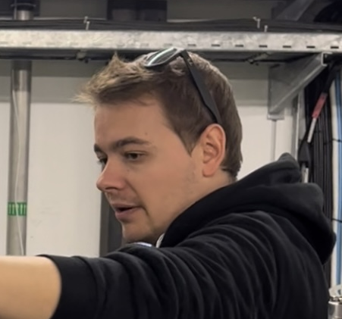
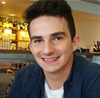
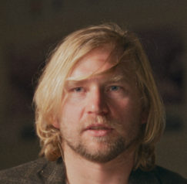
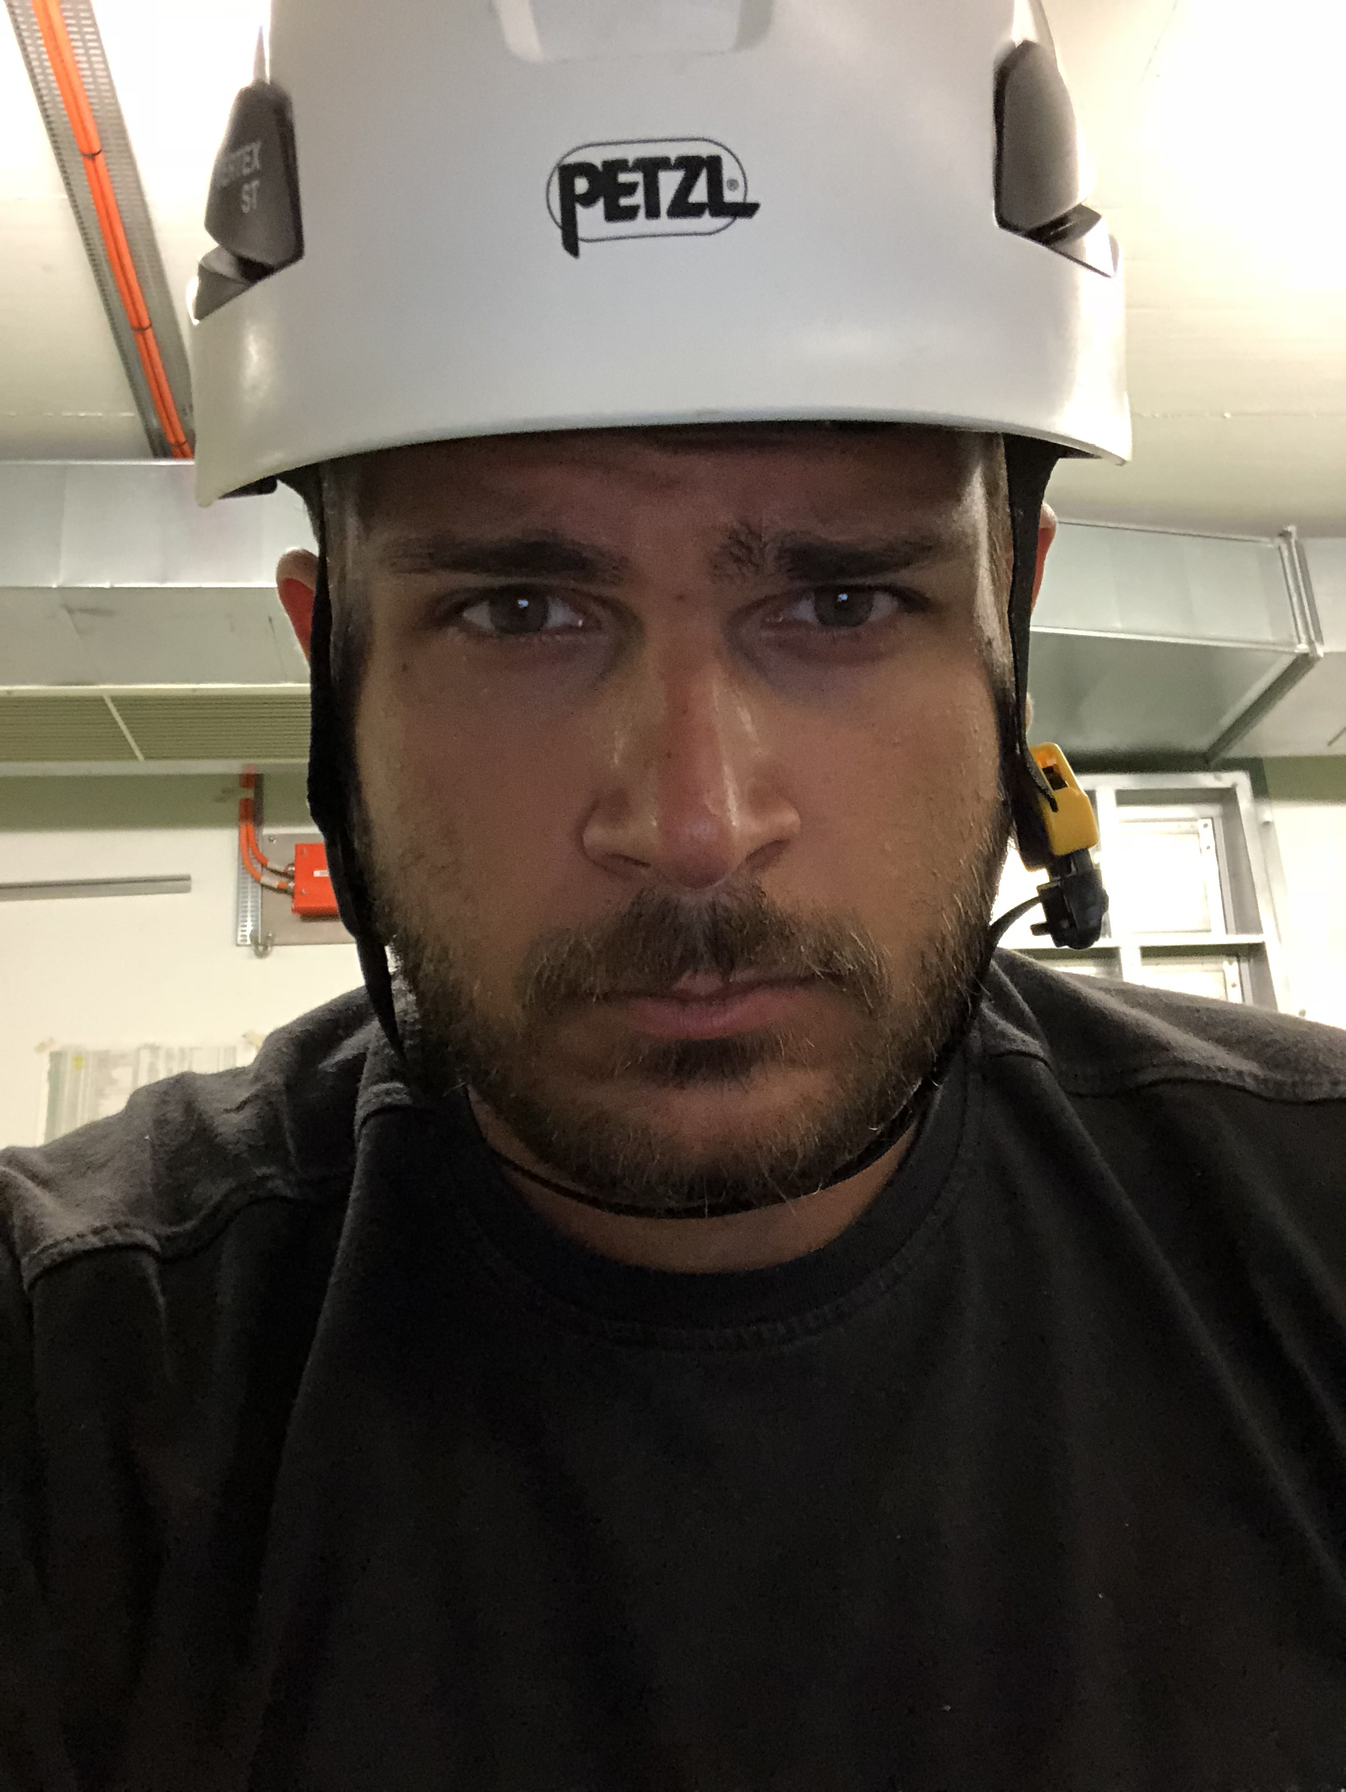
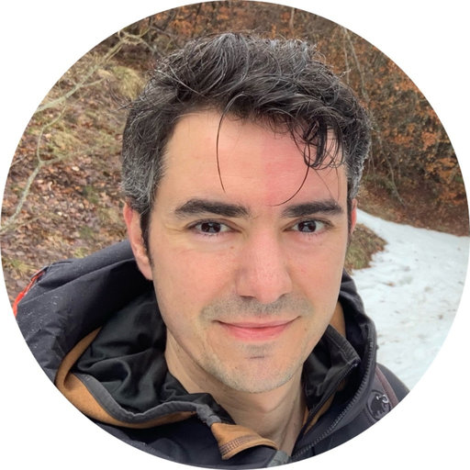
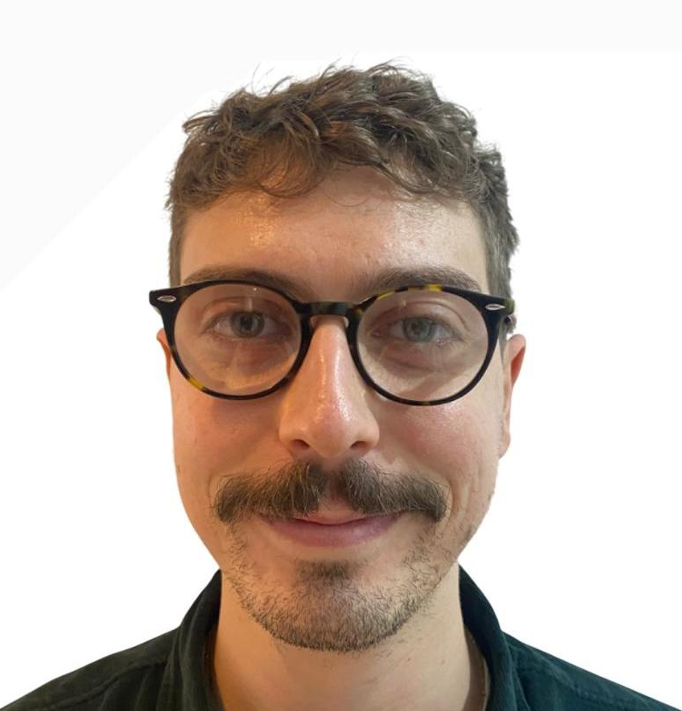
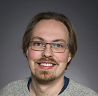
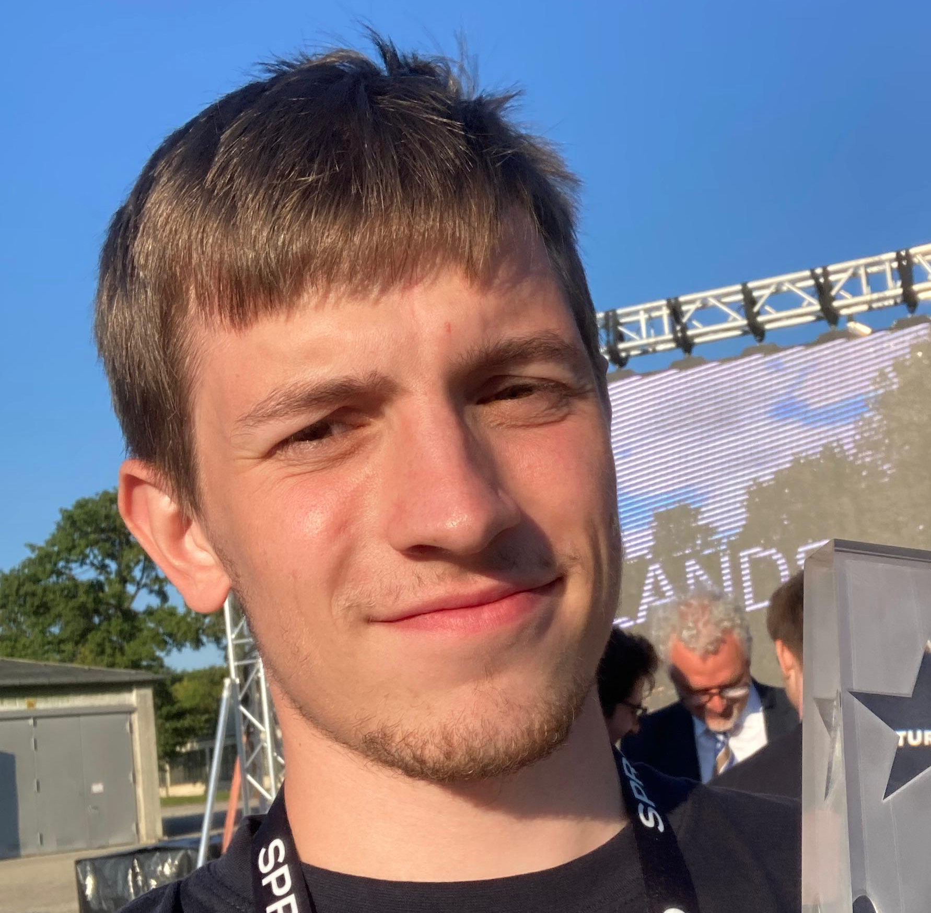
Vilde
The Team
Roberto
Davide
Alfred
Laurence
Wilfrid
Edu
Giacomo
Kyrre
Pierre
Alex
Antonio
Ondrej
CLEAR Scientific Board Meeting Antonio Gilardi (antonio.gilardi@cern.ch) 3/36

Slide 4

Operation Status
Thanks W.Farabolini
Scientist/operators
Expert scientist/operators
Set up the machine, oversee, and often actively participate in the experiments.
As you’ve seen, we’ve been extremely productive, and while doing so, we also took the time to identify where and how we could improve — and we did (sometimes).
CLEAR Scientific Board Meeting Antonio Gilardi (antonio.gilardi@cern.ch) 4/36

Slide 5
Operation Status
Difficulties identified:
  Schedule issue
  User organization/support
  Not sufficient/inadequate diagnostics
  Standardization
  Hand based operation
Of course, these issues are sometimes interconnected, sometimes unavoidable, and other times simply a trade-off.
Next, I’ll outline the actions we are taking — and will continue to take — to mitigate them and drive improvement.
HARDWARE
PROCEDURE
SOFTWARE
CLEAR Scientific Board Meeting Antonio Gilardi (antonio.gilardi@cern.ch) 5/36

Slide 6
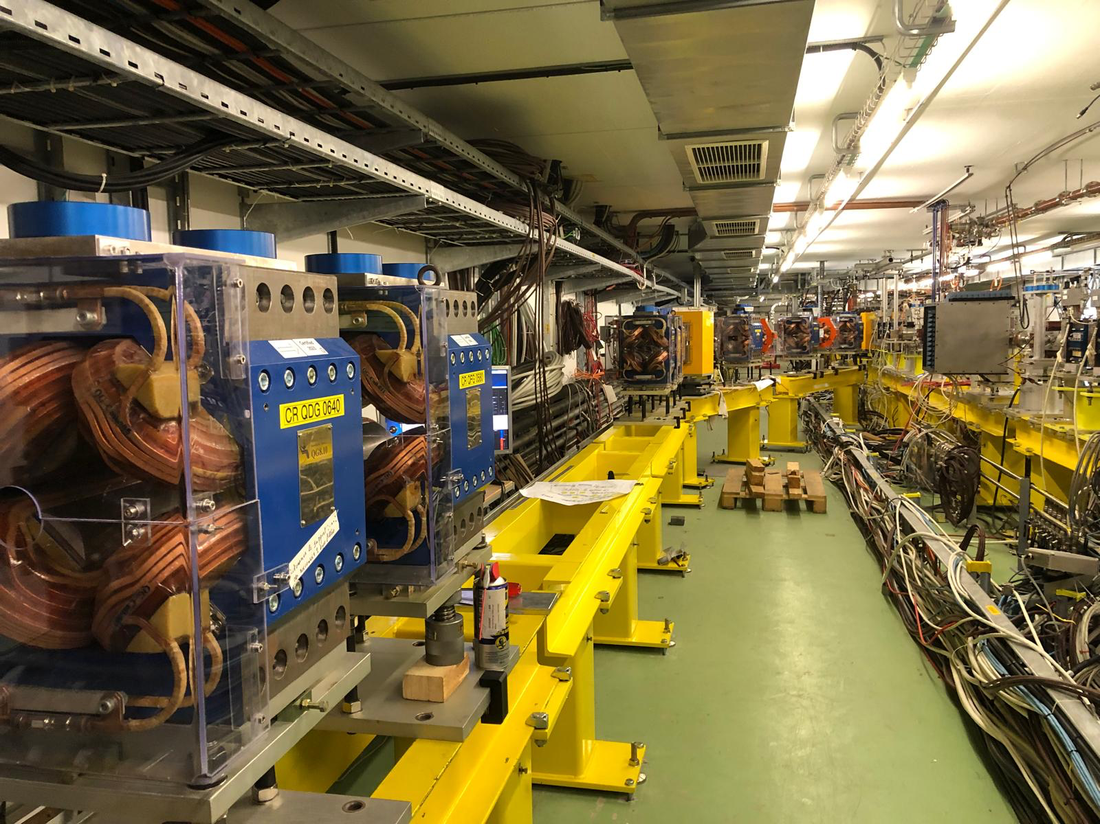
Consolidation & Improvements
HARDWARE
PROCEDURE
Schedule issue:
  Installing, dismantling, and reinstalling similar over the year.
    Additional work – drives reproducibility issue
Actions:
→ Second beamline coming up!
→ Schedule is mindful about this issue
SECOND BEAMLINE
Started January 2025.
Paused (experiment start) end of February 2025.
Resuming August 2025
Foreseen to be finished by September 2025.
CLEAR Scientific Board Meeting Antonio Gilardi (antonio.gilardi@cern.ch) 6/36

Slide 7
Consolidation & Improvements
HARDWARE
PROCEDURE
Schedule issue:
  Installing, dismantling, and reinstalling similar over the year.
    Additional work – drives reproducibility issue
Actions:
→ Second beamline coming up!
→ Schedule is mindful about this issue
SECOND BEAMLINE
  Status:
    5 new girders installed
    Dipoles, Quadrupoles, and Sextupoles installed and aligned
    Power supplies (plus cable) identified and under commissioning
    Procurement started
CLEAR Scientific Board Meeting Antonio Gilardi (antonio.gilardi@cern.ch) 7/36

Slide 8
Consolidation & Improvements
HARDWARE
PROCEDURE
SOFTWARE
User organization/support
- Last minute requests (hardware and software)
    Difficult to manage and risks jeopardizing the experiment.
Actions:
→ CLEAR operator in charge
→ Standardize acquisition process
II + ½ Standardize acquisition process
CLEAR Scientific Board Meeting Antonio Gilardi (antonio.gilardi@cern.ch) 8/36

Slide 9
Consolidation & Improvements
PROCEDURE
SOFTWARE
II + ½ Standardize acquisition process
About 15 software tools are used on daily basis in CLEAR
10 NOT internally developed (trying to leverage the CERN infrastructure)
5 internally developed
  Many are Matlab based – essential for operation
Actions:
When possible, develop new in python
Started CERN internal collaboration (more on it later)
We try to write code that is: Well-structured, maintainable, version-controlled, easy to understand, and designed for long-term scalability and collaboration
Leverage even more the CERN architecture
CLEAR Scientific Board Meeting Antonio Gilardi (antonio.gilardi@cern.ch) 9/36

Slide 10
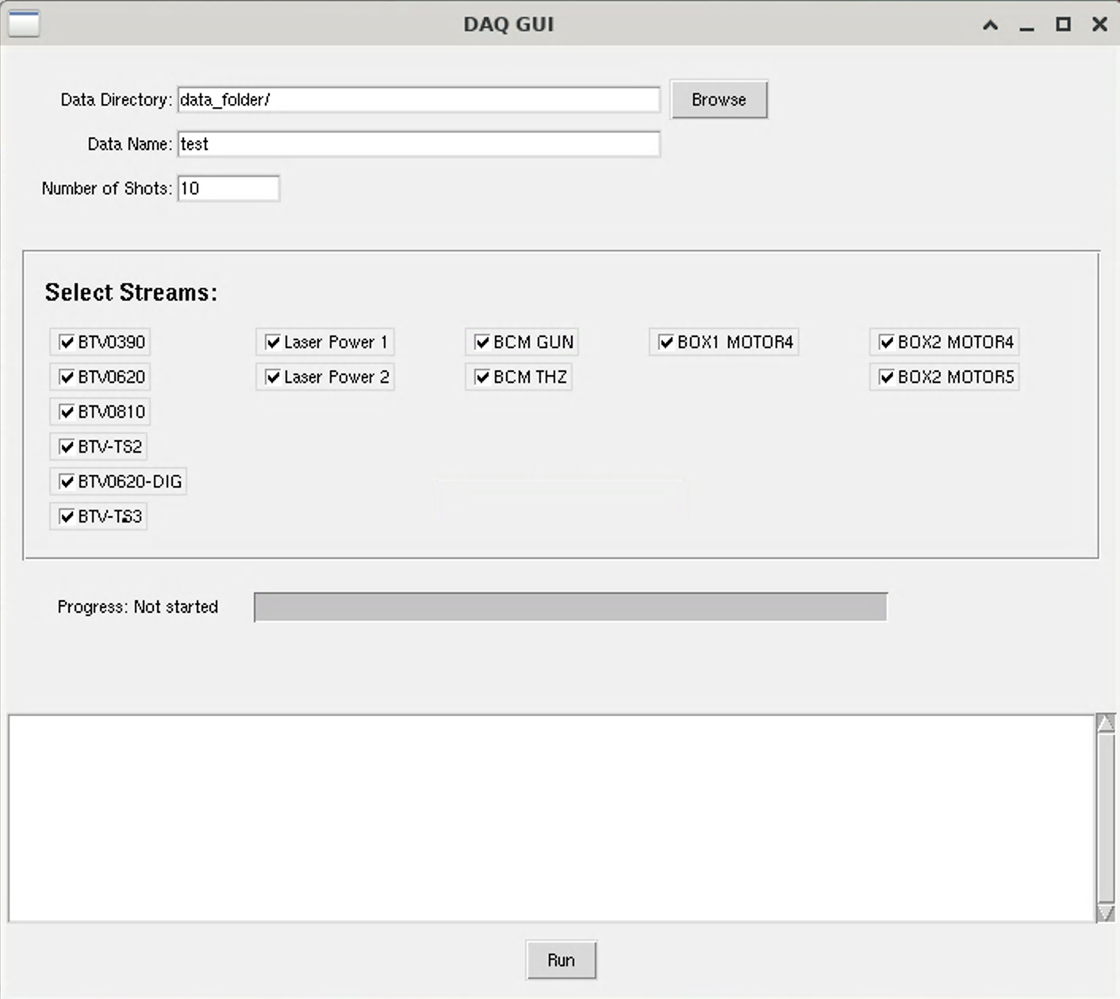
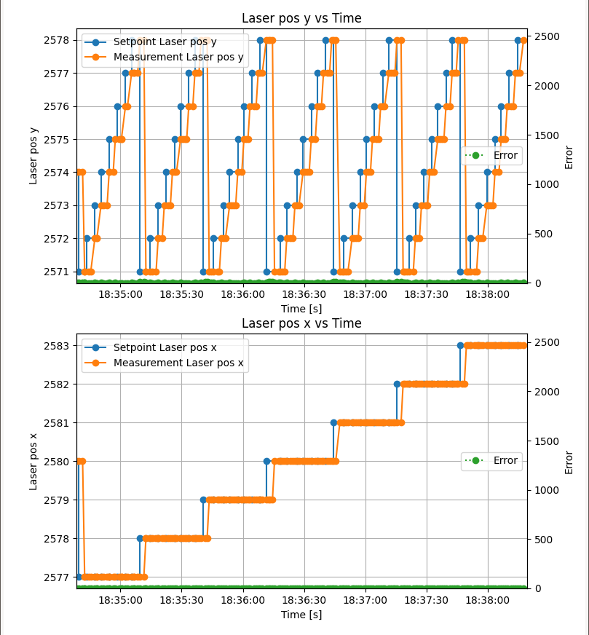
Consolidation & Improvements
PROCEDURE
SOFTWARE
II + ½ Standardize acquisition process
CLEAR DAQ
Scan worker
https://gitlab.cern.ch/CLEAR/scanworker
The data produced is highly standardized and easy to access (Cernbox)
CLEAR Scientific Board Meeting Antonio Gilardi (antonio.gilardi@cern.ch) 10/36

Slide 11
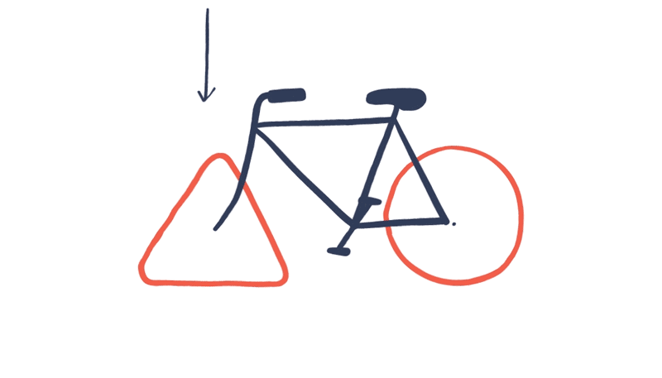
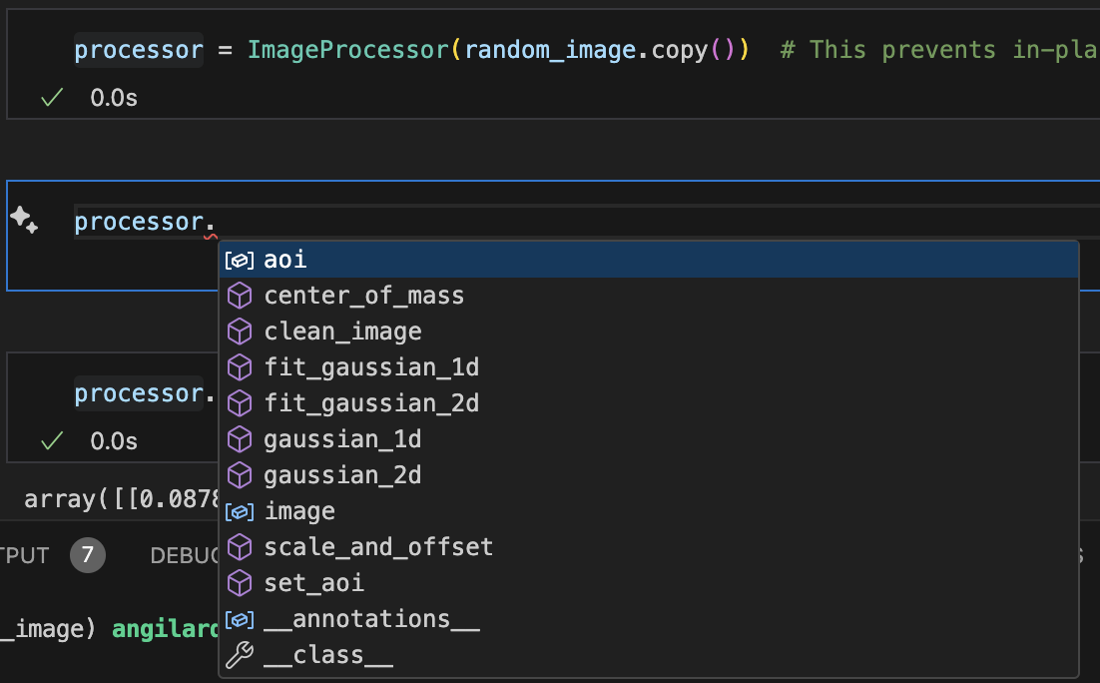
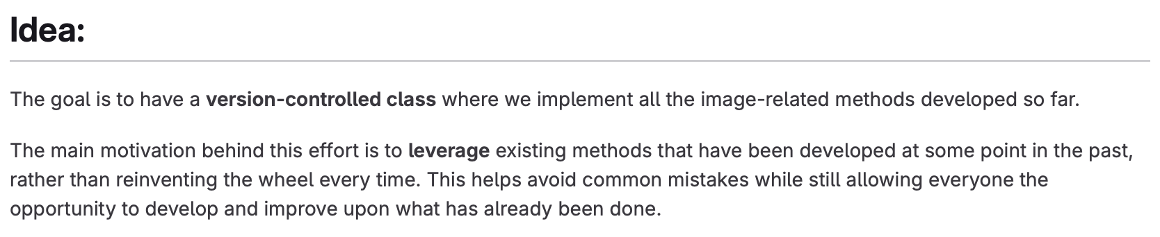
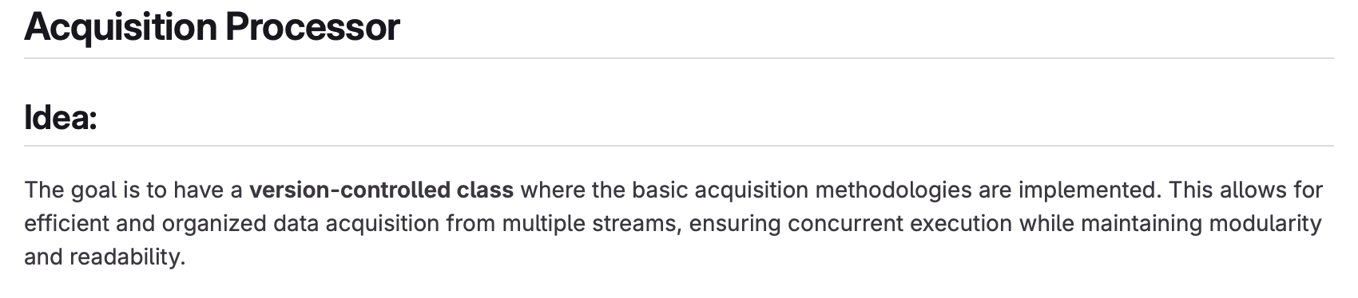
Consolidation & Improvements
PROCEDURE
SOFTWARE
II + ½ Standardize acquisition process
https://gitlab.cern.ch/CLEAR/clear_image_handling
https://gitlab.cern.ch/angilard/clear_acq_handling
User oriented
(hopefully easing operation)
CLEAR Scientific Board Meeting Antonio Gilardi (antonio.gilardi@cern.ch) 11/36

Slide 12
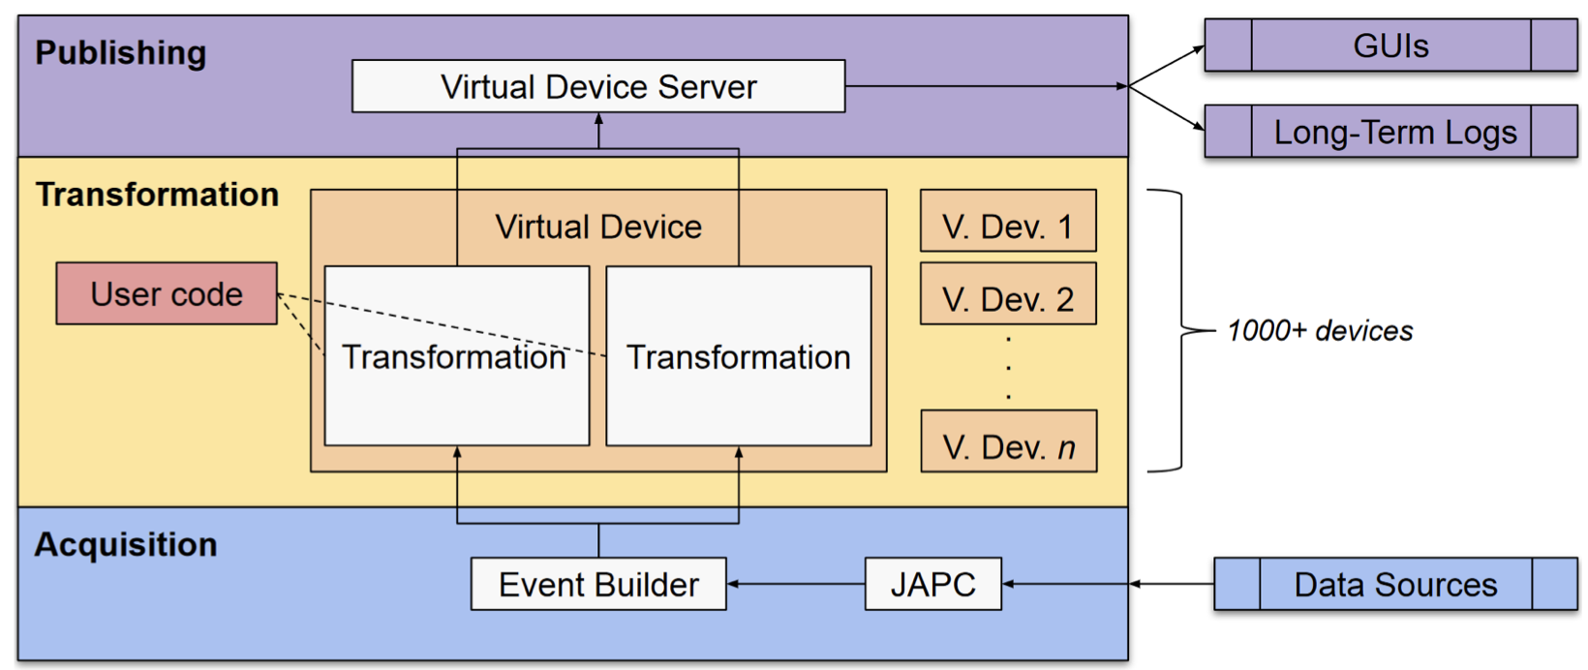
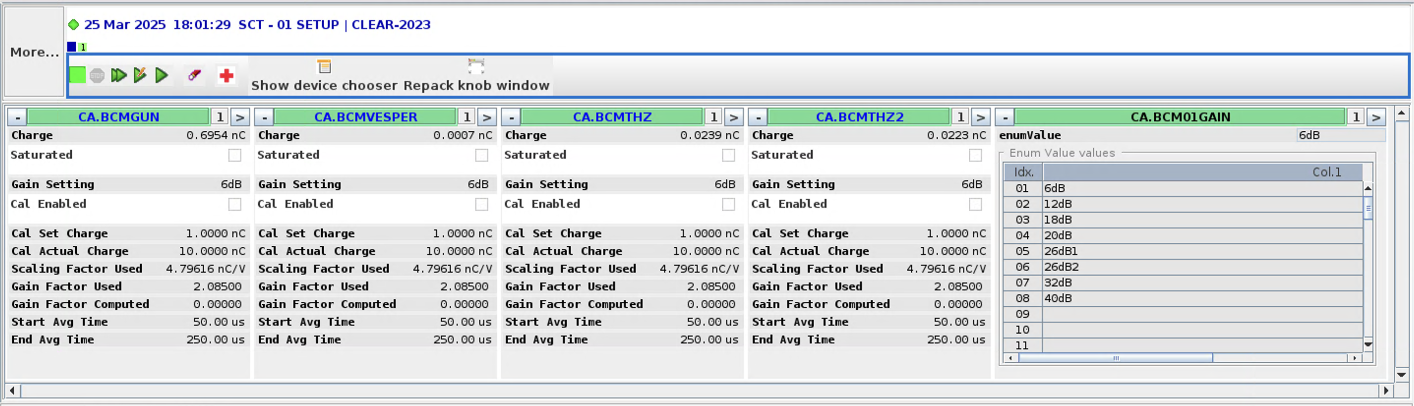

Consolidation & Improvements
PROCEDURE
SOFTWARE
II + ½ Standardize acquisition process
Leverage even more the CERN architecture:
  Developing new FESA classes to host virtual devices
  Leverage the power of UCAP architecture
CLEAR Scientific Board Meeting Antonio Gilardi (antonio.gilardi@cern.ch) 12/36

Slide 13
Consolidation & Improvements
HARDWARE
Not sufficient/inadequate diagnostics
  Screen based diagnostics
  System inconsistency
  Charge and laser power meter calibration
Not enough BPMs installed
Cavity BPMs without resonance cavity give only qualitative information
Inductive BPMs only work for trains and missing calibrations
Actions:
While installing the inductive BPMs on the second beamline we will take the time to properly calibrate and develop the one currently installed.
CLEAR Scientific Board Meeting Antonio Gilardi (antonio.gilardi@cern.ch) 13/36

Slide 14
Consolidation & Improvements
HARDWARE
PROCEDURE
SOFTWARE
Not sufficient/inadequate diagnostics
  Screen based diagnostics
  System inconsistency
  Charge and laser power meter calibration
Different type of screen/cameras installed over the beam line
Prototype style deployment
Actions:
Fully digital system.
Improved hardware control fetching data from FESA.
Installation clean-up with new hardware to be installed over summer shutdown.
CLEAR Scientific Board Meeting Antonio Gilardi (antonio.gilardi@cern.ch) 14/36

Slide 15
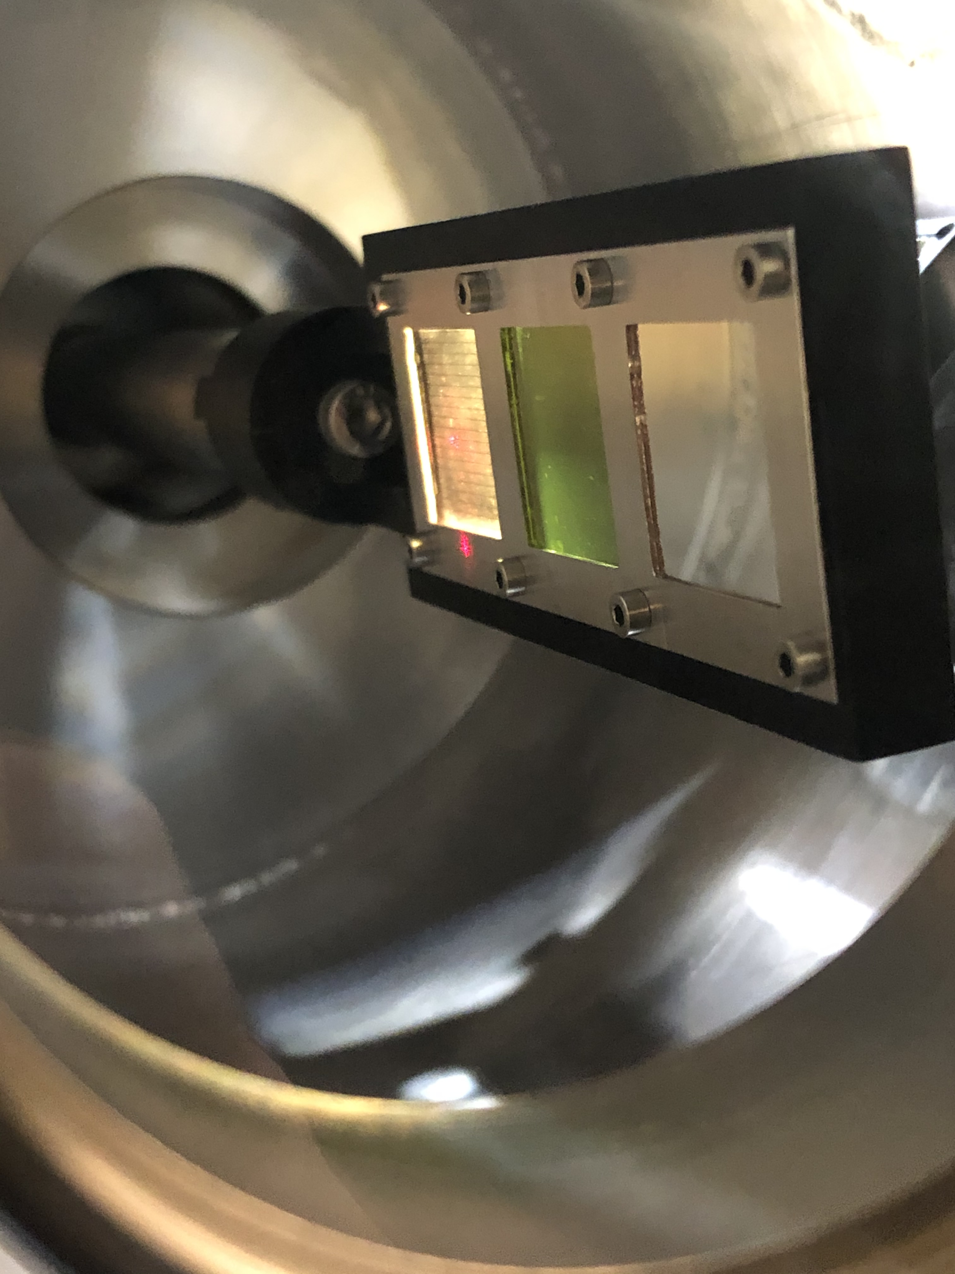
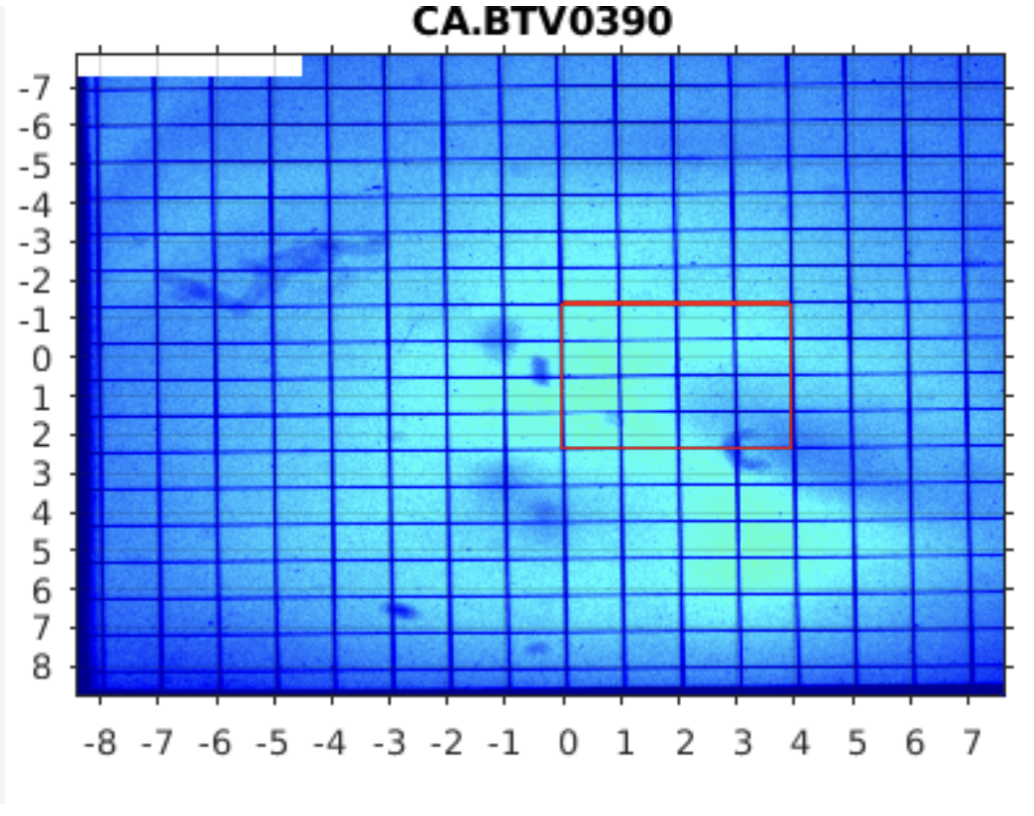
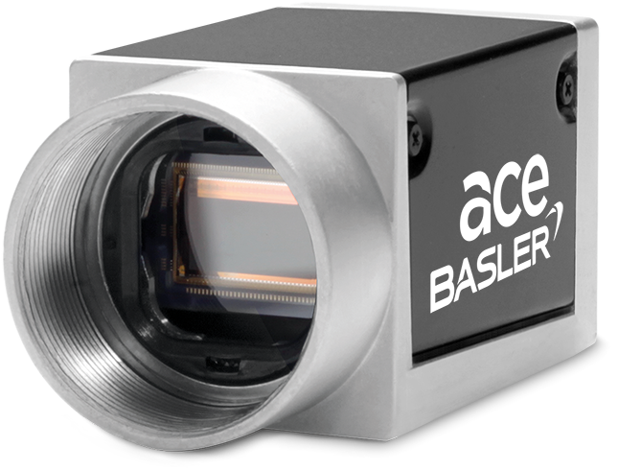
Consolidation & Improvements
HARDWARE
PROCEDURE
SOFTWARE
Not sufficient/inadequate diagnostics
  Screen based diagnostics
  System inconsistency
  Charge and laser power meter calibration
acA1920-40gm
CLEAR Scientific Board Meeting Antonio Gilardi (antonio.gilardi@cern.ch) 15/36

Slide 16
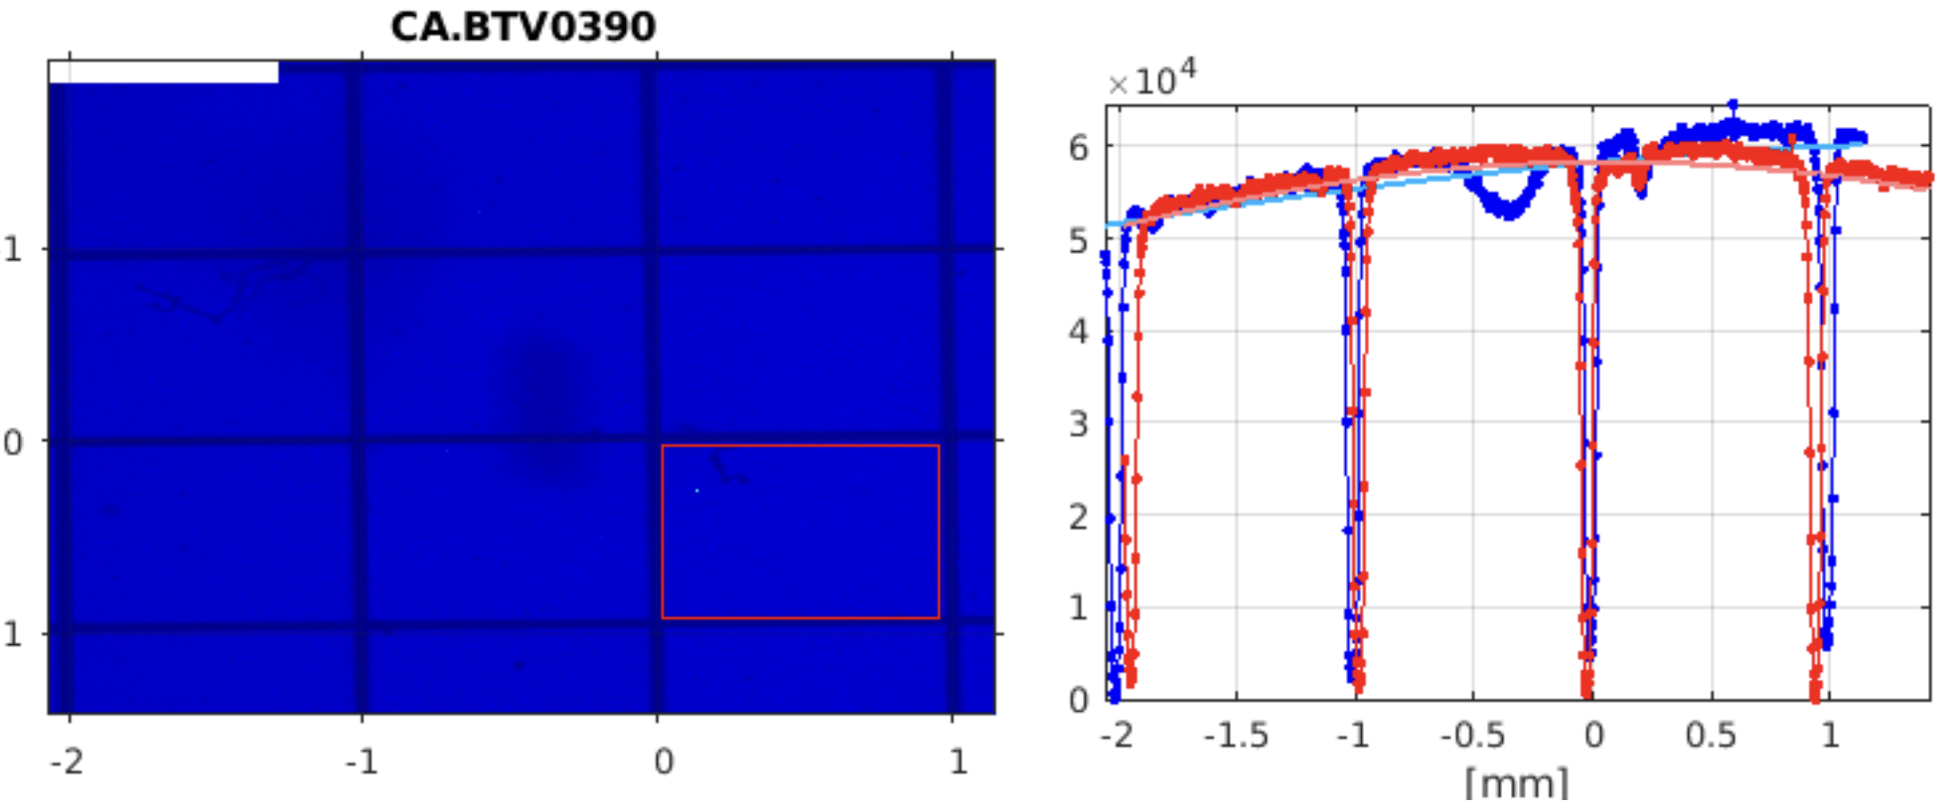
Consolidation & Improvements
HARDWARE
PROCEDURE
SOFTWARE
Not sufficient/inadequate diagnostics
  Screen based diagnostics
  System inconsistency
  Charge and laser power meter calibration
acA1920-40gm
CLEAR Scientific Board Meeting Antonio Gilardi (antonio.gilardi@cern.ch) 16/36

Slide 17
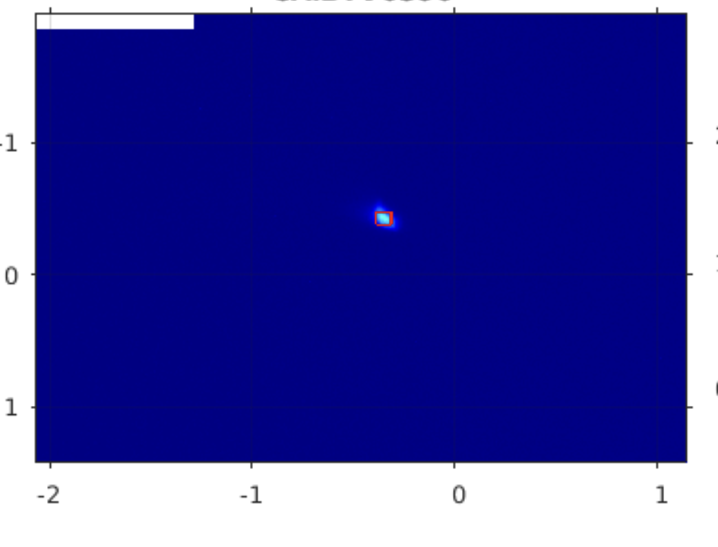


Consolidation & Improvements
HARDWARE
PROCEDURE
SOFTWARE
Not sufficient/inadequate diagnostics
  Screen based diagnostics
  System inconsistency
  Charge and laser power meter calibration
acA1920-40gm
$$30 x30 μm$$
Resolution of $\sim 3 μm$
CLEAR Scientific Board Meeting Antonio Gilardi (antonio.gilardi@cern.ch) 17/36

Slide 18
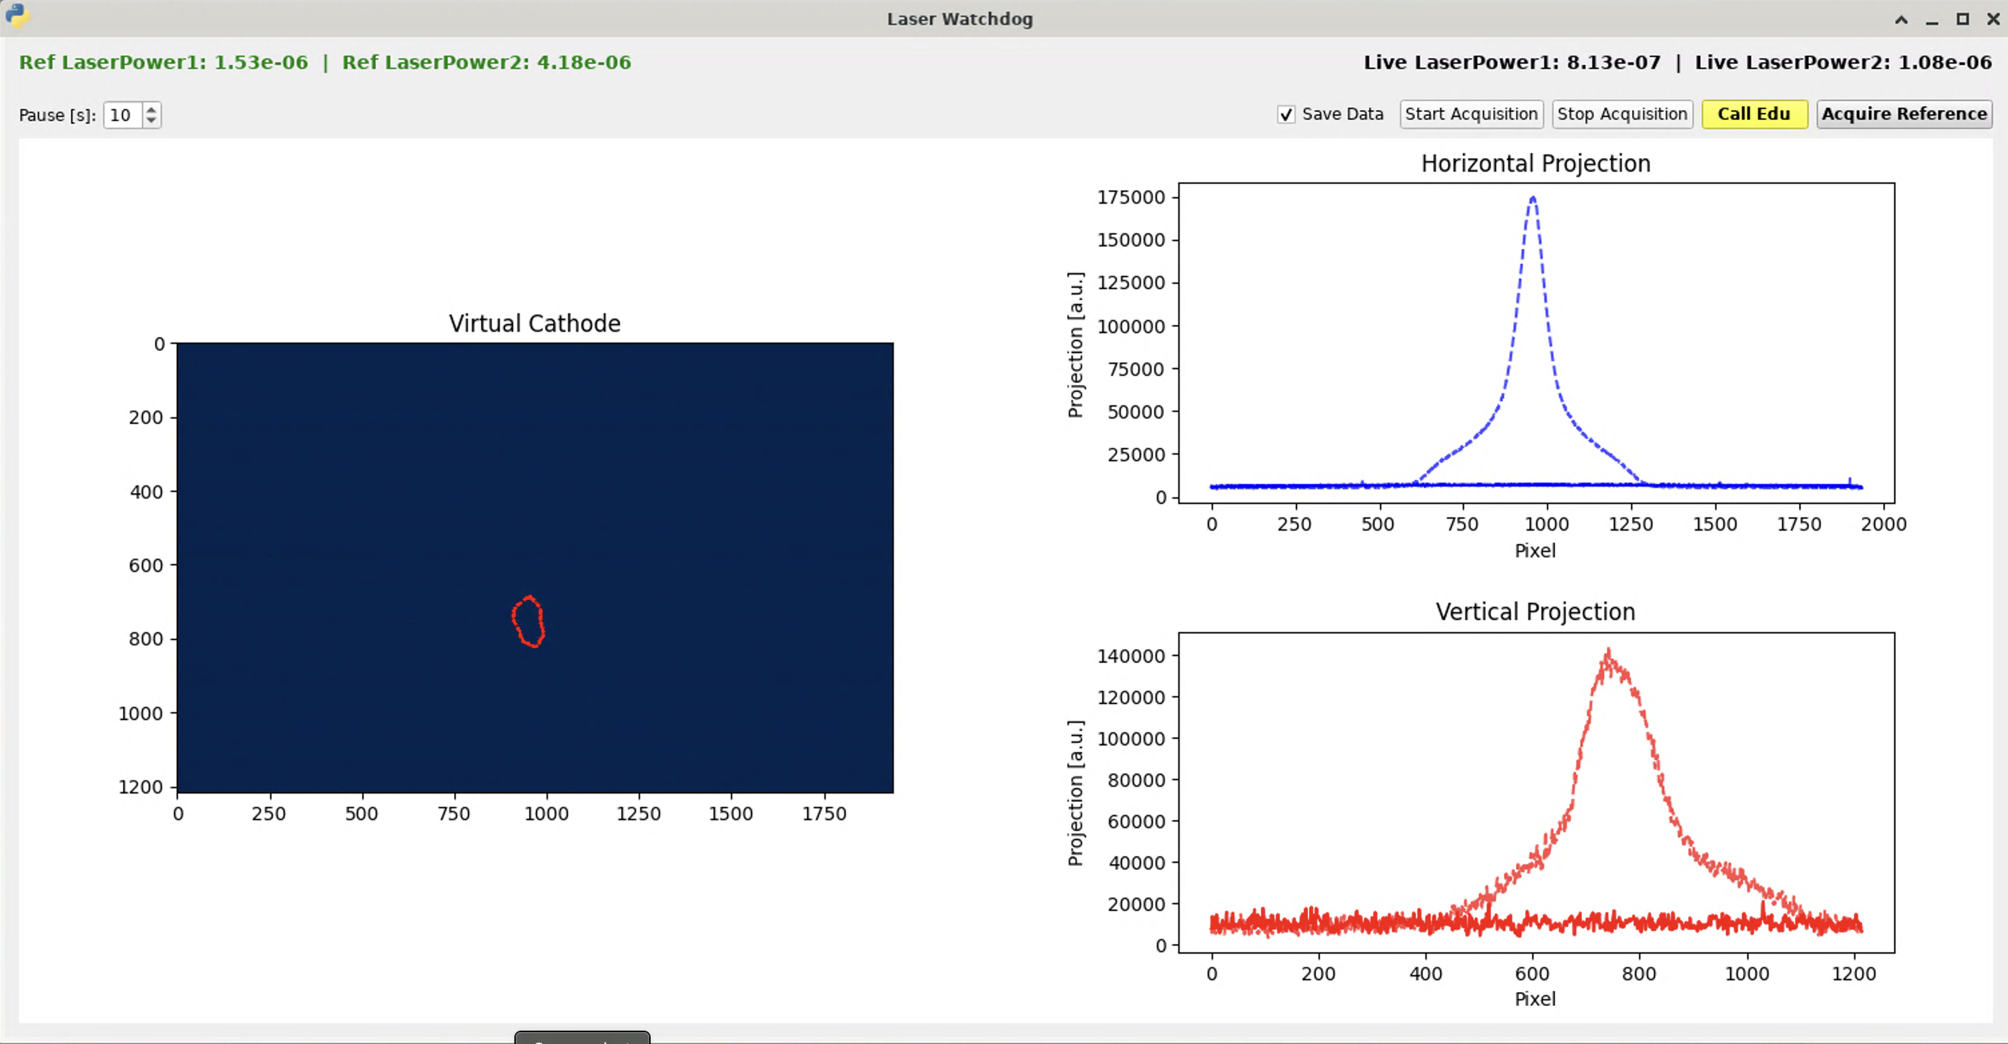
Consolidation & Improvements
HARDWARE
PROCEDURE
SOFTWARE
Not sufficient/inadequate diagnostics
  Screen based diagnostics
  System inconsistency
  Charge and laser power meter calibration
ICT calibration factor are old sparse over separate files
Power meter auto range via UCAP/LSA
Actions:
New ICT installed
Cross calibration to be performed
Laser watchdog implemented
Moving towards using FESA for parameter storing
CLEAR Scientific Board Meeting Antonio Gilardi (antonio.gilardi@cern.ch) 18/36

Slide 19
Consolidation & Improvements
PROCEDURE
Standardization
  Different operators - different styles
  Miscommunication
  Standard beam configuration
  Critical parameter monitoring
  Porting/debugging existing tools
CLEAR Scientific Board Meeting Antonio Gilardi (antonio.gilardi@cern.ch) 19/36

Slide 20
Consolidation & Improvements
PROCEDURE
Standardization
  Different operators - different styles
  Miscommunication
  Standard beam configuration
  Critical parameter monitoring
  Porting/debugging existing tools
Actions:
→ Weekly supervisor to coordinate and be always update on the status
→Trying to work in pairs during operation shifts
→ Organize the availability at the beginning of the week
CLEAR Scientific Board Meeting Antonio Gilardi (antonio.gilardi@cern.ch) 20/36

Slide 21
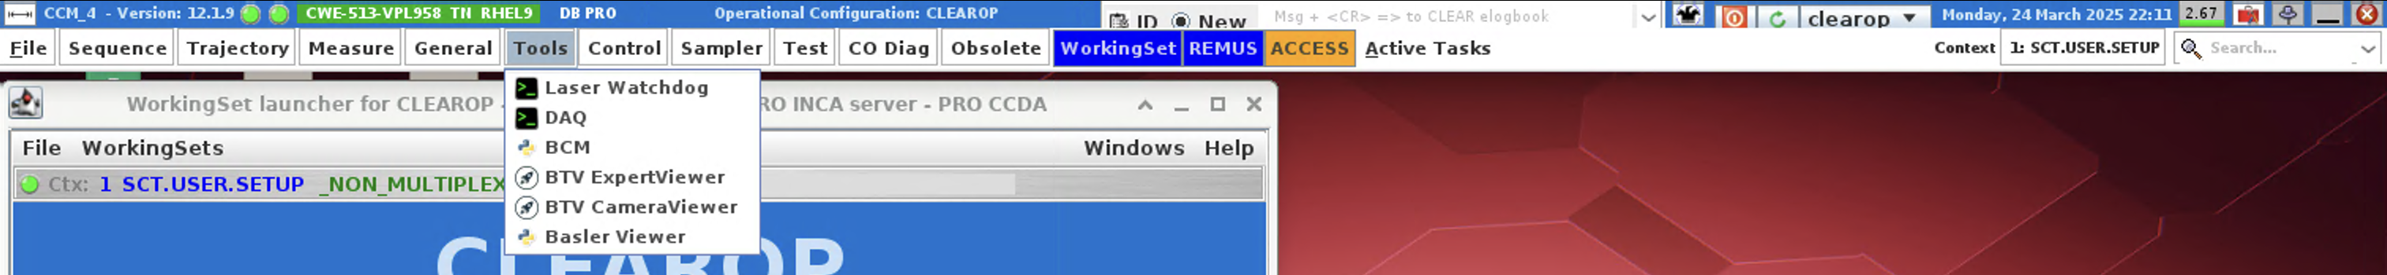
Consolidation & Improvements
PROCEDURE
SOFTWARE
Standardization
  Different operators - different styles
  Miscommunication
  Standard beam configuration
  Critical parameter monitoring
  Porting/debugging existing tools
Actions:
Fix conditions in the injector following a standard procedure for the optimization
Forcing ourselves to regularly perform QE/extraction checks using stable beam condition
Develop/use system monitoring/watchdog
CLEAR Scientific Board Meeting Antonio Gilardi (antonio.gilardi@cern.ch) 21/36

Slide 22
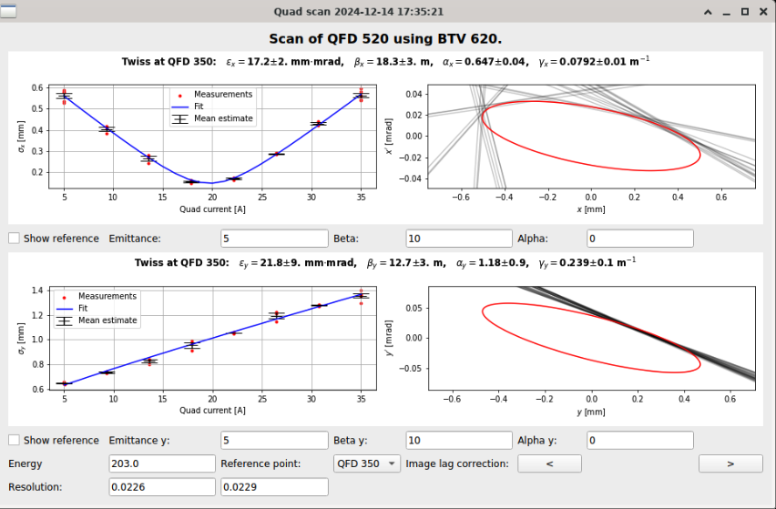
Consolidation & Improvements
PROCEDURE
SOFTWARE
Standardization
  Different operators - different styles
  Miscommunication
  Standard beam configuration
  Critical parameter monitoring
  Porting/debugging existing tools
Actions:
Going into operation critical tools and produce documentation
When needed a major debug/rework, it might be worth writing a new code using supported tool (case by case)
The new quadrupole scan procedure has allowed us to:
Achieve greater reproducibility
Gain better control over beam optics
Investigate effects that were previously not considered
CLEAR Scientific Board Meeting Antonio Gilardi (antonio.gilardi@cern.ch) 22/36

Slide 23
R&D as MD: A two way street
Often, we find ourselves needing a specific solution (personal interest or user driven) and end up leveraging MD time to build it.
When things align, this leads to highly productive MD sessions and allows us to pursue R&D efforts that can be directly applied to optimize the machine.
Few example:
New laser alignment system
Dosimetry study
Machine learning
Double bunch production
CLEAR Scientific Board Meeting Antonio Gilardi (antonio.gilardi@cern.ch) 23/36

Slide 24
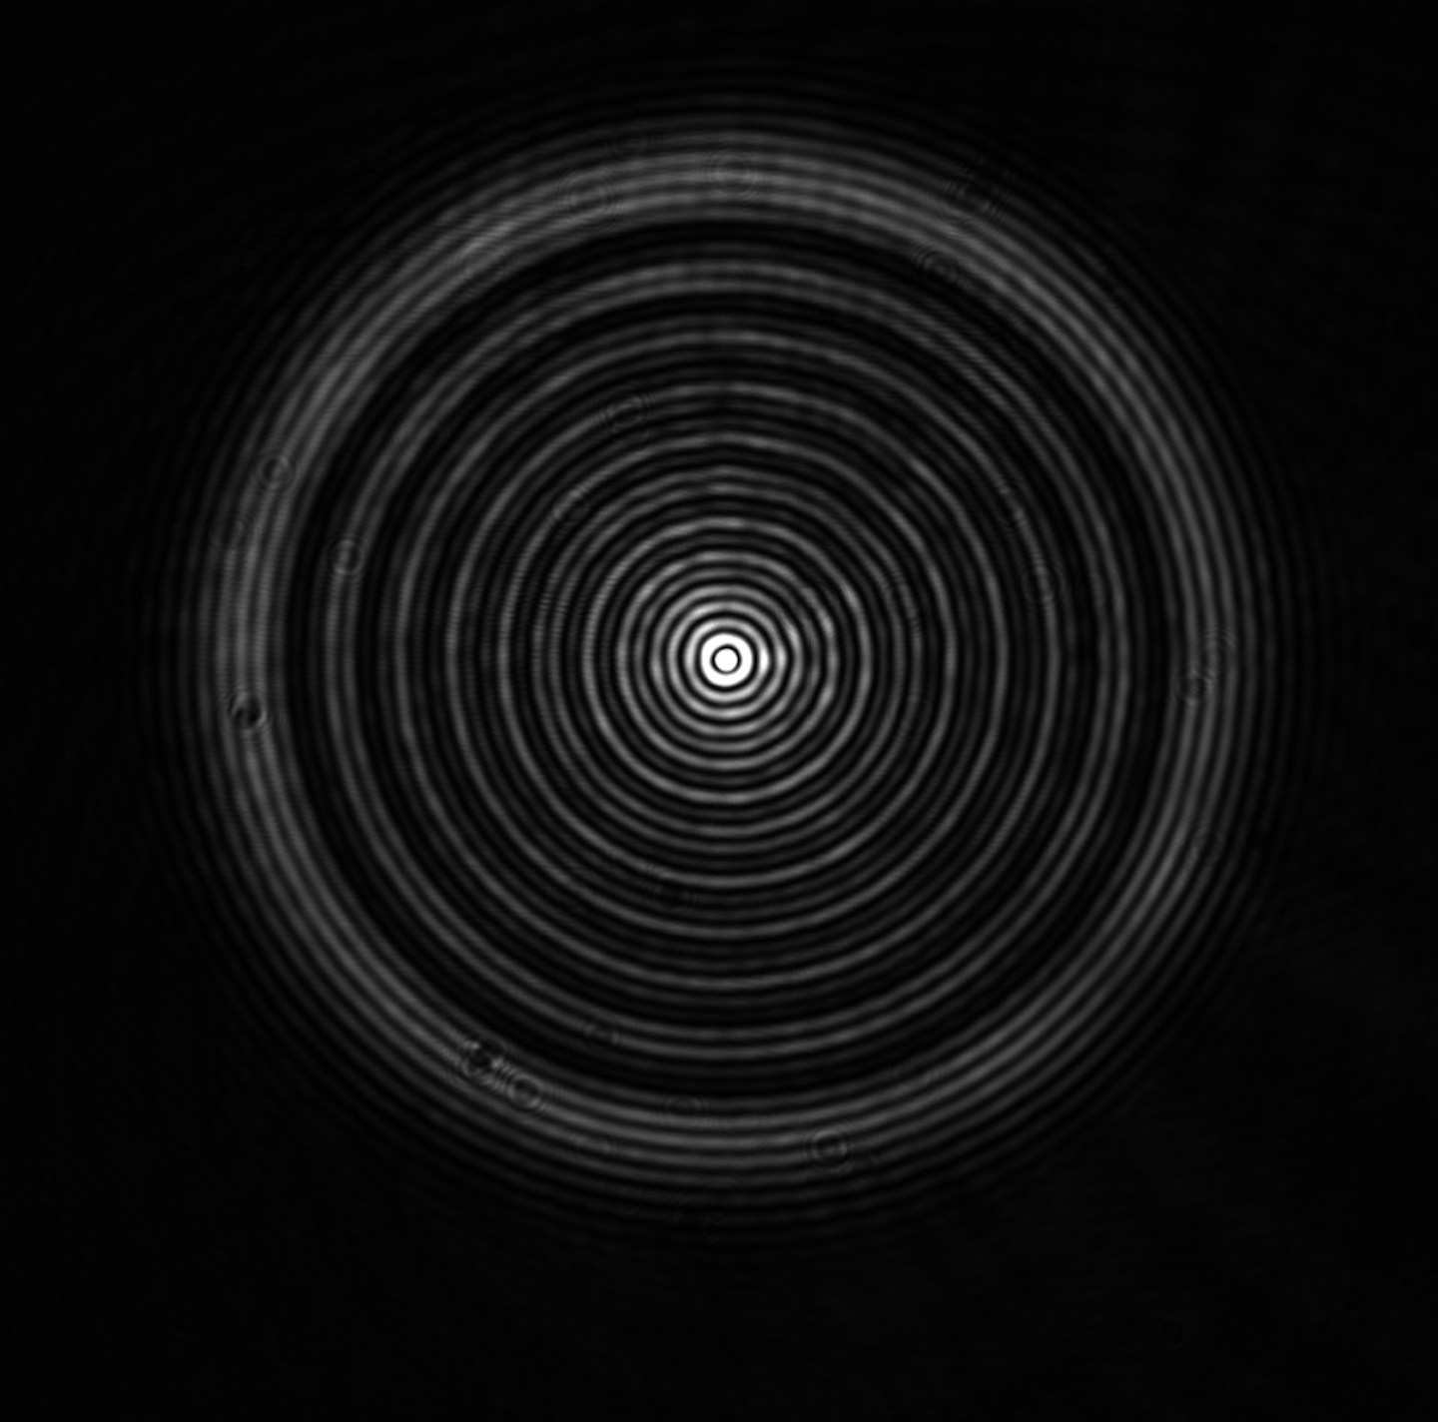
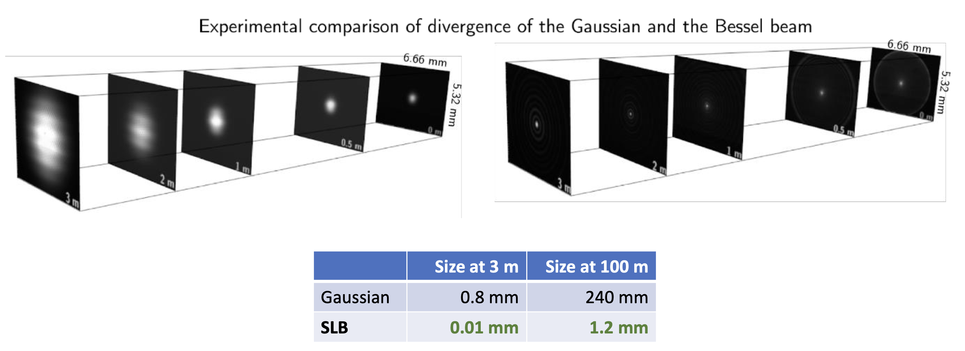
R&D as MD: A two way street
Often, we find ourselves needing a specific solution (personal interest or user driven) and end up leveraging MD time to build it.
When things align, this leads to highly productive MD sessions and allows us to pursue R&D efforts that can be directly applied to optimize the machine.
Few example:
New laser alignment system
Dosimetry study
Machine learning
Double bunch production
In collaboration with the BE-GM-ESA, we recently built and installed a new SLB laser on the beamline, injected into vacuum via mirrors.
Since our main diagnostic are screens, this setup will allow us to establish a stable and repeatable relative alignment system.
Thanks BE-GM-ESA
CLEAR Scientific Board Meeting Antonio Gilardi (antonio.gilardi@cern.ch) 24/36

Slide 25
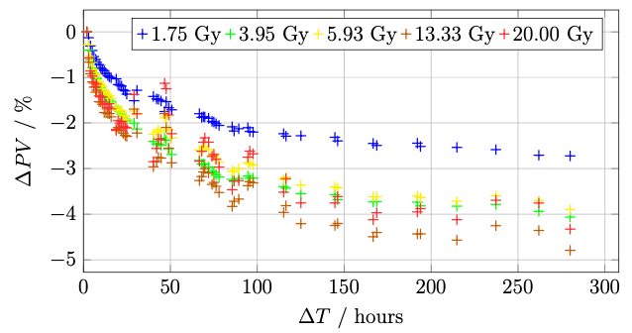
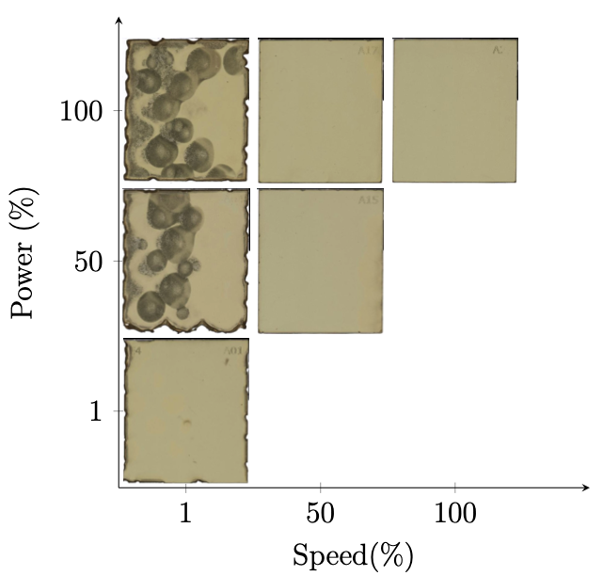

R&D as MD: A two way street
Often, we find ourselves needing a specific solution (personal interest or user driven) and end up leveraging MD time to build it.
When things align, this leads to highly productive MD sessions and allows us to pursue R&D efforts that can be directly applied to optimize the machine.
Few example:
New laser alignment system
Dosimetry study
Machine learning
Double bunch production
Thanks V. Rieker
A significant portion of our experiments are related to medical application.
This study requires extensive use of radiation-sensitive films.
Several studies have been conducted to develop reliable procedures and to better understand the behavior of these films.
CLEAR Scientific Board Meeting Antonio Gilardi (antonio.gilardi@cern.ch) 25/36

Slide 26
R&D as MD: A two way street
Machine learning
Two distinct branches of development can be identified in our recent efforts:
1. Simplifying accelerator operation — moving toward autonomous control:
Here, the focus is on streamlining day-to-day operations through automation, diagnostics, and control systems.
The goal is to reduce the complexity of manual tuning, improve reliability, and eventually enable more autonomous, hands-off operation of the accelerator
2. Enhancing accelerator performance to enable new measurements:
This includes improving beam quality, stability, and control, which directly expands the range and precision of experiments we can perform.
Simplifying accelerator operation
Enhancing accelerator performance
Autonomous beam trajectories optimization
Autonomous beam alignment
Beam energy evolution forecasting
Charge evolution forecasting
CLEAR Scientific Board Meeting Antonio Gilardi (antonio.gilardi@cern.ch) 26/36

Slide 27
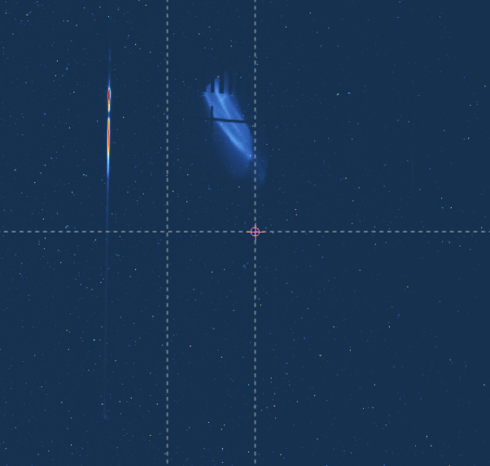
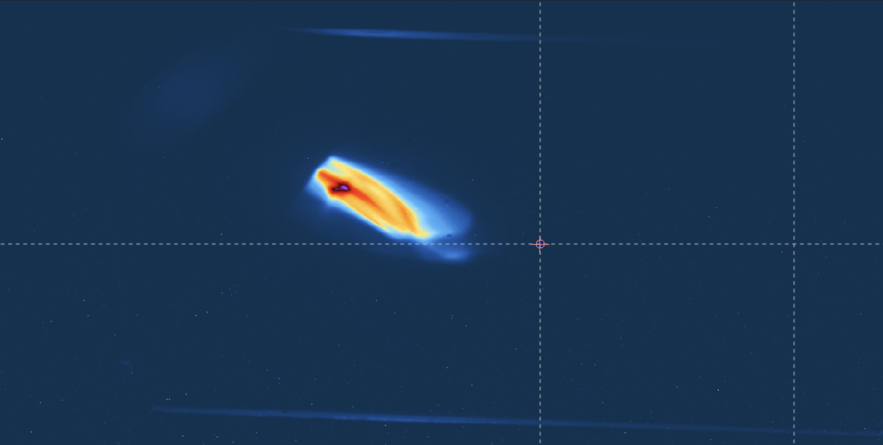
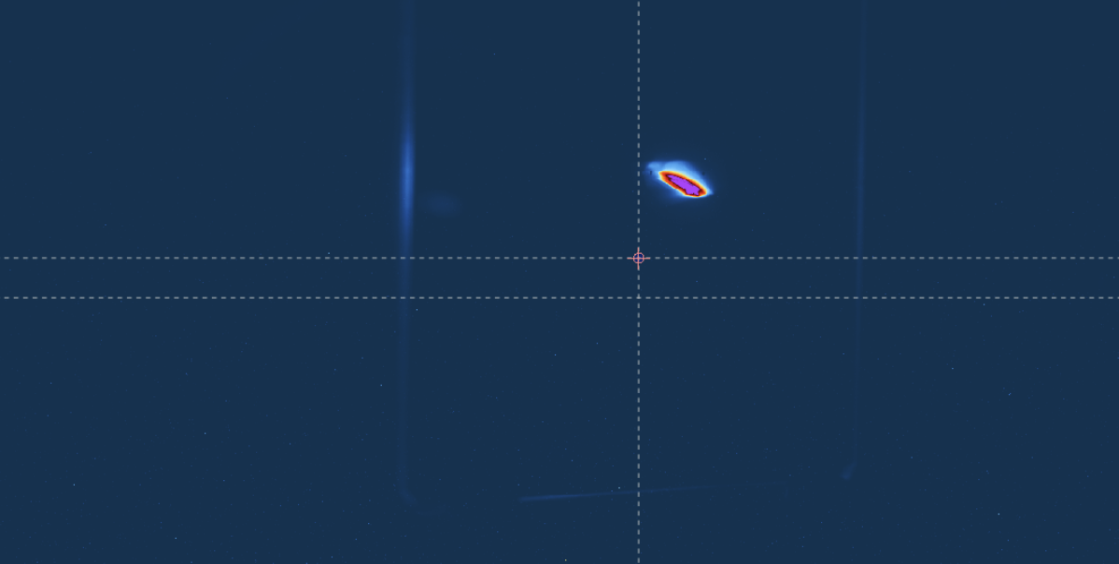
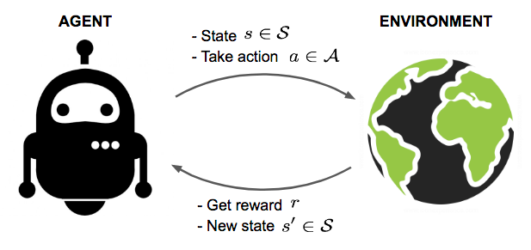
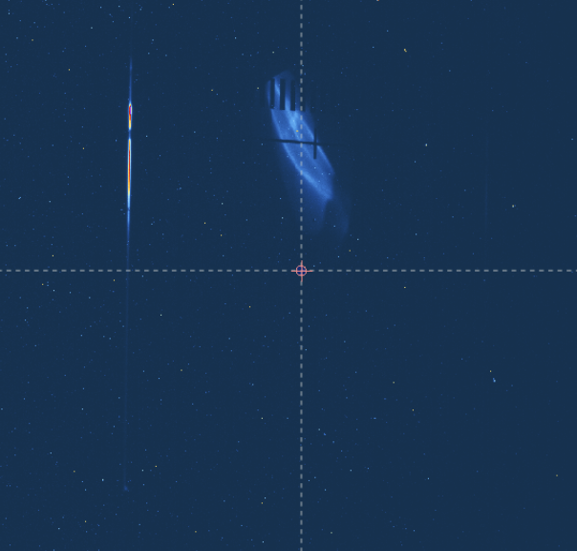
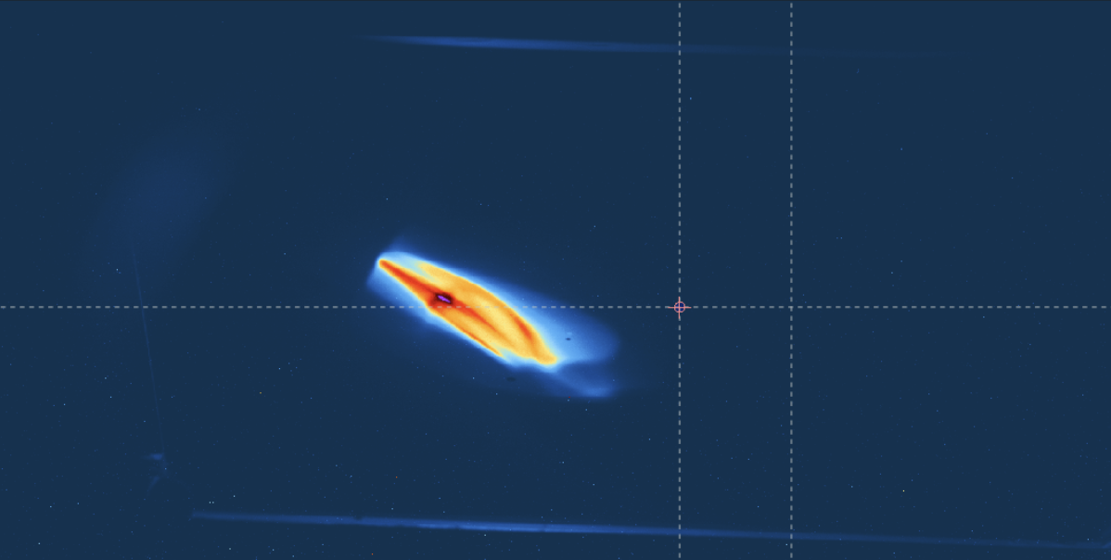
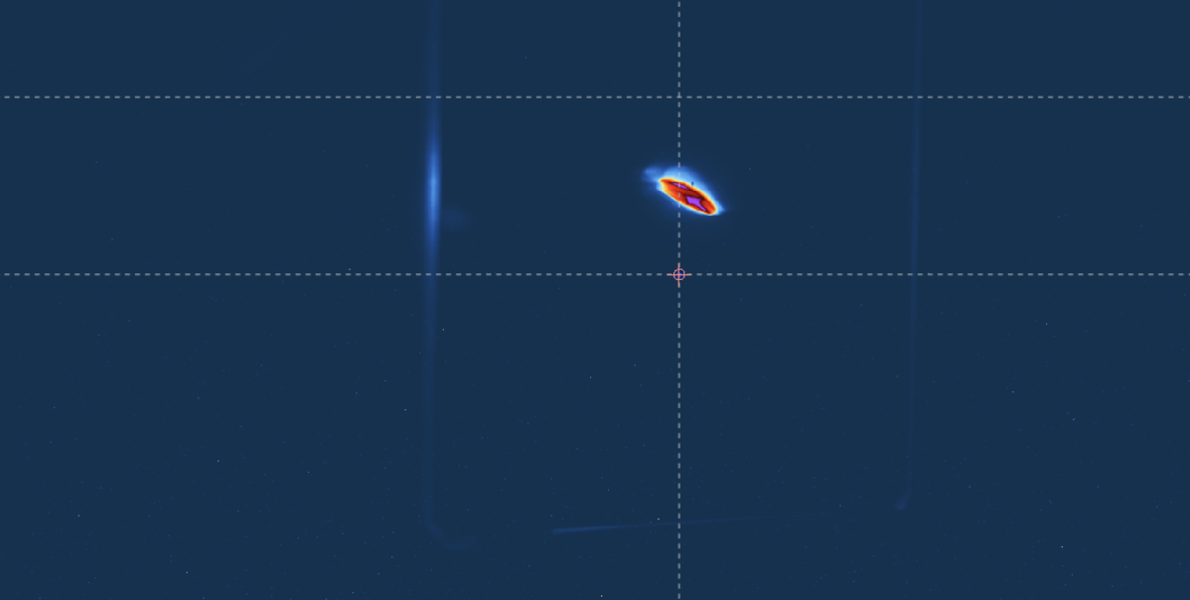
R&D as MD: A two way street
Spent approximately 14 hours training two agents (one for horizontal correction and one for vertical correction).
Machine learning
Simplifying accelerator operation
Autonomous beam trajectories optimization
Autonomous beam alignment
Before correction
Single shot correction
NOTE: The long training time was primarily due to the time required for the screen to move in and out. In the future, we plan to use non-invasive measurements (e.g., BPM) to improve efficiency.
CLEAR Scientific Board Meeting Antonio Gilardi (antonio.gilardi@cern.ch) 27/36

Slide 28
R&D as MD: A two way street
Spent approximately 14 hours training two agents (one for horizontal correction and one for vertical correction).
Machine learning
Simplifying accelerator operation
Autonomous beam trajectories optimization
Autonomous beam alignment
Single shot correction!!!
NOTE: The long training time was primarily due to the time required for the screen to move in and out. In the future, we plan to use non-invasive measurements (e.g., BPM) to improve efficiency.
CLEAR Scientific Board Meeting Antonio Gilardi (antonio.gilardi@cern.ch) 28/36

Slide 29
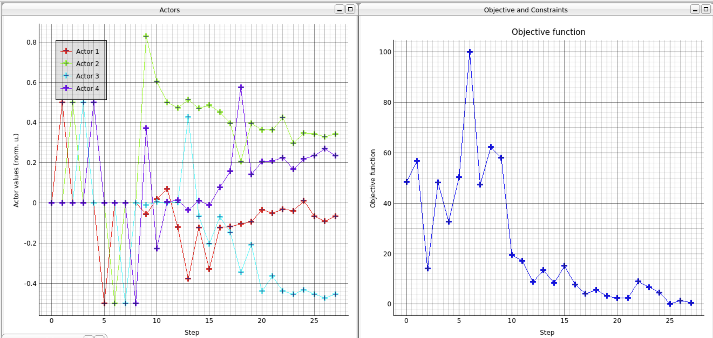
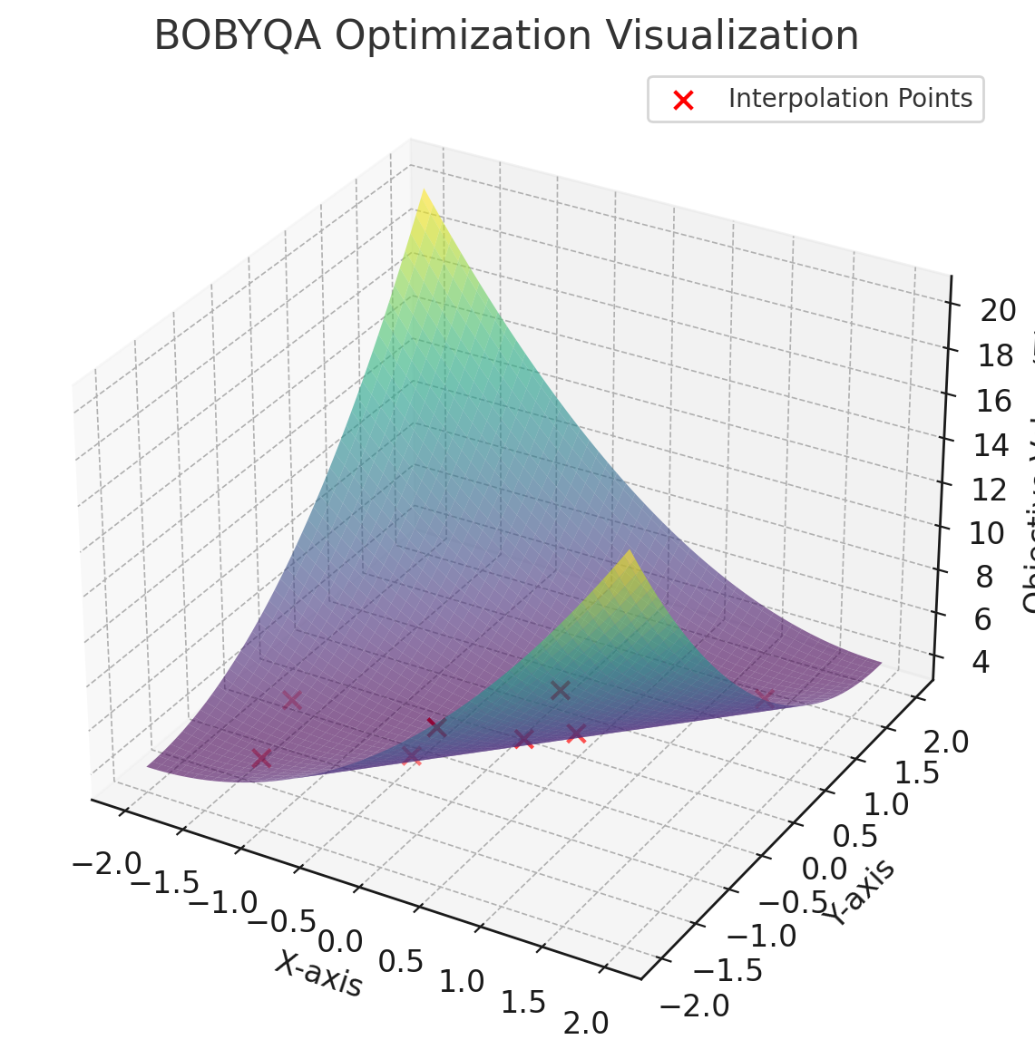
R&D as MD: A two way street
Machine learning
Simplifying accelerator operation
Autonomous beam trajectories optimization
Autonomous beam alignment
Automated alignment loop by inserting a screen after a quadrupole, applying a dither, and evaluating the resulting beam displacement.
Based on an objective function, orbit corrections are applied iteratively until alignment is achieved — typically in under 5 minutes.
This optimization-based method proved fast and effective.
Bayesian Optimization approach
CLEAR Scientific Board Meeting Antonio Gilardi (antonio.gilardi@cern.ch) 29/36

Slide 30

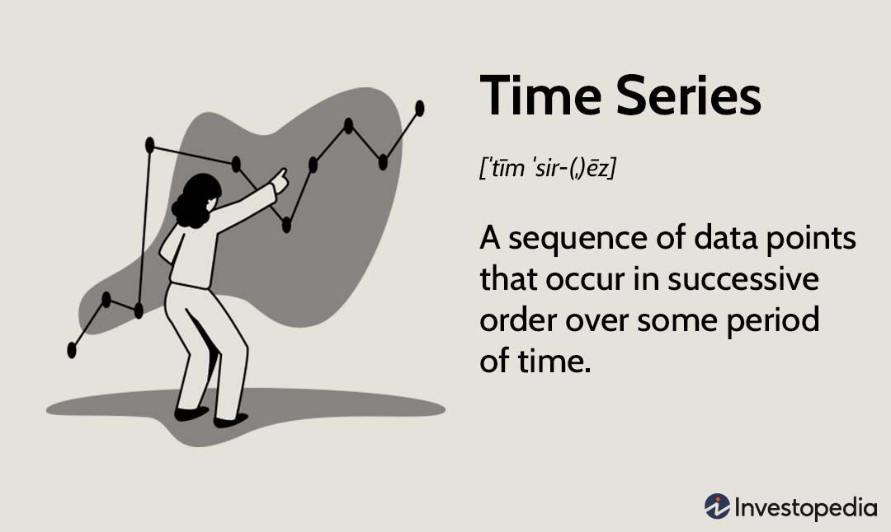
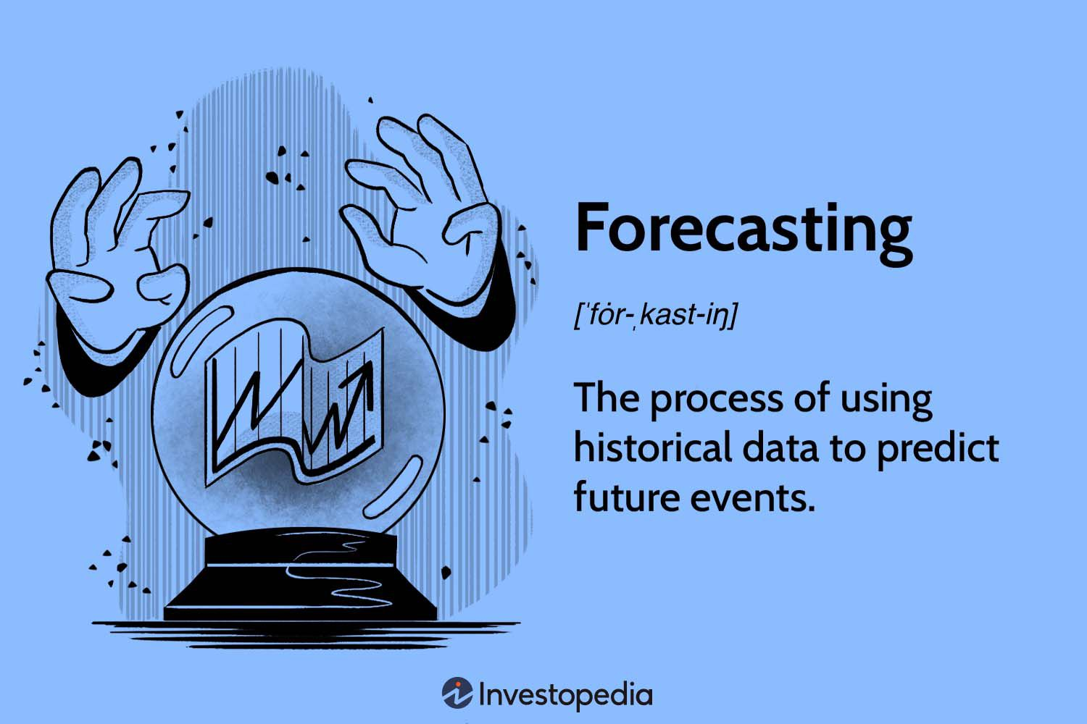
R&D as MD: A two way street
Machine learning
Enhancing accelerator performance
y
y
Beam energy evolution forecasting
Charge evolution forecasting
x (i.e., energy)
x (i.e., energy)
Thanks to:
CLEAR Scientific Board Meeting Antonio Gilardi (antonio.gilardi@cern.ch) 30/36

Slide 31







R&D as MD: A two way street
Machine learning
Enhancing accelerator performance
y
y
Beam energy evolution forecasting
Charge evolution forecasting
x (i.e., energy)
x (i.e., energy)
SINGLE SHOOT PREDICTION
X
$$X_{RF}$$
$$X_{Screen}$$
$$Y$$
$$t$$
$$y_{predicted}$$
$$t_{1}$$
$$t_{2}$$
CLEAR Scientific Board Meeting Antonio Gilardi (antonio.gilardi@cern.ch) 31/36

Slide 32





R&D as MD: A two way street
Machine learning
Enhancing accelerator performance
y
y
Beam energy evolution forecasting
Charge evolution forecasting
x (i.e., energy)
x (i.e., energy)
LOOP PREDICTION
X
$$X_{RF}$$
$$X_{Screen}$$
$$y$$
$$y_{predicted}$$
$$t_{1}$$
$$t_{2}$$
CLEAR Scientific Board Meeting Antonio Gilardi (antonio.gilardi@cern.ch) 32/36

Slide 33
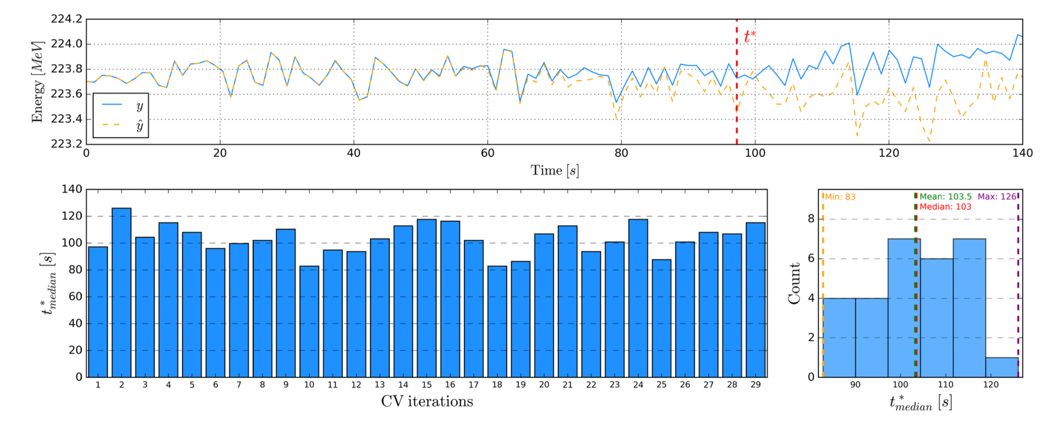
R&D as MD: A two way street
Machine learning
Enhancing accelerator performance
y
y
Beam energy evolution forecasting
Charge evolution forecasting
x (i.e., energy)
x (i.e., energy)
LOOP PREDICTION
X
$$X_{RF}$$
$$X_{Screen}$$
$$y$$
$$y_{predicted}$$
$$t_{1}$$
$$t_{2}$$
CLEAR Scientific Board Meeting Antonio Gilardi (antonio.gilardi@cern.ch) 33/36

Slide 34

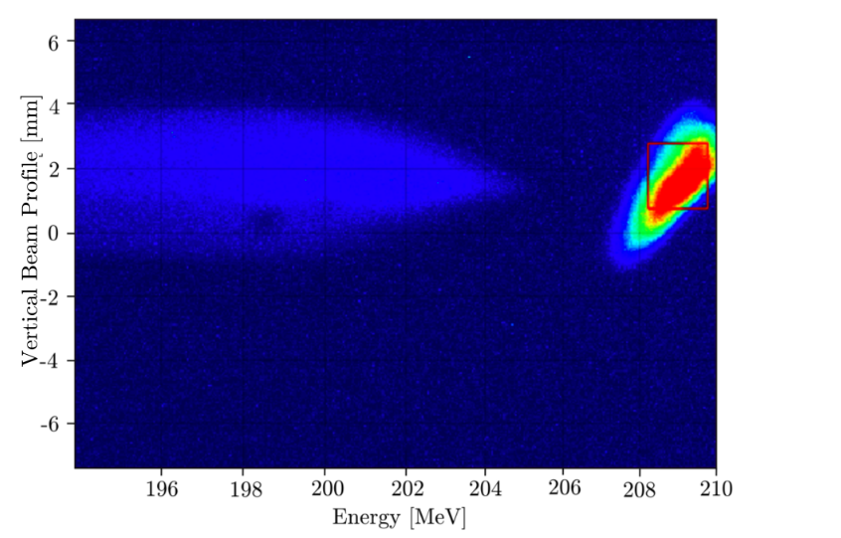
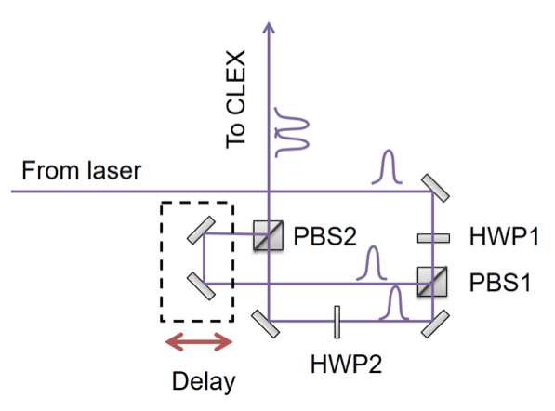


R&D as MD: A two way street
Double bunch production
We have the flexibility to inject two laser pulses into the same RF bucket with a tunable delay between them.
Thanks L. Dyks and E. Granados
2^{snd} bunch
Thanks Plasma lens team
Thanks E. De La Fuente
1st bunch
Electromagnetic fields
During a recent discussion with the AWAKE team, it became clear that there is strong interest in exploring this capability.
As a result, we are now preparing an MD/experiment to investigate it further.
After all—what if?
CLEAR Scientific Board Meeting Antonio Gilardi (antonio.gilardi@cern.ch) 34/36

Slide 35
On going collaboration
BI Collaboration:
Beyond BI being one of our main users, we also maintain a strong collaboration with the BI team.
CLEAR is the first facility where the new standard BTV acquisition and control system is deployed. Development of the camera interface (GUI) is ongoing as part of this joint effort.
EPA Collaboration:
Last year, a successful experiment clearly demonstrated CLEAR's potential as a testbed for developing and validating new paradigms in accelerator control.
Another experimental campaign is planned for this year, with more to follow.
BE-GM-ESA Collaboration:
We are currently developing the SLB beam for its first tests on a large-scale accelerator.
We are about to carry out tests to assess its performance.
ML Collaboration:
Exciting collaborations are underway both within CERN and with external partners.
Soon, we will begin testing multi-agent optimization and meta-reinforcement learning approaches for accelerator control.
CLEAR Scientific Board Meeting Antonio Gilardi (antonio.gilardi@cern.ch) 35/36

Slide 36
Conclusion
Over the past months, we’ve faced real challenges — from scheduling constraints and diagnostic limitations to an increasing number and complexity of user demands.
The team has been evolving over time, expanding and contracting, which makes implementing long-term, consistent approaches more challenging.
We are pushing forward, constantly questioning ourselves, learning from our mistakes, and seeking better solutions (at least trying to!).
We now have a clearer vision of our priorities and next steps, but of course, feedback, suggestions, and new ideas are always welcome.
Our research lines are growing — diverse, ambitious, and full of potential.
The journey to a better CLEAR is far from over—but it’s well underway.
CLEAR Scientific Board Meeting Antonio Gilardi (antonio.gilardi@cern.ch) 36/36

Slide 37


Thanks!
for the attention
If any questions

Slide 38
Operation Status
Difficulties identified:
  Schedule issue
  User organization/support
  Not sufficient/inadequate diagnostics
    Screen based diagnostics
    System inconsistency
  Standardization
    Standard beam configuration
    Critical parameter monitoring
    Different operators - different styles
    Miscommunication
  Hand based operation
    Prone to human error
    Subject to stop in sub-optimal conditions

Slide 39


Consolidation & Improvements
HARDWARE
Not sufficient/inadequate diagnostics
  Screen based diagnostics
  System inconsistency
  Charge and laser power meter calibration
CLEAR Scientific Board Meeting Antonio Gilardi (antonio.gilardi@cern.ch) 2/100

Slide 40


R&D as MD: A two way street
Often, we find ourselves needing a specific solution (personal interest or user driven) and end up leveraging MD time to build it.
When things align, this leads to highly productive MD sessions and allows us to pursue R&D efforts that can be directly applied to optimize the machine.
Few example:
New laser alignment system
Beam tomography
Dosimetry study
Machine learning
Double bunch production
Thanks A. Aksoy
To better understand the beam conditions in our beamline, we carried out a beam tomography study (simulation and experiment) with the aim of studying the different bunch trajectories.
CLEAR Scientific Board Meeting Antonio Gilardi (antonio.gilardi@cern.ch) 2/100

Slide 41







R&D focus

