Slide 1


CLEAR facility status and execution of the 2024 experimental program
W. Farabolini on behalf of the CLEAR team

Slide 2
CLEAR summary of operations weeks - 2024
From: https://pkorysko.web.cern.ch/CLEAR/Table/CLEAR_Weekly_Reports_2024.html

Slide 3
Extracted performance figures
2024
- 37 weeks of beam
- 318 hours of set-up installation
- 250 accesses with the radioprotection call
- 1222 hours of beam
- 68 hours of fatal failure
- 11 Saturday and 4 Sunday worked
(partial day but not all documented)
- 1.8 experiments per week in average
2023
- 37 weeks of beam
- 279 hours of set-up installation
- 230 accesses with the radioprotection
- 1209 hours of beam
- 40 hours of fatal failure
- 1.9 experiments per week in average
Surprisingly constant overall figures (1.8 experiments per week)
But much more MD, mixed within external user’s week
- Internal research program on Machine Learning: a new fellow (Anto),
a PhD (Giacomo) and a technical student (Ondrej)
Quad scan tools by another technical student (Alfred)
Flat beam delivery and dosimetry (Pierre, Alex, Vilde)

Slide 4
Field of experiments and origins of the requests
University/education
ESI
Eurolabs
Manchester Univ.
Oxford Univ.
Victoria Univ.
Liverpool Univ.
Sheffield Univ.
Strathclyde Univ.
Oslo Univ.
La Sapienza Univ.
Tor Vergata Univ.
Institutes
PSI
HUG
UNIGE
EPFL
Gustave Roussy
INFN Bologna
INFN Padova
KIT
IJC-Lab
LPSC
Cockcroft
Companies
BERGOZ
DAES
CERN
ABP
BI

Slide 5
Beam availability
Fatal failure time: 68 hours (94.4 % beam availability)
    last year 40 hours (96.7 % availability)
  Water cooling tower cracks
  Power cuts (planned or accidental)
  Cathode quantum efficiency
  Laser (diode cooling, ventilation, oscillator, pulse picker)
  Klystron replacement
  Robot grabber
  Camera
Consolidation program achieved
  Water cooling tower support reinforced (exchange foreseen next summer)
  Turbo-pump controllers installed in the klystron gallery
  All digital cameras (new CERN standard)
  Cathode rejuvenated during winter shutdown

Slide 6
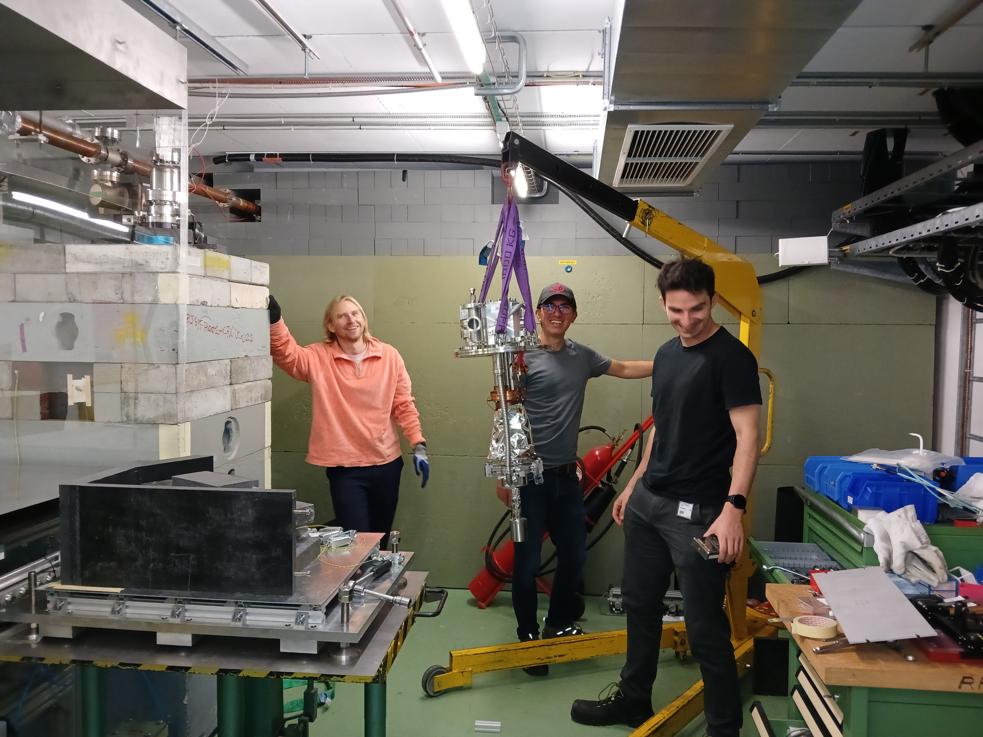
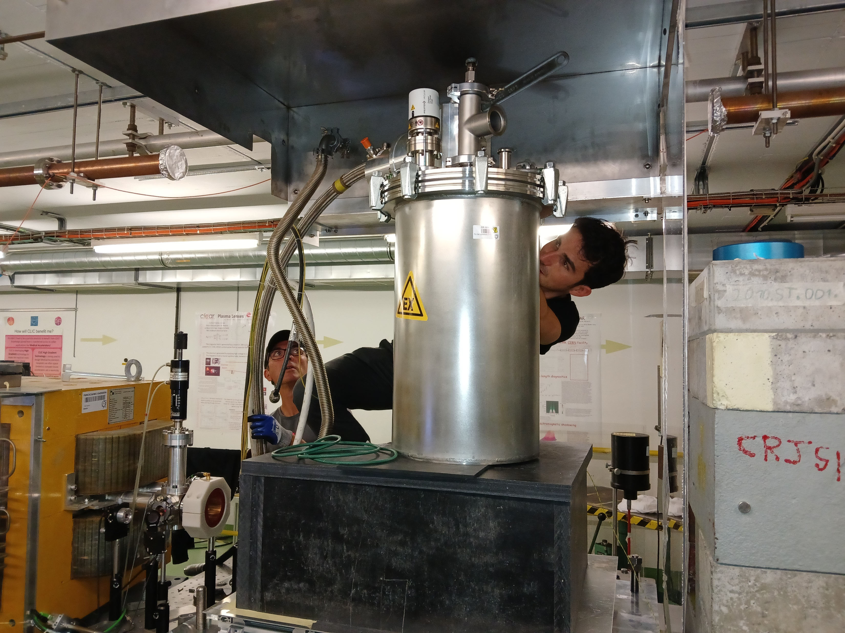
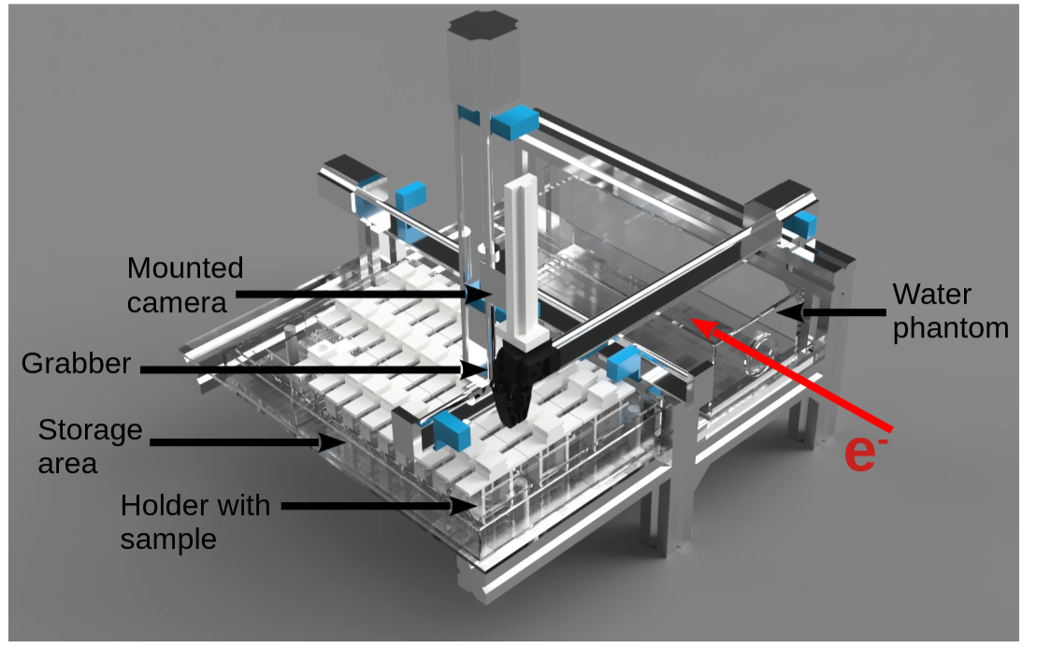
Some noticeable achievements
Plasma Lens experiment resumed with Oslo U. (magnetized plasma for controlled electron density).
VULCAN neutron target / cryogenic moderator successfully tested (3 weeks of beam after intensive development collaboration between DAES and the CLEAR team).
Knowledge transfer on a new handling robot and films preparation with PITZ and Melbourne.
The VULCAN experiment installation and the new robot

Slide 7
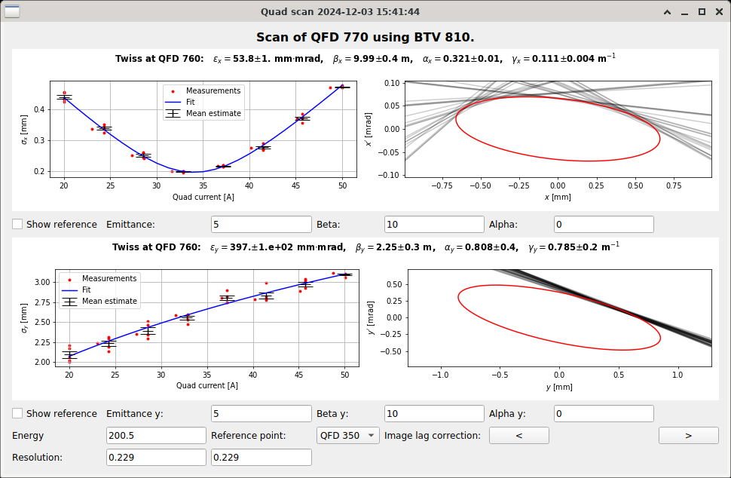
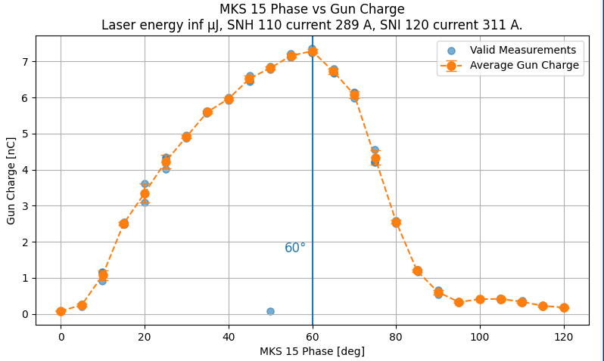
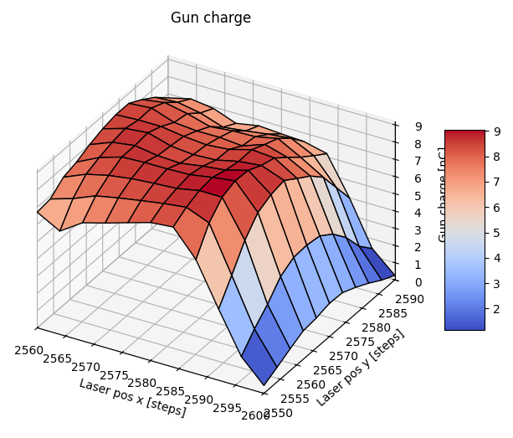
Optimized methods and additional manning
For increasing operations efficiency, the CLEAR team is engaged in the development of standard methods:
  Set of beam parameters applicable to most of the beam requests,
  Tools for fast beam checking and optimization (ML, beam base alignment, parameters scan…),
  Systematic beam check every morning for identifying machine drift or failures,
  Reference person allocated to each experiment.
The team has been reinforced this year: a new fellow, a PhD student, 2 technical students, a FSU for mechanics (shared with RF). Unfortunately, other members have left (3) or are going to leave (3).
Quad scan, RF phase scan and Laser position scan (A. Petersson, G. Tangari, O. Franek)

Slide 8
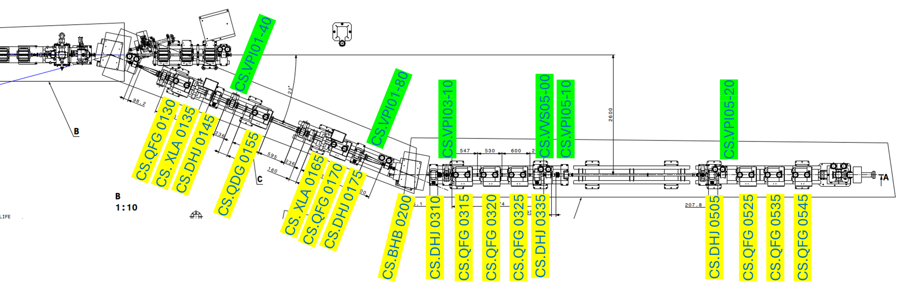
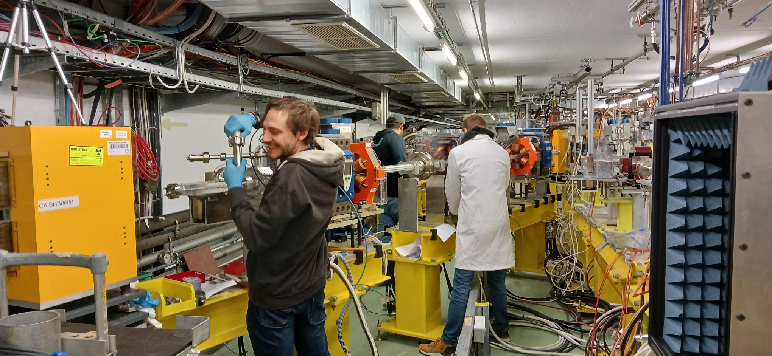
Second beam line construction
Installation of the second beamline progressed even further than expected during the winter shutdown (Alpaslan, the new FSU was instrumental, as well as the support of SY-RF-MKS and the whole CLEAR team).
  Girders fixed according to the footprint drawn by the survey (BE-GM-ASG)
  RP sensors installed and tested (HSE-RP-AS)
  9 Quads, 2 sextupoles, 1 dipole installed (EN-HE-HH) and aligned (BE-GM-ASG)
  All DC cables pulled in place (still to be connected, as well as water cooling)
  Other cables (BPMs, vacuum control) identified (SY-BI-BP, TE-VSC-ICM)
  All power supplies validated and already existing in the gallery (SY-EPC-MPC)
  Rectangular chamber installed and vacuum tested (TE-VSC-IVO)
  Drawings adapted in real time by EN-MME-EDS when difficulties are encountered
Beam line drawing and construction

Slide 9
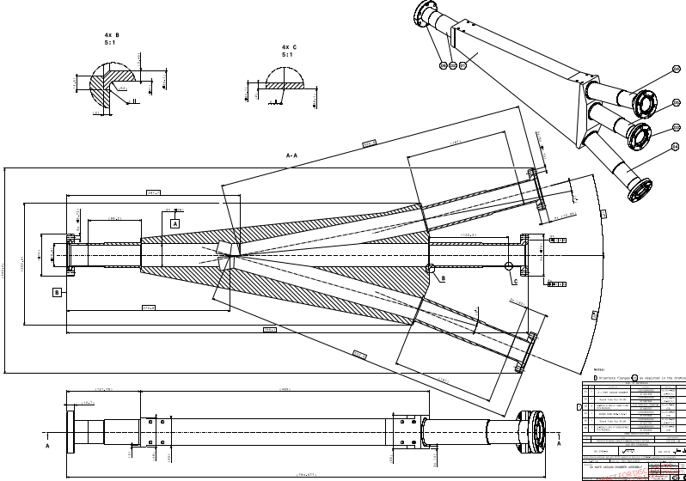
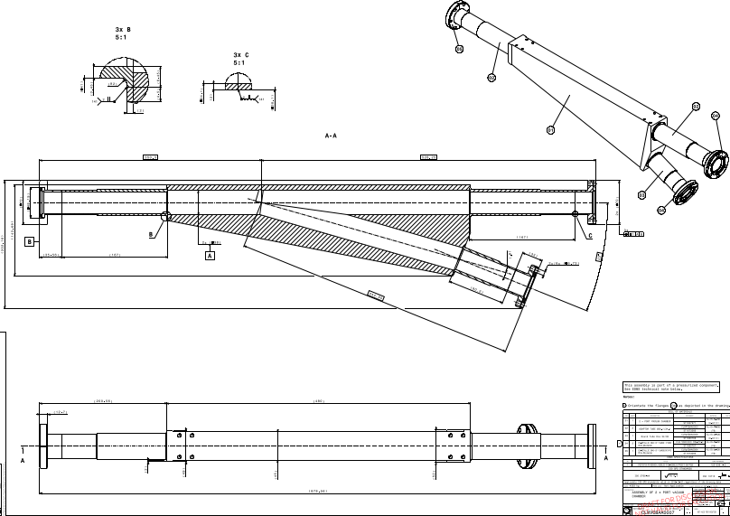
Second beam line, still to be achieved
Manufacturing of the 2 chambers inside the dipoles (EN/MME)
Correctors installation (TE/MSC are revising them)
BPMs and MTV screens preparation and installation (SY/BI and CLEAR team)
Vacuum equipment integrated control (TE/VSC)
Replacement and alignment of the first dipole.
Beam dump construction and new breadboard installation
The two dipole chambers (EN/MME)

Slide 10
Conclusions
2024 was another very productive year for CLEAR.
CLEAR attractivity to the external and internal user community remains strong.
In addition, the CLEAR team is currently developing its own researches in Machine Learning and automatic beam settings to improve its efficiency, with the support of PhD and technical students.
Medical applications represent a growing sector for beamtime demands, and CLEAR methods are being exported.
Complex experiments, requiring much larger effort than beam delivery have been performed.
Simultaneously, the construction of second beam line is progressing.

