Slide 1

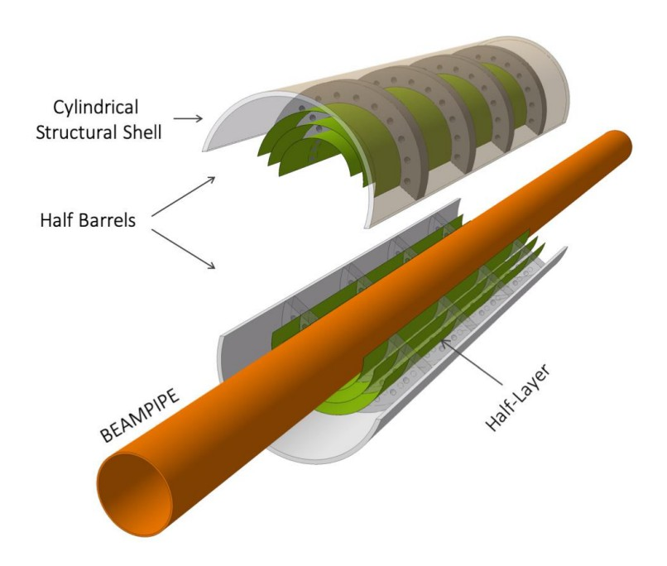

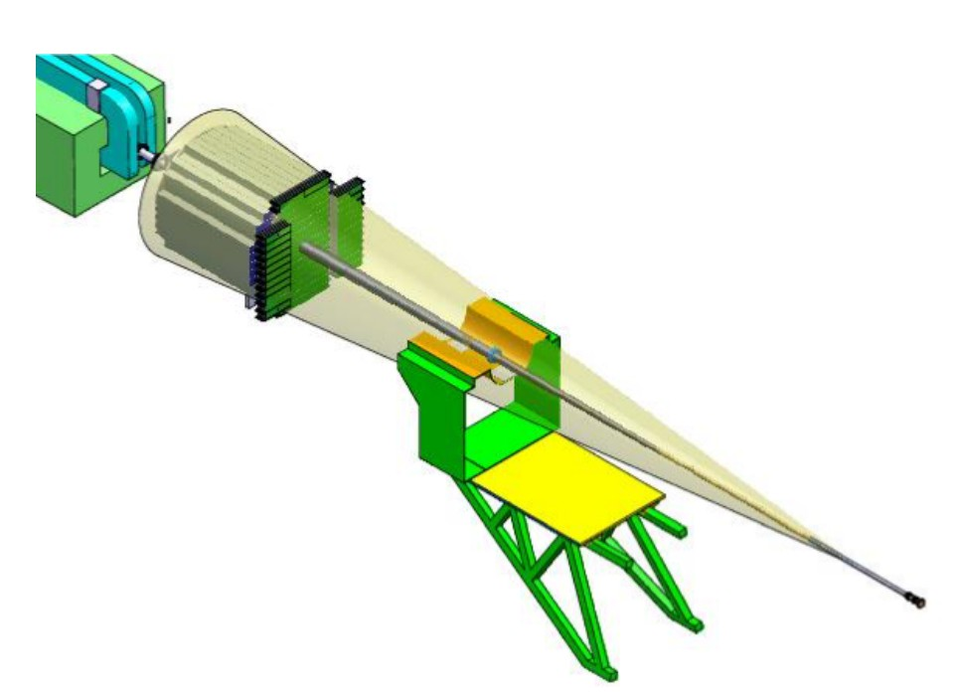

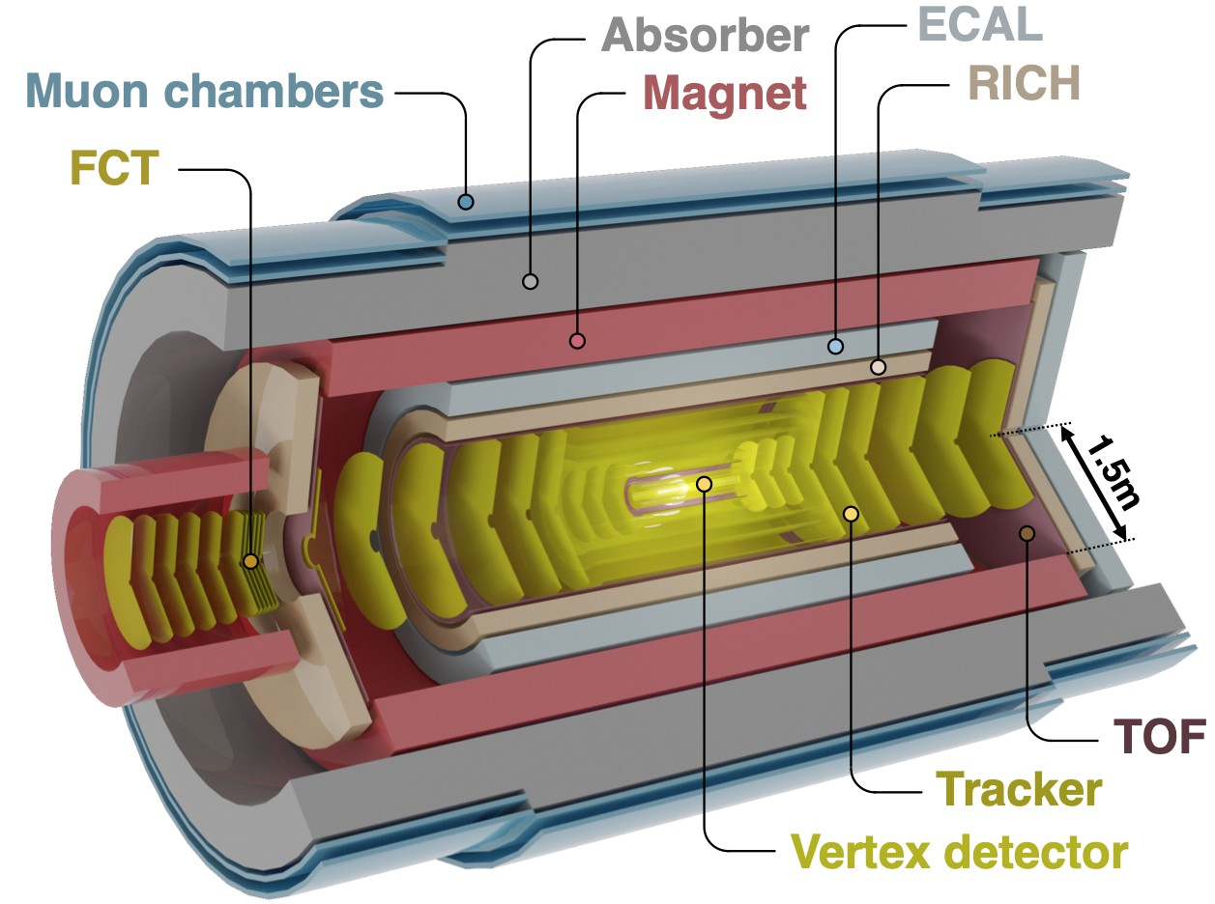
Future for Heavy Ions & ALICE 3
ALICE 3
ITS3
FOCAL

Slide 2





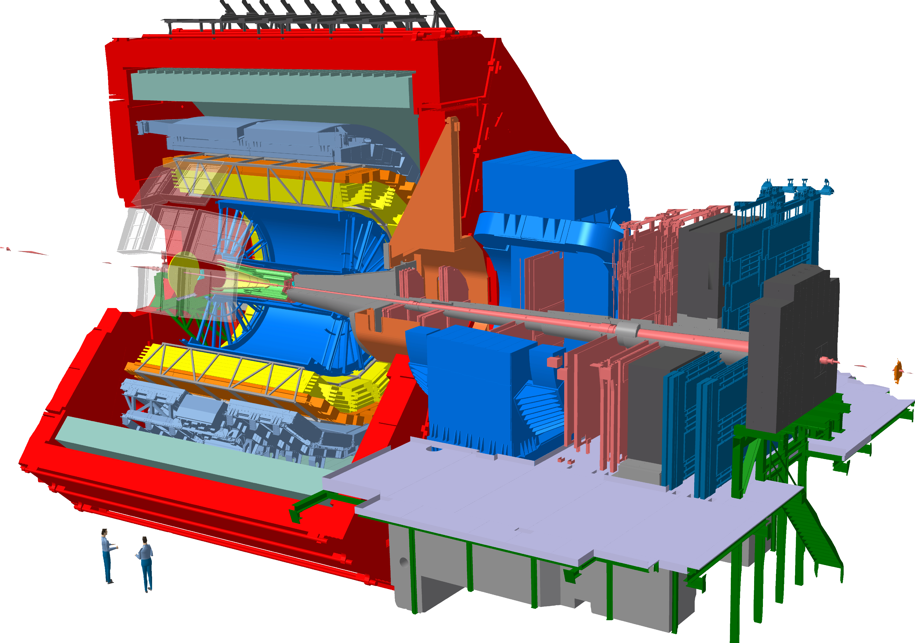


ALICE Upgrade Roadmap
ITS3
FOCAL
ALICE 2
Pb-Pb: 6.2 nb⁻¹
O-O: 500 µb⁻¹
Pb-Pb: 6.8 nb⁻¹
p-Pb: 0.6 pb⁻¹
Pb-Pb: ~ 35 nb⁻¹
Today
ALICE 3
ALICE 2
ALICE 2.1
ALICE 3
LHC LHC LHC LHC
Run 3 Run 4 LS4 Run 5
2022 2023 2024 2025 2026 2027 2028 2029 2030 2031 2032 2033 2034 2035 2036 2037 2038 2039 2040 2041
LHC LS3
LHC
LHC
Run 6
LS5

Slide 3
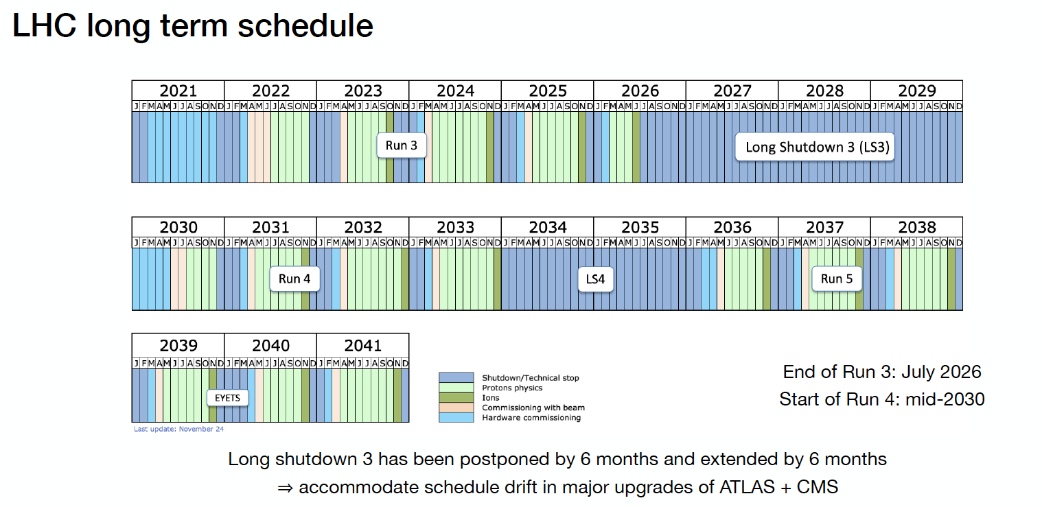
ALICE Upgrade Roadmap

Slide 4
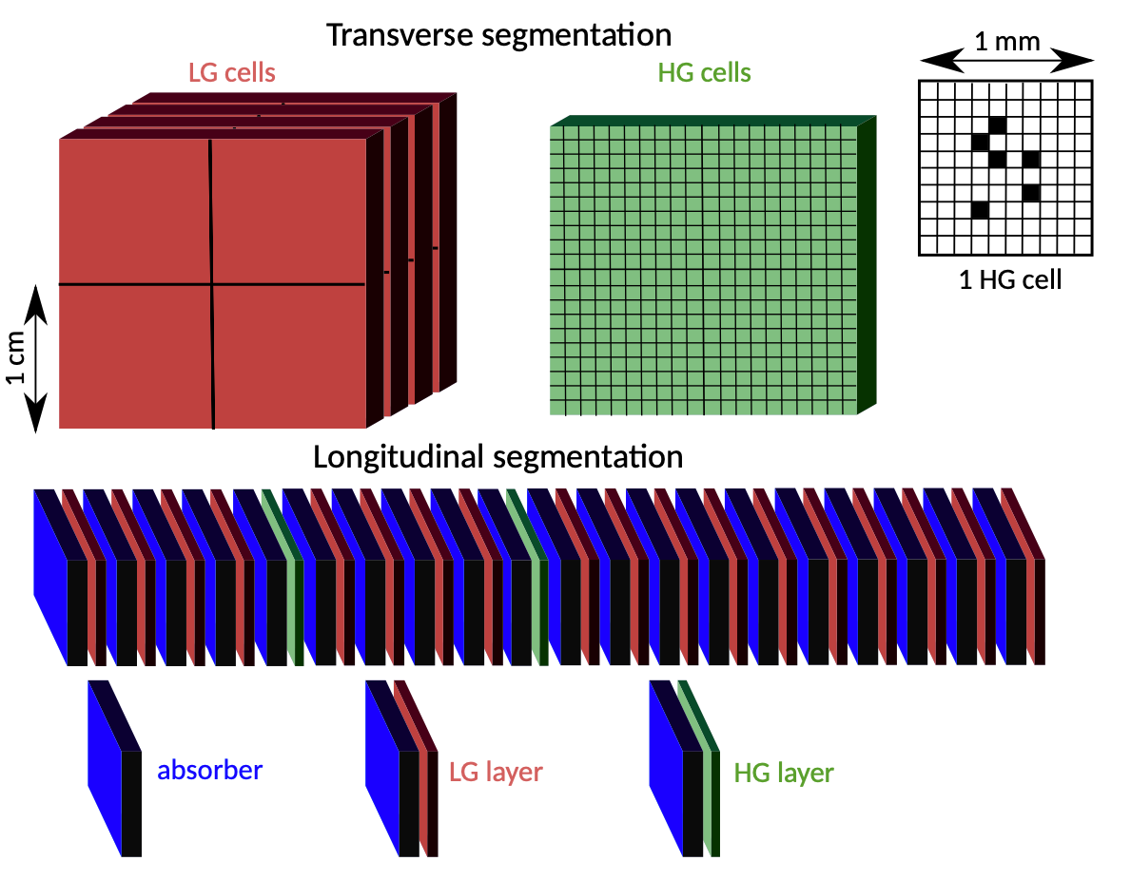
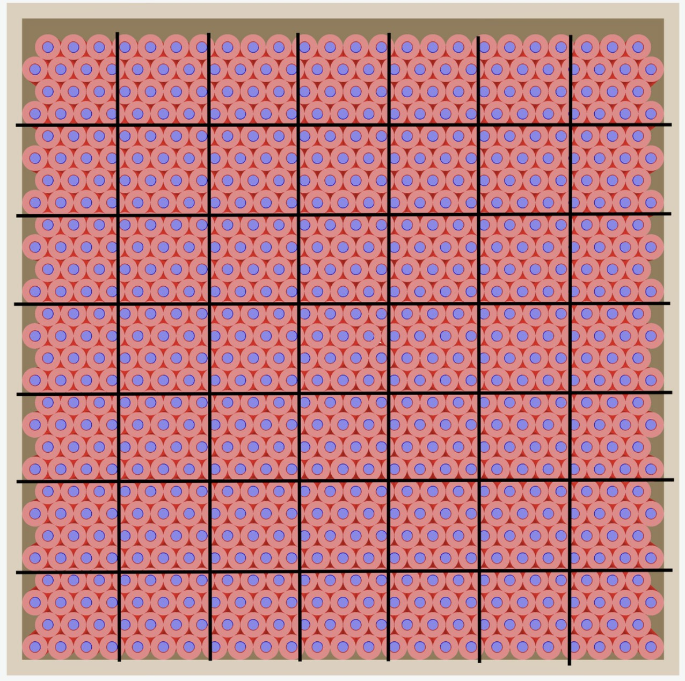
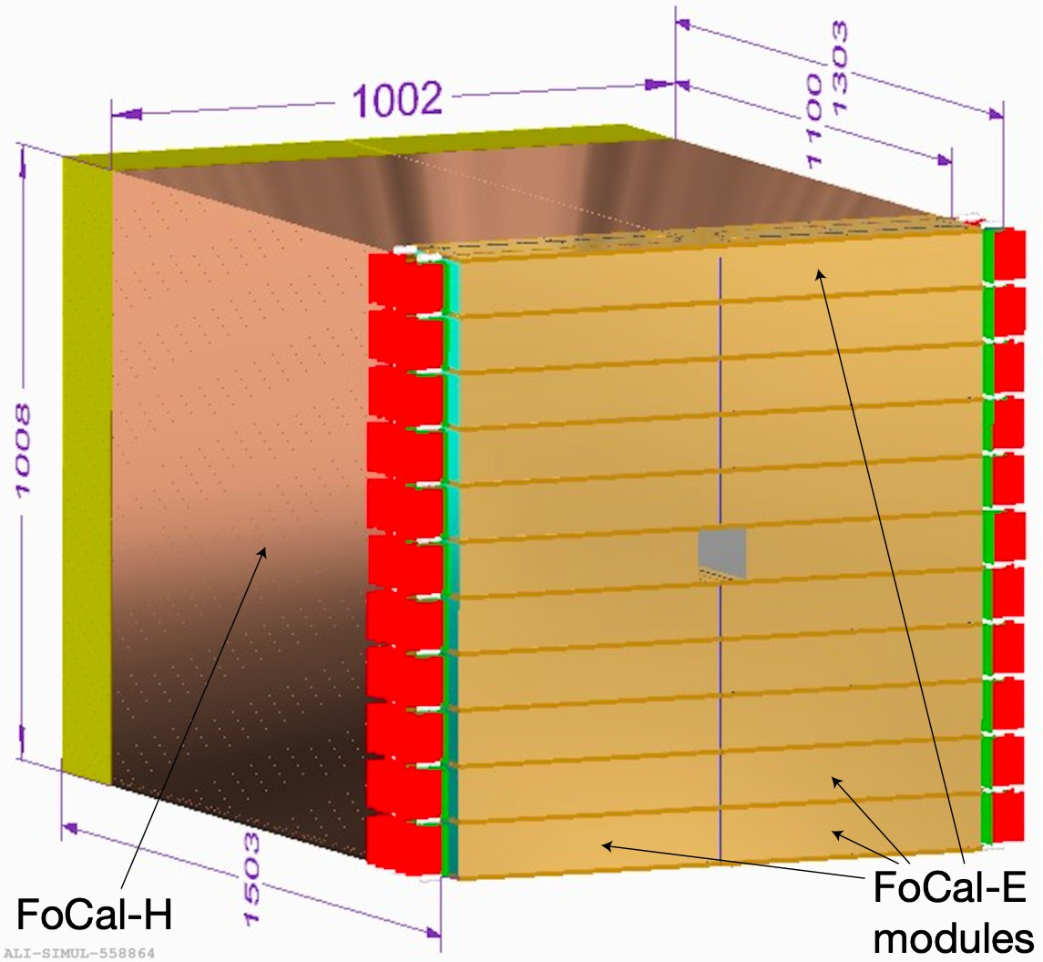
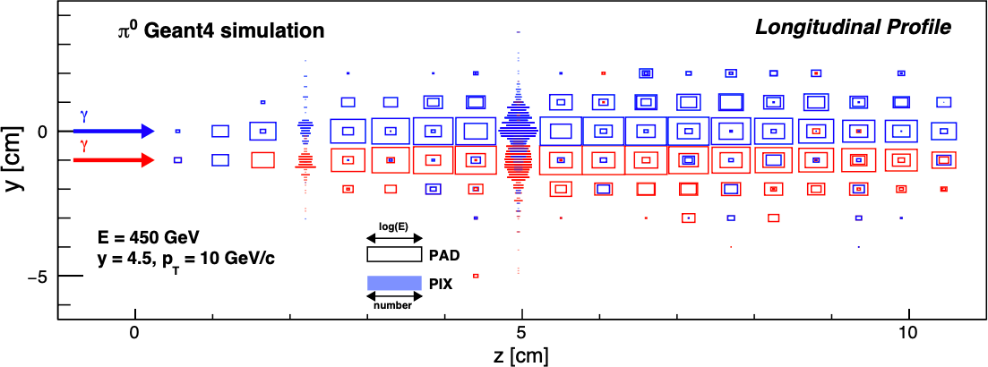
The Forward Calorimeter (FoCal)
Low Granularity (LG) cells
High Granularity (HG) cells
FoCal-E: a compact silicon-tungsten sampling electromagnetic calorimeter with pad (1 x 1 cm²) and pixel (30 x 30 µm²)
  High spatial resolution for discriminating between isolated photons and decay photon pairs
FoCal-H: hadronic calorimeter constructed from copper capillary tubes filled with scintillating fibres
  Photon isolation, energy and jet measurements
Coverage: 3.2 < η < 5.6
Segmentation of FoCal-E
FOCAL TDR
FOCAL TDR
FOCAL TDR — CERN-LHCC-2024-004
FOCAL TDR
Front view of a FoCal-H module in simulation
3d view of FoCal, dimensions in mm
Longitudinal shower profile of two photons in FoCal-E
5

Slide 5
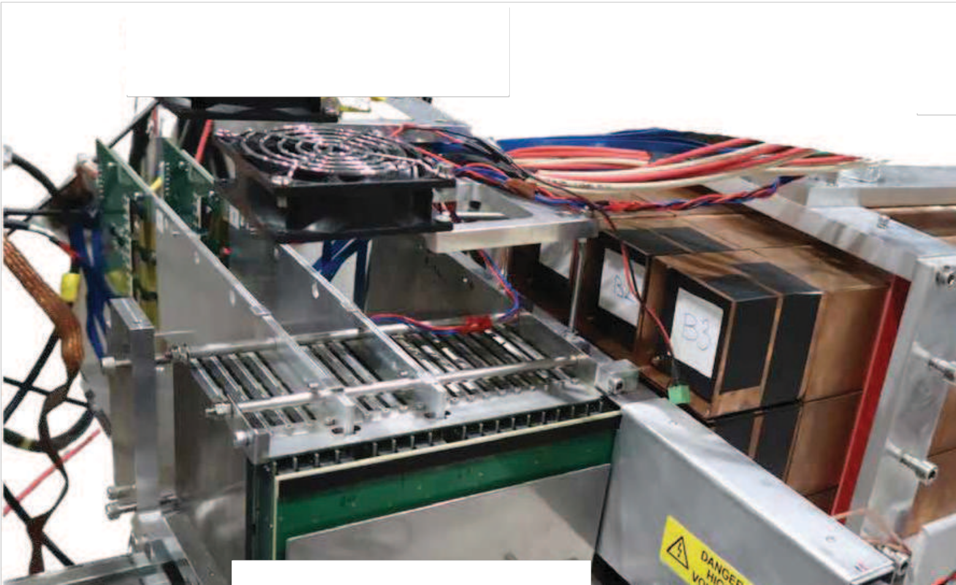



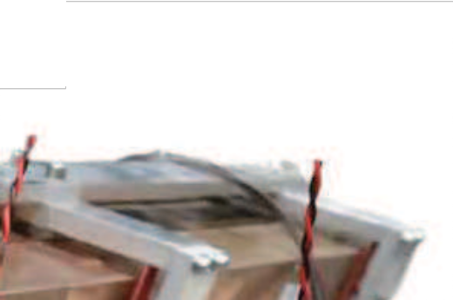
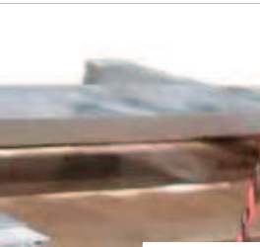
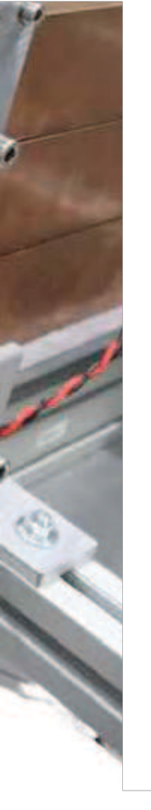
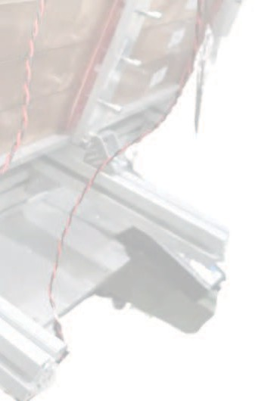

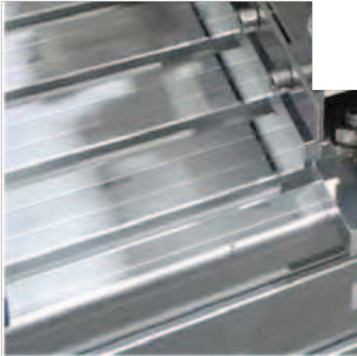
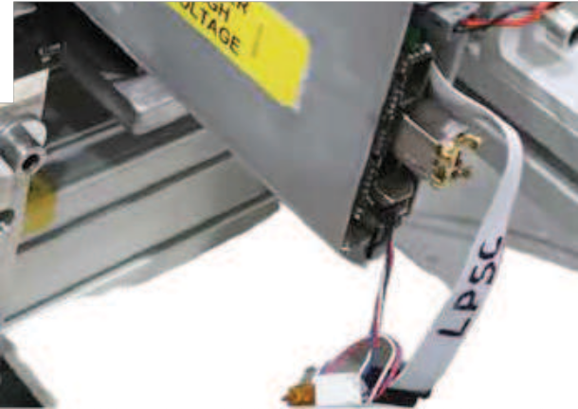
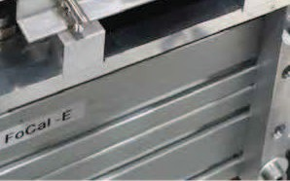
FoCal — Test Beams
FoCal-E Pixels
FoCal-H
FoCal-E Pads
18 layers Si pad sensors
wafers of 9 x 8 cm²
pad size 1 cm²
readout with HGCROC v2
FoCal-E Pixels
2 ALPIDE pixel layers
Monolithic Active Pixel Sensors
pixel size of ~30 x 30 μm²
two tested prototypes (HIC,pCT)
FoCal-E Pads
FoCal-H
9 Cu-scintillating fiber modules
towers size ~ 6.5 x 6.5 cm²
length ~110 cm
readout with CAEN DT5202
ALI-PERF-569144
FOCAL TDR
7

Slide 6

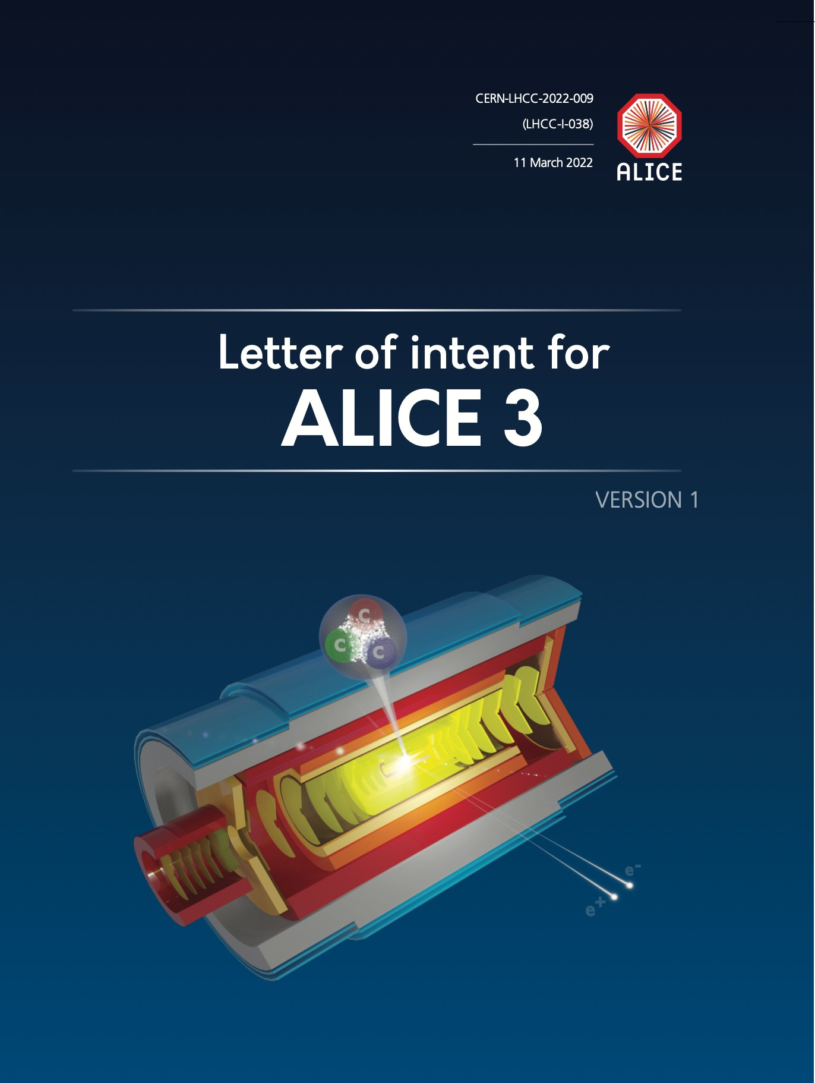
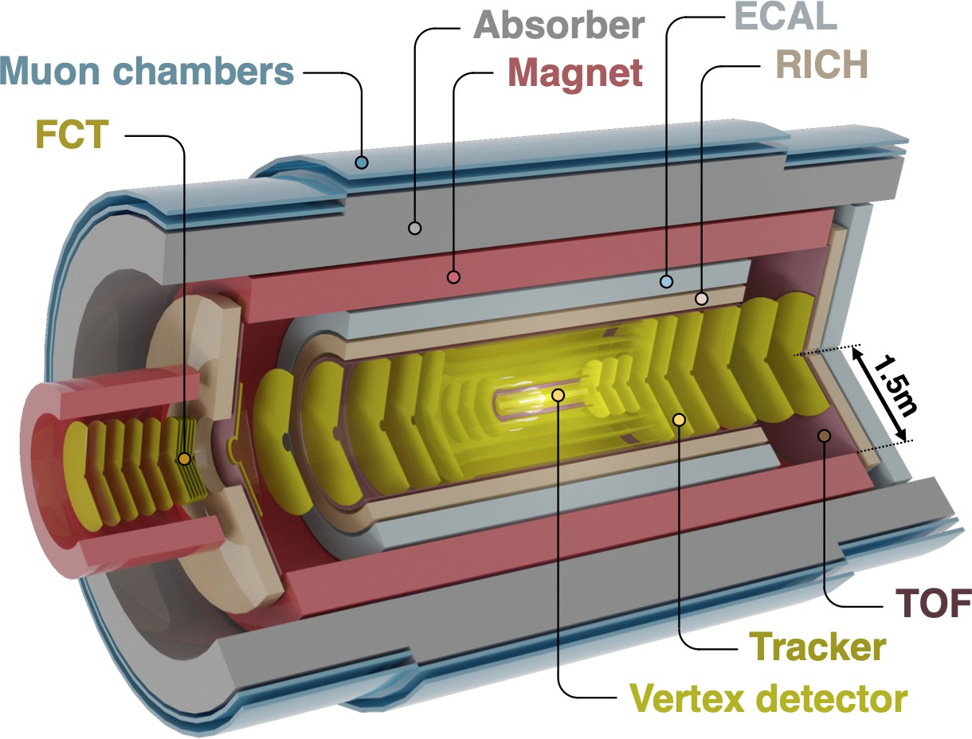
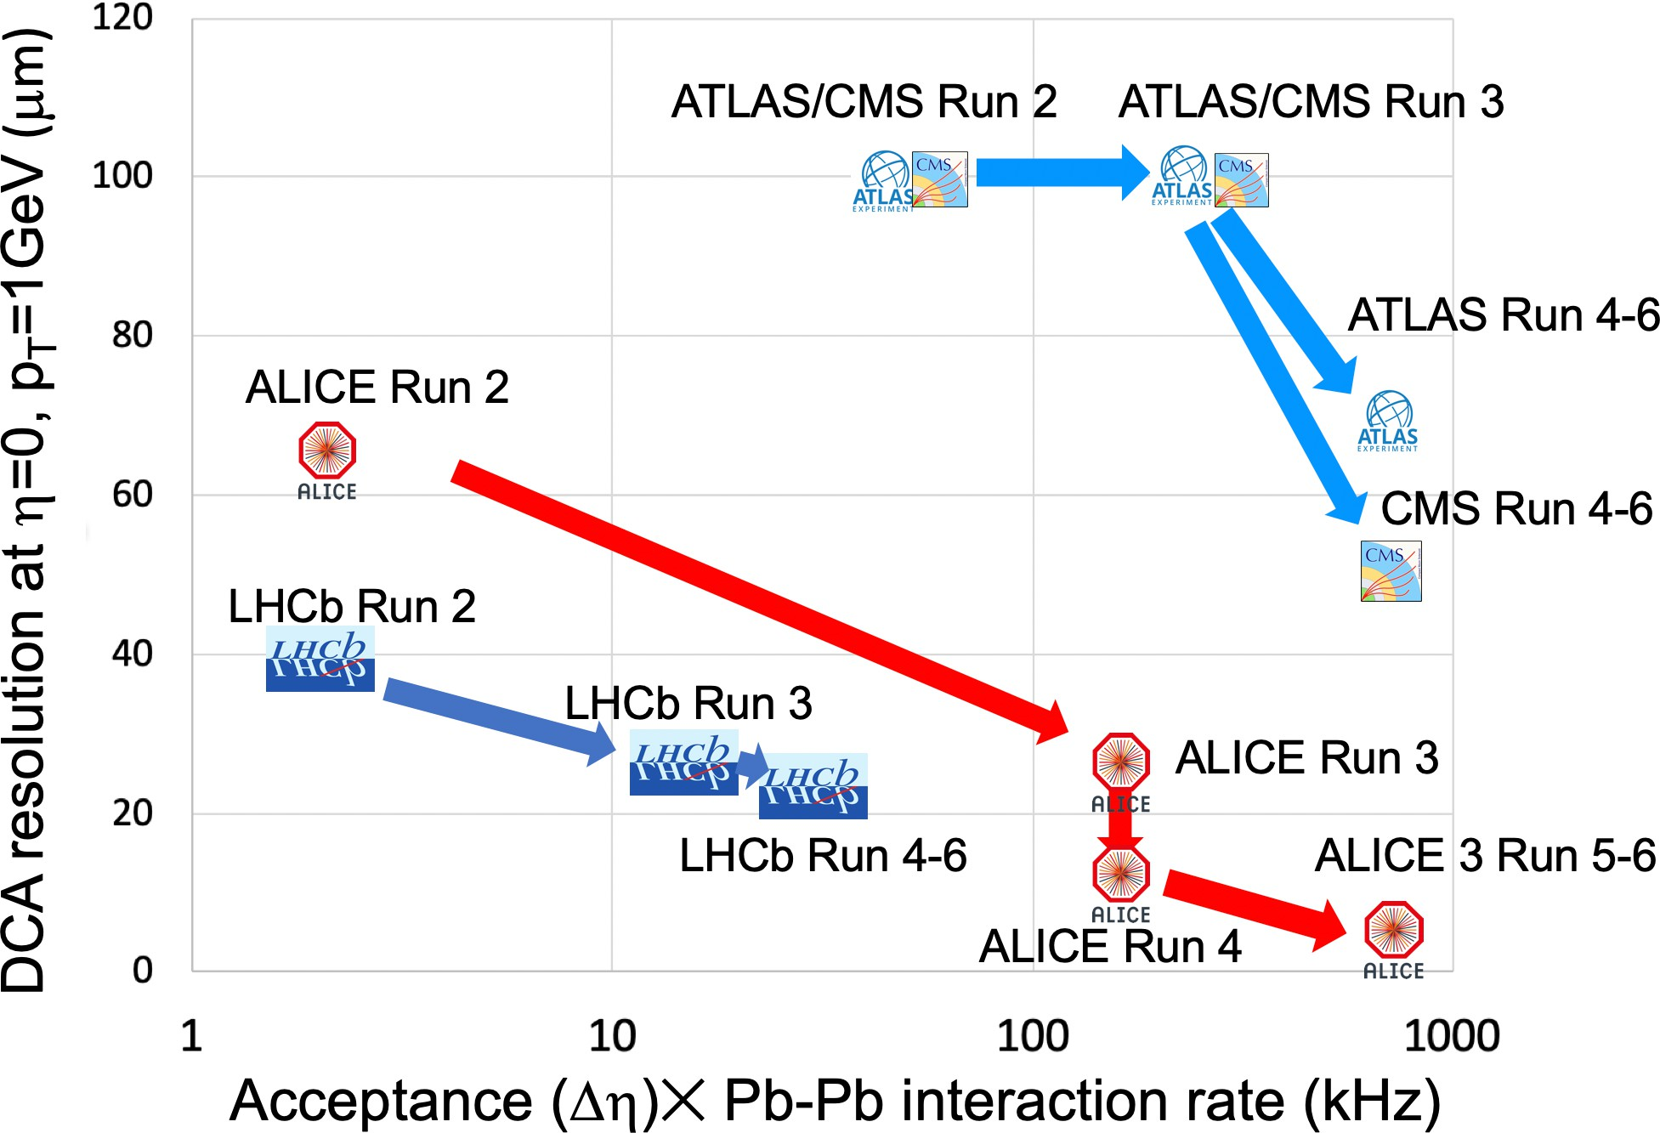
ALICE 3 — Concept
Compact, low-mass all-silicon tracker
Retractable vertex detector
Excellent vertex reconstruction
and PID capabilities
Large acceptance
Super-conducting magnet system
Continuous read-out and online processing
CERN-LHCC-2022-009
14

Slide 7



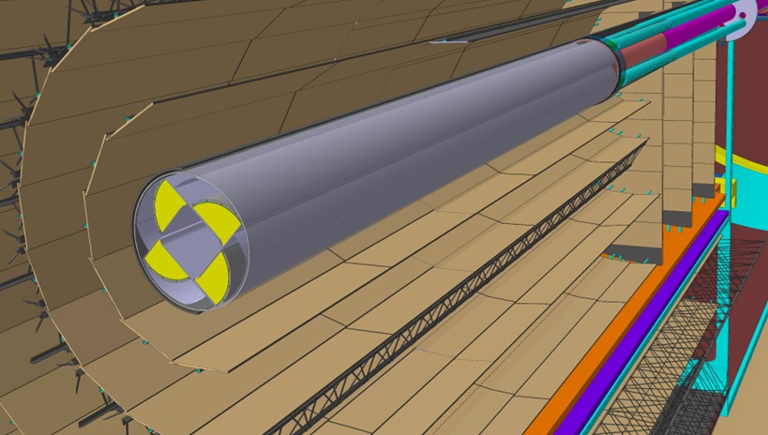
pointing resolution (∝m)
10⁴
ALICE 3 study
π
ALICE 3 — Vertex Detector (VD)
10³
η = 0 R = 100 cm
min
Layout V1
2x
ITS2 ITS3
10²
5x
ALICE 2
ALICE 2.1
Pointing resolution ∝ r₀ ⋅ x/X₀
(multiple scattering regime)
Radius and material of first layer crucial
Minimal radius given by required aperture:
R ≈ 5 mm at top energy,
R ≈ 15 mm at injection energy
→ retractable vertex detector
Key detector characteristics
10
1
ALICE 3
₁₀−1
₁₀−2
₁₀−1
1
10
10²
p (GeV/c)
ALI−SIMUL−491785
T
3 detection layers (barrel + disks)
Retractable: r0 = 5 mm
Material budget: 0.1% X0 / layer
Unprecedented spatial resolution: 2.5 µm
At injection energy — r0: 15 mm
Main R&D challenges
  Light-weight in-vacuum mechanics and cooling
  Radiation hardness* (10¹⁶ 1 MeV neq/cm² + 300 Mrad)
  Pixel pitch of 10 µm
R&D will build upon ITS3 experience
* LOI values, further simulation studies ongoing
15

Slide 8
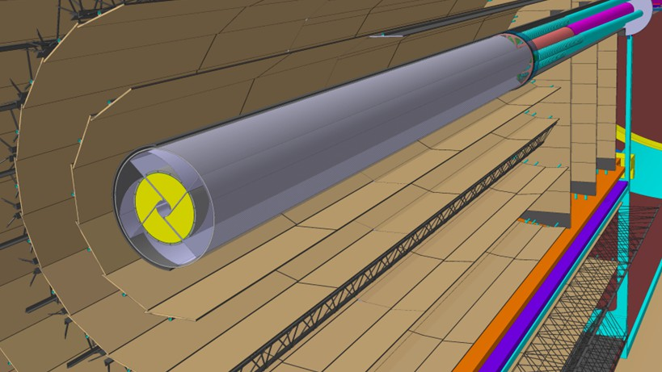
pointing resolution (∝m)
10⁴
ALICE 3 study
π
ALICE 3 — Vertex Detector (VD)
10³
η = 0 R = 100 cm
min
Layout V1
2x
ITS2 ITS3
10²
5x
ALICE 2
ALICE 2.1
Pointing resolution ∝ r₀ ⋅ x/X₀
(multiple scattering regime)
Radius and material of first layer crucial
Minimal radius given by required aperture:
R ≈ 5 mm at top energy,
R ≈ 15 mm at injection energy
→ retractable vertex detector
Key detector characteristics
10
1
ALICE 3
₁₀−1
₁₀−2
₁₀−1
1
10
10²
p (GeV/c)
ALI−SIMUL−491785
T
3 detection layers (barrel + disks)
Retractable: r0 = 5 mm
Material budget: 0.1% X0 / layer
Unprecedented spatial resolution: 2.5 µm
At top energy — r0: 5 mm
Main R&D challenges
  Light-weight in-vacuum mechanics and cooling
  Radiation hardness* (10¹⁶ 1 MeV neq/cm² + 300 Mrad)
  Pixel pitch of 10 µm
R&D will build upon ITS3 experience
* LOI values, further simulation studies ongoing
15

Slide 9
NorLHC III application
Covers period 1.7.2027 - 30.6.2032
FoCal
  Integration pixel layers - pad layers - HCAL
  Installation and commissioning (until 2030)
ALICE 3
  Contribution to R&D, construction, installation and commissioning of VD
    Chip-chip, chip-carrier vertical/horizontal integration
    Development of readout electronics, characterization of sensors and readout chain
20

