Slide 1



CNM nLGAD Run16375
Gain suppression on nLGAD detectors
April 1st 2025
Jairo Antonio Villegas Dominguez
Florent Dougados
Salvador Hidalgo Villena

Slide 2
Outline
The devices: IV and CV measurements at 20ºC
TCT setup: calibration of powermetter with laser diode of 404 nm wavelength
TCT setup: calibration of powermetter with laser diode of 1060 nm wavelength (IR)
Methodology and preliminary results

Slide 3
1.
The devices: IV and CV measurements at 20ºC

Slide 4
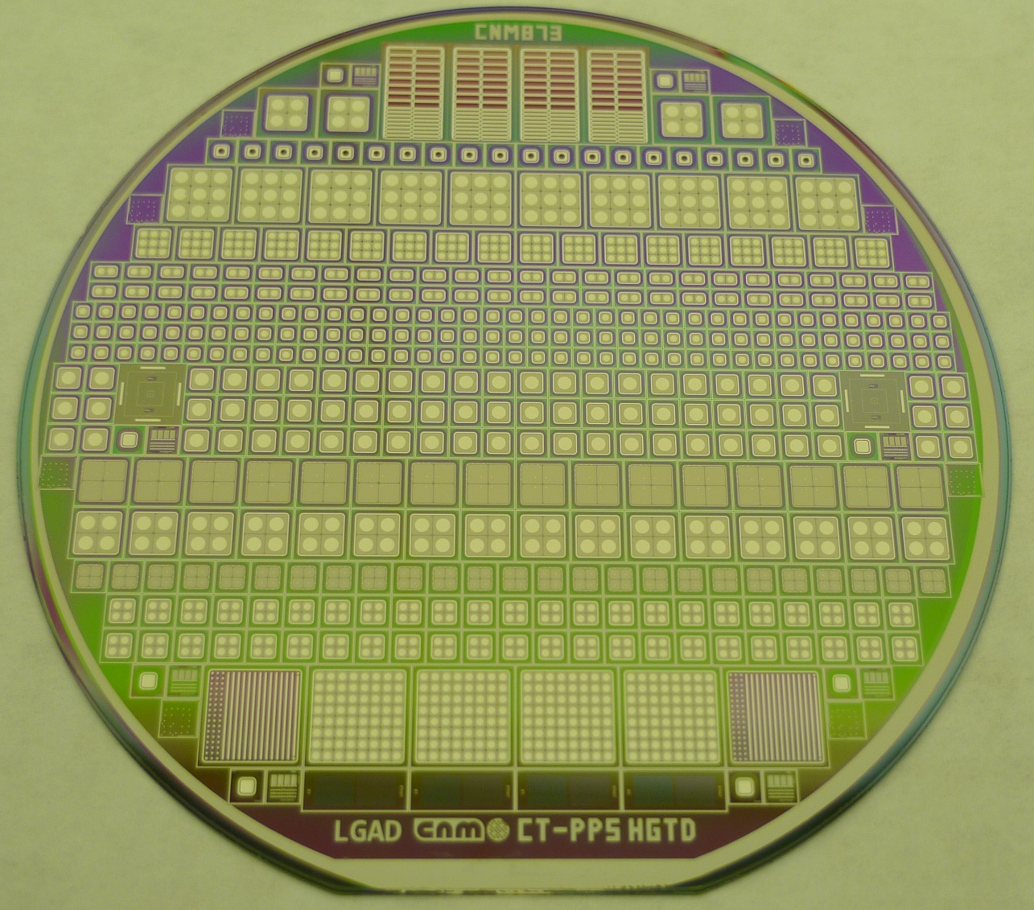
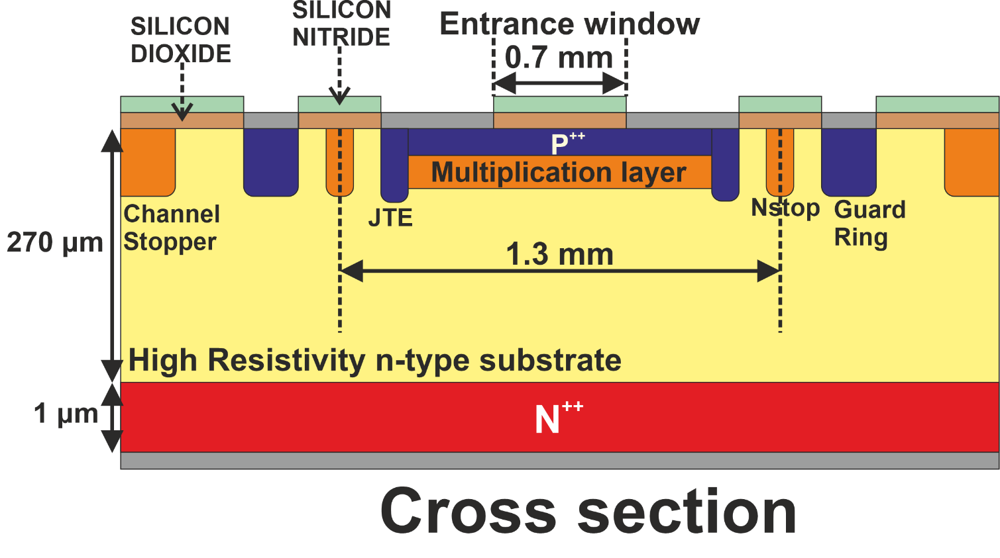


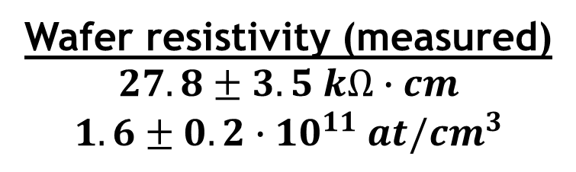
The devices: IV and CV measurements
LG03
LG14
$$≈$$
$$≈$$
Wafer resistivity (measured)
$$27.8±3.5 kΩ∙cm$$
$$1.6±0.2∙10^{11} at/cm^{3}$$

Slide 5
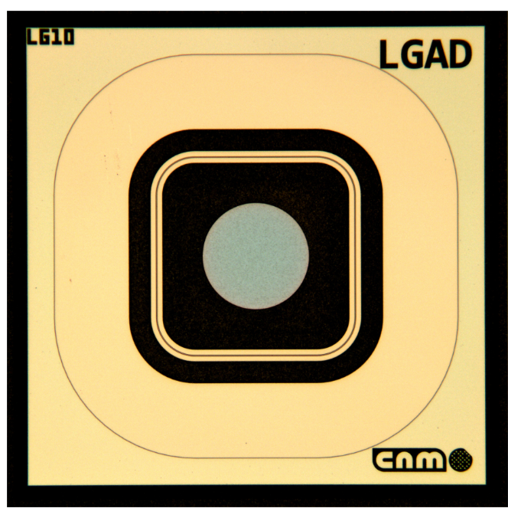
The devices: IV and CV measurements
Room temperature (20ºC)
Guard Ring biased

Slide 6


The devices: IV and CV measurements
$$V_{gl}≈28 V$$
$$V_{FD}≈$$
$$40−45 V$$

Slide 7
The devices: IV and CV measurements

Slide 8
The devices: IV and CV measurements
CV-extracted
doping profiles
Log Scale

Slide 9
The devices: IV and CV measurements
CV-extracted
doping profiles
Log Scale

Slide 10
The devices: IV and CV measurements
CV-extracted
doping profiles
Linear Scale

Slide 11
2.
TCT setup: calibration of powermeter with laser diode of 404 nm wavelength

Slide 12
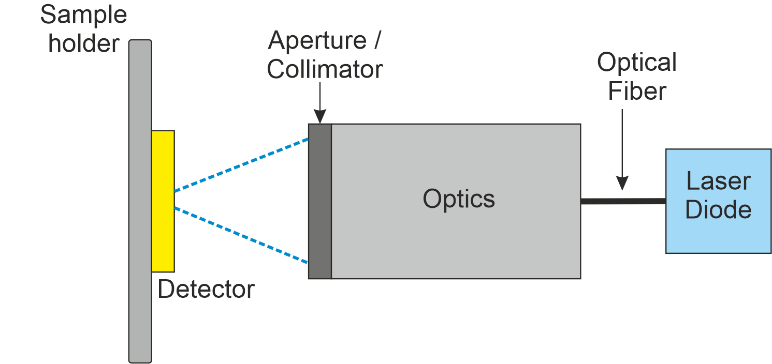
TCT Setup

Slide 13
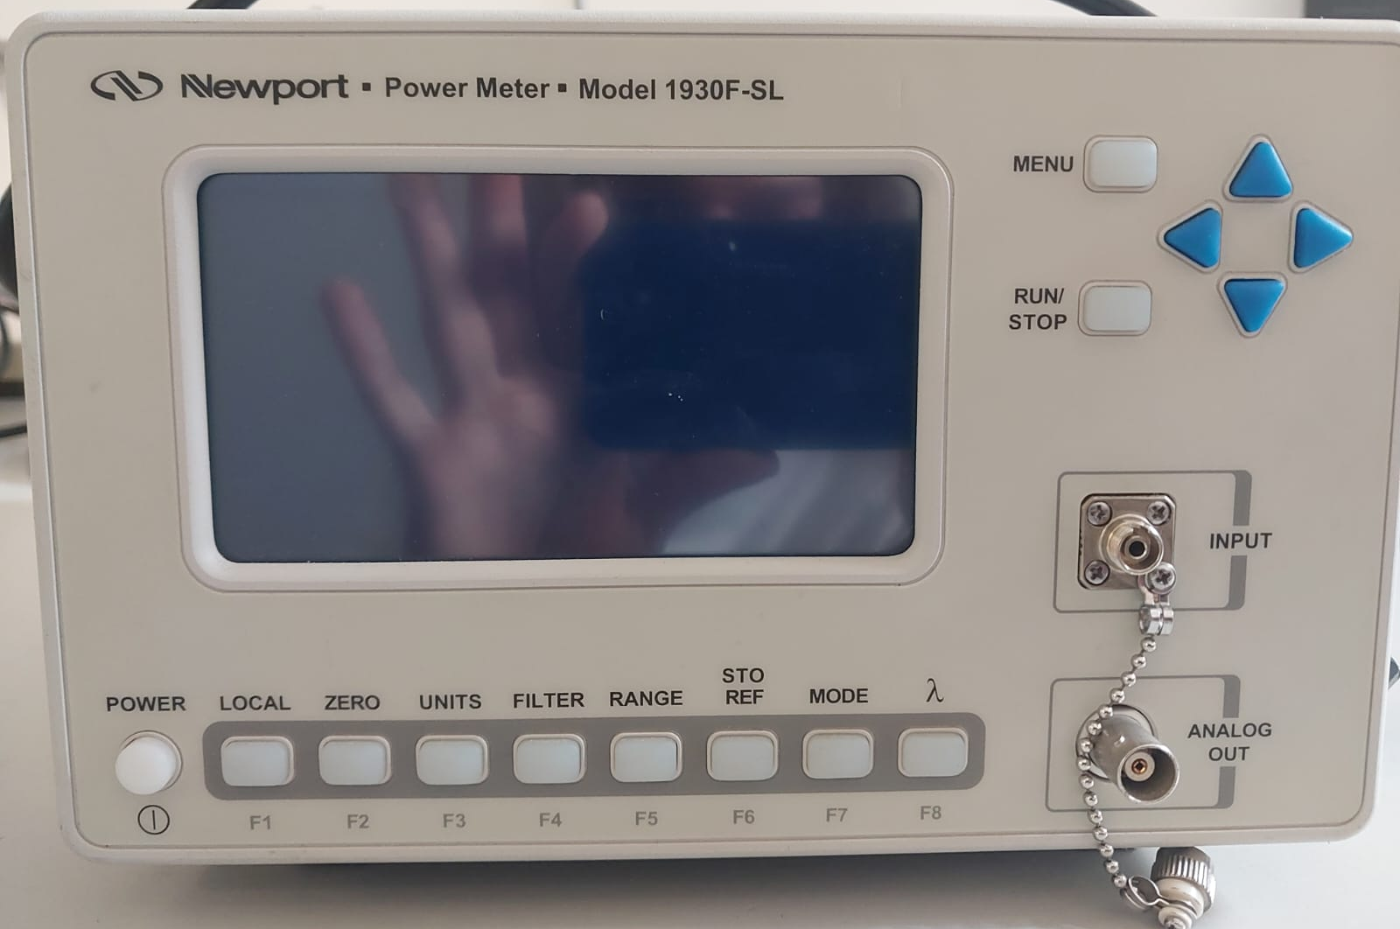
Optic Fiber Newport Power Meter Model 1930F-SL
400-1100 nm wavelength
Integrated Si detector
Accuracy of 5%
Optical Fiber connector
Wavelength
selection

Slide 14
Optic Fiber Newport Power Meter Model 1930F-SL
The laser power (measured with the powermeter) is correlated with the Particulars Laser Diode DAC Threshold

Slide 15
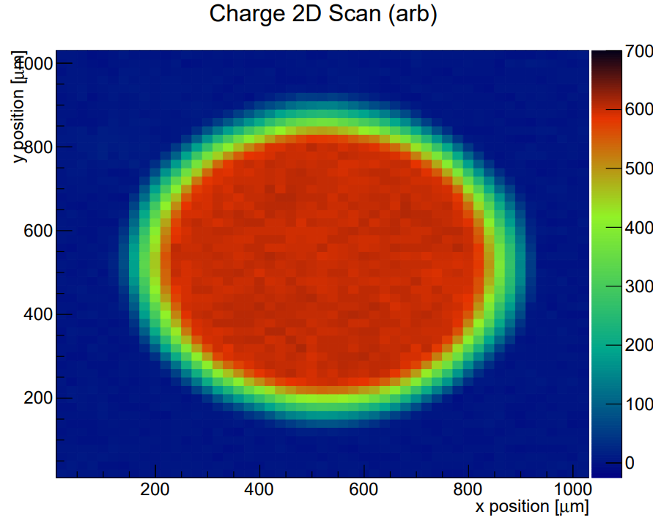
Reference nPiN for calibration (and gain extraction)
CNM Run16375 (W4_LG14)
The nPiN is 2D scanned to assure uniformity before calibration
400 V & 404 nm TCT light
≈ 700 µm

Slide 16
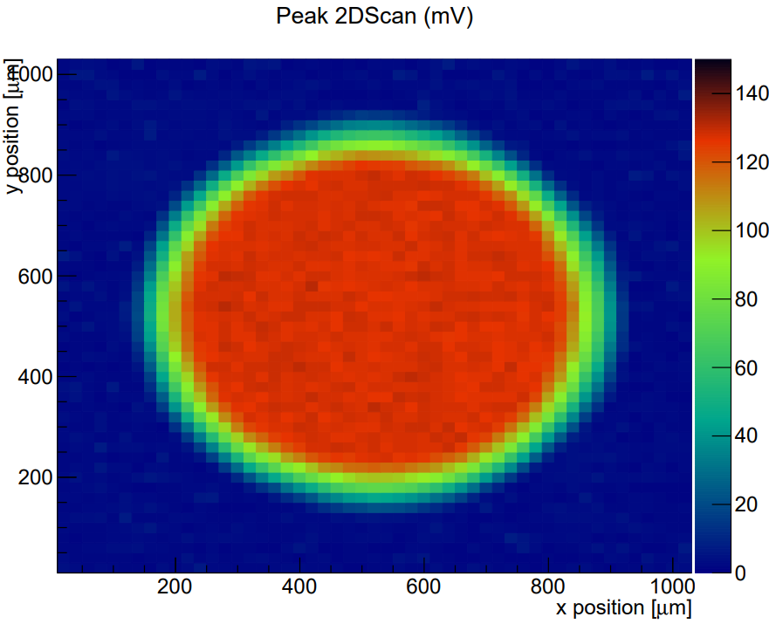
Reference nPiN for calibration (and gain extraction)
CNM Run16375 (W4_LG14)
The nPiN is 2D scanned to assure uniformity before calibration
400 V & 404 nm TCT light
≈ 700 µm

Slide 17
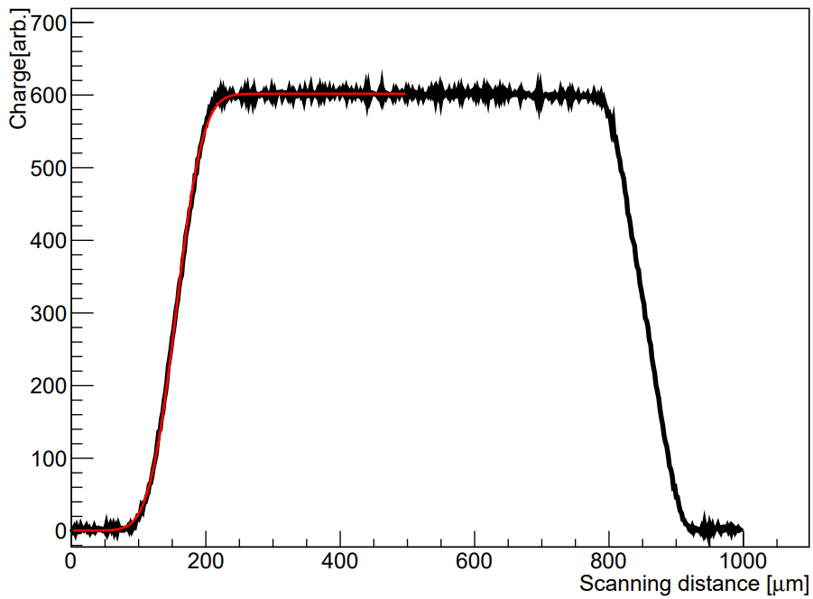

Reference nPiN for calibration (and gain extraction)
Laser Beam projection on nPiN ≈101x99 µm² < 700x700 µm² (window)
Optics aperture is fully opened, so no light is blocked
Laser is positioned in the center of the window
FWHM(X) = 101 µm
FWHM(Y) = 99 µm

Slide 18
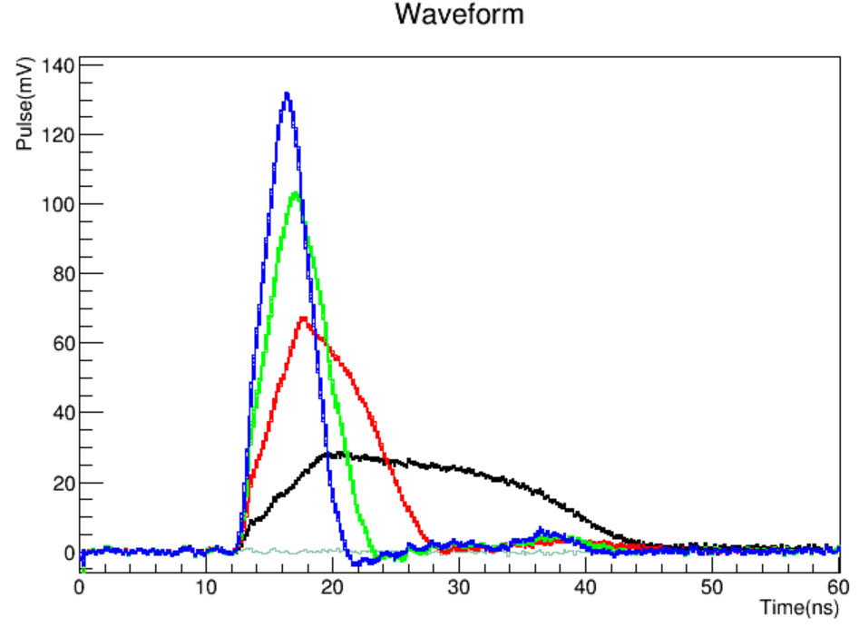
Reference nPiN for calibration (and gain extraction)
Laser Beam projection on nPiN ≈101x99 µm² < 700x700 µm² (window)
Optics aperture is fully opened, so no light is blocked
Laser is positioned in the center of the window
Power Meter: 10 measurements (one measurement every 30 s)
The CC (signal integral) is extracted for 100, 200, 300 and 400 V and averaged
Power Meter: 10 measurements (one measurement every 30 s)
No amplifier is used!
400 V
300 V
200 V
100 V

Slide 19
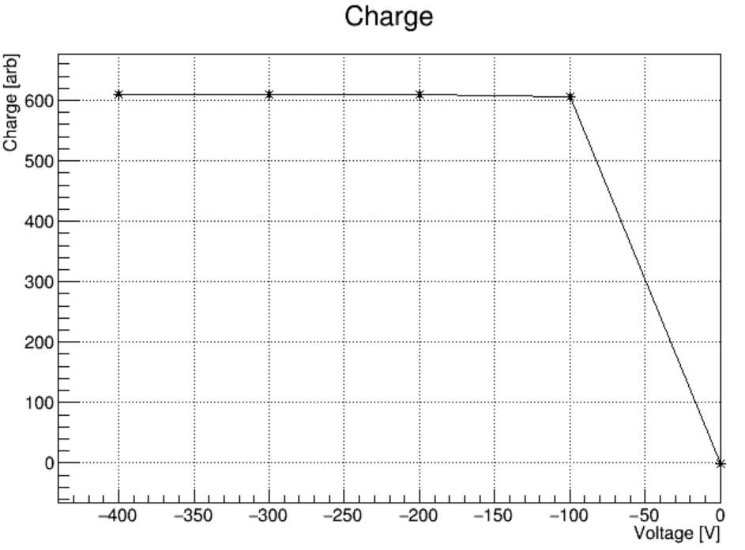
Reference nPiN for calibration (and gain extraction)
Laser Beam projection on nPiN ≈101x99 µm² < 700x700 µm² (window)
Optics aperture is fully opened, so no light is blocked
Laser is positioned in the center of the window
Power Meter: 10 measurements (one measurement every 30 s)
The CC (signal integral) is extracted for 100, 200, 300 and 400 V and averaged
Power Meter: 10 measurements (one measurement every 30 s)

Slide 20
Calibration Curves (404 nm wavelength)
Power Meter: 10 measurements (one measurement every 30 s)
The CC (signal integral) is extracted for 100, 200, 300 and 400 V and averaged
Power Meter: 10 measurements (one measurement every 30 s)
The relationship is not 100% linear!
Linear Scale

Slide 21
Calibration Curves (404 nm wavelength)
Power Meter: 10 measurements (one measurement every 30 s)
The CC (signal integral) is extracted for 100, 200, 300 and 400 V and averaged
Power Meter: 10 measurements (one measurement every 30 s)
The relationship is not 100% linear!
Log Scale

Slide 22
3.
TCT setup: calibration of powermeter with laser diode of 1060 nm wavelength (IR)

Slide 23
The issue with the IR Laser Beam projection
Laser Beam projection, with the optics aperture open, on nPiN was too big to fit with an error function (there was always signal when traversing the dashed region)
The signal of the n-stop overlapped with the signal at the device core
In order to have all the light going through the detector, the aperture needed to be partially closed

Slide 24
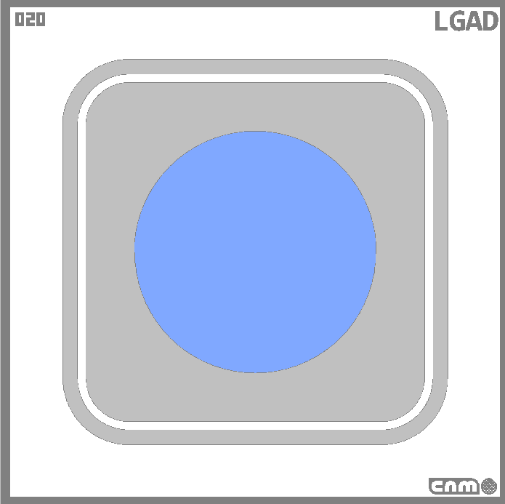
The issue with the IR Laser Beam projection
Reference 50 µm PiN
Laser Beam projection, with the optics aperture open, on nPiN was too big to fit with an error function (there was always signal when traversing the dashed region)
The signal of the n-stop overlapped with the signal at the device core
A p-type PiN of 50 µm was used to find out how much light we are blocking when partially closing the optics aperture
3.3 mm
2.3 mm

Slide 25
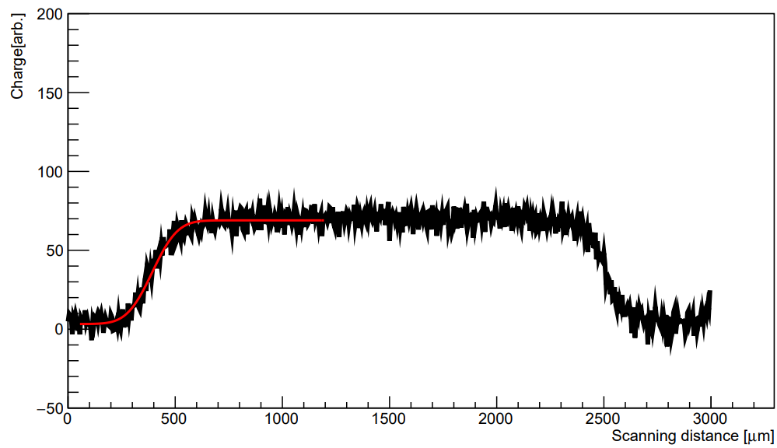
The issue with the IR Laser Beam projection
A p-type PiN of 50 µm was used to find out how much light we are blocking when partially closing the optics aperture
IR Optics Aperture fully OPEN
FWHM(X) ≈ FWHM(Y) = 220 µm
CC = 66.4 (arb)

Slide 26
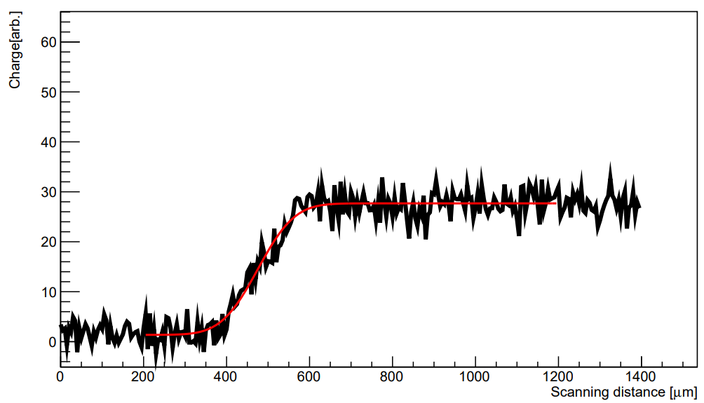
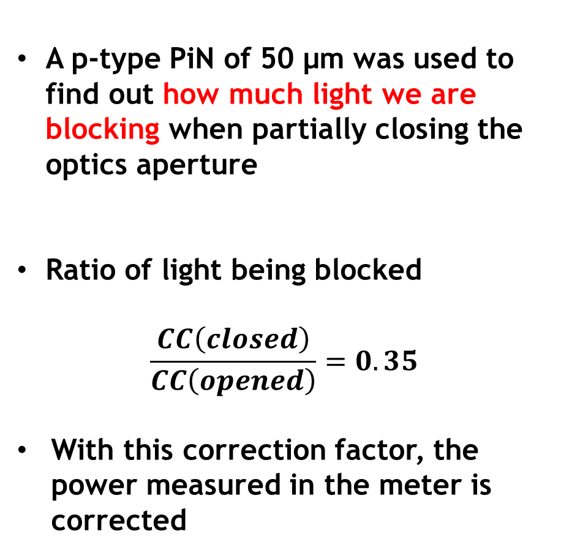
The issue with the IR Laser Beam projection
IR Optics Aperture partially closed
FWHM(X) ≈ FWHM(Y) = 160 µm
CC = 25.4 (arb)
A p-type PiN of 50 µm was used to find out how much light we are blocking when partially closing the optics aperture
Ratio of light being blocked
$$\frac{CC\left(closed\right)}{CC\left(opened\right)}=0.35$$
With this correction factor, the power measured in the meter is corrected

Slide 27
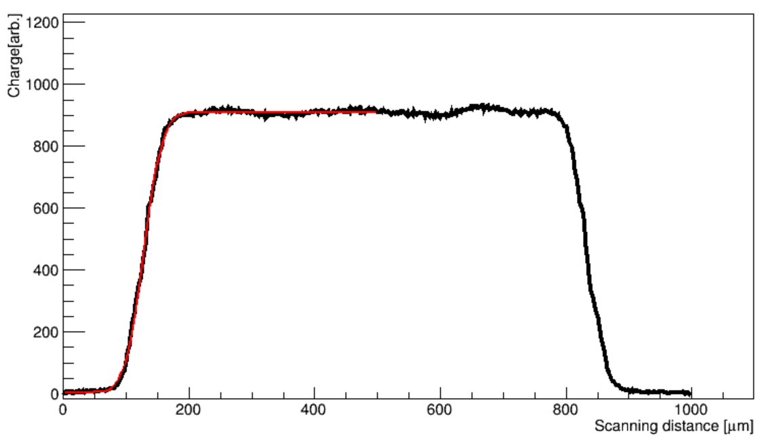

The issue with the IR Laser Beam projection
With the aperture partially closed, the beam projection on the nPiN and nLGADs has smaller areas
W1_LG14 (nLGAD)
FWHM(X) = 56 µm
FWHM(Y) = 52 µm

Slide 28
Calibration curve for 1060 nm IR light for nPiN
Power Meter: 10 measurements (one measurement every 30 s)
The CC (signal integral) is extracted for 100, 200, 300 and 400 V and averaged
Power Meter: 10 measurements (one measurement every 30 s)

Slide 29
4.
Methodology and preliminary results

Slide 30
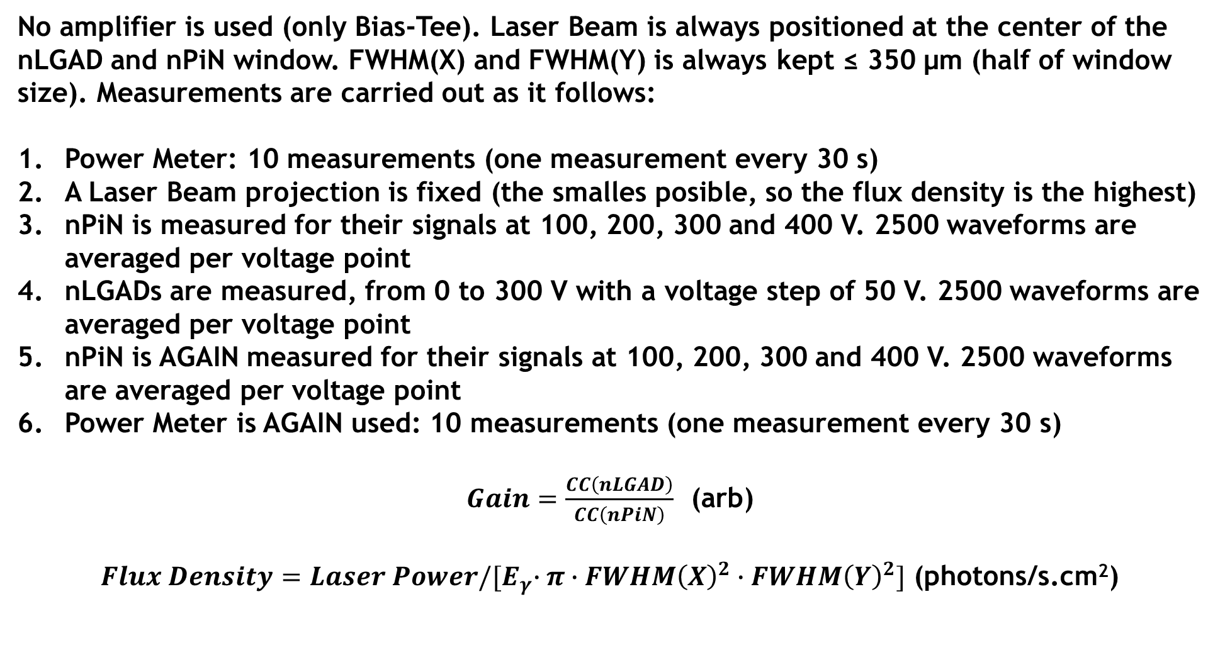
Methodology
No amplifier is used (only Bias-Tee). Laser Beam is always positioned at the center of the nLGAD and nPiN window. FWHM(X) and FWHM(Y) is always kept ≤ 350 µm (half of window size). Measurements are carried out as it follows:
Power Meter: 10 measurements (one measurement every 30 s)
A Laser Beam projection is fixed (the smalles posible, so the flux density is the highest)
nPiN is measured for their signals at 100, 200, 300 and 400 V. 2500 waveforms are averaged per voltage point
nLGADs are measured, from 0 to 300 V with a voltage step of 50 V. 2500 waveforms are averaged per voltage point
nPiN is AGAIN measured for their signals at 100, 200, 300 and 400 V. 2500 waveforms are averaged per voltage point
Power Meter is AGAIN used: 10 measurements (one measurement every 30 s)
$Gain=\frac{CC\left(nLGAD\right)}{CC\left(nPiN\right)}$ (arb)
$Flux Density=Laser Power/{[E}_{γ}∙π∙FWHM{\left(X\right)}^{2}∙FWHM{\left(Y\right)}^{2}]$ (photons/s.cm²)

Slide 31
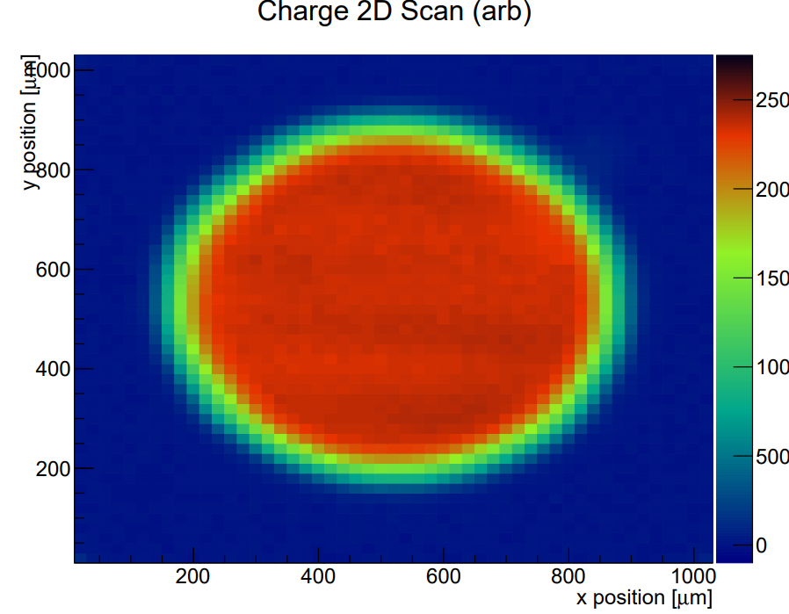
Uniformity of nLGAD devices: LG03
LG03 @ 150 V, 404 nm light

Slide 32
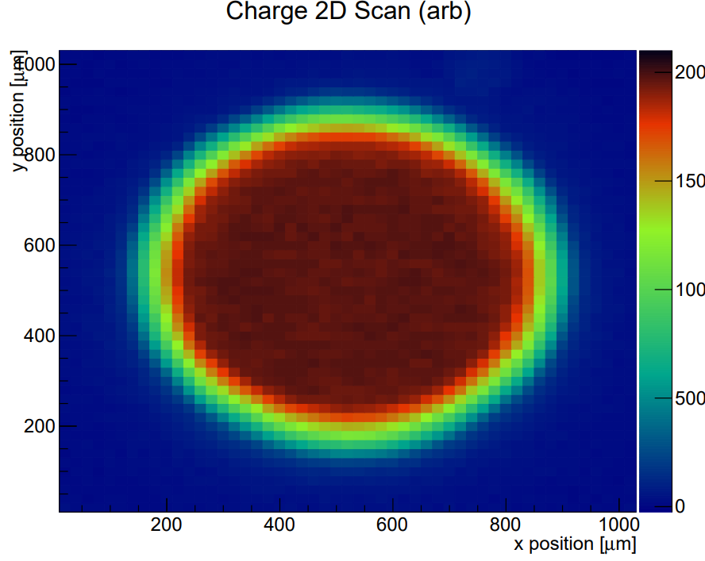
Uniformity of nLGAD devices: LG14
LG14 @ 200 V, 404 nm light

Slide 33
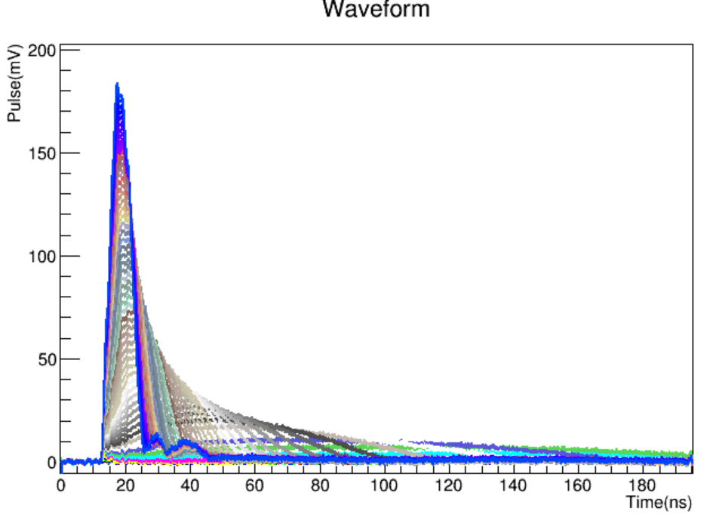
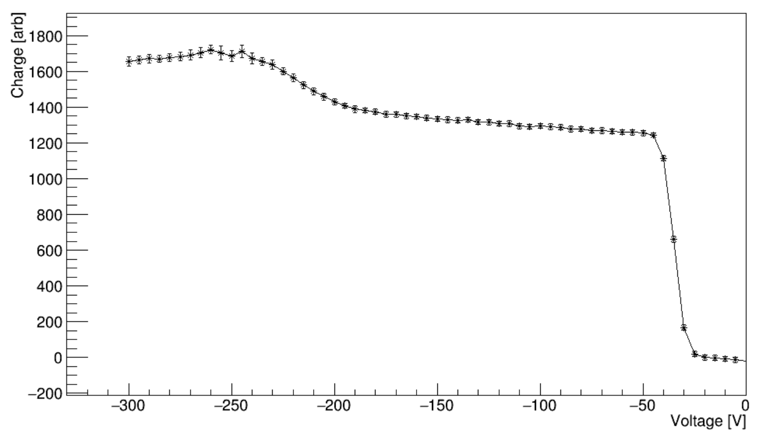
The integration issue: spurious signals?
W1_LG03 (nLGAD) signals to 404 nm wavelength light
Integration from 0 to 200 ns
Noise? Spurious signals? Appearing after 200 V

Slide 34
The integration issue: spurious signals?
W1_LG03 (nLGAD) signals to 404 nm wavelength light
The root code is being modified so the CC is calculated by integrating up to the time where the signal falls below a certain value, so the spurious signals can be avoided
Noise? Spurious signals? Appearing after 200 V

Slide 35
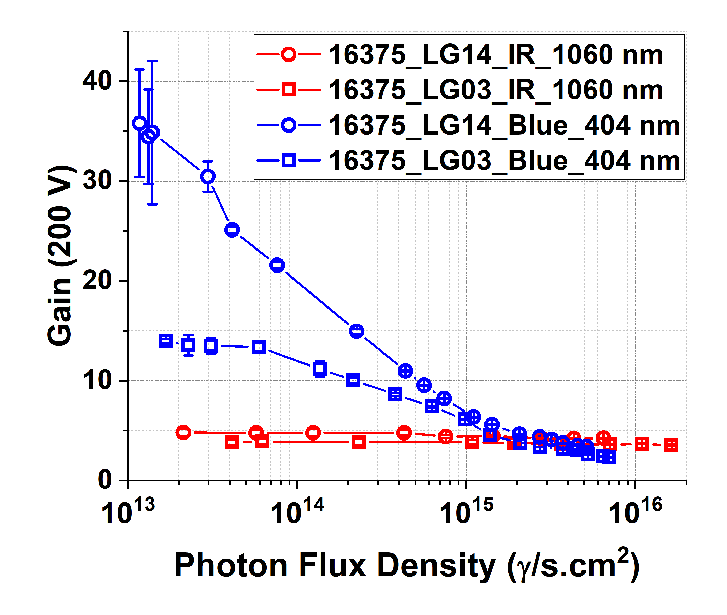
Preliminary results
For 200 V, the CC is “manually” obtained one by one (by tuning for every intensity the integration limits)
Gain suppression is observed for 404 nm wavelength light (low-penetrating) but not for IR light
Gain is higher for LG14 nLGAD device, as expected from CV-extracted doping profiles

Slide 36
Operational nLGAD with window
Label | Location / status
LG03 | CNM / broken
LG04 | CERN / type-inverted 1e14 p/cm^2 ; 23 GeV protons
LG06 | CERN
LG08 | CERN / PCB (non irradiated)
LG09 | CERN / PCB (non irradiated)
LG10 | CERN / PCB (non irradiated)
LG13 | CNA / Low E proton irradiated ; 600 keV protons IBIC
LG14 | CNM / broken
LG16 | CERN
LG17 | CERN / To irradiate in April 2e13 ; 23 GeV protons
LG18 | CERN / To irradiate in April 3e13 ; 23 GeV protons

