Slide 1
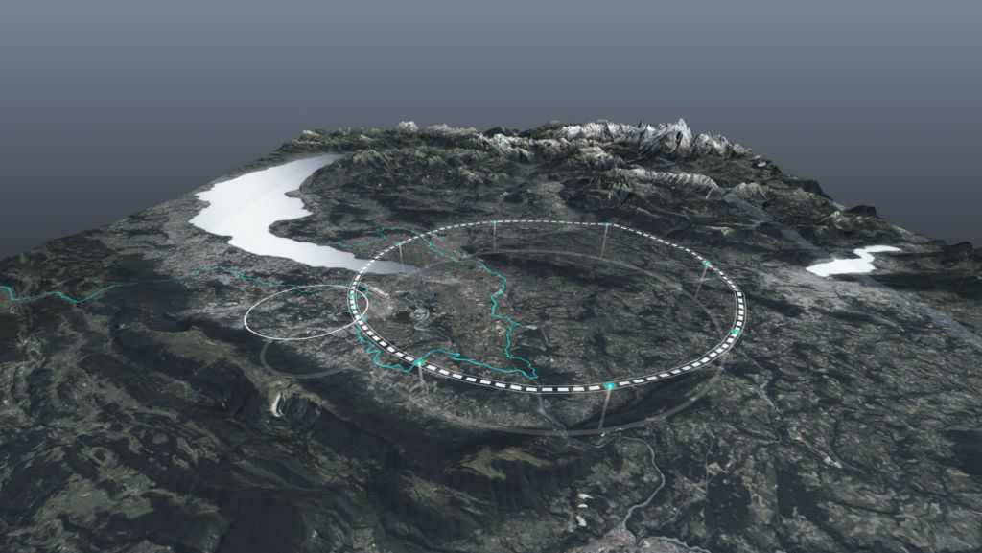









The FCC Feasibility Study
Exchange with French Journalists, 21 March 2025
Michael Benedikt, Patrick Janot, Jean-Paul Burnet CERN
on behalf of FCC collaboration & FCCIS DS team
http://cern.ch/fcc
Work supported by the European Commission under the HORIZON 2020 projects EuroCirCol, grant agreement 654305; EASITrain, grant agreement no. 764879; iFAST, grant agreement 101004730, FCCIS, grant agreement 951754; E-JADE, contract no. 645479; EAJADE, contract number 101086276; and by the Swiss CHART program
photo: J. Wenninger

Slide 2
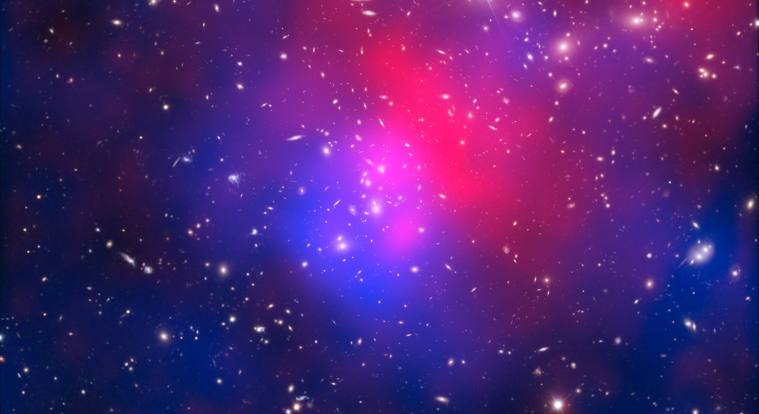
Some Big Open Questions
Despite of impressive progress and discoveries in the past decades several fundamental questions remain open:
Today 80 % of the mass of the universe is unknown.
What is the universe made of?
Is there only a single type of Higgs boson and does it behave exactly as predicted?
Why is the universe composed only of matter? Where has the anti-matter gone that was produced simultaneously in the big bang?
Why do neutrinos have mass?
How do neutrinos get their masses?

Slide 3

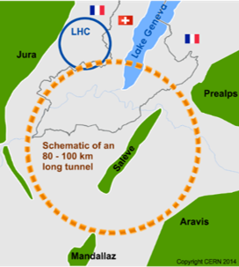
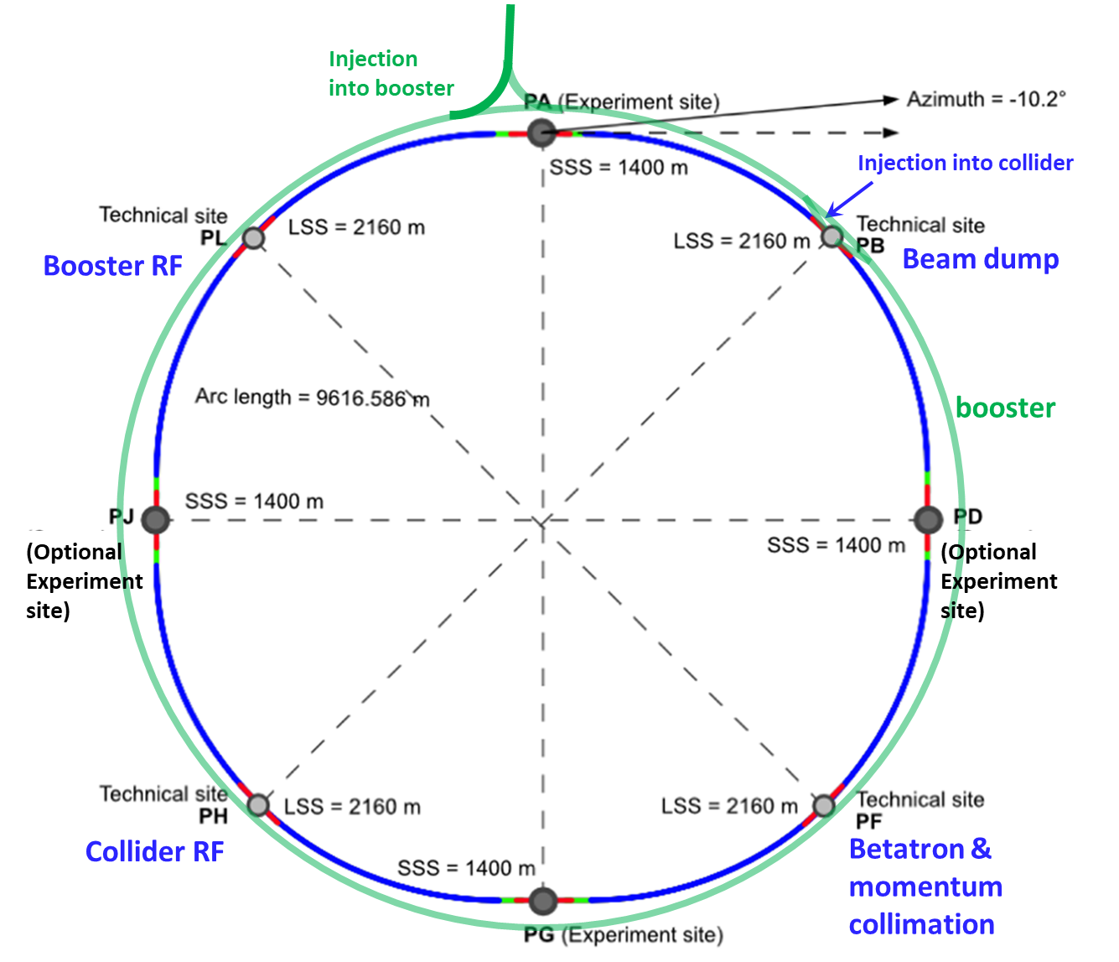
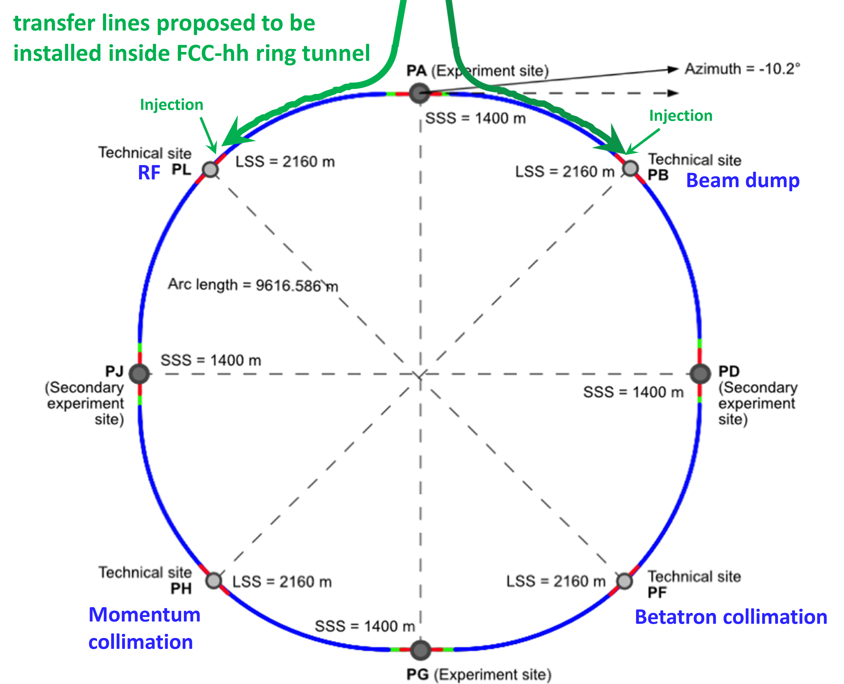
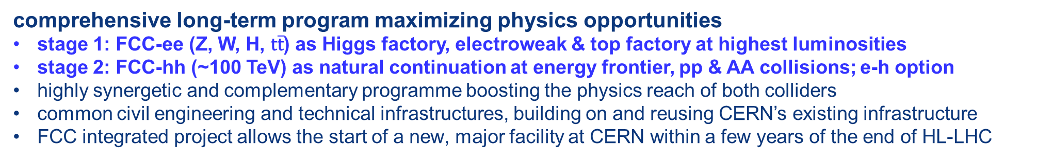
FCC integrated program
comprehensive long-term program maximizing physics opportunities
stage 1: FCC-ee (Z, W, H, $\text{t}\overline{\text{t}}$) as Higgs factory, electroweak & top factory at highest luminosities
stage 2: FCC-hh (~100 TeV) as natural continuation at energy frontier, pp & AA collisions; e-h option
highly synergetic and complementary programme boosting the physics reach of both colliders
common civil engineering and technical infrastructures, building on and reusing CERN’s existing infrastructure
FCC integrated project allows the start of a new, major facility at CERN within a few years of the end of HL-LHC
FCC-ee
FCC-hh
2020 - 2045
2045 - 2065
2070 -

Slide 4
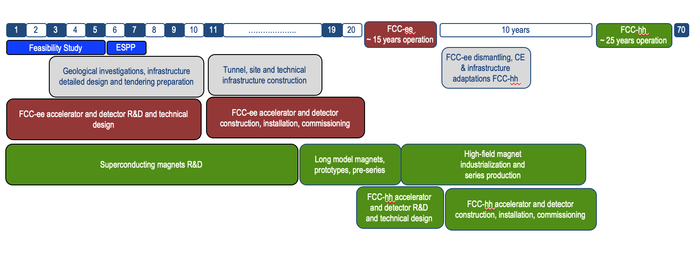
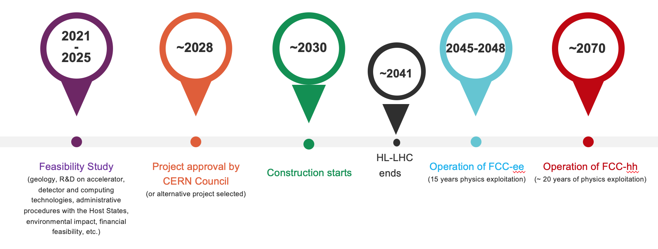
FCC integrated program - timeline
Note: FCC Conceptual Design Study
started in 2014 leading to CDR
in 2018
Ambitious schedule taking into account:
past experience in building colliders at CERN
approval timeline: ESPP, Council decision
that HL-LHC will run until 2041
project preparatory phase with adequate
resources immediately after Feasibility Study
2027/28
~2033
~2046
~2070

Slide 5
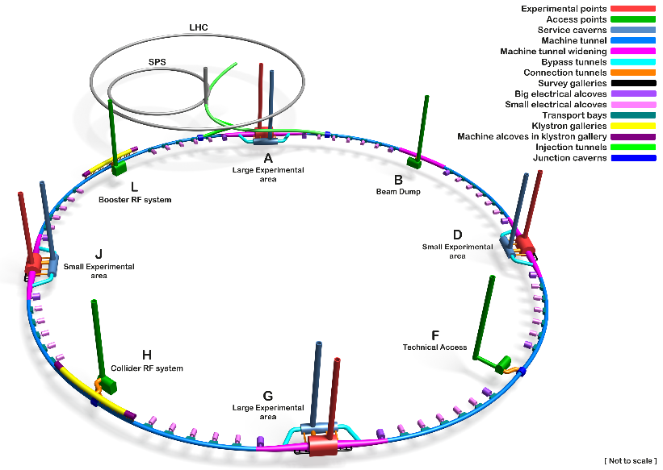
Key features of the FCC civil engineering
90.7 km main tunnel with an internal diameter of 5.5 m.
Average depth around 200 m.
12 shafts ,18 m in diameter.
2 larger experiment caverns (35m span).
2 smaller experiment caverns (span 25m).
5 km transfer tunnel from the surface.
3 km of Klystron Gallery tunnels.
8 surface sites
Injector at CERN Prevessin Site
Schematic Layout of the FCC ee Underground Structures

Slide 6
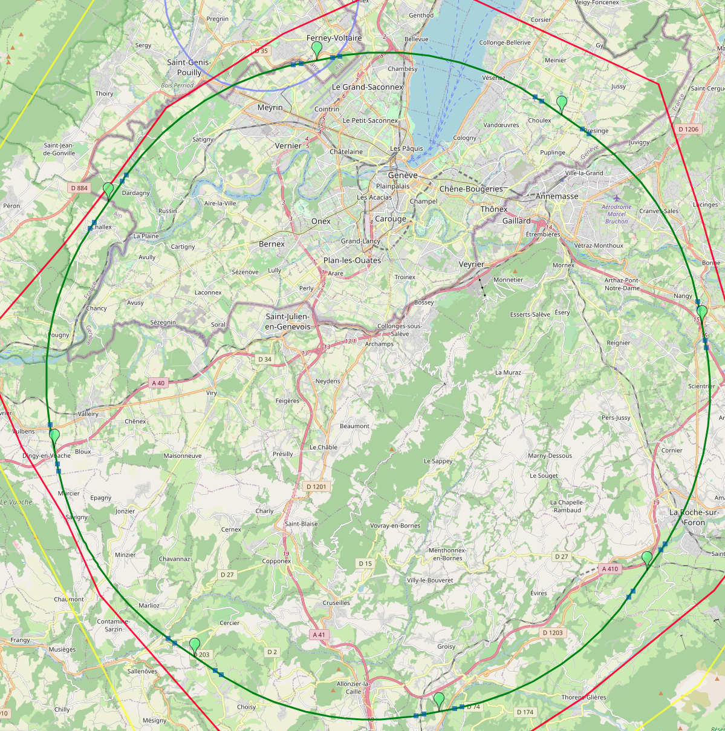
Reference layout and implementation: PA31 - 90.7 km
V. Mertens,
J. Gutleber
Layout chosen out of ~ 100 initial variants, based on geology and
surface constraints (land availability, access to roads, etc.), environment, (protected zones), infrastructure (water, electricity, transport), machine performance etc.
“Avoid-reduce-compensate” principle of EU and French regulations
PA: Experiment
PB: technical
PL: technical
Overall lowest-risk baseline: 90.7 km ring, 8 surface points,
(Reduction from the 97.7 km and the 12 surface sites in 2019)
Number of surface sites | 8
Surface requirements | ~40 ha
LSS@IP (PA, PD, PG, PJ) | 1400 m
LSS@TECH (PB, PF, PH, PL) | 2032 m
Arc length | 9.6 km
Sum of arc lengths | 76.9 m
Total length | 90.7 km
PD: experiment
PJ: experiment
4 experiments
PF: technical
PH: technical
6
PG: experiment

Slide 7

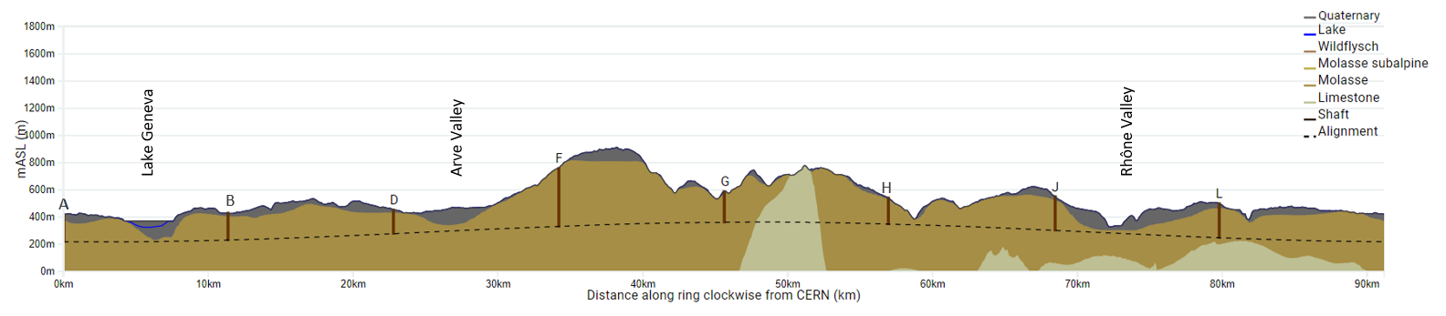
FCC tunnel implementation- geological conditions
FCC inclined at 0.5% gradient to minimise depth of point F
Limestone unavoidable between G-H
FCC above limestone
FCC passes below Lake Geneva moraines
  Tunneling mainly in moraine layer (soft rock), well suited for fast, low-risk TBM construction.
  6 million m³ excavated volume → 8.5 million m³ excavation material on surface
  CE Designs of all underground structures developed
  To fix the vertical position of the tunnel, interfaces between geological layers have to be known

Slide 8
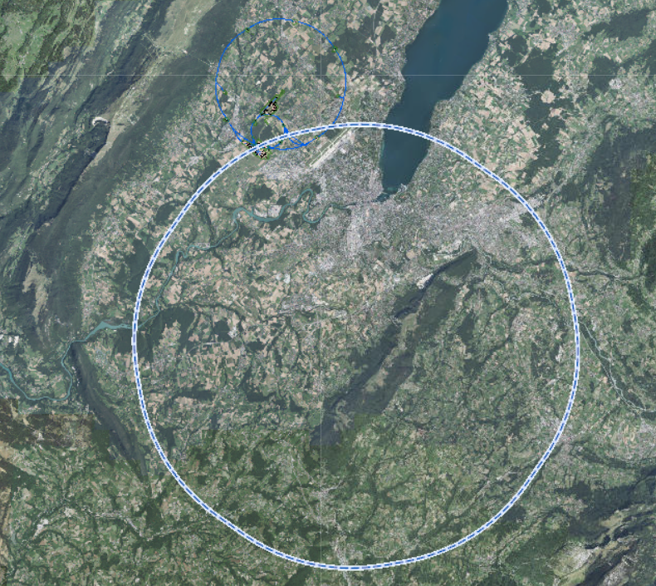
Site Investigations
  28 boreholes and 80 km of geophysics in total between October 2024 and December 2025
  Southern work package completed by March 2025
  All geophysics acquisition and interpretation in sections Arve, Mandallaz, Usses and Vuache is completed
  Drilling progress (including logging and testing) will be 100% complete
  Northern work package completed by end 2025
  Geophysics and drilling activities in the largest section (Jura 1) expected to begin in March 25 (pending permits)
JURA2
LAKE
JURA1
RHONE
ARVE
  Site investigation results provide:
  Locations of geologic interfaces, permitting to fix vertical position and inclination of tunnel
  All data will be made publicly available in particular for host states administrative and technical services.
VUACHE
BORNES
Complete
USSES
Ongoing
MANDALLAZ
Starting shortly

Slide 9
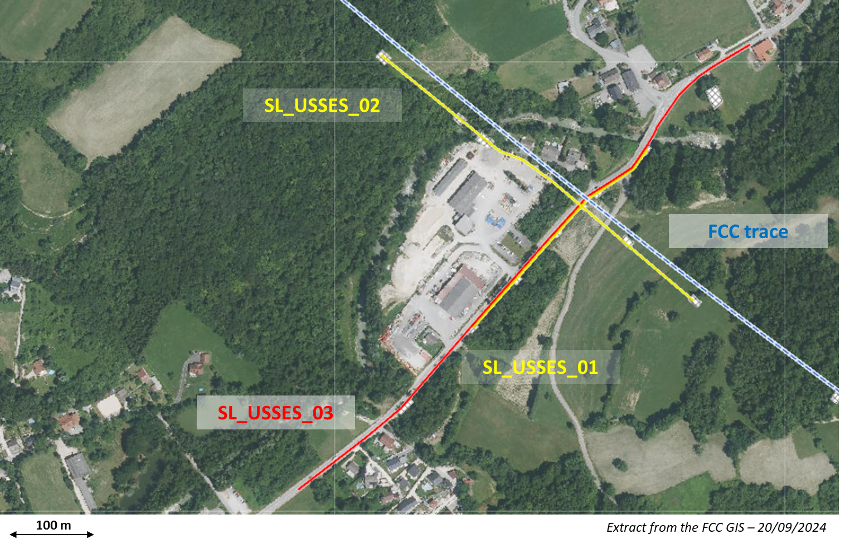
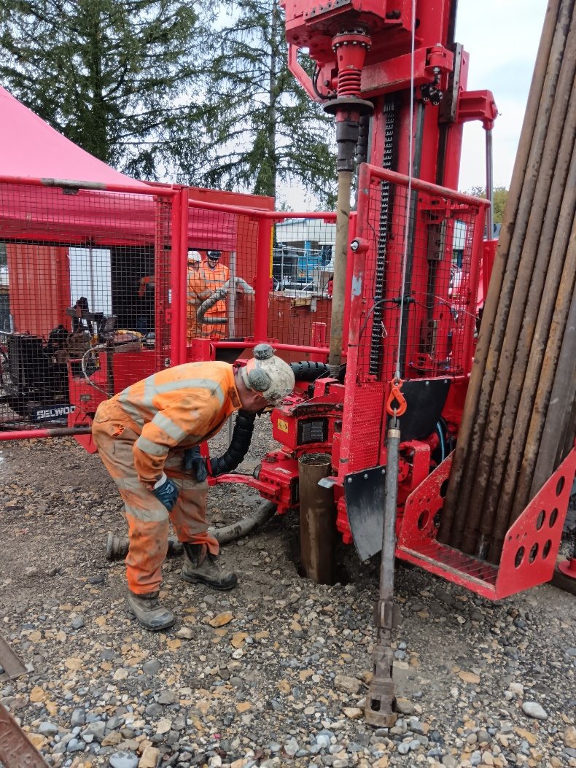
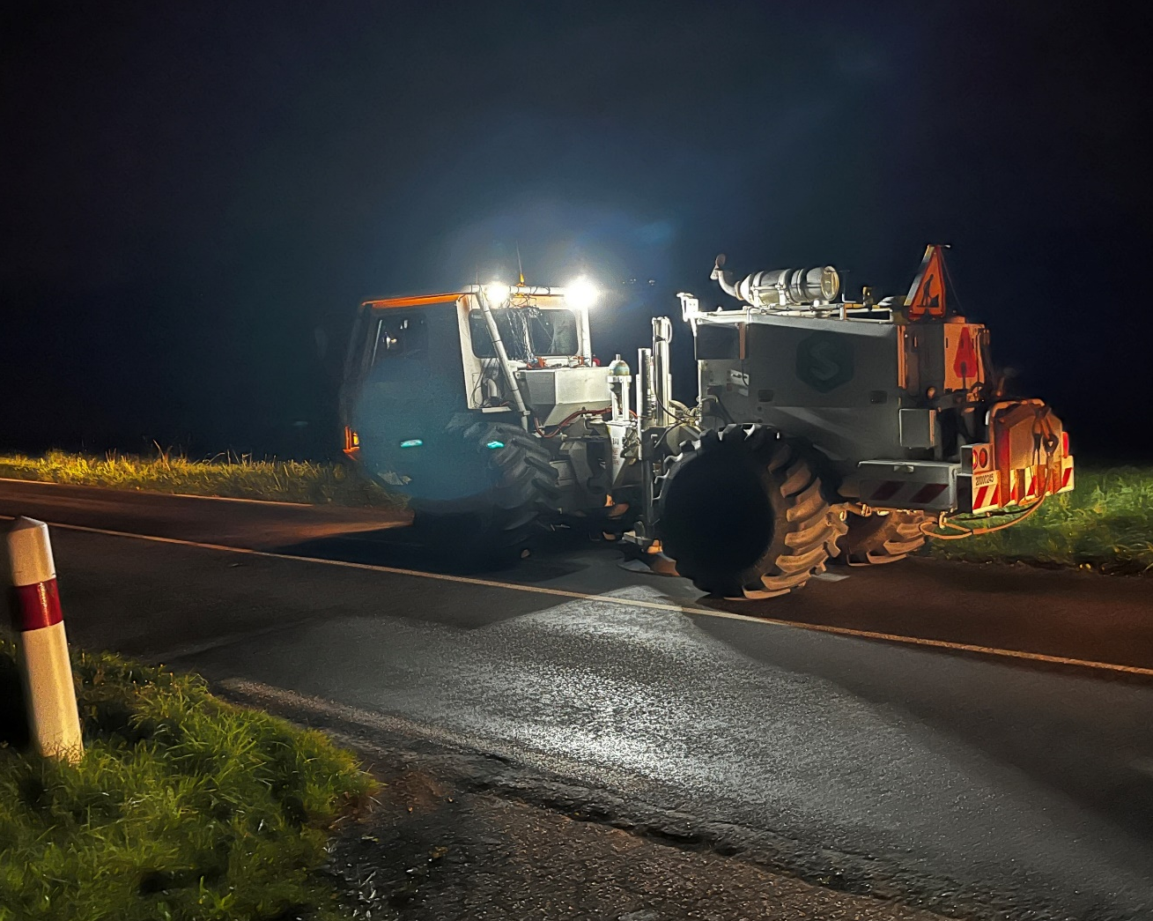
Seismic investigations drilings

Slide 10
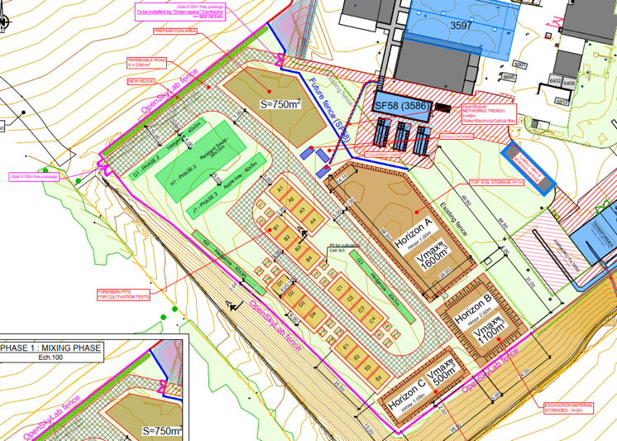









Development of excavation material re-use opportunities
OpenSkyLab: academic and industrial collaboration @LHC P5 CMS
Transformation of Molasse (FCC ~8 Mm³ volume) into fertile soil for agricultural and other uses
Materials: Molasse from the HL-LHC construction
Duration: 4+ years (2024 - )
Trials with 5 000 t molasse
  Soil fertilisation process (micro-organisms, mixing with fertile soil, etc.)
  Development of ferilisation mix products
  Development of quality managed processes
  Experimental phase with scientific protocol and field monitoring and control system support

Slide 11
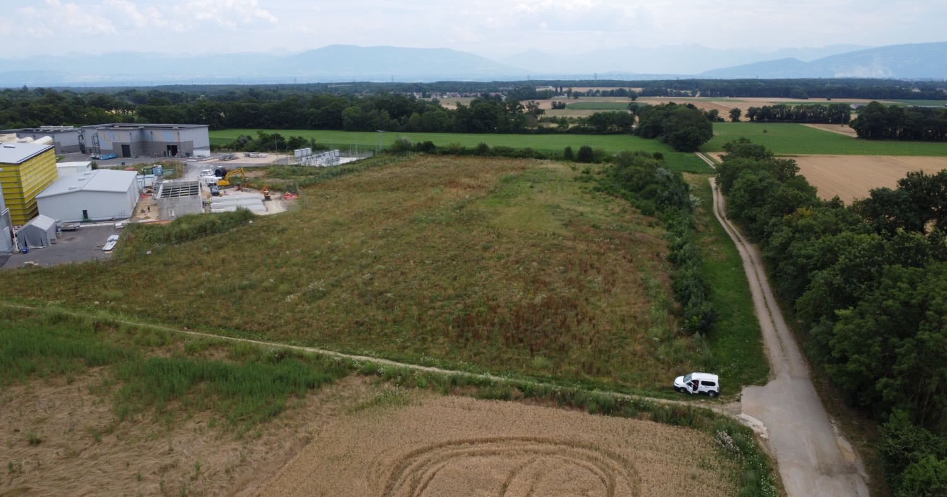
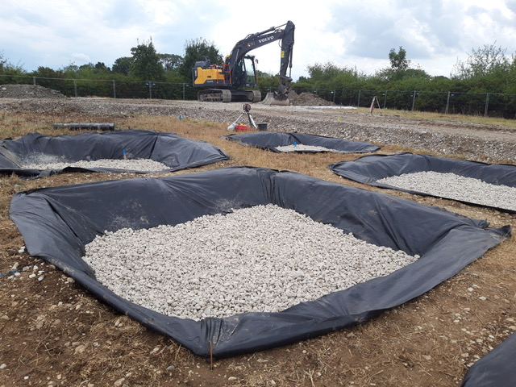
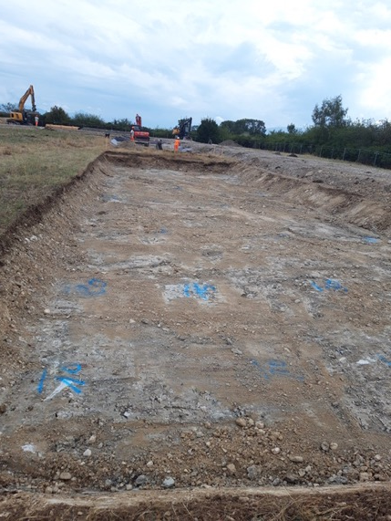
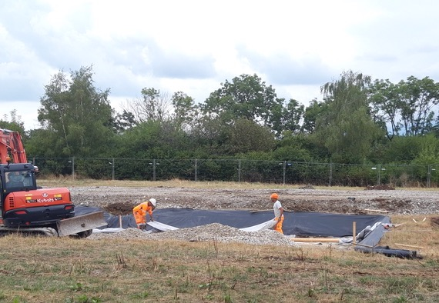
OpenSkyLab status and progress

Slide 12
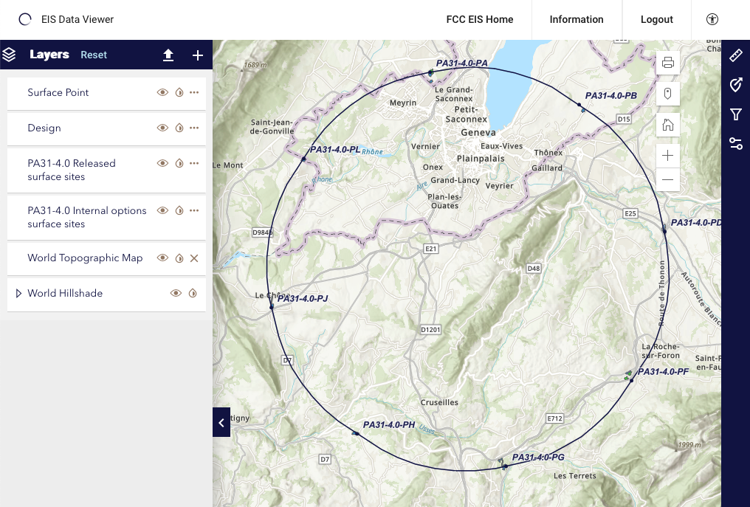
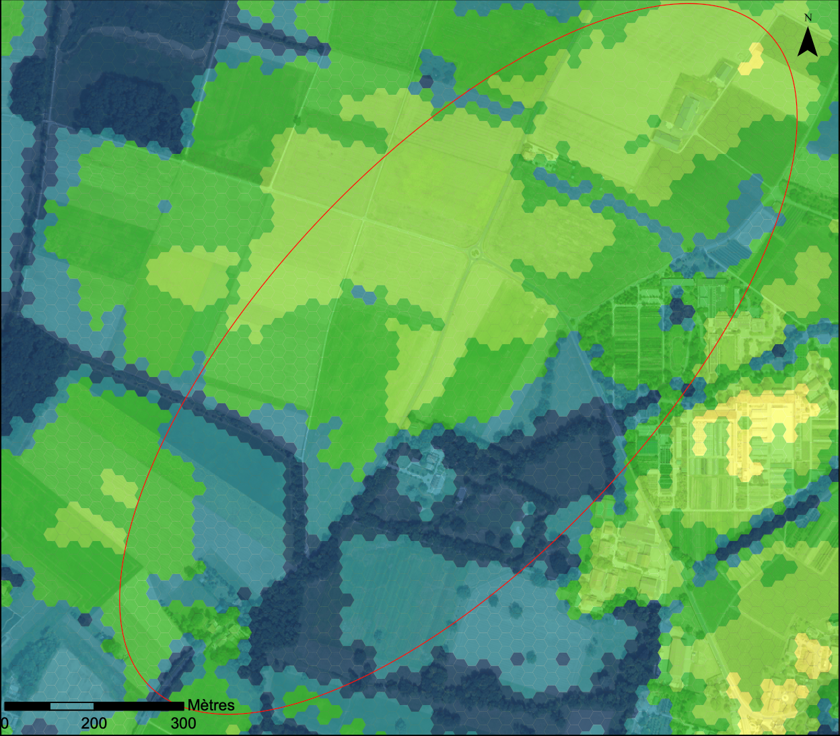
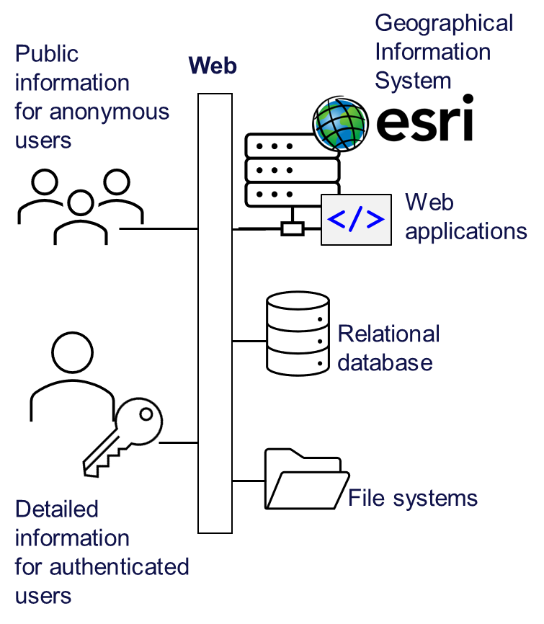
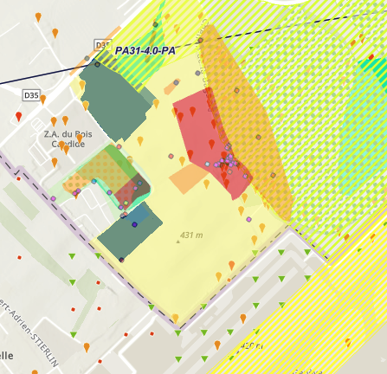
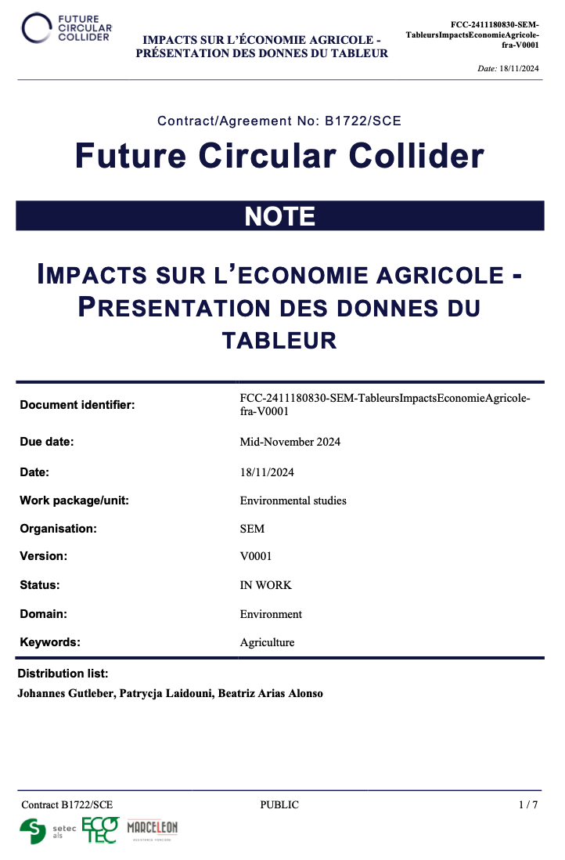
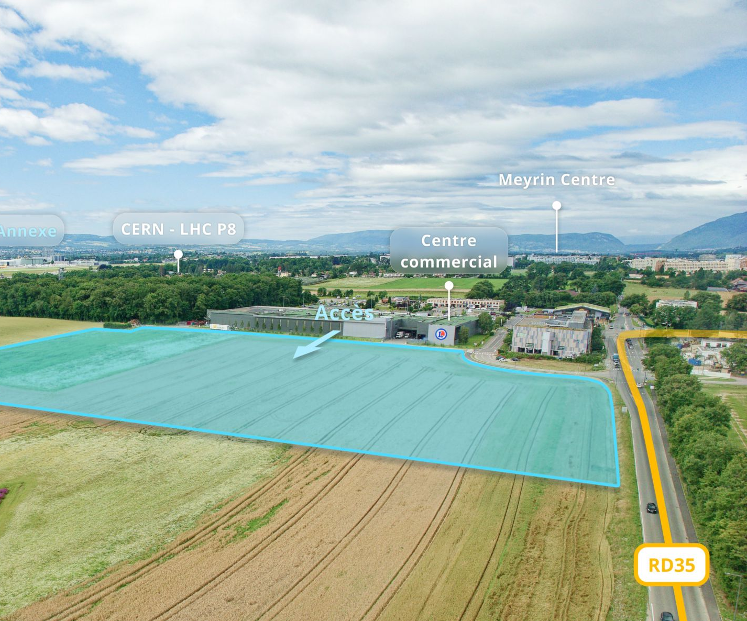
Environmental Initial State Study
Environmental information system
  The environmental initial state analysis at the eight surface site locations did not highlight principal showstoppers for the project and identified topics for further environmental optimization.
  All data will be made publicly available in particular for host states administrative and technical services.

Slide 13
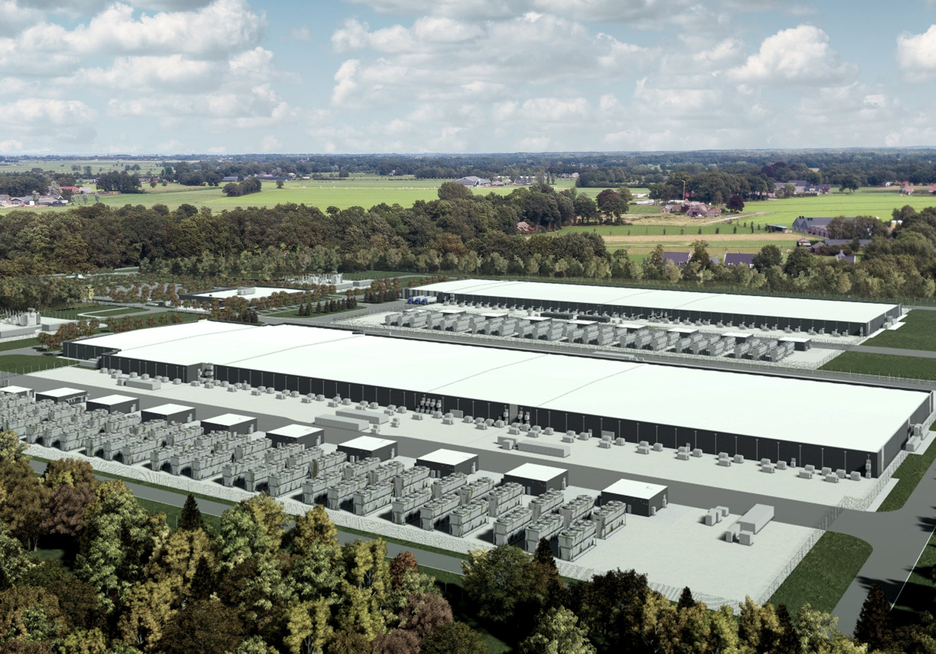
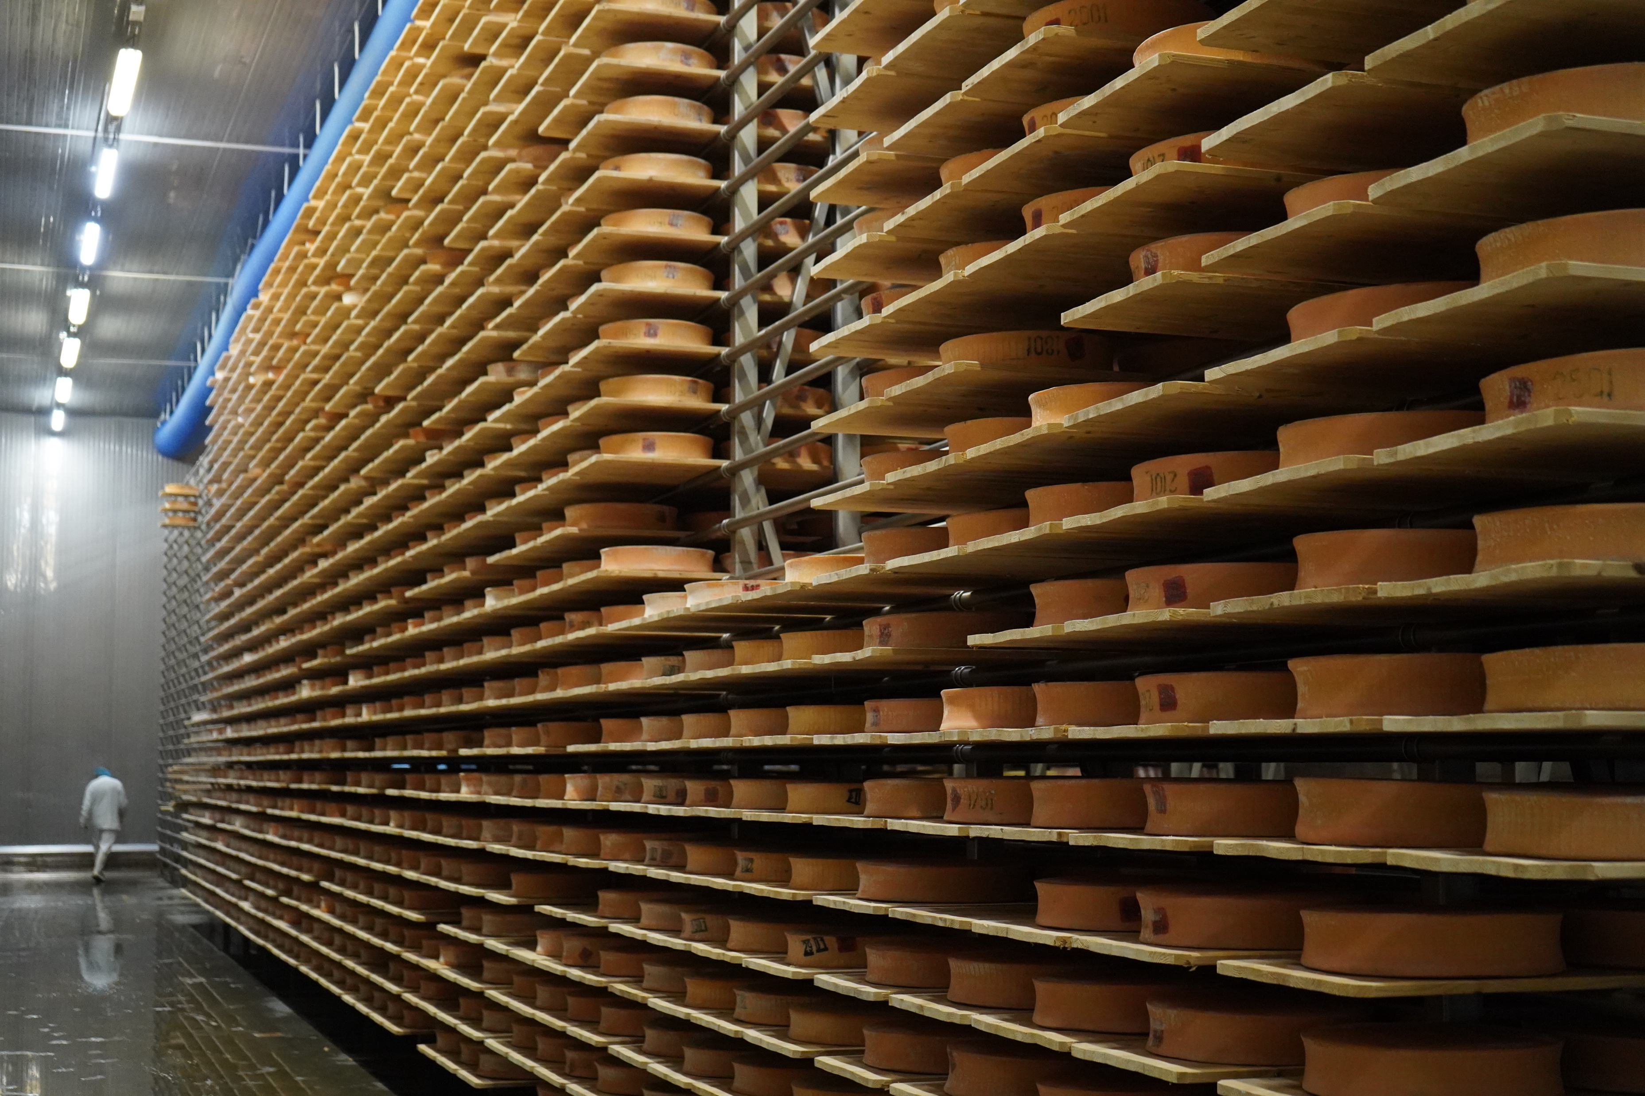
Resource needs for FCC-ee
Raw water 1 – 3 million m³/year
CERN 2022: 3.2 million m³
No new intake required.
No use of water bearing layers.
Waste heat recovery & supply to region
Demand for 400 GWh/year identified
Leads to water reduction
Requires development with stakeholders
Electricity 1.1 – 1.8 TWh/year
(Current CERN consumption: 1.3 TWh/year)
Feasibility confirmed with RTE

Slide 14
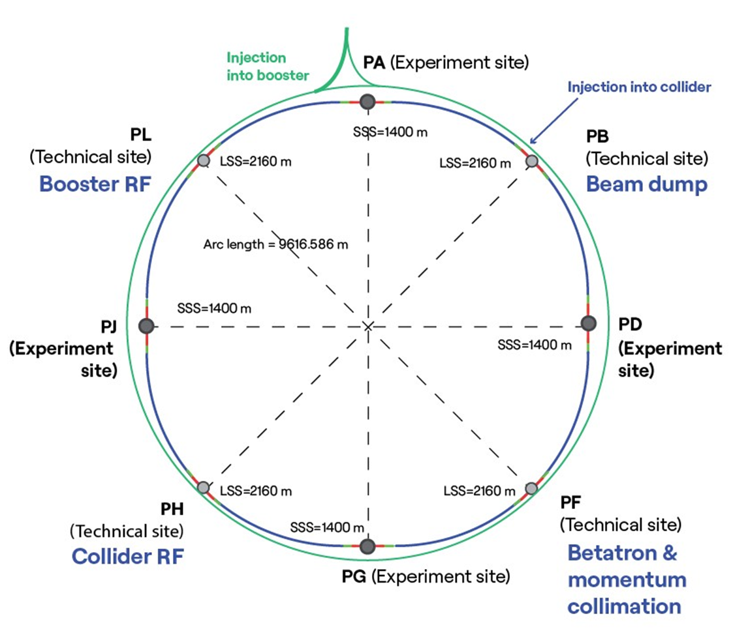
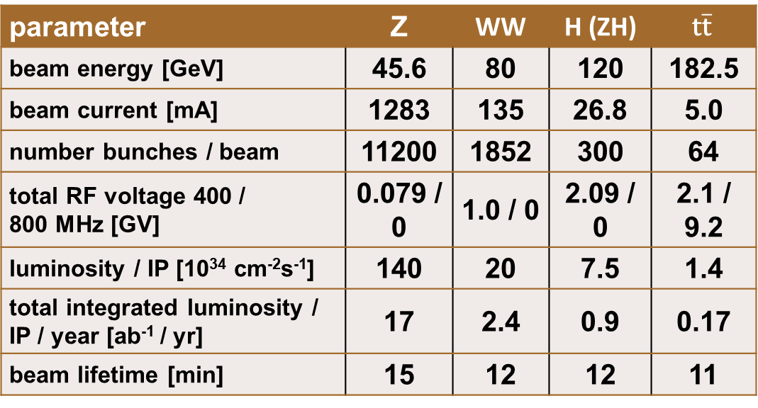
FCC-ee collider
parameter | Z | WW | H (ZH) | $$\text{t}\overline{\text{t}}$$
beam energy [GeV] | 45.6 | 80 | 120 | 182.5
beam current [mA] | 1283 | 135 | 26.8 | 5.0
number bunches / beam | 11200 | 1852 | 300 | 64
total RF voltage 400 / 800 MHz [GV] | 0.079 / 0 | 1.0 / 0 | 2.09 / 0 | 2.1 / 9.2
luminosity / IP [10³⁴ cm⁻²s⁻¹] | 140 | 20 | 7.5 | 1.4
total integrated luminosity / IP / year [ab⁻¹ / yr] | 17 | 2.4 | 0.9 | 0.17
beam lifetime [min] | 15 | 12 | 12 | 11
Swiss key contributions
Beam optics design | U. Geneva
Spin dynamics for precise energy calibration | EPFL
Beam-beam studies & code development | EPFL
Luminosity tuning | U Geneva
Electron-cloud studies | EPFL

Slide 15
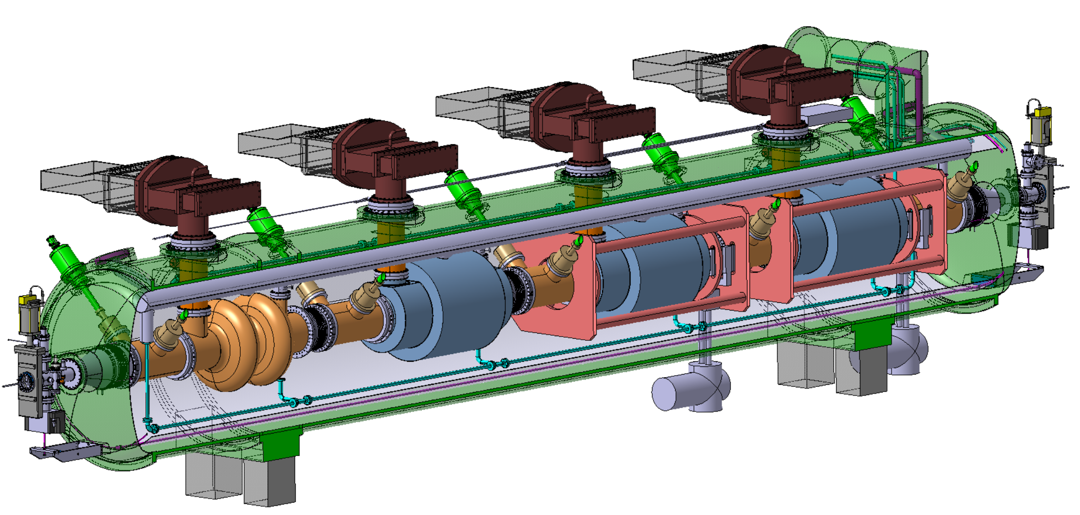
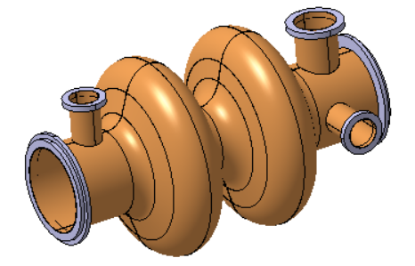
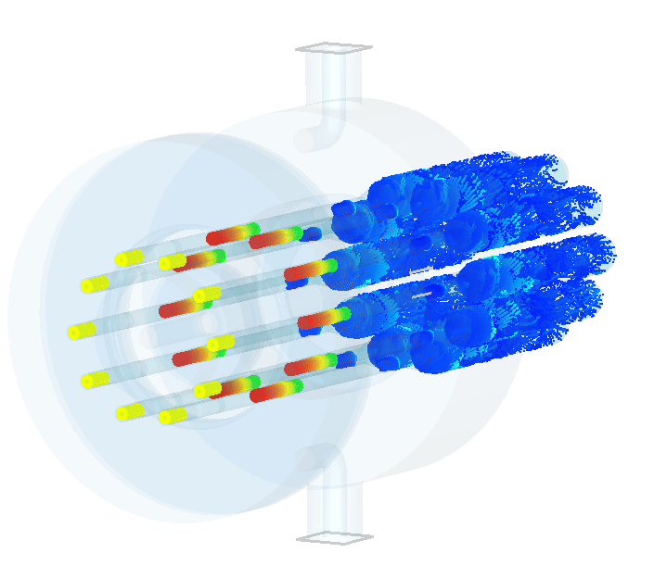
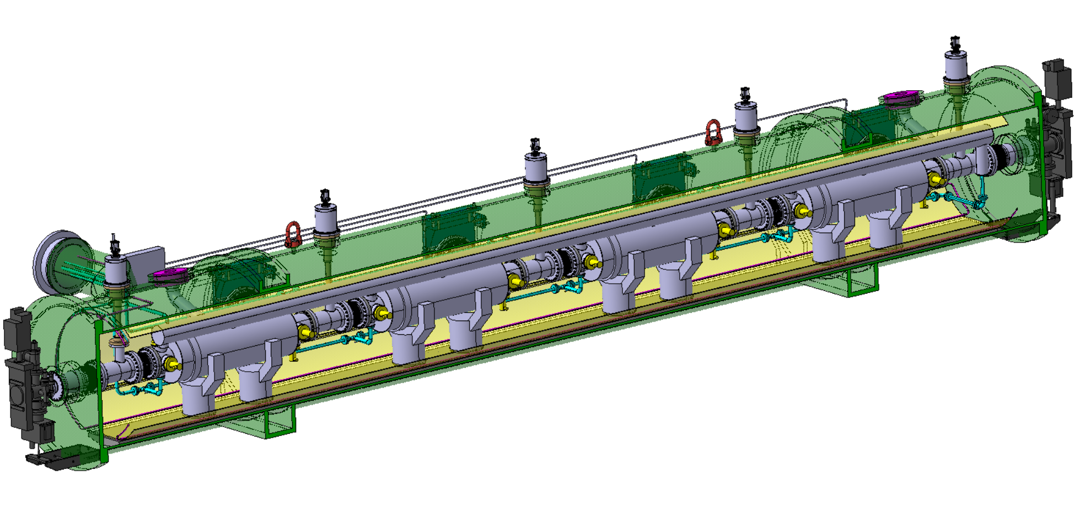
Key technology FCC-ee:
superconducting radio-frequency system for high efficiency
400 MHz Collider
Power source: Multibeam Tristron
Very efficient ~90 % ! <<OPEX
3 m long
50 kV
500 kW, CW
X 264
X 66
Superconducting elliptical cavity
400 MHz, 2-cell, copper Nb coated
1.5 m. long
400 MHz Cryomodule
X 264
800 MHz Collider + Booster
X (408 + 448 booster)
X (102 + 112 booster)
X 204
+ 448 x 10 kW SSA booster
Superconducting elliptical cavity
800 MHz, 6-cell, bulk Nb
Nb₃Sn if R&D is successful
800 MHz Cryomodule

Slide 16
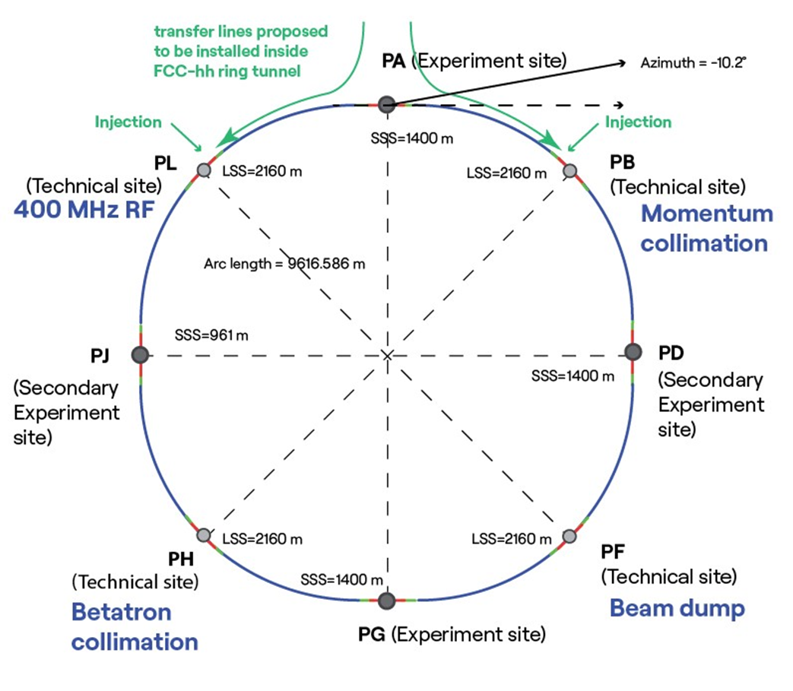
FCC-hh collider
parameter | FCC-hh | HL-LHC | LHC
collision energy cms [TeV] | 85 | 14
dipole field [T] | 14 | 8.33
circumference [km] | 90.7 | 26.7
beam current [A] | 0.5 | 1.1 | 0.58
synchr. rad. power / ring [kW] | 1200 | 7.3 | 3.6
peak luminosity [10³⁴ cm⁻²s⁻¹] | 30 | 5 (lev.) | 1
events/bunch crossing | 1000 | 132 | 27
stored energy/beam [GJ] | 6.5 | 0.7 | 0.36
integr. luminosity / IP [fb⁻¹] | 20000 | 3000 | 300
Swiss key contributions
High-field magnet development | PSI
Beam-beam studies & code development | EPFL
Superconductor R&D | U Geneva

Slide 17
New FCC-hh baseline – significantly reduced power consumption
Technical system choices and areas for optimisation:
Accelerator optics design to increase arc dipole filling factor and maximize beam energy
Cryo-magnet operation temperature
Cold mass either at 1.9 K with superfluid He (studied in CDR, cf. LHC) or with 4.5 K with forced flow
Cryogenics eco mode during shutdowns
Temperature of beam vacuum system (beam screen)
Impact on power consumption, integration, magnet design, Helium inventory, etc…
 | FCC-hh 90.7km 14T | FCC-hh 90.7km 14T
Magnet temperature | 1.9 K | 4.5 K
Yearly electricity consumption | < 2.8 TWh | < 2.2 TWh
Significant reduction of electrical power consumption (close to factor 2!) compared to CDR version 2019
Potential for further reduction, to be addressed with design optimisation and R&D in next phase

Slide 18
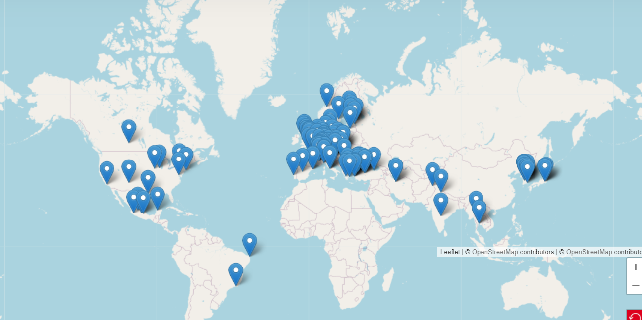


Status of FCC global collaboration and community
Increasing international collaboration as a prerequisite for success:
→links with science, research & development and high-tech industry will be essential to further advance and prepare the implementation of FCC
FCC Feasibility Study:
Aim is to increase further the collaboration,
on all aspects, in particular on
Accelerator and Particle/Experiments/Detectors
141 Institutes
32 countries
+
CERN

Slide 19

EU Competitiveness Report
edited by Mario Draghi, and officially handed over to Ursula von der Leyen in September 2024
“One of CERN’s most promising current projects, with significant scientific potential, is the construction of the Future Circular Collider (FCC): a 90-km ring designed initially for an electron collider and later for a hadron collider..
Refinancing CERN and ensuring its continued global leadership in frontier research should be regarded as a top EU priority, given the objective of maintaining European prominence in this critical area of fundamental research, which is expected to generate significant business spillovers in the coming years.”
https://commission.europa.eu/topics/strengthening-european-competitiveness/eu-competitiveness-looking-ahead_en

Slide 20
Back-up slides

Slide 21
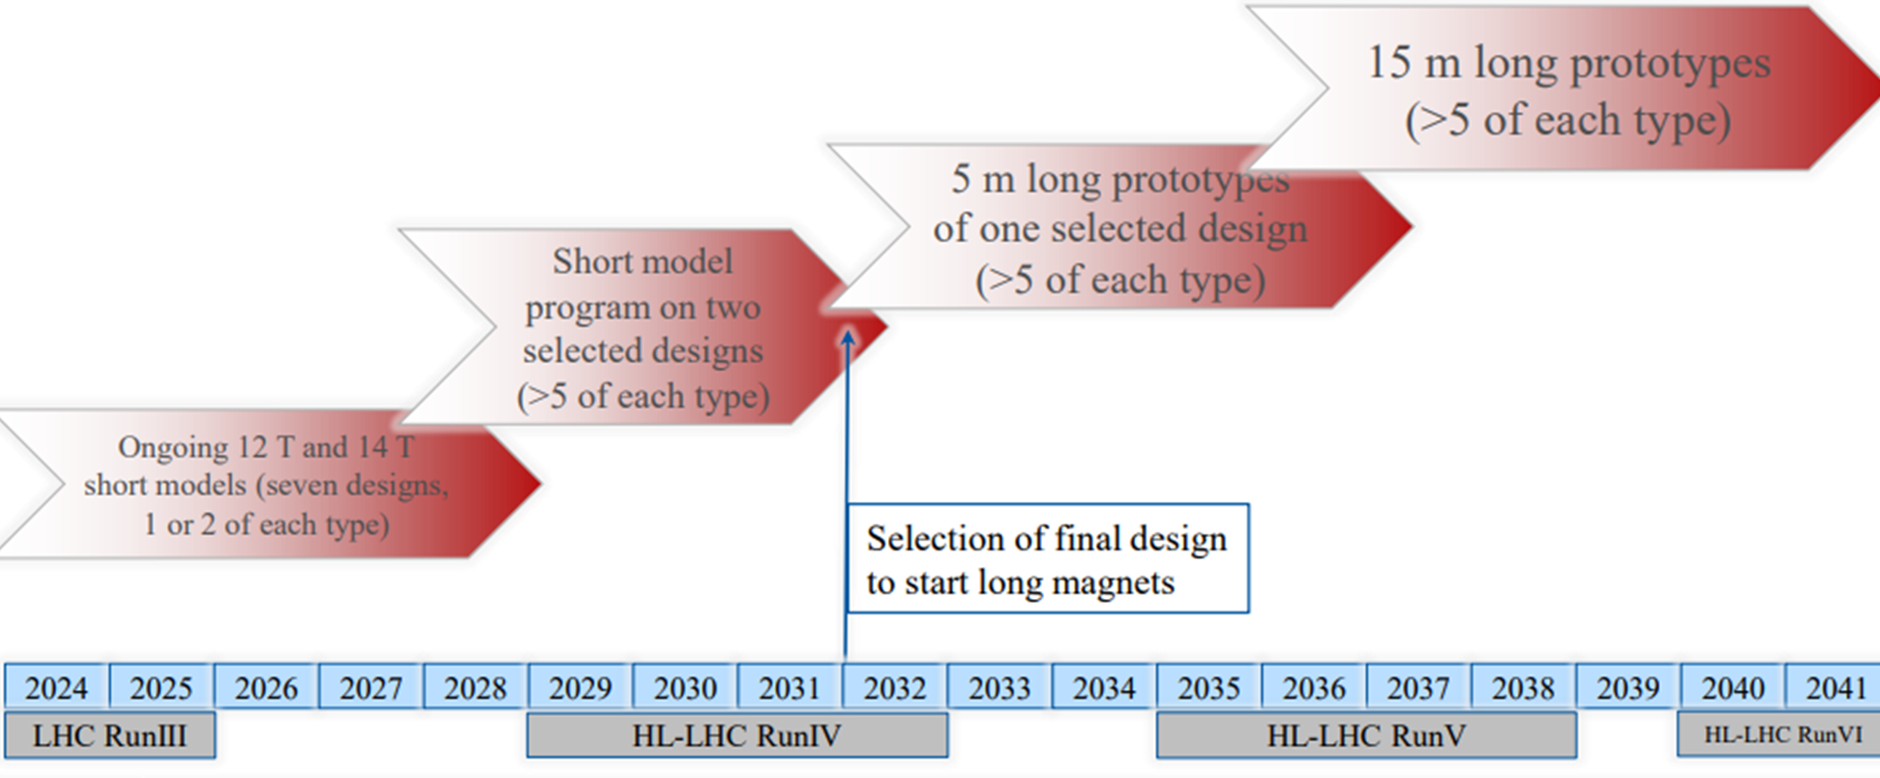
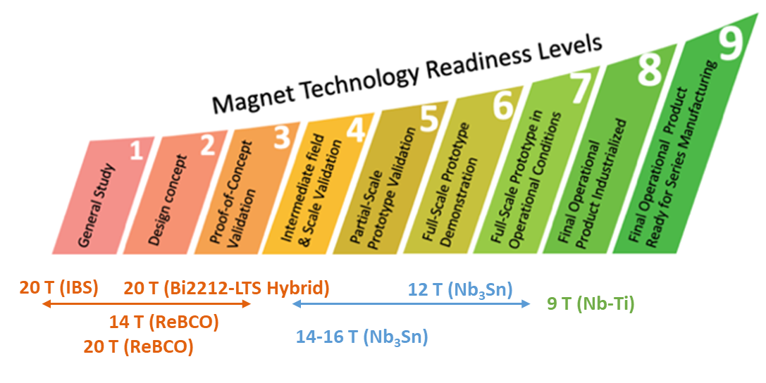
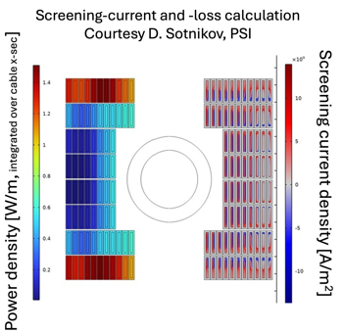
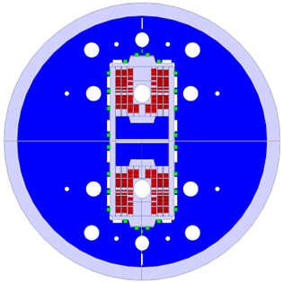
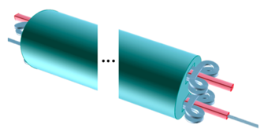

2nd stage FCC-hh – High Field Magnet Development
HTS Nb₃Sn Nb-Ti
(ReBCO, Bi2212, IBS)
14 T Nb₃Sn roadmap
→ 2055 as possible
FCC-hh start
Nb₃Sn model magnet
HTS model magnet
Design of 12 T SMACC1 ;
test in 2026
2025
HTS subSMCC manufacturing and testing
5-6 T field on conductor
HTS roadmap deliberations

