Slide 1
BSG 210278
A. Goldblatt, M.Duraffourg, D. Metin, F. Roncarolo and others

Slide 2
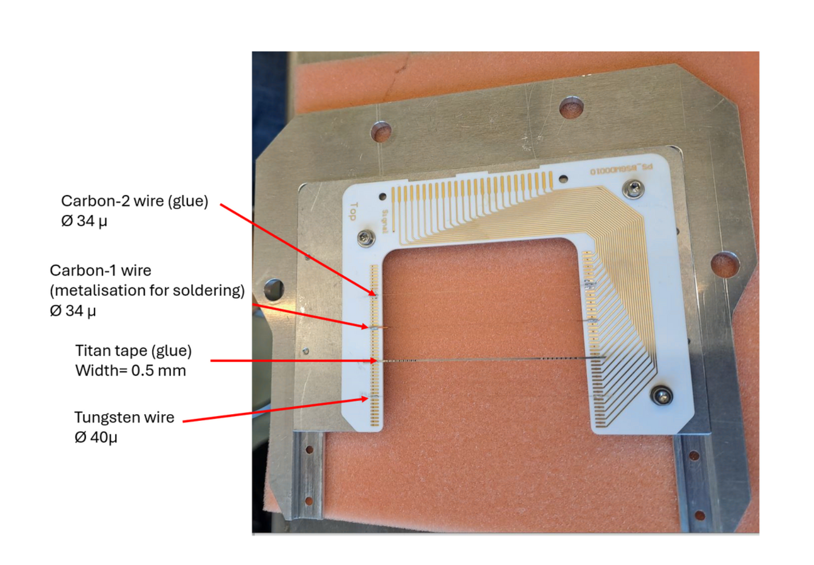
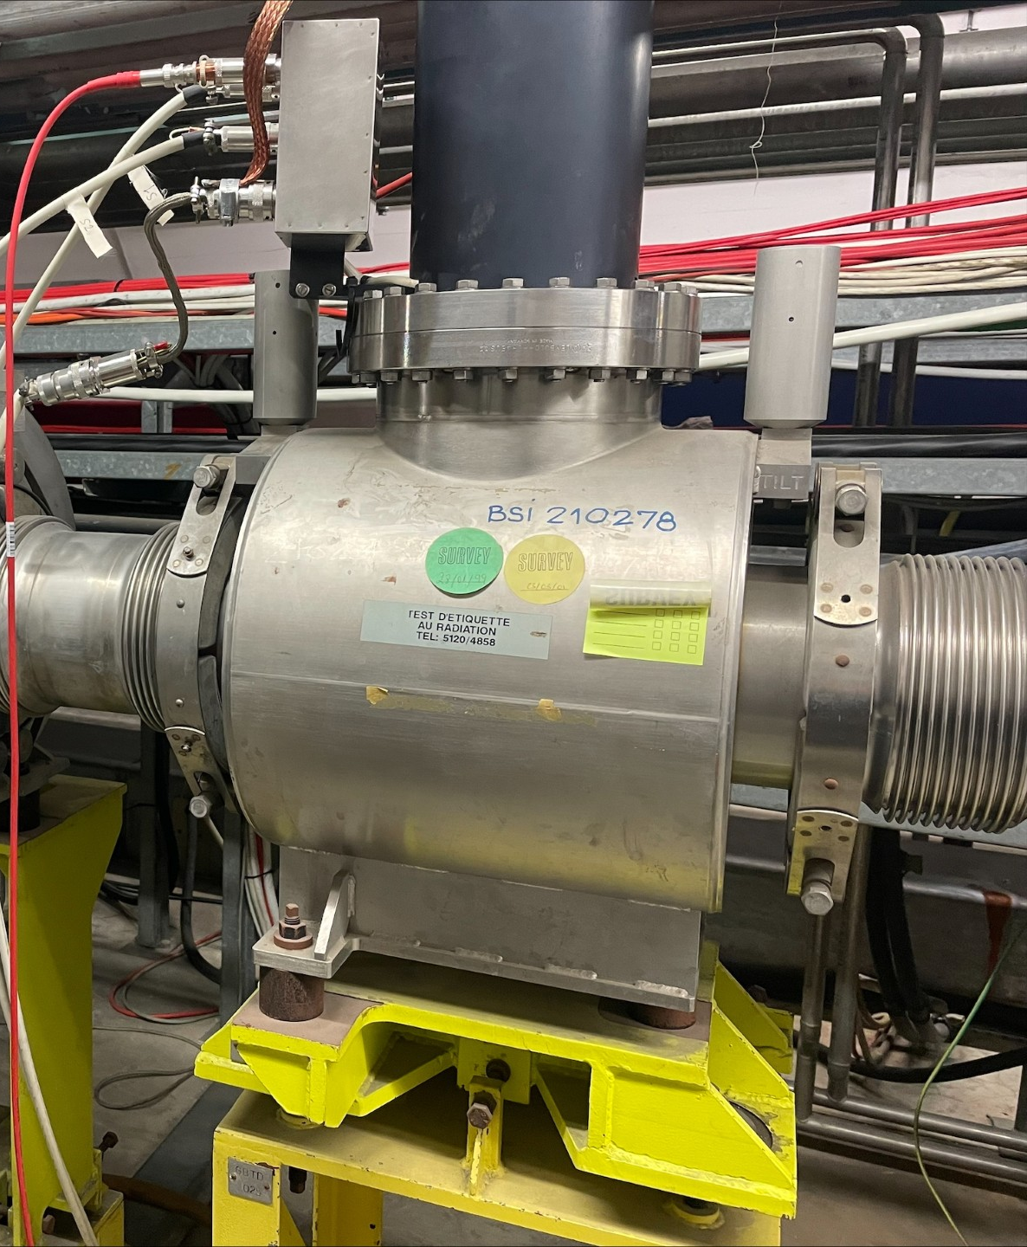
210278 Test Tank
Installed in 2022, comprised of 2 carbon wires, 1 tungsten wire coated with gold, and standard titanium band

Slide 3
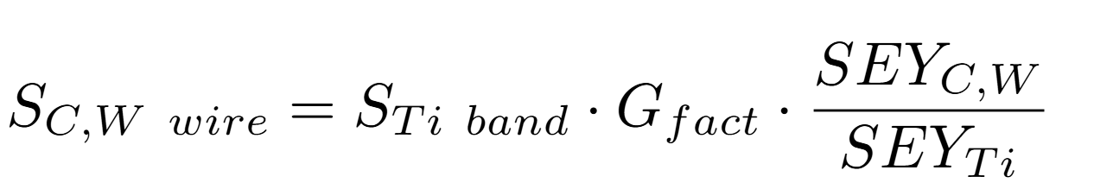
Signal difference
Estimated for different detector channels with knowledge of material properties (secondary emission yield) and wire geometry
Gfact from the ratio of primary particles intercepted by a wires as compared with the band

Slide 4
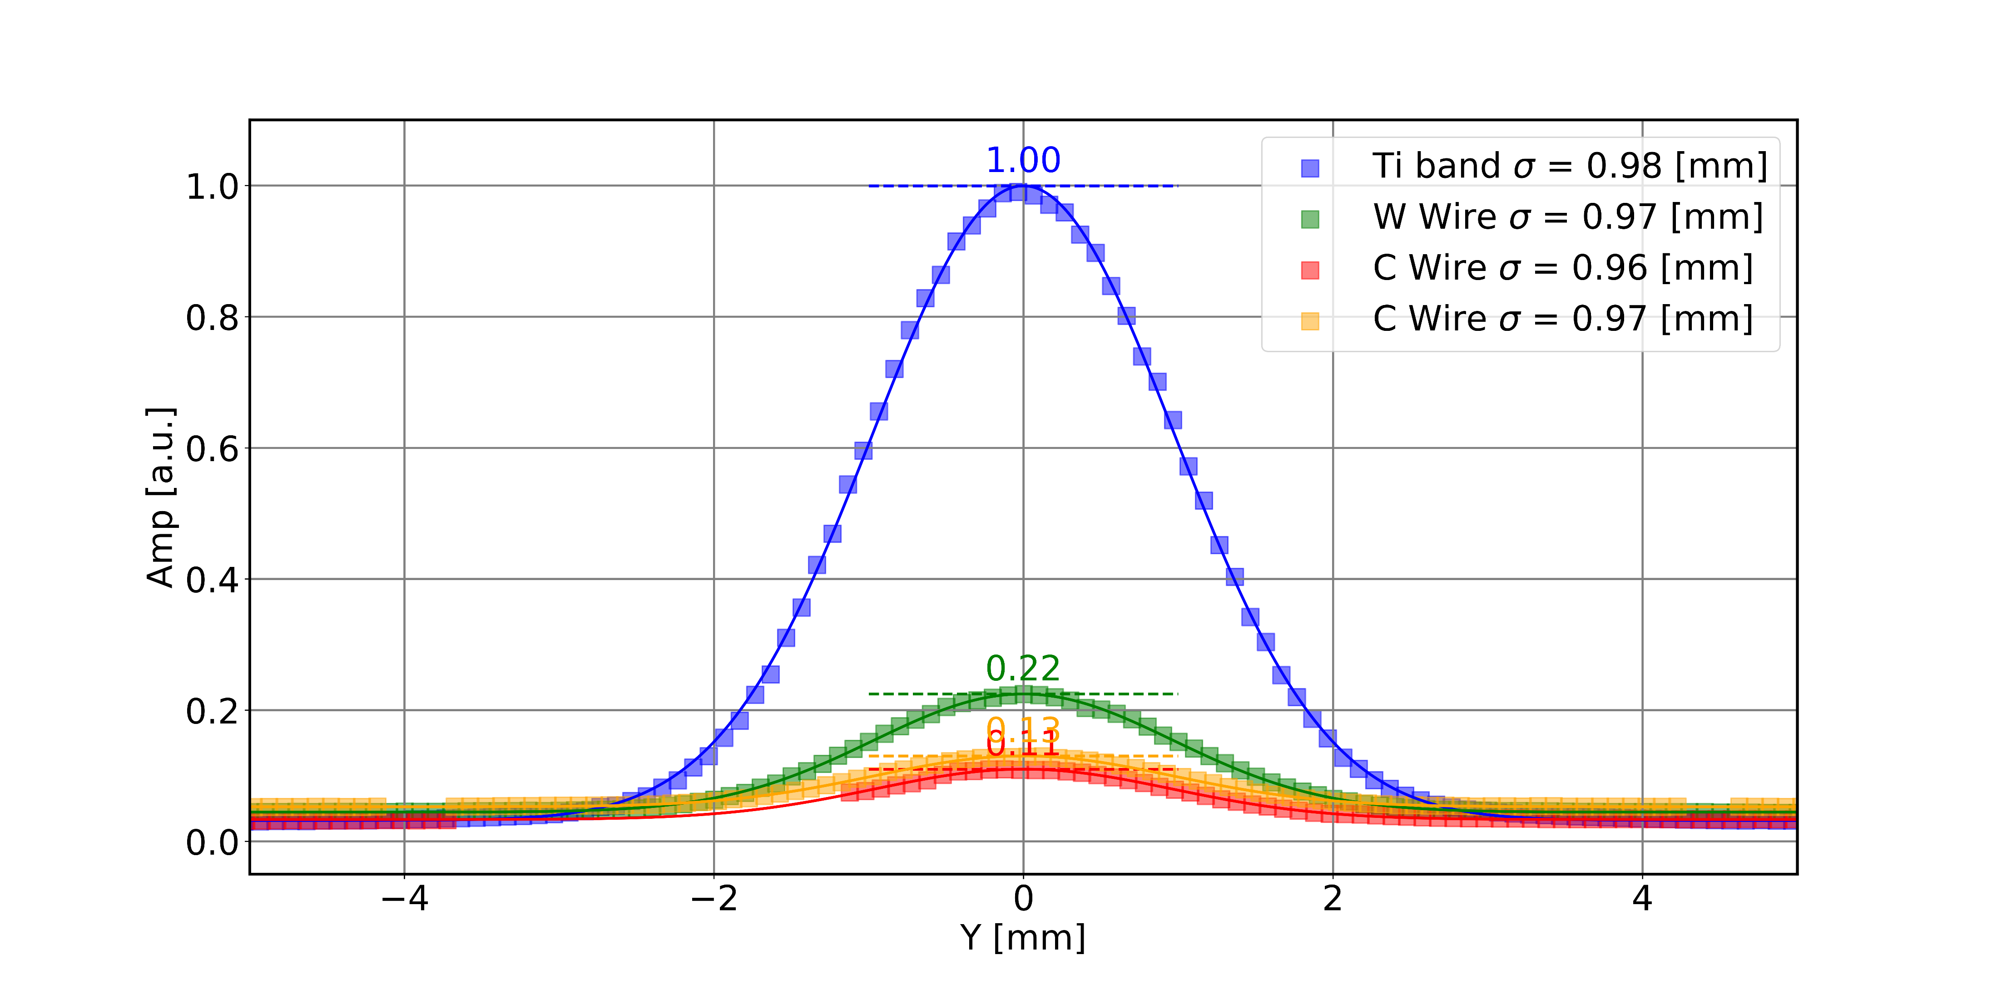
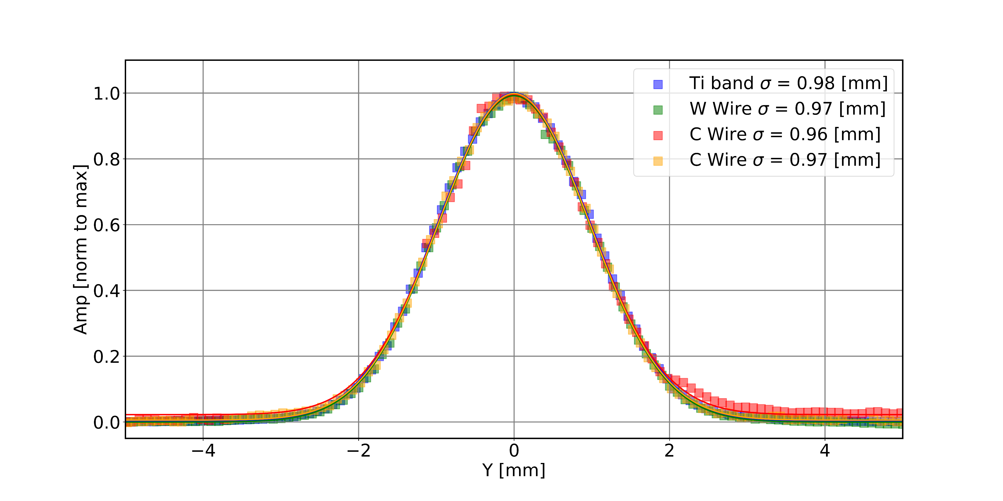
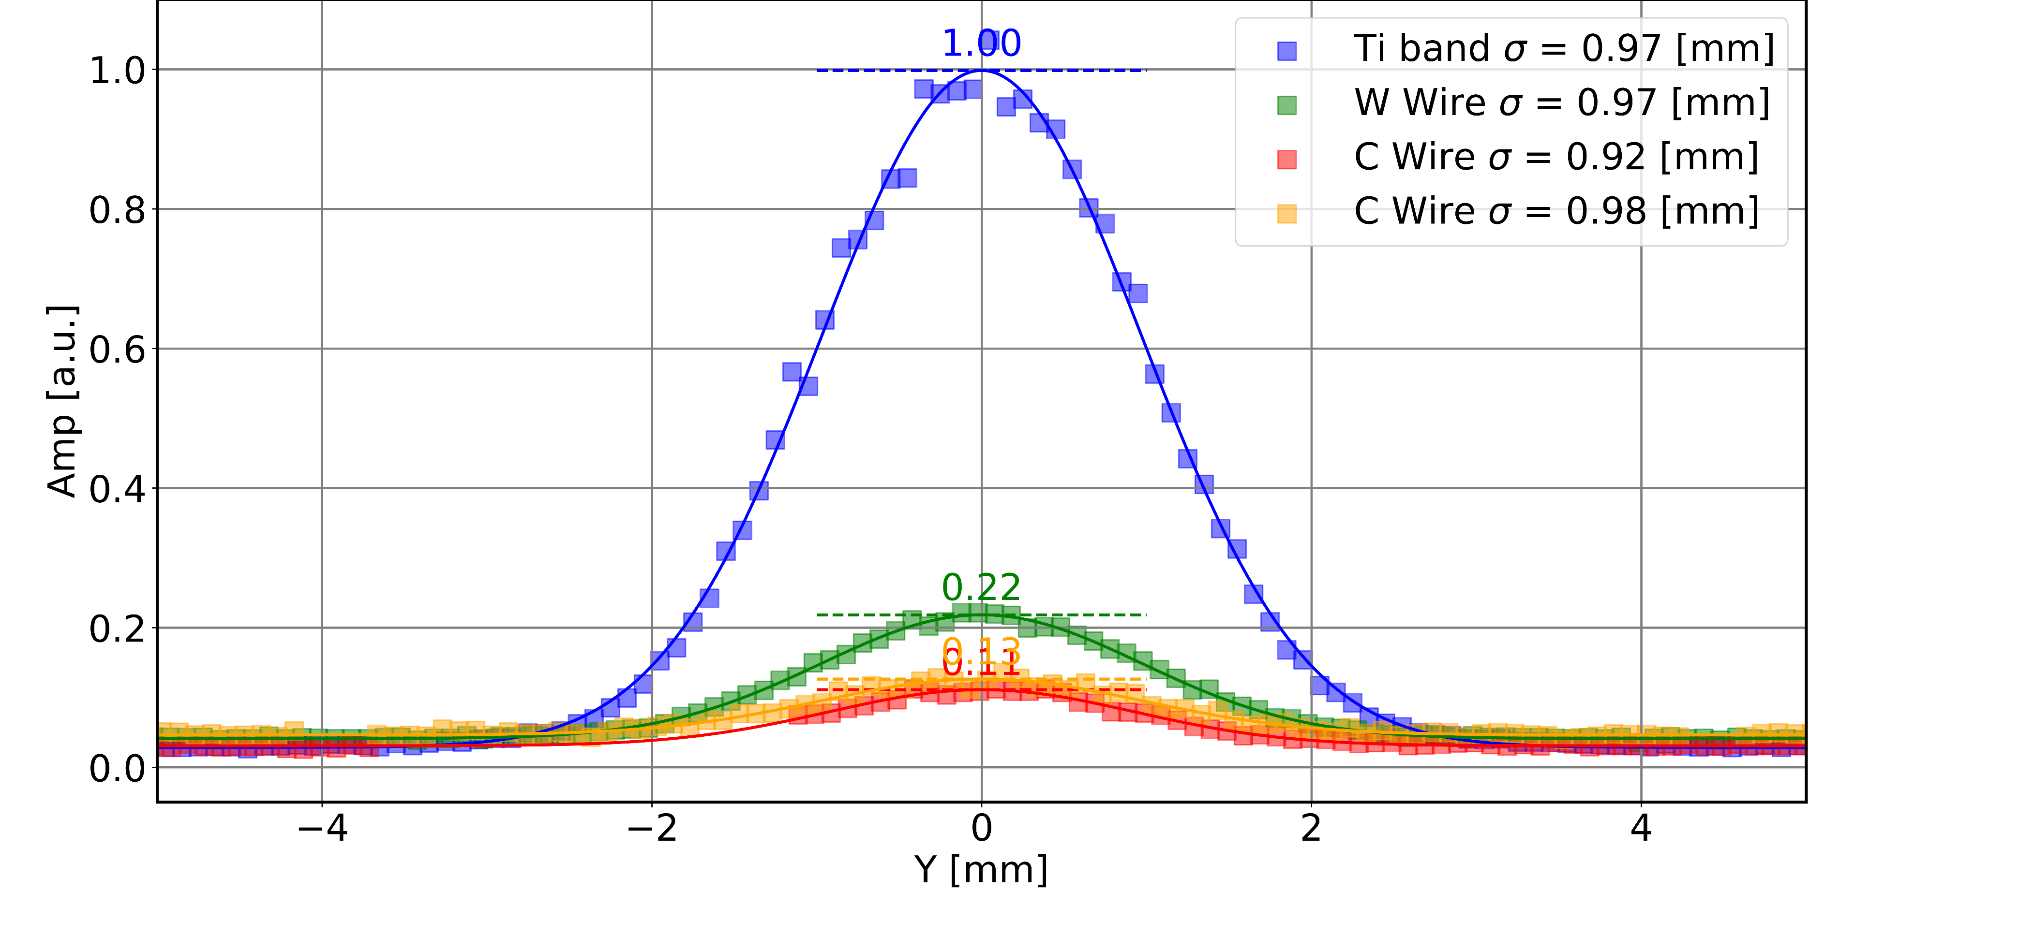
Profile reconstruction
Normalized to Titanium band
Normalized for peak
Profiles @ t=2.0 [s], normalized to titanium band
Data taken 11th August 2024 – High gain
Samples were scanned through the beam at intervals of 0.1mm for comparison of the signal amplitudes and reconstructed beam profiles
Average BCT intensity for data during this period 1.3e+13
When integrating over the spill, Ti band and W as well as C wires in agreement to within 2%
Agreement is within 6% with profile @ mid spill

Slide 5
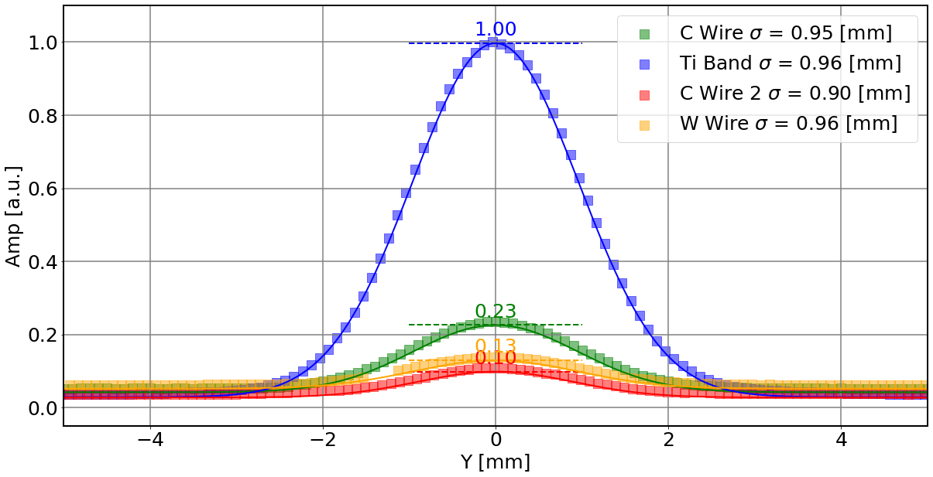
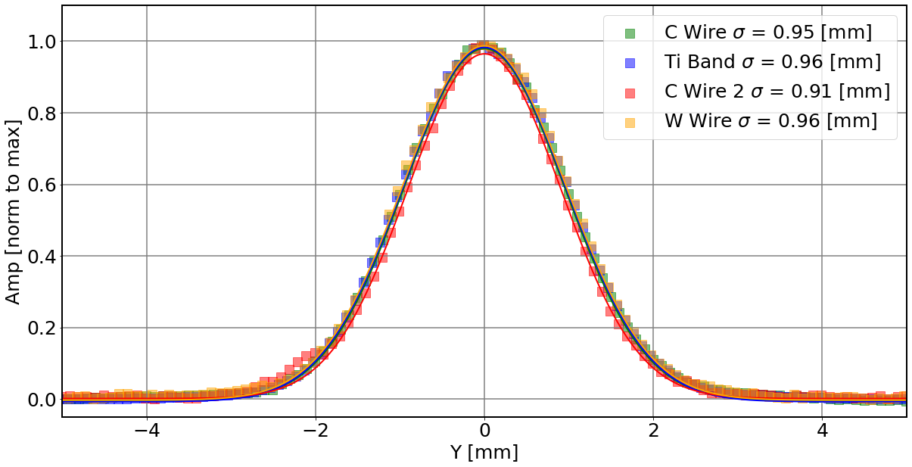
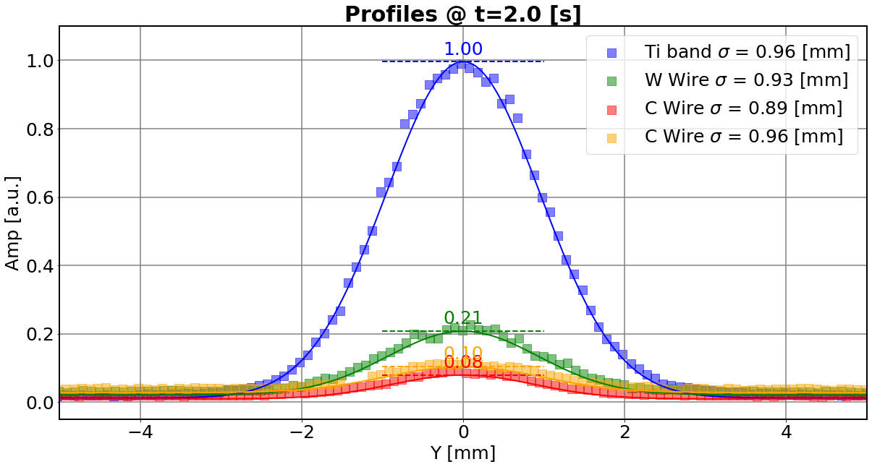
Profile reconstruction
Normalized to Titanium band
Normalized for peak
Profiles @ t=2.0 [s], normalized to titanium band
Data taken 28-29 August 2024 - Mid gain
When integrating over the spill, band and wires in agreement to within 6%
Within 7% agreement for profile @ mid spill

