Slide 1


Updates on 704 MHz, 3 cells cavity design and breakdown studies at CEA
Juliette Plouin, Sophie Pierron, Guillaume Ferrand, Claude Marchand
MC RF sub-WG on RF systems for muon cooling meeting #6
1st April 2025

Slide 2
3-D cavity design
Field emission in an elliptical cavity
Further studies on breakdown phenomena

Slide 3
3-D cavity design
Field emission in an elliptical cavity
Further studies on breakdown phenomena

Slide 4
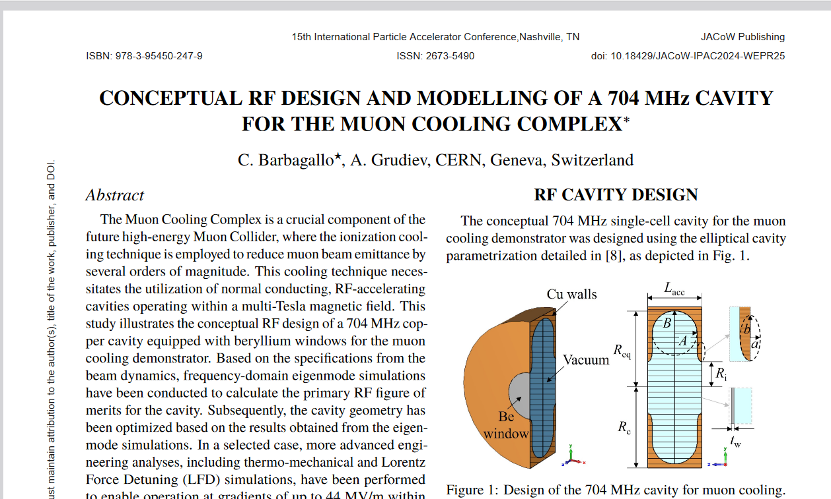
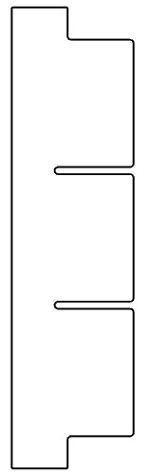
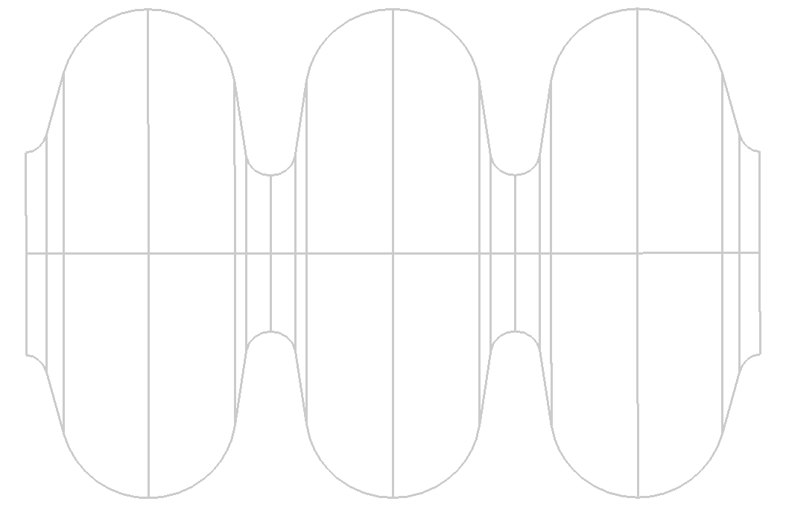







Building 3 cells cavity design with electrical coupling
Task 6.2
In parallel, a 3-cells cavity has been designed by CEA, based on electric coupling, in order to allow comparison with magnetic coupling structure. A main advantage is to avoid the presence of metallic sheet (beryllium or any other metal) between the cells.
$$L_{acc}$$
$$L_{acc}$$
$$L_{acc}$$
$$R_{iris}=60 mm$$
adapted from pill-box structures
adapted from an ESS elliptical cavity
$$L_{acc}=125 mm$$
$$L_{acc}=\frac{βλ}{2}=188 mm$$
$$β=0,884, f=704 MHz$$
adapted to the MuCol stage B5 requirement

Slide 5
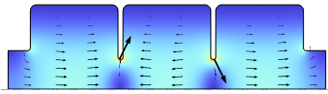
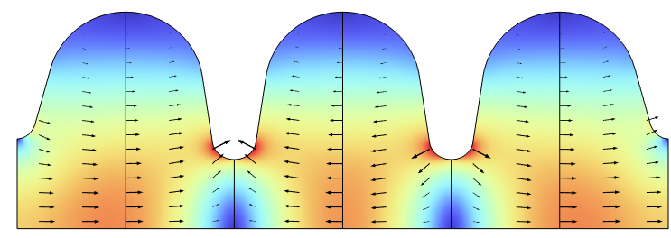
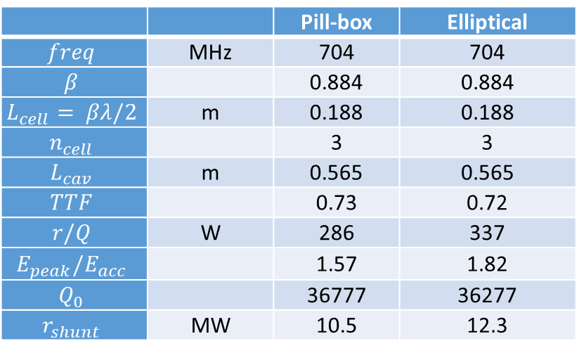
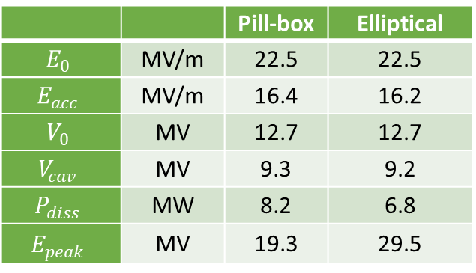
Figures of merit of pill box type and elliptical cavities
E field in cavity for the pi-mode
 |  | Pill-box | Elliptical
$$freq$$ | MHz | 704 | 704
$$β$$ |  | 0.884 | 0.884
$$L_{cell}= βλ/2$$ | m | 0.188 | 0.188
$$n_{cell}$$ |  | 3 | 3
$$L_{cav}$$ | m | 0.565 | 0.565
$$TTF$$ |  | 0.73 | 0.72
$$r/Q$$ | W | 286 | 337
$$E_{peak}/E_{acc}$$ |  | 1.57 | 1.82
$$Q_{0}$$ |  | 36777 | 36277
$$r_{shunt}$$ | MW | 10.5 | 12.3
 |  | Pill-box | Elliptical
$$E_{0}$$ | MV/m | 22.5 | 22.5
$$E_{acc}$$ | MV/m | 16.4 | 16.2
$$V_{0}$$ | MV | 12.7 | 12.7
$$V_{cav}$$ | MV | 9.3 | 9.2
$$P_{diss}$$ | MW | 8.2 | 6.8
$$E_{peak}$$ | MV | 19.3 | 29.5
Peak field is crucial for breakdown issue
Cavity shape is also important: in a cavity with non-parallel walls, the surface density of emitted electrons arriving on a cavity wall could be decreased due to the walls angle. Elliptical cavities could then be a good choice for lowering the breakdown issues.
Copper walls

Slide 6
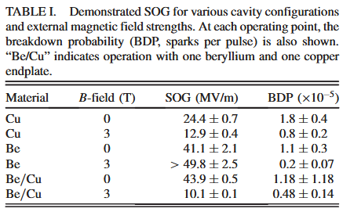
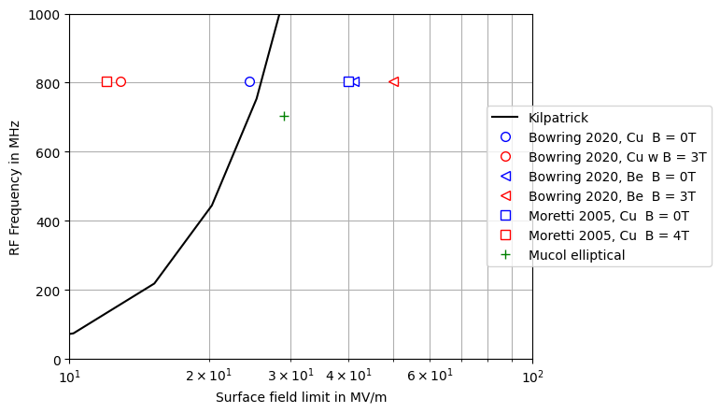
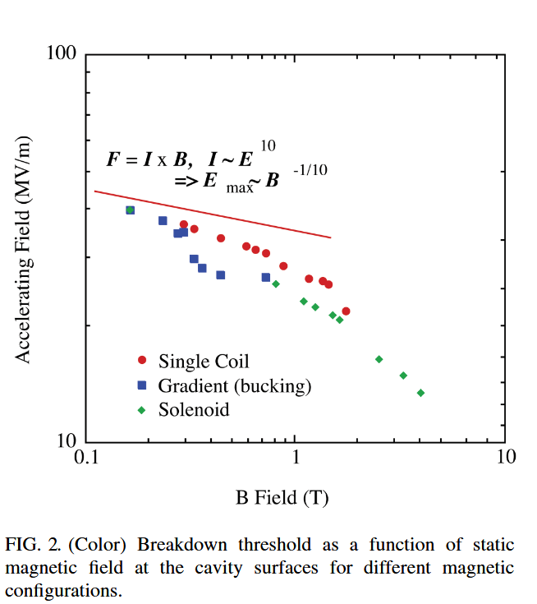
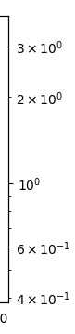
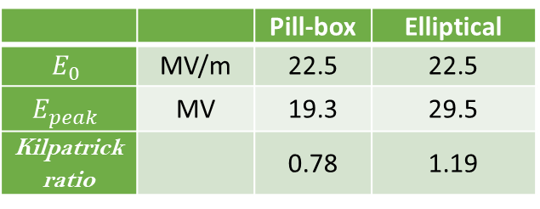
Bowring et al, 2020, 10.1103/PhysRevAccelBeams.23.072001
Kilpatrick ratios and experimental results
0,94
0,49
1,58
1,91
Kilpatrick ratio
704 MHz
Moretti et al., 2005, 10.1103/PhysRevSTAB.8.072001
24.7
29.5
Kilpatrick ratio
 |  | Pill-box | Elliptical
$$E_{0}$$ | MV/m | 22.5 | 22.5
$$E_{peak}$$ | MV | 19.3 | 29.5
Kilpatrick ratio |  | 0.78 | 1.19

Slide 7
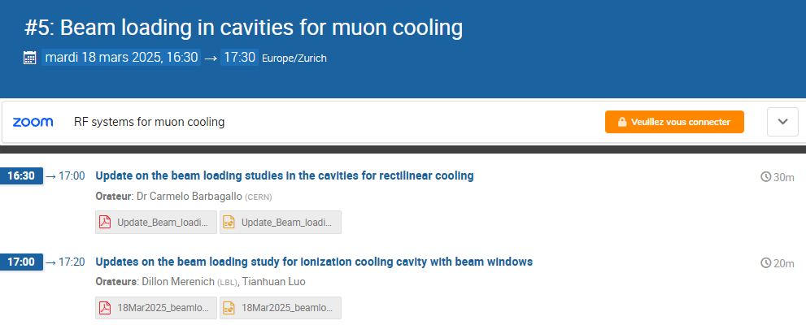
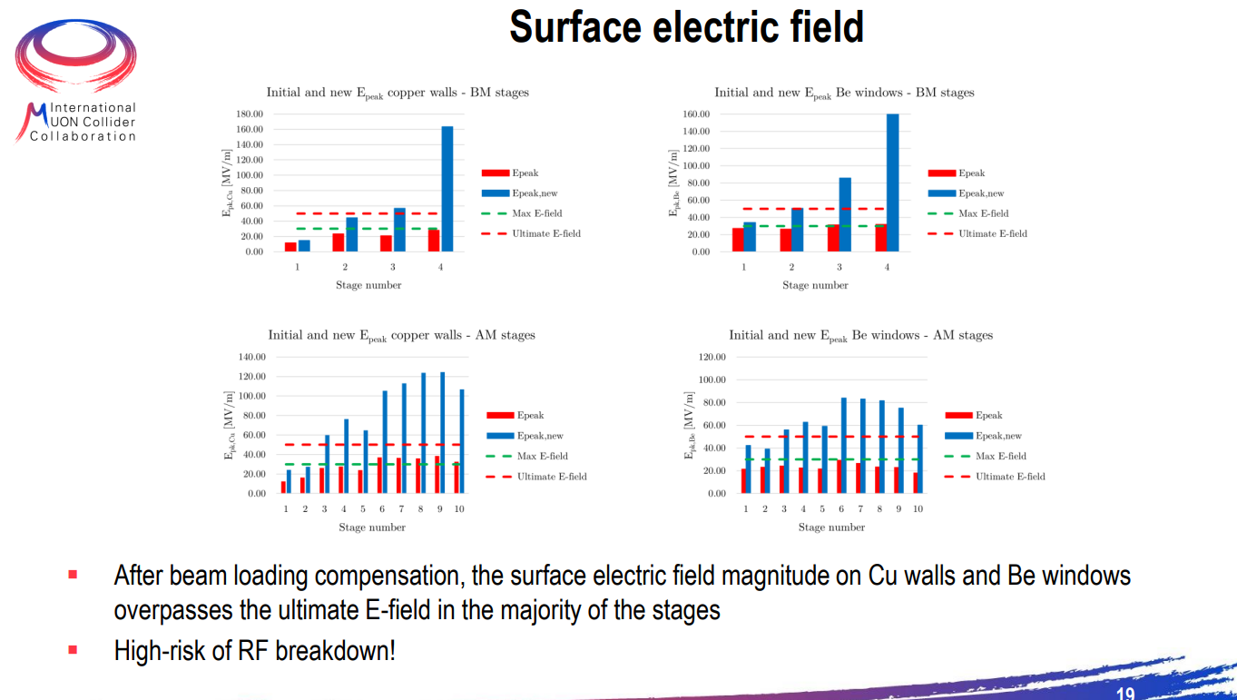
4
2
Kilpatrick ratio
4
2

Slide 8
3-D cavity design
Field emission in an elliptical cavity
Further studies on breakdown phenomena

Slide 9
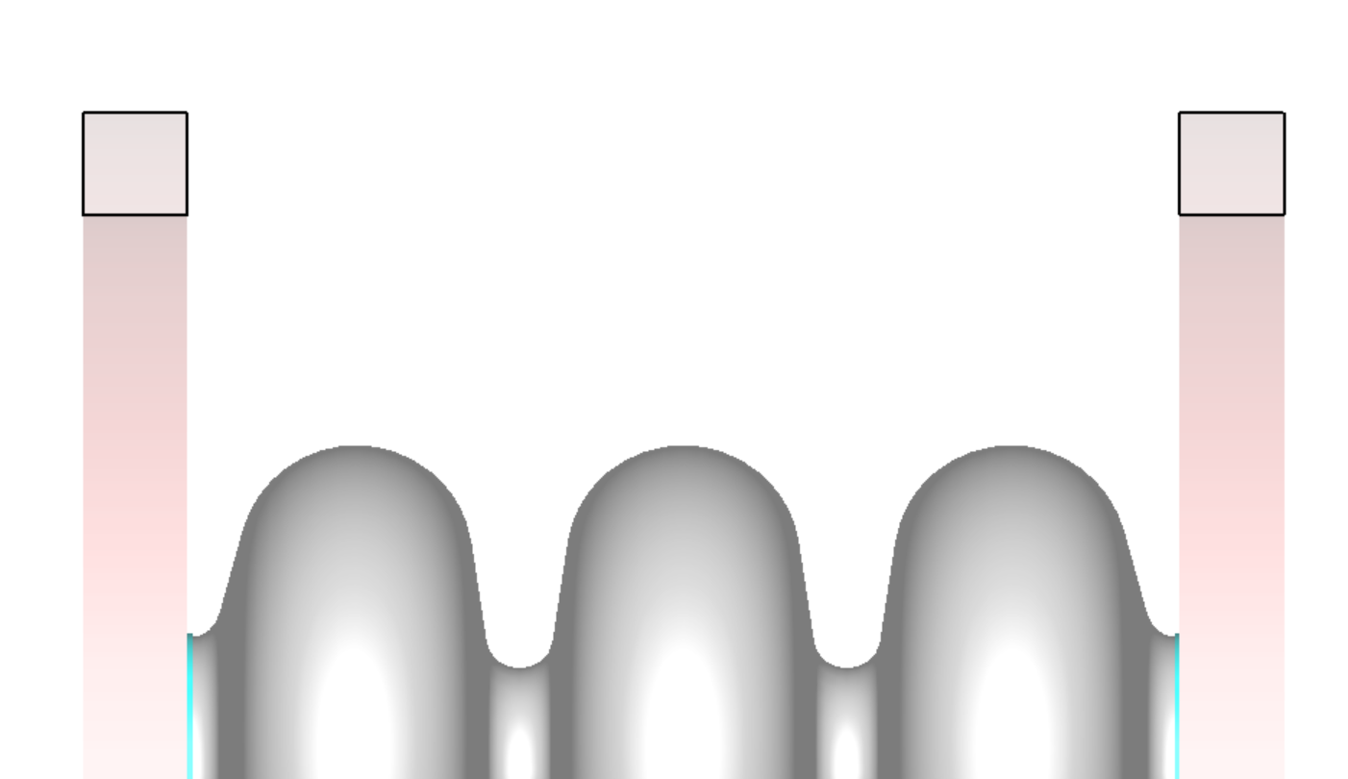
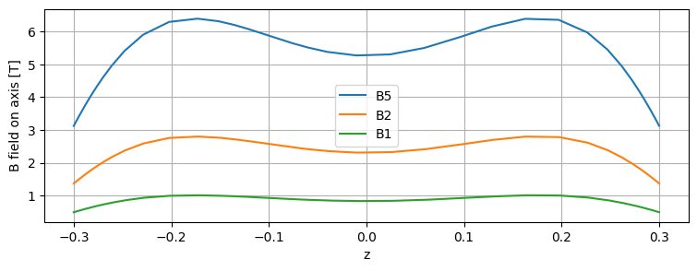
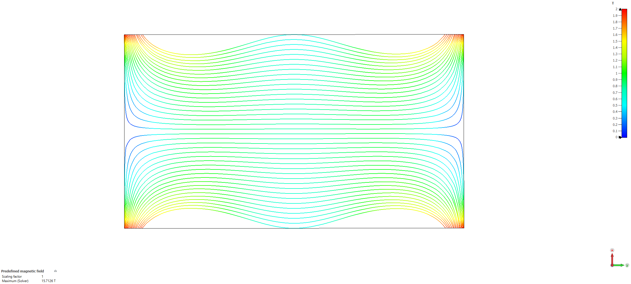
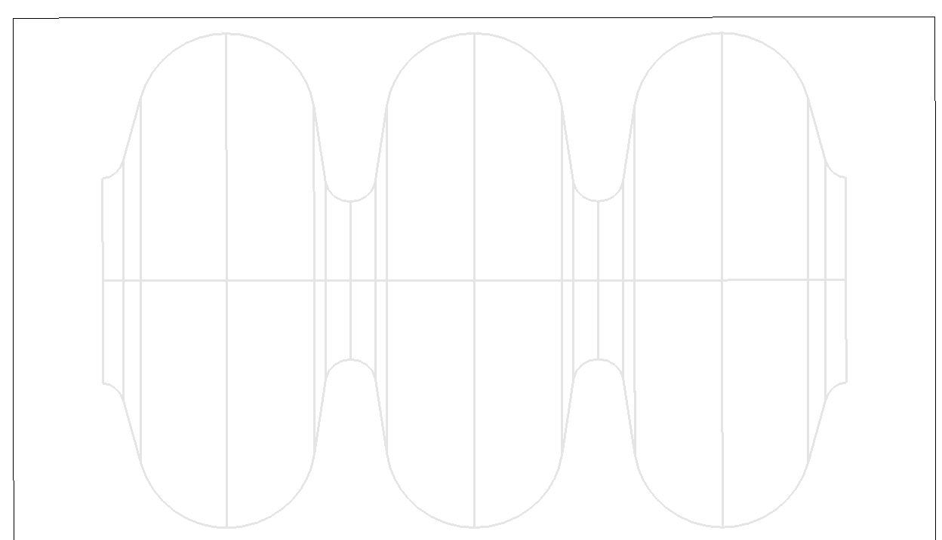
DC magnetic field generated by solenoids
Distance between solenoids 0,64 m
Lcav=0,565 m
Solenoid radius = 0,35 m
CST M static solver

Slide 10
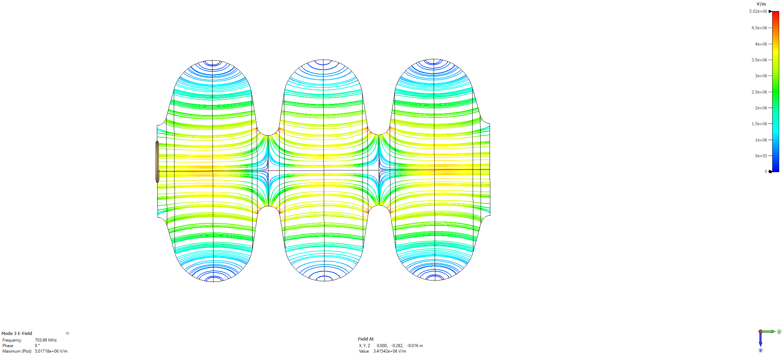
RF electromagnetic field for the pi-mode
$${×10}^{7}$$
E0 [MV/m] | 30,0
Eacc [MV/m] | 21,6
V0 [MV] | 17
Vcav [MV ] | 12
Pdiss [MW] | 12
Epk [MV] | 39,31
Stored energy | 100
CST eigensolver

Slide 11
Electron emission from surface
Emission from 3 points in the iris region of the cavity (where the E field is max)
Model : DC emission
Emission point area ~ 1 mm2
Initial e- energy : some eV
Space charge can be neglected
CST PIC Solver

Slide 12
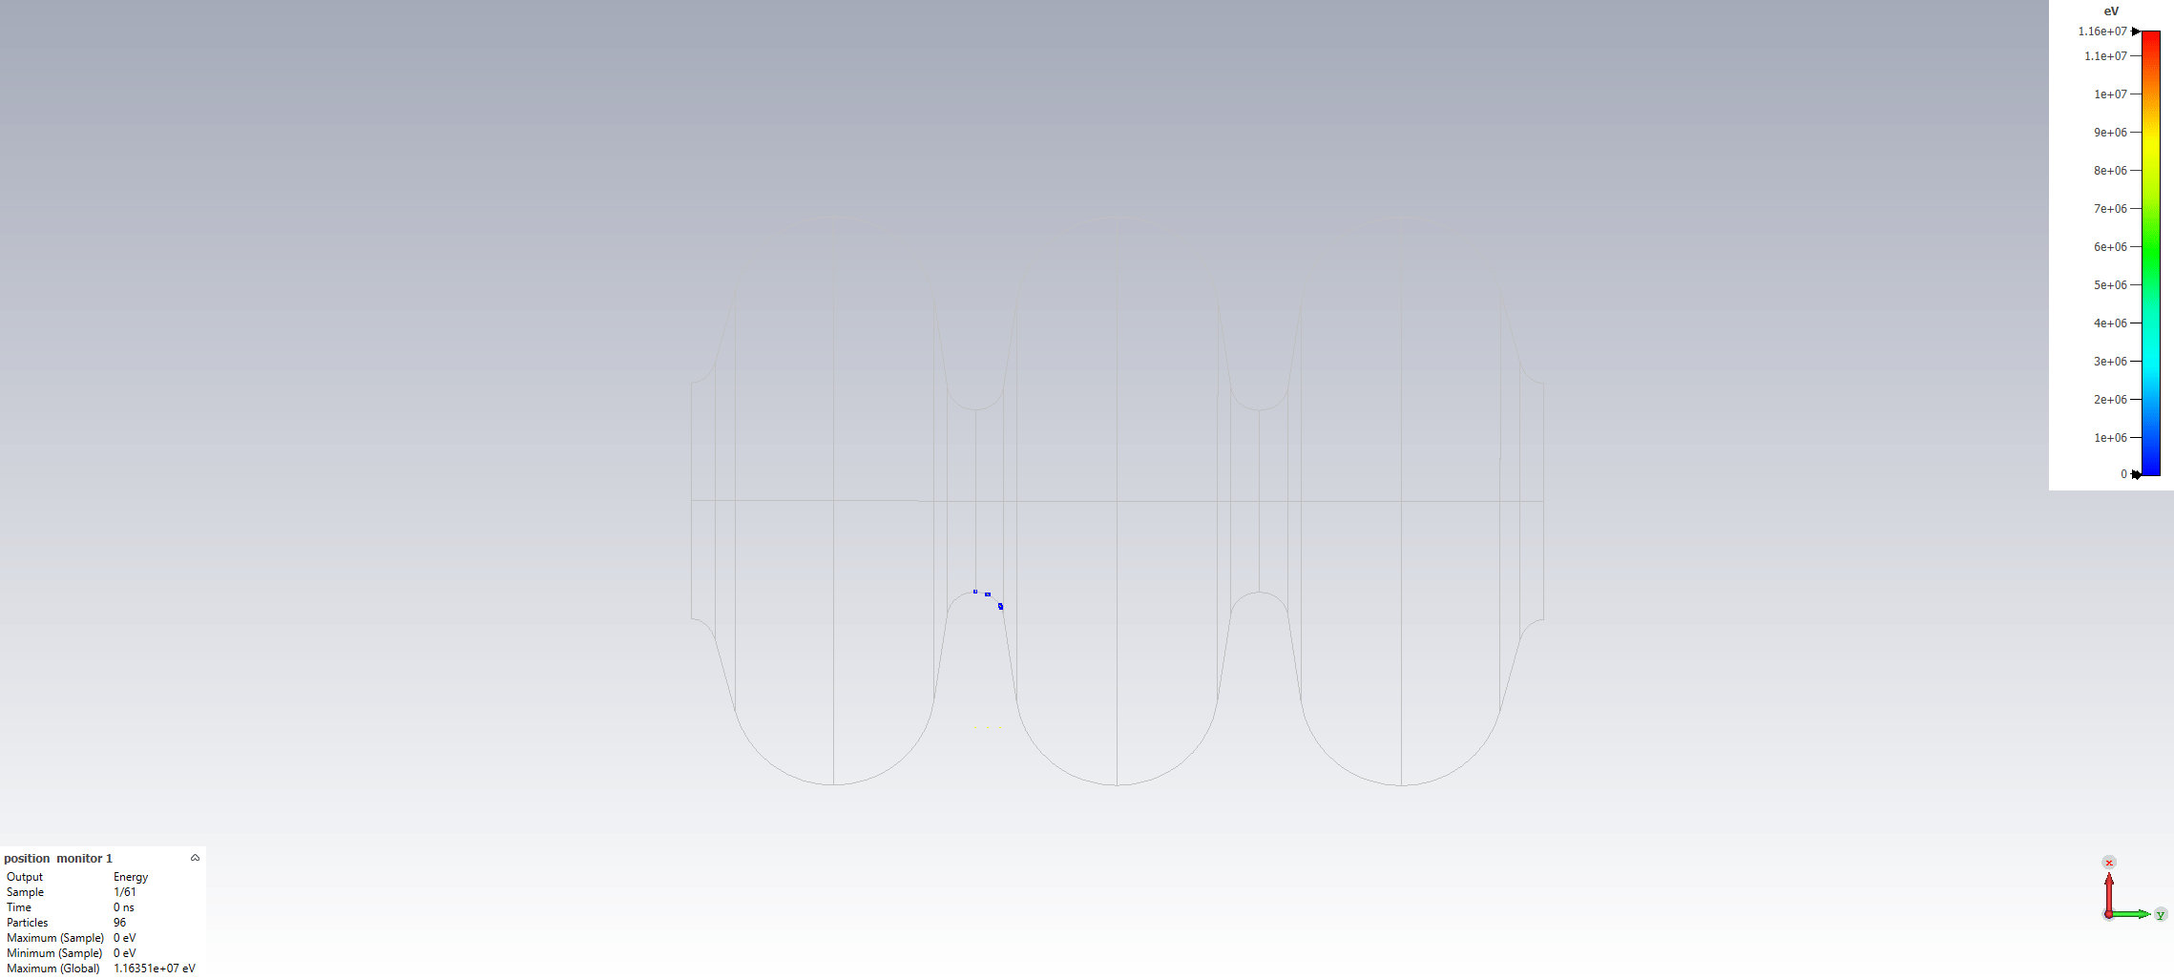
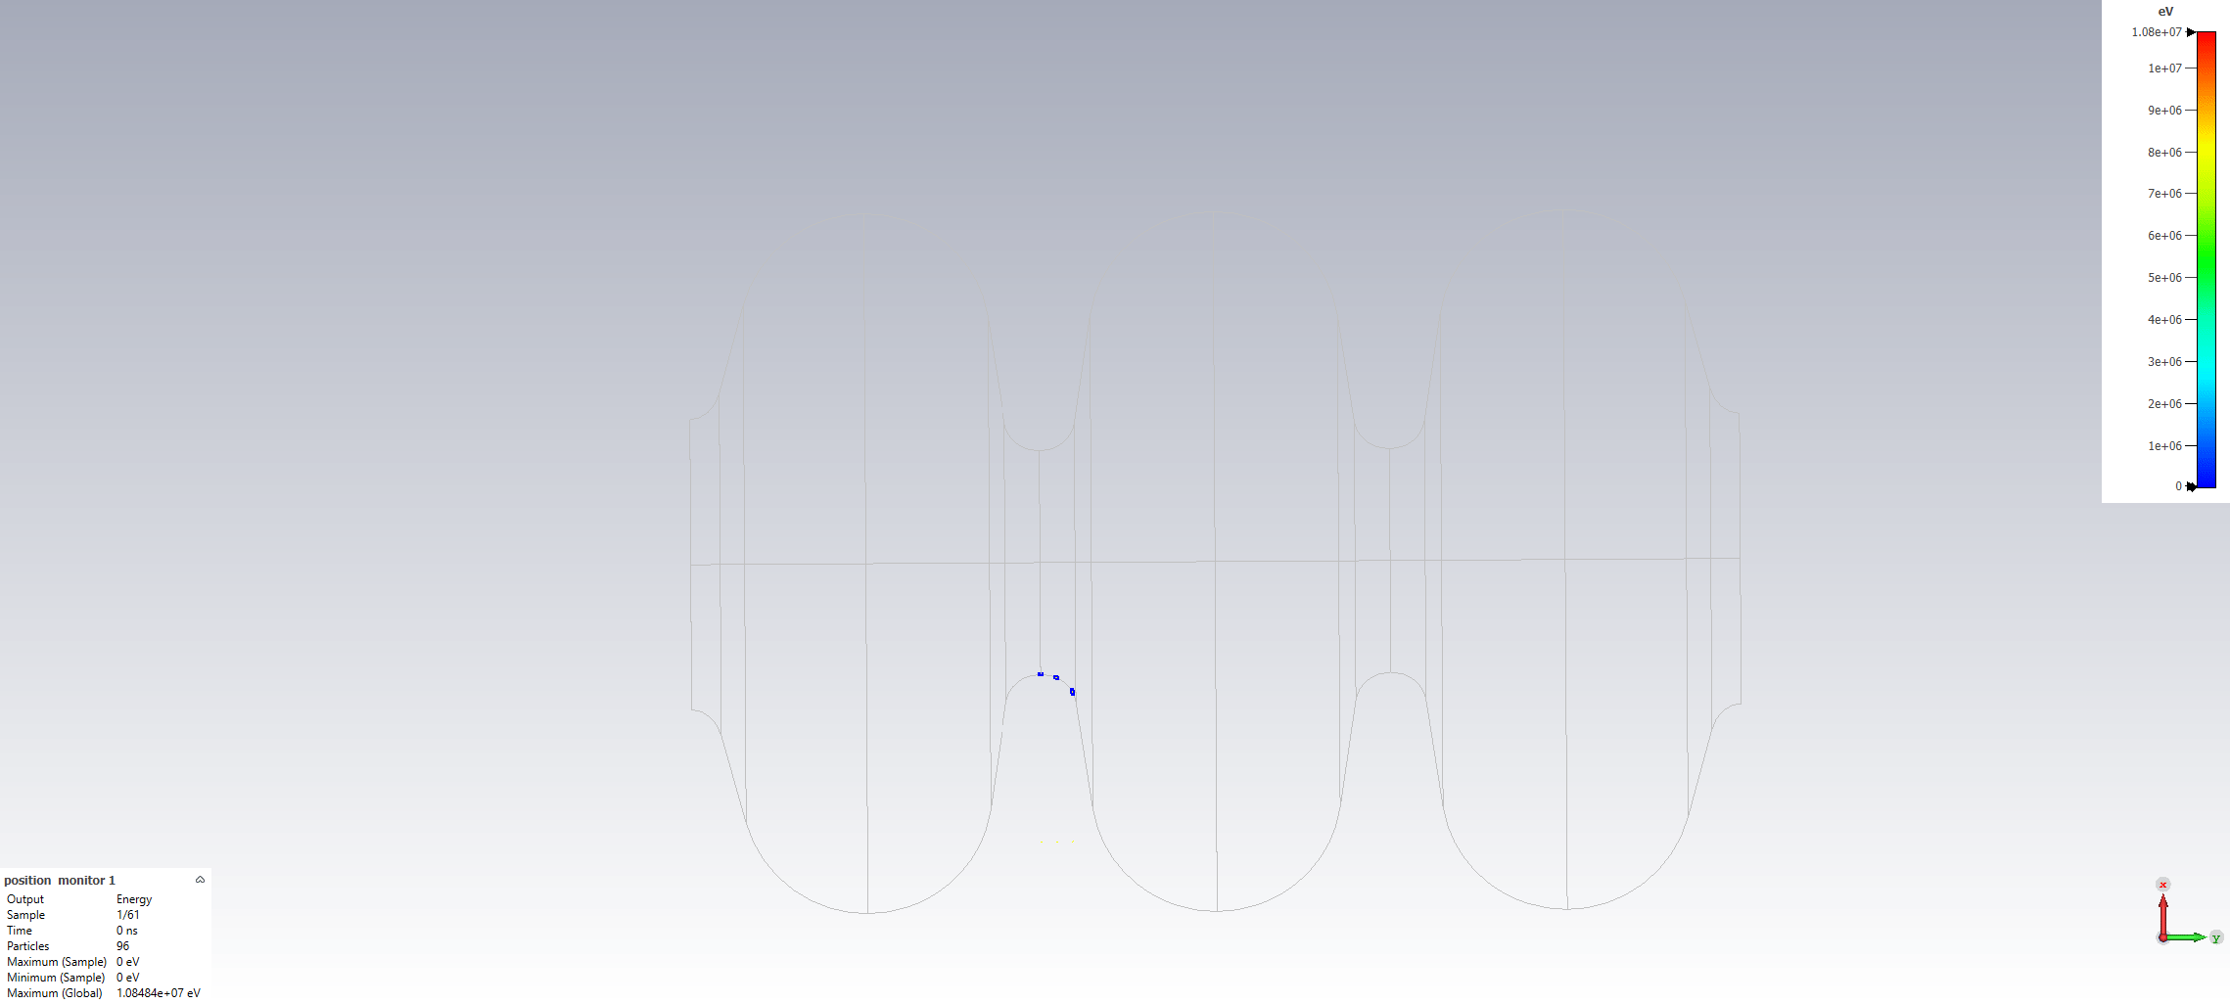
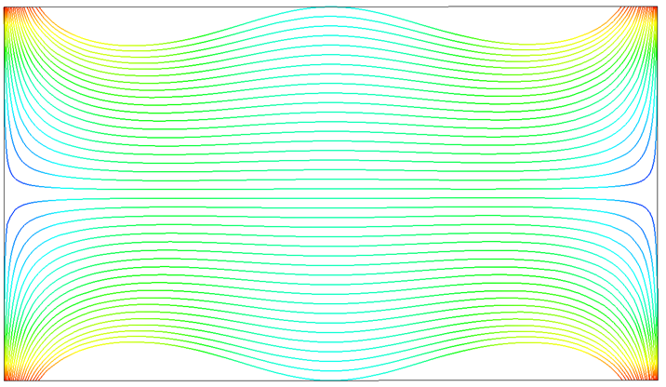
Electron emission with DC magnetic field and RF field
Without DC magnetic field
Electron max energy is 10 MeV
CST PIC solver with importation of M static and eigenmode solvers.
With DC magnetic field (superimposed)
Result is the same from B = 1 T
The electrons follow exactly the DC field lines.
Here, most electrons hit the facing iris, and some electron fly up to the window…

Slide 13
3-D cavity design
Field emission in an elliptical cavity
Further studies on breakdown phenomena

Slide 14
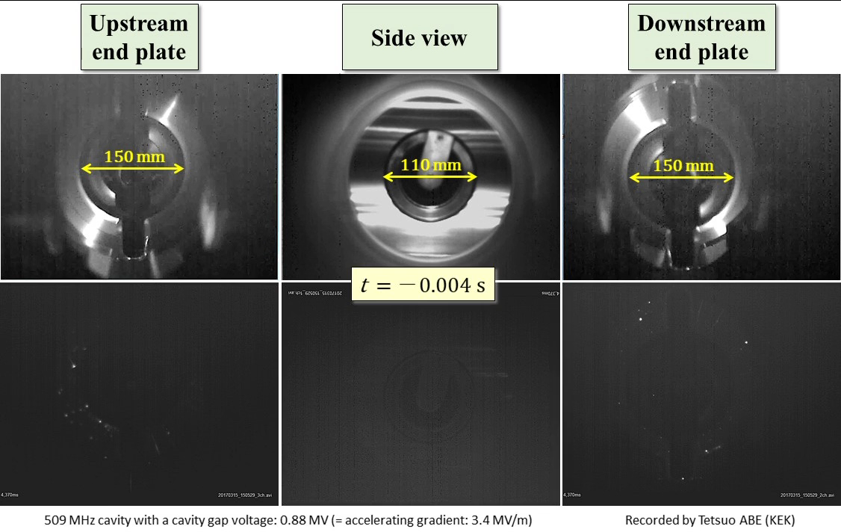
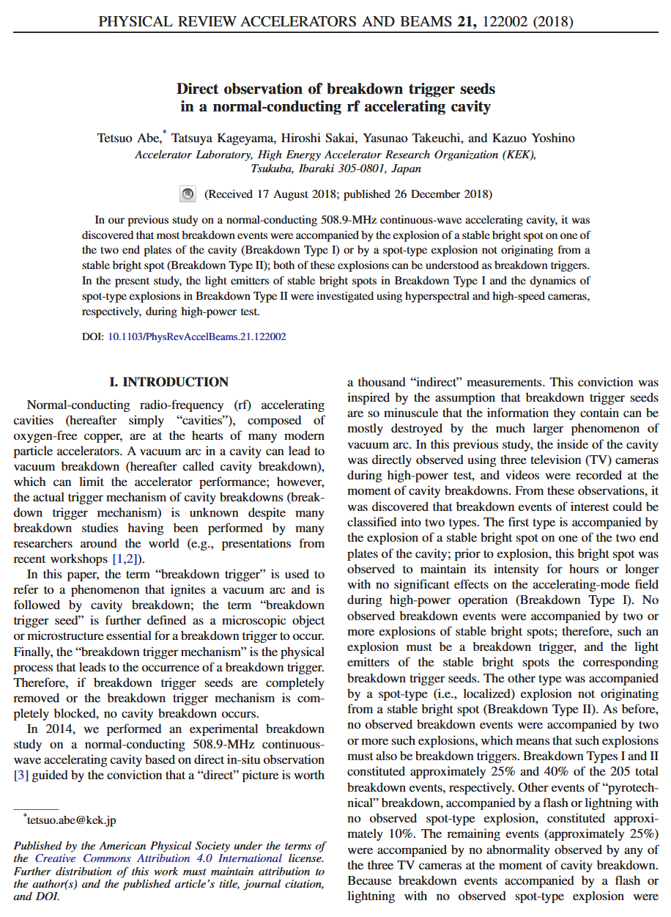
« fireball » emission from emitter, Abe et al.
https://www2.kek.jp/accl/eng/topics/topics190122.html
From temperature meas (IR camera) they conclude that the flying object is not copper
< Figure 7 > […] A flying bright object appeared near the downstream end plate (right image), moving upstream, and impacted the upstream end plate (left image) at t = 0.081 s. Breakdown occurred at the moment of impact (t = 0.081 s) […]
Fireballs speed ~few m/s

Slide 15
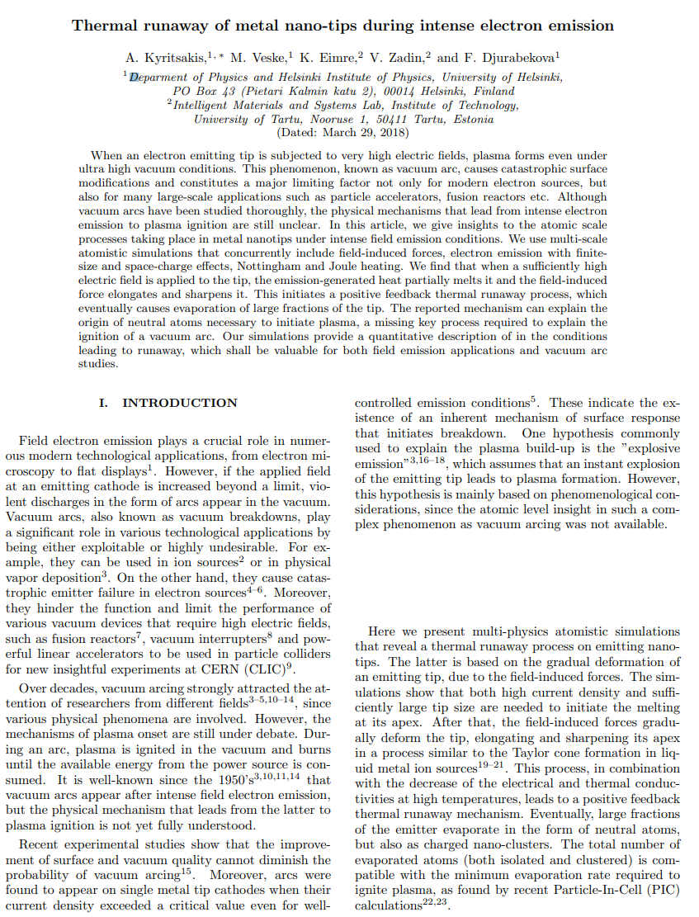
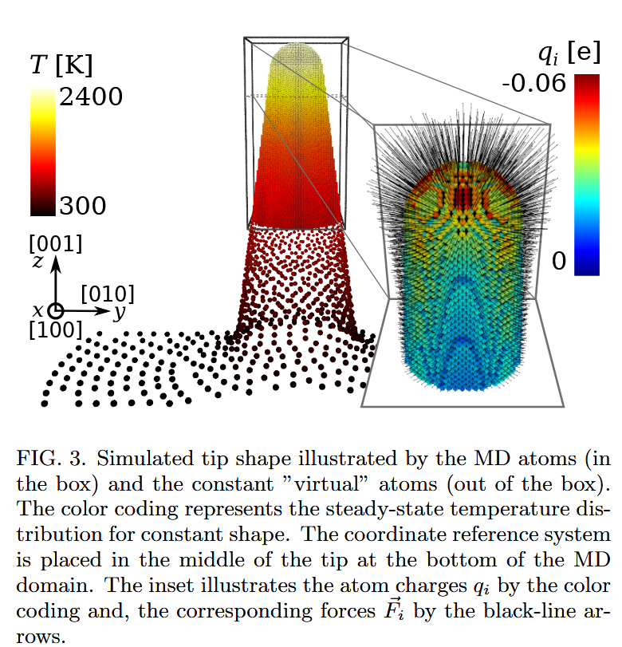
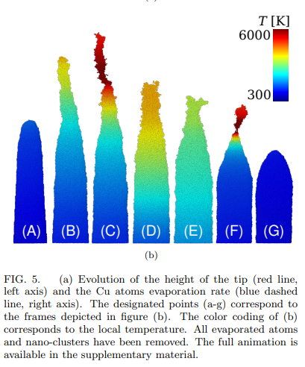
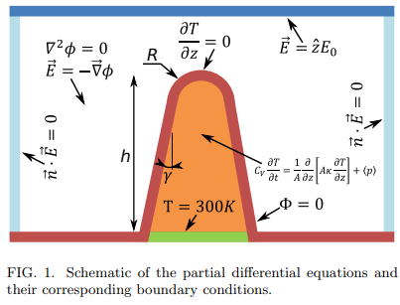
Atoms ejection from an emitter
“In this article, we give insights to the atomic scale
processes taking place in metal nanotips under intense field emission conditions. […]. We find that when a sufficiently high electric field is applied to the tip, the emission-generated heat partially melts it and the field-induced force elongates and sharpens it.”
Molecular dynamics simulations
Formation of Taylor cones
Static E field
Heat transfer

Slide 16
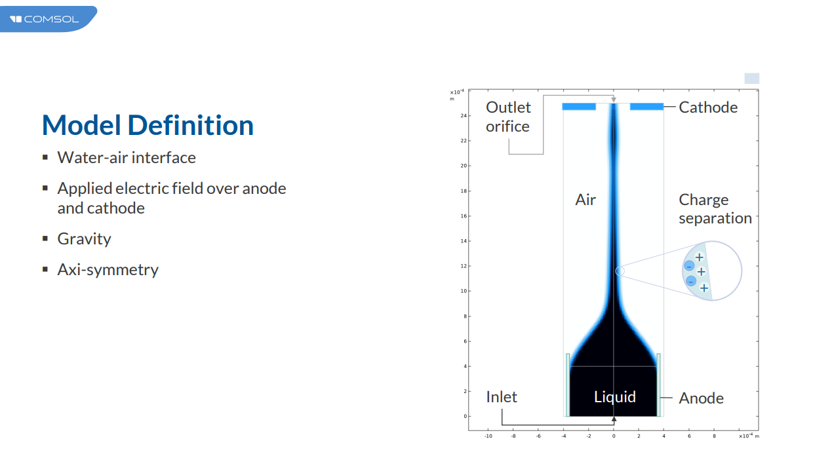
Magneto hydrodynamical simulations from an emitter in presence of RF field and DC magnetic field
Taylor cone existing cone model in Comsol : to be adapted to our physics.
Very preliminar…

