Slide 1

SPS-BGI Model to LHC Tunnel
Impedance Investigation
Updates
SY-RF-BR
27/03/2025
H. Bursali on behalf of Impedance Team
hikmet.bursali@cern.ch

Slide 2
Outline
Studied Models
  Models with Beam screen
  Models with Beam screen + HV feedthrough
Possible Options
Conclusion
1

Slide 3
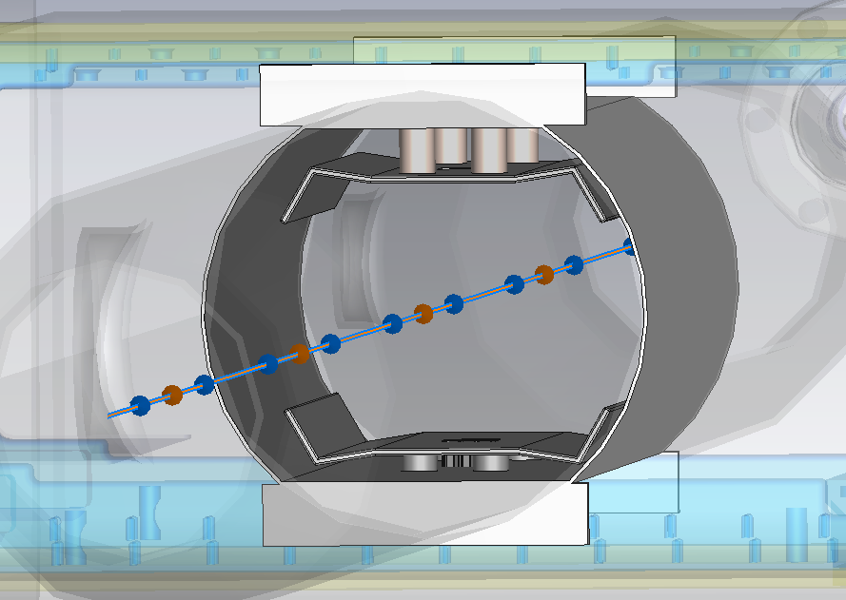
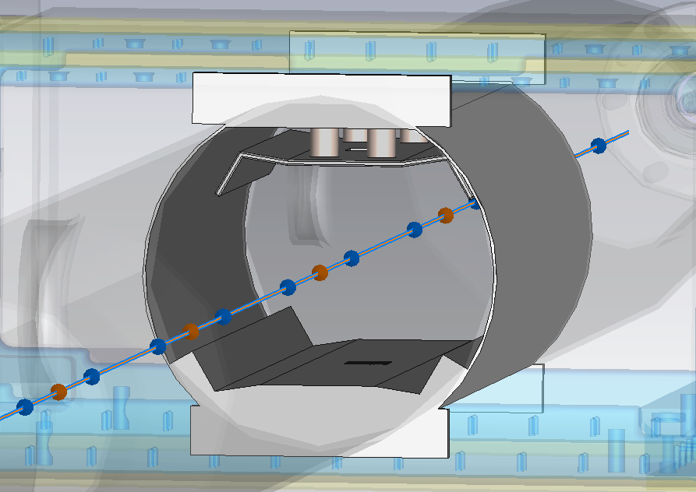
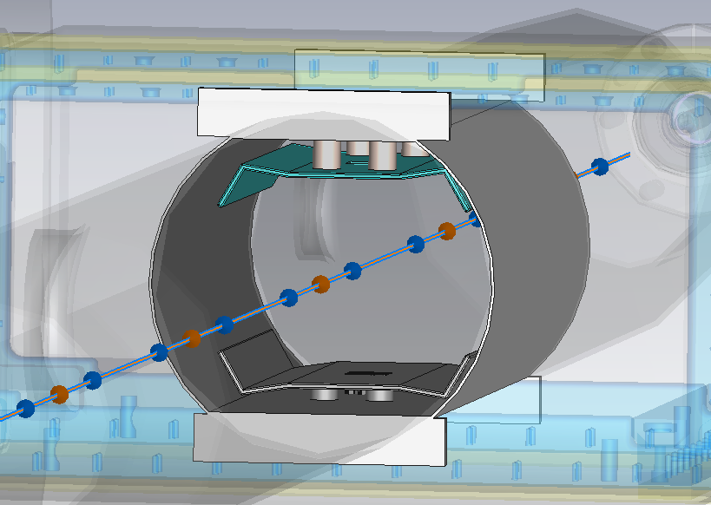
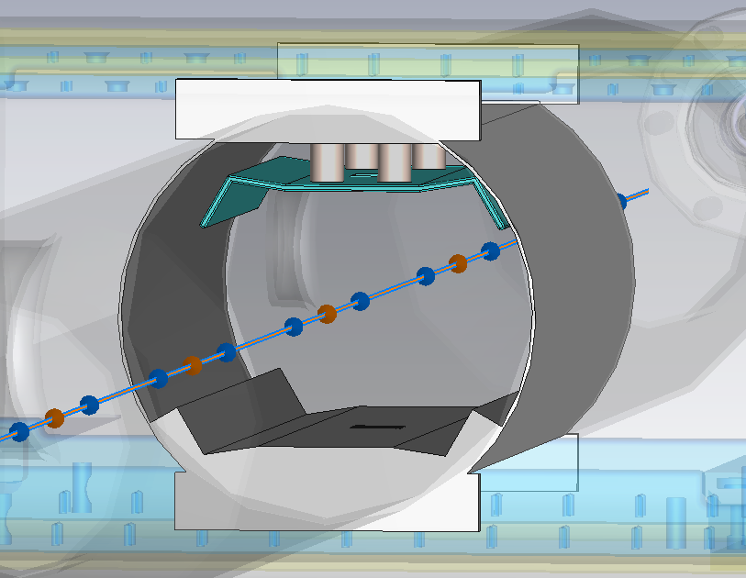
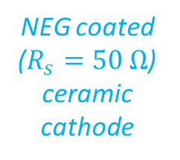
Studied Models (1)
Models with Beam screen
Steel Cathode
Steel Anode
Steel Anode
(Embedded to beam screen)
NEG coated
($R_{s}=50 Ω$) ceramic cathode
2

Slide 4
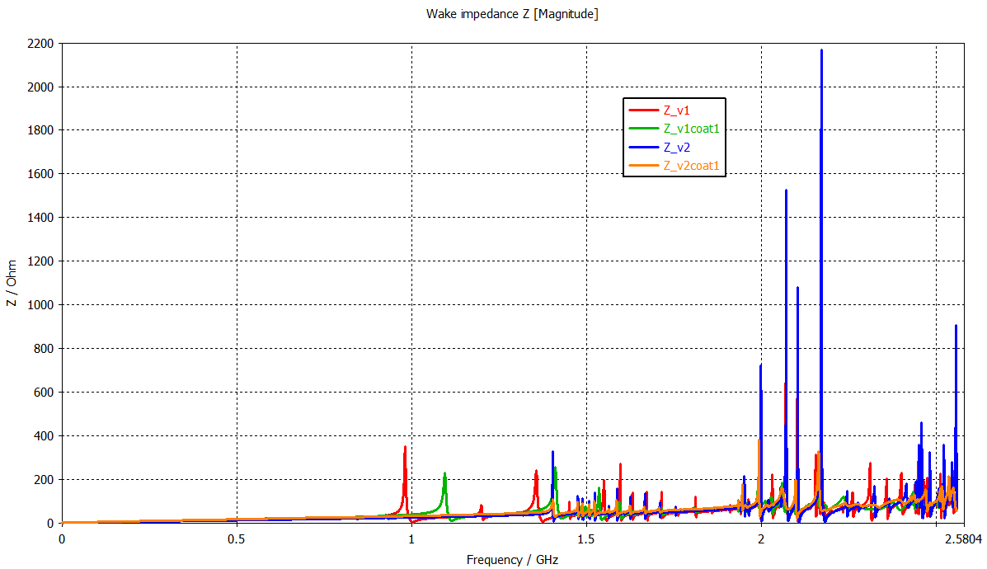
Studied Models (1)
Models with Beam screen
Steel Cathode & Anode
Steel Cathode & Emb. Anode
Coated Cathode & Steel Anode
Coated Cathode & Emb. Anode
3

Slide 5
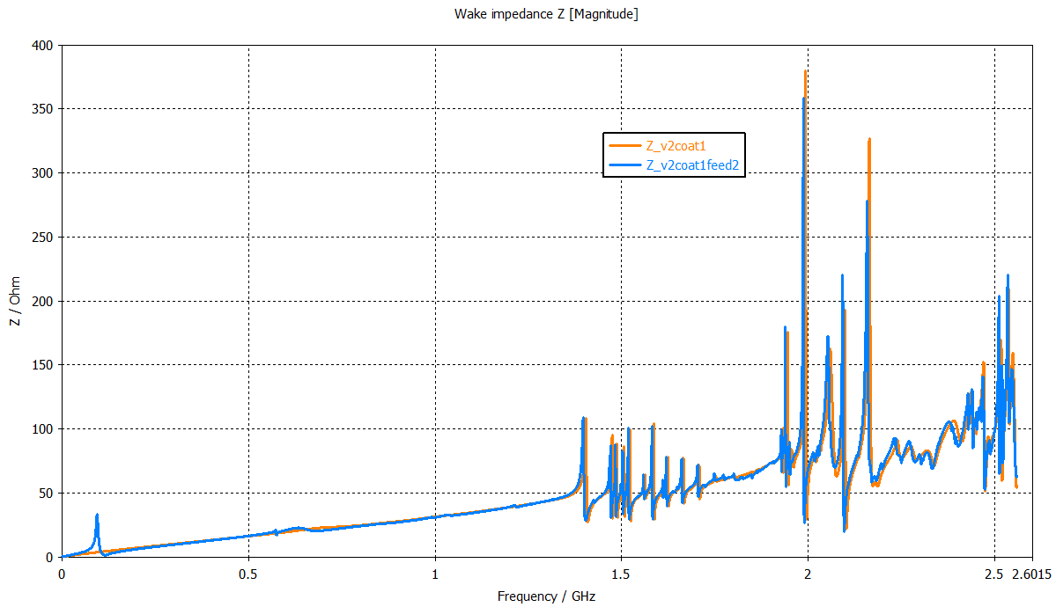
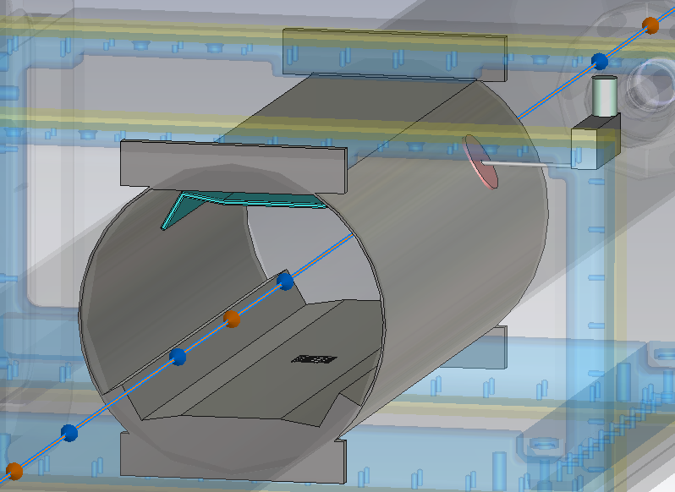
Studied Models (2)
1st Model with Beam screen & HV feedthrough
Coated Cathode & Steel Anode + HV feedthrough
Coated Cathode & Emb. Anode
HV feedthrough
94 MHz
4

Slide 6
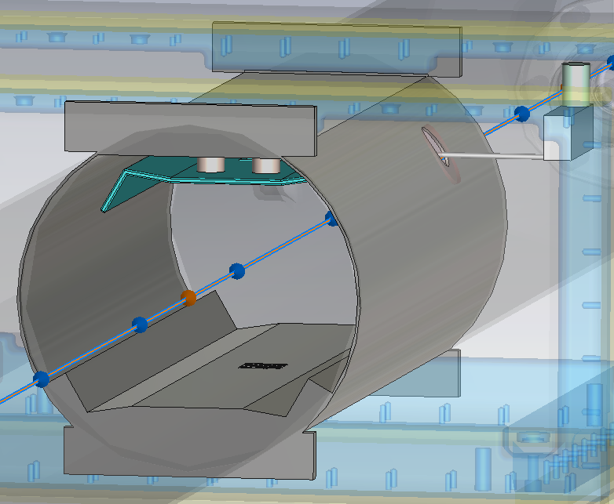
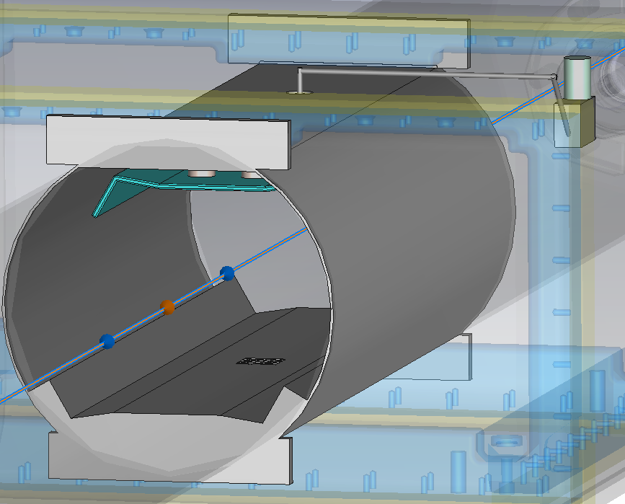
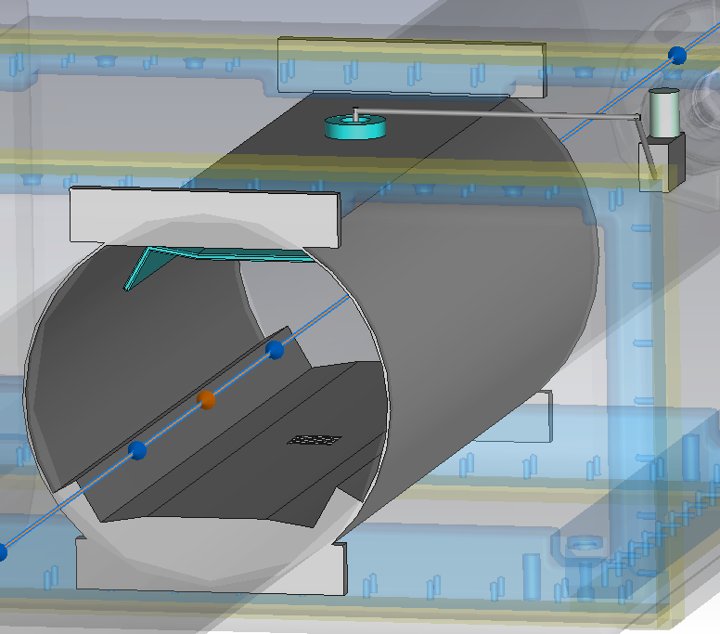
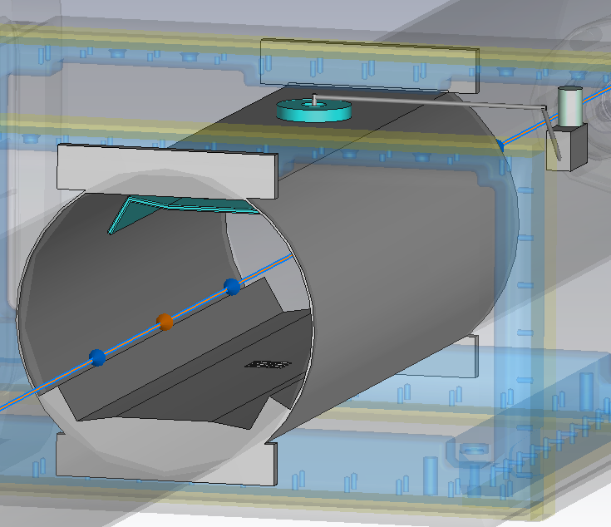
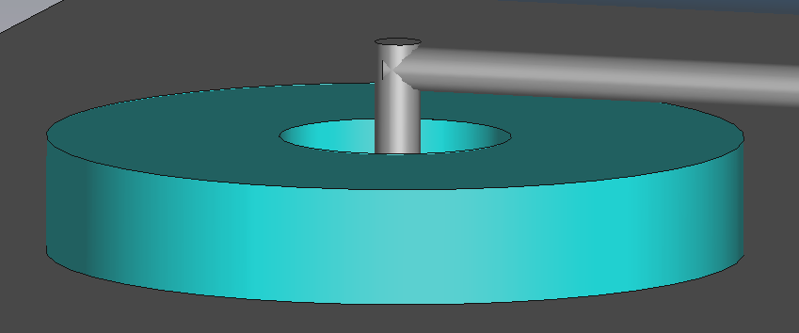
Studied Models (3)
Models with Beam screen + HV feedthrough
Different HV feedthrough connections
Model #1
Model #2
Model #3
Model #4
Smaller hole for the feedthrough
Hole on the top of the beam screen
NEG coated (50 Ω) macor
5

Slide 7
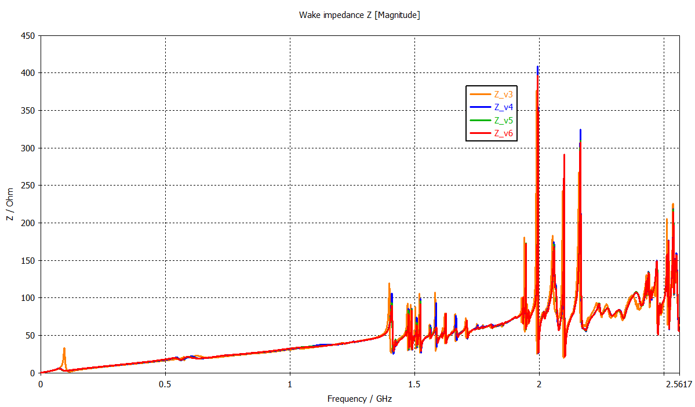
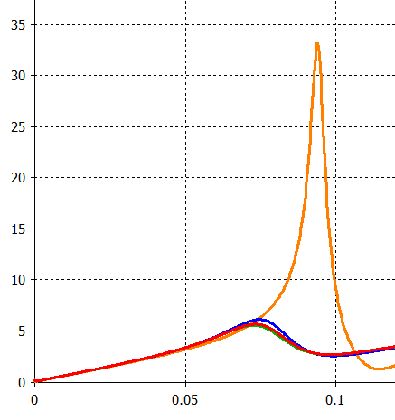
Studied Models (4)
Model #1
Model #2
Model #3
Model #4
6

Slide 8
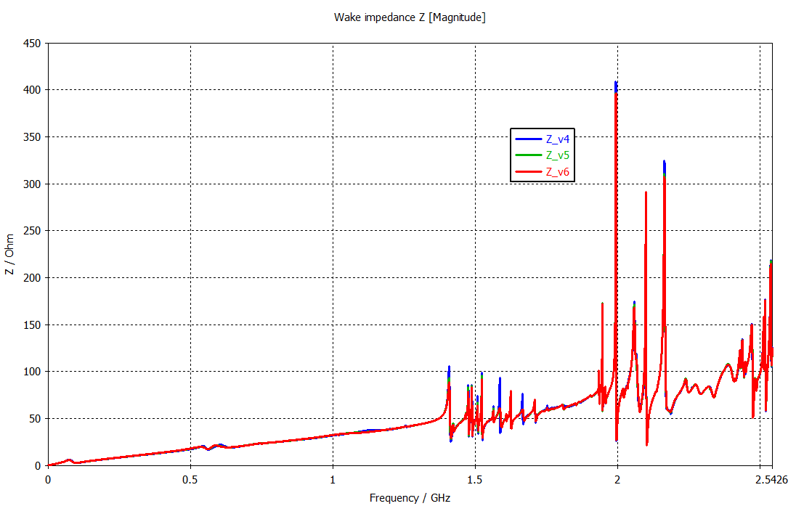
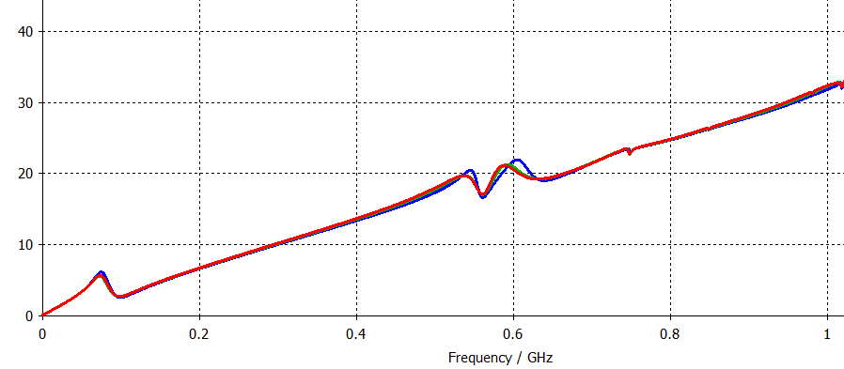
Possible Options
RF Power Loss
Model #2
Model #3
Model #4
74.5 W
74.1 W
75.7 W
7

Slide 9
Conclusion
Beam screen with the embedded anode is better than the separated anode in the impedance point of view.
HV feedthrough connection location is effective on the longitudinal impedance.
The models #2, #3 and #4 have nearly 74 W beam-induced RF power loss.
The models are simulating up to 5 GHz for the longitudinal instability check.
8

Slide 10
Thanks for your attention!
SY-RF-BR

Slide 11
Backup Slides

Slide 12
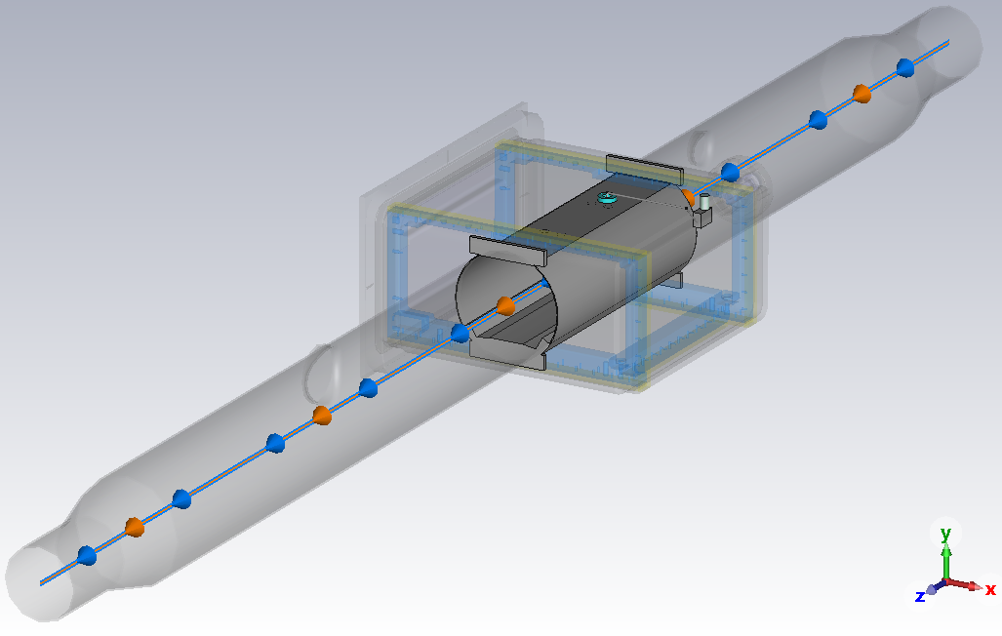
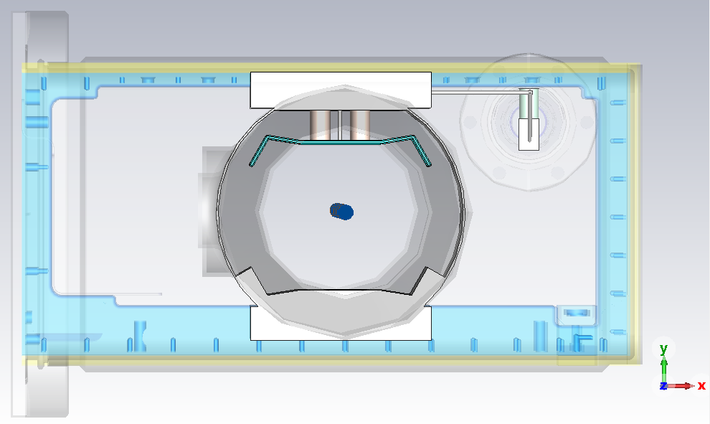
Model #3
SPS-BGI with Beam screen
Front view
NEG coated (50 Ω) cathode
HV feedthrough from the top

Slide 13
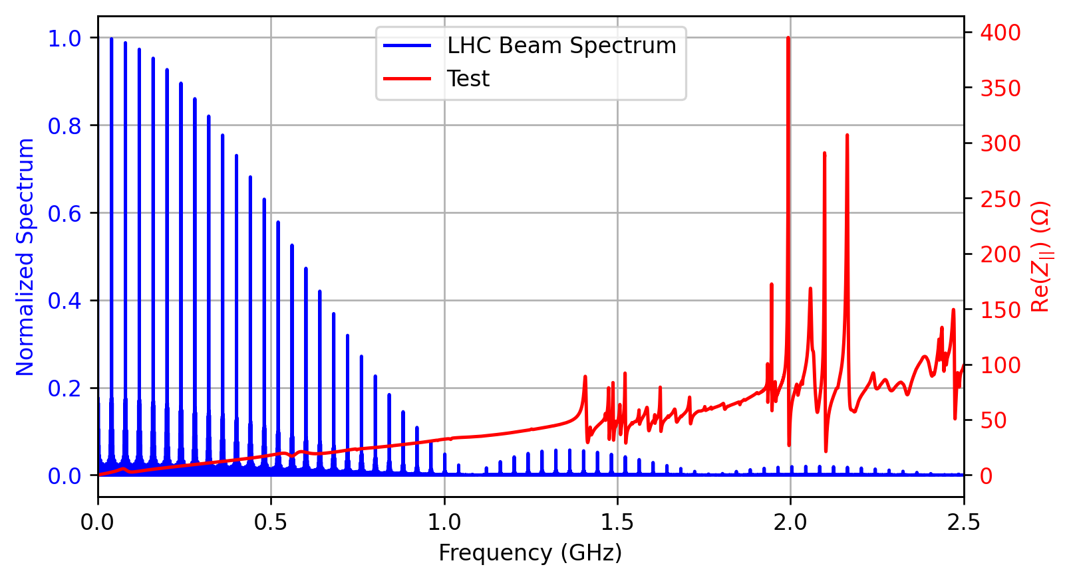
Beam-induced RF Power Loss
Model #3
74.1 W
Power Loss computation -> CERN Beam Longitudinal Dynamics code — BLonD. https://blond.web.cern.ch/

