Slide 1
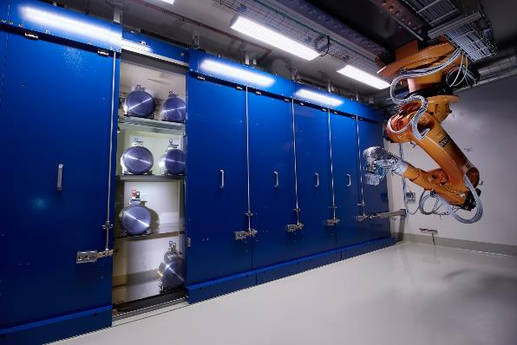

CERN-MEDICIS MEDical Isotopes Collected from ISolde
2025 YETS summary and program for 2025
Charlotte DUCHEMIN, (Edgars MAMIS) CERN, SY-STI-RBS
MEDICIS experimental program coordinator & PRISMAP technical manager
On behalf of the MEDICIS local dream-team, collaboration and all contributors
April 2025
14th CERN-MEDICIS Collaboration Board

Slide 2
CERN-MEDICIS – Last board was in Dec 2024
Last MEDICIS board was held in December, while starting our yearly technical stop.
We discussed:
  Summary of the production performed in 2024
  Summary of YETS foreseen maintenance and upgrade activities
  Overview of the radionuclide requested for 2025
MEDICIS is now integrated in the yearly and weekly ISOLDE schedule → highly helping with coordination and communication around target irradiations! ☺

Slide 3





CERN-MEDICIS
KPI DASHBOARD 2024
TARGETS
7 new targets built
5 reused from previous years
PROTONS ON TARGET
(excluding external sources)
4.1E19
DISPATCH TO PARTNER INSTITUTES
18 radioactive transports
ACTIVITY
2 GBq collected total
EFFICIENCY
Up to 72% (for Ra-225)
DOSE EXPOSURE
Maximum 52 μSv individual
(700 MBq Ra-224 + 110 MBq Ra-225)
328 μSv collective over the year

Slide 4


CERN-MEDICIS – yearly shutdown (YETS)
MEDICIS has been switched-off on Monday 09th of Dec morning for the yearly technical stop.
  Cleaning/emptying of the MEDICIS Glovebox;
  Update of vacuum software application;
  Target movement/eliminations;
  Installation of new module to get access to remote HV;
  CHRISTMAS BREAK
  Extensive maintenance of the rails/MONTRAC system following issues we got at the end of operation year;
  4 weeks ventilation cut … for improvement & maintenance;
  Installation of additional convection cooling system in target area.
  Electrical work;
  Frontend yearly maintenance with change of electrode tip, vacuum pumps check and oil change;
  Robot trajectory tests & maintenance;
  Deployment of new interlock system – no issues so far
  Faraday cups maintenance – got stuck during the year with temporary mitigation measures put in place;
  Yearly RP detector checks;
  FINAL safety tests for restart green light on 14th of March 2025 obtained successfully ! ☺
  Stable beam tests happened between 17th of March and 3rd of April prior the first irradiation on 4th of April

Slide 5
CERN-MEDICIS – Yearly technical stop & planning 2025
 | January | February | March | April | May | June | July | August | September | October | November | December
Technical stop
MEDICIS Operation
PSB Beam for physics at ISOLDE
MEDICIS Radioactive Ion Beams
External sources
17 Mar
28 Mar
08 Dec
End of year CERN closure
7 Apr
Sc & Yb (& Sm?)
Always a period of 2 to 3 weeks of stable beam tests before starting with radioactive ions beams (magnet calibration checks etc.)
Checks of the beam position with gafchromic® films performed (done every year before restarting irradiations);
Planning based on ISOLDE schedule as soon as released
  Considering already approved projects + PRISMAP User Projects
+ new MEDICIS projects will be presented and proposed to the board members → Planning of the rest of the year to be adapted accordingly
External sources scheduled all along the year (especially for Sm-153) – Sc-43/44 tentatively planed for June, Yb-175 for July

Slide 6
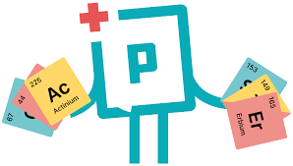

CERN-MEDICIS – in the program in 2025
Continuous high demand of Ra/Ac-225 (both PRISMAP and MEDICIS)
Ra-224 delivery (x2 to x3) for PRISMAP User (Call 4)
Ra-223 delivery (x1) for PRISMAP User (Call 5)
  Combined productions of Ra-223/225 and Ra-224/225
Yb-175 delivery (x1) for PRISMAP User (Call 5)
Ba-128 project still ongoing for CHUV
Tm-165 delivery (x1) for PRISMAP User (Call 1)
Sm-153 ~once every 6 weeks as targeted pace
  Deliveries schedule with SCK CEN and/or POLATOM will be organized as soon as possible.
Requests from NPL
  Ac-226 (+for HUG), Tb-155, Eu-145
  Developments
Sc-44/46/47 project still ongoing
Tb-155 improvement of the activity collected still ongoing (part of Patricija’s PhD) – repeat 6% from ARRONAX would be great!
Cu-67 development run

Slide 7
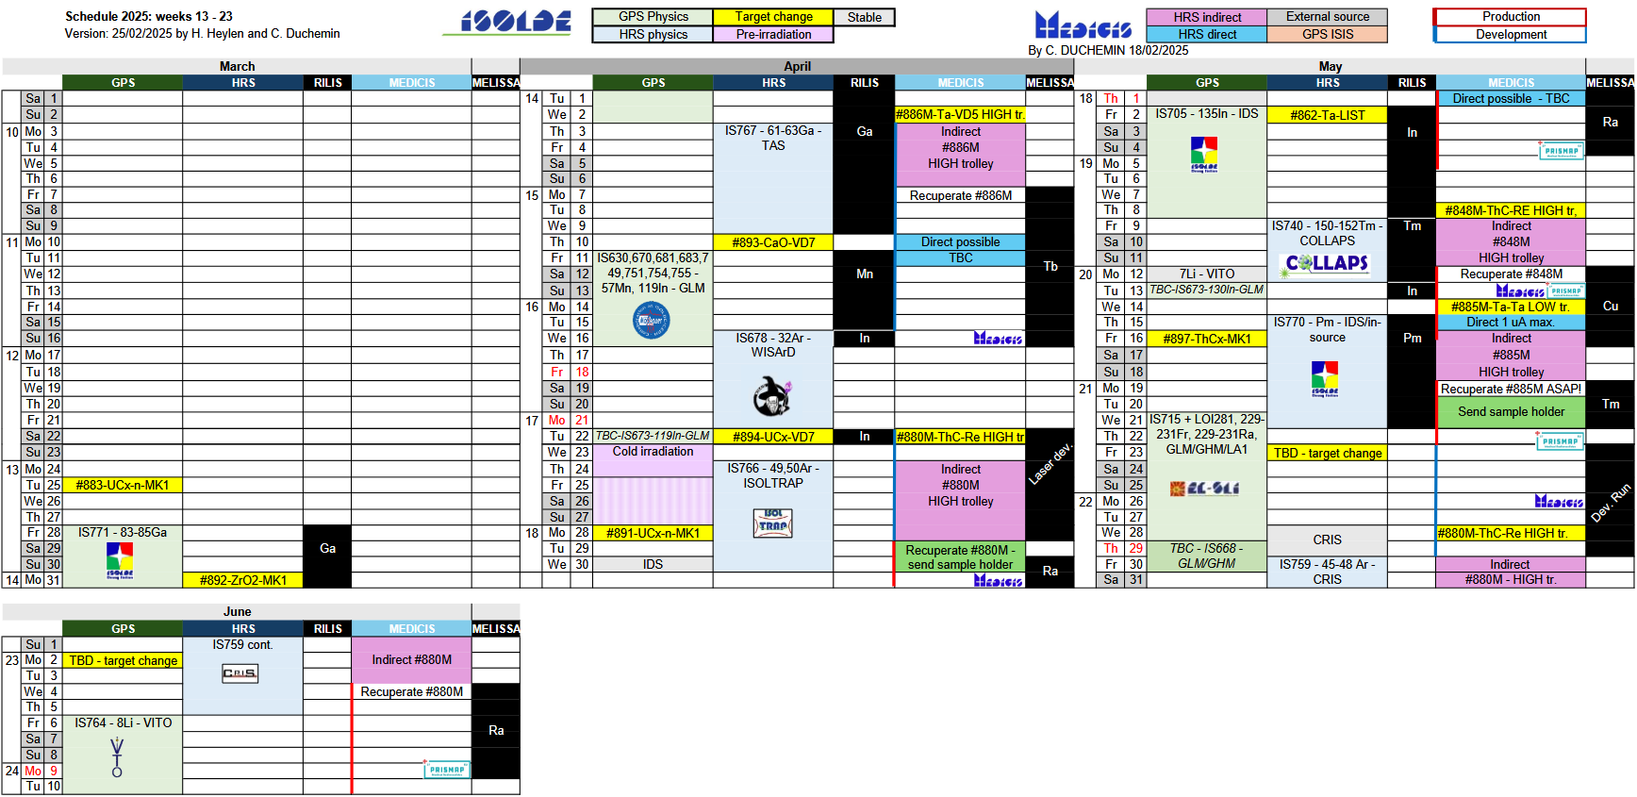
CERN-MEDICIS – integrated to the ISOLDE planning !
Not yet updated:
Since of few days ago MEDICIS schedule is planned already until mid-July including 16 (+2) target irradiations at HRS and collections of:
K-43; Sc-43/44(?); Cu-67; Eu-145; Tb-149; Tb-155; Tm-165; Yb-175;
Ra-223; Ra-224; Ra-225; Ac-226

Slide 8
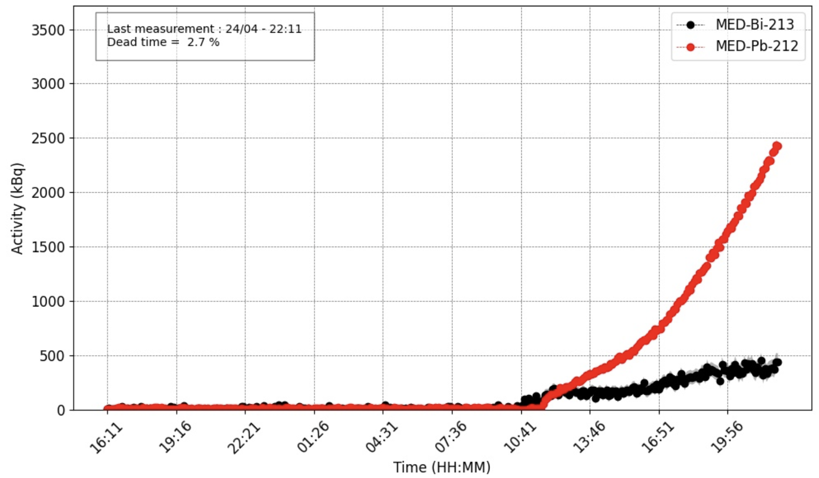
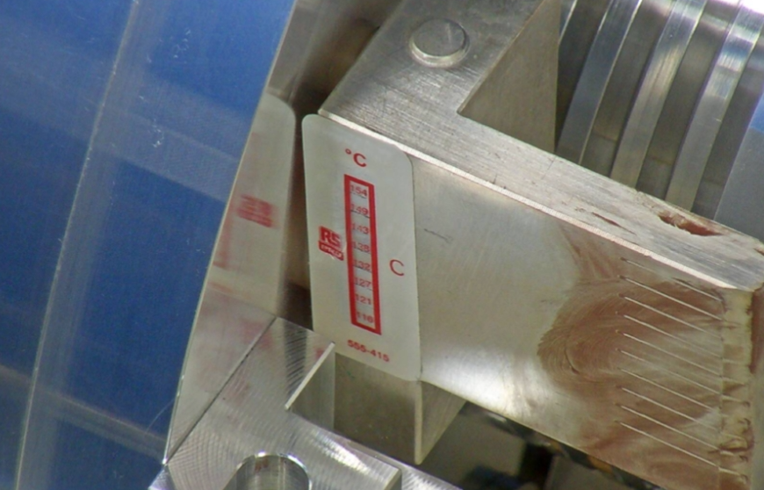
CERN-MEDICIS - Recent operational updates
Kromek detectors re-calibrated according to the collection foil type used (P. Kalniņa) – for more precise measurements
Eu laser ionization experiments in the scope of Ralitsa’s PhD
RIB year was begun with a successful Tb-155 collection as di-fluoride molecular ion beam from a TaC target (Patrīcijas PhD)
  No Ce-139 contamination found in final sample
Collected Tb-155 sample was used for radiochemical separation developments (A. Tariq)
On-going 1st Ra-224/Ra-225 collection of the year (for PRISMAP users)
Radionuclide (emphasis on Tb) release studies from irradiated Ta foil and TaC target materials (P. Kalniņa) in preparation for next week
Monitoring of target max reached temperatures during irradiation
A “new” MEDICIS operator is being taught – M. Deschamps

Slide 9
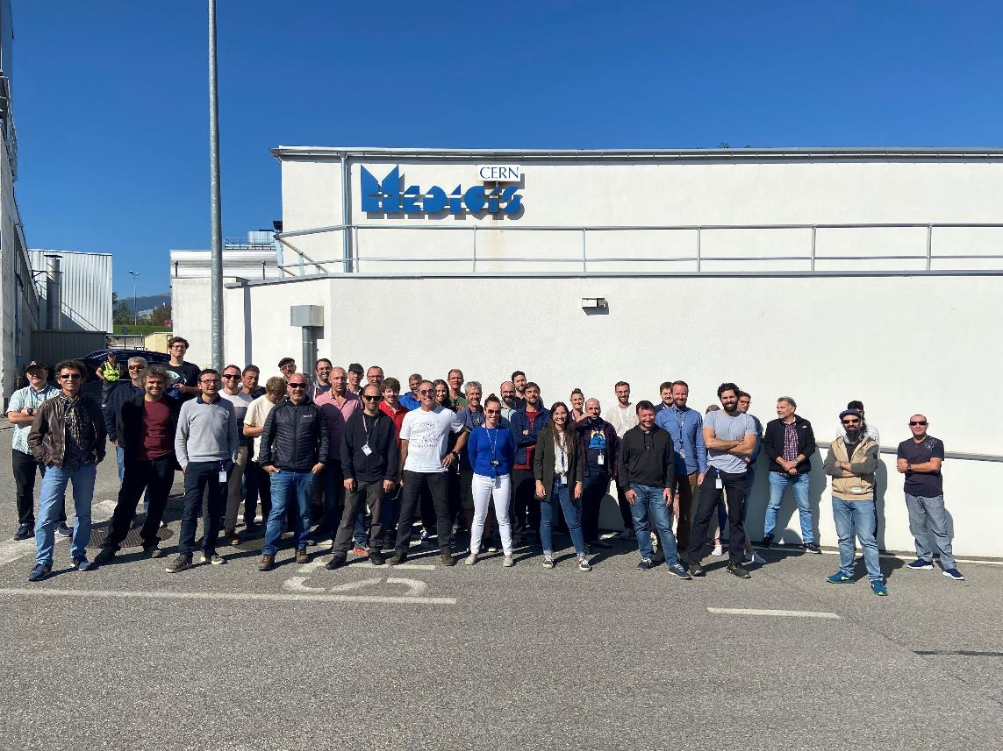
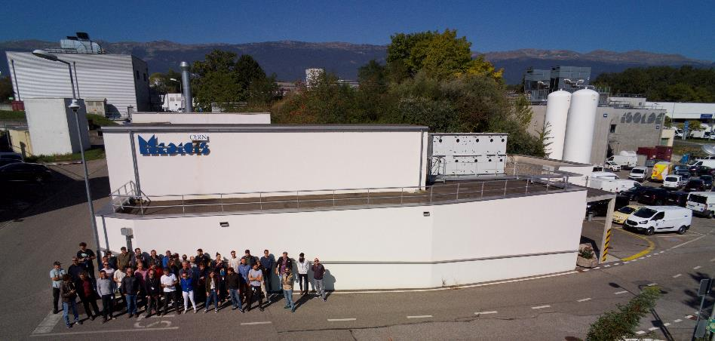
A BIG THANKS TO ALL THE PEOPLE, GROUPS, SERVICES, INSTITUTES, COLLABORATION … INVOLVED IN MEDICIS!
THANK YOU FOR
YOUR ATTENTION !
Charlotte.Duchemin@cern.ch

