Slide 1

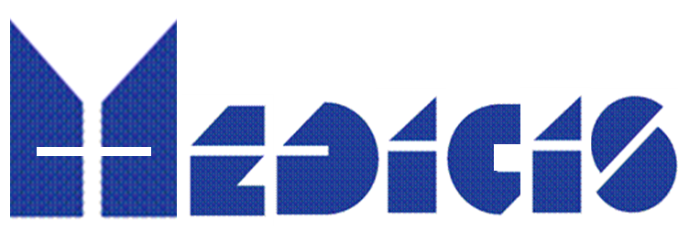
PRISMAP+ NEWS
14 MEDICIS Board
Thierry Stora, CERN
25 Apr 2025

Slide 2
PRISMAP extension and projects into clinics
Context:
PRISMAP (GA No. 101008571, Coordinated by CERN) started 4 years ago, in May 2021, for a duration of 48 months and was awarded 5M EUR, including 1M EUR for CERN.
Part of the project encountered some delay, and some activities were redistributed between the beneficiaries. The Consortium decided to formalise all these changes & to request an extension of the project to the EU funding agency. The request has been approved by the Project Officer and the Amendment is now available for signature at CERN level.
With the amended Grant Agreement, the duration is now of 56 months (until 31.12.2025), the consortium overall budget remains unchanged
→ Signed by ATS Director yesterday night

Slide 3
Projects highlighted
Only 2 projects are aiming to get translated to the clinical phase :
P4 : Tb-161 delivered for IMPD file in Italy : done
P31 : Council decision for clinical use in the context of MED-032 (PRISMAP – P31 project)
  203/212Pb-mcp-D-PSMA for an improved tumor therapy: Preclinical evaluation, automatization and translation to clinical application and

Slide 4
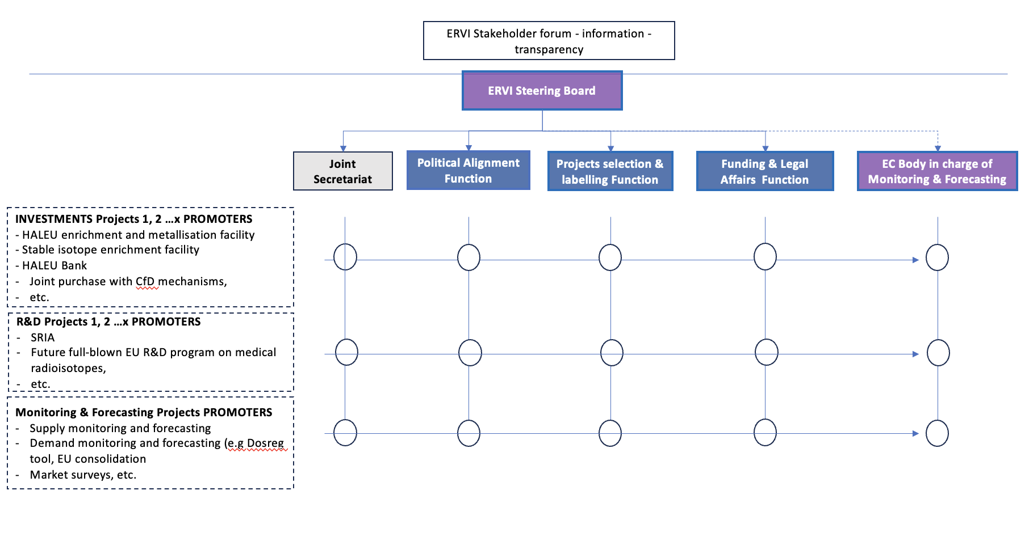
PRISMAP + announced as a targeted call in INFRADEV-20215-1
Call open 7 May 2025 – Subm. 18 Sept 2025
Prep meeting held in Nantes :
55 participants
5 Mi Euro overall budget
https://indico.cern.ch/event/1438450/
Intended to (slightly) extend the scope
2 emerging facilities made their 1st radionuclides : SPIRAL 2, SPES
Launch a Marie Curie ITN InnoMedRad – lead prof Cocolios
2nd prep meeting in Mol, after CM8 :
https://indico.cern.ch/event/1519881/
Involved in the ERVI process driven by DG-ENER:
Aiming at a high level committee which will discuss the follow-up of PRISMAP +
in the next multiannual Financial Framework (MFF) 2028-2034

Slide 5
PRISMAP + writing committee in place
T. Cocolios (KULeuven), C. Decristoforo (UMI), F. Haddad (Arronax), U. Koester (ILL), MD (CHUV), T. Stora (CERN)
C. Deville (DTU), C. Duchemin (CERN)*,G. Pupillo (INFN)
Sciprom, CERN EU project office
https://indico.cern.ch/category/19851/

