Slide 1
Status of the AD e-cooler project
@ E-cooler integration meeting – https://indico.cern.ch/event/1528547/
1 April 2025

Slide 2
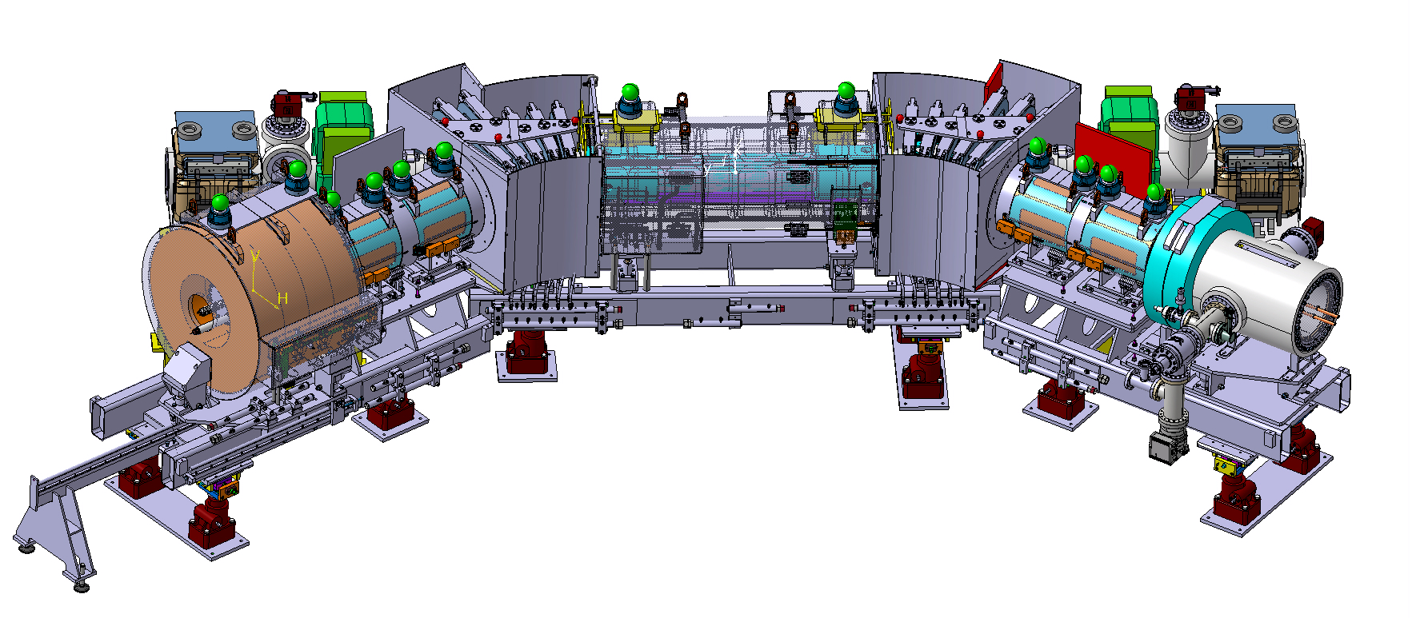
Overall mechanical design and integration, SY-BI & EN-MME
Mechanical integration (drawings)
  At the level of the AD ring completed (including H/V correctors)
  At the level of sub-component
    Girders completed (ready for manufacturing)
    Magnets (w/o H/V correctors) completed (being manufactured)
    H/V correctors presented by Jeremy & Nicolas
    Vacuum chambers completed (including BPM and cables), being manufactured
    Collector vacuum chamber integrated (being manufactured)
    Gun in design

Slide 3
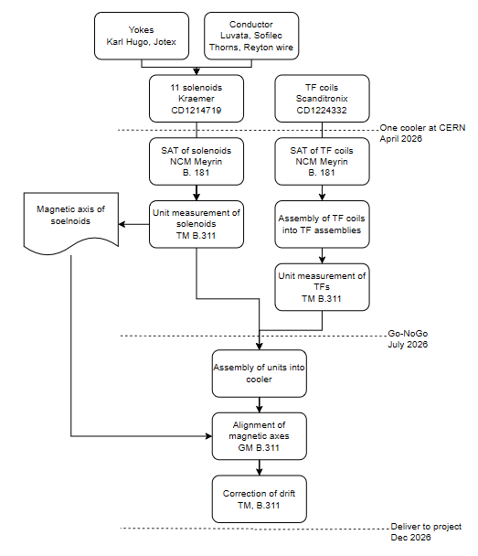
Magnets for e-cooler – TE-MSC
Contract 1 – 11 solenoids
  1+1 Drift, 4+1 Arm, 1+1 expansion, 1+1 squeeze
  Launched with Krämer Aug 24
  Batches to be delivered Nov 25 to Aug 26
  Free issued shields and conductor reduced total price
Contract 2 – TF region coils
  6+1 small racetracks, 6+1 large racetracks, 4+1 steerers
  Launched with Scanditronix Sept 24
  Manufacturing file accepted
  Batches to be delivered Aug 25 to Dec 25
  Go/No-go at end of single magnet acceptance tests
https://indico.cern.ch/event/1484477/

Slide 4
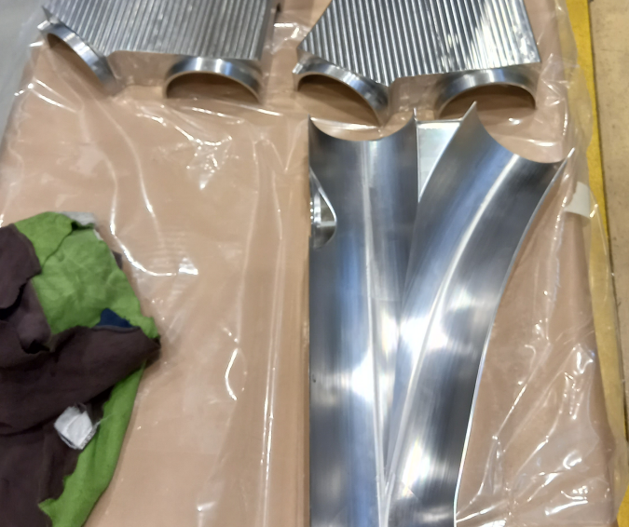
Vacuum – TE-VSC & EN-MME
Toroid chamber under production
Ancillaries (pumps, valves, gauges) being purchased
Schedule on time
20/02/25
BPM – SY-BI & EN-MME
Tests completed ✅
Series production started for 2 BPMS
Electronics to be procured

Slide 5
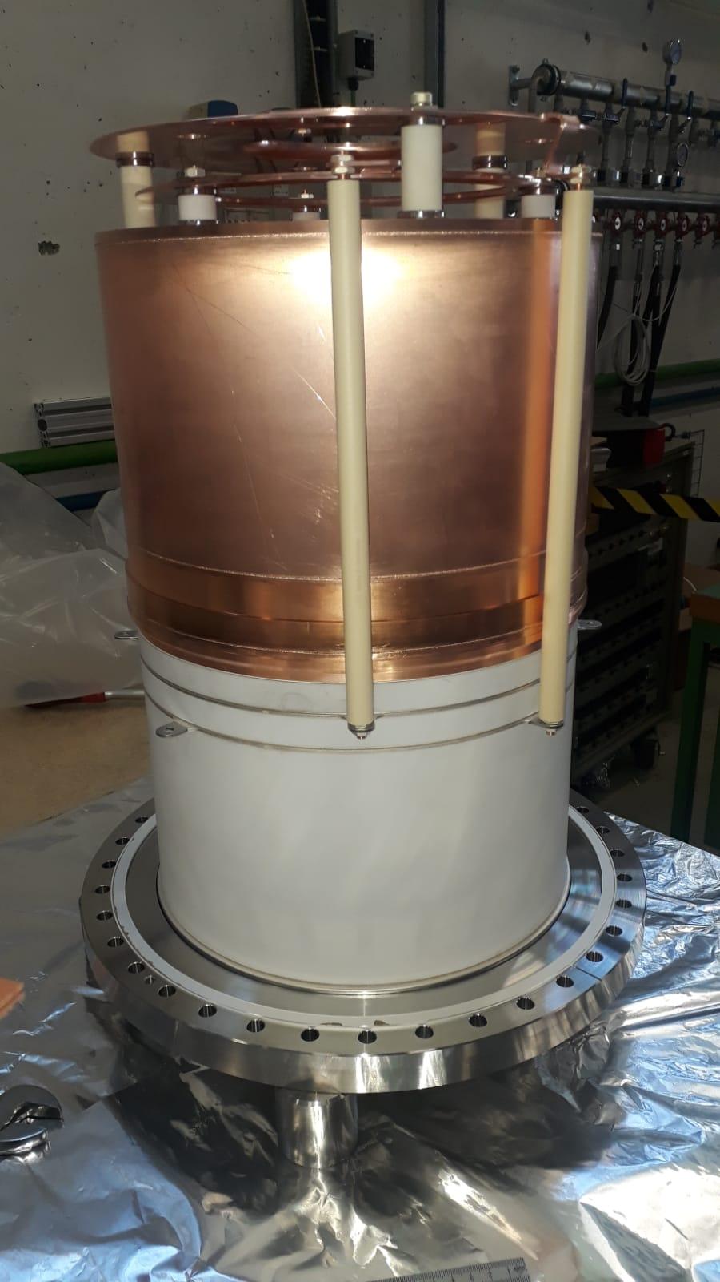
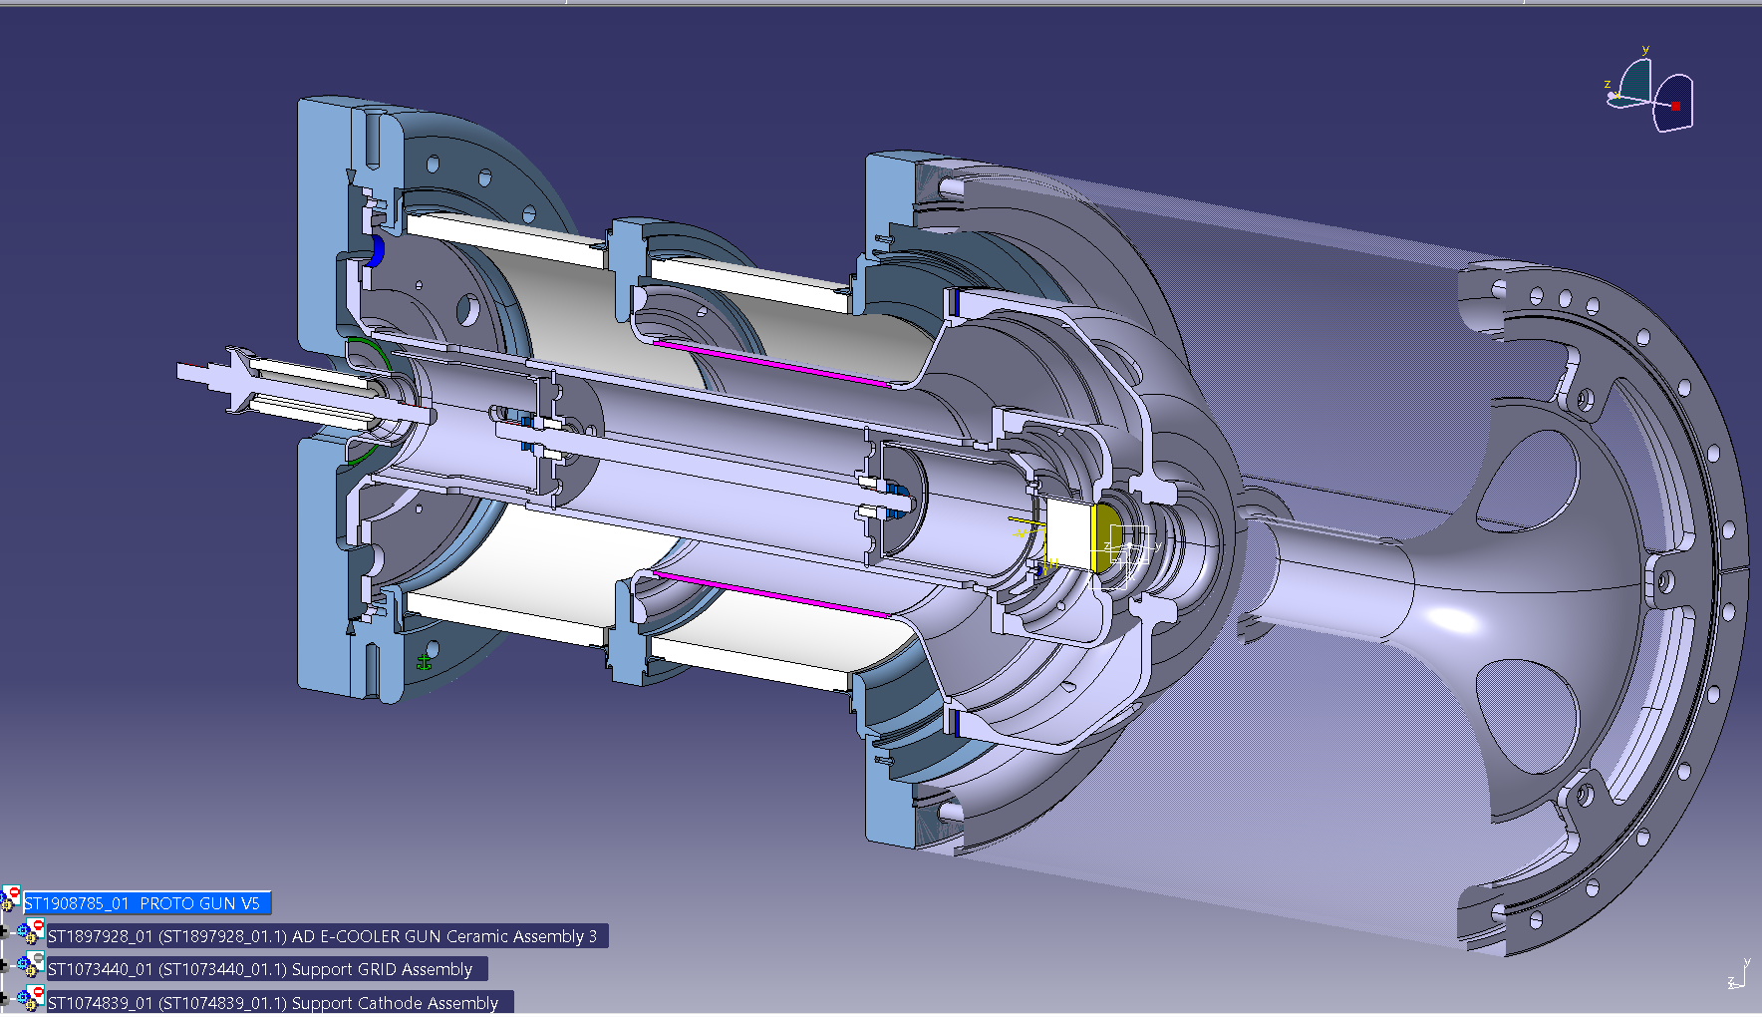
Gun and collector SY-BI & EN-MME
Collector tests
  Power ✅
  Electrodes ❎
Vac chamber in production
Tests and Go/No-go by end of 2026
Gun under design @ MME
Delivery Q1 or Q2 2026
Tests and Go/No-go by end of 2026

Slide 6
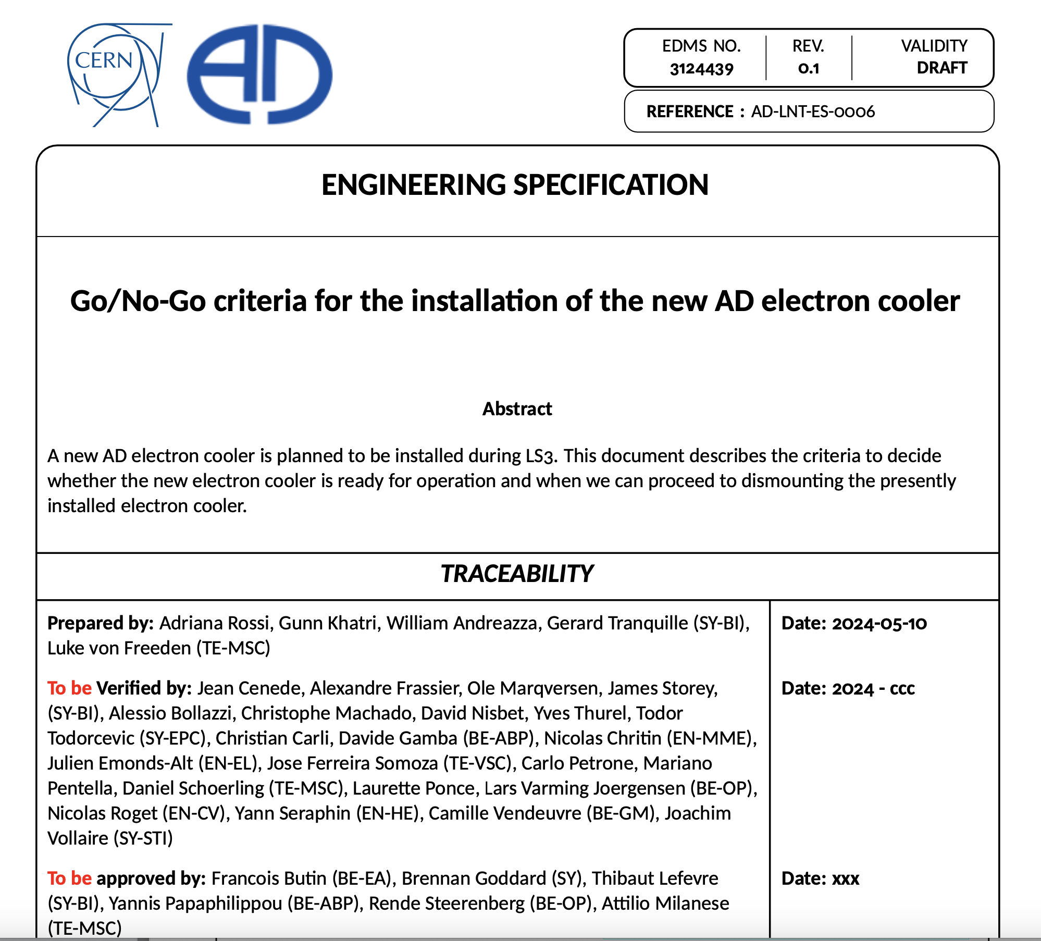
Go/No-Go principle
The limited timescales available between the delivery of its sub-components and final installation will not allow testing the fully assembled electron cooler
Testing only single components and characterize full magnetic system
Go/No-Go document details measurements to be performed and the target result values for the new electron cooler to be operational
Go/No-Go ➔ De-install only when all the critical components are delivered from the supplier at CERN and tested to their specifications (for magnets = single magnet acceptance test)

Slide 7
Powering SY-EPC
Both HV and magnet powering under procurements
Tests of acceptance as by SY-EPC
AD e-cooler Faraday Cage requires some modifications

Slide 8
Services
Water cooling requested for gun/collector & magnets
Cabling – new cable rooting
Handling – design of new crane ongoing

Slide 9
Integration and Installation Sequence Review
An Integration and Installation Sequence Review will be organized around Easter 2026
Scope
  To communicate to everyone any non-conformity during production and allow enough time to react and compensate
  To make sure that all tooling necessary for installation is ready in time
  Improve coordination between different teams and avoid time/space clashes
  Give guidelines

Slide 10
AD e-cooler cartoon
Controls & Intelocks

