Slide 1

DUNE's ND-LAr and its prototyping program (2x2 and FSD)
Richard Diurba (Bern) for the DUNE Collaboration
September 2nd, 2025
NuFACT 2025

Slide 2
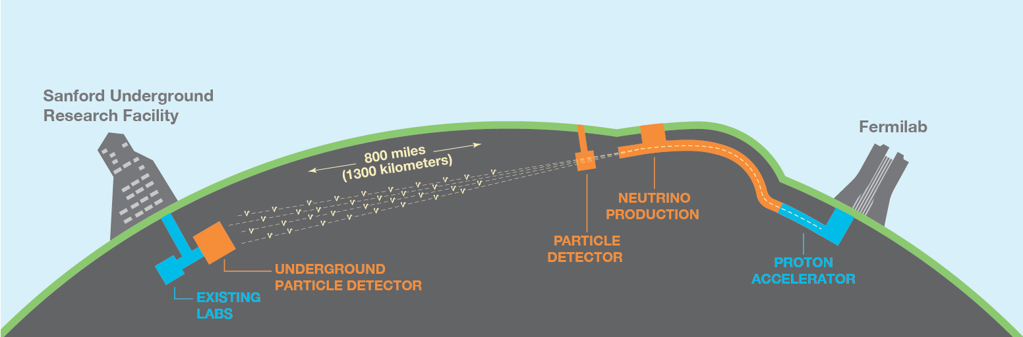
Deep Underground Neutrino Experiment
DUNE is a next-generation long-baseline oscillation experiment under construction.
LBNF beam will have world-leading intensity of 1.2-2.4 MW.
DUNE design allows for independent determinations of mass ordering and CP-violation.
Relies heavily on the wide-band beam and long baseline.

Slide 3
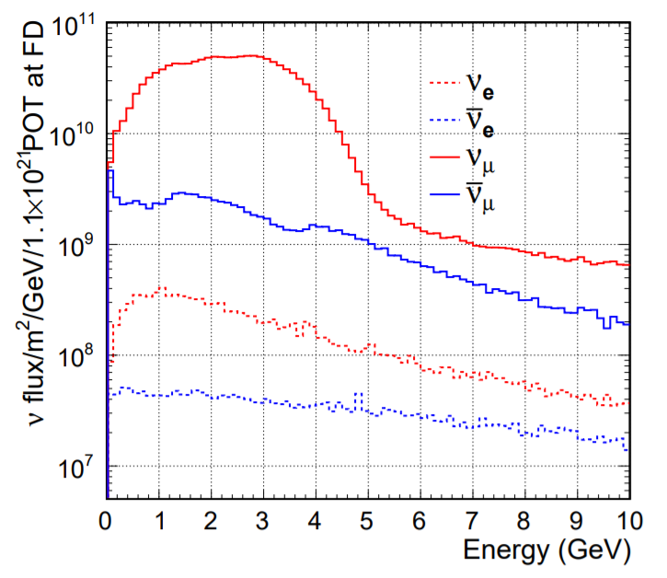
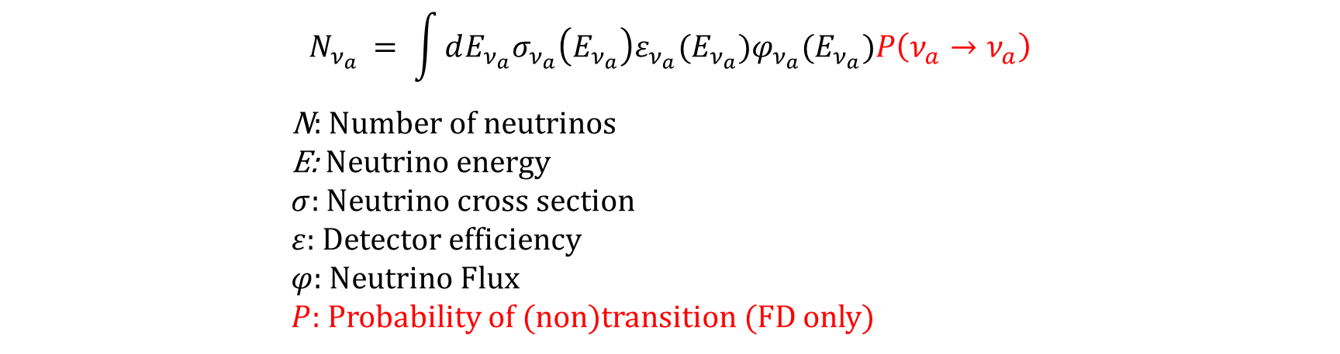
Necessity of the DUNE Near Detector
Neutrino flux wide-band beyond 1 GeV.
Beam extends heavily into RES and DIS.
Requires precise knowledge of both the neutrino cross section and flux.
Difficult given GeV-scale modeling challenges and wide-band flux.
$$N_{ν_{a} }= \int{dE_{ν_{a}}σ_{ν_{a}}\left(E_{ν_{a}}\right)ε_{ν_{a}}(E_{ν_{a}})φ_{ν_{a}}(E_{ν_{a}})P\left(ν_{a}→ν_{a}\right)}$$
N: Number of neutrinos
E: Neutrino energy
$σ:$ Neutrino cross section
$ε:$ Detector efficiency
$φ$: Neutrino Flux $P:$ Probability of (non)transition (FD only)
Neutrino flux of the beam operating in neutrino mode.
EPJ C 80 (2020) 978

Slide 4
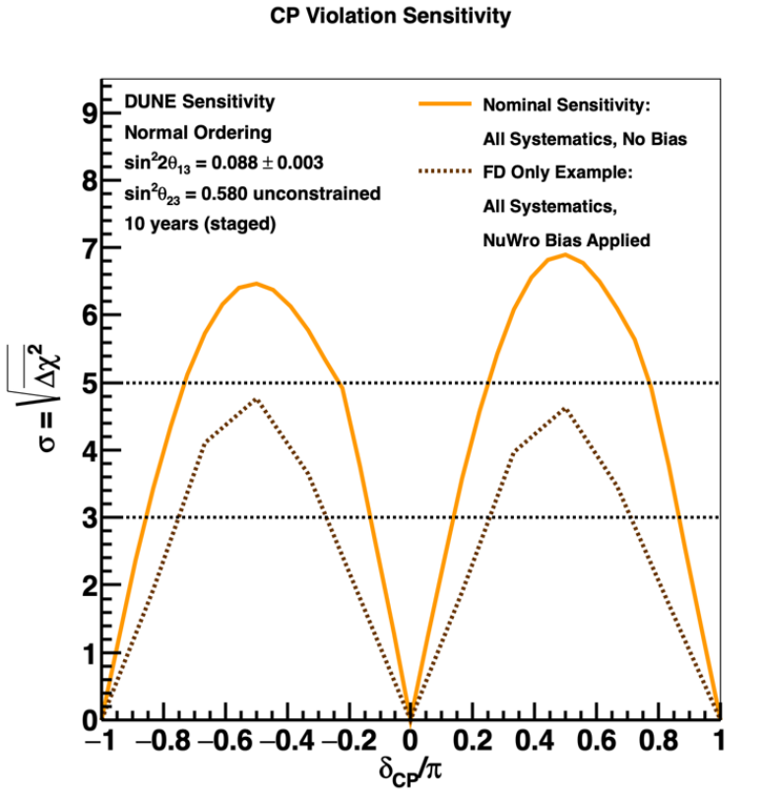
Necessity of the DUNE Near Detector
Challenges to quantifying neutrino cross section and flux make oscillation measurements difficult.
Requires a Near Detector to measure neutrino cross section and neutrino flux.
CP-violation measurement unable to reach discovery-level precision without a ND.
$$N_{ν_{a} }= \int{dE_{ν_{a}}σ_{ν_{a}}\left(E_{ν_{a}}\right)ε_{ν_{a}}(E_{ν_{a}})φ_{ν_{a}}(E_{ν_{a}})P\left(ν_{a}→ν_{a}\right)}$$
N: Number of neutrinos
E: Neutrino energy
$σ:$ Neutrino cross section
$ε:$ Detector efficiency
$φ$: Neutrino Flux $P:$ Probability of (non)transition (FD only)
Sensitivity to CP-violation without an ND if an alternative neutrino model is used (NuWro fake data).
arxiv:2002.03005

Slide 5
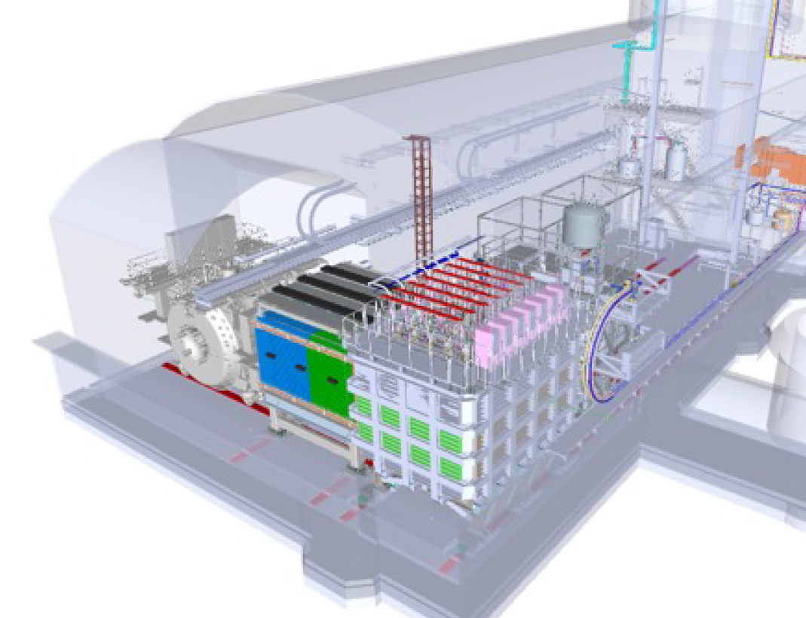
DUNE Near Detector Design
Near Detector has three components:
Liquid argon detector (ND-LAr)
The muon spectrometer (TMS)
On-axis beam monitor (SAND)
ND-LAr and TMS can move off-axis to sample different energy spectra of the neutrino beam.
Known as the Precision Reaction Independent Spectrum Measurement system (PRISM).
Muons exit ND-LAr and pass into TMS.
Muon spectrometer (TMS)
Rails to move off-axis
Beam Direction
System for on-axis
neutrino monitoring (SAND)
Liquid argon (ND-LAr)
Instruments 2021,5(4), 31

Slide 6
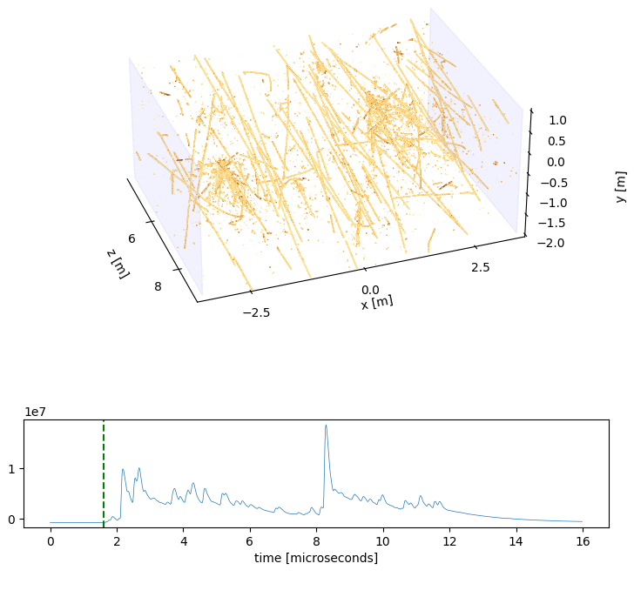
DUNE Beam Pile-Up
The LBNF beam of DUNE produces over a hundred interactions per beam spill in ND-LAr!
ND-LAr handles pile-up by:
Modularization of the argon volume into 35 modules.
Reduce signals per sensitive volume.
Pixelated charge readout
Prevents pile-up of charge signals.
Dielectric light traps in each module for fast readout.
Associate light to charge data to separate interactions.
SIMULATION
Work In-Progress
Simulated beam spill of ND-LAr with charge (yellow) and light (green) signals.

Slide 7
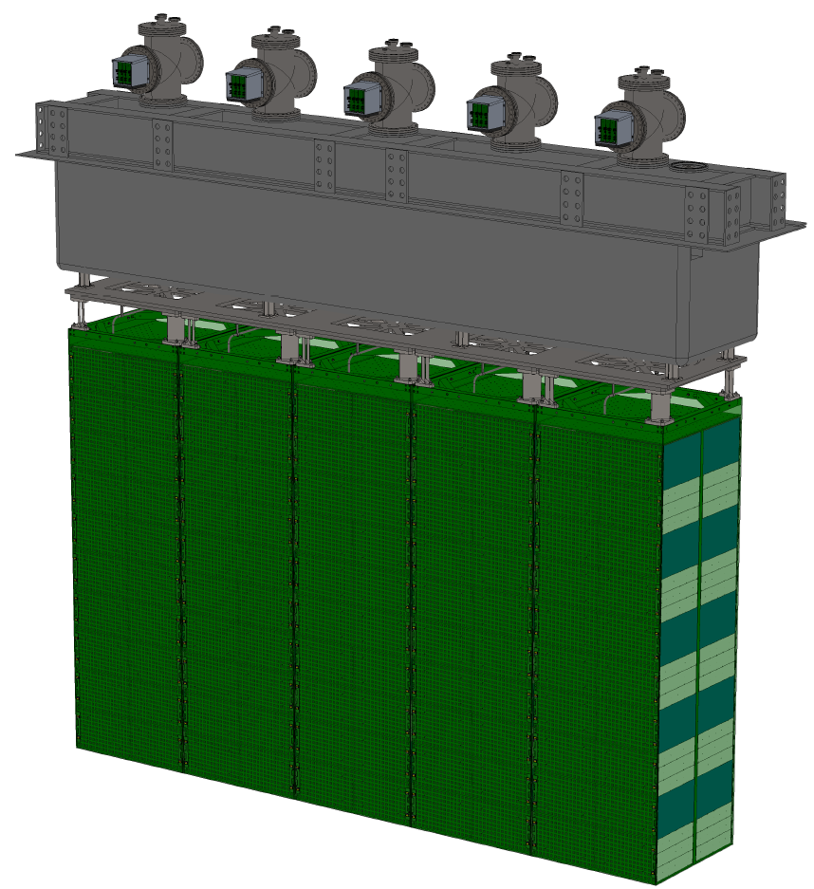
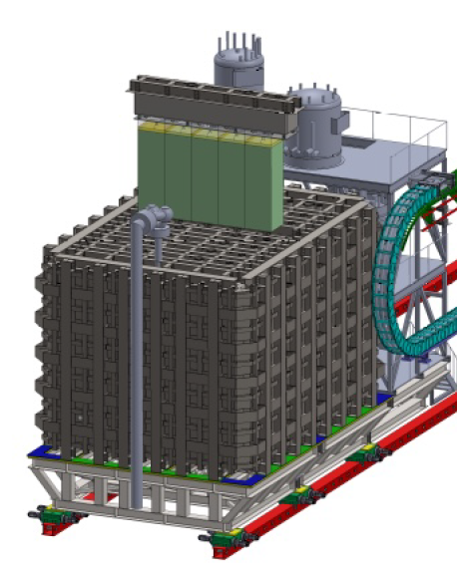
Liquid Argon Near Detector (ND-LAr)
ND-LAr consists of 35 modules, optimized for horizontal containment of hadrons.
Consists of seven rows of five modules.
Total fiducial mass of 67 tons.
Instruments 2021,5(4), 31

Slide 8
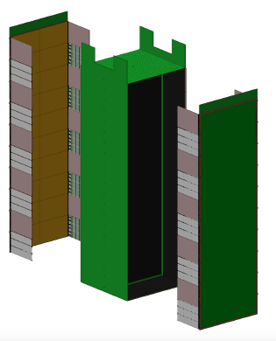
Liquid Argon Near Detector (ND-LAr)
Each row contains a module with two drift volumes that are optically segmented.
A module is 1 m (length) by 1 m (width) by 3 m (height).
Instruments 2021,5(4), 31

Slide 9
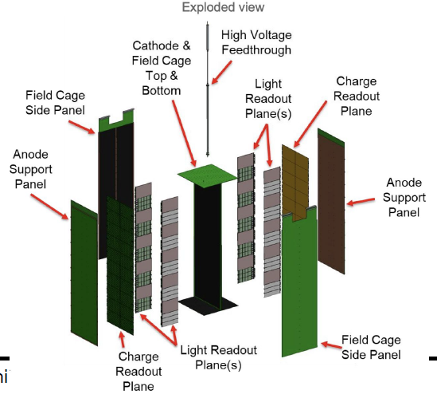
Liquid Argon Near Detector (ND-LAr)
Each row contains a module with two drift volumes that are optically segmented.
A module is 1 m (length) by 1 m (width) by 3 m (height).
Instruments 2021,5(4), 31

Slide 10
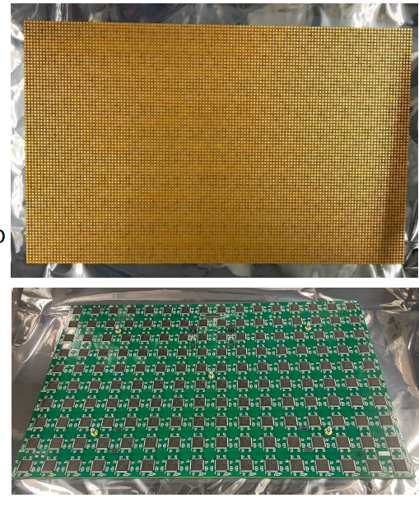
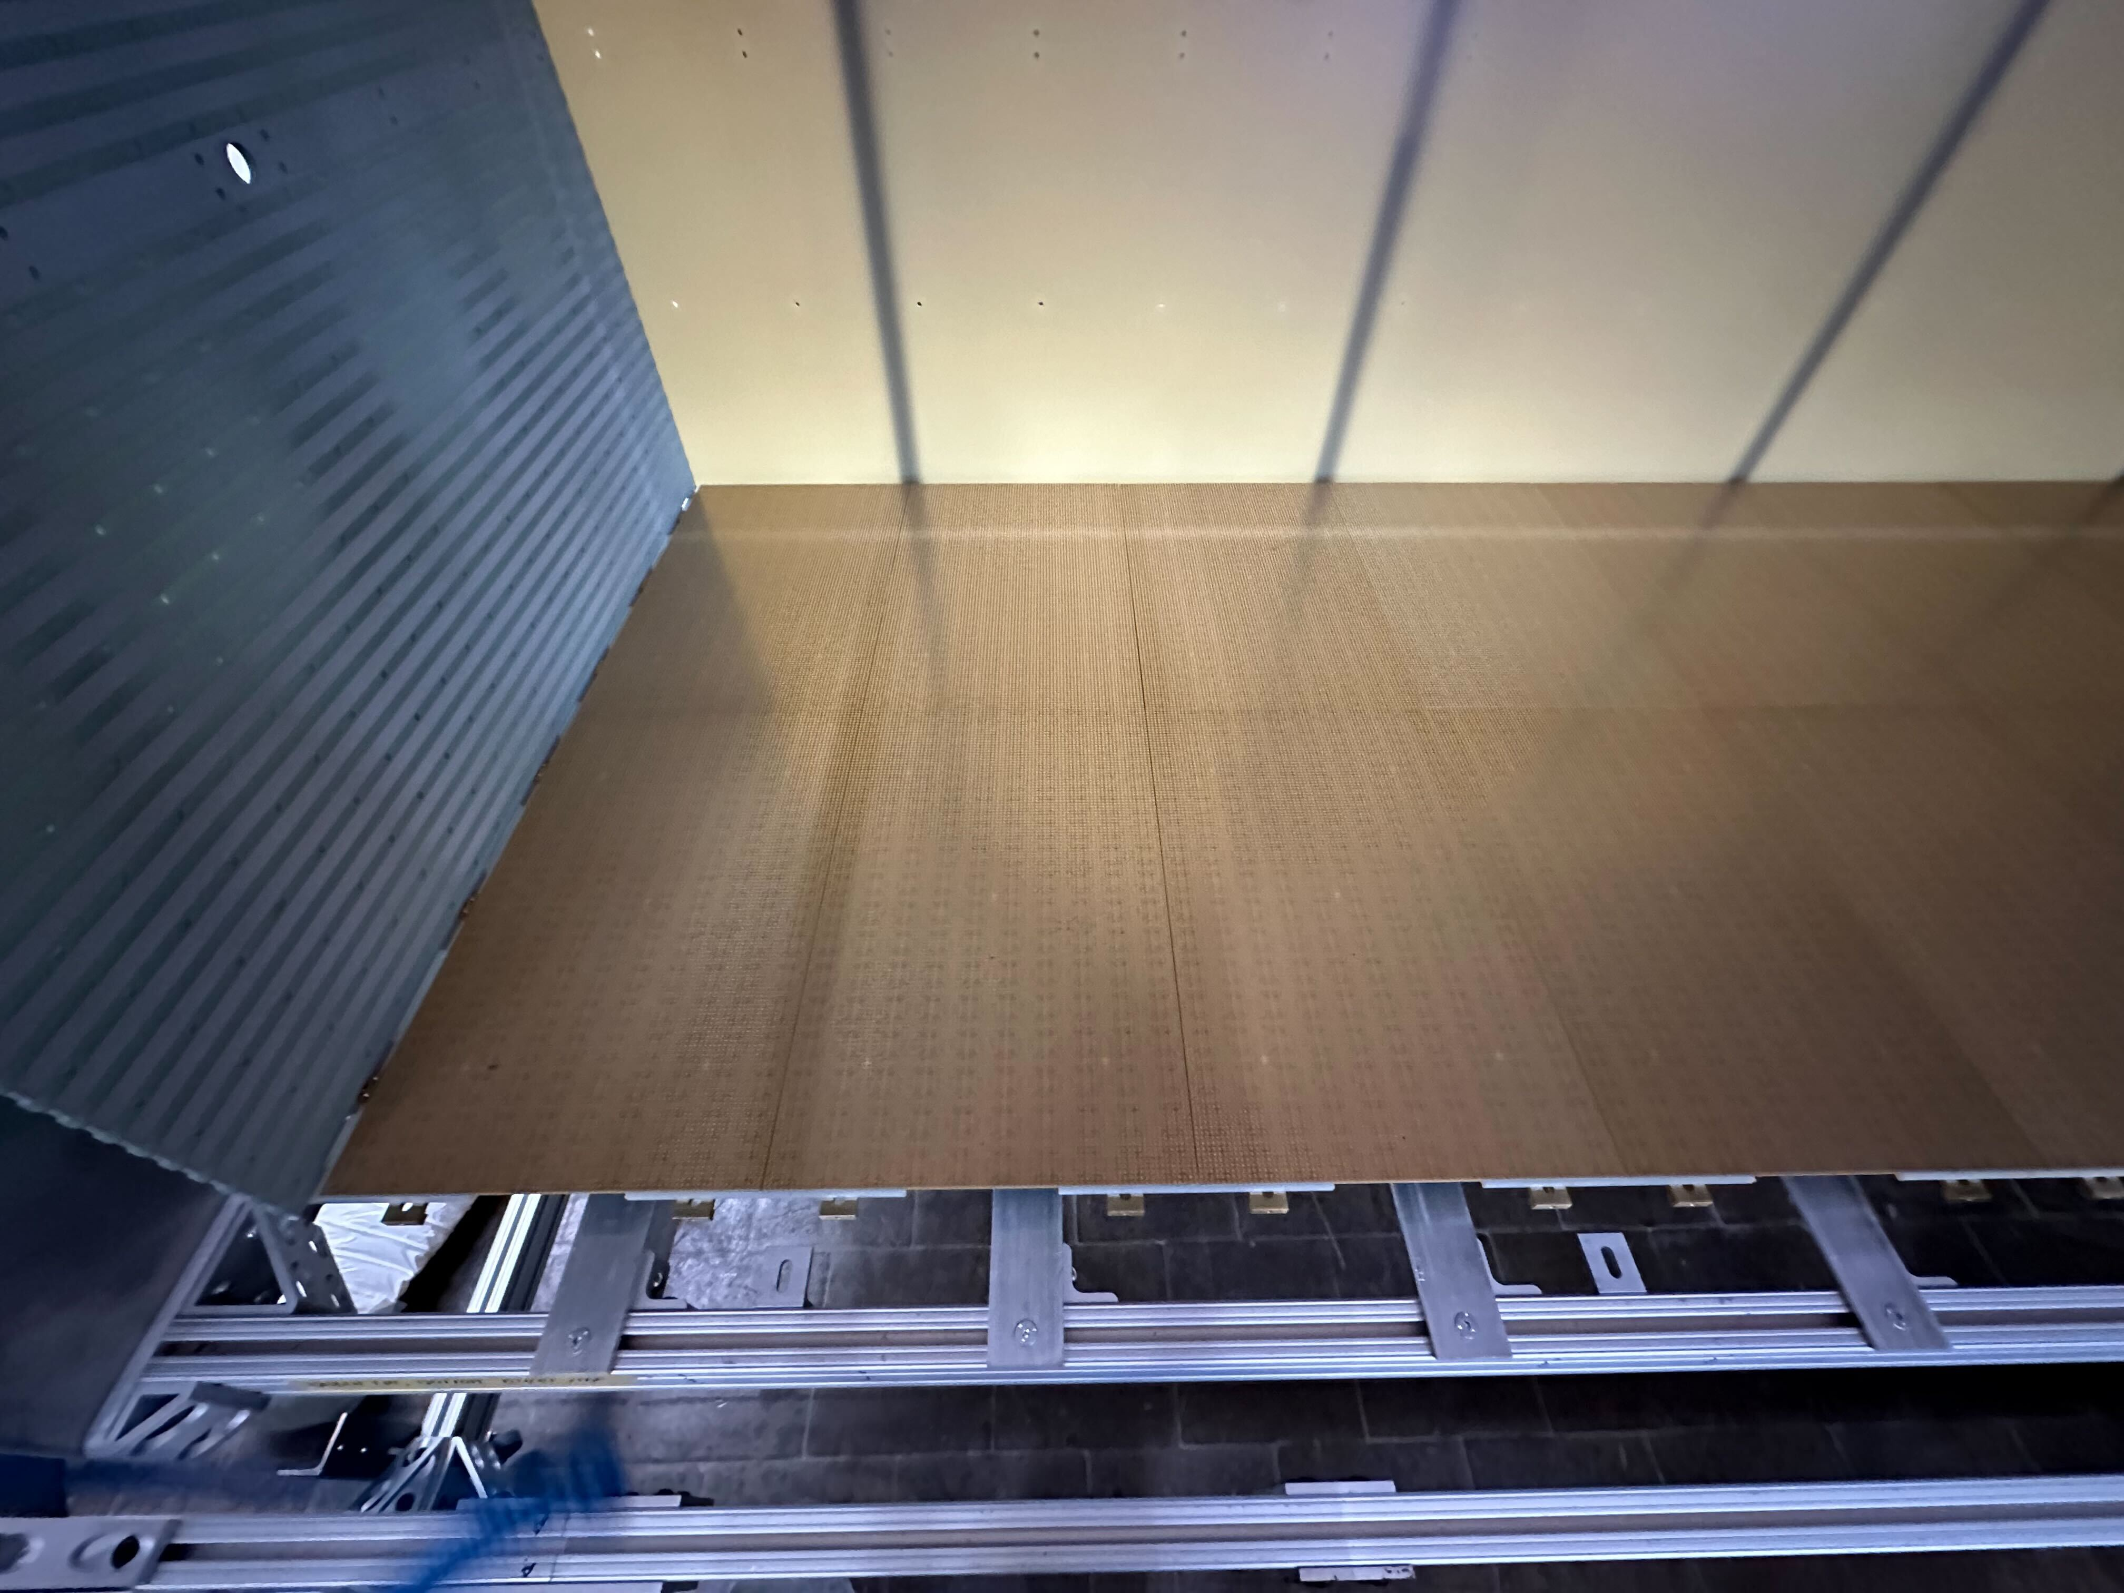
ND-LAr Charge Readout
Unique pixelated charge readout using LArPix design.
Over 14M pixels in whole ND-LAr.
Native three-dimensional reconstruction with self-triggering.
Pixel pitch of 4 mm.
Low proton energy thresholds of approximately 10 MeV.
A single full-size LArPix tile.
LArPix tiles installed in a full-size ND-LAr module prototype.
LArPix Design Paper: JINST 13 P10007

Slide 11
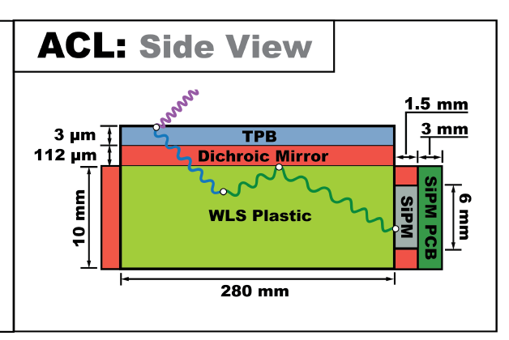
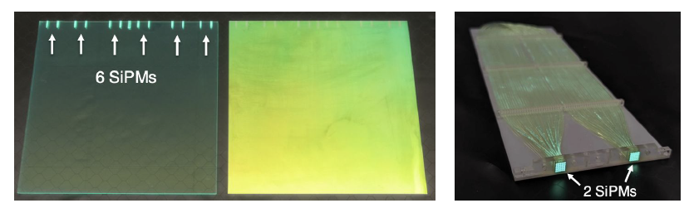
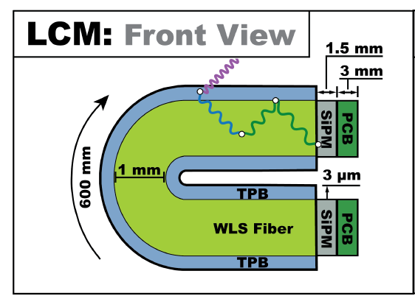
ND-LAr Light Readout
Dielectric traps based on ARAPUCA concept with ns-scale timing.
Two complementary technologies for position and timing:
ArgonCube Light Readout System (ACL)
Plastic with high spatial resolution (~10 cm).
Light Collection Module (LCM)
Wrapped fiber with higher PDE (~1%).
Instruments 8(4), 48
ACL
LCM
JINST 15 C07022

Slide 12
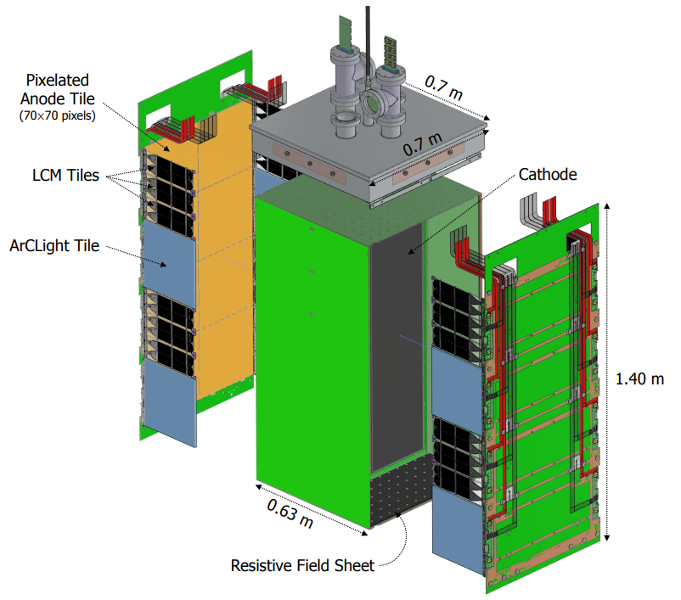
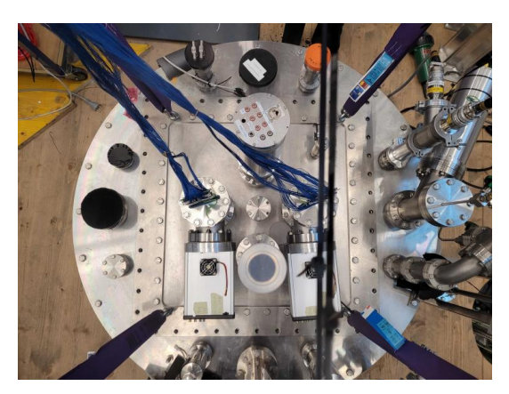
ND-LAr Prototyping Campaign: Ton-Scale Module
Constructed four ton-scale modules from 2021-2023.
Dimensions of 60 cm by 60 cm by 1.2 m.
Approximately 60% of ND-LAr module size.
Collected over 100M cosmic-ray events over several months of data-taking at the University of Bern.
Performance from Cosmic Ray Data: Instruments 2024, 8(3), 41.

Slide 13
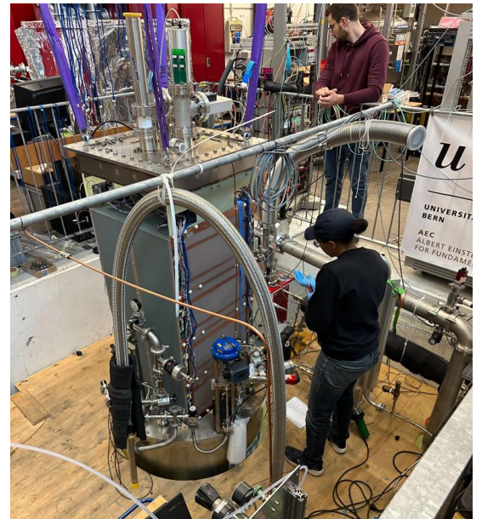
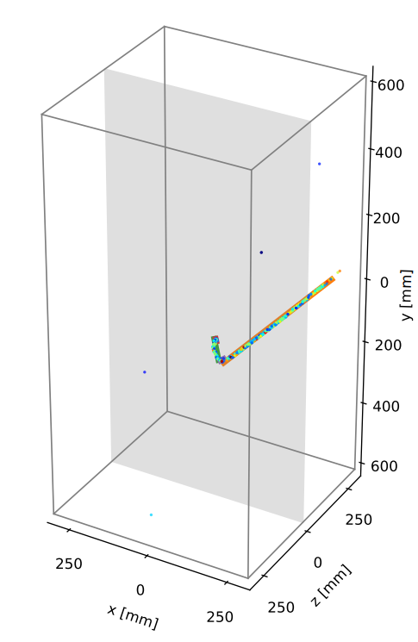
ND-LAr Prototyping Campaign: Ton-Scale Modules
Constructed four ton-scale modules from 2021-2023.
Dimensions of 60 cm by 60 cm by 1.2 m.
Approximately 60% of ND-LAr module size.
Collected over 100M cosmic-ray events over several months of data-taking at the University of Bern.
DUNE DATA
Michel candidate event
Performance from Cosmic Ray Data: Instruments 2024, 8(3), 41.

Slide 14
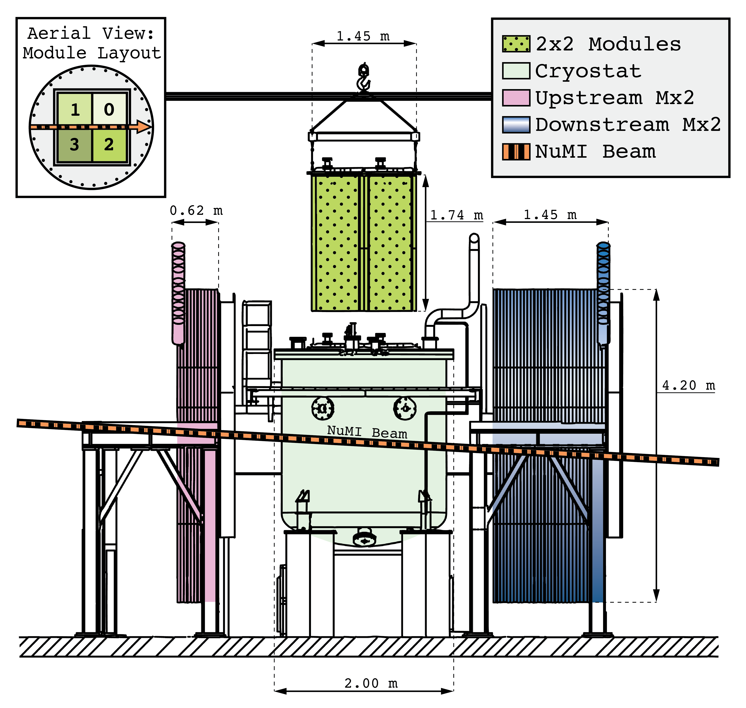
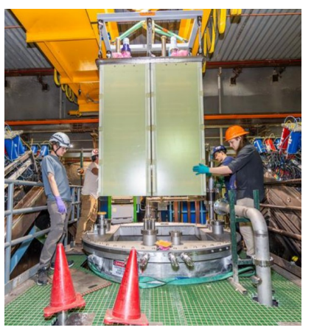
Prototyping Campaign: 2x2 Demonstrator
These four modules were sent to Fermilab to be placed in the MINOS hall in a 2 by 2 configuration.
On-axis with the NuMI neutrino beam.
Operated in July 2024 and currently going through a second run to collect non-beam data.

Slide 15
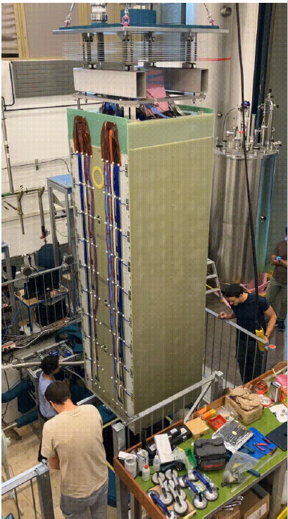
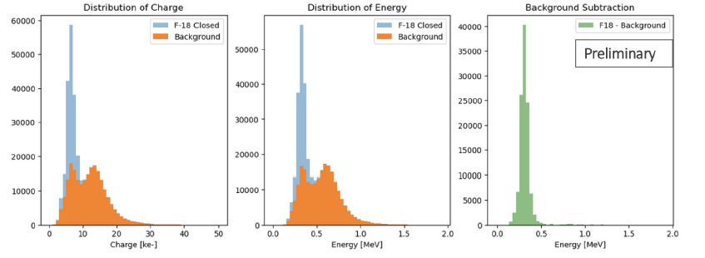
Prototyping Campaign: Full-Scale Demonstrator
In summer 2024, DUNE assembled and operated the first full-scale ND-LAr module at the University of Bern.
Collected 70M cosmic-ray events over several weeks of data-taking.
Additionally took radioactive data with fluoride to measure low-energy EM-scattering.

Slide 16
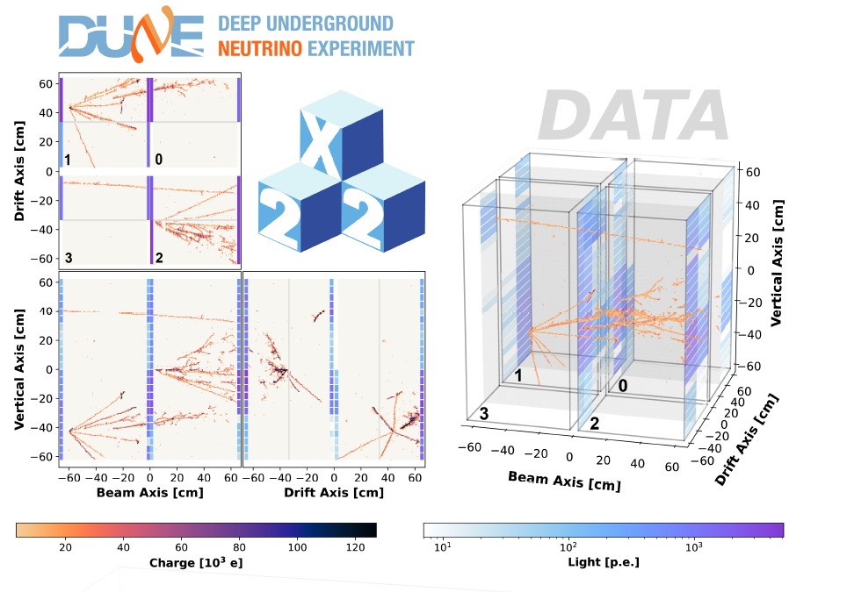
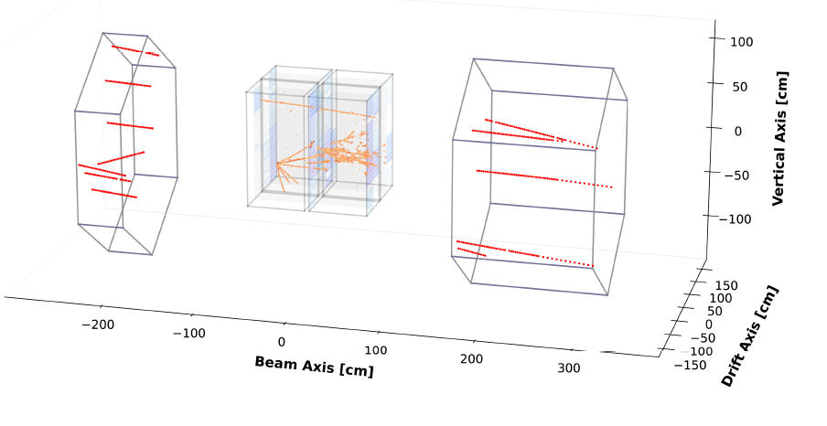
2x2 Neutrino Beam Data-Taking
Collected 4.5 days of NuMI data.
Total exposure of 1.3E19 POT.
Approximately 45k neutrino events.
Event display of 2x2 charge data and tracks in MINERvA (red)
Event display of charge and light data.

Slide 17
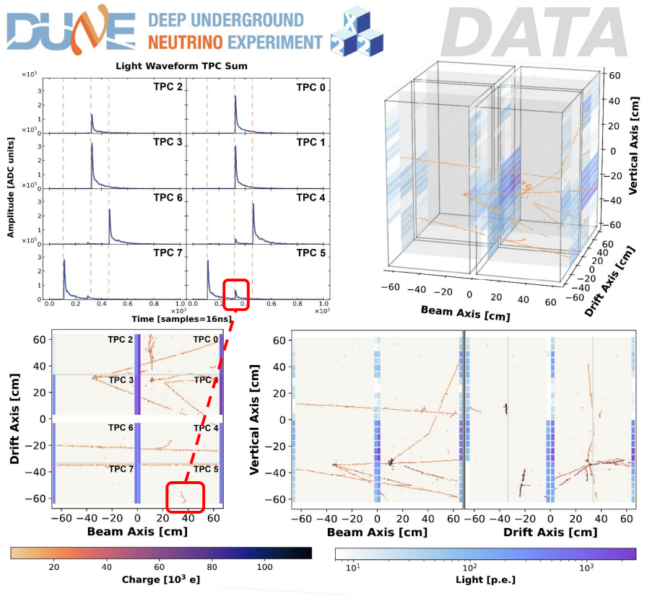
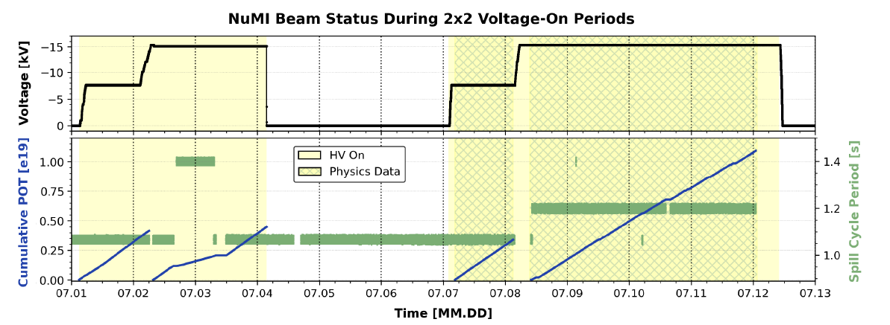
2x2 Neutrino Beam Data-Taking
Collected 4.5 days of NuMI data.
Total exposure of 1.3E19 POT.
Approximately 45k neutrino events.
Collection of 1.3E19 P.O.T. over July 2024.
Event display of charge and light data, showing background rejection when compared to the through-going muon.

Slide 18
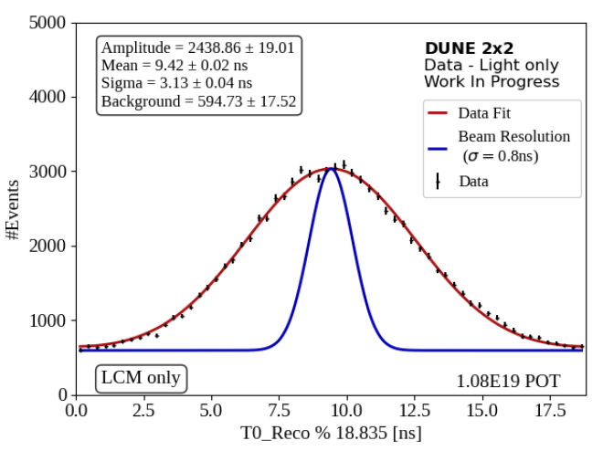
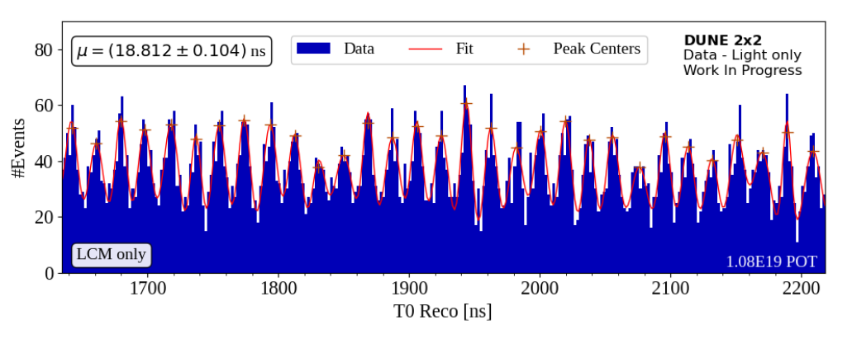
2x2 Preliminary Results
Able to extract the beam structure using only the light readout.
Timing resolution of 3.1 ns, showing definitive evidence of nanoscale timing with respect to the beam with ND-LAr concept.
Important for studying neutrino beam and BSM searches.
Fit of a single bunch of the NuMI beam using the scintillation light observed in 2x2 using a triple Gaussian function.
Calivers, Livio. Demonstration of a Novel Modular Neutrino Detector (PhD Thesis).
Timing distribution of the beam structure as measured by the light sensors and fit to multiple Gaussians (18 ns bunch spacing).

Slide 19
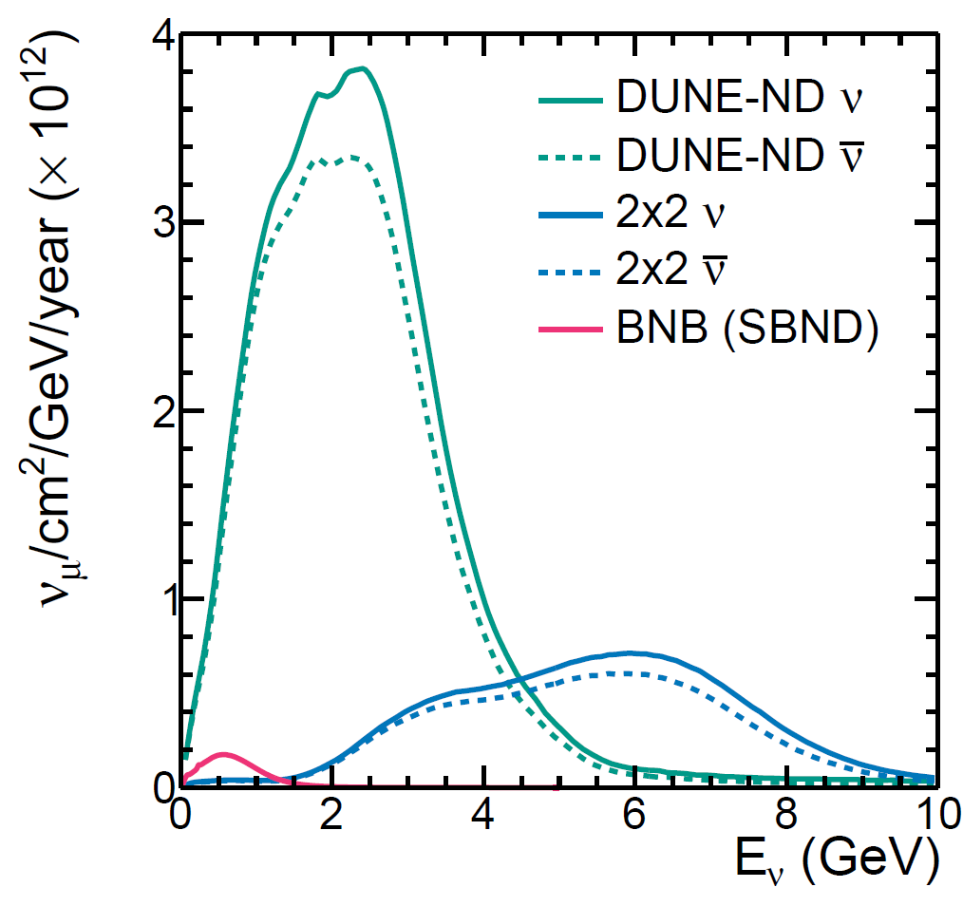
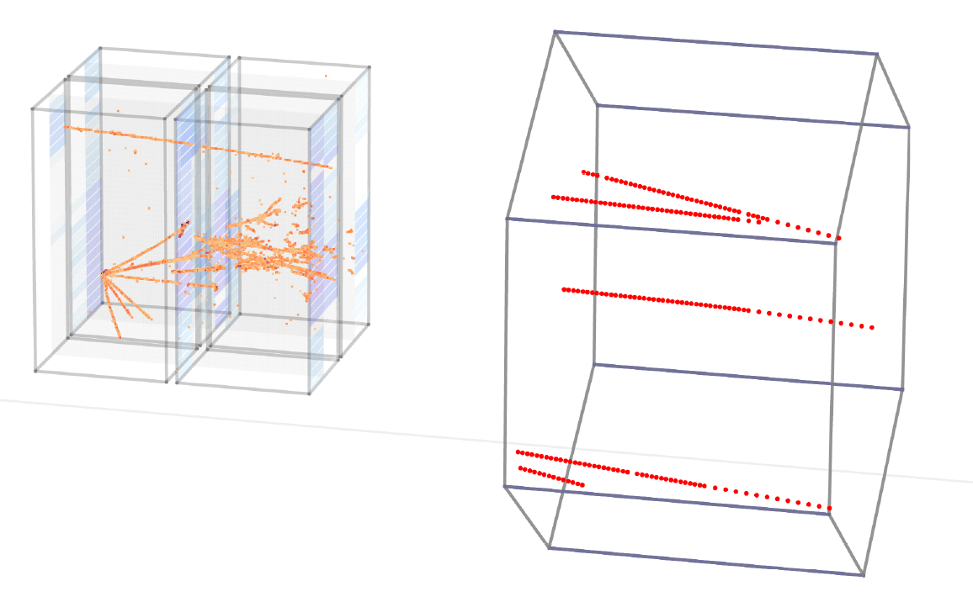
2x2 Ongoing Physics Studies
Neutrino analyses are investigating:
Inclusive measurements
Includes 66% of DIS and RES interactions.
Neutron production (See L. Mora-Lepin’s talk!)
Mesonless with muon antineutrinos
Neutral pion production
NC elastic
Comparisons of NuMI on-axis flux to BNB and DUNE (LBNF) fluxes.
Like ND-LAr, muons are not contained and MINERvA acts as a muon catcher.

Slide 20
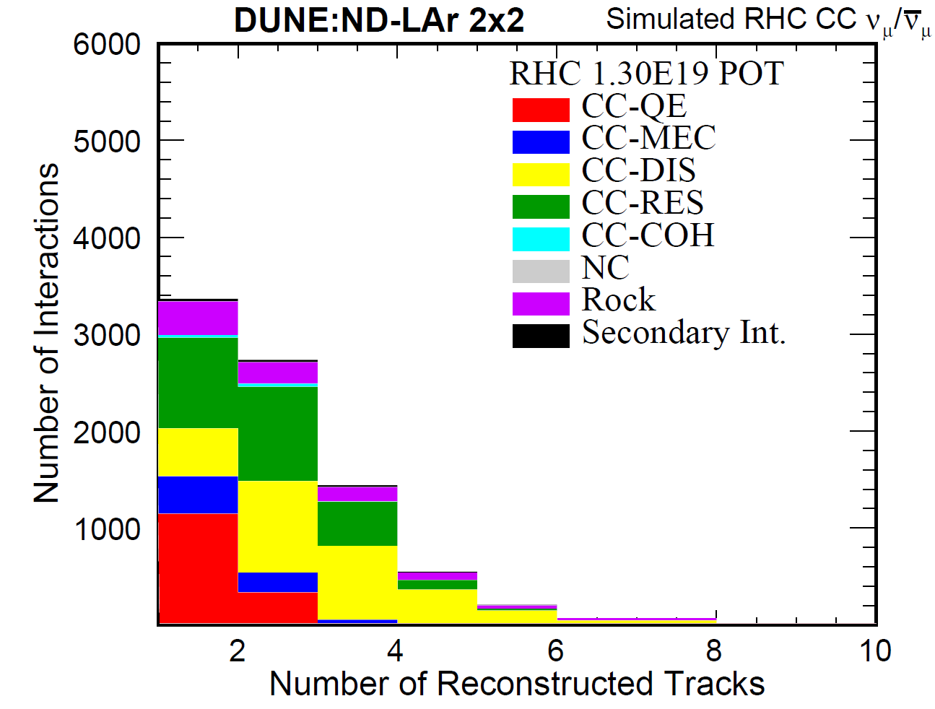
2x2 Ongoing Physics Studies
Neutrino analyses are investigating:
Inclusive measurements
Includes 66% of DIS and RES interactions.
Neutron production (See L. Mora-Lepin’s talk!)
Mesonless with muon antineutrinos
Neutral pion production
NC elastic
SIMULATION
Work In-Progress
Charged track multiplicity from simulation using the NuMI flux.

Slide 21
Conclusion
DUNE is a neutrino experiment under construction that needs a capable liquid argon near detector.
ND-LAr addresses beam pile-up using modular, pixelated detectors with dielectric light traps.
An extensive prototyping campaign has been developed over the past decade. These include:
Multiple ton-scale modules at the University of Bern.
A new neutrino detector based at Fermilab.
The first full-scale ND-LAr module at the University of Bern.
Currently, we are operating the 2x2 Demonstrator for cosmic-ray and radioactive data-taking.
In the future we plan to:
Operate the 2x2 Demonstrator in 2026 (aiming for data with ~1M neutrinos).
Continue operating full-scale demonstrator runs.
Begin production of the 35 ND-LAr modules.

