Slide 1
Reconstruction of Tau Neutrinos in LArTPC Detectors NuFact 2025 William Dallaway On Behalf of the DUNE Collaboration

Slide 2
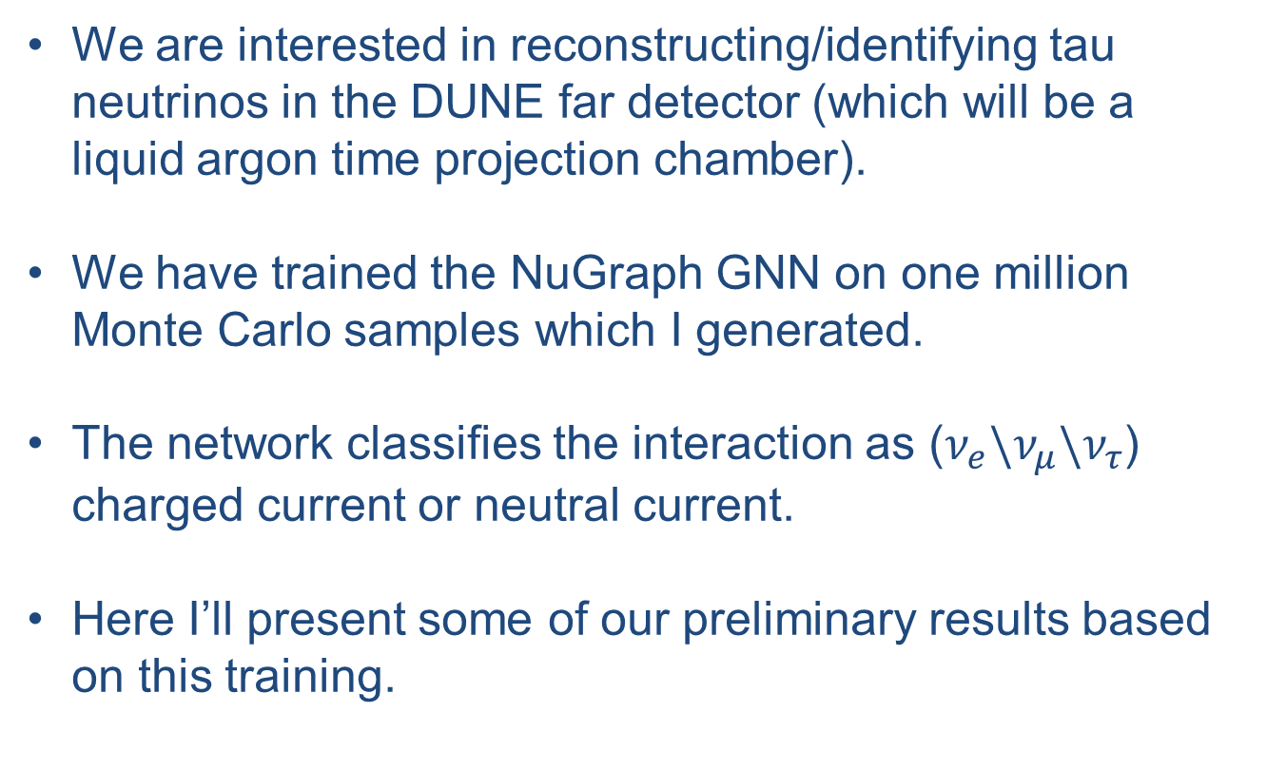
Introduction
We are interested in reconstructing/identifying tau neutrinos in the DUNE far detector (which will be a liquid argon time projection chamber).
We have trained the NuGraph GNN on one million Monte Carlo samples which I generated.
The network classifies the interaction as ($ν_{e}\backslash ν_{μ}\backslash ν_{τ}$) charged current or neutral current.
Here I’ll present some of our preliminary results based on this training.

Slide 3
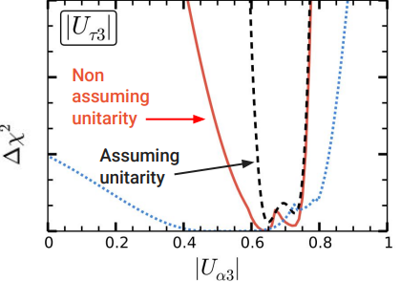
Why Tau Neutrinos?
Still Many Questions!
There have only been about 30 neutrino candidates found across all of DONuT, OPERA and IceCube[1][3][6].
Almost all our knowledge about tau neutrino oscillations are taking from PMNS unitarity. (Unitarity of τ row in PMNS at 30% level (at 95% CL)
[8]
It is critical to test our assumptions!

Slide 4
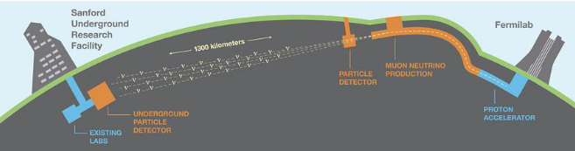
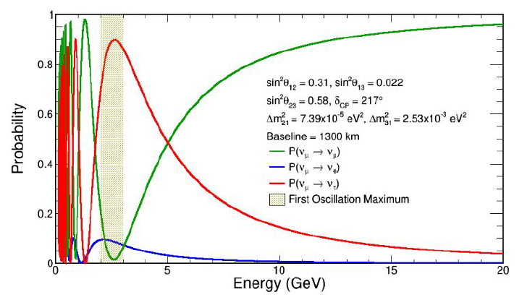
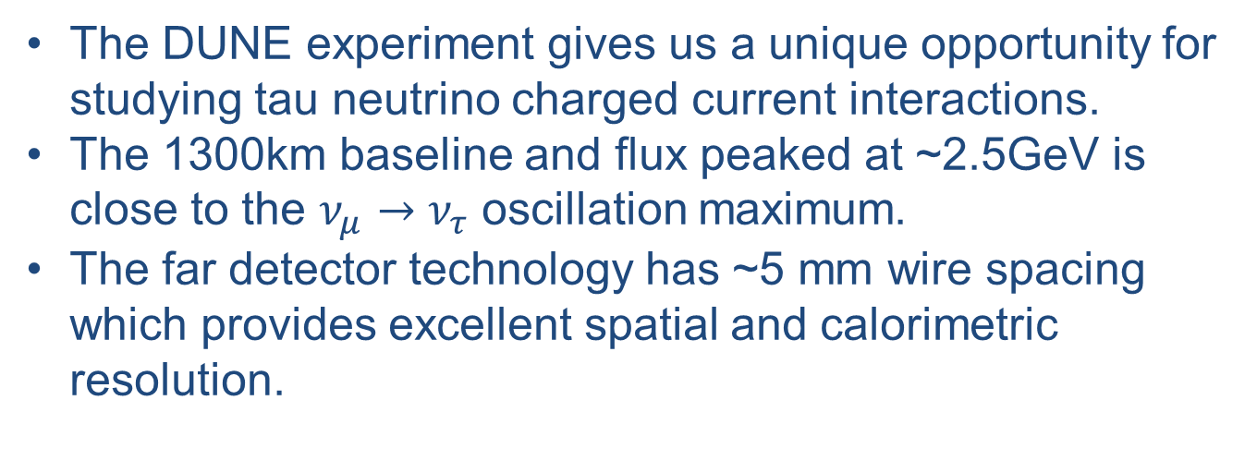
DUNE
The DUNE experiment gives us a unique opportunity for studying tau neutrino charged current interactions.
The 1300km baseline and flux peaked at ~2.5GeV is close to the $ν_{μ}→ν_{τ}$ oscillation maximum.
The far detector technology has ~5 mm wire spacing which provides excellent spatial and calorimetric resolution.
[2]
[4]

Slide 5
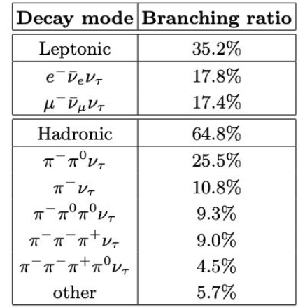
Tau Difficulties
Despite the several advantages offered by DUNE detecting tau neutrinos is still difficult!
The tau lepton cannot be resolved in the detector and worse the decay products which are resolved can be confused with the other leptons.
[7]

Slide 6
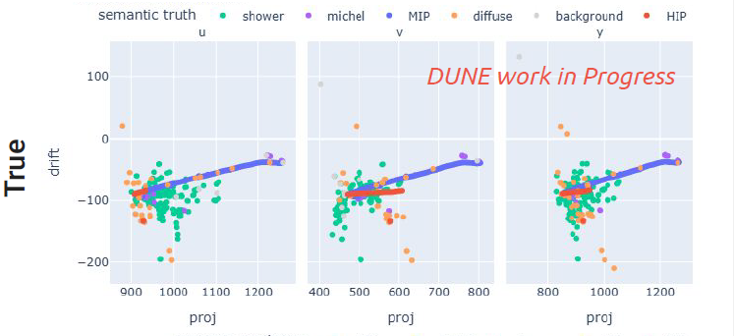
NuGraph
NuGraph is a graph neural network (GNN) we use this to do interaction level classification of our events.
The only input features are the hit positions and hit energies.
This means the network is using very basic reconstructed quantities. Less prone to bias from reconstruction

Slide 7
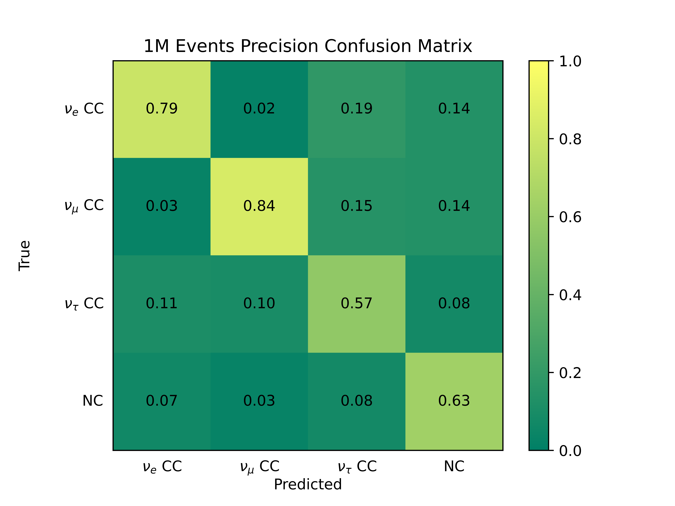
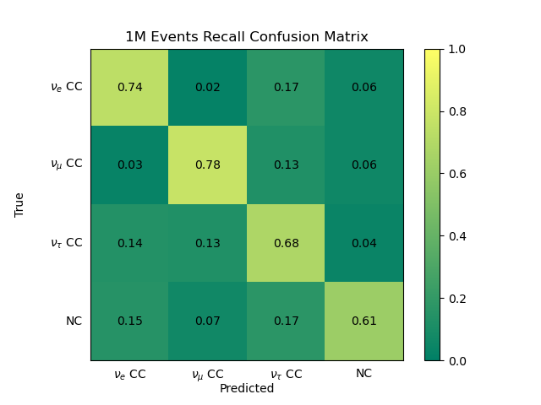
Training Results: Confusion
DUNE WORK IN PROGRESS
DUNE WORK IN PROGRESS

Slide 8
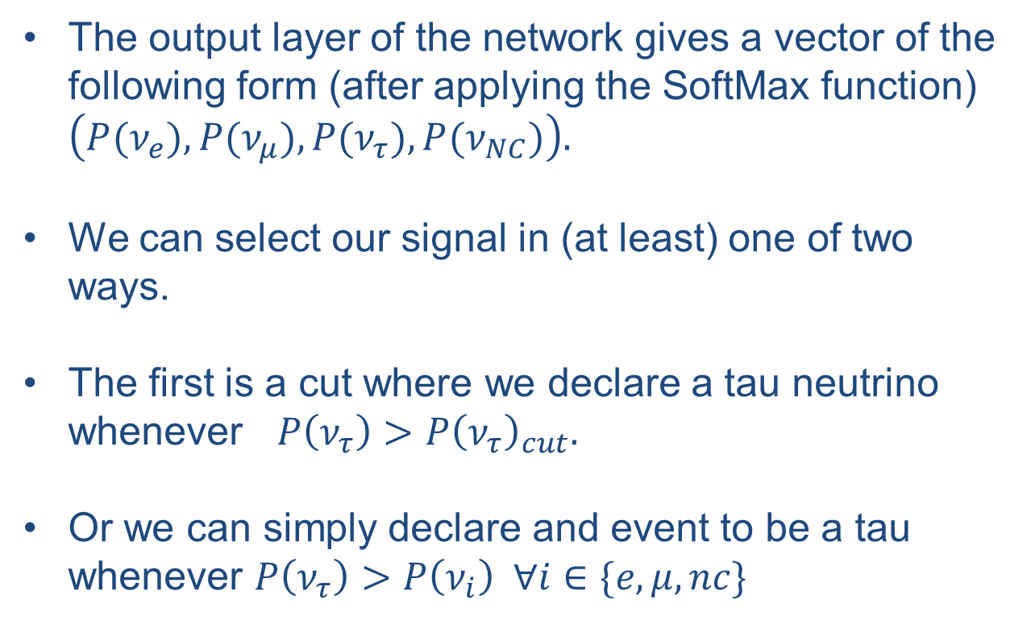
Using NuGraph For Cuts
The output layer of the network gives a vector of the following form (after applying the SoftMax function) $\left(P(ν_{e}), P(ν_{μ}),P(ν_{τ}), P(ν_{NC})\right).$
We can select our signal in (at least) one of two ways.
The first is a cut where we declare a tau neutrino whenever $P\left(ν_{τ}\right)>P{\left(ν_{τ}\right)}_{cut}.$
Or we can simply declare and event to be a tau whenever $P\left(ν_{τ}\right)>P\left(ν_{i}\right) ∀i∈\{e,μ,nc\}$

Slide 9
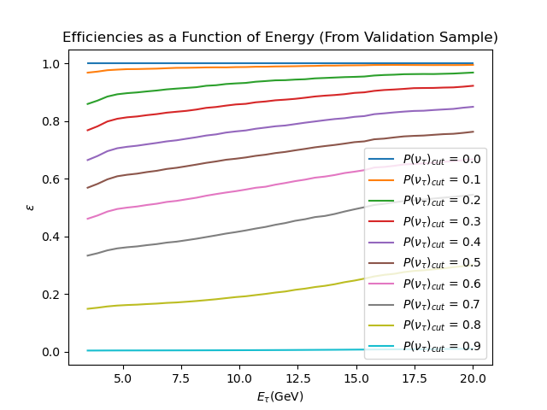
Efficiencies
We compute the tau neutrino efficiency as a function of energy. This is a good base for showing the power but we have another figure of merit (next slides)
DUNE WORK IN PROGRESS

Slide 10
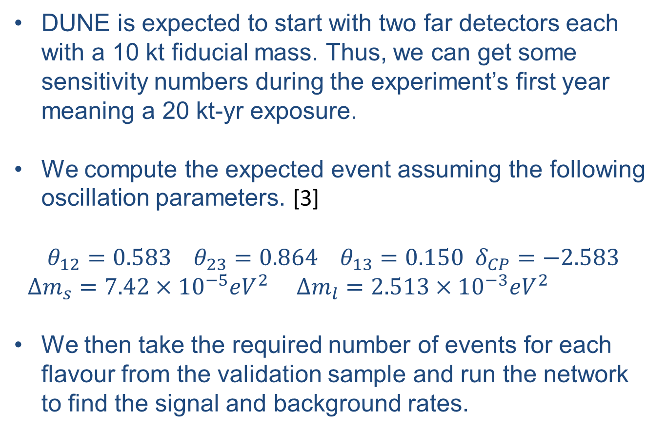
A Physics Application
DUNE is expected to start with two far detectors each with a 10 kt fiducial mass. Thus, we can get some sensitivity numbers during the experiment’s first year meaning a 20 kt-yr exposure.
We compute the expected event assuming the following oscillation parameters. [3]
$$θ_{12}=0.583{ θ}_{23}=0.864 θ_{13}=0.150 δ_{CP}=−2.583$$
$Δm_{s}=7.42×{10}^{−5}eV^{2} Δm_{l}=2.513×{10}^{−3}eV^{2}$
We then take the required number of events for each flavour from the validation sample and run the network to find the signal and background rates.

Slide 11
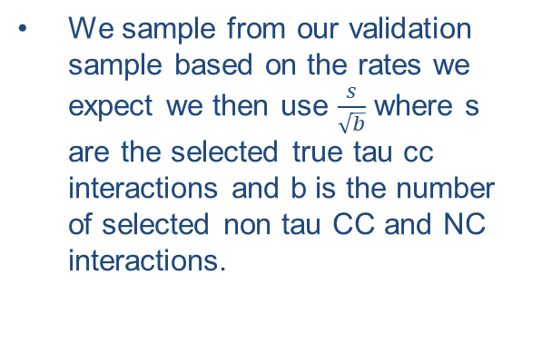
Our Figure Of Merit
We sample from our validation sample based on the rates we expect we then use $\frac{s}{\sqrt{b}}$ where s are the selected true tau cc interactions and b is the number of selected non tau CC and NC interactions.
DUNE WORK IN PROGRESS

Slide 12
Figure of Merit Ctd
Here is a scan of the figure of merit across energies and cut. As expected we get the best F.O.M at moderate tau probability and energy cuts.
DUNE WORK IN PROGRESS

Slide 13
Conclusions
We have shown that there is potential to get >1σ sensitivity to tau neutrino detection after only one year of the DUNE experiment with a standard exposure.
We have determined the ideal tau neutrino probability cuts and energy cuts from the neural networks.
We are continuing to improve the sensitivity by training the model on a sample generated with the tau optimized flux and by the addition of a term to the loss function to try to optimize the network for tau sensitivity.

Slide 14
References
[1] R. Abbasi, M. Ackermann, J. Adams, S.K. Agarwalla, J.A. Aguilar, M. Ahlers, J.M. Alameddine, N.M.Amin, K. Andeen, G. Anton, C. Arg¨uelles, Y. Ashida, S. Athanasiadou, S.N. Axani, X. Bai, V.A. Balagopal,M. Baricevic, S.W. Barwick, V. Basu, R. Bay, J.J. Beatty, J. Becker Tjus, J. Beise, C. Bellenghi, C. Benning,S. BenZvi, D. Berley, E. Bernardini, D.Z. Besson, E. Blaufuss, S. Blot, F. Bontempo, J.Y. Book, C. Bos-colo Meneguolo, S. B¨oser, O. Botner, J. B¨ottcher, E. Bourbeau, J. Braun, B. Brinson, J. Brostean-Kaiser,R.T. Burley, R.S. Busse, D. Butterfield, M.A. Campana, K. Carloni, E.G. Carnie-Bronca, S. Chattopadhyay,N. Chau, C. Chen, Z. Chen, D. Chirkin, S. Choi, B.A. Clark, L. Classen, A. Coleman, G.H. Collin, A. Con-nolly, J.M. Conrad, P. Coppin, P. Correa, D.F. Cowen, P. Dave, C. De Clercq, J.J. DeLaunay, D. Delgado,S. Deng, K. Deoskar, A. Desai, P. Desiati, K.D. de Vries, G. de Wasseige, T. DeYoung, A. Diaz, J.C. D´ıaz-V´elez, M. Dittmer, A. Domi, H. Dujmovic, M.A. DuVernois, T. Ehrhardt, P. Eller, E. Ellinger, S. El Mentawi,D. Els¨asser, R. Engel, H. Erpenbeck, J. Evans, P.A. Evenson, K.L. Fan, K. Fang, K. Farrag, A.R. Fazely,N. Feigl, S. Fiedlschuster, A.T. Fienberg, C. Finley, L. Fischer, D. Fox, A. Franckowiak, A. Fritz, P. F¨urst,J. Gallagher, E. Ganster, A. Garcia, L. Gerhardt, A. Ghadimi, C. Glaser, T. Glauch, T. Gl¨usenkamp,N. Goehlke, J.G. Gonzalez, S. Goswami, D. Grant, S.J. Gray, O. Gries, S. Griffin, S. Griswold, K.M. Groth,C. G¨unther, P. Gutjahr, C. Haack, A. Hallgren, R. Halliday, L. Halve, F. Halzen, H. Hamdaoui, M. Ha Minh,K. Hanson, J. Hardin, A.A. Harnisch, P. Hatch, A. Haungs, K. Helbing, J. Hellrung, F. Henningsen, L. Heuer-mann, N. Heyer, S. Hickford, A. Hidvegi, C. Hill, G.C. Hill, K.D. Hoffman, S. Hori, K. Hoshina, W. Hou,T. Huber, K. Hultqvist, M. H¨unnefeld, R. Hussain, K. Hymon, S. In, A. Ishihara, M. Jacquart, O. Janik,M. Jansson, G.S. Japaridze, M. Jeong, M. Jin, B.J.P. Jones, D. Kang, W. Kang, X. Kang, A. Kappes,D. Kappesser, L. Kardum, T. Karg, M. Karl, A. Karle, U. Katz, M. Kauer, J.L. Kelley, A. Khatee Zathul,A. Kheirandish, J. Kiryluk, S.R. Klein, A. Kochocki, R. Koirala, H. Kolanoski, T. Kontrimas, L. K¨opke,C. Kopper, D.J. Koskinen, P. Koundal, M. Kovacevich, M. Kowalski, T. Kozynets, J. Krishnamoorthi,K. Kruiswijk, E. Krupczak, A. Kumar, E. Kun, N. Kurahashi, N. Lad, C. Lagunas Gualda, M. Lam-oureux, M.J. Larson, S. Latseva, F. Lauber, J.P. Lazar, J.W. Lee, K. Leonard DeHolton, A. Leszczy´nska,M. Lincetto, Q.R. Liu, M. Liubarska, E. Lohfink, C. Love, C.J. Lozano Mariscal, F. Lucarelli, W. Luszczak,Y. Lyu, J. Madsen, K.B.M. Mahn, Y. Makino, E. Manao, S. Mancina, W. Marie Sainte, I.C. Mari¸s, S. Marka,Z. Marka, M. Marsee, I. Martinez-Soler, R. Maruyama, F. Mayhew, T. McElroy, F. McNally, J.V. Mead,K. Meagher, S. Mechbal, A. Medina, M. Meier, Y. Merckx, L. Merten, J. Micallef, J. Mitchell, T. Montaruli,R.W. Moore, Y. Morii, R. Morse, M. Moulai, T. Mukherjee, R. Naab, R. Nagai, M. Nakos, U. Naumann,J. Necker, A. Negi, M. Neumann, H. Niederhausen, M.U. Nisa, A. Noell, A. Novikov, S.C. Nowicki, A. Ober-tacke Pollmann, V. O’Dell, M. Oehler, B. Oeyen, A. Olivas, R. Orsoe, J. Osborn, E. O’Sullivan, H. Pandya,D.V. Pankova, N. Park, G.K. Parker, E.N. Paudel, L. Paul, C. P´erez de los Heros, J. Peterson, S. Philip-pen, A. Pizzuto, M. Plum, A. Pont´en, Y. Popovych, M. Prado Rodriguez, B. Pries, R. Procter-Murphy,G.T. Przybylski, C. Raab, J. Rack-Helleis, K. Rawlins, Z. Rechav, A. Rehman, P. Reichherzer, G. Renzi,E. Resconi, S. Reusch, W. Rhode, B. Riedel, A. Rifaie, E.J. Roberts, S. Robertson, S. Rodan, G. Roellinghoff,M. Rongen, C. Rott, T. Ruhe, L. Ruohan, D. Ryckbosch, I. Safa, J. Saffer, D. Salazar-Gallegos, P. Sam-pathkumar, S.E. Sanchez Herrera, A. Sandrock, M. Santander, S. Sarkar, S. Sarkar, J. Savelberg, P. Savina,M. Schaufel, H. Schieler, S. Schindler, L. Schlickmann, B. Schl¨uter, F. Schl¨uter, N. Schmeisser, T. Schmidt,J. Schneider, F.G. Schr¨oder, L. Schumacher, G. Schwefer, S. Sclafani, D. Seckel, M. Seikh, S. Seunarine,R. Shah, A. Sharma, S. Shefali, N. Shimizu, M. Silva, B. Skrzypek, B. Smithers, R. Snihur, J. Soedingrekso,A. Søgaard, D. Soldin, P. Soldin, G. Sommani, C. Spannfellner, G.M. Spiczak, M. Stamatikos, T. Stanev,3T. Stezelberger, T. St¨urwald, T. Stuttard, G.W. Sullivan, I. Taboada, S. Ter-Antonyan, M. Thiesmeyer,W.G. Thompson, J. Thwaites, S. Tilav, K. Tollefson, C. T¨onnis, S. Toscano, D. Tosi, A. Trettin, C.F. Tung,R. Turcotte, J.P. Twagirayezu, B. Ty, M.A. Unland Elorrieta, A.K. Upadhyay, K. Upshaw, N. Valtonen-Mattila, J. Vandenbroucke, N. van Eijndhoven, D. Vannerom, J. van Santen, J. Vara, J. Veitch-Michaelis,M. Venugopal, M. Vereecken, S. Verpoest, D. Veske, A. Vijai, C. Walck, C. Weaver, P. Weigel, A. Weindl,J. Weldert, A.Y. Wen, C. Wendt, J. Werthebach, M. Weyrauch, N. Whitehorn, C.H. Wiebusch, N. Willey,D.R. Williams, L. Witthaus, A. Wolf, M. Wolf, G. Wrede, X.W. Xu, J.P. Yanez, E. Yildizci, S. Yoshida,R. Young, F. Yu, S. Yu, Z. Zhang, P. Zhelnin, P. Zilberman, and M. Zimmerman. Observation of sevenastrophysical tau neutrino candidates with icecube. Physical Review Letters, 132(15), April 2024.

Slide 15
References
[2] Roshan Mammen Abraham, Jaime Alvarez-Mu˜niz, Carlos A Arg¨uelles, Akitaka Ariga, Tomoko Ariga, AdamAurisano, Dario Autiero, Mary Bishai, Nilay Bostan, Mauricio Bustamante, Austin Cummings, ValentinDecoene, Andr´e de Gouvˆea, Giovanni De Lellis, Albert De Roeck, Peter B Denton, Antonia Di Crescenzo,Milind V Diwan, Yasaman Farzan, Anatoli Fedynitch, Jonathan L Feng, Laura J Fields, Alfonso Garcia,Maria Vittoria Garzelli, Julia Gehrlein, Christian Glaser, Katarzyna Grzelak, Steffen Hallmann, JeremyHewes, D Indumathi, Ahmed Ismail, Sudip Jana, Yu Seon Jeong, Kevin J Kelly, Spencer R Klein, Fe-lix Kling, Thomas Kosc, Umut Kose, D Jason Koskinen, John Krizmanic, Jeff Lazar, Yichen Li, IvanMartinez-Soler, Irina Mocioiu, Jiwoo Nam, Valentin Niess, Nepomuk Otte, Sameer Patel, Roberto Petti,Remy L Prechelt, Steven Prohira, Miriama Rajaoalisoa, Mary Hall Reno, Ibrahim Safa, Carlos Sarasty-Segura, R Thiru Senthil, Juliana Stachurska, Oleksandr Tomalak, Sebastian Trojanowski, Roger AlexandreWendell, Dawn Williams, Stephanie Wissel, Barbara Yaeggy, Enrique Zas, Pavel Zhelnin, and Jing-yu Zhu.Tau neutrinos in the next decade: from gev to eev. Journal of Physics G: Nuclear and Particle Physics,49(11):110501, October 2022.
[3] N. Agafonova, A. Alexandrov, A. Anokhina, S. Aoki, A. Ariga, T. Ariga, A. Bertolin, C. Bozza, R. Brugnera,A. Buonaura, S. Buontempo, M. Chernyavskiy, A. Chukanov, L. Consiglio, N. D’Ambrosio, G. De Lellis,M. De Serio, P. del Amo Sanchez, A. Di Crescenzo, D. Di Ferdinando, N. Di Marco, S. Dmitrievsky,M. Dracos, D. Duchesneau, S. Dusini, T. Dzhatdoev, J. Ebert, A. Ereditato, J. Favier, R.A. Fini, F. Fornari,T. Fukuda, G. Galati, A. Garfagnini, V. Gentile, J. Goldberg, S. Gorbunov, Y. Gornushkin, G. Grella,A.M. Guler, C. Gustavino, C. Hagner, T. Hara, T. Hayakawa, A. Hollnagel, K. Ishiguro, A. Iuliano,K. Jakovcic, C. Jollet, C. Kamiscioglu, M. Kamiscioglu, S.H. Kim, N. Kitagawa, B. Klicek, K. Kodama,M. Komatsu, U. Kose, I. Kreslo, F. Laudisio, A. Lauria, A. Ljubicic, A. Longhin, P. Loverre, M. Malenica,A. Malgin, G. Mandrioli, T. Matsuo, V. Matveev, N. Mauri, E. Medinaceli, A. Meregaglia, S. Mikado,M. Miyanishi, F. Mizutani, P. Monacelli, M.C. Montesi, K. Morishima, M.T. Muciaccia, N. Naganawa,T. Naka, M. Nakamura, T. Nakano, K. Niwa, S. Ogawa, N. Okateva, A. Olchevsky, K. Ozaki, A. Paoloni,L. Paparella, B.D. Park, L. Pasqualini, A. Pastore, L. Patrizii, H. Pessard, C. Pistillo, D. Podgrudkov,N. Polukhina, M. Pozzato, F. Pupilli, M. Roda, T. Roganova, H. Rokujo, G. Rosa, O. Ryazhskaya,A. Sadovsky, O. Sato, A. Schembri, I. Shakiryanova, T. Shchedrina, E. Shibayama, H. Shibuya, T. Shiraishi,S. Simone, C. Sirignano, G. Sirri, A. Sotnikov, M. Spinetti, L. Stanco, N. Starkov, S.M. Stellacci, M. Stipce-vic, P. Strolin, S. Takahashi, M. Tenti, F. Terranova, V. Tioukov, S. Tufanli, A. Ustyuzhanin, S. Vasina,P. Vilain, E. Voevodina, L. Votano, J.L. Vuilleumier, G. Wilquet, B. Wonsak, and C.S. Yoon. Finalresults of the opera experiment on ¡mml:math xmlns:mml=”http://www.w3.org/1998/math/mathml” dis-play=”inline”¿¡mml:msub¿¡mml:mi¿¡/mml:mi¿¡mml:mi¿¡/mml:mi¿¡/mml:msub¿¡/mml:math¿ appearancein the cngs neutrino beam. Physical Review Letters, 120(21), May 2018.
[4] DUNE Collaboration. The dune far detector interim design report volume 1: Physics, technology andstrategies, 2018.
[5] Ivan Esteban, M.C. Gonzalez-Garcia, Michele Maltoni, Thomas Schwetz, and Albert Zhou. The fate ofhints: updated global analysis of three-flavor neutrino oscillations. Journal of High Energy Physics, 2020(9),September 2020.
[6] K. Kodama, N. Ushida, C. Andreopoulos, N. Saoulidou, G. Tzanakos, P. Yager, B. Baller, D. Boehnlein,W. Freeman, B. Lundberg, J. Morfin, R. Rameika, S. H. Chung, J. S. Song, C. S. Yoon, P. Berghaus,M. Kubantsev, N. W. Reay, R. Sidwell, N. Stanton, S. Yoshida, S. Aoki, T. Hara, J. T. Rhee, D. Ciampa,C. Erickson, M. Graham, E. Maher, K. Heller, R. Rusack, R. Schwienhorst, J. Sielaff, J. Trammell, J. Wilcox,T. Furukawa, K. Hoshino, H. Jiko, M. Komatsu, M. Nakamura, T. Nakano, K. Niwa, N. Nonaka, K. Okada,B. D. Park, O. Sato, S. Takahashi, V. Paolone, C. Rosenfeld, A. Kulik, T. Kafka, W. Oliver, T. Patzak,and J. Schneps. Final tau-neutrino results from the donut experiment. Physical Review D, 78(5), September2008.
[7] Pedro Machado, Holger Schulz, and Jessica Turner. Tau neutrinos at dune: New strategies, new opportuni-ties. Physical Review D, 102(5), September 2020.
[8] Stephen Parke and Mark Ross-Lonergan. Unitarity and the three flavor neutrino mixing matrix. PhysicalReview D, 93(11), June 2016.

Slide 16
Thank You!

Slide 17
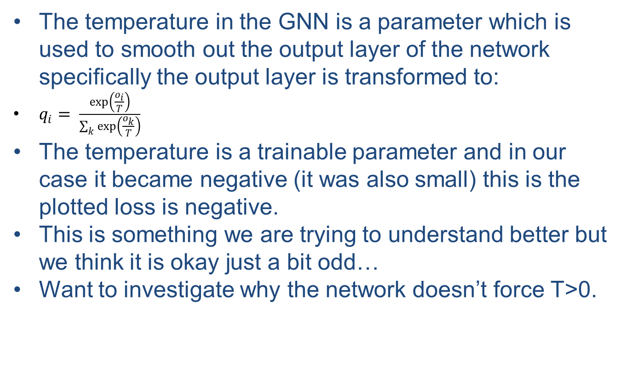
Backup Slide 1 GNN Temp
The temperature in the GNN is a parameter which is used to smooth out the output layer of the network specifically the output layer is transformed to:
$q_{i}= \frac{\exp\left(\frac{o_{i}}{T}\right)}{\sum_{k}{\exp\left(\frac{o_{k}}{T}\right)}}$
The temperature is a trainable parameter and in our case it became negative (it was also small) this is the plotted loss is negative.
This is something we are trying to understand better but we think it is okay just a bit odd…
Want to investigate why the network doesn’t force T>0.

Slide 18
Backup Slide 2 Global P and R
In our plots of the precision and recall they are both the same.
The reason for this is that here we are plotting global versions of these which are defined in the same way for both and are defined as #(Correctly Classified Events)/(#(Correctly Classified Events) + #(Incorrectly Classified Events))

Slide 19
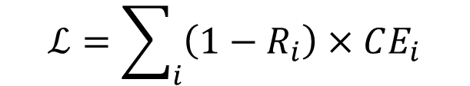
Training Details
We split our 1M events into a train/test/validation splits at rates of 90%/5%/5%.
We use the categorical cross entropy loss here where i indexes the category and R is the recall (efficiency).
This is called the recall loss see here () and is meant to compensate for slight differences in the rates of each category
$$ℒ=\sum_{i}{\left(1−R_{i}\right)×CE_{i}}$$

Slide 20
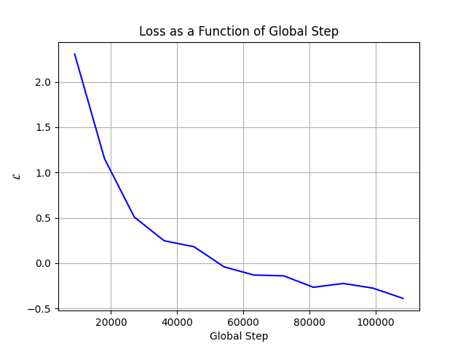

Training Results: Loss
The recall loss as a function of global step. Note that the loss plotted here is actually $2e^{−T}×ℒ+T$

Slide 21
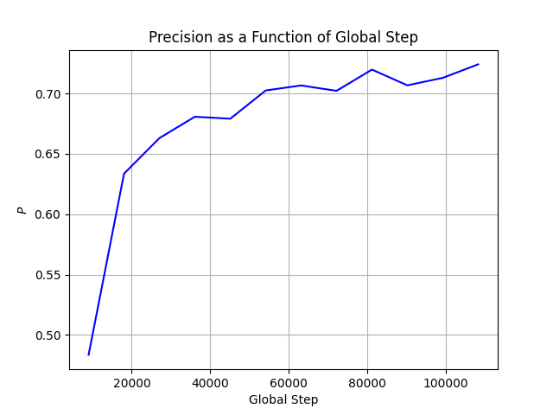
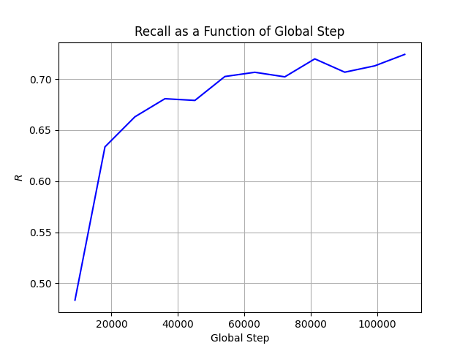
Precision and Recall
Precision (left) and recall (right) as a function of the global step

