Slide 1
T2K Beamline Studies with the Muon Monitor
Ian Heitkamp – T2K Beam Group
Tohoku University
heitkamp.ian.benjamin.q1@dc.tohoku.ac.jp

Slide 2
Contents
T2K Beamline:
T2K experiment & beamline overview
Muon Monitor overview
New Studies:
Beamline component alignment
Machine learning prediction of proton beam

Slide 3
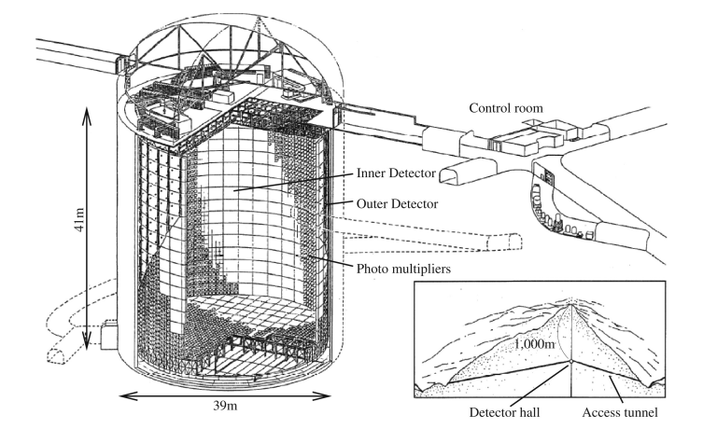
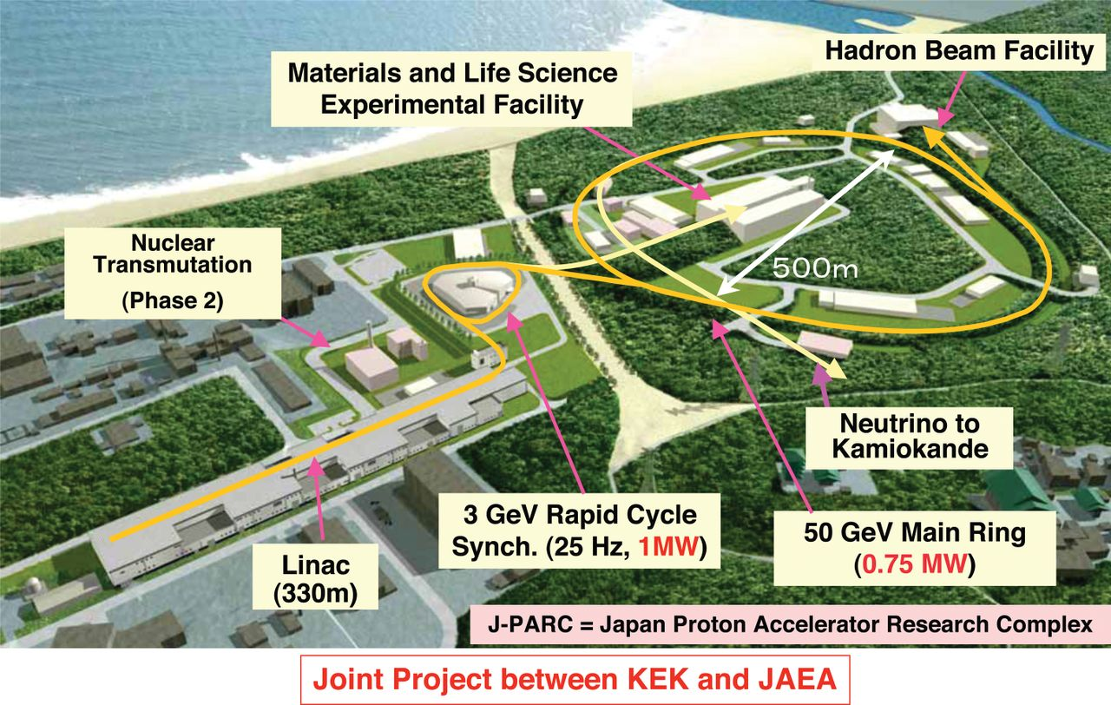
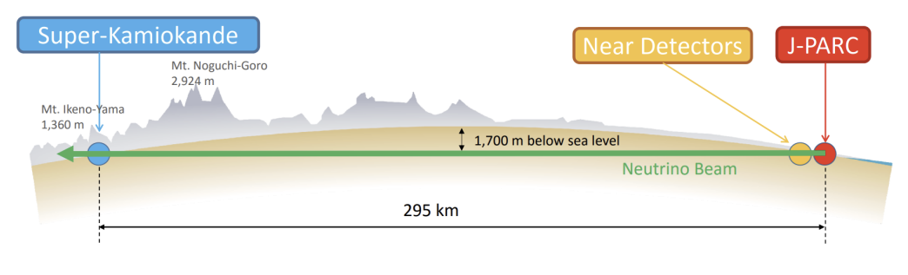
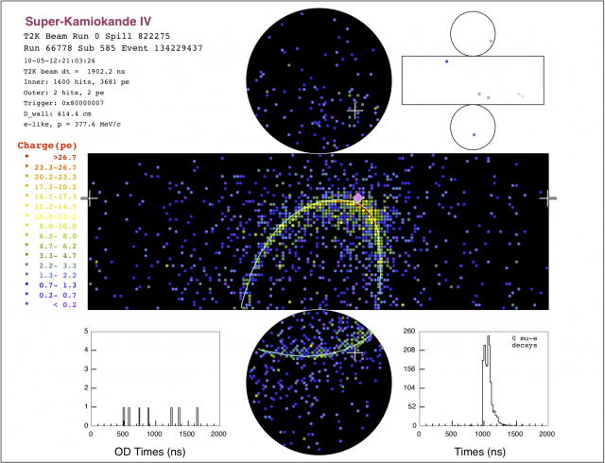
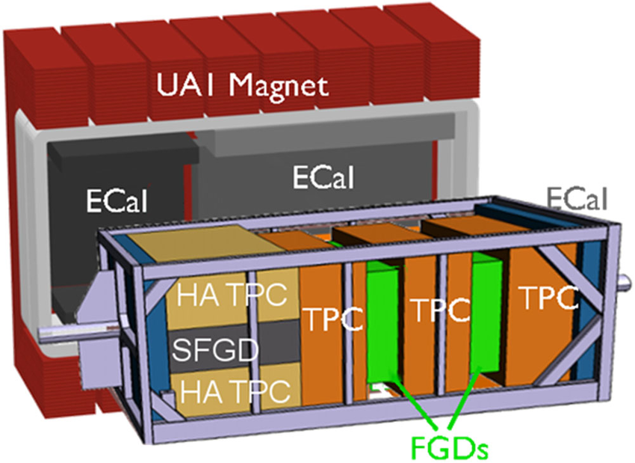
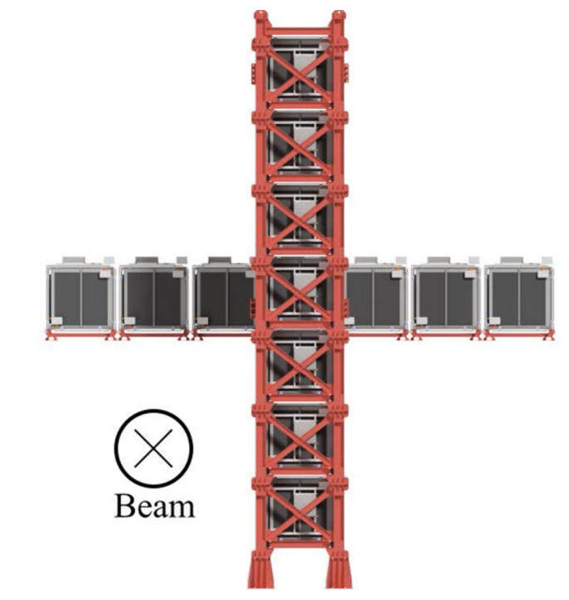
T2K Experiment
Long baseline accelerator neutrino oscillation experiment in Japan
Neutrino/Antineutrino beam created at J-PARC with 30 GeV proton beam
Detected 280 m downstream (unoscillated) at the near detectors and 295 km away (after oscillations) by Super Kamiokande via Cherenkov radiation
Upgraded near detector suite
2.5 degrees off axis
On axis neutrino detector

Slide 4
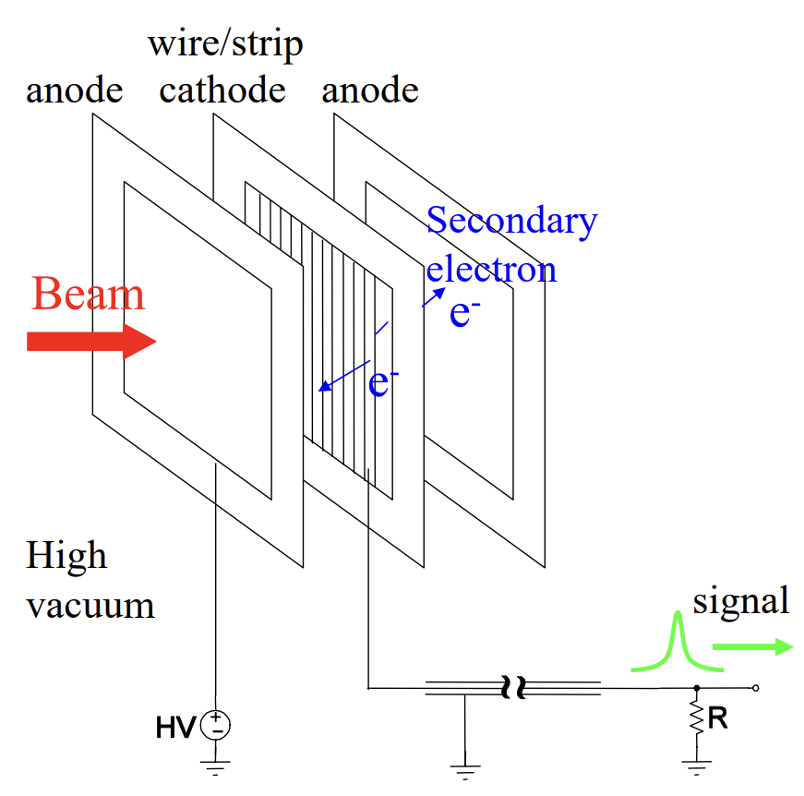
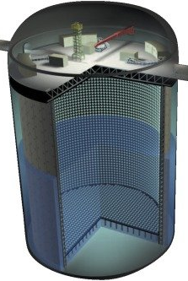
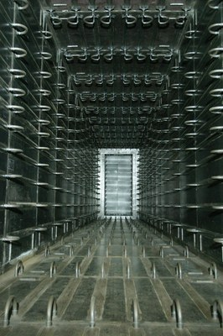
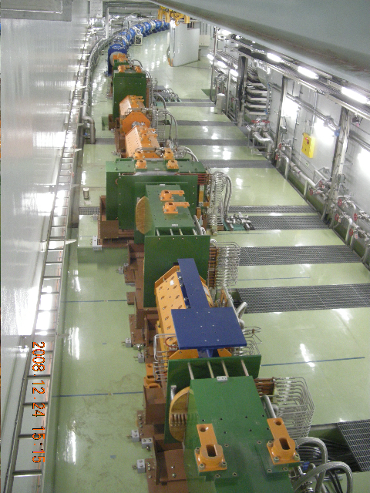
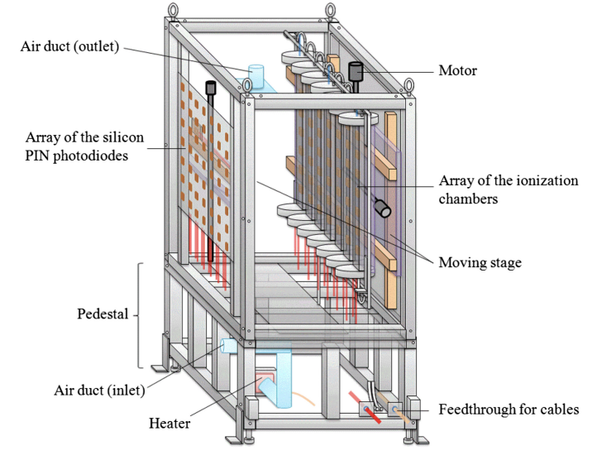
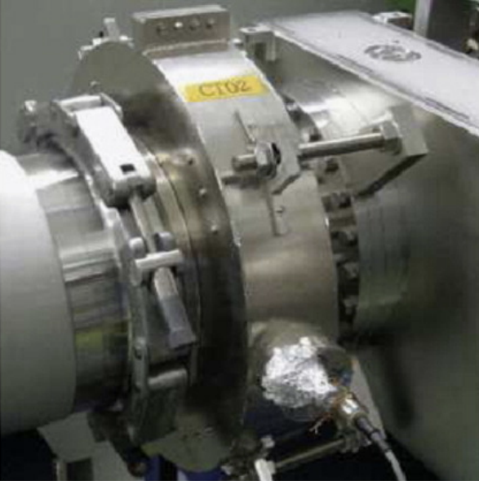
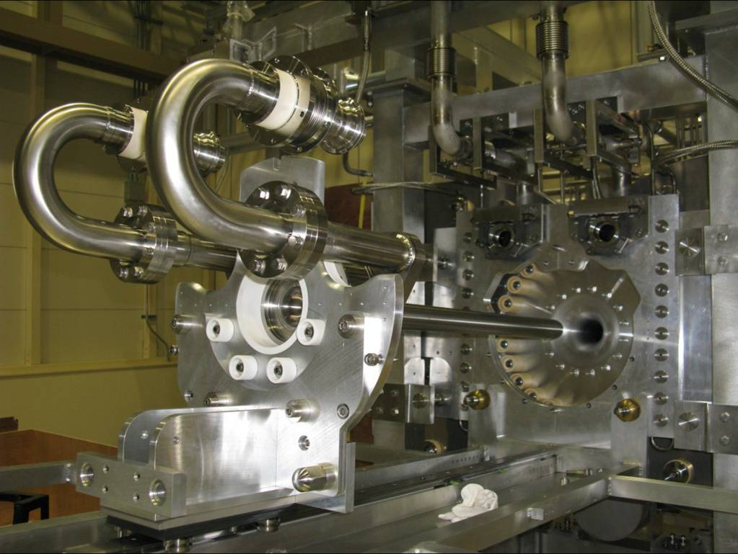




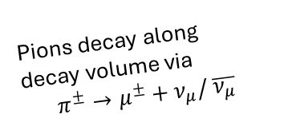


Neutrino Beam Production
*Distances not to scale
Segmented Secondary
Emission Monitor (SSEM):
Proton beam profile
Optical Transition
Radiation Monitor (OTR)
Pions decay along decay volume via
$$π^{±}→μ^{±}+ν_{μ}/ \overline{ν_{μ}}$$
To ND/SK
Final Focusing Magnets
$ν_{μ}$/$\overline{ν_{μ}}$
Focusing Horns
$$π^{±}$$
$2.5$゜
$$K^{±}$$
$$μ^{±}$$
30 GeV Proton Beam
Beam Dump
Target
Current Transformer:
# of protons
Collimator
(Baffle)
$$π^{∓}$$
Wrong sign pions
are defocused
Muon monitor

Slide 5
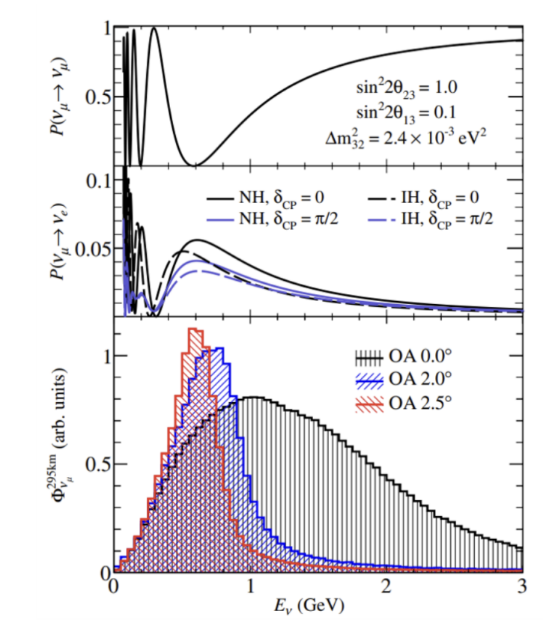
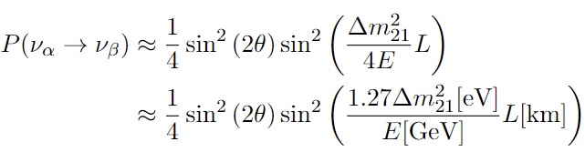
Off Axis Method
SK is located 2.5 degrees off beam axis
We can restrict neutrino energy to near oscillation maximum
Off axis angle (and thus neutrino beam direction) must be well controlled
2 neutrino oscillation probability

Slide 6
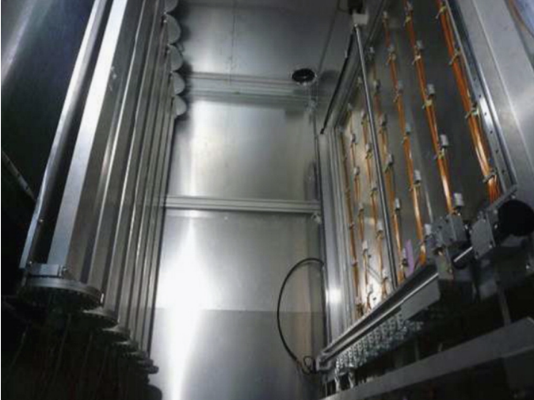
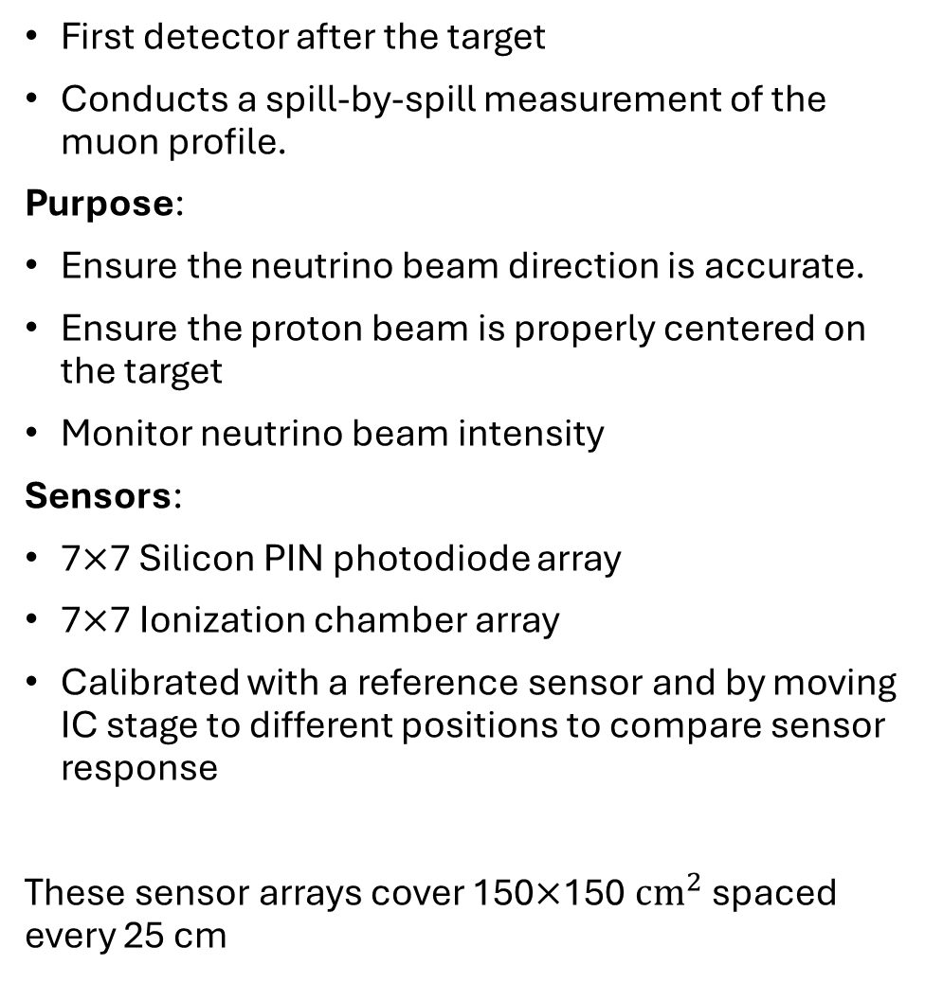
Muon Monitor - Overview
First detector after the target
Conducts a spill-by-spill measurement of the muon profile.
Purpose:
Ensure the neutrino beam direction is accurate.
Ensure the proton beam is properly centered on the target
Monitor neutrino beam intensity
Sensors:
7$×$7 Silicon PIN photodiode array
7$×$7 Ionization chamber array
Calibrated with a reference sensor and by moving IC stage to different positions to compare sensor response
These sensor arrays cover 150$×$150 ${cm}^{2}$ spaced every 25 cm
Muons <5 GeV are cut off in beam dump
Beam direction
*mirrored to match beam direction
Beam direction

Slide 7
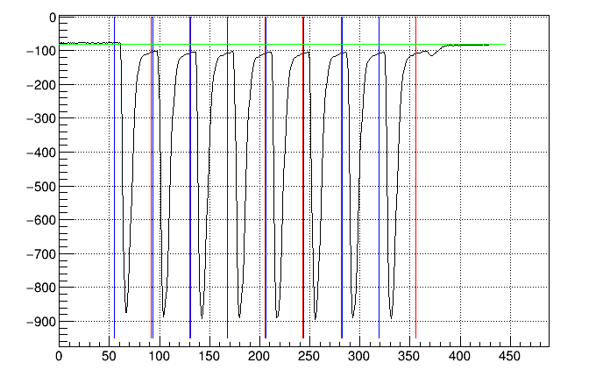
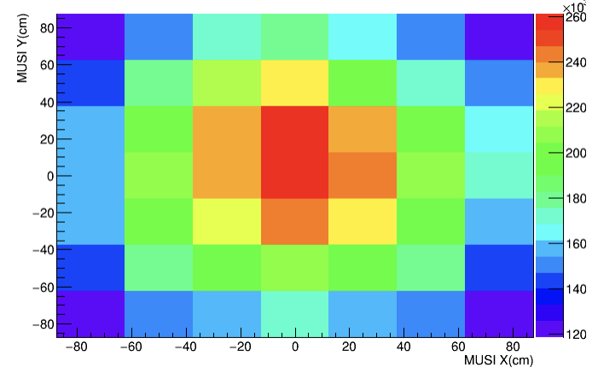
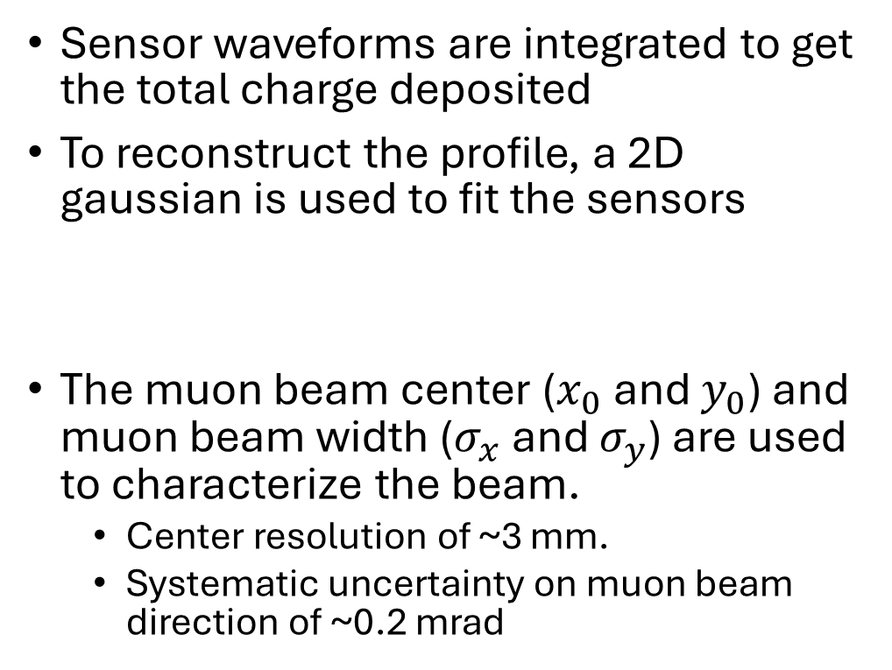
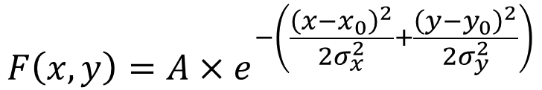
Muon Monitor – Methods
Sensor waveforms are integrated to get the total charge deposited
To reconstruct the profile, a 2D gaussian is used to fit the sensors
The muon beam center ($x_{0}$ and $y_{0}$) and muon beam width ($σ_{x}$ and $σ_{y}$) are used to characterize the beam.
  Center resolution of ~3 mm.
  Systematic uncertainty on muon beam direction of ~0.2 mrad
Example SI waveform
Pedestal
ADC count
$$F\left(x,y\right)={A×e}^{−\left(\frac{{\left(x−x_{0}\right)}^{2}}{2σ_{x}^{2}}+\frac{{\left(y−y_{0}\right)}^{2}}{2σ_{y}^{2}}\right)}$$
Integral windows
ADC clock cycle (~15 ns)

Slide 8
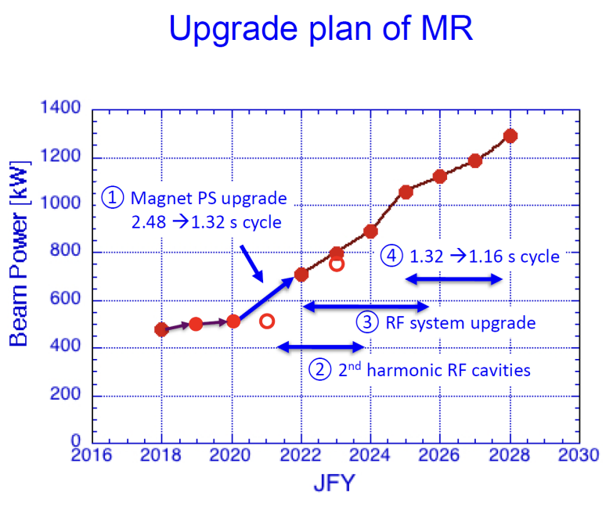
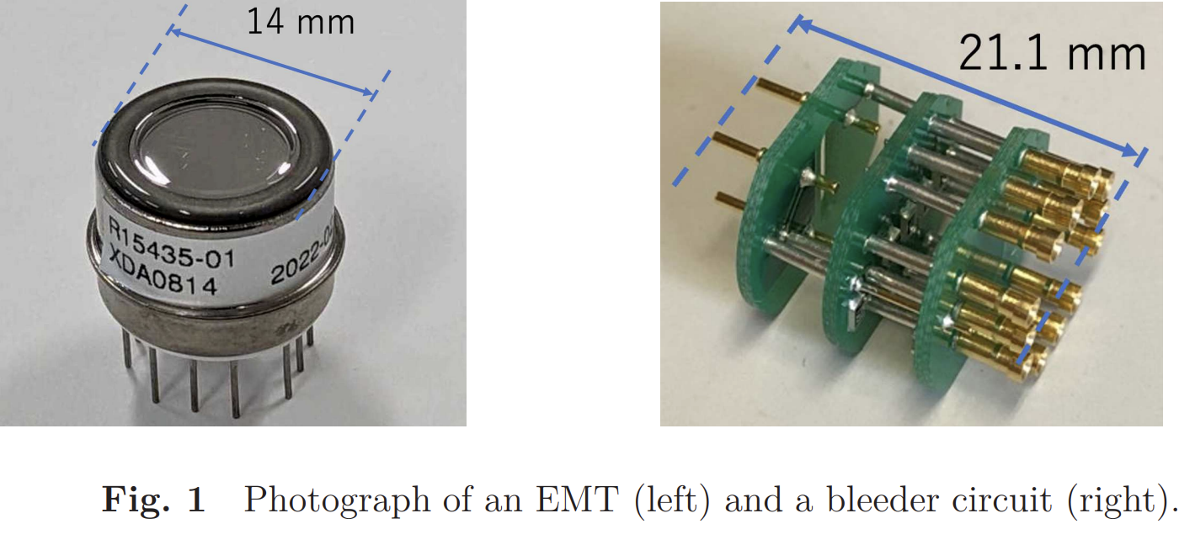
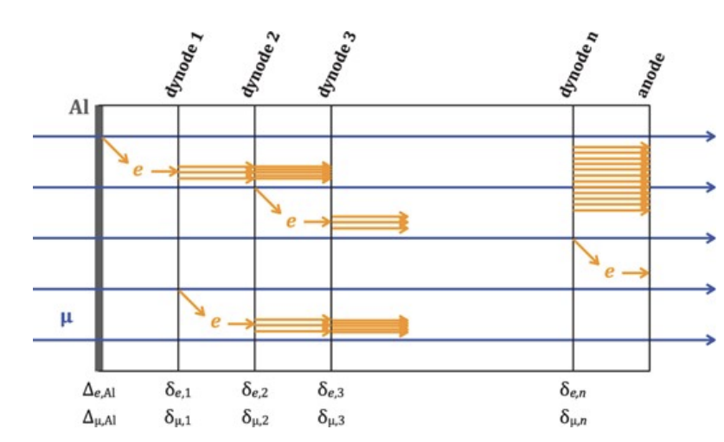
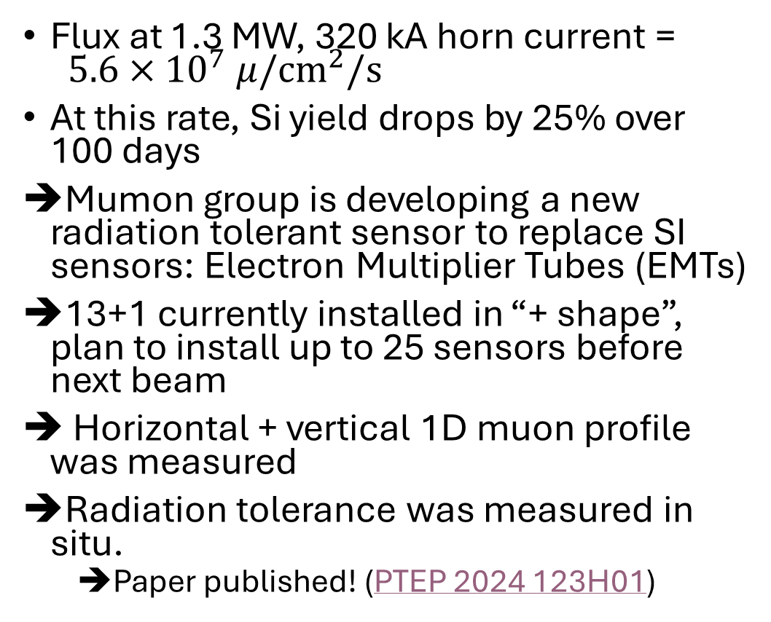
EMT Development - update
Flux at 1.3 MW, 320 kA horn current = $5.6×{10}^{7} μ/{cm}^{2}/s$
At this rate, Si yield drops by 25% over 100 days
Mumon group is developing a new radiation tolerant sensor to replace SI sensors: Electron Multiplier Tubes (EMTs)
13+1 currently installed in “+ shape”, plan to install up to 25 sensors before next beam
Horizontal + vertical 1D muon profile was measured
Radiation tolerance was measured in situ.
  Paper published! (PTEP 2024 123H01)

Slide 9
Beamline Alignment - Motivations
Ability to check component alignment in-situ is important
Target and horn alignment are important for accurate tuning and neutrino beam direction
Significantly off-center beams increases stress on target system
  Important to know target center location

Slide 10
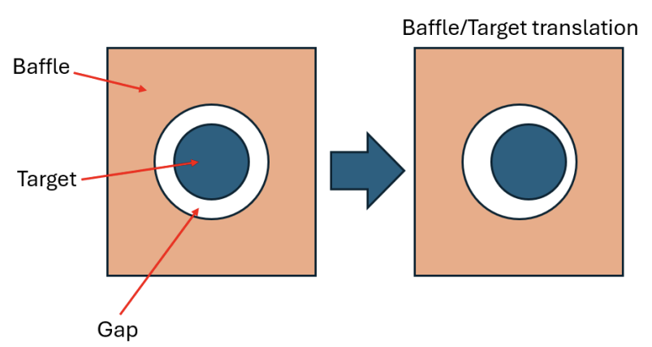
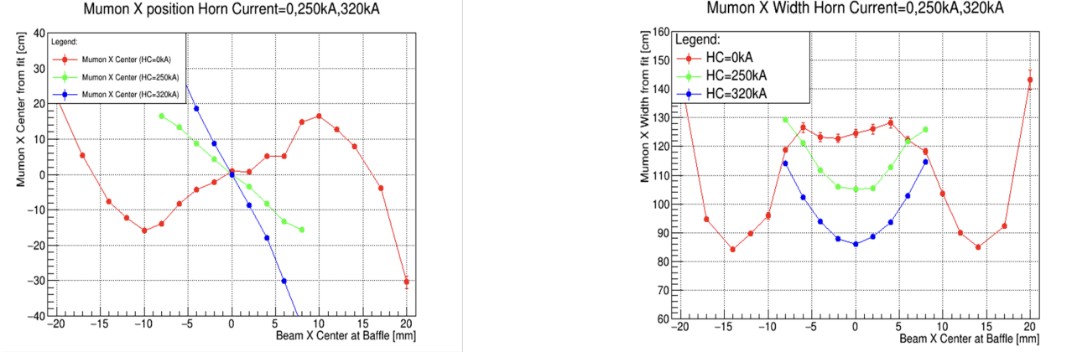
Beamline Alignment - Methods
Scan beam positions at low intensity
Measure Mumon center and width
Measurables:
Asymmetries in gap between baffle/target
Intersection point of different horn currents relates alignment of target/horn system
Simulations showing expected response for nominal geometry:
Edge of target
Mumon X Center v.s. Proton Beam X Position
Mumon X Width v.s. Proton Beam X Position
Baffle edge
Mumon X Center(cm)
Mumon X Width(cm)
Intersection point

Slide 11
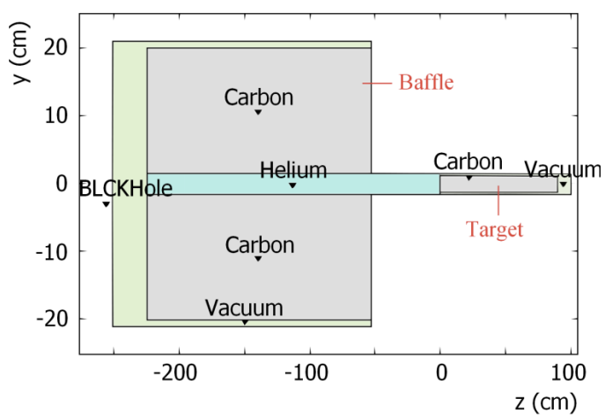
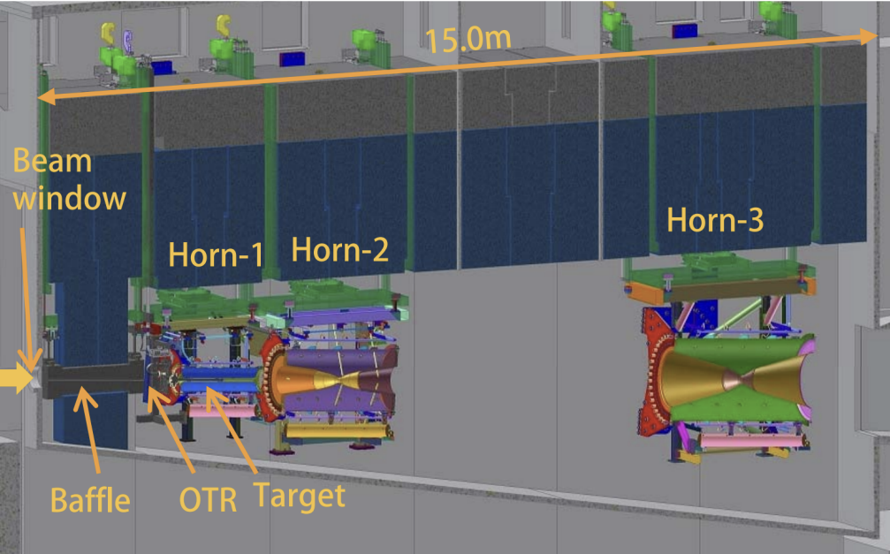
Beamline Alignment - Simulation
Simulation includes two steps, one in FLUKA then JNUBEAM (Geant3)
Particles passing through muon monitor are saved
Fluka includes baffle & target
Better hadron production model agreement
Jnubeam includes detailed geometry, horn system and magnetic fields
JNUBEAM imports particles exiting FLUKA region

Slide 12
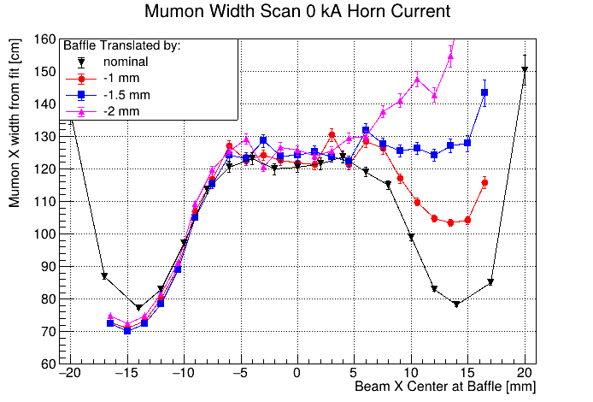
Baffle Alignment Simulations
Horn off
Asymmetric gap created if baffle/target centers are misaligned
Amount of beam missing the target is proportional to size of gap
Target
edge
Wider profile from target
Beam Dump
Offcenter
Baffle
Target
p
Baffle
edge
Narrower gaussian muon profile from protons hitting beam dump
Muon
Monitor
3 mm width proton beam
*not to scale

Slide 13
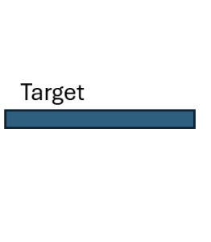
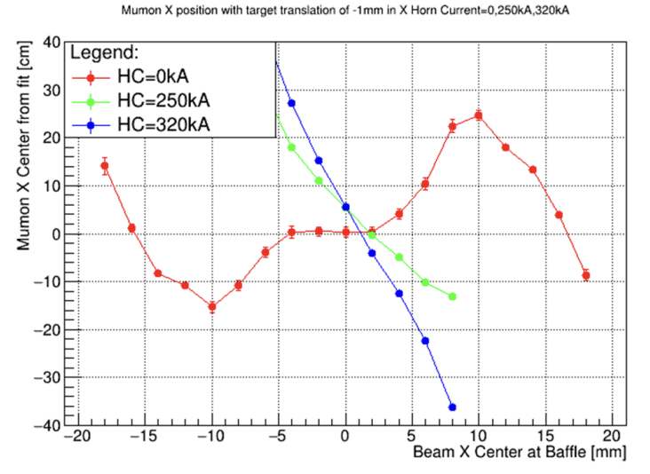
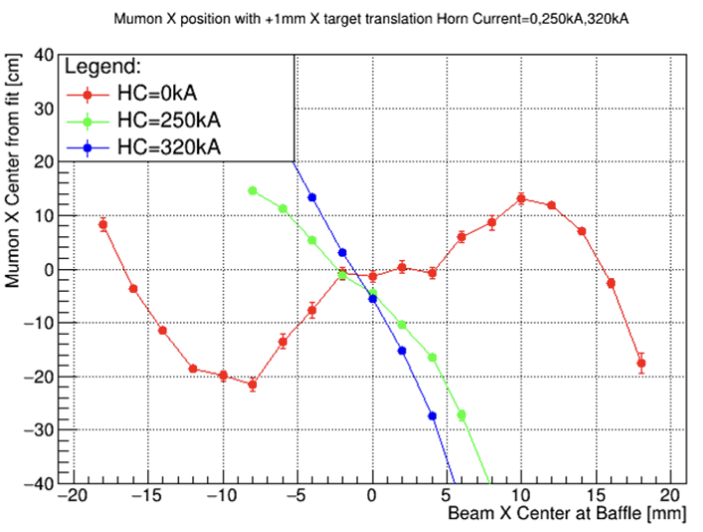


Target Alignment Simulations
Center of horn off response shifts with target shift
Intersection of horn on/off lines is no longer at 0,0
Target is installed inside horn 1, which is translated as well
Horn 2&3 axis
Mumon Center
-1 mm Target Translation
+1 mm Target Translation
Mumon X Center [cm]
Mumon X Center [cm]
Proton Beam Position [mm]
Proton Beam Position [mm]

Slide 14
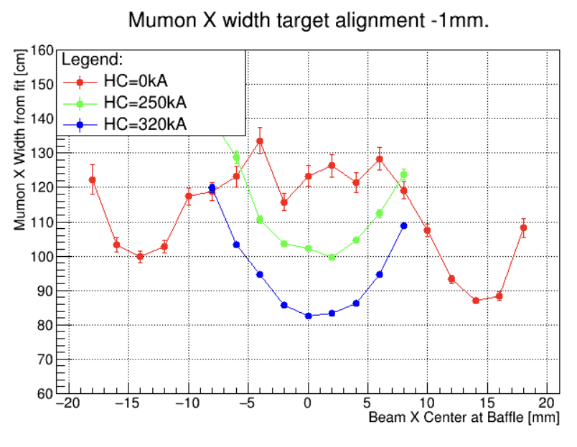
Target Translation
Width asymmetry is based off gap between baffle/target.
Opposite direction to baffle translation, but same effect
Target Translation of -1 mm in X

Slide 15
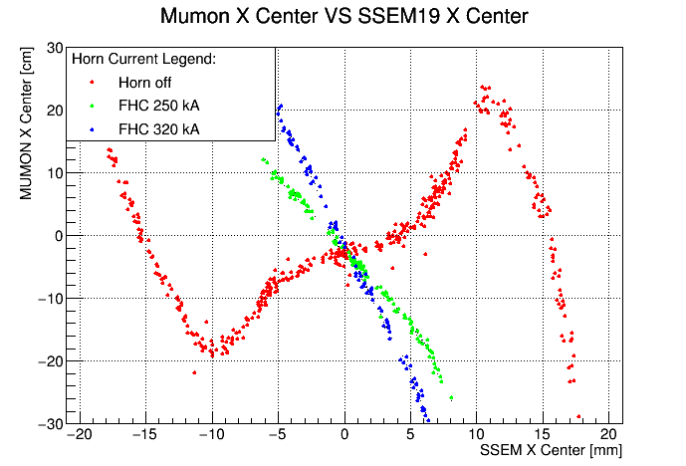
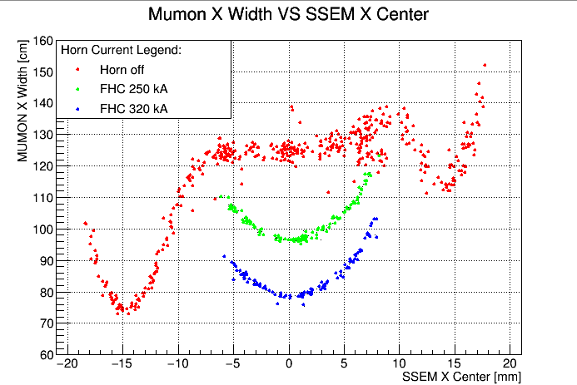
X Position Scan Data
Low intensity (~3 kW) beam is steered to position, then 10 shots are taken.
Proton beam position is measured from last profile monitor (SSEM19)
Asymmetry in width response indicates baffle/target misalignment

Slide 16
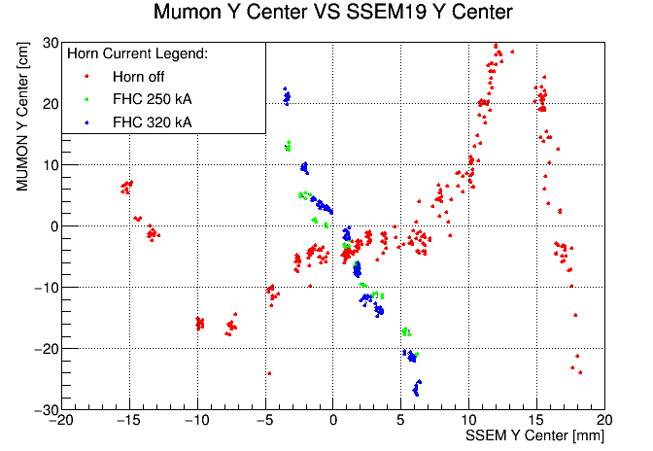
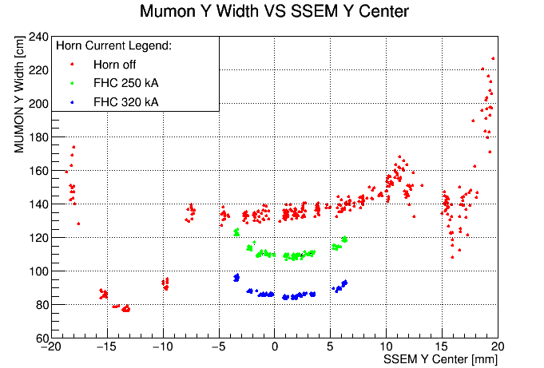
Y Position Scan Data
Low intensity (~3 kW) beam is steered to position, then 10 shots are taken.
Proton beam position is measured from last profile monitor (SSEM19)
Asymmetry in width response indicates baffle/target misalignment

Slide 17
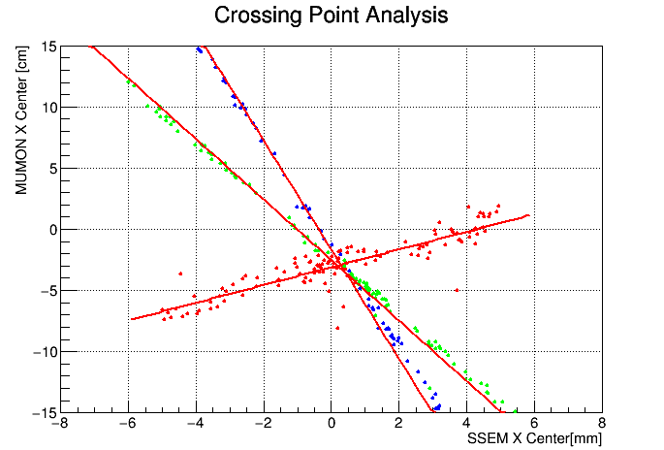
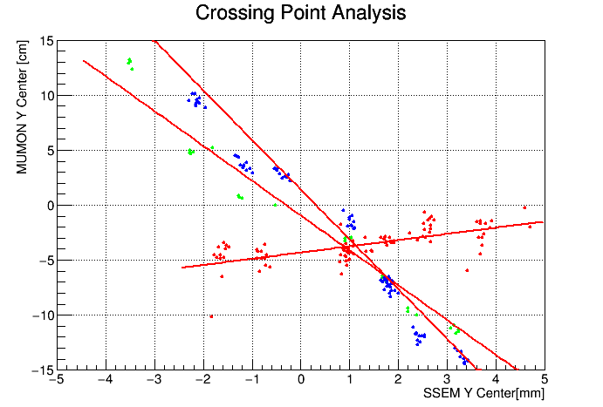
Horn On/Off intersection
+1 mm Target Translation
Mumon X Center [cm]
In X, all horn currents intersect at same point
In Y, horn off intersection is different than horn on intersection
Indicates possible target/horn offsest in Y
Proton Beam Position [mm]

Slide 18
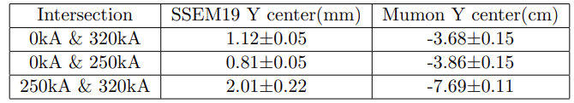
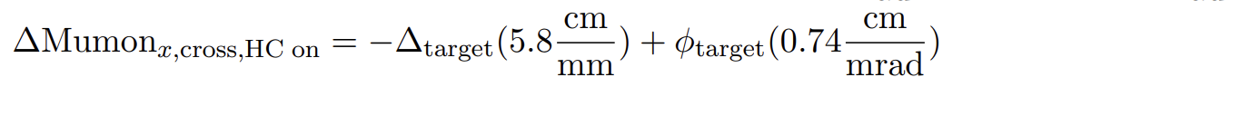
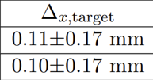


Target Translation Estimation
Note: Error is only from degenerate target angle effect (dominant) and error on intersection fit
No Significant difference in X
~0.5 mm translation predicted in Y
T2K Run 12 Intersection points
$Δ$Mumon
Run 12:
Run 13:

Slide 19
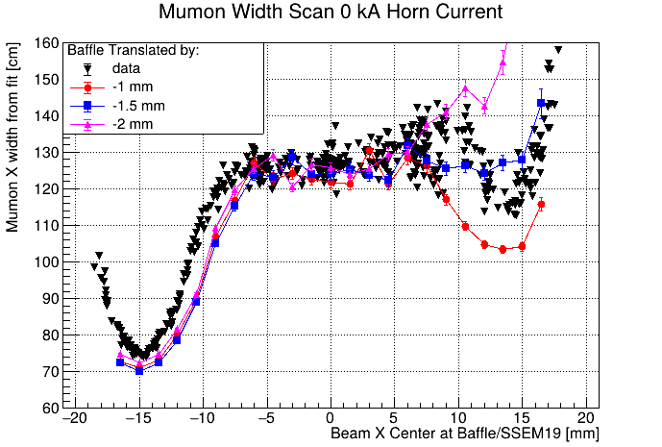
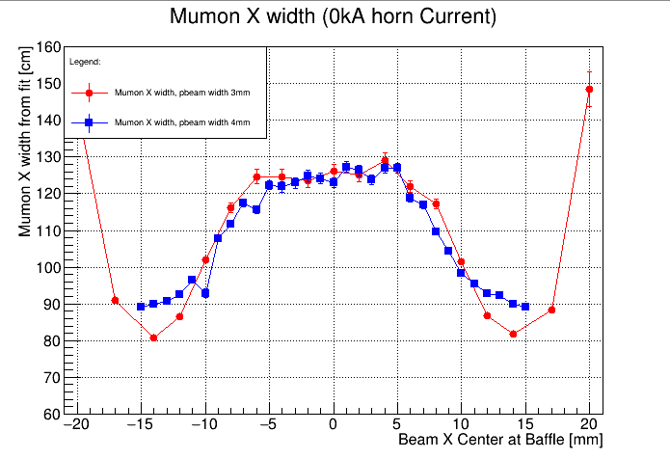
Baffle Translation Estimation
Simulation indicates translation between -1 mm and -1.5 mm baffle translation
Shape of simulation differs from data
Beam width also affects minimum Mumon width
3mm
4mm

Slide 20
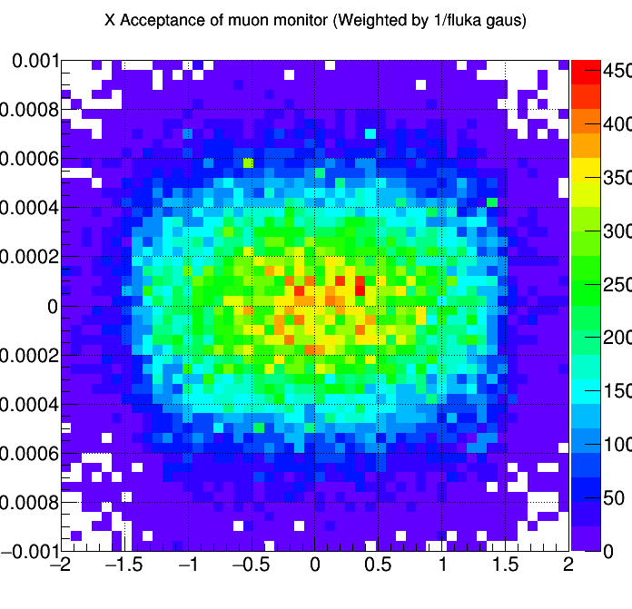
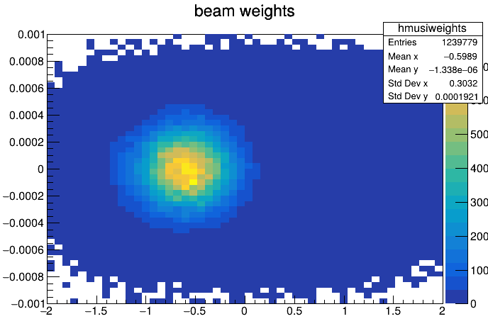
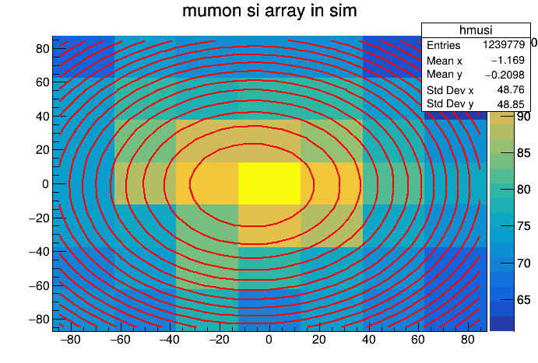
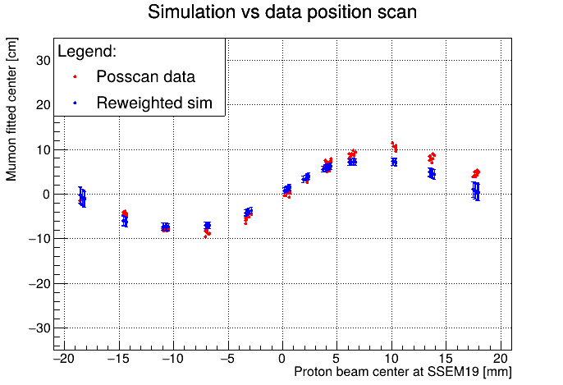

Proton Reweighting
Point-by-point simulation is limited and does not account for beam width/angle differences
Since every grid point needs to be run separately, becomes time/disk space consuming
Instead simulate a wide beam and reweight muons by their initial proton position/angle.
Method:
Weight for a muon with initial proton $i$ for beam profile $p$:
$$w_{i}={w(x_{i},y_{i})}_{x_{p},y_{p},σ_{p,x,y}}×w{\left(θ_{x,i},θ_{y,i}\right)}_{θ_{p,x,y},ε_{p,x,y}}$$
Proton beam angle
Proton beam position
Proton beam width
Simulate wide beam
Apply weights based on protons
Reweight muon profile
Fit & repeat for points in scan
Proton angle [rad]
Proton angle [rad]
Mumon Y [cm]
Proton position [cm]
Mumon X [cm]
Proton position [cm]

Slide 21






Proton Reweighting - Baffle
-0.5 mm baffle translation
-1.0 mm baffle translation
-1.5 mm baffle translation
X position scan
Width input is from SSEM19 width (not at baffle)
Angle set to 0
Statistics in total are similar to pt by pt (~10^9 protons)
-0.5 mm baffle translation
-1.0 mm baffle translation
-1.5 mm baffle translation
Sim – Data [cm]
Sim – Data [cm]
Sim – Data [cm]
Proton beam center [mm]
Proton beam center [mm]
Proton beam center [mm]

Slide 22



Comparison to Optical Survey
Surveyed baffle translation is smaller than Mumon prediction
Calculated target translation matches survey results
Simulation with baffle position from survey matches results in X
  Indicates that baffle angle has larger effect than expected
+x
direction
X Asymmetry reproduced with baffle parameters in simulation
Component misalignment | Calculated from simulation | Target station survey results
X Baffle translation | ~ -1.5 mm | -0.4 mm
Y Baffle translation | N/A | +0.65 mm
X Target translation | 0.1 $±$ 0.17 mm | +0.2 mm
Y target translation | 0.58 $±$ 0.08 mm | +0.5 mm
Simulated w/ survey baffle pos
Observed Position Scan

Slide 23
Future Plans
Conduct more simulations for Y direction misalignments
Fit proton beam for position/width/angle at baffle
  Should give more accurate proton beam values for reweighting
Test horn and target alignment
Incorporate proton beam twiss parameters
Next: Machine learning with the muon monitor

Slide 24




Machine Learning Application
Goal: Predict proton beam position/width/angle using muon monitor
No monitors between target and mumon
Good machine learning candidate: approximating multivariable fn
  Multivariable input: beam pos/angle/width
  Mumon output is some complicated function of many parameters
Y P-beam Position
Example neural network
Y P-beam angle
Charge accumulated by mumon sensor i,j: $Q_{ij}=f(x,y,θ_{x},θ_{y},σ_{x},σ_{y}, …)$

Slide 25
Summary
The muon monitor for T2K measures a spill by spill profile of the muon beam coincident with muon neutrinos
Development of Electron Multiplier Tubes is continuing for high intensity era at J-PARC
Beamline component alignment can be measured by the muon monitor
The muon monitor is a candidate for machine learning applications

Slide 26
Backup

Slide 27



Secondary Beamline – ML
Goal: Predict proton beam position/width/angle using muon monitor
No monitors between target and mumon
Good machine learning candidate: approximating multivariable fn
  Multivariable input: beam pos/angle/width
  Mumon output is some complicated function of many parameters
Mumon
Beam Dump
Proton Beam
Position
Angle
Width
Horns
Detector
Alignment,
Sensitivity,
Etc.
Target
Hadron production
Horn focusing
Charge accumulated by mumon sensor i,j: $Q_{ij}=F(x,y,θ_{x},θ_{y},σ_{x},σ_{y}, …)$
Beam dump structure

Slide 28
Training Data
Idea: incorporate a variety of conditions
Samples from “ssem all in” physics runs
  50 shots each, All beam profile monitors (SSEMs) in allows for more accurate beam angle calculation
  Variety of beam conditions from across a full run (~1/2 a year)

Slide 29


Tested Machine Learning Models
Models:
Simple linear regression:
Mumon has linear response to many parameters (position/angle)
Fast to train
Linear regression weights can be easily understood
Neural network:
Can approximate more complicated functions
Longer to train and weights are hard to understand
Linear Regression
$$\left(\begin{matrix}y_{1} \\ … \\ y_{nt}\end{matrix}\right)=\left(\begin{matrix}w_{11} & ⋯ & w_{1ni} \\ ⋮ & ⋱ & ⋮ \\ w_{nt,1} & ⋯ & w_{nt,ni}\end{matrix}\right)\left(\begin{matrix}x_{1} \\ … \\ x_{ni}\end{matrix}\right)+\left(\begin{matrix}b_{1} \\ … \\ b_{nt}\end{matrix}\right)$$
Becomes
$$\left(\begin{matrix}y_{1} \\ … \\ y_{nt}\end{matrix}\right)=\left(\begin{matrix}x_{1}w_{11}+x_{2}w_{12}+…+b_{1} \\ … \\ x_{1}w_{nt,1}+…+b_{nt} \end{matrix}\right)$$
Neural Network

Slide 30








Initial Results on testing data
P-Beam X Position
P-Beam Y Position
P-Beam X Angle
P-Beam Y Angle
Linear Regression
Neural Network

Slide 31


T2K Beamline – Target & Horns
30 GeV Proton beam
Graphite baffle acts as collimator before target
Proton beam hits graphite target producing primarily pions
Pions are focused/defocused by horn system depending on charge
Pions decay primarily to muons and muon (anti)neutrinos:
$$π^{±}→μ^{±}+{ ν}_{μ} ({\overline{ν}}_{μ})$$

Slide 32


T2K Beamline – Beam dump
Pions decay along the decay volume
$$π^{±}→μ^{±}+{ ν}_{μ} ({\overline{ν}}_{μ})$$
Beam dump located 110 m downstream stops remaining hadrons
Muons >5 GeV created coincident with neutrinos are detected by muon monitor

Slide 33


Y Beam Angle
Beam angle during Run 14 position scan
Between $±8$ mm OTR can be used as a 3rd sensor for the fit
Outside center region, only SSEM18 and SSEM19 are used
Region where OTR is reliable
(3 point fit)

Slide 34



Proton Reweighting - Baffle
X position scan
Width input is from SSEM19 width (not at baffle)
Angle set to 0

Slide 35






Proton Reweighting w/ angle
-1.0 mm translation
-1.5 mm translation

Slide 36

Linear Regression
Linear regression model
nt number of target variables (beam parameters)
ni number of input variables (49 mumon sensors)
Weights for each input variable. (trained from data)
Advantage of using linear regression: easy to check weights to see input-> output meaning.
$$\left(\begin{matrix}y_{1} \\ … \\ y_{nt}\end{matrix}\right)=\left(\begin{matrix}w_{11} & ⋯ & w_{1ni} \\ ⋮ & ⋱ & ⋮ \\ w_{nt,1} & ⋯ & w_{nt,ni}\end{matrix}\right)\left(\begin{matrix}x_{1} \\ … \\ x_{ni}\end{matrix}\right)+\left(\begin{matrix}b_{1} \\ … \\ b_{nt}\end{matrix}\right)$$
Becomes
$$\left(\begin{matrix}y_{1} \\ … \\ y_{nt}\end{matrix}\right)=\left(\begin{matrix}x_{1}w_{11}+x_{2}w_{12}+…+b_{1} \\ … \\ x_{1}w_{nt,1}+…+b_{nt} \end{matrix}\right)$$

Slide 37
Neural Network architecture
Fully connected feed forward network: multilayer perceptitron
7 targets: beam position x/y, beam angle x/y, beam width x/y, & avg horn current
49 inputs + 1 49 node hidden layer took >1 hour to train, so tried 49 inputs ->7+1->7+1->7 outputs, which took ~30 mins “777 network”
Trained with 50% training/50% test

Slide 38


“50 shot” dataset
Compiled 50 shot SSEM all in physics runs from run 13
  Total of 2910 spills to use as training/test data
Data has more variation and all SSEMs are used
With more profile monitors, we can find beam angle
Many intensities are in data, so normalize by dividing by ct5 charge.
Center Sensor charge:

Slide 39



Parent Particle Origin Analysis
It is useful to separate the muon monitor profile based on the parent particle origin, or in other words where in the beamline the proton beam impacted
At 0 kA focusing horn current:
Target origin particles form a wide gaussian
Beam dump origin particles form a thin gaussian.
At 320 kA focusing horn current:
Target origin particles are focused more strongly
Beam dump origin particles are now suppressed.

Slide 40




0 kA mumon histogram
On center beam
Peak mumon center shift
Mumon Width minima
Beam hitting baffle:

