Slide 2


A Low Energy Muon Storage Ring for
Neutrino Cross-Section Measurements
Maja Olvegård, on behalf of Ting Wing Choi
NuFact 2025, Liverpool, UK.

Slide 3
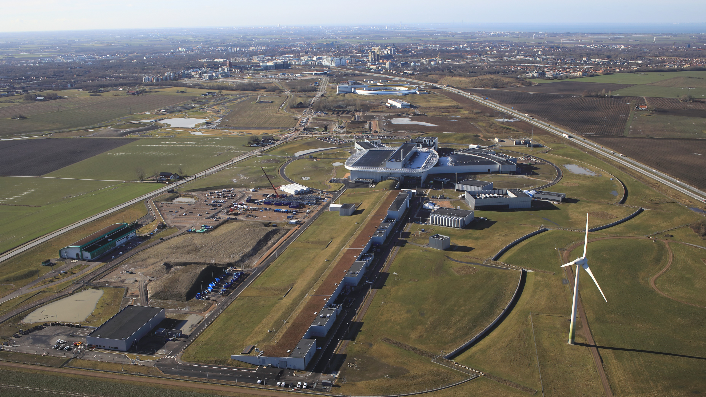
ESS – The European Spallation Source
European Research Infrastructure Consortium
The most powerful proton driver in the world!
2 GeV linear proton accelerator
Rotating tungsten wheel target
High beam power: 5 MW average, 125 MW peak
Long pulses 3 ms
Moderate rep. Rate: 14 Hz
First beam on target in 2025

Slide 4
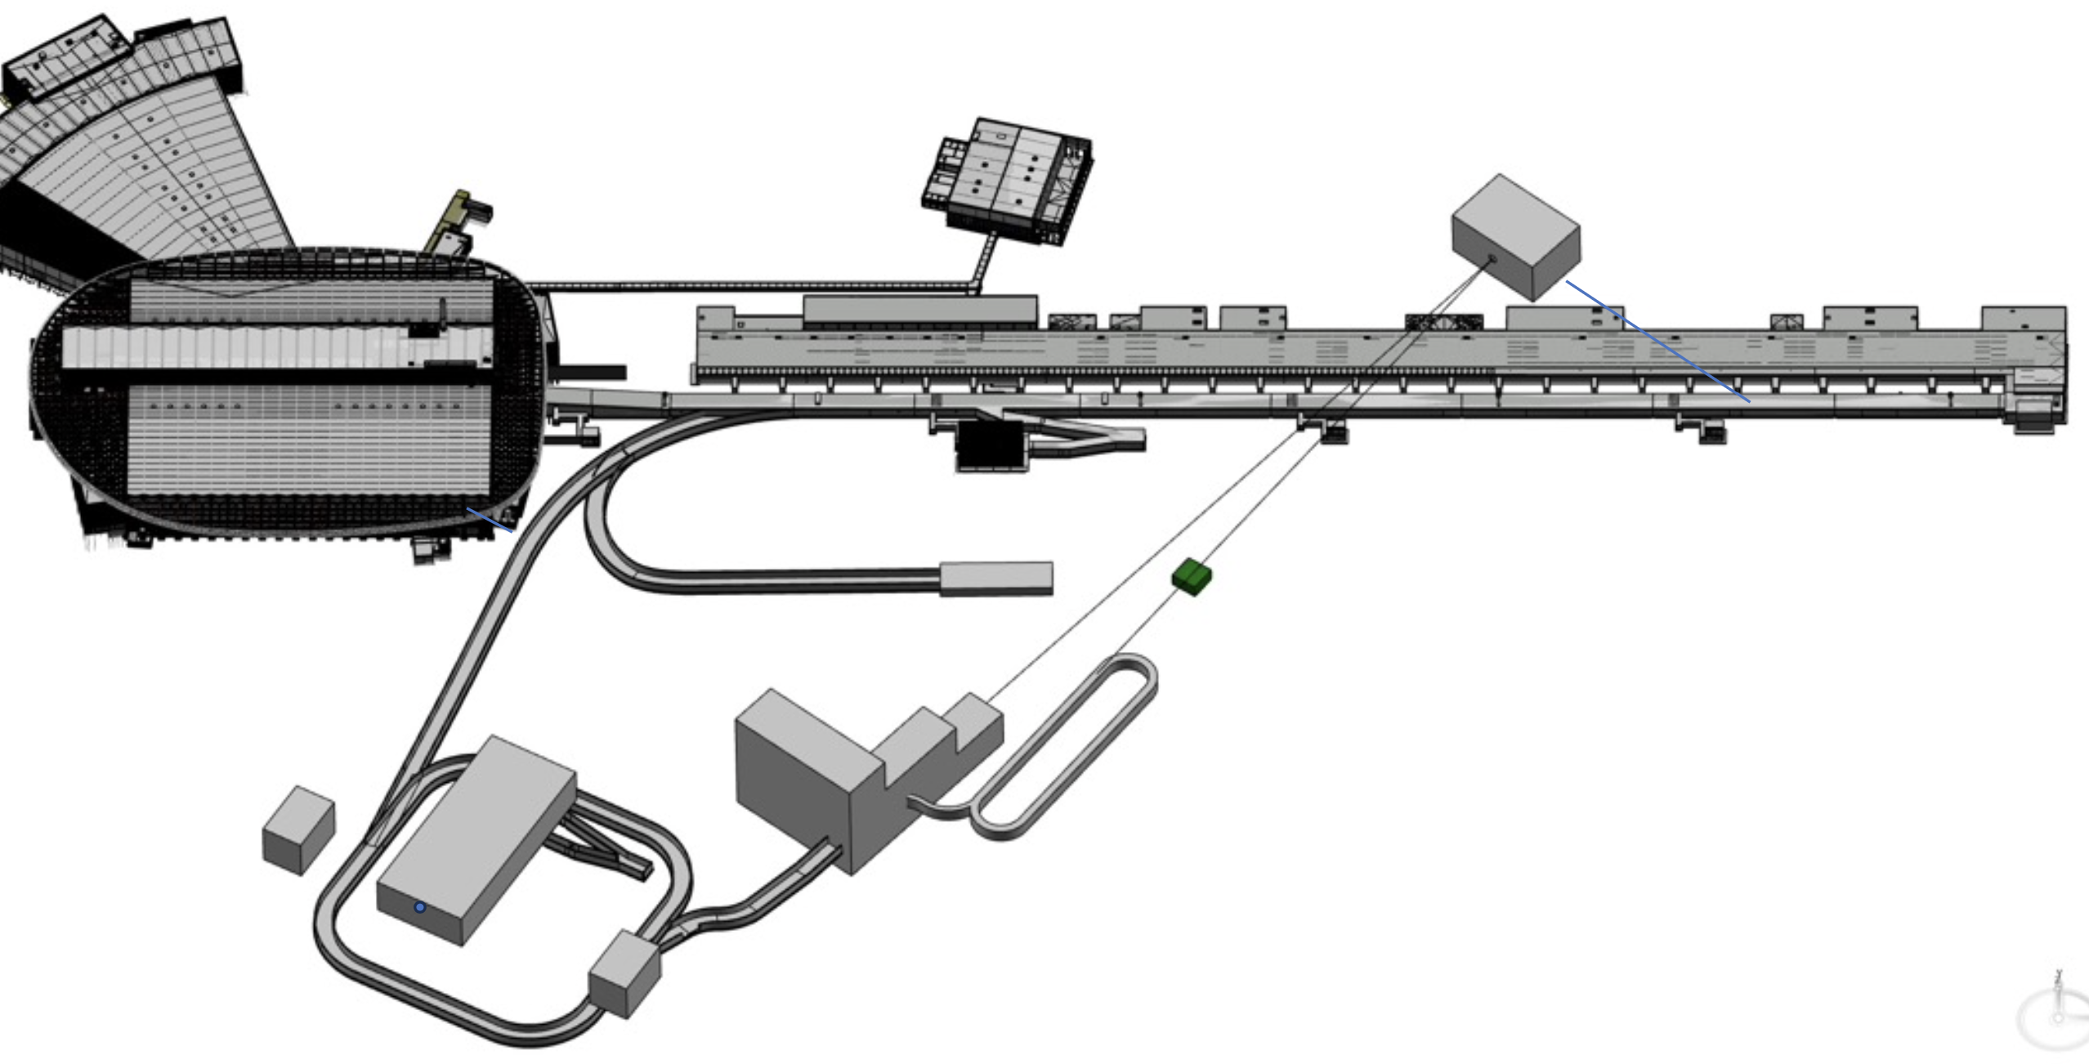
ESSnuSBplus
Towards ESSnuSB Far Detector
ESSnuSB Near Detector
ESS linear accelerator
LEMMOND
Target station
Muon storage ring
Accumulator ring
Pion transfer line

Slide 5
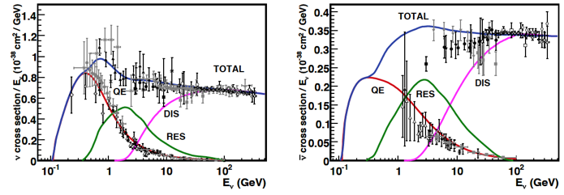
Why a muon storage ring at ESS?
Reduce systematic uncertainties in the ESSnuSB long baseline experiment through neutrino cross section measurement in the hundreds of MeV range.
J. A. Formaggio and G. P. Zeller, https://journals.aps.org/rmp/abstract/10.1103/RevModPhys.84.1307

Slide 6
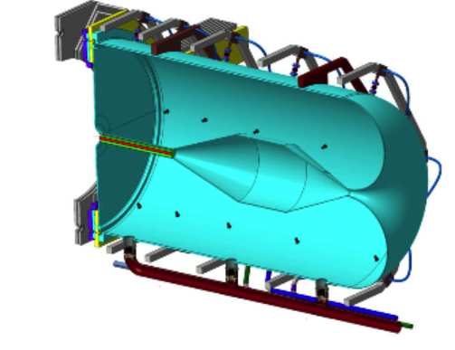
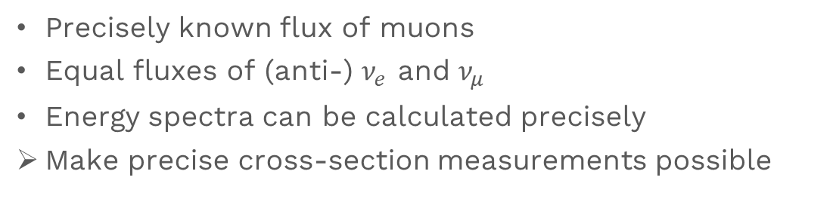

nuSTORM – Neutrinos from Stored Muons
Precisely known flux of muons
Equal fluxes of (anti-) $ν_{e}$ and $ν_{μ}$
Energy spectra can be calculated precisely
Make precise cross-section measurements possible
Pion transfer line
Beam target and
magnetic horn
Production straight section
Detector
$$μ$$
Muon storage ring

Slide 7
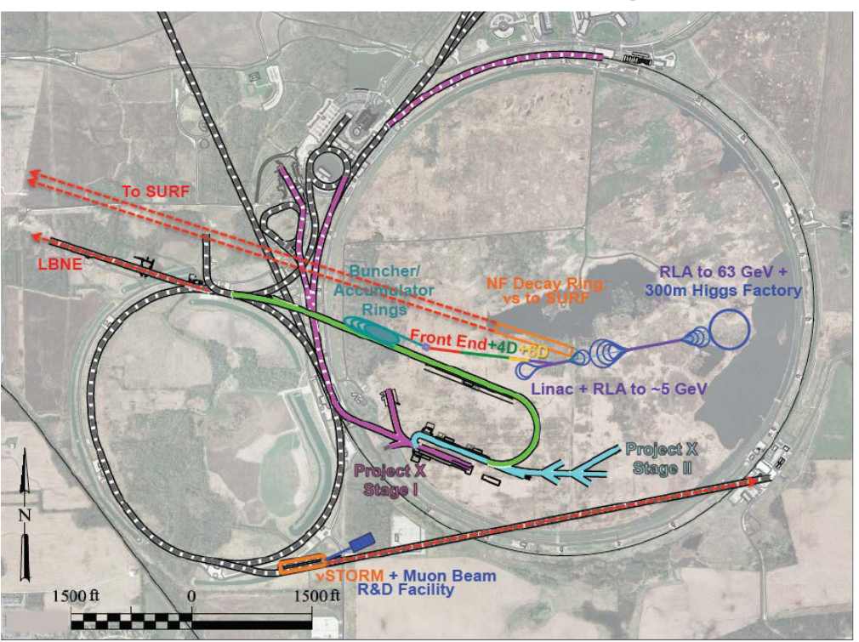
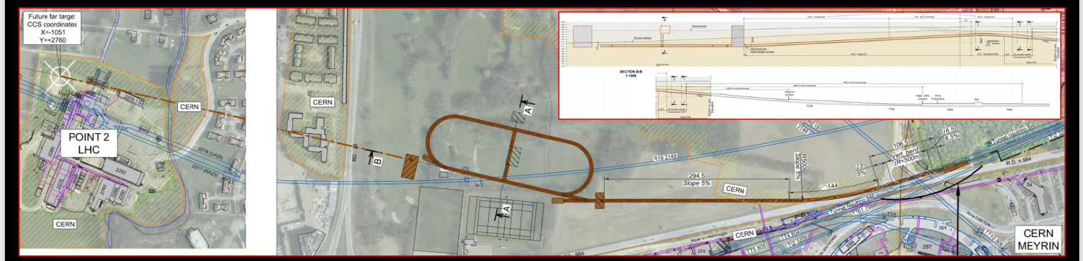


Other nuSTORM Initiatives
K. Long, https://indico.cern.ch/event/768000/contributions/3275092/
100 GeV protons from SPS
120 GeV protons from Main Injector
J.-P. Delahaye, https://arxiv.org/abs/1308.0494

Slide 8
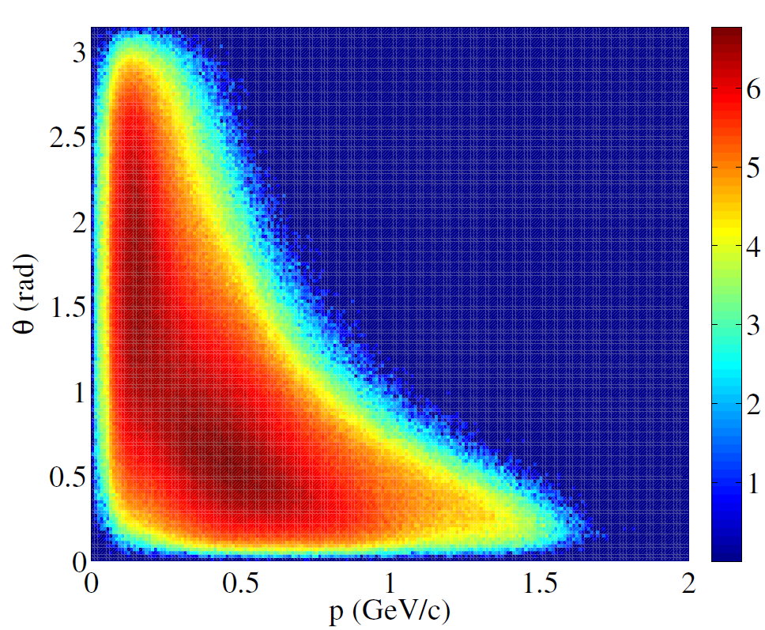
Challenges of the Low Energy nuSTORM
Example of pion distribution from the target
Low energy protons, 2.5 GeV
  low energy pions and muons
  Large spread in momentum and direction
    Huge “beams”
  Decay fast ~ 0.1 μs
  Short pion transfer ~ 20 m
Number of pions [log(Arb. Units)]
Goal: maximize transverse and momentum acceptance in ring

Slide 9
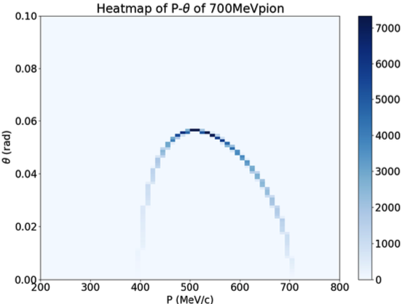

Operation Parameters: Momentum
Plan A
400 MeV/c muons to produce 200-400 MeV neutrinos
700 MeV/c pions to produce 400 MeV/c muons at a small angle
Plan B
600 MeV/c muons
Pions energy depends on injection scheme
Muon distribution from 700 MeV/c pion decay
$$θ$$

Slide 10
Operation Parameters: Ring Dimensions
Straight section ~80 m
Arc length < 25 m
Aperture (radius) 20 cm
Mean distance travelled:
Pions, 700 MeV/c: 38 m
Muons, 400 MeV/c: 2400 m

Slide 11
Design Strategy
Normalconducting magnets
  B < 2 T
FODO (Focusing-Defocusing) cells in arcs and straights
Tools:
  BMAD and Xsuite for optics calculations
  Xsuite for (long) ray tracking
  G4Beamline for tracking with decay activated (neutrino flux)

Slide 12
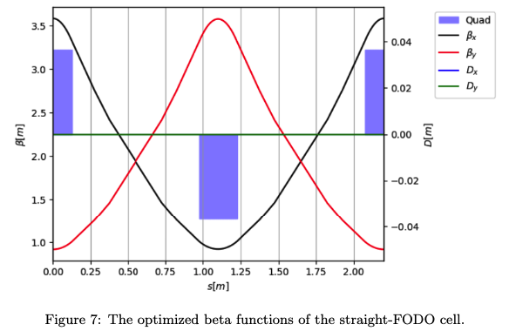
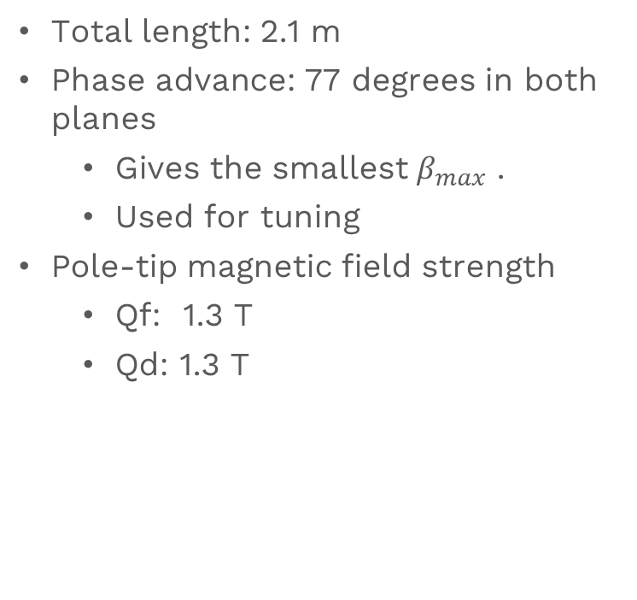
Straight Cell
Total length: 2.1 m
Phase advance: 77 degrees in both planes
  Gives the smallest $β_{max}$ .
  Used for tuning
Pole-tip magnetic field strength
  Qf: 1.3 T
  Qd: 1.3 T

Slide 13
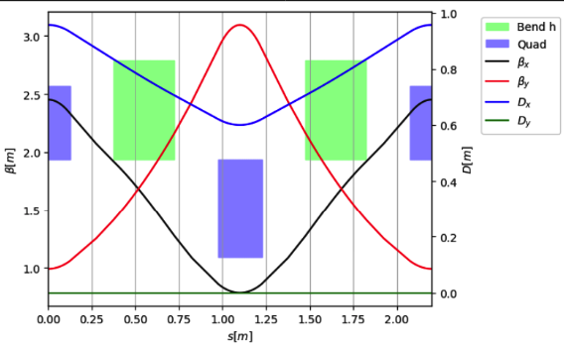
Arc Cell
Cell length: 2.1 m
  Four cells per arc
  32 cells per straight section
Phase advance
  90 degrees for closed dispersion in horizontal plane
  77 degrees in vertical plane
Beta function: 0.5 – 3 m
Pole-tip magnetic field strength
  Dipole : 1.5 T
  Qf, arc: 0.9 T
  Qd, arc: 1.2 T

Slide 14
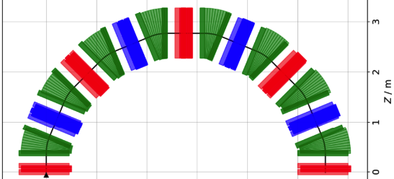
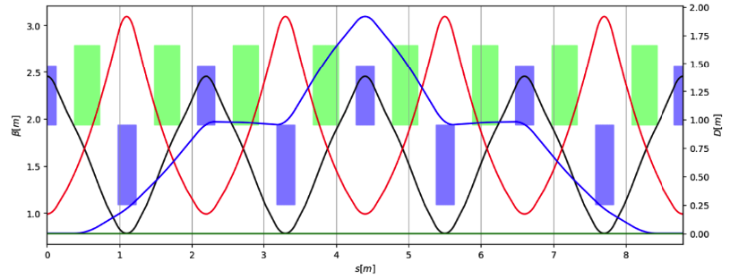
Full Arc
Length: 8.4 m
  Tightly packed
Max dispersion < 2 m

Slide 15
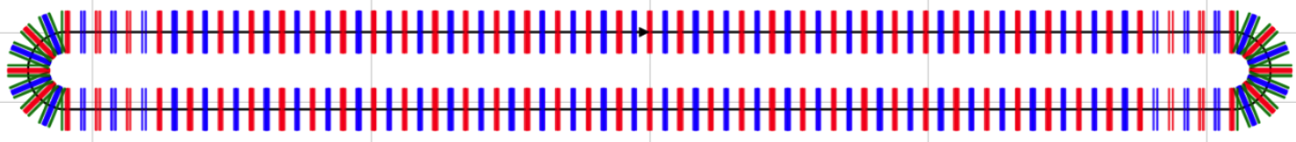
Full Ring: 176 m
Matching cells, 6.3 m
Arc, 8.4 m
Straight section, 67.2 m

Slide 16
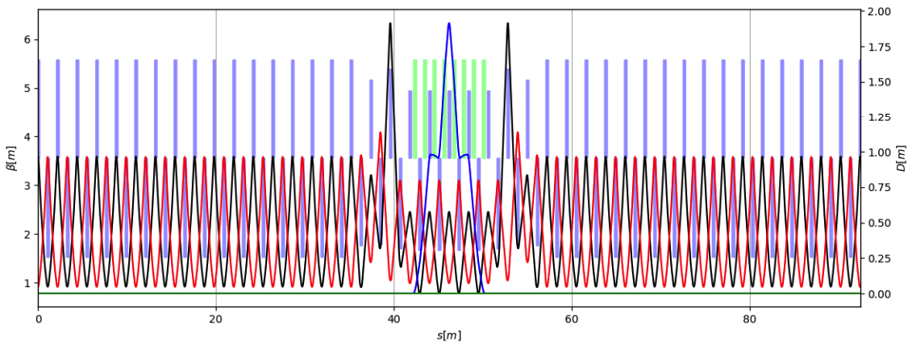
Full Ring: Optics
dipoles
quadrupoles
Dispersion can be further suppressed with more arc cells, longer arc.
Arc

Slide 17
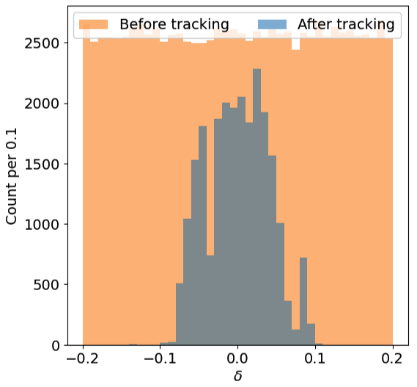
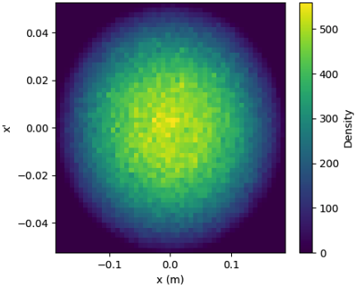
Ring Performance: Momentum Acceptance
Transverse distribution: Water-bag, 11 mmrad 100% emittance
After ~45 turns

Slide 18
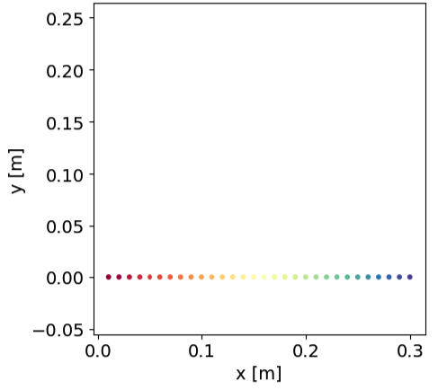
Ring Performance: Transverse Acceptance
1a.
Starting point

Slide 19
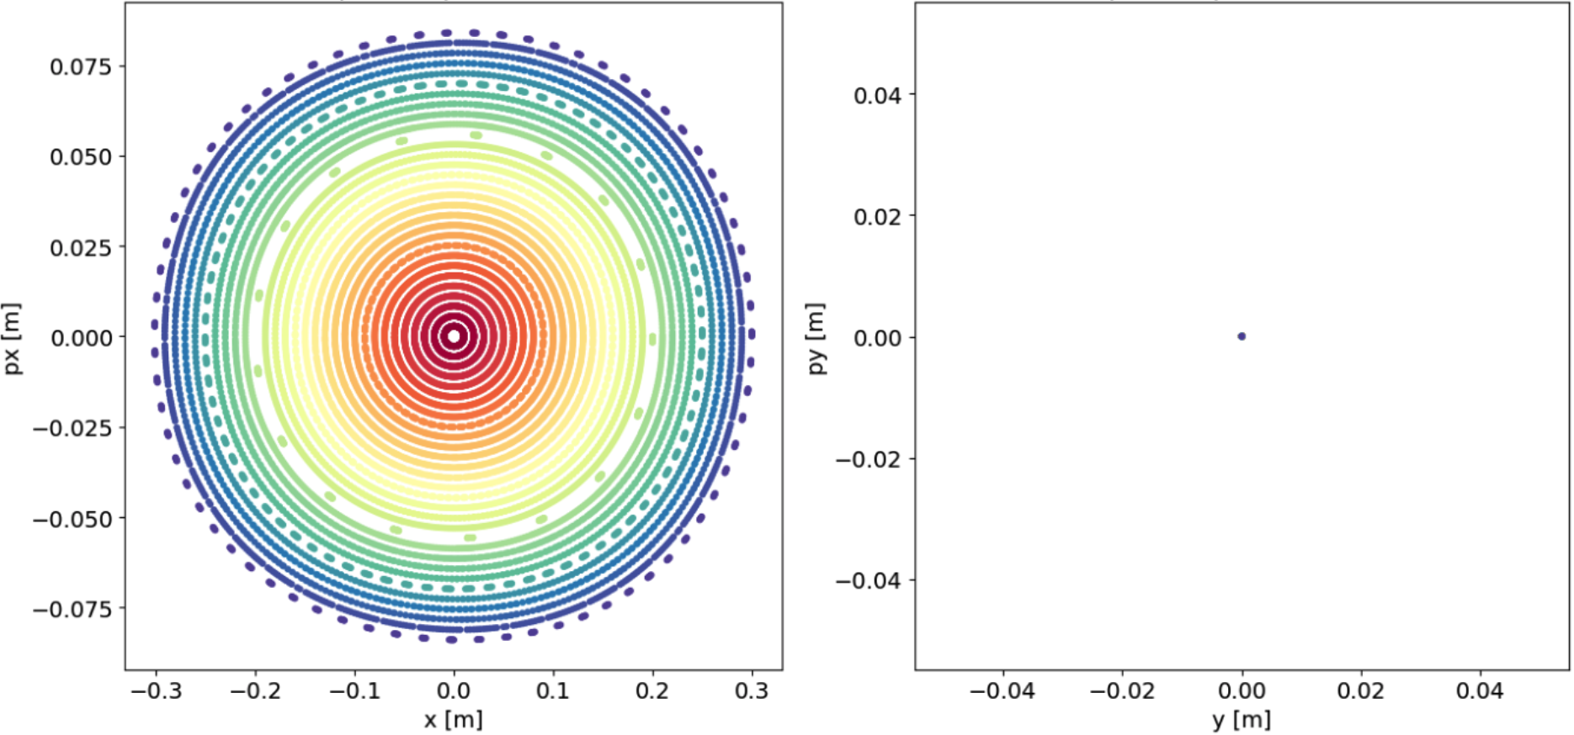
Ring Performance: Transverse Acceptance
1b.
512 turns

Slide 20
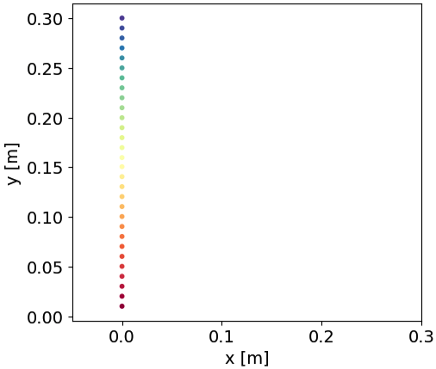
Ring Performance: Transverse Acceptance
2a.
Starting point

Slide 21
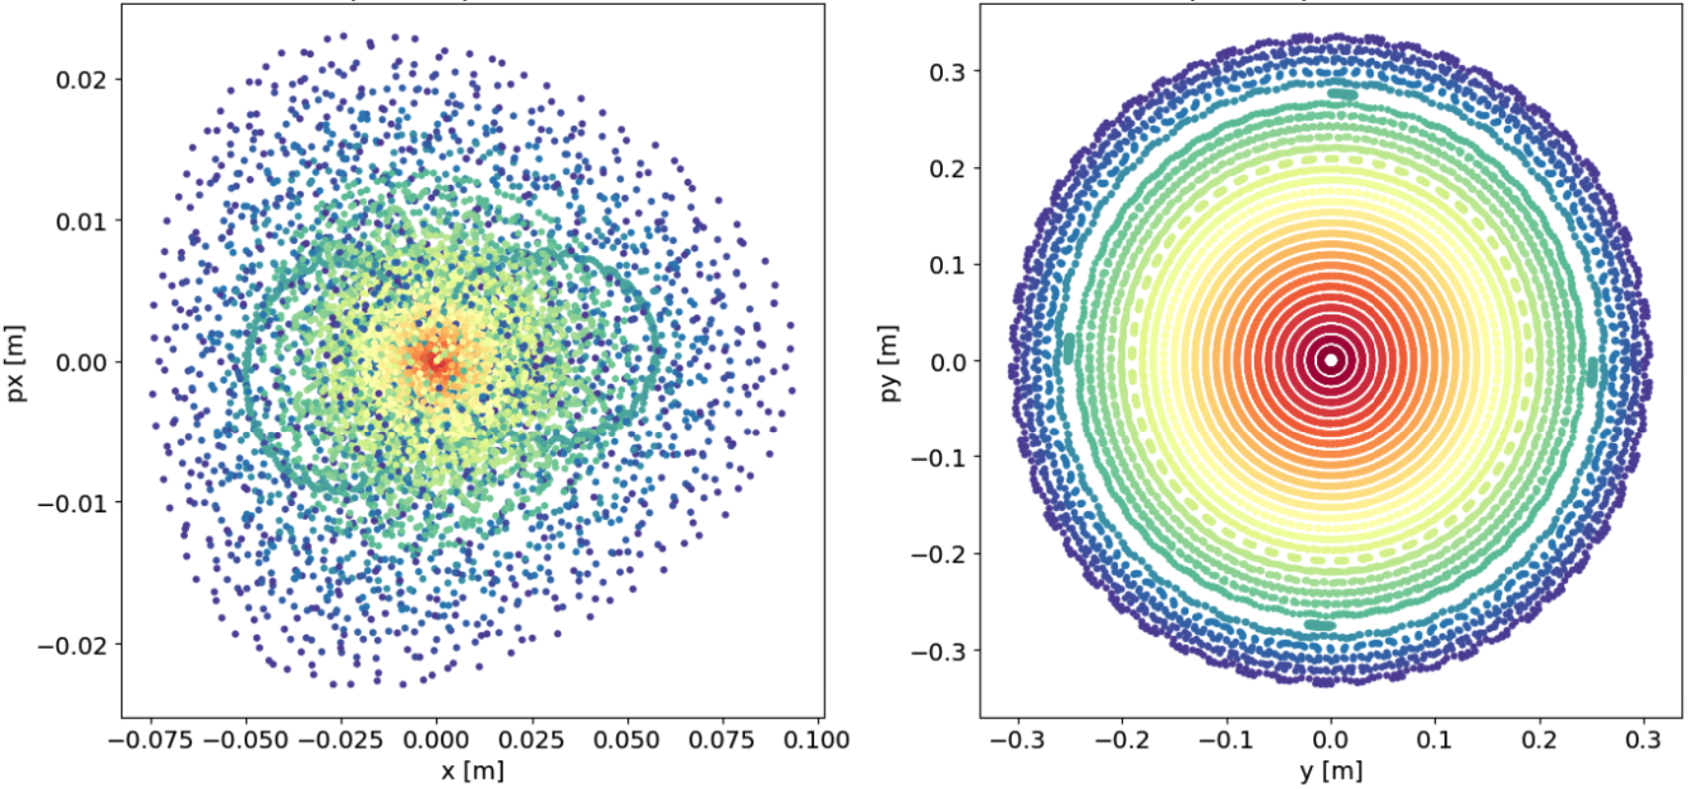
Ring Performance: Transverse Acceptance
2b.
512 turns

Slide 22
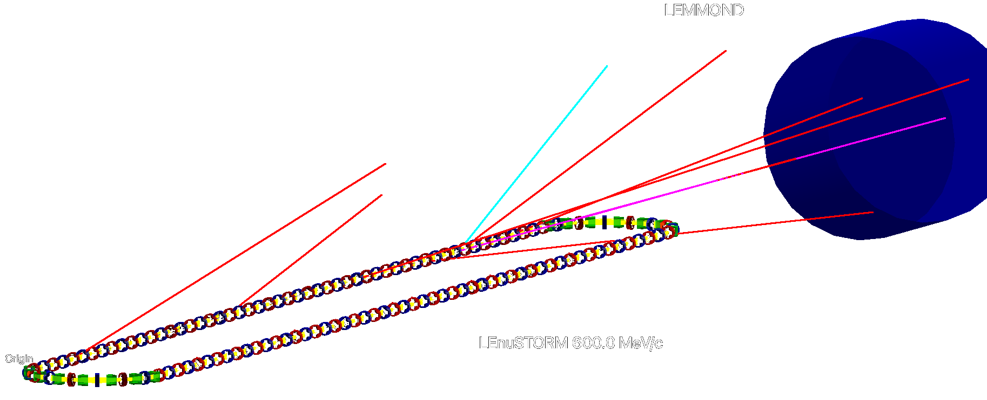

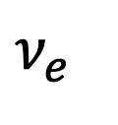
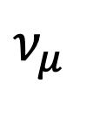

Tracking Simulations
Tracking in G4Beamline
Pencil pion beam at the injection point
Track pions and muons, score neutrinos crossing LEMMOND
  Electrons killed
Idea fields
No interaction with matter.
$$ν_{μ}$$
$$\overline{ν_{μ}}$$
$$ν_{e}$$

Slide 23
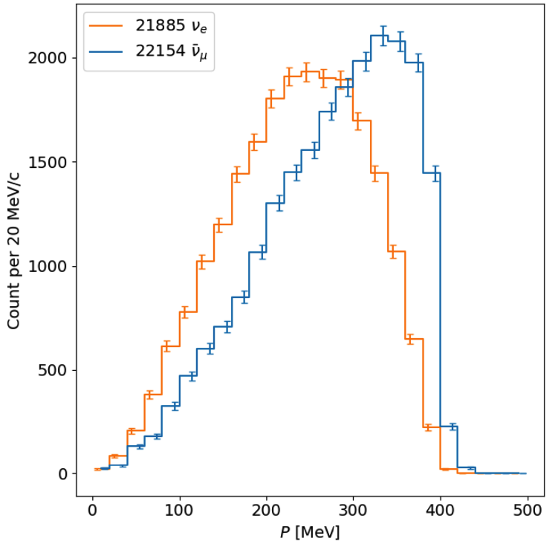
First estimates of neutrino flux at LEMMOND
2
*1E-10 neutrinos/20 MeV per P.O.T
1
0

Slide 24
Outlook: non-linear optics and losses
Very large energy spread, high chromaticity (-18.91, -19.11)
  -> huge beam tune spread
  Sextupolse, octupoles to be added to lattice
Large amplitudes -> amplitude detuning, strong fringe field effects
Characterize loss mechanisms, if possible mitigate them
Include the injection!
Continue working on a ring for 600 MeV/c muons.

Slide 25
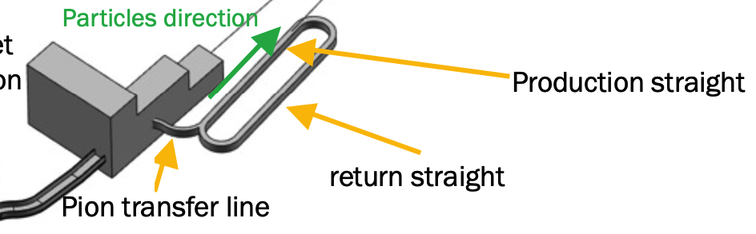
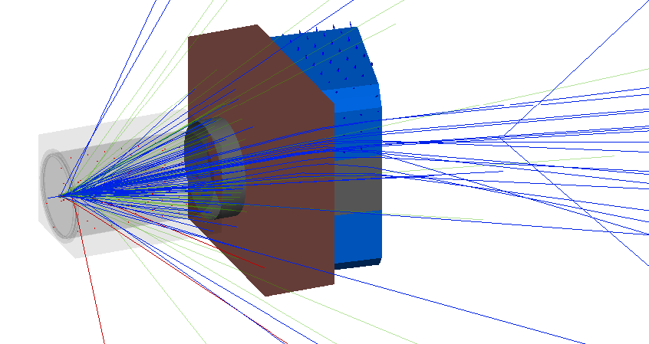
Outlook: Start-to-End
Set-up for start-to-end simulations in BDSIM has been initiated.
Target + horn
Pion extraction dipole
collimator

Slide 26
Summary
Low energy nuSTORM facility to measure neutrino cross-sections at 200-400 MeV
First design of a 180 m racetrack ring for muon storage
  Normalconducting magnets, FODO structure
Challenge: large, divergent beams
First (rough) neutrino flux estimate
Ongoing refinement of ring design and full characterization of performance
We target large transverse and momentum acceptance.
Goal: By Nufact2026, solid design and refined estimate of LEnuSTORM performance.

Slide 27
Thanks for your attention!
$$\overline{ν_{μ}}$$
$$ν_{μ}$$
$$ν_{e}$$
Contact: Ting.Choi@physics.uu.se

Slide 28
Extra slides

Slide 29
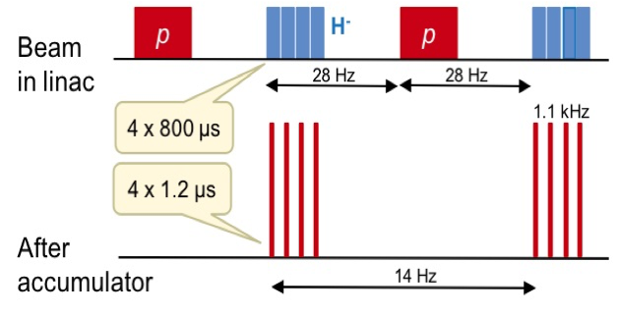
ESSnuSB pulse structure

Slide 30
nuSTORM comparison
 | FNAL FODO* | CERN FFA# | ESS
Proton energy | 120 GeV/c | 100 GeV | 2.5 GeV
Pion energy | 5 GeV/c | 5 GeV/c | ~ 0.7 GeV/c
Muon momentum | 3.8 GeV/c | 3.8 GeV/c | ~ 0.4 GeV/c
Momentum acceptance | ±10% | ±16% | ?
Transverse acceptance | 2π mm rad | 1π mm rad | Comparable
Length of decay straight | 181 m | 180 m | 80 m
Circumference | 490 m | 510 m | 176 m
Mean distance traveled (μ) | 24 km | 24 km | ~2.4 km
 | ~ 50 turns | ~ 50 turns | 14 turns
* FODO = Focusing – Defocusing
https://lss.fnal.gov/archive/thesis/2000/fermilab-thesis-2015-04.pdf
# FFA = Fixed Field alternating gradient Accelerator
https://ffa20.triumf.ca/wp-content/uploads/2020/11/lagrange_nustorm.pdf

Slide 31
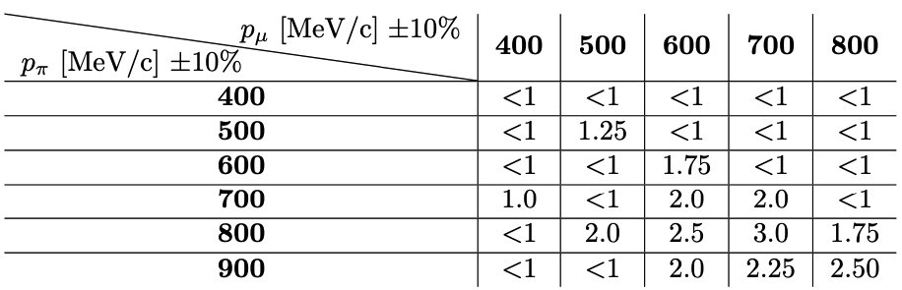
Choosing momenta
Number of muons per muon-pion momentum combination
  Normalised to the case of 400MeV/c muons from 700 MeV/c pions

Slide 32
Neutrino flux estimate
2.2e14 protons/pulse * 14 pulses/s * 3600 s/h* 24 h/day* 365 day/yr ≈ 1e23 protons/year
Pions after the transferline: 1e-4 pions/P.O.T.
Injection: ~50% efficiency
Pion beam shape “fudge factor”: 0.5
240e6 pencil beam pions in the simulation

Slide 33
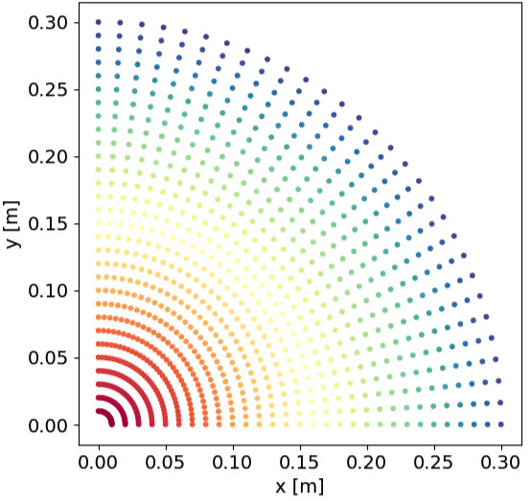
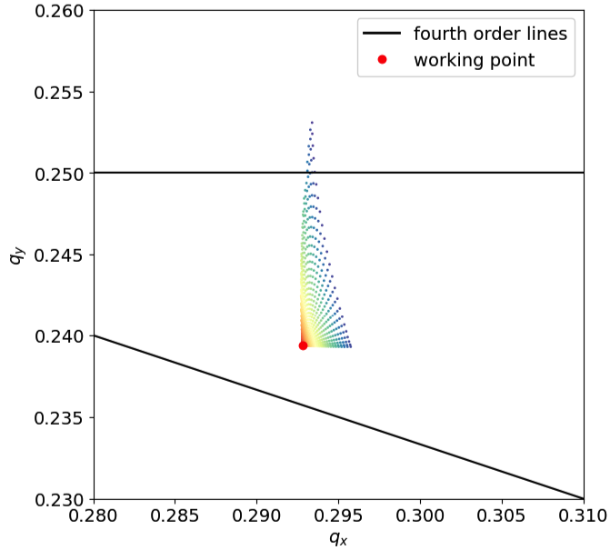
Ring Performance: Amplitude Detuning
Working point: (17.29, 17.24)

Slide 34
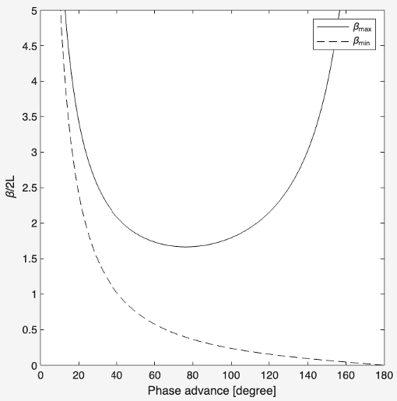
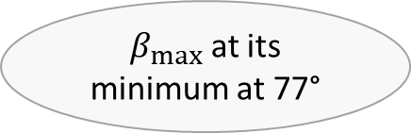
FODO Cell Phase Advance
$β_{max}$ at its minimum at 77°

