Slide 1
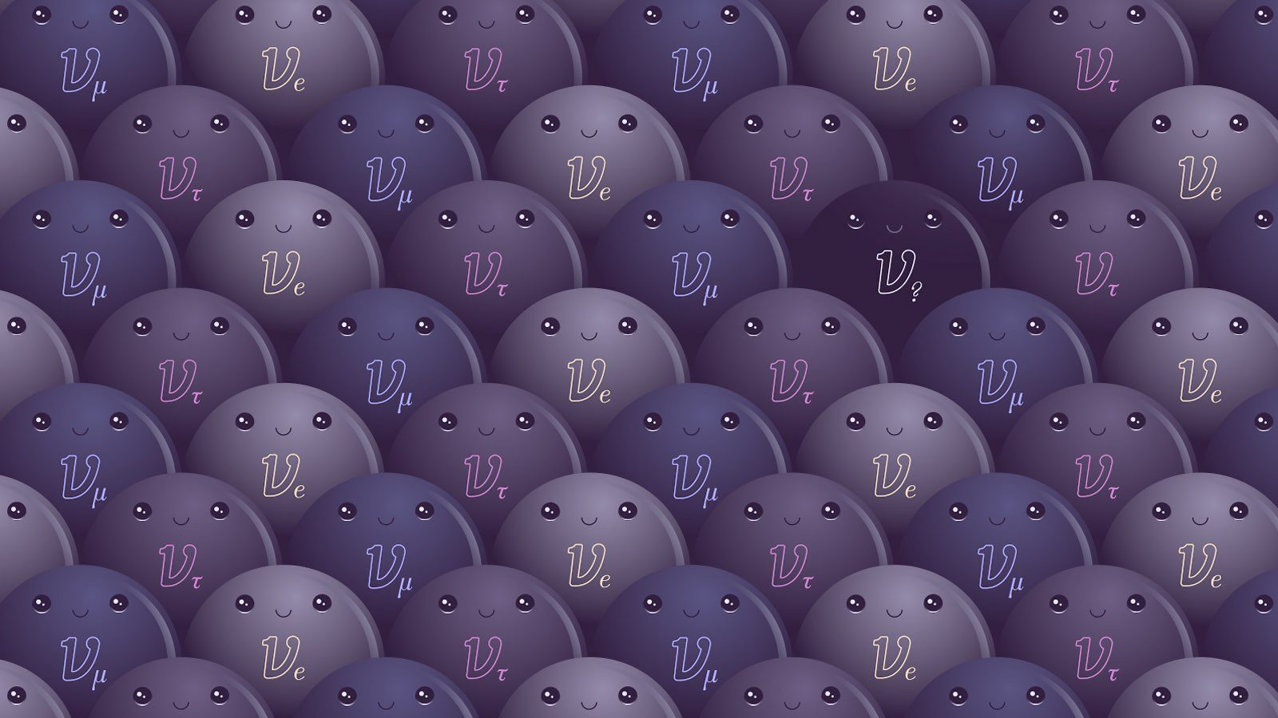




Investigations of the MiniBooNE anomaly and sterile neutrinos with MicroBooNE
Jessie Micallef
On Behalf of the MicroBooNE Collaboration
NSF IAIFI Postdoc Fellow jessie.micallef@tufts.edu
Notes:
Make contrast better

Slide 2

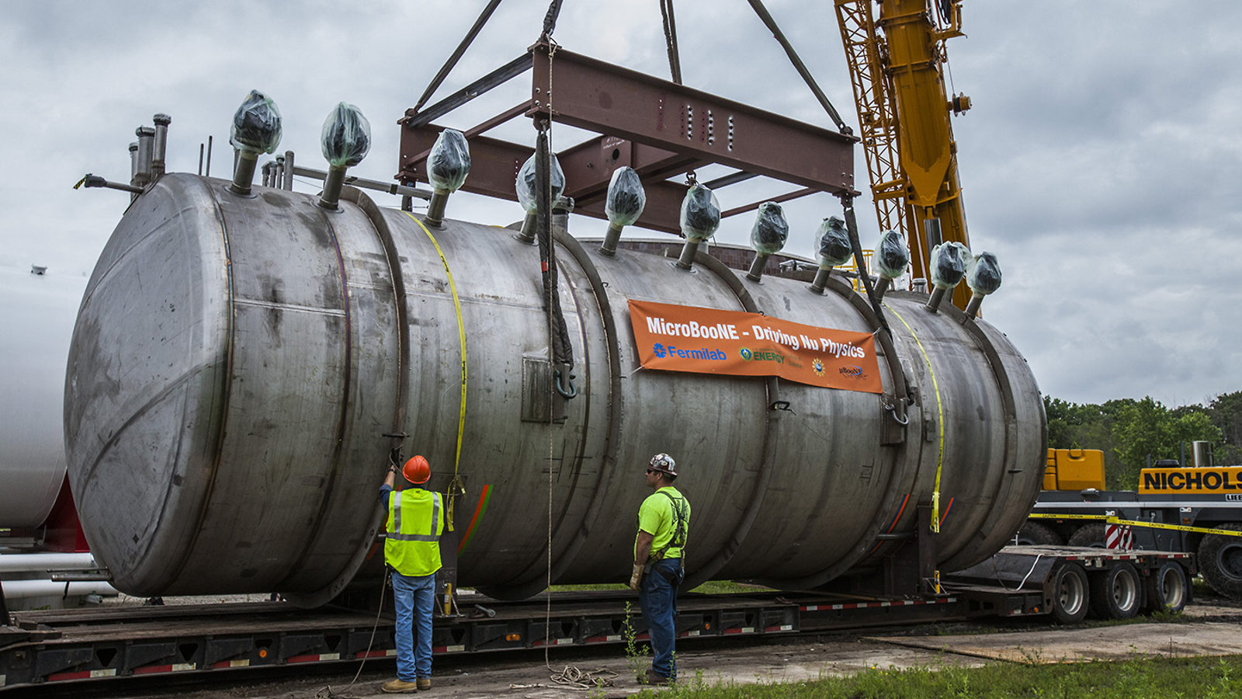
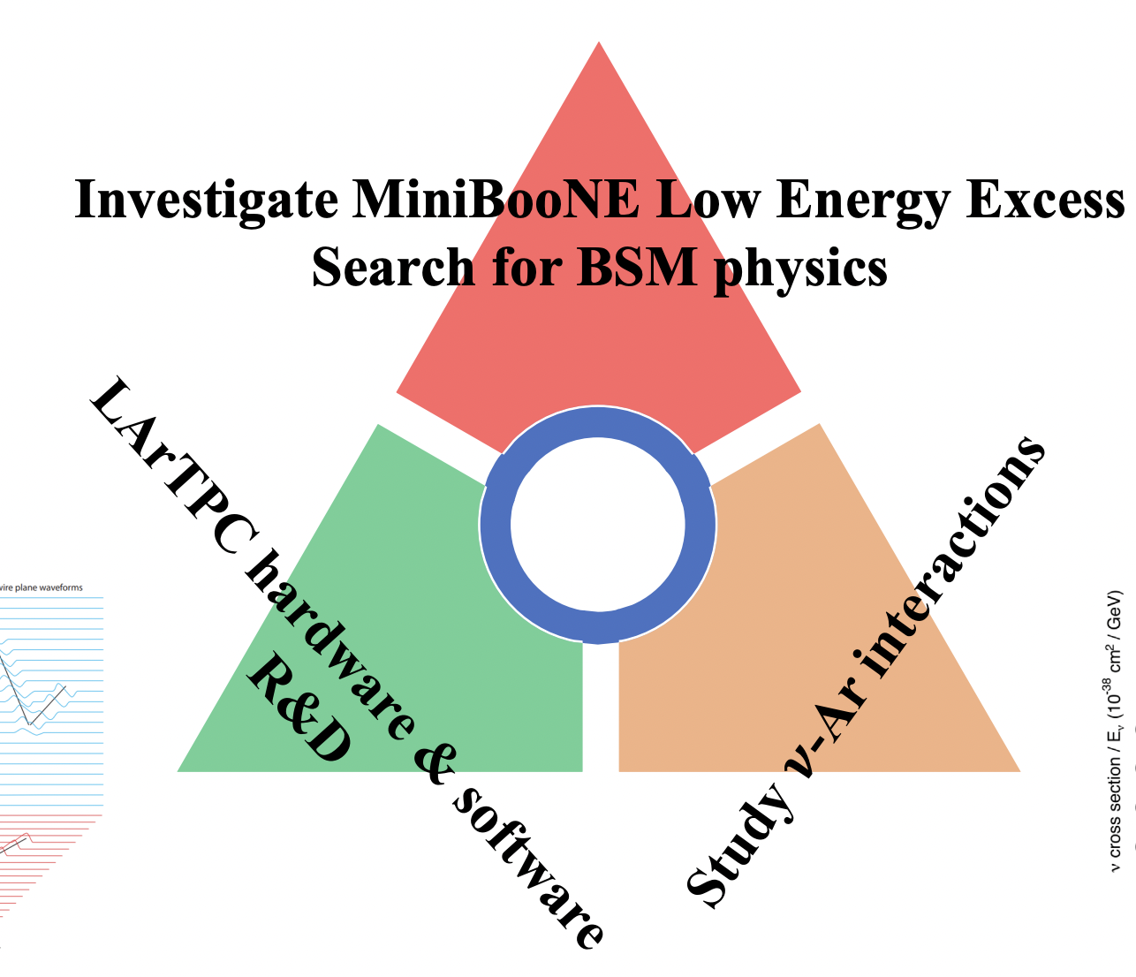

MicroBooNE Built to Solve Neutrino Mysteries
→ Built to test neutrino anomalies using 𝝂 beamline
Took 5 years of data (2015 - 2020)
85 metric ton active volume (school-bus-sized)
MicroBooNE’s Goals:
Liquid Argon (LAr) in MicroBooNE Detector
Why neutrinos matter - Sílvia Bravo Gallart

Slide 3
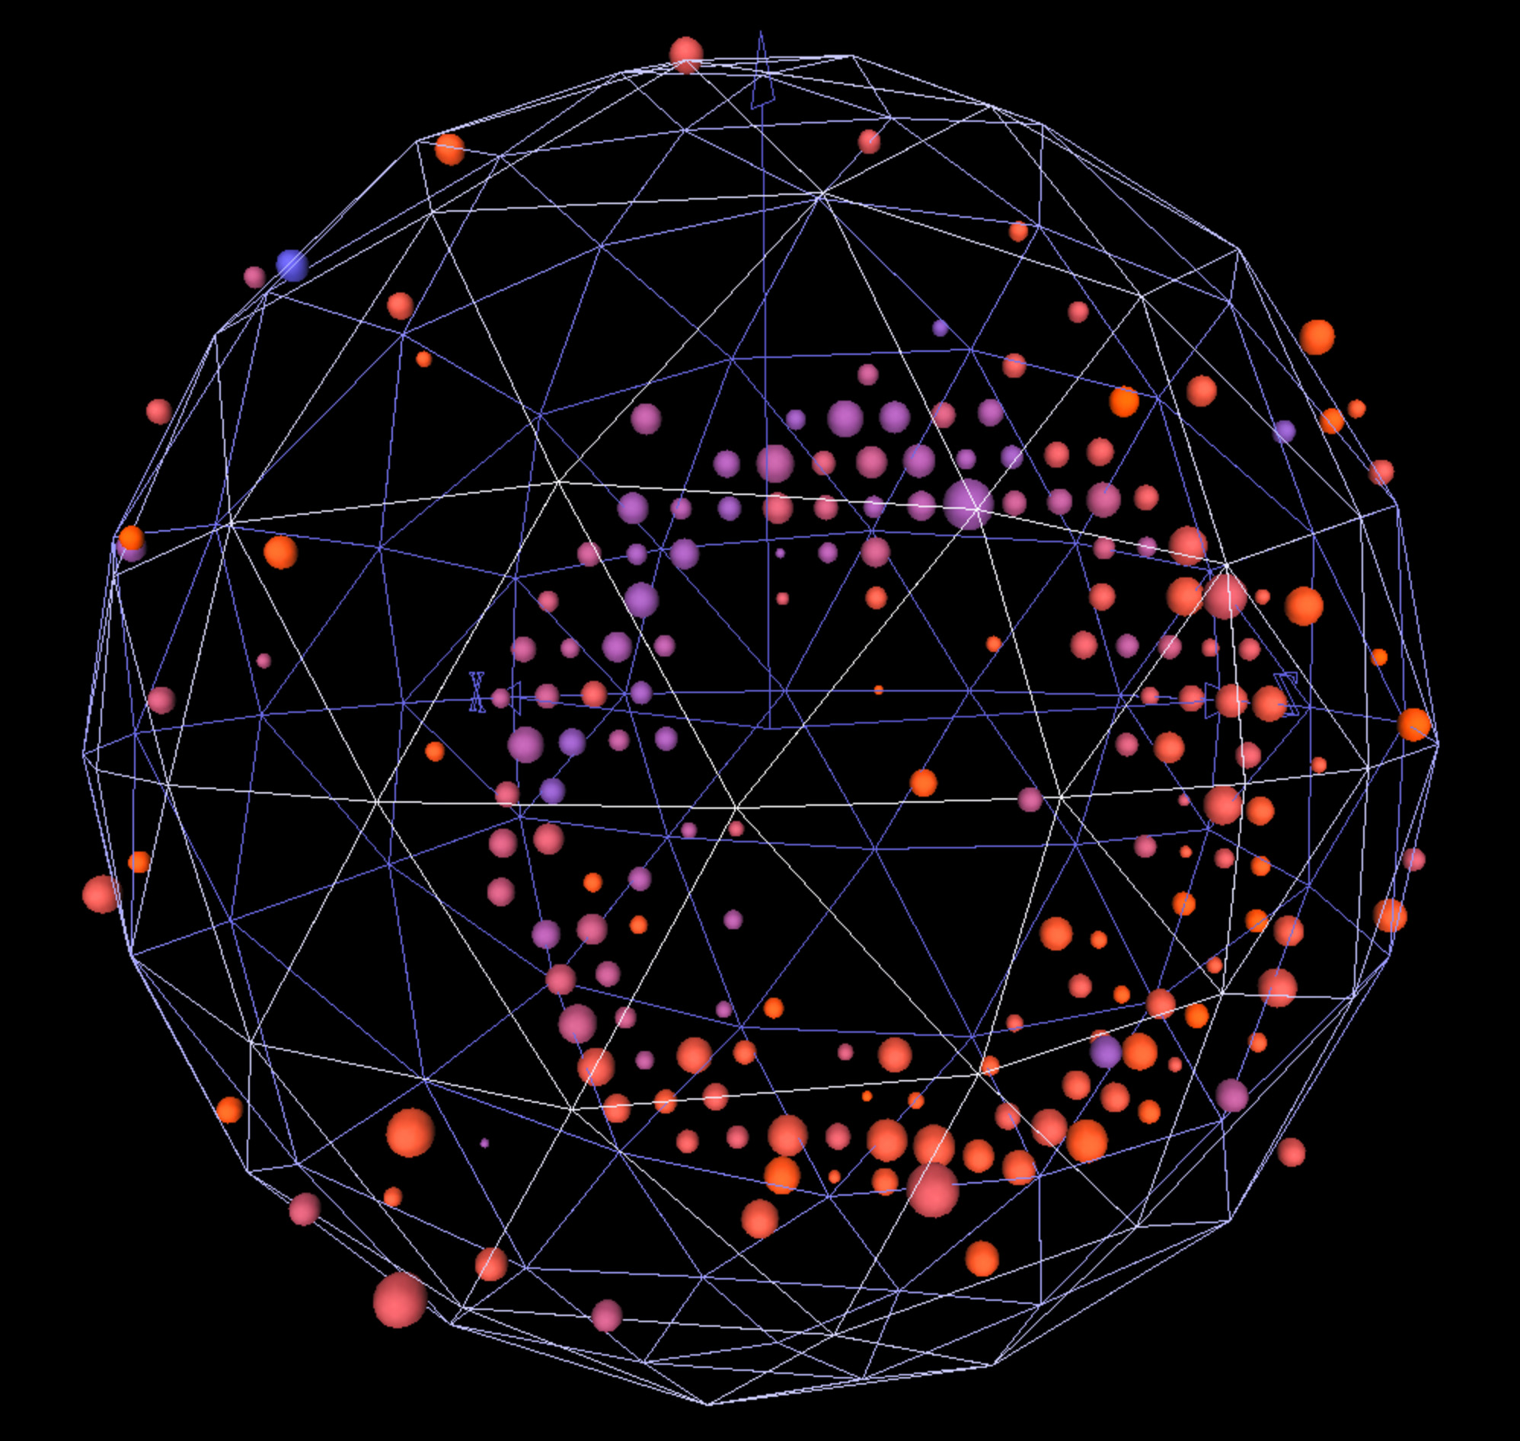
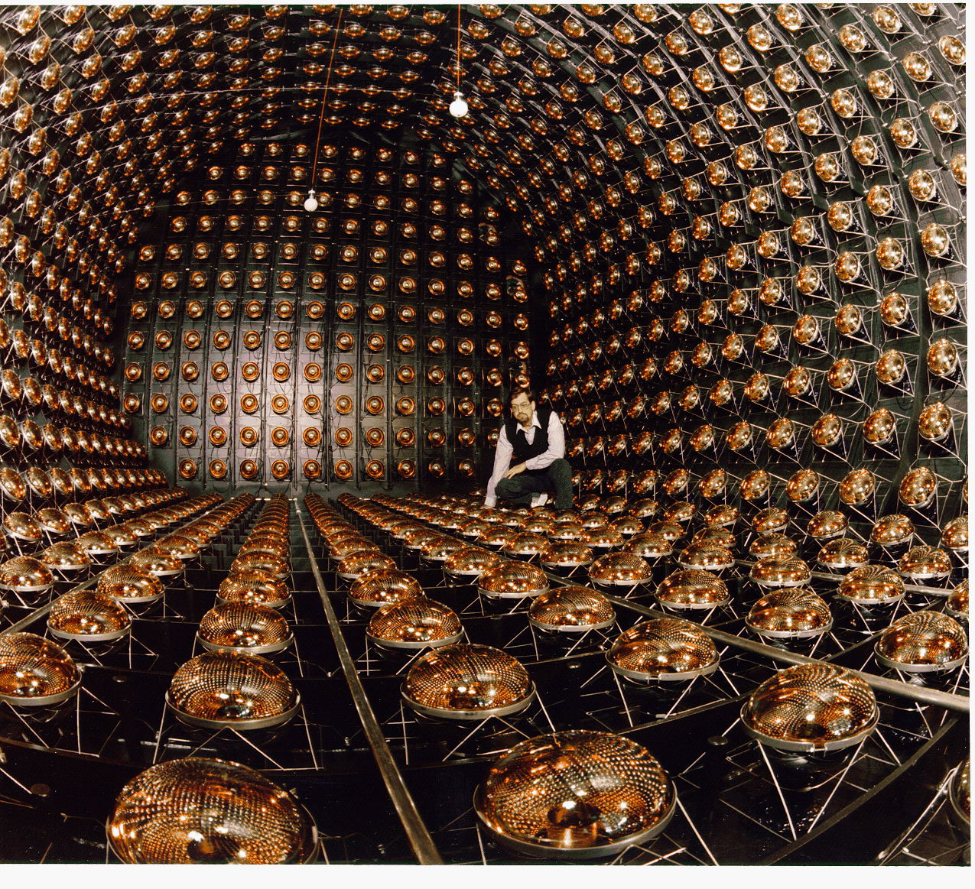
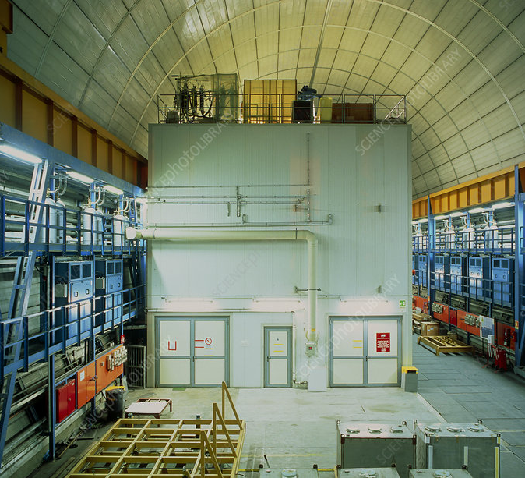
Short Baseline Neutrino Anomaly Landscape
MiniBooNE Anomaly
Decay-in-flight
LSND Anomaly
Decay-at-rest
Gallium Anomaly
Radioactive Source
𝝂_{𝝁} → 𝝂_{e}
𝝂_{𝝁} → 𝝂_{e}
𝝂_{e} → 𝝂_{e}
Source: Mark Ross-Lonergan @ APS2025

Slide 4
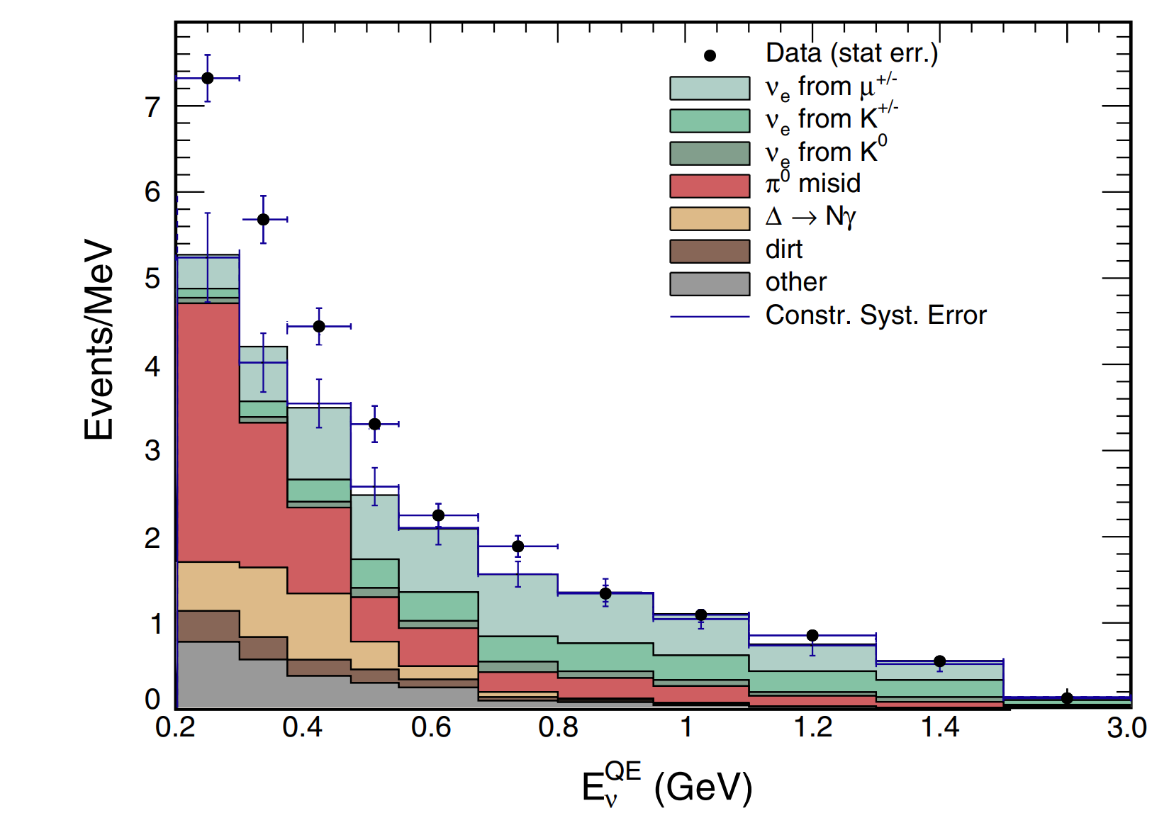
Short Baseline Neutrino Anomaly Landscape
MiniBooNE Anomaly
Decay-in-flight
LSND Anomaly
Decay-at-rest
Gallium Anomaly
Radioactive Source
𝝂_{𝝁} → 𝝂_{e}
4.8 𝝈
𝝂_{𝝁} → 𝝂_{e}
𝝂_{e} → 𝝂_{e}
Phys. Rev. D 103, 052002 (2021)
Source: Mark Ross-Lonergan @ APS2025

Slide 5
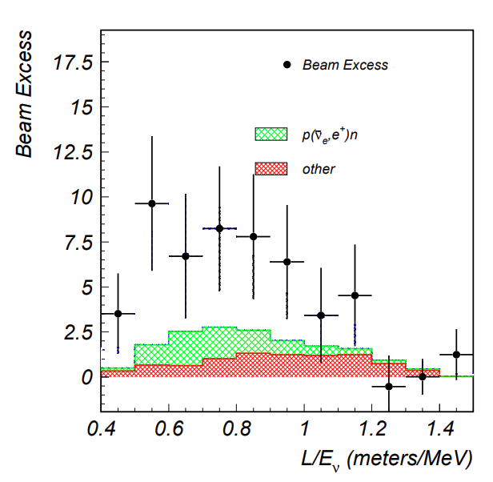
Short Baseline Neutrino Anomaly Landscape
MiniBooNE Anomaly
Decay-in-flight
LSND Anomaly
Decay-at-rest
Gallium Anomaly
Radioactive Source
𝝂_{𝝁} → 𝝂_{e}
4.8 𝝈
𝝂_{𝝁} → 𝝂_{e}
3.8 𝝈
𝝂_{e} → 𝝂_{e}
Phys. Rev. D 103, 052002 (2021)
Source: Mark Ross-Lonergan @ APS2025

Slide 6
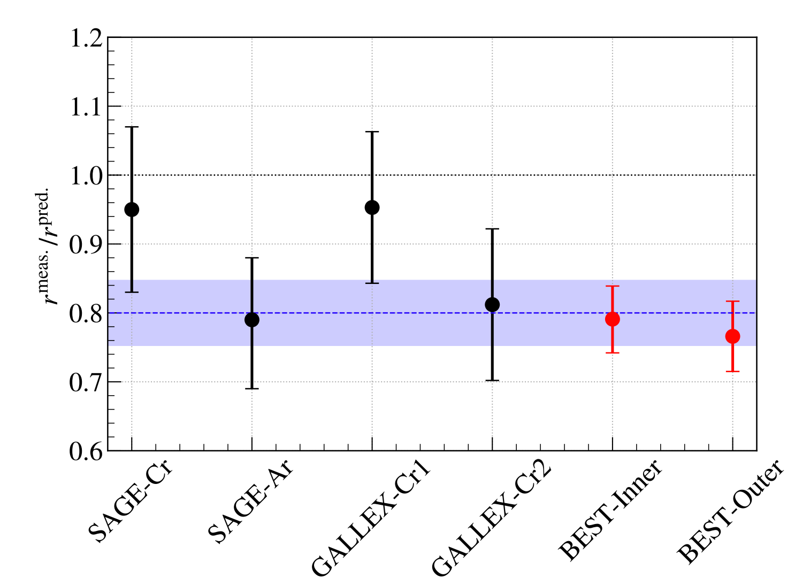
Short Baseline Neutrino Anomaly Landscape
MiniBooNE Anomaly
Decay-in-flight
LSND Anomaly
Decay-at-rest
Gallium Anomaly
Radioactive Source
𝝂_{𝝁} → 𝝂_{e}
4.8 𝝈
𝝂_{𝝁} → 𝝂_{e}
3.8 𝝈
𝝂_{e} → 𝝂_{e}
4.0 𝝈
Phys. Rev. D 103, 052002 (2021)
Source: Mark Ross-Lonergan @ APS2025

Slide 7

Neutrino Anomaly Landscape
MiniBooNE Anomaly
Decay-in-flight
LSND Anomaly
Decay-at-rest
Gallium Anomaly
Radioactive Source
𝝂_{𝝁} → 𝝂_{e}
4.8 𝝈
𝝂_{𝝁} → 𝝂_{e}
3.8 𝝈
𝝂_{e} → 𝝂_{e}
4.0 𝝈
All individually consistent with neutrino oscillations with a mass difference 𝚫m² ~ O(1 eV²)
Sterile 𝝂?!

Slide 8
Short Baseline Neutrino Anomaly Landscape
→ MicroBooNE built next to MiniBooNE to specifically explore this anomaly
MiniBooNE Anomaly
Decay-in-flight
LSND Anomaly
Decay-at-rest
Gallium Anomaly
Radioactive Source
𝝂_{𝝁} → 𝝂_{e}
4.8 𝝈
𝝂_{𝝁} → 𝝂_{e}
3.8 𝝈
𝝂_{e} → 𝝂_{e}
4.0 𝝈
Source: Mark Ross-Lonergan @ APS2025

Slide 9
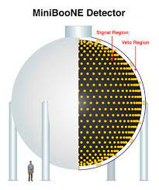
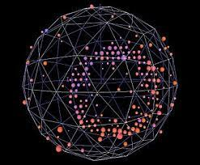
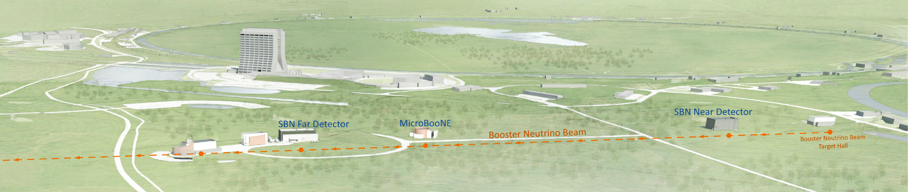


MiniBooNE → MicroBooNE
𝝂_{e} Cherenkov event
*over exaggeration
*
Booster Neutrino Beam (BNB)
𝝂_{𝝁}
𝝂_{e}
𝝂_{𝝁}*
𝝂_{𝝁}
𝝂_{𝝁}
𝝂_{e}
𝝂_{𝝁}
𝝂_{𝝁}
𝝂_{𝝁}
𝝂_{𝝁}
𝝂_{𝝁}*
540 m
470 m
𝝂_{e}
𝝂_{𝝁}
𝝂_{𝝁}
𝝂_{𝝁}
𝝂_{𝝁}
𝝂_{𝝁}
𝝂_{𝝁}

Slide 10
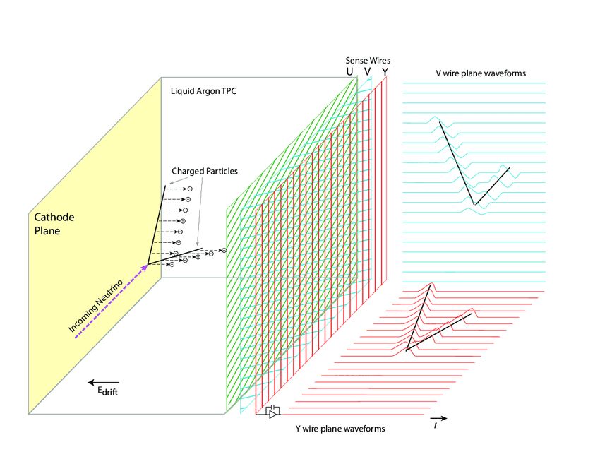
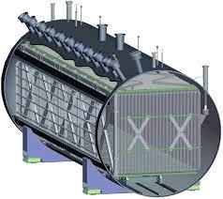
MiniBooNE → MicroBooNE
Liquid Argon (LAr) Time Projection Chamber (TPC)
𝝂_{e} Cherenkov event
DOI:10.1103/PhysRevD.99.092001
*over exaggeration
*
Booster Neutrino Beam (BNB)
𝝂_{𝝁}
𝝂_{e}
𝝂_{𝝁}*
𝝂_{𝝁}
𝝂_{𝝁}
𝝂_{e}
𝝂_{𝝁}
𝝂_{𝝁}
𝝂_{𝝁}
𝝂_{𝝁}
𝝂_{𝝁}*
540 m
470 m
𝝂_{e}
𝝂_{𝝁}
𝝂_{𝝁}
𝝂_{𝝁}
𝝂_{𝝁}
𝝂_{𝝁}
𝝂_{𝝁}

Slide 11
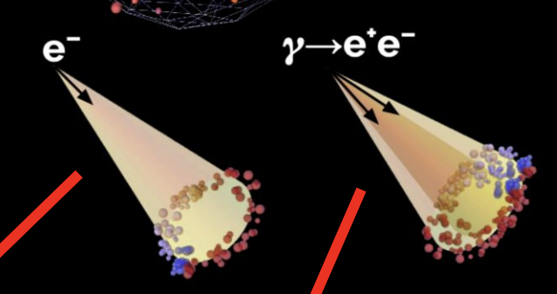
Cherenkov vs LAr TPC
“MiniBooNE Excess”
wire

Slide 12
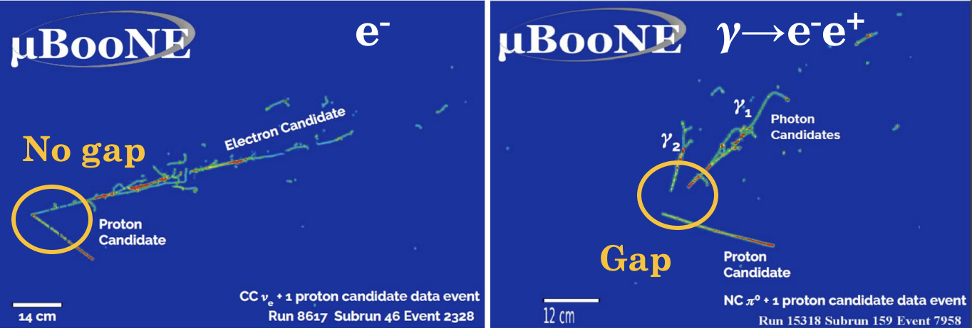
Cherenkov vs LAr TPC
𝝂
time
wire

Slide 13
Cherenkov vs LAr TPC
𝝂
𝝂
time
time
wire
wire

Slide 14
Cherenkov vs LAr TPC
𝝂
𝝂
dE/dx discrimination
dE/dx discrimination
time
time
wire
wire

Slide 15
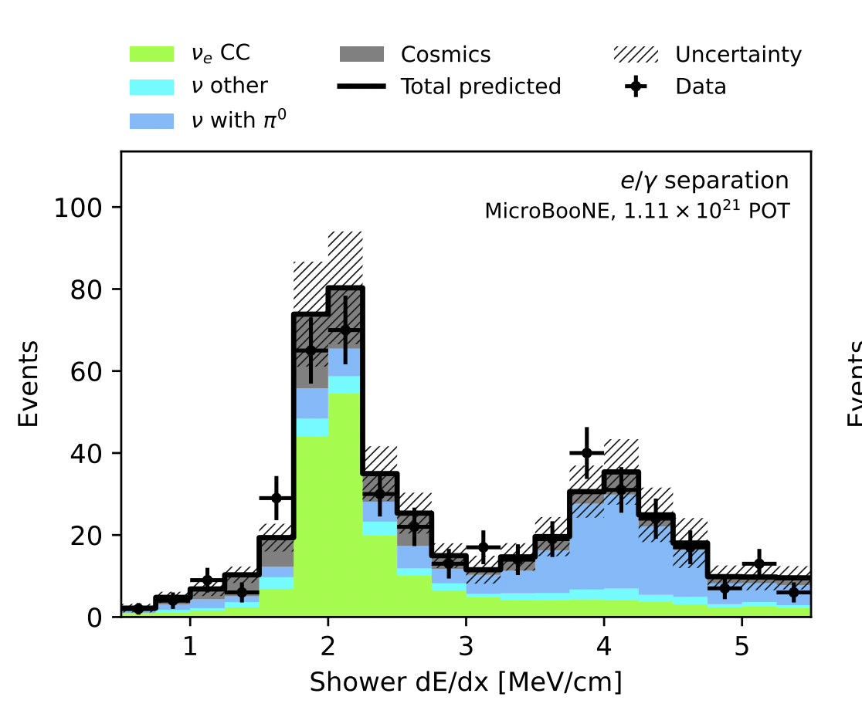
Cherenkov vs LAr TPC

Slide 16
Search for “Low Energy Excess”
Sterile 𝝂?!
𝝂
𝝂
dE/dx discrimination
dE/dx discrimination
time
time
wire
wire

Slide 17
Search for “Low Energy Excess”
𝝂_{e} + Ar → e⁻ + Xp + X𝜋
X ≥ 0
Sterile 𝝂?!
𝝂
𝝂
dE/dx discrimination
dE/dx discrimination
time
time
wire
wire

Slide 18
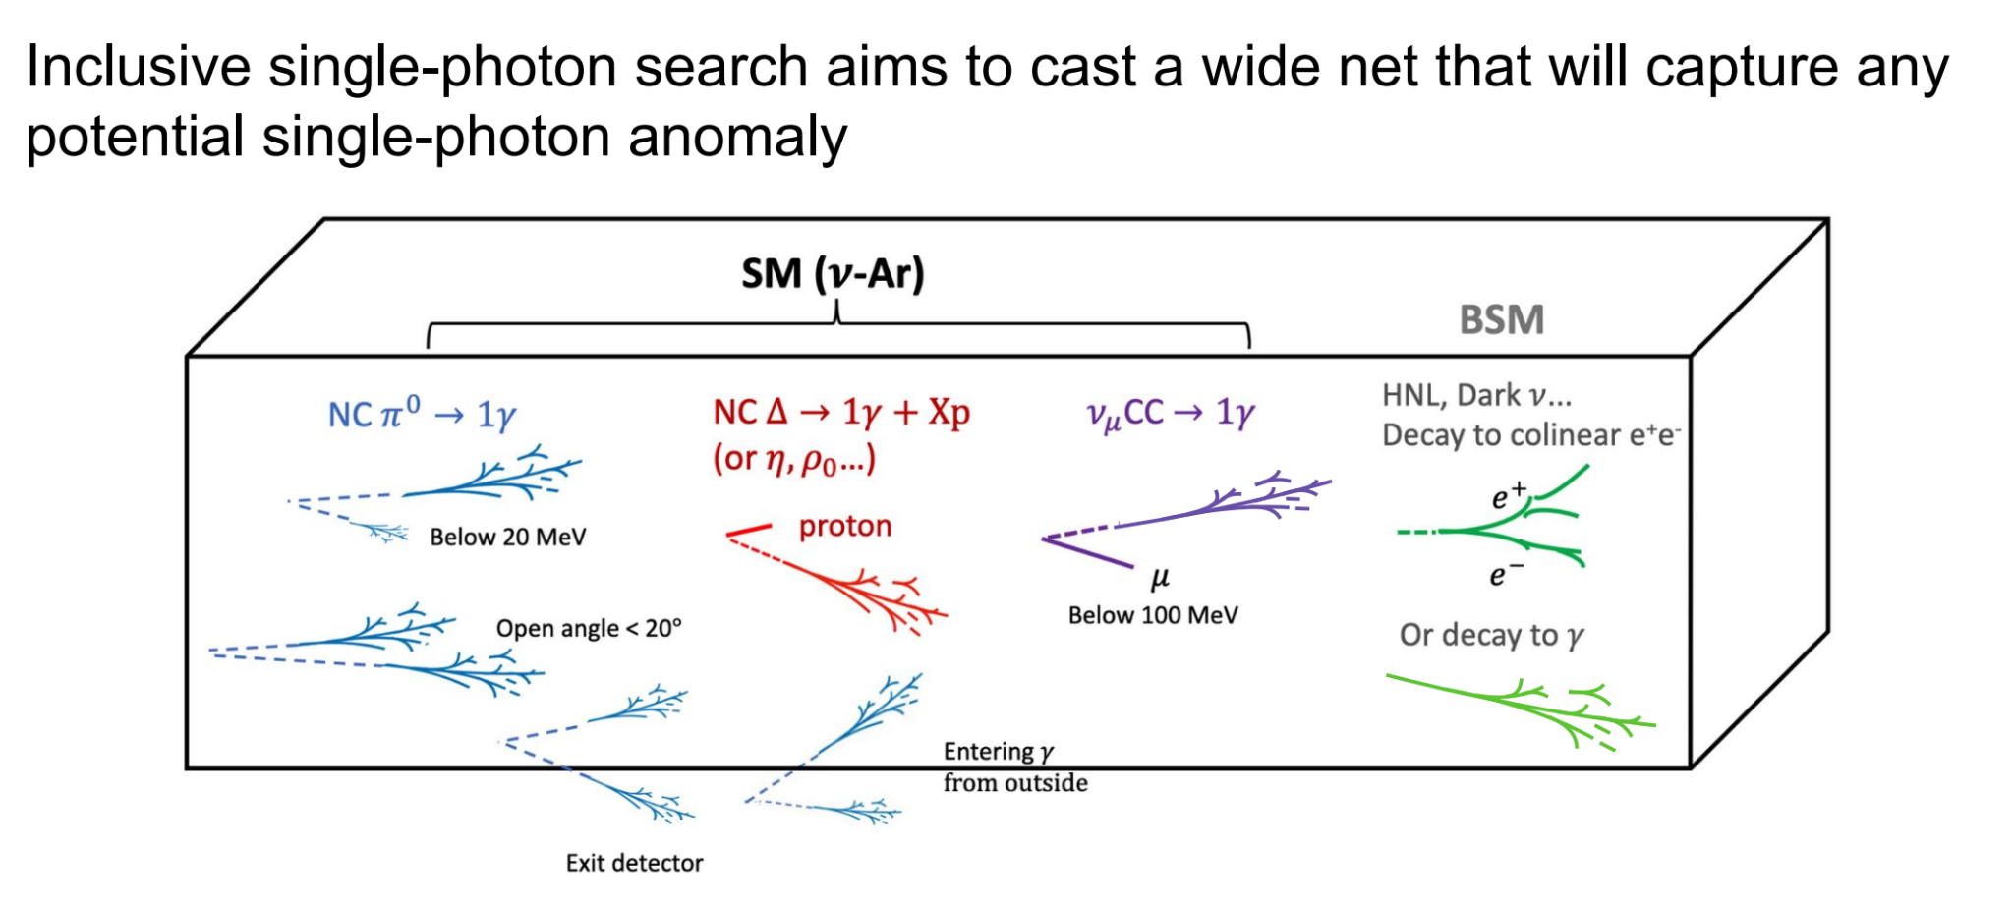
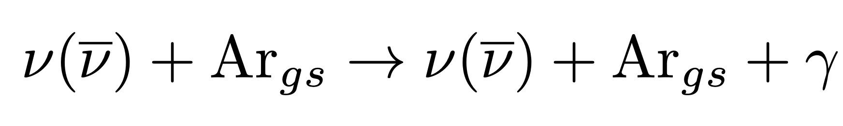
Search for “Low Energy Excess”
𝝂_{e} + Ar → e⁻ + Xp + X𝜋
NC 𝚫 → X𝛾
X ≥ 0
Sterile 𝝂?!
NC = neutral current
𝝂
𝝂
dE/dx discrimination
dE/dx discrimination
time
time
wire
wire

Slide 19
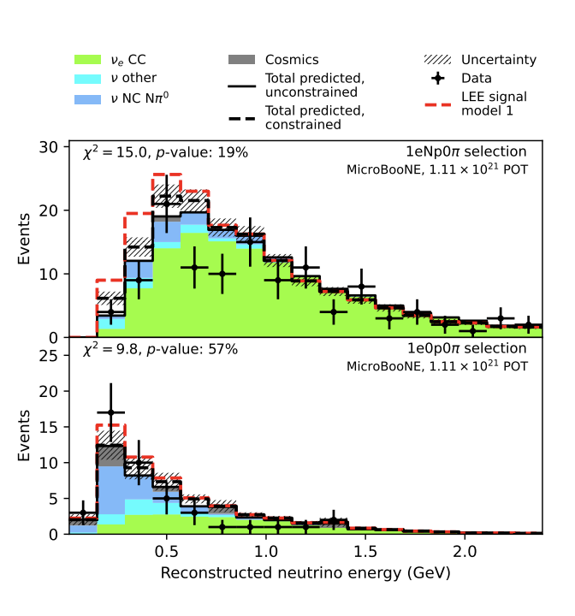
Low Energy Excess: Electrons
𝝂_{e} + Ar → e⁻ + Np + 0𝜋
→ e⁻ + 0p + 0𝜋
(N ≥ 1)
Editors Suggestion: Phys. Rev. Lett. 135, 081802

Slide 20
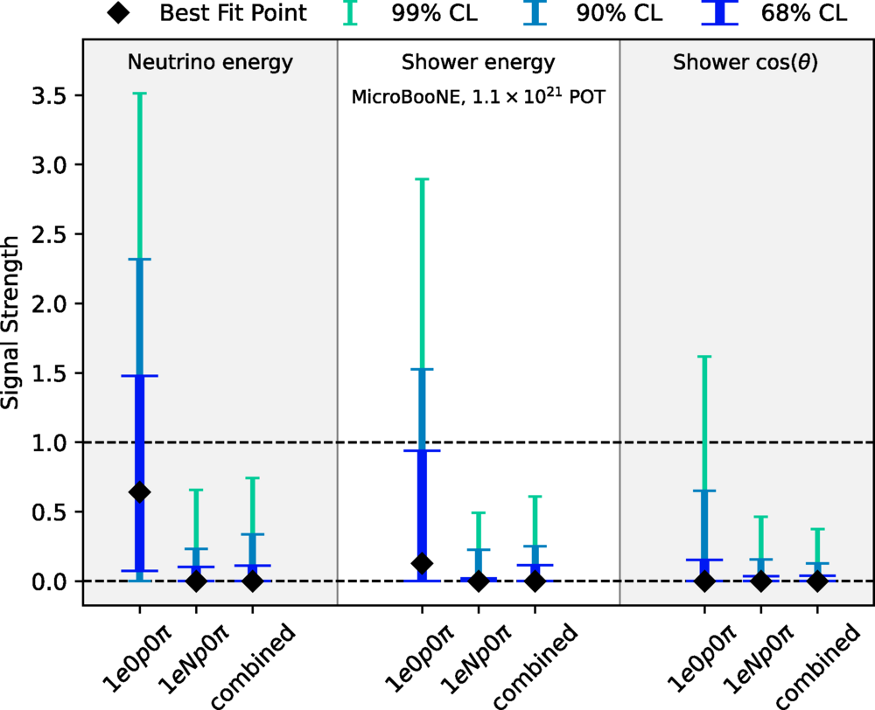
Low Energy Excess: Electrons
𝝂_{e} + Ar → e⁻ + Np + 0𝜋
→ e⁻ + 0p + 0𝜋
(N ≥ 1)
→ No e- excess observed in full MicroBooNE 5 year dataset, ruling out source of MiniBooNE excess at 99% CL_{s}
Editors Suggestion: Phys. Rev. Lett. 135, 081802

Slide 21

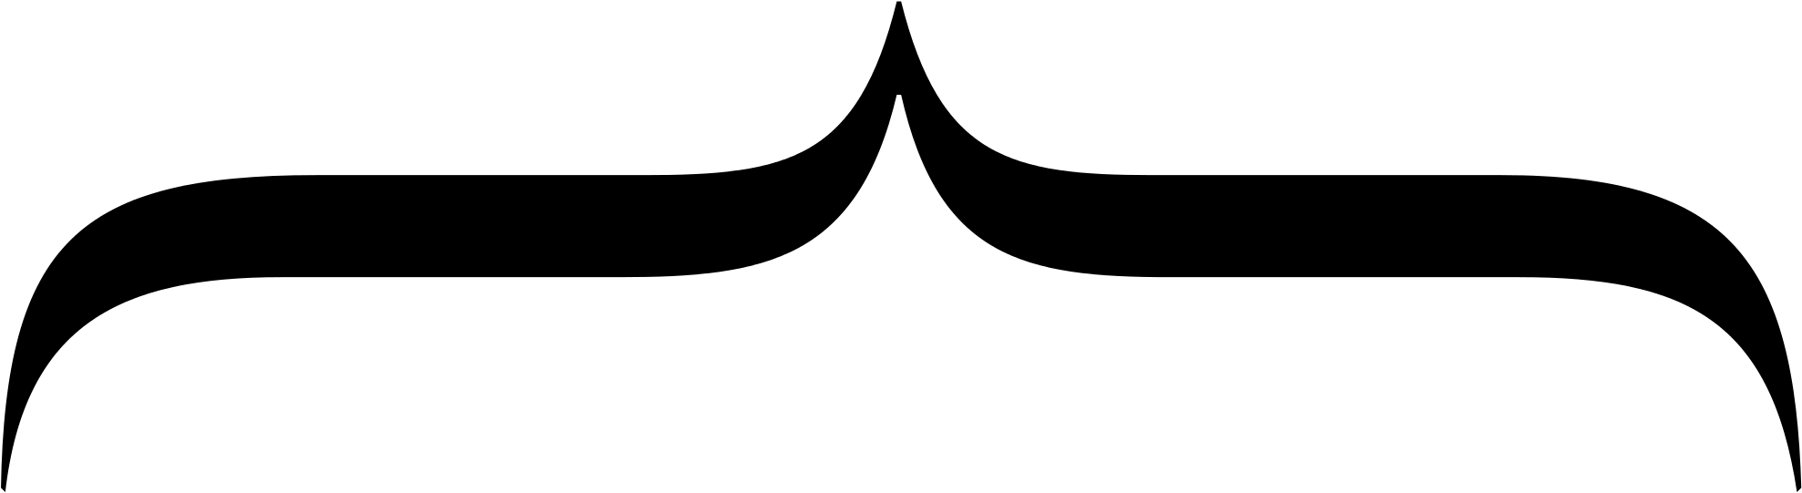


Sterile Neutrinos in 3+1 (1 Sterile)
𝝂₄
Introduce a 4th “sterile” neutrino
…
𝝂₃
3 Neutrino Paradigm
𝝂₂
𝝂₁
Notes:
Microboone also has sterile search (plans BNB+NuMI) → nue appearance…
ICECUBE → some hint of something in muon disappearance, could be something…consistent mass range, but it’s low sensitivity
KATRIN BOUNDS → nue coupling to e- (disappearance) pulling down in opposite shape of prospect
PROSPECT (reactor) pushing up in mass → between this and KATRIN will crush out

Slide 22
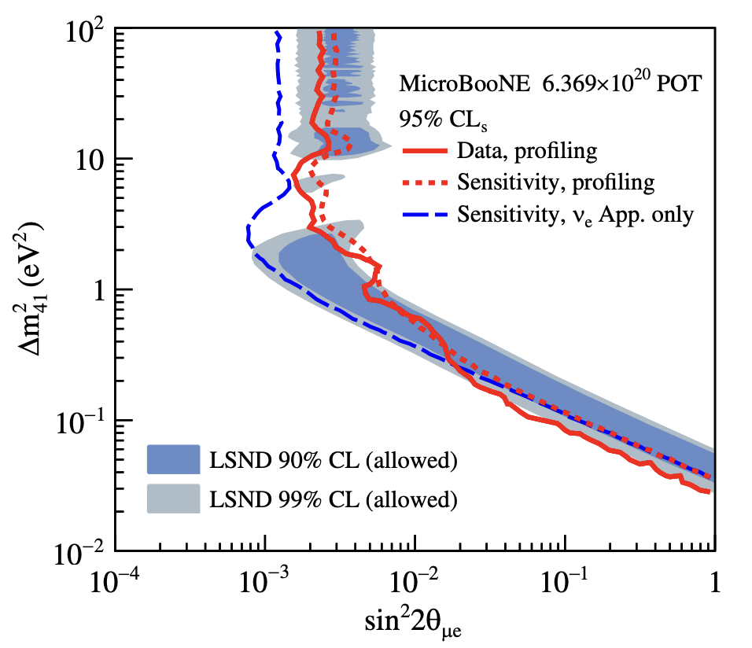
1 Sterile Neutrino
LSND Anomaly
Decay-at-rest
Gallium Anomaly
Radioactive Source
𝝂₄
Introduce a 4th “sterile” neutrino
…
𝝂_{𝝁} → 𝝂_{e}
𝝂_{e} → 𝝂_{e}
3.8 𝝈
𝝂_{e} → 𝝂_{e}
4.0 𝝈
𝝂₃
3 Neutrino Paradigm
Constraining possible values of
𝝂₂
𝝂₁
Notes:
Microboone also has sterile search (plans BNB+NuMI) → nue appearance…
ICECUBE → some hint of something in muon disappearance, could be something…consistent mass range, but it’s low sensitivity
KATRIN BOUNDS → nue coupling to e- (disappearance) pulling down in opposite shape of prospect
PROSPECT (reactor) pushing up in mass → between this and KATRIN will crush out

Slide 23
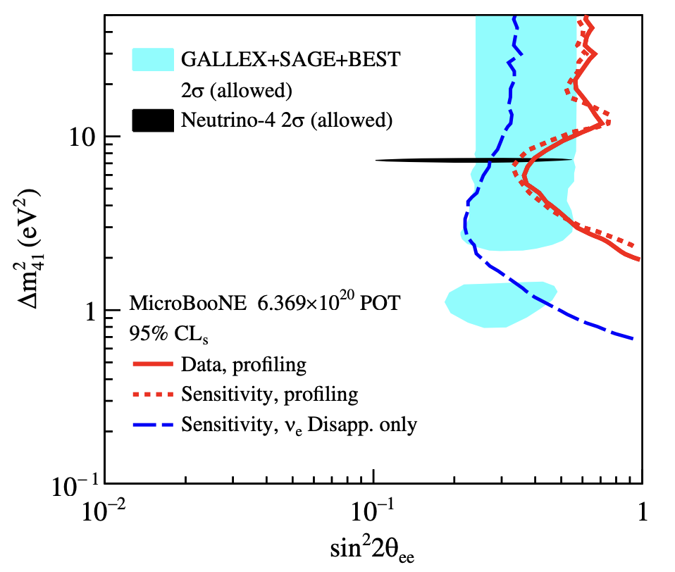
1 Sterile Neutrino
LSND Anomaly
Decay-at-rest
Gallium Anomaly
Radioactive Source
𝝂₄
Introduce a 4th “sterile” neutrino
…
𝝂_{𝝁} → 𝝂_{e}
𝝂_{e} → 𝝂_{e}
3.8 𝝈
𝝂_{e} → 𝝂_{e}
4.0 𝝈
𝝂₃
3 Neutrino Paradigm
[Allowed]
𝝂₂
[Allowed]
𝝂₁
PhysRevLett.130.011801
Notes:
Microboone also has sterile search (plans BNB+NuMI) → nue appearance…
ICECUBE → some hint of something in muon disappearance, could be something…consistent mass range, but it’s low sensitivity
KATRIN BOUNDS → nue coupling to e- (disappearance) pulling down in opposite shape of prospect
PROSPECT (reactor) pushing up in mass → between this and KATRIN will crush out

Slide 24
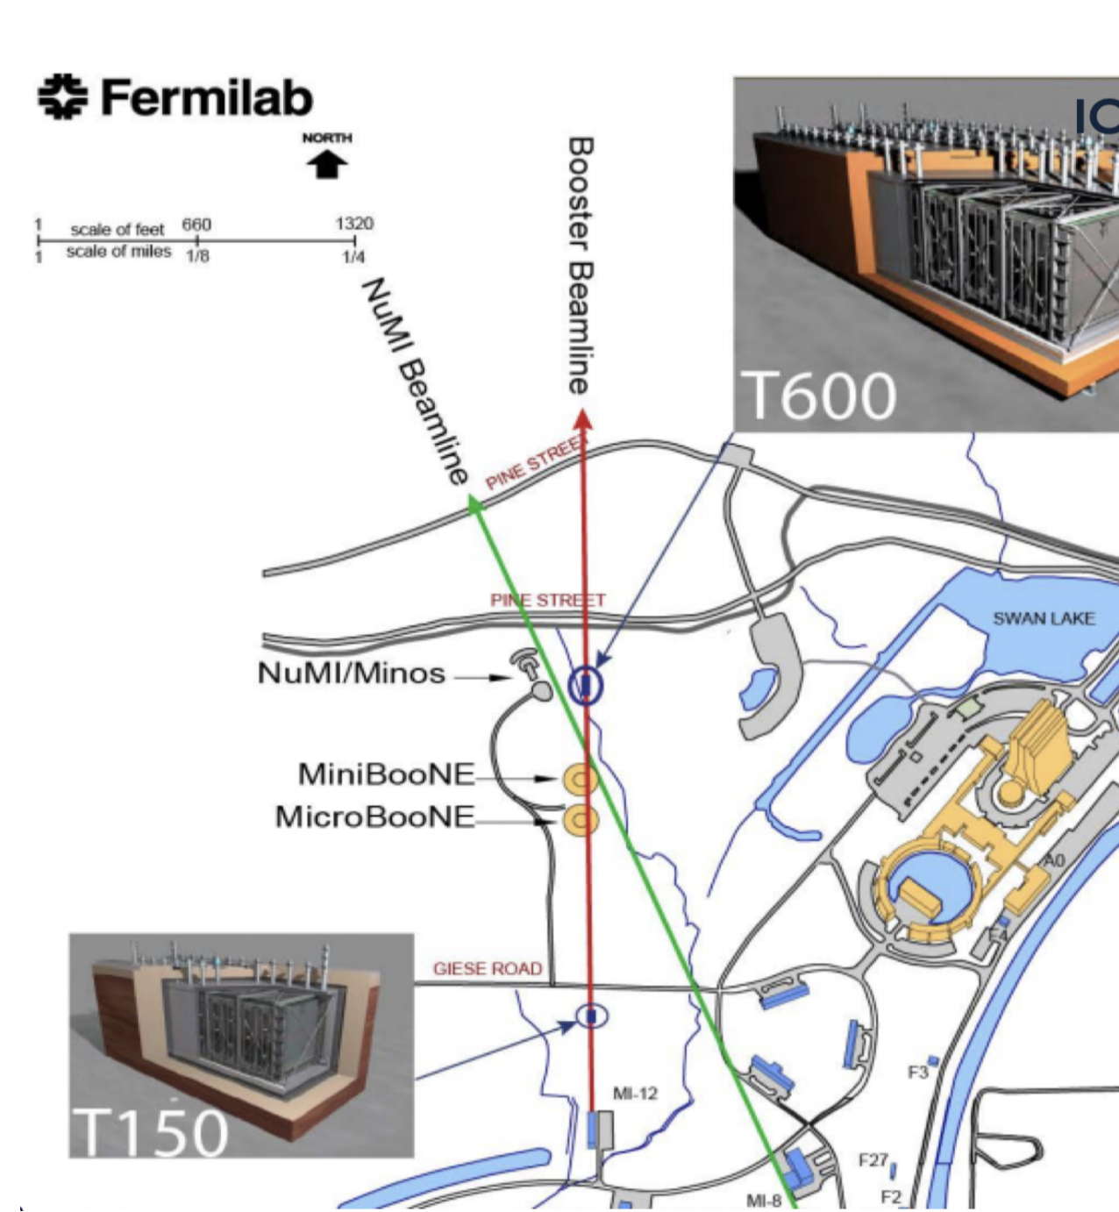
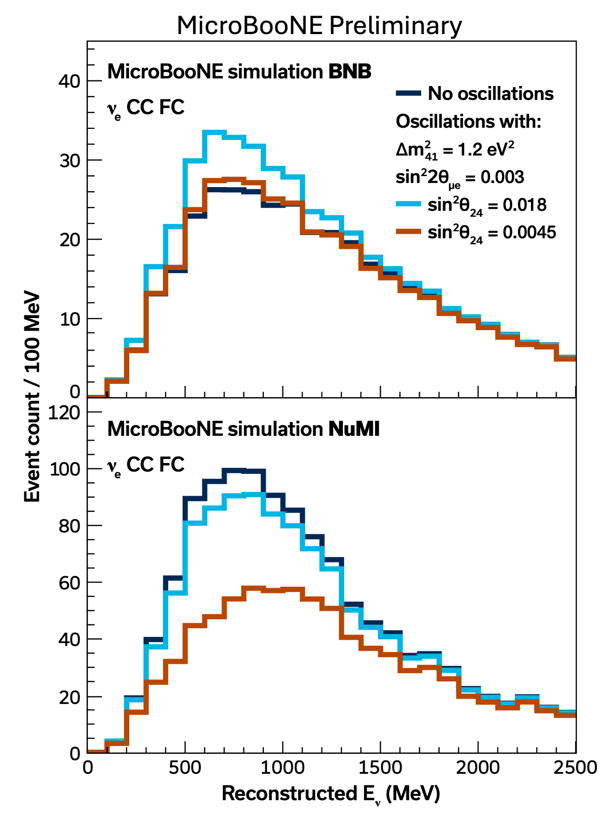
Two Beams are Better Than One
BNB

Slide 25
Two Beams are Better Than One
BNB
NuMI

Slide 26
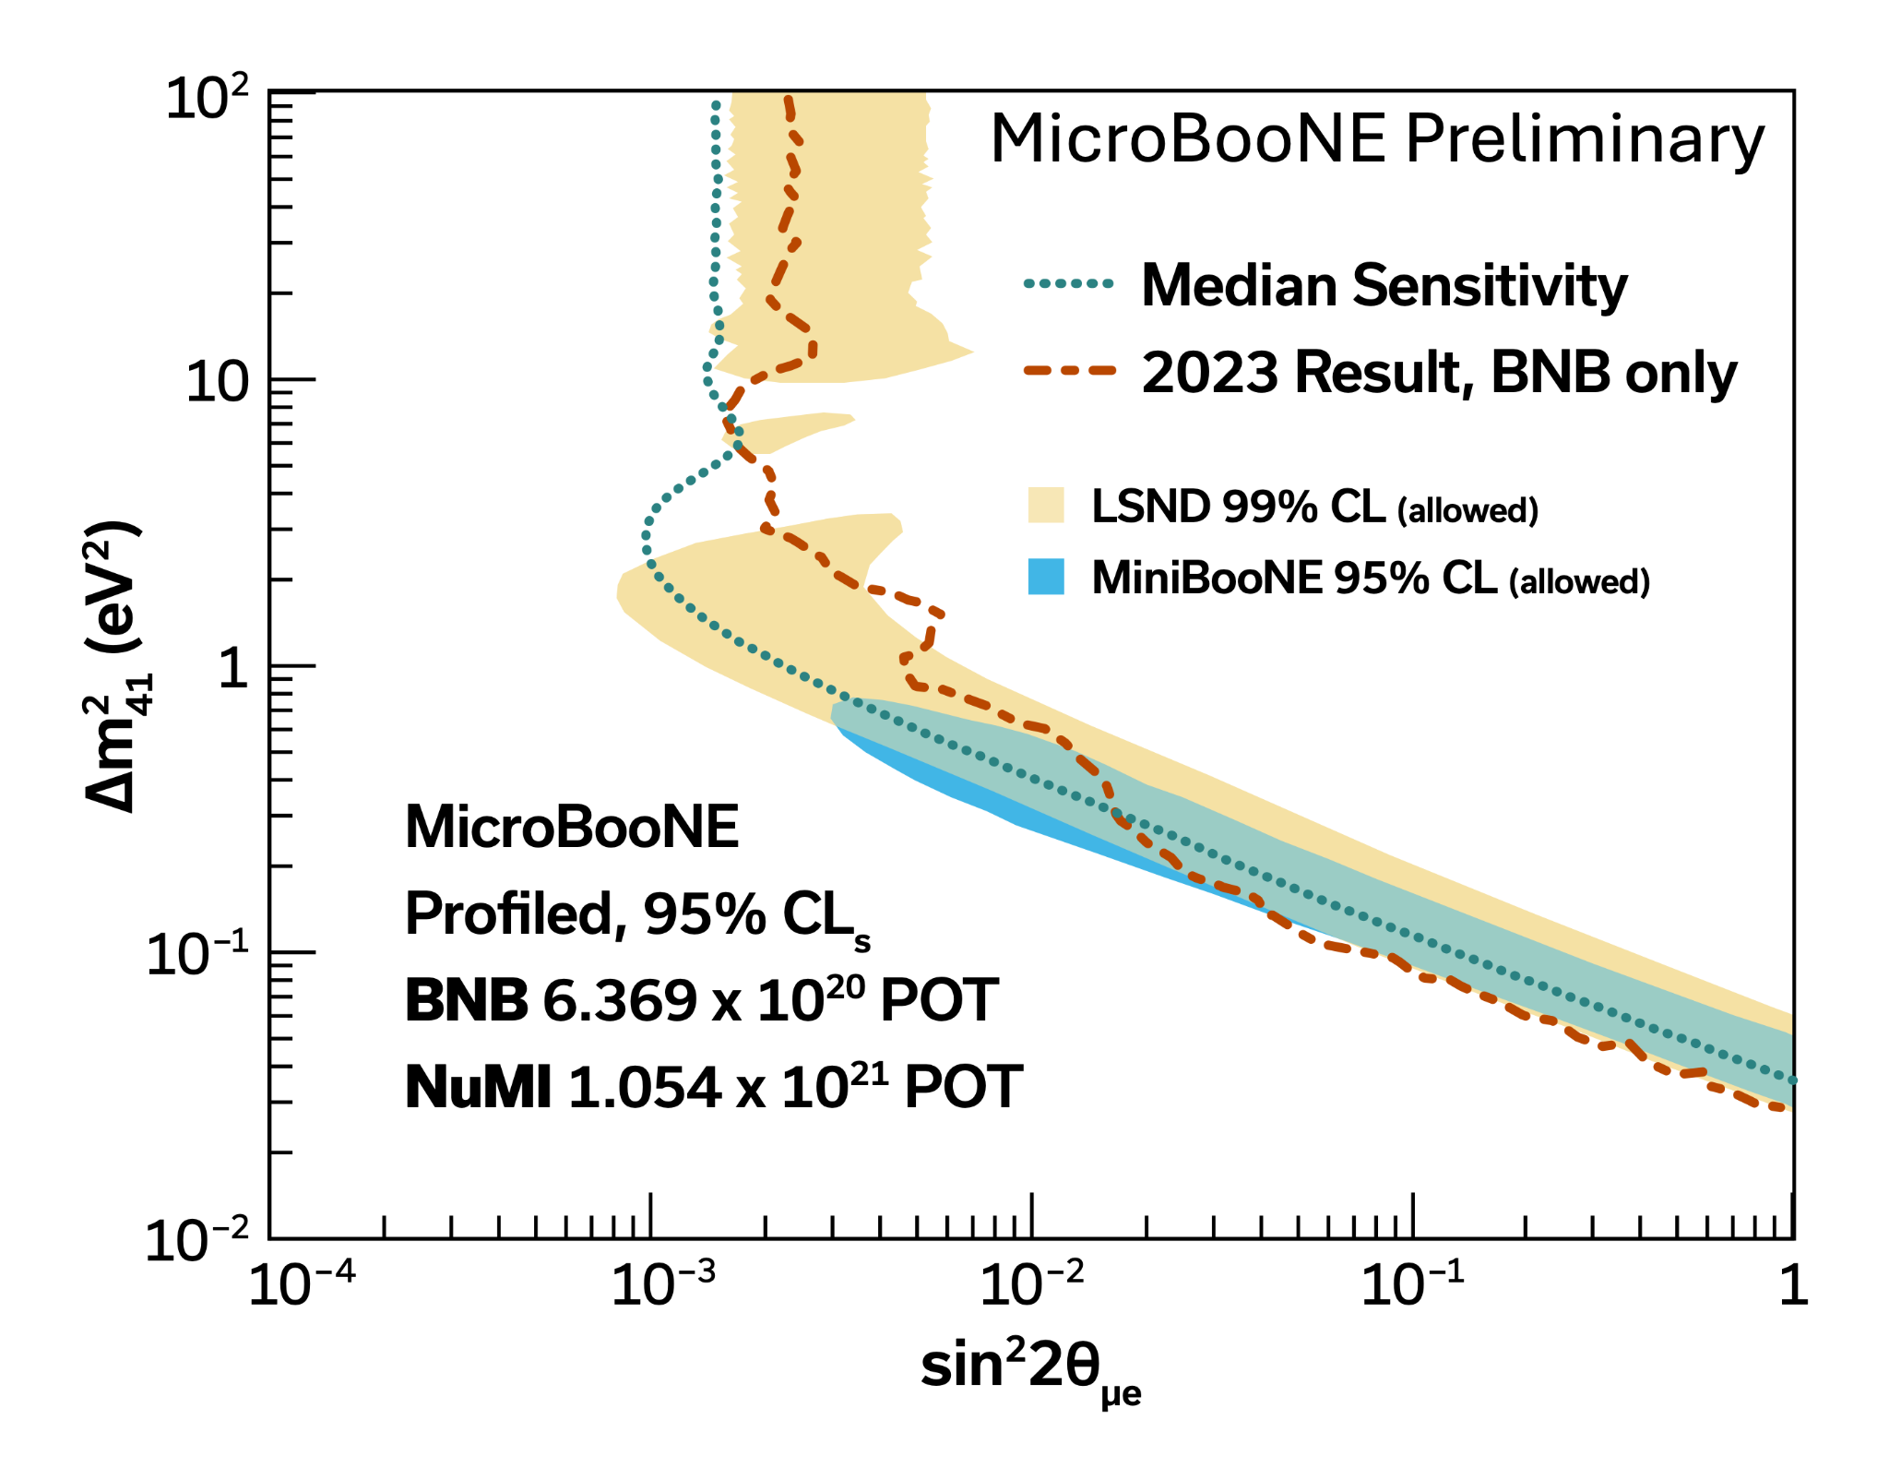
Two Beams
One Result
LSND Anomaly
Decay-at-rest
Gallium Anomaly
Radioactive Source
𝝂_{𝝁} → 𝝂_{e}
3.8 𝝈
𝝂_{e} → 𝝂_{e}
𝝂_{e} → 𝝂_{e}
4.0 𝝈
Single Beam
Allowed

Slide 27
Two Beams
One Result
LSND Anomaly
Decay-at-rest
Gallium Anomaly
Radioactive Source
𝝂_{𝝁} → 𝝂_{e}
3.8 𝝈
𝝂_{e} → 𝝂_{e}
𝝂_{e} → 𝝂_{e}
4.0 𝝈
Single Beam
Two Beams
Allowed

Slide 28
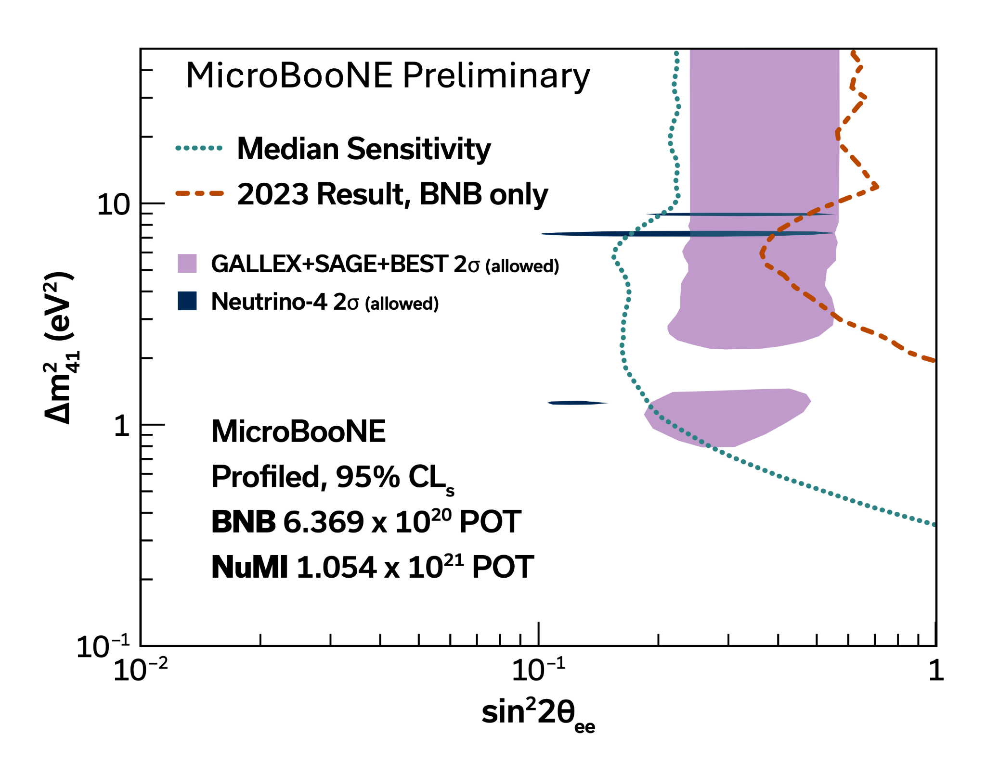
Two Beams
One Result
LSND Anomaly
Decay-at-rest
Gallium Anomaly
Radioactive Source
𝝂_{𝝁} → 𝝂_{e}
3.8 𝝈
𝝂_{e} → 𝝂_{e}
𝝂_{e} → 𝝂_{e}
4.0 𝝈
Single Beam
Two Beams
Single Beam
Allowed
Allowed
Two Beams

Slide 29
1 Sterile Neutrino: Takeaway
𝝂₄
LEE e-
First use of full MicroBooNE data finds no e- excess
Sterile Neutrino:
Using 2 neutrino beams in single detector improves sensitivity
  Results coming soon!
MicroBooNE sensitivity expects to cover single sterile region explaining LSND & Gallium anomaly
Searches in progress for other sterile neutrino models (3+2, etc.)
…
𝝂₃
𝝂₂
𝝂₁
Notes:
Microboone also has sterile search (plans BNB+NuMI) → nue appearance…
ICECUBE → some hint of something in muon disappearance, could be something…consistent mass range, but it’s low sensitivity
KATRIN BOUNDS → nue coupling to e- (disappearance) pulling down in opposite shape of prospect
PROSPECT (reactor) pushing up in mass → between this and KATRIN will crush out

Slide 30
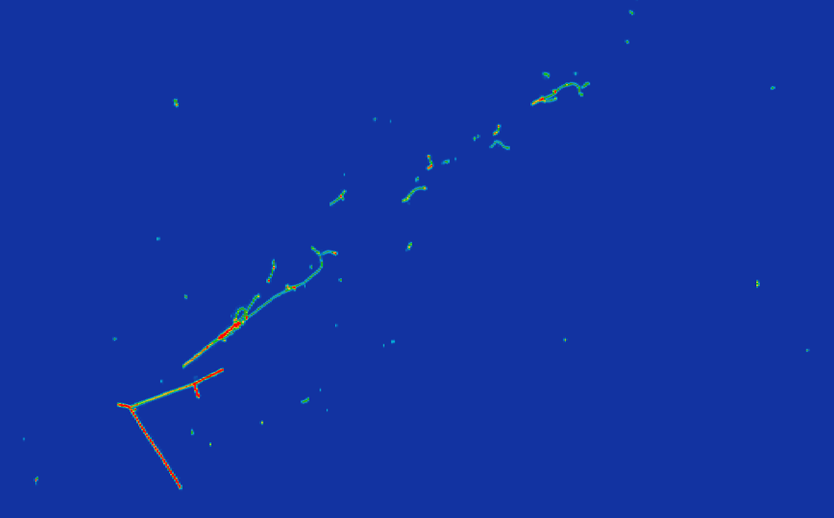
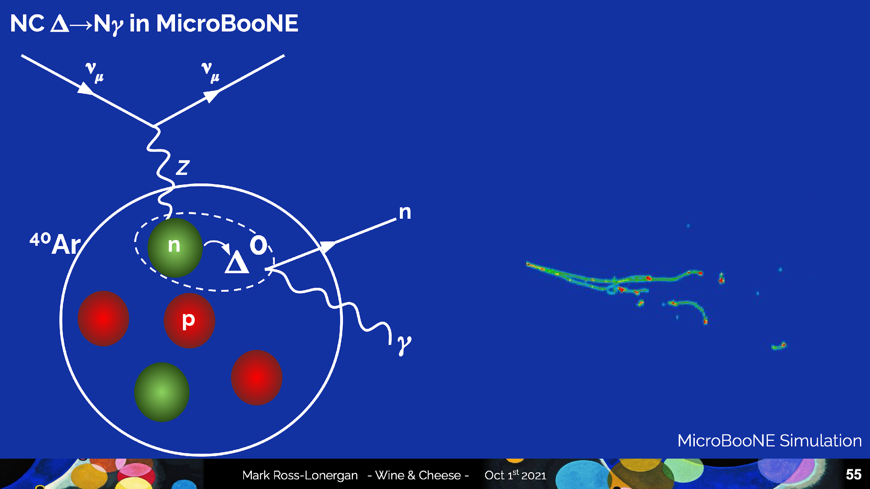
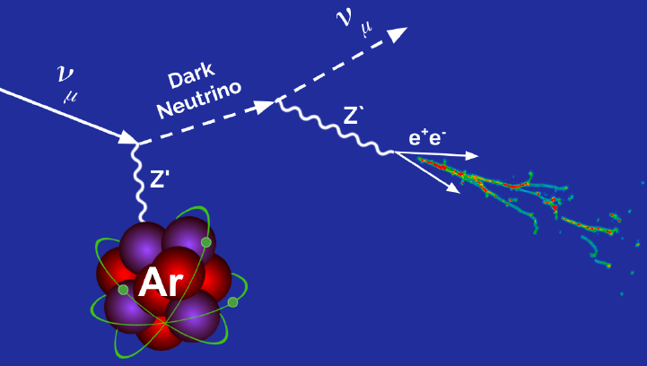
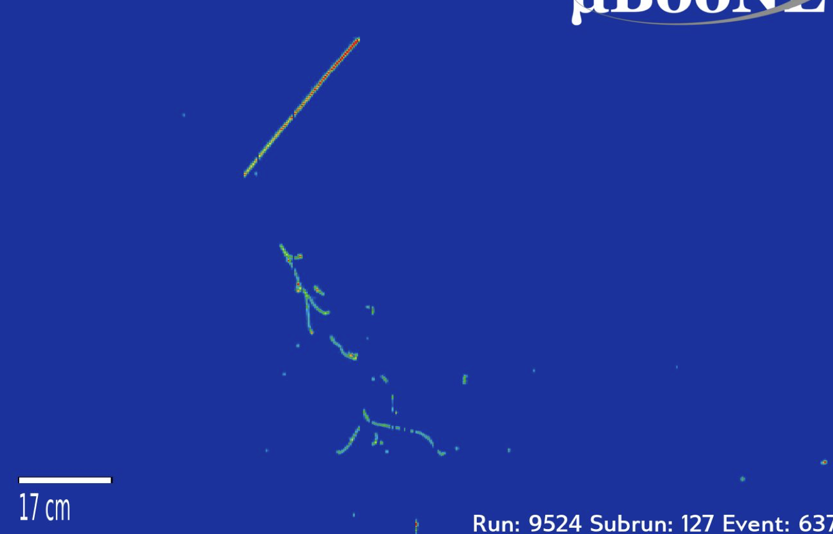

Low Energy Excess: Photons
Inclusive 1𝛄
NC Coherent 1𝛄
Inclusive
NC Coherent
NC 𝜟 → N𝛄
NC 𝚫
e⁺e⁻
Source: Hagaman & Yandel @ Fermilab 2025

Slide 31
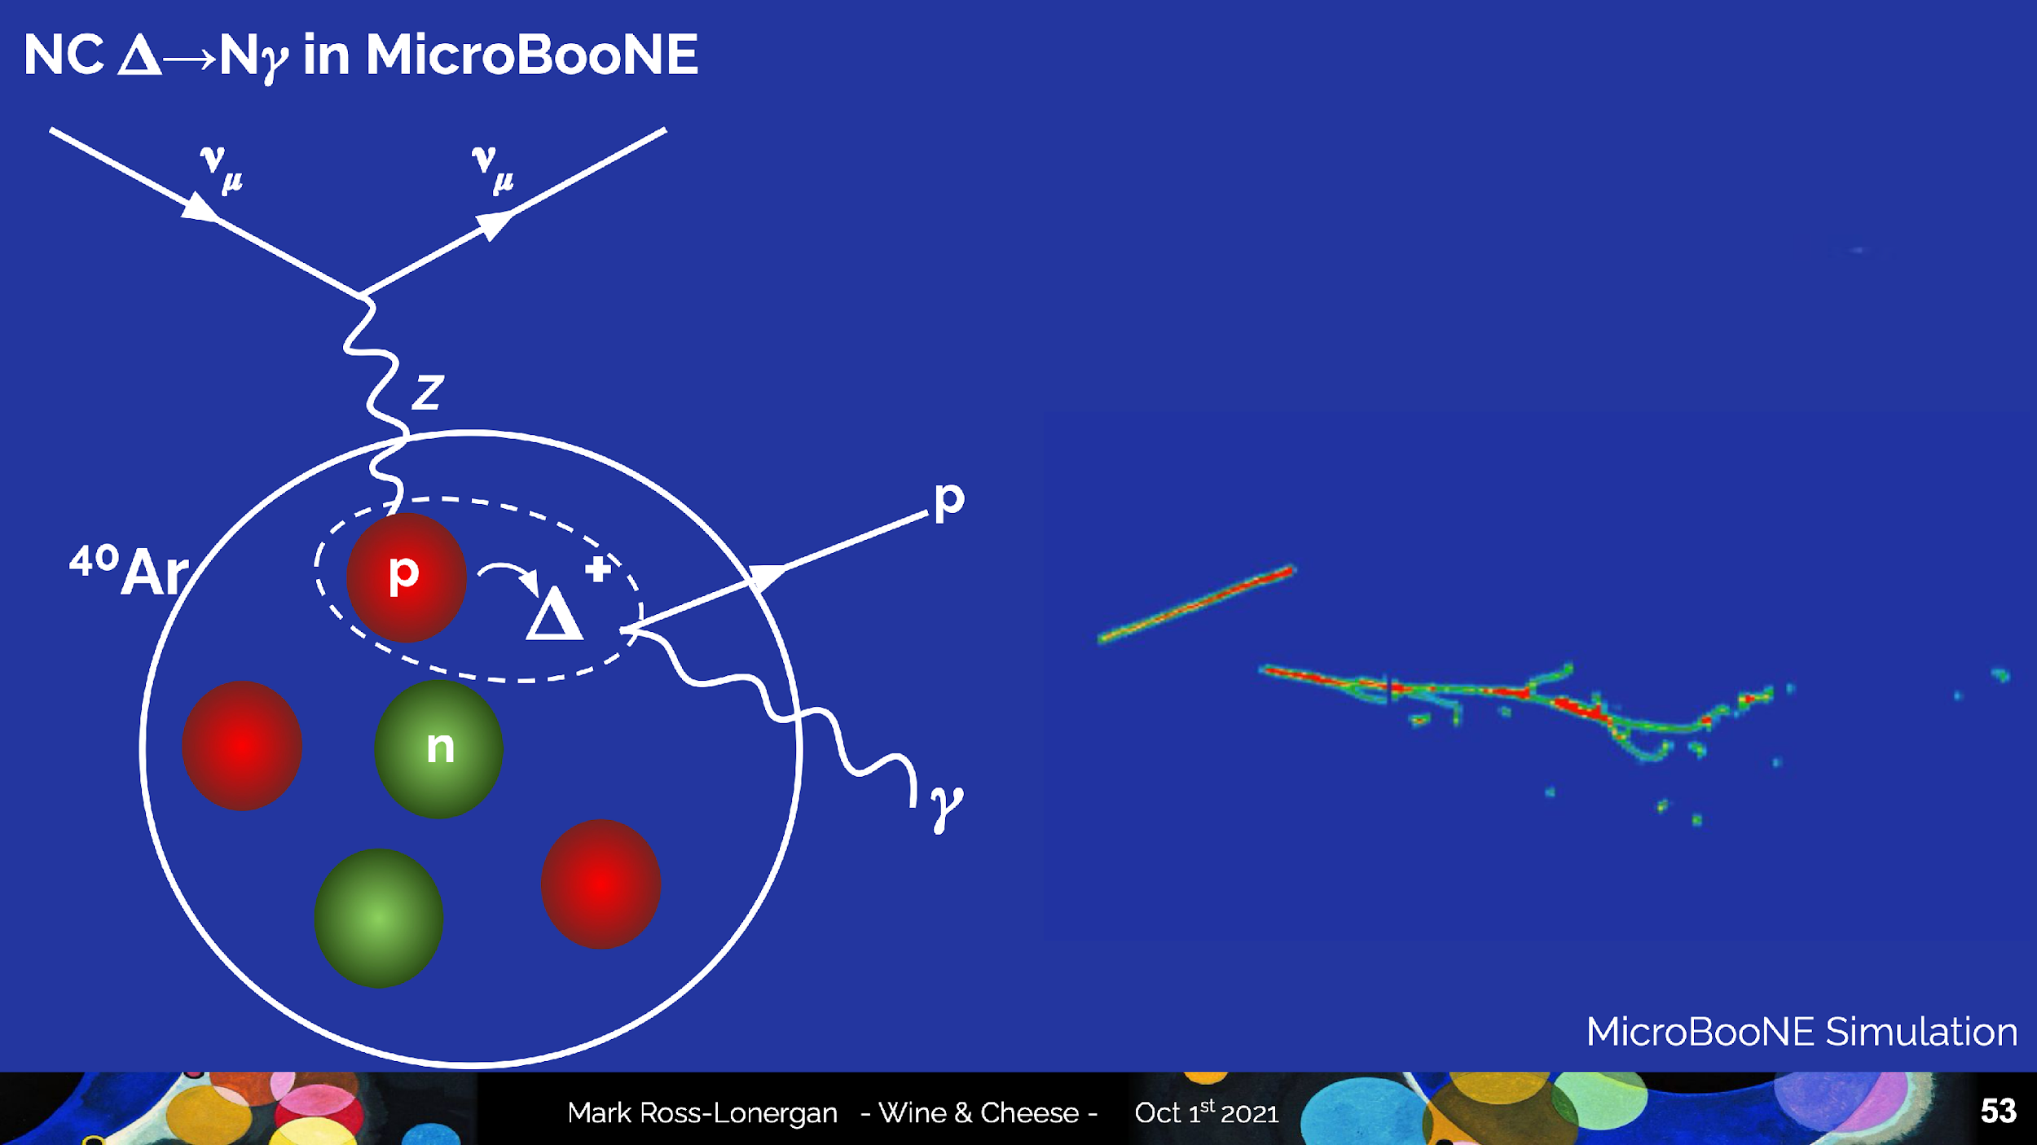
NC 𝚫 → N𝛾
Expanded NC 𝜟 Radiative Decay Paper: https://arxiv.org/abs/2502.05750
1𝛾0p
Could explain the MiniBooNE LEE as a factor of 3.18 enhancement of the NC 𝜟 → N𝛄 rate
1𝛾1p
Source: Hagaman & Yandel @ Fermilab 2025

Slide 32
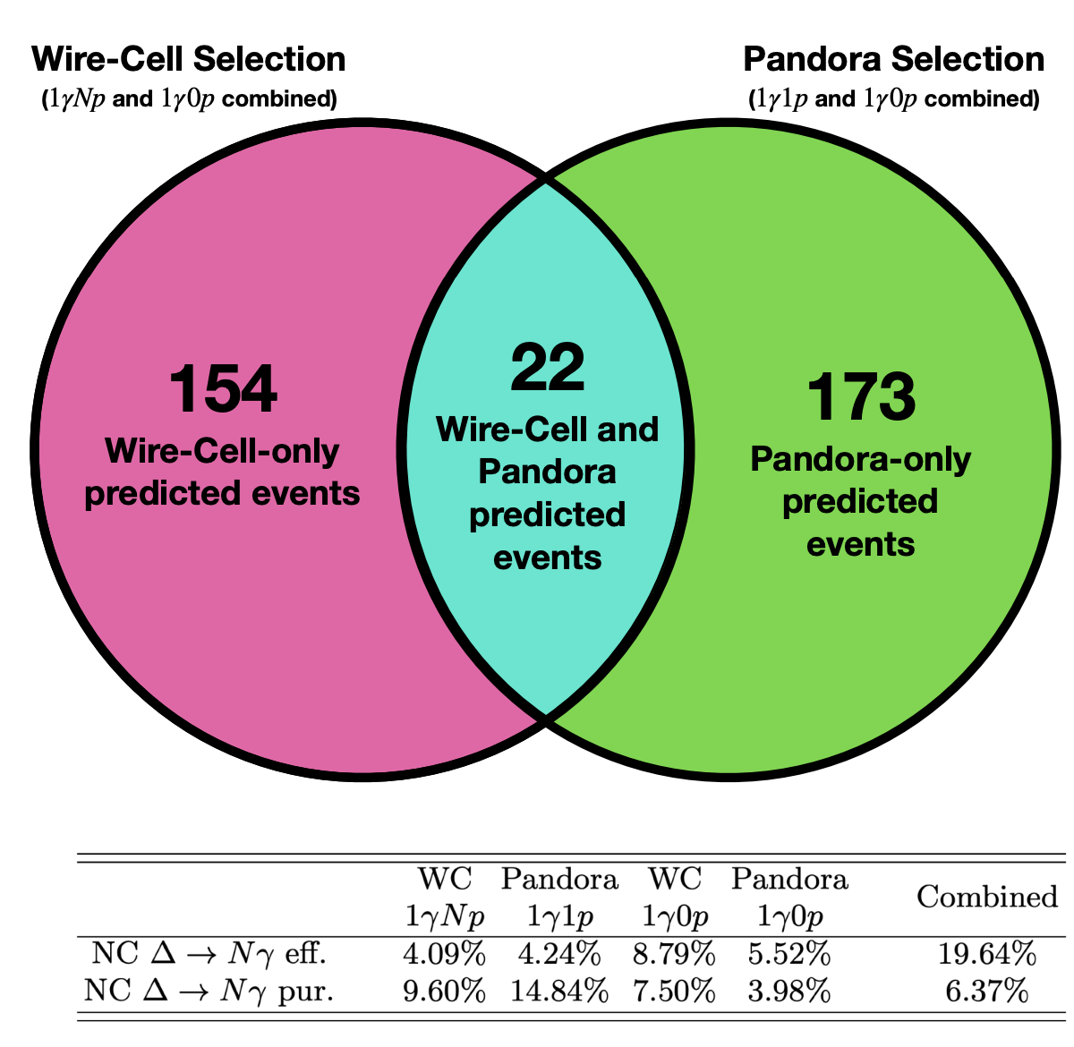
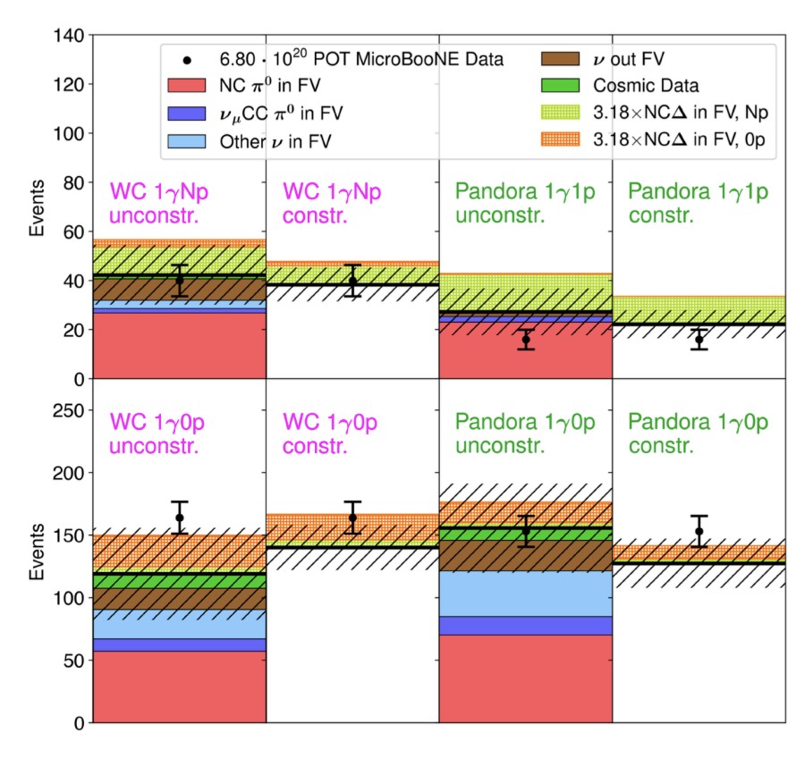
NC 𝚫 → N𝛾
Expanded NC 𝜟 Radiative Decay Paper: https://arxiv.org/abs/2502.05750
Two Complementary Reconstruction Paradigms: 1st LArTPC analysis to combine two independent 3D reconstruction techniques
Pandora: Combines 2D hits into 3D points before doing any clustering of particles
Wire-Cell: Clusters hits in 2D for each wire plane before reconstructing particles in 3D
Source: Hagaman & Yandel @ Fermilab 2025

Slide 33
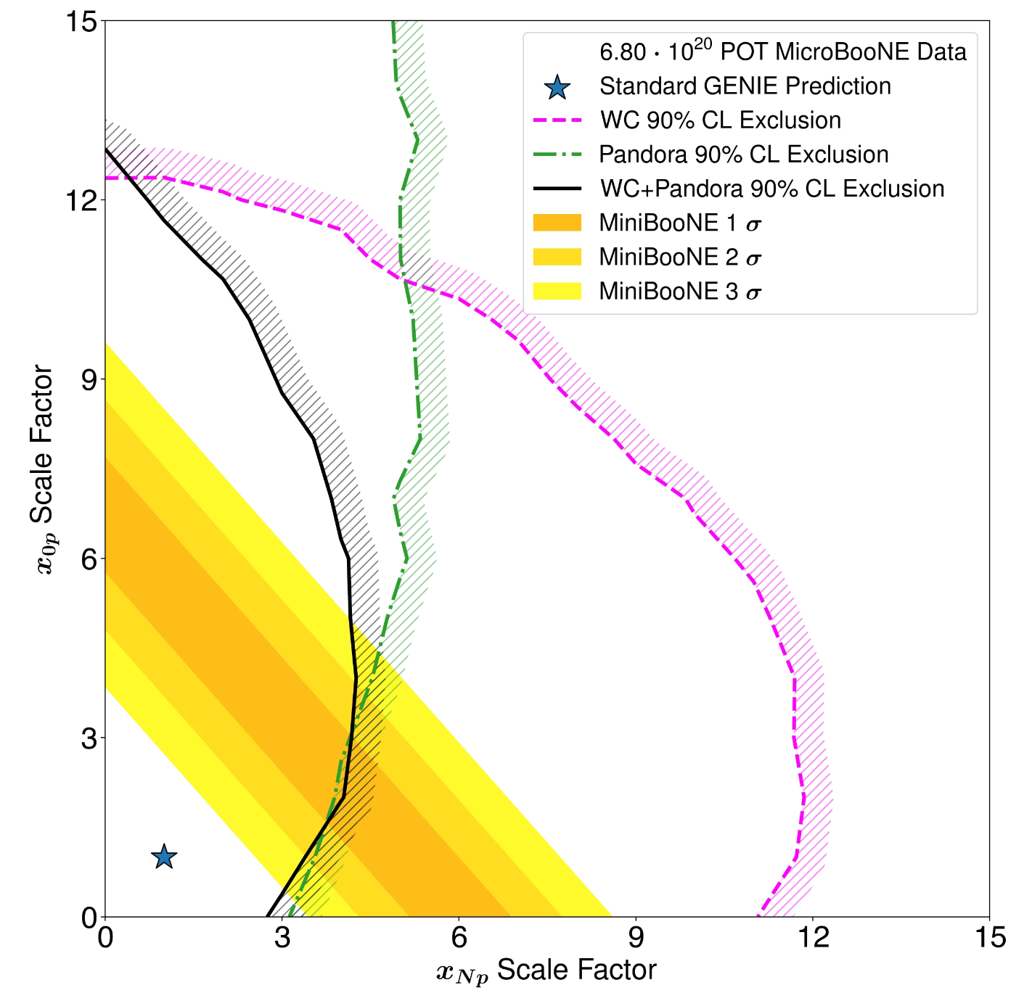
NC 𝚫 → N𝛾
Expanded NC 𝜟 Radiative Decay Paper: https://arxiv.org/abs/2502.05750
Rule out MiniBooNE LEE as a factor of 3.18 enhancement of the NC 𝜟 → N𝛄 rate at 94.4% CL
When looking at a more general space of hypotheses, cannot rule out a 1𝛾0p-like excess
Allowed
Excluded
Source: Hagaman & Yandel @ Fermilab 2025

Slide 34
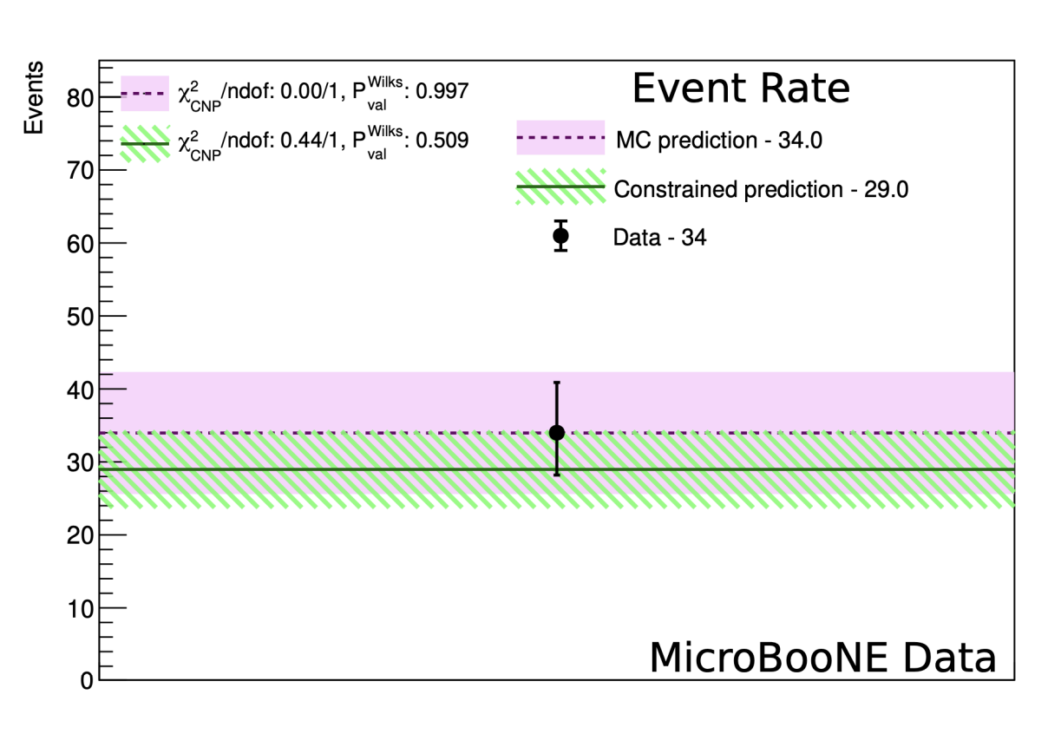
NC Coherent Scattering
NC Coherent Paper: https://arxiv.org/abs/2502.06091
➕ Sub-dominant source of 0 protons
➕No significant coherent excess observed with 0 protons
➕ Sets world’s first limit on the flux-averaged cross section for coherent single photon production:
< 1.49 × 10⁻⁴¹ cm2 / Ar (90% CL)
→ This is 24 times the standard model predicted rate
Source: Hagaman & Yandel @ Fermilab 2025

Slide 35
Inclusive Single 𝛄
Inclusive Paper: https://arxiv.org/abs/2502.06064
Any event that would look like a single 𝛄 at MiniBooNE’s threshold ⬇
Uses 3 of 5 runs of data
Source: Hagaman & Yandel @ Fermilab 2025

Slide 36
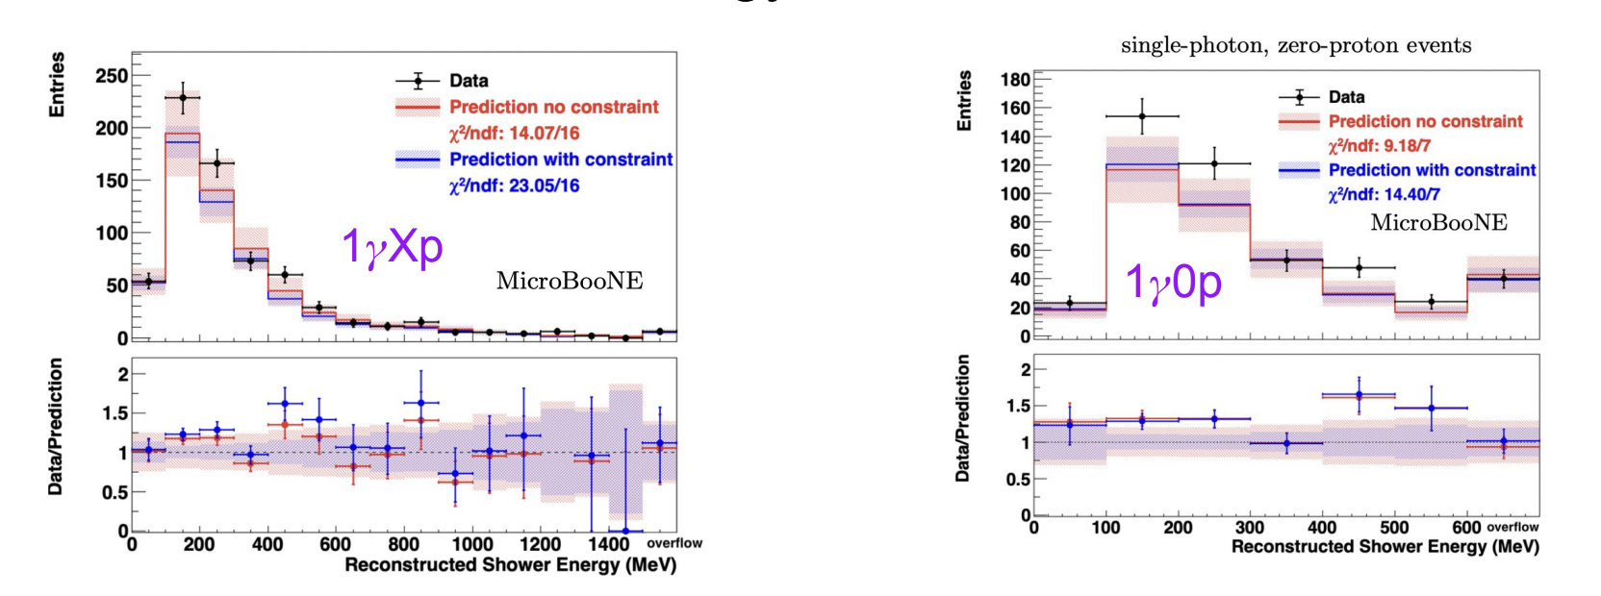
Inclusive Single 𝛄
Inclusive Paper: https://arxiv.org/abs/2502.06064
In the zero proton subsample, a 2𝝈 data excess is seen below 600 MeV shower energy
But the observed excess of 93 events > 33 event excess predicted by a MiniBooNE excess photon model
Source: Hagaman & Yandel @ Fermilab 2025

Slide 37
Dark Neutrino e⁺e⁻
First Search for Dark Sector e⁺e⁻ Explanations: https://arxiv.org/abs/2502.10900
Source: M. Ross-Lonergan @ Fermilab 2025

Slide 38
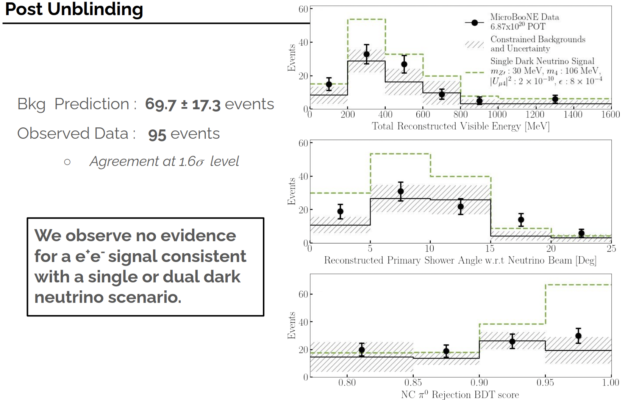
Dark Neutrino e⁺e⁻
First Search for Dark Sector e⁺e⁻ Explanations: https://arxiv.org/abs/2502.10900
More in MicroBooNE's beyond the Standard Model physics program by M. Handley [Sep 2, 2025, 2:10 PM]
Source: M. Ross-Lonergan @ Fermilab 2025

Slide 39
Photon Low Energy Excess”: Takeaway
Some topologies excluded, others in progress
NC 𝚫 → 1𝛄
An expanded search for NC 𝜟 confirmed no 𝜟-like excess (94.4% CL)
NC Coherent Scattering → 1𝛄
A first-ever search for coherent single-photon events focuses on the zero-proton topology and sees no significant coherent excess
Inclusive → 1𝛄
In the 0 proton subsample, a 2𝛔 data excess seen at < 600 MeV shower energy
➡ The observed excess exceeds prediction by a MiniBooNE excess photon model

Slide 40
Summary
MicroBooNE uniquely optimized to test neutrino anomalies
Direct searches for MiniBooNE excess sources
  Electron searches see no significant excess
  Targeted photon searches see no significant excess
  Inclusive photon search shows potential hint (~2𝞂), but does not match the MiniBooNE model
No indication yet of a single sterile neutrino
  New analysis method uses two beams to improve sensitivity to pass the LSND and Gallium anomaly regions

Slide 41
Backup

Slide 42
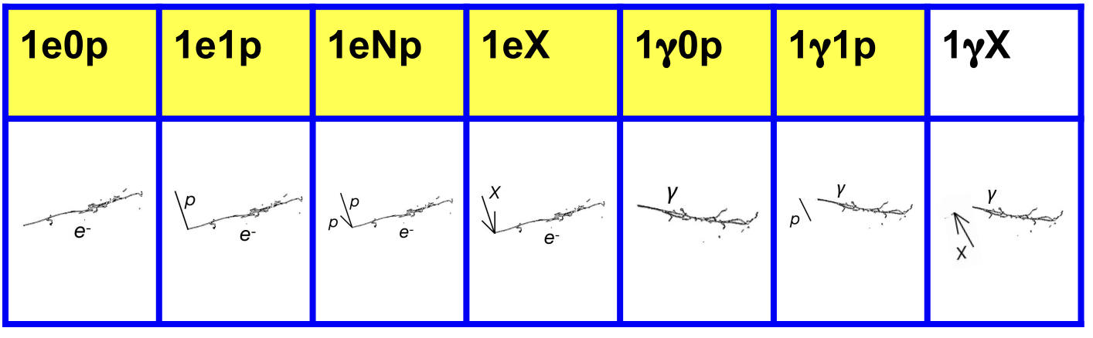
Possible Sources of MiniBooNE Low Energy Excess (LEE) studied with MicroBooNE
𝝂_{e} + Ar → e + Xp + X𝜋
Electron Channels
Photon Channels
1e0p0𝜋
1eNp0𝜋
1e1p0𝜋
1eXpX𝜋
where N > 1 and X ≥ 0

Slide 43
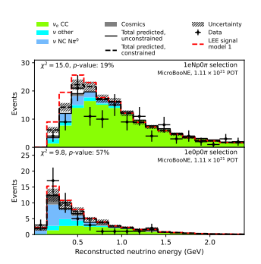
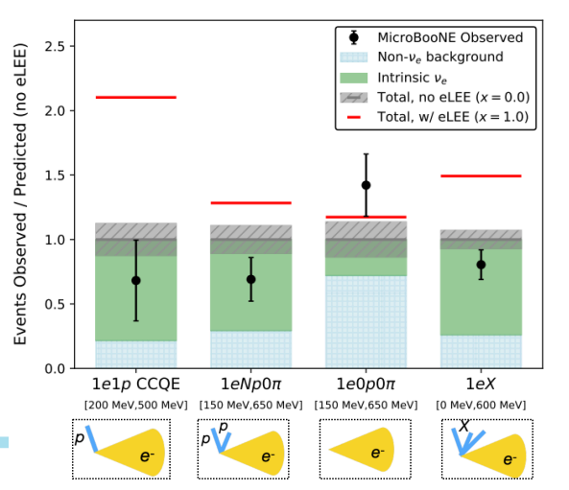
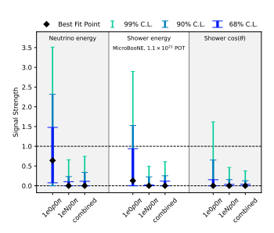
Low Energy Excess: Electrons
Run 1-5
Run 1-3
Run 1-5
PRL 128, 241801 (2022)
Editors Suggestion: Phys. Rev. Lett. 135, 081802

Slide 44


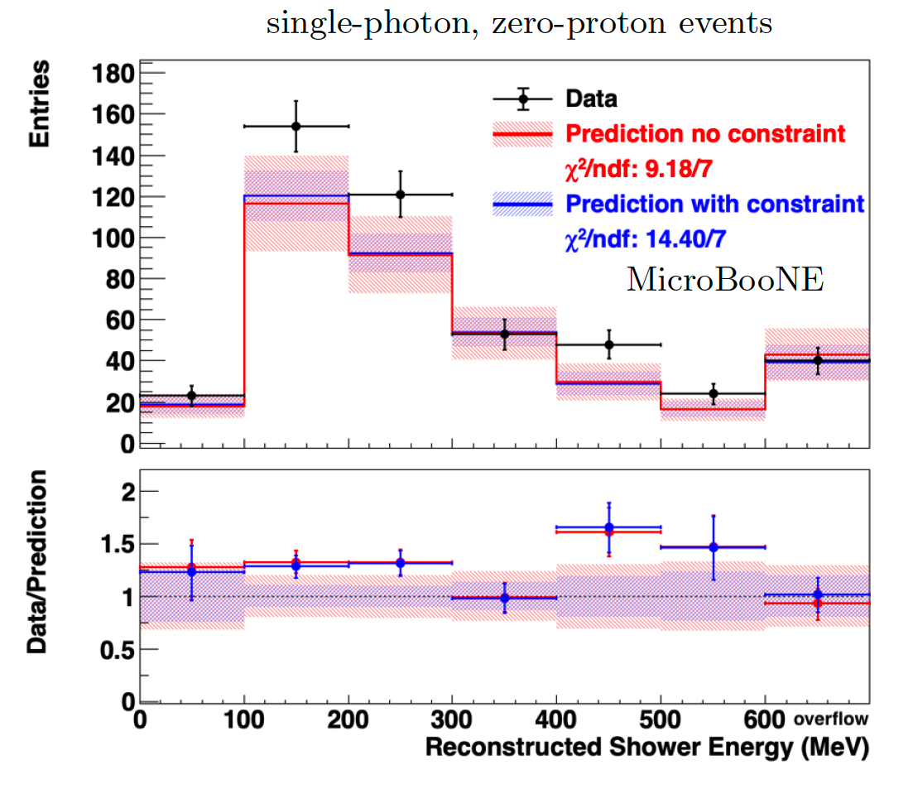
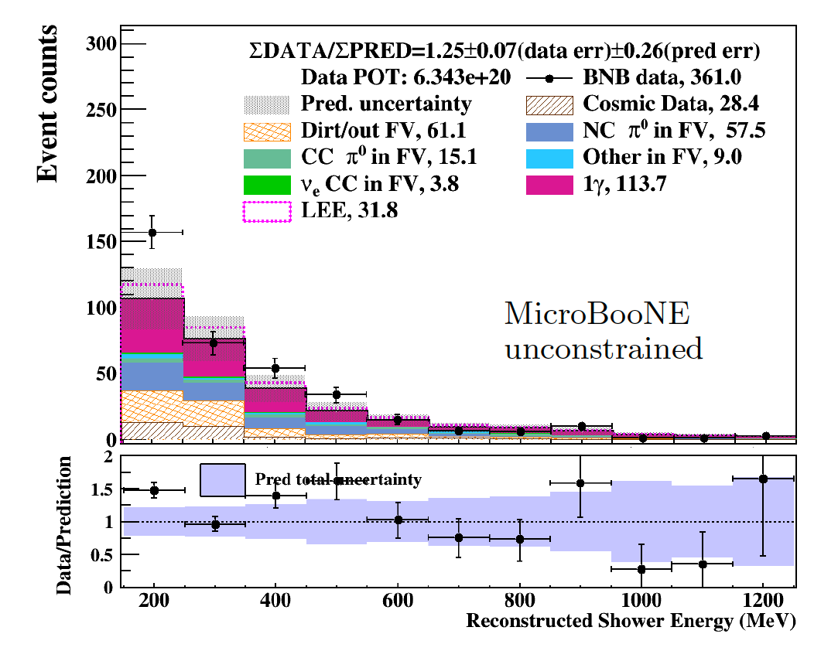
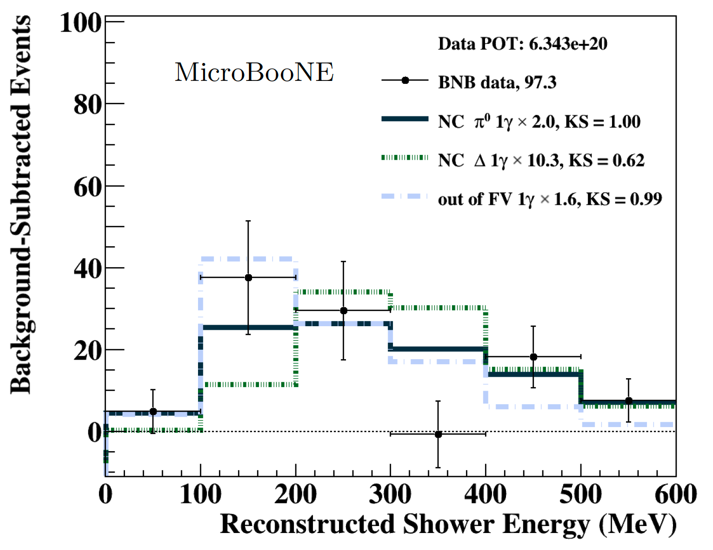
Inclusive Conclusions
Inclusive 1𝛄 search shows agreement at 1.6𝛔
In the zero proton subsample, a 2𝛔 data excess is seen below 600 MeV shower energy
  The observed excess of 93 events > 33 event excess predicted by a MiniBooNE excess photon model
  Studies indicate that NC 𝛑⁰ 1𝛄 events scaled by a factor of ~2 could fit the kinematics of the excess
Erin Yandel on behalf of the MicroBooNE Collaboration

Slide 45
Casting a Wide Next: Other Searches
Source: Mark Ross-Lonergan @ APS2025
Dark Sector e⁺e⁻ |  | MicroBooNE Dark Sector e+e-
Heavy Neutral Leptons (Neutrino Portal) |  | MicroBooNE PRL 2024 IceCube 2025
Higgs Scalar Portal |  | MicroBooNE arXiv 2025. ICARUS PRL 2025
Dark Trident |  | MicroBooNE PRL 2024
𝛄 Vector Portal
e⁺
A^{Dark}
e⁻
𝛎_{𝜇}
N_{HNL}
𝜋⁰
𝜙_{HSP}
𝜇⁺
𝜇⁻
𝜒
A^{Dark}
e⁺
𝜒
A^{Dark}
e⁻
Notes:
Microboone also has sterile search (plans BNB+NuMI) → nue appearance…
ICECUBE → some hint of something in muon disappearance, could be something…consistent mass range, but it’s low sensitivity
KATRIN BOUNDS → nue coupling to e- (disappearance) pulling down in opposite shape of prospect
PROSPECT (reactor) pushing up in mass → between this and KATRIN will crush out

Slide 46
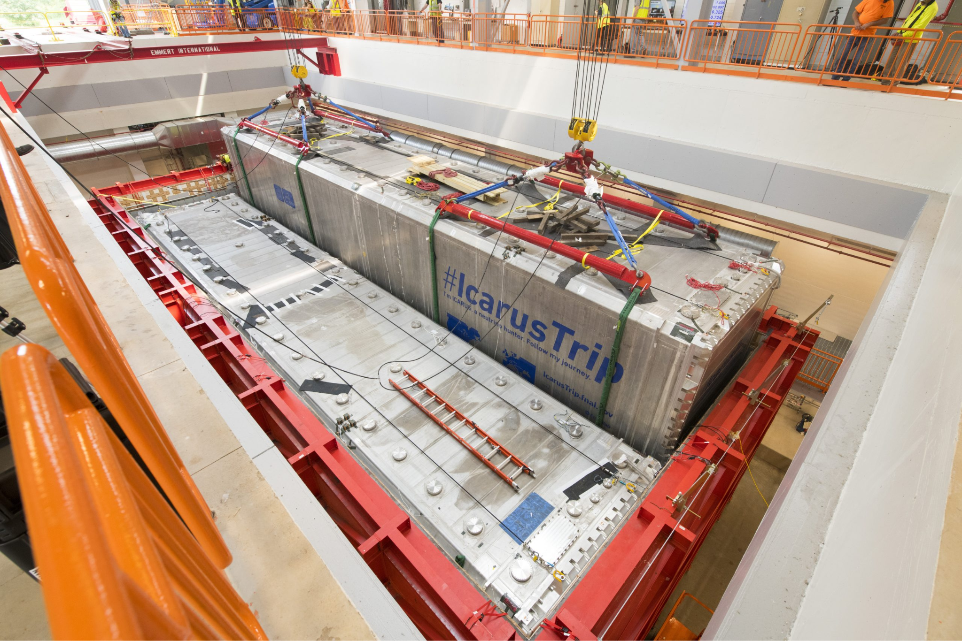
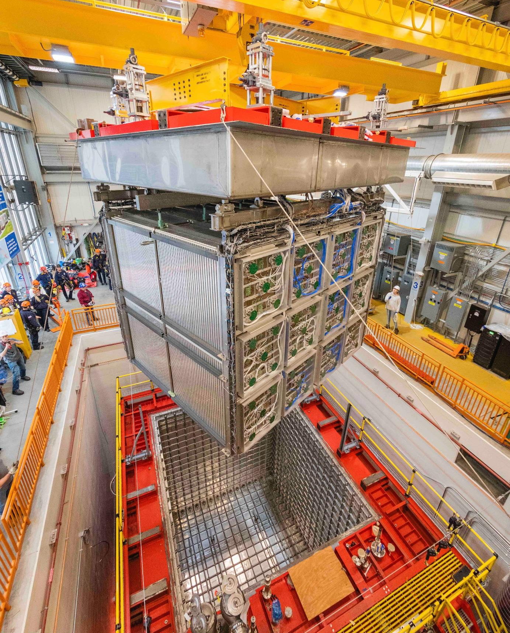
More Liquid Argon TPC @ Short Baselines
Data started 2023
MicroBooNE
5 years of data!
SBND
Data started 2024
ICARUS
476 t active
112 t active
89 t active
*over exaggeration
*
Booster Neutrino Beam (BNB)
𝝂_{𝝁}
𝝂_{e}
𝝂_{𝝁}*
𝝂_{𝝁}
𝝂_{𝝁}
𝝂_{e}
[MiniBooNE]
𝝂_{𝝁}
𝝂_{𝝁}
𝝂_{𝝁}
𝝂_{𝝁}
𝝂_{𝝁}*
110 m
600 m
470 m
𝝂_{e}
𝝂_{𝝁}
𝝂_{𝝁}
𝝂_{𝝁}
𝝂_{𝝁}
𝝂_{𝝁}
𝝂_{𝝁}

