Slide 1

Final Muon $g−2$Result at Fermilab
Ce Zhang on behalf of the Fermilab Muon g-2 collaboration
NuFact 2025

Slide 2
Final Muon $g−2$Result at Fermilab
Magnetic anomaly of the muon – concept, history, and limitations
A Journey to 127 ppb at Fermilab
Techniques, setup, and results from Runs 1–3
Runs 4/5/6: notable Improvements and final results
Are we done?

Slide 3
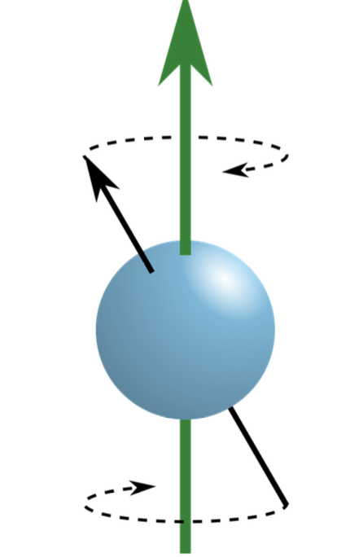
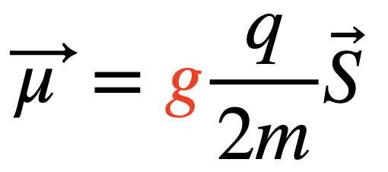
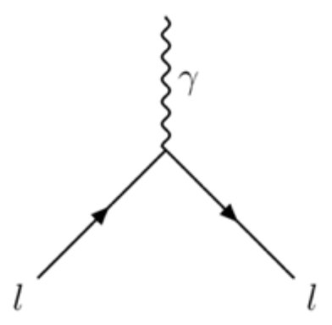
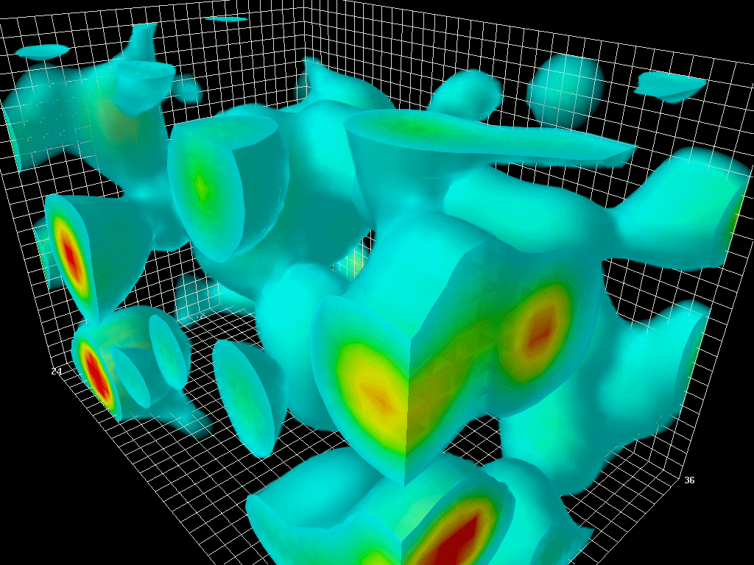
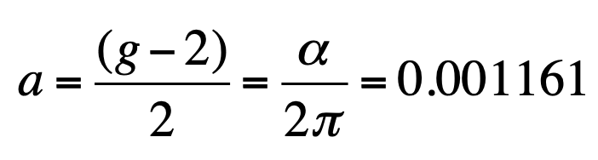
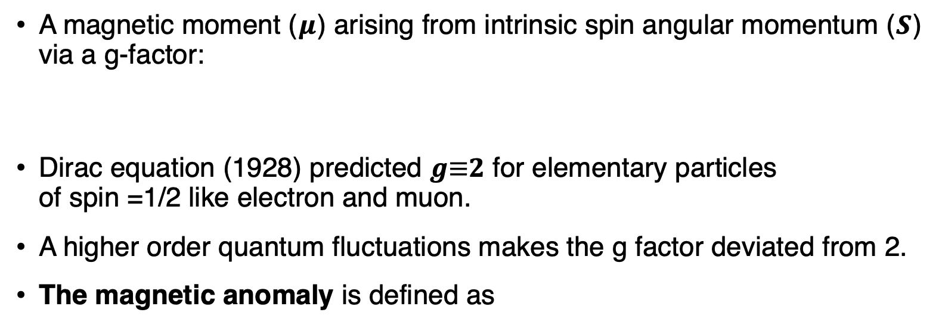

Magnetic anomaly of the muon
A magnetic moment ($μ$) arising from intrinsic spin angular momentum ($S$) via a g-factor:
Dirac equation (1928) predicted 𝒈≡𝟐 for elementary particles of spin =1/2 like electron and muon.
A higher order quantum fluctuations makes the g factor deviated from 2.
The magnetic anomaly is defined as
$$μ$$

Slide 4
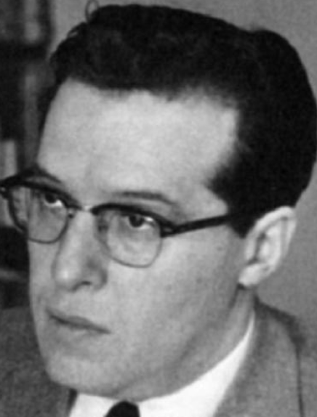
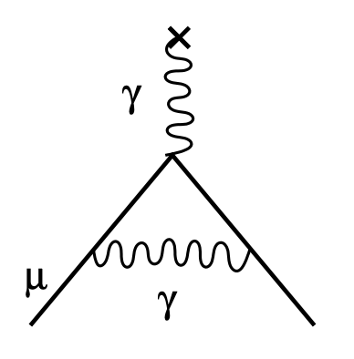
Magnetic anomaly of the muon
A magnetic moment ($μ$) arising from intrinsic spin angular momentum ($S$) via a g-factor:
Dirac equation (1928) predicted 𝒈≡𝟐 for elementary particles of spin =1/2 like electron and muon.
A higher order quantum fluctuations makes the g factor deviated from 2.
The magnetic anomaly is defined as
$$μ$$
1948: Triumph of QED by Schwinger

Slide 5
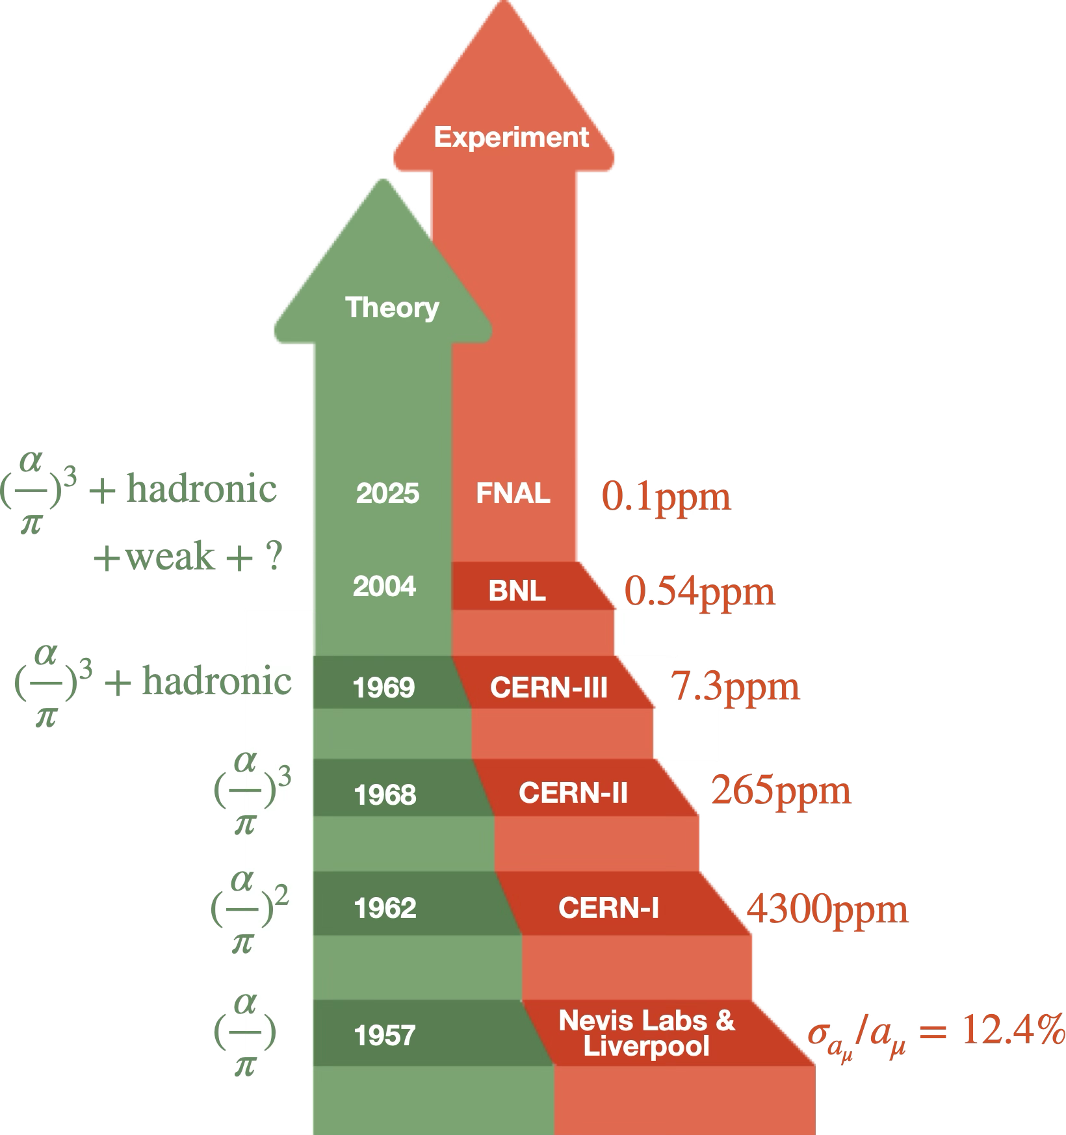
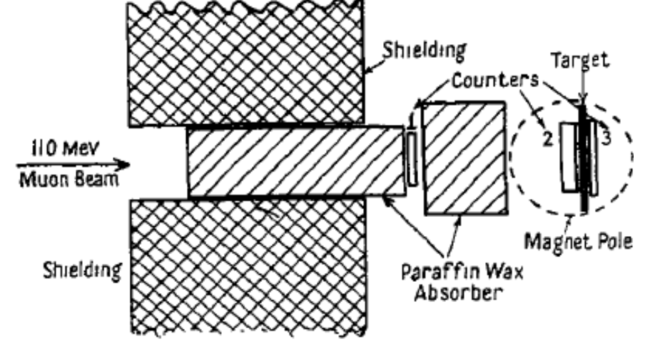
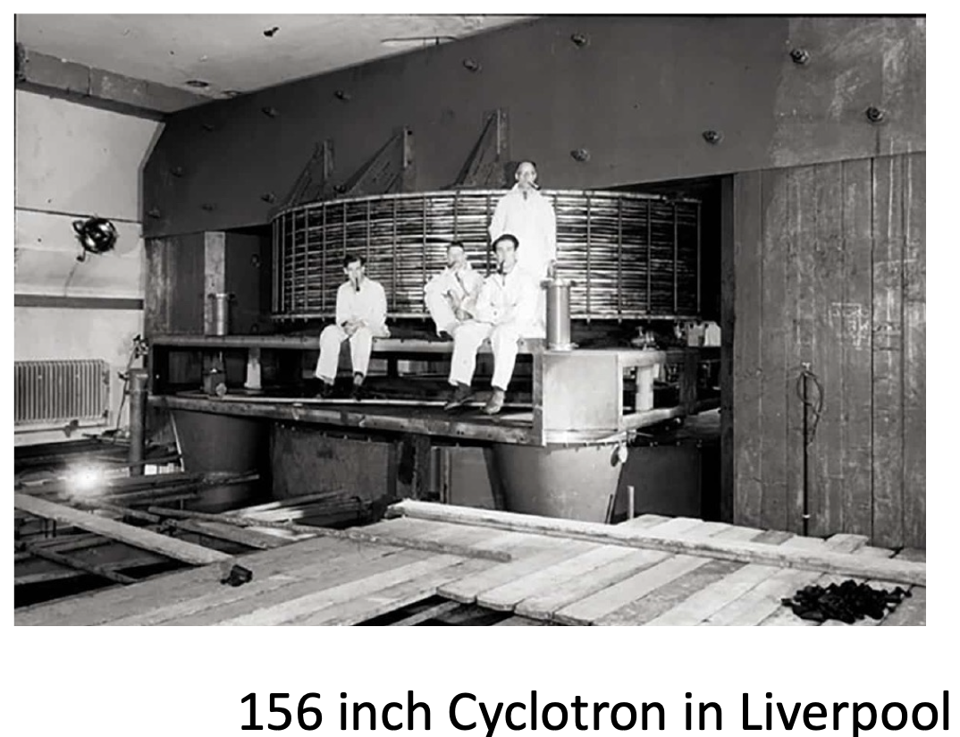
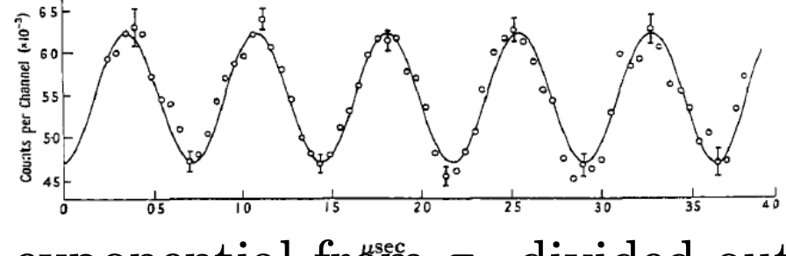
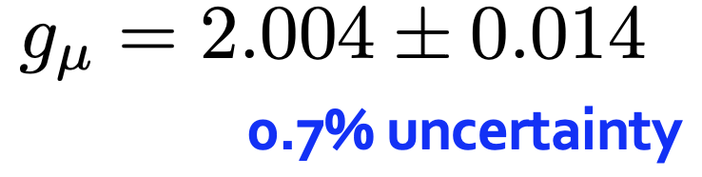
Magnetic anomaly of the muon
— how theory and experiments shape each other
1957 marked the first direct measurements of muon g-2:
Garwin, Lederman, Weinrich at Nevis
Cassels, et al. at Liverpool

Slide 6
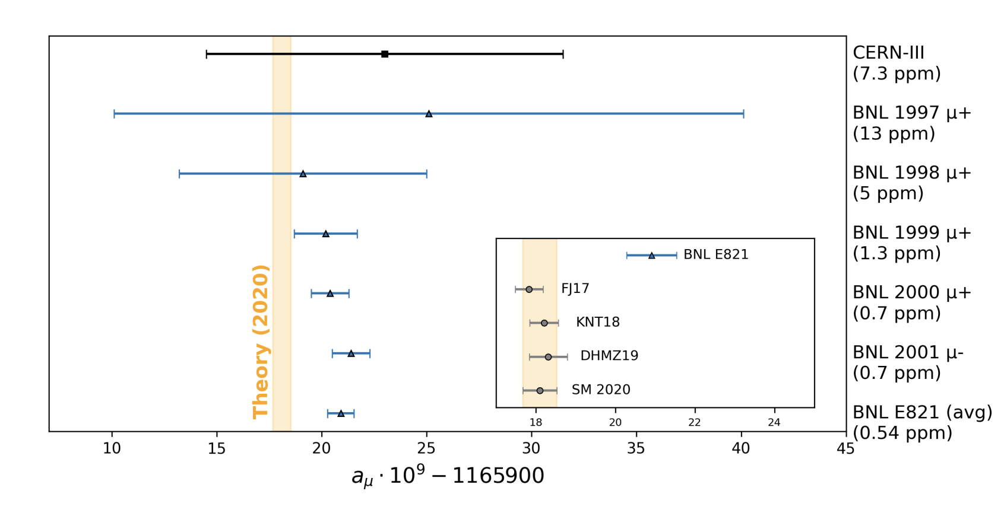
Magnetic anomaly of the muon
— how theory and experiments shape each other
Both theory and experiments evolve toward greater accuracy in a feedback loop
Improved SM predictions define targets for experiments;
Experiment results & discrepancies challenge the theory.

Slide 7
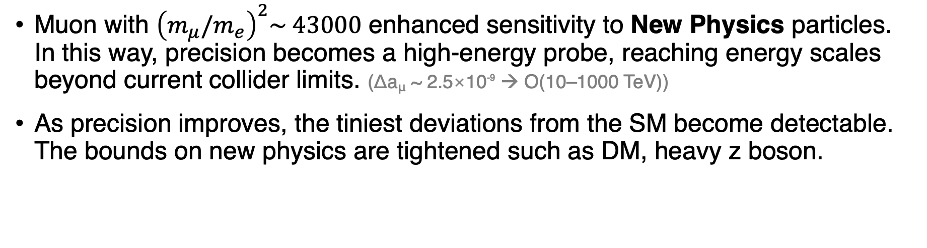
Magnetic anomaly of the muon
— precision as a path to New Physics
Muon with ${\left(m_{μ}/m_{e}\right)}^{2}\sim 43000$ enhanced sensitivity to New Physics particles. In this way, precision becomes a high-energy probe, reaching energy scales beyond current collider limits. (Δa_{μ} ~ 2.5×10⁻⁹ → O(10–1000 TeV))
As precision improves, the tiniest deviations from the SM become detectable. The bounds on new physics are tightened such as DM, heavy z boson.

Slide 8

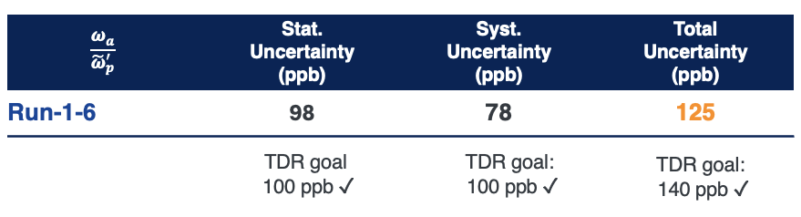
Magnetic anomaly of the muon
— statistical vs. systematic limits in experiments
Technology shapes the precision limits and defines what's possible:
Higher muon yield thanks to accelerator facility dev → smaller statistical errors
Better detectors, field calibration, etc. → lower systematic errors
Fermilab’s result has reached ~100 ppb in both statistical and systematic;
When systematics match statistics, new methods are required, not just more data!
Further gains using the same approach would be extremely difficult.
127

Slide 9
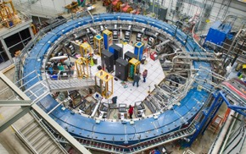
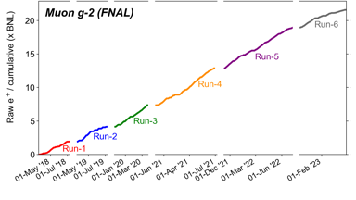
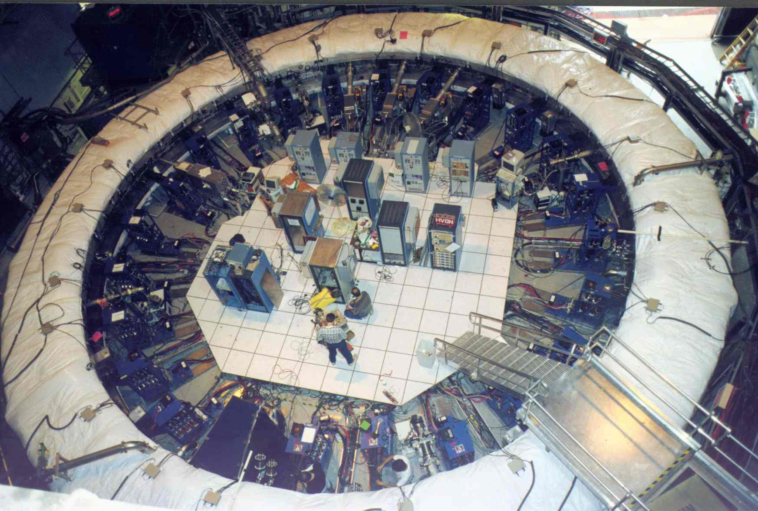
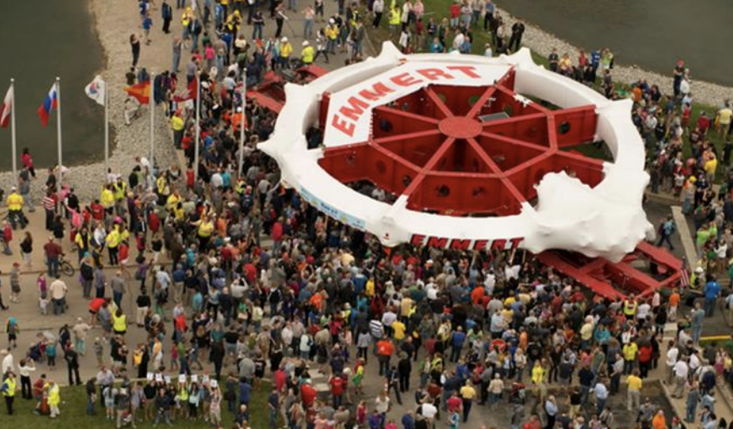
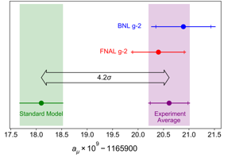
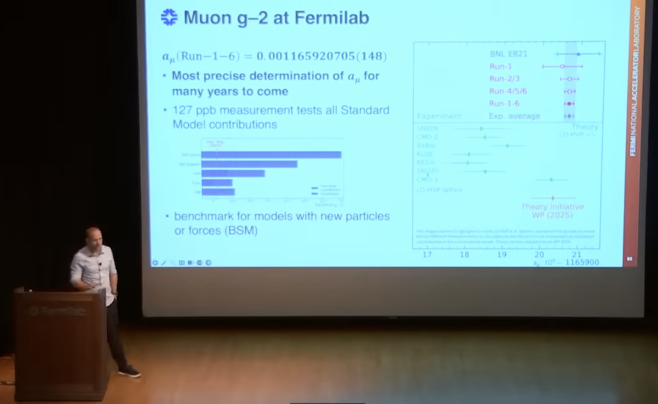
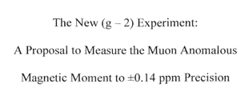
A Journey to 127 ppb at Fermilab
BNL final measurement
Muon g-2
Critical Decision-0
1st muon beam
End of data taking and second result
2002
2009
2012
2013
2017
2021
2023
2025
The Big Move
Proposal
First a_{μ} result
Final a_{μ} result at Fermilab

Slide 10
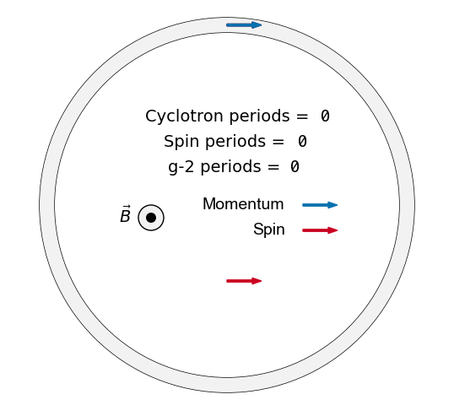
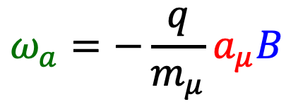

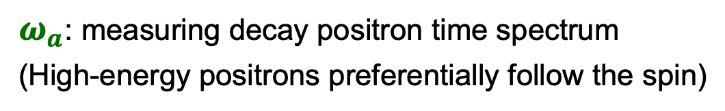
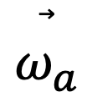
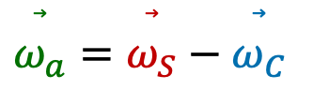
Measurement at Fermilab
Store spin-polarized muons in a uniform magnetic field
Spin rotates ahead of momentum as muon orbits the storage ring.
Frequency difference $ω_{a}$ is prop. to $a_{μ}$ and $B$:
Measure
$$\overset{⃗}{ω_{a}}$$
$$ω_{a}=−\frac{q}{m_{μ}}a_{μ}B$$
$$\overset{⃗}{ω_{a}}=\overset{⃗}{ω_{S}}−\overset{⃗}{ω_{C}}$$
Extract
$ω_{a}^{ }$: measuring decay positron time spectrum
(High-energy positrons preferentially follow the spin)

Slide 11
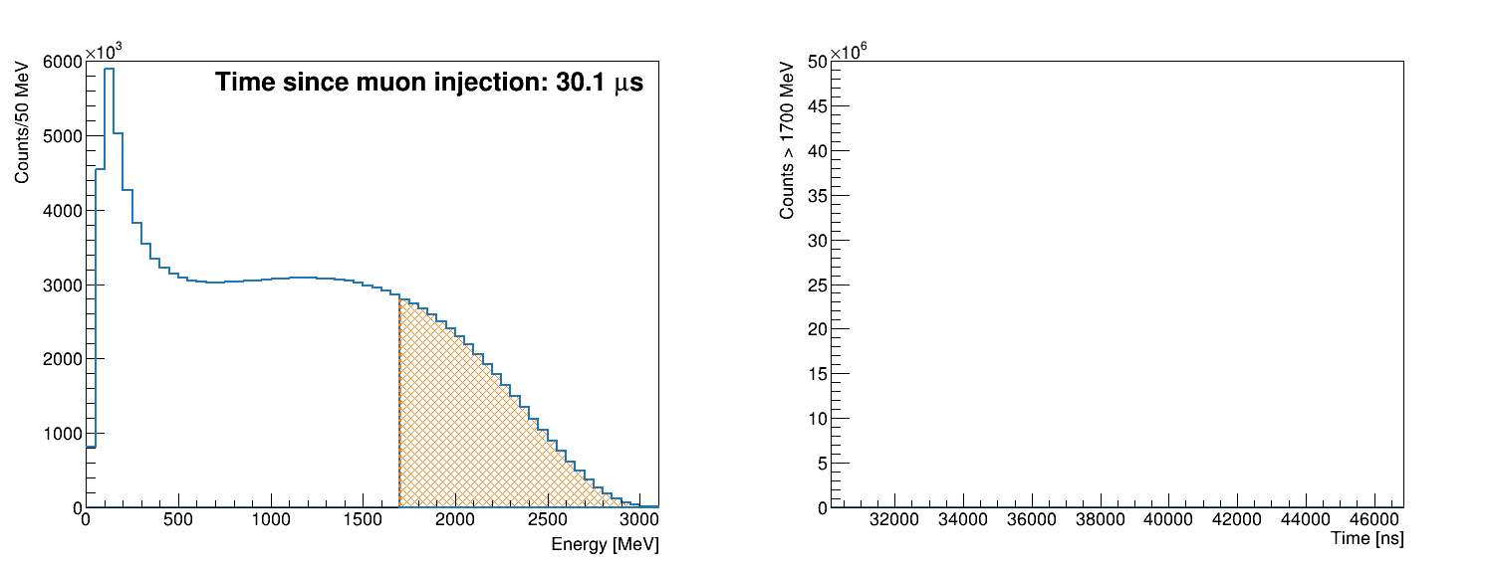
Measurement at Fermilab
Store spin-polarized muons in a uniform magnetic field
Spin rotates ahead of momentum as muon orbits the storage ring.
Frequency difference $ω_{a}$ is prop. to $a_{μ}$ and $B$:
Measure
Real data, Run-3a
$$\overset{⃗}{ω_{a}}$$
energy threshold
$$ω_{a}=−\frac{q}{m_{μ}}a_{μ}B$$
$$\overset{⃗}{ω_{a}}=\overset{⃗}{ω_{S}}−\overset{⃗}{ω_{C}}$$
Energy spectrum
Time spectrum
Extract
$ω_{a}^{ }$: measuring decay positron time spectrum
(High-energy positrons preferentially follow the spin)

Slide 12
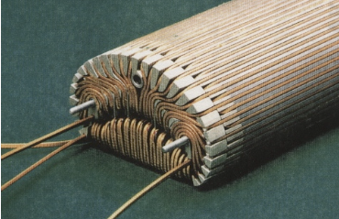
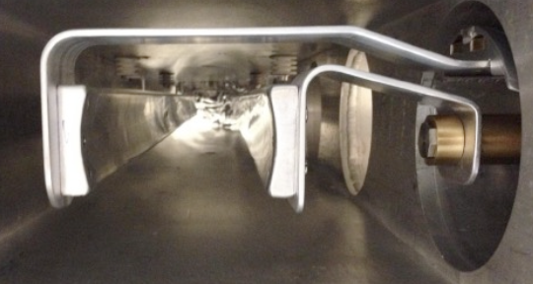
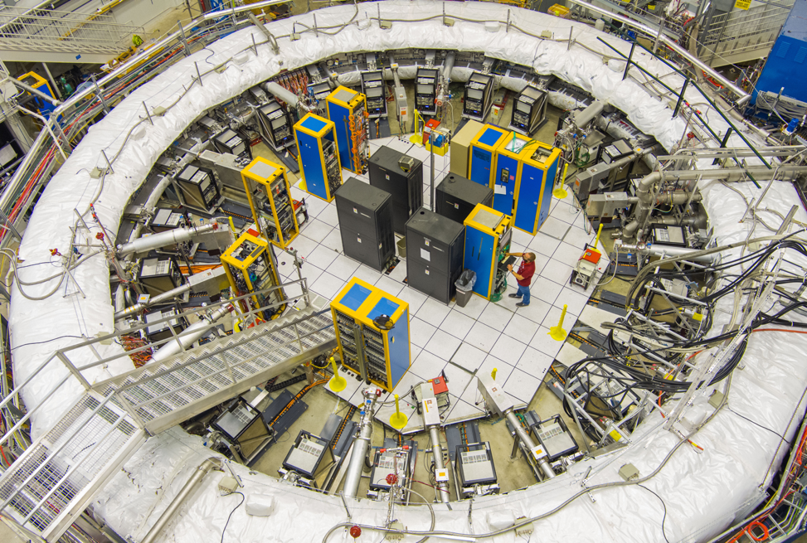


Measurement at Fermilab
Store spin-polarized muons in a uniform magnetic field
inflector
Spin rotates ahead of momentum as muon orbits the storage ring.
Frequency difference $ω_{a}$ is prop. to $a_{μ}$ and $B$:
kickers
$$μ^{+}$$
Measure
Real data, Run-3a
$$\overset{⃗}{ω_{a}}$$
energy threshold
$$ω_{a}=−\frac{q}{m_{μ}}a_{μ}B$$
Energy spectrum
Time spectrum
Extract
$ω_{a}^{ }$: measuring decay positron time spectrum

Slide 13
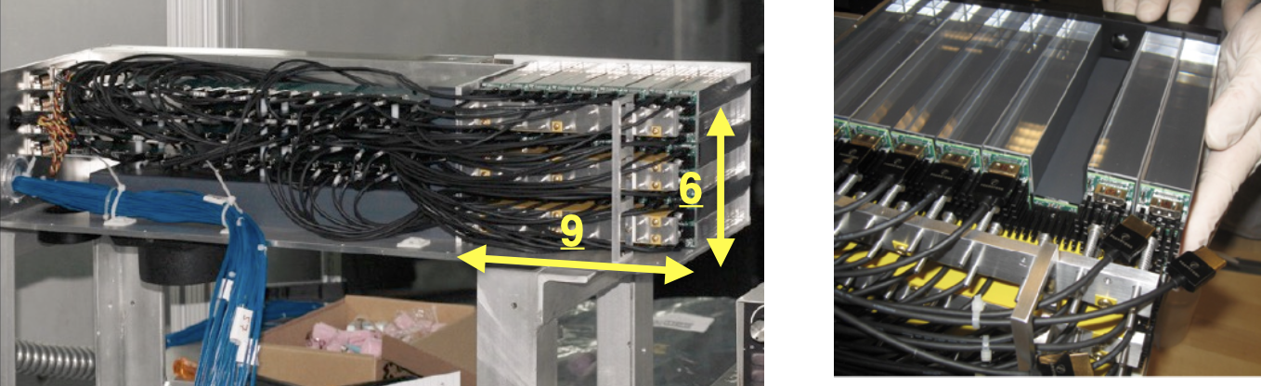
Measurement at Fermilab
Store spin-polarized muons in a uniform magnetic field
Spin rotates ahead of momentum as muon orbits the storage ring.
Frequency difference $ω_{a}$ is prop. to $a_{μ}$ and $B$:
24 calorimeters made of PbF₂ crystals
Measure
Real data, Run-3a
$$\overset{⃗}{ω_{a}}$$
energy threshold
$$ω_{a}=−\frac{q}{m_{μ}}a_{μ}B$$
Energy spectrum
Time spectrum
Extract
$ω_{a}^{ }$: measuring decay positron time spectrum

Slide 14
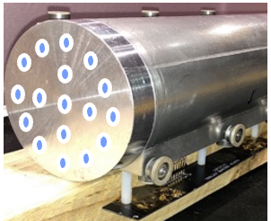
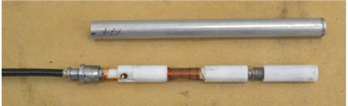
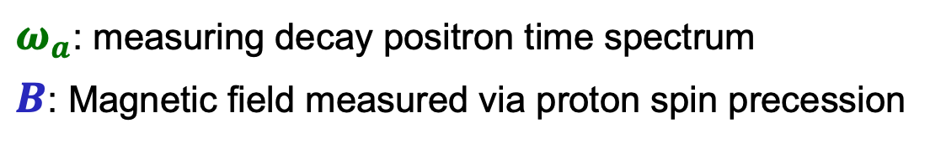
Measurement at Fermilab
Store spin-polarized muons in a uniform magnetic field
Spin rotates ahead of momentum as muon orbits the storage ring.
Frequency difference $ω_{a}$ is prop. to $a_{μ}$ and $B$:
378 Fixed NMR probes &
17 probes trolley
Measure
$$\overset{⃗}{ω_{a}}$$
$$ω_{a}=−\frac{q}{m_{μ}}a_{μ}B$$
Extract
$ω_{a}^{ }$: measuring decay positron time spectrum
$B$: Magnetic field measured via proton spin precession
378 Fixed NMR probes &
17 probe trolley

Slide 15
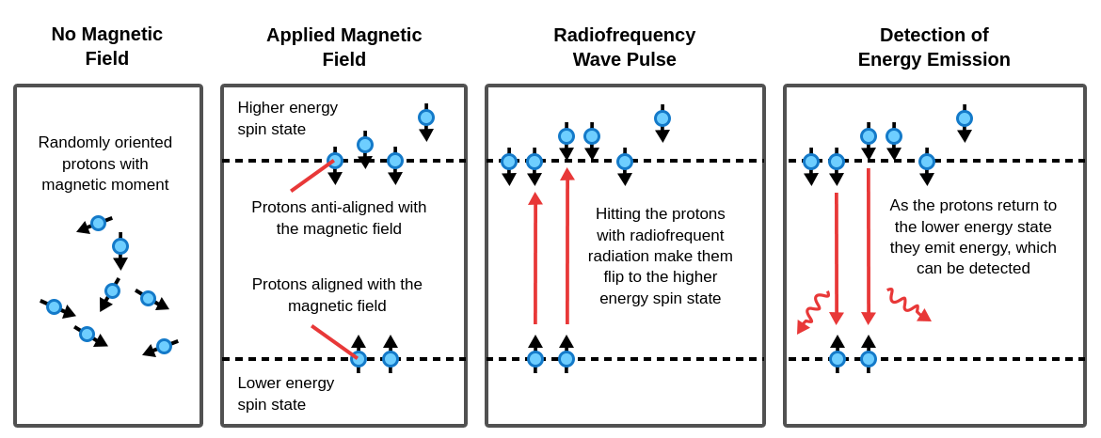

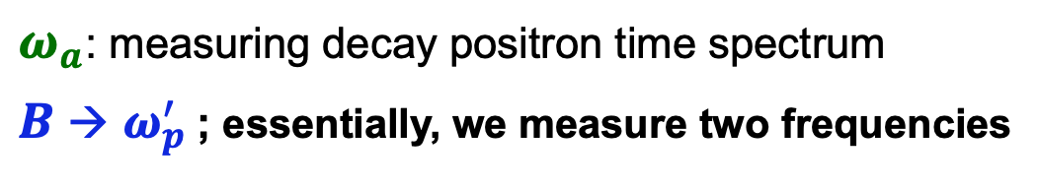
Measurement at Fermilab
Store spin-polarized muons in a uniform magnetic field
Spin rotates ahead of momentum as muon orbits the storage ring.
Frequency difference $ω_{a}$ is prop. to $a_{μ}$ and $B$:
378 Fixed NMR probes &
17 probes trolley
Measure
$$2{μ^{′}}_{p}^{ }\left(H_{2}O, T_{r}\right)B=ℏ{ω^{′}}_{p}^{ }(H_{2}O, T_{r})$$
$$\overset{⃗}{ω_{a}}$$
Measure B with nuclear magnetic resonance (NMR)
$$ω_{a}=−\frac{q}{m_{μ}}a_{μ}B$$
Extract
$ω_{a}^{ }$: measuring decay positron time spectrum
$B$ → ${ω_{p}^{′}}_{ }^{ }$; essentially, we measure two frequencies
378 Fixed NMR probes &
17 probe trolley

Slide 16
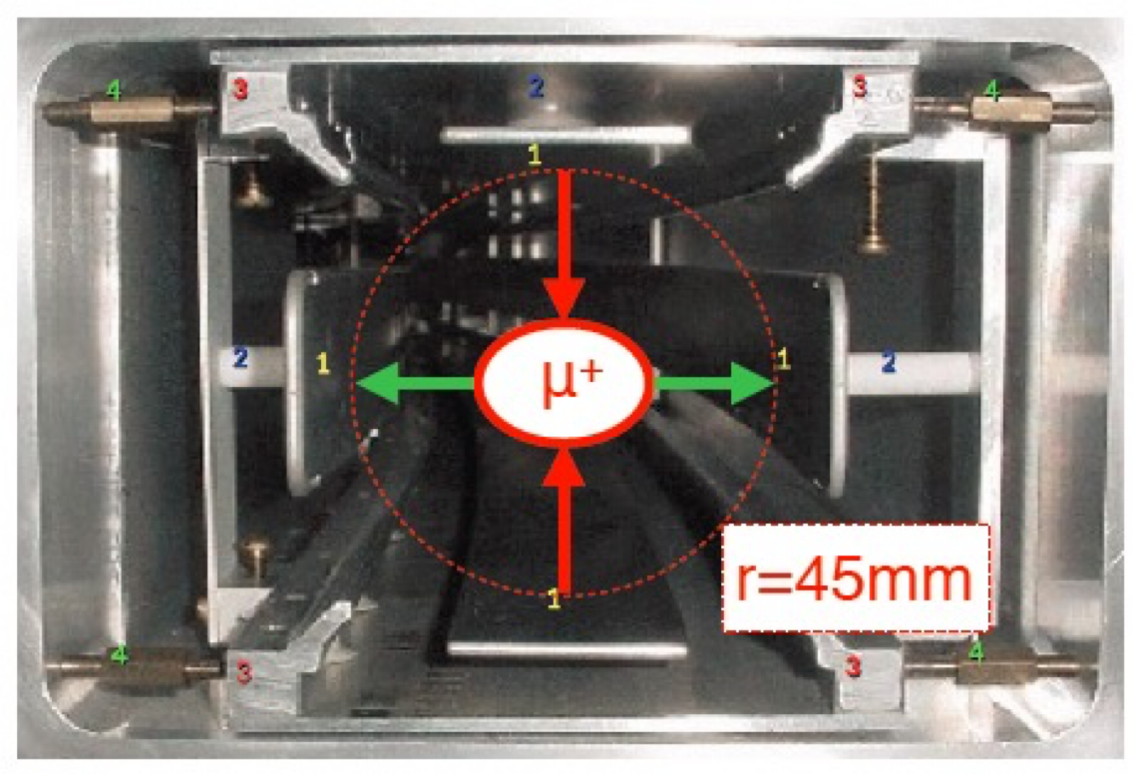
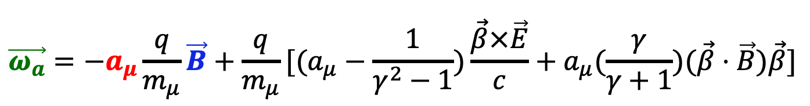
Measurement at Fermilab
‘Corrections’ in the real-world
The full formula is complicated by beam dynamics
$$\vec{ω_{a}}=−a_{μ}\frac{q}{m_{μ}}\vec{B}+\frac{q}{m_{μ}}[(a_{μ}−\frac{1}{γ^{2}−1})\frac{\vec{β}×\vec{E}}{c}+a_{μ}(\frac{γ}{γ+1})(\vec{β}⋅\vec{B})\vec{β}]$$
Electrostatic quadrupoles in four sections provide 43% azimuthal coverage and focus the muon beam vertically
Electrostatic quadrupoles in four sections provide 43% azimuthal coverage and focus the muon beam vertically

Slide 17
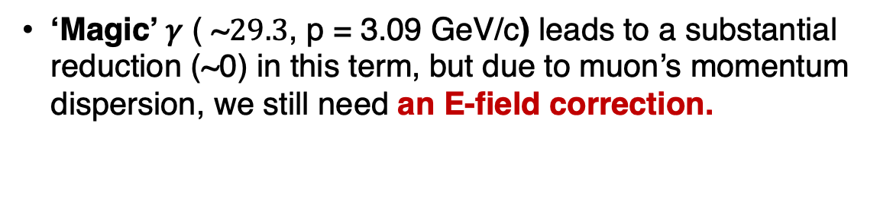
Measurement at Fermilab
‘Corrections’ in the real-world
The full formula is complicated by beam dynamics
$$\vec{ω_{a}}=−a_{μ}\frac{q}{m_{μ}}\vec{B}+\frac{q}{m_{μ}}[(a_{μ}−\frac{1}{γ^{2}−1})\frac{\vec{β}×\vec{E}}{c}+a_{μ}(\frac{γ}{γ+1})(\vec{β}⋅\vec{B})\vec{β}]$$
‘Magic’ 𝛾 ( ~$29.3$, p = 3.09 GeV/c) leads to a substantial reduction (~0) in this term, but due to muon’s momentum dispersion, we still need an E-field correction.
Electrostatic quadrupoles in four sections provide 43% azimuthal coverage and focus the muon beam vertically

Slide 18
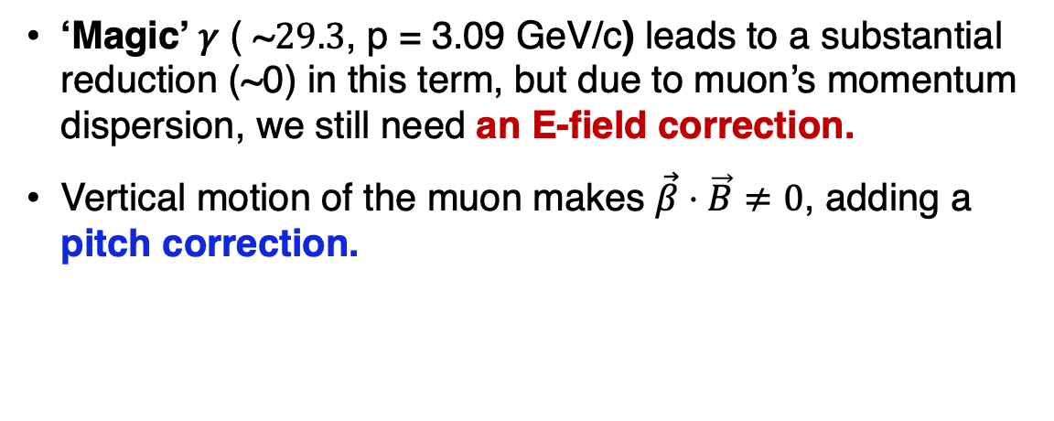
Measurement at Fermilab
‘Corrections’ in the real-world
The full formula is complicated by beam dynamics
$$\vec{ω_{a}}=−a_{μ}\frac{q}{m_{μ}}\vec{B}+\frac{q}{m_{μ}}[(a_{μ}−\frac{1}{γ^{2}−1})\frac{\vec{β}×\vec{E}}{c}+a_{μ}(\frac{γ}{γ+1})(\vec{β}⋅\vec{B})\vec{β}]$$
‘Magic’ 𝛾 ( ~$29.3$, p = 3.09 GeV/c) leads to a substantial reduction (~0) in this term, but due to muon’s momentum dispersion, we still need an E-field correction.
Vertical motion of the muon makes $\vec{β}⋅\vec{B}≠0$, adding a pitch correction.
Electrostatic quadrupoles in four sections provide 43% azimuthal coverage and focus the muon beam vertically

Slide 19

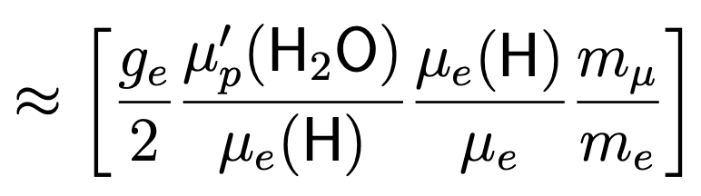
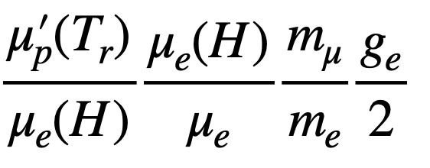


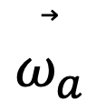
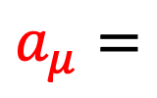
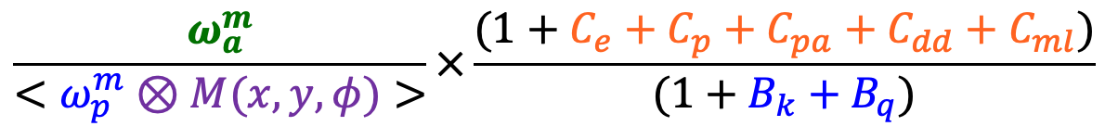
Measurement at Fermilab
An actual computation expression
Corrections from Beam Dynamics:
$$\overset{⃗}{ω_{a}}$$
① Spin dynamics
② Varying phase
$$\frac{ω_{a}^{m}}{<ω_{p}^{m}⊗M(x, y, φ)>}×\frac{(1+C_{e}+C_{p}+C_{pa}+C_{dd}+C_{ml})}{(1+B_{k}+B_{q})}$$
$$a_{μ}=$$
field weighted by muon
Corrections from Magnetic Field Transient
$$×$$
External constants precisely known (to 25 ppb)

Slide 20
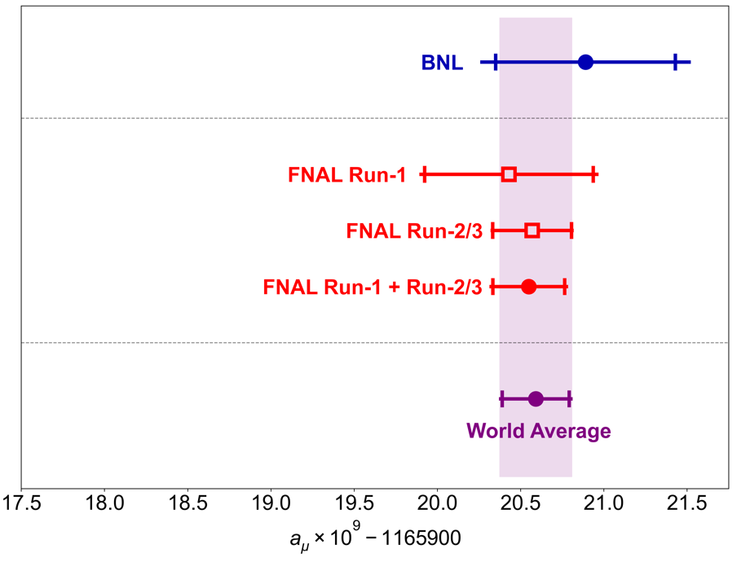
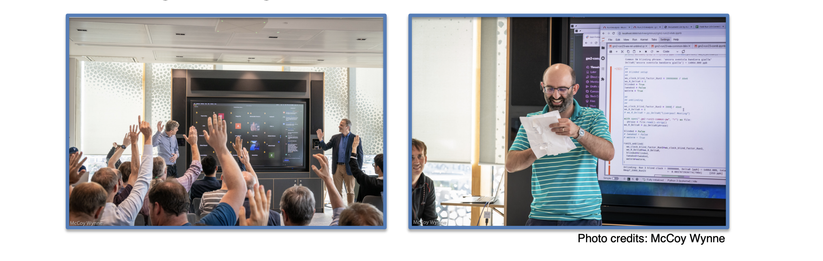
From Runs 1/2/3 to Runs 4/5/6
Run-1 (2021) and Run-2&3 releases show a very good agreement
Our unblinding meeting in Liverpool (2023) for Run2&3:
April 2021: Run-1 results, roughly matching the BNL data
August 2023: Run-2/3 results, 4.6 times more than Run-1

Slide 21
From Runs 1/2/3 to Runs 4/5/6
Key Improvements
from Run1 to Run2&3:
Running conditions
Damaged resistors were replaced, leading to a more stable beam
A stronger kicker improved the center beam position and smaller oscillation
Improved hall cooling makes the magnetic field less variable
Improved measurements
A new NMR probe in an insulator with more field measurement positions.
Analysis improvements
An improved reconstruction algorithm reduced the pile-up effect
Tracker method for E-field correction
...
April 2021: Run-1 results, roughly matching the BNL data
August 2023: Run-2/3 results, 4.6 times more than Run-1

Slide 22

From Runs 1/2/3 to Runs 4/5/6
Runs 4/5/6:
From early Run5 we add an additional Quad RF system;
The dataset is split into 4 sets: noRF, xRF (horizontal RF only), xyRF5 (horizontal and vertical RF in Run5) and xyRF6 (horizontal and vertical RF in Run6).
↑ mini sci-fi
and sys runs
↑ Quad RF
↑ similar to Run3
April 2021: Run-1 results, roughly matching the BNL data
August 2023: Run-2/3 results, 4.6 times more than Run-1
Final release 2025: Run-4/5/6 results; 2.6 x Run-1/2/3

Slide 23



Notable Improvements in Runs 4/5/6
1) Quad RF system
RF acts like a forced harmonic oscillator. Muon phase shifts partially cancel each other out, which helps reduce the overall oscillation of the beam oscillations.

Slide 24


Notable Improvements in Runs 4/5/6
1) Quad RF system
RF acts like a forced harmonic oscillator. Muon phase shifts partially cancel each other out, which helps reduce the overall oscillation of the beam oscillations.
2) Expanded use of tracker data
Straw tube tracking detectors allow us to “see” the beam. In Run 4/5/6, we expanded the use of the tracker data in many beam dynamics analyses, such as E-field (C_{e}) and Differential decay (C_{dd}).
Straw Tracker Module developed in Liverpool

Slide 25


Notable Improvements in Runs 4/5/6
1) Quad RF system
RF acts like a forced harmonic oscillator. Muon phase shifts partially cancel each other out, which helps reduce the overall oscillation of the beam oscillations.
2) Expanded use of tracker data
Straw tube tracking detectors allow us to “see” the beam. In Run 4/5/6, we expanded the use of the tracker data in many beam dynamics analyses, such as E-field (C_{e}) and Differential decay (C_{dd}).
No RF
Additional RF
Significant reduction in oscillation amplitude

Slide 26



Notable Improvements in Runs 4/5/6
3) New ‘mini sci-fi’ detector
Minimally Intrusive Scintillating Fiber Detector for both Vertical and Horizontal versions was applied in the later Run6 for cross-checks and uncertainty analysis
3 Fibers with 250 $μ$m diameter measure circulating beam fast rotation intensity
$$\frac{p−p(\text{magic})}{p(\text{magic})}$$

Slide 27

Notable Improvements in Runs 4/5/6
An integrated example: The E-field Correction
E-field correction — the largest uncertainty in the beam dynamics — was analyzed via three methods in Runs4/5/6: calorimeter approach (Runs1/2/3), updated tracker method and mini-scifi cross-checks.
Altogether, they increased confidence and a small reduction of uncertainties to a total of 27 ppb!

Slide 28

Notable Improvements in Runs 4/5/6
4) $ω_{a}$ analysis: new models, and discoveries
Larger statistics revels even more prominent frequency components
$N\left(t\right)=N_{0} e^{−t/τ} \left[1+A\cos{(ω_{a}t −φ_{0})}\right]$
$$ω_{a}/2π$$

Slide 29


Notable Improvements in Runs 4/5/6
4) $ω_{a}$ analysis: new models, and discoveries
Larger statistics revels even more prominent frequency components
In Runs-4/5/6, 5 groups with 8 method using up to 50 parameters in the fit model to account for beam oscillations, muons losses, and detector effects ...
Example:
Beam dynamics modeling, such as the Coherent Betatron Oscillation (CBO)
with the additional RF

Slide 30
Notable Improvements in Runs 4/5/6
4) $ω_{a}$ analysis: new models, and discoveries
Larger statistics revels even more prominent frequency components
In Runs-4/5/6, 5 groups with 8 method using up to 50 parameters in the fit model to account for beam oscillations, muons losses, and detector effects ...
Example:
Beam dynamics modeling, such as the Coherent Betatron Oscillation (CBO)
if not accounted for: ~800 ppb effect without the additional RF
if not accounted for: ~80 ppb effect with the additional RF

Slide 31

Notable Improvements in Runs 4/5/6
4) $ω_{a}$ analysis: new models, and discoveries
A mysterious “early-to-late effect” has been identified with a physical explanation.
Detector effects from preceding positron hits, with rate dependence at the μs scale; estimated impact 20–40 ppb with ~25 ppb uncertainty.
Positron Hit
Time
Calorimeter in lab for dedicated measurements

Slide 32


Notable Improvements in Runs 4/5/6
4) $ω_{a}$ analysis: new models, and discoveries
A mysterious “early-to-late effect” has been identified with a physical explanation.
Detector effects from preceding positron hits, with rate dependence at the μs scale; estimated impact 20–40 ppb with ~25 ppb uncertainty.
More details on the $ω_{a}$analysis – presentation on Tuesday in WG4:

Slide 33



Notable Improvements in Runs 4/5/6
5) $B$ field: newly measured kicker transient effect ($B_{k}$)
Kick field causes eddy currents and introduces a transient magnetic field.
In Runs 4/5/6, we newly developed two different magnetometers, both based on Faraday effect in TGG crystals
1000 ppb of 1.45 T
Fiber magnetometer
Free laser magnetometer
main kick pulse at t=0: amplitude -220 G, $Δt$=120ns

Slide 34


Final Results
$\frac{ω_{a}}{{\tilde{ω}}_{p}^{′}} =\frac{ω_{a}^{m}\left(1+C_{e}+C_{p}+C_{pa}+C_{dd}+C_{ml}\right)}{\left\langle ω_{p}^{′}×M\right\rangle \left(1+B_{k}+B_{q}\right)}$
Run-4/5/6
Electric Field
Pitch
Phase Acceptance
Differential Decay
Muon Loss
TDR goal: 100 ppb ✓
Systematics are “evenly” distributed:
No dominant source
Further improving would require to reduce in many categories
Transient Kicker
Transient ESQ

Slide 35
Final Results
$a_{μ}\text{(}\text{Run}\text{−4/5/6)}=0.001165920710(162)$
$a_{μ}(\text{Run}\text{−1−6})=0.001165920705(148)$
$a_{μ}\left(\text{exp}\right)=0.001165920715(145)$
Runs 4-6 uncertainty reduced by 1.8 times over Runs 1-3;
Combined Fermilab Runs 1-6 reduces BNL uncertainty by a factor of 4.3

Slide 36
Are we done?
Yes –
Most precise determination of 𝒂_{𝝁} - a 127-ppb measurement probing all SM contributions

Slide 37
Are we done?
Yes –
Most precise determination of 𝒂_{𝝁} - a 127-ppb measurement probing all SM contributions
and No –
The overall picture still remains unsettled;
What’s next from our collaboration:
Muon EDM
CPT/Lorenz-violating
Dark Matter
...
Other related projects: J-PARC, MUonE, ...

Slide 38



Are we done?
Related talks (all in Tuesday’s WG4 session)

Slide 39

Summary
We provide the final result from the Fermilab muon g-2 measurement
– a benchmark for many years to come;
Despite very different conditions in Runs 1-6, the remarkable consistency of the results further reinforces the robustness of our outcome;
Further projects and BSM analyses are underway. Muon g‑2 remains far from complete, continuing to play a central role in the pursuit of New Physics.

Slide 40








Thank you for the attention!
Collaboration meeting at Fermilab, March 2017
Collaboration meeting at Elba, Italy, May 2019
Collaboration meeting at Liverpool, UK, July 2023
Online Collaboration Meeting during Covid-19 period, April 2022
Final unblinding, May 2025
40

Slide 41

Thank you for the attention!
Acknowledgements

Slide 42
Backup

Slide 43



Consistency Check
We perform many consistency checks: fit residual FFTs, fit start time scans, fits by calorimeter, fits by positron energy, etc.
Per-calorimeter fits
Fit start time scan
Energy-bin fits

Slide 44

Consistency Check
We perform many consistency checks: fit residual FFTs, fit start time scans, fits by calorimeter, fits by positron energy, etc.

Slide 45



Blinding Scheme
Perform analysis with software & hardware blinding
Hardware blind comes from altering our clock frequency
Non-collaborators set frequency to (40 – $ε$) MHz
Clock is locked and value kept secret until analysis completed

Slide 46
Systematics
Run-2/3 with Run-4/5/6 knowledge
Identified physical source for residual slow term effects
Dedicated MiniSciFi detector and further improved methods
Improved understanding, leading to more conservative uncertainty (sign error correction in one component)
More conservative uncertainty motivated by additional cross-calibration
Reduction of uncertainties due to additional measurement
Additional measurement lead to refined spatial model
Run-4/5/6

Slide 47


Magnetic Field Shimming
Many “knobs” for shimming:
72 Poles: Shaping & homogeneity
864 Wedges: Quadrupole asymmetry
48 Iron Top Hats: Change effective μ
144 Edge Shims: Quad/sextapole asymmetry
8000 Surface Iron Foils: Local changes of effective μ
100 Active Surface Coils: Control current to add ring-wide average field moments

Slide 48



Gain-Like Detector Effects
Effective threshold changes over time Laser system to correct the gain on 10⁻⁴ –level
$$ω_{a}$$

Slide 49



Gain-Like Detector Effects
New! Sensitive also below 10⁻⁴ if
Rate & Energy dependent
Time constant $\sim 1/ω_{a}$
Correction shows $ω_{a}$-behavior but out of phase
Time-dependent phase-change
Fitted $ω_{a}$ sensitive to such effects
$$ω_{a}$$
*noRF dataset

Slide 50



Run-4/5/6: Superior Statistics, Additional Measurements
and simulation efforts allowed for many cross-checks and gain new insights
To combine our results: use this Run-4/5/6 knowledge for Run-1/2/3
Identified an Intensity-Dependent Gain Sag
with a magnitude below our stability design goal (10⁻⁴)
however, phase-shifted oscillation at $ω_{a}$ leads to larger sensitivity than orig. estimated
Resolved puzzle of residual slow terms in $ω_{a}$-fits
Run-2/3: +47 ppb $±$ 24 ppb (Run-1: +50 ppb$±$ 29 ppb)
Improved spatial-model of Kicker-Transients
Additional, dedicated measurement after muon storage periods
similar cross-checks for transient fields from ESQ ($B_{Q}$), confirmed used model
Run-2/3: +19 ppb $±$ 23 ppb *on $a_{μ}$, correction on $B_{k}$ has opposite sign
Identified and corrected a sign error
in one (of three) contribution to the Differential Decay Correction ($C_{dd}^{beamline}$)
Run-2/3: magnitude of $C_{dd}^{beamline}:$ 12 ppb to 20 ppb
Run-2/3: +32 ppb $±$17 ppb *uncertainty due to method not sign error
All these correction have the same sign. Run-2/3 total +89 ppb Total Run-2/3 uncertainty: from 70 ppb to 78 ppb

Slide 51
Large Dataset
allows to demonstrate consistency

Slide 52

CERN Experiments – what a difference!

Slide 53

Muon EDM
BNL: tracker-based analysis
(g-2)
EDM

Slide 54

CPT and Lorentz Violations
Lorentz Violation – existence of a preferred direction
Uniform background vector, b
What could it come from? Spontaneous Symmetry Breaking,
SM: In EWSB, scalar field gets non-zero vacuum expectation value, filling vacuum with Lorentz Symmetric quantities
SME: Can have Lorentz SB, where vector field gets non-zero vev, filling vacuum with 4-dimensionally oriented quantities → preferred direction in space → LV!
Possibilities: string theory, loop-quantum gravity, etc.
CPT Violation
LV allows but does not require CPTV, because CPT Theorem no longer holds (but CPTV does require LV)

Slide 55



Dark Matter - Physics Signature
Muon $g−2$ has a competitive sensitivity to the ultralight (thus bosonic and wave-like field) muonic DM. It is the first direct DM search with muons in a storage ring.
Scalar field (Yukawa coupling) $φ=φ_{0}\cos\left(m_{φ}t\right)$
It induces oscillating $m_{μ}$.
$$ℒ⊃−gφ\overline{μ}μ−g^{′}φ^{2}\overline{μ}μ ⇒ m_{μ}→m_{μ}+gφ+g^{′}φ^{2}$$
It leads $ω_{a}$ to oscillate: $ω_{a}→ω_{a}\left(1+A_{φ}\cos{m_{φ}t}\right)$
Pseudoscalar axion-like field $a=a_{0}\cos\left(m_{a}t\right)$
EDM coupling induces oscillating EDM ($d_{μ}$). $ℒ⊃−ig_{EDM}a\overline{μ}σ^{λν}γ_{5}μF_{λν} ⇒ d_{μ}→d_{μ}+g_{EDM}a$
Gradient coupling induces oscillating spin along the axis of the muon’s motion. $ℒ⊃g_{aμ}∂_{λ}a\overline{μ}γ^{λ}γ_{5}μ ⇒ ℋ⊃g_{aμ}∇a⋅S$
Both lead to oscillating $δω_{a}$ components perpendicular to $ω_{a}$.
Spin precession
No DM
Gradient coupling (10% of $ω_{a}$)

Slide 56

TI White Paper 2025
Last week:
New TI White Paper (2025) using only lattice-QCD based LO-HVP determination
*small changes in the $e^{+}e^{−}$ points from other (not HVP-LO) contributions
All the details in TI White Paper 2025 arXiv:2505.21476

Slide 57



LO-HVP: dispersive $e^{+}e^{−}$
~
https://arxiv.org/pdf/2505.21476

Slide 58

WP 2025 – Dispersive LO-HVP [pipi]
https://arxiv.org/pdf/2505.21476

Slide 59

WP 2025 – Dispersive $a_{μ}$
https://arxiv.org/pdf/2505.21476

