Slide 1


Liquid Argon Detector Technologies
Kostas Mavrokoridis
K.Mavrokoridis@liverpool.ac.uk
Nufact25, Liverpool, September 5th 2025

Slide 2
Outline
Single Phase LAr Neutrino TPCs and R&D
Dual Phase LAr TPCs and R&D
Neutrinos
Dark Matter
Wire Technology
(ICARUS T600, MicroBooNE, SBND, Proto/DUNE HD/VD)
Perforated PCB anode
(Vertical Drift)
S2 Optical readout
(ARIADNE)
S1 and S2 Light Readout
(Darkside-20k)
Pixelated Charge
(DUNE ND/LArPix/QPiX/SoLAr)
Knowledge exchange & S1 Light collection optimization efforts (ie APEX, PoWER)
Note: Material presented is the work of many people/collaborations, public links provided where possible

Slide 3
Why Liquid Argon?
Dense: 40% denser than water
Easy ionization: 55 000 e⁻/cm for MIPs
High electron lifetime if purified → long drifts
High scintillation light yield: 40k γ/MeV
Pulse shape discrimination ability: (S1:fast 6ns/slow 1.6 μs)
Abundant: ~1% of the atmosphere (needs ³⁹Ar depletion for DM)
Cheap: $2/L ($3000/L for Xe, $500/L for Ne)

Slide 4
Major R&D challenges toward kton scale LAr TPCs
Ultra-high purity
liquid argon in non
evacuated vessels
Very long e⁻ drift length requires very high voltage
Systems 100kV -600 kV
Scalable charge readout methods –high granularity tracking & good energy threshold
kton scale
LAr TPCs
Scalable light readout methods –high granularity tracking & good energy threshold
multichannel DAQ system & Cold electronics
Cryostats & cryogenics

Slide 5
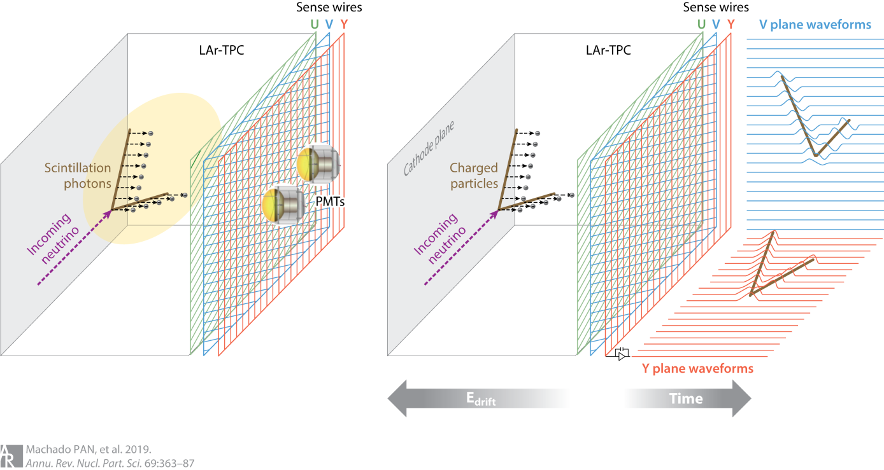
LAr Single Phase Wire Technologies
Ionisation readout
Light readout
3D image reconstruction by combining coordinates on different wire planes at the same drift time
No electron gain from the wires

Slide 6
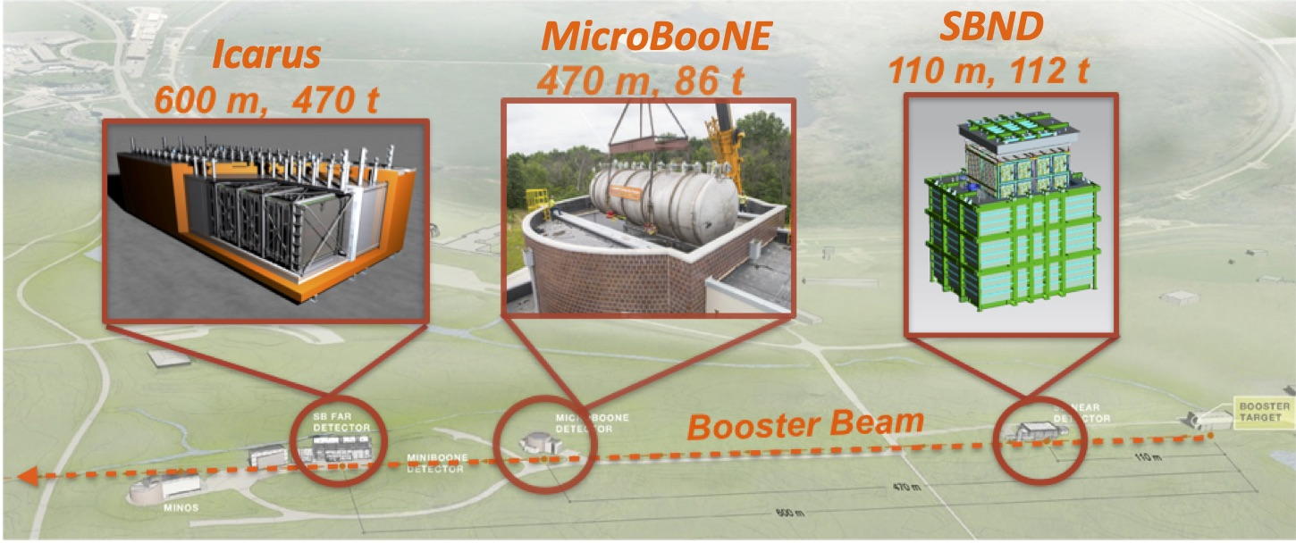
LAr Single Phase Experiments in the SBN Program
Program aims at solving the “sterile neutrino puzzle” by exploiting the well characterized FNAL Booster ν beamline
[1-4]

Slide 7
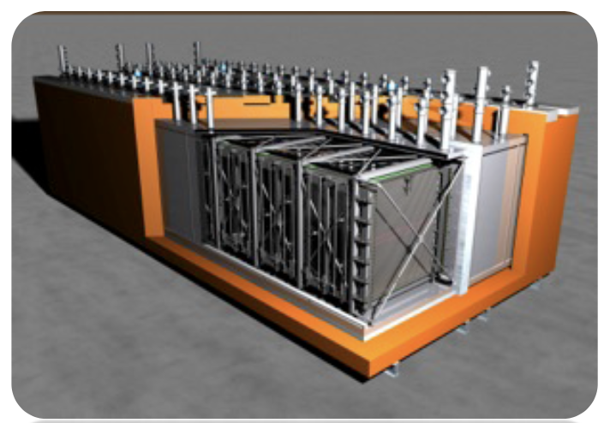
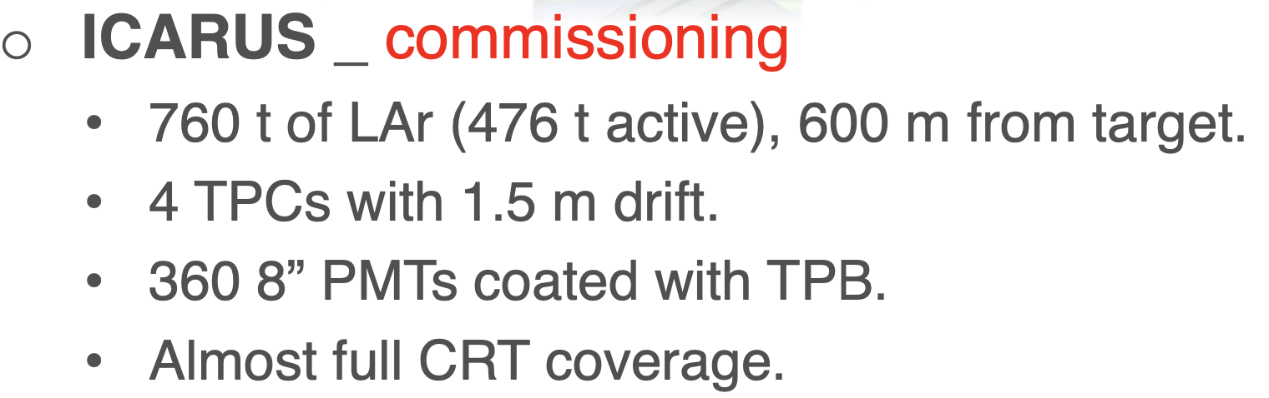
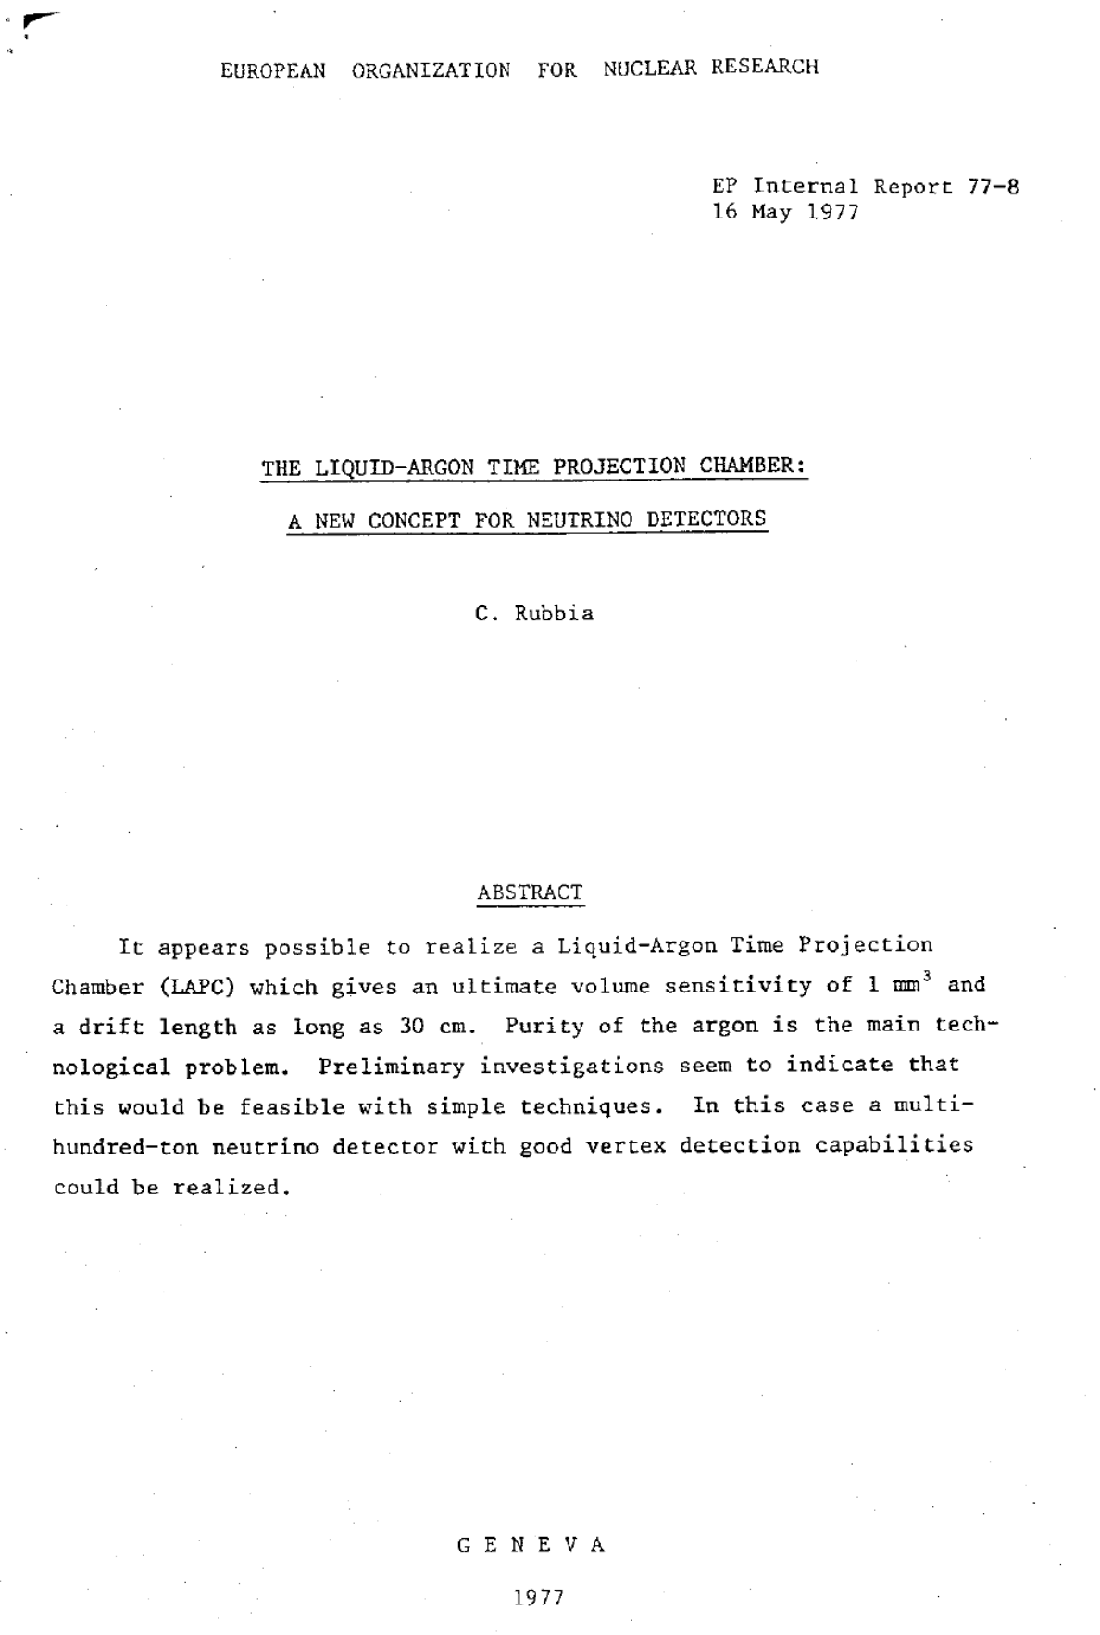
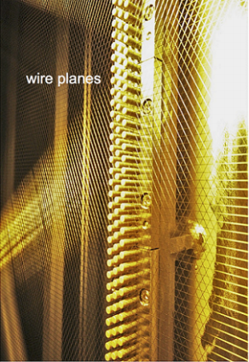
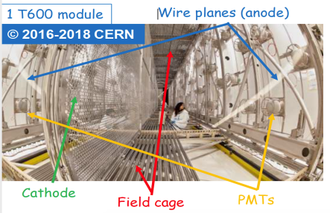
ICARUS T600
Running
1977 - the LArTPC Concept by C. Rubbia
First physics result, Phys. Rev. Lett. 134, 151801 (2025)
[1-4,19]

Slide 8
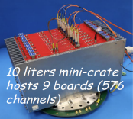
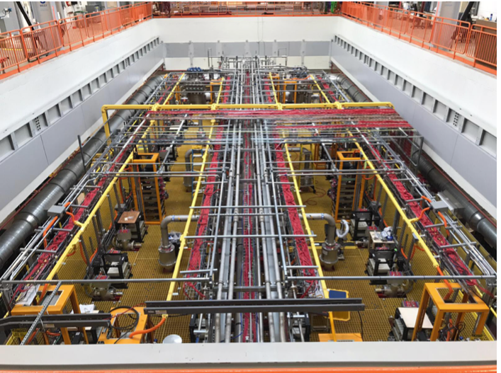
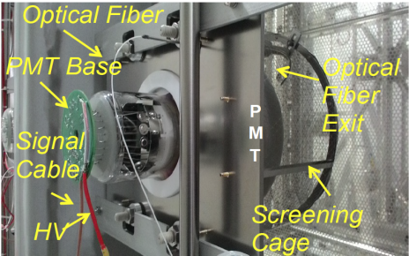
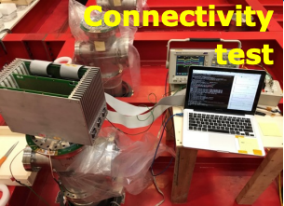
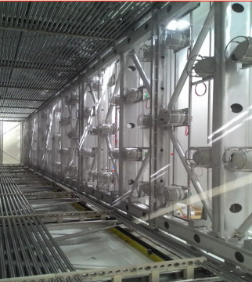
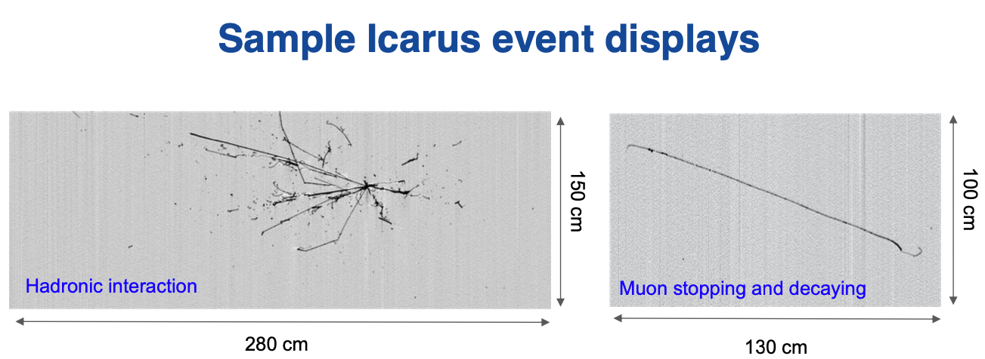
ICARUS T600
“warm” low-noise front-end amplifier
Compact layout: both analog+digital electronics hosted on a single flange
Icarus @Fermillab
ICARUS PMTs behind the wire planes (90 per TPC)
Provide t₀ of any ionizing event in the TPC
[1-4]

Slide 9
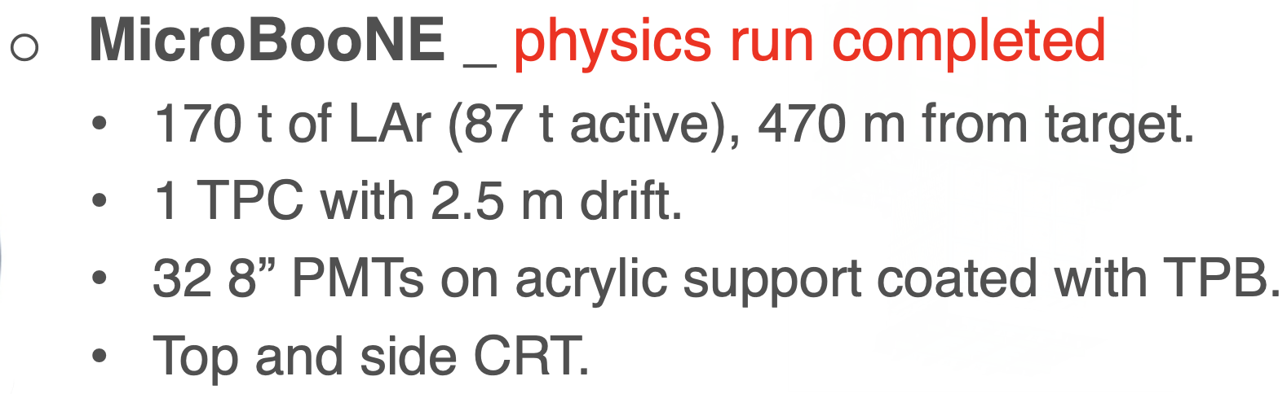
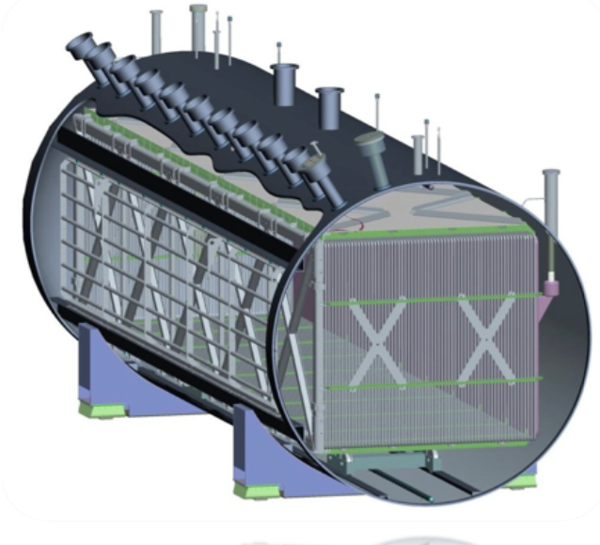
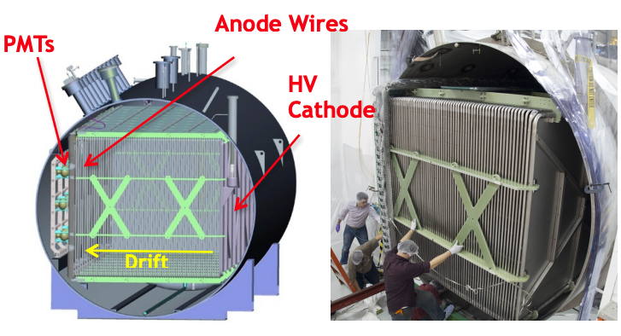
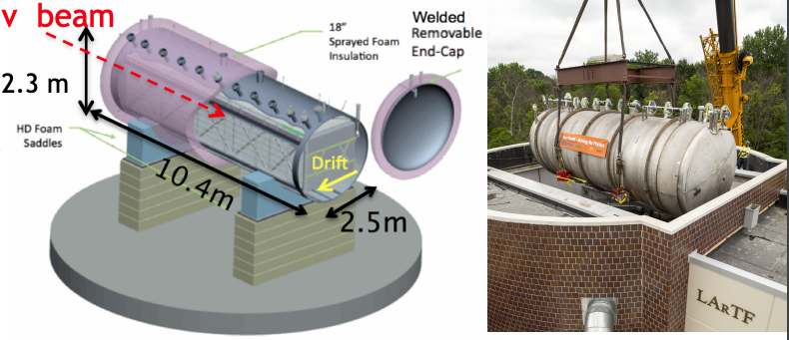
MicroBooNE
UV calibration LASER
(See slides also from Magnus Handley and
Afroditi Papadopoulou @Nufact 25)
[1-4]

Slide 10
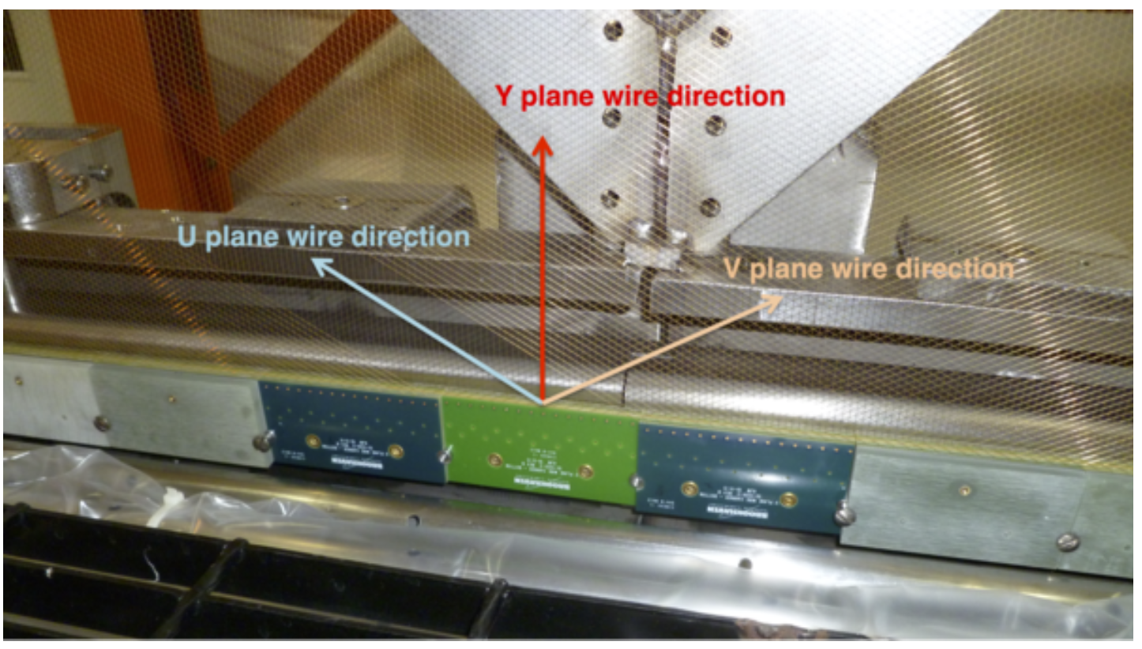
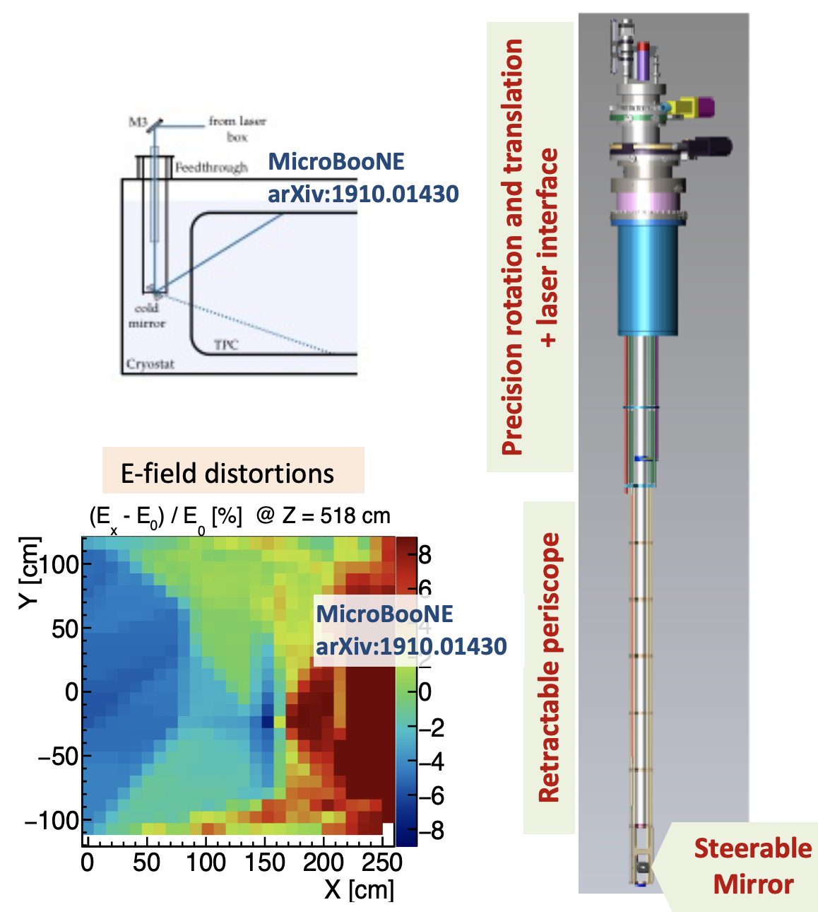
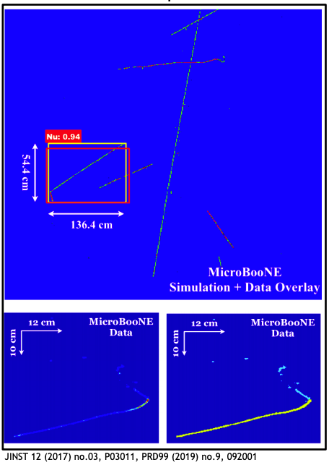
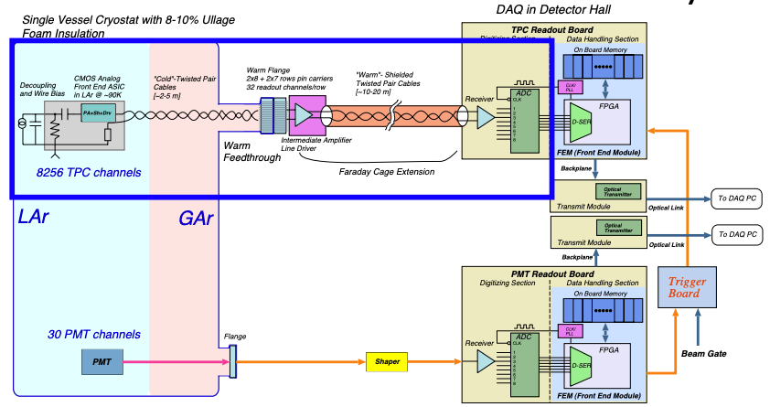
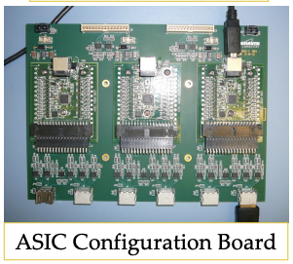
MicroBooNE
Deep Learning
Convolutional Neural Nets
Calibration LASER
(multiphoton ionization)
(Leverage advances in computer vision and AI techniques to identify neutrino interactions or label pixels)
8256 wires/channels
MicroBooNE is the first experiment instrumented with cold CMOS ASICs
[1-5]

Slide 11
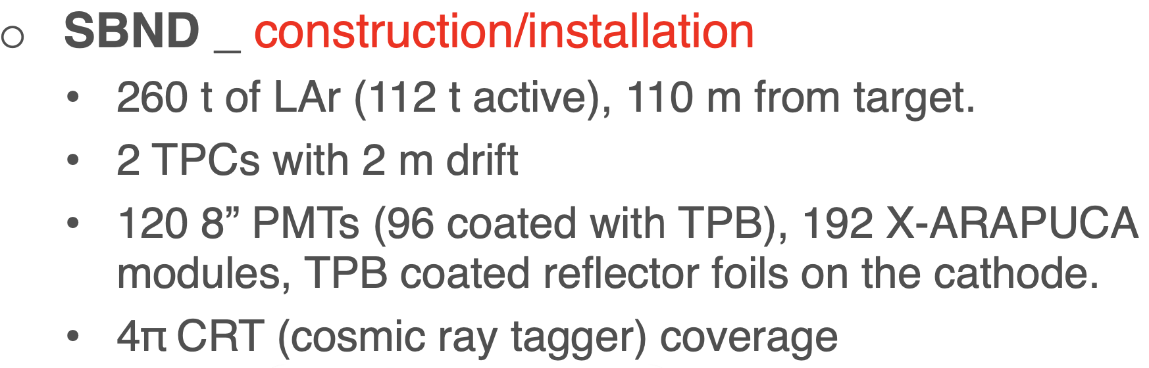
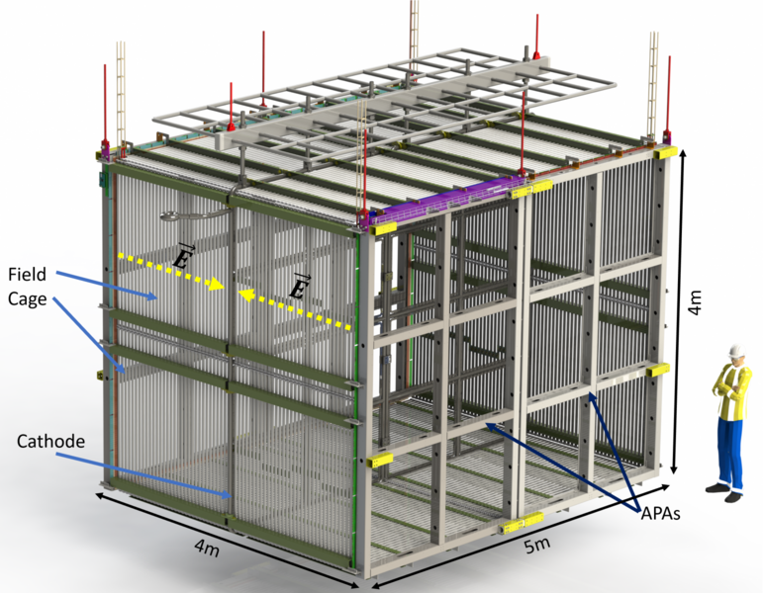
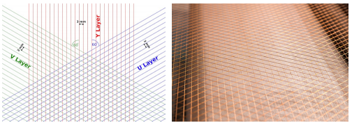
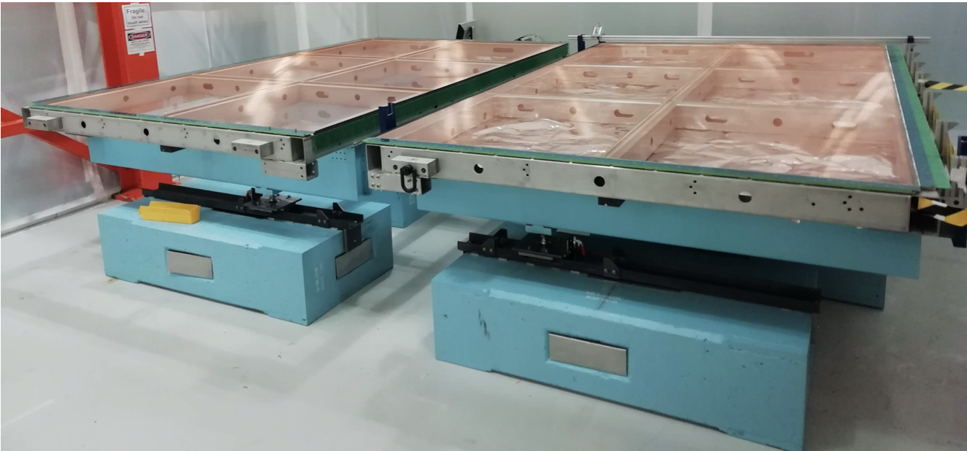
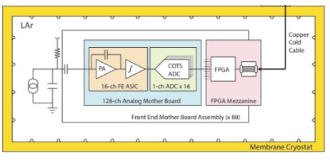
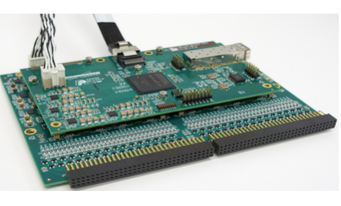
SBND
Running (first physics run completed)
Improved Cold electronics similar to ProtoDUNE SP
(FPGA also in cold)
11,264 wires/channels
[1-5,20]

Slide 12
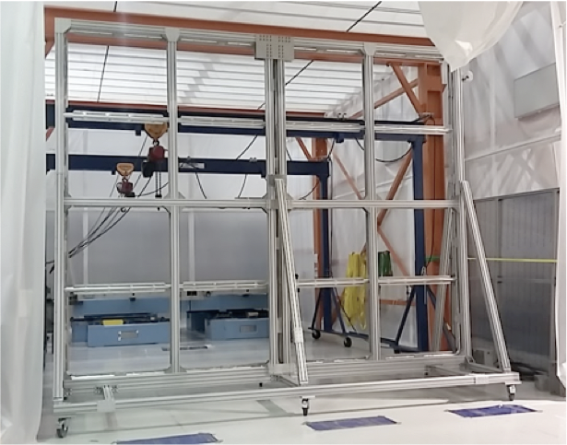
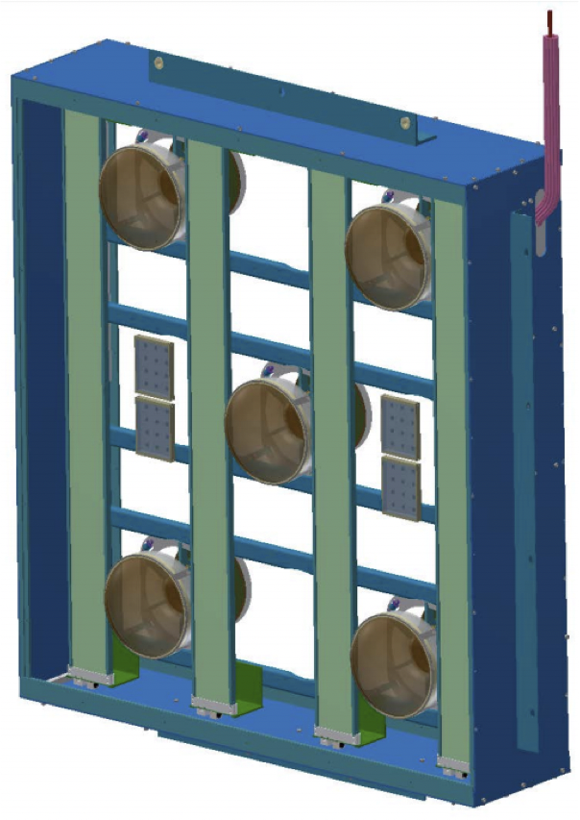
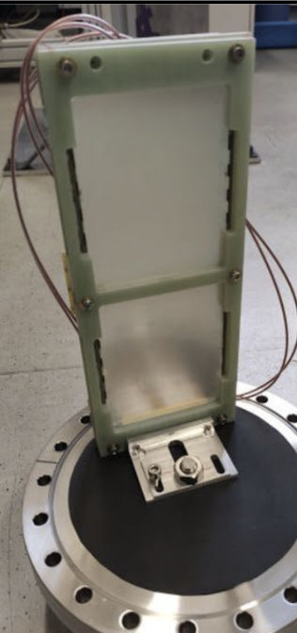
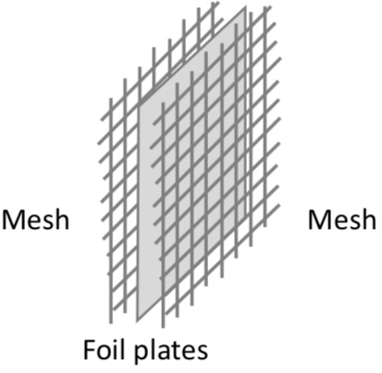
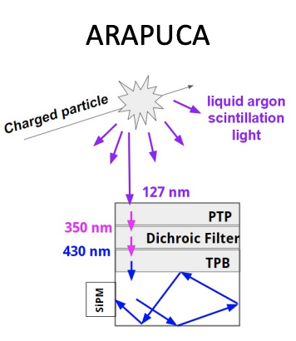
SBND –Photon Detection system
Modular photon detection system mounted behind APAs
PMTs
Wavelength-shifting reflector foils (TPB coated) mounted at the cathode to Improve the uniformity of collected light
X-ARAPURCA R&D
(A device for “trapping” photons to increase the active area of SiPM)
[1-5,20]

Slide 13
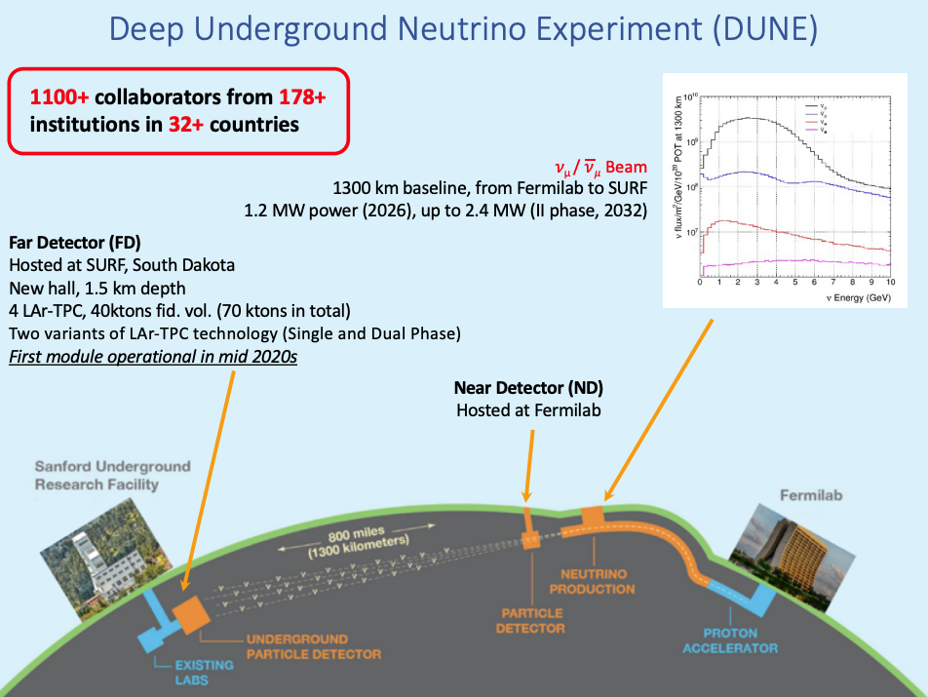
DUNE
First module operational in end 2020s
(See also slides from
Pierre Granger @Nufact25)
[6-8,21]

Slide 14
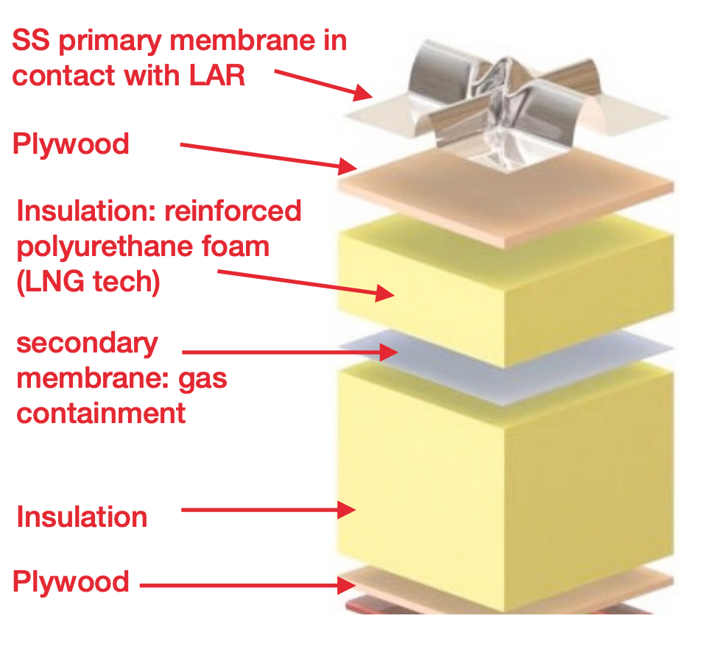
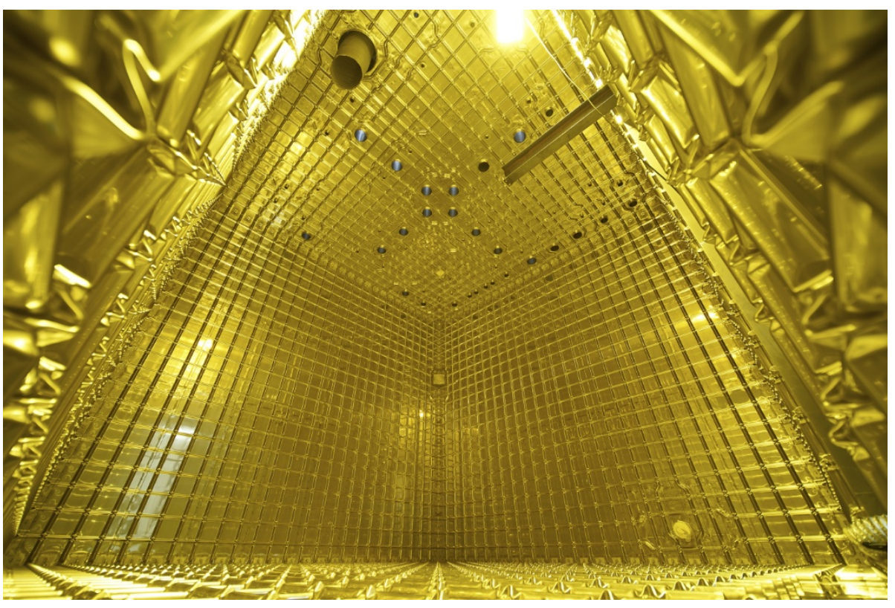
Membrane Cryostat Technology
Membrane cryostat technology developed for LNG transport ships → re-engineered for LAr-TPC detectors
Used by protoDUNEs, DUNE, SBND and Darkside-20k
[6-8]

Slide 15
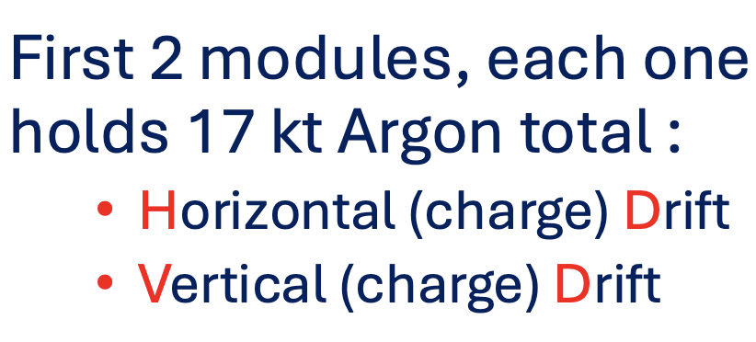
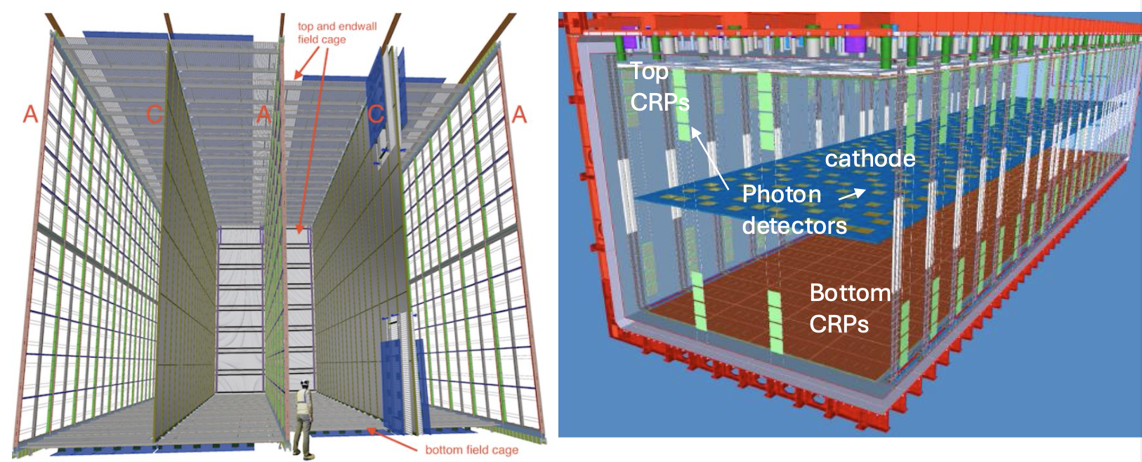
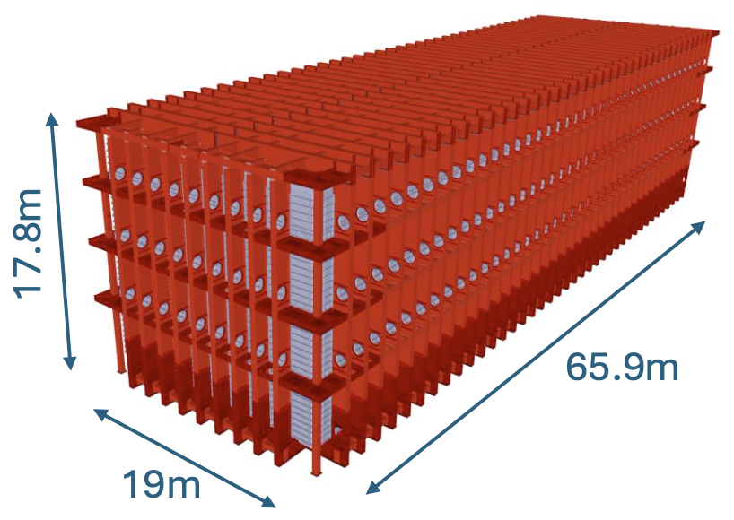
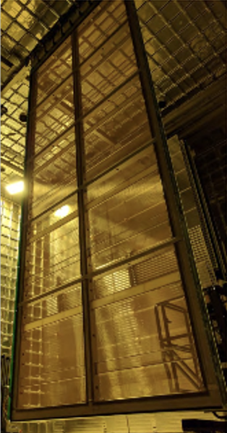
DUNE Far Detectors: two realizations: HD, VD
HD
Anode Plane Assemblies :
Wire chamber technology
Drift length 350 cm -> ~ 180 KV
9800 m3 = 13.2 ktons active LAr
VD
Charge Readout Planes :
perforated PCB technology
Drift length ~ 640 cm -> ~ 300 KV
10180 m3 = 14.2 ktons active LAr
Photon detectors on the cathode at
300 KV
[6-8, 22]

Slide 16
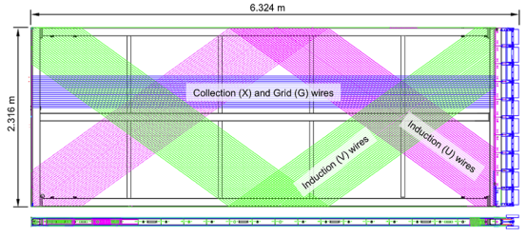
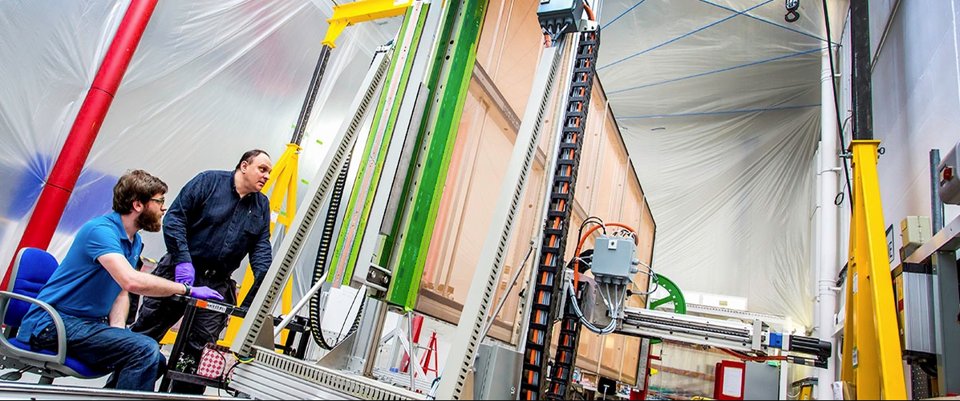
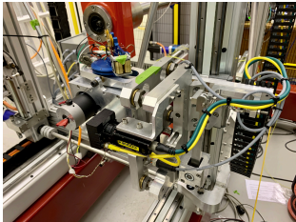
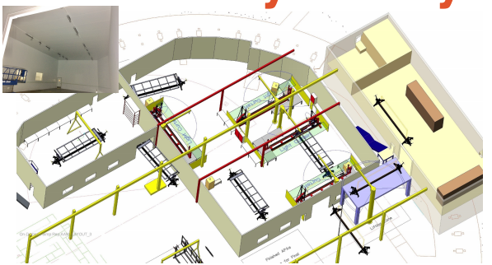
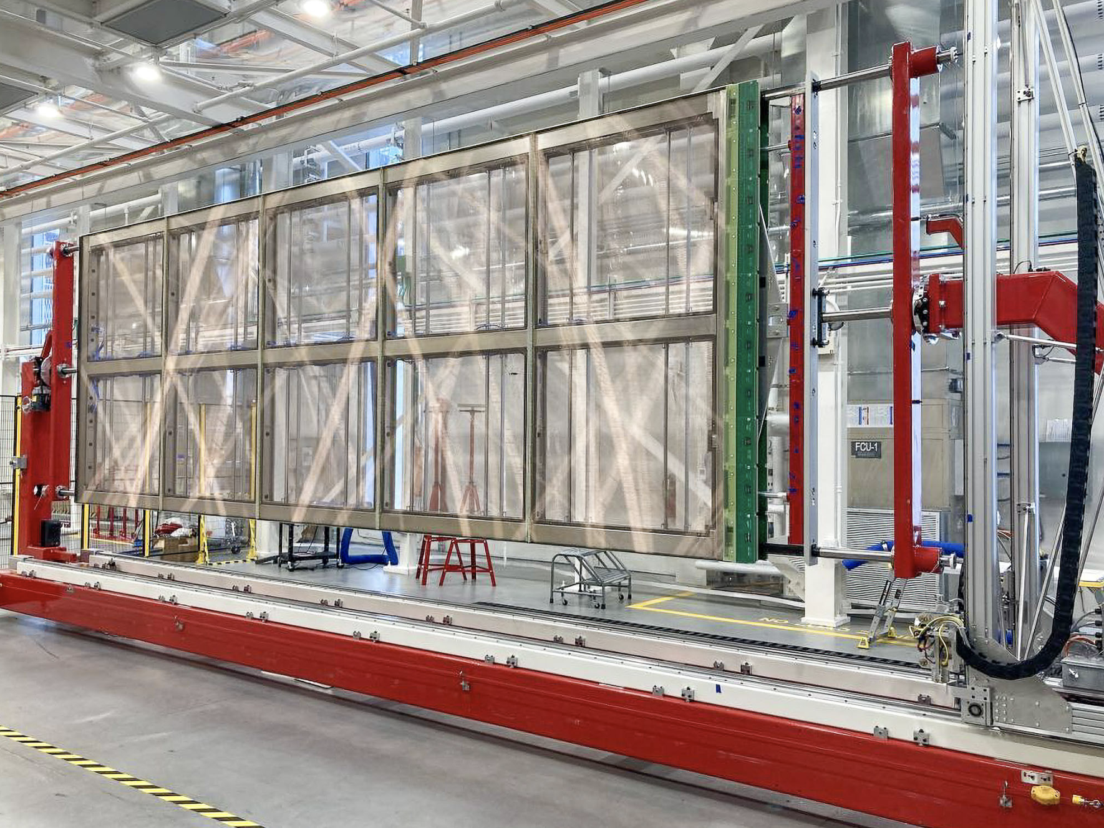
DUNE APA Factories
Aiming to produce 150 APAs in total
Daresbury, UK
Wiring head
Chicago, USA
[6-8,21,22]

Slide 17
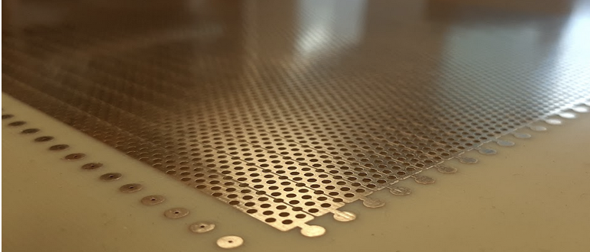
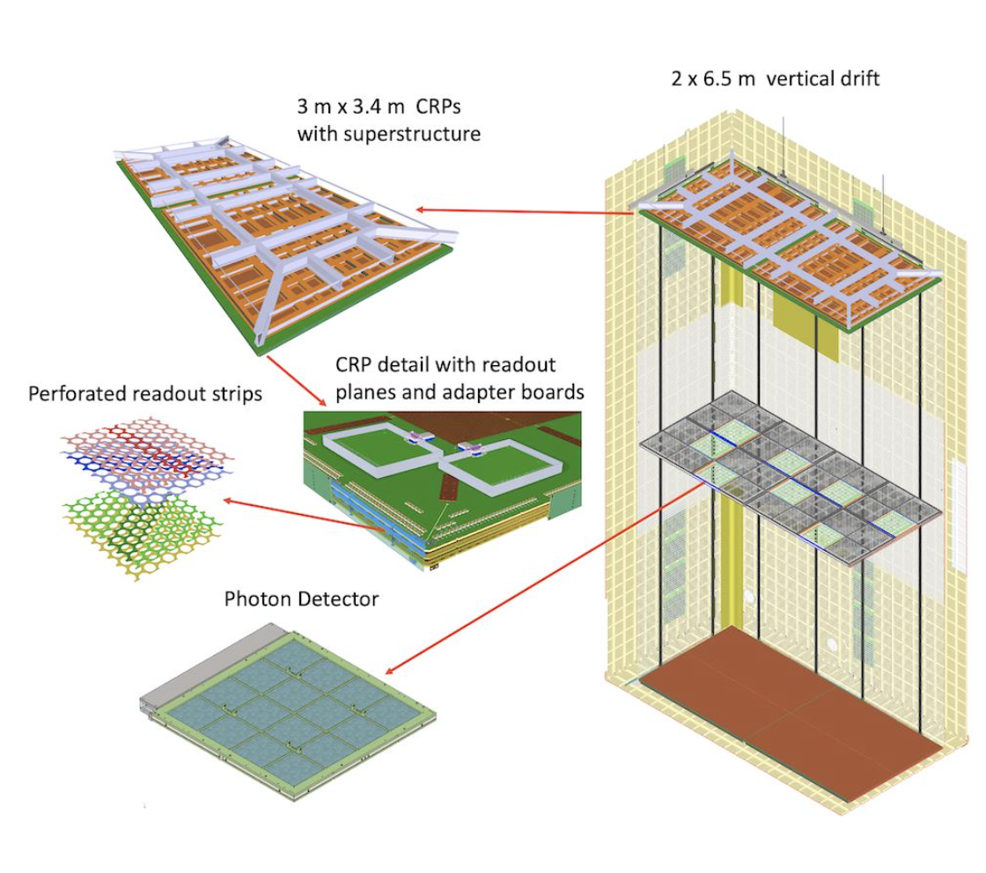
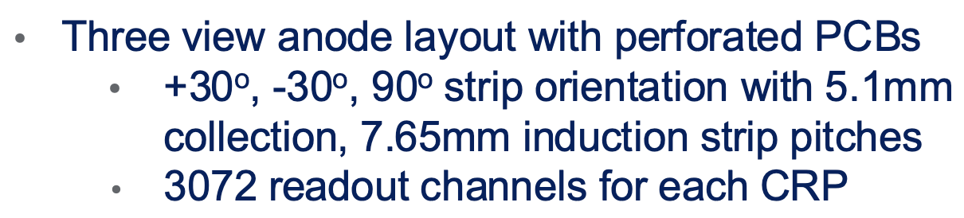
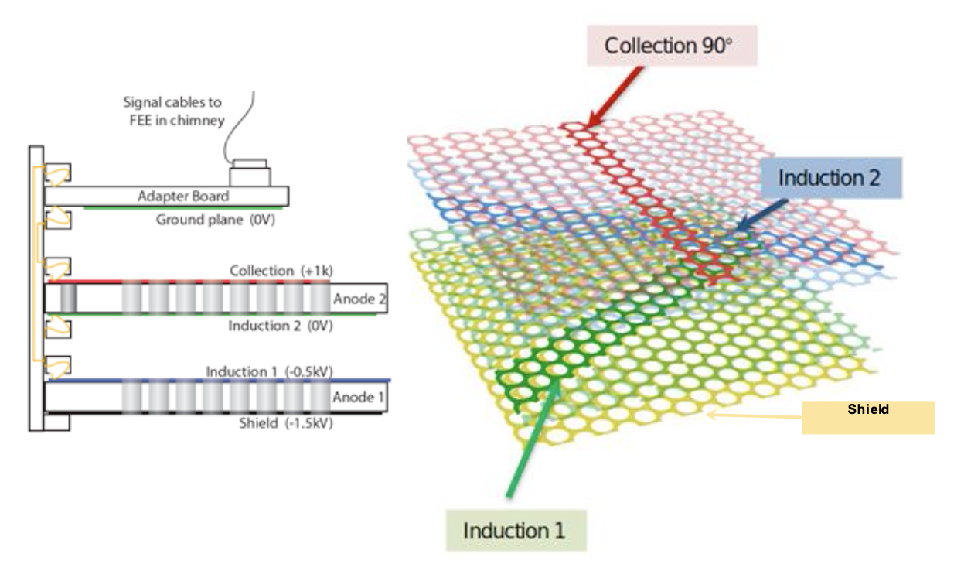
Vertical Drift Single Phase LAr TPC with PCBs
Evolution from ProtoDUNE DP
[9, 22]

Slide 18
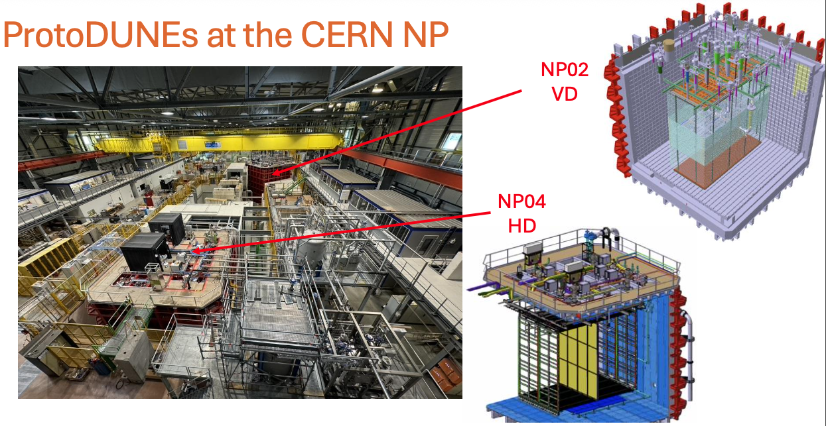
[6-8, 22]

Slide 19






ProtoDUNE SP/HD (Wires)
[6-8,21,22]

Slide 20

Argon purification
NP04 run in 2024
NP04 run in 2024
[6-8, 22]

Slide 21




ProtoDUNE VD
Cosmics sample event
[6-8,21,22]

Slide 22


DUNE Photon Detection System: X-ARAPUCA
Photon trapping through:
✓ Total internal reflection in the WLS
✓ Trapping through dichroic filter
(See also talk by Carmen Palomares @Nufact25)
[6-8, 22]

Slide 23





Optimising further S1 photon detection efficiency – APEX
APEX: Aluminum profiles with embedded X-ARAPUCA
R&D for phase II of DUNE
2ton prototype @CERN
[23]

Slide 24


Optimising further S1 photon detection efficiency -PoWER
R&D for phase II of DUNE
PEN
Field Cage
LDUs
ESR
Vis.
VUV
S1
See slides from André Steklain @Nufact 25

Slide 25


LArTPC single phase Pixel Technologies
Motivation: The anode is made of a grid of pixels, which can directly detect the ionization charge at a specific (X, Y) position without needing projections.
[10,11,25]

Slide 26

LArPiX
Multi-channel charge processing ASICS: LArPix new generation, speed up, more channels, lower power.
[10,11,25]
Continuous readout, ~100% uptime
ASICs
LArPix: Design Concept
Each pixel operates as an independent detector
- LAr data is inherently sparse
- Self-triggering and digitization for each pixel [O(100) keV threshold]
- Only digitize and readout pixels with signals
Pixelated anode based on LArPix V2 ASIC (LBNL) Pixel tile: 30x30 cm, 100 ASICs, 4900 pixels
Pixel rate 0.4 Hz/pixel, Tile rate 2 kHz
Data rate - 32 kB/s per tile or ~1 MB/s/m³
Tiles
P = 64 uW/ch, Total power 0.3 W/tile or 3W/m²

Slide 27

LArPix and DUNE ND-LAr
[10,11,25]

Slide 28



LArPix and DUNE ND-LAr
FSD Operation @ Univ. of Bern, 21 Oct – 15 Nov, 2024
FSD Anode Assembly
[10,11,25]

Slide 29





QPIX
D. Nygren's Qpix ASIC (time-to-charge approach)
[25, 26]
Charge integrate/replenishment circuit
Q-Pix summary:
Measures the time to integrate a pre-defined integrated charge (∆Q).
Average detector current is encoded in the reset rate
Self-triggered, per pixel
$$∆Q=\int{I\left(t\right)dt=I_{avg}∙∆t}$$
replenishment time difference (RTD)
64-channel Q-Pix prototype (QPixLAr)

Slide 30





Multimodal pixel readout –SoLAr
A pixel plane which is sensitive to
(UV-VIS) photons (L) and ionizationcharge (Q) simultaneously
Multiple ways to achieve this concept
SoLAr: Integration of conventional light
detectors (e.g. VUV SiPM’s) into the pixel
plane
[25]

Slide 31



Multimodal pixel readout –aSe photoconductor
(Elena Gramellini et al)
Amorphous selenium (aSe)
Direct sensitivity to VUV light with low detection threshold
large area coverage & avalanche gain possible Demonstrated at both room and LAr temperature
[25]

Slide 32



Dual Phase LAr Detector Operation Principles
Darkside
ProtoDUNE DP
ARIADNE
Charge amplification and light readout with fast cameras
Electroluminescence light (no e⁻ avalanche) readout with radiopure SiPM array
Charge amplification and readout

Slide 33





ARIADNE (1ton): Optical LArTPC with TPX3Cam
Instead of reading out the charge from the THGEM, fast TPX3 Cameras photograph the S2 light generated in the THGEM holes
[13-15]
FR4 THGEM
500µm
New Glass THGEM
New Manufacturing glass THGEM technique (patent pending) allows use of large scale radiopure glass opening application also to Dark Matter
1-ton Detector at Liverpool

Slide 34


ARIADNE: Optical LArTPC with TPX3Cam
Full 3D Readout
Silicon pixel readout chip developed by the Medipix collaboration. Very well established technology at CERN.
Simultaneous 10 bit Time over Threshold (ToT) and 18 bit Time Of Arrival (TOA).
ToT allows accurate calorimetry measurements.
TOA accurate timing and 3D reconstruction.
“Data driven readout”: pixels read out asynchronously, allows very efficient sparse readout.
Possible to have continuous trigger-free readout.
All pixels read out
No timing data within event
Only active pixels read out
Per pixel timing information
ASI
Sensor resolution | 256x256 pixels
Pixel size | 55µm x 55µm
Max readout rate | 40Mhits•cm⁻² •sec⁻¹
Time resolution | 1.6 ns
[13-15]

Slide 35


ARIADNE: LAr Cosmics
1.75 sec streaming (ie equivalent to 3km e⁻ drift)
~1mm/pixel
Raw 3D only ToT cut
Camera can cover 1mx1m at 4mm/pix
[13-15]
TPXCam sensitive to electroluminescence regime (no e⁻ gain)

Slide 36






ARIADNE⁺ 15 ton Demonstration @CERN
Sixteen 50cm x 50cm glass THGEMs
2mx2m glass THGEM array
cosmic
dE/dx

Slide 37


DarkSide-20k
[16-18,27,28]

Slide 38




DarkSide-20k ³⁹Ar depletion & Large Area SiPM Readout
Silicon is intrinsically radiopure
ARIA -distillation column
ARIA project (Darkside Collab.), production of depleted argon, below the UAr levels
[16-18,27,28]

Slide 39


DarkSide-20k inner detector
PDU
Outer detector PDUs similar with the inner. Production in UK close to completion.
[16-18,27,28]

Slide 40







A very Exciting Era for LAr Detectors
DarkSide-20k
DUNE- ND LAr
DUNE FD 10kt
Thank You!
ICARUS T600
SBND -112t
ProtoDUNEs 750t @CERN
1-ton prototypes
ARIADNE
MicroBooNe

Slide 41
Citations
https://indico.cern.ch/event/768000/contributions/3275101/attachments/1817037/2970272/NeutrinoTelescopes2019Varanini.pdf
https://agenda.infn.it/event/24250/contributions/127449/attachments/79423/103217/Fava_SBN_Neutel_2021.pdf
JINST 13 (2018) P12007
https://indico.cern.ch/event/835190/contributions/3576893/attachments/1941976/3220400/Toups_NNN_2019.pdf
https://indico.fnal.gov/event/14063/contributions/23475/attachments/15115/19246/SBNDUNE.20170515.pdf
https://indico.in2p3.fr/event/19194/contributions/73545/attachments/54180/70812/CERNNP_sbordoni.pdf
https://indico.cern.ch/event/881818/attachments/1972807/3299895/CERN-Colloquium-Jan-20-60MB.pdf
https://indico.cern.ch/event/857610/contributions/3651379/attachments/1957901/3253223/LBNC_Dec19_CTouramanis.pdf
https://edms.cern.ch/ui/#!master/navigator/document?P:100722921:100738064:subDocs
https://indico.cern.ch/event/999815/contributions/4221588/attachments/2223005/3764756/ChargeReadout_Kreslo.pdf
https://indico.fnal.gov/event/21535/contributions/63303/attachments/39668/48006/QpixConceptFEelect2.pdf
https://indico.in2p3.fr/event/19194/contributions/73346/attachments/54154/70767/ProtoDUNE-DP-duchesneau-250619.pdf
https://www.mdpi.com/2410-390X/4/4/35
https://arxiv.org/pdf/1810.09955.pdf
https://iopscience.iop.org/article/10.1088/1748-0221/15/03/P03003
https://indico.fnal.gov/event/19947/contributions/54727/attachments/34154/41785/DarrenPrice_DMUK_DarkSide20k.pdf
https://iopscience.iop.org/article/10.1088/1748-0221/15/03/C03038/pdf
https://indico.cern.ch/event/868940/contributions/3814880/attachments/2080507/3494419/DS_ICHEP2020.pdf
https://inspirehep.net/files/03e6542a060e9e668f35ac140d494387
https://indico-cdex.ep.tsinghua.edu.cn/event/175/contributions/2282/attachments/1116/1700/20250828_sbnd_status_twester.pdf
https://indico-cdex.ep.tsinghua.edu.cn/event/175/contributions/2525/attachments/1115/1699/DUNE_TAUP_2025_MANZANILLASv3.pdf
https://indico.cern.ch/event/1492360/attachments/3006084/5298729/CT-CERNcolloquium25.pdf
https://indico.cern.ch/event/1390649/contributions/6061504/attachments/2916604/5118565/DUNE_APEX_PHASEII_LIDINE2024_v0.pdf
https://indico.fnal.gov/event/67540/timetable/#20250312
https://indico.cern.ch/event/1485254/timetable/#20250211.detailed
Qpix: https://indico.phy.ornl.gov/event/510/contributions/2165/
https://indico.global/event/652/contributions/16971/attachments/57443/110377/CaminataUCLA.pdf
https://indico.global/event/652/contributions/16907/

