Slide 1
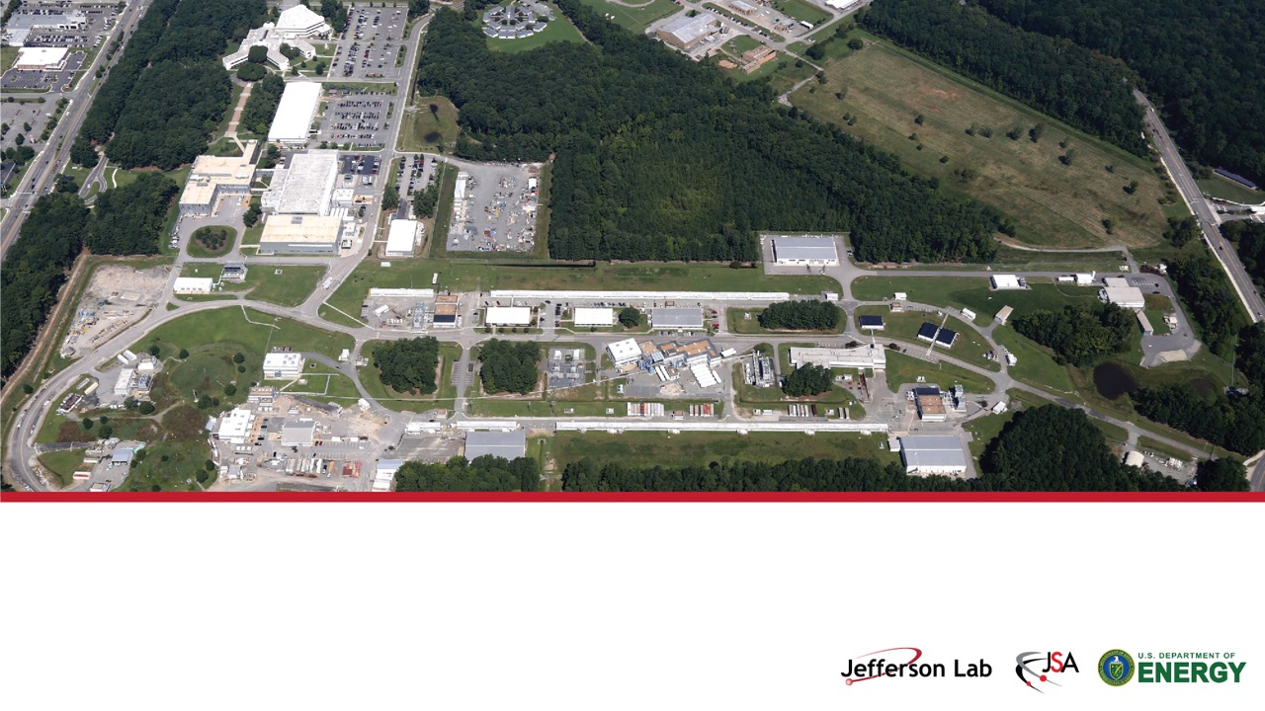
Secondary Beams at Jefferson Lab
Cynthia Keppel
Thomas Jefferson National Accelerator Facility
The 26th International Workshop on Neutrinos from Accelerators (NuFact 2025)
Liverpool, UK 1-6 September 2025

Slide 2
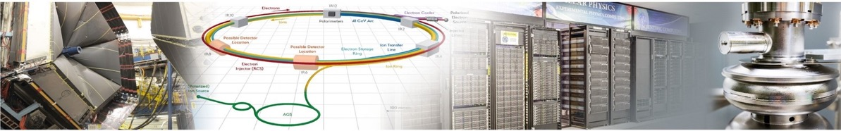
Jefferson Lab At A Glance
Physics at CEBAF
Collider R&D
Computational & Data Science
Applied Research & Technology
Vibrant nuclear physics research program at Continuous Electron Beam Accelerator Facility (CEBAF) with optimal 32 weeks/yr
High precision pictures of the quarks and gluons inside hadrons
BSM Physics – BDX, MOLLER
Developing CEBAF upgrade paths including positrons and energy doubling
Partnering with BNL in the management, design, and construction of the Electron-Ion Collider Project
Leadership in the design and construction of SRF accelerator capability for the Office of Science
Leadership in energy recovery, polarized e- beams, emerging expertise in polarized e+ and FFA
Among the leaders in Lattice QCD
Pioneers in multi-facility streaming data and fast data transfer and analysis
Will be home to first-of-its-kind Data specific scientific computing facility: High Performance Data Facility (HPDF)
R&D in accelerator, detectors and applications in nuclear imaging and medicine
Compact accelerator technology for industrial applications
Industrial partnerships on lithographic technology
Advanced detector development (MPGD)
S&T thrusts are synergistic and mutually supportive
Build on our core capabilities to pursue a diverse scientific portfolio

Slide 3
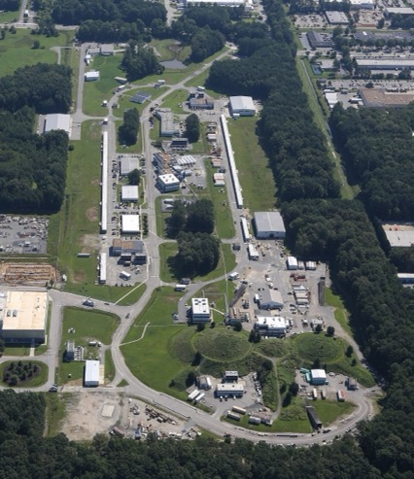
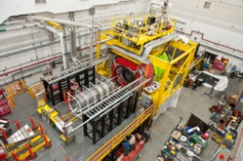
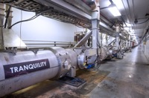
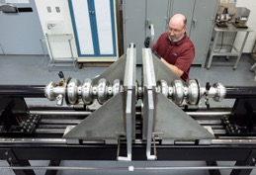

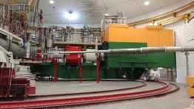
User Facility: CEBAF, a 12-GeV CW Electron Beam Delivered Simultaneously to 4 Target Halls
12 GeV CW electron beam, 90% polarization, high beam power (~1 MW)
Over a decade of approved science program ”on the books”
1,778 scientist users from 324 institutions in 39 countries
Cryomodule
Hall D
Superconducting Radiofrequency (SRF) cavities
An aerial view of the recirculating linear accelerator and 4 experimental halls.
Machine Control Center (MCC)
Hall C
3

Slide 4
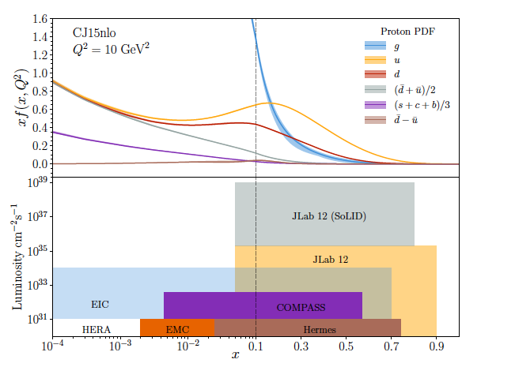
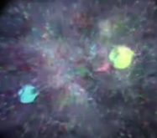
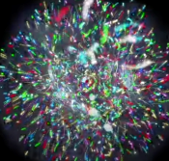
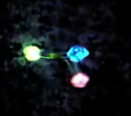
JLab 12 to 22 GeV: Probing Nucleon Valence Structure at Unparalleled Luminosity
Partonic structure in the valence region defines the hadron
Baryon number, charge, flavor content, total spin, …
But, how does this happen? What is the mechanism? Are there thresholds? -
Nucleon structure in the non-perturbative regime
Large x, low Q² evolves to low x, high Q² via pQCD, extract PDF shape and strength from data
Precision measurements (2D,3D) in the valence regime require high luminosity, and are the unique purview of JLab, providing overlap with EIC into the low x region
Probability Distribution
Probability Distribution
JLab 22
Luminosity (cm⁻²s⁻¹)
2030s-2040s
Fraction of nucleon momentum
Physics with CEBAF at 12 GeV and Future Opportunities
Prog. Part. Nucl. Phys. 127 (2022) 103985

Slide 5
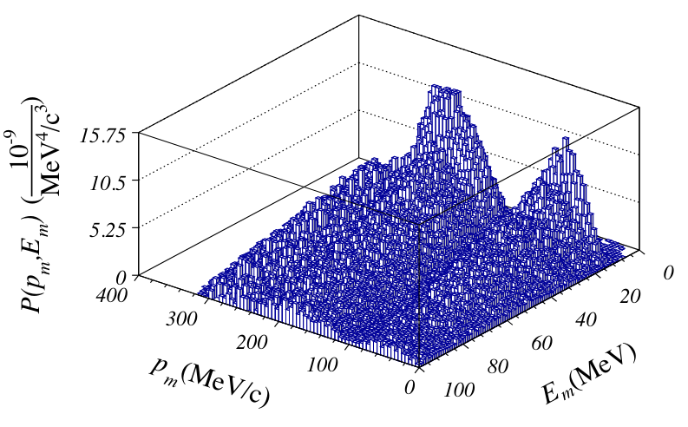

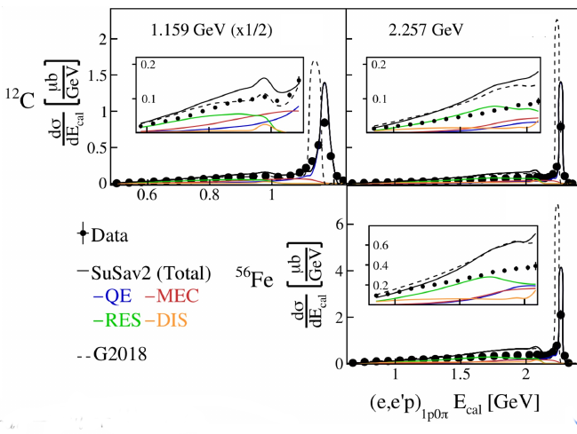
Electron data provides input for neutrino oscillation experiments
Collaborations have significant participation by HEP community
Electron scattering data provides:
precision input of vector form factors and structure functions
testing ground for event generators w/ monochromatic beam
provide initial state nucleon momentum distributions eg. Argon spectral function for DUNE LarTPC
provide observables on hadron transport through nuclei and final state interactions
Hall C: nucleon spectral function in Argon
Phys. Rev. D 105, 112002, (2022)
Hall B data mining by collaboration
Guidance for event generators requires engagement of nuclear theory
HEP/JLab Experiment/Theory Collaboration to ensure successful neutrino oscillation program in development
Nature 599, 565-570, 2023
→ study systematics due to beam reconstruction techniques.

Slide 6
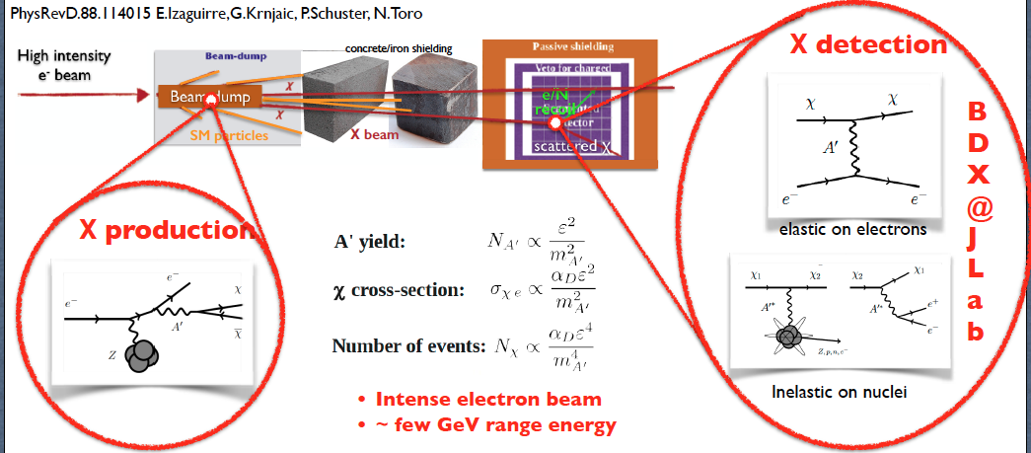
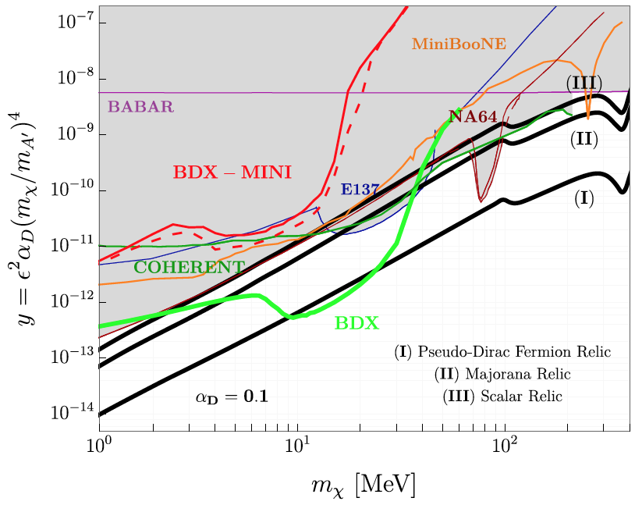
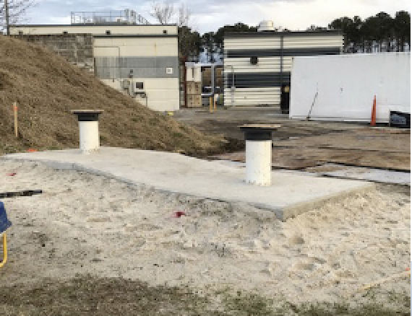
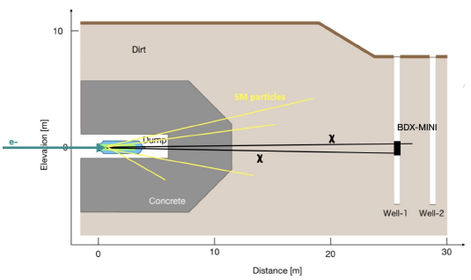
Beam Dump Experiment (BDX)
A cutting-edge experiment designed to search for light dark matter
Two step process
An electron radiates an A’ and the A’ promptly decays to a χ (DM) pair
II) The χ (in-)elastically scatters on a e-/nucleon in the detector producing a visible recoil (GeV)
Experimental signature in the detector:
Χ-electron → EM shower ~GeV energy
BDX-MINI: pilot experiment to prove the validity and feasibility of the BDX exp
Accumulating 10²² EOT in ~2y BDΧ sensitivity is 10-100 times better than existing limits on LDM
Two wells dug for bg muon tests
E_{beam}=2.2 GeV, no muons
Limited reach but first physics result!
BDX will improve exclusion limits by 2 orders of magnitude, be sensitive to thermal targets and leptophilic interactions, fully parasitic, and doesn’t require new beamlines
M.Battaglieri et al. PRD 106, 072011
Collected 4e21 EOT (40% BDX!) in ~4 months (+ cosmics)
6

Slide 7
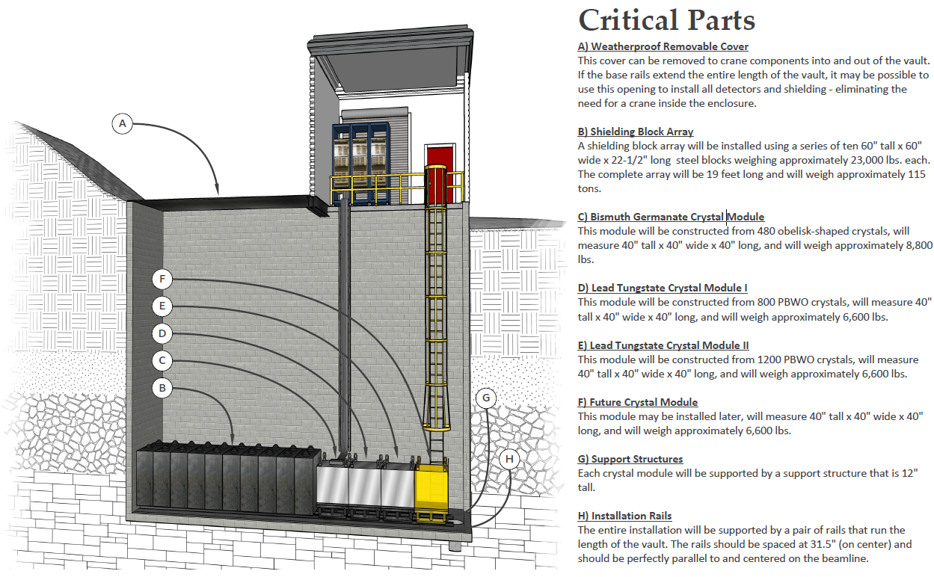
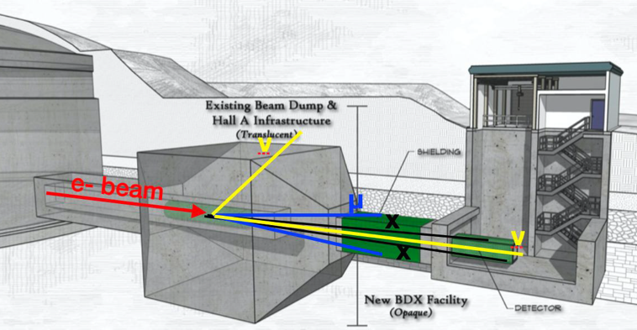
Realization of the Beam-Dump Experiment (BDX)
During last years, detector design and concept was validated
Now going from proof-of-principle to full-scale experiment
Planned new vault:
High-intensity secondary beams are produced in the dump(s) fully parasitically with high-intensity 10 GeV (22 GeV) electron beam

Slide 8
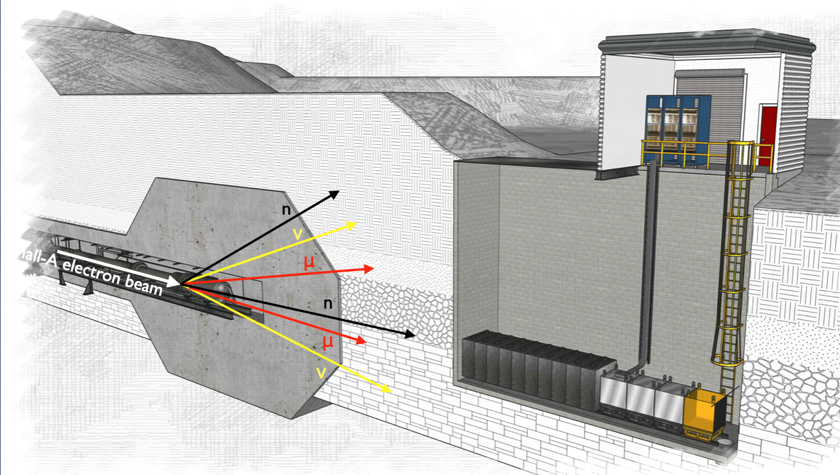
Secondary muon and neutrino beams @ Hall-A BDX facility
CEBAF provides a high-intensity 12 GeV (in future 20+ GeV) electron beam for extracted-beam experiments
High-intensity secondary beams are produced in the dump(s) fully parasitically
The machine can sustain up to ~MW power (100 uA @ 12 GeV, 200 uA @ 5 GeV)
Hall-A routinely receives ~50-70 uA @11 GeV, Hall-D 7-8 uA @ 12 GeV
High-intensity secondary beams:
Muon
Neutrino
Light Dark Matter (hypothetical)
neutrons
Hall-A beam dump
BDX pit
beam dump
concrete vault
Based on https://www.mdpi.com/2410-390X/8/1/1/pdf

Slide 9




The simulation framework
Hall-A beam-dump geometry/materials implemented in FLUKA (with JLab RadCon Group)
FLUKA biasing: xsecs enhancement, ‘leading particle’, importance sampling, threshold T>100 MeV
GEANT: detailed and realistic descriptions of the detector active volume response
Hall A Beam Dump & alcove
Fluence at the BD exit
Muon
Statistics equivalent to ~10²² Electron on Target (EOT)
GEANT4
FLUKA
Neutron
FLUKA
Good consistency between G4 and FLUKA for μ and high energy neutrons (Tn>100 MeV) in the BD

Slide 10
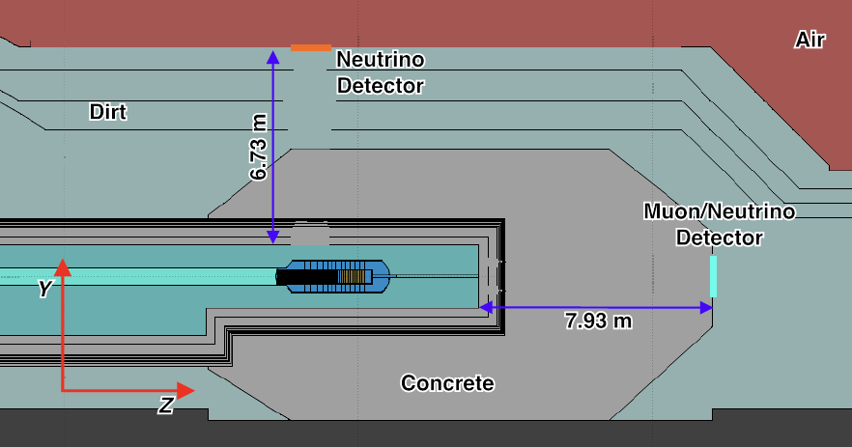
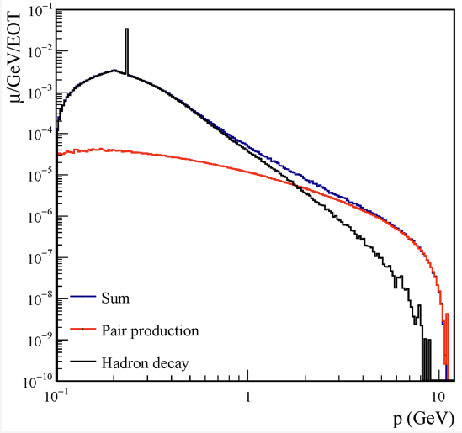
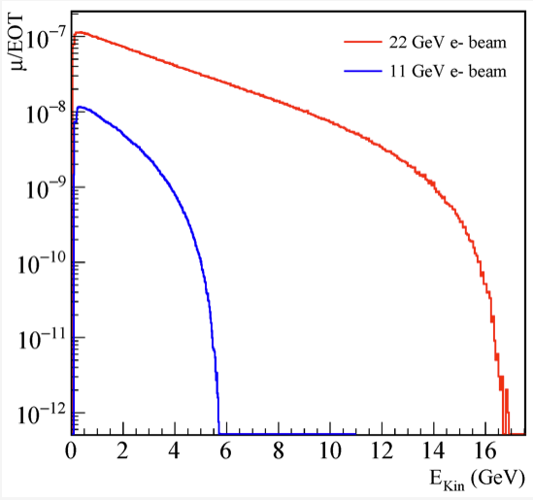
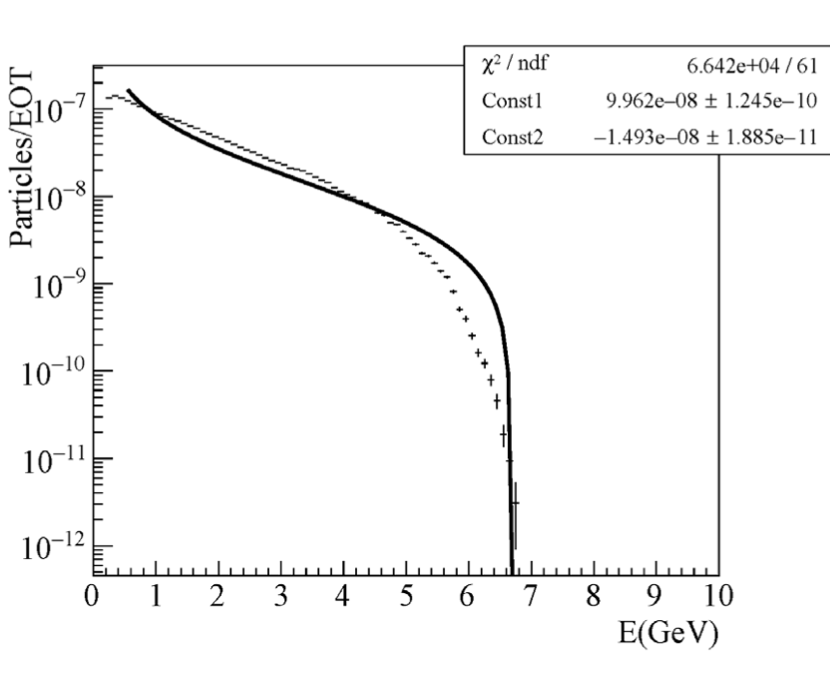
Muon beam
Muon flux estimated using FLUKA for 11 GeV and 22 GeV primary e- beam on Hall-A BD
High-energy muon produced via two processes:
Photo-production of π and k and decay
Pair-production: γN -> μμN
Muon flux sampled on-axis
11 GeV beam
Significant advantage at 22 GeV (higher muon flux and higher energy
11 GeV e- beam
9 10⁻⁷ μ/EOT
Bremsstrahlung-like energy spectrum

Slide 11
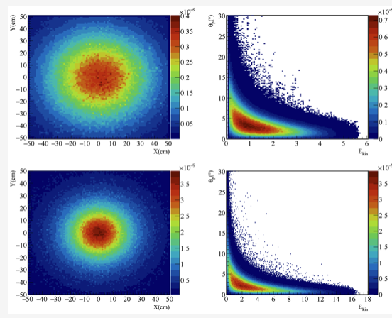
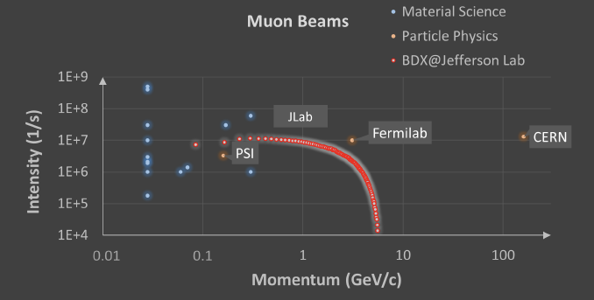
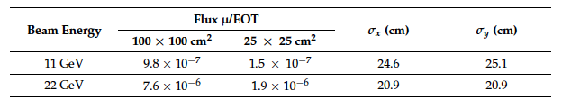
The muon beam
The flux increases with the energy of primary beam:
Muon flux (11 GeV e- beam): 9 10⁻⁷ μ/EOT
Rate ~ 3 10⁸ μ/s
Muon (22 GeV e- beam): 5.3 10⁻⁶ μ/EOT\
Rate ~ 2 10⁹ μ/s
CERN’s M2 beamline (Eμ>100GeV - Rate ~2 10⁷)
Muon flux profile: σx and σy ~ 20 cm
Muon fluxes are worldwide among the highest wrt. dedicated facilities

Slide 12
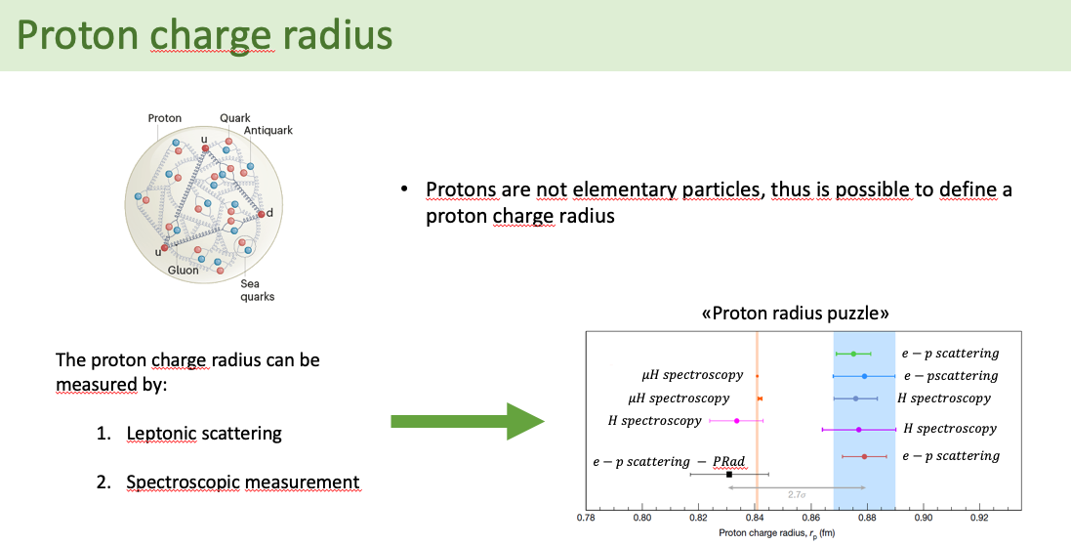
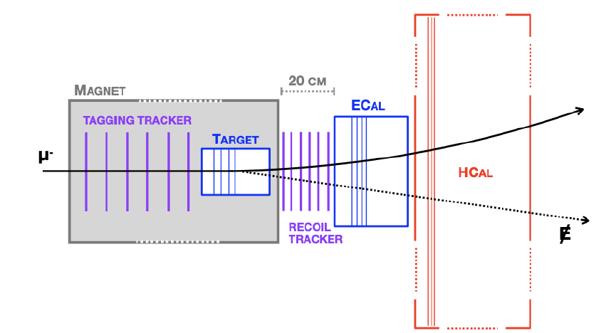
Probing muon-philic forces with secondary muon beam
Proton radius
μ³BDX @ JLab
Fixed-target, missing-momentum experiment to probe invisibly decaying particles
Scalar or vector mediator of a new force
This experiment is similar to M³ experiment proposed at FERMILAB
μBDX @ JLab
Smaller Bohr radius / closer probing
Reduced radiative effects
Higher momentum transfer at same energy
Independent cross-check
AMBER @ CERN (M2 beam line)
Muon beam dump experiment to probe the visible decay into e+e-(γγ)
Same infrastructure requested by BDX

Slide 13
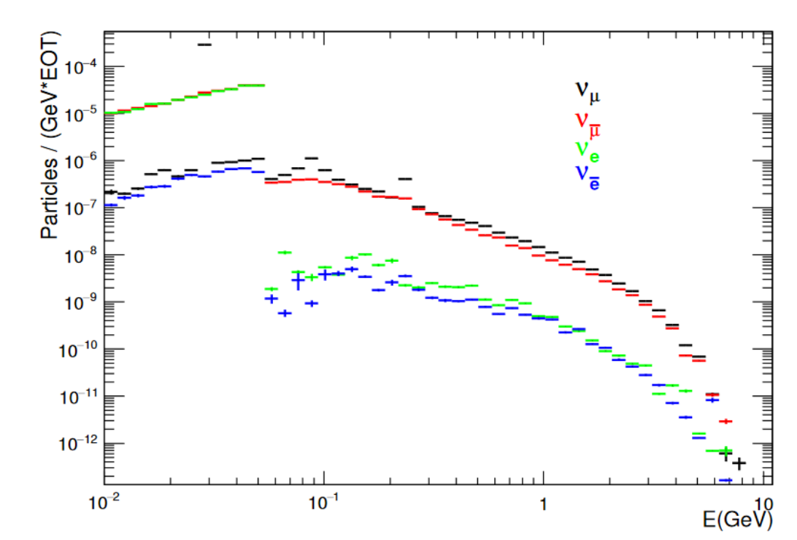

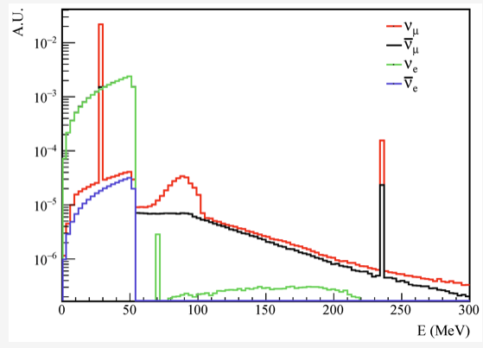
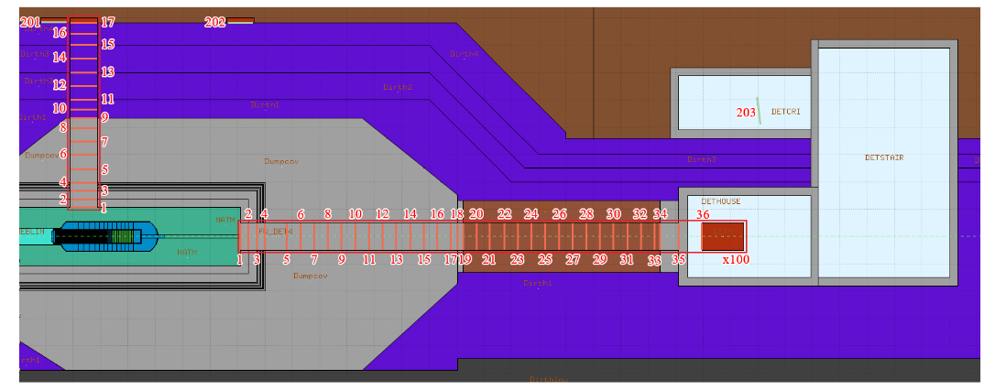
Neutrino beam
Neutrino flux estimated using FLUKA for 11 GeV and 22 GeV primary e- beam on Hall-A BD
Low energy νs due pion and muon decay at rest
π decay produces a prompt 28.5 MeV v_{μ} along with a μ which subsequently decays producing a v_{e} and a v_{μ}
Weak angular dependence
High-energy v from in-flight pion and muon decay

Slide 14
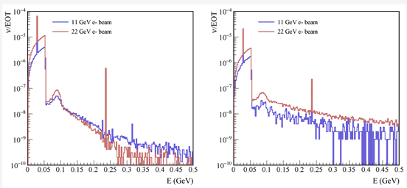
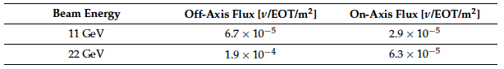
Neutrino beam
Neutrino flux estimated using FLUKA for 11 GeV and 22 GeV primary e- beam on Hall-A BD
Flux scored on a plane downstream Hall-A beam dump:
11 GeV e- beam: 3 10¹⁷ v/m²/year (1 year corresponding to 10²² EOT)
22 GeV e- beam: 9 10¹⁷ v/m²/year (1 year corresponding to 10²² EOT)
Decay-At-Rest (DAR) energy spectrum
Off-axis
On-axis

Slide 15
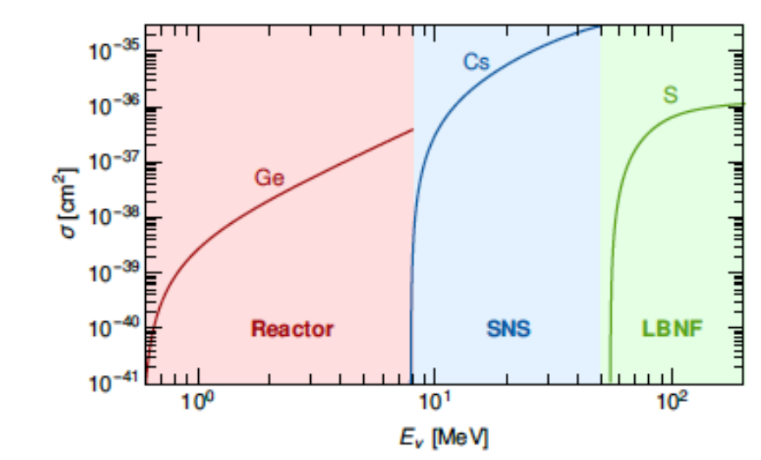
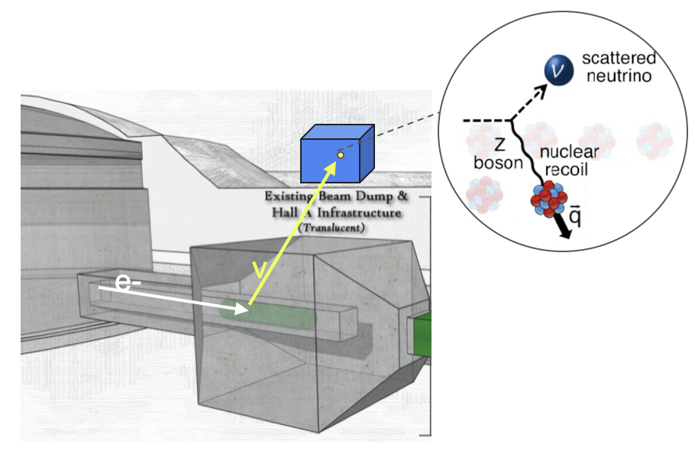
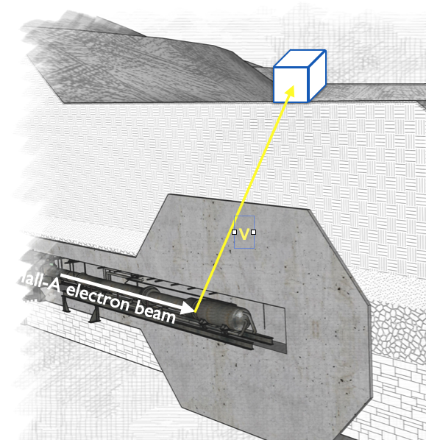
νBDX @ JLab
CEvNS XSec
Detecting CEvNS at JLab
CEvNS (Coherent Elastic nu-Nucleus Scattering)
Low-energy neutrinos (<100 MeV) coherent scatter on nucleus
Cross-section scales as N²
The largest xsec for Eν < 100 MeV
First detected in 2017 on CsI by COHERENT (~134 events)
Low recoil energy due to kinematics O(10 keV)
Why interesting?
weak parameters -> mixing angle
nuclear properties -> neutron distribution radius
sterile neutrino
neutrino magnetic moment
non standard interaction mediated by exotic particles
Requirements
High-intense v-flux
v-flux energy range: few MeV - few 100 MeV
detector sensitive to small energy deposition
small background

Slide 16
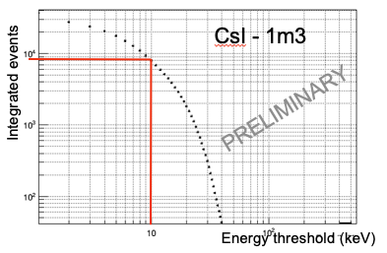
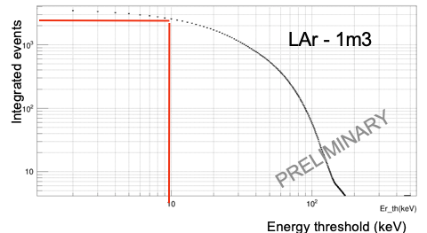
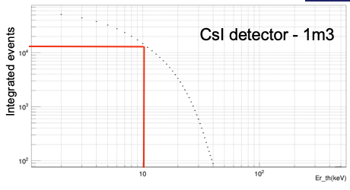
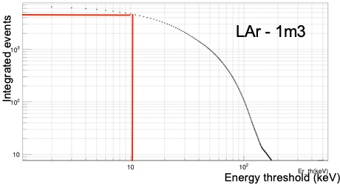
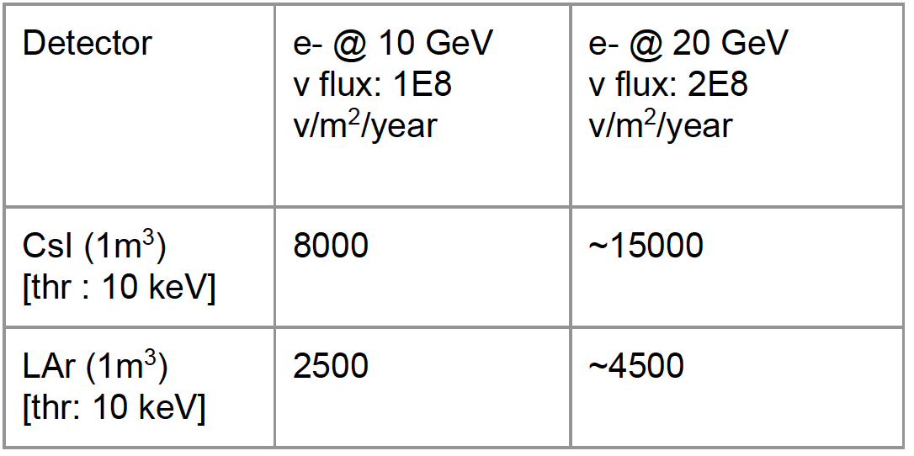
νBDX @ JLab
Detecting CEvNS at JLab
Neutrino beam
Produced by the interaction between e- beam and Hall A dump
DAR energy spectrum: 10MeV - 300 MeV
11 GeV e- beam : ~10¹⁸ v/m² at ~8 m above the dump for 10²² EOT
22 GeV e- beam: ~2 10¹⁸ v/m² at ~8 m above the dump for 10²² EOT
The detector
8m above the dump
Two detection technologies under study:
CsI
LAr-TPC
Veto system: active (plastic …) and passive (lead, water, borate silicone and/or cadmium sheet layers…)
The detector
The beam-related background: neutron
beam-unrelated background: cosmic, radioactive detector contamination, environmental radioactivity
Background studies ongoing using MC simulation
In situ bg assessment to validate MC framework

Slide 17
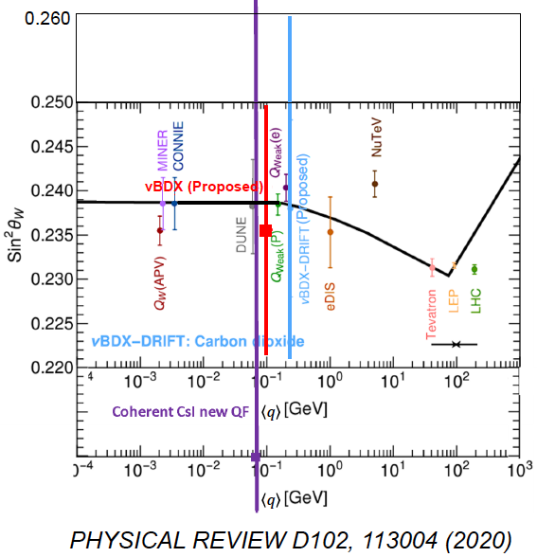
νBDX @ JLab
Detecting CEvNS at JLab
Neutron background (beam-related and cosmics) included in νBDX reach
Neutrino beam
Produced by the interaction between e- beam and Hall A dump
DAR energy spectrum: 10MeV - 300 MeV
11 GeV e- beam : ~10¹⁸ v/m² at ~10 m above the dump for 10²² EOT
22 GeV e- beam: ~2 10¹⁸ v/m² at ~10 m above the dump for 10²² EOT
The detector
10m above the dump
Two detection technologies under study:
CsI
LAr-TPC
Veto system: active (plastic …) and passive (lead, water, borate silicone and/or cadmium sheet layers…)
The detector
The beam-related background: neutron
beam-unrelated background: cosmic, radioactive detector contamination, environmental radioactivity
Background studies ongoing using MC simulation
In situ bg assessment to validate MC framework
Projected νBDX sensitivity to θW
sin²θW=0.209^{+0.072}−0.069

Slide 18
Summary
High-intensity electron beams are a precious – and untapped - source of secondary beams:
The high intensity (~100uA), medium energy (~10 GeV) CEBAF electron beam at Jefferson lab is ideal for producing secondary beams
Light Dark Matter (if it exists)
Neutrinos
Muons
Neutrons
(positrons)
Realistic simulations performed with FLUKA and GEANT4
Muon beam: Bremsstrahlung-like energy spectrum, (100 MeV - 5 GeV), ~10⁻⁶ μ/EOT = 10⁸ μ/s for an electron current of 50 µA
Neutrino beam: DAR energy spectrum , (0 - 50 MeV), 3 10¹⁷ v/m²/year
LDM: best beam around the world for a beam-dump experiment
The 22 GeV upgrade of CEBAF will provide even better secondary beams (in particular muons)
Secondary beams offer new opportunities to complement hadron physics at lepton-beam facilities fully parasitically

Slide 19
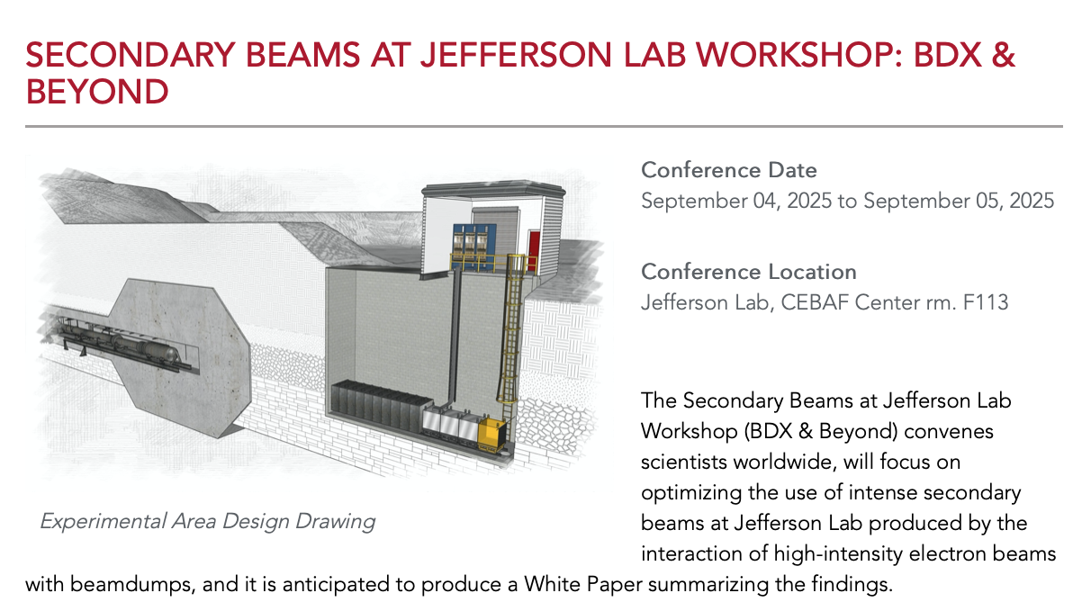
We’re very interested in collaboration!
A Jefferson Lab beam dump facility can provide access to low-cost, opportunistic, high-intensity secondary particle beams of muons, neutrinos, and neutrons
Design?
Beamline?
Detectors?
Science?
There’s time to realize your best ideas!
Contact me (JLab), Marco Battaglieri (INFN), Patrick Achenbach (Mainz)
19

