Slide 1
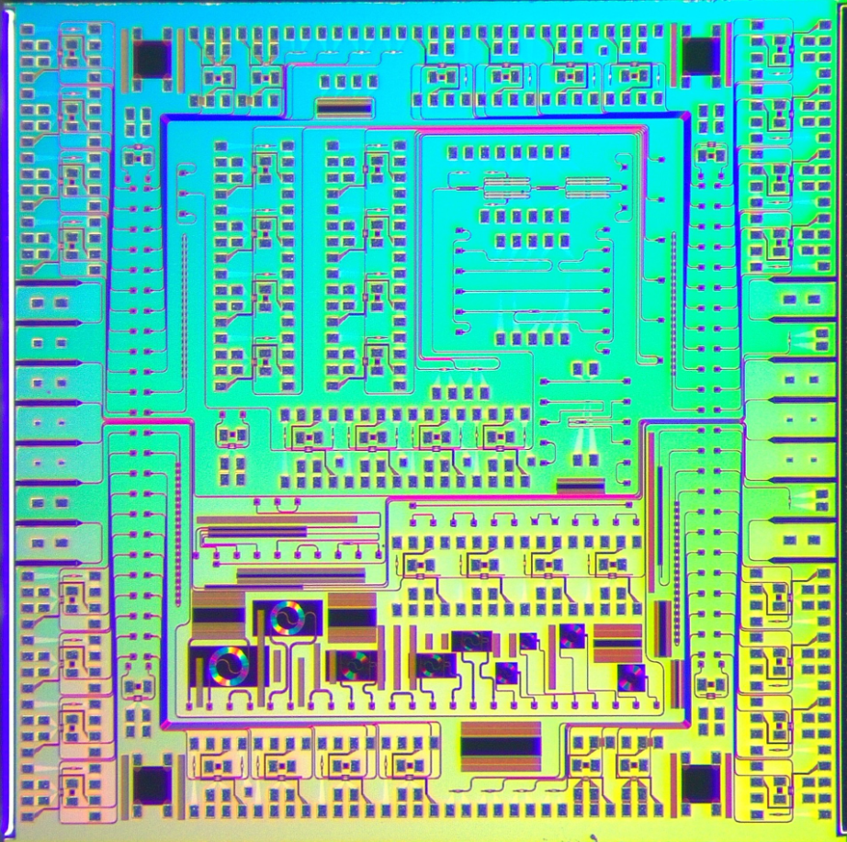
Simulation of photonic devices for optical links
Hemalatha Muthuganesan
EP-ESE-BE

Slide 2
Outline
Introduction
Photonics in particle detectors
Photonic Integrated Circuits
Example of waveguide simulation in MODE
Ring modulators
Lumerical INTERCONNECT
Simulation results
Summary and future work

Slide 3
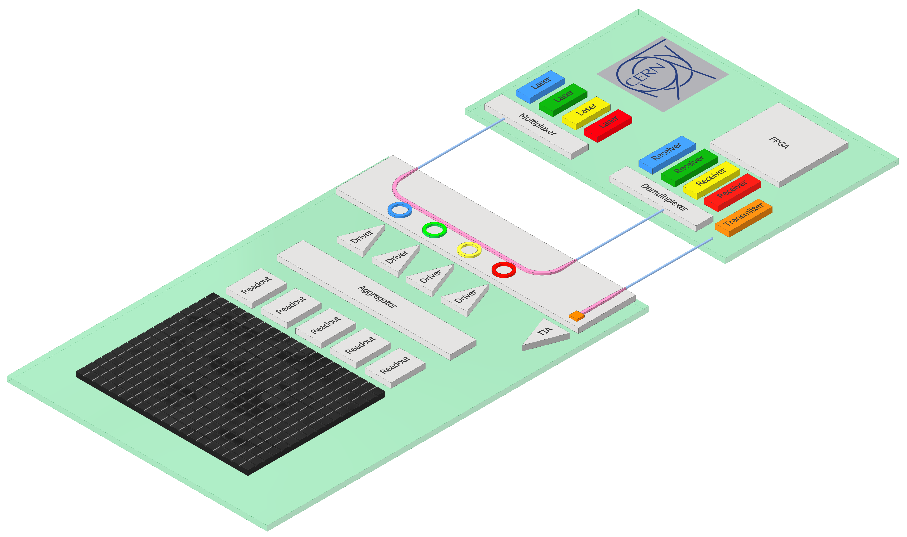


Why photonics for optical links?
Silicon Photonic Integrated Circuits (PICs)
  Mass production from CMOS foundries
  Low mass
  Low power consumption
  High bandwidth
  High radiation tolerance
Back-end (Radiation-free zone)
  External Laser Source
  Commercial transceivers
Single Mode fibers connecting BE and FE
Front-end (High-radiation)
  Transmitter based on ring modulators and filters
  Receiver based on photodetectors
High Energy Physics experiments, require transmission of large volumes of data from particle detectors in radiation environments to radiation-free zones.
>> 100 m Single-mode fibre
PIC
Fiber coupler
FPGA
Modulator
Photodiode
OPTO
Particle sensor
ASIC
System concept under development in the
EP R&D WP6 project

Slide 4
Photonic Integrated Circuit (PIC)
Fiber
Waveguide
Grating couplers
Ring modulators
Wavelength
filters
Edge
couplers
Fiber
Photodetector
SOI wafer

Slide 5
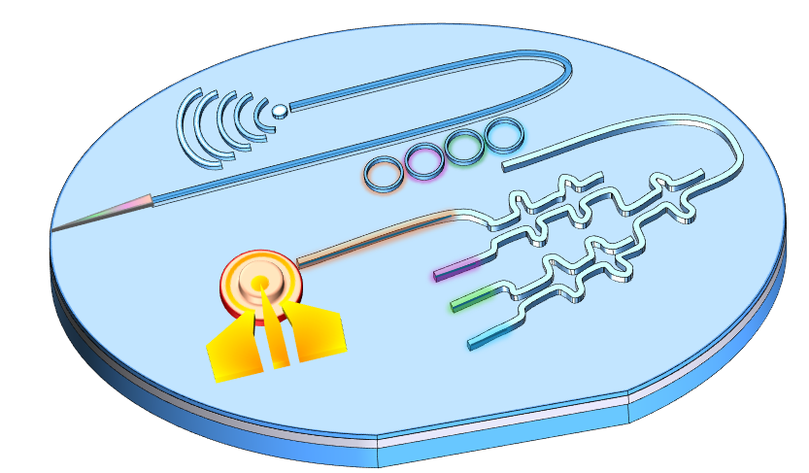
How to design a PIC?
To design a PIC, foundry provides Process Design Kit (PDK) with building block of optical components.
Some components are used from PDK.
Some components are custom made using optical simulations.
PIC Idea
PIC
Foundry
Reference elements
Simulations
Custom elements

Slide 6
Optical Simulation software
Ansys Lumerical Suite is a software package to model photonic devices.
To customize photonic components tools from Lumerical are employed.
Lumerical INTERCONNECT
Circuit level solver
Optical source
Electrical source
Optical anlayzer
Lumerical MODE
Device level solver
Lumerical FDTD
Device level solver
Waveguides
Ring modulators

Slide 7
Waveguides

Slide 8
Waveguides
Waveguide carries light in a PIC from one element to another.
Dimensions vary with wavelength of choice.
Light is squeezed by choosing a high refractive index material.
3D schematic
Cross-sectional view
n_{clad_top}
Si n_{core}
n_{clad_bottom}
Refractive index of core > Refractive index of clad

Slide 9
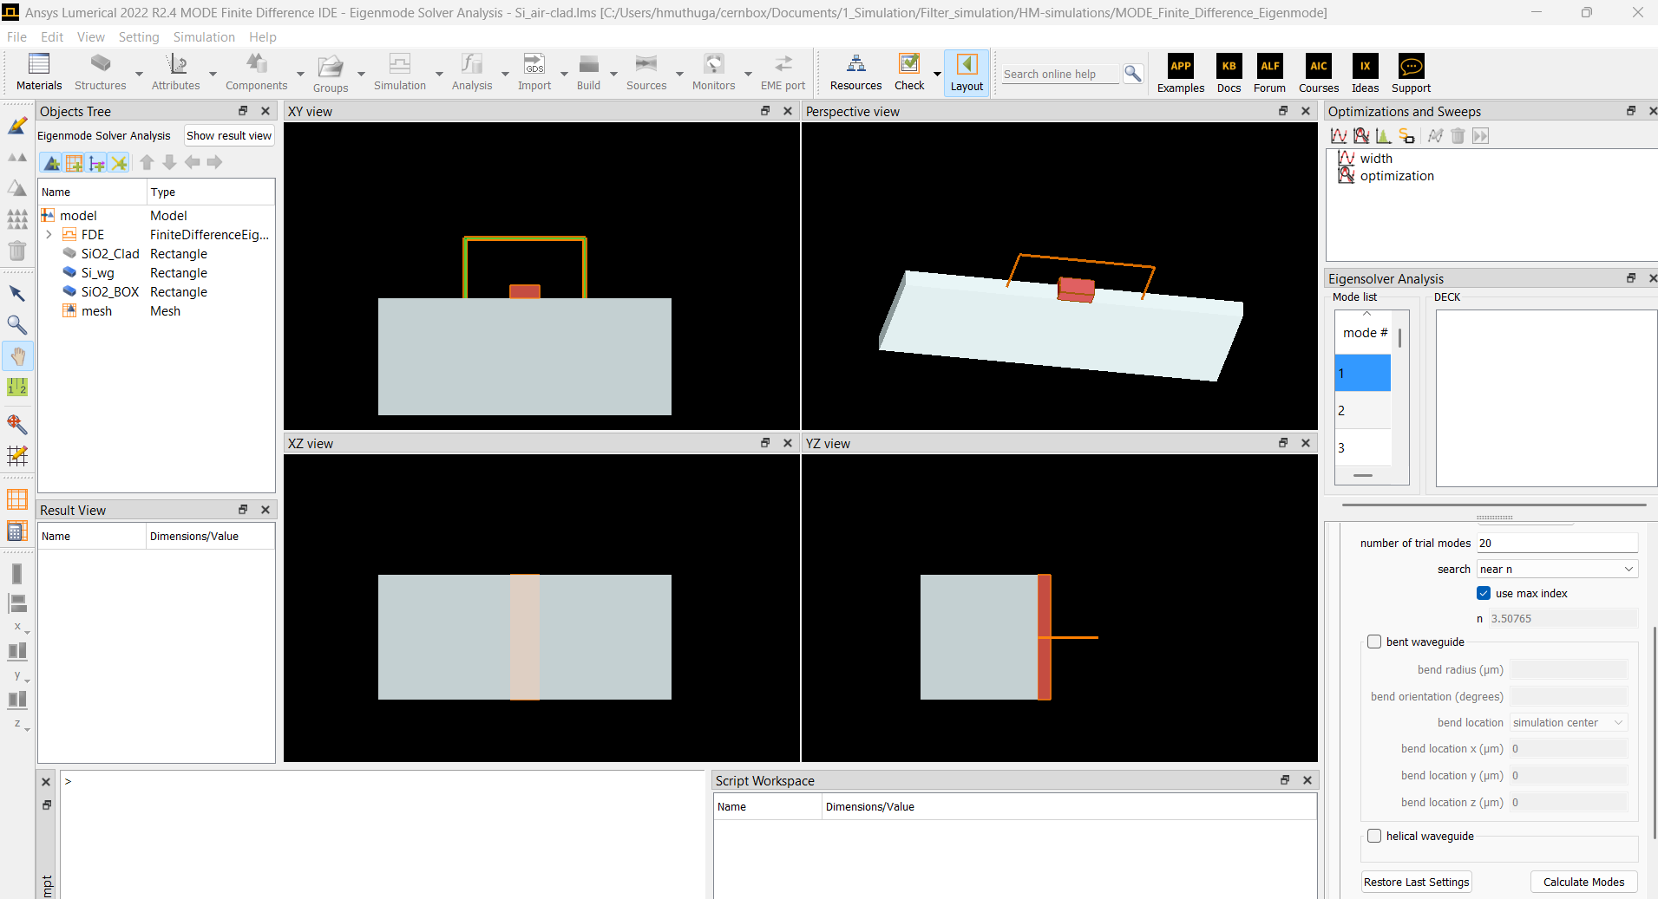
Waveguide simulations in MODE
Structures
Sources
Monitor
Materials:
Built in data +
import data (refractive index, absorption coefficient)
Air _{clad_top}
Simulation region
Si waveguide
SiO₂ _{clad_bottom}

Slide 10

Waveguide simulations in MODE
Refractive index of core > Refractive index of clad
SiO₂
Si index =3.5
Si
SiO₂ index =1.4
SiO₂

Slide 11
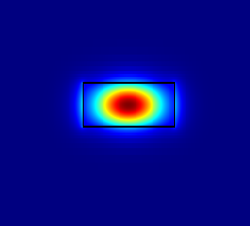
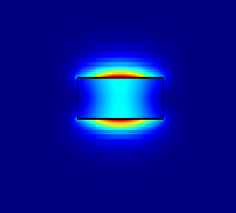
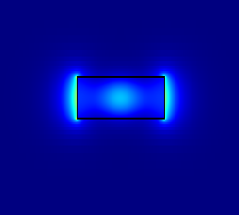
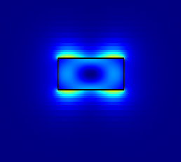
Waveguide simulations in MODE
Waveguide core is silicon with top and bottom clad as silicon dioxide.
1310 nm light is used as source in Lumerical MODE.
Full length waveguide properties are obtained by doing cross-section.
Mode 1: Higher mode confinement and less lossy.
Electric filed distribution in silicon waveguide
Mode1
Mode 2
Mode 3
Mode 4
Si index =3.5
SiO₂ index =1.4
Only the first mode is propagated for long distance in waveguides

Slide 12
Ring Modulators

Slide 13
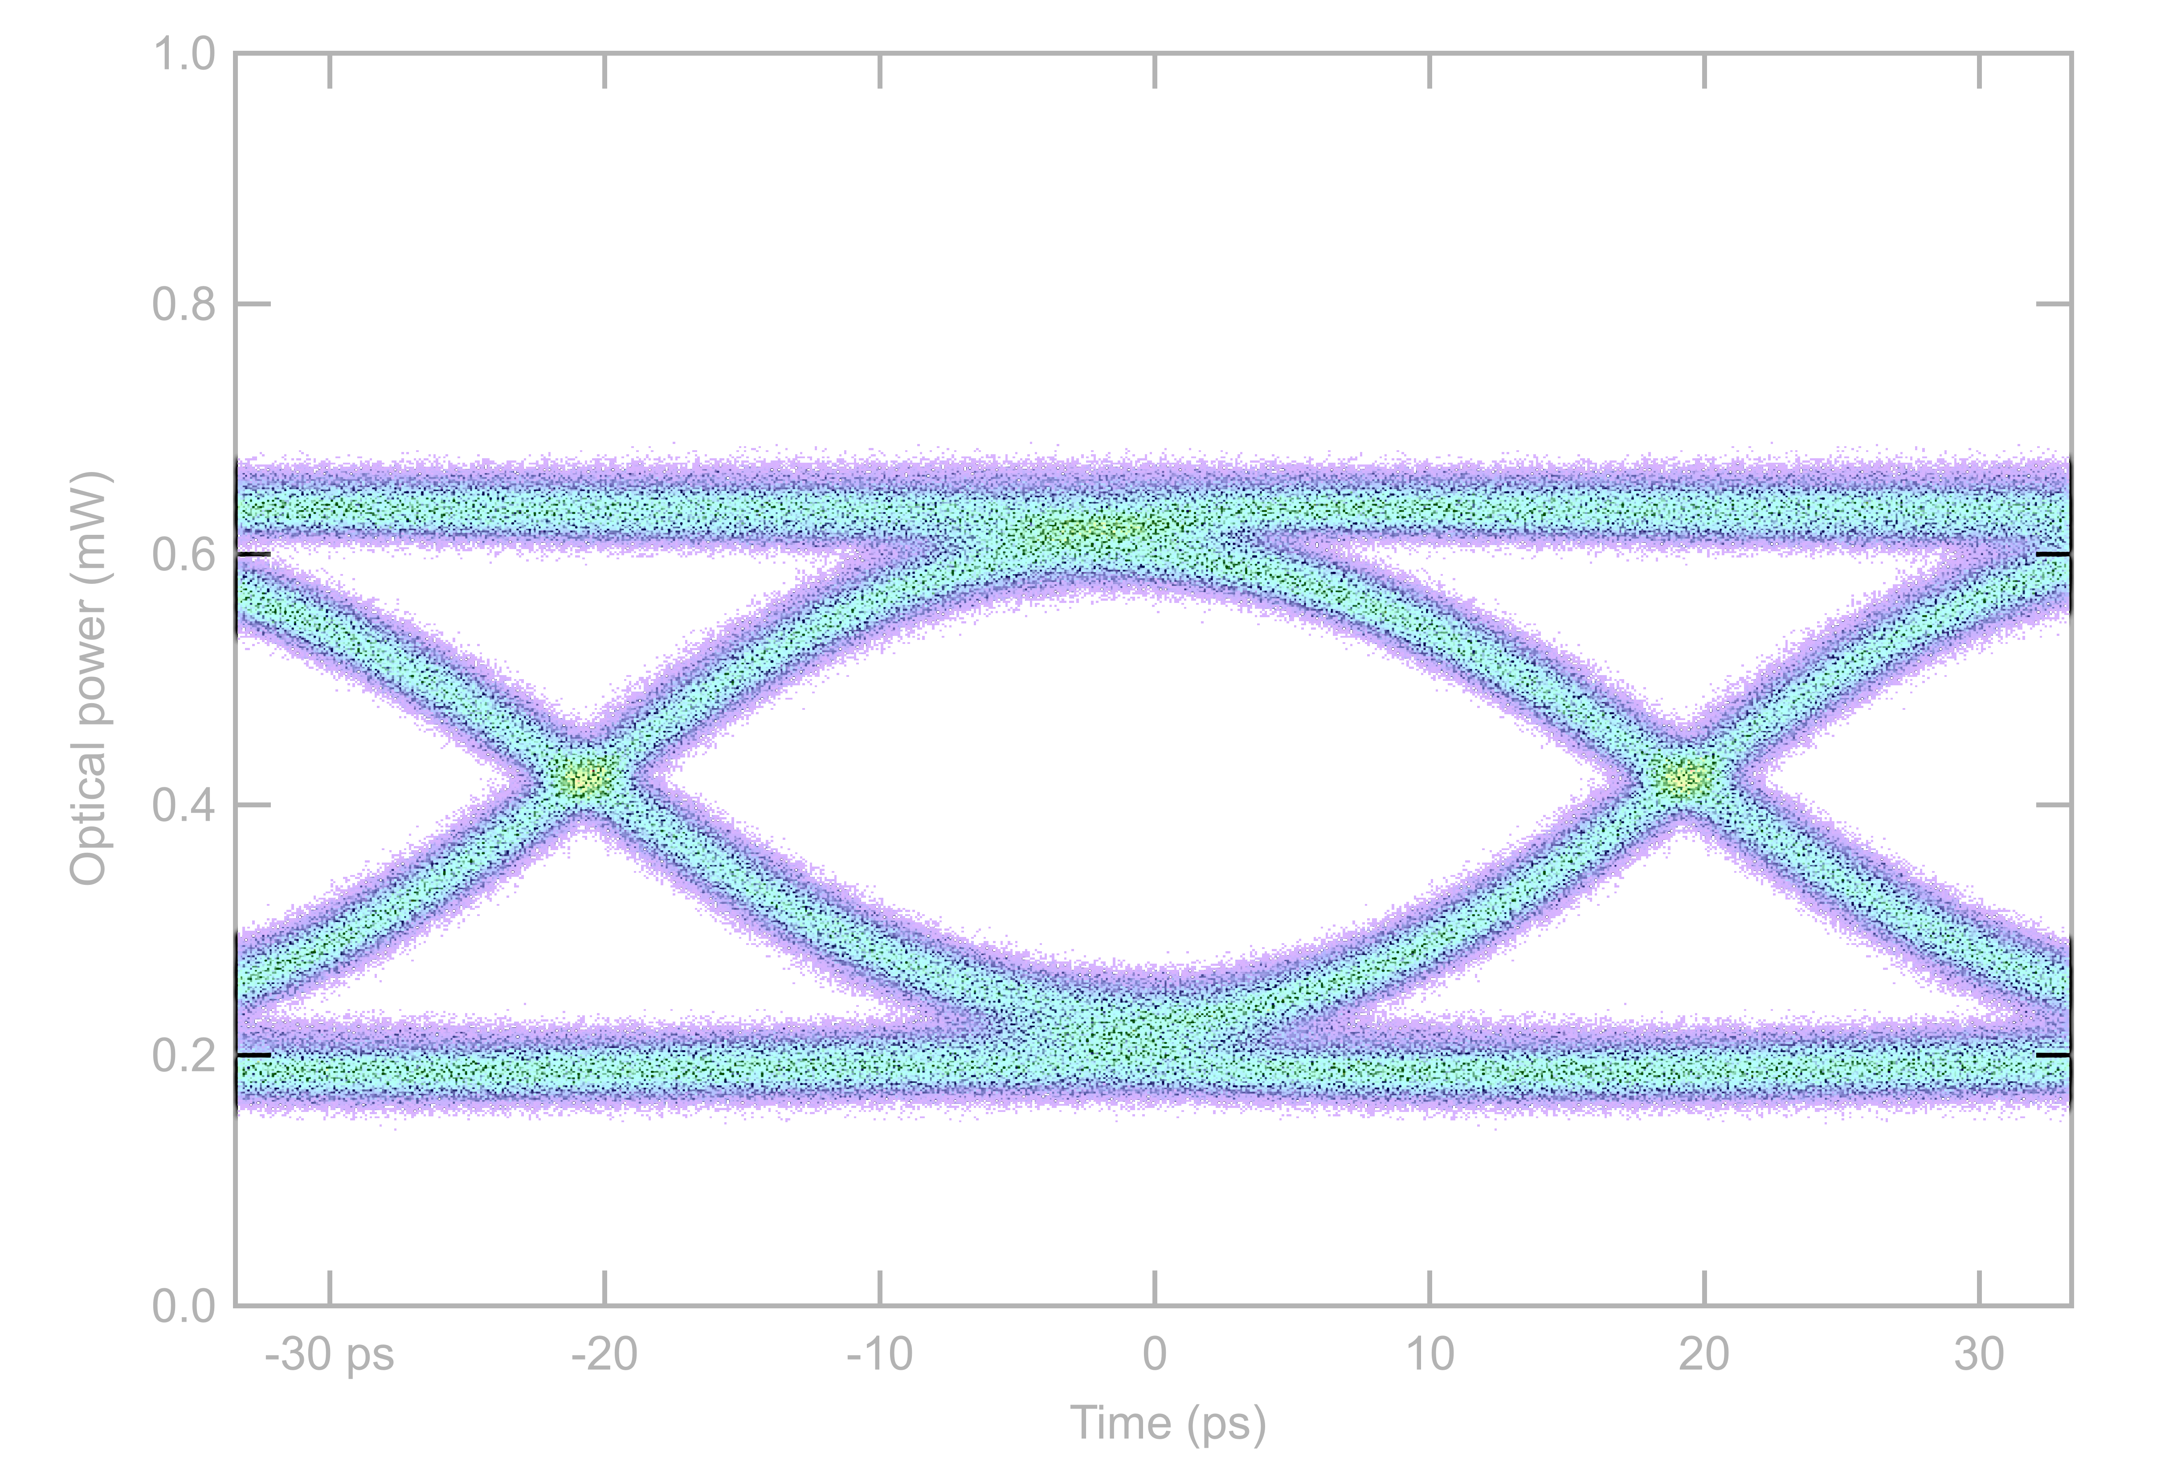
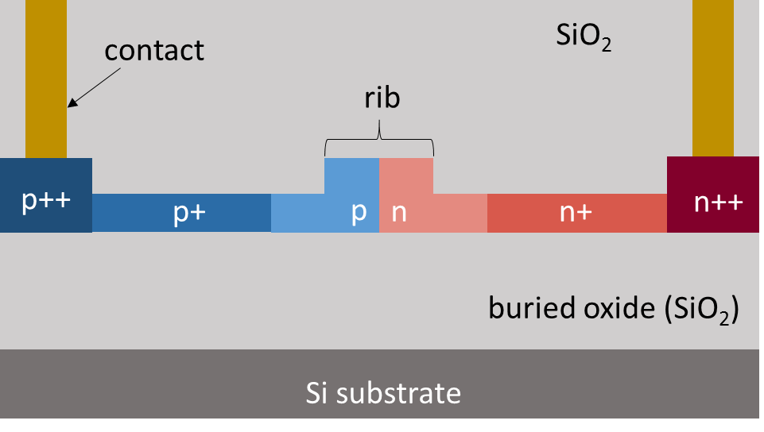
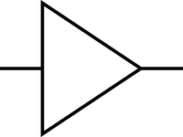

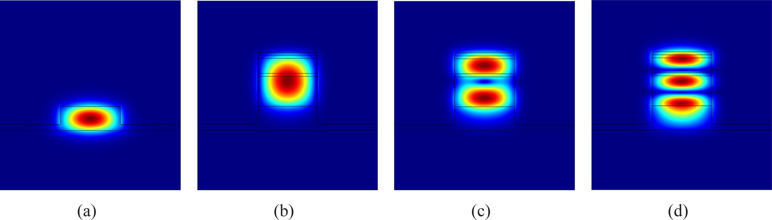
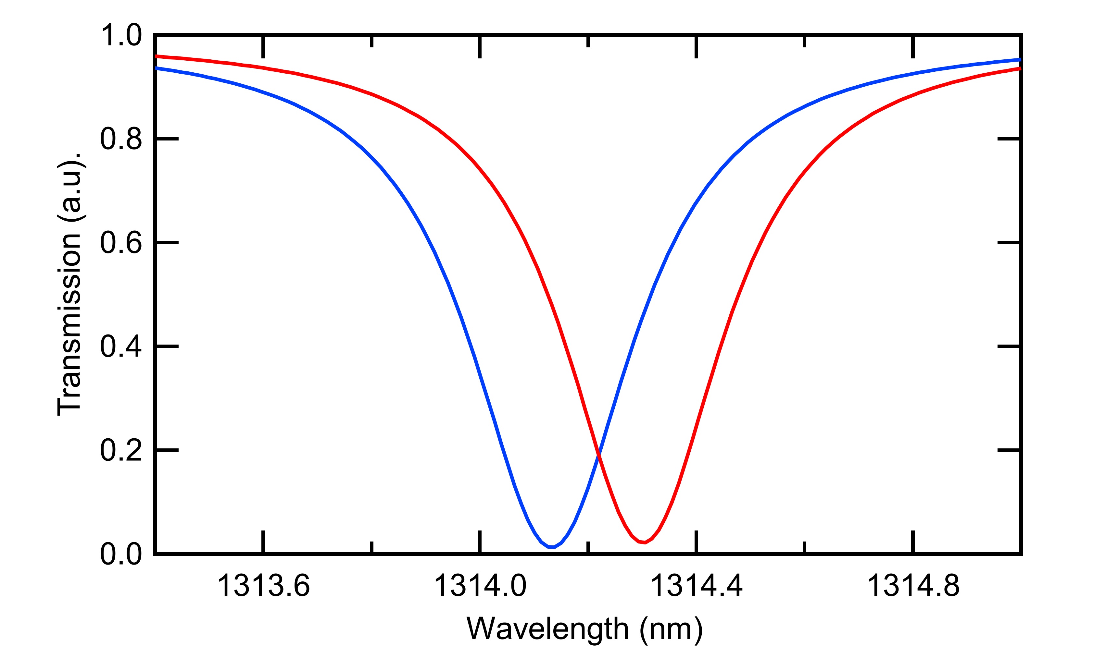
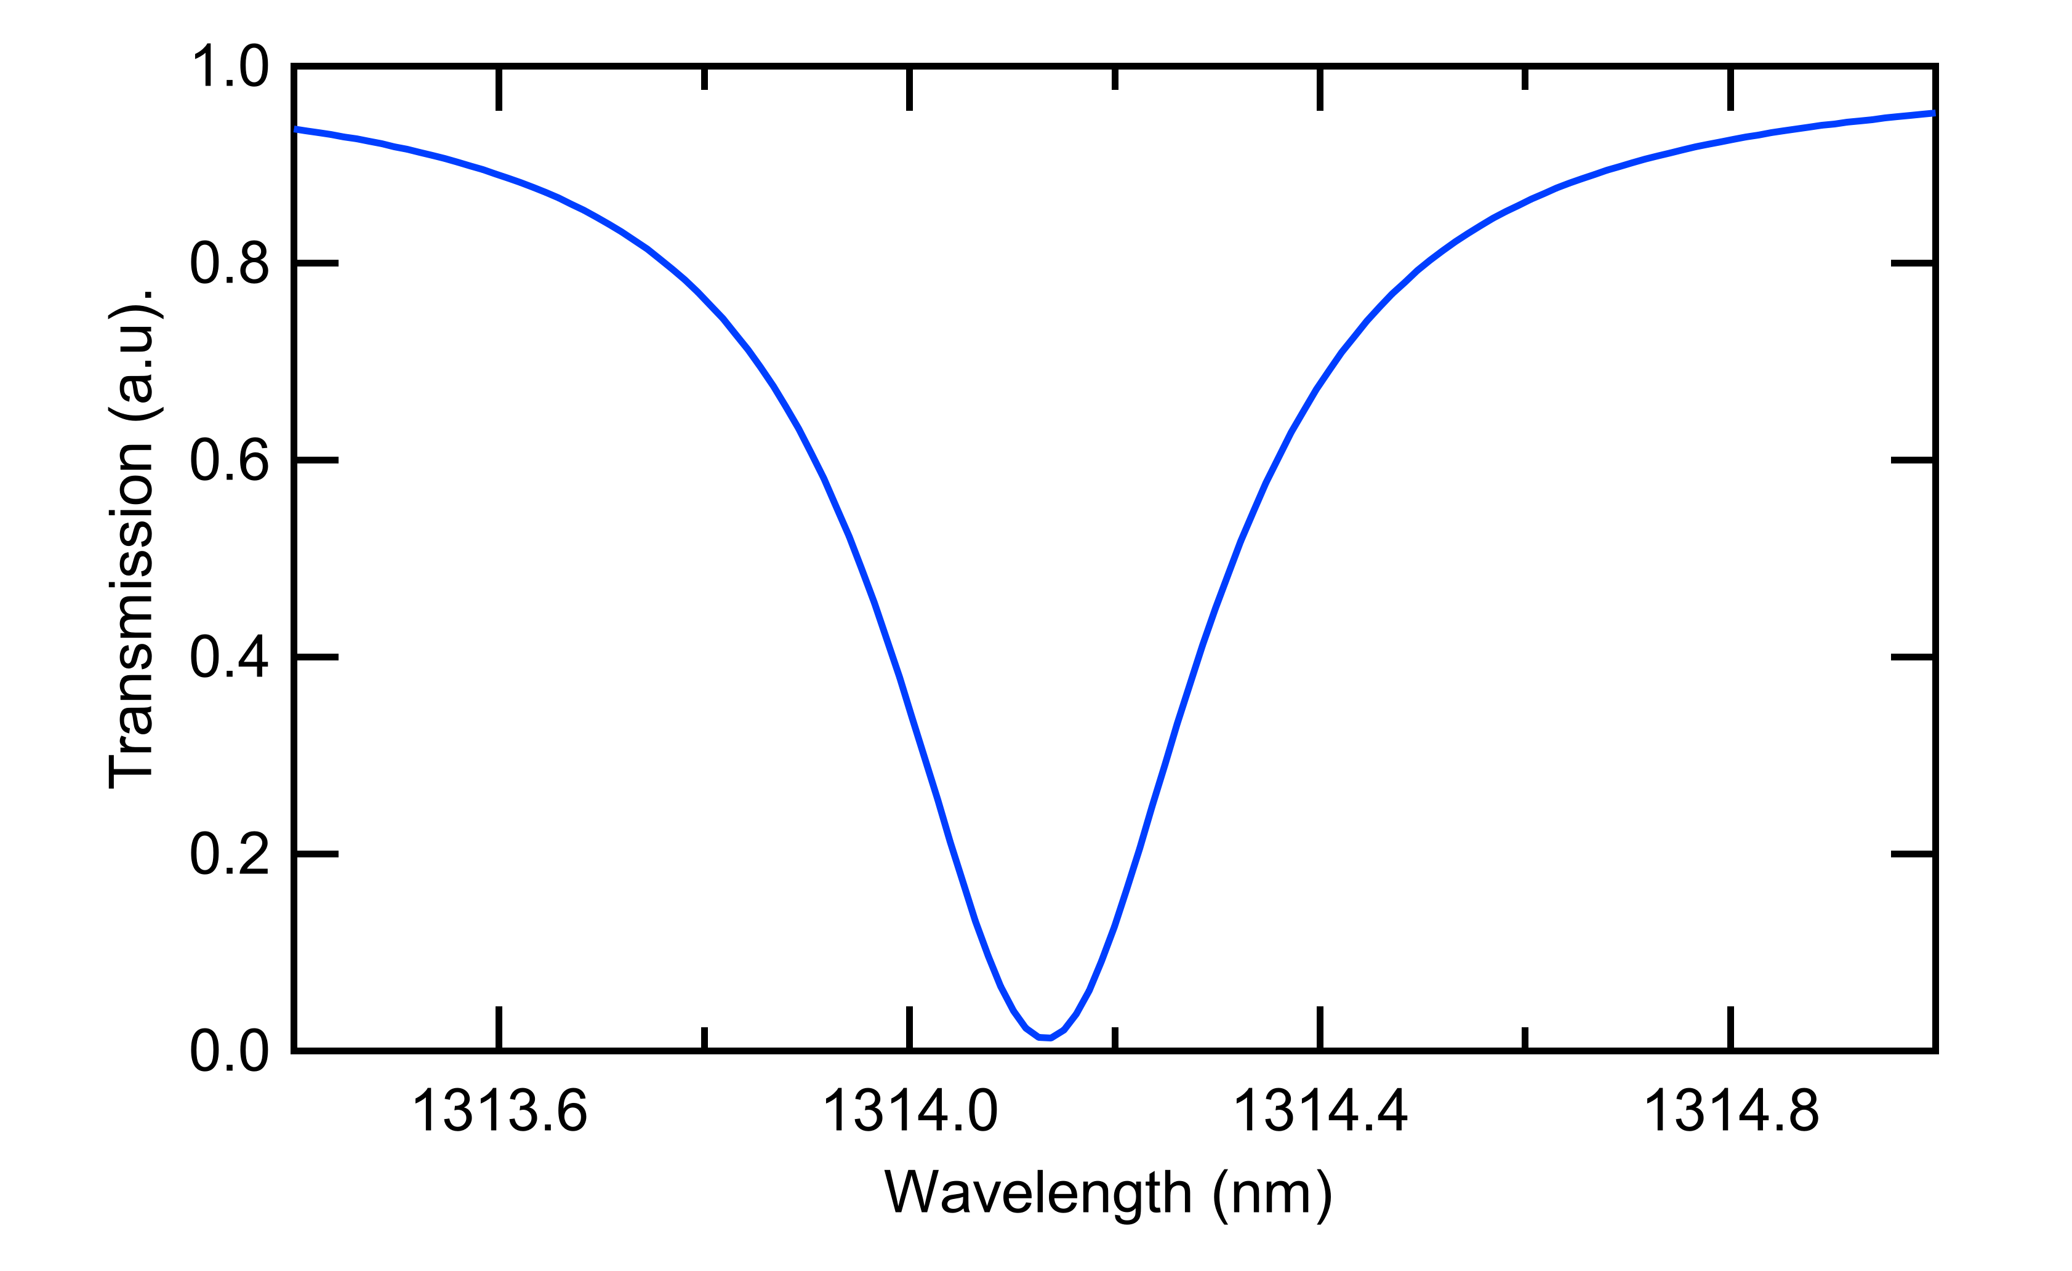
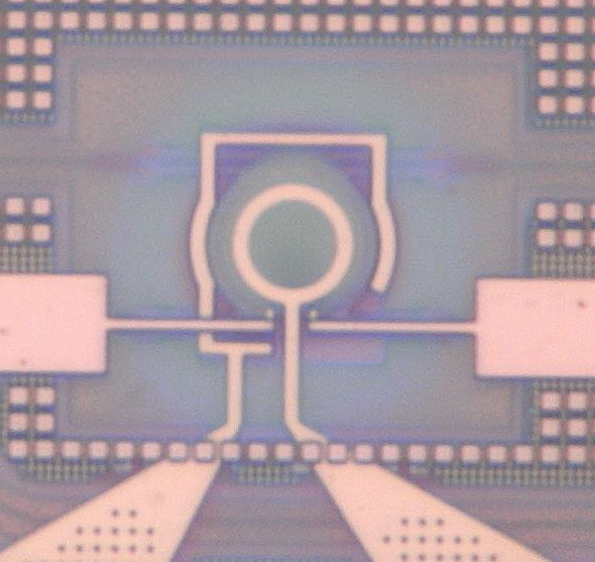
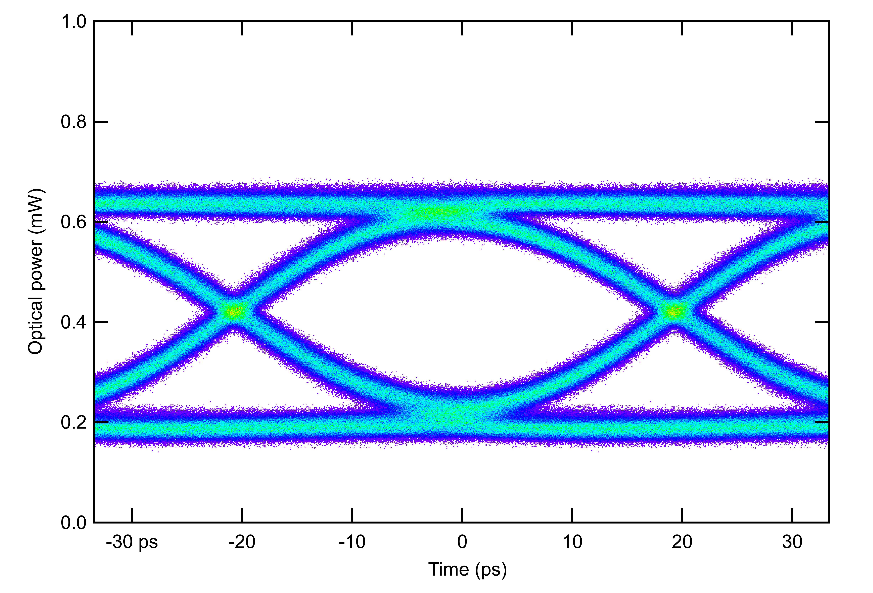
Si µ-ring modulator
-
V
+
Selective wavelength filters
Small footprint (radius ~ 5µm)
Optically narrowband (< 1nm)
Thermally sensitive (< 1 K)
Input laser
Optical data
Waveguide cross-section
_{Δλ(V)}
Electrical
data
p-n junction
Reverse biased pn Junction
CERN custom design
10 µm
Input
laser
Optical
Modulation
Amplitude
V₀
V₁
Electrical contacts

Slide 14
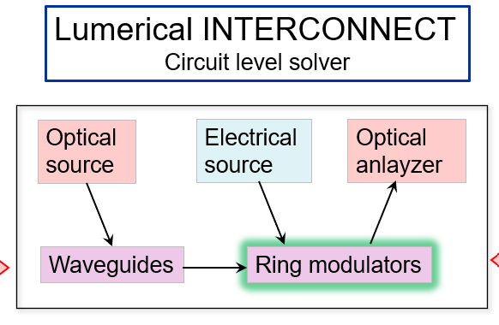
Simulation of ring modulator (RM)
Reference ring modulators are provided by the foundry.
Custom RM are designed to improve the performance according to our needs.
These custom RM are already measured in lab.
Aim is to develop accurate analytical models of the custom RM.
Why to do this?
To target better RM designs for next iterations.
To make PIC design compatible with driver requirements.
To simulate a full circuit of optical link.
Currently completed frequency domain models of custom RM.
To do: Time domain simulations based on these models, to evaluate bandwidth, rise time and fall time.

Slide 15
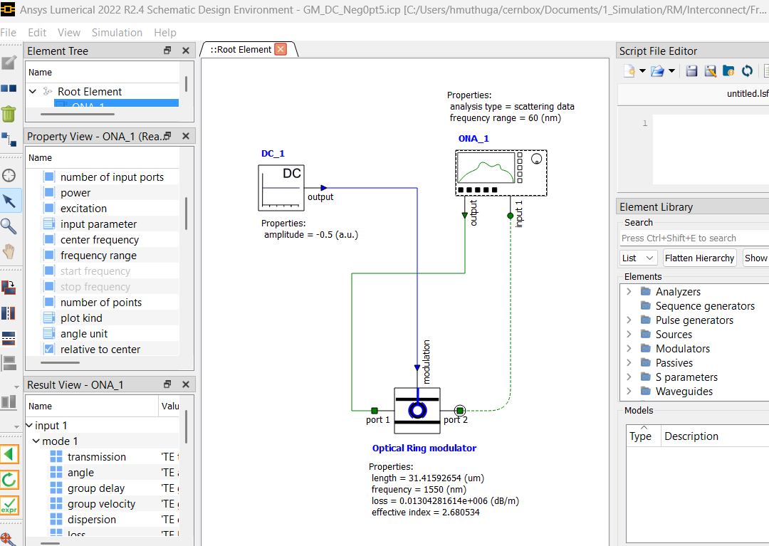
Frequency domain simulations in INTERCONNECT
Main workspace
Element properties
Elements library
Results

Slide 16
Frequency domain simulations in INTERCONNECT
Main workspace
Element properties
Elements library
Results

Slide 17
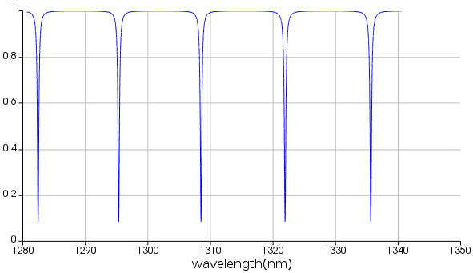
Frequency domain simulations in INTERCONNECT
Interconnect is a circuit level optical solver.
Ring Modulator:
Basic parameters are used from reference design.
Rest of the properties are optimized.
Power supply:
Bias voltage to RM is provided using a DC source.
For each bias, corresponding inputs are provided.
Analyzer:
The output is measured using Optical Network Analyzer.
From the ONA output, functional parameters are calculated.
ONA Transmission spectrum

Slide 18
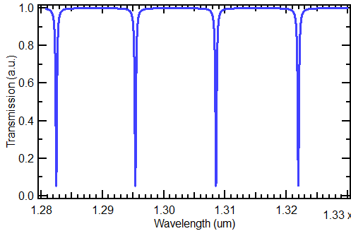
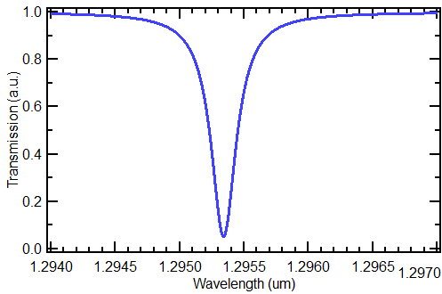
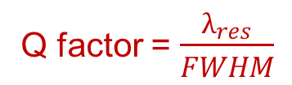
Functional parameters
Free Spectral Range (FSR): Ring resonator supports multiple resonances and FSR is the spacing between them. To achieve larger FSR, rings has to be small.
Quality factor (Q-factor): Measure of sharpness of resonance relative to its central frequency.
A high Q factor means that the ring resonator can store energy for a longer time.
Extinction ratio (ER): The contrast between the optical power coupled into the resonator when it is in resonance (on state) and when it is off-resonance (off state).
FWHM
Q factor = $\frac{λ_{res}}{FWHM}$
FSR
$$λ_{res}$$

Slide 19
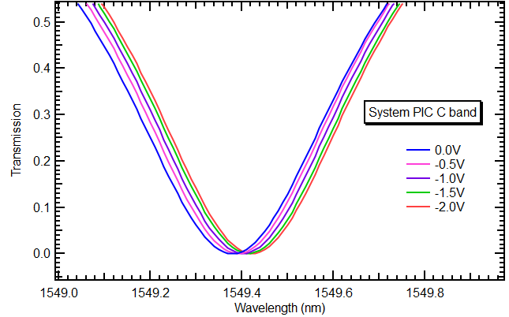
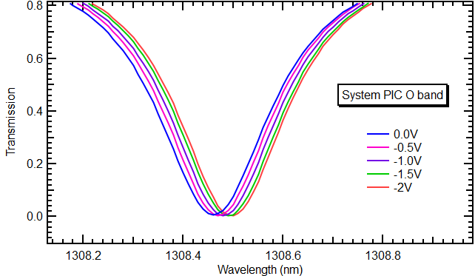
Simulation results of reference RM
Simulated reference RM using values from PDK and compared with measured results.
Modulation Efficiency (ME) is the shift in resonant wavelength for varying bias voltage input.
Functional parameters are matched within permissible tolerances.
Simulation setup is validated by matching simulation and measurement results.
Results comparison of reference design PICv3
Functional parameters | C band |  | O band
 | Measured RM | Simulated RM | Measured RM | Simulated RM
FSR | 19.16 nm | 19.34 nm | 13.54 nm | 13.77 nm
Q factor | ~2600 | ~2500 | ~5000 | ~4700
ER | 22 dB | 30 dB | 20 dB | 21 dB
ME | ~ 40 pm/V | ~ 40 pm/V | ~ 30 pm/V | ~ 30 pm/V
Modulation Efficiency (ME)
Transmission plots from simulated RM PICv3
ME

Slide 20
Custom models RM results
To build custom models, ring radius and gap between waveguide is varied for O band.
Simulated values of FWHM, Q factor are within tolerable range and align with measured results.
Device | Results | Full Width Half Maximum (pm) | Q value
Ref Ring | Measured | 262 | 5000
 | Simulated | 278 | 4700
Ring1 | Measured | 223 | 5820
 | Simulated | 220 | 5750
Ring2 | Measured | 197 | 6600
 | Simulated | 200 | 6581
Ring3 | Measured | 150 | 8600
 | Simulated | 150 | 8643
Ring4 | Measured | 193 | 6700
 | Simulated | 190 | 6712
Ring5 | Measured | 168 | 7750
 | Simulated | 160 | 7957
Ring6 | Measured | 156 | 8400
 | Simulated | 160 | 8401

Slide 21
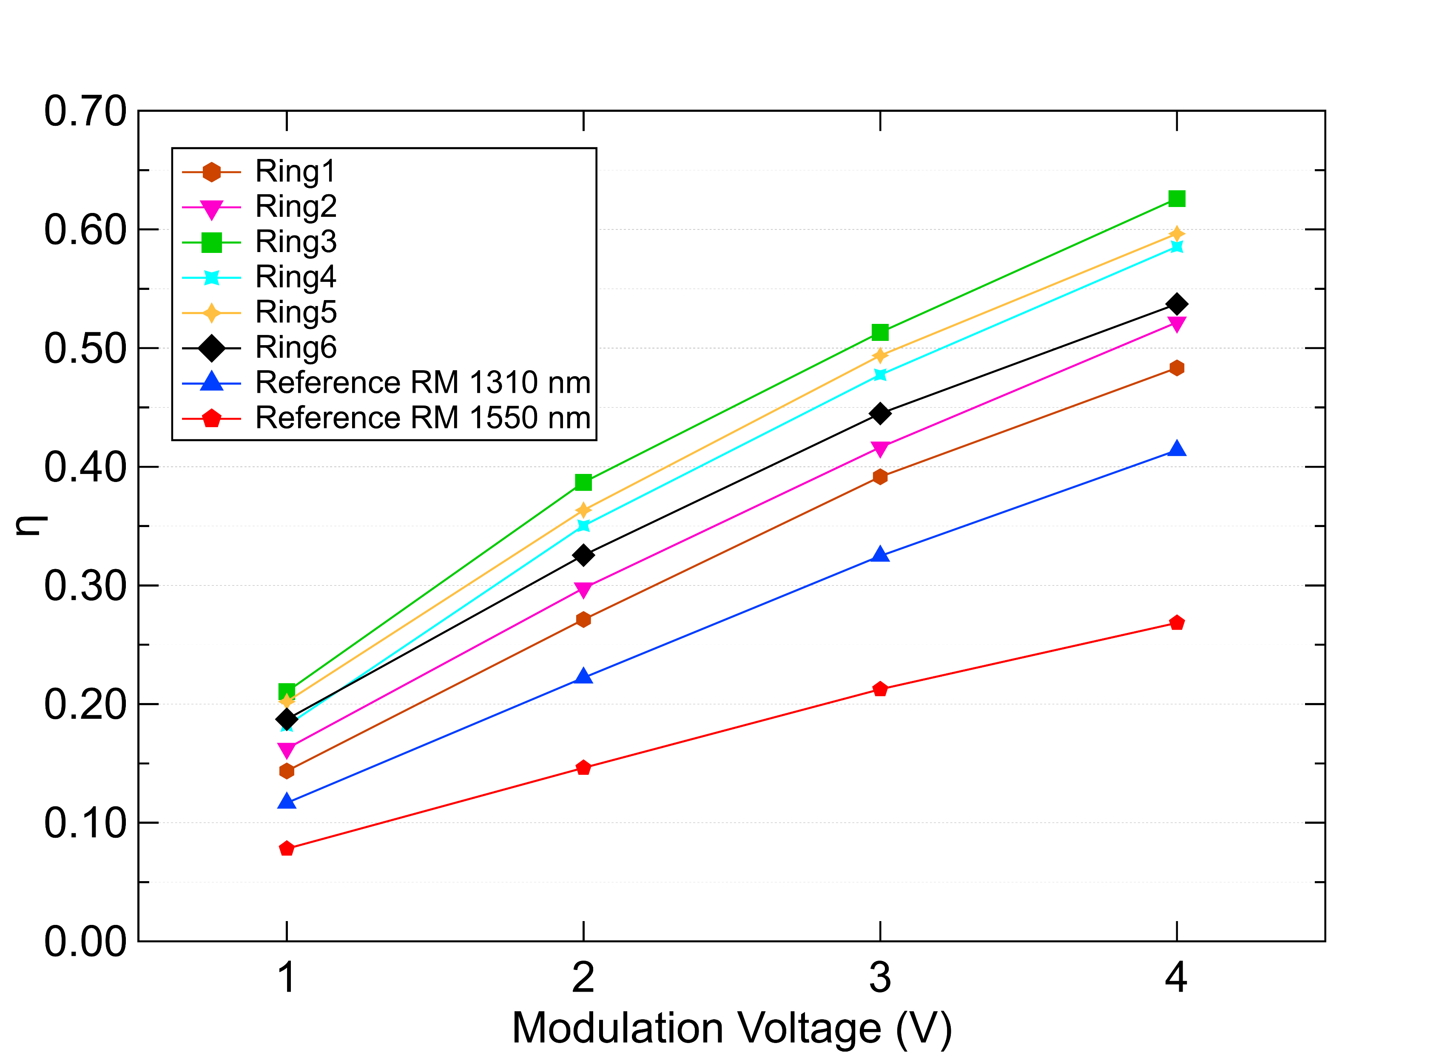
Custom models RM results
To build custom models, ring radius and gap between waveguide is varied for O band.
Simulated values of FWHM, Q factor are within tolerable range and align with measured results.
Device | Results | Full Width Half Maximum (pm) | Q value
Ref Ring | Measured | 262 | 5000
 | Simulated | 278 | 4700
Ring1 | Measured | 223 | 5820
 | Simulated | 220 | 5750
Ring2 | Measured | 197 | 6600
 | Simulated | 200 | 6581
Ring3 | Measured | 150 | 8600
 | Simulated | 150 | 8643
Ring4 | Measured | 193 | 6700
 | Simulated | 190 | 6712
Ring5 | Measured | 168 | 7750
 | Simulated | 160 | 7957
Ring6 | Measured | 156 | 8400
 | Simulated | 160 | 8401
Amplitude
~ 3 dB
1550 nm legacy PICv2

Slide 22
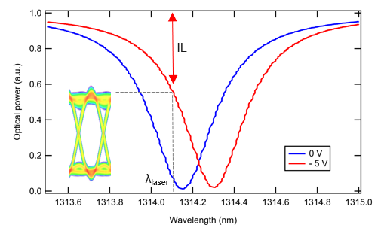
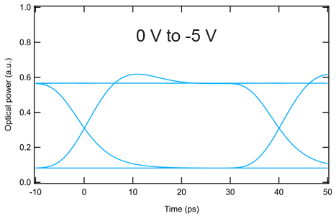
Future work: Time domain simulations
Frequency domain simulations are completed for custom models of O band ring modulators.
Next step is to move on to time domain simulation from these simulated results.
An example is provided below for O band 1310 nm reference design.
Frequency domain results
Time domain results
Optical power (a.u.)
Optical power (a.u.)
Wavelength (nm)
Time (ps)

Slide 23
Summary
Introduced photonic integrated circuits and optical simulations.
Demonstration of Lumerical MODE software was given with waveguide example.
Conducted frequency-domain simulations of O-band ring modulators.
Confirmed the simulation setup using reference ring modulators from PDK.
Built analytical model for six custom ring modulators.
Simulation results align with measurements within tolerance.
Future work:
Time domain simulations on simulated custom models.
Carry out simulation of wavelength filters.

Slide 24
Backup slides

Slide 25





SystemPIC ring modulator characterization results
$$V_{mod}$$
CW laser
$$P_{in}$$
$$OMA$$
r
Coupling gap
~ 3 dB
p-n junction
1550 nm legacy PICv2
$$OMA=P_{in}∙ƞ(V_{mod})$$
28 nm CMOS driver provides limited modulation voltage swing V_{mod}
Need to increase modulator efficiency (ƞ) for margin in link power budget
Multiple ring modulators sweeping the design parameter space
  Radius (r), p-n junction type, coupling gap
  Trade-off between efficiency and bandwidth

