Slide 1
AFP-ToF
Tomáš Komárek

Slide 2
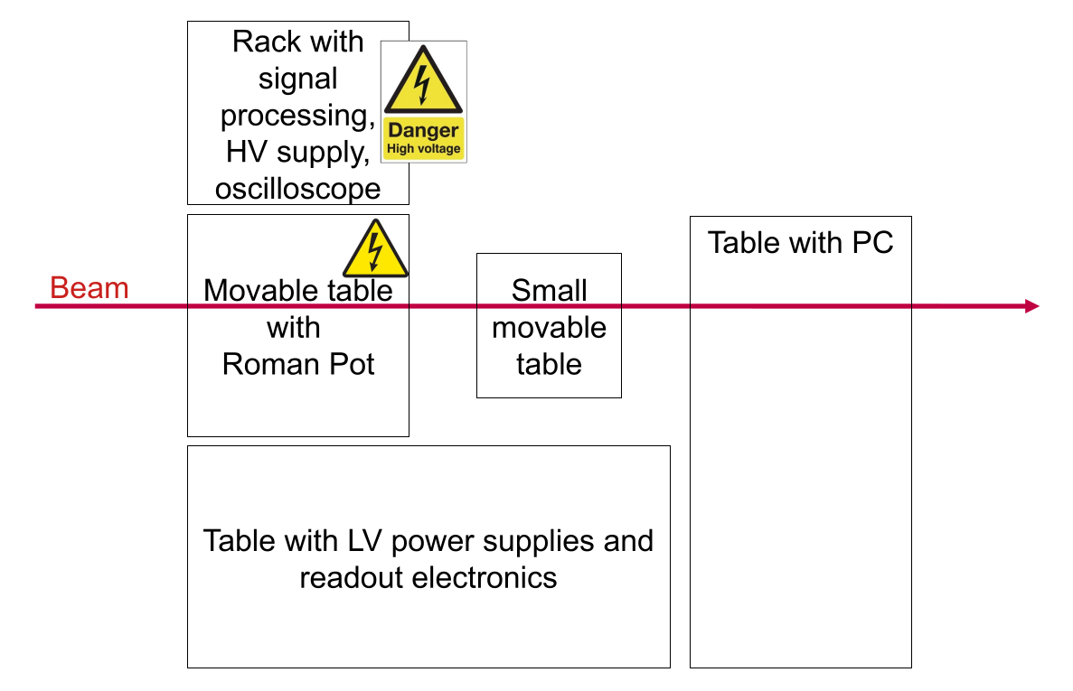
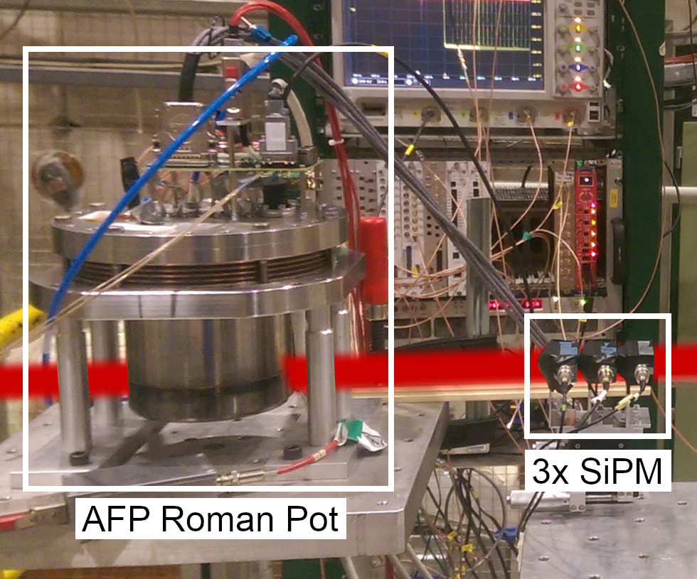
Schematic of the installation
AFP-ToF is a time of flight system for the AFP forward detector.
The Beam Test setup consists of a Roman pot container with SiT and ToF and a separate reference timing detector, placed on two separate movable tables. A rack contains signal processing equipment and two more normal tables carry readout system, PSUs and movement control. The small movable table is placed on a concrete block to reach the beam. We do not use any beam telescope nor external trigger.
Total length : 3 m
Total width : 3 m
Height of beam : ~1.2 m

Slide 3
Beam Condition
Please enter all the beams condition required.
If multiple beam time with different beam condition, please detail the run number under the corresponding column.
Particle | Polarity | Energy (0.1 to 15 GeV/c (T09) and 11.5 GeV (T10) ) | High purity | Intensity | Beam size (Ømm) | Run number (if applicable
Any hadrons | does not matter | >80 GeV | NO | >1E4 (>1E5 preferred) | 20 to 40

Slide 4
Services needed
Tables
  Fix table : YES (2), also one concrete block as a solid foundation
  Moving table : YES (2: 1 coarse – XCSA, 1 fine – PI stage)
  Purpose for the moving table: Alignment of main det., scanning with reference det.
  Large moving table: Size (0.3 m x 0.4 m) and weight (10 kg) of setup on the table
  Small moving table: Size (0.1 m x 0.1 m) and weight (0.1 kg) of setup on the table
GAS : NO
High Voltage : YES (2.5 kV max)
Instrumentation :
  Wire Chamber : NO
  Cherenkov signal : NO
  Scintillator signal : NO
Infrastructure
  Electronics rack in zone : YES (1)
  Any other : Numerous power outlets (~16)

Slide 5
Contact during the run
Contact :
Tomáš Komárek tomas.komarek@cern.ch 167882
David Bartůněk bartunek@fel.zcu.cz

