Slide 1
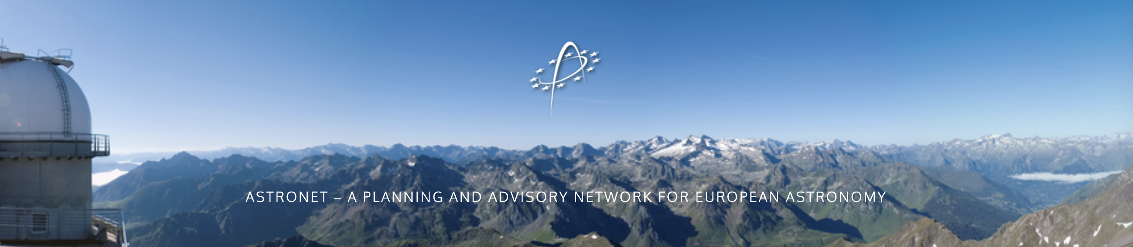
https://www.astronet-eu.org/
First started in 2005 as a consortium of European funding agencies and research organisations.
Astronet was an ERA-NET up to 2015, in the context of Horizon 2020 and with the support of the European Commission.
It is now a self-sustained group of funding agencies and associated bodies.
Astronet aims at encouraging a common science vision for all of European astronomy.
One of its key goals is to deliver a strategic plan and an infrastructure roadmap.
Astronet Science Vision
& Infrastructure Roadmap 2023-2035

Slide 2
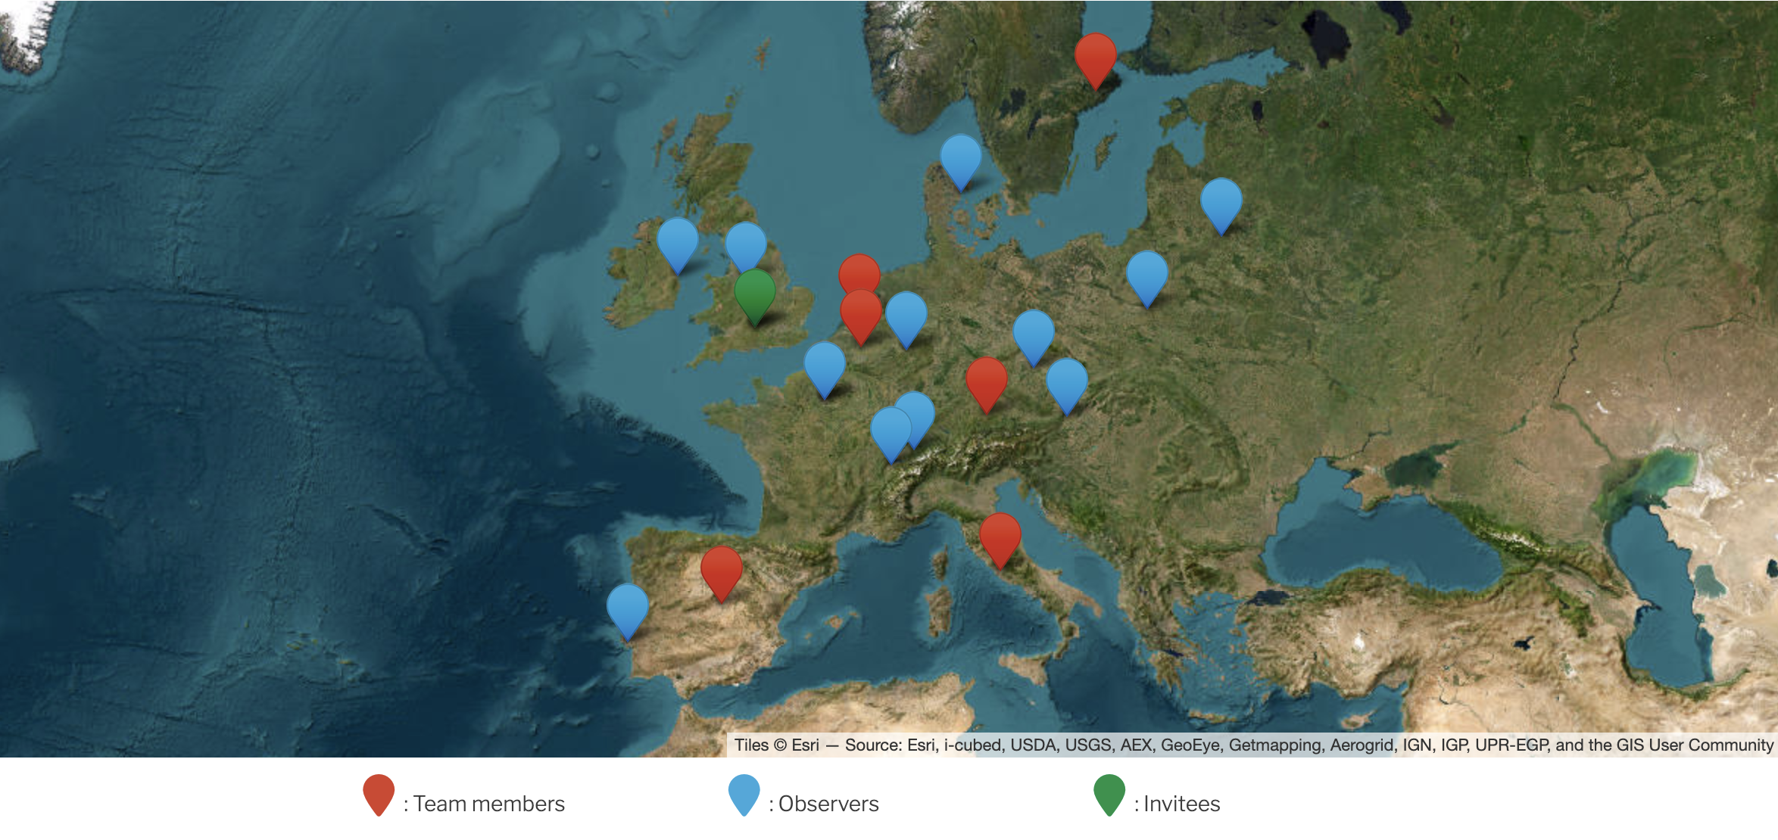

SRC
ASTRONET core team:
- M. Janssen (NWO), Project manager
Executive :
- CNRS (Fr), M. Giard, Chair
- NWO (NL), S. Matheussen, co-Chair
- STFC (UK), Ch. Woolford
- INAF (Italie), S. Sciortino
Other Members:
- FWO (Belgium), H. Sana
- SRC (Sweden), G. Mellema
- CMIN (Spain), B. Garcia
- ESO, A. Mérand
IDA
TFAI
ASI
SKAO
STFC
NWO
PTA
KU Leuven
RDS
CNKA
+
ESA
EAS
APPEC
CNRS
ESO
OAW
SCNAT
INAF
Spain
PSA
CSIC

Slide 3
ASTRONET restarts with new working groups on october 2024 board meeting
WG1 : Link with APPEC and elaboration of common strategies
M. Giard (coordinator), S. Matheussen, A. Haung, N. Rea, P. Chadwick, A. Kouchner
WG2 : Future strategies for science with small telescopes : a concerted European exercise (including transnational access and « after ORP »)
P. Callanan (coordinator), J. Hiscock, A. Merand, H. Sana, Ph. Stee,
WG3 : Building strategies to materialize the roadmap (EST, SKA-SRC, data science, etc.)
M. Giard (coordinator), S. Sciortino, V. Martin (IAC), A. Merand (ESO), SKAO
WG4 : Connections and joint policies with the EC and with key stakeholders (participation to EAS 2025)
S. Matheussen (coordinator), S. Sciortino, S. Wedemeyer
WG5 : Sustainability and societal issues
H. Sana (coordinator), SKAO, CNRS, ESO

Slide 4
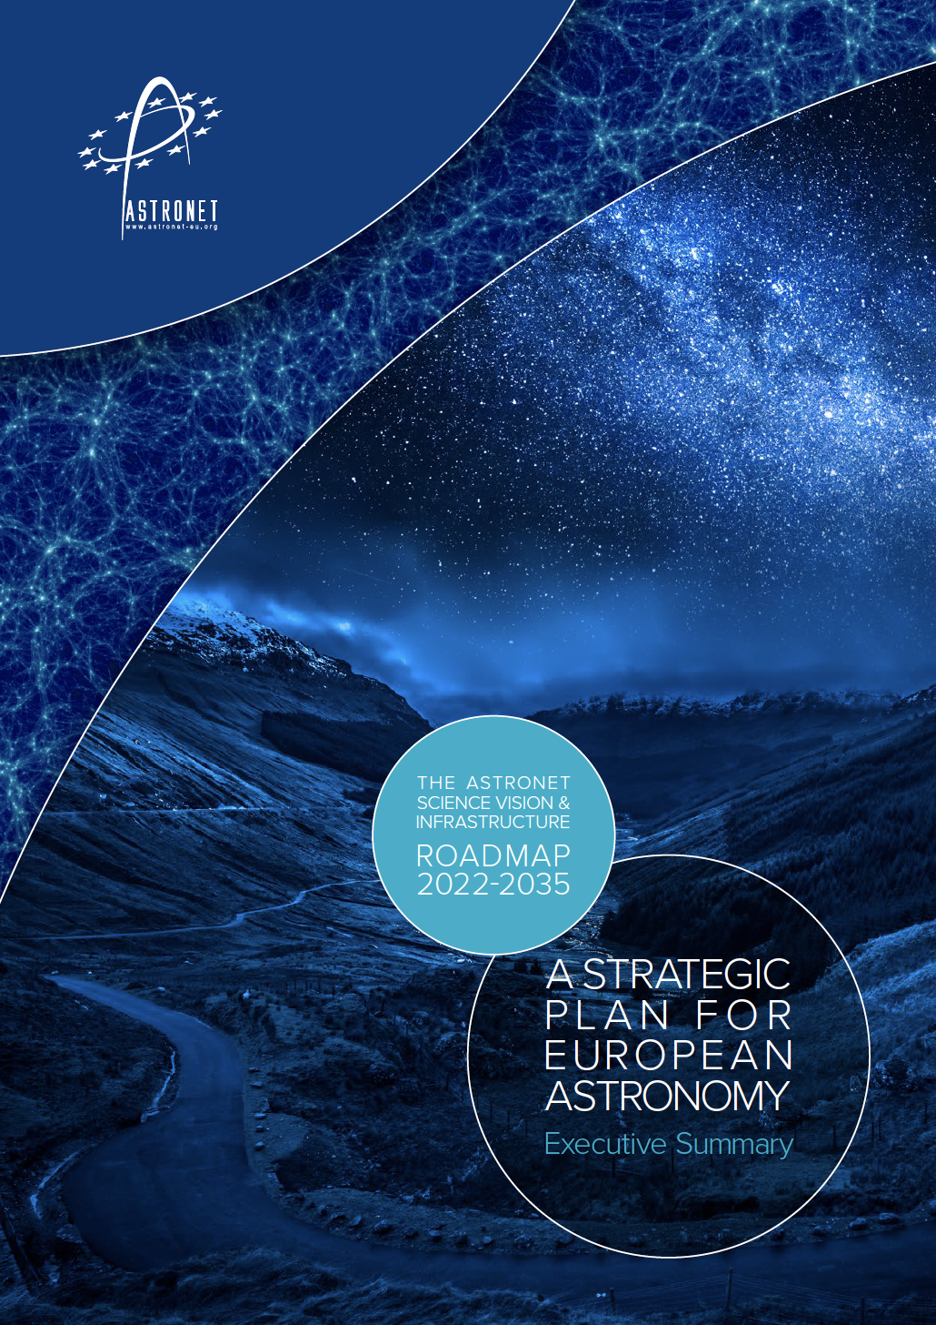
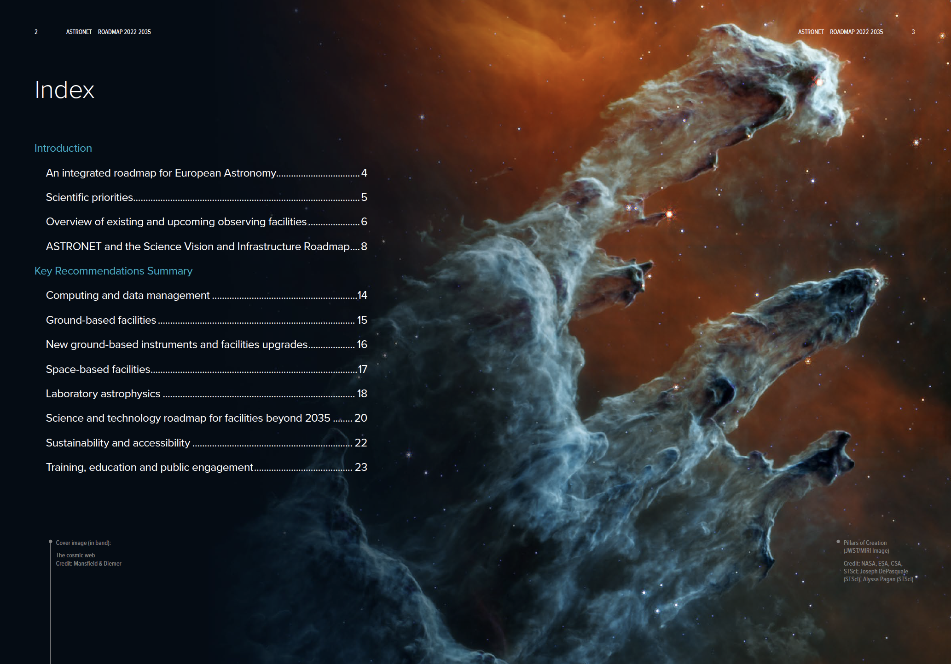
Astronet Science Vision
& Infrastructure Roadmap 2023-2035

Slide 5
Organisation
Science panels (~100 scientists involved)
A- Computing; big data, HPC and data infrastructure (chair: E. Emsellem, ESO / U. Lyon)
B- Origin and evolution of the Universe (chair: L. Koopmans, U. Groningen)
C- Formation and evolution of galaxies (chairs: P. Dayal, U. Groningen / M. Hayes, Stockholm U.)
D- Formation and evolution of stars (chair: C. Evans, STFC / STScI)
E- Formation and evolution of planetary systems (chairs: I. Snellen, Leiden / A. Sozzetti, INAF Torino)
F- Solar system and the conditions for life (chairs: L.M. Lara, IAA-CSIC Granada / N. Vilmer, Obs. Paris)
G- Extreme Astrophysics (chairs: J. Hessels, U. Amsterdam / A. Levan, Radboud U. / N. Rea, ICE Barcelona)
H- Astronomy and society (chair: P. Russo, Leiden)
2020
ASTRONET board
Fall 2021
Editorial board
Reports
Prioritisation and
key recommendations
Roadmap
Community consultation
+ expert advice

Slide 6
New ground-based facilities
Reminder: completion and commissioning of
ELT + 1st generation instruments
SKA-1 + SKA regional centres
Major importance for European astronomy
Three other facilities emerge from the current exercise, already among priorities of the 2008 roadmap
As the first true large-scale observatory dedicated to the study of high energy gamma rays, the Cherenkov Telescope Array (CTA) is expected to lead to breakthrough in our understanding of extreme astrophysical phenomena. Bringing CTA to completion (by 2028) is a high priority
The European Solar Telescope (EST), will significantly increase our understanding of the solar magnetic field and its relations with the heliosphere and the Earth. Its completion and scientific exploitation in synergy with the US-based DKIST is a priority
A general-purpose, wide-field, high multiplex optical spectroscopic facility, behind a 8-10m class telescope is a priority across many science areas. Will enable a broad range of science investigations and provide follow-up capabilities for facilities such as JWST, LSST and Euclid

Slide 7
Summary of recommendations
  New ground-based facilities: ELT + 1st gen instruments; SKA-1; CTA; EST; Wide-field/High multiplex spectrograph
  Upgrades and new instruments: ALMA; VLT (BlueMuse, High contrast/High angular res); ELT 2nd gen instruments
  Space-based facilities: Athena + LISA; Exomars (re-examine European strategy for Mars exploration)
  Laboratory astrophysics: Data on atoms, molecules, solids + investigations of meteorites and space samples
  Technology developments toward: radio-astronomy; space FIR space; ELT-PCS; UV-to-IR space telescope; optical/IR interferometry
  Computing, data, theory: science-ready data products and analysis tools; data infrastructure; professional skills base; collaborative, open and synergistic view of the computing ecosystem
  Sustainability, accessibility: carbon-neutrality, climate science, diversity/inclusion, dark and radio-quiet skies
  Education, training, society: training programmes, transferable skills, career paths for instrumentation, computing and data science, public engagement, big science, big data, AI, R&D, equal/respectful engagement with communities
  Future beyond 2035: set-up pan-European working groups for
  Defining roadmap towards ELT-PCS Launching detailed design study for SKA-2
  Defining European participation in CMB-S4 Defining roadmap towards European CMB space mission
  Defining European contribution to HWO Defining European contribution to NASA far-IR space mission

Slide 8
Last but not least:
What will be the consequences of the Big Beautiful Bill if it is voted by the US congress ?
=> Space missions
=> Ground based observatories and infrastructures
….
=> IR detectors ?
=> free science on the planet ?
Europe has to adapt and, more than ever, build its place at the forefront of fundamental and sustainable research
X

Slide 9
THANK YOU !

