Slide 1




Hot Winding Activities 2 cm thick soldered pancake
Giuseppe Scarantino,
Mahmoud Abdel Hafiz

Slide 2
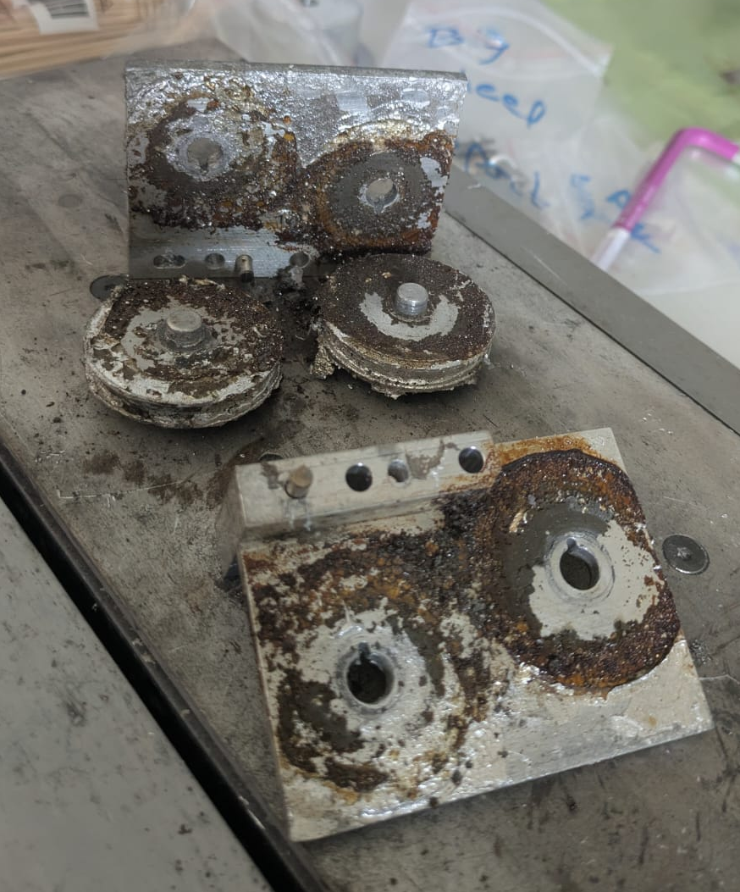
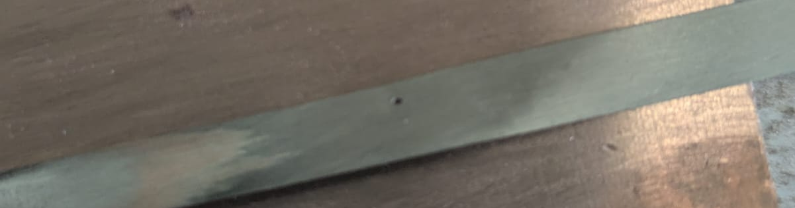
Hot winding: setup preparation
Proposition : different bench for precoating
Wheel FAR ENOUGH for solder to be cold
Spool
Spool
Accurate wipe needs to be set with precision (5um)
Clean: abrasive paper + alcool sponge?
Flux
Other clean step ?
Solder bath
Funny fact
State of the wheels in solder bath after 120 m coating

Slide 3
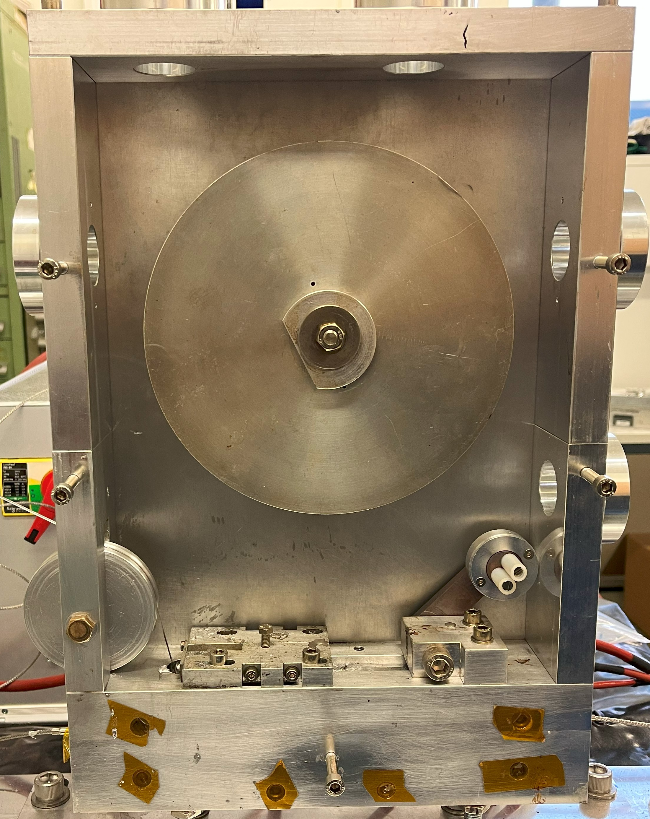
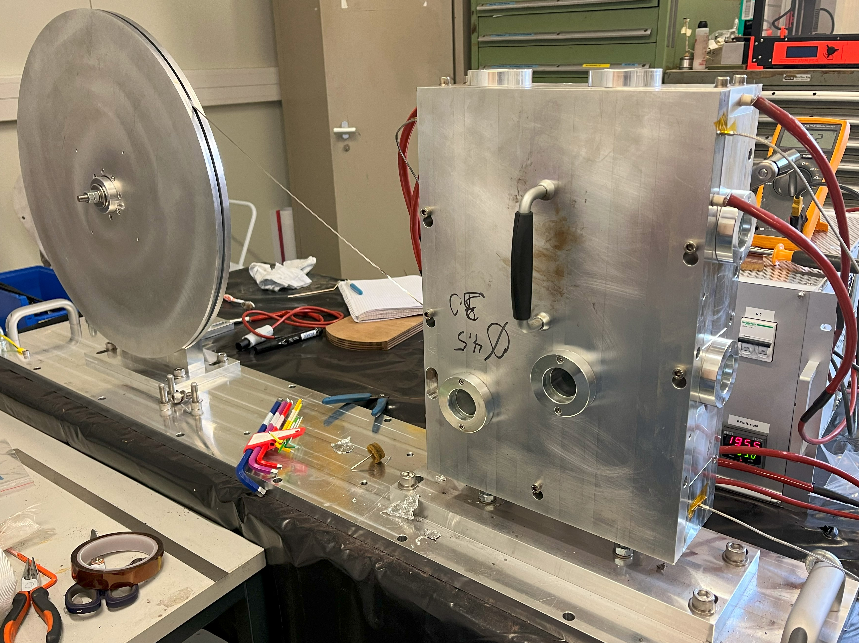
Hot winding: setup preparation
Winding setup assembled.
Installed 60 mm inner diameter mandrel.
Winding tension: 2 – 2.2 kg.
Wiping tool not installed.
Expected 263 turns (67 m) for a 20 mm thick pancake based on 75 um thick tape
obtained: 276 turns (68 m) for a 18,5 mm thick pancake, 67 um tape
Wiping tool
Hot box enclosure:
10 heaters installed,
4 temperature probes.
Name | Dimension (mm) |  | nb of turn | Equivalent thickness per tape (um)
 | Outer diameter | Inner diameter
HW08_SST276 | 96,95 | 60 | 276 | 66,94
Pancake
HW08_SST276
68 m
Coated tape
CT04_SST120
Mandrel
Hastelloy
Brushed tape
80 cm
Hastelloy
Brushed tape
50 cm

Slide 4
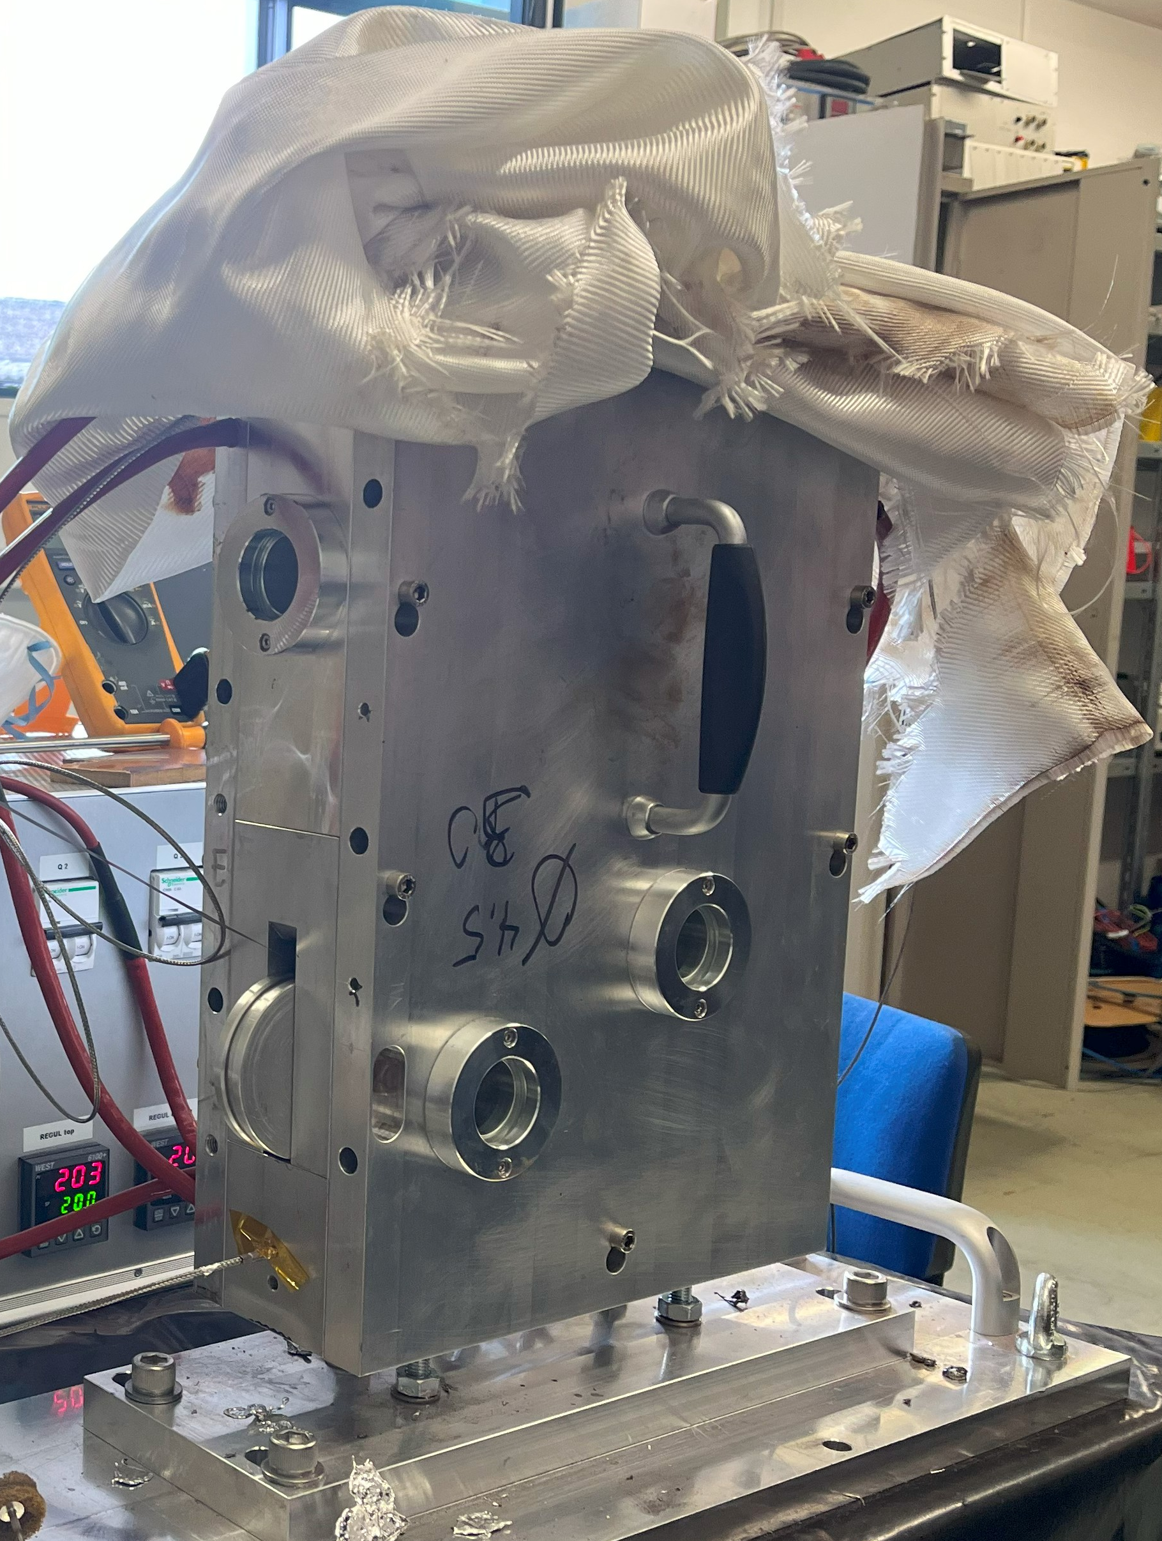
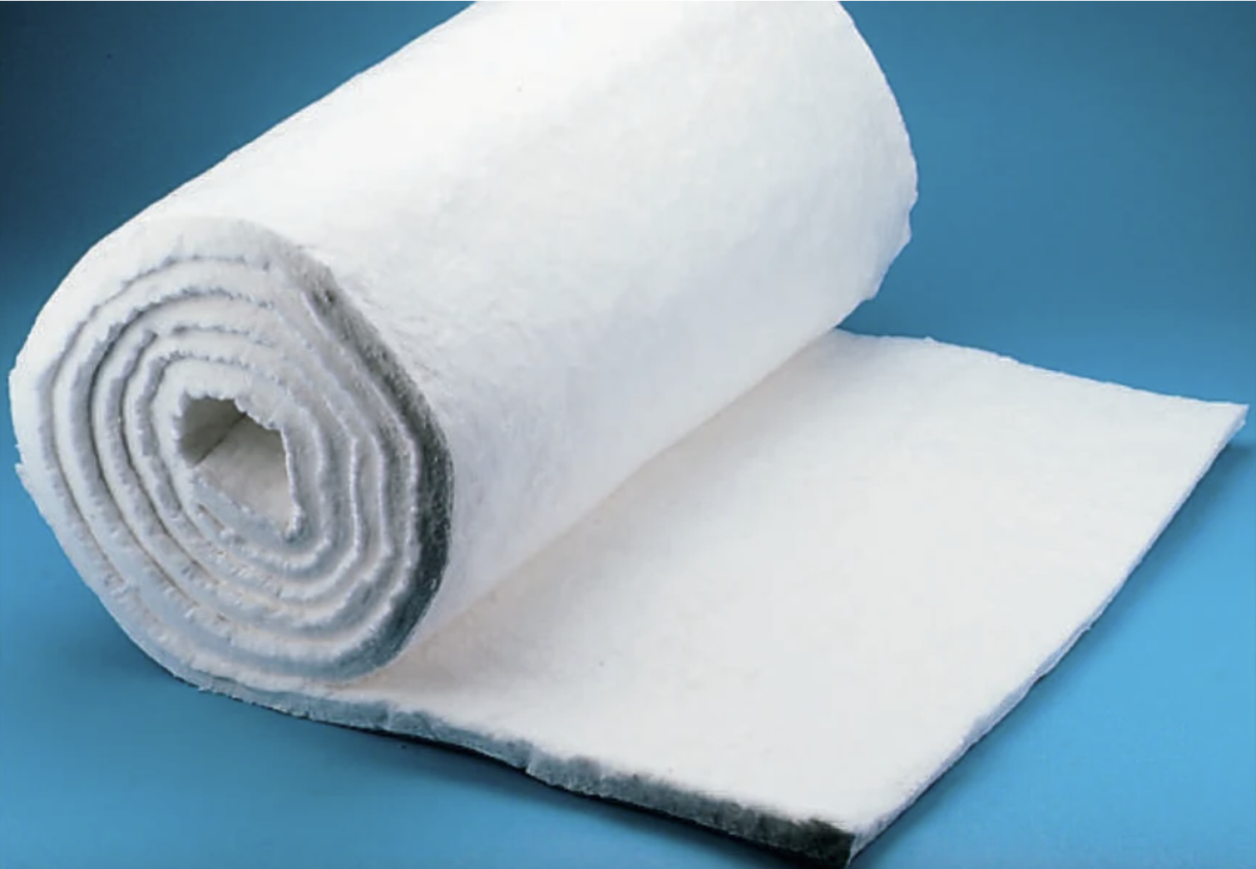
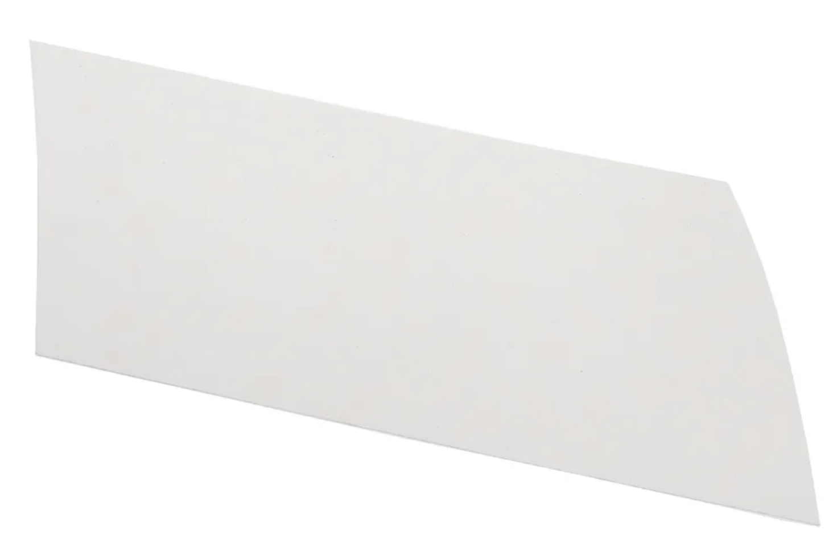
Need for thermal insulation
Around 3 h needed to warm-up the winding spool at ~190°C
Need for thermal insulation?
Winding 30 minutes + minute to cool down to 150°C. Force convection with fan
Alternatives found in CERN RS Shop:
Fiberglass blanket for thermal insulation
Calcium Magnesium Silicate Thermal Insulation sheet.
5m x 610mm x 6mm.
Thermal conductivity: 0.04 – 0.048 W/m*K.
Maximum temperature: 1150°C.
NOTE: since temperature probes/heaters controlled by the PIDs are in the walls of the hot chamber, the addition of external thermal insulation layers will be beneficial to reduce the electric power consumption to keep the walls at 200*C. No significant beneficial is expected for the reduction of the warm-up time.
Nomex Thermal Insulation sheet.
304mm x 200mm x 0.25mm.
Thermal conductivity: 0.14 W/m*K.

Slide 5
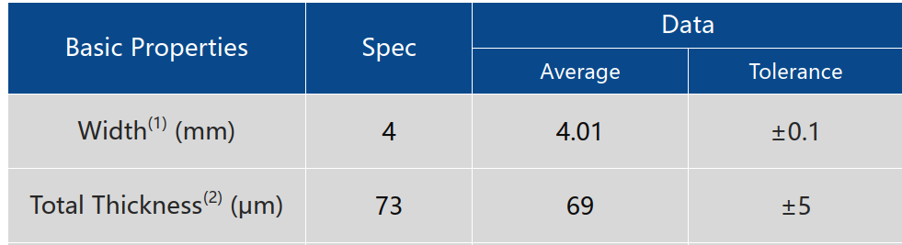
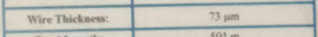
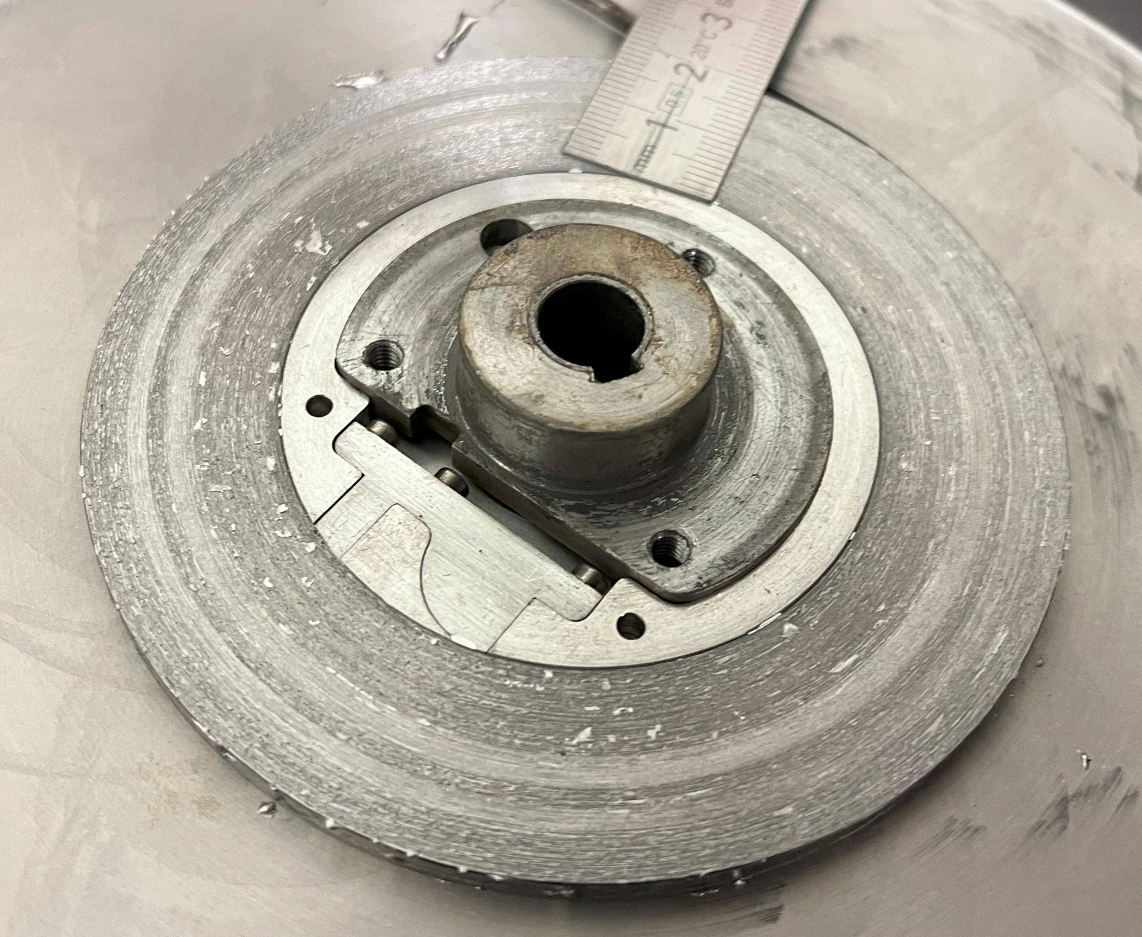
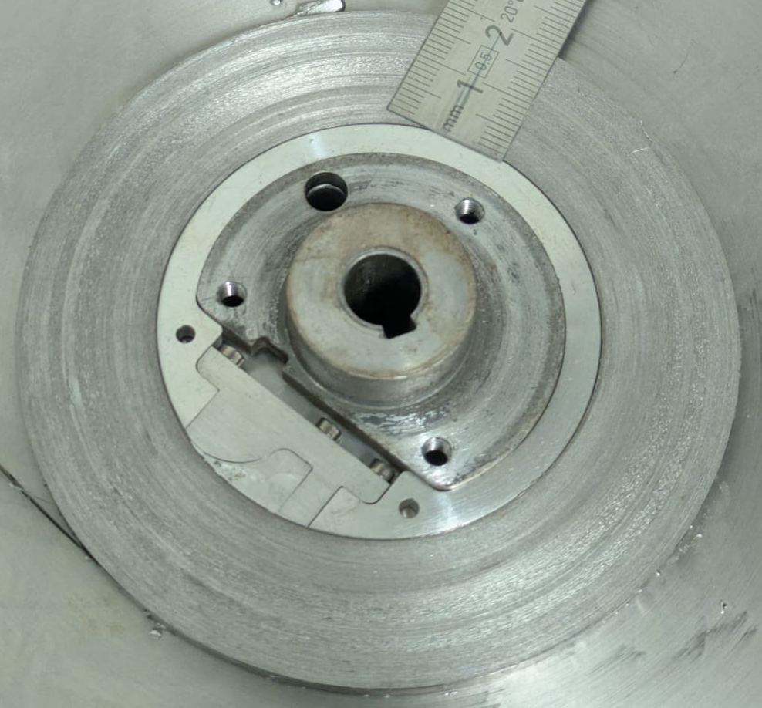
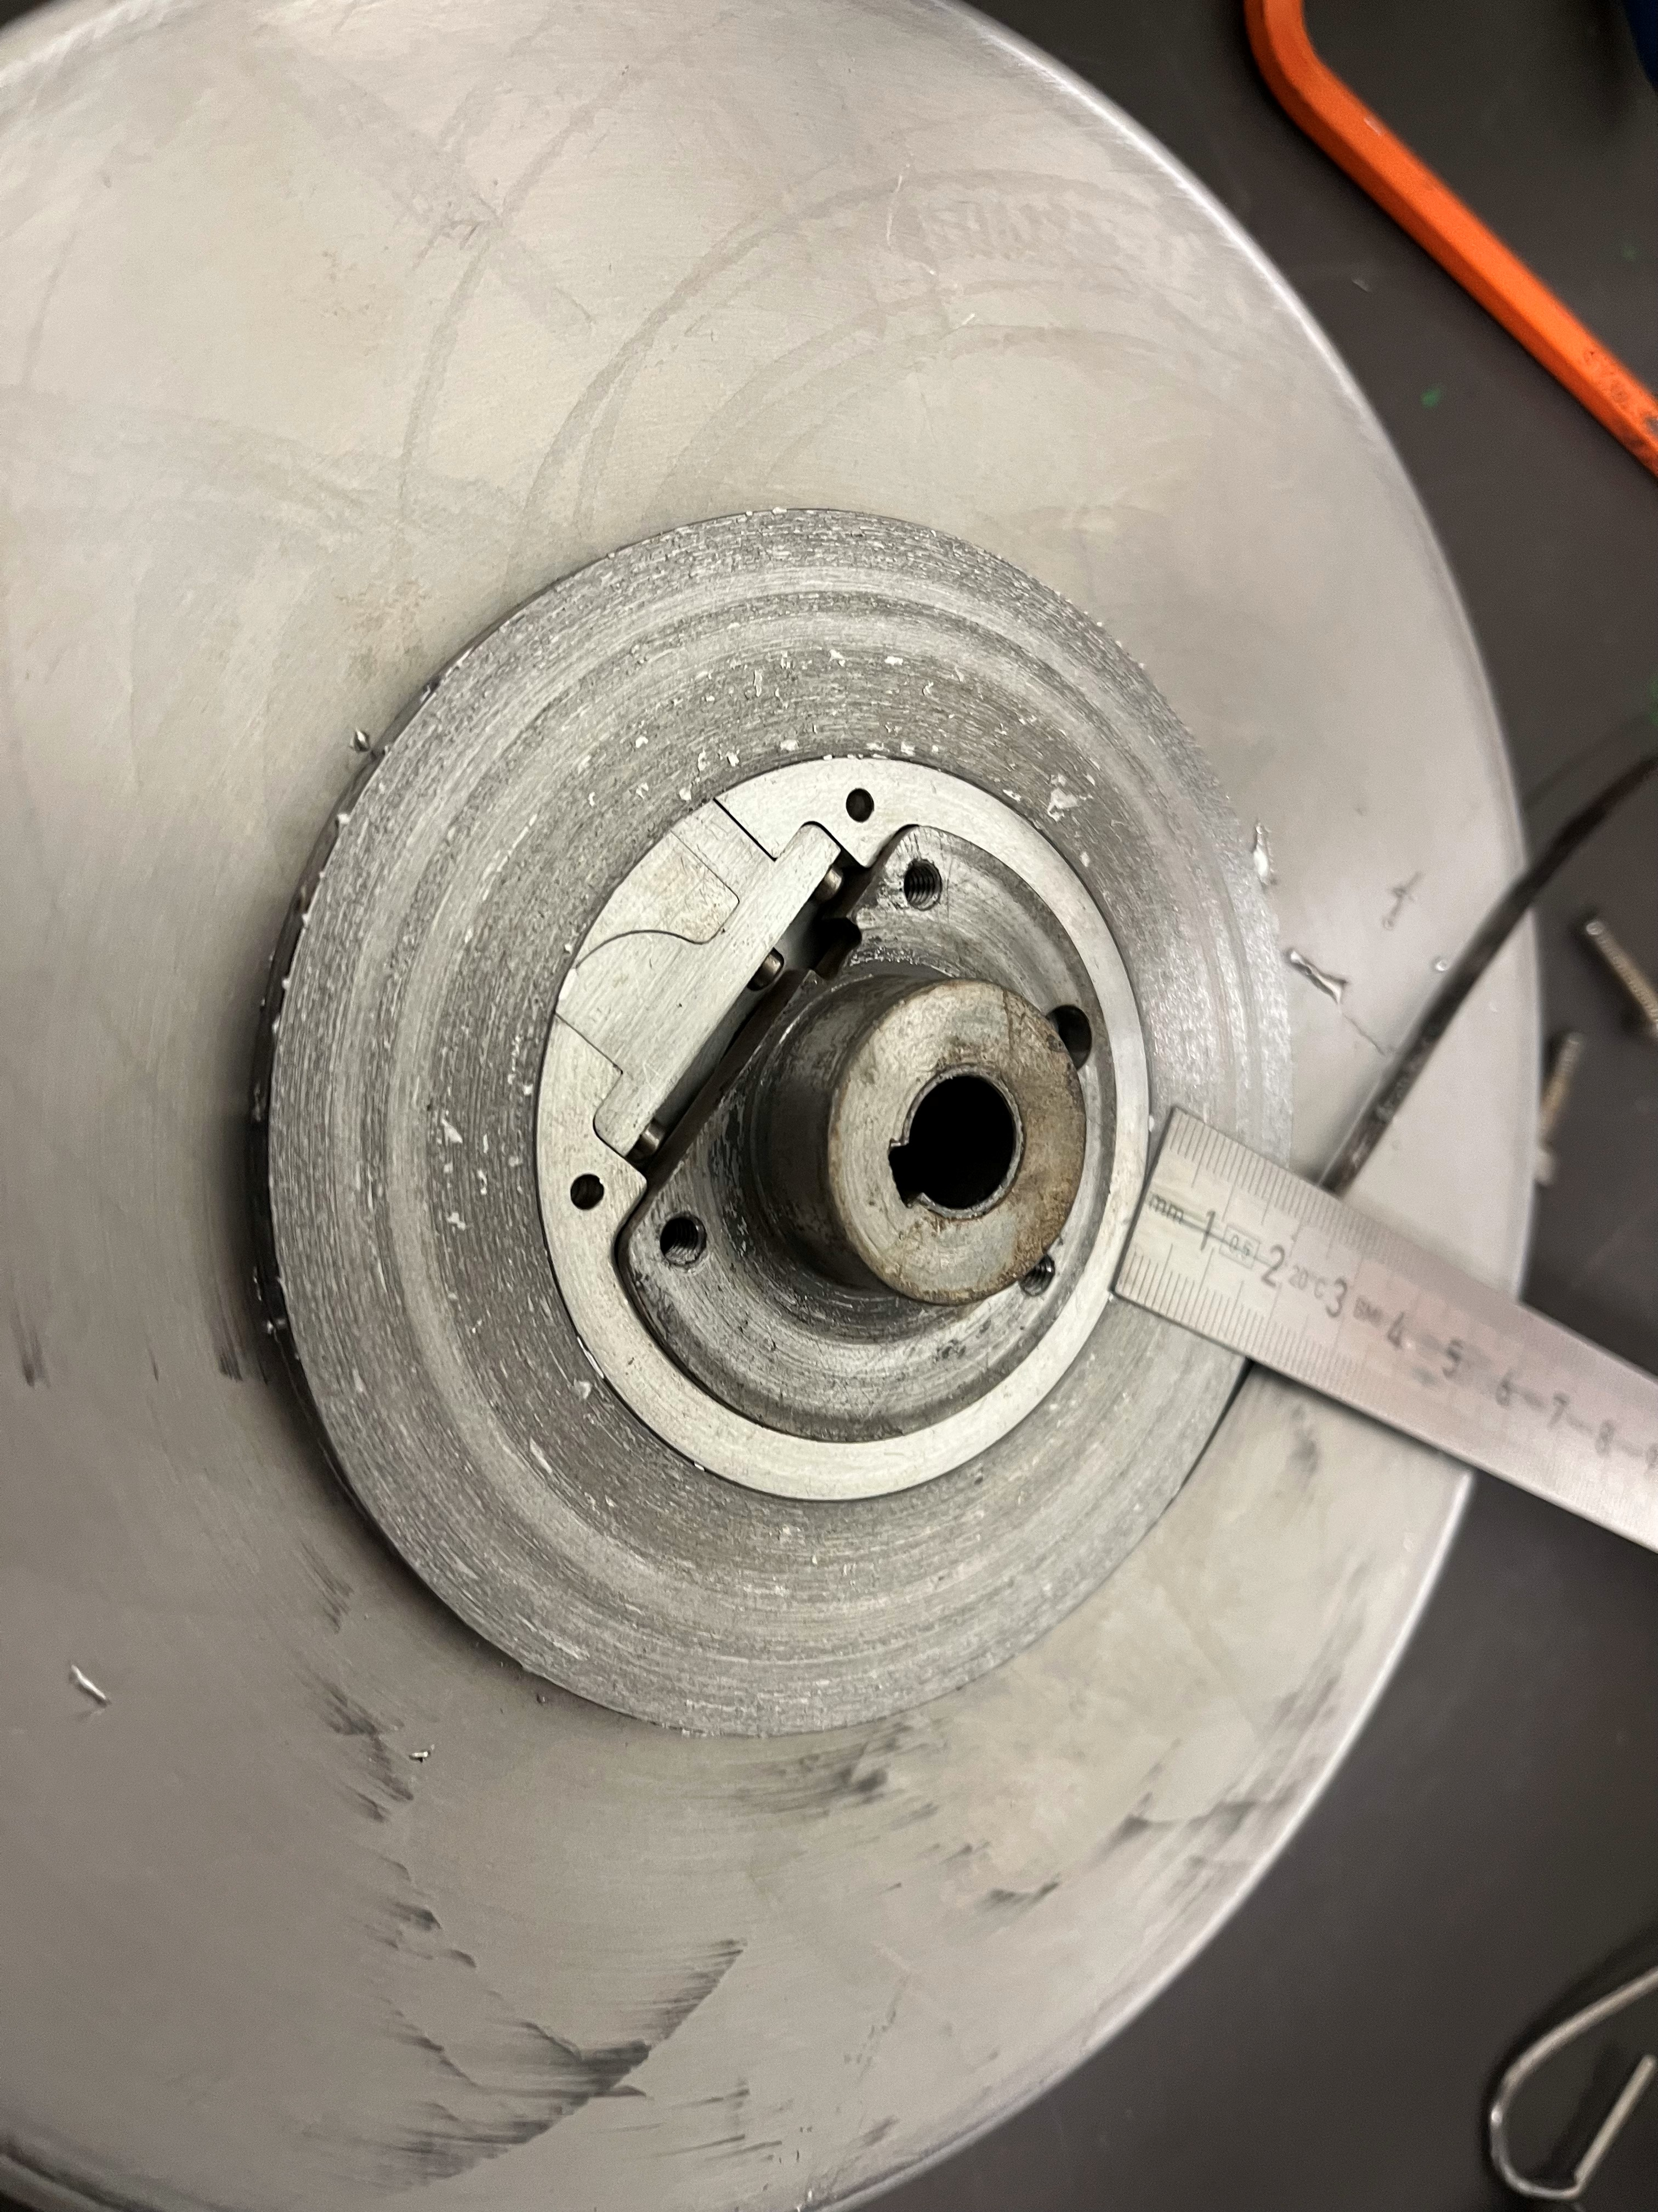
Hot winding: result
Pancake
Value | Uncertainity
4,10 | 0,02
67 | < 0,1
~1.9 cm thick pancake (target: 2 cm)
Effect of winding tension?
3% elastic strain ? weird
290 turns
For 2 cm pancake
299 turns
PbSn droplets accumulated on the pancake sides.
Effect of porosity/roughness of the Al disks on the winding spool?
Absence of the wiping rolls after the solder bath?
Are the droplets only on the sides or are they also affecting the turns?
It is safe to assume it does not affect the turns as we have a very accurate circle + less diameter than expected
Side A
Side B

Slide 6
Next steps
Etching/cleaning of the produced coil to remove the PbSn droplets?
Polish the disks on the winding spool?
Foresee tests on the produced coil?
Pancake instrumentation and testing in LN2?
Proceed with the vacuum oven cooking of the HTS stacks.
Critical current measurements on pre-coated HTS tapes.
Proceed with the check of tape degradation at 200°C for >3h.
Wiping tool updates? Setup modifications?
Microscopy inspection on produced samples.

Slide 7
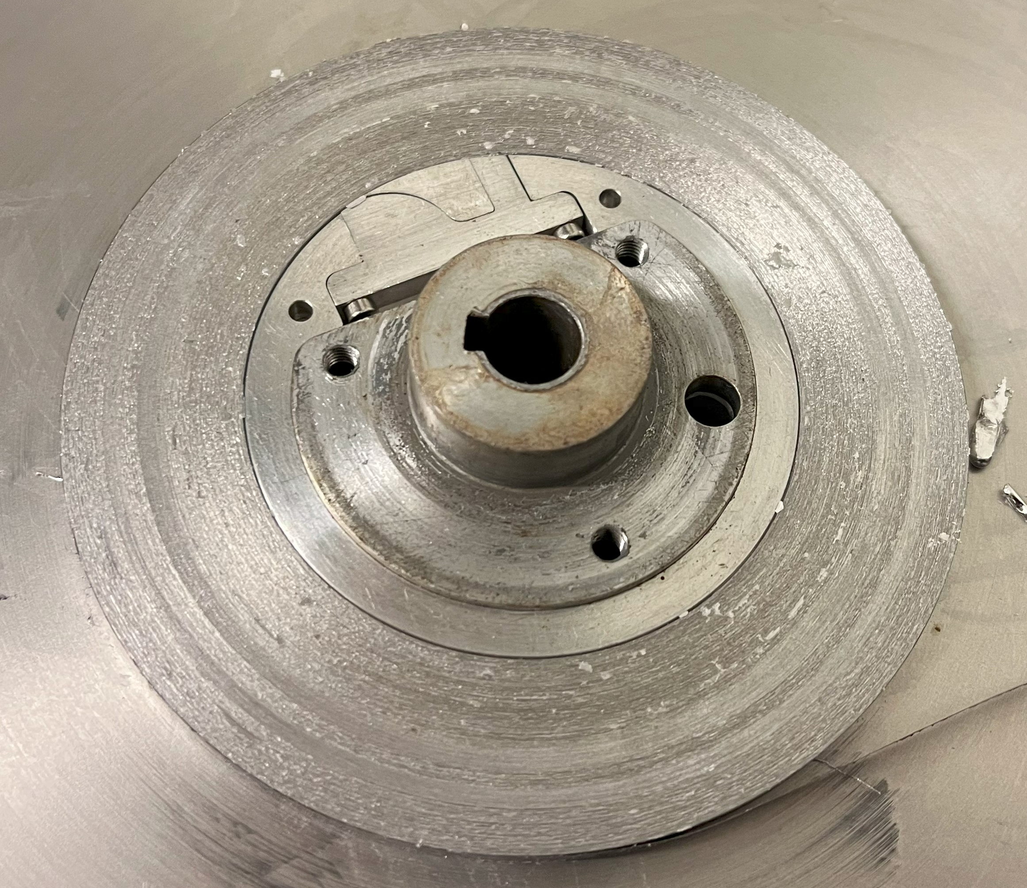
Pictures

