Slide 1
Stacks, Current leads & instrumentation
High-field solenoid technology for the Muon Collider
11/04/2025

Slide 2
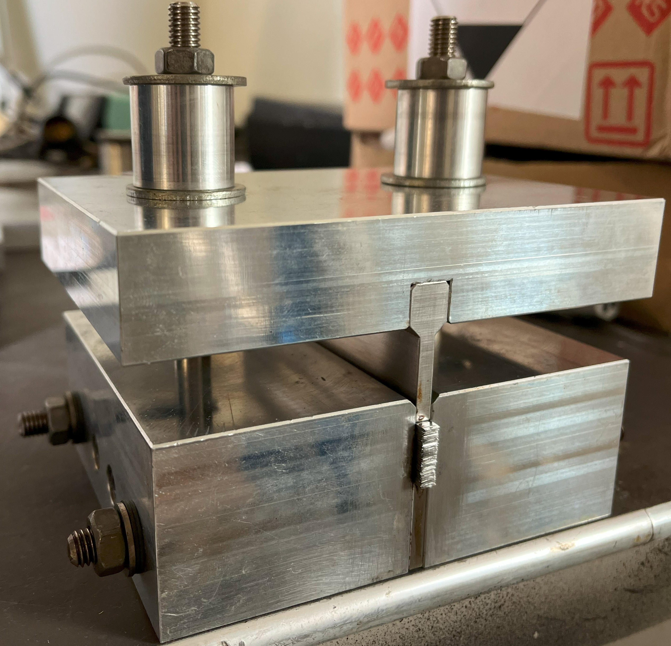
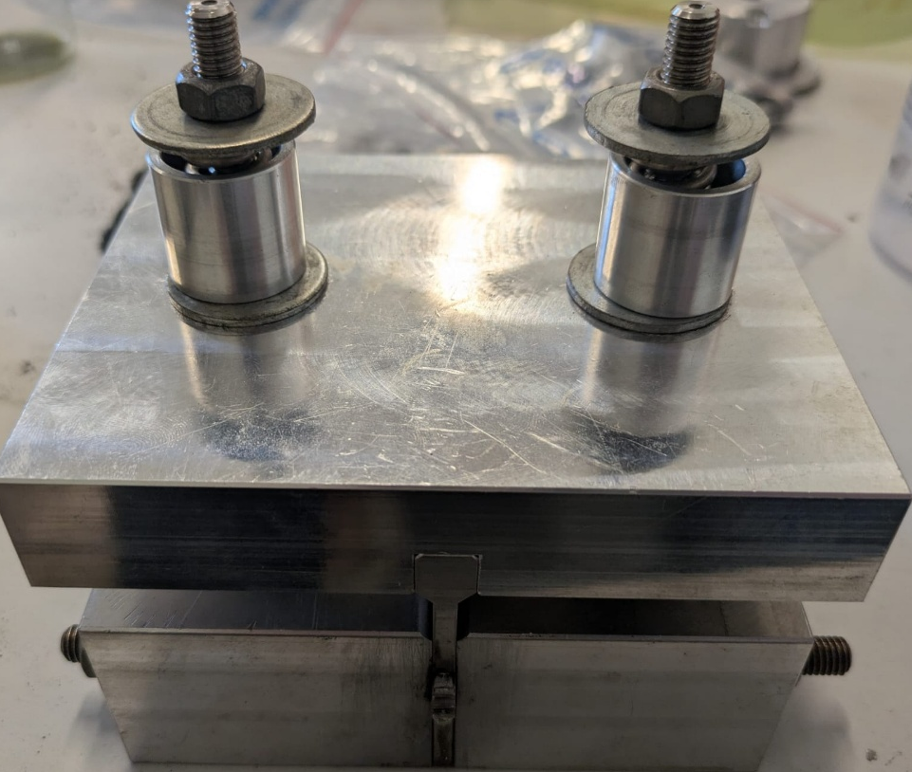
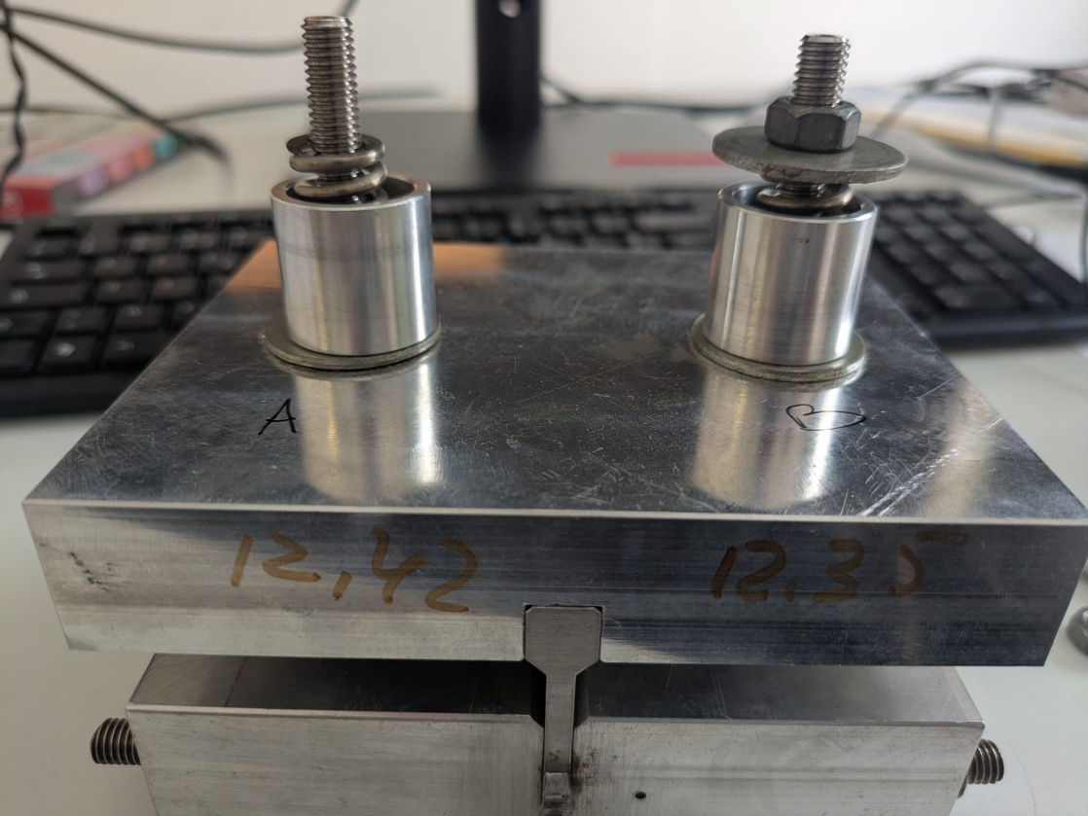
Stack SK12_SST120
Message from Tim : it would be beneficial to our modeling efforts if some thermal conductivity measurements could be done on the HTS stacks
Name |  | Manufacturor | Batch | Tape length reference (m) | Coated Sample | Thickness (mm) | nb of turn/tape | Eq. thickness per tape (um)
SK12_SST120 | Before | SST | ST2403-02 | 151 - 164 | CT04_SST120 | 15 | 120 | 125
 | After |  |  |  |  | 8,6 |  | 71,7
HW08_SST276 |  |  |  | 166 - 234 |  | 18,5 | 276 | 66,9
Acc. to Alexandre, more solder went out than previous one
Thickness before oven
15 +/- 1 mm before
Thickness before oven
8,6 +/- 0,05 mm before
24,0 +/- 0,5 mm
33,6 +/- 0,5 mm
32,0 +/- 0,5 mm
Loss of ~ 80% of initial pressure

Slide 3
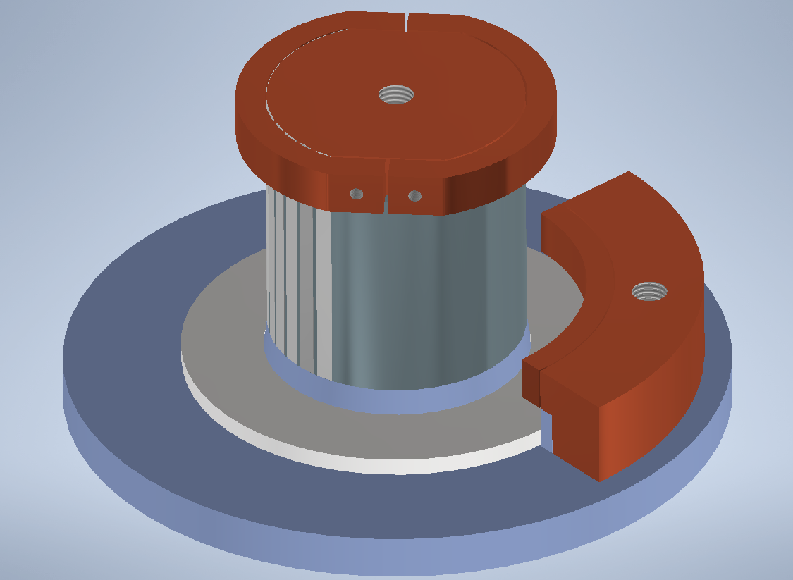
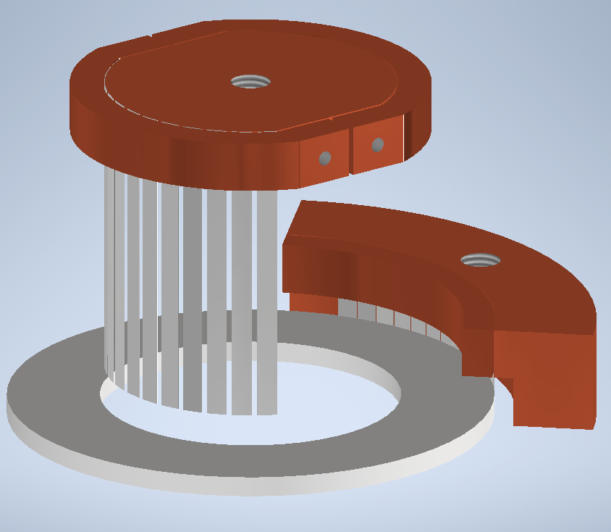
HTS current leads design
IN Cu disk
Cu clamps
G10 support cylinder
13x pre-coated HTS tapes IN
13x pre-coated HTS tapes OUT
OUT Cu block
Coil support plate
Cu clamp
Electrical contacts → low temperature solder (InSn). External tightening on the tape/Cu joints with bolted clamps.

Slide 4
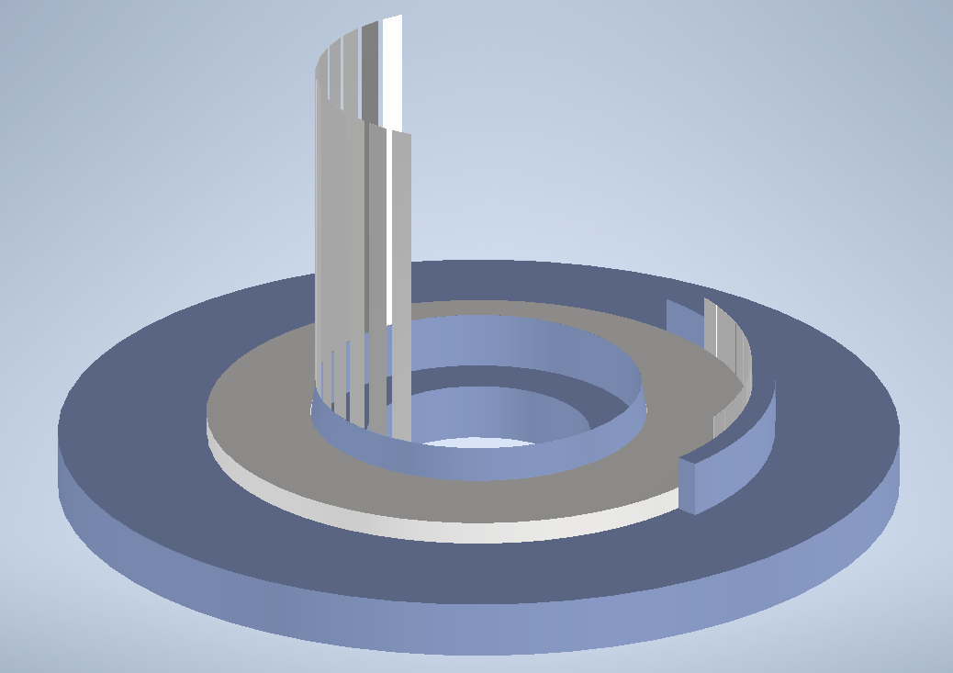
Coil support plate
Wedge-shaped element to place the HTS tapes in contact with the pancake.
0.2 mm gap to be filled with InSn solder.
External support.
0.2 mm gap to be filled with InSn solder.

Slide 5
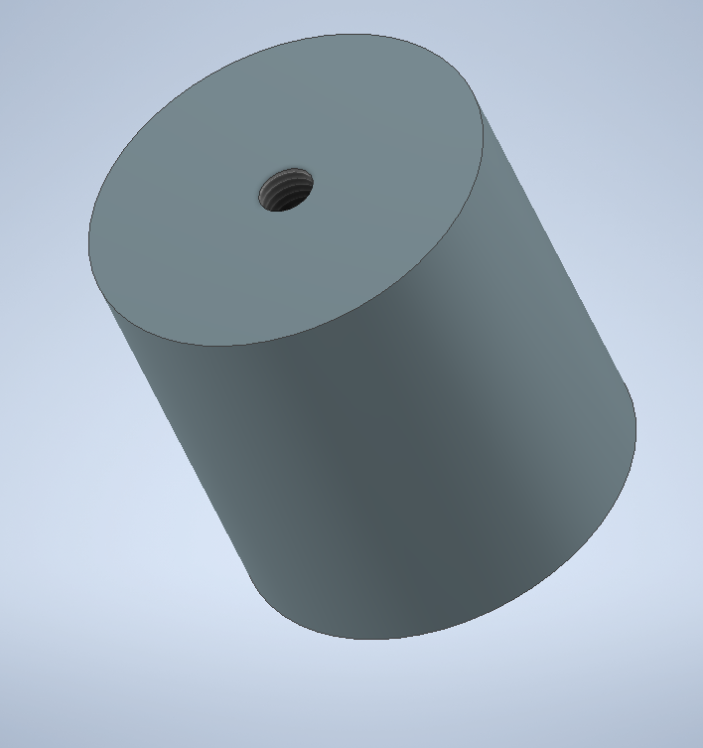
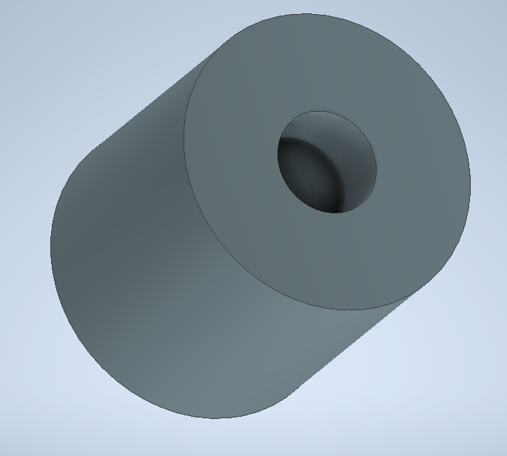
HTS leads inner support
20 mm hole, 15 mm deep to access the coil center for instrumentation.
Support element for Hall probe installation will be placed in this gap.
Hole to connect with the top Cu disk
TOP
BOTTOM
The HTS current leads will be placed along the cylinder. We want to avoid tape movements by mishandling the pancake and by screening currents induced stresses. On the other hand, we want to reduce thermal stresses during cooldown phase.
Possible solutions could be: - Kapton tape to place the leads around the cylinders; - add grooves on the cylinder to fit the tapes and use epoxy to impregnate them; - consider using a brass cylinder and solder the tapes there (?)

Slide 6
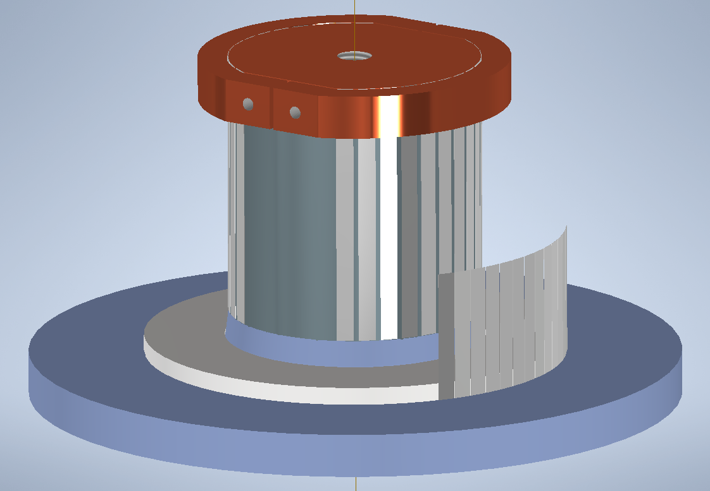
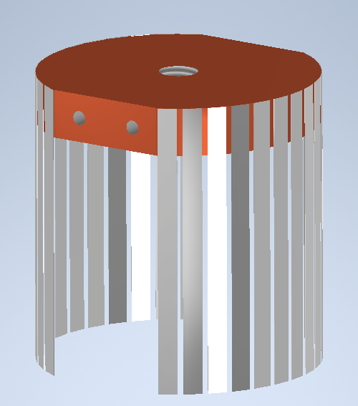
Backup: equally spaced input current feeding (?)
Are there any advantages?

Slide 7
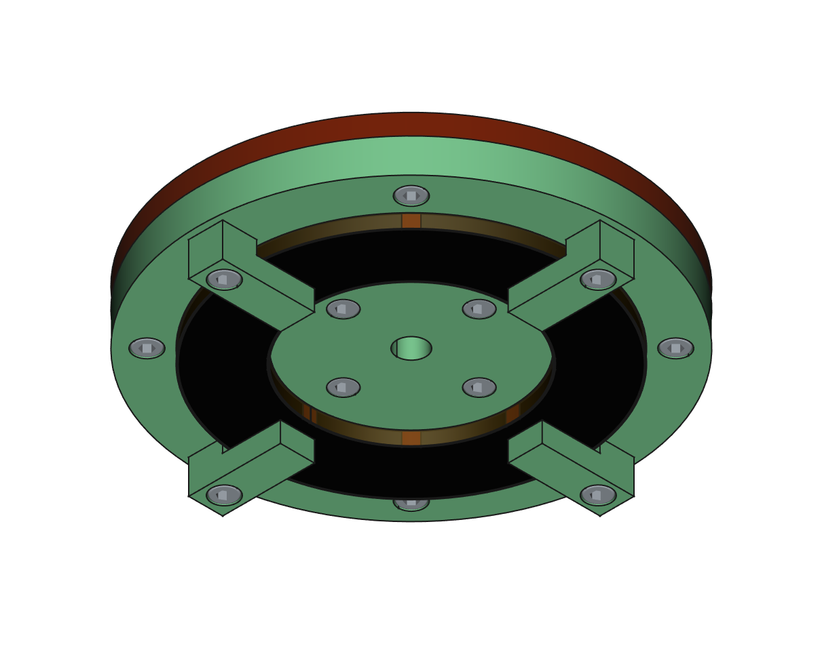
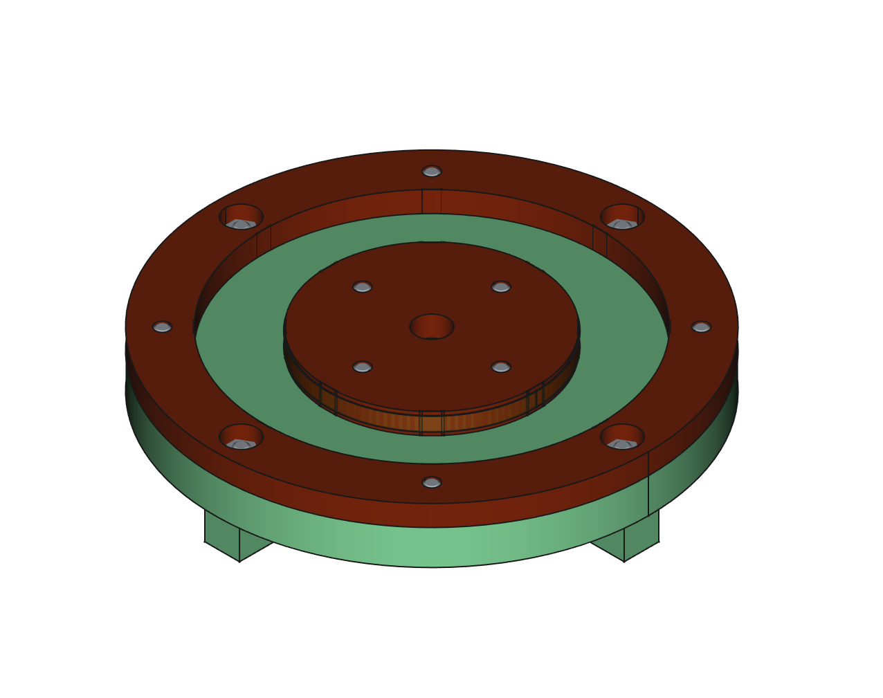
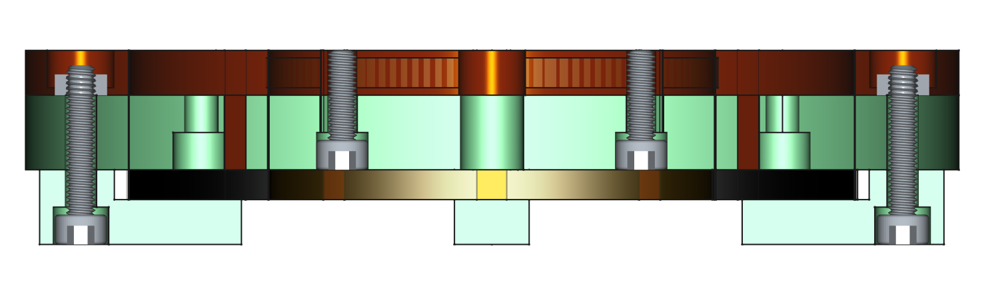
Current lead
Outer copper lead
G10 Support plate
Top
Inner copper lead
G10 Clamp
Avoid shear stress
  Lower amount of material inner and outer part of the pancake
  HTS soldered type current lead
Concern of local stress and damaging current leads
  Assemble leads and pancake as one body (no relative displacement)
Idea: Preassemble the body before heating once in oven
Bottom part space free for instrumentation
Pancake
HTS Tapes
Bottom
Top
Bottom
Kapton tape

Slide 8
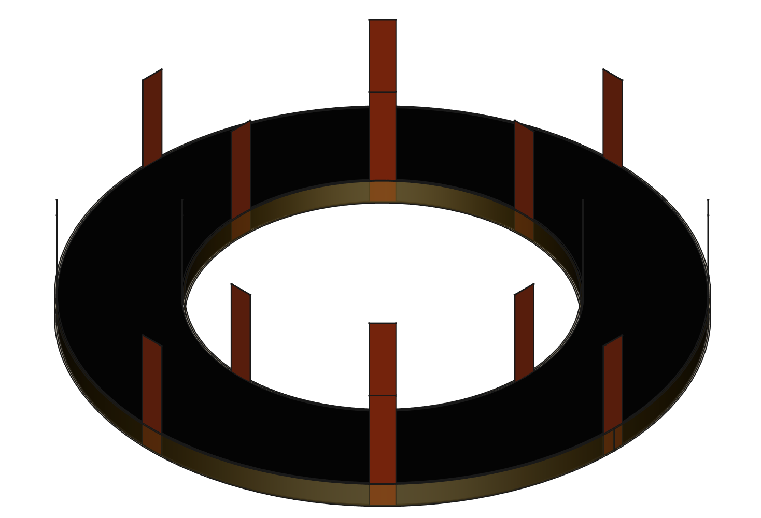
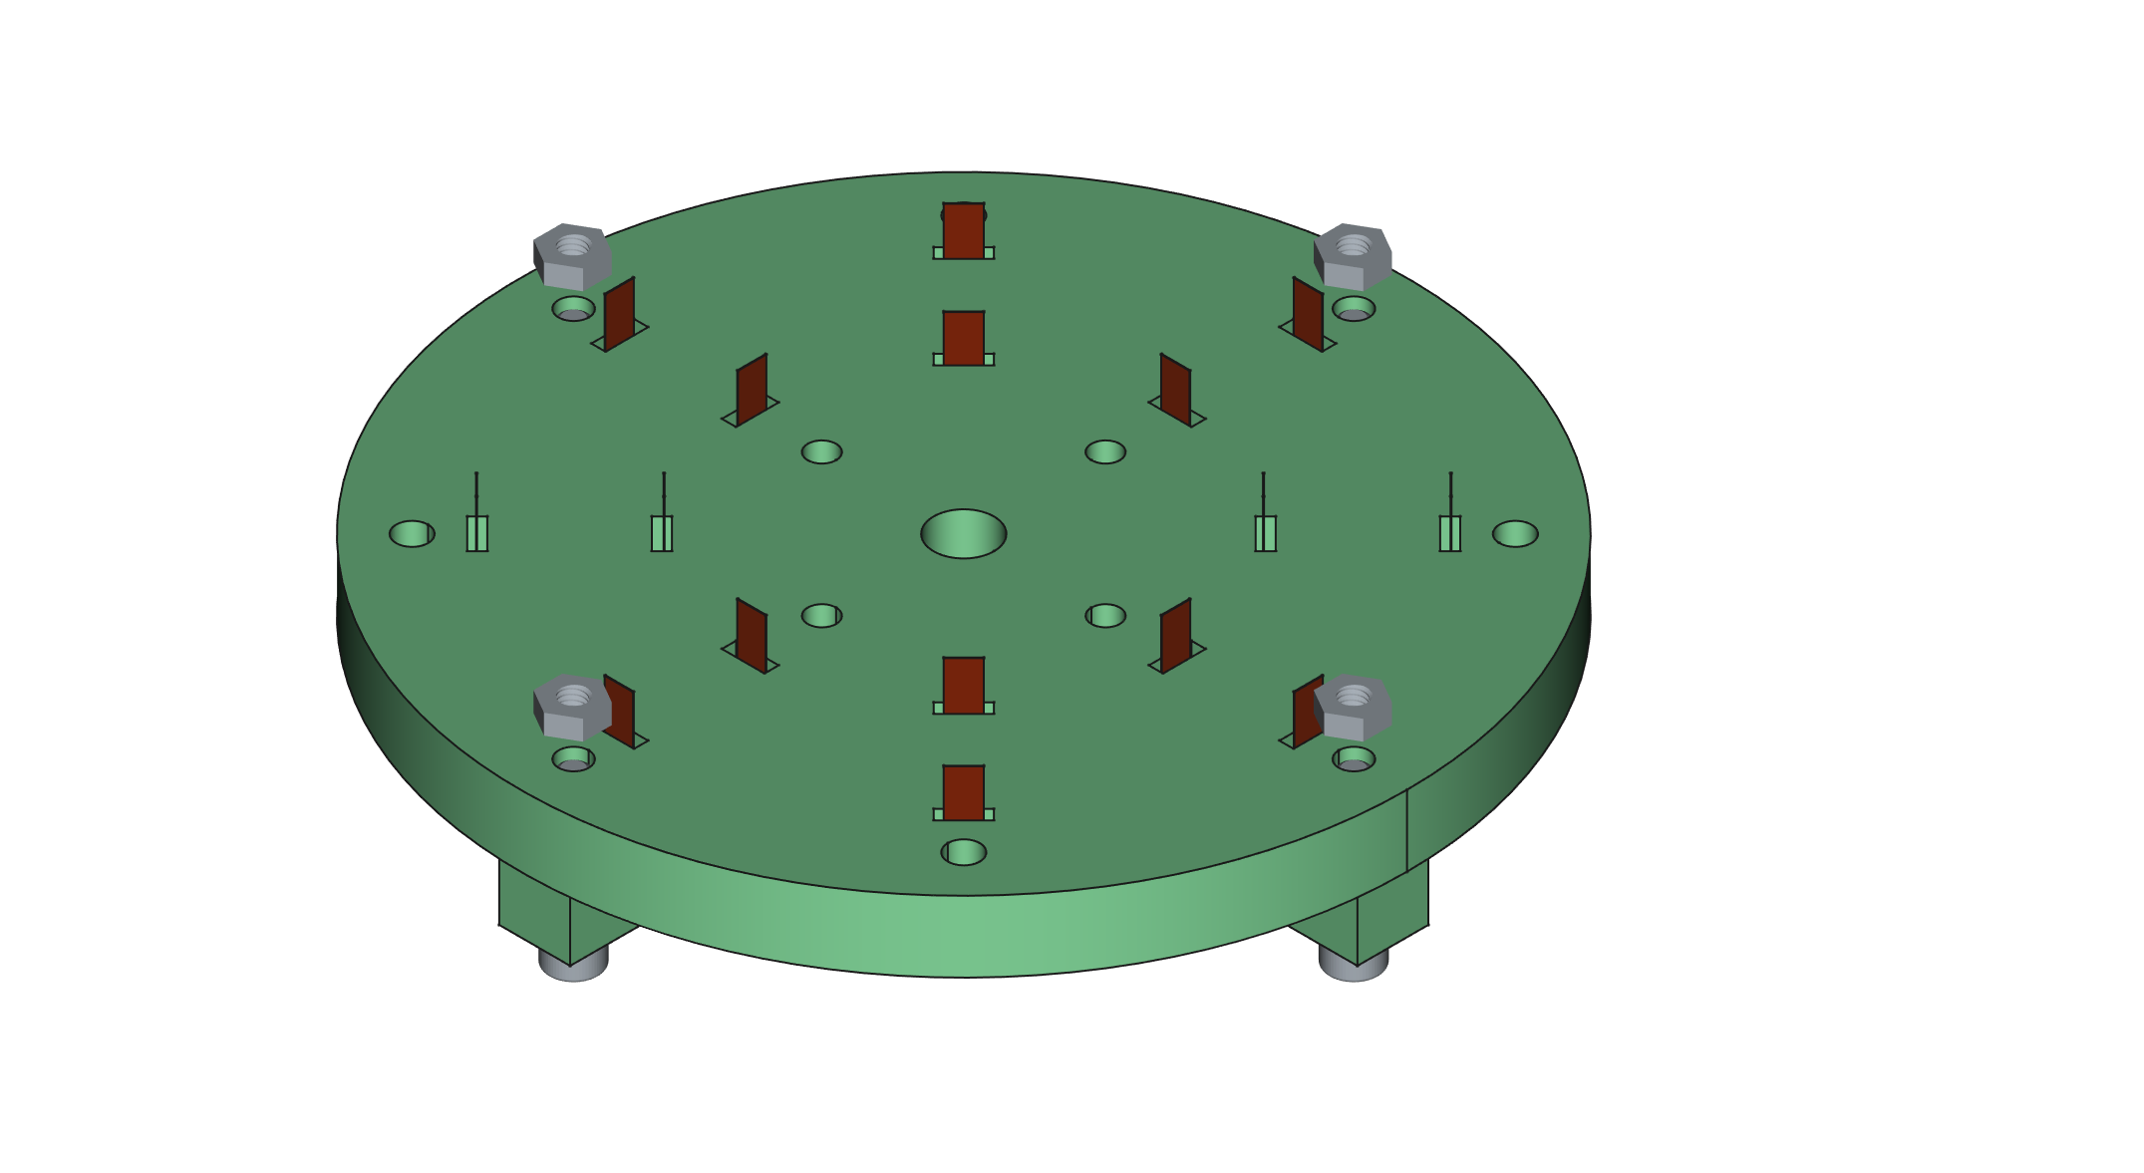
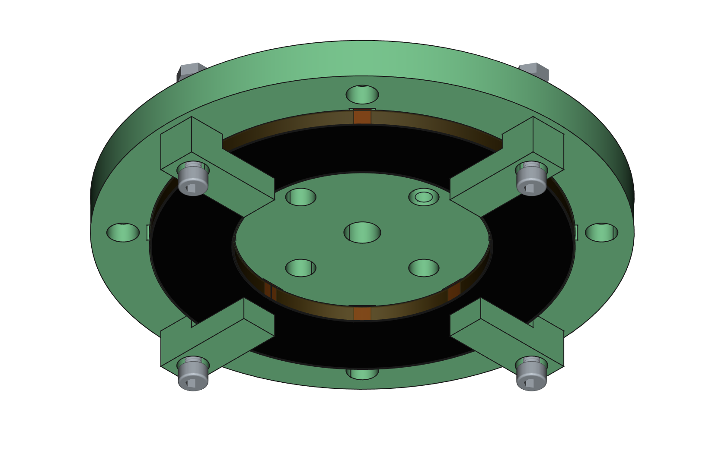
Assembly Protocol
Step 4
Precoat HTS tapes, 8 x 2 (inner and outer) x ~ 2 cm
  bismuth-tin 138°C
  tin-indium 118°C
Precoat side of copper leads
Scratch and Clean (ethanol)
Wrap HTS tapes to pancake with Kapton
Clamp pancake to G10 support
Step 5

Slide 9
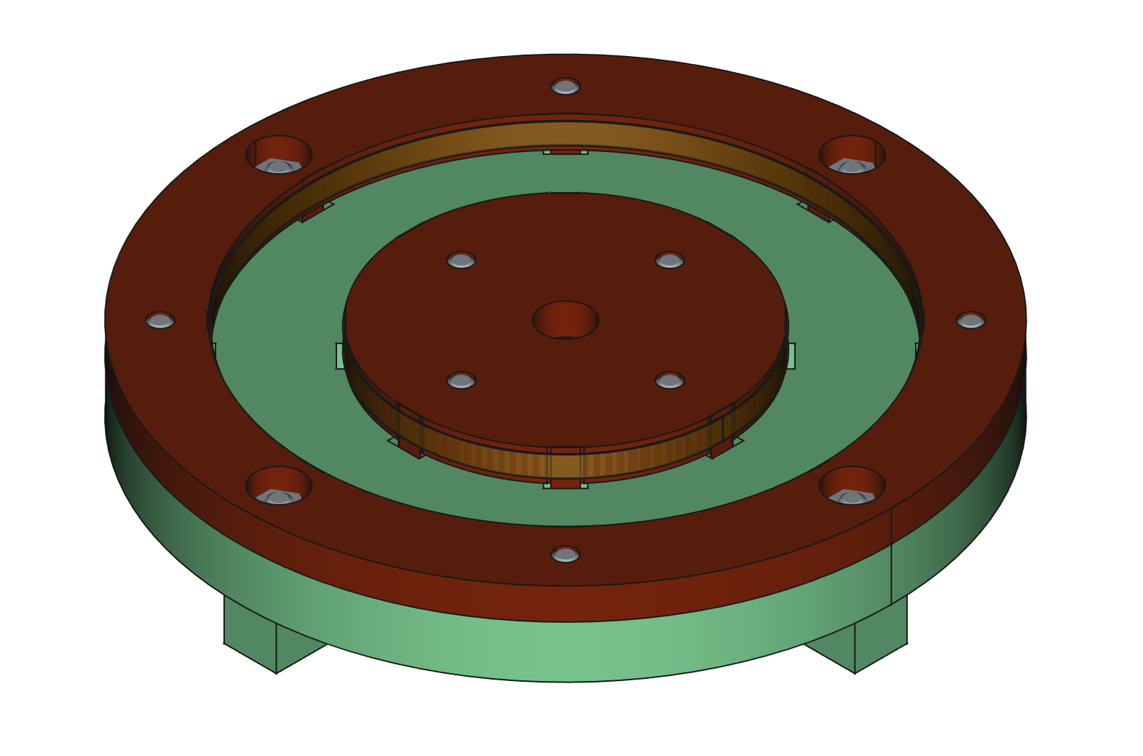
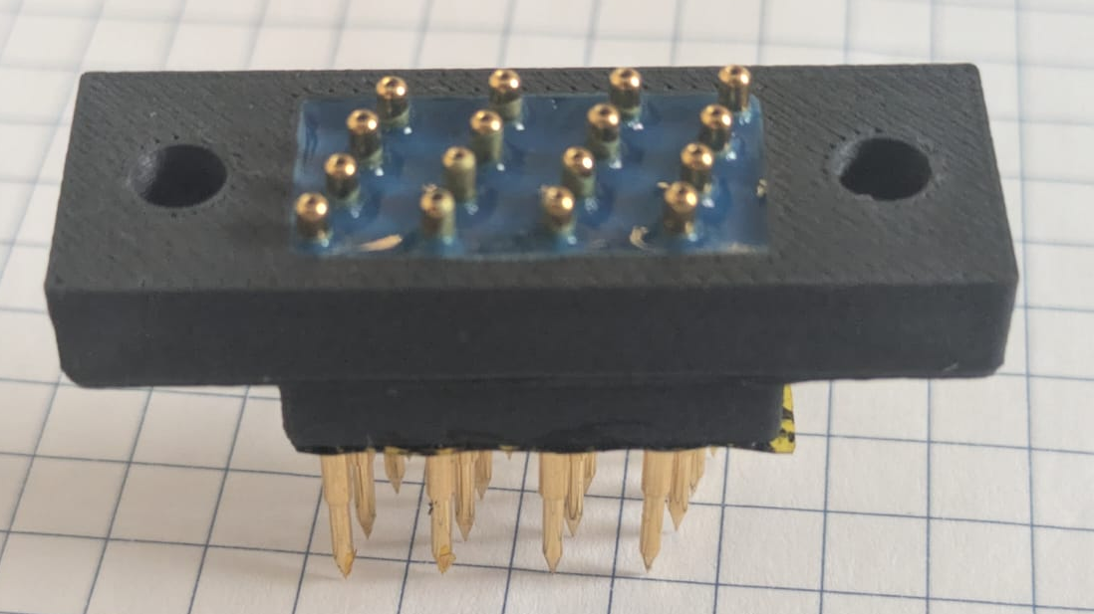
Assembly Protocol
Step 7
Precoat HTS tapes, 8 x 2 (inner and outer) x ~ 2 cm
  bismuth-tin 138°C
  tin-indium 118°C
Precoat side of copper leads
Scratch and Clean (ethanol)
Wrap HTS tapes to pancake with Kapton
Clamp pancake to G10 support
Assemble copper leads
Wrap HTS tapes to copper lead with Kapton
Oven
Add instrumentation

Slide 10
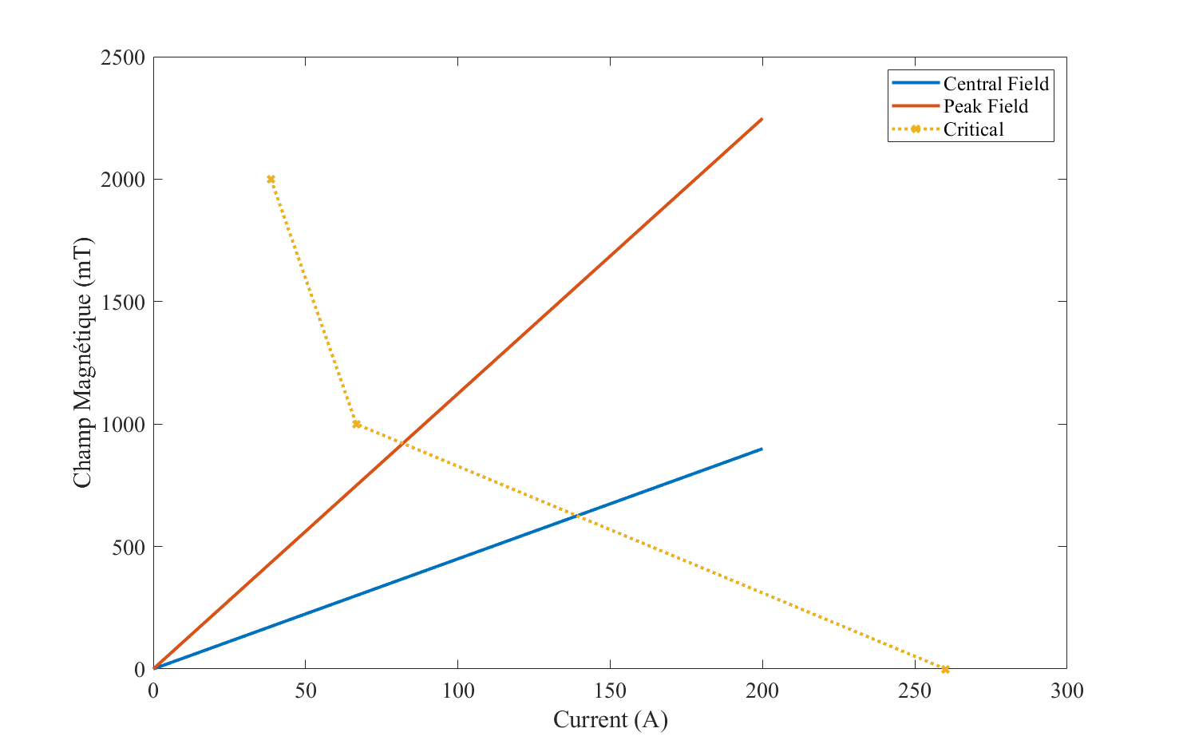
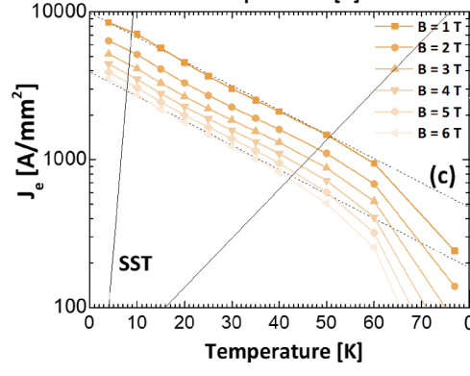









HTS current leads
$$B$$
Eddy current copper
$$S = lw$$
$$A = we$$
$$\frac{ΔB}{Δt}S=−RI$$
$$I = 100 A$$
$$ΔB = 1 T$$
$$Δt=1 s$$
$$e=20 μm$$
$$w=4 mm$$
$$ρ={10}^{−9} Ω.m$$
$$I=\frac{ΔB}{Δt}\frac{{ew}^{2}}{ρ}≈3 mA$$
X 1000 for etched $\left(τ\right)$
$$l$$
$$e$$
$$S$$
$$I$$
$$A$$
$$w$$
Flux vartiation
$$EMF$$
Carmine Senatore et al 2024 Supercond. Sci. Technol. 37 115013
For 1 tape
I = 100 A
B = 1 T
f = 100 N/m
B// / B|_ can reach 10
Discuss Quench for curent leads

